Slide 1
German phonics collection
[w]
Artwork: Steve Clarke
Date updated: 21 / 07 / 21
Notes:
Artwork by Steve Clarke. All additional pictures selected are available under a Creative Commons license, no attribution required.

Slide 2
[w]
Phonetik
Introduction
Y7 T1.1 Week 5 Slides 5-7; 39-44

Slide 3
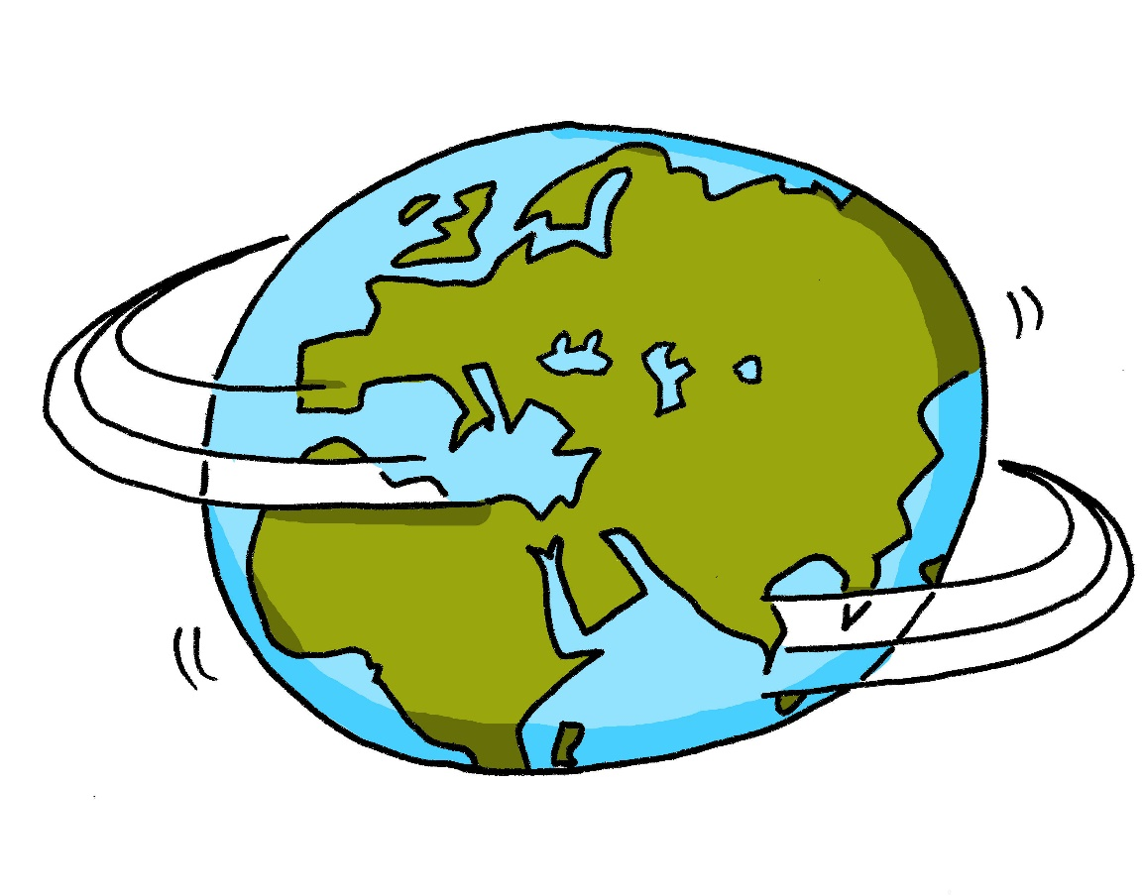
w
Welt
Notes:
Timing: 1 minute
Aim: To introduce/consolidate SSC [w]
Procedure: 1. Present the letter(s) and say the [w] sound first, on its own. Students repeat it with you. 2. Bring up the word ”Welt” on its own, say it, students repeat it, so that they have the opportunity to focus all of their attention on the connection between the written word and its sound.
3. A possible gesture for this would be to start with your hands above your head and draw them down, out and then back into the body, tracing the shape of the world.
4. Roll back the animations and work through 1-3 again, but this time, dropping your voice completely to listen carefully to the students saying the [w] sound, pronouncing ”Welt” and, if using, doing the gesture. Word frequency (1 is the most frequent word in German): Welt [190] Source: Jones, R.L. & Tschirner, E. (2006). A frequency dictionary of German: core vocabulary for learners. Routledge

Slide 4
w
Welt
Notes:
With sound and no pictures to focus all attention on the sound-symbol correspondence.

Slide 5
w
Welt
Notes:
Without sound to elicit pronunciation (without first hearing the teacher).
Teacher to elicit pronunciation by asking “Wie sagt man…”

Slide 6
w
Wasser
wahr
Welt
Was?
gewinnen
antworten
Notes:
Timing: 2 minutes
Aim: To introduce/consolidate SSC [w]
Procedure:
Introduce and elicit the pronunciation of the individual SSC [w] and then the source word again ‘Welt’ (with gesture, if using).
Then present and elicit the pronunciation of the five cluster words.
The cluster words have been chosen for their high-frequency, from a range of word classes, with the SSC (where possible) positioned within a variety of syllables within the words (e.g. initial, 2nd, final etc.). Additionally, we have tried to use words that build cumulatively on previously taught SSCs (see the Phonics Teaching Sequence document) and do not include new SSCs. Where new SSCs are used, they are often consonants which have a similar symbol-sound correspondence in English.
Word frequency (1 is the most frequent word in German): Welt [190]; Wasser [297] wahr [662]; Was? [39]; antworten [804]; gewinnen [410]. Source: Jones, R.L. & Tschirner, E. (2006). A frequency dictionary of German: core vocabulary for learners. Routledge

Slide 7
w
Wasser
wahr
Welt
Was?
gewinnen
antworten
Notes:
With sound and no pictures to focus all attention on the sound-symbol correspondence.

Slide 8
w
Wasser
wahr
Welt
Was?
gewinnen
antworten
Notes:
Without sound to elicit pronunciation (without first hearing the teacher).
Teacher to elicit pronunciation by asking “Wie sagt man…”

Slide 9
[w]
Phonetik
Consolidation [1]
Y7 T1.1 Week 6 Slides 38-41; 45-46

Slide 10
Phonetik
hören / sprechen
sagen
geben
Welt
Zug
frei
kalt
denken
Notes:
Timing: 3 minutes Aim: To revise all the SSCs introduced so far: long and short a, long and short e, ei, W, Z.
Procedure: 1. Click on the word to play the audio. Repeat if necessary.
2. Students write the whole word in full in their exercise books.
3. The next slide allows removal of the ‘blots’ to reveal the missing SSCs.

Slide 11
Phonetik
hören / sprechen
sagen
geben
Welt
Zug
frei
kalt
denken
Notes:
Timing: 1 minute Aim: To reveal the answers to the activity. Procedure: 1. Click on the ‘blots to remove them individually and reveal the missing SSCs.

Slide 12
Phonetik
zehn
antworten
A
D
Zug
H
allein
C
E
Welt
klein
[alone]
Wasser
I
F
G
frei
B
Arzt
Notes:
Timing: 5 minutes Aim: To consolidate SSC knowledge
Ask students to write down which pictures go together (based on the obscured SSC).
The teacher can remind them of the source words they have just seen.
Clicking on the pictures will play the word if the students need an extra prompt.
Clicking on the paw prints will remove them.

Slide 13
Phonetik
Arzt
lesen / sprechen
antworten
60
zehn
Zug
allein
Sekunden
Welt
frei
klein
Wasser
0
LOS!
Notes:
Timing: 2 minutes (one minute per attempt) Aim: To consolidate SSC knowledge Procedure: 1. Pupils read out the words but in alphabetical order. They keep going for one minute.
2. Teacher can circulate to listen into their SSC knowledge.
Word frequency (1 is the most frequent word in German): der Arzt [614] allein [258] Source: Jones, R.L. & Tschirner, E. (2006). A frequency dictionary of German: core vocabulary for learners. Routledge

Slide 14
Phonetik
hören / schreiben
1
ei
Der Mann sit_t all__n. ☹
z
2
e
a
Der Arzt d_nkt ’W_s?!’
3
ei
i
Der Gast hat __n Z_mmer.
4
Der Freund ge_ innt __n B_tt.
w
ei
e
5
ei
a
Die Frau h_t __nen G_st.
a
6
a
Der Lehrer s_gt ‘Hurr_’. ☺
a
Notes:
Timing: 5 minutes Aim: To consolidate all SSCs introduced so far in a written transcription activity Procedure: 1. Click on the audio buttons to play the sentences.
2. Certain SSCs are missing from the transcript on the slide.
Students listen and write out the sentences in full.
3. Click to bring up the missing SSCs.
Transcript: As displayed on the slide. Word frequency (1 is the most frequent word in German): gewinnen [410] der Arzt [614] der Gast [675] das Zimmer [609] allein [258] Source: Jones, R.L. & Tschirner, E. (2006). A frequency dictionary of German: core vocabulary for learners. Routledge

Slide 15
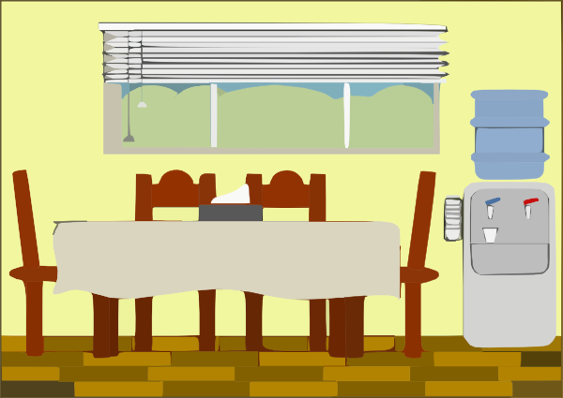
Phonetik
hören / sprechen
1
Der Mann sitzt allein. ☹
2
Der Arzt denkt ’Was?!’
3
der Artzt
Der Gast hat ein Zimmer.
4
Der Freund gewinnt ein Bett.
das Zimmer
5
Die Frau hat einen Gast.
6
Der Lehrer sagt ‘Hurra’. ☺
Notes:
Timing: 5-10 minutes Aim: To consolidate SSC and word knowledge in a listening and speaking activity Procedure (alternatives): 1. Students read each sentence aloud, as a whole-class activity or in pairs.
2) Students translate the sentences into English (orally or in writing).
3) Students play a paired vocabulary tennis task (with gestures for the verbs)
Word frequency (1 is the most frequent word in German): gewinnen [410] der Arzt [614] der Gast [675] das Zimmer [609] allein [258] Source: Jones, R.L. & Tschirner, E. (2006). A frequency dictionary of German: core vocabulary for learners. Routledge

Slide 16
[w]
Phonetik
Consolidation [2]
Y7 T2.2 Week 1 Slides 25-27

Slide 17
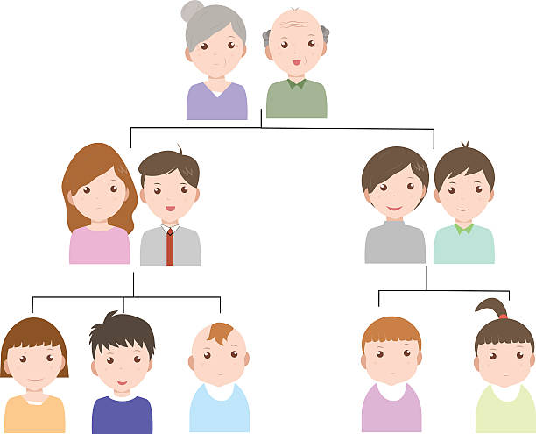
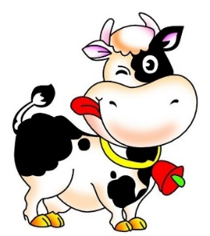
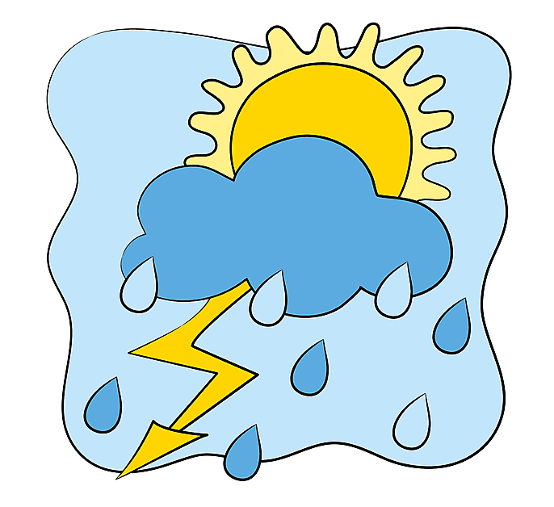
Minimalpaare
hören / sprechen
das Vieh
wie?
der Vetter
das Wetter
das Veilchen
das Weilchen
voll
die Wolle
Notes:
Timing: 2 minutes
Aim: Teacher-led pronunciation practice which draws attention to the importance of individual sounds in creating meaning.
Procedure: 1. Clicking on an image plays the German word(s).
2. Teacher leads class in imitating the pronunciation heard, drawing attention to the difference in meaning produced by changing between [v] and [w].
Word frequency (1 is the most frequent word in German):
Vieh [>5009] Veilchen [>5009] Weilchen [>5009] Vetter [>5009] Wetter [1881] voll [388] Wolle [>5009]
Source: Jones, R.L & Tschirner, E. (2019). A frequency dictionary of German: Core vocabulary for learners. London: Routledge.

Slide 18
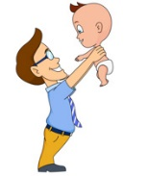
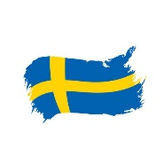
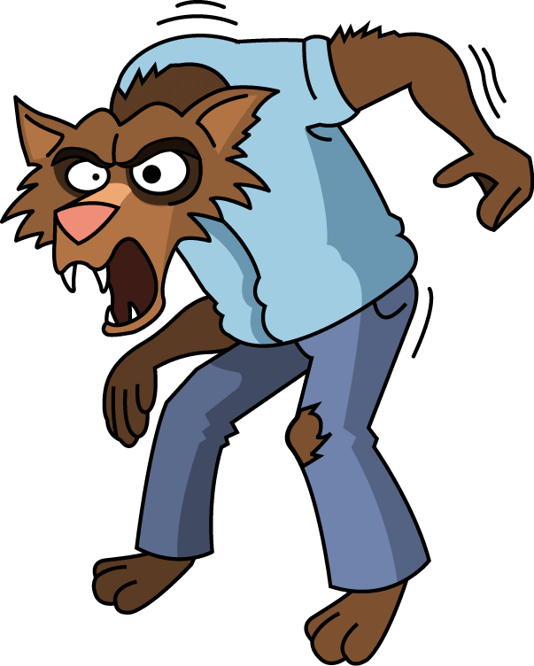
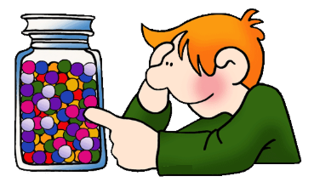
Wie sagt man das?
hören / schreiben
1
d e r W i k i n g e r
6
d e r V a t e r
__
__
2
S c h w e d e n
7
d e r W e r w o l f
__
__
__
3
d e r V o g e l
8
w i e v i e l e ?
__
__
__
4
d i e K r a w a t t e
9
v i e r u n d z w a n z i g
__
__
__
5
d a s V i e r e c k
10
w a r m
__
__
Notes:
Timing: 8 minutes
Aim: This listening exercise both helps students strengthen the association with German SSC [v], and lose the interfering association with the English SSC [v]. Words have been chosen which may have a surprising pronunciation in German (e.g. ‘Sweden vs Schweden’) or because they are pronounced similarly in German to English (e.g. Viking / Wikinger) which may throw students in terms of spelling.
Procedure: 1. Teacher to remind students to resist the temptation to write ‘v’ straight away for words they recognise from English. They must first listen, and focus on the sound.
2. Audio plays on clicking individual buttons.
3. Teacher can elicit responses by asking ‘Wie schreibt man das? Mit v oder mit w?’
4. Answers revealed on individual clicks.
Transcript:
1. der Wikinger
2. Schweden
3. der Vogel
4. die Krawatte
5. das Viereck
6. das Vater
7. der Werwolf
8. Wie viele?
9. Vierundzwanzig
10. warm
Word frequency (1 is the most frequent word in German):
Wikinger [>5009] Schweden [2478] Vogel [1701] Krawatte [>5009] Viereck [>5009] Vater [232] Werwolf [>5009] vierundzwanzig [>5009] warm [1281]
Source: Jones, R.L & Tschirner, E. (2019). A frequency dictionary of German: Core vocabulary for learners. London: Routledge.

Slide 19
Wie sagt man das?
sprechen
60
d e r W i k i n g e r
d e r V a t e r
S c h w e d e n
d e r W e r w o l f
Sekunden
d e r V o g e l
w i e v i e l e ?
d i e K r a w a t t e
v i e r u n d z w a n z i g
0
d a s V i e r e c k
w a r m
LOS!
Notes:
Timing: 3 minutes
Aim: Now, students work in pairs to practise saying the words they have just learned in turn.
Procedure: 1. Once they have practised a couple of times, the teacher can set the timer to see how many words students can pronounce correctly within ten seconds. Students act as jurors for one another. If a student pronounces a word incorrectly, they must start again!
2. Teacher may wish to run the times several times, depending on the needs of the class.
Word frequency (1 is the most frequent word in German):
Wikinger [>5009] Schweden [2478] Vogel [1701] Krawatte [>5009] Viereck [>5009] Vater [232] Werwolf [>5009] vierundzwanzig [>5009] warm [1281]
Source: Jones, R.L & Tschirner, E. (2019). A frequency dictionary of German: Core vocabulary for learners. London: Routledge.

Slide 20
[w]
Phonetik
Consolidation [3]
Y7 T3.1 Week 2 Slide 11

Slide 21
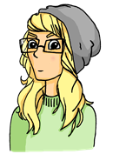
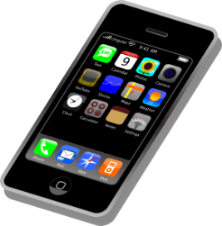
Samstagnachmittag
lesen / hören
Jetzt hat Heidi ein bisschen Angst. Wo ist Wolfgang? Sie telefoniert mit Wolfgang. Er sagt: „Jaaa … ich brauche eine …“
a) Weile
b) viele
8
Notes:
Here, SSCs [w] and [ei] are contrasted with SSCs [v] and [ie].
Teacher to draw attention to use of word order 2 in the first sentence, which starts with a time phrase. Before eliciting the English translation, remind students that the time phrase normally appears at the end of the sentence in English.
Students have not yet met cognate telefonieren [3352].
As no pictures are provided here, teacher to elicit meaning by asking students what English word Weile sounds like.
Frequencies of unknown vocabulary: Weile [1807]
Transcript
Weile

Slide 22
[w]
Phonetik
Consolidation [4]
Y7 T3.2 Week 6 Slides 2-3

Slide 23
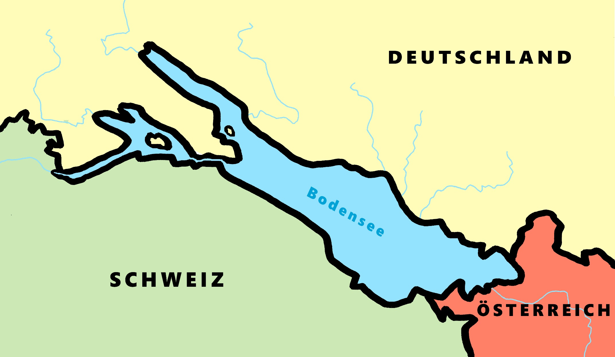
Phonetik - der Bodensee [1/2]
hören / schreiben
4
Allensbach
5
Wallhausen
3
Radolfzell
6
Hagnau
7
Friedrichshafen
1
Kreuzlingen
2
Steckborn
9
Romanshorn
8
Altenrhein
Notes:
Phonetik [1]
Time: 5 minutes Aim: To practise recognising and transcribing 10 previously taught SSC, in unknown words.
Procedure: 1. Click number to hear the full word. Students listen and transcribe only the missing letters. 2. Animations support item-by-item checking, as instant feedback on each SSC may be particularly helpful for students’ learning. 3. Teachers can additionally ask, Wo liegt [Hagnau]? Es liegt in [Deutschland]… Students have met the use of ‘in’ with die Schweiz. It will be helpful to focus their attention on the use of ‘in’ + der + Schweiz here, reminding them of the ‘in’ + movement (R2-accusative) or location (R3-dative) change. SSC revisited here: [eu] [st-] [z] [ch-hard] [w] [au] [ie] [ch-soft] [ei] [r] Transcript: 1 Kreuzlingen 2 Steckborn 3 Radolfzell 4 Allensbach 5 Wallhausen 6 Hagnau 7 Friedrichshafen 8 Altenrhein 9 Romanshorn

Slide 24
Phonetik - der Bodensee [1/2]
lesen / sprechen
9
Ludwigshafen
1
2
Friedrichshafen
Stein am Rhein
6
Konstanz
8
7
Reichenau
5
Altnau
3
Bregenz
4
Rorschach
Notes:
Phonetik [2]
Time: 5 minutes Aim: To practise reading aloud / saying 10 previously taught SSC, in unknown words (apart from Deutschland, which starts the task off). Here, 9 additional towns on the Bodensee are used.
Procedure: 1. Students work in pairs to pronounce each of the towns. 2. Click number to hear and check pronunciation. SSC revisited here: [eu] [st-] [z] [ch-hard] [w] [au] [ie] [ch-soft] [ei] [r] [sch] Transcript: 1 Deutschland 2 Friedrichshafen 3 Bregenz 4 Rorschach 5 Altnau 6 Konstanz 7 Reichenau 8 Stein am Rhein 9 Ludwigshafen

Slide 25
[w]
Phonetik
Consolidation [5]
Y8 T1.1 Week 7 Slides 2; 4; 18

Slide 26
w
Welt
Notes:
Timing: 1 minute
Aim: To introduce/consolidate SSC [w]
Procedure: 1. Present the letter(s) and say the [w] sound first, on its own. Students repeat it with you. 2. Bring up the word ”Welt” on its own, say it, students repeat it, so that they have the opportunity to focus all of their attention on the connection between the written word and its sound.
3. A possible gesture for this would be to start with your hands above your head and draw them down, out and then back into the body, tracing the shape of the world.
4. Roll back the animations and work through 1-3 again, but this time, dropping your voice completely to listen carefully to the students saying the [w] sound, pronouncing ”Welt” and, if using, doing the gesture. Word frequency (1 is the most frequent word in German): Welt [190] Source: Jones, R.L. & Tschirner, E. (2006). A frequency dictionary of German: core vocabulary for learners. Routledge

Slide 27
Phonetik
hören / schreiben
Hörst du [V] oder [W] oder beide?
 |  | [V] | [W]
 | voll [full]
 | Wettbewerb [competition]
 | Verantwortung [responsibility]
 | wunderbar [wonderful]
 | verweisen [to refer, expel]
 | relativ [relative]
1
2
3
4
5
6
Notes:
Timing: 5 minutes Aim: To practise differentiating between the two German SSC [v] and [w] in the spoken modality, which is tricky because of the pronunciation crossover between English [f] and German [v] and English [v] and German [w]. Procedure: 1. Write 1-6.
2. Listen to the words (click on audio buttons) and tick the appropriate column, according to whether you hear [v], [w] or both.
3. Click on the mouse to reveal the correct tick and also the words themselves (together with their English meanings).
Transcript: 1. voll
2. Wettbewerb
3. Verantwortung
4. wunderbar
5. verweisen
6. relativ Word frequency (1 is the most frequent word in German): voll [388] Wettbewerb [1493] Verantwortung [1104] wunderbar [1604] verweisen [1670] relativ [571] Source: Jones, R.L. & Tschirner, E. (2006). A frequency dictionary of German: core vocabulary for learners. Routledge

Slide 28
Phonetik
hören / schreiben
Hörst du [V] oder [W] oder beide?
 |  | [V] | [W]
 | verwenden [to use]
 | aktiv [active]
 | weltweit [worldwide]
 | warnen [to warn]
 | verschwinden [to disappear]
 | Verwandte [relative]
1
2
The following German words, borrowed from the English, pronounce ‘v’ in the English way:
Interview
Universität
Aktivität
3
4
5
6
Notes:
Timing: 5 minutes Aim: To practise differentiating between the two German SSC [v] and [w] in the spoken modality, which is tricky because of the pronunciation crossover between English [f] and German [v] and English [v] and German [w].
N.B. A similar task featured in lesson 1. Procedure: 1. Write 1-6.
2. Listen to the words (click on audio buttons) and tick the appropriate column, according to whether you hear [v], [w] or both.
3. Click on the mouse to reveal the correct tick and also the words themselves (together with their English meanings).
4. Point out that, in certain words borrowed from the English, the [v] is pronounced in the English way.
Transcript:
1. verwenden
2. aktiv
3. weltweit
4. warnen
5. verschwinden
6. Verwandte Word frequency (1 is the most frequent word in German): verwenden [538] aktiv [790] welweit [843] warnen [1337] verschwinden [559] Verwandte [2850]
Source: Jones, R.L. & Tschirner, E. (2006). A frequency dictionary of German: core vocabulary for learners. Routledge

Slide 29
[w]
Phonetik
Consolidation [6]
Y8 T3.1 Week 6 Slides 30-36

Slide 30
w
Welt
Notes:
Timing: 1 minute
Aim: To introduce/consolidate SSC [w]
Procedure: 1. Present the letter(s) and say the [w] sound first, on its own. Students repeat it with you. 2. Bring up the word ”Welt” on its own, say it, students repeat it, so that they have the opportunity to focus all of their attention on the connection between the written word and its sound.
3. A possible gesture for this would be to start with your hands above your head and draw them down, out and then back into the body, tracing the shape of the world.
4. Roll back the animations and work through 1-3 again, but this time, dropping your voice completely to listen carefully to the students saying the [w] sound, pronouncing ”Welt” and, if using, doing the gesture. Word frequency (1 is the most frequent word in German): Welt [190] Source: Jones, R.L. & Tschirner, E. (2006). A frequency dictionary of German: core vocabulary for learners. Routledge

Slide 31
w
Wasser
wahr
Welt
Was?
gewinnen
antworten
Notes:
Timing: 2 minutes
Aim: To introduce/consolidate SSC [w]
Procedure:
Introduce and elicit the pronunciation of the individual SSC [w] and then the source word again ‘Welt’ (with gesture, if using).
Then present and elicit the pronunciation of the five cluster words.
The cluster words have been chosen for their high-frequency, from a range of word classes, with the SSC (where possible) positioned within a variety of syllables within the words (e.g. initial, 2nd, final etc.). Additionally, we have tried to use words that build cumulatively on previously taught SSCs (see the Phonics Teaching Sequence document) and do not include new SSCs. Where new SSCs are used, they are often consonants which have a similar symbol-sound correspondence in English.
Word frequency (1 is the most frequent word in German): Welt [190]; Wasser [297] wahr [662]; Was? [39]; antworten [804]; gewinnen [410]. Source: Jones, R.L. & Tschirner, E. (2006). A frequency dictionary of German: core vocabulary for learners. Routledge

Slide 32
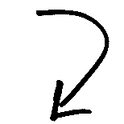
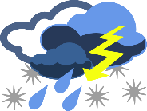
Phonetik: [v] oder [w]?
hören / schreiben
Partner(in) A
Partner(in) B
A
Vetter
Wetter
[male cousin]
[weather]
B
Wehlen
Velen
[German town names]
C
wir
vier
[we]
[four]
D
wogt
Vogt
[undulates]
[bailiff]
Notes:
Timing: 5 minutes Aim: to apply SSC knowledge of [v] and [w] to unknown words in transcription [Slide 1 of 2]. Procedure: 1. Partner B turns away from the board.
2. Click to reveal four pairs of words, which Partner A reads aloud.
3. Partner B transcribes all words.
4. Then turns back to check answers.
5. Next slide, repeat the task with roles reversed.
Transcript: Vetter - Wetter Wehlen - Velen wir – vier
wogt – Vogt
Word frequency (1 is the most frequent word in German): Vetter [>5000] Wetter [1881] wogen [>5000] Vogt [>5000]
Source: Jones, R.L. & Tschirner, E. (2019). A frequency dictionary of German: core vocabulary for learners. Routledge

Slide 33
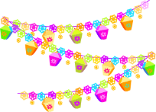
Phonetik: [v] oder [w]?
hören / schreiben
Partner(in) B
Partner(in) A
A
wie
Vieh
[how]
[cattle]
B
Weilchen
Veilchen
[little while]
[violet flower]
C
Veste
Weste
[festival]
[waistcoat]
D
voran
woran
[ahead]
[about which]
Notes:
Timing: 5 minutes Aim: to apply SSC knowledge of [v] and [w] to unknown words in transcription [Slide 2 of 2]. Procedure: 1. Partner A now turns away from the board.
2. Click to reveal four pairs of words, which Partner B reads aloud.
3. Partner A transcribes all words.
4. Then turns back to check answers.
Transcript: wie - Vieh Weilchen - Veilchen
Veste – Weste
voran - woran Word frequency (1 is the most frequent word in German): Vieh [>5000] Weilchen [>5000] Veilchen [>5000] Veste [>5000] Weste [>5000] voran [n/a] woran [3545]
Source: Jones, R.L. & Tschirner, E. (2019). A frequency dictionary of German: core vocabulary for learners. Routledge

Slide 34
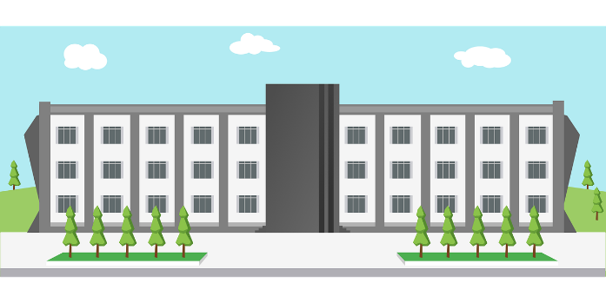
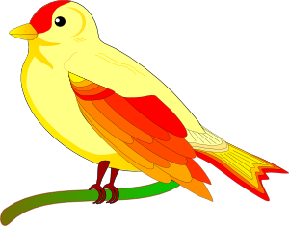
Phonetik: [v] oder [w]?
sprechen
Deutsches [w] ist wie englisches [v].
Deutsches [v] ist wie englisches [f].
However, in German words of foreign origin, [v] is usually like English [v].
5
Sekunden
[Universität]
[Vogel]
[November]
0
LOS!
Notes:
Timing: 2 minutes (for 3 slides) Aim: to apply SSC knowledge of both variants of [v] to unknown words in pronunciation. Procedure: 1. Teacher clicks and all 3 words appear.
2. Then, s/he quickly clicks the timer.
3. Students try to say all three words within the 5 seconds, chorally, differentiating the two ‘v’ pronunciations. Note: Teacher to reinforce that it will be the cognates that are likely to have English-sounding [v]. 4. Click on each word to hear the pronunciations, as desired.
Word frequency (1 is the most frequent word in German):
Vogel [1701]
Source: Jones, R.L & Tschirner, E. (2019). A frequency dictionary of German: Core vocabulary for learners. London: Routledge.

Slide 35
Phonetik: [v] oder [w]?
sprechen
5
Sekunden
[Wolke]
[Vase]
[Aktivität]
0
LOS!
Notes:
As for previous slide.
Word frequency (1 is the most frequent word in German):
Wolke [2114] Vase [>5000] Aktivität [1422]
Source: Jones, R.L & Tschirner, E. (2019). A frequency dictionary of German: Core vocabulary for learners. London: Routledge.

Slide 36
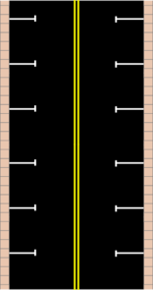
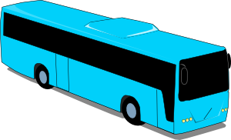
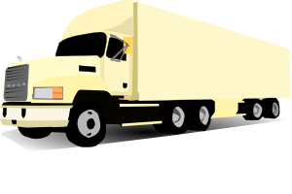
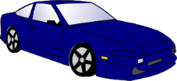
Phonetik: [v] oder [w]?
sprechen
5
Sekunden
[vage]
[Verkehr]
[vierzig]
0
LOS!
Notes:
As for previous slide.
Word frequency (1 is the most frequent word in German):
vage [>5000] Verkehr [2131]
Source: Jones, R.L & Tschirner, E. (2019). A frequency dictionary of German: Core vocabulary for learners. London: Routledge.

Slide 37
[w]
Phonetik
Consolidation [6]
Y9 T3.1 Week 1 Slide 2; 15-16

Slide 38
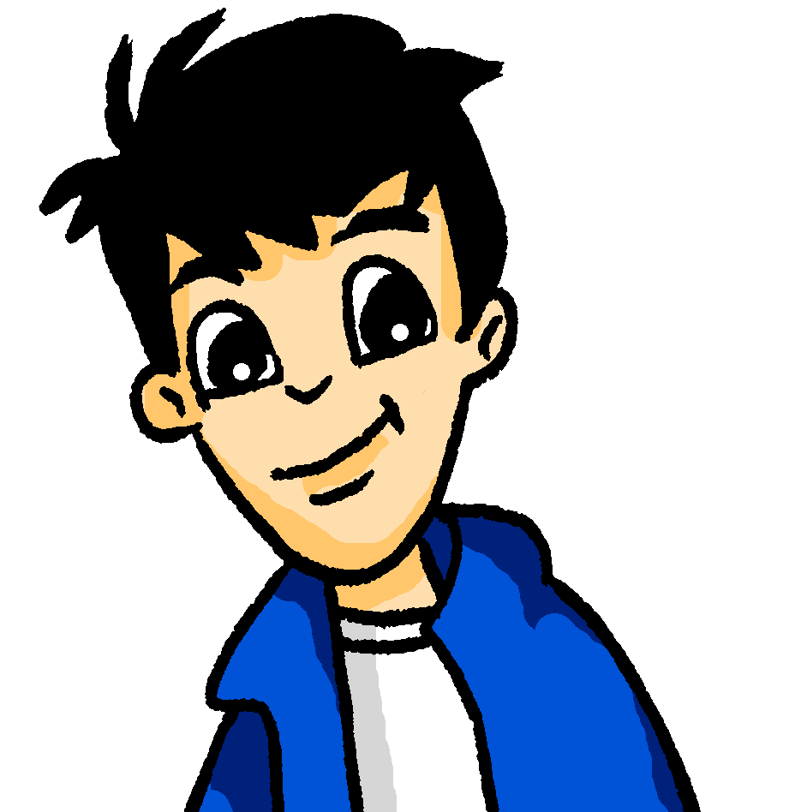
Phonetik
Wolfgang recherchiert internationale Ferien für seine Hausaufgaben.
hören / schreiben
Hör zu. Ist das [w] oder [v]?
 |  | w | v
 | Der internationale Weltfrauentag ist am 8. März.
 | In Armenien ist der Tag des Wissens und der Literatur am 1. September.
 | Botswana Tag ist am 30. September.
 | In Deutschland findet der Vatertag normalerweise im Mai statt.
 | Der Vorabend von Rosch ha-Schana ist ein jüdisches Fest.
 | Im Dezember feiere ich gern Weihnachten!
 | Der Tag der spanischen Verfassung ist am 6. Dezember.
 | In Deutschland feiert man Silvester am 31. Dezember.
1
_eltfrauentag
2
_issens
3
Bots_ana
4
_atertag
_orabend
Silvester (New Year’s Eve) is an exception, as it sounds like a ‘v’ rather than an ‘f’. Silvester is named after the 4th century Pope Sylvester.
5
6
_eihnachten!
7
_erfassung
8
Sil_ester
Notes:
Timing: Aim: To practise aural recognition of SSCs [w] and [v]. Procedure: 1. Explain the task. Students will listen to audio and decide whether the gaps in the transcription contain [w] or [v] based on what they hear.
2. Click to play the audio for each sentence and ask students to note down [w] or [v].
3. Click to reveal answers.
Word frequency (1 is the most frequent word in German): Silvester [>5000] Armenien [>5000] Botswana [>5000] Verfassung [2678] Source: Jones, R.L. & Tschirner, E. (2019). A frequency dictionary of German: core vocabulary for learners. Routledge

Slide 39
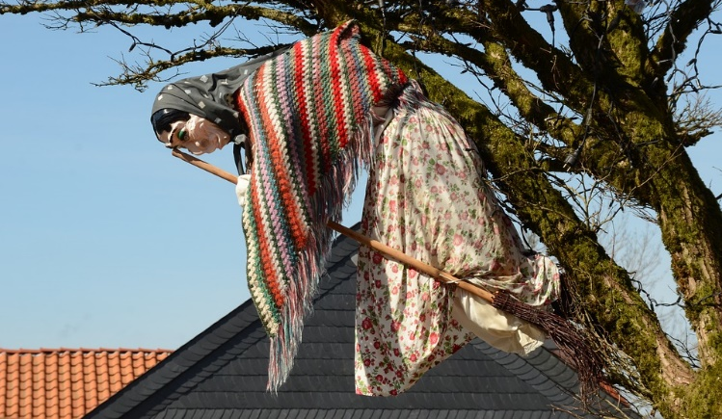
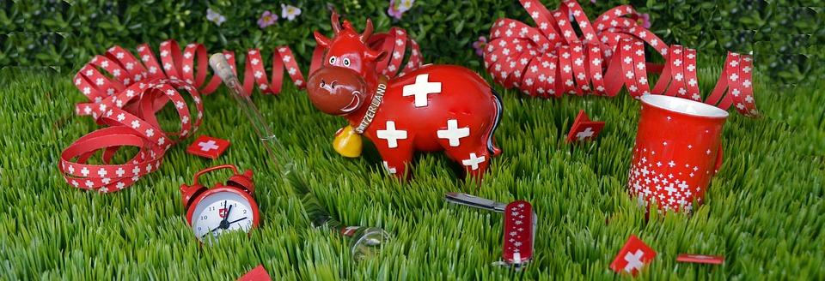
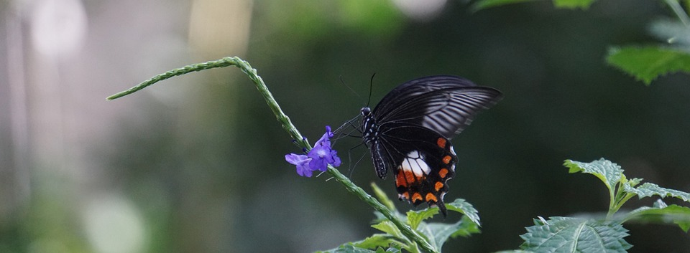
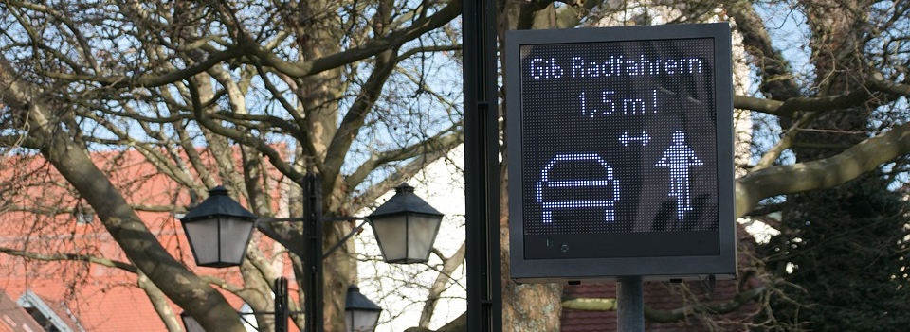
Was feiert man am…? [1/2]
sprechen / hören / schreiben
1
August Schweizer Nationalfeiertag | 30. April Walpurgisnacht
22. Mai Internationaler Tag der biologischen Vielfalt | 18. Juni Tag der Verkehrssicherheit in Deutschland
2
3
4
The exact date varies each year.
Notes:
Timing: (2 slides) Aim: To practise spoken production and aural recognition of SSCs [w] and [v]. Procedure: 1. Partner A writes down all of the dates on the board. Then they turn away.
2. Click to reveal the events. Partner A asks Partner B ‘was feiert man am ….’, giving one of the dates they have noted down. Note: encourage students to ask in a random order.
3. Partner B responds. Partner A listens carefully and transcribes what Partner B has said, paying particular attention to [w] and [v]. Partner B should repeat the answer as many times as Partner A requests (Wiederholen, bitte!).
4. Partner A turns back around to check answers.
5. Click to reveal audio buttons to check pronunciation.
6. Move to the next slide. Swap roles and repeat the procedure.
Transcript:
1. Schweizer Nationalfeiertag
2. Walpurgisnacht
3. Internationaler Tag der biologischen Vielfalt
4. Tag der Verkehrssicherheit in Deutschland
Word frequency (1 is the most frequent word in German): Vielfalt [2326] Verkehr [2131] Sicherheit [776] Source: Jones, R.L. & Tschirner, E. (2019). A frequency dictionary of German: core vocabulary for learners. Routledge

Slide 40
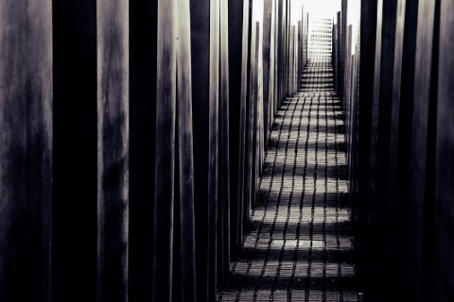
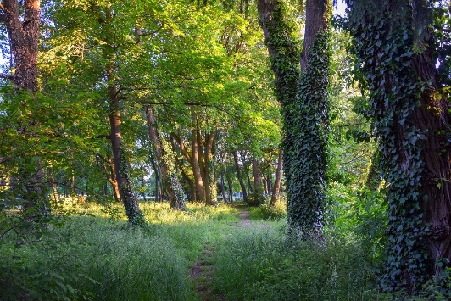
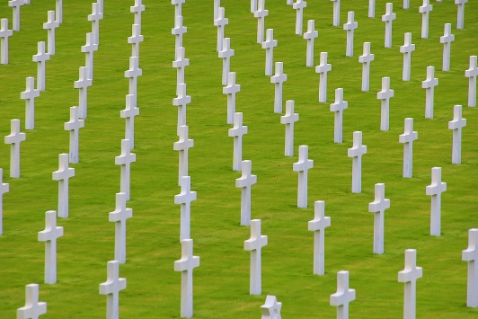
Was feiert man am…? [2/2]
sprechen /hören / schreiben
1
5. Mai Tag gegen Gewalt und Rassismus in Österreich | 21. März Internationaler Tag des Waldes
13. November Volkstrauertag in Deutschland | 24. Oktober Tag der Vereinten Nationen
2
3
4
The exact date varies each year.
Notes:
SLIDE 2
Transcript:
5. Tag gegen Gewalt und Rassismus in Österreich
6. Internationaler Tag des Waldes
7. Volkstrauertag in Deutschland
8. Tag der Vereinten Nationen
Word frequency (1 is the most frequent word in German): Gewalt [1316] Rassismus [>5000] Volk [1032] Trauer [3568] Vereinte Nationen [4181] Source: Jones, R.L. & Tschirner, E. (2019). A frequency dictionary of German: core vocabulary for learners. Routledge

