Slide 1
German phonics collection
vocalic [r]
Artwork: Steve Clarke
Date updated: 21 / 07 / 21
Notes:
Artwork by Steve Clarke. All additional pictures selected are available under a Creative Commons license, no attribution required.

Slide 2
vocalic [r]
Phonetik
Introduction
Y7 T2.2 Week 3 Slides 20-25

Slide 3
r
Uhr
Notes:
Timing: 1 minute
Aim: To introduce/consolidate SSC [r]
Procedure: 1. Present the letter(s) and say the [r] sound first, on its own. Students repeat it with you. 2. Bring up the word ”Uhr” on its own, say it, students repeat it, so that they have the opportunity to focus all of their attention on the connection between the written word and its sound.
3. A possible gesture for this would be to look at your left wrist and tap your imaginary watch twice, to emphasise the two distinct sounds you hear – Uh-r.
4. Roll back the animations and work through 1-3 again, but this time, dropping your voice completely to listen carefully to the students saying the [r] sound, pronouncing ”Uhr” and, if using, doing the gesture. Word frequency (1 is the most frequent word in German): Uhr [349] Source: Jones, R.L. & Tschirner, E. (2006). A frequency dictionary of German: core vocabulary for learners. Routledge

Slide 4
r
Uhr
Notes:
With sound and no pictures to focus all attention on the sound-symbol correspondence.

Slide 5
r
Uhr
Notes:
Without sound to elicit pronunciation (without first hearing the teacher).
Teacher to elicit pronunciation by asking “Wie sagt man…”

Slide 6
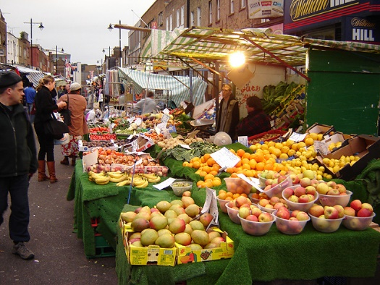
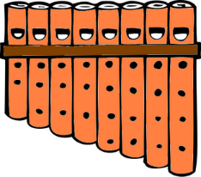
r
Markt
Morgen
Uhr
By Tarquin Binary - Own work, CC BY-SA 2.5
Kultur
Wort
dort
W O R T
Notes:
Timing: 2 minutes
Aim: To introduce/consolidate SSC [r]
Procedure:
Introduce and elicit the pronunciation of the individual SSC [r] and then the source word again ‘uhr’ (with gesture, if using).
Then present and elicit the pronunciation of the five cluster words.
The cluster words have been chosen for their high-frequency, from a range of word classes, with the SSC (where possible) positioned within a variety of syllables within the words (e.g. initial, 2nd, final etc.). Additionally, we have tried to use words that build cumulatively on previously taught SSCs (see the Phonics Teaching Sequence document) and do not include new SSCs. Where new SSCs are used, they are often consonants which have a similar symbol-sound correspondence in English.
Word frequency (1 is the most frequent word in German): Uhr [349]; Markt [508] Morgen [311]; Kultur [593]; dort [104]; Wort [243]. Source: Jones, R.L. & Tschirner, E. (2006). A frequency dictionary of German: core vocabulary for learners. Routledge

Slide 7
r
Markt
Morgen
Uhr
Kultur
Wort
dort
Notes:
With sound and no pictures to focus all attention on the sound-symbol correspondence.

Slide 8
r
Markt
Morgen
Uhr
Kultur
Wort
dort
Notes:
Without sound to elicit pronunciation (without first hearing the teacher).
Teacher to elicit pronunciation by asking “Wie sagt man…”

Slide 9
vocalic [r]
Phonetik
Consolidation [1]
Y7 T3.2 Week 3 Slide 35

Slide 10
Welcher R?
hören
 | ‘r’ as in ‘Regel’ | ‘r’ as in ‘Wort’
1
2
3
4
5
6
1
2
3
4
5
6
Notes:
Timing: 3 minutes
Aim: Students are challenged to distinguish between the sounds of the ‘r’ at the beginning of a word or syllable and the post-vocalic ‘r’. Click on the number to play the audio. Words from the new and revisited vocabulary sets for this week are used.
Procedure:
1. Click on the number to play the audio.
2. Students tick the appropriate column.
3. Click to reveal the answers one by one.
Transcript:
1. dürfen
2. die Straße
3. ruhig
4. der Markt
5. springen
6. die Party

Slide 11
vocalic [r]
Phonetik
Consolidation [2]
Y7 T3.2 Week 6 Slides 2; 20

Slide 12
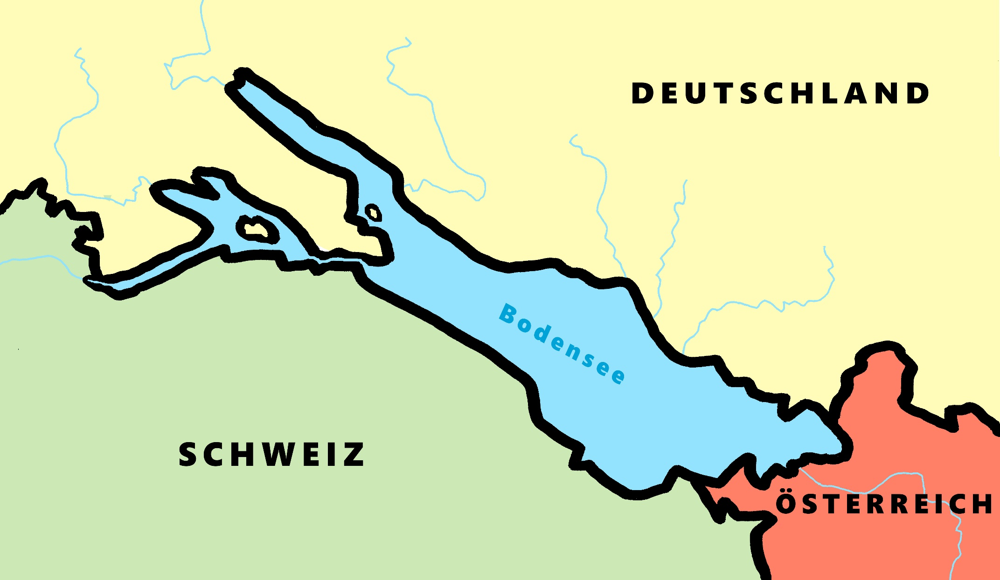
Phonetik - der Bodensee [1/2]
hören / schreiben
4
Allensbach
5
Wallhausen
3
Radolfzell
6
Hagnau
7
Friedrichshafen
1
Kreuzlingen
2
Steckborn
9
Romanshorn
8
Altenrhein
Notes:
Phonetik [1]
Time: 5 minutes Aim: To practise recognising and transcribing 10 previously taught SSC, in unknown words.
Procedure: 1. Click number to hear the full word. Students listen and transcribe only the missing letters. 2. Animations support item-by-item checking, as instant feedback on each SSC may be particularly helpful for students’ learning. 3. Teachers can additionally ask, Wo liegt [Hagnau]? Es liegt in [Deutschland]… Students have met the use of ‘in’ with die Schweiz. It will be helpful to focus their attention on the use of ‘in’ + der + Schweiz here, reminding them of the ‘in’ + movement (R2-accusative) or location (R3-dative) change. SSC revisited here: [eu] [st-] [z] [ch-hard] [w] [au] [ie] [ch-soft] [ei] [r] Transcript: 1 Kreuzlingen 2 Steckborn 3 Radolfzell 4 Allensbach 5 Wallhausen 6 Hagnau 7 Friedrichshafen 8 Altenrhein 9 Romanshorn

Slide 13
Wie heißt die Band?
Phonetik
Alastair telefoniert mit Mia. Sie reden über deutsche Bands. Wie heißen sie?
 | die P r i n z e n
 | J u l i
 | F e t t e s B r o t
 | die F a n t a s t i s c h e n V i e r
 | S ö h n e M a n n h e i m s
 | S p o r t f r e u n d e S t i l l e r
 | R o s e n s t o l z
 | die Ä r t z e
1
_
2
_
3
_
_
4
_
_
_
_
_
5
_
_
_
6
_
_
_
_
7
_
_
8
_
_
Notes:
Phonetik [1] Time: 5 minutes
Aim: To practise recognising and transcribing 14 previously taught SSC, in unknown words.
Note: These are real German band names.
Procedure: 1. Click number to hear the full word. Students listen and transcribe only the missing letters. 2. Animations support item-by-item checking, as instant feedback on each SSC may be particularly helpful for students’ learning. SSC revisited here: [z] [j] [r-consonantal] [o-long] [sch] [v] [r-vocalic] [ö-long] [ei] [st] [-er] [st] [ä] [-e]
Transcript: [1] die Prinzen
[2] Juli
[3] Fettes Brot
[4] die Fantastischen Vier
[5] Söhne Mannheims
[6] Sportfreunde Stiller
[7] Rosenstolz
[8] die Ärzte

Slide 14
vocalic [r]
Phonetik
Consolidation [3]
Y8 T1.1 Week 6 Slides 3; 7-11

Slide 15
r
Uhr
Notes:
Timing: 1 minute
Aim: To introduce/consolidate SSC [r]
Procedure: 1. Present the letter(s) and say the [r] sound first, on its own. Students repeat it with you. 2. Bring up the word ”Uhr” on its own, say it, students repeat it, so that they have the opportunity to focus all of their attention on the connection between the written word and its sound.
3. A possible gesture for this would be to look at your left wrist and tap your imaginary watch twice, to emphasise the two distinct sounds you hear – Uh-r.
4. Roll back the animations and work through 1-3 again, but this time, dropping your voice completely to listen carefully to the students saying the [r] sound, pronouncing ”Uhr” and, if using, doing the gesture. Word frequency (1 is the most frequent word in German): Uhr [349] Source: Jones, R.L. & Tschirner, E. (2006). A frequency dictionary of German: core vocabulary for learners. Routledge

Slide 16
r
Markt
Morgen
Uhr
By Tarquin Binary - Own work, CC BY-SA 2.5
Kultur
Wort
dort
W O R T
Notes:
Timing: 2 minutes
Aim: To introduce/consolidate SSC [r]
Procedure:
Introduce and elicit the pronunciation of the individual SSC [r] and then the source word again ‘uhr’ (with gesture, if using).
Then present and elicit the pronunciation of the five cluster words.
The cluster words have been chosen for their high-frequency, from a range of word classes, with the SSC (where possible) positioned within a variety of syllables within the words (e.g. initial, 2nd, final etc.). Additionally, we have tried to use words that build cumulatively on previously taught SSCs (see the Phonics Teaching Sequence document) and do not include new SSCs. Where new SSCs are used, they are often consonants which have a similar symbol-sound correspondence in English.
Word frequency (1 is the most frequent word in German): Uhr [349]; Markt [508] Morgen [311]; Kultur [593]; dort [104]; Wort [243]. Source: Jones, R.L. & Tschirner, E. (2006). A frequency dictionary of German: core vocabulary for learners. Routledge

Slide 17
r
Markt
Morgen
Uhr
Kultur
Wort
dort
Notes:
With sound and no pictures to focus all attention on the sound-symbol correspondence.

Slide 18
r
Markt
Morgen
Uhr
Kultur
Wort
dort
Notes:
Without sound to elicit pronunciation (without first hearing the teacher).
Teacher to elicit pronunciation by asking “Wie sagt man…”

Slide 19
Phonetik
hören / schreiben
Wie oft hörst du [r]?
1
Ihre Schwester trägt einen roten Rock.
////
2
Sein großer Bruder reist nach Rom.
//// /
3
Deine Eltern fahren immer über die Brücke.
////
4
Das traurige Kind erlebt die Kultur.
////
5
Wir verbringen eine schöne Zeit in Frankfurt.
////
Notes:
Timing: 4 minutes Aim: Listening for and noticing the SSC [r] in a sentence context. Procedure: 1. Click on a number to hear the sentence. Click on the number again to repeat if necessary.
2. Write down how many Rs you hear in each sentence.
3. Click to see the sentence and check the answer.
4. Check understanding of sentences.
Transcript: 1. Ihre Schwester trägt einen roten Rock.
2. Sein großer Bruder reist nach Rom.
3. Deine Eltern fahren immer über die Brücke.
4. Das traurige Kind erlebt die Kultur.
5. Wir verbringen eine schöne Zeit in Frankfurt.

Slide 20
Phonetik
lesen / sprechen
reden
Tier
30
schreiben
lernen
oder
Wort
Eltern
Lehrerin
Schwester
reisen
Morgen
Farbe
Sekunden
Problem
fahren
Frage
Markt
Bruder
Frau
rund
leider
Kultur
Straße
rot
groß
0
aber
Herr
LOS!
Grund
Notes:
Timing: 1 minute Aim: To automatize pronunciation of the SSC [r] by saying words containing the SSC in a speeded fashion. All the words are known. Procedure: 1. Say a many of these words out loud in 30 seconds
2. Click on Los! to start the timer.

Slide 21
vocalic [r]
Phonetik
Consolidation [4]
Y9 T3.2 Week 1 Slides 2; 20-21

Slide 22
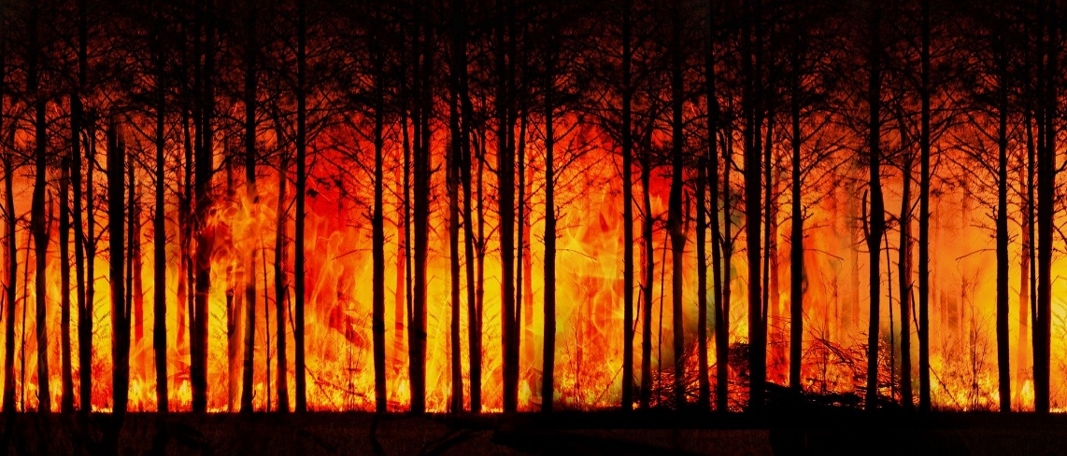
Phonetik
hören / schreiben
Hör zu. Schreib 1-8 und die Wörter, die fehlen.
*der Waldbrand – forest fire
*das Klima – climate
Es gibt schon Rekordtemperaturen und Waldbrände* in Nordamerika und Sibirien. Wir wollen keine hohen Temperaturen und extremes Wetter. Deshalb brauchen wir eine schnelle Reduzierung von Emissionen.
2021 hat Deutschland versprochen, bis 2045 klimaneutral* zu sein. Das wird schwierig sein und viel Geld kosten. Das Land muss jetzt mehr grüne Technologien und Infrastruktur benutzen.
1
_ _ _ _ _ _ _ _ _ _ _ _ _ _ _ _ _
_ _ _ _ _ _ _ _ _ _ _
_ _ _ _ _ _ _ _
_ _ _ _ _ _ _ _ _ _ _
2
_ _ _ _ _ _ _ _ _ _ _
_ _ _ _ _ _ _ _ _ _
_ _ _ _ _
_ _ _ _ _ _ _ _ _ _ _ _ _
Notes:
Timing: 5 minutes Aim: to revisit SSC [r] in different positions in words. Procedure: 1. Click on the audio buttons to hear each paragraph.
2. Students transcribe the blanked out words using their knowledge of [r]. (The blanked out words are mostly cognates to aid understanding of the text).
4. Click to reveal answers.
Transcript: 1. Es gibt schon Rekordtemperaturen und Waldbrände* in Nordamerika und Sibirien. Wir wollen keine hohen Temperaturen und extremes Wetter. Deshalb brauchen wir eine schnelle Reduzierung von Emissionen.
2. 2021 hat Deutschland versprochen, bis 2045 klimaneutral* zu sein. Das wird schwierig sein und viel Geld kosten. Das Land muss jetzt mehr grüne Technologien und Infrastruktur benutzen.
Source: https://www.dw.com/de/deutschland-klimaneutral-2045-kosten/a-59197085
Word frequency (1 is the most frequent word in German): Temperatur [873] Brand [3937] Sibirien [>5009] Wetter [1881] Emission [>500] Klima [3146] Technologie [2170] Infrastruktur [2807] Source: Jones, R.L. & Tschirner, E. (2019). A frequency dictionary of German: core vocabulary for learners. Routledge

Slide 23
Phonetik
sprechen / hören
Mia und Freunde müssen sich für eine Rede anmelden. Sie müssen den Namen und die Adresse angeben.
Partner A dreht sich um.
Note! When spelling is important and the final –r might not be heard, German speakers often exaggerate it. Be helpful to your partner in the same way.
Partner B liest die Namen und Adressen vor.
Partner A schreibt sie auf.
Mia und Wolfgang Richter. Forststraße 203, Zehlendorf.
Heidi Schröder. Berner Straße 314, Lichterfelde.
Walter Schulte. Riesaer Straße 416, Hellersdorf.
Dieter Werner. Raabestraße 632, Hoppegarten.
Notes:
Timing: 10 minutes
Aim: to practise saying [r] in different positions in words. To simulate a real-life example where German speakers would over-enunciate the sound to be clearer. Procedure: 1. Explain the task. The group have gone to see an environment activist and need to register at the desk.
2. Partner A turns away from the board.
3. Click to reveal the characters’ names and addresses
4. Partner B carefully reads out the names and addresses, over enunciating the ‘r’ sound where need be for clarity.
5. Partner A notes down what they hear.
6. Partner A turns around to check answers.
7. If desired, click the people image to hear native speaker audio.
8. Click to reveal the following slide and partners swap roles.

Slide 24
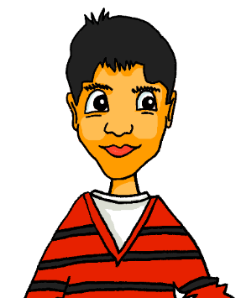
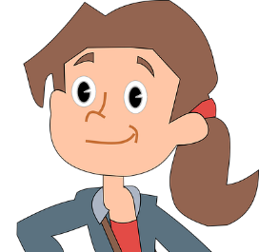
Phonetik
sprechen / hören
Partner B dreht sich um.
Partner A liest die Namen und Adressen vor.
Partner B schreibt sie auf.
Katja Nowak. Reger Straße 854, Grunewald.
Mehmet Bayrak. Sundgauer Straße 503, Lichterfelde.
Uwe Müller. Kaiser-Friedrich-Straße 698, Charlottenburg.
Anneliese Krause. Trelleborger Straße 713, Prenzlauerberg.
Notes:
Slide 2

