Slide 1
German phonics collection
[v]
Artwork: Steve Clarke
Date updated: 24 / 07 / 21
Notes:
Artwork by Steve Clarke. All additional pictures selected are available under a Creative Commons license, no attribution required.

Slide 2
[v]
Phonetik
Introduction
Y7 T2.2 Week 1 Slides 2-8; 25-27

Slide 3
v
vor
Notes:
Timing: 1 minute
Aim: To introduce/consolidate SSC [v]
Procedure: 1. Present the letter(s) and say the [v] sound first, on its own. Students repeat it with you. 2. Bring up the word ”vor” on its own, say it, students repeat it, so that they have the opportunity to focus all of their attention on the connection between the written word and its sound.
3. A possible gesture for this would be to hold your hands, left in front of right, in front of your body, palms facing inward. Quickly move the right hand over the top of the left, as you say ‘vor’, to mime ‘in front’.
4. Roll back the animations and work through 1-3 again, but this time, dropping your voice completely to listen carefully to the students saying the [v] sound, pronouncing ”vor” and, if using, doing the gesture. Word frequency (1 is the most frequent word in German): vor [55] Source: Jones, R.L. & Tschirner, E. (2006). A frequency dictionary of German: core vocabulary for learners. Routledge

Slide 4
v
vor
Notes:
With sound and no pictures to focus all attention on the sound-symbol correspondence.

Slide 5
v
vor
Notes:
Without sound to elicit pronunciation (without first hearing the teacher).
Teacher to elicit pronunciation by asking “Wie sagt man…”

Slide 6
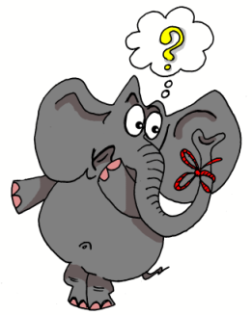
v
positiv
voll
vor
bevor
Vater
vergessen
Notes:
Timing: 2 minutes
Aim: To introduce/consolidate SSC [v]
Procedure:
Introduce and elicit the pronunciation of the individual SSC [v] and then the source word again ‘vor’ (with gesture, if using).
Then present and elicit the pronunciation of the five cluster words.
The cluster words have been chosen for their high-frequency, from a range of word classes, with the SSC (where possible) positioned within a variety of syllables within the words (e.g. initial, 2nd, final etc.). Additionally, we have tried to use words that build cumulatively on previously taught SSCs (see the Phonics Teaching Sequence document) and do not include new SSCs. Where new SSCs are used, they are often consonants which have a similar symbol-sound correspondence in English.
Word frequency (1 is the most frequent word in German): vor [55]; positiv [690] voll [357]; bevor[541]; vergessen [595]; Vater [216]. Source: Jones, R.L. & Tschirner, E. (2006). A frequency dictionary of German: core vocabulary for learners. Routledge

Slide 7
v
positiv
voll
vor
bevor
Vater
vergessen
Notes:
With sound and no pictures to focus all attention on the sound-symbol correspondence.

Slide 8
v
positiv
voll
vor
bevor
Vater
vergessen
Notes:
Without sound to elicit pronunciation (without first hearing the teacher).
Teacher to elicit pronunciation by asking “Wie sagt man…”

Slide 9
Wie sagt man …?
Volkswagen
Notes:
Timing: 1 minute
Aim: To introduce/consolidate SSC [v], as opposed to [w]
Procedure: 1. Students may be surprised to hear the pronunciation of this German car manufacturer! Ask students to sound out the word before leading whole-class pronunciation.
2. Students may also be interested in the translation of the word (the people’s car)., which is another example of compounding.

Slide 10
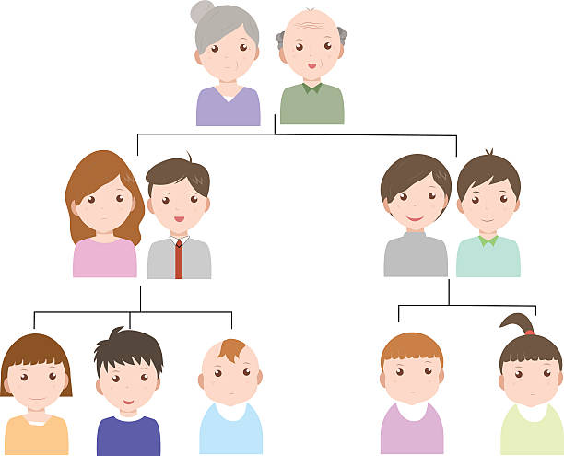
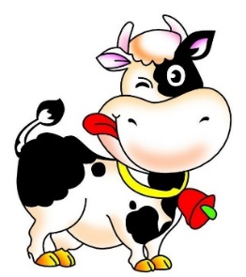
Minimalpaare
hören / sprechen
das Vieh
wie?
der Vetter
das Wetter
das Veilchen
das Weilchen
voll
die Wolle
Notes:
Timing: 2 minutes
Aim: Teacher-led pronunciation practice which draws attention to the importance of individual sounds in creating meaning.
Procedure: 1. Clicking on an image plays the German word(s).
2. Teacher leads class in imitating the pronunciation heard, drawing attention to the difference in meaning produced by changing between [v] and [w].
Word frequency (1 is the most frequent word in German):
Vieh [>5009] Veilchen [>5009] Weilchen [>5009] Vetter [>5009] Wetter [1881] voll [388] Wolle [>5009]
Source: Jones, R.L & Tschirner, E. (2019). A frequency dictionary of German: Core vocabulary for learners. London: Routledge.

Slide 11
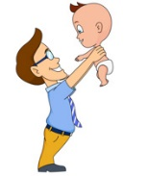
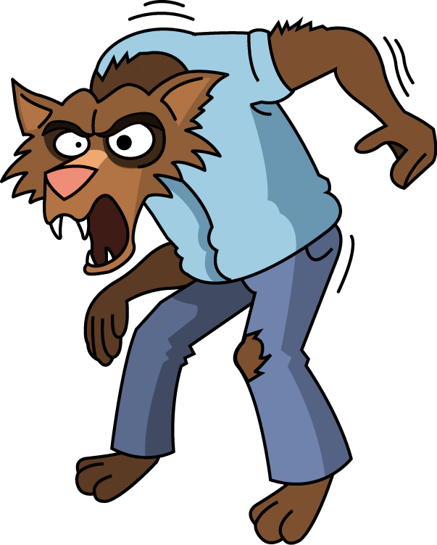
Wie sagt man das?
hören / schreiben
1
d e r W i k i n g e r
6
d e r V a t e r
__
__
2
S c h w e d e n
7
d e r W e r w o l f
__
__
__
3
d e r V o g e l
8
w i e v i e l e ?
__
__
__
4
d i e K r a w a t t e
9
v i e r u n d z w a n z i g
__
__
__
5
d a s V i e r e c k
10
w a r m
__
__
Notes:
Timing: 8 minutes
Aim: This listening exercise both helps students strengthen the association with German SSC [v], and lose the interfering association with the English SSC [v]. Words have been chosen which may have a surprising pronunciation in German (e.g. ‘Sweden vs Schweden’) or because they are pronounced similarly in German to English (e.g. Viking / Wikinger) which may throw students in terms of spelling.
Procedure: 1. Teacher to remind students to resist the temptation to write ‘v’ straight away for words they recognise from English. They must first listen, and focus on the sound.
2. Audio plays on clicking individual buttons.
3. Teacher can elicit responses by asking ‘Wie schreibt man das? Mit v oder mit w?’
4. Answers revealed on individual clicks.
Transcript:
1. der Wikinger
2. Schweden
3. der Vogel
4. die Krawatte
5. das Viereck
6. das Vater
7. der Werwolf
8. Wie viele?
9. Vierundzwanzig
10. warm
Word frequency (1 is the most frequent word in German):
Wikinger [>5009] Schweden [2478] Vogel [1701] Krawatte [>5009] Viereck [>5009] Vater [232] Werwolf [>5009] vierundzwanzig [>5009] warm [1281]
Source: Jones, R.L & Tschirner, E. (2019). A frequency dictionary of German: Core vocabulary for learners. London: Routledge.

Slide 12
Wie sagt man das?
sprechen
60
d e r W i k i n g e r
d e r V a t e r
S c h w e d e n
d e r W e r w o l f
Sekunden
d e r V o g e l
w i e v i e l e ?
d i e K r a w a t t e
v i e r u n d z w a n z i g
0
d a s V i e r e c k
w a r m
LOS!
Notes:
Timing: 3 minutes
Aim: Now, students work in pairs to practise saying the words they have just learned in turn.
Procedure: 1. Once they have practised a couple of times, the teacher can set the timer to see how many words students can pronounce correctly within ten seconds. Students act as jurors for one another. If a student pronounces a word incorrectly, they must start again!
2. Teacher may wish to run the times several times, depending on the needs of the class.
Word frequency (1 is the most frequent word in German):
Wikinger [>5009] Schweden [2478] Vogel [1701] Krawatte [>5009] Viereck [>5009] Vater [232] Werwolf [>5009] vierundzwanzig [>5009] warm [1281]
Source: Jones, R.L & Tschirner, E. (2019). A frequency dictionary of German: Core vocabulary for learners. London: Routledge.

Slide 13
[v]
Phonetik
Consolidation [1]
Y7 T3.1 Week 2 Slide 11

Slide 14
Samstagnachmittag
lesen / hören
Jetzt hat Heidi ein bisschen Angst. Wo ist Wolfgang? Sie telefoniert mit Wolfgang. Er sagt: „Jaaa … ich brauche eine …“
a) Weile
b) viele
8
Notes:
Here, SSCs [w] and [ei] are contrasted with SSCs [v] and [ie].
Teacher to draw attention to use of word order 2 in the first sentence, which starts with a time phrase. Before eliciting the English translation, remind students that the time phrase normally appears at the end of the sentence in English.
Students have not yet met cognate telefonieren [3352].
As no pictures are provided here, teacher to elicit meaning by asking students what English word Weile sounds like.
Frequencies of unknown vocabulary: Weile [1807]
Transcript
Weile

Slide 15
[v]
Phonetik
Consolidation [2]
Y7 T3.2 Week 6 Slide 20

Slide 16
Wie heißt die Band?
Phonetik
Alastair telefoniert mit Mia. Sie reden über deutsche Bands. Wie heißen sie?
 | die P r i n z e n
 | J u l i
 | F e t t e s B r o t
 | die F a n t a s t i s c h e n V i e r
 | S ö h n e M a n n h e i m s
 | S p o r t f r e u n d e S t i l l e r
 | R o s e n s t o l z
 | die Ä r t z e
1
_
2
_
3
_
_
4
_
_
_
_
_
5
_
_
_
6
_
_
_
_
7
_
_
8
_
_
Notes:
Phonetik [1] Time: 5 minutes
Aim: To practise recognising and transcribing 14 previously taught SSC, in unknown words.
Note: These are real German band names.
Procedure: 1. Click number to hear the full word. Students listen and transcribe only the missing letters. 2. Animations support item-by-item checking, as instant feedback on each SSC may be particularly helpful for students’ learning. SSC revisited here: [z] [j] [r-consonantal] [o-long] [sch] [v] [r-vocalic] [ö-long] [ei] [st] [-er] [st] [ä] [-e]
Transcript: [1] die Prinzen
[2] Juli
[3] Fettes Brot
[4] die Fantastischen Vier
[5] Söhne Mannheims
[6] Sportfreunde Stiller
[7] Rosenstolz
[8] die Ärzte

Slide 17
[v]
Phonetik
Consolidation [3]
Y8 T1.1 Week 7 Slides 3; 4; 18

Slide 18
v
vor
Notes:
Timing: 1 minute
Aim: To introduce/consolidate SSC [v]
Procedure: 1. Present the letter(s) and say the [v] sound first, on its own. Students repeat it with you. 2. Bring up the word ”vor” on its own, say it, students repeat it, so that they have the opportunity to focus all of their attention on the connection between the written word and its sound.
3. A possible gesture for this would be to hold your hands, left in front of right, in front of your body, palms facing inward. Quickly move the right hand over the top of the left, as you say ‘vor’, to mime ‘in front’.
4. Roll back the animations and work through 1-3 again, but this time, dropping your voice completely to listen carefully to the students saying the [v] sound, pronouncing ”vor” and, if using, doing the gesture. Word frequency (1 is the most frequent word in German): vor [55] Source: Jones, R.L. & Tschirner, E. (2006). A frequency dictionary of German: core vocabulary for learners. Routledge

Slide 19
Phonetik
hören / schreiben
Hörst du [V] oder [W] oder beide?
 |  | [V] | [W]
 | voll [full]
 | Wettbewerb [competition]
 | Verantwortung [responsibility]
 | wunderbar [wonderful]
 | verweisen [to refer, expel]
 | relativ [relative]
1
2
3
4
5
6
Notes:
Timing: 5 minutes Aim: To practise differentiating between the two German SSC [v] and [w] in the spoken modality, which is tricky because of the pronunciation crossover between English [f] and German [v] and English [v] and German [w]. Procedure: 1. Write 1-6.
2. Listen to the words (click on audio buttons) and tick the appropriate column, according to whether you hear [v], [w] or both.
3. Click on the mouse to reveal the correct tick and also the words themselves (together with their English meanings).
Transcript: 1. voll
2. Wettbewerb
3. Verantwortung
4. wunderbar
5. verweisen
6. relativ Word frequency (1 is the most frequent word in German): voll [388] Wettbewerb [1493] Verantwortung [1104] wunderbar [1604] verweisen [1670] relativ [571] Source: Jones, R.L. & Tschirner, E. (2006). A frequency dictionary of German: core vocabulary for learners. Routledge

Slide 20
Phonetik
hören / schreiben
Hörst du [V] oder [W] oder beide?
 |  | [V] | [W]
 | verwenden [to use]
 | aktiv [active]
 | weltweit [worldwide]
 | warnen [to warn]
 | verschwinden [to disappear]
 | Verwandte [relative]
1
2
The following German words, borrowed from the English, pronounce ‘v’ in the English way:
Interview
Universität
Aktivität
3
4
5
6
Notes:
Timing: 5 minutes Aim: To practise differentiating between the two German SSC [v] and [w] in the spoken modality, which is tricky because of the pronunciation crossover between English [f] and German [v] and English [v] and German [w].
N.B. A similar task featured in lesson 1. Procedure: 1. Write 1-6.
2. Listen to the words (click on audio buttons) and tick the appropriate column, according to whether you hear [v], [w] or both.
3. Click on the mouse to reveal the correct tick and also the words themselves (together with their English meanings).
4. Point out that, in certain words borrowed from the English, the [v] is pronounced in the English way.
Transcript:
1. verwenden
2. aktiv
3. weltweit
4. warnen
5. verschwinden
6. Verwandte Word frequency (1 is the most frequent word in German): verwenden [538] aktiv [790] welweit [843] warnen [1337] verschwinden [559] Verwandte [2850]
Source: Jones, R.L. & Tschirner, E. (2006). A frequency dictionary of German: core vocabulary for learners. Routledge

Slide 21
[v]
Phonetik
Consolidation [4]
Y8 T3.1 Week 6 Slides 2-14; 32-36

Slide 22
v
vor
Notes:
Timing: 1 minute
Aim: To introduce/consolidate SSC [v]
Procedure: 1. Present the letter(s) and say the [v] sound first, on its own. Students repeat it with you. 2. Bring up the word ”vor” on its own, say it, students repeat it, so that they have the opportunity to focus all of their attention on the connection between the written word and its sound.
3. A possible gesture for this would be to hold your hands, left in front of right, in front of your body, palms facing inward. Quickly move the right hand over the top of the left, as you say ‘vor’, to mime ‘in front’.
4. Roll back the animations and work through 1-3 again, but this time, dropping your voice completely to listen carefully to the students saying the [v] sound, pronouncing ”vor” and, if using, doing the gesture. Word frequency (1 is the most frequent word in German): vor [55] Source: Jones, R.L. & Tschirner, E. (2006). A frequency dictionary of German: core vocabulary for learners. Routledge

Slide 23
v
positiv
voll
vor
bevor
Vater
vergessen
Notes:
Timing: 2 minutes
Aim: To introduce/consolidate SSC [v]
Procedure:
Introduce and elicit the pronunciation of the individual SSC [v] and then the source word again ‘vor’ (with gesture, if using).
Then present and elicit the pronunciation of the five cluster words.
The cluster words have been chosen for their high-frequency, from a range of word classes, with the SSC (where possible) positioned within a variety of syllables within the words (e.g. initial, 2nd, final etc.). Additionally, we have tried to use words that build cumulatively on previously taught SSCs (see the Phonics Teaching Sequence document) and do not include new SSCs. Where new SSCs are used, they are often consonants which have a similar symbol-sound correspondence in English.
Word frequency (1 is the most frequent word in German): vor [55]; positiv [690] voll [357]; bevor[541]; vergessen [595]; Vater [216]. Source: Jones, R.L. & Tschirner, E. (2006). A frequency dictionary of German: core vocabulary for learners. Routledge

Slide 24
Phonetik / Vokabeln
lesen / sprechen / hören
Mia hilft Andrea mit den Hausaufgaben. Andrea hört Mia zu. Welches Wort hat die SSC [v]?
Vierzehn beginnt mit [v], nicht wahr?
Und wie sagt man den Satz auf Englisch, Mia?
Beispiel: FranzifängtvierzehnFischeamFreitag.
Ja, richtig!
Franzi catches fourteen fish on Friday?
Notes:
Timing: 7 minutes (including answers)
Aim: to practise reading aloud familiar words in novel combinations to practise decoding at sentence level, and to differentiate words that start with the SSC [v] by drawing on previous vocabulary knowledge (as the SSC [f] is the same). This activity includes 13 of the words from this week’s vocabulary sets.
Procedure: 1. Model the task, using the example on this slide.
2. Then student B turns away from the board. 2. Student A reads the first sentence aloud. 3. Student B listens and identifies any words that start with the SSC [v]. There is usually just one, though number 3 has two. S/he writes the word down. 4. Student A continues with sentences 2-4. 5. The students swap roles for sentences 5-8. 6. Then the teacher elicits the answers from students, including an oral translation of each sentence into English, and prompts them to re-read the German sentences as quickly as possible.

Slide 25
Partner(in) A
lesen / sprechen / hören
1. FelixfindetvieleeinfacheFehlerimText. 2. DasFeldhatvierzigfantastischeBäume. 3. IhrVaterversuchtFranzösischzulernen. 4. WirsollenunsereGefühleversteckenundnichtlachen.
Notes:
DO NOT CLICK TO BRING UP THE TEXT UNTIL STUDENT B HAS TURNED AWAY FROM THE BOARD

Slide 26
Partner(in) B
lesen / sprechen / hören
1. DievierFreundefindenihreFahrräderhinterdemGebäude. 2. ElefantenvergessennieihreFamilie. 3. FrankfurthateineBevölkerungvonetwasiebenhundert
fünzigtausendPersonen. 4. VielleichtfindestdueinpaarFotosvomHausfürmich?
Notes:
DO NOT CLICK TO BRING UP THE TEXT UNTIL STUDENT A HAS TURNED AWAY FROM THE BOARD

Slide 27
Phonetik / Vokabeln
lesen / sprechen / hören
1. FelixfindetvieleeinfacheFehlerimText.
1
Felix is finding a lot of simple mistakes in the text.
Notes:
Answers

Slide 28
Phonetik / Vokabeln
lesen / sprechen / hören
2. DasFeldhatvierzigfantastischeBäume.
2
The field has forty fantastic trees.
Notes:
Answers

Slide 29
Phonetik / Vokabeln
lesen / sprechen / hören
3. IhrVaterversuchtFranzösischzulernen.
3
Her/their father is trying to learn French.
Notes:
Answers

Slide 30
Phonetik / Vokabeln
lesen / sprechen / hören
4. WirsollenunsereGefühleversteckenundnichtlachen.
4
We should hide our feelings and not laugh.
Notes:
Answers

Slide 31
Phonetik / Vokabeln
lesen / sprechen / hören
5. DievierFreundefindenihreFahrräderhinterdemGebäude.
5
The four friends find their bikes behind the building.
Notes:
Answers

Slide 32
Phonetik / Vokabeln
lesen / sprechen / hören
6. ElefantenvergessennieihreFamilie.
6
Elephants never forget their family.
Notes:
Answers

Slide 33
Phonetik / Vokabeln
lesen / sprechen / hören
7. FrankfurthateineBevölkerungvonetwasiebenhundert
fünzigtausendPersonen.
7
Frankfurt has a population of about seven hundred and fifty thousand people.
Notes:
Answers

Slide 34
Phonetik / Vokabeln
lesen / sprechen / hören
8. VielleichtfindestdueinpaarFotosvomHausfürmich?
8
Perhaps you’ll find a few photos of the house for me?
Notes:
Answers

Slide 35
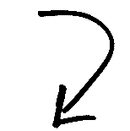
Phonetik: [v] oder [w]?
hören / schreiben
Partner(in) A
Partner(in) B
A
Vetter
Wetter
[male cousin]
[weather]
B
Wehlen
Velen
[German town names]
C
wir
vier
[we]
[four]
D
wogt
Vogt
[undulates]
[bailiff]
Notes:
Timing: 5 minutes Aim: to apply SSC knowledge of [v] and [w] to unknown words in transcription [Slide 1 of 2]. Procedure: 1. Partner B turns away from the board.
2. Click to reveal four pairs of words, which Partner A reads aloud.
3. Partner B transcribes all words.
4. Then turns back to check answers.
5. Next slide, repeat the task with roles reversed.
Transcript: Vetter - Wetter Wehlen - Velen wir – vier
wogt – Vogt
Word frequency (1 is the most frequent word in German): Vetter [>5000] Wetter [1881] wogen [>5000] Vogt [>5000]
Source: Jones, R.L. & Tschirner, E. (2019). A frequency dictionary of German: core vocabulary for learners. Routledge

Slide 36
Phonetik: [v] oder [w]?
hören / schreiben
Partner(in) B
Partner(in) A
A
wie
Vieh
[how]
[cattle]
B
Weilchen
Veilchen
[little while]
[violet flower]
C
Veste
Weste
[festival]
[waistcoat]
D
voran
woran
[ahead]
[about which]
Notes:
Timing: 5 minutes Aim: to apply SSC knowledge of [v] and [w] to unknown words in transcription [Slide 2 of 2]. Procedure: 1. Partner A now turns away from the board.
2. Click to reveal four pairs of words, which Partner B reads aloud.
3. Partner A transcribes all words.
4. Then turns back to check answers.
Transcript: wie - Vieh Weilchen - Veilchen
Veste – Weste
voran - woran Word frequency (1 is the most frequent word in German): Vieh [>5000] Weilchen [>5000] Veilchen [>5000] Veste [>5000] Weste [>5000] voran [n/a] woran [3545]
Source: Jones, R.L. & Tschirner, E. (2019). A frequency dictionary of German: core vocabulary for learners. Routledge

Slide 37
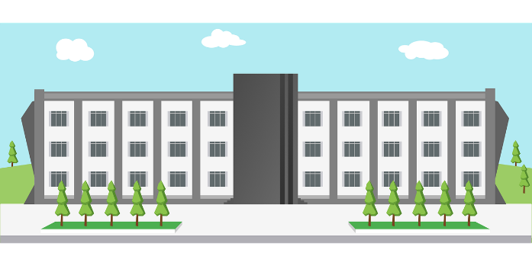
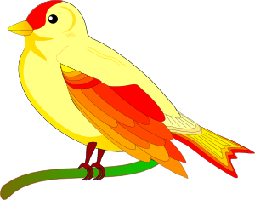
Phonetik: [v] oder [w]?
sprechen
Deutsches [w] ist wie englisches [v].
Deutsches [v] ist wie englisches [f].
However, in German words of foreign origin, [v] is usually like English [v].
5
Sekunden
[Universität]
[Vogel]
[November]
0
LOS!
Notes:
Timing: 2 minutes (for 3 slides) Aim: to apply SSC knowledge of both variants of [v] to unknown words in pronunciation. Procedure: 1. Teacher clicks and all 3 words appear.
2. Then, s/he quickly clicks the timer.
3. Students try to say all three words within the 5 seconds, chorally, differentiating the two ‘v’ pronunciations. Note: Teacher to reinforce that it will be the cognates that are likely to have English-sounding [v]. 4. Click on each word to hear the pronunciations, as desired.
Word frequency (1 is the most frequent word in German):
Vogel [1701]
Source: Jones, R.L & Tschirner, E. (2019). A frequency dictionary of German: Core vocabulary for learners. London: Routledge.

Slide 38
Phonetik: [v] oder [w]?
sprechen
5
Sekunden
[Wolke]
[Vase]
[Aktivität]
0
LOS!
Notes:
As for previous slide.
Word frequency (1 is the most frequent word in German):
Wolke [2114] Vase [>5000] Aktivität [1422]
Source: Jones, R.L & Tschirner, E. (2019). A frequency dictionary of German: Core vocabulary for learners. London: Routledge.

Slide 39
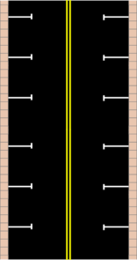
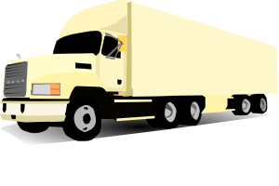
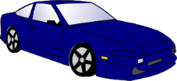
Phonetik: [v] oder [w]?
sprechen
5
Sekunden
[vage]
[Verkehr]
[vierzig]
0
LOS!
Notes:
As for previous slide.
Word frequency (1 is the most frequent word in German):
vage [>5000] Verkehr [2131]
Source: Jones, R.L & Tschirner, E. (2019). A frequency dictionary of German: Core vocabulary for learners. London: Routledge.

Slide 40
[w]
Phonetik
Consolidation [5]
Y9 T3.1 Week 1 Slide 2

Slide 41
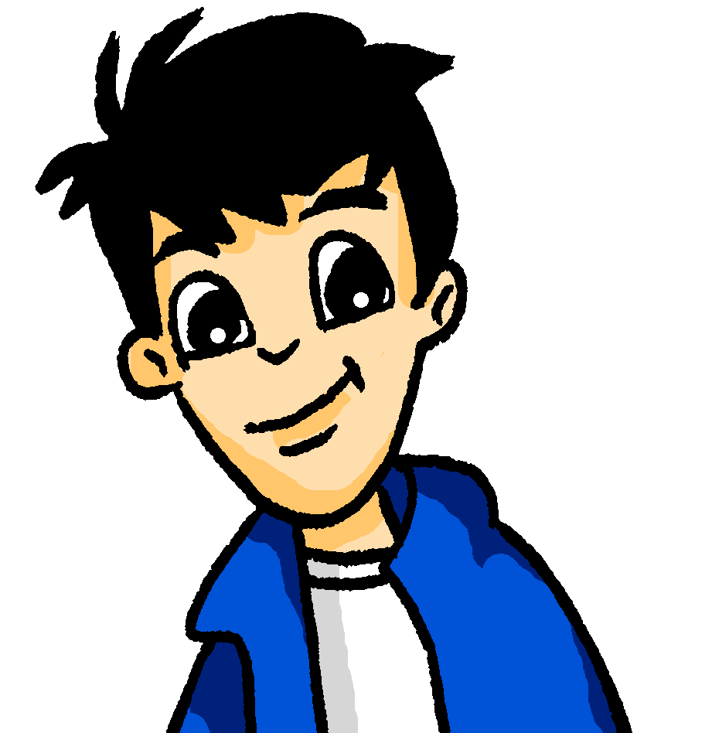
Phonetik
Wolfgang recherchiert internationale Ferien für seine Hausaufgaben.
hören / schreiben
Hör zu. Ist das [w] oder [v]?
 |  | w | v
 | Der internationale Weltfrauentag ist am 8. März.
 | In Armenien ist der Tag des Wissens und der Literatur am 1. September.
 | Botswana Tag ist am 30. September.
 | In Deutschland findet der Vatertag normalerweise im Mai statt.
 | Der Vorabend von Rosch ha-Schana ist ein jüdisches Fest.
 | Im Dezember feiere ich gern Weihnachten!
 | Der Tag der spanischen Verfassung ist am 6. Dezember.
 | In Deutschland feiert man Silvester am 31. Dezember.
1
_eltfrauentag
2
_issens
3
Bots_ana
4
_atertag
_orabend
Silvester (New Year’s Eve) is an exception, as it sounds like a ‘v’ rather than an ‘f’. Silvester is named after the 4th century Pope Sylvester.
5
6
_eihnachten!
7
_erfassung
8
Sil_ester
Notes:
Timing: Aim: To practise aural recognition of SSCs [w] and [v]. Procedure: 1. Explain the task. Students will listen to audio and decide whether the gaps in the transcription contain [w] or [v] based on what they hear.
2. Click to play the audio for each sentence and ask students to note down [w] or [v].
3. Click to reveal answers.
Word frequency (1 is the most frequent word in German): Silvester [>5000] Armenien [>5000] Botswana [>5000] Verfassung [2678] Source: Jones, R.L. & Tschirner, E. (2019). A frequency dictionary of German: core vocabulary for learners. Routledge

Slide 42
[w]
Phonetik
Consolidation [6]
Y9 T3.1 Week 1 Slides 15-16

Slide 43
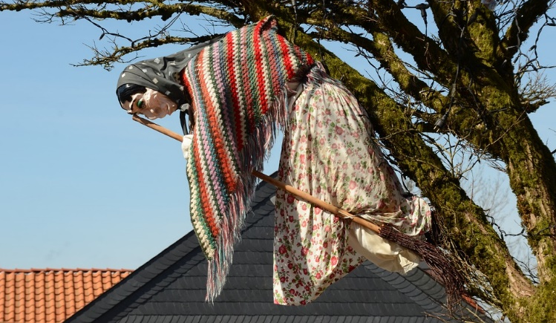
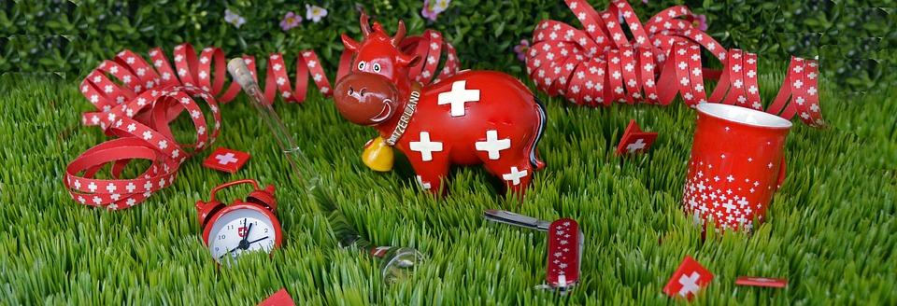
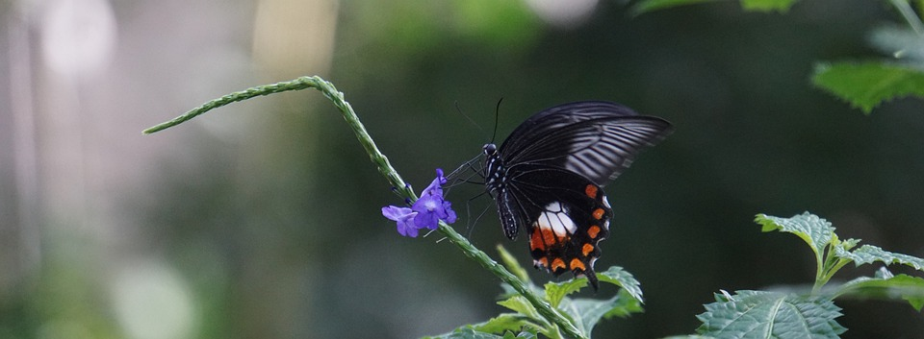
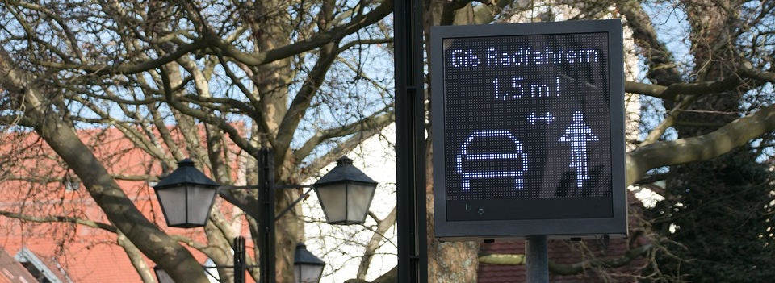
Was feiert man am…? [1/2]
sprechen / hören / schreiben
1
August Schweizer Nationalfeiertag | 30. April Walpurgisnacht
22. Mai Internationaler Tag der biologischen Vielfalt | 18. Juni Tag der Verkehrssicherheit in Deutschland
2
3
4
The exact date varies each year.
Notes:
Timing: (2 slides) Aim: To practise spoken production and aural recognition of SSCs [w] and [v]. Procedure: 1. Partner A writes down all of the dates on the board. Then they turn away.
2. Click to reveal the events. Partner A asks Partner B ‘was feiert man am ….’, giving one of the dates they have noted down. Note: encourage students to ask in a random order.
3. Partner B responds. Partner A listens carefully and transcribes what Partner B has said, paying particular attention to [w] and [v]. Partner B should repeat the answer as many times as Partner A requests (Wiederholen, bitte!).
4. Partner A turns back around to check answers.
5. Click to reveal audio buttons to check pronunciation.
6. Move to the next slide. Swap roles and repeat the procedure.
Transcript:
1. Schweizer Nationalfeiertag
2. Walpurgisnacht
3. Internationaler Tag der biologischen Vielfalt
4. Tag der Verkehrssicherheit in Deutschland
Word frequency (1 is the most frequent word in German): Vielfalt [2326] Verkehr [2131] Sicherheit [776] Source: Jones, R.L. & Tschirner, E. (2019). A frequency dictionary of German: core vocabulary for learners. Routledge

Slide 44
Was feiert man am…? [2/2]
sprechen /hören / schreiben
1
5. Mai Tag gegen Gewalt und Rassismus in Österreich | 21. März Internationaler Tag des Waldes
13. November Volkstrauertag in Deutschland | 24. Oktober Tag der Vereinten Nationen
2
3
4
The exact date varies each year.
Notes:
SLIDE 2
Transcript:
5. Tag gegen Gewalt und Rassismus in Österreich
6. Internationaler Tag des Waldes
7. Volkstrauertag in Deutschland
8. Tag der Vereinten Nationen
Word frequency (1 is the most frequent word in German): Gewalt [1316] Rassismus [>5000] Volk [1032] Trauer [3568] Vereinte Nationen [4181] Source: Jones, R.L. & Tschirner, E. (2019). A frequency dictionary of German: core vocabulary for learners. Routledge

