Slide 1
German phonics collection
unstressed [-er]
Artwork: Steve Clarke
Date updated: 8/02/23
Notes:
Artwork by Steve Clarke. All additional pictures selected are available under a Creative Commons license, no attribution required.

Slide 2
Unstressed [-er]
Phonetik
Introduction
Y7 T2.1 Week 5 Slides 28-33; 34

Slide 3
er
wieder
Notes:
Timing: 1 minute
Aim: To introduce/consolidate SSC [er]
Procedure: 1. Present the letter(s) and say the [er] sound first, on its own. Students repeat it with you. 2. Bring up the word ”wieder” on its own, say it, students repeat it, so that they have the opportunity to focus all of their attention on the connection between the written word and its sound.
3. A possible gesture for this would be to roll your hands over in the air, clockwise. Your hands are in front of your body.
4. Roll back the animations and work through 1-3 again, but this time, dropping your voice completely to listen carefully to the students saying the [er] sound, pronouncing ”wieder” and, if using, doing the gesture. Word frequency (1 is the most frequent word in German): wieder [75] Source: Jones, R.L. & Tschirner, E. (2006). A frequency dictionary of German: core vocabulary for learners. Routledge

Slide 4
er
wieder
Notes:
With sound and no pictures to focus all attention on the sound-symbol correspondence.

Slide 5
er
wieder
Notes:
Without sound to elicit pronunciation (without first hearing the teacher).
Teacher to elicit pronunciation by asking “Wie sagt man…”

Slide 6
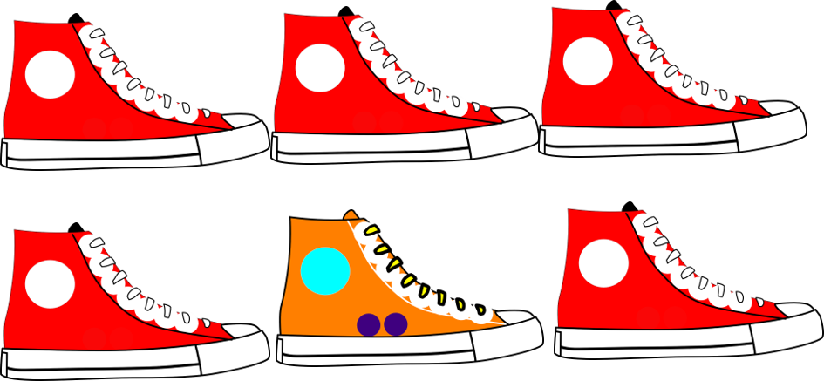
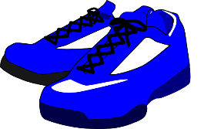
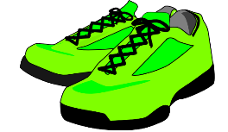
er
Eltern
aber
wieder
anders
oder
?
hundert
Notes:
Timing: 2 minutes
Aim: To introduce/consolidate SSC [er]
Procedure:
Introduce and elicit the pronunciation of the individual SSC [er] and then the source word again ‘wieder’ (with gesture, if using).
Then present and elicit the pronunciation of the five cluster words.
The cluster words have been chosen for their high-frequency, from a range of word classes, with the SSC (where possible) positioned within a variety of syllables within the words (e.g. initial, 2nd, final etc.). Additionally, we have tried to use words that build cumulatively on previously taught SSCs (see the Phonics Teaching Sequence document) and do not include new SSCs. Where new SSCs are used, they are often consonants which have a similar symbol-sound correspondence in English.
Word frequency (1 is the most frequent word in German): wieder [75]; Eltern [351] aber [32]; anders [306]; hundert [945]; oder [30]. Source: Jones, R.L. & Tschirner, E. (2006). A frequency dictionary of German: core vocabulary for learners. Routledge

Slide 7
er
Eltern
aber
wieder
anders
oder
hundert
Notes:
With sound and no pictures to focus all attention on the sound-symbol correspondence.

Slide 8
er
Eltern
aber
wieder
anders
oder
hundert
Notes:
Without sound to elicit pronunciation (without first hearing the teacher).
Teacher to elicit pronunciation by asking “Wie sagt man…”

Slide 9
Wie viele … ?
Wie viele [Stressed and unstressed –er]?
hören
Der Herr versteht kein Deutsch.
1
Der Herr versteht kein Deutsch.
2
Er lernt nichts.
Er lernt nichts.
Die Eltern putzen das Fenster
3
Die Eltern putzen das Fenster
4
Die Mutter ist groß, aber das Kind ist klein.
Die Mutter ist groß, aber das Kind ist klein.
5
Wer hat leider kein Herz?
Wer hat leider kein Herz?
6
Der Fußballspieler gewinnt wieder hundert Trophäen.
Der Fußballspieler gewinnt wieder hundert Trophäen.
Notes:
Timing: 5 minutes
Aim: Phonics practice - How many stressed and unstressed –er can you hear in the sentences?
Procedure: 1. Click on the numbered buttons to play the audio.
2. Students listen and identify where the two types of –er occur.
3. Answers appear on successive mouse clicks: stressed –er are underlined, unstressed –er are hignlighted in colour only (no underlining).
Note:
Sentences 1 and 2 only contain stressed -er
Sentences 2 and 3 only contain unstressed –er
Sentences 5 and 6 contain both stressed and unstressed –er
Word frequency (1 is the most frequent word in German):
7.2.1.5 (introduce) verstehen [222]
Source: Jones, R.L & Tschirner, E. (2019). A frequency dictionary of German: Core vocabulary for learners. London: Routledge.

Slide 10
Unstressed [-er]
Phonetik
Consolidation [1]
Y8 T1.2 Week 4 Slides 5-9

Slide 11
er
Eltern
aber
wieder
anders
oder
?
hundert
Notes:
Timing: 2 minutes
Aim: To introduce/consolidate SSC [er]
Procedure:
Introduce and elicit the pronunciation of the individual SSC [er] and then the source word again ‘wieder’ (with gesture, if using).
Then present and elicit the pronunciation of the five cluster words.
The cluster words have been chosen for their high-frequency, from a range of word classes, with the SSC (where possible) positioned within a variety of syllables within the words (e.g. initial, 2nd, final etc.). Additionally, we have tried to use words that build cumulatively on previously taught SSCs (see the Phonics Teaching Sequence document) and do not include new SSCs. Where new SSCs are used, they are often consonants which have a similar symbol-sound correspondence in English.
Word frequency (1 is the most frequent word in German): wieder [75]; Eltern [351] aber [32]; anders [306]; hundert [945]; oder [30]. Source: Jones, R.L. & Tschirner, E. (2006). A frequency dictionary of German: core vocabulary for learners. Routledge

Slide 12
er
Eltern
aber
wieder
anders
oder
hundert
Notes:
With sound and no pictures to focus all attention on the sound-symbol correspondence.

Slide 13
er
Eltern
aber
wieder
anders
oder
hundert
Notes:
Without sound to elicit pronunciation (without first hearing the teacher).
Teacher to elicit pronunciation by asking “Wie sagt man…”

Slide 14
Phonetik
hören / schreiben
[er] sounds like the two German vowels [e] [a] spoken together quickly, when [er] starts a word OR is the stressed syllable.
[er] sounds like the English ‘uh’ in other instances. It is similar to the German final [-e] but you drop your jaw and pull your tongue back.
1
der Berg
2
die Ferien
dieser Mann – diese Frau
ein letzter Blick – eine letzte Minute
3
[this man – this woman]
4
[one last look – one last minute]
bitte – bitter
6
Liebe – lieber
5
[please - bitter]
[rather]
Notes:
Timing: Aim: Explain and exemplify [-er] sounds in German Procedure: 1. Cycle through the explanation and examples using the animated sequence.
Transcript: 1. der Berg
2. die Ferien
3. dieser Mann – diese Frau
4. ein letzter Blick – eine letzte Minute
5. bitte – bitter
6. Liebe - lieber Word frequency (1 is the most frequent word in German): Source: Jones, R.L. & Tschirner, E. (2006). A frequency dictionary of German: core vocabulary for learners. Routledge

Slide 15
Phonetik
lesen / sprechen
Sag die Wörter.
erleben
Ferien
die Erfahrung
wandern
erfahren
klettern
sterben
hundert
dieser
letzter
die Unterstützung
selber
die Bevölkerung
der Berg
Notes:
Timing: 4 minutes Aim: To practise reading and saying the target SSC [er] in a word context. Procedure: 1. In pairs take turns reading a word from the board. Make sure to say each word only once!
2. When all the words have been done click to start an animated sequence. Words will fade away in 4 seconds. Say the word before it disappears. This is a whole-class activity.
Word frequency (1 is the most frequent word in German):
erfahren [690] klettern [2601] wandern [1803] Berg [934] die Erfahrung [619] sterben [475] Bevölkerung [1018] Unterstüzung [1141] hundert [1107] erleben [570] Ferien [3448] dieser, diese, dieses [24] letzter, letzte, letztes [152/53] selbst, selber [101]
Source: Jones, R.L. & Tschirner, E. (2006). A frequency dictionary of German: core vocabulary for learners. Routledge

Slide 16
Unstressed [-er]
Phonetik
Consolidation [2]
Y8 T2.2 Week 4 Slide 3

Slide 17
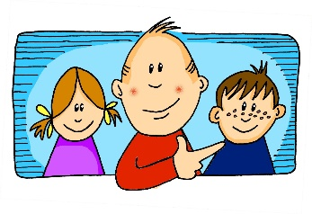
Phonetik
Hör zu. Schreib die Wörter. Wie viele enthalten die SSC?
hören / schreiben
[er-]
[-er]
[ei]
[j]
[z]
[o]
er
wieder
frei
ja
Zug
Kopf
 |  | ?
 | [er-]
 | [-er]
 | [ei]
 |  | ?
 | [j]
 | [z]
 | [o]
gern – erklären - unser
2
jung – jedoch - Jugendclub
3
alle – erzählen - anderer
1
kurz – unser - zwar
2
Kleid – weit - alleine
3
1
genau – Schloss - erlauben
Notes:
Timing: 7 minutes Aim: Transcription activity to revisit six further SSC, and to practise writing vocabulary from this week’s sets, as well as a few unknown words. As such, this is a hybrid phonics – vocabulary activity. Procedure: 1. Click on each individual SSC to hear it.
2. Elicit the source word from students, if remembered. Note that all of these words have also been taught as key vocabulary on the SOW.
3. Bring up the source words to check, and for reference for the read aloud activity.
4. Students listen to the sets of three words and transcribe them. 5. They decide how many words contain the target SSC.
6. Reveal the answers. 7. Optional – elicit the English meanings of the vocabulary.
Transcript: gern – erklären - unser
alle – erzählen - anderer
Kleid – weit – alleine
jung – jedoch – Jugendclub
kurz – unser - zwar
genau – Schloss - erlauben
Word frequency of unknown words (1 is the most frequent word in German): weit [230] zwar [227] Source: Jones, R.L. & Tschirner, E. (2019). A frequency dictionary of German: core vocabulary for learners. Routledge

Slide 18
Unstressed [-er]
Phonetik
Consolidation [3]
Y9 T1.1 Week 3 Slides 3-4

Slide 19
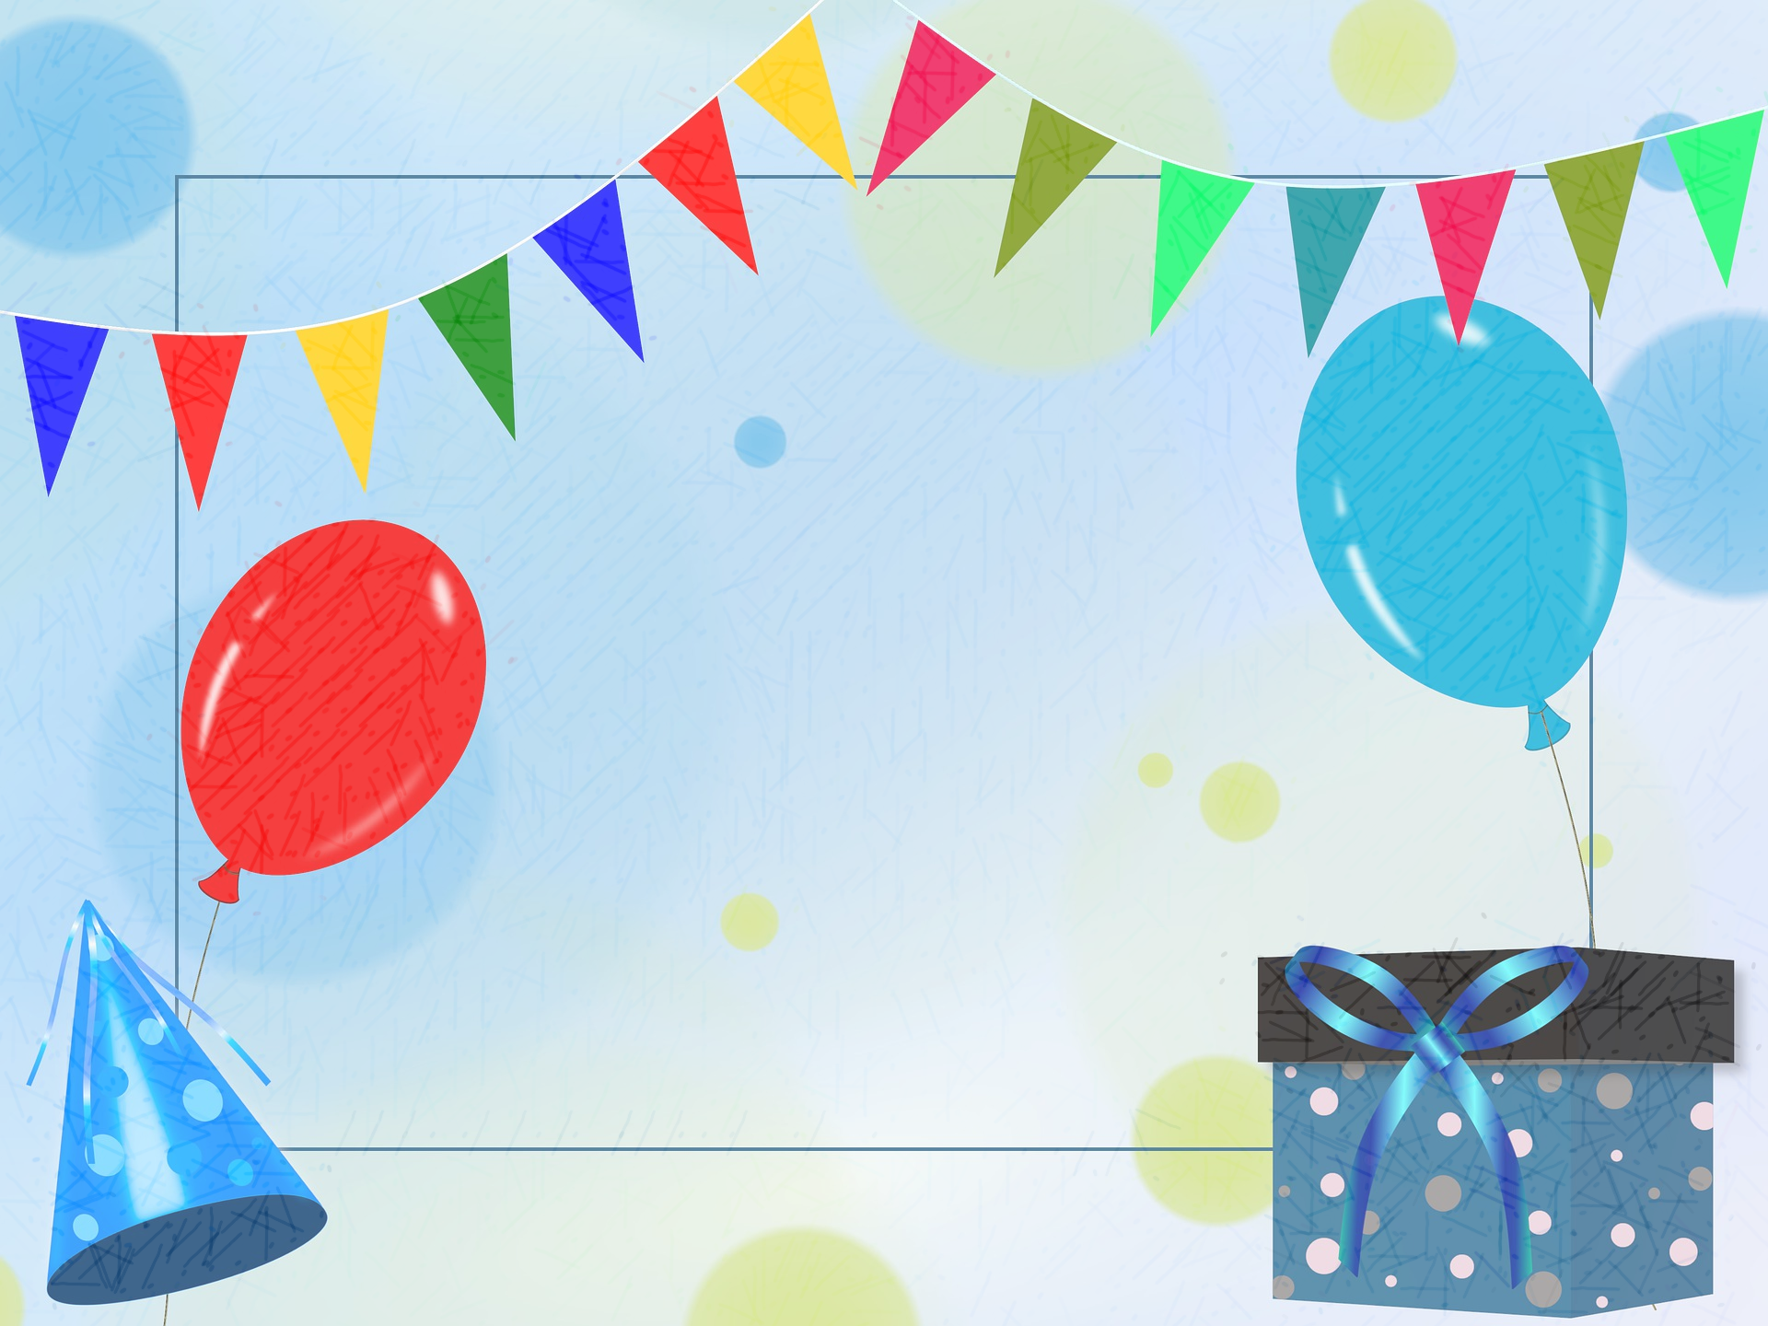
Phonetik
Wer hat Geburtstag? Hör zu. Schreibe den Namen auf.
The adjective lieb (kind, dear) needs R1 endings -er for masculine and -e for feminine nouns/names.
hören / schreiben
Zum Geburtstag viel Glück Zum Geburtstag viel Glück Zum Geburtstag lieber Dieter Zum Geburtstag viel Glück
 | liebe / lieber | Mädchen | Junge
 | lieber | Julia | Jonas
 | liebe | Paula | Paul
 | lieber | Emilie | Emil
 | lieber | Lena | Luka
 | liebe | Melanie | Moritz
 | lieber | Franziska | Franz
[_ _ _ _ _ _]
1
2
Zum Geburtstag viel Glück Zum Geburtstag viel Glück Zum Geburtstag liebe Elke Zum Geburtstag viel Glück
3
4
[_ _ _ _]
5
6
What do these words mean literally? Try adding ich wünsche dir (I wish you) in your head.
Note: the difference is very small! To say lieber, drop your jaw a little.
Notes:
Timing: 7 minutes Aim: to practise oral comprehension of the R1 endings –er for masculine and –e for feminine nouns using liebe/r plus masculine/ feminine name. Procedure: 1. Click to hear recording of the song (recording includes the names ‘Dieter’ and ‘Elke’).
2. Unpack what the words mean literally – use the example of ‘Guten Tag’ to explain that the implication is ‘I wish you a happy birthday / guten Tag.
3. Click for callout bubble to explain that lieber refers to masculine, liebe to feminine noun/name.
4. Listen to song again, click again to reveal the names ’Dieter’ and ‘Elke’.
5. Listening exercise using the name table on the right: Click sound button to play recording for item one. In pairs, learners decide whether they hear liebe or lieber, and whether it refers to a male or female name.
6. Click to reveal the answer.
7. Repeat for items 2-6.
Transcript:
Zum Geburtstag viel Glück! Zum Geburtstag viel Glück! Zum Geburtstag lieber [Dieter] Zum Geburtstag viel Glück!
Zum Geburtstag viel Glück! Zum Geburtstag viel Glück! Zum Geburtstag liebe [Elke] Zum Geburtstag viel Glück!
1. lieber Jonas
2. liebe Paula
3. lieber Emil
4. lieber Luka
5. liebe Melanie
6. lieber Franz
Word frequency of unknown words(1 is the most frequent word in German): Glück [641] Source: Jones, R.L. & Tschirner, E. (2019). A frequency dictionary of German: core vocabulary for learners. Routledge

Slide 20
Phonetik
Wer hat Geburtstag? Hör zu. Schreibe den Namen auf.
The adjective lieb (kind, dear) needs R1 endings -er for masculine and -e for feminine nouns/names.
hören / schreiben
Zum Geburtstag viel Glück Zum Geburtstag viel Glück Zum Geburtstag lieber Dieter Zum Geburtstag viel Glück
 | liebe / lieber | Mädchen | Junge
 | lieber | Julia | Jonas
 | liebe | Paula | Paul
 | lieber | Emilie | Emil
 | lieber | Lena | Luka
 | liebe | Melanie | Moritz
 | lieber | Franziska | Franz
[_ _ _ _ _ _]
1
2
Zum Geburtstag viel Glück Zum Geburtstag viel Glück Zum Geburtstag liebe Elke Zum Geburtstag viel Glück
3
4
[_ _ _ _]
5
6
What do these words mean literally? Try adding ich wünsche dir (I wish you) in your head.
Note: the difference is very small! To say lieber, drop your jaw a little.
Notes:
Timing: 7 minutes Aim: to practise oral comprehension of the R1 endings –er for masculine and –e for feminine nouns using liebe/r plus masculine/ feminine name. Procedure: 1. Click to hear recording of the song (recording includes the names ‘Dieter’ and ‘Elke’).
2. Unpack what the words mean literally – use the example of ‘Guten Tag’ to explain that the implication is ‘I wish you a happy birthday / guten Tag.
3. Click for callout bubble to explain that lieber refers to masculine, liebe to feminine noun/name.
4. Listen to song again, click again to reveal the names ’Dieter’ and ‘Elke’.
5. Listening exercise using the name table on the right: Click sound button to play recording for item one. In pairs, learners decide whether they hear liebe or lieber, and whether it refers to a male or female name.
6. Click to reveal the answer.
7. Repeat for items 2-6.
Transcript:
Zum Geburtstag viel Glück! Zum Geburtstag viel Glück! Zum Geburtstag lieber [Dieter] Zum Geburtstag viel Glück!
Zum Geburtstag viel Glück! Zum Geburtstag viel Glück! Zum Geburtstag liebe [Elke] Zum Geburtstag viel Glück!
1. lieber Jonas
2. liebe Paula
3. lieber Emil
4. lieber Luka
5. liebe Melanie
6. lieber Franz
Word frequency of unknown words(1 is the most frequent word in German): Glück [641] Source: Jones, R.L. & Tschirner, E. (2019). A frequency dictionary of German: core vocabulary for learners. Routledge

Slide 21
Unstressed [-er]
Phonetik
Consolidation [4]
Y9 T3.1 Week 6 Slide 6

Slide 22
Phonetik
Partnerarbeit Person A sagt liebe oder lieber. Person B sagt den richtigen Namen. Dann tauscht die Rollen.
lesen / sprechen
Person A
Person B
 | liebe / lieber | Mädchen | Junge
1 |  | Leah | Leon
2 |  | Martina | Martin
3 |  | Andrea | Andreas
4 |  | Sabine | Sebastian
5 |  | Nicole | Nils
6 |  | Karina | Kurt
 | liebe / lieber | Mädchen | Junge
1 |  | Anna | Anton
2 |  | Lina | Liam
3 |  | Elke | Elias
4 |  | Daniela | Daniel
5 |  | Katrin | Klaus
6 |  | Jana | Jörg
Herzlichen Glückwunsch! What does it mean? Why the en on herzlichen?
Again, “ich wünsche dir” (I wish you) is implied – making the phrase the direct object.
Notes:
Timing: 4 minutes Aim: to practise the R1 endings –er for masculine and –e for feminine nouns using liebe/r plus masculine/ feminine names. Procedure:
Pairwork activity
Before the speaking activity, click to reveal callout bubble and explain that ‘herzlichen Glückwunsch’ works along the same lines as Guten Tag and Zum Geburtstag viel Glück, where ‘I wish you’ is missing but implied.
1. Person A says liebe or lieber.
2. Person B says the male or female name accordingly. Continue for items 2-6.
3. Swap roles and do the other 6 items.

