Slide 1
German phonics collection
Long and short [u]
Artwork: Steve Clarke
Date updated: 10 / 08 / 21
Notes:
Artwork by Steve Clarke. All additional pictures selected are available under a Creative Commons license, no attribution required.

Slide 2
Long and short [u]
Phonetik
Introduction
Y7 T1.2 Week 5 Slides 3-8; 34-35

Slide 3
u
du
Notes:
Timing: 1 minute
Aim: To introduce/consolidate SSC [u]
Procedure: 1. Present the letter(s) and say the [u] sound first, on its own. Students repeat it with you. 2. Bring up the word ”du” on its own, say it, students repeat it, so that they have the opportunity to focus all of their attention on the connection between the written word and its sound.
3. A possible gesture for this would be to point out directly in front of you.
4. Roll back the animations and work through 1-3 again, but this time, dropping your voice completely to listen carefully to the students saying the [u] sound, pronouncing ”du” and, if using, doing the gesture. Word frequency (1 is the most frequent word in German): du [52]
Source: Jones, R.L. & Tschirner, E. (2006). A frequency dictionary of German: core vocabulary for learners. Routledge

Slide 4
u
du
Notes:
With sound and no pictures to focus all attention on the sound-symbol correspondence.

Slide 5
u
du
Notes:
Without sound to elicit pronunciation (without first hearing the teacher).
Teacher to elicit pronunciation by asking “Wie sagt man…”

Slide 6
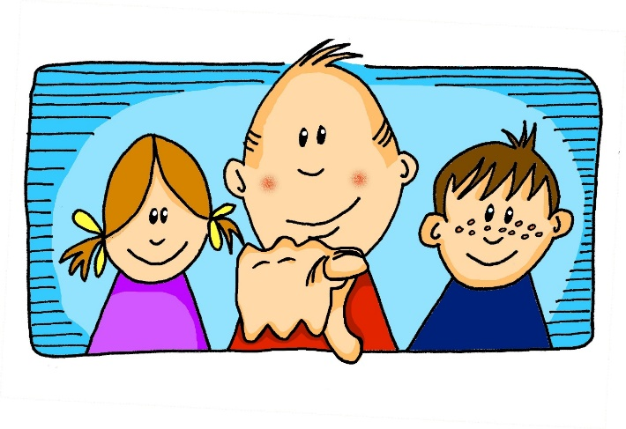
u
absolut
gut
%
du
Minute
Schule
tun
[to do]
Notes:
Timing: 2 minutes
Aim: To introduce/consolidate SSC [u]
Procedure:
Introduce and elicit the pronunciation of the individual SSC [u] and then the source word again ‘du’ (with gesture, if using).
Then present and elicit the pronunciation of the five cluster words.
The cluster words have been chosen for their high-frequency, from a range of word classes, with the SSC (where possible) positioned within a variety of syllables within the words (e.g. initial, 2nd, final etc.). Additionally, we have tried to use words that build cumulatively on previously taught SSCs (see the Phonics Teaching Sequence document) and do not include new SSCs. Where new SSCs are used, they are often consonants which have a similar symbol-sound correspondence in English.
Word frequency (1 is the most frequent word in German): du [52]; absolut [993] gut [78]; Minute [361]; tun [140]; Schule [208].
Source: Jones, R.L. & Tschirner, E. (2006). A frequency dictionary of German: core vocabulary for learners. Routledge

Slide 7
u
absolut
gut
du
Minute
Schule
tun
Notes:
With sound and no pictures to focus all attention on the sound-symbol correspondence.

Slide 8
u
absolut
gut
du
Minute
Schule
tun
[to do]
Notes:
Without sound to elicit pronunciation (without first hearing the teacher).
Teacher to elicit pronunciation by asking “Wie sagt man…”

Slide 9
Vowels
German vowels can be short or long.
Vowels are short when followed by more than one consonant, e.g., hundert, nutzen.
Vowels are long when:
there is a double vowel (no examples of ‘uu’ in German)
or when followed by the letter ‘h’, e.g., Uhr,
or by a single consonant, e.g., absolut.
Notes:
Timing: 2 minutes Aim: To recap what students were taught in Week 1 about the long/short [a] SSC. Note: Here we include ‘hundert’ and ‘Uhr’, which students will be taught soon when they learn other SSC.
Procedure: 1. Click to animate the explanation.
2. Ensure students’ understanding at each stage.
Word frequency (1 is the most frequent word in German):
hundert [945] and Uhr [349]
Source: Jones, R.L. & Tschirner, E. (2006). A frequency dictionary of German: core vocabulary for learners. Routledge

Slide 10
‘U’: lang oder kurz?
Was passt nicht?
R.
und /
putzen /
du
U.
der Zug /
der Junge /
der Hund
S.
die Mutter /
der Hut /
der Grund
V.
der Bruder /
dunkel /
zu Hause
T.
die Uniform /
die Nummer /
gesund
Notes:
Timing: 5 minutes Aim: Odd one out read aloud task - long and short ‘u’ sound Note: This task includes some unknown high-frequency words that will soon be appearing on the SOW, as well as a few known words.
Procedure: 1. Animations are staged to allow R and S to be worked through as examples.
2. Then T-V appear together, for students to have a few minutes to work on in pairs before whole class feedback of answers.

Slide 11
Long and short [u]
Phonetik
Consolidation [1]
Y7 T1.2 Week 6 Slides 15; 65-66

Slide 12
U oder Ü?
hören
 | U | Ü
1
2
3
4
5
6
1
2
3
4
5
6
Notes:
Timing: 3 minutes Aim: To practise distinguishing between [u] and [ü]
Procedure: 1. Click on the numbers to play the audio.
2. Students tick the appropriate column for each word.
3. Click to reveal the correct answers.
Transcript:
1. der Zug
2. die Nummer
3. die Tür
4. grün
5. putzen
6. wünschen

Slide 13
‘U’ oder ‘Ü’?
hören
O Tannenbaum, o Tannenbaum,
wie gr_n sind deine Blätter!
D_ gr_nst nicht n_r z_r Sommerszeit,
Nein auch im Winter, wenn es schneit.
O Tannenbaum, o Tannenbaum,
wie gr_n sind deine Blätter!
Notes:
Timing: 3 minutes Aim: Phonics practice contrasting ‘u’ and ‘ü’.
Procedure: 1. Click on the fir tree in the top right hand corner to play the song. Students write ‘u’ or ‘ü’ for each missing vowel.
2. Play the song a second time. The text could also be read aloud if the recording seems too fast.
3. Alternatively, here is a link to a commercial version: https://www.youtube.com/watch?v=lS4wTuvR7Ik
(single voice, but quite clear sound – 3 verses, only play verse 1).
4. The answers are provided on the next slide.
Note: We include the source words and pictures as a refresher.
Instructions in German:
Hör zu
Schreib ‘u’ oder ‘ü’

Slide 14
Antworten – u vs ü
Antworten
O Tannenbaum, o Tannenbaum,
wie gr_n sind deine Blätter!
D_ gr_nst nicht n_r z_r Sommerszeit,
Nein auch im Winter, wenn es schneit.
O Tannenbaum, o Tannenbaum,
wie gr_n sind deine Blätter!
grün
Du
grünst
nur
zur
grün
Notes:
Timing: 2 minutes Aim: To provide the answers to the activity on the previous slide
Procedure: 1. Ask students which SSC is missing each time.c, licking to reveal the answers one by one.

Slide 15
long and short [u]
Phonetik
Consolidation [2]
Y7 T2.2 Week 5 Slides 3-4

Slide 16
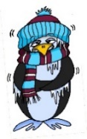
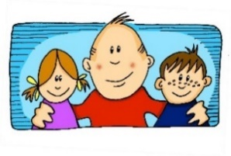
Phonetik
e
e
a
a
sagen
kalt
geben
denken
i
i
o
o
u
wir
u
finden
wo?
Kopf
ü
ü
ö
du
ö
Punkt
Tür
fünf
ä
ä
schön
plötzlich
spät
lächeln
Notes:
Timing: 3 minutes
Aim: The long and short vowel sounds in German are practised here in familiar words, with audio.
Procedure:
1. Students should listen and repeat.

Slide 17
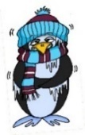
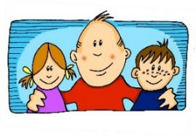
Phonetik
e
e
a
a
sagen
kalt
geben
denken
i
i
o
o
u
wir
u
finden
wo?
Kopf
ü
ü
ö
ö
fünf
du
Punkt
Tür
ä
ä
schön
plötzlich
spät
lächeln
Notes:
Timing: 3 minutes
Aim: This version of the slide is without audio.
Procedure:
1. Students should chant the words chorally first, as they appear, then perhaps individually (the teacher quizzing students on individual words; it will be important to continue to juxtapose the long and short forms of each vowel in this practice).

Slide 18
Long and short [u]
Phonetik
Consolidation [3]
Y7 T3.1 Week 2 Slides 8; 9

Slide 19
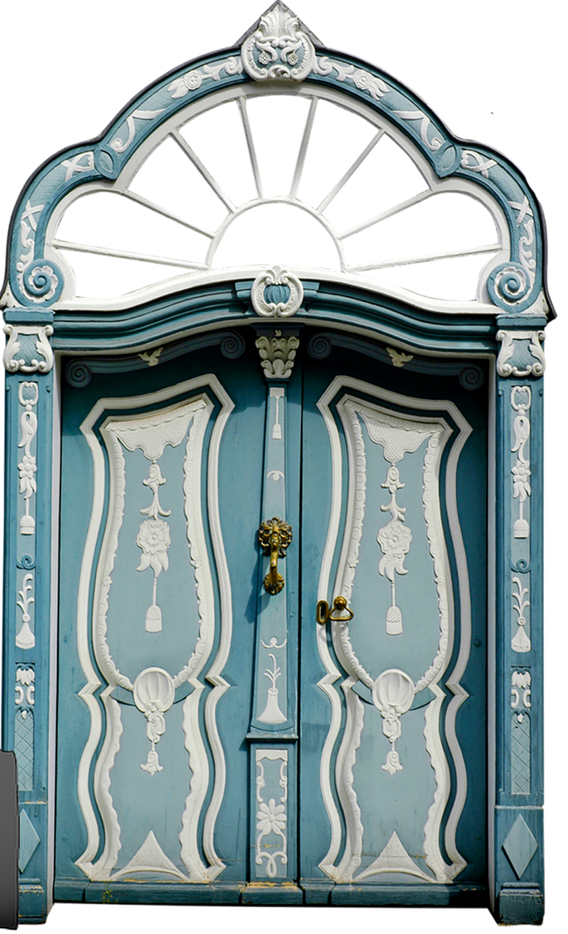
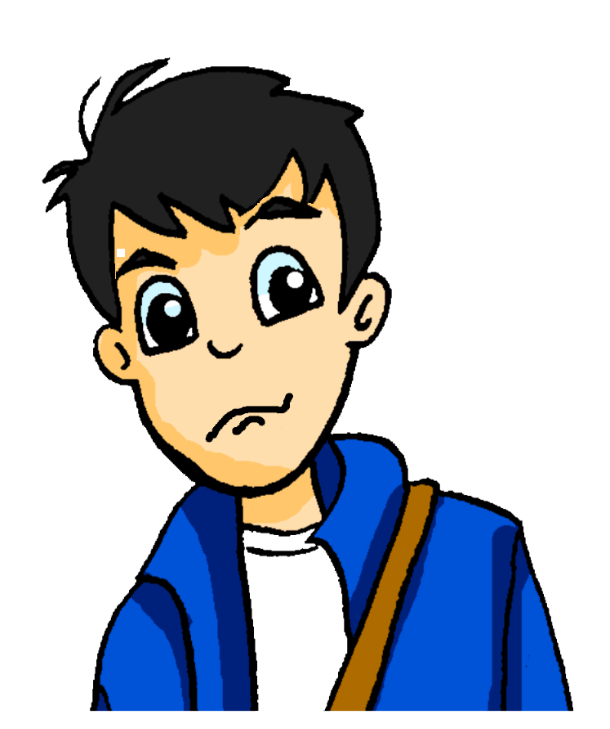
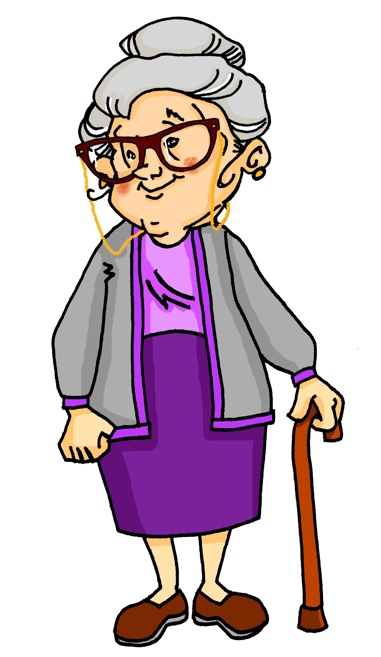
Samstagnachmittag
lesen / hören
Wolfgang hat ein bisschen Angst. Es wird spät, und er hat heute Nachmittag ein Date! Er sieht Oma im Wohnzimmer. Sie surft im Internet. Sie fragt: „Wolfgang! Wie findest du die …“
a) Tour
b) Tür
5
Notes:
Here, SSCs [u] and [ü] are contrasted.
Teacher to draw attention to the strong verb stems in sieht and wird, eliciting the infinitive form and meaning from students.
Teacher to students how they might translate ‘es wird spät’ - ‘it is getting late’ in English, rather than becoming
Teacher to point out cross-linguistic differences in punctuation conventions (speech marks)
Students have not yet met the cognate surfen [>4034]. Teacher to elicit pronunciation of this word, asking students to draw on their knowledge of SSC [s-].
Frequencies of unknown vocabulary: Tour [2474]
Transcript
Tür

Slide 20
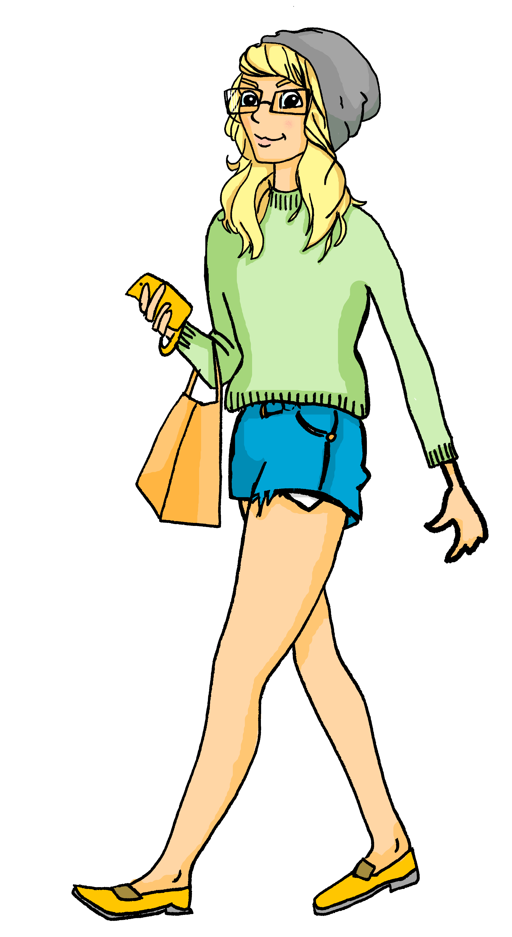
Samstagnachmittag
lesen / hören
Heidi geht ganz relaxt in den Park. Wolfgang kommt in zehn Minuten.
Sie bleibt ein Moment stehen, und sieht einen/eine …
a) Berg
b) Burg
6
Notes:
Here, SSCs short [e] and [u] are contrasted.
Students have not yet met cognates relaxen [>4034] or Moment [383]. They have met cognate Minute [360] as an SSC cluster word.
Frequencies of unknown vocabulary: Berg [1134], Burg [2984]
Transcript
Burg

Slide 21
Long and short [u]
Phonetik
Consolidation [4]
Y7 T3.2 Week 3 Slides 9-11

Slide 22
U oder Ü?
sprechen
das Buch
60
fühlen
grün
gut
die Nummer
Sekunden
die Küche
über
früh
der Zug
0
die Kunst
LOS!
Notes:
Timing: 2 minutes
Aim: Pairwork ‘tennis’ – pupils say the words alternately out loud with a partner, building up speed, over 1 minute’s intensive practice.
Procedure:
1. Click on ‘LOS!’ to start a one-minute timer on the screen.
2. Pupils call in any order they like, but are not allowed to repeat the one they said in their last turn. 3. Teacher can circulate to listen into their SSC knowledge.

Slide 23
U oder Ü?
hören
 | U | Ü
1
2
3
4
5
6
1
2
3
4
5
6
Notes:
Timing: 5 minutes (both slides)
Aim: Practice in distinguishing between [u] and [ü].
Procedure:
1. Click on the number to play the audio.
2. Students tick the appropriate column.
3. Click to reveal the answers one by one.
4. Activity continues on next slide.
Transcript:
1. das Museum
2. dürfen
3. ruhig
4. früh
5. genug
6. glücklich

Slide 24
U oder Ü? [2]
hören
 | U | Ü
1
2
3
4
5
6
7
8
9
10
11
12
Notes:
This slide continues the activity on the previous slide.
Transcript:
7. türkisch
8. zusammen
9. gesund
10. müssen
11. sie muss
12. du musst

Slide 25
Long and short [u]
Phonetik
Consolidation [5]
Y8 T1.1 Week 3 Slides 2-3; 24

Slide 26
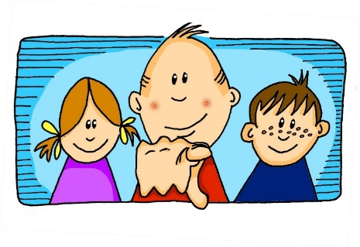
Phonetik
hören / schreiben
u
u
du
Punkt
ü
ü
Tür
fünf
Notes:
Timing: 1 minute Aim: To introduce/consolidate SSC long and short [u] and [ü] Procedure: 1. Present the letter(s) and say the [u] sound first, on its own. Students repeat it with you. 2. Bring up the source word ”du” on its own, say it, students repeat it, so that they have the opportunity to focus all of their attention on the connection between the written word and its sound.
3. A possible gesture for this would be to point out directly in front of you.
4. Repeat for the other three source words, with gesture suggestions as follows: short [u] - mime putting a full stop with your index finger in the air (point away from yourself, with a quick jabbing motion). long [ü] – hold both hands touching in front of your body, palms facing inward, thumbs to the ceiling. Then, with the right hand, mime a door opening by drawing it away from the left so that it finishes at a right angle, like a fully open door.
short [ü] - hold up your right hand, five digits spread apart.
Word frequency (1 is the most frequent word in German): du [52]; Punkt [427] Tür [400] fünf [272]
Source: Jones, R.L. & Tschirner, E. (2006). A frequency dictionary of German: core vocabulary for learners. Routledge

Slide 27
Phonetik
hören / schreiben
Hör zu. Schreib das Wort.
[u] du
[u] Punkt
1
absolut
unten
2
tun
nutzen
3
4
[ü] Tür
[ü] fünf
5
über
Glück
6
Küche
Rücken
7
8
Notes:
Timing: 4 minutes Aim: To practise SSC long and short [u] and [ü] Procedure: 1. Draw a 2 x 2 and write the source words. 2. Click to listen and write each word into the correct square. 3. Click to hear and see and word again. NB: Words will appear on clicks, so take care that the mouse is on action button when you click for audio (or the answers will appear too soon). Word frequency (1 is the most frequent word in German): absolut [993] tun [140];
unten [590] nutzen [463]; Küche [960]; über [48] Rücken [914] Glück [763];
Source: Jones, R.L. & Tschirner, E. (2006). A frequency dictionary of German: core vocabulary for learners. Routledge

Slide 28
[u] oder [ü] im Plural?
hören
 |  | same | different
As you know, Mutter and Bruder add an umlaut in the plural form:
eine Mutter, zwei Mütter
ein Bruder, zwei Brüder
Some nouns with [u] add umlaut + e in plural. Others add only +e. Some don’t change at all.
Listen and decide whether the vowel changes in plural.
1
2
3
4
5
6
7
8
Notes:
Timing: 5 minutes Aim: to distinguish aurally between SSCs [ü] and [u], and revise plural formation patterns. Procedure: 1. Students write 1-8 in their books.
2. Click on a number to hear nouns said in the singular and plural.
3. Students listen to see whether the SSCs are the same or different.
4. Click to reveal
Transcript: 1. die Kunst, die Künste
2. die Küche, die Küchen
3. der Bus, die Busse
4. der Fluss, die Flüsse
5. die Küste, die Küsten
6. der Kuss, die Küsse
7. die Nuss, die Nüsse
8. der Hummer, die Hummer Word frequency (1 is the most frequent word in German): Bus [1562], Fluss [1551], Hummer [>5000], Kunst [554], Küste [2628], Küche [960], Nuss [>5000] Source: Jones, R.L. & Tschirner, E. (2006). A frequency dictionary of German: core vocabulary for learners. Routledge

Slide 29
Long and short [u]
Phonetik
Consolidation [6]
Y8 T2.1 Week 3 Slide 2

Slide 30
Phonetik
lesen / sprechen
Sag die Zungenbrecher.
15
1.
[u]
[ü]
Fünf gute Schüler müssen Kunst in der Küche üben.
Five good pupils must practise art in the kitchen.
üben
Sekunden
in der Küche
Kunst
fünf
müssen
gute
Schüler
0
langsamer
LOS!
Notes:
Procedure: 1. Students use the English and German prompts to construct and say aloud the tongue twister within the five seconds.
2. Click the blue text box to hear it pronounced.
3. Follow the same procedure for the next two slides.
Transcript: Fünf gute Schüler müssen Kunst in der Küche üben.
Word frequency of unknown words and cognates (1 is the most frequent word in German): üben [1928] Source: Jones, R.L. & Tschirner, E. (2019). A frequency dictionary of German: core vocabulary for learners. Routledge

Slide 31
Long and short [u]
Phonetik
Consolidation [7]
Y8 T3.2 Week 1 Slides 24; 25; 27

Slide 32
Phonetik [u], [ü], [y]
lesen / sprechen
Sag die Wörter. Wie schnell kannst du das?
Tür
du
ü
u
y
typisch
Punkt
fünf
u
ü
Notes:
Timing: 1 minute Aim: To reactivate SSC knowledge of long and short [u], [ü], and [y]. Procedure: 1. Click and elicit the SSC and the source word from students. 2. If required, the SSC and the picture can be clicked to hear the audio. 3. Give students 30 seconds to say the words as fast as they can, one after the other.

Slide 33
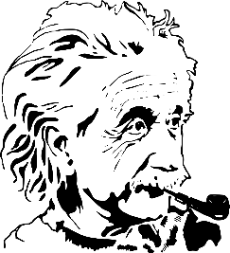
Phonetik [1/3]
Sag den Satz. Wie schnell kannst du das?
lesen / sprechen
10
1
2
In Ulm und um Ulm und um Ulm herum.
3
In Ulm and round Ulm and around Ulm.
Sekunden
Ulm ist eine Stadt in Süddeutschland und die Geburtsstadt von Albert Einstein.
0
LOS!
Notes:
Timing: 1 minute (for three slides) Aim: To apply SSC knowledge in the oral production of longer sentences. Procedure: 1. Students read the tongue twister aloud. The 10-second timer is an additional spur to speeding up oral production. 2. Listen and check (three different speeds). 3. Clarity meaning, using the cultural information about Ulm. 4. Repeat the steps for the next two slides.
Word frequency of unknown or cognate words (1 is the most frequent word in German):
herum [3033] Source: Jones, R.L. & Tschirner, E. (2019). A frequency dictionary of German: core vocabulary for learners. Routledge

Slide 34
Phonetik [3/3]
Sag den Satz. Wie schnell kannst du das?
lesen / sprechen
10
Ein Fuß zwei Füße
Ein Gruß zwei Grüße
Ein Fluss zwei Flüsse
Ein Schluss.
1
Hallo!
Hallo!
Hallo!
2
3
Sekunden
0
LOS!
Notes:
Word frequency of unknown or cognate words (1 is the most frequent word in German):
Fuß [573] Gruß [4722] Schluss [1030] Source: Jones, R.L. & Tschirner, E. (2019). A frequency dictionary of German: core vocabulary for learners. Routledge
Translation, in case needed: One/A foot, two feet One/A greeting, two greetings One/A river, two rivers An end.

Slide 35
Long and short [u]
Phonetik
Consolidation [8]
Y9 T3.1 Week 3 Slides 2; 21-22

Slide 36
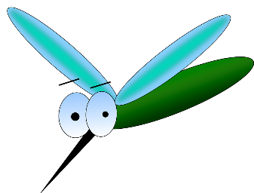
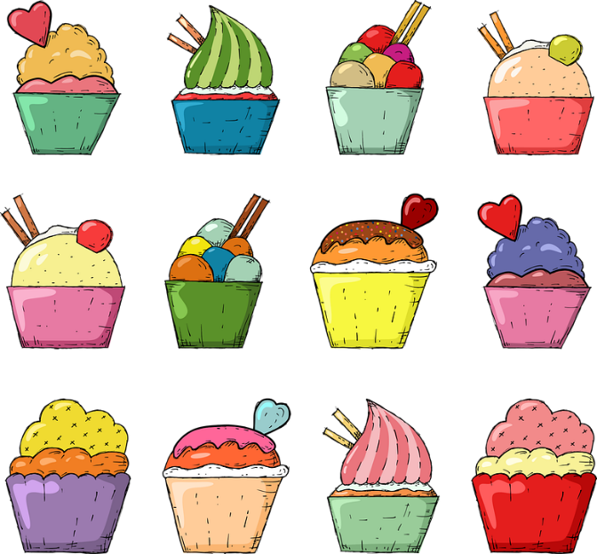
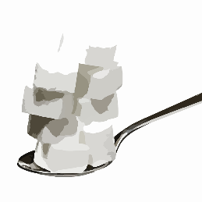
Phonetik
Zungenbrecher mit [u] und [ü]
hören / sprechen
Remember ! To say [ü] shape your mouth to say long ‘ee’ but round your lips to say ‘oo’.
Sag diese Sätze so schnell wie möglich.
*Mücken mögen müde Menschen, müde Menschen mögen Mücken meistens nicht.
1
(Edeltraud Rudatzki)
2
Süßer Zucker, kühle Butter, bunte Kuchen wirst du suchen.
*die Mücke – mosquito, midge
süß – sweet
Notes:
Timing: 5 minutes Aim: to practise spoken pronunciation of the [u] and [ü] sounds. Procedure: 1. Students listen to each other pronouncing these tongue twisters. They can make each other start again if they hear a wrong sound, so advise students not to start off too fast. They should say each one several times, improving speed and accuracy each time. (2 – 2.5 minutes)
2. Then swap roles (2 – 2.5 minutes).
3. Click to hear each one spoken by a native speaker.
Transcript: Mücken mögen müde Menschen, müde Menschen mögen Mücken meistens nicht.
Süßer Zucker, kühle Butter, bunte Kuchen wirst du suchen.
Word frequency (1 is the most frequent word in German):
Butter [4960] kühl [2730] Mücke [>5009] Zucker {2559] Source: Jones, R.L. & Tschirner, E. (2019). A frequency dictionary of German: core vocabulary for learners. Routledge

Slide 37
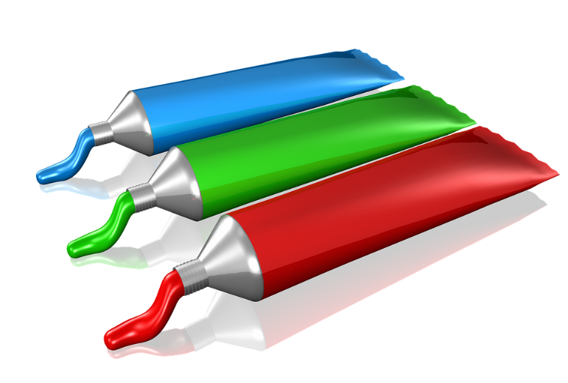
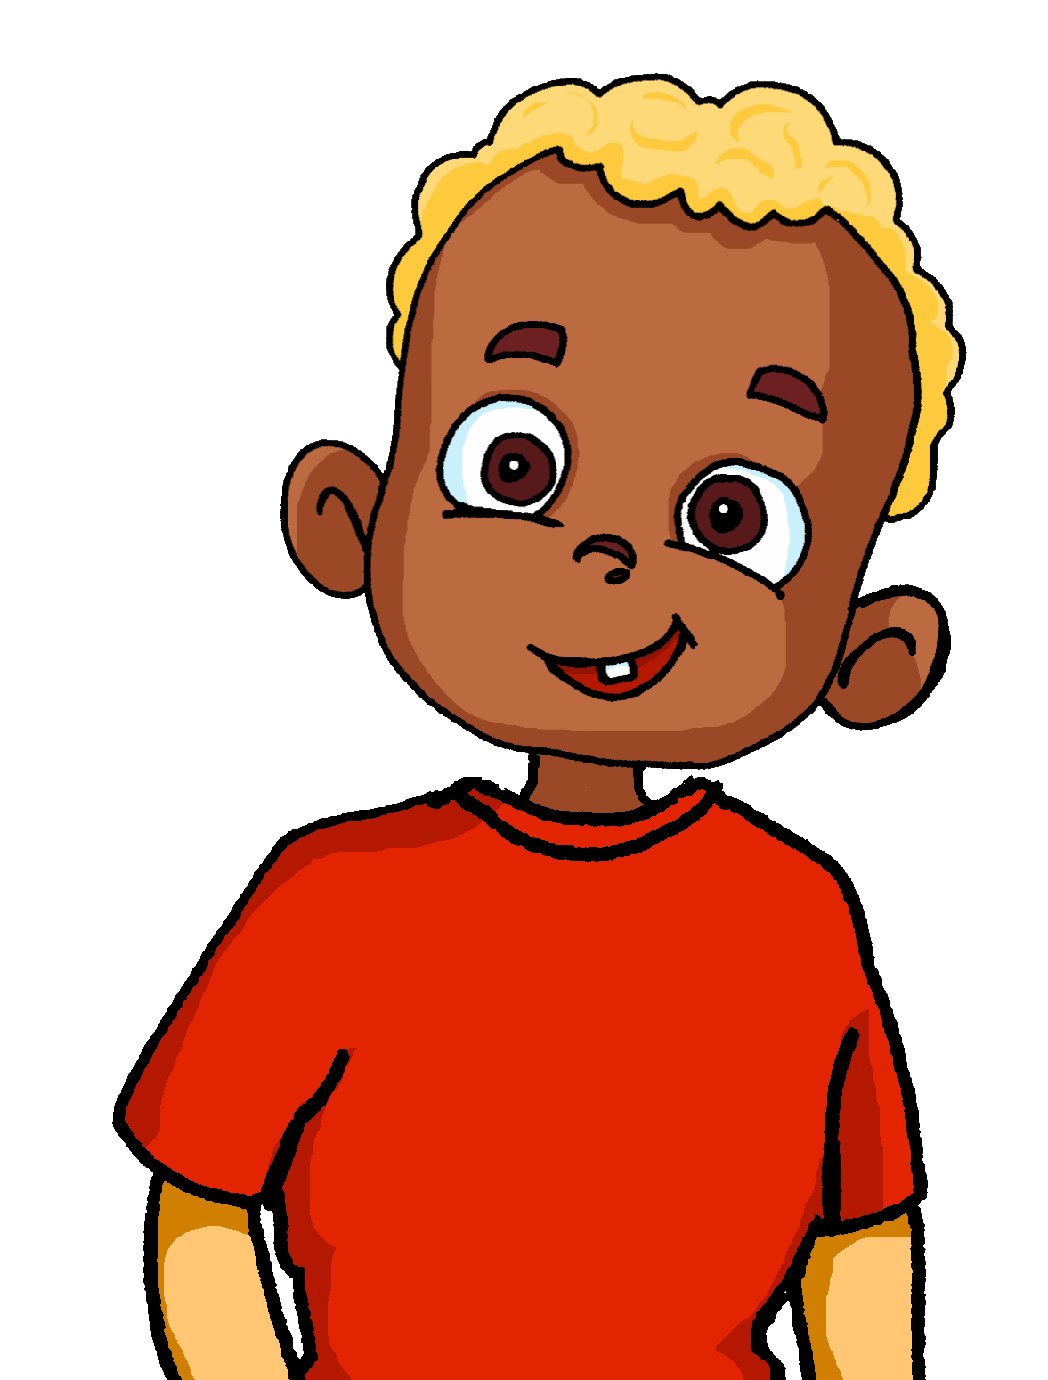
Phonetik 1/2
Heidi bemalt die Wände im Zimmer von ihrem kleinen Bruder. Er will immer eins mehr als sie! Person A ist Heidi, Person B der Bruder.
lesen / sprechen
60
1. Ein Zug?
1. Zwei Züge!
2. Ein Stuhl?
2. Zwei Stühle!
Sekunden
3. Ein Buch?
3. Zwei Bücher!
6. Eine Nuss?
6. Zwei Nüsse!
4. Ein Fluss?
4. Zwei Flüsse!
7. Ein Kuss?
7. Zwei Küsse!
5. Ein Sturm?
5. Zwei Stürme!
8. Ein Turm?
8. Zwei Türme!
0
LOS!
Notes:
Timing: 10 minutes (two slides) Aim: to practise oral production of [u] and [ü] sounds in a set of mostly unfamiliar singular and plural nouns. Procedure: 1. Ensure students understand that Heidi is painting her younger brother’s walls with pictures. She makes a suggestion but he always wants two of what she suggests.
2. Remind students that many masculine and neuter nouns (and a few feminine nouns) form their plurals by adding –e and an umlaut over the vowel.
3. Student A is Heidi and makes the singular noun suggestions. Student B is the brother who replies ‘two XXX’! to each suggestion.
4. Click to start timer.
5. Move to the next slide and swap roles.
Word frequency (1 is the most frequent word in German):
Kuss [>5009] Nuss [>5009] Sturm [2913] Turm [3118] Source: Jones, R.L. & Tschirner, E. (2019). A frequency dictionary of German: core vocabulary for learners. Routledge

Slide 38
Phonetik 2/2
lesen / sprechen
Tauscht die Rollen.
60
1. Eine Wurst?
1. Zwei Würste!
2. Ein Hut?
2. Zwei Hüte!
6. Eine Kuh?
6. Zwei Kühe!
Sekunden
3. Eine Frucht?
3. Zwei Früchte!
7. Ein Fuß?
7. Zwei Füße!
4. Ein Fuchs?
4. zwei Füchse!
8. Eine Schnur?
6. Zwei Schnüre!
5. Ein Wunsch?
5. Zwei Wünsche!
0
LOS!
Notes:
Word frequency (1 is the most frequent word in German):
Frucht [3323] Fuchs [>5009] Fuß [573] Kuh [2935] Schnur [>5009] Wunsch [1072] Wurst [3923] Source: Jones, R.L. & Tschirner, E. (2019). A frequency dictionary of German: core vocabulary for learners. Routledge

