Slide 1
German phonics collection
[th]
Artwork: Steve Clarke
Date updated: 24 / 07 / 21
Notes:
Artwork by Steve Clarke. All additional pictures selected are available under a Creative Commons license, no attribution required.

Slide 2
[th]
Phonetik
Introduction
Y7 T3.1 Week 1 Slides 2-10

Slide 3
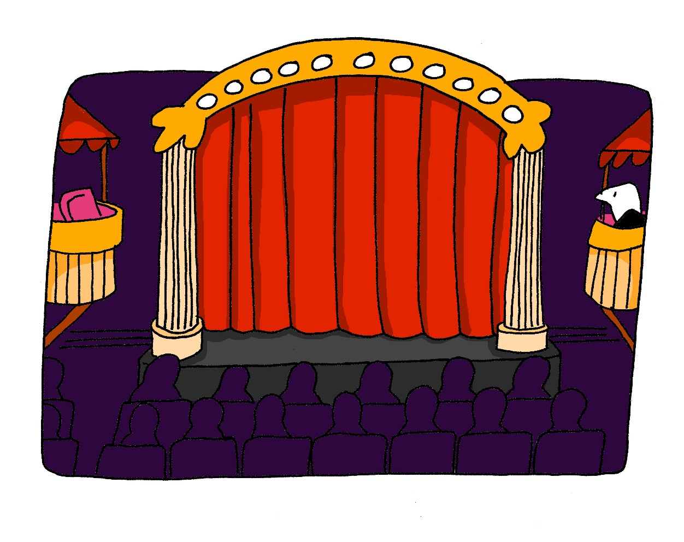
th
Theater
Notes:
Timing: 1 minute
Aim: To introduce/consolidate SSC [th]
Procedure: 1. Present the letter(s) and say the [th] sound first, on its own. Students repeat it with you. 2. Bring up the word ”Theater” on its own, say it, students repeat it, so that they have the opportunity to focus all of their attention on the connection between the written word and its sound.
3. A possible gesture for this would be to mime the opening of a theatre’s curtains, by drawing your hands away from each other quickly, in front of your body. This is very much like the gesture for ‘play’ in charades.
4. Roll back the animations and work through 1-3 again, but this time, dropping your voice completely to listen carefully to the students saying the [th] sound, pronouncing ”Theater” and, if using, doing the gesture. Word frequency (1 is the most frequent word in German): Theater [725] Source: Jones, R.L. & Tschirner, E. (2006). A frequency dictionary of German: core vocabulary for learners. Routledge

Slide 4
th
Theater
Notes:
With sound and no pictures to focus all attention on the sound-symbol correspondence.

Slide 5
th
Theater
Notes:
Without sound to elicit pronunciation (without first hearing the teacher).
Teacher to elicit pronunciation by asking “Wie sagt man…”

Slide 6
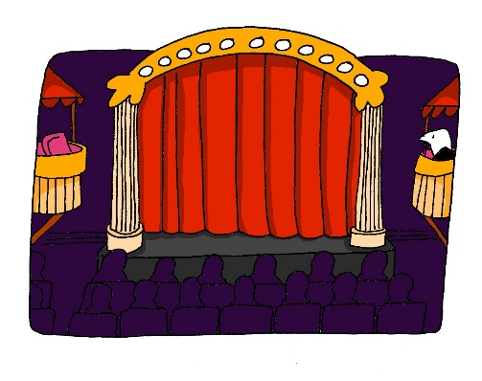
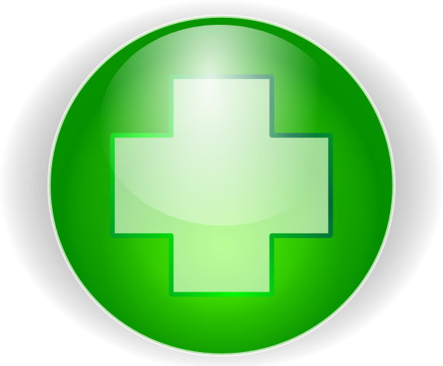
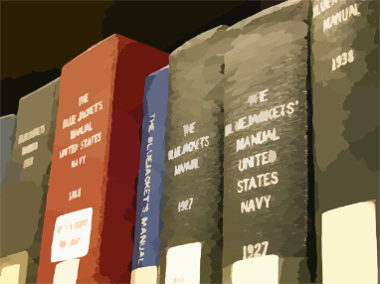
th
Theorie
Methode
Theater
Apotheke
Bibliothek
Thema
[topic]
Notes:
Timing: 2 minutes
Aim: To introduce/consolidate SSC [th]
Procedure:
Introduce and elicit the pronunciation of the individual SSC [th] and then the source word again ‘Theater’ (with gesture, if using).
Then present and elicit the pronunciation of the five cluster words.
The cluster words have been chosen for their high-frequency, from a range of word classes, with the SSC (where possible) positioned within a variety of syllables within the words (e.g. initial, 2nd, final etc.). Additionally, we have tried to use words that build cumulatively on previously taught SSCs (see the Phonics Teaching Sequence document) and do not include new SSCs. Where new SSCs are used, they are often consonants which have a similar symbol-sound correspondence in English.
Word frequency (1 is the most frequent word in German): Theater [725]; Theorie [>4034] Methode [835]; Apotheke [>4034]; Thema [328]; Bibliothek [927]. Source: Jones, R.L. & Tschirner, E. (2006). A frequency dictionary of German: core vocabulary for learners. Routledge

Slide 7
th
Theorie
Methode
Theater
Apotheke
Bibliothek
Thema
Notes:
With sound and no pictures to focus all attention on the sound-symbol correspondence.

Slide 8
th
Theorie
Methode
Theater
Apotheke
Bibliothek
Thema
Notes:
Without sound to elicit pronunciation (without first hearing the teacher).
Teacher to elicit pronunciation by asking “Wie sagt man…”

Slide 9
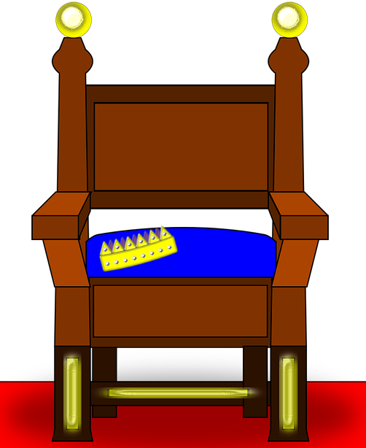
Wie sagt man das?
sprechen
[th]is not a typical German SSC. All German words containing [th]come from other languages.
You will recognise a lot of the words from English. Be careful to pronounce them correctly!
 | der Rythmus
 | das Thema [topic]
 | der Athlet
 | das Thermometer
 | der Thron
 | die Methode [method]
 | die Apotheke
 | Matthias
 | Katharina
 | die Diskothek
 | die Ethik [ethics]
 | Athen
 | die Theorie
 | die Bibliothek
45
1
1
2
2
3
3
Sekunden
4
4
5
5
6
6
0
7
7
LOS!
Notes:
Timing: 5 minutes
Aim: In this exercise, students work in pairs to practise pronouncing a set of unknown cognate words containing SSC [th] in a given time.
Note: This is one of a set of three slides with different timer settings (this slide being the slowest). The speed of the exercise can be chosen to match the ability level of the class, or the teacher may wish to start with the slowest speed and increase gradually.
Procedure: 1. Teacher explains to students that the part of the word in bold is the part that must be stressed. The stress position sometimes differs from English, so students must pay attention.
2. Teacher clicks ‘los’.
3. Student A reads the list of words out loud to student B. Student B listens carefully to their partner’s pronunciation, and stops Student A if the [th] sound is pronounced the English way. They only stop their partner if the [th] is pronounced incorrectly. If an incorrect stress of other mispronunciation is noticed, the listening student should note this and correct it at the end of the round.
4. Students count how many words Student A managed to say correctly.
5. Students swap roles. The student with the most points at the end is the winner.
6. After two rounds, the teacher plays the correct pronunciation by clicking on the audio. Students repeat.
Word frequency (1 is the most frequent word in German):
Rythmus [>4034], Thema [328]; Athlet [>4034]; Thermometer [>4034]; Thron [>4034]; Methode [835]; Apotheke [>4034]; Diskothek [>4034]; Ethik [>4034]; Theorie [>4034]; Bibliothek [927]
Source: Jones, R.L & Tschirner, E. (2019). A frequency dictionary of German: Core vocabulary for learners. London: Routledge.

Slide 10
Wie sagt man das?
sprechen
[th]is not a typical German SSC. All German words containing [th]come from other languages.
You will recognise a lot of the words from English. Be careful to pronounce them correctly!
 | der Rythmus
 | das Thema [topic]
 | der Athlet
 | das Thermometer
 | der Thron
 | die Methode [method]
 | die Apotheke
 | Matthias
 | Katharina
 | die Diskothek
 | die Ethik [ethics]
 | Athen
 | die Theorie
 | die Bibliothek
1
1
2
2
30
3
3
4
4
Sekunden
5
5
6
6
0
7
7
LOS!
Notes:
This is a faster version of the previous slide.

Slide 11
Wie sagt man das?
sprechen
[th]is not a typical German SSC. All German words containing [th]come from other languages.
You will recognise a lot of the words from English. Be careful to pronounce them correctly!
 | der Rythmus
 | das Thema [topic]
 | der Athlet
 | das Thermometer
 | der Thron
 | die Methode [method]
 | die Apotheke
 | Matthias
 | Katharina
 | die Diskothek
 | die Ethik [ethics]
 | Athen
 | die Theorie
 | die Bibliothek
1
1
2
2
3
3
4
4
15
5
5
Sekunden
6
6
0
7
7
LOS!
Notes:
This is a still faster version of the previous slide.

Slide 12
[th]
Phonetik
Consolidation [1]
Y9 T2.2 Week 3 Slide 23

Slide 13
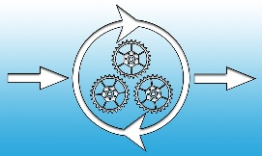
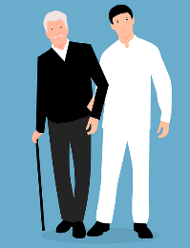
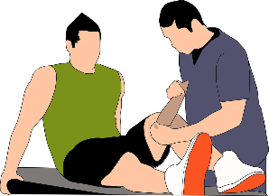
Phonetik
hören / schreiben
Remember, in German [th] is pronounced ‘t’ when both letters are in the same syllable. In compounds and words with prefixes ending in ‘t’, the ‘t’ and ‘h’ are both pronounced separately, e.g. enthalten.
Hör zu. Alle Wörter enthalten [th]. Du musst die Wörter schreiben und die in Silben trennen. Ist die SSC [th] oder [t] + [h]?
1
2
3
4
Athlet
Methode
Rathaus
ethisch
5
6
7
8
dorthin
mithelfen
ernsthaft
Therapie
Notes:
Timing: 5 minutes Aim: to consolidate and extend knowledge of SSC [th]. Procedure: 1. Read the explanation with students.
2. Click on the buttons to hear audio. Students transcribe the words they hear, noting separate syllables.
3. Click to reveal answers.
Word frequency of unknown words (1 is the most frequent word in German): Athlet [3316] Methode [796] Rathaus [3960] ethisch [4681] dorthin [2599] mithelfen [>5009] ernsthaft [2551] Therapie [2484] Source: Jones, R.L. & Tschirner, E. (2019). A frequency dictionary of German: core vocabulary for learners. Routledge

