Slide 1
German phonics collection
[sp]
Artwork: Steve Clarke
Date updated: 24 / 07 / 21
Notes:
Artwork by Steve Clarke. All additional pictures selected are available under a Creative Commons license, no attribution required.

Slide 2
[sp]
Phonetik
Introduction
Y7 T1.2 Week 3 Slides 8-14; 31-32

Slide 3
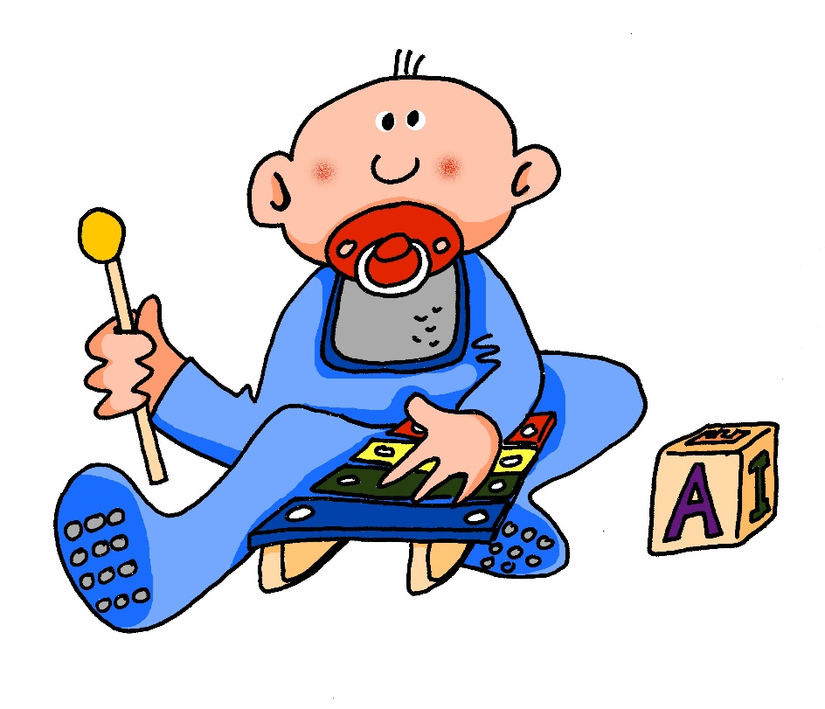
sp-
spielen
Notes:
Timing: 1 minute
Aim: To introduce/consolidate SSC [sp-]
Procedure: 1. Present the letter(s) and say the [sp-] sound first, on its own. Students repeat it with you. 2. Bring up the word ”spielen” on its own, say it, students repeat it, so that they have the opportunity to focus all of their attention on the connection between the written word and its sound.
3. A possible gesture for this would be to mime playing a xylophone.
4. Roll back the animations and work through 1-3 again, but this time, dropping your voice completely to listen carefully to the students saying the [sp-] sound, pronouncing ”spielen” and, if using, doing the gesture. Word frequency (1 is the most frequent word in German): spielen [197] Source: Jones, R.L. & Tschirner, E. (2006). A frequency dictionary of German: core vocabulary for learners. Routledge

Slide 4
sp-
spielen
Notes:
With sound and no pictures to focus all attention on the sound-symbol correspondence.

Slide 5
sp-
spielen
Notes:
Without sound to elicit pronunciation (without first hearing the teacher).
Teacher to elicit pronunciation by asking “Wie sagt man…”

Slide 6
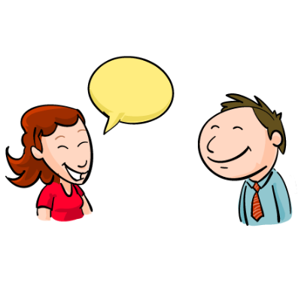
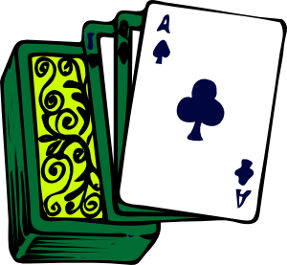
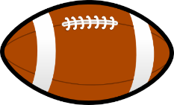
sp-
Spaß
Sprache
[fun] (noun)
spielen
sprechen
Spiel
Sport
Notes:
Timing: 2 minutes
Aim: To introduce/consolidate SSC [sp]
Procedure:
Introduce and elicit the pronunciation of the individual SSC [sp] and then the source word again ‘spielen’ (with gesture, if using).
Then present and elicit the pronunciation of the five cluster words.
The cluster words have been chosen for their high-frequency, from a range of word classes, with the SSC (where possible) positioned within a variety of syllables within the words (e.g. initial, 2nd, final etc.). Additionally, we have tried to use words that build cumulatively on previously taught SSCs (see the Phonics Teaching Sequence document) and do not include new SSCs. Where new SSCs are used, they are often consonants which have a similar symbol-sound correspondence in English.
Word frequency (1 is the most frequent word in German): spielen [197]; Spaß [666] Sprache [367]; sprechen [157]; Sport [845]; Spiel [500]. Source: Jones, R.L. & Tschirner, E. (2006). A frequency dictionary of German: core vocabulary for learners. Routledge

Slide 7
sp-
Spaß
Sprache
spielen
sprechen
Spiel
Sport
Notes:
With sound and no pictures to focus all attention on the sound-symbol correspondence.

Slide 8
sp-
Spaß
Sprache
spielen
sprechen
Spiel
Sport
Notes:
Without sound to elicit pronunciation (without first hearing the teacher).
Teacher to elicit pronunciation by asking “Wie sagt man…”

Slide 9
Wie sagt man …?
Spinne
sprechen
15
Spiegel
spanisch
Speck
Spaniel
Spezialität
Spargel
Sport
springen
spät
sprechen
0
Spagetti
spielen
LOS!
Notes:
Timing: 3 minutes
Aim: To practise SSC [sp]. this pronunciation activity, students must correctly pronounce as many words as they can in 15 seconds.
Procedure: 1. Students work in pairs, and decide who will go first (Student A).
2. Teacher starts the timer begins by clicking on ‘los!’
3. Student A reads words at random from the screen. Their partner (Student B) counts the number of words Student A says, and acts as a ‘juror’ by listening for any ‘English’ pronunciations of sp-. If Student A makes a mistake, the game is stopped and their total number of words counted.
4. Students swap roles. Teacher restarts the timer.
5. The student with the most words wins.
The teacher may wish to run this activity two or three times.
NB: For differentiation purposes, a mix of known words, cognates, and unknown words (illustrated with pictures) are used. With the exception of [r] in Spargel and springen, the words chosen contain previously studied SSCs and transferable consonants only.
Word frequency (1 is the most frequent word in German):
der Spiegel [2046]; der Spargel [>4037]; springen [1468]; der Speck [>4037]; die Spinne [>4037]
Source: Jones, R.L & Tschirner, E. (2019). A frequency dictionary of German: Core vocabulary for learners. London: Routledge.

Slide 10
Zungenbrecher!
Phonetik
Sieben spanische Spinnen schauen ein spanisches Fußballspiel an!
1
2
3
4
Notes:
Timing: 2 minutes
Aim: This tongue twister offers practice of this week’s SSCs in a full sentence. It consists of previously encountered vocabulary with the exception of schauen [470] to look (at) and Spinne [>4037] which will need to be translated for students.
Procedure:
1. Recordings of the tongue twister said at various speeds play on clicking numbers 1 (slow) to 4 (very fast). All students should start by listening and repeating recording 1. Higher level students may enjoy the challenge of trying the faster versions.
English translation: Seven Spanish spiders are watching a Spanish football match. Word frequency (1 is the most frequent word in German):
sieben [570], spanisch [1865], Spinne [>4037] anschauen [1271], schauen [470], Fußball [1497], Spiel [500]
Source: Jones, R.L & Tschirner, E. (2019). A frequency dictionary of German: Core vocabulary for learners. London: Routledge.

Slide 11
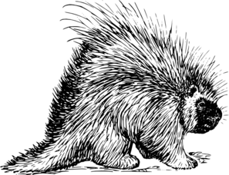
Zungenbrecher!
Phonetik
Ein Stachelschwein, ein Stachelschwein,
das muss ein Schwein mit Stacheln sein!
1
2
3
4
Notes:
Timing: 2 minutes
Aim: This tongue twister offers practice of the SSCs [sch] and [st-] in a full sentence.
Procedure:
1. Recordings of the tongue twister said at various speeds play on clicking numbers 1 (slow) to 4 (very fast). All students should start by listening and repeating recording 1. Higher level students may enjoy the challenge of trying the faster versions.
English translation: a porcupine, a porcupine, that must be a pig with spines!
Word frequency (1 is the most frequent word in German):
Schwein [4009], Stachel [>4037], müssen [45], mit [13], sein [3]
Source: Jones, R.L & Tschirner, E. (2019). A frequency dictionary of German: Core vocabulary for learners. London: Routledge.

Slide 12
[sp]
Phonetik
Consolidation [1]
Y7 T3.2 Week 4 Slides 2-3

Slide 13
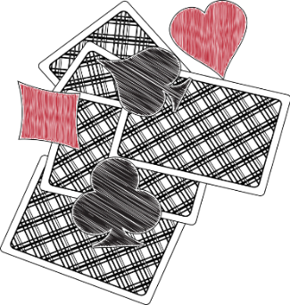
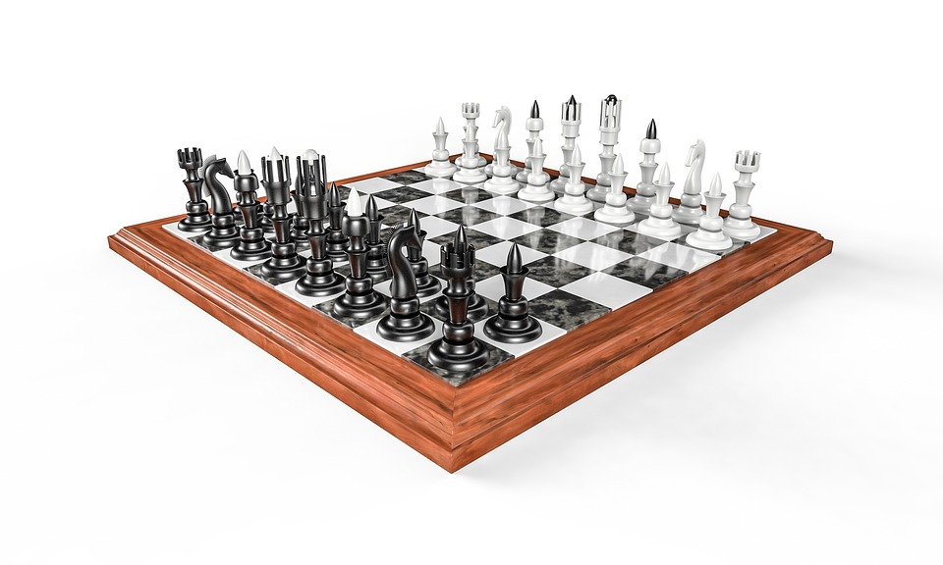
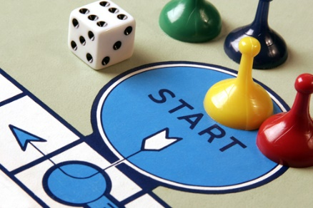
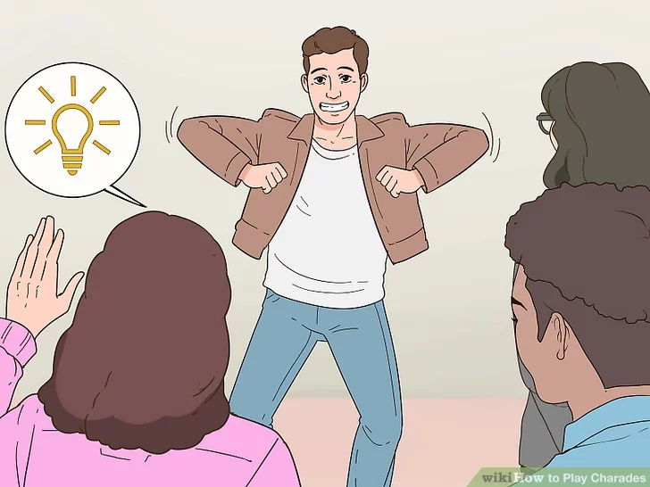
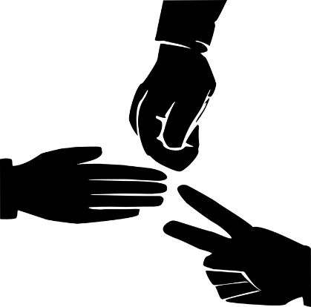
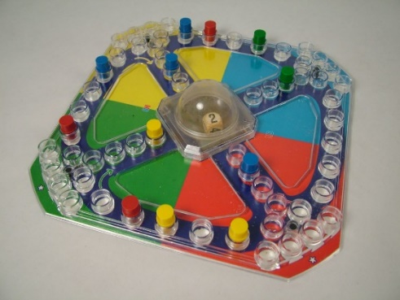
Phonetik
hören
5
Kein Stich
1
das Schach
6
das Brettspiel
2
Stadt – Land - Fluss
7
die Scharade
3
Spitzeln
4
Mensch ärgere
Dich nicht
8
Schere-Stein-Papier
Notes:
Timing: 5 minutes
Aim: This phonics listening / writing activity revisits the SSCs [sch], [sp], and [st]. The activity uses the names of common games to practise.
Cultural interest: Germany has a long history of game creation. Two famous and popular games were invented by Germans. Klaus Teuber created Die Siedler von Catan (1995) and Josef Friedrich Schmidt created Mensch ärgere dich nicht. Can students guess how old the game is? (It dates from 1907).
Procedure:
Click for the first picture and the gapped word.
Listen to the word (sound will play on clicking the number).
Write in the missing SSC.
Check the answer.
Repeat for numbers 2-8.
Transcript:
1. das Schach
2. Stadt – Land – Fluss
3. spitzeln
4. Mensch ärgere Dich nicht
5. Kein Stich
6. das Brettspiel
7. die Scharade
8. Schere – Stein – Papier
Word frequency (1 is the most frequent word in German):
Schach [>5009] spitzeln [>5009] ärgern [2841] Stich [4382] Brettspiel [>5009] Scharade [>5009] Schere [>5009] Stein [1181] Papier [1163]
Source: Jones, R.L & Tschirner, E. (2019). A frequency dictionary of German: Core vocabulary for learners. London: Routledge.

Slide 14
Phonetik
sprechen
1
Gesellschaftsspiele wie Mensch-ärgere-Dich-nicht machen Spaß*.
2
Bei Scharaden darf man nicht sprechen und auch nicht schreiben.
3
Meine Geschwister spielen Schere-Stein-Papier.
4
Seine Schwester versteht Sport ganz gut.
5
Schachfiguren sind schwarz und weiß und sehr schön.
6
Die Mitspieler sind bestimmt* schnell und stark.
*Spaß machen - to be fun *bestimmt - certainly
Notes:
Timing: 5 minutes
Aim: This phonics reading / speaking activity revisits the SSCs [sch], [sp], and [st]. The names of some of the games on the previous slide and some SSC cluster words are used in a sentence to practise production of the target SSCs.
Note: the glossed vocabulary will be explicitly taught in Y8.
Procedure:
Students read the sentences out loud (to each other).
Either bring up the sentences one by one, or alternatively all at once to allow pairs to work at their own speed.
Click on buttons to hear the spoken sentences.
Word frequency (1 is the most frequent word in German):
Schach [>5009] ärgern [2841] Scharade [>5009] Schere [>5009] Stein [1181] Papier [1163] Spaß [666] bestimmt [226] Source: Jones, R.L & Tschirner, E. (2019). A frequency dictionary of German: Core vocabulary for learners. London: Routledge.

Slide 15
[sp]
Phonetik
Consolidation [2]
Y8 T1.1 Week 2 Slides 2-9

Slide 16
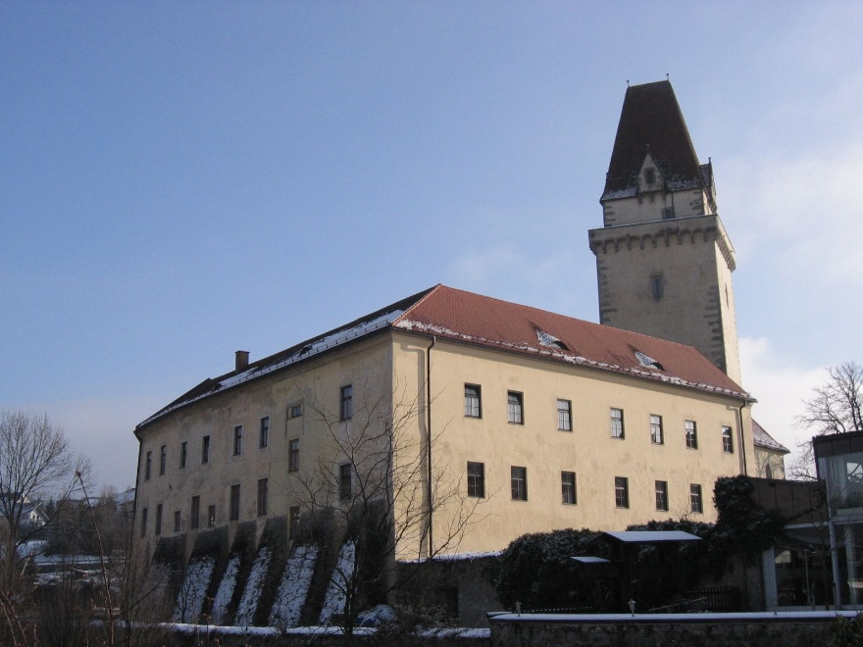
sch, st-, sp- : wie viele hörst du?
hören
1
Freistadt hat ein Schloss.
sch- | st- | sp-
Photo licensed under Creative Commons Author: Hjanko
Notes:
Timing (phonics slides)
10 minutes
Aim
Practice in recognising the following SSCs: sch-; st- ; sp-.
Suggested procedure
1. Click on the audio button to play the sentence. Students tally the SSCs as per the table on the slide. They may do this in their exercise books.
2. Click again on the mouse to make the animated answers appear.
Transcript
1. Freistadt hat ein Schloss.

Slide 17
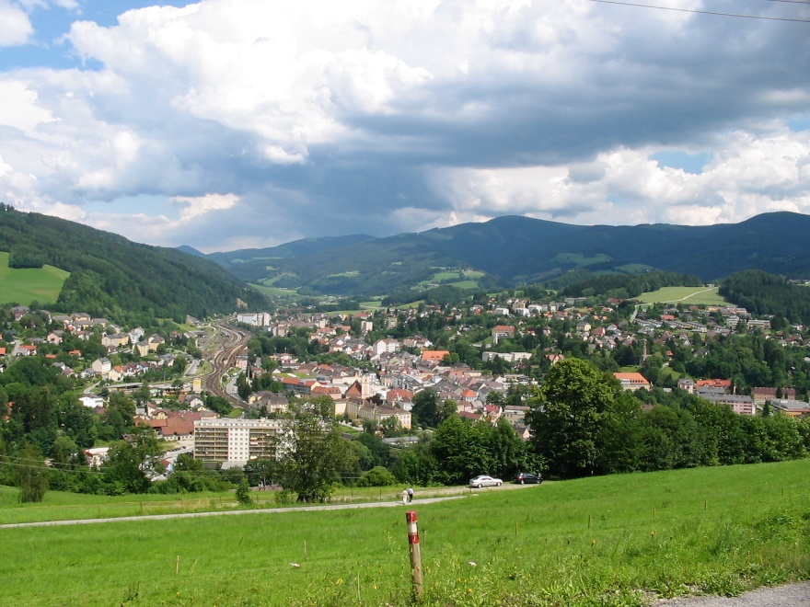
sch, st-, sp- : wie viele hörst du?
hören
2
Mürzzuschlag hat ein Wintersportmuseum.
sch- | st- | sp-
Photo licensed under Creative Commons Author: Mikegr
Notes:
Transcript
2. Mürzzuschlag hat ein Wintersportmuseum.

Slide 18
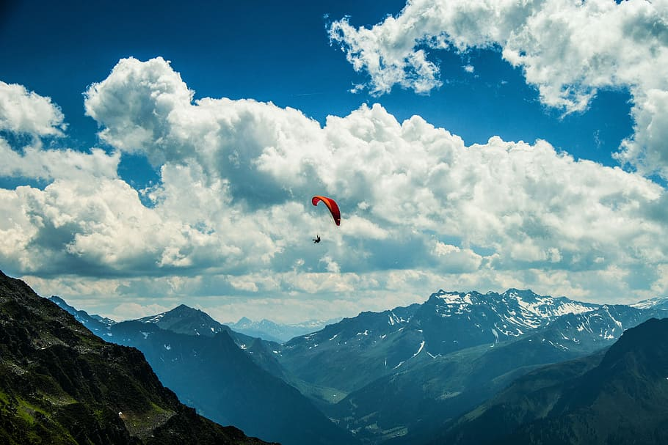
sch, st-, sp- : wie viele hörst du?
hören
3
In Schruns kann man viel Sport machen.
sch- | st- | sp-
Notes:
Transcript
3. In Schruns kann man viel Sport machen.

Slide 19
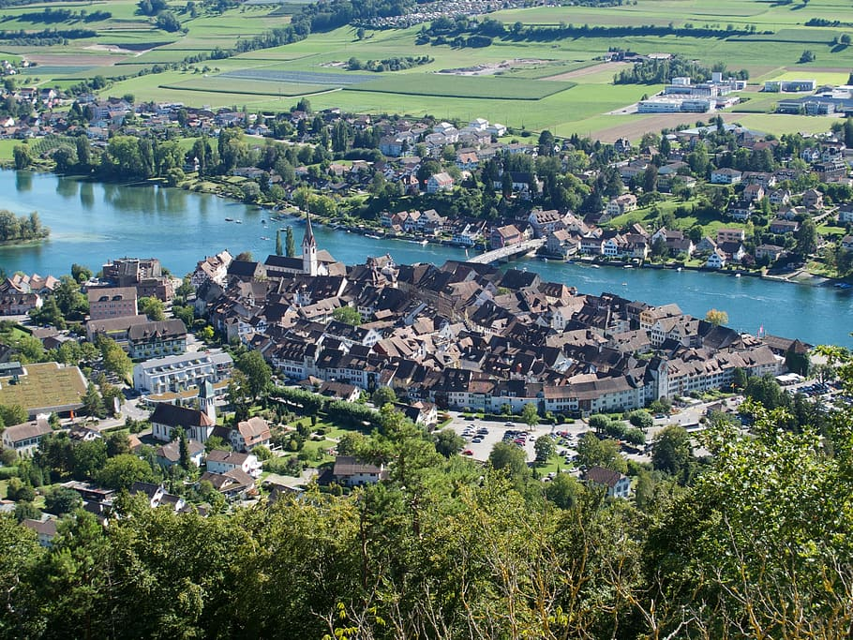
sch, st-, sp- : wie viele hörst du?
hören
4
Stein am Rhein ist historisch.
sch- | st- | sp-
Notes:
Transcript
4. Stein am Rhein ist historisch.

Slide 20
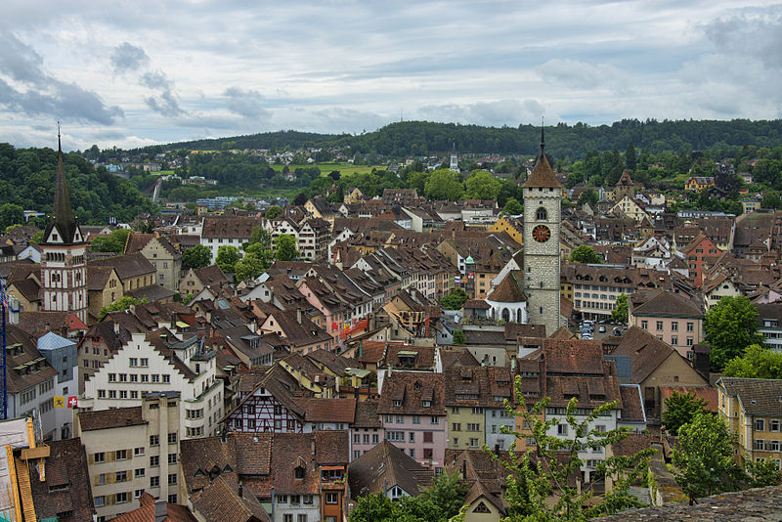
sch, st-, sp- : wie viele hörst du?
hören
5
Schaffhausen ist sehr schön!
sch- | st- | sp-
Photo licensed under Creative Commons Author: chensiyuan
Notes:
Transcript
5. Schaffhausen ist sehr schön!

Slide 21
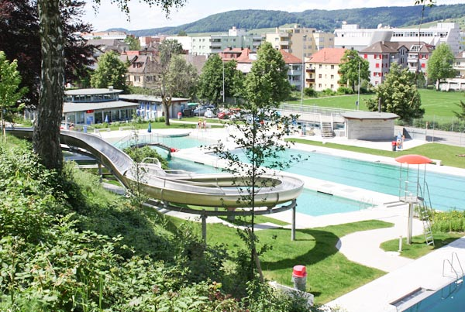
sch, st-, sp- : wie viele hörst du?
hören
6
Schlieren hat ein Schwimmbad.
sch- | st- | sp-
Notes:
Transcript
6. Schlieren hat ein Schwimmbad.

Slide 22
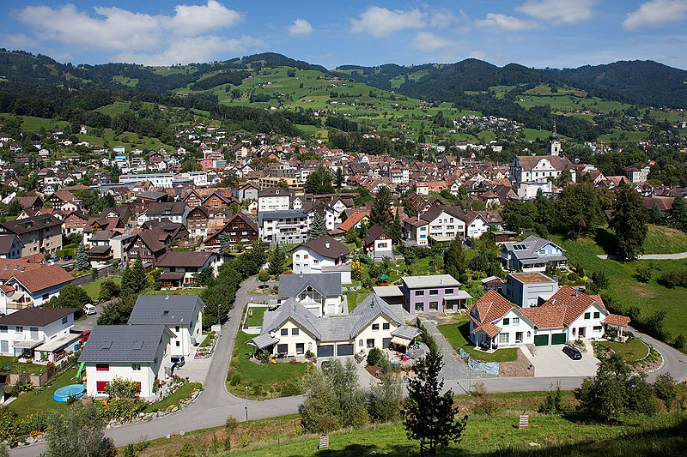
sch, st-, sp- : wie viele hörst du?
hören
7
In Altstätten spricht man Deutsch.
sch- | st- | sp-
Photo licensed under Creative Commonsm Author: Roland Zumbuehl
Notes:
Transcript
7. In Altstätten spricht man Deutsch.

Slide 23
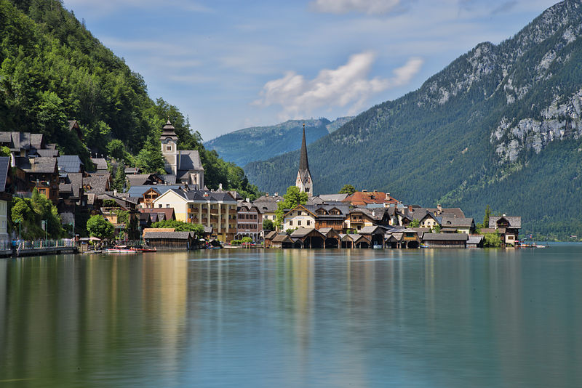
sch, st-, sp- : wie viele hörst du?
hören
8
Hallstatt is sehr touristisch.
sch- | st- | sp-
Photo licensed under Creative Commons Author: chensiyuan
Notes:
Transcript
8. Hallstatt is sehr touristisch.

Slide 24
[sp]
Phonetik
Consolidation [3]
Y8 T2.2 Week 3 Slides 2-3; 16

Slide 25
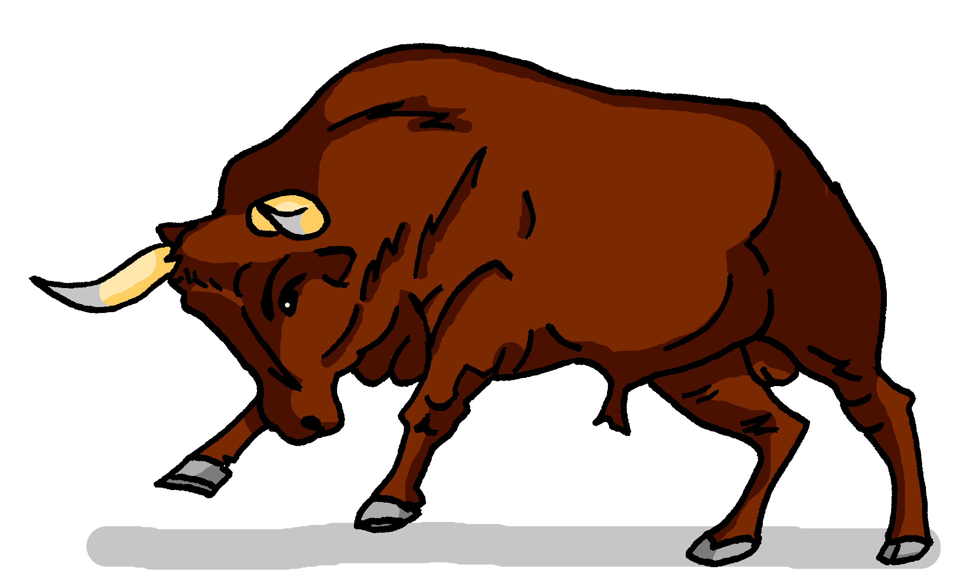
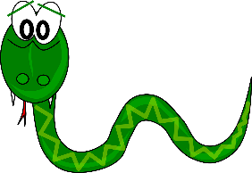
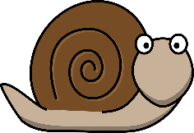
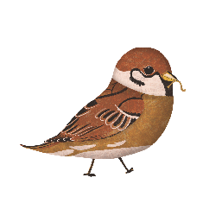
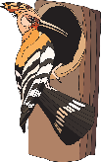
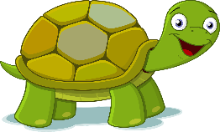
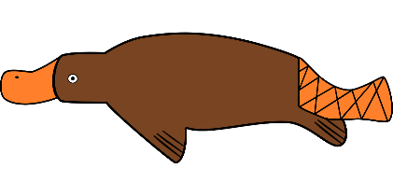
Phonetik
hören / schreiben
At the start of words, German [sp-] and [st-] are pronounced ‘schp-’ and ‘scht-’. [sch] is always pronounced ‘sh’.
Hör zu. Was fehlt? Schreib [sch], [sp-] oder [st-].
1 | 2 | 3
4 | 5 | 6
7 | 8 | 9
1
2
3
__
__
__
Schnecke
Stier
Schlange
4
5
6
__
__
__
Specht
Stinktier
Spatz
7
8
9
__
__
__
__
Schildkröte
Schnabeltier
Stachel sch wein
Notes:
Timing: 5 minutes Aim: To revisit and consolidate [sch], [sp], and [st]. Students listen out for and spell the SSCs Procedure: 1. Click the action buttons to play a word.
2. For each item write the sound that fills the gap.
3. Click to reveal and check answers.
Transcript: Schnecke, Stier, Schlange, Specht, Stinktier, Spatz , Schildkröte, Schnabeltier, Stachelschwein Word frequency (1 is the most frequent word in German): Schnecke [>5009] , Stier [>5009], Schlange [3601], Specht [4900], Stinktier [>5009], Spatz [>5009], Schildkröte [>5009], Schnabeltier [>5009], Stachelschwein [>5009]
Source: Jones, R.L. & Tschirner, E. (2019). A frequency dictionary of German: core vocabulary for learners. Routledge

Slide 26
Phonetik
When [sp] and [st] occur in the middle or end of a word, pronounce them as in English, except for compound nouns and separable verbs.
lesen / sprechen
savings bank
20
Sag diese deutschen Wörter.
stone
Sparkasse
snow
Stein
Schnee
cough
wasp
menu
Husten
Wespe
Speisekarte
Sekunden
stand up
crispy
capital
aufstehen
knusprig
Hauptstadt
fabric
cheque
funny
Stoff
0
Scheck
komisch
LOS!
Notes:
Timing: 2-3 minutes Aim: to practise pronouncing German unknown words, applying known SSC. Procedure: 1. Working individually, students have 20 seconds to pronounce all of the words.
2. Alternatively, they could work in pairs, conditions permitting.
3. Teacher to click to elicit the pronunciation of each word chorally from the class to check their SSC knowledge. Note: on successive clicks the German words are highlighted, to facilitate choral pronunciation of each. Then each English word is also highlighted to facilitate a further round of choral elicitation of the German words.
Word frequency (1 is the most frequent word in German):
Schnee [1760], Stein [1181], Sparkasse [>5009], Wespe [>5009], Speisekarte [>5009], Husten [>5009], knusprig [>5009], Hauptstadt [1694], aufstehen [966], Scheck [>5009], komisch [1875], Stoff [758]
Source: Jones, R.L. & Tschirner, E. (2019). A frequency dictionary of German: core vocabulary for learners. Routledge

Slide 27
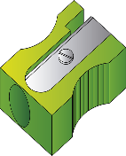
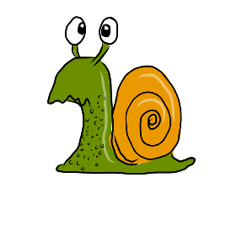
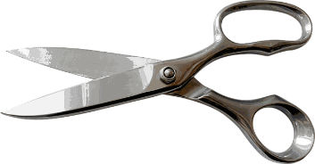
Phonetik
lesen / sprechen
20
Mein Spitzer spitzt Stifte spielend spitz.
1
My sharpener sharpens pencils effortlessly sharp.
Schnecken erschrecken, wenn sie an Schnecken schlecken.
2
Sekunden
Snails are startled, when they lick snails.
Schneiders Schere schneidet scharf –
scharf schneidet Schneiders Schere.
3
0
Schneider’s scissors cut sharply –
sharply (is how) Schneider’s scissors cut
LOS!
Notes:
Timing: 2 minutes Aim: To practise this week’s SSC in a sentences context. The time limit will help to speed up production of the words. Procedure: 1. Try to say the tongue twisters within the time available.
2. Click LOS! to start the timer.
3. Click the action buttons to hear the tongue twisters pronounced by a native speaker, first slowly, then at normal speed.

Slide 28
[sp]
Phonetik
Consolidation [4]
Y9 T3.1 Week 2 Slides 2; 17

Slide 29
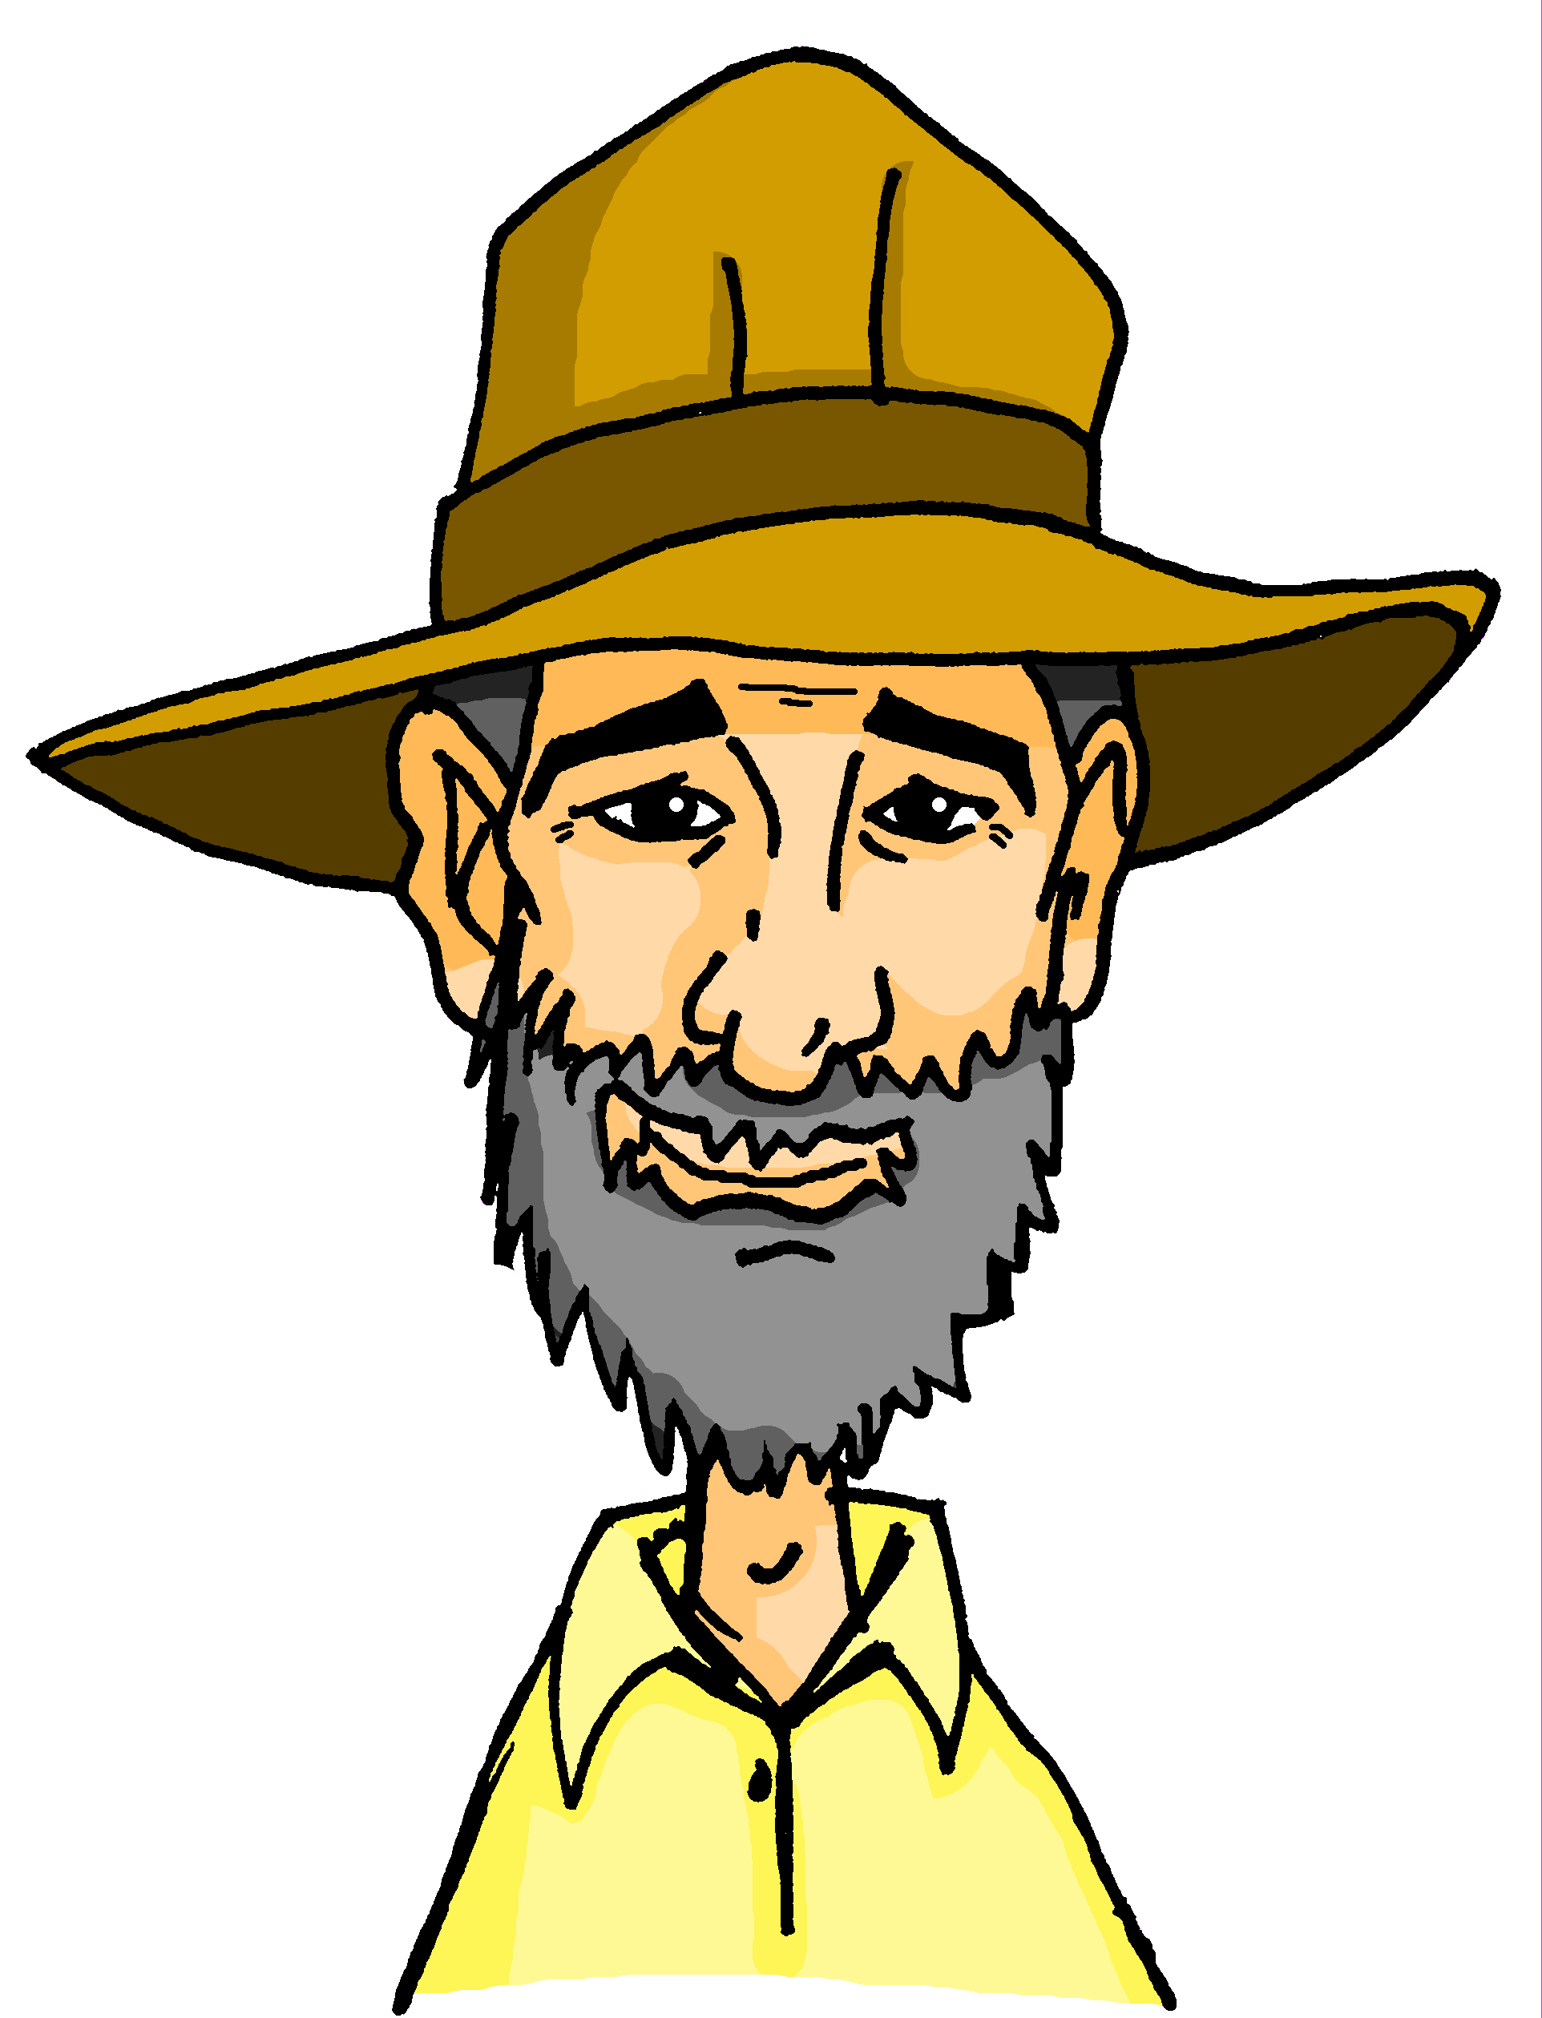
[sch] [sp [st]
hören / schreiben
1
Markranstädt
Markran___ädt
Schönberg
___önberg
2
Sprötau
3
___rötau
Eberstedt
Eber___edt
4
Springstille
5
___ring___ille
Steindorf
___eindorf
6
Schwifting
7
___wifting
___itzingsee
8
Spitzingsee
9
Bild___ein
Bildstein
___warzach
10
Schwarzach
Schaan
11
___aan
12
___ig
Stig
Notes:
Timing: 10 minutes Aim: to practise aural recognition and transcription of [sp] [st] [sch] Procedure: 1. Explain the task. Onkel Heinrich is travelling again and has gone to Liechtenstein. Mia and Wolfgang are travelling to meet him and pass through different towns en route.
2. Click on the audio buttons to hear each town.
3. Students transcribe the missing letters, either sch, sp, st
4. Click to reveal answers.
Transcript: 1. Markranstädt
2. Schönberg
3. Sprötau
4. Eberstedt
5. Springstille
6. Steindorf
7. Schwifting
8. Spitzingsee
9. Bildstein
10. Schwarzach
11. Schaan
12. Stig

Slide 30
[sch] [sp [st]
Nord
hören / sprechen
Süd
Ost
Wo ist Wolf?
West
Schöneberg
1
2
Steglitz
Spreewald
3
4
Spergau
Schmiedehausen
5
6
Bechstedtstraß
Schwarzburg
7
8
Ingolstadt
9
Spullersee
10
Stegen
11
12
Springen
Schauner
Schlins
14
Schellenberg
13
15
Steg
Notes:
Timing: 5 minutes Aim: To practise spoken production of SSCs [sp] [st] [sch] Procedure: 1. Explain the task.
2. Student A picks a town where Wolfgang is.
3. Student B tries to guess which town Student A has picked. They ask ‘Ist Wolf in…?’
4. Student A responds ‘nein, du musst nach Osten/Westen/Süden/Norden fahren‘ until Student B correctly guesses Wolfgang‘s location.
5. Students swap roles.
6. Click to reveal audio buttons to check pronunciation.
Transcript: 1. Schöneberg
2. Steglitz
3. Spreewald
4. Spergau
5. Schmiedehausen
6. Bechstedtstraß
7. Schwarzburg
8. Ingolstadt
9. Spullersee
10. Stegen
11. Schauner
12. Springen
13. Schlins
14. Schellenberg
15. Steg

