Slide 1
German phonics collection
[qu]
Artwork: Steve Clarke
Date updated: 16 / 07 / 22
Notes:
Artwork by Steve Clarke. All additional pictures selected are available under a Creative Commons license, no attribution required.

Slide 2
Long and short [qu]
Phonetik
Introduction
Y9 T3.2 Week 2 Slides 2-5; 19-22

Slide 3
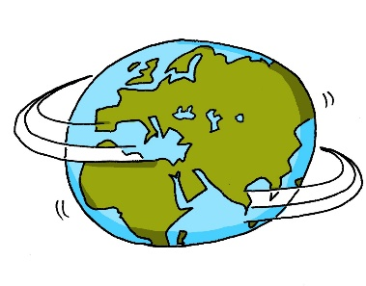
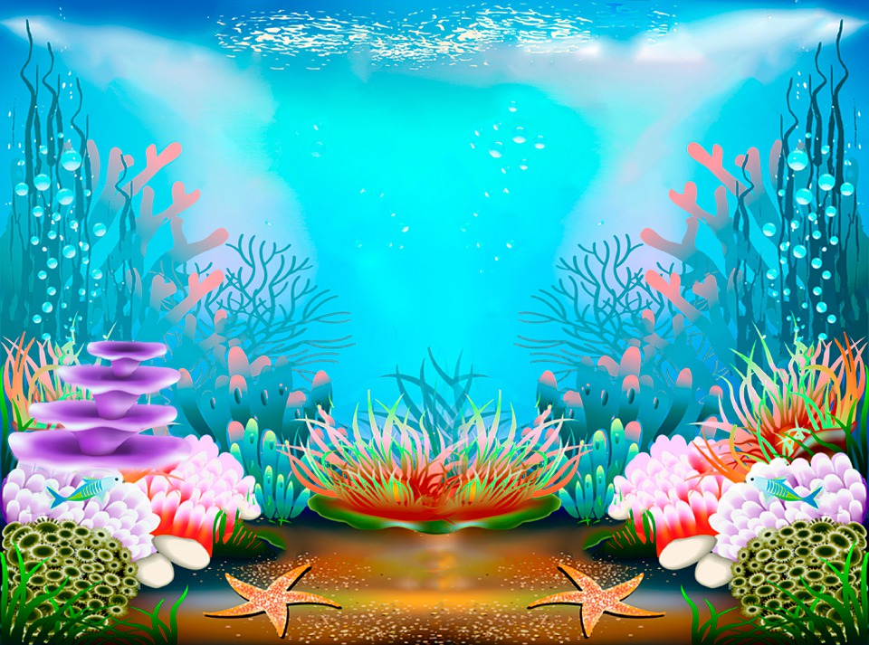
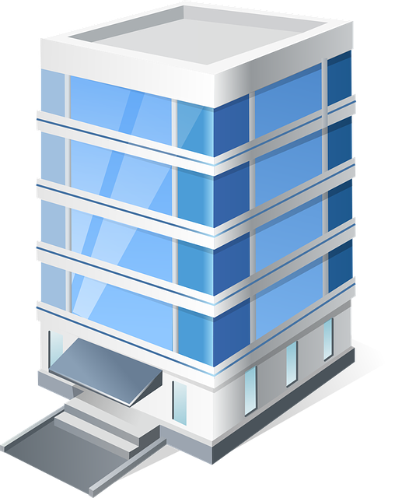
SSC [qu]
Phonetik
[qu] sounds like kw but remember German [w] is as in Welt.
In German, the letters kw only appear next to each other in compounds:
Note: in compounds the kw sound is two separate syllables.
Stockwerk [floor,storey]
Aquarium
Where the kw sound is in one syllable it is always written [qu].
Notes:
Timing: 1 minute Aim: to introduce the SSC [qu] and contrast it with kw. Procedure: Click through the animations to present the new information.
Word frequency (1 is the most frequent word in German): Aquarium [>5009] Stockwerk [4935] Source: Jones, R.L. & Tschirner, E. (2019). A frequency dictionary of German: core vocabulary for learners. Routledge

Slide 4
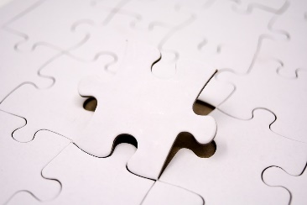
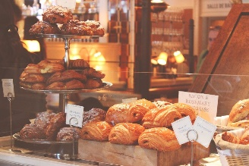
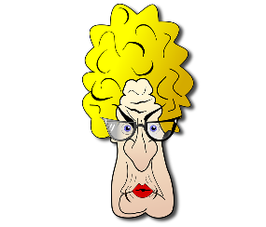
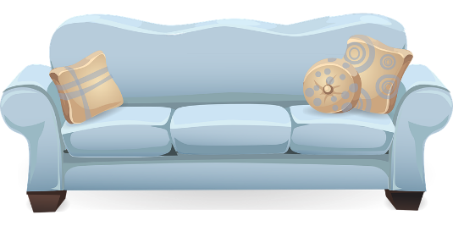
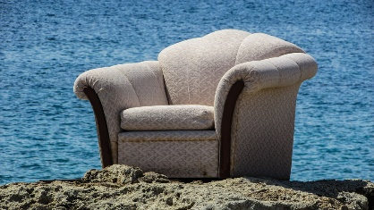
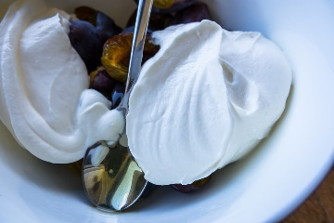
Phonetik
hören / schreiben
Hör zu. Ist das ‘kw’ oder ‘qu’?
quasi | Backwaren | Quatsch!
Quittung | bequem | Musikwerk
merkwürdig | Quark | Rückweg
__
__
__
__
__
__
__
__
__
Notes:
Timing: 5 minutes Aim: to practise the SSC [qu] and contrast it with [kw]. Procedure: 1. Click on each picture to hear the word.
2. Students note down whether they heard [qu] or [kw] in the gap.
3. Click to reveal answers.
Word frequency (1 is the most frequent word in German): quasi [200] Backwaren [>5009] quatsch [3893] Quittung [>5009] bequem [3369] Musikwerk [>5009] merkwürdig [2933] Quark [>5009] rückweg [>5009] Source: Jones, R.L. & Tschirner, E. (2019). A frequency dictionary of German: core vocabulary for learners. Routledge

Slide 5
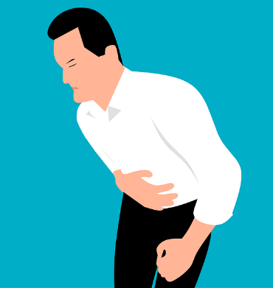
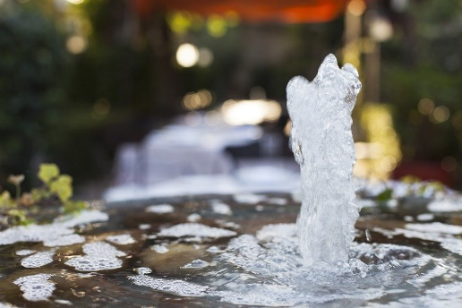
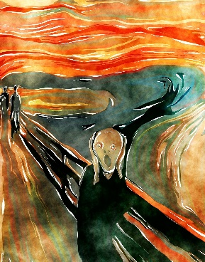
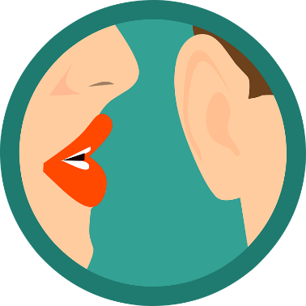
Phonetik [1/2]
hören
Hör zu. Ist das ‘w’ oder ‘qu’?
Wal Qual | Quelle Welle
wählen quälen | quackeln wackeln
1
2
__
__
__
__
3
4
__
__
__
__
Notes:
Timing: 5 minutes (2 slides) Aim: to differentiate between minimal pairs with [qu] and [w]. Procedure: 1. Click on the audio buttons to hear the two words.
2. Students note down whether they hear [qu] or [w] for each gap.
3. Click to reveal answers.
Transcript:
1. Wal / Qual 2. Quelle / Welle 3. wählen / quälen 4. quackeln / wackeln 5. Quarte / Warte
6. wallen / Quallen 7. Warzen / quarzen 8. quatschen / watschen
Word frequency (1 is the most frequent word in German): Wal [>5009] Qual [>5009] Quelle [1108] Welle [1263] wählen [636] quälen [3832] quackeln [>5009] wackeln [>5009] Quarte [>5009] Warte [>5009] wallen [>5009] Quallen [>5009] Warzen [>5009] quarzen [>5009] quatschen [>5009] watschen [>5009] Source: Jones, R.L. & Tschirner, E. (2019). A frequency dictionary of German: core vocabulary for learners. Routledge

Slide 6
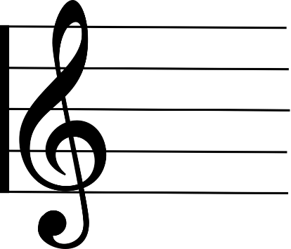
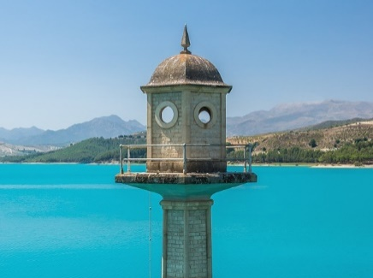
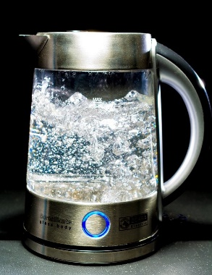
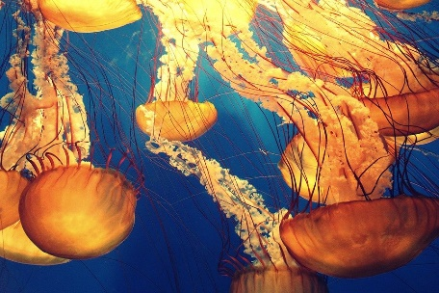
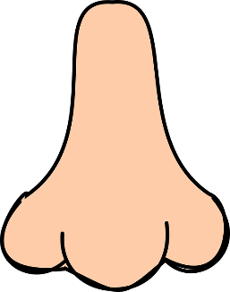
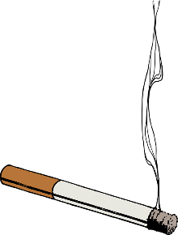
Phonetik [2/2]
hören
Hör zu. Ist das ‘w’ oder ‘qu’?
Quarte Warte | wallen Quallen
Warzen quarzen | quatschen watschen
1
2
__
__
__
__
3
4
__
__
__
__
Notes:
Slide 2

Slide 7
Phonetik
lesen / hören
Often, words with [qu] are cognates, but we pronounce them differently. Listen to the word and then repeat.
Aquarium
Notes:
Timing: 1 minute Aim: to practise SSC [qu] Procedure: 1. Read the explanation.
2. Click on the picture to hear the audio.
3. Ask students to repeat.
Word frequency (1 is the most frequent word in German): Aquarium [>5009] Source: Jones, R.L. & Tschirner, E. (2019). A frequency dictionary of German: core vocabulary for learners. Routledge

Slide 8
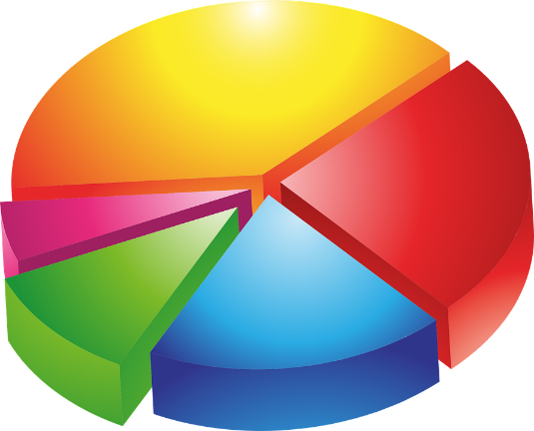
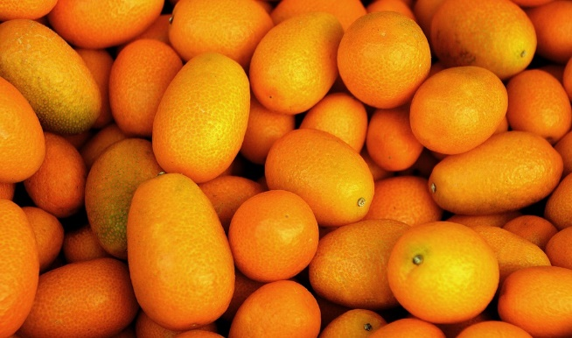
Phonetik
lesen / sprechen
Sag die Wörter so schnell wie möglich.
15
Sekunden
Qualifikation Quote Kumquat
0
LOS!
Notes:
Timing: 4 minutes (3 slides) Aim: to practise [qu] and to reinforce German pronunciation of words that look English. Procedure: 1. Click on ‘Los!’ to start the timer.
2. Students chorally say the words as quickly as they can, ensuring they use German pronunciation for [qu].
Word frequency (1 is the most frequent word in German): Qualifikation [3600] Quote [3978] Kumquat [>5009] Quadfahren [>5009] Qualität [1202] Quarz [>5009] Aquafitness [>5009] Konsequenz [1582] Frequenz [2539] Source: Jones, R.L. & Tschirner, E. (2019). A frequency dictionary of German: core vocabulary for learners. Routledge

Slide 9
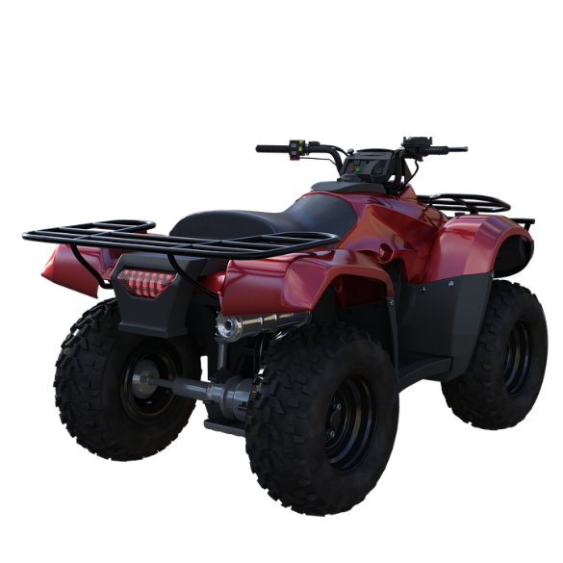
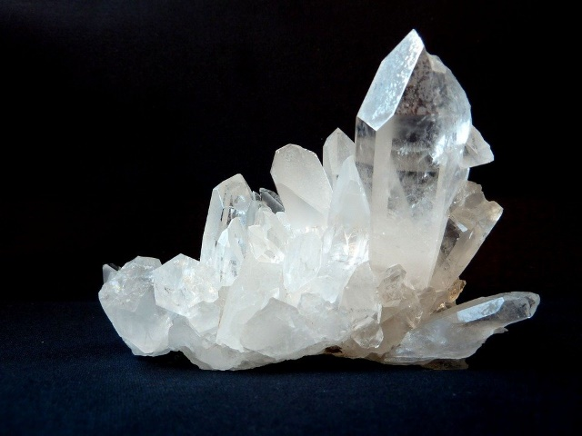
Phonetik
lesen / sprechen
Sag die Wörter so schnell wie möglich.
15
Sekunden
Quadfahren Qualität Quarz
0
LOS!
Notes:
Slide 2

Slide 10
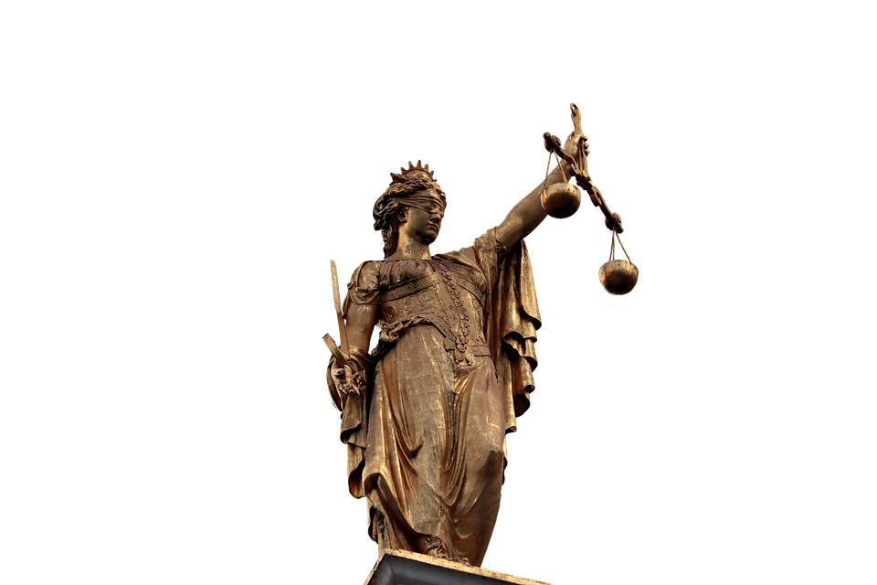
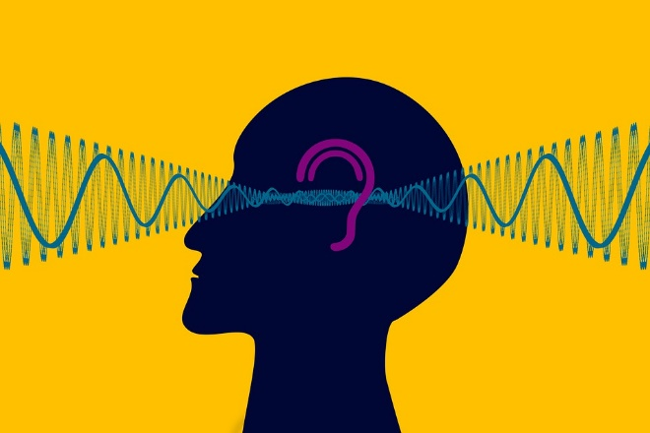
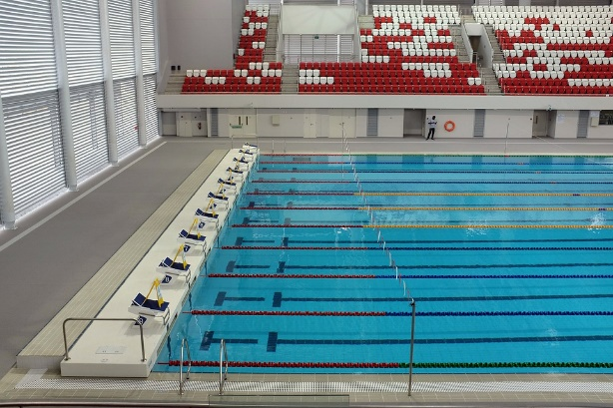
Phonetik
lesen / sprechen
Sag die Wörter so schnell wie möglich.
15
Sekunden
Aquafitness Konsequenz Frequenz
0
LOS!
Notes:
Slide 3

