Slide 1
German phonics collection
[pf]
Artwork: Steve Clarke
Date updated: 10 / 02 / 21
Notes:
Artwork by Steve Clarke. All additional pictures selected are available under a Creative Commons license, no attribution required.

Slide 2
[pf]
Phonetik
Introduction
Y8 T3.1 Week 3 Slides 2; 31; 33

Slide 3
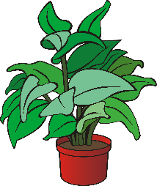
Phonetik
[pf] auf Deutsch ist oft [p] auf Englisch.
hören / schreiben
die Pflanze
plant
_____
_____
Hör zu. Schreib die deutschen Wörter auf. Wie heißt das auf Englisch?
 | Deutsch | Englisch?
 | Apfel | apple
 | Pfund | pound
 | Pfeffer | pepper
 | Pflaster | plaster
 | Deutsch | Englisch?
 | Pfeife | pipe
 | Pfannkuchen | pancake
 | Krampf | cramp
 | Pfefferminze | peppermint
1
________
________
5
________
________
2
________
________
6
________________
______________
3
________
________
7
__________
________
4
________
________
8
________________
______________
Notes:
Timing: 5 minutes Aim: To practise SSC [pf].
Procedure: 1. Click on the action button to play the recording of the German word.
2. Students write the German word.
3. Click to reveal spelling of German word.
4. Students write English translation.
5. Click to reveal English translation.
Transcript:
1. Apfel
2. Pfund
3. Pfeffer
4. Pflaster
5. Pfeife
6. Pfannkuchen
7. Krampf 8. Pfefferminze Word frequency of unknown words and cognates (1 is the most frequent word in German): Apfel [3491] Pfund [4163] Pfeffer [>5009] Pflaster [>5009] Pfeife [>5009] Pfannkuchen [>5009] Krampf [>5009] Pfefferminze [>5009] Source: Jones, R.L. & Tschirner, E. (2019). A frequency dictionary of German: core vocabulary for learners. Routledge

Slide 4
Wie sagt man das?
hören
1
[kn]
[pf]
2
beide
Pflicht
3
_ _ _ _ _ _ _ [duty]
knapp
4
_ _ _ _ _ [tight]
Knopf
_ _ _ _ _ [button]
Pfarrer
_ _ _ _ _ _ _ [priest]
5
Knall
_ _ _ _ _ [boom]
knüpfen
6
_ _ _ _ _ _ _ [to knot]
pfeifen
_ _ _ _ _ _ _ [to whistle]
7
Knochen
_ _ _ _ _ _ _ [bone]
8
Pfeil
_ _ _ _ _ [arrow]
9
Notes:
Timing: 5 minutes
Aim: To practise transcribing SSC [kn] and [pf].
Procedure:
Draw the Venn diagram.
Listen to each word. Organise the words into one three categories.
Note: Sometimes students will need to write them down and read them before they can decide where to place them, so encourage them to do this.
Do the first one as an example with the class.
Differentiation: If teachers want to make the task more straightforward, then can add additional letters in to each word (e.g. the vowels).
Transcript (with English meanings given in brackets): Knopf (button) Pflicht (duty) knapp (tight) Knall (boom) knüpfen (to knot) Pfarrer (priest) pfeifen (to whistle) Knochen (bone) Pfeil (arrow)
Word frequency of unknown words and cognates (1 is the most frequent word in German):
Knall [4659] knapp [639] Knochen [1931] Knopf [4357] knüpfen [4864] Pfarrer [3566] pfeifen [4545] Pfeil [4266] Pflicht [2048]
Source: Jones, R.L. & Tschirner, E. (2019). A frequency dictionary of German: core vocabulary for learners. Routledge

Slide 5
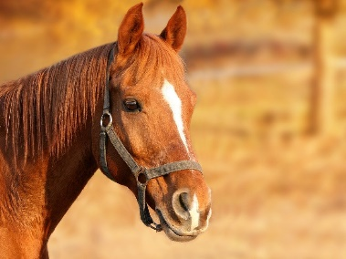
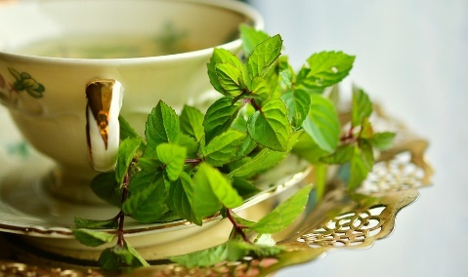
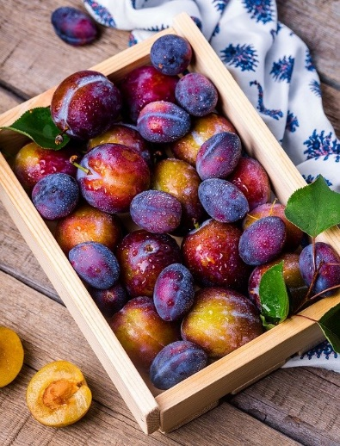
Phonetik
sprechen / hören
1
Pfarrers Pferd Pfiffig-Prinz pfeift auf Pfefferminz.
Auf Pfefferminz pfeift Pfarrers Pferd Pfiffig-Prinz.
2
3
1
Franz pflückt Pfingsten fleißig dreißig Pflaumen.
Fleißig dreißig Pflaumen pflückt Franz Pfingsten.
2
3
Notes:
Timing: 4 mins (two slides)
Aim: to gain confidence in producing the SSCs [kn] and [pf] in a range of words.
Procedure:
The teacher reveals the words, allowing students to read them out loud one by one.
The teachers asks students to say what they think the sentence means, explaining that Pfififg-Prinz is the name of the horse (not a common horse name – Prinz might be, but here we added the Pfiffig for the sake of practising the [pf]). Like for the previous slide, you might bring students’ attention to the inverted word order of the 2nd sentence. Subject and object have swapped places. This gives a little emphasis to the dumplings in the 2nd sentence, but is mostly to increase the challenge of the tongue twister. Also, idiomatic expression: ‘auf etwas pfeifen = to care less’: the horse couldn't; care less about peppermint.
Students then practise saying the full tongue twister in pairs, at increasing speed.
The teacher can get students listen to a native speaker read the sentence at three different speeds (1=slow; 3=very fast). Each time, students can be challenged to say it themselves at the same speed.
There is a 2nd tongue twister for use, if desired.
Transcript
Pfarrers Pferd Pfiffig-Prinz pfeift auf Pfefferminz.
Auf Pfefferminz pfeift Pfarrers Pferd Pfiffig-Prinz.
Franz pflückt Pfingsten fleißig Pflaumen.
Fleißig Pflaumen pflückt Franz Pfingsten.
Word frequency of unknown words and cognates (1 is the most frequent word in German):
Pfarrer [3566] Pferd [1504] Pfefferminz [>5000] pfeifen [4545] pfiffig [>5000] Pfingsten [>5000] Pflaumen [>5000] pflücken [>5000]
Source: Jones, R.L. & Tschirner, E. (2019). A frequency dictionary of German: core vocabulary for learners. Routledge

Slide 6
[pf]
Phonetik
Consolidation [1]

Slide 7
[pf]
Phonetik
Consolidation [2]

