Slide 1
German phonics collection
long and short [ö]
Artwork: Steve Clarke
Date updated: 03/ 08 / 21
Notes:
Artwork by Steve Clarke. All additional pictures selected are available under a Creative Commons license, no attribution required.

Slide 2
long and short [ö]
Phonetik
Introduction
Y7 T2.1 Week 1 Slides 2-14

Slide 3
a
sagen
Notes:
Timing: 1 minute
Aim: To introduce/consolidate SSC [a]
Procedure: 1. Present the letter(s) and say the [a] sound first, on its own. Students repeat it with you. 2. Bring up the word ”sagen” on its own, say it, students repeat it, so that they have the opportunity to focus all of their attention on the connection between the written word and its sound.
3. A possible gesture for this would be mime speech coming out of your mouth, opening your mouth and drawing your hand away quickly away from you.
4. Roll back the animations and work through 1-3 again, but this time, dropping your voice completely to listen carefully to the students saying the [a] sound, pronouncing ”sagen” and, if using, doing the gesture. Word frequency (1 is the most frequent word in German): sagen [46] Source: Jones, R.L. & Tschirner, E. (2006). A frequency dictionary of German: core vocabulary for learners. Routledge

Slide 4
ö
schön
Notes:
Timing: 1 minute
Aim: To introduce/consolidate SSC [ö]
Procedure: 1. Present the letter(s) and say the [ö] sound first, on its own. Students repeat it with you. 2. Bring up the word ”schön” on its own, say it, students repeat it, so that they have the opportunity to focus all of their attention on the connection between the written word and its sound.
3. A possible gesture for this would be to mime an exaggerated exclamation of seeing / receiving something beautiful. As you say ‘schön’ with an appropriate sigh, bring your hands to the rest on your cheeks, and smile!
4. Roll back the animations and work through 1-3 again, but this time, dropping your voice completely to listen carefully to the students saying the [ö] sound, pronouncing ” schön” and, if using, doing the gesture. Word frequency (1 is the most frequent word in German): schön [164] Source: Jones, R.L. & Tschirner, E. (2006). A frequency dictionary of German: core vocabulary for learners. Routledge

Slide 5
ö
schön
Notes:
With sound and no pictures to focus all attention on the sound-symbol correspondence.

Slide 6
ö
schön
Notes:
Without sound to elicit pronunciation (without first hearing the teacher).
Teacher to elicit pronunciation by asking “Wie sagt man…”

Slide 7
ö
Lösung
mögen
[solution]
[to like]
schön
französisch
Körper
möglich
[possible]
Notes:
Timing: 2 minutes
Aim: To introduce/consolidate SSC [ö]
Procedure:
Introduce and elicit the pronunciation of the individual SSC [ö] and then the source word again ‘schön’ (with gesture, if using).
Then present and elicit the pronunciation of the five cluster words.
The cluster words have been chosen for their high-frequency, from a range of word classes, with the SSC (where possible) positioned within a variety of syllables within the words (e.g. initial, 2nd, final etc.). Additionally, we have tried to use words that build cumulatively on previously taught SSCs (see the Phonics Teaching Sequence document) and do not include new SSCs. Where new SSCs are used, they are often consonants which have a similar symbol-sound correspondence in English.
Word frequency (1 is the most frequent word in German): schön [164]; Lösung [620] mögen [151]; französisch [644]; möglich [156]; Körper [617]. Source: Jones, R.L. & Tschirner, E. (2006). A frequency dictionary of German: core vocabulary for learners. Routledge

Slide 8
ö
Lösung
mögen
schön
französisch
Körper
möglich
Notes:
With sound and no pictures to focus all attention on the sound-symbol correspondence.

Slide 9
ö
Lösung
mögen
schön
französisch
Körper
möglich
Notes:
Without sound to elicit pronunciation (without first hearing the teacher).
Teacher to elicit pronunciation by asking “Wie sagt man…”

Slide 10
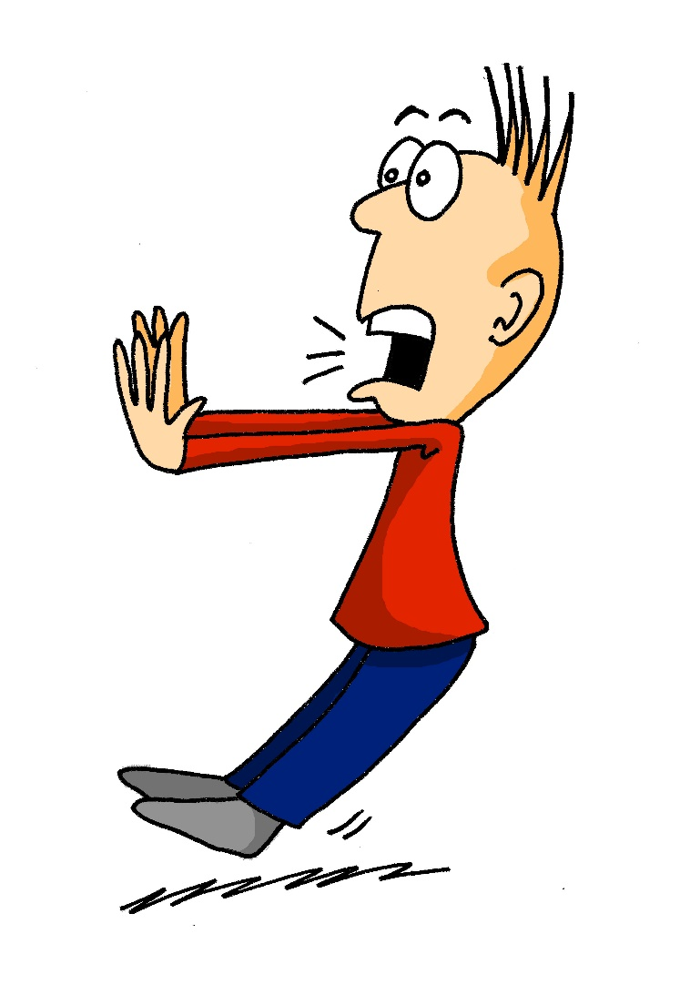
ö
plötzlich
Notes:
Timing: 1 minute
Aim: To introduce/consolidate SSC [ö]
Procedure: 1. Present the letter(s) and say the [ö] sound first, on its own. Students repeat it with you. 2. Bring up the word ”plötzlich” on its own, say it, students repeat it, so that they have the opportunity to focus all of their attention on the connection between the written word and its sound.
3. A possible gesture for this would be to mime a sudden shock that makes you jump backwards. Put your hands up and look shocked, as in the picture.
4. Roll back the animations and work through 1-3 again, but this time, dropping your voice completely to listen carefully to the students saying the [ö] sound, pronouncing ”plötzlich” and, if using, doing the gesture. Word frequency (1 is the most frequent word in German): plötzlich [459] Source: Jones, R.L. & Tschirner, E. (2006). A frequency dictionary of German: core vocabulary for learners. Routledge

Slide 11
ö
plötzlich
Notes:
With sound and no pictures to focus all attention on the sound-symbol correspondence.

Slide 12
ö
plötzlich
Notes:
Without sound to elicit pronunciation (without first hearing the teacher).
Teacher to elicit pronunciation by asking “Wie sagt man…”

Slide 13
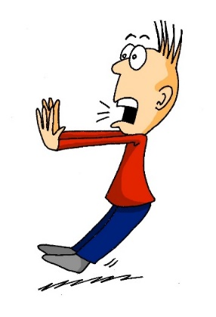
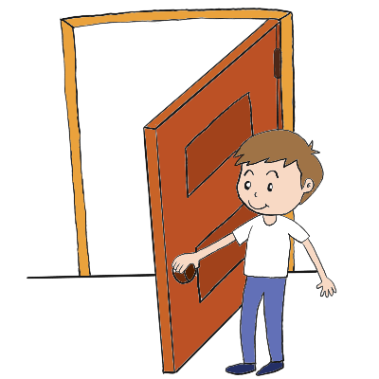
ö
Bevölkerung
zwölf
12
plötzlich
völlig
öffnen
%
öffentlich
[public]
Notes:
Timing: 2 minutes
Aim: To introduce/consolidate SSC [ei]
Procedure:
Introduce and elicit the pronunciation of the individual SSC [ö] and then the source word again ‘plötzlich’ (with gesture, if using).
Then present and elicit the pronunciation of the five cluster words.
The cluster words have been chosen for their high-frequency, from a range of word classes, with the SSC (where possible) positioned within a variety of syllables within the words (e.g. initial, 2nd, final etc.). Additionally, we have tried to use words that build cumulatively on previously taught SSCs (see the Phonics Teaching Sequence document) and do not include new SSCs. Where new SSCs are used, they are often consonants which have a similar symbol-sound correspondence in English.
Word frequency (1 is the most frequent word in German): plötzlich [459]; Bevölkerung [769] völlig [462]; öffentlich [399]; zwölf [882]; öffnen [538]. Source: Jones, R.L. & Tschirner, E. (2006). A frequency dictionary of German: core vocabulary for learners. Routledge

Slide 14
ö
Bevölkerung
zwölf
plötzlich
völlig
öffnen
öffentlich
Notes:
With sound and no pictures to focus all attention on the sound-symbol correspondence.

Slide 15
ö
Bevölkerung
zwölf
plötzlich
völlig
öffnen
öffentlich
Notes:
Without sound to elicit pronunciation (without first hearing the teacher).
Teacher to elicit pronunciation by asking “Wie sagt man…”

Slide 16
Lang oder kurz?
hören / sprechen
 |  | lang wie schön | kurz wie plötzlich
 | Köln
 | das Vereinigte Königreich
 | Mönchen­gladbach
 | Görlitz
 | Österreich
 | Göttingen
 | Mödling
A
B
C
D
E
F
G
Notes:
Timing: 3 minutes
Aim: To practise distinguishing between long and short SSC [ö]. Place names have been chosen for this exercise as they are unlikely to have been encountered before, so students must focus on the sound.
Procedure: 1. Teacher to highlight the English translations of ‘Köln’, ‘das Vereinigte Königreich’ and ‘Österreich’ (‘Wie sagt man Köln auf Englisch?’) and explain the structure of ‘das Vereinigte Königreich’ (though make it clear that ‘Großbritannien’ is more commonly used).
2. Click on the numbered audio buttons to play the items.
3. Students listen to each place name and ticj the appropriate column, according to whether the [ö] is long or short.
4. Teacher elicits answers by pointing at the word and asking ‘Ist das ö lang oder kurz?’ Students respond ‘Das ö ist lang/kurz.’
5. Click to reveal the answers.
6. Once answers have been revealed, students are asked to read the names aloud. They now have direct information about how to pronounce the ‘ö’ SSC. The exercise also provides an opportunity to apply previous SSC knowledge of soft and hard /ch/ (das Vereinigte Königreich, Mönchen­gladbach, Österreich) and /ei/ (das Vereinigte Königreich, Österreich).
NB: Should students ask why Österreich and Mödling are long ö despite being followed by two consonants, here are two possible responses, depending on who has asked and how much time you have! 1. Place names can often be exceptional - think of some strange ones in English e.g. Holborn doesn’t pronounce the ‘l’ at all, but in English we don’t have silent ‘l’ as a letter, generally. Towcester is pronounced ‘toaster’ etc.. 2. This is to do with the syllable separation - here Ös - ter - reich is made up of 3 syllables - the end of the first syllable is just a single consonant, and the ö pronunciation is driven by that. The same applies to Möd - ling. When the syllables are separated, the double consonants disappear.

Slide 17
long and short [ö]
Phonetik
Consolidation [1]
Y7 T2.2 Week 5 Slides 3-4; 35

Slide 18
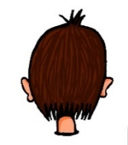
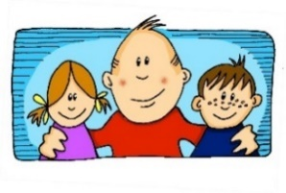
Phonetik
e
e
a
a
sagen
kalt
geben
denken
i
i
o
o
u
wir
u
finden
wo?
Kopf
ü
ü
ö
du
ö
Punkt
Tür
fünf
ä
ä
schön
plötzlich
spät
lächeln
Notes:
Timing: 3 minutes
Aim: The long and short vowel sounds in German are practised here in familiar words, with audio.
Procedure:
1. Students should listen and repeat.

Slide 19
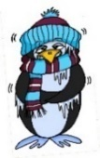
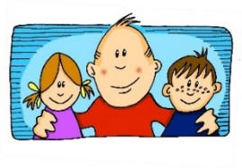
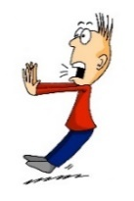
Phonetik
e
e
a
a
sagen
kalt
geben
denken
i
i
o
o
u
wir
u
finden
wo?
Kopf
ü
ü
ö
ö
fünf
du
Punkt
Tür
ä
ä
schön
plötzlich
spät
lächeln
Notes:
Timing: 3 minutes
Aim: This version of the slide is without audio.
Procedure:
1. Students should chant the words chorally first, as they appear, then perhaps individually (the teacher quizzing students on individual words; it will be important to continue to juxtapose the long and short forms of each vowel in this practice).

Slide 20
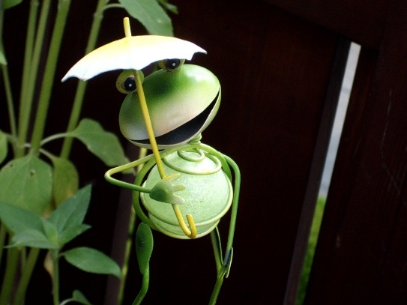
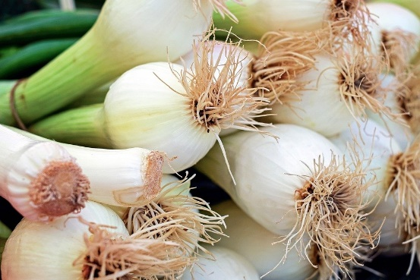
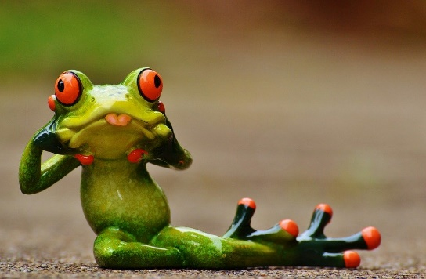
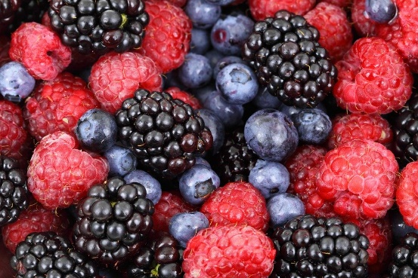
Zungenbrecher [2]
Phonetik
1
2
Fromme Frösche fressen
frische Frühlingszwiebeln,
aber freche Frösche fressen
frische Früchte.
Notes:
Timing: 3 minutes
Aim: Opportunity to practise the following SSCs: o - ö - i - ü – e.
Procedure:
1. Students listen to either the slower [1] or the faster [2] version of the tongutwister (or both in turn), then try to say it chorally or in pairs.
Transcription:
Fromme Frösche fressen
frische Frühlingszwiebeln,
aber freche Frösche fressen
frische Früchte.
Translation:
Pious frogs eat
fresh spring onions,
but eat naughty frogs
fresh fruits.
Word frequency (1 is the most frequent word in German):
fromm [>4029] Frosch [>4029] fressen [3448] frisch [1297] Frühling [3975] Zwiebel [3382] aber [32] frech [>4029] Frucht [3876]
Source: Jones, R.L & Tschirner, E. (2019). A frequency dictionary of German: Core vocabulary for learners. London: Routledge.

Slide 21
long and short [ö]
Phonetik
Consolidation [2]
Y7 T3.1 Week 2 Slide 19

Slide 22
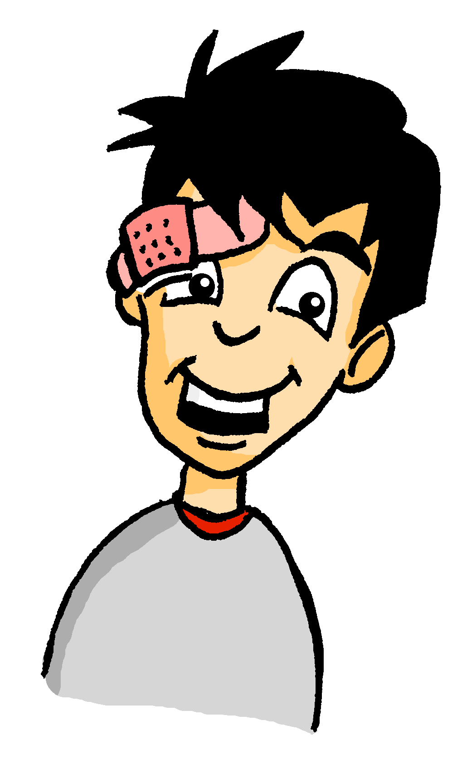
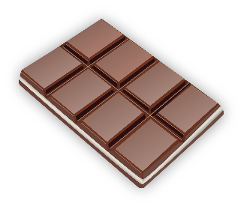
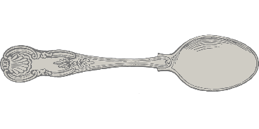
Wolfgangs Shoppingliste
Schokolade
_
_
Und was braucht Wolfgang? Ordne die Dinge zu!
Löffel
_
Brötchen
_
o/ö
o
ö
Knöpfe
_
Kopfhörer
_
_
Socken
_
Tomaten
_
Sonnenbrille
_
Olivenöl
_
_
Notes:
This phonics exercise contrasts for SSCs which were not revisited in lesson 1 - long [o], short [o], long [ö] and short [ö].
Students sketch the Venn-diagram in their answer books, listen to the pronunciation of these unknown words, and assign each to the appropriate part of the diagram.
Audio plays on clicking the images.
Answers are revealed (clockwise) on clicks, starting with Schokolade and finishing with Löffel.
During the feedback, teacher could break down the word Kopfhörer, asking students which noun and verb they recognise in the compound.
Frequency values of words used: Schokolade [>4034], Socke [>4034], Knopf [>4034], Tomate [>4034], Olivenöl [>4034], Sonnenbrille [953/3423], Löffel[>4034], Kopfhörer [279/1557], Brötchen [>4034]

Slide 23
long and short [ö]
Phonetik
Consolidation [3]
Y7 T3.2 Week 6 Slide 20

Slide 24
Wie heißt die Band?
Phonetik
Alastair telefoniert mit Mia. Sie reden über deutsche Bands. Wie heißen sie?
 | die P r i n z e n
 | J u l i
 | F e t t e s B r o t
 | die F a n t a s t i s c h e n V i e r
 | S ö h n e M a n n h e i m s
 | S p o r t f r e u n d e S t i l l e r
 | R o s e n s t o l z
 | die Ä r t z e
1
_
2
_
3
_
_
4
_
_
_
_
_
5
_
_
_
6
_
_
_
_
7
_
_
8
_
_
Notes:
Phonetik [1] Time: 5 minutes
Aim: To practise recognising and transcribing 14 previously taught SSC, in unknown words.
Note: These are real German band names.
Procedure: 1. Click number to hear the full word. Students listen and transcribe only the missing letters. 2. Animations support item-by-item checking, as instant feedback on each SSC may be particularly helpful for students’ learning. SSC revisited here: [z] [j] [r-consonantal] [o-long] [sch] [v] [r-vocalic] [ö-long] [ei] [st] [-er] [st] [ä] [-e]
Transcript: [1] die Prinzen
[2] Juli
[3] Fettes Brot
[4] die Fantastischen Vier
[5] Söhne Mannheims
[6] Sportfreunde Stiller
[7] Rosenstolz
[8] die Ärzte

Slide 25
long and short [ö]
Phonetik
Consolidation [4]
Y8 T1.2 Week 7 Slides 2-3; 21

Slide 26
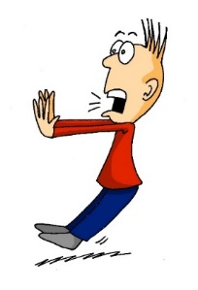
Phonetik
hören / sagen
o
o
wo?
Kopf
ö
ö
schön
plötzlich
Notes:
Timing: 1 minute Aim: To introduce/consolidate SSC long and short [o] and [ö] Procedure: 1. Present the letter(s) and say the [o] sound first, on its own. Students repeat it with you. 2. Bring up the source word ”wo?” on its own, say it, students repeat it, so that they have the opportunity to focus all of their attention on the connection between the written word and its sound.
3. A possible gesture for this would be to point out directly in front of you.
4. Repeat for the other three source words, with gesture suggestions as follows: short [o] – .
long [ö] – .
short [ö] - .
Word frequency (1 is the most frequent word in German): schön [164] zwölf [882] wo? [94] holen [640] Source: Jones, R.L. & Tschirner, E. (2006). A frequency dictionary of German: core vocabulary for learners. Routledge

Slide 27
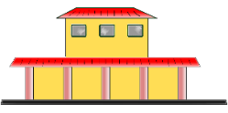
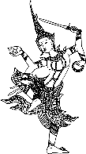
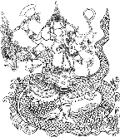
Phonetik
lesen / sprechen
Sag die Wörter.
 | Singular | Plural
1 | Wort | Wörter
2 | Chor | Chöre
3 | Bahnhof | Bahnhöfe
4 | Dorf | Dörfer
5 | Boden | Böden
6 | Kopf | Köpfe
7 | Gott | Götter
8 | Sohn | Söhne
1
[word]
_________
[words]
2
_________
3
_________
4
[village]
_________
[villages]
5
[floor]
_________
[floors]
6
_________
7
_________
8
_________
Notes:
Timing: 5 minutes Aim: Practise the phonetics of plural o → ö. Procedure: 1. Students can initially be asked to fill in the grid without any audio.
2. Clicking the buttons plays both the singular and plural words. Students write and/or check their written versions of the singular nouns.
3. Clicking reveals the singular nouns. 4. Students read aloud/pronounce all of the nouns in pairs, taking it in turns to say whichever the ‘matching’ plural or singular, depending on the word their partner says first.
Transcript:
1. Wort – Wörter
2. Chor – Chöre
3. Bahnhof – Bahnhöfe
4. Dorf – Dörfer
5. Boden – Böden
6. Kopf – Köpfe
7. Gott – Götter
8. Sohn - Söhne
Word frequency (1 is the most frequent word in German): Wort [194], Chor [>5000], Bahnhof [2027], Dorf [959], Boden [536], Kopf [250], Gott [514], Sohn [596] Source: Jones, R.L. & Tschirner, E. (2006). A frequency dictionary of German: core vocabulary for learners. Routledge

Slide 28
Phonetik
hören / sprechen
Welches Wort ist das? Schreib a-f und 1,2 oder 2,1.
[o]
[ö]
1 fordern [to encourage]
2 fördern [to promote]
a
__
__
2 Osten [East]
1 östlich [easterly]
b
__
__
2 Polen [Poland]
1 Pönale [penalty]
c
__
__
1 noch [still]
2 Nöck [water sprite]
d
__
__
2 flott [quick]
1 Flöte [flute]
e
__
__
1 Kode [code]
2 Köder [bait]
f
__
__
Notes:
Phonics Timing: 5 minutes Aim: To differentiate between pairs of words that differ primarily by one phoneme (one SSC that changes the meaning). These words are near-minimal pairs. Procedure: 1. Click to listen. 2. Write 1, 2 or 2, 1 depending on the order in which the words are spoken. 3. Click to see the answers.
4. Students can then partner up. Partner A reads one side aloud while partner B reads the other, word-by-word. They can then switch.
Transcript
fordern, fördern
östlich, Osten
Pönale, Polen
Noch, Nock
Flöte, flott
Kode, Köder
Word frequency (1 is the most frequent word in German): fordern [599], fördern [1089], Osten [1208], östlich [4883], Polen [2023], Pönale [>5000], noch [33], Nöck [>5000], flott [>5000], Flöte [>5000], Code [>5000], Köder [>5000] Source: Jones, R.L. & Tschirner, E. (2006). A frequency dictionary of German: core vocabulary for learners. Routledge

Slide 29
long and short [ö]
Phonetik
Consolidation [5]
Y8 T2.1 Week 3 Slide 4

Slide 30
Phonetik
lesen / sprechen
Sag die Zungenbrecher.
15
3.
[o]
[ö]
Zwölf tolle Töchter mögen oft Obst holen.
Twelve great daughters often like fetching fruit.
holen
Sekunden
Töchter
zwölf
tolle
Obst
oft
mögen
0
langsamer
LOS!
Notes:
Transcript: Zwölf tolle Töchter* mögen oft Obst holen.
Word frequency of unknown words and cognates (1 is the most frequent word in German): Tochter [694] Source: Jones, R.L. & Tschirner, E. (2019). A frequency dictionary of German: core vocabulary for learners. Routledge

Slide 31
long and short [ö]
Phonetik
Consolidation [6]
Y9 T1.1 Week 2 Slide 15

Slide 32
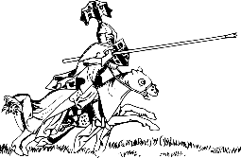
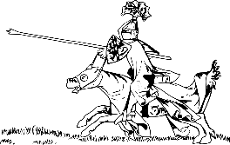
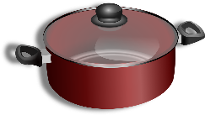
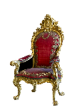
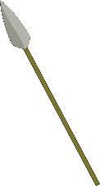
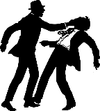
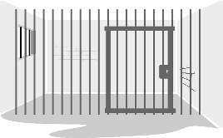
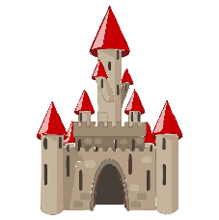
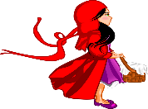
Phonetik
hören / schreiben
Person A liest die Wörter, Person B schreibt auf. Dann tauscht die Rollen.
6 Wörter – Person A liest:
6 Wörter – Person B liest:
1. Lanzen
1. Töpfe
2. Throne
2. Kronen
3. Rösser
3. Waffen
4. Kämpfe
4. Stäbe
5. Gewänder
5. Wassergräben
6. Schlösser
6. Köpfe
Notes:
Timing: 5 minutes Aim: to read aloud to practise spoken production of a, ä, o, ö. Procedure: 1. Partner B turns away from the board.
2. Click to make the words and images appear for Person A to read out. Person B writes down what Person A says.
3. When all 6 words have been read and transcribed, Person B turns back to the board, and together with Person A, checks their spelling.
4. Students work out meaning of the words using the images as clues – they may need help with this.
5. Swap roles and follow procedure 1 – 5 for the second set of six words.
Word frequency of unknown words (1 is the most frequent word in German): Lanze [>5009] Thron [>5009] [4962] Ross [>5009] Kampf [867] Gewand [>5009] Topf [4136] Krone [3743] Waffe [1625] Stab [>5009] Wassergraben [>5009]

