Slide 1
German phonics collection
Long and short [o]
Artwork: Steve Clarke
Date updated: 03 / 08 / 21
Notes:
Artwork by Steve Clarke. All additional pictures selected are available under a Creative Commons license, no attribution required.

Slide 2
Long and short [o]
Phonetik
Introduction
Y7 T1.2 Week 1 Slides 2-13

Slide 3
o
wo?
Notes:
Timing: 1 minute
Aim: To introduce/consolidate SSC [o]
Procedure: 1. Present the letter(s) and say the [o] sound first, on its own. Students repeat it with you. 2. Bring up the word ”wo” on its own, say it, students repeat it, so that they have the opportunity to focus all of their attention on the connection between the written word and its sound.
3. A possible gesture for this would be to mime looking for someone.
4. Roll back the animations and work through 1-3 again, but this time, dropping your voice completely to listen carefully to the students saying the [o] sound, pronouncing ”wo” and, if using, doing the gesture. Word frequency (1 is the most frequent word in German): wo? [94]
Source: Jones, R.L. & Tschirner, E. (2006). A frequency dictionary of German: core vocabulary for learners. Routledge

Slide 4
o
wo?
Notes:
With sound and no pictures to focus all attention on the sound-symbol correspondence.

Slide 5
o
wo?
Notes:
Without sound to elicit pronunciation (without first hearing the teacher).
Teacher to elicit pronunciation by asking “Wie sagt man…”

Slide 6
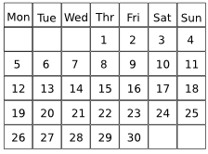
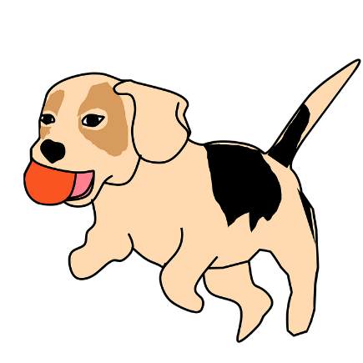
o
wohnen
Montag
wo?
ohne
holen
Million
Notes:
Timing: 2 minutes
Aim: To introduce/consolidate SSC [o]
Procedure:
Introduce and elicit the pronunciation of the individual SSC [o] and then the source word again ‘wo’ (with gesture, if using).
Then present and elicit the pronunciation of the five cluster words.
The cluster words have been chosen for their high-frequency, from a range of word classes, with the SSC (where possible) positioned within a variety of syllables within the words (e.g. initial, 2nd, final etc.). Additionally, we have tried to use words that build cumulatively on previously taught SSCs (see the Phonics Teaching Sequence document) and do not include new SSCs. Where new SSCs are used, they are often consonants which have a similar symbol-sound correspondence in English.
Word frequency (1 is the most frequent word in German): wo? [94]; wohnen [380] Montag [794]; ohne [119]; Million [206]; holen [640]. Source: Jones, R.L. & Tschirner, E. (2006). A frequency dictionary of German: core vocabulary for learners. Routledge

Slide 7
o
wohnen
Montag
wo?
ohne
holen
Million
Notes:
With sound and no pictures to focus all attention on the sound-symbol correspondence.

Slide 8
o
wohnen
Montag
wo?
ohne
holen
Million
Notes:
Without sound to elicit pronunciation (without first hearing the teacher).
Teacher to elicit pronunciation by asking “Wie sagt man…”.

Slide 9
o
Kopf
Notes:
Timing: 1 minute
Aim: To introduce/consolidate SSC [o]
Procedure: 1. Present the letter(s) and say the [o] sound first, on its own. Students repeat it with you. 2. Bring up the word ”Kopf” on its own, say it, students repeat it, so that they have the opportunity to focus all of their attention on the connection between the written word and its sound.
3. A possible gesture for this would be to tap the top of your head.
4. Roll back the animations and work through 1-3 again, but this time, dropping your voice completely to listen carefully to the students saying the [o] sound, pronouncing ”Kopf” and, if using, doing the gesture. Word frequency (1 is the most frequent word in German): Kopf [279] Source: Jones, R.L. & Tschirner, E. (2006). A frequency dictionary of German: core vocabulary for learners. Routledge

Slide 10
o
Kopf
Notes:
With sound and no pictures to focus all attention on the sound-symbol correspondence.

Slide 11
o
Kopf
Notes:
Without sound to elicit pronunciation (without first hearing the teacher).
Teacher to elicit pronunciation by asking “Wie sagt man…”

Slide 12
o
wollen
Woche
Kopf
offen
kommen
[to come]
noch
[still]
Notes:
Timing: 2 minutes
Aim: To introduce/consolidate SSC [o]
Procedure:
Introduce and elicit the pronunciation of the individual SSC [o] and then the source word again ‘Kopf’ (with gesture, if using).
Then present and elicit the pronunciation of the five cluster words.
The cluster words have been chosen for their high-frequency, from a range of word classes, with the SSC (where possible) positioned within a variety of syllables within the words (e.g. initial, 2nd, final etc.). Additionally, we have tried to use words that build cumulatively on previously taught SSCs (see the Phonics Teaching Sequence document) and do not include new SSCs. Where new SSCs are used, they are often consonants which have a similar symbol-sound correspondence in English.
Word frequency (1 is the most frequent word in German): Kopf [279]; wollen [65] Woche [209]; offen [382]; noch [37]; kommen [61]. Source: Jones, R.L. & Tschirner, E. (2006). A frequency dictionary of German: core vocabulary for learners. Routledge

Slide 13
o
wollen
Woche
Kopf
offen
kommen
noch
Notes:
With sound and no pictures to focus all attention on the sound-symbol correspondence.

Slide 14
o
wollen
Woche
Kopf
offen
kommen
noch
Notes:
Without sound to elicit pronunciation (without first hearing the teacher).
Teacher to elicit pronunciation by asking “Wie sagt man…”

Slide 15
long and short [o]
Phonetik
Consolidation [1]
Y7 T2.2 Week 5 Slides 3-4; 5; 35

Slide 16
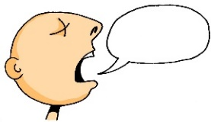
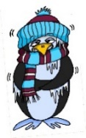
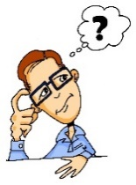
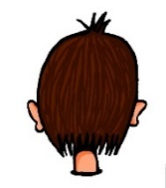
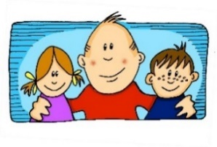
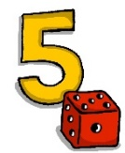
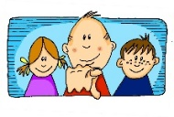
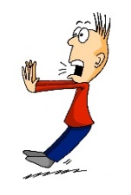
Phonetik
e
e
a
a
sagen
kalt
geben
denken
i
i
o
o
u
wir
u
finden
wo?
Kopf
ü
ü
ö
du
ö
Punkt
Tür
fünf
ä
ä
schön
plötzlich
spät
lächeln
Notes:
Timing: 3 minutes
Aim: The long and short vowel sounds in German are practised here in familiar words, with audio.
Procedure:
1. Students should listen and repeat.

Slide 17
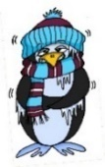
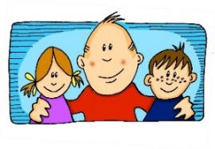
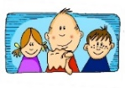
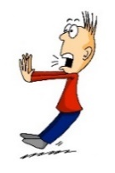
Phonetik
e
e
a
a
sagen
kalt
geben
denken
i
i
o
o
u
wir
u
finden
wo?
Kopf
ü
ü
ö
ö
fünf
du
Punkt
Tür
ä
ä
schön
plötzlich
spät
lächeln
Notes:
Timing: 3 minutes
Aim: This version of the slide is without audio.
Procedure:
1. Students should chant the words chorally first, as they appear, then perhaps individually (the teacher quizzing students on individual words; it will be important to continue to juxtapose the long and short forms of each vowel in this practice).

Slide 18
Phonetik
hören
Wie sagt man das?
 | i [lang] | i [kurz]
Linz
Ingolstadt
Iserlohn
Interlaken
Innsbruck
 | o [lang] | o [kurz]
Iserlohn
Ingolstadt
Oberammergau
Oldenburg
Ottendorf
1
1
2
2
3
3
4
4
5
5
Notes:
Timing: 5 minutes
Aim: This is a phonics recap of long and long and short [i] and [o]. Towns listed are from Germany, Austria and Switzerland. Students may like to do an extension research task to identify which towns they know (e.g from the football team) and/or where the towns are situated.
Procedure:
1. Students are asked to listen and decide if they hear long or short ‘i’ and ‘o’.
2. The city names appear together with the answer. 3. Students can have one minute in pairs to re-read aloud all the cities for additional practice.
Note: Students are not expected to transcribe the cities.

Slide 19
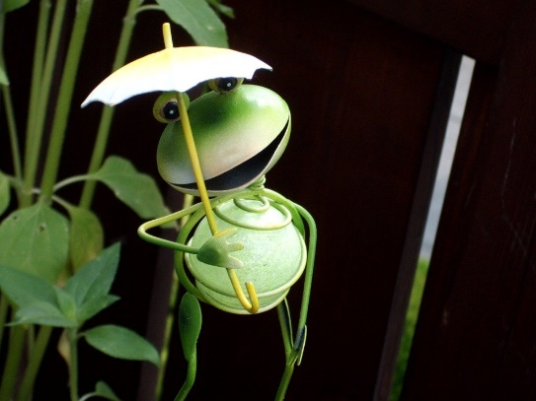
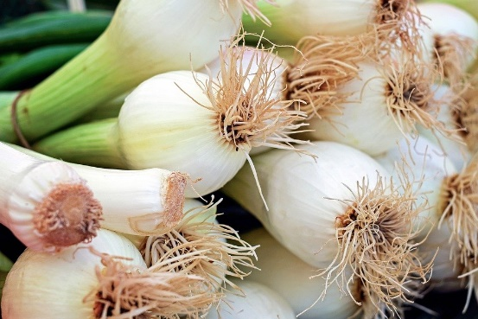
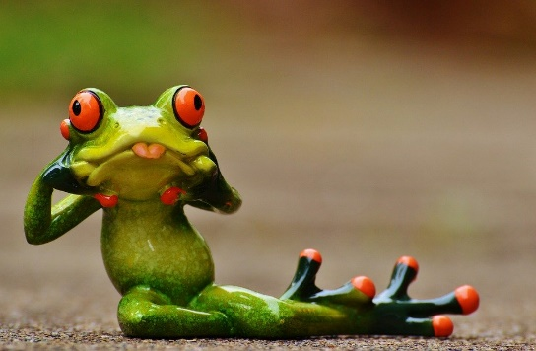
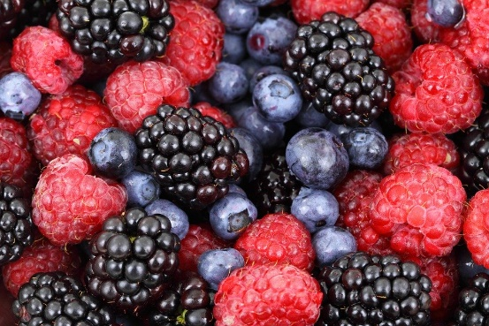
Zungenbrecher [2]
Phonetik
1
2
Fromme Frösche fressen
frische Frühlingszwiebeln,
aber freche Frösche fressen
frische Früchte.
Notes:
Timing: 3 minutes
Aim: Opportunity to practise the following SSCs: o - ö - i - ü – e.
Procedure:
1. Students listen to either the slower [1] or the faster [2] version of the tongutwister (or both in turn), then try to say it chorally or in pairs.
Transcription:
Fromme Frösche fressen
frische Frühlingszwiebeln,
aber freche Frösche fressen
frische Früchte.
Translation:
Pious frogs eat
fresh spring onions,
but eat naughty frogs
fresh fruits.
Word frequency (1 is the most frequent word in German):
fromm [>4029] Frosch [>4029] fressen [3448] frisch [1297] Frühling [3975] Zwiebel [3382] aber [32] frech [>4029] Frucht [3876]
Source: Jones, R.L & Tschirner, E. (2019). A frequency dictionary of German: Core vocabulary for learners. London: Routledge.

Slide 20
Long and short [o]
Phonetik
Consolidation [2]
Y7 T3.1 Week 2 Slide 19

Slide 21
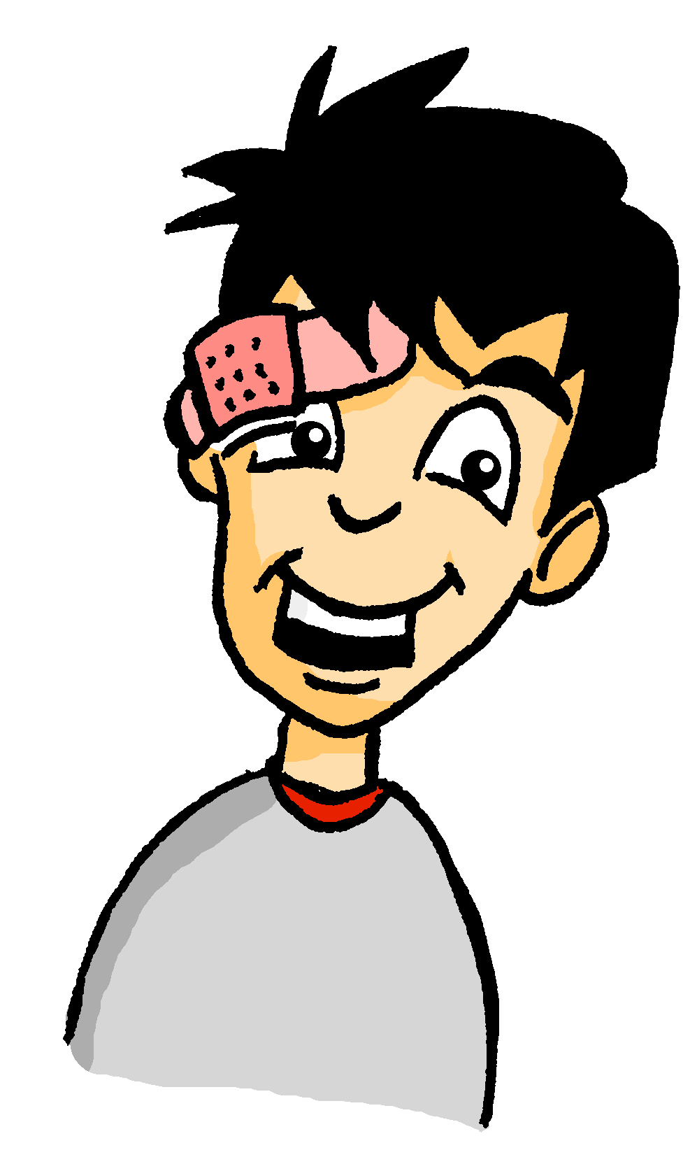
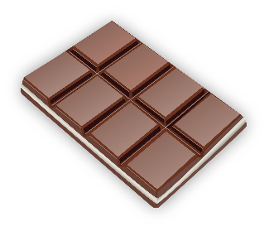
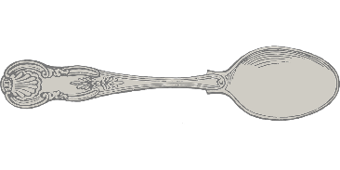
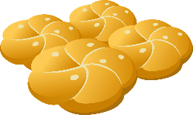
Wolfgangs Shoppingliste
Schokolade
_
_
Und was braucht Wolfgang? Ordne die Dinge zu!
Löffel
_
Brötchen
_
o/ö
o
ö
Knöpfe
_
Kopfhörer
_
_
Socken
_
Tomaten
_
Sonnenbrille
_
Olivenöl
_
_
Notes:
This phonics exercise contrasts for SSCs which were not revisited in lesson 1 - long [o], short [o], long [ö] and short [ö].
Students sketch the Venn-diagram in their answer books, listen to the pronunciation of these unknown words, and assign each to the appropriate part of the diagram.
Audio plays on clicking the images.
Answers are revealed (clockwise) on clicks, starting with Schokolade and finishing with Löffel.
During the feedback, teacher could break down the word Kopfhörer, asking students which noun and verb they recognise in the compound.
Frequency values of words used: Schokolade [>4034], Socke [>4034], Knopf [>4034], Tomate [>4034], Olivenöl [>4034], Sonnenbrille [953/3423], Löffel[>4034], Kopfhörer [279/1557], Brötchen [>4034]

Slide 22
long and short [o]
Phonetik
Consolidation [3]
Y7 T3.2 Week 6 Slide 20

Slide 23
Wie heißt die Band?
Phonetik
Alastair telefoniert mit Mia. Sie reden über deutsche Bands. Wie heißen sie?
 | die P r i n z e n
 | J u l i
 | F e t t e s B r o t
 | die F a n t a s t i s c h e n V i e r
 | S ö h n e M a n n h e i m s
 | S p o r t f r e u n d e S t i l l e r
 | R o s e n s t o l z
 | die Ä r t z e
1
_
2
_
3
_
_
4
_
_
_
_
_
5
_
_
_
6
_
_
_
_
7
_
_
8
_
_
Notes:
Phonetik [1] Time: 5 minutes
Aim: To practise recognising and transcribing 14 previously taught SSC, in unknown words.
Note: These are real German band names.
Procedure: 1. Click number to hear the full word. Students listen and transcribe only the missing letters. 2. Animations support item-by-item checking, as instant feedback on each SSC may be particularly helpful for students’ learning. SSC revisited here: [z] [j] [r-consonantal] [o-long] [sch] [v] [r-vocalic] [ö-long] [ei] [st] [-er] [st] [ä] [-e]
Transcript: [1] die Prinzen
[2] Juli
[3] Fettes Brot
[4] die Fantastischen Vier
[5] Söhne Mannheims
[6] Sportfreunde Stiller
[7] Rosenstolz
[8] die Ärzte

Slide 24
long and short [o]
Phonetik
Consolidation [4]
Y8 T1.2 Week 3 Slides 4-7; 21-24

Slide 25
o
wohnen
Montag
wo?
ohne
holen
Million
Notes:
Timing: 2 minutes
Aim: To introduce/consolidate SSC [o]
Procedure:
Introduce and elicit the pronunciation of the individual SSC [o] and then the source word again ‘wo’ (with gesture, if using).
Then present and elicit the pronunciation of the five cluster words.
The cluster words have been chosen for their high-frequency, from a range of word classes, with the SSC (where possible) positioned within a variety of syllables within the words (e.g. initial, 2nd, final etc.). Additionally, we have tried to use words that build cumulatively on previously taught SSCs (see the Phonics Teaching Sequence document) and do not include new SSCs. Where new SSCs are used, they are often consonants which have a similar symbol-sound correspondence in English.
Word frequency (1 is the most frequent word in German): wo? [94]; wohnen [380] Montag [794]; ohne [119]; Million [206]; holen [640]. Source: Jones, R.L. & Tschirner, E. (2006). A frequency dictionary of German: core vocabulary for learners. Routledge

Slide 26
o
wollen
Woche
Kopf
offen
kommen
[to come]
noch
[still]
Notes:
Timing: 2 minutes
Aim: To introduce/consolidate SSC [o]
Procedure:
Introduce and elicit the pronunciation of the individual SSC [o] and then the source word again ‘Kopf’ (with gesture, if using).
Then present and elicit the pronunciation of the five cluster words.
The cluster words have been chosen for their high-frequency, from a range of word classes, with the SSC (where possible) positioned within a variety of syllables within the words (e.g. initial, 2nd, final etc.). Additionally, we have tried to use words that build cumulatively on previously taught SSCs (see the Phonics Teaching Sequence document) and do not include new SSCs. Where new SSCs are used, they are often consonants which have a similar symbol-sound correspondence in English.
Word frequency (1 is the most frequent word in German): Kopf [279]; wollen [65] Woche [209]; offen [382]; noch [37]; kommen [61]. Source: Jones, R.L. & Tschirner, E. (2006). A frequency dictionary of German: core vocabulary for learners. Routledge

Slide 27
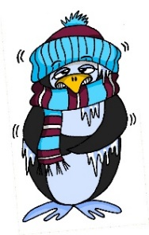
Phonetik
hören
As you know, German vowels can be long or short.
Vowels followed by more than one consonant are short.
Other vowels are long.
sagen
kalt
a
a
o
o
wo?
Kopf
Notes:
Timing: 30 seconds Aim: To bring the four source words together in summary before the transcription task on the next slide. Procedure:

Slide 28
Phonetik
hören / schreiben
Hör zu. Schreib das Wort.
1
[a] sagen
[a] kalt
2
Bahnhof
spannend
3
gefahren
Tante
4
5
[o] wo?
[o] Kopf
geflogen
Osten
6
7
Polen
polnisch
8
Notes:
Timing: 4 minutes Aim: To practise SSC long and short [a] and [o] with vocabulary that is part of this week’s and revisited vocabulary sets. The task is thus also a vocabulary practice task. Procedure: 1. Draw a 2 x 2 and write the source words. 2. Click to listen and write each word into the correct square. 3. Click to hear and see and word again. NB: Words will appear on clicks, so take care that the mouse is on action button when you click for audio (or the answers will appear too soon). Word frequency (1 is the most frequent word in German): Osten [1208] der Bahnhof [1953] polnisch [3237] geflogen [824] gefahren [215] spannend [1810] Polen [2023] Tante [1826] Source: Jones, R.L. & Tschirner, E. (2006). A frequency dictionary of German: core vocabulary for learners. Routledge
Transcript: 1. Osten (short [o] 2. Bahnhof (long [a]) 3. polnisch (short [o]) 4. geflogen (long [o]) 5. gefahren (long [a]) 6. spannend (short [a]) 7. Polen (long [o]) 8. Tante (short [a])

Slide 29
Phonetik
sprechen / hören / schreiben
Partner A sagt die Wörter. Partner B schreibt.
[a] sagen
[a] kalt
_______
_______
1. Kosten [costs]
2, planen [to plan]
3. Stoff [material] 4. Sohn [son] 5. einladen [to invite] 6. Gast [guest] 7. wohl [well] 8. relativ [relatively]
_______
_______
[o] wo?
[o] Kopf
_______
_______
_______
_______
Notes:
Timing: 4 minutes Aim: To practise SSC long and short [a] and [o] with mostly unknown vocabulary, compelling students to apply their phonics knowledge. This vocabulary will appear later in Year 8. Procedure: 1. Partner B draws a 2 x 2 and write the source words. 2. Partner A reads the words aloud. Partner B must turn away from the board and must write the words in the corresponding boxes. 3. The next slide has the answers. Click to hear and see and word again. Word frequency (1 is the most frequent word in German):
relativ [571] Gast [576] einladen [1279] planen [597] Kosten [564] Stoff [702] Sohn [596] wohl [261] Source: Jones, R.L. & Tschirner, E. (2006). A frequency dictionary of German: core vocabulary for learners. Routledge
Transcript: 1. Kosten (short [o] 2. planen (long [a]) 3. Stoff (short [o]) 4. Sohn (long [o]) 5. einladen (long [a]) 6. Gast (short [a]) 7. wohl (long [o]) 8. relativ (short [a])

Slide 30
Antworten
sprechen / hören / schreiben
[a] sagen
[a] kalt
This word comes from another language and doesn't follow German vowel length patterns. Other examples include: informativ, alternativ.
einladen [to invite]
relativ [relatively]
planen [to plan]
Gast [guest]
[o] wo?
[o] Kopf
Sohn [son]
Kosten [costs]
wohl [well]
Stoff [material]
Notes:
Answers
Timing: 30 seconds
Aim: to check work of Partner B (who write) and Partner A (who spoke)
Answers appear in order of the transcript.
Transcript:
1. Kosten 2. planen 3. Stoff 4. Sohn 5. einladen 6. Gast 7. wohl 8. relativ
Word frequency (1 is the most frequent word in German):
Source: Jones, R.L. & Tschirner, E. (2006). A frequency dictionary of German: core vocabulary for learners. Routledge

Slide 31
Phonetik
sprechen / hören / schreiben
Partner A schreibt. Partner B sagt die Wörter.
[a] sagen
[a] kalt
_______
_______
1. doch [however,but] 2. Rahmen [frame] 3. modern 4. ohne [without]
5. Daten [data] 6. Blatt [leaf, sheet] 7. Lohn [wage] 8. fassen [to grasp]
_______
_______
[o] wo?
[o] Kopf
_______
_______
_______
_______
Notes:
Same activity, roles reversed.
Timing: 4 minutes Aim: To practise SSC long and short [a] and [o] with mostly unknown vocabulary, compelling students to apply their phonics knowledge. This vocabulary will appear later in Year 8. Procedure: 1. Partner B draws a 2 x 2 and write the source words. 2. Partner A reads the words aloud. Partner B must turn away from the board and must write the words in the corresponding boxes. 3. The next slide has the answers. Click to hear and see and word again. NB: Words will appear on clicks, so take care that the mouse is on action button when you click for audio (or the answers will appear too soon). Word frequency (1 is the most frequent word in German):
fassen [1144] Blatt [1270] Daten [574] Rahmen [753] doch [73] modern [747] ohne [120] Lohn [2243] Source: Jones, R.L. & Tschirner, E. (2006). A frequency dictionary of German: core vocabulary for learners. Routledge
Transcript: 1. Doch (short [o] 2. Rahmen (long [a]) 3. modern (short [o]) 4. ohne (long [o]) 5. Daten (long [a]) 6. Blatt (short [a]) 7. Lohn (long [o]) 8. fassen (short [a])

Slide 32
Antworten
hören / sprechen
[a] sagen
[a] kalt
Daten [data]
fassen [to grasp]
Rahmen [frame]
Blatt [leaf, sheet]
[o] wo?
[o] Kopf
modern [modern]
doch [however, but]
ohne [without]
Lohn [wage]
Notes:
Antworten

Slide 33
long and short [o]
Phonetik
Consolidation [5]
Y8 T1.2 Week 7 Slides 2-3; 21

Slide 34
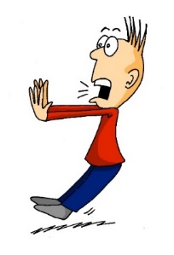
Phonetik
hören / sagen
o
o
wo?
Kopf
ö
ö
schön
plötzlich
Notes:
Timing: 1 minute Aim: To introduce/consolidate SSC long and short [o] and [ö] Procedure: 1. Present the letter(s) and say the [o] sound first, on its own. Students repeat it with you. 2. Bring up the source word ”wo?” on its own, say it, students repeat it, so that they have the opportunity to focus all of their attention on the connection between the written word and its sound.
3. A possible gesture for this would be to point out directly in front of you.
4. Repeat for the other three source words, with gesture suggestions as follows: short [o] – .
long [ö] – .
short [ö] - .
Word frequency (1 is the most frequent word in German): schön [164] zwölf [882] wo? [94] holen [640] Source: Jones, R.L. & Tschirner, E. (2006). A frequency dictionary of German: core vocabulary for learners. Routledge

Slide 35
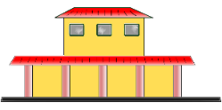
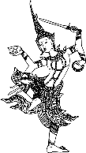
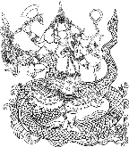
Phonetik
lesen / sprechen
Sag die Wörter.
 | Singular | Plural
1 | Wort | Wörter
2 | Chor | Chöre
3 | Bahnhof | Bahnhöfe
4 | Dorf | Dörfer
5 | Boden | Böden
6 | Kopf | Köpfe
7 | Gott | Götter
8 | Sohn | Söhne
1
[word]
_________
[words]
2
_________
3
_________
4
[village]
_________
[villages]
5
[floor]
_________
[floors]
6
_________
7
_________
8
_________
Notes:
Timing: 5 minutes Aim: Practise the phonetics of plural o → ö. Procedure: 1. Students can initially be asked to fill in the grid without any audio.
2. Clicking the buttons plays both the singular and plural words. Students write and/or check their written versions of the singular nouns.
3. Clicking reveals the singular nouns. 4. Students read aloud/pronounce all of the nouns in pairs, taking it in turns to say whichever the ‘matching’ plural or singular, depending on the word their partner says first.
Transcript:
1. Wort – Wörter
2. Chor – Chöre
3. Bahnhof – Bahnhöfe
4. Dorf – Dörfer
5. Boden – Böden
6. Kopf – Köpfe
7. Gott – Götter
8. Sohn - Söhne
Word frequency (1 is the most frequent word in German): Wort [194], Chor [>5000], Bahnhof [2027], Dorf [959], Boden [536], Kopf [250], Gott [514], Sohn [596] Source: Jones, R.L. & Tschirner, E. (2006). A frequency dictionary of German: core vocabulary for learners. Routledge

Slide 36
Phonetik
hören / sprechen
Welches Wort ist das? Schreib a-f und 1,2 oder 2,1.
[o]
[ö]
1 fordern [to encourage]
2 fördern [to promote]
a
__
__
2 Osten [East]
1 östlich [easterly]
b
__
__
2 Polen [Poland]
1 Pönale [penalty]
c
__
__
1 noch [still]
2 Nöck [water sprite]
d
__
__
2 flott [quick]
1 Flöte [flute]
e
__
__
1 Kode [code]
2 Köder [bait]
f
__
__
Notes:
Phonics Timing: 5 minutes Aim: To differentiate between pairs of words that differ primarily by one phoneme (one SSC that changes the meaning). These words are near-minimal pairs. Procedure: 1. Click to listen. 2. Write 1, 2 or 2, 1 depending on the order in which the words are spoken. 3. Click to see the answers.
4. Students can then partner up. Partner A reads one side aloud while partner B reads the other, word-by-word. They can then switch.
Transcript
fordern, fördern
östlich, Osten
Pönale, Polen
Noch, Nock
Flöte, flott
Kode, Köder
Word frequency (1 is the most frequent word in German): fordern [599], fördern [1089], Osten [1208], östlich [4883], Polen [2023], Pönale [>5000], noch [33], Nöck [>5000], flott [>5000], Flöte [>5000], Code [>5000], Köder [>5000] Source: Jones, R.L. & Tschirner, E. (2006). A frequency dictionary of German: core vocabulary for learners. Routledge

Slide 37
long and short [o]
Phonetik
Consolidation [6]
Y8 T2.1 Week 3 Slide 4

Slide 38
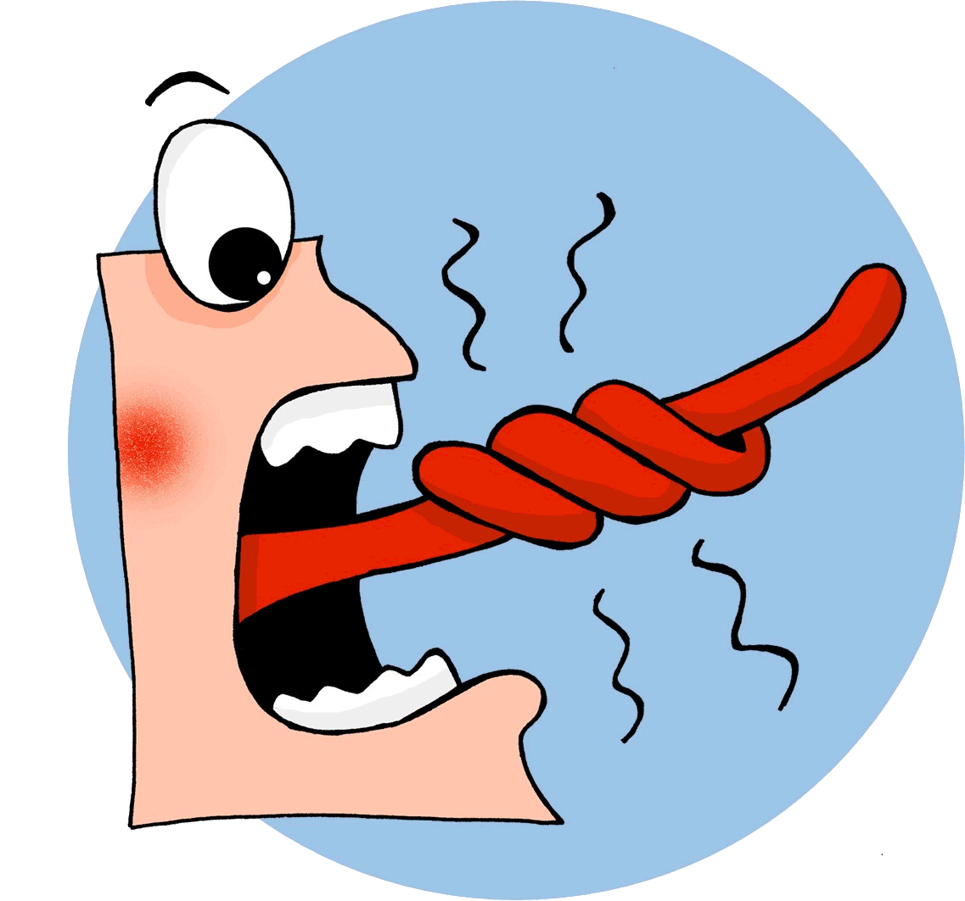
Phonetik
lesen / sprechen
Sag die Zungenbrecher.
15
3.
[o]
[ö]
Zwölf tolle Töchter mögen oft Obst holen.
Twelve great daughters often like fetching fruit.
holen
Sekunden
Töchter
zwölf
tolle
Obst
oft
mögen
0
langsamer
LOS!
Notes:
Transcript: Zwölf tolle Töchter* mögen oft Obst holen.
Word frequency of unknown words and cognates (1 is the most frequent word in German): Tochter [694] Source: Jones, R.L. & Tschirner, E. (2019). A frequency dictionary of German: core vocabulary for learners. Routledge

Slide 39
long and short [o]
Phonetik
Consolidation [7]
Y8 T2.2 Week 4 Slides 2; 3

Slide 40
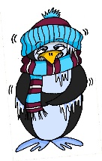
Phonetik
lesen / sprechen
Sag die Wörter. Wie viele enthalten die SSC?
[e]
[ch]
[s]
[o]
[a]
[ä]
denken
ich
sollen
Wo?
kalt
lächeln
 |  | ?
 | [e]
 | [ch]
 | [s]
 |  | ?
 | [o]
 | [a]
 | [ä]
eng – Bett – Weg
2
ohne – Telefon – Rock
2
reich – jedoch – einfach
1
alt – arm – normal
1
unser – langsam – alles
2
2
hängen – Aktivität – schnell
Notes:
Timing: 3 minutes Aim: A read aloud activity to revise 12 SSC (six explicitly, and six by contrast) using a range of new, revisited and unfamiliar vocabulary. Procedure: 1. Click on each individual SSC to hear it.
2. Elicit the source word from students, if remembered. Note that 4/6 these words have since been taught as key vocabulary (with sollen and lächeln to follow on the SOW)
3. Bring up the source words to check, and for reference for the read aloud activity.
4. Students pronounce the sets of three words, individually or in pairs, and decide how many contain the target SSC.
5. Optional – Click on the words to hear the sets of words pronounced. 6. Reveal the answers. 7. Optional – elicit the English meanings of the vocabulary.
Transcript:
eng – Bett – Weg
reich – jedoch – einfach
unser – langsam – alles
ohne – Telefon – Rock
alt – arm – normal
hängen – Aktivität – schnell
Word frequency of unknown words (1 is the most frequent word in German): hängen [580] Weg [220] Source: Jones, R.L. & Tschirner, E. (2019). A frequency dictionary of German: core vocabulary for learners. Routledge

Slide 41
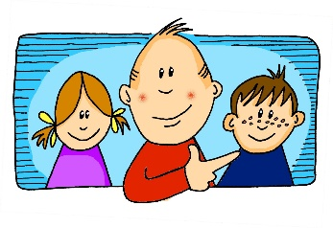
Phonetik
Hör zu. Schreib die Wörter. Wie viele enthalten die SSC?
hören / schreiben
[er-]
[-er]
[ei]
[j]
[z]
[o]
er
wieder
frei
ja
Zug
Kopf
 |  | ?
 | [er-]
 | [-er]
 | [ei]
 |  | ?
 | [j]
 | [z]
 | [o]
gern – erklären - unser
2
jung – jedoch - Jugendclub
3
alle – erzählen - anderer
1
kurz – unser - zwar
2
Kleid – weit - alleine
3
1
genau – Schloss - erlauben
Notes:
Timing: 7 minutes Aim: Transcription activity to revisit six further SSC, and to practise writing vocabulary from this week’s sets, as well as a few unknown words. As such, this is a hybrid phonics – vocabulary activity. Procedure: 1. Click on each individual SSC to hear it.
2. Elicit the source word from students, if remembered. Note that all of these words have also been taught as key vocabulary on the SOW.
3. Bring up the source words to check, and for reference for the read aloud activity.
4. Students listen to the sets of three words and transcribe them. 5. They decide how many words contain the target SSC.
6. Reveal the answers. 7. Optional – elicit the English meanings of the vocabulary.
Transcript: gern – erklären - unser
alle – erzählen - anderer
Kleid – weit – alleine
jung – jedoch – Jugendclub
kurz – unser - zwar
genau – Schloss - erlauben
Word frequency of unknown words (1 is the most frequent word in German): weit [230] zwar [227] Source: Jones, R.L. & Tschirner, E. (2019). A frequency dictionary of German: core vocabulary for learners. Routledge

Slide 42
long and short [o]
Phonetik
Consolidation [8]
Y9 T1.1 Week 2 Slides 4; 15

Slide 43
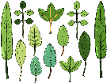
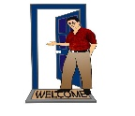
Phonetik
Hör zu. Ist der Buchstabe [a] oder [ä]? Schreibe die Wörter. Wie heißen sie auf Englisch?
hören / schreiben
 | [a] | [ä] | Deutsch | Englisch
 |  |  | Blätter | leaves
 |  |  | Arme | arms
 |  |  | Angriffe | attacks
 |  |  | Gäste | guests
 |  |  | Pläne | plans
 |  |  | Äpfel | apples
 |  |  | Wälder | forests
 |  |  | Fälle | cases
1
2
3
4
5
6
7
8
Notes:
Timing: 7 minutes Aim: to distinguish between [a] and [ä] in the aural modality. Transcribe unknown plurals. Procedure: 1. Click audio button 1. Students listen and indicate whether they hear [a] or [ä].
2. Click for tick to appear in correct column.
3. Click audio again and students transcribe the word they hear. Hopefully when looking at what they have written, students will recognise the plurals of previously taught singular nouns.
4. Click to reveal answer – German transcription.
5. Students then write the English meaning.
6. Click to reveal answer – an image will appear at the same time.
7. Repeat for 2 – 4. For 5 – 8, depending on level of the class, possibly only play the audio once, students tick [a] / [ä] and transcribe at the same time.
8. When all times 1 – 8 have been ‘done’, students read the words aloud with a partner.
Word frequency (1 is the most frequent word in German):
Apfel [3491] Fall [188] Plan [955] Source: Jones, R.L. & Tschirner, E. (2019). A frequency dictionary of German: core vocabulary for learners. Routledge

Slide 44
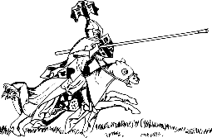
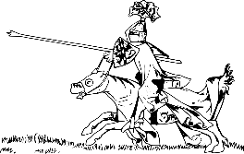
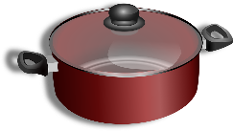
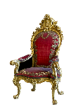
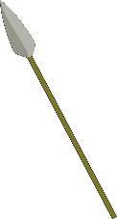
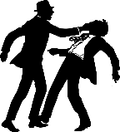
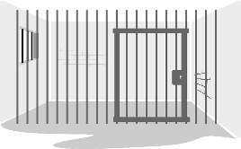
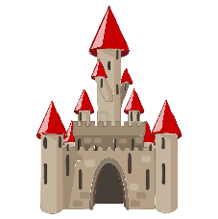
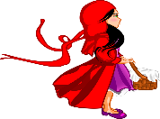
Phonetik
hören / schreiben
Person A liest die Wörter, Person B schreibt auf. Dann tauscht die Rollen.
6 Wörter – Person A liest:
6 Wörter – Person B liest:
1. Lanzen
1. Töpfe
2. Throne
2. Kronen
3. Rösser
3. Waffen
4. Kämpfe
4. Stäbe
5. Gewänder
5. Wassergräben
6. Schlösser
6. Köpfe
Notes:
Timing: 5 minutes Aim: to read aloud to practise spoken production of a, ä, o, ö. Procedure: 1. Partner B turns away from the board.
2. Click to make the words and images appear for Person A to read out. Person B writes down what Person A says.
3. When all 6 words have been read and transcribed, Person B turns back to the board, and together with Person A, checks their spelling.
4. Students work out meaning of the words using the images as clues – they may need help with this.
5. Swap roles and follow procedure 1 – 5 for the second set of six words.
Word frequency of unknown words (1 is the most frequent word in German): Lanze [>5009] Thron [>5009] [4962] Ross [>5009] Kampf [867] Gewand [>5009] Topf [4136] Krone [3743] Waffe [1625] Stab [>5009] Wassergraben [>5009]

