Slide 1
German phonics collection
[kn]
Artwork: Steve Clarke
Date updated: 10 / 02 / 21
Notes:
Artwork by Steve Clarke. All additional pictures selected are available under a Creative Commons license, no attribution required.

Slide 2
[kn]
Phonetik
Introduction
Y7 T3.1 Week 3 Slides 30-32

Slide 3
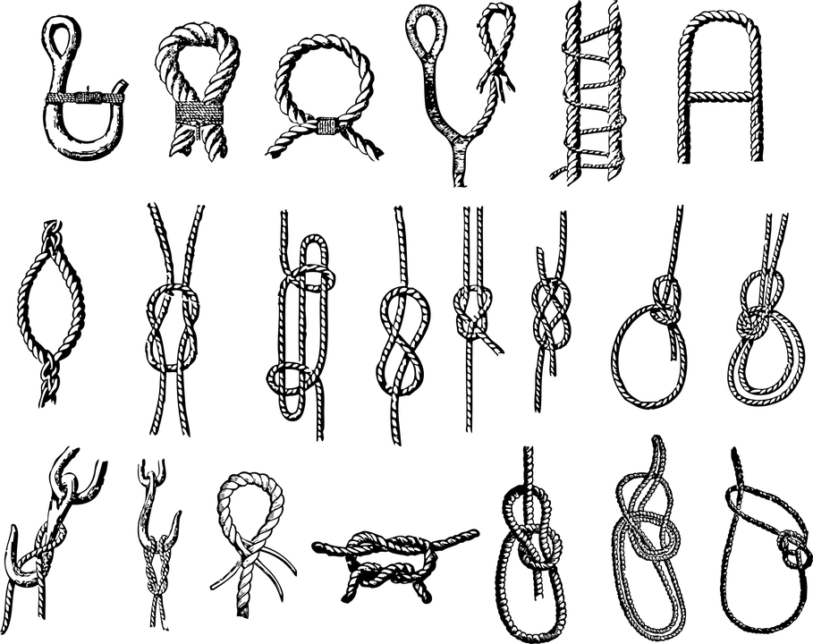
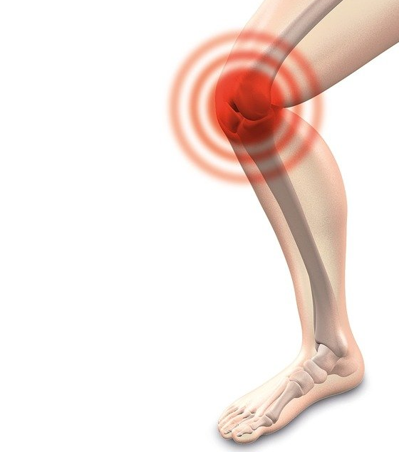
Phonetik
[kn]
hören / sprechen
In English the k in words starting with kn (e.g. knee, knot) is silent.
In German the k is pronounced, (K-nie, K-noten).
das Knie
der Knoten
Notes:
Timing: 1 minute
Aim: To introduce SSC [kn]
Procedure:
Introduce and elicit the pronunciation of the individual SSC [kn] and then the source word again ‘und’ (with gesture, if using).
Then present and elicit the pronunciation of the two words with [kn] – Knie, Knoten.
Word frequency (1 is the most frequent word in German): Knie [1680], Knoten [2607]
Source: Jones, R.L. & Tschirner, E. (2006). A frequency dictionary of German: core vocabulary for learners. Routledge

Slide 4
Wie sagt man das?
hören
1
[kn]
[pf]
2
beide
Pflicht
3
_ _ _ _ _ _ _ [duty]
knapp
4
_ _ _ _ _ [tight]
Knopf
_ _ _ _ _ [button]
Pfarrer
_ _ _ _ _ _ _ [priest]
5
Knall
_ _ _ _ _ [boom]
knüpfen
6
_ _ _ _ _ _ _ [to knot]
pfeifen
_ _ _ _ _ _ _ [to whistle]
7
Knochen
_ _ _ _ _ _ _ [bone]
8
Pfeil
_ _ _ _ _ [arrow]
9
Notes:
Timing: 5 minutes
Aim: To practise transcribing SSC [kn] and [pf].
Procedure:
Draw the Venn diagram.
Listen to each word. Organise the words into one three categories.
Note: Sometimes students will need to write them down and read them before they can decide where to place them, so encourage them to do this.
Do the first one as an example with the class.
Differentiation: If teachers want to make the task more straightforward, then can add additional letters in to each word (e.g. the vowels).
Transcript (with English meanings given in brackets): Knopf (button) Pflicht (duty) knapp (tight) Knall (boom) knüpfen (to knot) Pfarrer (priest) pfeifen (to whistle) Knochen (bone) Pfeil (arrow)
Word frequency of unknown words and cognates (1 is the most frequent word in German):
Knall [4659] knapp [639] Knochen [1931] Knopf [4357] knüpfen [4864] Pfarrer [3566] pfeifen [4545] Pfeil [4266] Pflicht [2048]
Source: Jones, R.L. & Tschirner, E. (2019). A frequency dictionary of German: core vocabulary for learners. Routledge

Slide 5
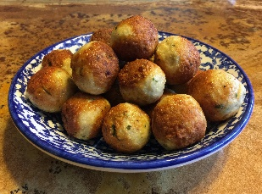
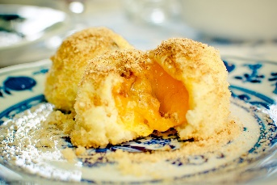
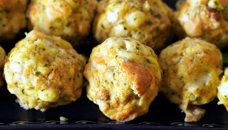
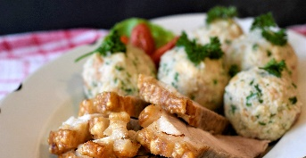
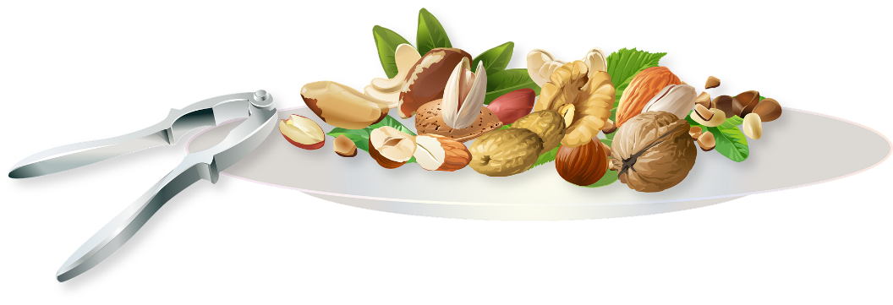
Phonetik
sprechen / hören
1
Klaus Knopf liebt Knödel, Klöße, Klöpse. Knödel, Klöße, Klöpse liebt Klaus Knopf.
2
3
1
Kleine Nussknacker knacken knackig. Knackiger knacken große Nussknacker.
2
3
Notes:
Timing: 4 mins (two slides)
Aim: to gain confidence in producing the SSCs [kn] and [pf] in a range of words.
Procedure:
The teacher reveals the words, allowing students to read them out loud one by one.
The teachers asks students to say what they think the sentence means, explaining that Knödel, Klöße are dumplings (both savoury and sweet) and Klopse are the equivalent of meatballs, that there are many different varieties in German and Austrian cuisine. You might bring students’ attention to the inverted word order of the 2nd sentence. Subject and object have swapped places. This gives a little emphasis to the dumplings in the 2nd sentence, but is mostly to increase the challenge of the tongue twister.
Students then practise saying the full tongue twister in pairs, at increasing speed.
The teacher can get students listen to a native speaker read the sentence at three different speeds (1=slow; 3=very fast). Each time, students can be challenged to say it themselves at the same speed.
There is a 2nd tongue twister for use, if desired.
Transcript
Klaus Knopf liebt Knödel, Klöße, Klöpse. Knödel, Klöße, Klöpse liebt Klaus Knopf. Kleine Nussknacker knacken knackig. Knackiger knacken große Nussknacker.
Word frequency of unknown words and cognates (1 is the most frequent word in German):
knacken [4657] Knopf [4357] Knödel [>5009] Kloß [>5009] Klops [>5009] Knacker [>5009] Nuss [>5009] knackig [>5009]
Source: Jones, R.L. & Tschirner, E. (2019). A frequency dictionary of German: core vocabulary for learners. Routledge

Slide 6
[kn]
Phonetik
Consolidation [1]

Slide 7
[kn]
Phonetik
Consolidation [2]

