Slide 1
German phonics collection
[j]
Artwork: Steve Clarke
Date updated: 21 / 07 / 21
Notes:
Artwork by Steve Clarke. All additional pictures selected are available under a Creative Commons license, no attribution required.

Slide 2
[j]
Phonetik
Introduction
Y7 T3.2 Week 1 Slides 2-9

Slide 3
j
ja
Notes:
Timing: 1 minute
Aim: To introduce/consolidate SSC [j]
Procedure: 1. Present the letter(s) and say the [j] sound first, on its own. Students repeat it with you. 2. Bring up the word ”ja” on its own, say it, students repeat it, so that they have the opportunity to focus all of their attention on the connection between the written word and its sound.
3. A possible gesture for this would be to mime yes by nodding your head quickly twice, as you say ‘ja’.
4. Roll back the animations and work through 1-3 again, but this time, dropping your voice completely to listen carefully to the students saying the [j] sound, pronouncing ”ja” and, if using, doing the gesture. Word frequency (1 is the most frequent word in German): ja [27]
Source: Jones, R.L. & Tschirner, E. (2006). A frequency dictionary of German: core vocabulary for learners. Routledge

Slide 4
j
ja
Notes:
With sound and no pictures to focus all attention on the sound-symbol correspondence.

Slide 5
j
ja
Notes:
Without sound to elicit pronunciation (without first hearing the teacher).
Teacher to elicit pronunciation by asking “Wie sagt man…”

Slide 6
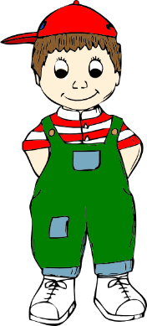
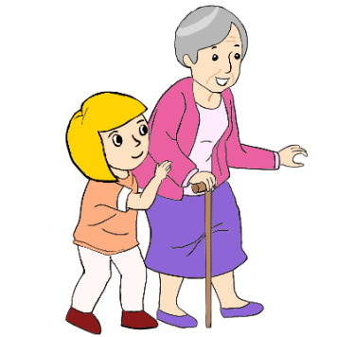
j
Junge
Jahr
2019
ja
jung
jemand
[someone]
jetzt
[now]
Notes:
Timing: 2 minutes
Aim: To introduce/consolidate SSC [j]
Procedure:
Introduce and elicit the pronunciation of the individual SSC [j] and then the source word again ‘ja’ (with gesture, if using).
Then present and elicit the pronunciation of the five cluster words.
The cluster words have been chosen for their high-frequency, from a range of word classes, with the SSC (where possible) positioned within a variety of syllables within the words (e.g. initial, 2nd, final etc.). Additionally, we have tried to use words that build cumulatively on previously taught SSCs (see the Phonics Teaching Sequence document) and do not include new SSCs. Where new SSCs are used, they are often consonants which have a similar symbol-sound correspondence in English.
Word frequency (1 is the most frequent word in German): ja [27]; Junge [630] Jahr [51]; jemand [397]; jetzt [62]; jung [184]. Source: Jones, R.L. & Tschirner, E. (2006). A frequency dictionary of German: core vocabulary for learners. Routledge

Slide 7
j
Junge
Jahr
ja
jung
jemand
jetzt
Notes:
With sound and no pictures to focus all attention on the sound-symbol correspondence.

Slide 8
j
Junge
Jahr
ja
jung
jemand
jetzt
Notes:
Without sound to elicit pronunciation (without first hearing the teacher).
Teacher to elicit pronunciation by asking “Wie sagt man…”

Slide 9
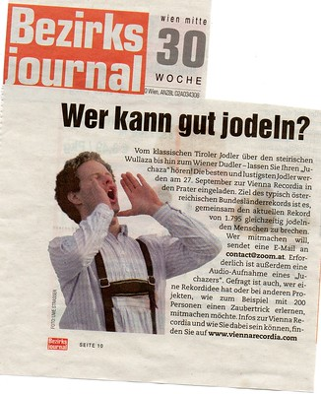
Wie sagt man das?
hören
Some German words starting with [j] come from other languages.
Some are like English words starting with ‘Y’. Others are pronounced with an English ‘J’ sound.
German ‘J’
English ‘J’
1
7
ja
English ‘Y’
Jeans
2
8
Jacht
Job
Junge
3
9
Jo-Jo
Jazz
4
10
jeden Tag
Joghurt
5
11
jodeln
joggen
jetzt
6
12
Notes:
Timing: 8 minutes
Aim: To focus on the pronunciation of [j] in German words of foreign origin.
Note: There is a less challenging version of this task, with picture prompts, on the following slide.
Procedure: 1. In this exercise, students listen and organise the words they hear into the three categories. Sometimes students will need to write them down and read them before they can decide where to place them, so encourage them to do this. 2. The first one can be done as an example with the class. It is one of the trickier ones. Tell students there are four words in each category, and that the four German ‘J’ words are known to them already.
Note: students may not recognise ‘yodel’. Give them a definition and context, e.g., yodelling started off as a form of communication between people living in remote mountain locations. The quick modulations from normal to falsetto (high) voice make the sound carry for long distances. Click for an image. Click on the player to hear an example of recreational yodelling from a Stammtisch in Graz, Austria (48 seconds). Tell students that Stammtisch (lit. regular table) is a general word for a regular (usually weekly) meeting of a group of friends often for the pursuit a particular hobby.
Transcript (with English meanings given in brackets): Jacht (yacht) Jeans (jeans) ja (yes) Junge (boy) Jo-Jo (yo-yo) Joghurt (yoghurt) Job (job) Jazz (jazz) jeden Tag (every day) joggen (jogging) jetzt (now)
jodeln (yodel)
Word frequency (1 is the most frequent word in German): Jacht[>4034], Jeans [4942 (2019 list)]; ja[27]; Junge [630]; Jo-Jo [>4034]; Joghurt [>4034]; Job [1090]; Jazz [3467]; jeden Tag[88/108]; joggen [>4034]; jetzt [62] jodeln [>4034]
Source: Jones, R.L. & Tschirner, E. (2006). A frequency dictionary of German: core vocabulary for learners. Routledge.

Slide 10
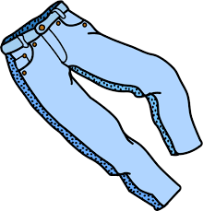
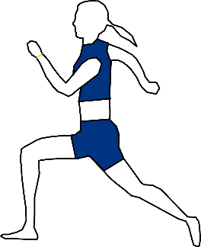
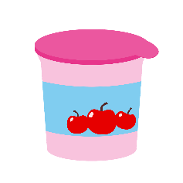
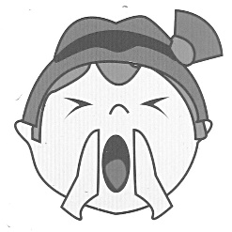
Wie sagt man das?
hören
Some German words starting [j] come from other languages.
Some are like English words starting with ‘Y’. Others are pronounced with an English ‘J’.
German ‘J’
English ‘J’
1
7
10. joggen
2. Jeans
3. ja
4. Junge
English ‘Y’
2
8
5. Jo-Jo
1. Jacht
3
9
8. Jazz
6. Joghurt
4
10
11. jetzt
7. Job
[now]
5
11
9. jeden Tag
12. jodeln
[every day]
6
12
Notes:
Timing: 8 minutes
Aim: To focus on the pronunciation of [j] in German words of foreign origin.
Note: There is a more challenging version of this task, without picture prompts, on the previous slide.
Procedure: 1. In this exercise, students listen and organise the words they hear into the three categories. They can simply write the number into the correct part of the Venn OR they can also try to write the full word (or a mixture). Sometimes students will need to write them down and read them before they can decide where to place them, so encourage them to do this. 2. The first one can be done as an example with the class. It is one of the trickier ones. Tell students there are four words in each category, and that the four German ‘J’ words are known to them already.
Note: students may not recognise ‘yodel’. Give them a definition and context, e.g., yodelling started off as a form of communication between people living in remote mountain locations. The quick modulations from normal to falsetto (high) voice make the sound carry for long distances. Click for an image. Click on the player to hear an example of recreational yodelling from a Stammtisch in Graz, Austria (48 seconds). Tell students that Stammtisch (lit. regular table) is a general word for a regular (usually weekly) meeting of a group of friends often for the pursuit a particular hobby.
Transcript (with English meanings given in brackets): Jacht (yacht) Jeans (jeans) ja (yes) Junge (boy) Jo-Jo (yo-yo) Joghurt (yoghurt) Job (job) Jazz (jazz) jeden Tag (every day) joggen (jogging) jetzt (now)
jodeln (yodel)
Word frequency (1 is the most frequent word in German): Jacht[>4034], Jeans [4942 (2019 list)]; ja[27]; Junge [630]; Jo-Jo [>4034]; Joghurt [>4034]; Job [1090]; Jazz [3467]; jeden Tag[88/108]; joggen [>4034]; jetzt [62] jodeln [>4034]
Source: Jones, R.L. & Tschirner, E. (2006). A frequency dictionary of German: core vocabulary for learners. Routledge.

Slide 11
[j]
Phonetik
Consolidation [1]
Y7 T3.2 Week 6 Slide 20

Slide 12
Wie heißt die Band?
Phonetik
Alastair telefoniert mit Mia. Sie reden über deutsche Bands. Wie heißen sie?
 | die P r i n z e n
 | J u l i
 | F e t t e s B r o t
 | die F a n t a s t i s c h e n V i e r
 | S ö h n e M a n n h e i m s
 | S p o r t f r e u n d e S t i l l e r
 | R o s e n s t o l z
 | die Ä r t z e
1
_
2
_
3
_
_
4
_
_
_
_
_
5
_
_
_
6
_
_
_
_
7
_
_
8
_
_
Notes:
Phonetik [1] Time: 5 minutes
Aim: To practise recognising and transcribing 14 previously taught SSC, in unknown words.
Note: These are real German band names.
Procedure: 1. Click number to hear the full word. Students listen and transcribe only the missing letters. 2. Animations support item-by-item checking, as instant feedback on each SSC may be particularly helpful for students’ learning. SSC revisited here: [z] [j] [r-consonantal] [o-long] [sch] [v] [r-vocalic] [ö-long] [ei] [st] [-er] [st] [ä] [-e]
Transcript: [1] die Prinzen
[2] Juli
[3] Fettes Brot
[4] die Fantastischen Vier
[5] Söhne Mannheims
[6] Sportfreunde Stiller
[7] Rosenstolz
[8] die Ärzte

Slide 13
[j]
Phonetik
Consolidation [2]
Y8 T2.2 Week 4 Slide 3

Slide 14
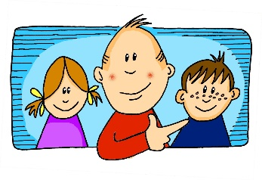
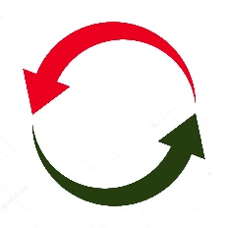
Phonetik
Hör zu. Schreib die Wörter. Wie viele enthalten die SSC?
hören / schreiben
[er-]
[-er]
[ei]
[j]
[z]
[o]
er
wieder
frei
ja
Zug
Kopf
 |  | ?
 | [er-]
 | [-er]
 | [ei]
 |  | ?
 | [j]
 | [z]
 | [o]
gern – erklären - unser
2
jung – jedoch - Jugendclub
3
alle – erzählen - anderer
1
kurz – unser - zwar
2
Kleid – weit - alleine
3
1
genau – Schloss - erlauben
Notes:
Timing: 7 minutes Aim: Transcription activity to revisit six further SSC, and to practise writing vocabulary from this week’s sets, as well as a few unknown words. As such, this is a hybrid phonics – vocabulary activity. Procedure: 1. Click on each individual SSC to hear it.
2. Elicit the source word from students, if remembered. Note that all of these words have also been taught as key vocabulary on the SOW.
3. Bring up the source words to check, and for reference for the read aloud activity.
4. Students listen to the sets of three words and transcribe them. 5. They decide how many words contain the target SSC.
6. Reveal the answers. 7. Optional – elicit the English meanings of the vocabulary.
Transcript: gern – erklären - unser
alle – erzählen - anderer
Kleid – weit – alleine
jung – jedoch – Jugendclub
kurz – unser - zwar
genau – Schloss - erlauben
Word frequency of unknown words (1 is the most frequent word in German): weit [230] zwar [227] Source: Jones, R.L. & Tschirner, E. (2019). A frequency dictionary of German: core vocabulary for learners. Routledge

Slide 15
[j]
Phonetik
Consolidation [3]
Y9 T3.2 Week 5 Slide 19

Slide 16
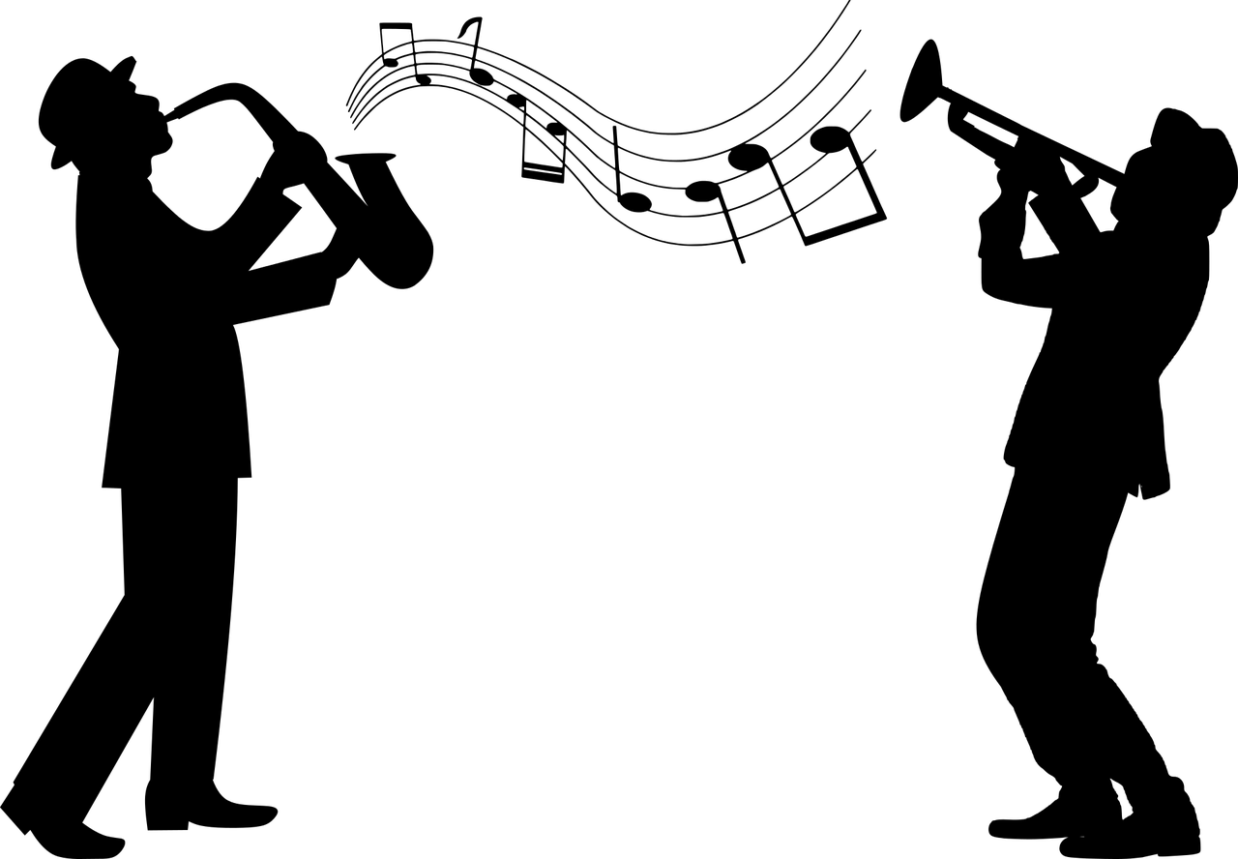
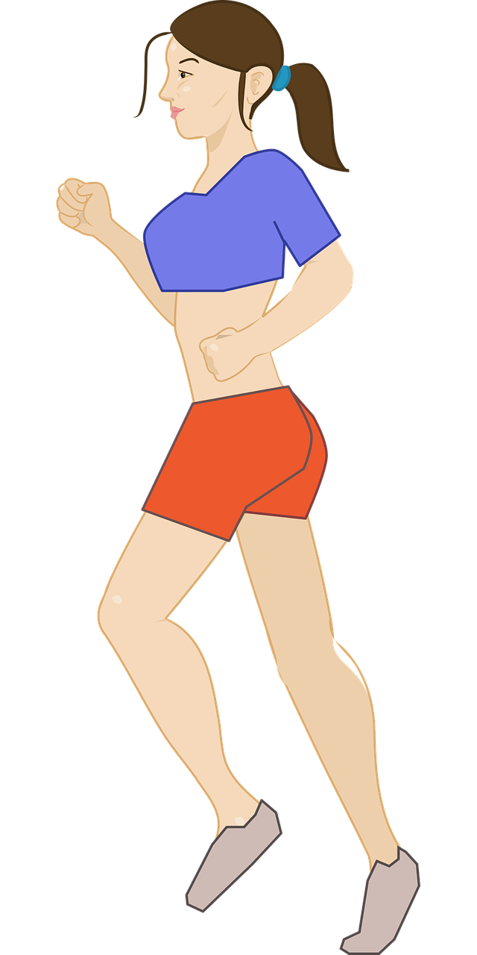
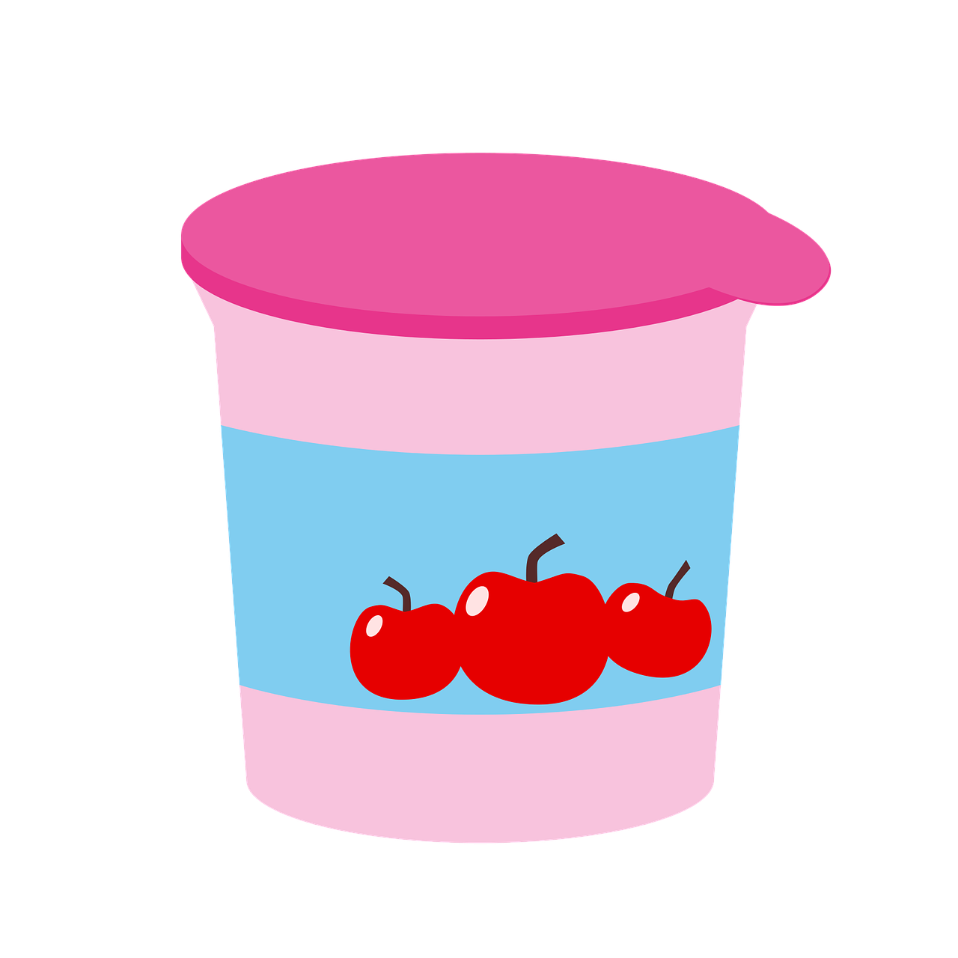
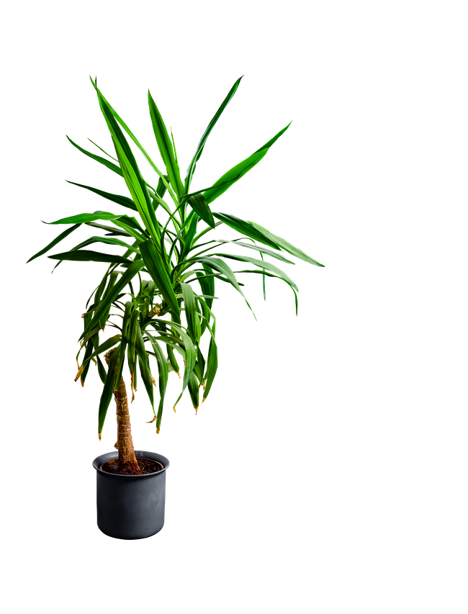
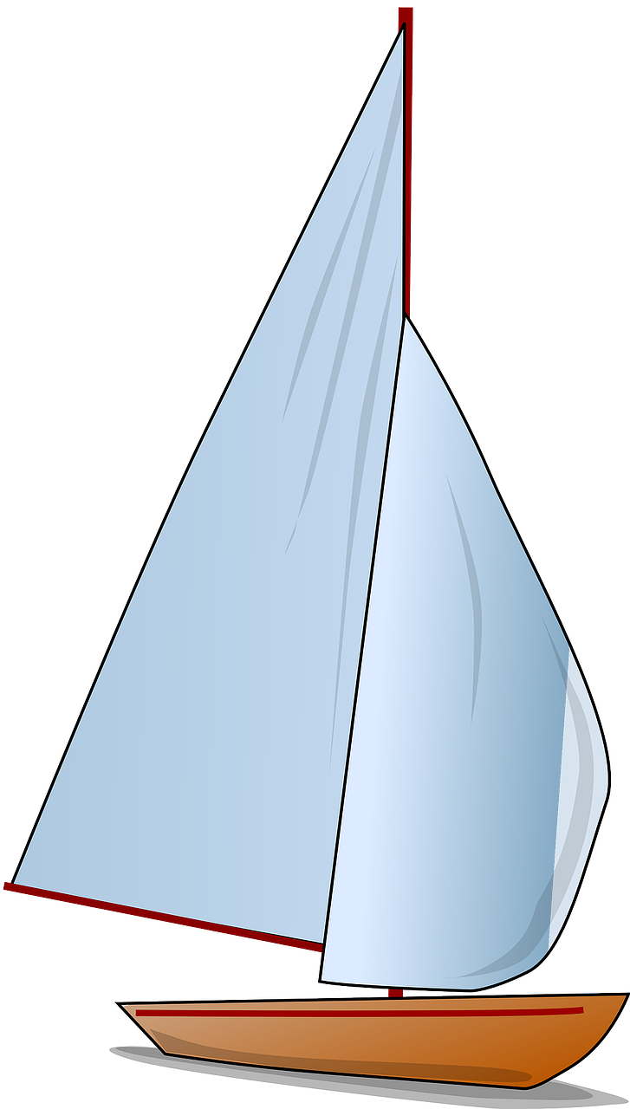
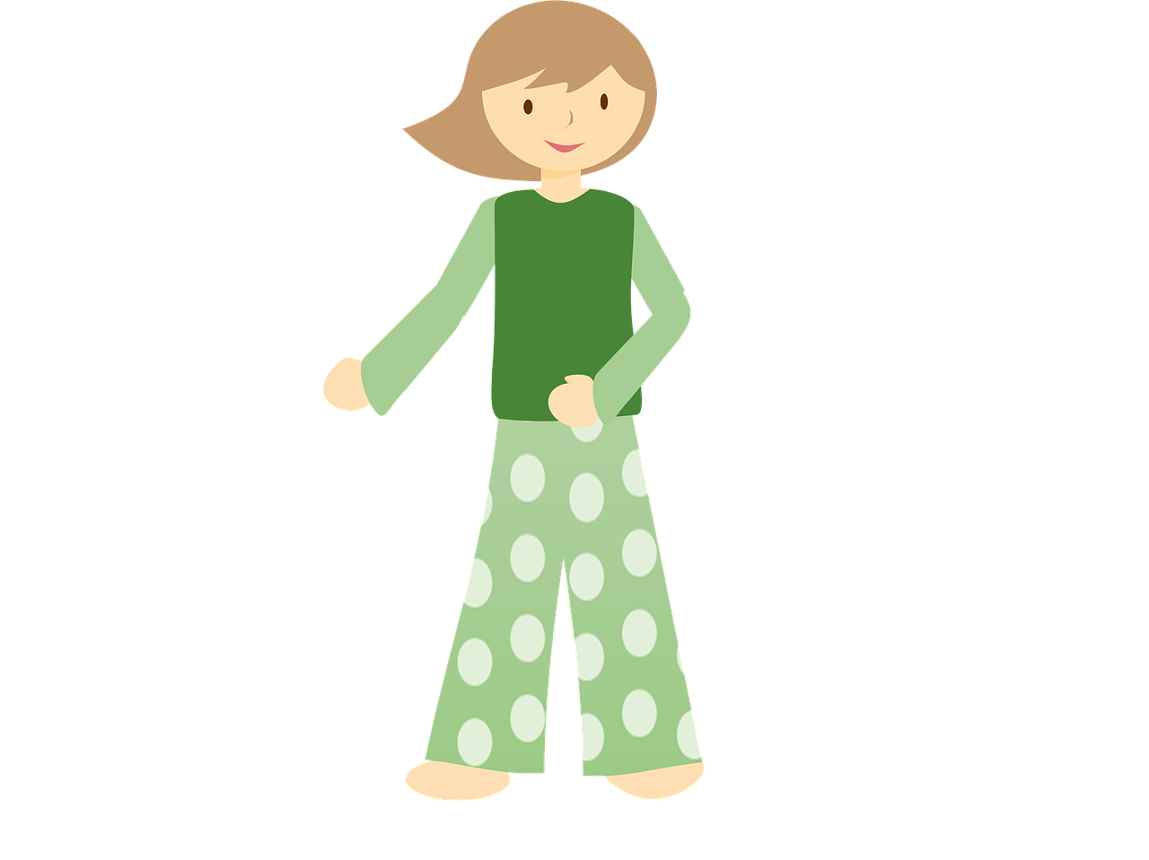
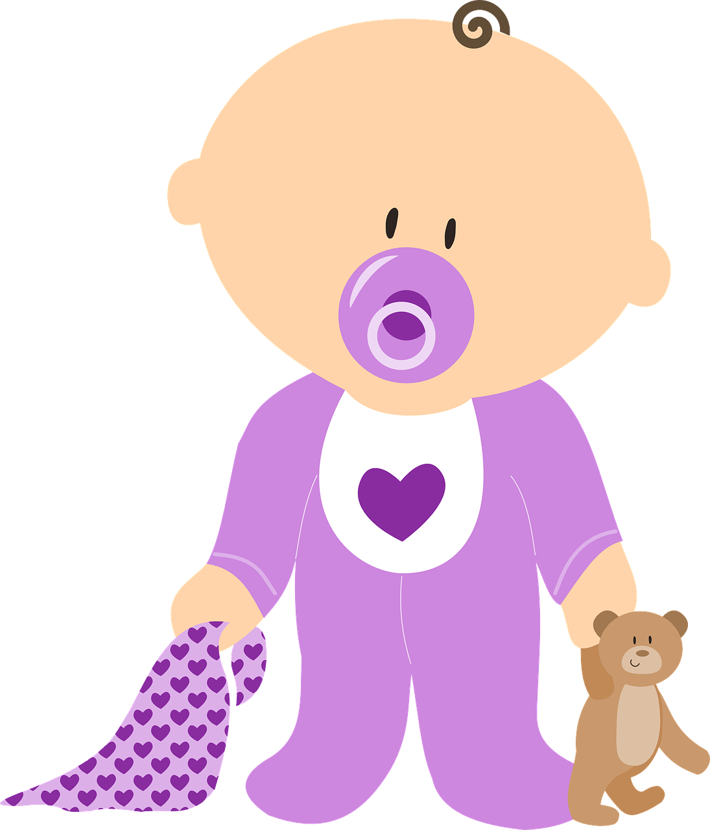
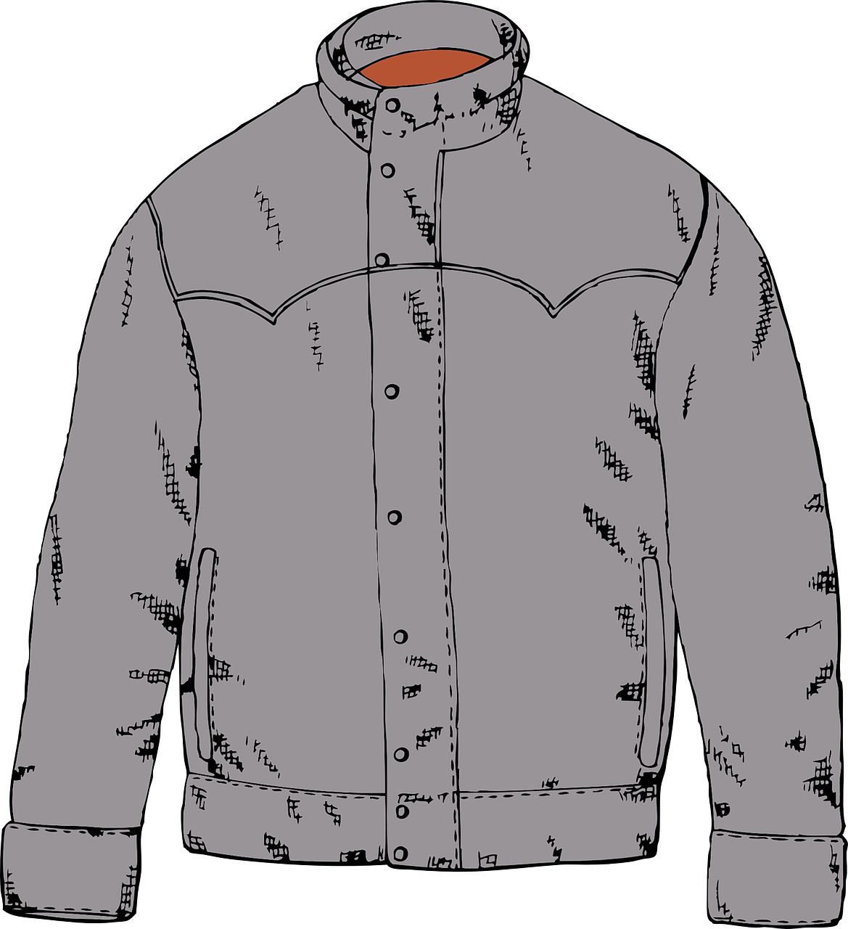
Mein Buch
Worüber lese ich?
Phonetik
Was passt nicht? Schreib 1-6 und A, B oder C.
 | A | B | C
 | Jazz | Jahr | Joggen
 | Joghurt | Hobby | Yoga
 | Pyjama | Yucca | Jacht
 | Baby | Hymne | Physik
 | Jacke | Jeans | Jemand
 | Jubeln | Projekt | Typisch
1
2
3
4
5
6
Notes:
Timing: 5 minutes Aim: to revise the different ways [j] and [y] can be pronounced. Procedure: 1. Students write 1-6 and choose which book topic (A-C) is the odd one out in each set, based on the pronunciation of the letters in bold.
2. Students say the words to each other in pairs to check their answers.
3. Click to reveal the answers, eliciting the correct pronunciations.
4. Ensure the English meanings of the words are understood.
Word frequency (1 is the most frequent word in German): Yoga [>5009] Joggen [>5009] Joghurt [>5009] Jazz [>5009] Pyjama [>5009] Yucca [>5000] Jacht [>5009] Baby [2297] Hymne [>5009] Jeans [4942] jubeln [>5009] Source: Jones, R.L. & Tschirner, E. (2019). A frequency dictionary of German: core vocabulary for learners. Routledge

