Slide 1
German phonics collection
[-ig]
Artwork: Steve Clarke
Date updated: 24 / 07 / 21
Notes:
Artwork by Steve Clarke. All additional pictures selected are available under a Creative Commons license, no attribution required.

Slide 2
[-ig]
Phonetik
Introduction
Y7 T3.1 Week 6 Slides 2-8

Slide 3
-ig
richtig
Notes:
Timing: 1 minute
Aim: To introduce/consolidate SSC [-ig]
Procedure: 1. Present the letter(s) and say the [-ig] sound first, on its own. Students repeat it with you. 2. Bring up the word ”richtig” on its own, say it, students repeat it, so that they have the opportunity to focus all of their attention on the connection between the written word and its sound.
3. A possible gesture for this would be to mime ‘correct’ by tracing a tick in the air with the index finger on your right hand.
4. Roll back the animations and work through 1-3 again, but this time, dropping your voice completely to listen carefully to the students saying the [-ig] sound, pronouncing ”richtigi” and, if using, doing the gesture. Word frequency (1 is the most frequent word in German): richtig [211]
Source: Jones, R.L. & Tschirner, E. (2006). A frequency dictionary of German: core vocabulary for learners. Routledge

Slide 4
-ig
richtig
Notes:
With sound and no pictures to focus all attention on the sound-symbol correspondence.

Slide 5
-ig
richtig
Notes:
Without sound to elicit pronunciation (without first hearing the teacher).
Teacher to elicit pronunciation by asking “Wie sagt man…”

Slide 6
-ig
notwendig
wichtig
[necessary]
[important]
richtig
fertig
wenig
[ready, finished]
Schwierigkeit
[little / not very much]
[difficulty]
Notes:
Timing: 2 minutes
Aim: To introduce/consolidate SSC [-ig]
Procedure:
Introduce and elicit the pronunciation of the individual SSC [-ig] and then the source word again ‘richtig’ (with gesture, if using).
Then present and elicit the pronunciation of the five cluster words.
The cluster words have been chosen for their high-frequency, from a range of word classes, with the SSC (where possible) positioned within a variety of syllables within the words (e.g. initial, 2nd, final etc.). Additionally, we have tried to use words that build cumulatively on previously taught SSCs (see the Phonics Teaching Sequence document) and do not include new SSCs. Where new SSCs are used, they are often consonants which have a similar symbol-sound correspondence in English.
Word frequency (1 is the most frequent word in German): richtig [211]; notwendig [168] wichtig [177]; fertig [717]; Schwierigkeit [866]; wenig [102]. Source: Jones, R.L. & Tschirner, E. (2006). A frequency dictionary of German: core vocabulary for learners. Routledge

Slide 7
-ig
notwendig
wichtig
richtig
fertig
wenig
Schwierigkeit
Notes:
With sound and no pictures to focus all attention on the sound-symbol correspondence.

Slide 8
-ig
notwendig
wichtig
richtig
fertig
wenig
Schwierigkeit
Notes:
Without sound to elicit pronunciation (without first hearing the teacher).
Teacher to elicit pronunciation by asking “Wie sagt man…”

Slide 9
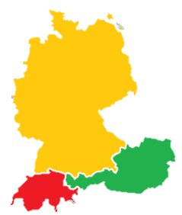
Phonetik
hören
Es gibt viele Dialekte in Deutschland, Österreich und der Schweiz!
In Norddeutschland
sagt man:
In Süddeutschland, Österreich und der Schweiz sagt man:
1
-ig wie [ich]
1
-ig wie [ik]
D
2
wichtig
2
wichtig
3
fertig
Ö
3
fertig
S
4
wenig
4
wenig
Notes:
Opportunity to introduce students to the idea of regional variation in the DACH countries.
Frequency rankings of unknown vocabulary: Dialekt [2993], Nord- [1204], Süd- [1534]

Slide 10
[-ig]
Phonetik
Consolidation [1]
Y8 T1.2 Week 6 Slides 17-25

Slide 11
-ig
richtig
Notes:
Timing: 1 minute
Aim: To introduce/consolidate SSC [-ig]
Procedure: 1. Present the letter(s) and say the [-ig] sound first, on its own. Students repeat it with you. 2. Bring up the word ”richtig” on its own, say it, students repeat it, so that they have the opportunity to focus all of their attention on the connection between the written word and its sound.
3. A possible gesture for this would be to mime ‘correct’ by tracing a tick in the air with the index finger on your right hand.
4. Roll back the animations and work through 1-3 again, but this time, dropping your voice completely to listen carefully to the students saying the [-ig] sound, pronouncing ”richtigi” and, if using, doing the gesture. Word frequency (1 is the most frequent word in German): richtig [211]
Source: Jones, R.L. & Tschirner, E. (2006). A frequency dictionary of German: core vocabulary for learners. Routledge

Slide 12
-ig
richtig
Notes:
With sound and no pictures to focus all attention on the sound-symbol correspondence.

Slide 13
-ig
richtig
Notes:
Without sound to elicit pronunciation (without first hearing the teacher).
Teacher to elicit pronunciation by asking “Wie sagt man…”

Slide 14
-ig
notwendig
wichtig
[necessary]
[important]
richtig
fertig
wenig
[ready, finished]
Schwierigkeit
[little / not very much]
[difficulty]
Notes:
Timing: 2 minutes
Aim: To introduce/consolidate SSC [-ig]
Procedure:
Introduce and elicit the pronunciation of the individual SSC [-ig] and then the source word again ‘richtig’ (with gesture, if using).
Then present and elicit the pronunciation of the five cluster words.
The cluster words have been chosen for their high-frequency, from a range of word classes, with the SSC (where possible) positioned within a variety of syllables within the words (e.g. initial, 2nd, final etc.). Additionally, we have tried to use words that build cumulatively on previously taught SSCs (see the Phonics Teaching Sequence document) and do not include new SSCs. Where new SSCs are used, they are often consonants which have a similar symbol-sound correspondence in English.
Word frequency (1 is the most frequent word in German): richtig [211]; notwendig [168] wichtig [177]; fertig [717]; Schwierigkeit [866]; wenig [102]. Source: Jones, R.L. & Tschirner, E. (2006). A frequency dictionary of German: core vocabulary for learners. Routledge

Slide 15
-ig
notwendig
wichtig
richtig
fertig
wenig
Schwierigkeit
Notes:
With sound and no pictures to focus all attention on the sound-symbol correspondence.

Slide 16
-ig
notwendig
wichtig
richtig
fertig
wenig
Schwierigkeit
Notes:
Without sound to elicit pronunciation (without first hearing the teacher).
Teacher to elicit pronunciation by asking “Wie sagt man…”

Slide 17
Phonetik [–ig] [1/3]
hören
Es gibt viele Dialekte in Deutschland, Österreich und der Schweiz!
In Norddeutschland
sagt man:
In Süddeutschland, Österreich und der Schweiz sagt man:
-ig wie [ich]
-ig wie [ik]
D
wichtig
wichtig
fertig
Ö
fertig
S
wenig
wenig
Notes:
Timing: 2 minutes Aim: A reminder to students of regional variation in the DACH countries, with respect to this SSC. It prepares the ground for the learning on the next slide, too.
Procedure: 1. Click through animations and play the sounds. Word frequency (1 is the most frequent word in German): Dialekt [2993], Nord- [1204], Süd- [1534]

Slide 18
Phonetik [–ig] [2/3]
Sag die Wörter.
hören
German [-ig] usually occurs at the end of a word. Whether you pronounce it with [ch] or [k] you don’t use your vocal chords.
However, adding additional letters to adjectives ending in [-ig] changes its sound to a voiced [g].
Compare:
1
Das ist richtig!
Das ist eine richtige Antwort!
2
Notes:
Timing: 30 seconds Aim: To explain the difference between [-ig] and [-ig-] and prepare students for the next practice task.

Slide 19
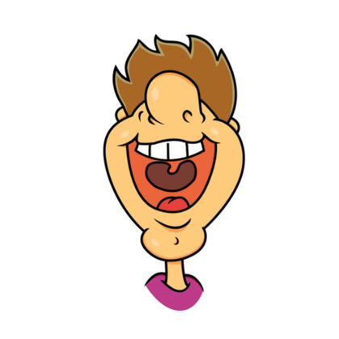
Phonetik [–ig] [3/3]
lesen / sprechen
Sag die Satzteile auf Deutsch.
Sag die Wörter.
richtig | eine richtige Idee | a right idea
wichtig | ein wichtiges Ziel | an important goal
schwierig | ein schwieriges Spiel | a difficult game
freiwillig | eine freiwillige Person | a willing person
ruhig | ein ruhiger Platz | a quiet square
langweilig | ein langweiliger Mann | a boring man
traurig | eine traurige Frau | a sad woman
riesig | ein riesiges Stück | a huge piece
_________
1
Remember! The adjective ending depends on the gender and case of the noun. (Here, R1-nominative)
_________
2
_________
3
_________
4
_________
5
_________
6
7
_________
8
_________
Notes:
Timing: 3 minutes Aim: Practise the different forms of [-ig] and recall adjective endings (R1 – nominative) with indefinite articles, together with revisited vocabulary from Y7. Procedure: 1. Students partner up and take turns to pronounce the words. First they pronounce the adjectives on their own, and then the phrases, inserting the adjective with the correct ending (which changes the sound of the [g]). The images appear to remind students that the [-ig] in adjectives alone are unvoiced (do not use the vocal chords) but the [-ig-] within a word, i.e. once there is an adjective ending as occurs with prenominal adjectives, the sound of the [g] changes to a voiced [g].
Transcript: eine richtige Idee ein wichtiges Ziel ein schwieriges Spiel eine freiwillige Person ein ruhiger Platz ein langweiliger Mann eine traurige Frau ein riesiges Stück Word frequency (1 is the most frequent word in German): Platz [344], Stück [417] Spiel [500] Ziel [325] richtig [211] freiwillig [1718] wichtig [177] schwierig [471] langweilig [2921] ruhig [905] traurig [1871]
riesig [1075] Source: Jones, R.L. & Tschirner, E. (2006). A frequency dictionary of German: core vocabulary for learners. Routledge

Slide 20
[-ig]
Phonetik
Consolidation [1]
Y9 T3.1 Week 5 Slides 13-15

Slide 21
Phonetik [–ig]
Sag die Wörter.
hören
Remember that German [-ig] usually occurs at the end of a word. Whether you pronounce it with [ch] as in Germany or [k] as in Austria, you don’t use your vocal chords.
However, adding additional letters to adjectives ending in [-ig] changes its sound to a voiced [g].
Compare:
1
Das ist richtig!
Das ist eine richtige Antwort!
2
Notes:
Timing: 30 seconds Aim: to recap the difference between [-ig] and [-ig-] and prepare students for the next practice task.

Slide 22
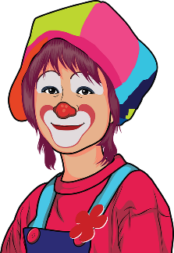
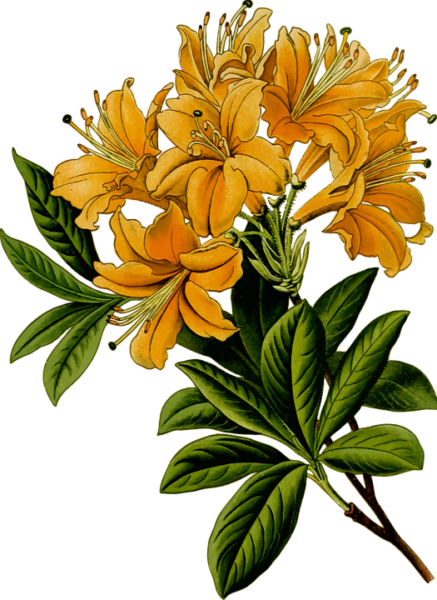
Phonetik 1
Person A
hören / schreiben
Person A liest 1-4, Person B dreht sich um und schreibt auf.
1. Ach, dieser Film ist sehr blutig. Ich will keinen blutigen Film sehen.
2. Ha ha! Sehr witzig! Du bist ein witziger Mensch.
3. Die Blumen für Alastairs Eltern haben Wasser nötig. Ich bringe ihnen das nötige Wasser.
4. Ich muss diese Woche für wichtige Tests lernen. Der Deutschtest ist ganz besonders wichtig!
Notes:
Timing: 8 minutes (two slides) – slide 1 of 2 Aim: to practise this week’s Phonics focus in a paired read-aloud and transcription task. Procedure: 1. Explain the task: Person A reads his/her four messages to Person B who is turned away from the board. Person B transcribes the messages. Then a 2nd slide with 4 x more messages to be transcribed as students swap roles. NB: the Phonics words (-g, -g-, -ig) are unknown words but that the other words in the sentences are all known, so that when the partner turns round to compare answers, an additional step is for the pair to work out what they think each adjective means.
2. Once Person B has turned away from the board, click for the messages to appear. Person A reads the messages and Person B transcribes.
3. When all four messages have been transcribed by Person B, they turn round again. Click on each speech bubble to play the recording, for checking.
4. The pair then discuss what they think the unknown words might mean.
5. Now click for the next slide, where students swap roles.
Word frequency (1 is the most frequent word in German):
blutig [4410] lebendig [2314] nötig {1038] witzig [4500] Source: Jones, R.L. & Tschirner, E. (2019). A frequency dictionary of German: core vocabulary for learners. Routledge

Slide 23
Phonetik 2
Person B
hören / schreiben
Person A liest 1-4, Person B dreht sich um und schreibt auf.
1. Alastairs Hund ist so winzig! Ich liebe so winzige Hunde.
2. Aber obwohl er winzig ist, ist er mutig. Toll, du winziger mutiger Hund!
3. Künftig will ich auch einen Hund haben. Mein künftiger Hund wird Fiffi heißen.
4. Winzige und mutige Hunde gibt es nicht so häufig. Häufiger sind große und mutige Hunde!
Notes:
slide 2 of 2
Aim: to practise this week’s Phonics focus in a paired read-aloud and transcription task. Procedure: 1. Explain the task: Person A reads his/her four messages to Person B who is turned away from the board. Person B transcribes the messages. Then a 2nd slide with 4 x more messages to be transcribed as students swap roles. NB: the Phonics words (-g, -g*) are unknown words but that the other words in the sentences are all known, so that when the partner turns round to compare answers, an additional step is for the pair to work out what they think each adjective means.
2. Once Person B has turned away from board, click for the messages to appear. Person A reads the messages and Person B transcribes.
3. When all four messages have been transcribed by Person B, they turn round again. Click on each speech bubble to play the recording, for checking.
4. The pair then discuss what they think the unknown words might mean.
Word frequency (1 is the most frequent word in German):
künftig [2332] mutig [3812] vorsichtig [1641] winzig [2219] Source: Jones, R.L. & Tschirner, E. (2019). A frequency dictionary of German: core vocabulary for learners. Routledge

