Slide 1
German phonics collection
[ie]
Artwork: Steve Clarke
Date updated: 10 / 08 / 21
Notes:
Artwork by Steve Clarke. All additional pictures selected are available under a Creative Commons license, no attribution required.

Slide 2
[ie]
Phonetik
Introduction
Y7 T1.1 Week 7 Slides 22-27; 29; 33

Slide 3
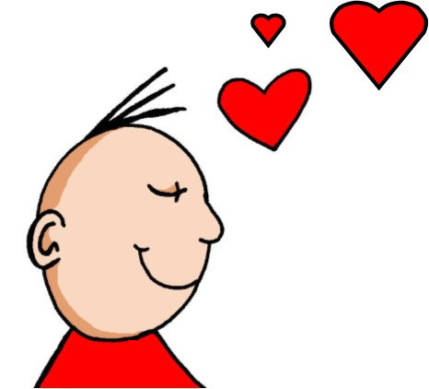
ie
Liebe
Notes:
Timing: 1 minute
Aim: To introduce/consolidate SSC [ie]
Procedure: 1. Present the letter(s) and say the [ie] sound first, on its own. Students repeat it with you. 2. Bring up the word ”Liebe” on its own, say it, students repeat it, so that they have the opportunity to focus all of their attention on the connection between the written word and its sound.
3. A possible gesture for this would be to fold both hands over your heart, and smile!
4. Roll back the animations and work through 1-3 again, but this time, dropping your voice completely to listen carefully to the students saying the [ie] sound, pronouncing ”Liebe” and, if using, doing the gesture. Word frequency (1 is the most frequent word in German): Liebe [843]
Source: Jones, R.L. & Tschirner, E. (2006). A frequency dictionary of German: core vocabulary for learners. Routledge

Slide 4
ie
Liebe
Notes:
With sound and no pictures to focus all attention on the sound-symbol correspondence.

Slide 5
ie
Liebe
Notes:
Without sound to elicit pronunciation (without first hearing the teacher).
Teacher to elicit pronunciation by asking “Wie sagt man…”

Slide 6
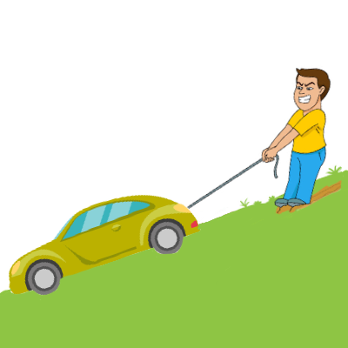
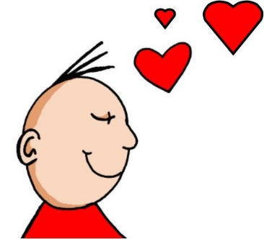
ie
ziehen
sie
Liebe
tief
Brief
liegen
2000 Kilometer
Notes:
Timing: 2 minutes
Aim: To introduce/consolidate SSC [ie]
Procedure:
Introduce and elicit the pronunciation of the individual SSC [ie] and then the source word again ‘Liebe’ (with gesture, if using).
Then present and elicit the pronunciation of the five cluster words.
The cluster words have been chosen for their high-frequency, from a range of word classes, with the SSC (where possible) positioned within a variety of syllables within the words (e.g. initial, 2nd, final etc.). Additionally, we have tried to use words that build cumulatively on previously taught SSCs (see the Phonics Teaching Sequence document) and do not include new SSCs. Where new SSCs are used, they are often consonants which have a similar symbol-sound correspondence in English.
Word frequency (1 is the most frequent word in German): Liebe [843]; ziehen[266] sie [10]; tief [506]; liegen [118]; Brief [813].
Source: Jones, R.L. & Tschirner, E. (2006). A frequency dictionary of German: core vocabulary for learners. Routledge

Slide 7
ie
ziehen
sie
Liebe
tief
Brief
liegen
Notes:
With sound and no pictures to focus all attention on the sound-symbol correspondence.

Slide 8
ie
ziehen
sie
Liebe
tief
Brief
liegen
Notes:
Without sound to elicit pronunciation (without first hearing the teacher).
Teacher to elicit pronunciation by asking “Wie sagt man…”

Slide 9
Phonetik
lesen / sprechen
Liebe
ei
kein
die
ie
weiß
Brief
ich heiβe
Lieblings-
Wie schreibt man das?
Frankreich
sie
Haustier
leider
ein
wie sagt man …
hier
klein
ziehen
die Schweiz
Lied
Polizei
tief
Notes:
Timing: 5 minutes Aim: To provide practice in distinguishing between this week’s SSC [ie] and the SSC [ei] Procedure: 1. This is a paired read aloud task. The students use different colours to play. Pupil A says one of the words/phrases and pupil B has 3 seconds to locate it and cross it off with their colour. If the pupil takes longer than 3 seconds pupil A can steal the point. Clearly, the classroom conditions need to be right with the individual class for friendly competition.
2. Alternatively, they can do it more slowly and carefully, scrutinising each other’s pronunciation. If one makes a mistake (quite common with ei/ie), then the other pupil corrects and crosses off in his/her colour. Note: Not all of these words have been taught before, so there is the opportunity for some genuine decoding.
Word frequency (1 is the most frequent word in German): Lied [1726] leider [642] Lieblings- [>4034] kein [50] weiß [563] heiße [123] schreibt [245] Liebe [843] Brief [813] sie [10] hier [71] Haustier [>5000] wie [28] ziehen [266] tief [506]
Source: Jones, R.L. & Tschirner, E. (2006). A frequency dictionary of German: core vocabulary for learners. Routledge

Slide 10
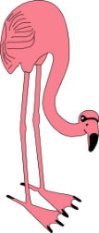
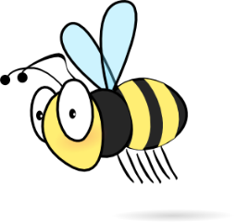
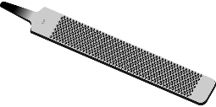
Phonetik
lesen / sprechen
Wien
[Vienna]
Wein
[wine]
Beine
[legs]
Biene
[bee]
viele
[many]
Feile
[file]
Lieder
[songs]
leider
[unfortunately]
Riese
[giant]
Reise
[journey]
Notes:
Timing: 2 minutes Aim: To introduce the concept of minimal pairs Procedure: 1. Teacher introduces students to the concept of minimal pairs and the importance of connecting sound to meaning.
2. Teacher-led pronunciation practice.

Slide 11
[ie]
Phonetik
Consolidation [1]
Y7 T1.2 Week 6 Slides 67-68

Slide 12
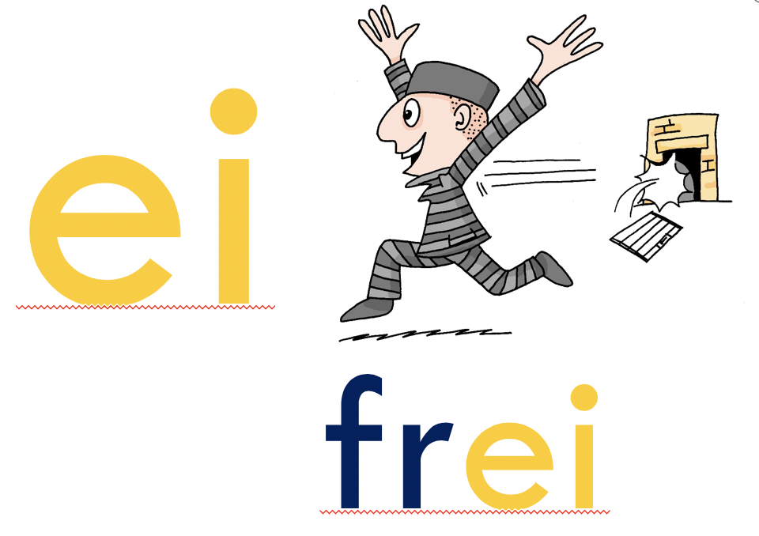
‘IE’ oder ‘EI’
hören
O Tannenbaum, o Tannenbaum,
w__ grün sind d__ne Blätter!
Du grünst nicht nur zur Sommersz__t,
N__n auch im Winter, wenn es schn__t.
O Tannenbaum, o Tannenbaum,
w__ grün sind d__ne Blätter!
Notes:
Timing: 3 minutes Aim: Phonics practice contrasting ‘ie’ and ‘ei’.
Procedure: 1. Click on the fir tree in the top right hand corner to play the song. Students write ‘ie’ or ei’ for each missing vowel.
2. Play the song a second time. The text could also be read aloud if the recording seems too fast.
3. Alternatively, here is a link to a commercial version: https://www.youtube.com/watch?v=lS4wTuvR7Ik
(single voice, but quite clear sound – 3 verses, only play verse 1).
4. The answers are provided on the next slide.
Note: Revisiting SSCs. In the NCELP SOW these SSCs have been introduced during Term 1.1, Weeks 3 (ei) and 7 (ie). We are using these as a minimal pair because of the spelling similarities. We include the source words and pictures as a refresher.
Instructions:
Hör zu
Schreib ie oder ei

Slide 13
Antworten – ie vs ei
Antworten
O Tannenbaum, o Tannenbaum,
w__ grün sind d__ne Blätter!
Du grünst nicht nur zur Sommersz__t,
N__n auch im Winter, wenn es schn__t.
O Tannenbaum, o Tannenbaum,
w__ grün sind d__ne Blätter!
wie
deine
Sommerszeit
Nein
schneit
wie
deine
Notes:
Timing: 2 minutes Aim: To provide the answers to the activity on the previous slide
Procedure: 1. Ask students which SSC is missing each time.c, licking to reveal the answers one by one.

Slide 14
[ie]
Phonetik
Consolidation [2]
Y7 T3.1 Week 2 Slides 6; 11

Slide 15
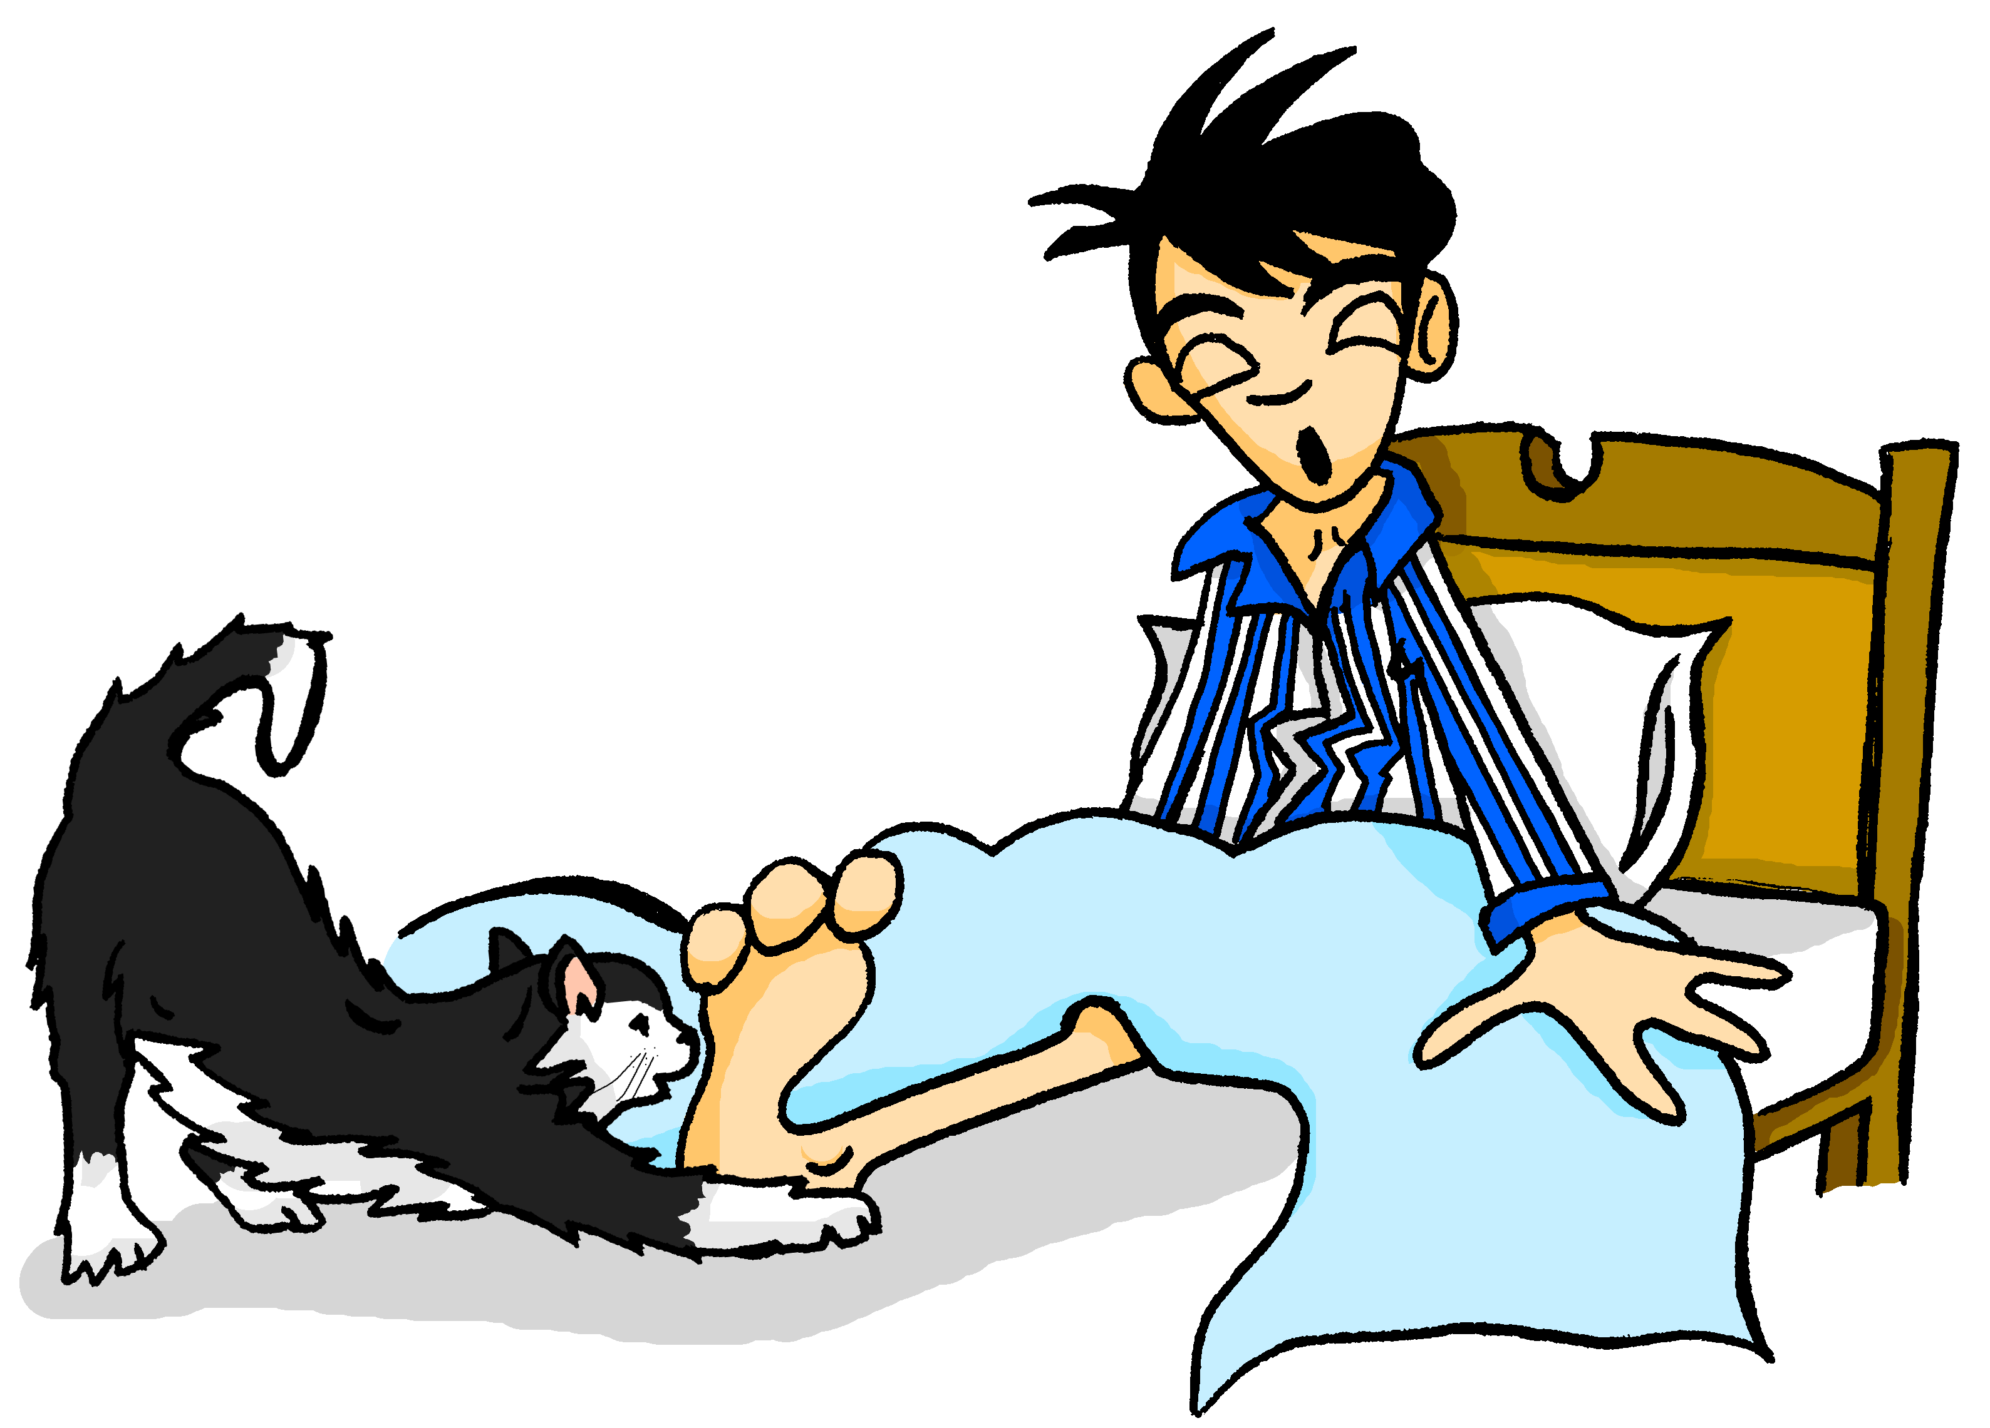
Samstagnachmittag
lesen / hören
Mieze ist auch sehr aktiv. Sie spielt mit Wolfgangs …
a) Beinen
b) Bienen
3
Notes:
Here, SSCs [ei] and [ei] are contrasted.
Frequencies of unknown vocabulary: Bein [937], Biene [>4034]
Transcript
Beinen

Slide 16
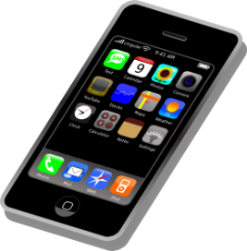
Samstagnachmittag
lesen / hören
Jetzt hat Heidi ein bisschen Angst. Wo ist Wolfgang? Sie telefoniert mit Wolfgang. Er sagt: „Jaaa … ich brauche eine …“
a) Weile
b) viele
8
Notes:
Here, SSCs [w] and [ei] are contrasted with SSCs [v] and [ie].
Teacher to draw attention to use of word order 2 in the first sentence, which starts with a time phrase. Before eliciting the English translation, remind students that the time phrase normally appears at the end of the sentence in English.
Students have not yet met cognate telefonieren [3352].
As no pictures are provided here, teacher to elicit meaning by asking students what English word Weile sounds like.
Frequencies of unknown vocabulary: Weile [1807]
Transcript
Weile

Slide 17
[ie]
Phonetik
Consolidation [3]
Y7 T3.1 Week 4 Slides 3-8; 15

Slide 18
ie
Liebe
Notes:
Timing: 1 minute
Aim: To introduce/consolidate SSC [ie]
Procedure: 1. Present the letter(s) and say the [ie] sound first, on its own. Students repeat it with you. 2. Bring up the word ”Liebe” on its own, say it, students repeat it, so that they have the opportunity to focus all of their attention on the connection between the written word and its sound.
3. A possible gesture for this would be to fold both hands over your heart, and smile!
4. Roll back the animations and work through 1-3 again, but this time, dropping your voice completely to listen carefully to the students saying the [ie] sound, pronouncing ”Liebe” and, if using, doing the gesture. Word frequency (1 is the most frequent word in German): Liebe [843]
Source: Jones, R.L. & Tschirner, E. (2006). A frequency dictionary of German: core vocabulary for learners. Routledge

Slide 19
ie
Liebe
Notes:
With sound and no pictures to focus all attention on the sound-symbol correspondence.

Slide 20
ie
Liebe
Notes:
Without sound to elicit pronunciation (without first hearing the teacher).
Teacher to elicit pronunciation by asking “Wie sagt man…”

Slide 21
ie
ziehen
sie
Liebe
tief
Brief
liegen
2000 Kilometer
Notes:
Timing: 2 minutes
Aim: To introduce/consolidate SSC [ie]
Procedure:
Introduce and elicit the pronunciation of the individual SSC [ie] and then the source word again ‘Liebe’ (with gesture, if using).
Then present and elicit the pronunciation of the five cluster words.
The cluster words have been chosen for their high-frequency, from a range of word classes, with the SSC (where possible) positioned within a variety of syllables within the words (e.g. initial, 2nd, final etc.). Additionally, we have tried to use words that build cumulatively on previously taught SSCs (see the Phonics Teaching Sequence document) and do not include new SSCs. Where new SSCs are used, they are often consonants which have a similar symbol-sound correspondence in English.
Word frequency (1 is the most frequent word in German): Liebe [843]; ziehen[266] sie [10]; tief [506]; liegen [118]; Brief [813].
Source: Jones, R.L. & Tschirner, E. (2006). A frequency dictionary of German: core vocabulary for learners. Routledge

Slide 22
ie
ziehen
sie
Liebe
tief
Brief
liegen
Notes:
With sound and no pictures to focus all attention on the sound-symbol correspondence.

Slide 23
ie
ziehen
sie
Liebe
tief
Brief
liegen
Notes:
Without sound to elicit pronunciation (without first hearing the teacher).
Teacher to elicit pronunciation by asking “Wie sagt man…”

Slide 24
ei
ei
ie
leicht
Ziel
kein
wie
schwierig
dein
heißen
Schauspieler
erreichen
ziemlich
sie
leider
schließlich
mein
sein
Lied
langweilig
ziehen
Schweiz
Computerspiel
Notes:
Timing: 5 minutes
Aim: Phonics revision.
Procedure: 1. This is a paired read aloud task. The students use different colours to play. Student A says one of the words/phrases and student B has 3 seconds to locate it and cross it off with their colour. If the student takes longer than 3 seconds pupil A can steal the point. Clearly, the classroom conditions need to be right with the individual class for friendly competition.
2. Alternatively, they can do it more slowly and carefully, scrutinising each other’s pronunciation. If one makes a mistake (quite common with ei/ie), then the other student corrects and crosses off in their colour.
Note: Not all of these words have been taught before, so there is the opportunity for some genuine decoding.

Slide 25
[ie]
Phonetik
Consolidation [4]
Y7 T3.2 Week 6 Slides 2-3

Slide 26
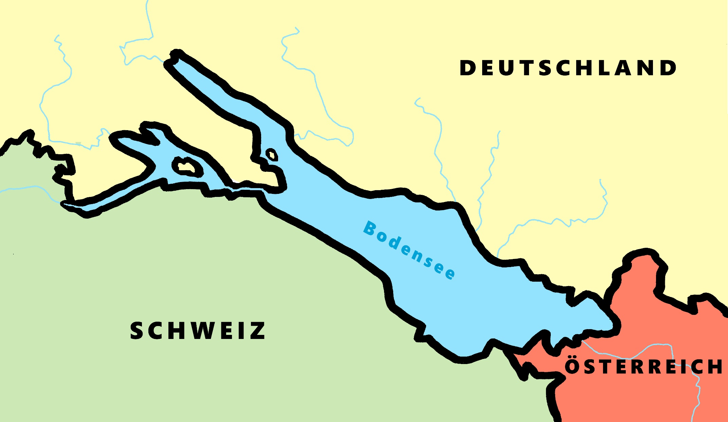
Phonetik - der Bodensee [1/2]
hören / schreiben
4
Allensbach
5
Wallhausen
3
Radolfzell
6
Hagnau
7
Friedrichshafen
1
Kreuzlingen
2
Steckborn
9
Romanshorn
8
Altenrhein
Notes:
Phonetik [1]
Time: 5 minutes Aim: To practise recognising and transcribing 10 previously taught SSC, in unknown words.
Procedure: 1. Click number to hear the full word. Students listen and transcribe only the missing letters. 2. Animations support item-by-item checking, as instant feedback on each SSC may be particularly helpful for students’ learning. 3. Teachers can additionally ask, Wo liegt [Hagnau]? Es liegt in [Deutschland]… Students have met the use of ‘in’ with die Schweiz. It will be helpful to focus their attention on the use of ‘in’ + der + Schweiz here, reminding them of the ‘in’ + movement (R2-accusative) or location (R3-dative) change. SSC revisited here: [eu] [st-] [z] [ch-hard] [w] [au] [ie] [ch-soft] [ei] [r] Transcript: 1 Kreuzlingen 2 Steckborn 3 Radolfzell 4 Allensbach 5 Wallhausen 6 Hagnau 7 Friedrichshafen 8 Altenrhein 9 Romanshorn

Slide 27
Phonetik - der Bodensee [1/2]
lesen / sprechen
9
Ludwigshafen
1
2
Friedrichshafen
Stein am Rhein
6
Konstanz
8
7
Reichenau
5
Altnau
3
Bregenz
4
Rorschach
Notes:
Phonetik [2]
Time: 5 minutes Aim: To practise reading aloud / saying 10 previously taught SSC, in unknown words (apart from Deutschland, which starts the task off). Here, 9 additional towns on the Bodensee are used.
Procedure: 1. Students work in pairs to pronounce each of the towns. 2. Click number to hear and check pronunciation. SSC revisited here: [eu] [st-] [z] [ch-hard] [w] [au] [ie] [ch-soft] [ei] [r] [sch] Transcript: 1 Deutschland 2 Friedrichshafen 3 Bregenz 4 Rorschach 5 Altnau 6 Konstanz 7 Reichenau 8 Stein am Rhein 9 Ludwigshafen

Slide 28
[ie]
Phonetik
Consolidation [5]
Y8 T1.1 Week 1 Slides 2-11

Slide 29
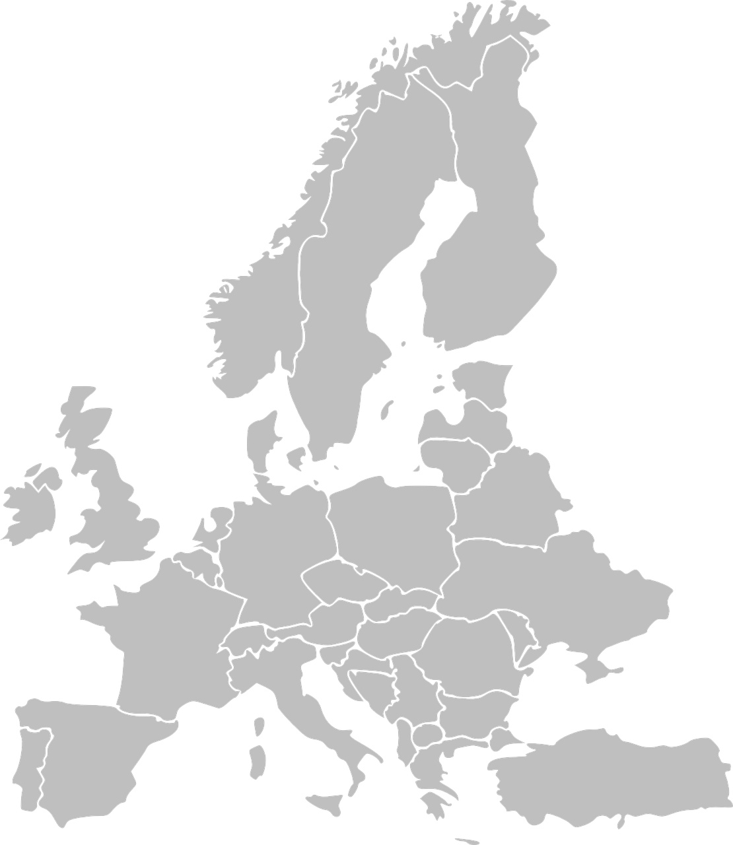
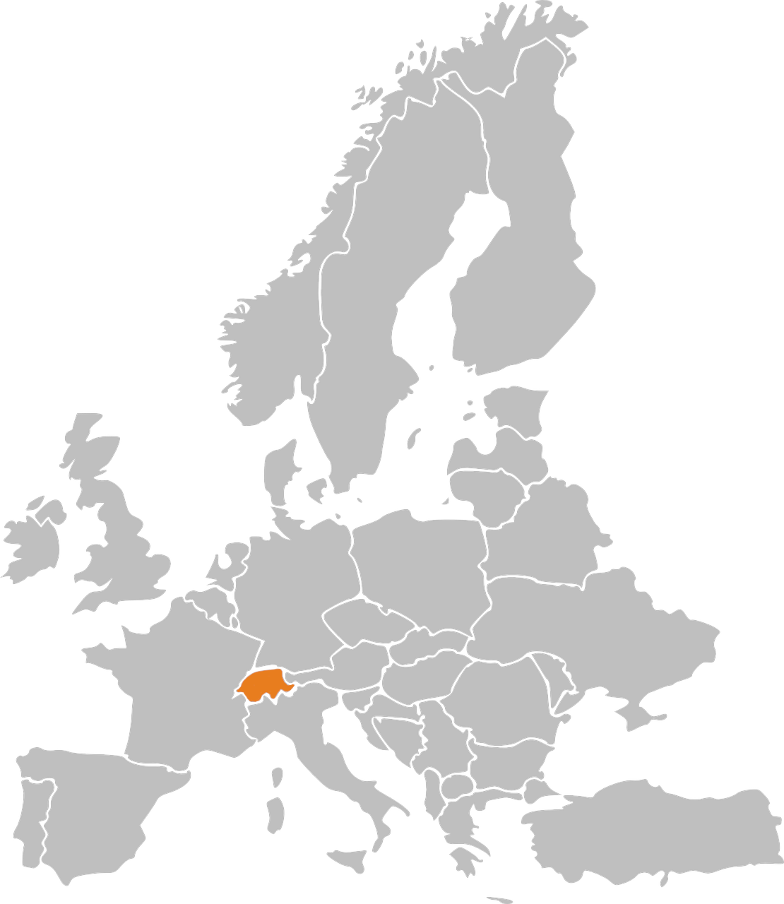
Phonetik: Stadt oder Land?
hören / schreiben
1
die Schweiz
Notes:
Timing: 3 minutes Aim: to revisit and practise the distinction between [ie] and [ei] Procedure: 1. Write 1-10.
2. Click on the number to play the sound. Note: each word is said TWICE. Transcribe either the whole word OR just the SSC [ei] / [ie].
3. Click again for spelling to appear.
4. Bist du in einer Stadt oder einem Land?
5. Click will reveal Stadt oder Land.
Transcript: die Schweiz
die Türkei
Wien
Kiel
Freiburg
Italien
Liechtenstein
Österreich
Spanien
Lienz

Slide 30
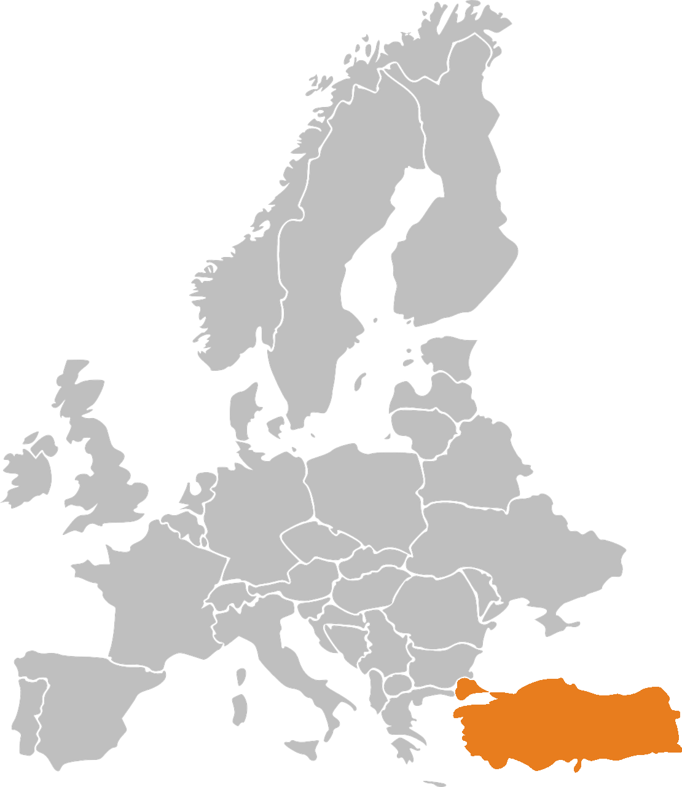
Phonetik: Stadt oder Land?
hören / schreiben
2
die Türkei

Slide 31
Phonetik: Stadt oder Land?
hören / schreiben
3
Wien

Slide 32
Phonetik: Stadt oder Land?
hören / schreiben
4
Kiel

Slide 33
Phonetik: Stadt oder Land?
hören / schreiben
5
Freiburg

Slide 34
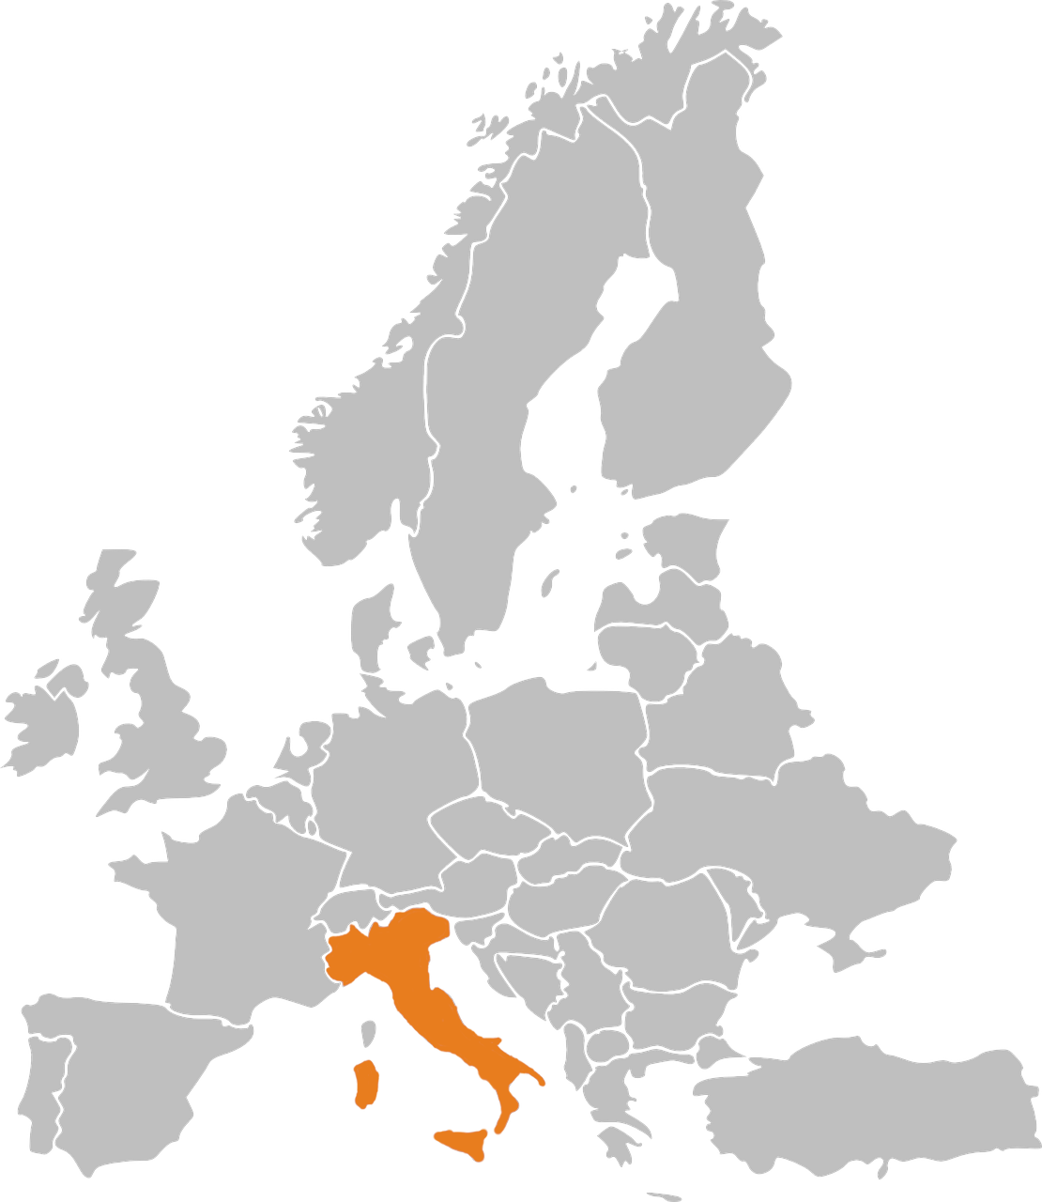
Phonetik: Stadt oder Land?
hören / schreiben
6
Italien

Slide 35
Phonetik: Stadt oder Land?
hören / schreiben
7
Liechtenstein

Slide 36
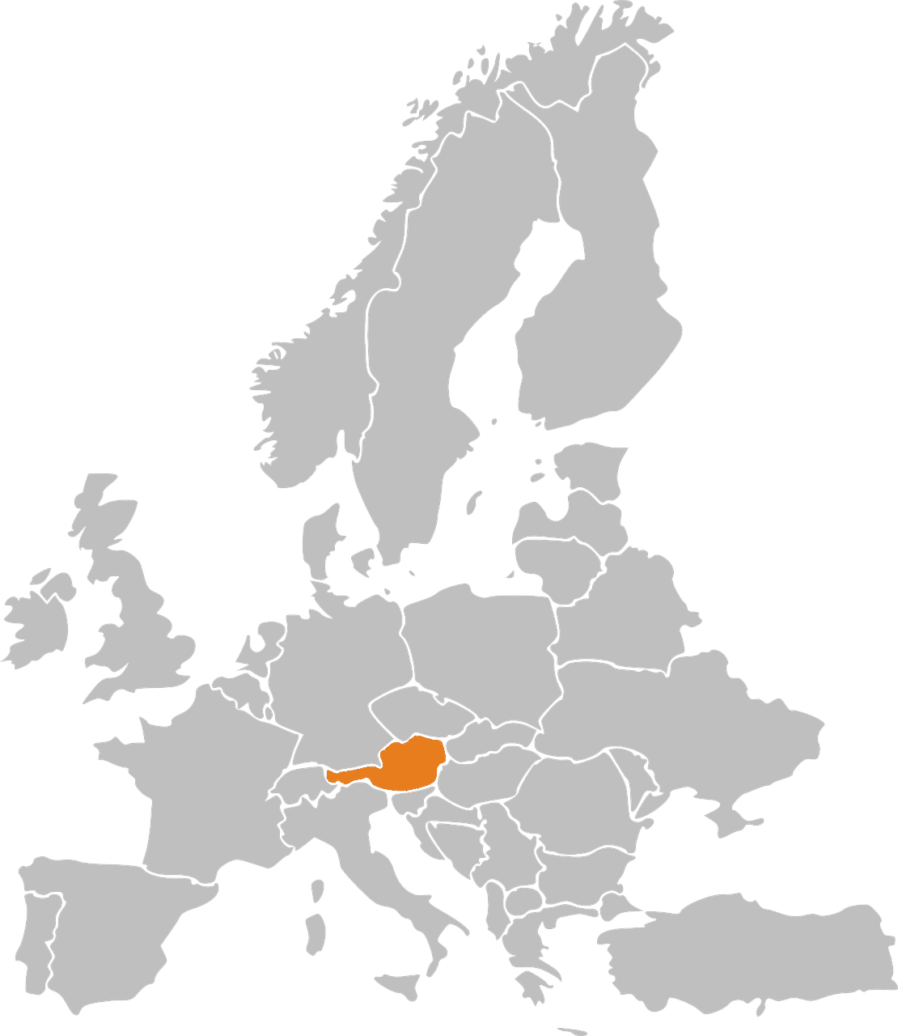
Phonetik: Stadt oder Land?
hören / schreiben
8
Österreich

Slide 37
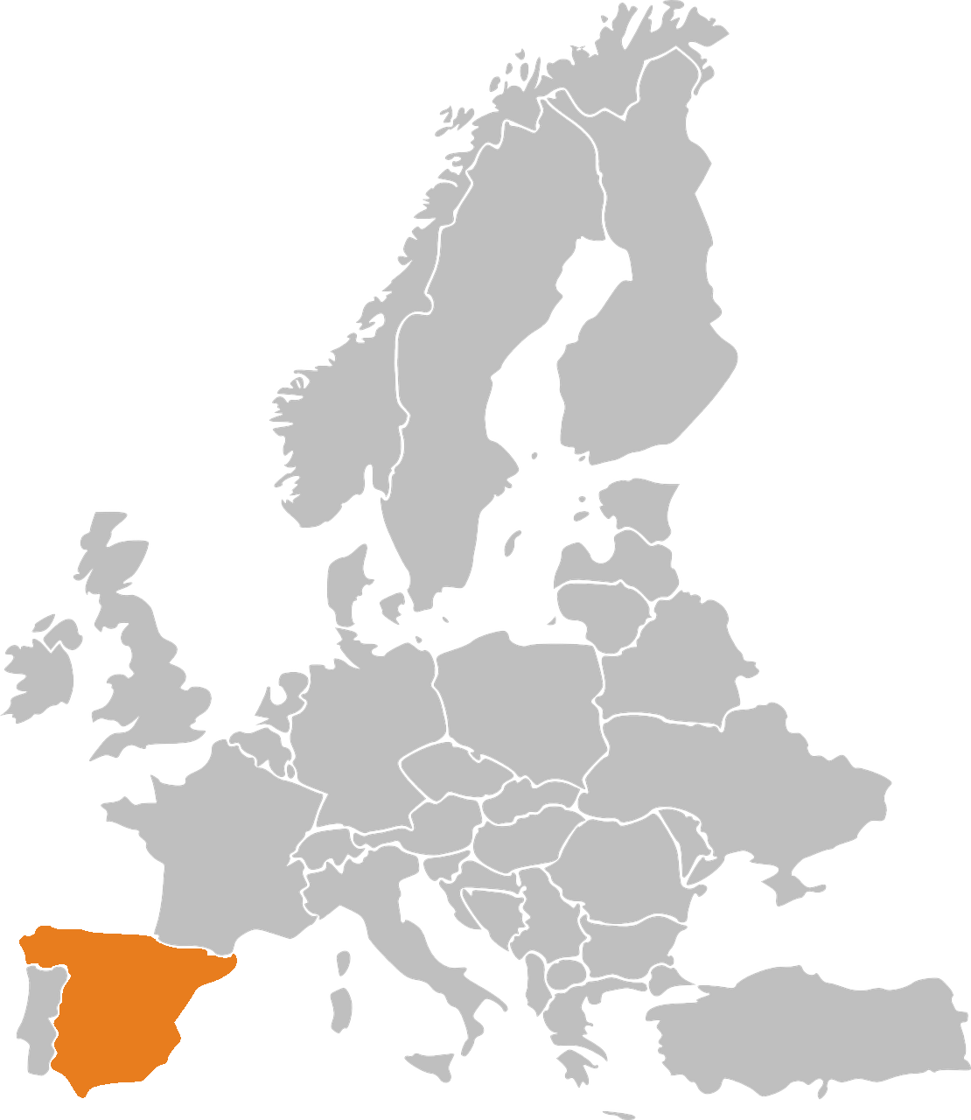
Phonetik: Stadt oder Land?
hören / schreiben
9
Spanien

Slide 38
Phonetik: Stadt oder Land?
hören / schreiben
10
Lienz
Note that when followed by –n, [ie] sometimes sounds as two syllables. Wie sagt man…? Spanien Italien Lienz

Slide 39
[ie]
Phonetik
Consolidation [6]
Y8 T2.1 Week 1 Slides 26-33

Slide 40
ie
Liebe
Notes:
Timing: 1 minute
Aim: To introduce/consolidate SSC [ie]
Procedure: 1. Present the letter(s) and say the [ie] sound first, on its own. Students repeat it with you. 2. Bring up the word ”Liebe” on its own, say it, students repeat it, so that they have the opportunity to focus all of their attention on the connection between the written word and its sound.
3. A possible gesture for this would be to fold both hands over your heart, and smile!
4. Roll back the animations and work through 1-3 again, but this time, dropping your voice completely to listen carefully to the students saying the [ie] sound, pronouncing ”Liebe” and, if using, doing the gesture. Word frequency (1 is the most frequent word in German): Liebe [843]
Source: Jones, R.L. & Tschirner, E. (2006). A frequency dictionary of German: core vocabulary for learners. Routledge

Slide 41
ie
Liebe
Notes:
With sound and no pictures to focus all attention on the sound-symbol correspondence.

Slide 42
ie
Liebe
Notes:
Without sound to elicit pronunciation (without first hearing the teacher).
Teacher to elicit pronunciation by asking “Wie sagt man…”

Slide 43
ie
ziehen
sie
Liebe
tief
Brief
liegen
2000 Kilometer
Notes:
Timing: 2 minutes
Aim: To introduce/consolidate SSC [ie]
Procedure:
Introduce and elicit the pronunciation of the individual SSC [ie] and then the source word again ‘Liebe’ (with gesture, if using).
Then present and elicit the pronunciation of the five cluster words.
The cluster words have been chosen for their high-frequency, from a range of word classes, with the SSC (where possible) positioned within a variety of syllables within the words (e.g. initial, 2nd, final etc.). Additionally, we have tried to use words that build cumulatively on previously taught SSCs (see the Phonics Teaching Sequence document) and do not include new SSCs. Where new SSCs are used, they are often consonants which have a similar symbol-sound correspondence in English.
Word frequency (1 is the most frequent word in German): Liebe [843]; ziehen[266] sie [10]; tief [506]; liegen [118]; Brief [813].
Source: Jones, R.L. & Tschirner, E. (2006). A frequency dictionary of German: core vocabulary for learners. Routledge

Slide 44
ie
ziehen
sie
Liebe
tief
Brief
liegen
Notes:
With sound and no pictures to focus all attention on the sound-symbol correspondence.

Slide 45
ie
ziehen
sie
Liebe
tief
Brief
liegen
Notes:
Without sound to elicit pronunciation (without first hearing the teacher).
Teacher to elicit pronunciation by asking “Wie sagt man…”

Slide 46
Phonetik
hören / schreiben
Hör zu. Welches Wort hat das SSC [ie]? Schreib 1-4 und a) oder b).
1
3
a) b i tten | b) b ie ten
[rent] | [middle]
a) M ie te | b) M i tte
[to ask for]
[to offer]
__
__
__
__
2
[crooked] | [ship, boat]
a) sch ie f | b) Sch i ff
4
[silence] | [stems, stalks]
b) St i lle | b) St ie le
__
__
__
__
Notes:
Timing: 5 minutes (for two slides)
Aim: Aural differentiation between SSC [ie] and short [i] in minimal pairs.
Procedure:
1. Click the numbers to play the audio.
2. Students write 1-8 and decide which word contains [ie], and write down a) or b). If they wish, they can write down both words in full.
3. Click to reveal the answers.
4. Students sound out the pairs of words.
Transcript:
1. a) bitten b) bieten
2. a) schief b) Schiff
3. a) Miete b) Mitte
4. a) Stille b) Stiele
Word frequency (1 is the most frequent word in German): bitten [491] bieten [531] schief [3021] Schiff [1176] Miete [3488] Mitte [711] Stille [2753] Stiele [>5000] Source: Jones, R.L. & Tschirner, E. (2019). A frequency dictionary of German: core vocabulary for learners. Routledge

Slide 47
Phonetik
hören / schreiben
Hör zu. Welches Wort hat das kurze [i]? Schreib 5-8 und a) oder b).
5
7
a) R i sse | b) R ie se
[within] | [bees]
a) b i nnen | b) B ie nen
[cracks]
[giant]
__
__
__
__
6
[to sit] | [to address someone as ‘Sie’]
a) s i tzen | b) s ie zen
8
[hall] | [dill]
b) D ie le | b) D i lle
__
__
__
__
Notes:
NB: No 7 audio is currently wrong – we are changing to match the transcript below!
This is the continuation of the activity on the previous slide but note that students now listen out for the short [i].
Transcript:
5. a) Risse b) Riese
6. a) sitzen b) siezen
7. a) binnen b) Bienen
8. a) Diele b) Dille Word frequency (1 is the most frequent word in German): Riss [>5000] Riese [4585] sitzen [231] siezen [>50000] binnen [>4171] Biene [>5000] Diele [>5000] Dille [>5000] Source: Jones, R.L. & Tschirner, E. (2019). A frequency dictionary of German: core vocabulary for learners. Routledge

Slide 48
[ie]
Phonetik
Consolidation [7]
Y8 T2.1 Week 2 Slides 8-16; 38-42

Slide 49
ie
Liebe
Notes:
Timing: 1 minute
Aim: To introduce/consolidate SSC [ie]
Procedure: 1. Present the letter(s) and say the [ie] sound first, on its own. Students repeat it with you. 2. Bring up the word ”Liebe” on its own, say it, students repeat it, so that they have the opportunity to focus all of their attention on the connection between the written word and its sound.
3. A possible gesture for this would be to fold both hands over your heart, and smile!
4. Roll back the animations and work through 1-3 again, but this time, dropping your voice completely to listen carefully to the students saying the [ie] sound, pronouncing ”Liebe” and, if using, doing the gesture. Word frequency (1 is the most frequent word in German): Liebe [843]
Source: Jones, R.L. & Tschirner, E. (2006). A frequency dictionary of German: core vocabulary for learners. Routledge

Slide 50
ie
Liebe
Notes:
With sound and no pictures to focus all attention on the sound-symbol correspondence.

Slide 51
ie
Liebe
Notes:
Without sound to elicit pronunciation (without first hearing the teacher).
Teacher to elicit pronunciation by asking “Wie sagt man…”

Slide 52
ie
ziehen
sie
Liebe
tief
Brief
liegen
2000 Kilometer
Notes:
Timing: 2 minutes
Aim: To introduce/consolidate SSC [ie]
Procedure:
Introduce and elicit the pronunciation of the individual SSC [ie] and then the source word again ‘Liebe’ (with gesture, if using).
Then present and elicit the pronunciation of the five cluster words.
The cluster words have been chosen for their high-frequency, from a range of word classes, with the SSC (where possible) positioned within a variety of syllables within the words (e.g. initial, 2nd, final etc.). Additionally, we have tried to use words that build cumulatively on previously taught SSCs (see the Phonics Teaching Sequence document) and do not include new SSCs. Where new SSCs are used, they are often consonants which have a similar symbol-sound correspondence in English.
Word frequency (1 is the most frequent word in German): Liebe [843]; ziehen[266] sie [10]; tief [506]; liegen [118]; Brief [813].
Source: Jones, R.L. & Tschirner, E. (2006). A frequency dictionary of German: core vocabulary for learners. Routledge

Slide 53
ie
ziehen
sie
Liebe
tief
Brief
liegen
Notes:
With sound and no pictures to focus all attention on the sound-symbol correspondence.

Slide 54
ie
ziehen
sie
Liebe
tief
Brief
liegen
Notes:
Without sound to elicit pronunciation (without first hearing the teacher).
Teacher to elicit pronunciation by asking “Wie sagt man…”

Slide 55
Phonetik
hören
ei
ie
frei
Liebe
Notes:
Timing: 5 seconds Aim: To recap the two source words before the listening task on the next slide.

Slide 56
Welcher Buchstabe ist das? A, B, C…?
hören
Hör zu. Schreib 1-6 und A, B, C…
Biene
Beine
1
2
3
Wiese
Weise
Wein
Wien
4
5
Leib
lieb
hieß
heiß
Schein
schien
reif
rief
6
A
B
C
D
E
F
G
H
Antworten:
4
6
1
5
2
3
Notes:
Timing: 3 minutes Aim: To practise recognition of minimal pairs with SSC [ei] and [ie]
Procedure:
1. Click on a number to hear a recording. Students listen and follow the correct pathway, taking the left- or right-hand branch in each case according to which SSC they hear, [ei] or [ie].
2. The answers are animated and appear on clicks.
Transcript:
1. Biene, Weise, hieß 2. Beine, Wein, schien
3. Beine, Wien, reif
4. Biene, Wiese, Leib
5. Beine, Wein, Schein
6. Biene, Wiese, Lieb
Frequencies

Slide 57
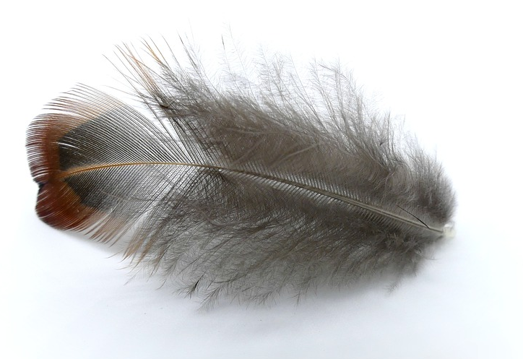
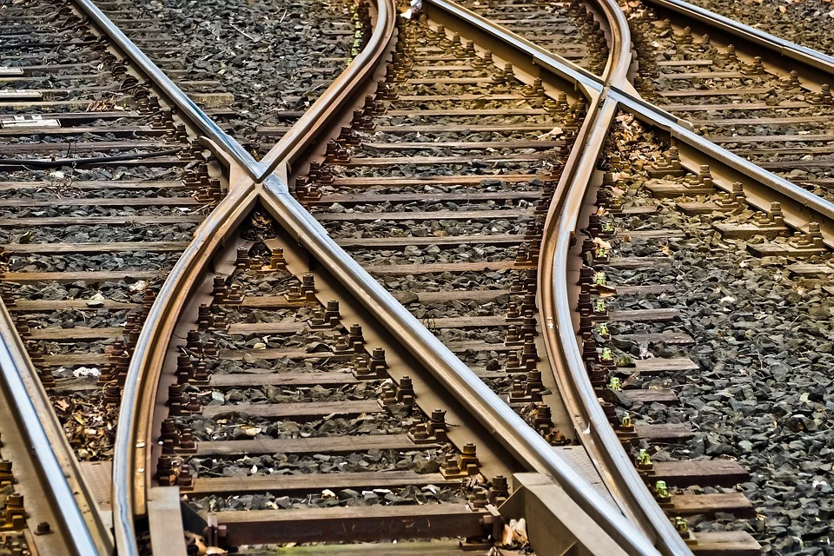
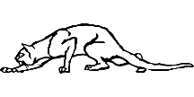
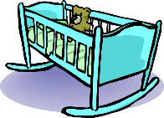
Phonetik
lesen / sprechen
60
Schiene [rail]
weich [soft]
Stein [stone]
biegen [bend]
Teich [pond]
fliehen [to flee]
Reis [rice]
schleichen [slink]
Sekunden
Leiter [ladder]
Frieden [peace]
beißen [to bite]
Wiege [crib]
Kiesel [pebble]
Sieg [victory]
Scheitel [parting]
Fliege [fly]
0
LOS!
Notes:
Timing: 1 minute for practice + 1 minute for saying them out loud Aim: To practise SSCs in unfamiliar word context. The time limit helps automatization. Procedure: 1. Students take 60 seconds to practise saying the words out loud to themselves. Click LOS! to start the timer.
2. Then teacher clicks and each word flashes a couple of times before disappearing. Students have to pronounce the word (in chorus) – teacher checks pronunciation this week (as Covid prevents circulating round the class currently).
Word frequency (1 is the most frequent word in German): Schiene [>5000], weich [1836], Stein [1404], biegen [2986], Teich [>5000], fliehen [2824], Reis [>5000], schleichen [4008], Leiter [1321], Frieden[1478], beißen [>5000], Wiege [>5000], Kiesel [>5000], Sieg [1246], Scheitel [>5000], Fliege [>5000]
Source: Jones, R.L. & Tschirner, E. (2019). A frequency dictionary of German: core vocabulary for learners. Routledge

Slide 58
Phonetik
hören
ei
ie
frei
Liebe
Notes:
Timing: 5 seconds Aim: To recap the two source words before the listening task on the next slide.

Slide 59
Phonetik [1/2]
sprechen / hören / schreiben
Partner A sagt die Wörter. Partner B schreibt.
[ei]
[ie]
1. _______
1. _______
1. Schwein [pig]
2. peinlich [embarassing]
3. Kiefer [jaw] 4. Geige [violin] 5. Ziege [goat] 6. nieder [down] 7. Riese [giant] 8. Eiche [oak]
2. _______
2. _______
3. _______
3. _______
4. _______
4. _______
Notes:
Timing: 4 minutes Aim: To practise SSC [ei] and [ie] with mostly unknown vocabulary, compelling students to apply their phonics knowledge.
Procedure: 1. Partner B draws two columns and numbers 1-4 in each column
2. Partner A reads the words aloud. Partner B must turn away from the board and must transcribe the words in the correct column.
3. The next slide has the answers. Word frequency (1 is the most frequent word in German):
Schwein [4009], peinlich [2936], Kiefer [>5000], Geige [>5000], Ziege [>5000], nieder [>5000], Riese [2794], Eiche [>5000]
Source: Jones, R.L. & Tschirner, E. (2019). A frequency dictionary of German: core vocabulary for learners. Routledge

Slide 60
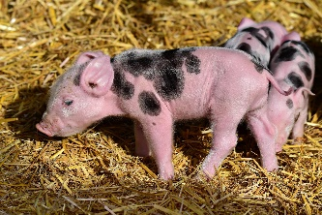
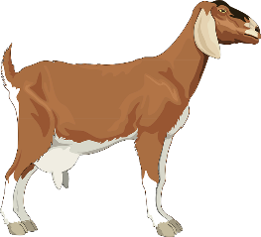
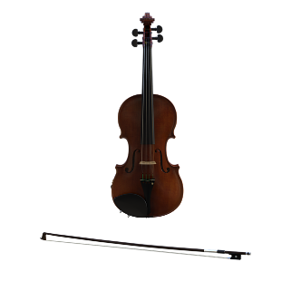
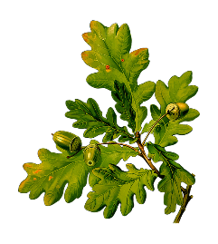
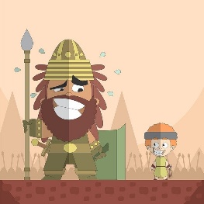
Antworten
sprechen / hören / schreiben
[ei]
[ie]
Schwein
Kiefer
1. _______
1. _______
peinlich
Ziege
2. _______
2. _______
[embarrassing]
Geige
nieder
3. _______
3. _______
Eiche
Riese
4. _______
4. _______
Notes:
Answers
Timing: 30 seconds
Aim: to check work of Partner B (who write) and Partner A (who spoke)
Answers appear in order of the transcript.
Transcript:
1. Schwein 2. peinlich 3. Kiefer 4. Geige 5. Ziege 6. nieder 7. Riese 8. Eiche

Slide 61
Phonetik [2/2]
sprechen / hören / schreiben
Partner A schreibt. Partner B sagt die Wörter.
[ei]
[ie]
1. _______
1. _______
1. Krieg [war]
2. Kleid [dress]
3. Sieb [sieve] 4. Diener [servant] 5. Feind [enemy] 6. heiter [cheerful, bright] 7. Kreide [chalk] 8. niedlich [cute]
2. _______
2. _______
3. _______
3. _______
4. _______
4. _______
Notes:
Timing: 4 minutes Aim: To practise SSC [ei] and [ie] with mostly unknown vocabulary, compelling students to apply their phonics knowledge.
Procedure: 1. Partner A draws two columns and numbers 1-4 in each column
2. Partner B reads the words aloud. Partner A must turn away from the board and must transcribe the words in the correct column.
3. The next slide has the answers. Word frequency (1 is the most frequent word in German):
Krieg [407], Kleid [1681], Sieb [>5000], Diener [>5000], Feind [24524], heiter [>5000], Kreide [>5000], niedlich [>5000].
Source: Jones, R.L. & Tschirner, E. (2019). A frequency dictionary of German: core vocabulary for learners. Routledge

Slide 62
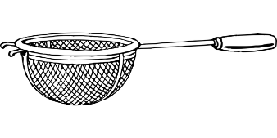
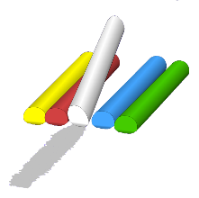
Antworten
sprechen / hören / schreiben
[ei]
[ie]
Kleid
Krieg
1. _______
1. _______
Feind
[enemy]
Sieb
2. _______
2. _______
heiter
[cheerful, bright]
Diener
3. _______
3. _______
Kreide
niedlich
4. _______
4. _______
Notes:
Answers
Timing: 30 seconds
Aim: to check work of Partner B (who write) and Partner A (who spoke)
Answers appear in order of the transcript.
Transcript:
1. Krieg
2. Kleid
3. Sieb 4. Diener 5. Feind 6. heiter 7. Kreide 8. niedlich

Slide 63
[ie]
Phonetik
Consolidation [8]
Y8 T3.2 Week 7 Slide 16

Slide 64
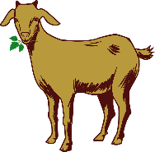
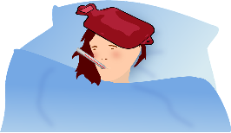
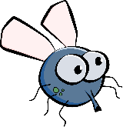
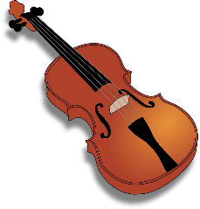
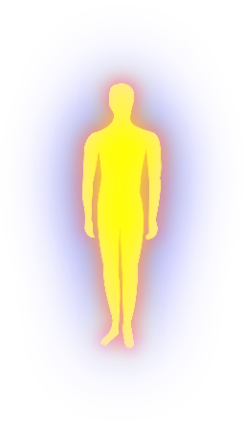
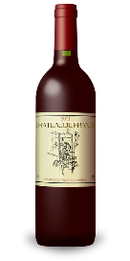
Phonetik
Partner A: Schreib fünf Wörter.
lesen / sprechen
Du sollst sie nicht zeigen!
Partner B: Sag alle Wörter.
Versuch, die fünf Wörter zu sagen.
10
die Ziege
die Wiese
das Fieber
die Liebe
die Fliege
das Schwein
Sekunden
die Freiheit
die Zeit
die Geige
die Allergie
die Beine
die Leiber*
der Haifisch
0
die Leiber – bodies
die Biene
der Frieden
der Wein
LOS!
Notes:
Timing: 3 minutes Aim: To revisit SSC [ei] and [ie] in a read aloud task. Procedure: 1. Partner A writes down 5 of the words on the slide. 2. Partner B, without seeing A’s list, says all the words on the slide as quickly as possible, trying to match all of Partner A’s list before the 40 seconds is up. Note: Partner A should listen very carefully to B’s pronunciation. S/he doesn’t need to cross a word off if the [ei] and [ie] are pronounced wrongly! 3. Swap roles. 4. Note: this activity can be repeated a couple of times.
Word frequency of cognates and unknown words (1 is the most frequent word in German): Allergie [>5009] Bein [884] Biene [>5009] Fieber [4774] Fliege [3994] Freiheit [814] Frieden [1696] Geige [>5009] Haifisch [>5009] Leib [3274] Liebe [844] Schwein [2975] Wein [1736] Wiese [2963] Ziege [>5009]
Source: Jones, R.L. & Tschirner, E. (2019). A frequency dictionary of German: core vocabulary for learners. Routledge

Slide 65
[ie]
Phonetik
Consolidation [9]
Y9 T2.2 Week 1 Slides 5-7

Slide 66
Phonetik
hören / schreiben
When the letters 'ie' are the final syllable in a word, they can be pronounced in two different ways.
If the final syllable is stressed, then the letters are pronounced as the long [i] vowel:
Biographie
Philosophie
Akrophobie
*die Akrophobie – fear of heights
When 'ie’ is in an unstressed syllable at the end of a word, the letters are pronounced as two separate vowel sounds:
Familie
Italien
Syrien
Notes:
Timing: 2 minutes Aim: to learn the two ways of pronouncing [ie] as word-final syllable. Procedure: 1. Click to bring up the stages of the explanation.
2. Click to hear a native speaker say the example words.
Word frequency (1 is the most frequent word in German):
Akrophobie [>5009] Source: Jones, R.L. & Tschirner, E. (2019). A frequency dictionary of German: core vocabulary for learners. Routledge

Slide 67
Phonetik
hören / schreiben
*die Heimat – homeland
Person A liest laut. Person B dreht sich um, hört zu und schreibt.
Adel Karasholi ist ein Dichter aus Syrien.
2. Seine Familie ist kurdisch.
3. Er wurde 1936 in Syrien geboren.
4. Als Dichter und Journalist hatte er in seiner Heimat* zu wenig Freiheit.
Notes:
Timing: 8 minutes (2 slides) Aim: to practise differentiating between [ie] (in different pronunciations) and [ei]. Procedure: 1. Partner B turns away from the board. Make sure this happens before the sentences are revealed!
2. Click to reveal sentences.
3. Partner A reads the sentences to partner B who transcribes what they hear. Depending upon difficulty level, partner B can either transcribe the full sentence, or use the handout and fill in the [ei] and [ie] sounds.
4. Partner B turns back around to check answers.
5. Move to the next slide and partners swap roles. 6. Note: the following task on Slide 8 re-uses the same text; students can first check their written transcriptions before starting the comprehension task.
Word frequency of unknown words (1 is the most frequent word in German):
Heimat [1305] Source: Jones, R.L. & Tschirner, E. (2019). A frequency dictionary of German: core vocabulary for learners. Routledge

Slide 68
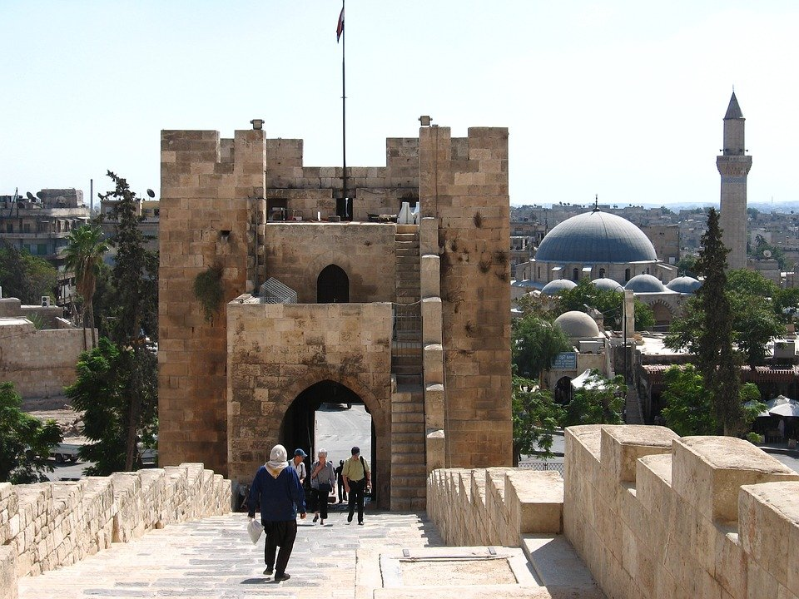
Phonetik
hören / schreiben
Person A liest laut. Person B dreht sich um, hört zu und schreibt.
5. 1961 ist er nach Leipzig in Deutschland gekommen.
6. Er hat dort Deutsch studiert und eine Doktorarbeit geschrieben.
7. Er schreibt Gedichte auf Deutsch.
8. Sein Gedicht ‘Seiltanz’ gehört zum Genre ‘Migrationsliteratur’.
Notes:
Slide 2

