Slide 1
German phonics collection
Long and short [i]
Artwork: Steve Clarke
Date updated: 23 / 07 / 21
Notes:
Artwork by Steve Clarke. All additional pictures selected are available under a Creative Commons license, no attribution required.

Slide 2
Long and short [i]
Phonetik
Introduction
Y7 T1.2 Week 2 Slides 3-14

Slide 3
i
wir
Notes:
Timing: 1 minute
Aim: To introduce/consolidate SSC [i]
Procedure: 1. Present the letter(s) and say the [i] sound first, on its own. Students repeat it with you. 2. Bring up the word ”wir” on its own, say it, students repeat it, so that they have the opportunity to focus all of their attention on the connection between the written word and its sound.
3. A possible gesture for this would be to mime putting your arms around two people, one on either side.
4. Roll back the animations and work through 1-3 again, but this time, dropping your voice completely to listen carefully to the students saying the [i] sound, pronouncing ”wir” and, if using, doing the gesture. Word frequency (1 is the most frequent word in German): wir [31]
Source: Jones, R.L. & Tschirner, E. (2006). A frequency dictionary of German: core vocabulary for learners. Routledge

Slide 4
i
wir
Notes:
With sound and no pictures to focus all attention on the sound-symbol correspondence.

Slide 5
i
wir
Notes:
Without sound to elicit pronunciation (without first hearing the teacher).
Teacher to elicit pronunciation by asking “Wie sagt man…”

Slide 6
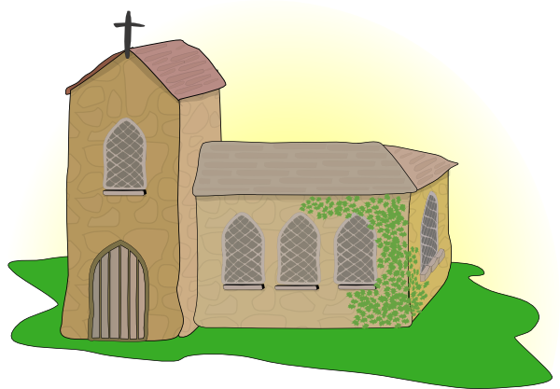
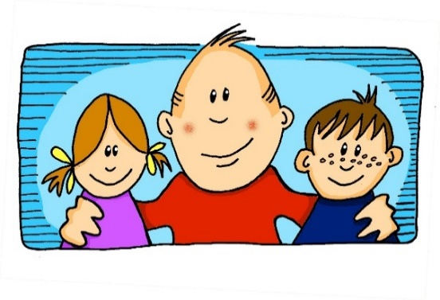
i
Kirche
Familie
wir
Linie
ihr
privat
Notes:
Timing: 2 minutes
Aim: To introduce/consolidate SSC [i]
Procedure:
Introduce and elicit the pronunciation of the individual SSC [i] and then the source word again ‘wir’ (with gesture, if using).
Then present and elicit the pronunciation of the five cluster words.
The cluster words have been chosen for their high-frequency, from a range of word classes, with the SSC (where possible) positioned within a variety of syllables within the words (e.g. initial, 2nd, final etc.). Additionally, we have tried to use words that build cumulatively on previously taught SSCs (see the Phonics Teaching Sequence document) and do not include new SSCs. Where new SSCs are used, they are often consonants which have a similar symbol-sound correspondence in English.
Word frequency (1 is the most frequent word in German): wir [31]; Kirche [519] Familie [310]; Linie [897]; privat [665]; ihr [26]. Source: Jones, R.L. & Tschirner, E. (2006). A frequency dictionary of German: core vocabulary for learners. Routledge

Slide 7
i
Kirche
Familie
wir
Linie
ihr
privat
Notes:
With sound and no pictures to focus all attention on the sound-symbol correspondence.

Slide 8
i
Kirche
Familie
wir
Linie
ihr
privat
Notes:
Without sound to elicit pronunciation (without first hearing the teacher).
Teacher to elicit pronunciation by asking “Wie sagt man…”

Slide 9
i
finden
Notes:
Timing: 1 minute
Aim: To introduce/consolidate SSC [i]
Procedure: 1. Present the letter(s) and say the [i] sound first, on its own. Students repeat it with you. 2. Bring up the word ”finden” on its own, say it, students repeat it, so that they have the opportunity to focus all of their attention on the connection between the written word and its sound.
3. A possible gesture for this would be to mime looking by holding a magnifying glass in your left hand, and pointing to what you’ve found with your right hand.
4. Roll back the animations and work through 1-3 again, but this time, dropping your voice completely to listen carefully to the students saying the [i] sound, pronouncing ”finden” and, if using, doing the gesture. Word frequency (1 is the most frequent word in German): finden [110]
Source: Jones, R.L. & Tschirner, E. (2006). A frequency dictionary of German: core vocabulary for learners. Routledge

Slide 10
i
finden
Notes:
With sound and no pictures to focus all attention on the sound-symbol correspondence.

Slide 11
i
finden
Notes:
Without sound to elicit pronunciation (without first hearing the teacher).
Teacher to elicit pronunciation by asking “Wie sagt man…”

Slide 12
i
mit
bitte
finden
Hilfe
wissen
[to know]
interessant
[interesting]
Notes:
Timing: 2 minutes
Aim: To introduce/consolidate SSC [i]
Procedure:
Introduce and elicit the pronunciation of the individual SSC [i] and then the source word again ‘finden’ (with gesture, if using).
Then present and elicit the pronunciation of the five cluster words.
The cluster words have been chosen for their high-frequency, from a range of word classes, with the SSC (where possible) positioned within a variety of syllables within the words (e.g. initial, 2nd, final etc.). Additionally, we have tried to use words that build cumulatively on previously taught SSCs (see the Phonics Teaching Sequence document) and do not include new SSCs. Where new SSCs are used, they are often consonants which have a similar symbol-sound correspondence in English.
Word frequency (1 is the most frequent word in German): finden [110]; mit [13] bitte [547]; wissen [79]; interessant [531]; Hilfe [737]. Source: Jones, R.L. & Tschirner, E. (2006). A frequency dictionary of German: core vocabulary for learners. Routledge

Slide 13
i
mit
bitte
finden
Hilfe
wissen
interessant
Notes:
With sound and no pictures to focus all attention on the sound-symbol correspondence.

Slide 14
i
mit
bitte
finden
Hilfe
wissen
interessant
Notes:
Without sound to elicit pronunciation (without first hearing the teacher).
Teacher to elicit pronunciation by asking “Wie sagt man…”

Slide 15
Long and short [i]
Phonetik
Consolidation [1]
Y7 T2.2 Week 3 Slide 4

Slide 16
[e] vs [i]
phonetik
e[long]
i[long]
geben
wir
e[short]
i[short]
denken
finden
1
gel i ngen
2
M i ttel
winden/ wenden
7
winden/ wenden
3
eng
setzen / sitzen
8
setzen / sitzen
4
werfen
blecken / blicken
9
blecken / blicken
5
Zelle
wirken / werken
10
wirken / werken
6
S i cht
Notes:
Timing: 3 minutes
Aim: Phonics refresher - e vs i.
The contrast between e and i is important for this week’s grammar point (strong verbs). Both sounds have been introduced already we are simply revisiting them here.
Procedure:
Click on the example words (denken / geben / finden / wir) to play them and remind the students of the the sounds.
The first 6 words a transcription (fill in the blank). The words are high frequency, but haven’t yet been taught.
The second four are minimal pairs (some of these are rare).
Transcript:
gelingen
Mittel
eng
werfen
Zelle
Sicht
winden / wenden
setzen / sitzen
blecken / blicken
wirken / Werken
Word frequency (1 is the most frequent word in German):
gelingen [502] Mittel [691] eng [593] werfen [718] Zelle [592] Sicht [940] winden [>5009] wenden [1530] setzen [228] sitzen [231] blecken [>5009] blicken [1256] wirken [401] werken [>5009]
Source: Jones, R.L & Tschirner, E. (2019). A frequency dictionary of German: Core vocabulary for learners. London: Routledge.

Slide 17
long and short [i]
Phonetik
Consolidation [2]
Y7 T2.2 Week 5 Slides 3-4; 5; 35

Slide 18
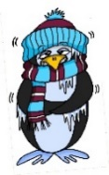
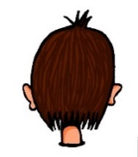
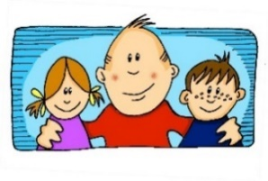
Phonetik
e
e
a
a
sagen
kalt
geben
denken
i
i
o
o
u
wir
u
finden
wo?
Kopf
ü
ü
ö
du
ö
Punkt
Tür
fünf
ä
ä
schön
plötzlich
spät
lächeln
Notes:
Timing: 3 minutes
Aim: The long and short vowel sounds in German are practised here in familiar words, with audio.
Procedure:
1. Students should listen and repeat.

Slide 19
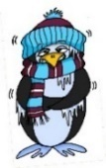
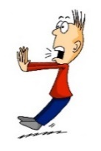
Phonetik
e
e
a
a
sagen
kalt
geben
denken
i
i
o
o
u
wir
u
finden
wo?
Kopf
ü
ü
ö
ö
fünf
du
Punkt
Tür
ä
ä
schön
plötzlich
spät
lächeln
Notes:
Timing: 3 minutes
Aim: This version of the slide is without audio.
Procedure:
1. Students should chant the words chorally first, as they appear, then perhaps individually (the teacher quizzing students on individual words; it will be important to continue to juxtapose the long and short forms of each vowel in this practice).

Slide 20
Phonetik
hören
Wie sagt man das?
 | i [lang] | i [kurz]
Linz
Ingolstadt
Iserlohn
Interlaken
Innsbruck
 | o [lang] | o [kurz]
Iserlohn
Ingolstadt
Oberammergau
Oldenburg
Ottendorf
1
1
2
2
3
3
4
4
5
5
Notes:
Timing: 5 minutes
Aim: This is a phonics recap of long and long and short [i] and [o]. Towns listed are from Germany, Austria and Switzerland. Students may like to do an extension research task to identify which towns they know (e.g from the football team) and/or where the towns are situated.
Procedure:
1. Students are asked to listen and decide if they hear long or short ‘i’ and ‘o’.
2. The city names appear together with the answer. 3. Students can have one minute in pairs to re-read aloud all the cities for additional practice.
Note: Students are not expected to transcribe the cities.

Slide 21
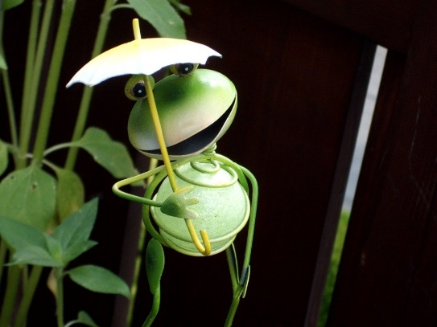
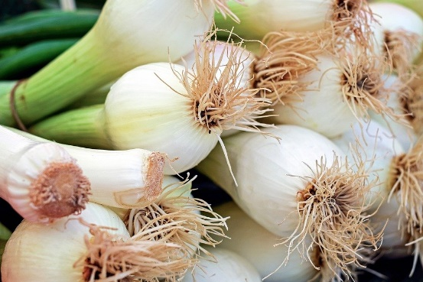
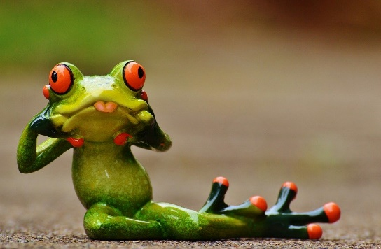
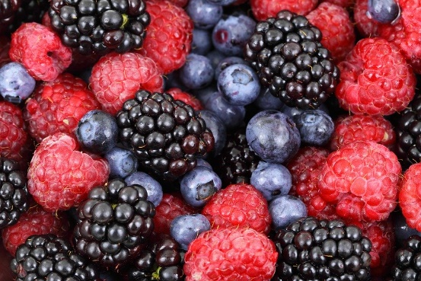
Zungenbrecher [2]
Phonetik
1
2
Fromme Frösche fressen
frische Frühlingszwiebeln,
aber freche Frösche fressen
frische Früchte.
Notes:
Timing: 3 minutes
Aim: Opportunity to practise the following SSCs: o - ö - i - ü – e.
Procedure:
1. Students listen to either the slower [1] or the faster [2] version of the tongutwister (or both in turn), then try to say it chorally or in pairs.
Transcription:
Fromme Frösche fressen
frische Frühlingszwiebeln,
aber freche Frösche fressen
frische Früchte.
Translation:
Pious frogs eat
fresh spring onions,
but eat naughty frogs
fresh fruits.
Word frequency (1 is the most frequent word in German):
fromm [>4029] Frosch [>4029] fressen [3448] frisch [1297] Frühling [3975] Zwiebel [3382] aber [32] frech [>4029] Frucht [3876]
Source: Jones, R.L & Tschirner, E. (2019). A frequency dictionary of German: Core vocabulary for learners. London: Routledge.

Slide 22
long and short [i]
Phonetik
Consolidation [3]
Y7 T3.1 Week 2 Slides 5; 7

Slide 23
Samstagnachmittag
lesen / hören
Heidi schläft nicht. Am Wochenende ist sie sehr aktiv. Heidi mag Kunst. Sie malt eine(n) …
a) Stirn
b) Stern
2
Notes:
Here, SSCs short [e] and short [i] are contrasted.
Teacher to draw attention to use of word order 2 in the second sentence, which starts with a time phrase. Before eliciting the English translation, remind students that the time phrase normally appears at the end of the sentence in English.
Students have not yet met the cognate aktiv [859]. Teacher to elicit pronunciation of this word, asking students to draw on their knowledge of SSC [v].
Students have not yet encountered malen [1851]. Teacher to draw attention to the third person form malt, and ask students what the infinitive ‘to paint’ must be.
Frequencies of unknown vocabulary: Stirn [1943], Stern [1446]
Transcript
Stirn

Slide 24
Samstagnachmittag
lesen / hören
Heidi chillt jetzt ein bisschen. Sie liest ein Buch, aber es ist langweilig.
Sie findet ________ nicht so interessant.
a) Kisten
b) Küsten
4
Notes:
Here, SSCs short [i] and [ü] are contrasted.
Teacher to draw attention to strong verb stem in liest, eliciting the infinitive form and meaning from students.
Students met cognate chillen [>4034] in week 3.1.1.
Students should also be asked to suggest the singular for these plural nouns and their gender. The 3rd plural rule they learnt [1.2.7] - die → (e)n.
Frequencies of unknown vocabulary: Kiste [1943], Küste [1446]
Transcript
Kisten

Slide 25
long and short [i]
Phonetik
Consolidation [4]
Y8 T2.1 Week 1 Slides 2-14; 32-33

Slide 26
i
wir
Notes:
Timing: 1 minute
Aim: To introduce/consolidate SSC [i]
Procedure: 1. Present the letter(s) and say the [i] sound first, on its own. Students repeat it with you. 2. Bring up the word ”wir” on its own, say it, students repeat it, so that they have the opportunity to focus all of their attention on the connection between the written word and its sound.
3. A possible gesture for this would be to mime putting your arms around two people, one on either side.
4. Roll back the animations and work through 1-3 again, but this time, dropping your voice completely to listen carefully to the students saying the [i] sound, pronouncing ”wir” and, if using, doing the gesture. Word frequency (1 is the most frequent word in German): wir [31]
Source: Jones, R.L. & Tschirner, E. (2006). A frequency dictionary of German: core vocabulary for learners. Routledge

Slide 27
i
wir
Notes:
With sound and no pictures to focus all attention on the sound-symbol correspondence.

Slide 28
i
wir
Notes:
Without sound to elicit pronunciation (without first hearing the teacher).
Teacher to elicit pronunciation by asking “Wie sagt man…”

Slide 29
i
Kirche
Familie
wir
Linie
ihr
privat
Notes:
Timing: 2 minutes
Aim: To introduce/consolidate SSC [i]
Procedure:
Introduce and elicit the pronunciation of the individual SSC [i] and then the source word again ‘wir’ (with gesture, if using).
Then present and elicit the pronunciation of the five cluster words.
The cluster words have been chosen for their high-frequency, from a range of word classes, with the SSC (where possible) positioned within a variety of syllables within the words (e.g. initial, 2nd, final etc.). Additionally, we have tried to use words that build cumulatively on previously taught SSCs (see the Phonics Teaching Sequence document) and do not include new SSCs. Where new SSCs are used, they are often consonants which have a similar symbol-sound correspondence in English.
Word frequency (1 is the most frequent word in German): wir [31]; Kirche [519] Familie [310]; Linie [897]; privat [665]; ihr [26]. Source: Jones, R.L. & Tschirner, E. (2006). A frequency dictionary of German: core vocabulary for learners. Routledge

Slide 30
i
Kirche
Familie
wir
Linie
ihr
privat
Notes:
With sound and no pictures to focus all attention on the sound-symbol correspondence.

Slide 31
i
Kirche
Familie
wir
Linie
ihr
privat
Notes:
Without sound to elicit pronunciation (without first hearing the teacher).
Teacher to elicit pronunciation by asking “Wie sagt man…”

Slide 32
i
finden
Notes:
Timing: 1 minute
Aim: To introduce/consolidate SSC [i]
Procedure: 1. Present the letter(s) and say the [i] sound first, on its own. Students repeat it with you. 2. Bring up the word ”finden” on its own, say it, students repeat it, so that they have the opportunity to focus all of their attention on the connection between the written word and its sound.
3. A possible gesture for this would be to mime looking by holding a magnifying glass in your left hand, and pointing to what you’ve found with your right hand.
4. Roll back the animations and work through 1-3 again, but this time, dropping your voice completely to listen carefully to the students saying the [i] sound, pronouncing ”finden” and, if using, doing the gesture. Word frequency (1 is the most frequent word in German): finden [110]
Source: Jones, R.L. & Tschirner, E. (2006). A frequency dictionary of German: core vocabulary for learners. Routledge

Slide 33
i
finden
Notes:
With sound and no pictures to focus all attention on the sound-symbol correspondence.

Slide 34
i
finden
Notes:
Without sound to elicit pronunciation (without first hearing the teacher).
Teacher to elicit pronunciation by asking “Wie sagt man…”

Slide 35
i
mit
bitte
finden
Hilfe
wissen
[to know]
interessant
[interesting]
Notes:
Timing: 2 minutes
Aim: To introduce/consolidate SSC [i]
Procedure:
Introduce and elicit the pronunciation of the individual SSC [i] and then the source word again ‘finden’ (with gesture, if using).
Then present and elicit the pronunciation of the five cluster words.
The cluster words have been chosen for their high-frequency, from a range of word classes, with the SSC (where possible) positioned within a variety of syllables within the words (e.g. initial, 2nd, final etc.). Additionally, we have tried to use words that build cumulatively on previously taught SSCs (see the Phonics Teaching Sequence document) and do not include new SSCs. Where new SSCs are used, they are often consonants which have a similar symbol-sound correspondence in English.
Word frequency (1 is the most frequent word in German): finden [110]; mit [13] bitte [547]; wissen [79]; interessant [531]; Hilfe [737]. Source: Jones, R.L. & Tschirner, E. (2006). A frequency dictionary of German: core vocabulary for learners. Routledge

Slide 36
i
mit
bitte
finden
Hilfe
wissen
interessant
Notes:
With sound and no pictures to focus all attention on the sound-symbol correspondence.

Slide 37
i
mit
bitte
finden
Hilfe
wissen
interessant
Notes:
Without sound to elicit pronunciation (without first hearing the teacher).
Teacher to elicit pronunciation by asking “Wie sagt man…”

Slide 38
Phonetik
As you know, German vowels can be long or short.
Vowels followed by more than one consonant are short.
Other vowels are long.
sprechen / hören
Sag die deutschen Wörter. Ist das [i] wie im Englischen oder anders?
anders
anders
 | Finger
 | britisch
 | Kilogramm
 | Ticket
 | Familie
 | Instrument
 | Musik
 | Maschine
1
5
2
6
3
7
4
8
Notes:
Timing: 2 minutes Aim: This activity highlights similarities and differences in the English and German pronunciation of the SSC [i], using cognates and near-cognates (most of which have not been previously taught). Students apply the rule about long and short [i] to recognise when the German and English pronunciations of [i] are the same and different. Procedure: 1. Students say the words aloud in German, (following the rule that German vowels followed by more than one consonant are short. Other vowels are long.)
2. They compare how the words sound with the pronunciation of their English equivalents.
3. They note down for each whether the [i] sound is the same as in English or different.
4. Click to listen and check the German pronunciation.
Transcript: 1. Finger 2. britisch 3. Kilogramm 4. Ticket 5. Familie 6. Instrument 7. Musik 8. Maschine Word frequency (1 is the most frequent word in German): Finger [1019] britisch [1419] Kilogramm [1280] Ticket [4769] Familie [329] Instrument [1572] Musik [509] Radio [2575] Source: Jones, R.L. & Tschirner, E. (2019). A frequency dictionary of German: core vocabulary for learners. Routledge

Slide 39
Phonetik
hören / schreiben
Hör zu. Welches Wort hat das SSC [ie]? Schreib 1-4 und a) oder b).
1
3
a) b i tten | b) b ie ten
[rent] | [middle]
a) M ie te | b) M i tte
[to ask for]
[to offer]
__
__
__
__
2
[crooked] | [ship, boat]
a) sch ie f | b) Sch i ff
4
[silence] | [stems, stalks]
b) St i lle | b) St ie le
__
__
__
__
Notes:
Timing: 5 minutes (for two slides)
Aim: Aural differentiation between SSC [ie] and short [i] in minimal pairs.
Procedure:
1. Click the numbers to play the audio.
2. Students write 1-8 and decide which word contains [ie], and write down a) or b). If they wish, they can write down both words in full.
3. Click to reveal the answers.
4. Students sound out the pairs of words.
Transcript:
1. a) bitten b) bieten
2. a) schief b) Schiff
3. a) Miete b) Mitte
4. a) Stille b) Stiele
Word frequency (1 is the most frequent word in German): bitten [491] bieten [531] schief [3021] Schiff [1176] Miete [3488] Mitte [711] Stille [2753] Stiele [>5000] Source: Jones, R.L. & Tschirner, E. (2019). A frequency dictionary of German: core vocabulary for learners. Routledge

Slide 40
Phonetik
hören / schreiben
Hör zu. Welches Wort hat das kurze [i]? Schreib 5-8 und a) oder b).
5
7
a) R i sse | b) R ie se
[within] | [bees]
a) b i nnen | b) B ie nen
[cracks]
[giant]
__
__
__
__
6
[to sit] | [to address someone as ‘Sie’]
a) s i tzen | b) s ie zen
8
[hall] | [dill]
b) D ie le | b) D i lle
__
__
__
__
Notes:
NB: No 7 audio is currently wrong – we are changing to match the transcript below!
This is the continuation of the activity on the previous slide but note that students now listen out for the short [i].
Transcript:
5. a) Risse b) Riese
6. a) sitzen b) siezen
7. a) binnen b) Bienen
8. a) Diele b) Dille Word frequency (1 is the most frequent word in German): Riss [>5000] Riese [4585] sitzen [231] siezen [>50000] binnen [>4171] Biene [>5000] Diele [>5000] Dille [>5000] Source: Jones, R.L. & Tschirner, E. (2019). A frequency dictionary of German: core vocabulary for learners. Routledge

