Slide 1
German phonics collection
[eu]
Artwork: Steve Clarke
Date updated: 21 / 07 / 21
Notes:
Artwork by Steve Clarke. All additional pictures selected are available under a Creative Commons license, no attribution required.

Slide 2
[eu]
Phonetik
Introduction
Y7 T2.2 Week 4 Slides 2-7

Slide 3
eu
Deutschland
Notes:
Timing: 1 minute
Aim: To introduce/consolidate SSC [eu]
Procedure: 1. Present the letter(s) and say the [eu] sound first, on its own. Students repeat it with you. 2. Bring up the word ”Deutschland” on its own, say it, students repeat it, so that they have the opportunity to focus all of their attention on the connection between the written word and its sound.
3. A possible gesture for this would be to act as though you are addressing Germany, saying ‘Oy! Deutschland!’ and jabbing your finger into the air (joyfully) twice, once on ‘Oy!’ and once on the first syllable of Deutschland.
4. Roll back the animations and work through 1-3 again, but this time, dropping your voice completely to listen carefully to the students saying the [eu] sound, pronouncing ”Deutschland” and, if using, doing the gesture. Word frequency (1 is the most frequent word in German): Deutschland [N/A proper noun]
Source: Jones, R.L. & Tschirner, E. (2006). A frequency dictionary of German: core vocabulary for learners. Routledge

Slide 4
eu
Deutschland
Notes:
With sound and no pictures to focus all attention on the sound-symbol correspondence.

Slide 5
eu
Deutschland
Notes:
Without sound to elicit pronunciation (without first hearing the teacher).
Teacher to elicit pronunciation by asking “Wie sagt man…”

Slide 6
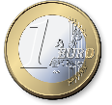
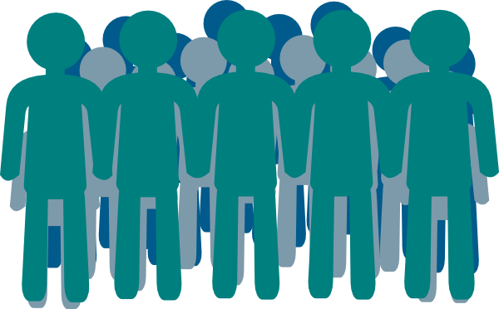
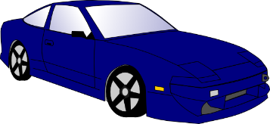
eu
Euro
heute
[today]
Deutschland
Freund
Leute
neu
Notes:
Timing: 2 minutes
Aim: To introduce/consolidate SSC [eu]
Procedure:
Introduce and elicit the pronunciation of the individual SSC [eu] and then the source word again ‘Deutschland’ (with gesture, if using).
Then present and elicit the pronunciation of the five cluster words.
The cluster words have been chosen for their high-frequency, from a range of word classes, with the SSC (where possible) positioned within a variety of syllables within the words (e.g. initial, 2nd, final etc.). Additionally, we have tried to use words that build cumulatively on previously taught SSCs (see the Phonics Teaching Sequence document) and do not include new SSCs. Where new SSCs are used, they are often consonants which have a similar symbol-sound correspondence in English.
Word frequency (1 is the most frequent word in German): Deutschland [N/A proper noun]; Euro [333] heute [121]; Freund [327]; neu [80]; Leute[163].
Source: Jones, R.L. & Tschirner, E. (2006). A frequency dictionary of German: core vocabulary for learners. Routledge

Slide 7
eu
Euro
heute
Deutschland
Freund
Leute
neu
Notes:
With sound and no pictures to focus all attention on the sound-symbol correspondence.

Slide 8
eu
Euro
heute
Deutschland
Freund
Leute
neu
Notes:
Without sound to elicit pronunciation (without first hearing the teacher).
Teacher to elicit pronunciation by asking “Wie sagt man…”

Slide 9
[eu]
Phonetik
Consolidation [1]
Y7 T3.2 Week 6 Slides 2-3

Slide 10
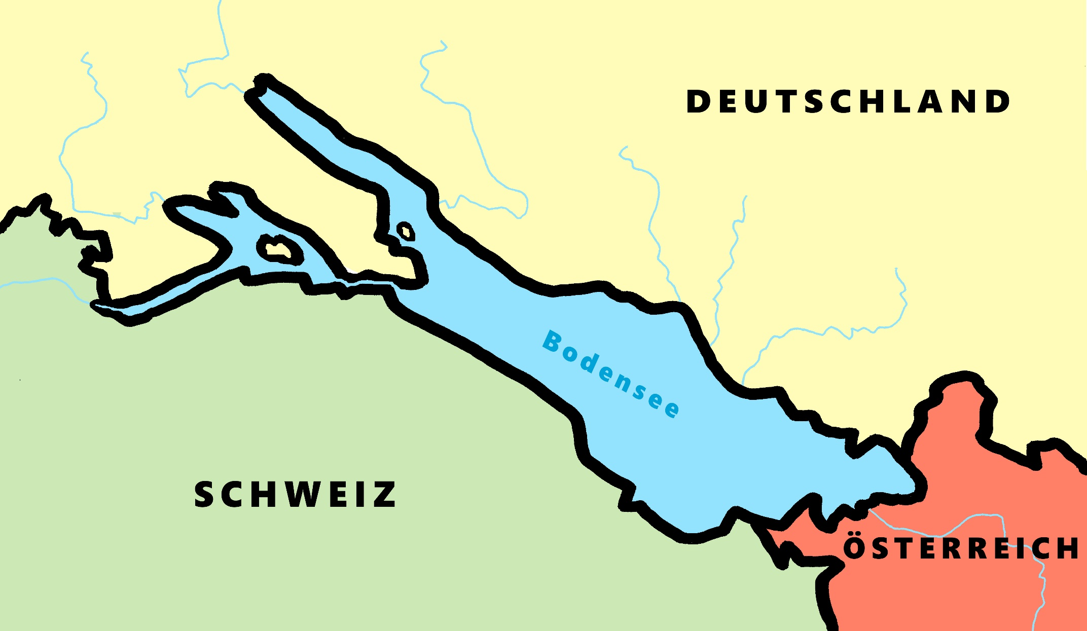
Phonetik - der Bodensee [1/2]
hören / schreiben
4
Allensbach
5
Wallhausen
3
Radolfzell
6
Hagnau
7
Friedrichshafen
1
Kreuzlingen
2
Steckborn
9
Romanshorn
8
Altenrhein
Notes:
Phonetik [1]
Time: 5 minutes Aim: To practise recognising and transcribing 10 previously taught SSC, in unknown words.
Procedure: 1. Click number to hear the full word. Students listen and transcribe only the missing letters. 2. Animations support item-by-item checking, as instant feedback on each SSC may be particularly helpful for students’ learning. 3. Teachers can additionally ask, Wo liegt [Hagnau]? Es liegt in [Deutschland]… Students have met the use of ‘in’ with die Schweiz. It will be helpful to focus their attention on the use of ‘in’ + der + Schweiz here, reminding them of the ‘in’ + movement (R2-accusative) or location (R3-dative) change. SSC revisited here: [eu] [st-] [z] [ch-hard] [w] [au] [ie] [ch-soft] [ei] [r] Transcript: 1 Kreuzlingen 2 Steckborn 3 Radolfzell 4 Allensbach 5 Wallhausen 6 Hagnau 7 Friedrichshafen 8 Altenrhein 9 Romanshorn

Slide 11
Phonetik - der Bodensee [1/2]
lesen / sprechen
9
Ludwigshafen
1
2
Friedrichshafen
Stein am Rhein
6
Konstanz
8
7
Reichenau
5
Altnau
3
Bregenz
4
Rorschach
Notes:
Phonetik [2]
Time: 5 minutes Aim: To practise reading aloud / saying 10 previously taught SSC, in unknown words (apart from Deutschland, which starts the task off). Here, 9 additional towns on the Bodensee are used.
Procedure: 1. Students work in pairs to pronounce each of the towns. 2. Click number to hear and check pronunciation. SSC revisited here: [eu] [st-] [z] [ch-hard] [w] [au] [ie] [ch-soft] [ei] [r] [sch] Transcript: 1 Deutschland 2 Friedrichshafen 3 Bregenz 4 Rorschach 5 Altnau 6 Konstanz 7 Reichenau 8 Stein am Rhein 9 Ludwigshafen

Slide 12
[eu]
Phonetik
Consolidation [2]
Y8 T3.1 Week 5 Slides 2-3; 6-7; 32-33

Slide 13
eu
Deutschland
Notes:
Timing: 1 minute
Aim: To introduce/consolidate SSC [eu]
Procedure: 1. Present the letter(s) and say the [eu] sound first, on its own. Students repeat it with you. 2. Bring up the word ”Deutschland” on its own, say it, students repeat it, so that they have the opportunity to focus all of their attention on the connection between the written word and its sound.
3. A possible gesture for this would be to act as though you are addressing Germany, saying ‘Oy! Deutschland!’ and jabbing your finger into the air (joyfully) twice, once on ‘Oy!’ and once on the first syllable of Deutschland.
4. Roll back the animations and work through 1-3 again, but this time, dropping your voice completely to listen carefully to the students saying the [eu] sound, pronouncing ”Deutschland” and, if using, doing the gesture. Word frequency (1 is the most frequent word in German): Deutschland [N/A proper noun]
Source: Jones, R.L. & Tschirner, E. (2006). A frequency dictionary of German: core vocabulary for learners. Routledge

Slide 14
eu
Euro
heute
[today]
Deutschland
Freund
Leute
neu
Notes:
Timing: 2 minutes
Aim: To introduce/consolidate SSC [eu]
Procedure:
Introduce and elicit the pronunciation of the individual SSC [eu] and then the source word again ‘Deutschland’ (with gesture, if using).
Then present and elicit the pronunciation of the five cluster words.
The cluster words have been chosen for their high-frequency, from a range of word classes, with the SSC (where possible) positioned within a variety of syllables within the words (e.g. initial, 2nd, final etc.). Additionally, we have tried to use words that build cumulatively on previously taught SSCs (see the Phonics Teaching Sequence document) and do not include new SSCs. Where new SSCs are used, they are often consonants which have a similar symbol-sound correspondence in English.
Word frequency (1 is the most frequent word in German): Deutschland [N/A proper noun]; Euro [333] heute [121]; Freund [327]; neu [80]; Leute[163].
Source: Jones, R.L. & Tschirner, E. (2006). A frequency dictionary of German: core vocabulary for learners. Routledge

Slide 15
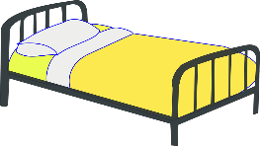
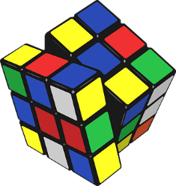
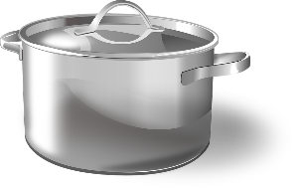
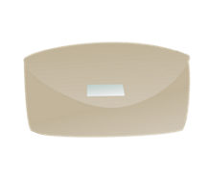
Was packt Wolfgang ein*?
hören / schreiben
Die Familie zieht um*. Es gibt nicht viel Platz im Auto! Wolfgang darf nur die Sachen mit [eu] und [äu] mitnehmen. Welche sind das?
das Bettzeug
die Leuchte
__
__
die Vorh ä nge
__
die Puppenhäuser
die Handt ü cher
der Kl ei derschrank
__
__
__
die T ö pfe
die Fäustlinge
__
__
das Spielzeug
__
__
*einpacken = to wrap up, box
*umziehen = to move house
der Geldbeutel
der Fotor a hmen
__
Notes:
Timing: 5 minutes Aim: Aural recognition of SSCs [eu] and [äu]. Raising awareness that this sound corresponds to two spelling patterns. Procedure: 1. Check students understand the context and task instructions. They haven’t come across the word mitnehmen before, but should be able to work out its meaning using their knowledge of mit and nehmen.
2. Begin with Bettzeug in the top left. Click on picture to hear the word said aloud.
3. Students decide whether they hear the target sound or not. Ask: Hörst du SSC eu? Students respond ja/nein, or the teacher could ask ‘Wer denkt ja/nein?’ to take a vote. At advanced levels, students could volunteer the correct SSC where they answer nein.
4. Click to reveal the missing SSC. Where a different SSC is revealed, click again to make the item disappear as Wolfgang doesn’t pack it!
5. Continue for the others, working from left to right.
Transcript: das Bettzeug
die Leuchte
die Vorhänge
die Puppenhäuser
die Handtücher
der Kleiderschrank
die Töpfe
die Fäustlinge
das Spielzeug
der Geldbeutel
der Fotorahmen Word frequency of unknown words used (1 is the most frequent word in German): Bettzeug [>5000], Vorhang [3513], Topf [4136], Geldbeutel [>5000], Leuchte [>5000], Spielzeug [>5000], Handtücher [>5000], Fäustling [>5000], Kleiderschrank [>5000], Fotorahmen [633/753], Puppenhaus [4676/147], mitnehmen [1459], einpacken [>5000], umziehen [>5000] Source: Jones, R.L. & Tschirner, E. (2019). A frequency dictionary of German: core vocabulary for learners. Routledge

Slide 16
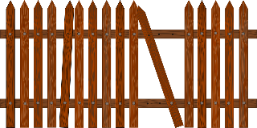
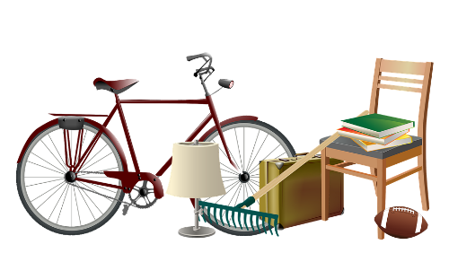
Was packt Mia nicht ein?
Was bringt Mia mit? Lies die Wörter laut vor.
Mia darf keine Sachen mit diesen SSC mitbringen. Was packt sie nicht ein? Lies die Wörter laut vor.
lesen / sprechen
die Zukäufe
[additional purchases]
die Seife
der Zaun
das Kreuz
das Brettspiel
die sauren Gurken
das Zeug
[stuff]
die Eule
die Werkzeuge
das Zeugnis
die Gläser
die Kräuter
Notes:
Timing: 5 minutes Aim: Written recognition of SSCs pronounced liked [eu]. Oral production of these and a selection of other SSCs. Procedure: 1. Click to bring up the first task. Say the target SSC aloud to remind students what to look for.
2. Students work in pairs and decide which words contain the target SSC. They practise saying these aloud for 2 minutes.
3. Elicit answers by asking: Was packt Mia nicht ein?
4. Click on the pictures representing words containing [eu] and [äu] to hear them said aloud.
5. Click to remove these words, as Mia is not packing them.
6. Click to bring up the second task. Students practise saying the words for 1 minute.
7. Click on the pictures to hear the remaining words said aloud. Students repeat.
Transcript: die Zukäufe
der Zaun
die Seife
das Zeug
das Kreuz
das Zeugnis
die Gläser
die saure Gurken
das Brettspiel
die Kräuter
die Werkzeuge
die Eule
Word frequency of unknown words used (1 is the most frequent word in German): Kräuter [>5000], Eule [>5000], Schlagzeuge [>5000], Werkzeug [3681], Zeugnis [4456], Brettspiel [>5000], Zukauf [>5000], Kreuz [2358], Zeug [3069], Zaun [3279], Brettspiel [4845/328], Glas [885], mitnehmen [1459], einpacken [>5000] Source: Jones, R.L. & Tschirner, E. (2019). A frequency dictionary of German: core vocabulary for learners. Routledge

Slide 17
Phonetik
lesen / sprechen
Partner A’s Sentences:
1. Er träumt von einstürzenden Gebäuden.
2. Der Verkäufer ist über die häufigen Diebstähle enttäuscht.
3. Der europäische Zeuge täuscht den Richter, und kommt ins
Gefängnis.
 | Tally of [eu] [äu] heard
1
2
3
Partner B’s Sentences:
4. Das Fräulein seufzt, denn das ganze Zeug ist weg.
5. Heutzutage werden viele Leute
neunzig Jahre alt.
6. Man hat vor Kurzem ein neues Gebäude gebaut.
 | Tally of [eu] [äu] heard
4
5
6
Notes:
DO NOT DISPLAY THIS SLIDE Printable version is provided.
Timing: 5 minutes [2 slides].
Aim: Fluency development. Procedure: 1. Students work in pairs.
2. Partner A reads a sentence containing a mixture of known and unknown words.
3. Partner B tallies the number of [eu/äu] SSCs they hear. Hence there is a joint responsibility to get the answer right.
4. Native speaker recordings are provided on the following slides. Students can use these to check their tallies.
5. Answers and translations are also provided on the following slide.
Word frequency of unknown words used (1 is the most frequent word in German): träumen [1793], einstürzend [>5000], Gebäude [1386], Verkäufer [2374], enttäuschen [2042], Diebstahl [>5000], wenn [42], Zeug [3069], Richter [2286]. Täuschen [3613], Europäer [2750], Gefängnis [2523], Fräulein [3265], seufen [>5000], weg [965], heutzutage [3356], erscheinen [408] Source: Jones, R.L. & Tschirner, E. (2019). A frequency dictionary of German: core vocabulary for learners. Routledge

Slide 18
Phonetik
lesen / sprechen
 | Er träumt von einstürzenden Gebäuden. | He dreams of falling buildings.
 | Der Verkäufer ist über die häufigen Diebstähle enttäuscht. | The salesman is disappointed by the frequent thefts.
 | Der europäische Zeuge täuscht den Richter und kommt ins Gefängnis. | The European witness deceives the judge and goes to prison.
 | Das Fräulein seufzt, denn das ganze Zeug ist weg. | The young lady is sighing because all the stuff is gone.
 | Heutzutage werden viele Leute neunzig Jahre alt. | Nowadays a lot of people live to be ninety.
 | Ein neues Gebäude ist vor kurzer Zeit erschienen. | A new building has recently appeared.
1
2
3
4
5
6
Notes:
Answers for the activity on the previous slide.
Procedure: 1. Click numbers to hear sentence pronounced by native speaker.
2. Click to reveal transcript with highlighted SSCs.
3. Click again to reveal translation of sentence.
Transcript: 1. Er träumt von einstürzenden Gebäuden.
2. Der Verkäufer ist über die häufigen Diebstähle enttäuscht.
3. Der europäische Zeuge täuscht den Richter und kommt ins Gefängnis.
4. Das Fräulein seufzt, denn das ganze Zeug ist weg.
5. Heutzutage werden viele Leute neunzig Jahre alt.
6. Man hat vor Kurzem ein neues Gebäude gebaut.
Word frequency of unknown words used (1 is the most frequent word in German): träumen [1793], einstürzend [>5000], Gebäude [1386], Verkäufer [2374], enttäuschen [2042], Diebstahl [>5000], wenn [42], Zeug [3069], Richter [2286]. Täuschen [3613], Europäer [2750], Gefängnis [2523], Fräulein [3265], seufen [>5000], weg [965], heutzutage [3356], erscheinen [408] Source: Jones, R.L. & Tschirner, E. (2019). A frequency dictionary of German: core vocabulary for learners. Routledge

