Slide 1
German phonics collection
long and short [e]
Artwork: Steve Clarke
Date updated: 10 / 08 / 21
Notes:
Artwork by Steve Clarke. All additional pictures selected are available under a Creative Commons license, no attribution required.

Slide 2
long and short [e]
Phonetik
Introduction
Y7 T1.1 Week 2 Slides 2-14; 35-39

Slide 3
e
geben
Notes:
Timing: 1 minute
Aim: To introduce/consolidate [] SSC [ei]
Procedure: 1. Present the letter(s) and say the [ei] sound first, on its own. Students repeat it with you. 2. Bring up the word ”frei” on its own, say it, students repeat it, so that they have the opportunity to focus all of their attention on the connection between the written word and its sound.
3. A possible gesture for this would be [to stretch both arms up in the air (pointing outwards slightly to make a Y shape with your body), and smile!]
4. Roll back the animations and work through 1-3 again, but this time, dropping your voice completely to listen carefully to the students saying the [ei] sound, pronouncing ”frei” and, if using, doing the gesture. Word frequency (1 is the most frequent word in German): frei [318] Source: Jones, R.L. & Tschirner, E. (2006). A frequency dictionary of German: core vocabulary for learners. Routledge

Slide 4
e
geben
Notes:
With sound and no pictures to focus all attention on the sound-symbol correspondence.

Slide 5
e
geben
Notes:
Without sound to elicit pronunciation (without first hearing the teacher).
Teacher to elicit pronunciation by asking “Wie sagt man…”

Slide 6
e
mehr
Leben
geben
sehen
Idee
Meer
Notes:
Timing: 1 minute
Aim: To introduce/consolidate SSC [e]
Procedure:
Introduce and elicit the pronunciation of the individual SSC [e] and then the source word again ‘geben’ (with gesture, if using).
Then present and elicit the pronunciation of the five cluster words.
The cluster words have been chosen for their high-frequency, from a range of word classes, with the SSC (where possible) positioned within a variety of syllables within the words (e.g. initial, 2nd, final etc.). Additionally, we have tried to use words that build cumulatively on previously taught SSCs (see the Phonics Teaching Sequence document) and do not include new SSCs. Where new SSCs are used, they are often consonants which have a similar symbol-sound correspondence in English.
Word frequency (1 is the most frequent word in German): geben [57]; mehr [58] Leben [220]; sehen [81]; Meer [977]; Idee [641].
Source: Jones, R.L. & Tschirner, E. (2006). A frequency dictionary of German: core vocabulary for learners. Routledge

Slide 7
e
mehr
Leben
geben
sehen
Idee
Meer
Notes:
With sound and no pictures to focus all attention on the sound-symbol correspondence.

Slide 8
e
mehr
Leben
geben
sehen
Idee
Meer
Notes:
Without sound to elicit pronunciation (without first hearing the teacher).
Teacher to elicit pronunciation by asking “Wie sagt man…”

Slide 9
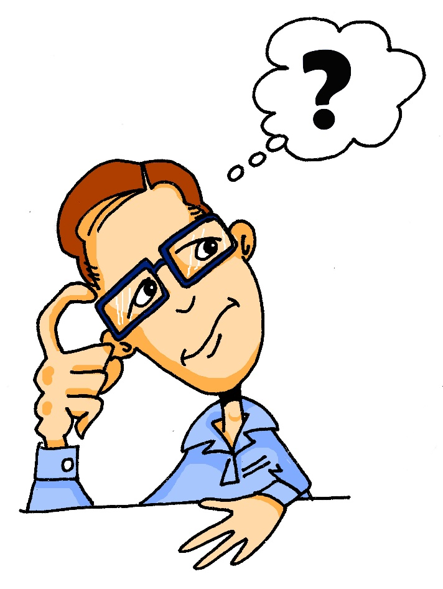
e
denken
Notes:
Timing: 1 minute
Aim: To introduce/consolidate SSC [e]
Procedure: 1. Present the letter(s) and say the [e] sound first, on its own. Students repeat it with you. 2. Bring up the word ”denken” on its own, say it, students repeat it, so that they have the opportunity to focus all of their attention on the connection between the written word and its sound.
3. A possible gesture for this would be to put your index finger to your temple and look thoughtful!
4. Roll back the animations and work through 1-3 again, but this time, dropping your voice completely to listen carefully to the students saying the [e] sound, pronouncing ”denken” and, if using, doing the gesture. Word frequency (1 is the most frequent word in German): denken [124] Source: Jones, R.L. & Tschirner, E. (2006). A frequency dictionary of German: core vocabulary for learners. Routledge

Slide 10
e
denken
Notes:
With sound and no pictures to focus all attention on the sound-symbol correspondence.

Slide 11
e
denken
Notes:
Without sound to elicit pronunciation (without first hearing the teacher).
Teacher to elicit pronunciation by asking “Wie sagt man…”

Slide 12
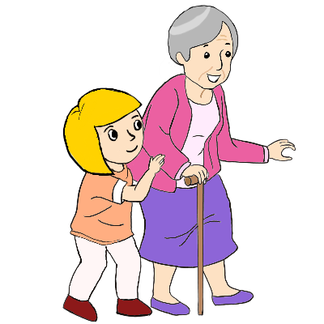
e
besser
Ende
denken
helfen
eng
Bett
Notes:
Timing: 2 minutes
Aim: To introduce/consolidate SSC [e]
Procedure:
Introduce and elicit the pronunciation of the individual SSC [e] and then the source word again ‘denken’ (with gesture, if using).
Then present and elicit the pronunciation of the five cluster words.
The cluster words have been chosen for their high-frequency, from a range of word classes, with the SSC (where possible) positioned within a variety of syllables within the words (e.g. initial, 2nd, final etc.). Additionally, we have tried to use words that build cumulatively on previously taught SSCs (see the Phonics Teaching Sequence document) and do not include new SSCs. Where new SSCs are used, they are often consonants which have a similar symbol-sound correspondence in English.
Word frequency (1 is the most frequent word in German): denken [124]; besser [231] Ende [204]; helfen [406]; Bett [654]; eng [591].
Source: Jones, R.L. & Tschirner, E. (2006). A frequency dictionary of German: core vocabulary for learners. Routledge

Slide 13
e
besser
Ende
denken
helfen
eng
Bett
Notes:
With sound and no pictures to focus all attention on the sound-symbol correspondence.

Slide 14
e
besser
Ende
denken
helfen
eng
Bett
Notes:
Without sound to elicit pronunciation (without first hearing the teacher).
Teacher to elicit pronunciation by asking “Wie sagt man…”

Slide 15
Phonetik
hören
Lang oder kurz?
 | geben | denken
1
Leben
2
Bett
3
besser
4
Ende
Notes:
Timing: 4 minutes Aim: To provide practice in distinguishing between lond and short vowel ‘e’ sounds Procedure: 1. Click on the audio buttons to play words.
2. Students listen and tick the appropriate column, according to wheter the vowel sound is short or long.
3. Click to animate the answers.
Transcript:
Leben
Bett
besser
Ende
Word frequency (1 is the most frequent word in German): Leben [220]; besser [231] Ende [204]; Bett [654] Source: Jones, R.L. & Tschirner, E. (2006). A frequency dictionary of German: core vocabulary for learners. Routledge

Slide 16
e
geben
Notes:
Without sound to elicit pronunciation (without first hearing the teacher).
Teacher to elicit pronunciation by asking “Wie sagt man…”

Slide 17
e
mehr
Leben
geben
sehen
Idee
Meer
Notes:
Without sound to elicit pronunciation (without first hearing the teacher).
Teacher to elicit pronunciation by asking “Wie sagt man…”

Slide 18
e
denken
Notes:
Without sound to elicit pronunciation (without first hearing the teacher).
Teacher to elicit pronunciation by asking “Wie sagt man…”

Slide 19
e
besser
Ende
denken
helfen
eng
Bett
Notes:
Without sound to elicit pronunciation (without first hearing the teacher).
Teacher to elicit pronunciation by asking “Wie sagt man…”

Slide 20
Phonetik
hören
Lang oder kurz?
 | lang | kurz
1
Idee
A
E
2
eng
3
Paar
4
danke
5
Gast
6
sehen
Notes:
Timing: 5 minutes Aim: To provide practice in distinguishing between lond and short vowel ‘e’ and ‘a’ sounds Procedure: 1. Click on the audio buttons to play words.
2. Students listen and tick the appropriate column, according to wheter the vowel sound is short or long.
3. Click to animate the answers.
Transcript:
Idee
eng
Paar
danke
Gast
sehen
Word frequency (1 is the most frequent word in German): Leben [220]; besser [231] Ende [204]; Bett [654] Source: Jones, R.L. & Tschirner, E. (2006). A frequency dictionary of German: core vocabulary for learners. Routledge

Slide 21
long and short [e]
Phonetik
Consolidation [1]
Y7 T1.1. Week 6 Slides 38-41; 45-46

Slide 22
Phonetik
hören / sprechen
sagen
geben
Welt
Zug
frei
kalt
denken
Notes:
Timing: 3 minutes Aim: To revise all the SSCs introduced so far: long and short a, long and short e, ei, W, Z.
Procedure: 1. Click on the word to play the audio. Repeat if necessary.
2. Students write the whole word in full in their exercise books.
3. The next slide allows removal of the ‘blots’ to reveal the missing SSCs.

Slide 23
Phonetik
hören / sprechen
sagen
geben
Welt
Zug
frei
kalt
denken
Notes:
Timing: 1 minute Aim: To reveal the answers to the activity. Procedure: 1. Click on the ‘blots to remove them individually and reveal the missing SSCs.

Slide 24
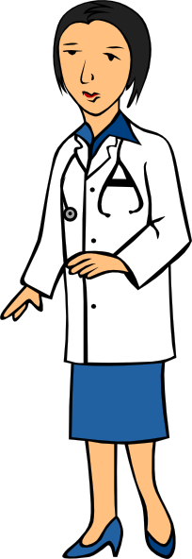
Phonetik
zehn
antworten
A
D
Zug
H
allein
C
E
Welt
klein
[alone]
Wasser
I
F
G
frei
B
Arzt
Notes:
Timing: 5 minutes Aim: To consolidate SSC knowledge
Ask students to write down which pictures go together (based on the obscured SSC).
The teacher can remind them of the source words they have just seen.
Clicking on the pictures will play the word if the students need an extra prompt.
Clicking on the paw prints will remove them.

Slide 25
Phonetik
Arzt
lesen / sprechen
antworten
60
zehn
Zug
allein
Sekunden
Welt
frei
klein
Wasser
0
LOS!
Notes:
Timing: 2 minutes (one minute per attempt) Aim: To consolidate SSC knowledge Procedure: 1. Pupils read out the words but in alphabetical order. They keep going for one minute.
2. Teacher can circulate to listen into their SSC knowledge.
Word frequency (1 is the most frequent word in German): der Arzt [614] allein [258] Source: Jones, R.L. & Tschirner, E. (2006). A frequency dictionary of German: core vocabulary for learners. Routledge

Slide 26
Phonetik
hören / schreiben
1
ei
Der Mann sit_t all__n. ☹
z
2
e
a
Der Arzt d_nkt ’W_s?!’
3
ei
i
Der Gast hat __n Z_mmer.
4
Der Freund ge_ innt __n B_tt.
w
ei
e
5
ei
a
Die Frau h_t __nen G_st.
a
6
a
Der Lehrer s_gt ‘Hurr_’. ☺
a
Notes:
Timing: 5 minutes Aim: To consolidate all SSCs introduced so far in a written transcription activity Procedure: 1. Click on the audio buttons to play the sentences.
2. Certain SSCs are missing from the transcript on the slide.
Students listen and write out the sentences in full.
3. Click to bring up the missing SSCs.
Transcript: As displayed on the slide. Word frequency (1 is the most frequent word in German): gewinnen [410] der Arzt [614] der Gast [675] das Zimmer [609] allein [258] Source: Jones, R.L. & Tschirner, E. (2006). A frequency dictionary of German: core vocabulary for learners. Routledge

Slide 27
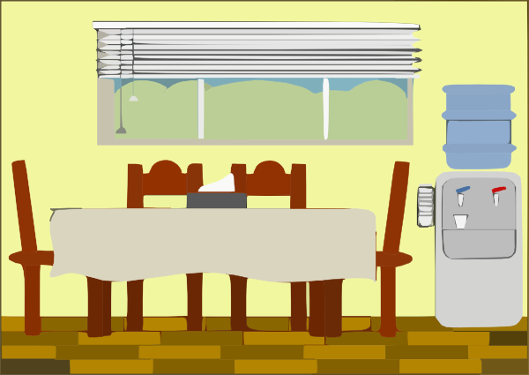
Phonetik
hören / sprechen
1
Der Mann sitzt allein. ☹
2
Der Arzt denkt ’Was?!’
3
der Artzt
Der Gast hat ein Zimmer.
4
Der Freund gewinnt ein Bett.
das Zimmer
5
Die Frau hat einen Gast.
6
Der Lehrer sagt ‘Hurra’. ☺
Notes:
Timing: 5-10 minutes Aim: To consolidate SSC and word knowledge in a listening and speaking activity Procedure (alternatives): 1. Students read each sentence aloud, as a whole-class activity or in pairs.
2) Students translate the sentences into English (orally or in writing).
3) Students play a paired vocabulary tennis task (with gestures for the verbs)
Word frequency (1 is the most frequent word in German): gewinnen [410] der Arzt [614] der Gast [675] das Zimmer [609] allein [258] Source: Jones, R.L. & Tschirner, E. (2006). A frequency dictionary of German: core vocabulary for learners. Routledge

Slide 28
long and short [e]
Phonetik
Consolidation [2]
Y7 T2.2 Week 3 Slide 4

Slide 29
[e] vs [i]
phonetik
e[long]
i[long]
geben
wir
e[short]
i[short]
denken
finden
1
gel i ngen
2
M i ttel
winden/ wenden
7
winden/ wenden
3
eng
setzen / sitzen
8
setzen / sitzen
4
werfen
blecken / blicken
9
blecken / blicken
5
Zelle
wirken / werken
10
wirken / werken
6
S i cht
Notes:
Timing: 3 minutes
Aim: Phonics refresher - e vs i.
The contrast between e and i is important for this week’s grammar point (strong verbs). Both sounds have been introduced already we are simply revisiting them here.
Procedure:
Click on the example words (denken / geben / finden / wir) to play them and remind the students of the the sounds.
The first 6 words a transcription (fill in the blank). The words are high frequency, but haven’t yet been taught.
The second four are minimal pairs (some of these are rare).
Transcript:
gelingen
Mittel
eng
werfen
Zelle
Sicht
winden / wenden
setzen / sitzen
blecken / blicken
wirken / Werken
Word frequency (1 is the most frequent word in German):
gelingen [502] Mittel [691] eng [593] werfen [718] Zelle [592] Sicht [940] winden [>5009] wenden [1530] setzen [228] sitzen [231] blecken [>5009] blicken [1256] wirken [401] werken [>5009]
Source: Jones, R.L & Tschirner, E. (2019). A frequency dictionary of German: Core vocabulary for learners. London: Routledge.

Slide 30
long and short [e]
Phonetik
Consolidation [3]
Y7 T2.2 Week 5 Slides 3-4; 6; 35

Slide 31
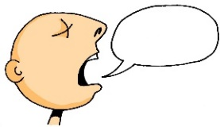
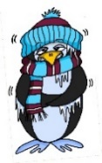
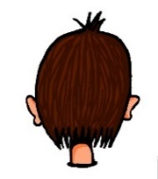
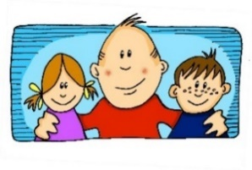
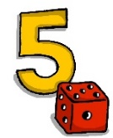
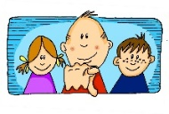
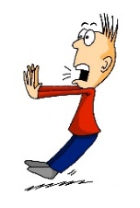
Phonetik
e
e
a
a
sagen
kalt
geben
denken
i
i
o
o
u
wir
u
finden
wo?
Kopf
ü
ü
ö
du
ö
Punkt
Tür
fünf
ä
ä
schön
plötzlich
spät
lächeln
Notes:
Timing: 3 minutes
Aim: The long and short vowel sounds in German are practised here in familiar words, with audio.
Procedure:
1. Students should listen and repeat.

Slide 32
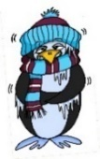
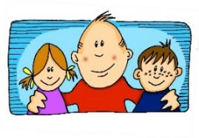
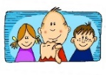
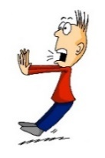
Phonetik
e
e
a
a
sagen
kalt
geben
denken
i
i
o
o
u
wir
u
finden
wo?
Kopf
ü
ü
ö
ö
fünf
du
Punkt
Tür
ä
ä
schön
plötzlich
spät
lächeln
Notes:
Timing: 3 minutes
Aim: This version of the slide is without audio.
Procedure:
1. Students should chant the words chorally first, as they appear, then perhaps individually (the teacher quizzing students on individual words; it will be important to continue to juxtapose the long and short forms of each vowel in this practice).

Slide 33
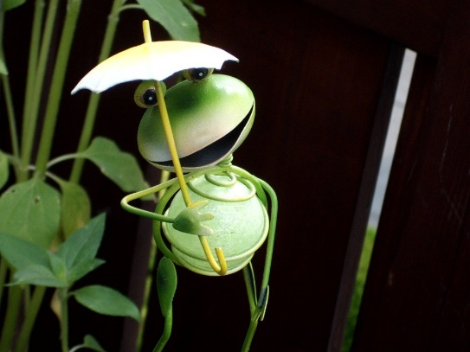
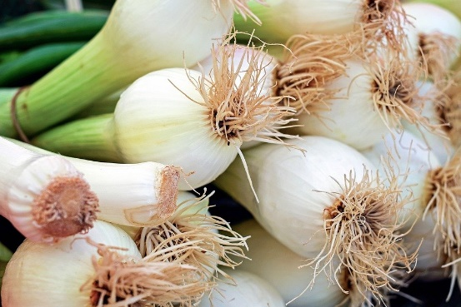
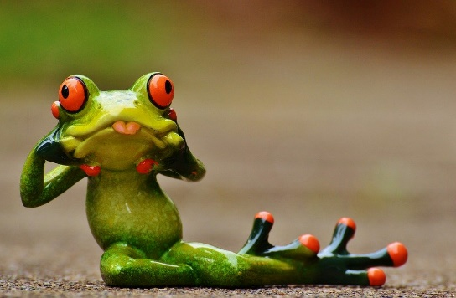
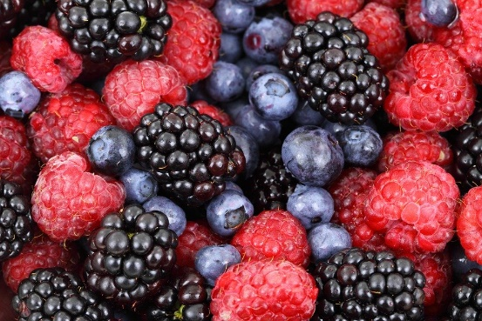
Zungenbrecher [2]
Phonetik
1
2
Fromme Frösche fressen
frische Frühlingszwiebeln,
aber freche Frösche fressen
frische Früchte.
Notes:
Timing: 3 minutes
Aim: Opportunity to practise the following SSCs: o - ö - i - ü – e.
Procedure:
1. Students listen to either the slower [1] or the faster [2] version of the tongutwister (or both in turn), then try to say it chorally or in pairs.
Transcription:
Fromme Frösche fressen
frische Frühlingszwiebeln,
aber freche Frösche fressen
frische Früchte.
Translation:
Pious frogs eat
fresh spring onions,
but eat naughty frogs
fresh fruits.
Word frequency (1 is the most frequent word in German):
fromm [>4029] Frosch [>4029] fressen [3448] frisch [1297] Frühling [3975] Zwiebel [3382] aber [32] frech [>4029] Frucht [3876]
Source: Jones, R.L & Tschirner, E. (2019). A frequency dictionary of German: Core vocabulary for learners. London: Routledge.

Slide 34
Phonetik
lesen / sprechen
Wie sagt man das?
 | a [lang] | a [kurz]
Hamburg
Graz
Kassel
Hannover
Aachen
 | e [lang] | e [kurz]
Genf
Bremen
Gelsenkirchen
Essen
Regensburg
1
1
2
2
3
3
4
4
5
5
Notes:
Timing: 5 minutes
Aim: This is a phonics recap of long and short ‘a’ and ‘e’.
Procedure:
1. Students are asked to read aloud each city, either chorally or in pairs. The table prompts ‘lang’ and ‘kurz’ are there to remind students to think about their vowels before saying them.
2. Audio to check is then available upon clicking each word, and answers are animated.
Note: Two of the towns have examples of both long and short ‘e’.
Towns listed are from Germany, Austria and Switzerland. As an additional self-study task, students may like to do an extension research task to identify which towns they know (e.g from the football team) and/or where the towns are situated.

Slide 35
long and short [e]
Phonetik
Consolidation [4]
Y7 T3.1 Week 2 Slides 5; 9

Slide 36
Samstagnachmittag
lesen / hören
Heidi schläft nicht. Am Wochenende ist sie sehr aktiv. Heidi mag Kunst. Sie malt eine(n) …
a) Stirn
b) Stern
2
Notes:
Here, SSCs short [e] and short [i] are contrasted.
Teacher to draw attention to use of word order 2 in the second sentence, which starts with a time phrase. Before eliciting the English translation, remind students that the time phrase normally appears at the end of the sentence in English.
Students have not yet met the cognate aktiv [859]. Teacher to elicit pronunciation of this word, asking students to draw on their knowledge of SSC [v].
Students have not yet encountered malen [1851]. Teacher to draw attention to the third person form malt, and ask students what the infinitive ‘to paint’ must be.
Frequencies of unknown vocabulary: Stirn [1943], Stern [1446]
Transcript
Stirn

Slide 37
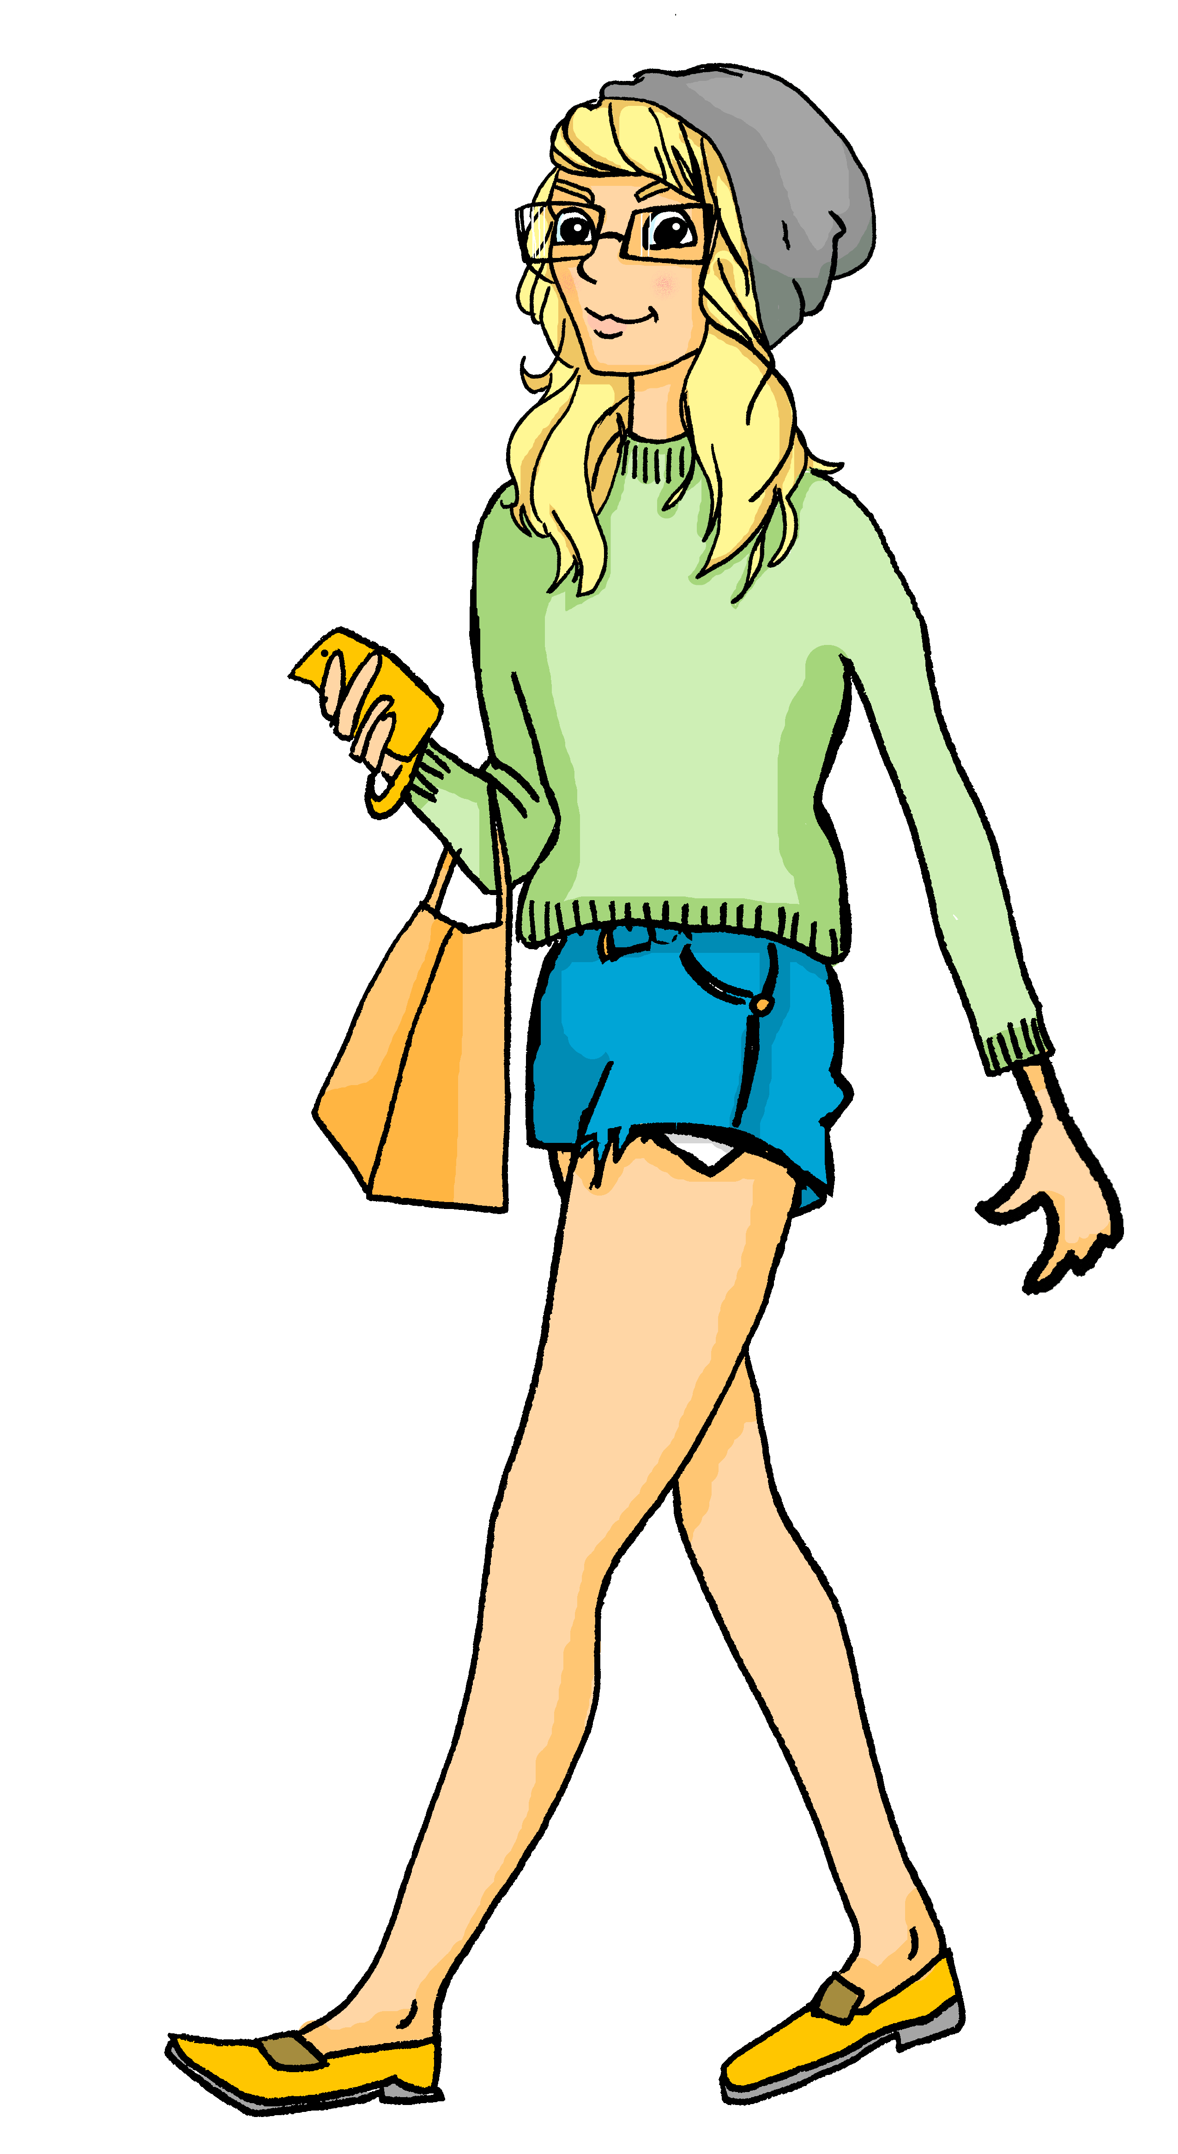
Samstagnachmittag
lesen / hören
Heidi geht ganz relaxt in den Park. Wolfgang kommt in zehn Minuten.
Sie bleibt ein Moment stehen, und sieht einen/eine …
a) Berg
b) Burg
6
Notes:
Here, SSCs short [e] and [u] are contrasted.
Students have not yet met cognates relaxen [>4034] or Moment [383]. They have met cognate Minute [360] as an SSC cluster word.
Frequencies of unknown vocabulary: Berg [1134], Burg [2984]
Transcript
Burg

Slide 38
long and short [e]
Phonetik
Consolidation [5]
Y7 T3.2 Week 6 Slide 20

Slide 39
Wie heißt die Band?
Phonetik
Alastair telefoniert mit Mia. Sie reden über deutsche Bands. Wie heißen sie?
 | die P r i n z e n
 | J u l i
 | F e t t e s B r o t
 | die F a n t a s t i s c h e n V i e r
 | S ö h n e M a n n h e i m s
 | S p o r t f r e u n d e S t i l l e r
 | R o s e n s t o l z
 | die Ä r t z e
1
_
2
_
3
_
_
4
_
_
_
_
_
5
_
_
_
6
_
_
_
_
7
_
_
8
_
_
Notes:
Phonetik [1] Time: 5 minutes
Aim: To practise recognising and transcribing 14 previously taught SSC, in unknown words.
Note: These are real German band names.
Procedure: 1. Click number to hear the full word. Students listen and transcribe only the missing letters. 2. Animations support item-by-item checking, as instant feedback on each SSC may be particularly helpful for students’ learning. SSC revisited here: [z] [j] [r-consonantal] [o-long] [sch] [v] [r-vocalic] [ö-long] [ei] [st] [-er] [st] [ä] [-e]
Transcript: [1] die Prinzen
[2] Juli
[3] Fettes Brot
[4] die Fantastischen Vier
[5] Söhne Mannheims
[6] Sportfreunde Stiller
[7] Rosenstolz
[8] die Ärzte

Slide 40
long and short [e]
Phonetik
Consolidation [6]
Y8 T1.1 Week 6 Slide 26

Slide 41
Phonetik: Was passt nicht in die Reihe?
hören
Welches Wort ist nicht wie die anderen Wörter?
1
Bruder / Schwester / Spiele
2
Schauspieler / Schule / Stunde
3
Partner / Sänger / Karte
4
Jede / nächster / diese
5
Welche / jeder / dieser
Notes:
Timing: 3 minutes Aim: To notice –e vs –er in a contrasting context. Procedure: 1. Click on a number to play a three-word sequence.
2. For each sequence say which one is the odd one out.
3. Click to check answers.
Transcript: 1. Bruder / Schwester / Spiele
2. Schauspieler / Schule / Stunde
3. Partner / Sänger / Karte
4. Jede / nächster / diese
5. Welche / jeder / dieser
Word frequency (1 is the most frequent word in German): Source: Jones, R.L. & Tschirner, E. (2006). A frequency dictionary of German: core vocabulary for learners. Routledge

Slide 42
long and short [e]
Phonetik
Consolidation [7]
Y8 T2.2 Week 1 Slides 2; 21

Slide 43
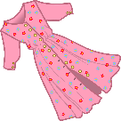
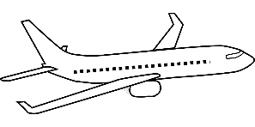
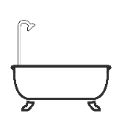
Pluralformen – [-e] oder [-er]?
About 75% neuter nouns add [-e] for their plural and 25% add [-er].
hören / schreiben
As you know, German final [-e]is not silent, but very short, e.g. danke, Klasse.
German final [-er] is a bit longer. Drop your jaw to say it, e.g. Hunger, Bruder.
Hör gut zu. Ist die Pluralform mit [-e] oder [-er]? Schreib 1-10 und die Pluralform.
Adding [-e] is Plural Rule 1, [-er] is Rule 4.
 | die Schiffe |  | die Kleider
 | die Flugzeuge |  | die Telefone
 | die Gesichter |  | die Bäder
 | die Haare |  | die Schlösser
 | die Einzelkinder |  | die Male
1
6
2
7
3
8
4
9
5
10
Notes:
Timing: 5 minutes Aim: This is a phonics activity to practise differentiating aurally between final [-e] and [-er] and connecting these SSC with the plural forms of previously learnt singular nouns. It connects SSC knowledge with building grammar knowledge of plural forms. Note – the plurals of these nouns have not previously been encountered (with the exception of Haare). Procedure: 1. Listen and transcribe the full word, paying particular attention to the final phoneme.
2. Click to reveal answers.
Transcript: die Schiffe die Flugzeuge die Gesichter die Haare die Einzelkinder die Kleider die Telefone die Bäder die Schlösser die Male Word frequency (1 is the most frequent word in German): Bad [1637] Einzelkind [308/133] Flugzeug [1776] Gesicht [346] Haare [748] Kleid [1780] Mal [82] Schiff [1176] Schloss [1907] Telefon [1595] Source: Jones, R.L. & Tschirner, E. (2019). A frequency dictionary of German: core vocabulary for learners. Routledge

Slide 44
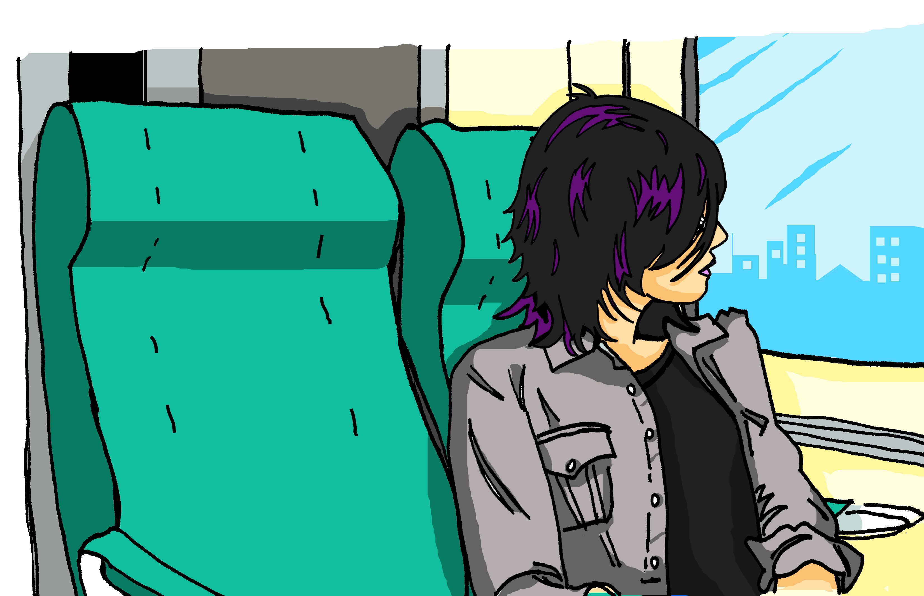
Was war es?
Hör zu. Ist die SSC [-e] oder [-er]? Schreib 1-5 und A-E.
hören / sprechen
Katja sitzt im Zug und telefoniert mit Alastair. Es ist sehr laut im Zug!
ein netter Mann
eine nette Frau
Was?! Was war das??!!!
ein einfacher Monat
eine einfache Woche
eine schwere Tasche
ein schwerer Rucksack
ein
kurzer Tag
ein jungerHund
eine kurze Liste
eine junge Katze
eine helle Sonne
ein heller Stern
ein enger Platz
eine enge Straße
1
2
3
4
5
A
B
C
D
E
F
G
H
Notes:
Timing: 6 minutes Aim: To practise aural differentiation (then oral production) of the SSC [-e] and [-er], this time as adjective endings. Procedure: 1. Click audio buttons 1-5 to hear the three-word audio sequences of adjectives.
2. Students choose between two options each time, based on the difference in adjective ending.
3. Click to reveal answers. This could be done item by item. Note: The difference is sound is very small with these two SSC. Reassure students of this. Play the audio several times, as requested, and perhaps correct item-by-item. It will get clearer for them the more examples they do.
4. Students then use the same slide to practise producing the two SSC, directing their partner to a particular letter by saying an appropriate three-adjective sequence.
Transcript: 1. nette – einfache – enger 2. netter – schwerer – junge 3. netter – schwere – kurzer 4. nette – einfacher – helle 4. netter – schwerer - junger
Answers: 1. G 2. D 3. B 4. E 5. C

Slide 45
long and short [e]
Phonetik
Consolidation [8]
Y8 T2.2 Week 4 Slide 2

Slide 46
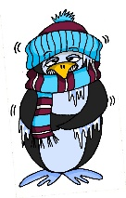
Phonetik
lesen / sprechen
Sag die Wörter. Wie viele enthalten die SSC?
[e]
[ch]
[s]
[o]
[a]
[ä]
denken
ich
sollen
Wo?
kalt
lächeln
 |  | ?
 | [e]
 | [ch]
 | [s]
 |  | ?
 | [o]
 | [a]
 | [ä]
eng – Bett – Weg
2
ohne – Telefon – Rock
2
reich – jedoch – einfach
1
alt – arm – normal
1
unser – langsam – alles
2
2
hängen – Aktivität – schnell
Notes:
Timing: 3 minutes Aim: A read aloud activity to revise 12 SSC (six explicitly, and six by contrast) using a range of new, revisited and unfamiliar vocabulary. Procedure: 1. Click on each individual SSC to hear it.
2. Elicit the source word from students, if remembered. Note that 4/6 these words have since been taught as key vocabulary (with sollen and lächeln to follow on the SOW)
3. Bring up the source words to check, and for reference for the read aloud activity.
4. Students pronounce the sets of three words, individually or in pairs, and decide how many contain the target SSC.
5. Optional – Click on the words to hear the sets of words pronounced. 6. Reveal the answers. 7. Optional – elicit the English meanings of the vocabulary.
Transcript:
eng – Bett – Weg
reich – jedoch – einfach
unser – langsam – alles
ohne – Telefon – Rock
alt – arm – normal
hängen – Aktivität – schnell
Word frequency of unknown words (1 is the most frequent word in German): hängen [580] Weg [220] Source: Jones, R.L. & Tschirner, E. (2019). A frequency dictionary of German: core vocabulary for learners. Routledge

Slide 47
long and short [e]
Phonetik
Consolidation [9]
Y8 T2.2 Week 5 Slides 2; 4; 22; 24-26

Slide 48
e
besser
Ende
denken
helfen
eng
Bett
Notes:
Timing: 2 minutes
Aim: To introduce/consolidate SSC [e]
Procedure:
Introduce and elicit the pronunciation of the individual SSC [e] and then the source word again ‘denken’ (with gesture, if using).
Then present and elicit the pronunciation of the five cluster words.
The cluster words have been chosen for their high-frequency, from a range of word classes, with the SSC (where possible) positioned within a variety of syllables within the words (e.g. initial, 2nd, final etc.). Additionally, we have tried to use words that build cumulatively on previously taught SSCs (see the Phonics Teaching Sequence document) and do not include new SSCs. Where new SSCs are used, they are often consonants which have a similar symbol-sound correspondence in English.
Word frequency (1 is the most frequent word in German): denken [124]; besser [231] Ende [204]; helfen [406]; Bett [654]; eng [591].
Source: Jones, R.L. & Tschirner, E. (2006). A frequency dictionary of German: core vocabulary for learners. Routledge

Slide 49
kurzes [e] oder [ä]?
hören / schreiben
Short [e] and [ä] sound the same in German.
As you know, some nouns with [a] form their plural by adding –e and an umlaut.
Hör dir die Pluralformen an. Ist das [e] oder [ä]? Schreib die Plural- und Singularformen.
1
Hände
Hand
4
Städte
Stadt
7
Konzepte
Konzept
2
Betten
Bett
5
Enden
Ende
8
Elemente
Element
3
Modelle
Modell
6
Fälle
Fall
[case]
9
Anwälte
Anwalt
Notes:
Timing: 5 minutes Aim: To practise recall of plural forms with [e] and [ä] and to associate them with singular forms. Procedure: 1. Click on an action button to play the recording of a plural form.
2. Write down the plural and singular form of the word.
3. Click on the mouse to reveal and check answers.
4. Ensure meanings are clear.
Transcript: Hände
Betten Modelle Enden Städte
Fälle Konzept Elemente Anwälte Word frequency untaught and cognate words (1 is the most frequent word in German): Bett [638] Modell [708] Ende [183] Konzept [1623] Element [699] Source: Jones, R.L. & Tschirner, E. (2019). A frequency dictionary of German: core vocabulary for learners. Routledge

Slide 50
e
mehr
Leben
geben
sehen
Idee
Meer
Notes:
Timing: 1 minute
Aim: To introduce/consolidate SSC [e]
Procedure:
Introduce and elicit the pronunciation of the individual SSC [e] and then the source word again ‘geben’ (with gesture, if using).
Then present and elicit the pronunciation of the five cluster words.
The cluster words have been chosen for their high-frequency, from a range of word classes, with the SSC (where possible) positioned within a variety of syllables within the words (e.g. initial, 2nd, final etc.). Additionally, we have tried to use words that build cumulatively on previously taught SSCs (see the Phonics Teaching Sequence document) and do not include new SSCs. Where new SSCs are used, they are often consonants which have a similar symbol-sound correspondence in English.
Word frequency (1 is the most frequent word in German): geben [57]; mehr [58] Leben [220]; sehen [81]; Meer [977]; Idee [641].
Source: Jones, R.L. & Tschirner, E. (2006). A frequency dictionary of German: core vocabulary for learners. Routledge

Slide 51
long [e] oder [ä]?
hören / schreiben
As you know, short [e] and [ä] sound the same in German.
Long [e] and [ä] sound a bit different.
However, some German speakers pronounce the long [e] and [ä] in the same way.
To practise, our speaker always pronounces [ä] differently from [e] in the next activity.
Notes:
Timing: 1 minute Aim: To explain the pronunciation similarity/difference between long [e] and [ä] and prepare students for the next activity. Procedure: 1. Click to present the new information.

Slide 52
Phonetik
hören
Hör zu. Schreib 1- 8 und [e] oder [ä].
 | [e] | [ä] | Wort auf Deutsch
1
ähnlich
(similar)
2
zählen
(to count)
3
Fehler
(mistake)
4
Fernsehen
(tv)
5
Jahrzehnt
(decade)
6
jährlich
(annually)
7
dreht
(turns)
8
ehrlich
(honest)
Notes:
Timing: 4 minutes Aim: To practise SSC long [e] and [ä] with mostly unknown vocabulary, compelling students to apply their phonics knowledge. Much of this vocabulary will appear later in Year 8. Procedure: 1. Click to hear the words. Note: the first word is known. The idea is that this will help students to ‘anchor’ the [ä] sound securely before listening to the other words.
2. Students write [e] or [ä] and try to transcribe the whole word, if able. 3. Click to reveal answer and word spelling. Word frequency (1 is the most frequent word in German): Fehler [861] zählen [704] jährlich [1707] Fernsehen [1444] Jahrzehnt [1123] ähnlich [437] drehen [788] ehrlich [1588]
Source: Jones, R.L. & Tschirner, E. (2019). A frequency dictionary of German: core vocabulary for learners. Routledge
Transcript: 1. Fehler 2. zählen 3. jährlich 4. Fernsehen 5. Jahrzehnt 6. ähnlich 7. dreht 8. ehrlich

Slide 53
Phonetik
sprechen / hören / schreiben
Jetzt bist du dran!
1 – 4: Partner A sagt die Wörter. Partner B schreibt.
5 – 8: Partner B sagt die Wörter. Partner A schreibt.
[e] | [ä] | Wort auf Deutsch
1. Aktivität [activity]
2. mehr [more]
3. spät [late] 4. Universität [university]
Aktivität
mehr
spät
Universität
5. geht [goes]
6. wählen [to choose]
7. ungefähr [approx.] 8. Nähe [nearby]
geht
wählen
ungefähr
Nähe
Notes:
Timing: 4 minutes Aim: To practise SSC long [e] and [ä] with a mixture of familiar and cognate vocabulary, to give students the opportunity to produce the two SSC.
Procedure: 1. Partner B writes 1-4 and turns away from the board. 2. Partner A reads words 1-4 aloud in German. 3. Partner B writes the words down. 4. Partner B turns back to check his/her answers. Click on the green ticks to hear the words pronounced again. 5. Partner A turns away from the board, and the process is repeated with words 5-8. Note: Remind students that they are deliberately making a difference between [e] and [ä] here, but that it is also likely that they will hear some German native speakers pronouncing them in the same way. Word frequency unknown words (1 is the most frequent word in German): wählen [636] ungefähr ]1458] Nähe [918]
Source: Jones, R.L. & Tschirner, E. (2019). A frequency dictionary of German: core vocabulary for learners. Routledge
Transcript: 1. Aktivität 2. mehr 3. spät 4. Universität 5. geht 6. wählen 7. ungefähr 8. Nähe

Slide 54
long and short [e]
Phonetik
Consolidation [10]
Y9 T1.1 Week 3 Slides 3-4

Slide 55
Phonetik
Wer hat Geburtstag? Hör zu. Schreibe den Namen auf.
The adjective lieb (kind, dear) needs R1 endings -er for masculine and -e for feminine nouns/names.
hören / schreiben
Zum Geburtstag viel Glück Zum Geburtstag viel Glück Zum Geburtstag lieber Dieter Zum Geburtstag viel Glück
 | liebe / lieber | Mädchen | Junge
 | lieber | Julia | Jonas
 | liebe | Paula | Paul
 | lieber | Emilie | Emil
 | lieber | Lena | Luka
 | liebe | Melanie | Moritz
 | lieber | Franziska | Franz
[_ _ _ _ _ _]
1
2
Zum Geburtstag viel Glück Zum Geburtstag viel Glück Zum Geburtstag liebe Elke Zum Geburtstag viel Glück
3
4
[_ _ _ _]
5
6
What do these words mean literally? Try adding ich wünsche dir (I wish you) in your head.
Note: the difference is very small! To say lieber, drop your jaw a little.
Notes:
Timing: 7 minutes Aim: to practise oral comprehension of the R1 endings –er for masculine and –e for feminine nouns using liebe/r plus masculine/ feminine name. Procedure: 1. Click to hear recording of the song (recording includes the names ‘Dieter’ and ‘Elke’).
2. Unpack what the words mean literally – use the example of ‘Guten Tag’ to explain that the implication is ‘I wish you a happy birthday / guten Tag.
3. Click for callout bubble to explain that lieber refers to masculine, liebe to feminine noun/name.
4. Listen to song again, click again to reveal the names ’Dieter’ and ‘Elke’.
5. Listening exercise using the name table on the right: Click sound button to play recording for item one. In pairs, learners decide whether they hear liebe or lieber, and whether it refers to a male or female name.
6. Click to reveal the answer.
7. Repeat for items 2-6.
Transcript:
Zum Geburtstag viel Glück! Zum Geburtstag viel Glück! Zum Geburtstag lieber [Dieter] Zum Geburtstag viel Glück!
Zum Geburtstag viel Glück! Zum Geburtstag viel Glück! Zum Geburtstag liebe [Elke] Zum Geburtstag viel Glück!
1. lieber Jonas
2. liebe Paula
3. lieber Emil
4. lieber Luka
5. liebe Melanie
6. lieber Franz
Word frequency of unknown words(1 is the most frequent word in German): Glück [641] Source: Jones, R.L. & Tschirner, E. (2019). A frequency dictionary of German: core vocabulary for learners. Routledge

Slide 56
Phonetik
Partnerarbeit Person A sagt liebe oder lieber. Person B sagt den richtigen Namen. Dann tauscht die Rollen.
lesen / sprechen
Person A
Person B
 | liebe / lieber | Mädchen | Junge
1 |  | Leah | Leon
2 |  | Martina | Martin
3 |  | Andrea | Andreas
4 |  | Sabine | Sebastian
5 |  | Nicole | Nils
6 |  | Karina | Kurt
 | liebe / lieber | Mädchen | Junge
1 |  | Anna | Anton
2 |  | Lina | Liam
3 |  | Elke | Elias
4 |  | Daniela | Daniel
5 |  | Katrin | Klaus
6 |  | Jana | Jörg
Herzlichen Glückwunsch! What does it mean? Why the en on herzlichen?
Again, “ich wünsche dir” (I wish you) is implied – making the phrase the direct object.
Notes:
Timing: 4 minutes Aim: to practise the R1 endings –er for masculine and –e for feminine nouns using liebe/r plus masculine/ feminine names. Procedure:
Pairwork activity
Before the speaking activity, click to reveal callout bubble and explain that ‘herzlichen Glückwunsch’ works along the same lines as Guten Tag and Zum Geburtstag viel Glück, where ‘I wish you’ is missing but implied.
1. Person A says liebe or lieber.
2. Person B says the male or female name accordingly. Continue for items 2-6.
3. Swap roles and do the other 6 items.

Slide 57
long and short [e]
Phonetik
Consolidation [11]
Y9 T2.1 Week 6 Slides 3-7; 18-20

Slide 58
der Vokal ‘e’
Remember! German [e] can be short or long.
It is short when followed by more than one consonant, e.g., denken, Essen.
It is long when:
there is a double vowel, e.g. Meer,
or when followed by the letter ‘h’, e.g. Lehrerin,
or by a single consonant, e.g. geben.
Note: German final [e] is pronounced ‘uh’, e.g. danke, Klasse.
It is the same sound in the inseparable prefix ‘ge’ e.g. Gebäude.
Notes:
Timing: 1 minute
Aim: to introduce/consolidate SSC [e]
Procedure:
Introduce and elicit the pronunciation of the individual SSC [e] and then the source word again ‘geben’ (with gesture, if using).
Then present and elicit the pronunciation of the five cluster words.

Slide 59
e
mehr
Leben
geben
sehen
Idee
Meer
Notes:
Timing: 1 minute
Aim: to introduce/consolidate SSC [e]
Procedure:
Introduce and elicit the pronunciation of the individual SSC [e] and then the source word again ‘geben’ (with gesture, if using).
Then present and elicit the pronunciation of the five cluster words.
The cluster words have been chosen for their high-frequency, from a range of word classes, with the SSC (where possible) positioned within a variety of syllables within the words (e.g. initial, 2nd, final etc.). Additionally, we have tried to use words that build cumulatively on previously taught SSCs (see the Phonics Teaching Sequence document) and do not include new SSCs. Where new SSCs are used, they are often consonants which have a similar symbol-sound correspondence in English.
Word frequency (1 is the most frequent word in German): geben [57]; mehr [58] Leben [220]; sehen [81]; Meer [977]; Idee [641].
Source: Jones, R.L. & Tschirner, E. (2006). A frequency dictionary of German: core vocabulary for learners. Routledge

Slide 60
e
besser
Ende
denken
helfen
eng
Bett
Notes:
Timing: 2 minutes
Aim: to introduce/consolidate SSC [e]
Procedure:
Introduce and elicit the pronunciation of the individual SSC [e] and then the source word again ‘denken’ (with gesture, if using).
Then present and elicit the pronunciation of the five cluster words.
The cluster words have been chosen for their high-frequency, from a range of word classes, with the SSC (where possible) positioned within a variety of syllables within the words (e.g. initial, 2nd, final etc.). Additionally, we have tried to use words that build cumulatively on previously taught SSCs (see the Phonics Teaching Sequence document) and do not include new SSCs. Where new SSCs are used, they are often consonants which have a similar symbol-sound correspondence in English.
Word frequency (1 is the most frequent word in German): denken [124]; besser [231] Ende [204]; helfen [406]; Bett [654]; eng [591].
Source: Jones, R.L. & Tschirner, E. (2006). A frequency dictionary of German: core vocabulary for learners. Routledge

Slide 61
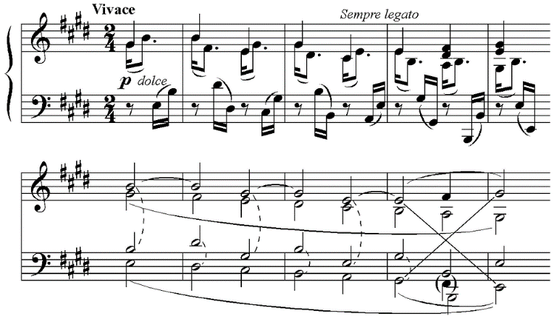
Phonetik [1/2]
Welches Wort passt nicht?
die Ausnahme – exception
hören / schreiben
Person A liest die Wörter laut. Person B dreht sich um  und schreibt die Ausnahme* auf.
 | Beethoven | Wechsel | zehn
 | Bett | Männer | leben
 | Nest | Bremen | See
 | steht | Essen | Mensch
1
2
3
4
Note: the ‘e’s not in bold are pronounced ‘uh’. We have a lot of this sound in English in, for example, ‘the butter’. It is called ‘schwa’.
Notes:
Timing: 8 minutes (2 slides) Aim: to practise long and short [e] sounds. Procedure: 1. Ensure that students are clear that the odd one out is based on the long and short [e] sounds.
2. Partner B turns away.
3. Click for the words to appear.
4. Partner A reads the four sets of three words.
5. For each set, Partner B writes down the odd one out in each set, based on long and short [e].
6. Partner B turns back to check answers.
7. Click audio buttons to hear a native speaker pronouncing the words.
8. Repeat on the following slide with partners swapping roles.
Word frequency of unknown words (1 is the most frequent word in German): Nest [>5000] Allee [>5000] Athlet [>5000] Insekt [4736] Source: Jones, R.L. & Tschirner, E. (2019). A frequency dictionary of German: core vocabulary for learners. Routledge

Slide 62
Phonetik [2/2]
Welches Wort passt nicht?
hören / schreiben
Person A liest die Wörter laut. Person B dreht sich um  und schreibt die Ausnahme* auf.
 | Fehler | Allee | helfen
 | schlecht | gegen | Athlet
 | perfekt | fängt | legen
 | geben | Insekt | letzte
1
2
3
4
Notes:
Slide 2

Slide 63
Phonetik [1/2]
lesen / hören
Hör zu. Wie viele Wörter haben langes oder kurzes [e]?
Person A liest die Sätze laut. Person B dreht sich um  und schreibt / für jede SSC.
 |  | langes [e] | kurzes [e]
 | Meine Eltern hatten ein Haus am Mittelmeer
 | Der türkische Kaffee ist so lecker. Er fehlt mir immer noch.
 | Im Winter gab es sehr wenig Schnee.
 | In der englischen Gesellschaft trinkt man viel Tee.
1
/
/
2
//
/
3
///
/
4
/
//
Notes:
Timing: 10 minutes (2 slides) Aim: to practise long and short [e] sounds.
Notes:
i) There is an easier version of this activity on slide 19. ii) Remind students that they are only listening out for long [e] and short [e], not schwa or [er] sounds. Procedure: 1. Partner B turns away.
2. Click to bring up the table of four sentences.
3. Partner A reads the four sentences.
4. Partner B writes down how many long and short [e] sounds they hear in each sentence.
5. Click to reveal answers.
6. Click audio buttons to hear a native speaker.
7. Repeat on the following slide with partners swapping roles.
Word frequency (1 is the most frequent word in German): Mittelmeer [4033] Schnee [1760] Gesellschaft [363] Armee [2209] Beere [>5000] ehemalig [883] Source: Jones, R.L. & Tschirner, E. (2019). A frequency dictionary of German: core vocabulary for learners. Routledge

Slide 64
Phonetik [2/2]
lesen / hören
Hör zu. Wie viele Wörter haben langes oder kurzes [e]?
Person B liest die Sätze laut. Person A dreht sich um  und schreibt / für jede SSC.
 |  | langes [e] | kurzes [e]
 | Ich habe ein Jahr in der Armee gelebt.
 | Jetzt esse ich weniger frische Beeren.
 | Ich werde mein ehemaliges Unternehmen in Belgien nie vergessen.
 | Ich konnte jeden Tag im See schwimmen.
1
//
--
2
//
/
3
//
//
4
//
--
Notes:
Slide 2

Slide 65
Phonetik
lesen / hören
Hör zu. Schreibe die Wörter mit [e]
 | Meine Eltern hatten ein Haus am Mittelmeer.
 | Der türkische Kaffee ist so lecker. Er fehlt mir immer noch.
 | Im Winter gab es sehr wenig Schnee.
 | In der englischen Gesellschaft trinkt man viel Tee.
 | Ich habe ein Jahr in der Armee gelebt.
 | Jetzt esse ich weniger frische Beeren.
 | Ich werde mein ehemaliges Unternehmen in Belgien nie vergessen.
 | Ich konnte jeden Tag im See schwimmen.
1
___
________.
2
_____
_____.
___
3
___ ____ _____.
4
_______ _____________
_____.
5
_______ ______.
6
___
_____
_____.
7
_______ ___________
___
______.
8
_____
__
Notes:
Note: A more challenging version of this activity can be found on the previous two slides.
Timing: 10 minutes Aim: to practise long and short [e] sounds.
Procedure: 1. Click to play audio.
2. Students transcribe gapped words with long and short [e].
3. Click to reveal the sentence. Note: Some words are known, some are unknown. Where words are underknown and multiple spellings of the SSC are possible (i.e. e, ee, eh), teachers should acknowledge all appropriate attempts at transcription.
Word frequency (1 is the most frequent word in German): Mittelmeer [4033] Schnee [1760] Gesellschaft [363] Armee [2209] Beere [>5000] ehemalig [883] Source: Jones, R.L. & Tschirner, E. (2019). A frequency dictionary of German: core vocabulary for learners. Routledge

Slide 66
long and short [e]
Phonetik
Consolidation [12]
Y9 T3.1 Week 6 Slide 6

