Slide 1
German phonics collection
[-d]
Artwork: Steve Clarke
Date updated: 10 / 08 / 21
Notes:
Artwork by Steve Clarke. All additional pictures selected are available under a Creative Commons license, no attribution required.

Slide 2
[-d]
Phonetik
Introduction
Y7 T3.1 Week 5 Slides 2-8

Slide 3
-d
und
Notes:
Timing: 1 minute
Aim: To introduce/consolidate SSC [-d]
Procedure: 1. Present the letter(s) and say the [-d] sound first, on its own. Students repeat it with you. 2. Bring up the word ”und” on its own, say it, students repeat it, so that they have the opportunity to focus all of their attention on the connection between the written word and its sound.
3. A possible gesture for this would be to make an exaggerated plus sign with your index fingers, holding them up in front of you.
4. Roll back the animations and work through 1-3 again, but this time, dropping your voice completely to listen carefully to the students saying the [-d] sound, pronouncing ”und” and, if using, doing the gesture. Word frequency (1 is the most frequent word in German): und [2]
Source: Jones, R.L. & Tschirner, E. (2006). A frequency dictionary of German: core vocabulary for learners. Routledge

Slide 4
-d
und
Notes:
With sound and no pictures to focus all attention on the sound-symbol correspondence.

Slide 5
-d
und
Notes:
Without sound to elicit pronunciation (without first hearing the teacher).
Teacher to elicit pronunciation by asking “Wie sagt man…”

Slide 6
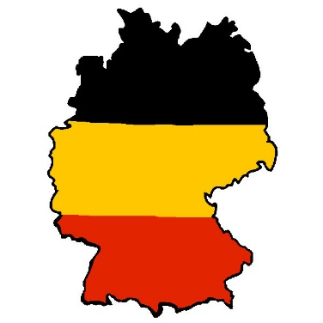
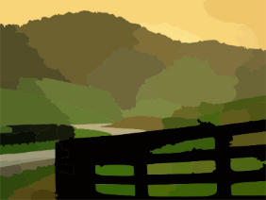
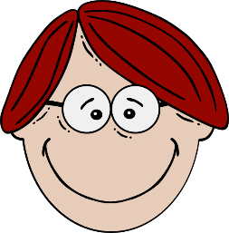
-d
rund
Land
und
Hand
Kind
Grund
[reason]
Notes:
Timing: 2 minutes
Aim: To introduce/consolidate SSC [-d]
Procedure:
Introduce and elicit the pronunciation of the individual SSC [-d] and then the source word again ‘und’ (with gesture, if using).
Then present and elicit the pronunciation of the five cluster words.
The cluster words have been chosen for their high-frequency, from a range of word classes, with the SSC (where possible) positioned within a variety of syllables within the words (e.g. initial, 2nd, final etc.). Additionally, we have tried to use words that build cumulatively on previously taught SSCs (see the Phonics Teaching Sequence document) and do not include new SSCs. Where new SSCs are used, they are often consonants which have a similar symbol-sound correspondence in English.
Word frequency (1 is the most frequent word in German): und [2]; rund [316] Land [146]; Hand [179]; Grund [230]; Kind [106]. Source: Jones, R.L. & Tschirner, E. (2006). A frequency dictionary of German: core vocabulary for learners. Routledge

Slide 7
-d
rund
Land
und
Hand
Kind
Grund
Notes:
With sound and no pictures to focus all attention on the sound-symbol correspondence.

Slide 8
-d
rund
Land
und
Hand
Kind
Grund
Notes:
Without sound to elicit pronunciation (without first hearing the teacher).
Teacher to elicit pronunciation by asking “Wie sagt man…”

Slide 9
Phonetik
Hör die Pluralformen an. Endet das Wort mit -d oder -t?
Phonetik
1
das Fahrrad
7
die Möglichkeit
2
das Land
8
das Mitglied
Some of these plurals use rule 4, -er plus umlaut if possible:
Mitglieder, Fahrräder, Länder, Kinder
3
der Hut
9
die Luft
4
die Antwort
10
der Unterschied
5
das Kind
11
der Umstand
6
die Welt
12
der Monat
Notes:
Timing: 5 minutes
Aim: Practise final -d and -t with singulars and plurals. Final -d sounds like a -t in German. Here, students listen to plural forms to work out whether the nouns’ equivalent singular forms end in -d or -t.
Procedure:
1. Teacher clicks for each gapped singular noun to appear, then clicks the number to play the audio each time.
Note: Item one can be used as an example. Animation supports this.
2. Students listen to the audio of the plurals of these words and fill in whether the singular ends in a -d or a -t.
3. 1 to 6 are are familiar words and 7 to 12 are new words.
4. Answers are animated to appear on separate clicks. Teachers can elicit the full word from students, providing additional read aloud / pronunciation practice.

Slide 10
[-d]
Phonetik
Consolidation [1]
Y8 T3.1 Week 2 Slides 2-4; 22

Slide 11
-d
und
Notes:
Timing: 1 minute
Aim: To introduce/consolidate SSC [-d]
Procedure: 1. Present the letter(s) and say the [-d] sound first, on its own. Students repeat it with you. 2. Bring up the word ”und” on its own, say it, students repeat it, so that they have the opportunity to focus all of their attention on the connection between the written word and its sound.
3. A possible gesture for this would be to make an exaggerated plus sign with your index fingers, holding them up in front of you.
4. Roll back the animations and work through 1-3 again, but this time, dropping your voice completely to listen carefully to the students saying the [-d] sound, pronouncing ”und” and, if using, doing the gesture. Word frequency (1 is the most frequent word in German): und [2]
Source: Jones, R.L. & Tschirner, E. (2006). A frequency dictionary of German: core vocabulary for learners. Routledge

Slide 12
-d
rund
Land
und
Hand
Kind
Grund
[reason]
Notes:
Timing: 2 minutes
Aim: To introduce/consolidate SSC [-d]
Procedure:
Introduce and elicit the pronunciation of the individual SSC [-d] and then the source word again ‘und’ (with gesture, if using).
Then present and elicit the pronunciation of the five cluster words.
The cluster words have been chosen for their high-frequency, from a range of word classes, with the SSC (where possible) positioned within a variety of syllables within the words (e.g. initial, 2nd, final etc.). Additionally, we have tried to use words that build cumulatively on previously taught SSCs (see the Phonics Teaching Sequence document) and do not include new SSCs. Where new SSCs are used, they are often consonants which have a similar symbol-sound correspondence in English.
Word frequency (1 is the most frequent word in German): und [2]; rund [316] Land [146]; Hand [179]; Grund [230]; Kind [106]. Source: Jones, R.L. & Tschirner, E. (2006). A frequency dictionary of German: core vocabulary for learners. Routledge

Slide 13
hören / schreiben
At the start or in the middle of words, German [d] is like the ‘d’ in English ‘do’. At the end of words, as you know, it sounds like ‘t’.
Hör dir die Pluralform an. Schreib die Singularform.
Endet die Singularform mit ‘d’ oder ‘t’?
 |  | ‘t’ | ‘d’
 | Tod
 | Tat
 | Staat
 |  | ‘t’ | ‘d’
 | Hund
 | Einzelkind
 | Gründ
 | Soldat
 | Hundert
1
Land
__
6
__
2
Schwimmbad
__
7
__
3
__
8
__
4
__
9
__
5
__
10
__
Notes:
Timing: 5 minutes Aim: To revisit and consolidate [d] and [t] in the middle and at the end of words. Procedure: 1. Click on the action button to play the recording of a plural.
2. Write [d] or [t] at the end of the singular form.
3. Click on the mouse to view and check answers.
Transcript: 1. Länder 2. Schwimmbäder 3. Tode 4. Taten 5. Staaten 6. Hunde 7. Einzelkinder 8. Gründe 9. Soldaten 10. Hunderte
Note: Staaten and Soldaten are irregular plurals, but the focus is on listening out for the more English-sounding consonant (‘t’ or ‘d’) in the plural word and using it to arrive at the singular form that will be written with that consonant whilst sounding like a ‘t’. Word frequency (1 is the most frequent word in German):
Land [134], Schwimmbad [>5009], Tod [540], Tat [1178], Staat [337], Hund [825], Einzelkind [>5009], Grund [249], Soldat [1267], hundert [1107] Source: Jones, R.L. & Tschirner, E. (2019). A frequency dictionary of German: core vocabulary for learners. Routledge

Slide 14
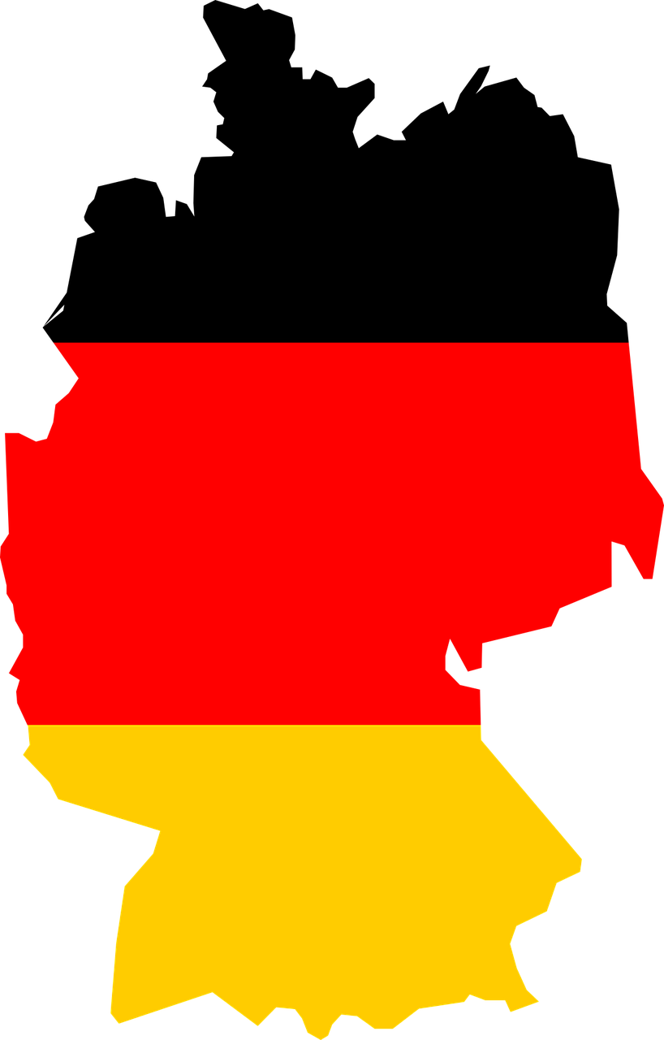
Phonetik
At the start or in the middle of words, German [d] is like the ‘d’ in English ‘do’. At the end of words, as you know, it sounds like ‘t’.
Sag die Wörter. Ist das [d] wie im Englischen oder anders?
1 |  |  |  |  | I | D | E | A | L
2 |  |  |  |  |  | E | N | G | L | A | N | D
3 |  | P | R | O | D | U | K | T | E
4 |  |  |  |  | S | T | A | N | D
5 | D | I | M | E | N | S | I | O | N
6 |  |  |  |  | S | C | H | A | D | E
7 |  |  |  |  |  | H | A | N | D
8 |  |  |  | W | I | L | D
9 |  |  |  | S | T | A | N | D | A | R | D
10 |  |  |  | K | A | N | D | I | D | A | T
11 |  |  | S | T | U | D | I | E
anders
1
2
3
4
5
6
7
8
9
10
11
Say Schade! to mean (It’s a )pity! or (What a) shame!’
Notes:
Timing: 2 minutes Aim: This activity highlights similarities and differences in the English and German pronunciation of the SSC [d-] and [-d], using cognates and near-cognates which have not been previously taught.
Procedure: 1. Students say the words aloud in German, (following the rule that [d] at the start or in the middle of words sounds like ‘d’ in ‘do’ and final [-d] is like ‘t’)
2. They compare how the words sound with the pronunciation of their English equivalents.
3. They note down for each whether the [d] sound is the same as in English or different.
4. Click the ticks to listen and check the German pronunciation. 5. Students identify the hidden word (Deutschland) running top to bottom, which also contains this week’s SSC [-d] and initial [d-].
Transcript: ideal England Produkte Stand Dimension Schade Hand wild Standard Kandidat Studie Word frequency of words, including unknown words or cognates (1 is the most frequent word in German): Dimension [1998] England [1762] Hand [180] ideal [1234] Kandidat [1854] Produkte [422] schade [2788] Stand [1357] Standard [1982] Studie [784] wild [1643] Source: Jones, R.L. & Tschirner, E. (2006). A frequency dictionary of German: core vocabulary for learners. Routledge

Slide 15
[-d]
Phonetik
Consolidation [2]
Y9 T1.2 Week 2 Slides 2-3; 16

Slide 16
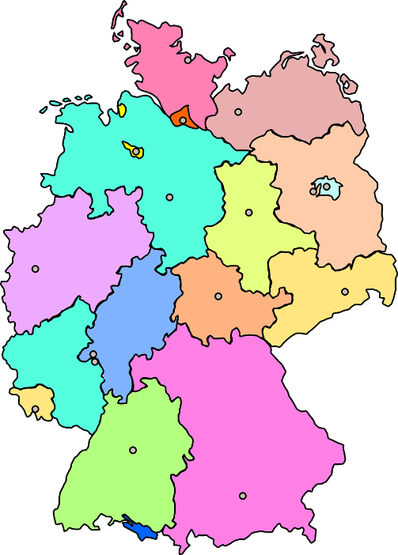
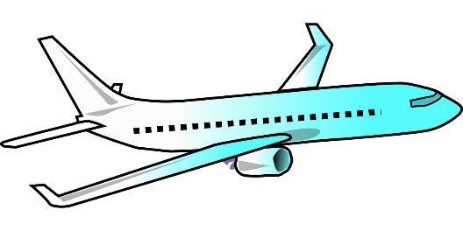
Phonetik
sprechen / hören
As you know -d- at the beginning or in the middle of a word is pronounced as in English.
1
landen
At the end of a word -d sounds like t.
2
Saarland
If d ends a word within a compound, it also sounds like t, though softer.
3
die Landschaft
Notes:
Timing: 1 minute Aim: to recap the different sounds of –d- in German. Procedure: 1. Click to bring up the reminders and play the audio for each example.
Transcript: 1. landen
2. Saarland
3. die Landschaft
Word frequency of unknown words (1 is the most frequent word in German): landen [1316] Saarland [>5009] Landschaft [1669] Source: Jones, R.L. & Tschirner, E. (2019). A frequency dictionary of German: core vocabulary for learners. Routledge

Slide 17
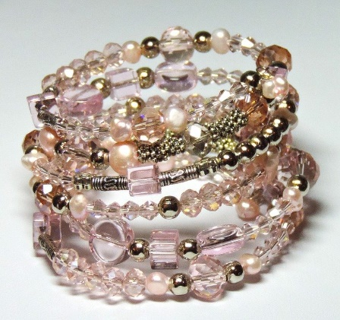
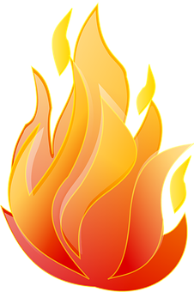
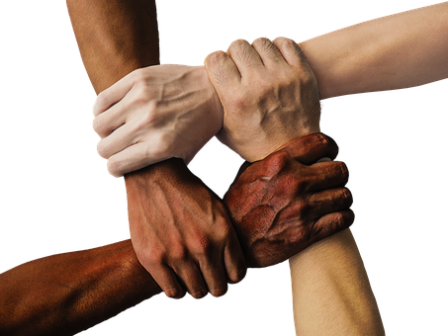
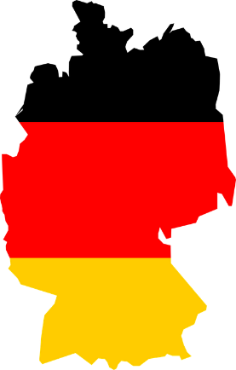
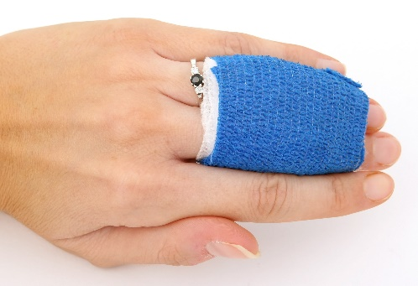
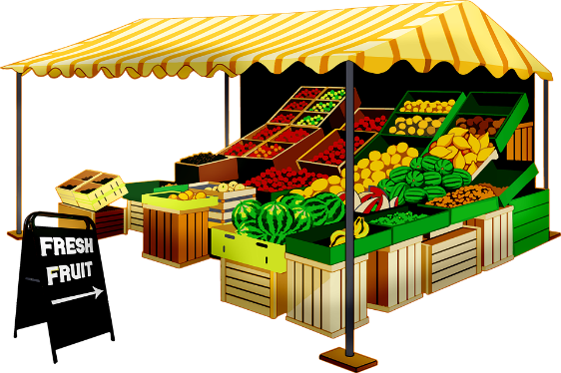
Phonetik
hören / sprechen
Hör zu. Welches Wort ist es? Sag die Singularform.
1
2
3
4
[die Wand]
[das Armband]
[die Hand]
[der Brand]
5
6
7
8
[das Land]
[der Verband]
[der Strand]
[der Stand]
Notes:
Timing: 5 minutes Aim: to practise aural comprehension of plural noun forms with SSC [-d-], connecting them to their singular forms containing SSC [-d]; to produce the singular nouns orally.
Procedure: 1. Click to play the audio.
2. Students say the singular form.
3. Click to check responses.
Transcript: 1. Hände 2. Wände 3. Länder 4. Strände 5. Verbände 6. Armbänder
7. Stände 8. Brände
Word frequency (1 is the most frequent word in German): Hand [180] Wand [828] Land [134] Strand [1966] Armband [>5000] Stand [1357] Brand [3937] Verband [1711] Source: Jones, R.L. & Tschirner, E. (2019). A frequency dictionary of German: core vocabulary for learners. Routledge

Slide 18
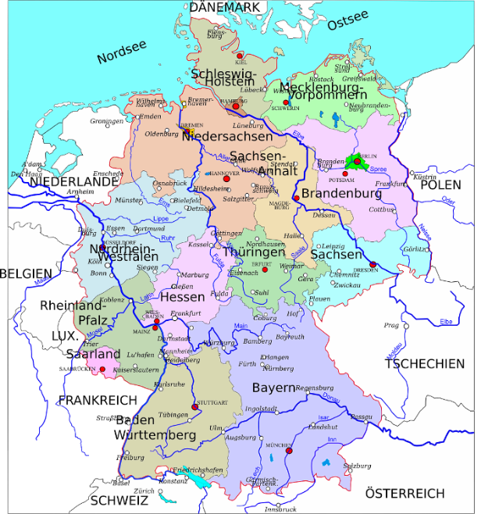
Phonetik
hören / sprechen
Hör zu. Wie oft hörst du [d]? Include all [d] sounds.
 |  | [-d-]
 | Deutschland hat sechzehn Bundesländer, die alle eigene Regierungen haben. | 5
 | Bayern ist ein großes Bundesland, das im Süden von Deutschland liegt. | 6
 | Die Stadt Dortmund liegt in einem Bundesland, das Nordrhein-Westfalen heißt. | 6
 | Ein Dortmunder ist jemand, der in Dortmund wohnt. | 6
 | Die Niederlande sind ein Land, das links von Norddeutschland liegt. | 7
 | Die Niederlande haben Inseln, die in der Nordsee liegen. | 5
die Niederlande – Netherlands
1
2
3
4
5
6
Bundesland (state, province) is similar to the English county.
Notes:
Timing: 6 minutes Aim: to practise aural comprehension of SSC [-d-] in longer sentences that include relative clause.
Procedure: 1. Click to play the audio.
2. Students tally the number of [-d] sounds they hear. (Initial, middle and final -d- sounds all count).
3. Click to check answers and reveal written full written sentences.
Transcript: 1. Deutschland hat sechzehn Bundesländer, die alle eigene Regierungen haben.
2. Bayern ist ein großes Bundesland, das im Süden von Deutschland liegt.
3. Die Stadt Dortmund liegt in einem Bundesland, das Nordrhein-Westfalen heißt.
4. Ein Dortmunder ist jemand, der in Dortmund wohnt.
5. Die Niederlande sind ein Land, das links von Norddeutschland liegt.
6. Die Niederlande haben Inseln, die in der Nordsee liegen.
Word frequency (1 is the most frequent word in German): Regierung [521] Bundesland [1993] Niederlande [3798] Source: Jones, R.L. & Tschirner, E. (2019). A frequency dictionary of German: core vocabulary for learners. Routledge

Slide 19
[-d]
Phonetik
Consolidation [3]
Y9 T3.1 Week 4 Slides 2-3

Slide 20
Phonetik
hören / schreiben
Mia und Katja lernen für eine Chemieprüfung. Hör zu, ist das mit ‘b’ oder ‘p’?
 |  | ‘b’ | ‘p’
 | lieb
 | halb
 | Prinzip
 | gelb
 |  | ‘b’ | ‘p’
 | Lampe
 | Isotop
 | Maßstab
 | knapp
1
__
5
__
2
__
6
__
3
__
7
__
4
__
8
__
Notes:
Timing: 10 minutes (2 slides) Aim: to revisit [-b] and contrast with [p] and to revisit [-d] and contrast with [t] Procedure: 1. Explain the task. Our characters have exams coming up and they are revising.
2. Click on the audio buttons to hear the conversations. In the audio, the plural or inflected adjective of the words in the table is given. Students must work out the last letter of the word based on what they hear.
3. Click to reveal answers.
4. Repeat on the following slide.
Transcript: 1. Der Chemielehrer ist ein lieber Mensch.
2. Ich will deshalb eine ganze halbe Stunde lernen.
3. Ja, und dann kennen wir die Prinzipien sehr gut! 4. Das ist ein gelber Stoff.
5. Unter Lampen kann man das aber besser sehen.
6. Es gibt viele Isotope.
7. Welche Maßstäbe verwenden diese Bilder?
8. Hmm, hier ist eine knappe Erklärung.
Word frequency (1 is the most frequent word in German): Prinzip [865] Lampe [4144] Isotop [4897] Maßstab [3510] knapp [638] Source: Jones, R.L. & Tschirner, E. (2019). A frequency dictionary of German: core vocabulary for learners. Routledge

Slide 21
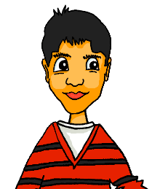
Phonetik
hören / schreiben
Wolfgang und Mehmet lernen für eine Erdkundeprüfung. Hör zu, ist das mit ‘d’ oder ‘t’?
 |  | ‘d’ | ‘t’
 | Urwald
 | Mitgliedsstaat
 | Strand
 | Tierart
 |  | ‘d’ | ‘t’
 | Brand
 | Gebiet
 | Soldat
 | dutzend
1
__
5
__
2
__
6
__
3
__
7
__
4
__
8
__
Notes:
Transcript: 1. In Brasilien gibt es viele Urwälder
2. Das Land hat Staaten wie Deutschland.
3. Es hat auch schöne Strände.
4. Und viele Tierarten.
5. Leider gibt es auch Probleme mit Bränden.
6. Die Menschen in diesen Gebieten müssen flüchten.
7. Die Soldaten helfen ihnen.
8. Ich habe Dutzende von Bildern von Brasilien.
Word frequency (1 is the most frequent word in German): Brasilien [2649] Urwald [>5009] Brand [3937] Gebiet [1110] Soldat [1267] Dutzend [2110] Source: Jones, R.L. & Tschirner, E. (2019). A frequency dictionary of German: core vocabulary for learners. Routledge

