Slide 1
German phonics collection
Hard and soft [ch]
Artwork: Steve Clarke
Date updated: 21 / 07 / 21
Notes:
Artwork by Steve Clarke. All additional pictures selected are available under a Creative Commons license, no attribution required.

Slide 2
Hard and soft [ch]
Phonetik
Introduction
Y7 T1.2 Week 3 Slides 3-8

Slide 3
ch
ich
Notes:
Timing: 1 minute
Aim: To introduce/consolidate SSC [ch]
Procedure: 1. Present the letter(s) and say the [ch] sound first, on its own. Students repeat it with you. 2. Bring up the word ”ich” on its own, say it, students repeat it, so that they have the opportunity to focus all of their attention on the connection between the written word and its sound.
3. A possible gesture for this would be to do an exaggerated gesture of pointing to yourself.
4. Roll back the animations and work through 1-3 again, but this time, dropping your voice completely to listen carefully to the students saying the [ch] sound, pronouncing ”ich” and, if using, doing the gesture. Word frequency (1 is the most frequent word in German): ich [8]
Source: Jones, R.L. & Tschirner, E. (2006). A frequency dictionary of German: core vocabulary for learners. Routledge

Slide 4
ch
ich
Notes:
With sound and no pictures to focus all attention on the sound-symbol correspondence.

Slide 5
ch
ich
Notes:
Without sound to elicit pronunciation (without first hearing the teacher).
Teacher to elicit pronunciation by asking “Wie sagt man…”

Slide 6
ch
Buch
Notes:
Timing: 1 minute
Aim: To introduce/consolidate SSC [ch]
Procedure: 1. Present the letter(s) and say the [ch] sound first, on its own. Students repeat it with you. 2. Bring up the word ”Buch” on its own, say it, students repeat it, so that they have the opportunity to focus all of their attention on the connection between the written word and its sound.
3. A possible gesture for this would be to mime opening the pages of a book with both hands.
4. Roll back the animations and work through 1-3 again, but this time, dropping your voice completely to listen carefully to the students saying the [ch] sound, pronouncing ”Buch” and, if using, doing the gesture. Word frequency (1 is the most frequent word in German): Buch [195]
Source: Jones, R.L. & Tschirner, E. (2006). A frequency dictionary of German: core vocabulary for learners. Routledge

Slide 7
ch
Buch
Notes:
With sound and no pictures to focus all attention on the sound-symbol correspondence.

Slide 8
ch
Buch
Notes:
Without sound to elicit pronunciation (without first hearing the teacher).
Teacher to elicit pronunciation by asking “Wie sagt man…”

Slide 9
Hard and soft [ch]
Phonetik
Consolidation [1]
Y7 T1.2 Week 4 Slides 2-13; 41-42

Slide 10
ch
ich
Notes:
Timing: 1 minute
Aim: To introduce/consolidate SSC [ch]
Procedure: 1. Present the letter(s) and say the [ch] sound first, on its own. Students repeat it with you. 2. Bring up the word ”ich” on its own, say it, students repeat it, so that they have the opportunity to focus all of their attention on the connection between the written word and its sound.
3. A possible gesture for this would be to do an exaggerated gesture of pointing to yourself.
4. Roll back the animations and work through 1-3 again, but this time, dropping your voice completely to listen carefully to the students saying the [ch] sound, pronouncing ”ich” and, if using, doing the gesture. Word frequency (1 is the most frequent word in German): ich [8]
Source: Jones, R.L. & Tschirner, E. (2006). A frequency dictionary of German: core vocabulary for learners. Routledge

Slide 11
ch
ich
Notes:
With sound and no pictures to focus all attention on the sound-symbol correspondence.

Slide 12
ch
ich
Notes:
Without sound to elicit pronunciation (without first hearing the teacher).
Teacher to elicit pronunciation by asking “Wie sagt man…”

Slide 13
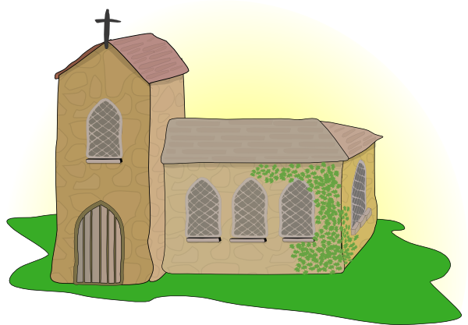
ch
Licht
Kirche
ich
nicht
endlich
[finally]
manchmal
[sometimes]
Notes:
Timing: 2 minutes
Aim: To introduce/consolidate SSC [ch]
Procedure:
Introduce and elicit the pronunciation of the individual SSC [ch] and then the source word again ‘ich’ (with gesture, if using).
Then present and elicit the pronunciation of the five cluster words.
The cluster words have been chosen for their high-frequency, from a range of word classes, with the SSC (where possible) positioned within a variety of syllables within the words (e.g. initial, 2nd, final etc.). Additionally, we have tried to use words that build cumulatively on previously taught SSCs (see the Phonics Teaching Sequence document) and do not include new SSCs. Where new SSCs are used, they are often consonants which have a similar symbol-sound correspondence in English.
Word frequency (1 is the most frequent word in German): ich [8]; Licht [503] Kirche [519]; endlich [496]; manchmal [394]; nicht [12]
Source: Jones, R.L. & Tschirner, E. (2006). A frequency dictionary of German: core vocabulary for learners. Routledge

Slide 14
ch
Licht
Kirche
ich
nicht
endlich
manchmal
Notes:
With sound and no pictures to focus all attention on the sound-symbol correspondence.

Slide 15
ch
Licht
Kirche
ich
nicht
endlich
manchmal
Notes:
Without sound to elicit pronunciation (without first hearing the teacher).
Teacher to elicit pronunciation by asking “Wie sagt man…”

Slide 16
ch
Buch
Notes:
Timing: 1 minute
Aim: To introduce/consolidate SSC [ch]
Procedure: 1. Present the letter(s) and say the [ch] sound first, on its own. Students repeat it with you. 2. Bring up the word ”Buch” on its own, say it, students repeat it, so that they have the opportunity to focus all of their attention on the connection between the written word and its sound.
3. A possible gesture for this would be to mime opening the pages of a book with both hands.
4. Roll back the animations and work through 1-3 again, but this time, dropping your voice completely to listen carefully to the students saying the [ch] sound, pronouncing ”Buch” and, if using, doing the gesture. Word frequency (1 is the most frequent word in German): Buch [195]
Source: Jones, R.L. & Tschirner, E. (2006). A frequency dictionary of German: core vocabulary for learners. Routledge

Slide 17
ch
Buch
Notes:
With sound and no pictures to focus all attention on the sound-symbol correspondence.

Slide 18
ch
Buch
Notes:
Without sound to elicit pronunciation (without first hearing the teacher).
Teacher to elicit pronunciation by asking “Wie sagt man…”

Slide 19
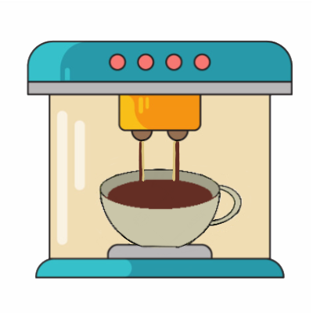
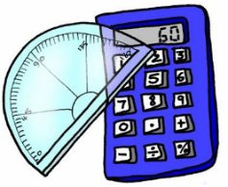
ch
machen
nochmal
Buch
acht
Nacht
Fach
Notes:
Timing: 2 minutes
Aim: To introduce/consolidate SSC [ch]
Procedure:
Introduce and elicit the pronunciation of the individual SSC [ch] and then the source word again ‘Buch’ (with gesture, if using).
Then present and elicit the pronunciation of the five cluster words.
The cluster words have been chosen for their high-frequency, from a range of word classes, with the SSC (where possible) positioned within a variety of syllables within the words (e.g. initial, 2nd, final etc.). Additionally, we have tried to use words that build cumulatively on previously taught SSCs (see the Phonics Teaching Sequence document) and do not include new SSCs. Where new SSCs are used, they are often consonants which have a similar symbol-sound correspondence in English.
Word frequency (1 is the most frequent word in German): Buch [195]; machen [49] nochmal [773]; acht [458]; Fach [698]; Nacht [335]. Source: Jones, R.L. & Tschirner, E. (2006). A frequency dictionary of German: core vocabulary for learners. Routledge

Slide 20
ch
machen
nochmal
Buch
acht
Nacht
Fach
Notes:
With sound and no pictures to focus all attention on the sound-symbol correspondence.

Slide 21
ch
machen
nochmal
Buch
acht
Nacht
Fach
Notes:
Without sound to elicit pronunciation (without first hearing the teacher).
Teacher to elicit pronunciation by asking “Wie sagt man…”

Slide 22
Soft or hard /ch/?
Phonetik
The German /ch/ can be soft or hard.
It is hard after these sounds:
/a/ (machen, acht, Sachen)
/o/ (die Woche, kochen, nochmal)
/u/ (das Buch)
/au/ (auch)
It is soft after other sounds: (manchmal, nicht, richtig).
Notes:
Timing: 2 minutes Aim: This animated slide provides a reminder of the pronunciation rules for [ch]
Procedure: 1. Click to animate the explanation.
2. Notes: hard and soft here refer to the physiological differences in sound production, i.e. whether the air is forced through the soft palette (‘soft’) or from a place lower in the throat (‘hard’). Students have encountered all words used as examples here with the exception of auch.
3. Ensure students’ understanding at each stage.
Word frequency (1 is the most frequent word in German):
auch [16]
Source: Jones, R.L. & Tschirner, E. (2006). A frequency dictionary of German: core vocabulary for learners. Routledge

Slide 23
Soft or hard /ch/?
Phonetik
lesen / sprechen
Consider the words below. Is the /ch/ is soft or hard?
 | soft | hard |  | soft | hard
leicht (light, easy) |  |  | ziemlich (quite, fairly)
brauchen (to need) |  |  | ein bisschen (a bit)
danach (afterwards) |  |  | die Fremdsprache (foreign language)
schlecht (bad) |  |  | lachen (to laugh)
Notes:
Timing: 2 minutes Aim: To practise sounding out new words and recognising the different versions of the SSC [ch] that result from the different mouth positions.
Note: Unknown words have been chosen so that students must focus on the sound. The words are all highly frequent and will be introduced over the coming weeks.
Procedure: 1. First, students read the words and decide based on spelling with the [ch] is soft or hard.
2. The teacher then reads the words out loud. Students check their answers based on what they hear.
3. Answers revealed on clicks. Teacher elicits oral pronunciation of the words. The words are comprised of previously studied SSCs and transferable consonants with the exception of [au] brauchen and [sp] in Fremdsprache.
Word frequency (1 is the most frequent word in German):
leicht [285]; danach [437]; brauchen [201]; ziemlich [443]; schlecht [332]; lachen [561]; Fremdsprache [1791]
Source: Jones, R.L. & Tschirner, E. (2006). A frequency dictionary of German: core vocabulary for learners. Routledge

Slide 24
Hard and soft [ch]
Phonetik
Consolidation [2]
Y7 T3.1 Week 2 Slide 4

Slide 25
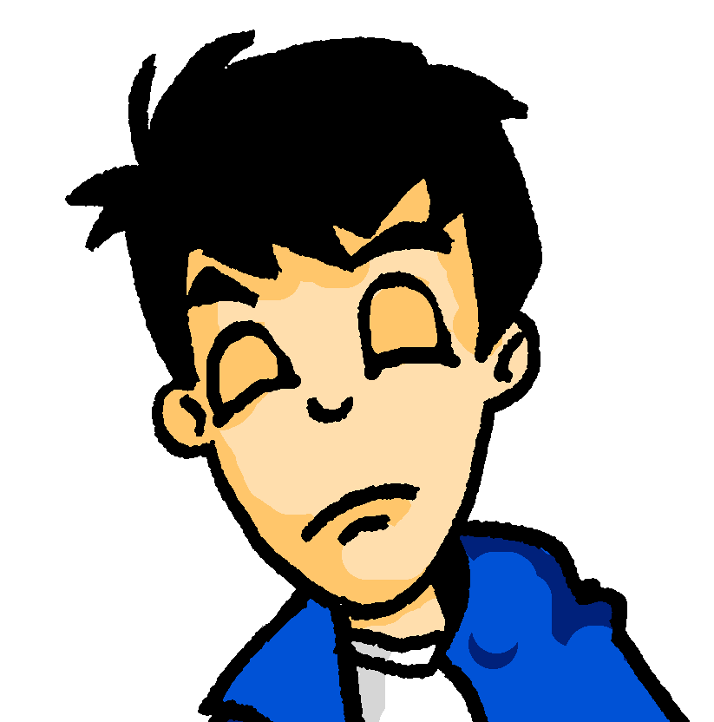
Samstagnachmittag
lesen / hören
Es ist Samstagnachmittag und Wolfgang schläft. Er träumt von …
Kirschen
Kirchen
1
Notes:
In slides 4-11, students encounter a range of known SSCs contrasted in minimal pairs. By correctly identifying the word they hear, they complete the story of Wolfgang and Heidi’s very different Saturday afternoons. The activity aims to show how a single SSC can change the meaning of a full sentence! Point out to students how differently the story would unfold if they had heard the other SSC instead!
The following SSCs are revisited in this activity: [sch], [ch], short [i], short [e], [ei], [ie], [ü], [u], [äu], [v] and [w].
Students are also encouraged to write short summaries of each slide in English. A range of vocabulary and key grammar points from across terms 1 and 2 are revisited.
Procedure for each slide:
1/ Teacher clicks on the loudspeaker to play the audio.
2/ Students hear one of the options and circle a) or b) to complete the sentence.
3/ Students write a one sentence summary in English (at more advanced levels, the teacher might wish to ask for the summary in German).
4/ The answer is revealed on a click.
5/ Teacher elicits example translations from one or two students.
6/ Teacher elicits oral pronunciation of the other word using “Wie sagt man …” to create the alternative scenario!
Here, SSCs [ch] and [sch] are contrasted.
Teacher to draw attention to compound ‘Samstagnachmittag’ and help students break it down.
Students have encountered träumen [1907] as an SSC cluster word, but not as a vocabulary item. Teacher to remind students of its meaning. Students have not yet met preposition von [11]. Teacher to explain its use here to of mean of.
Frequencies of unknown vocabulary: Kirsche [4034]
Transcript
Kirschen

Slide 26
Hard and soft [ch]
Phonetik
Consolidation [3]
Y7 T3.2 Week 6 Slides 2-3

Slide 27
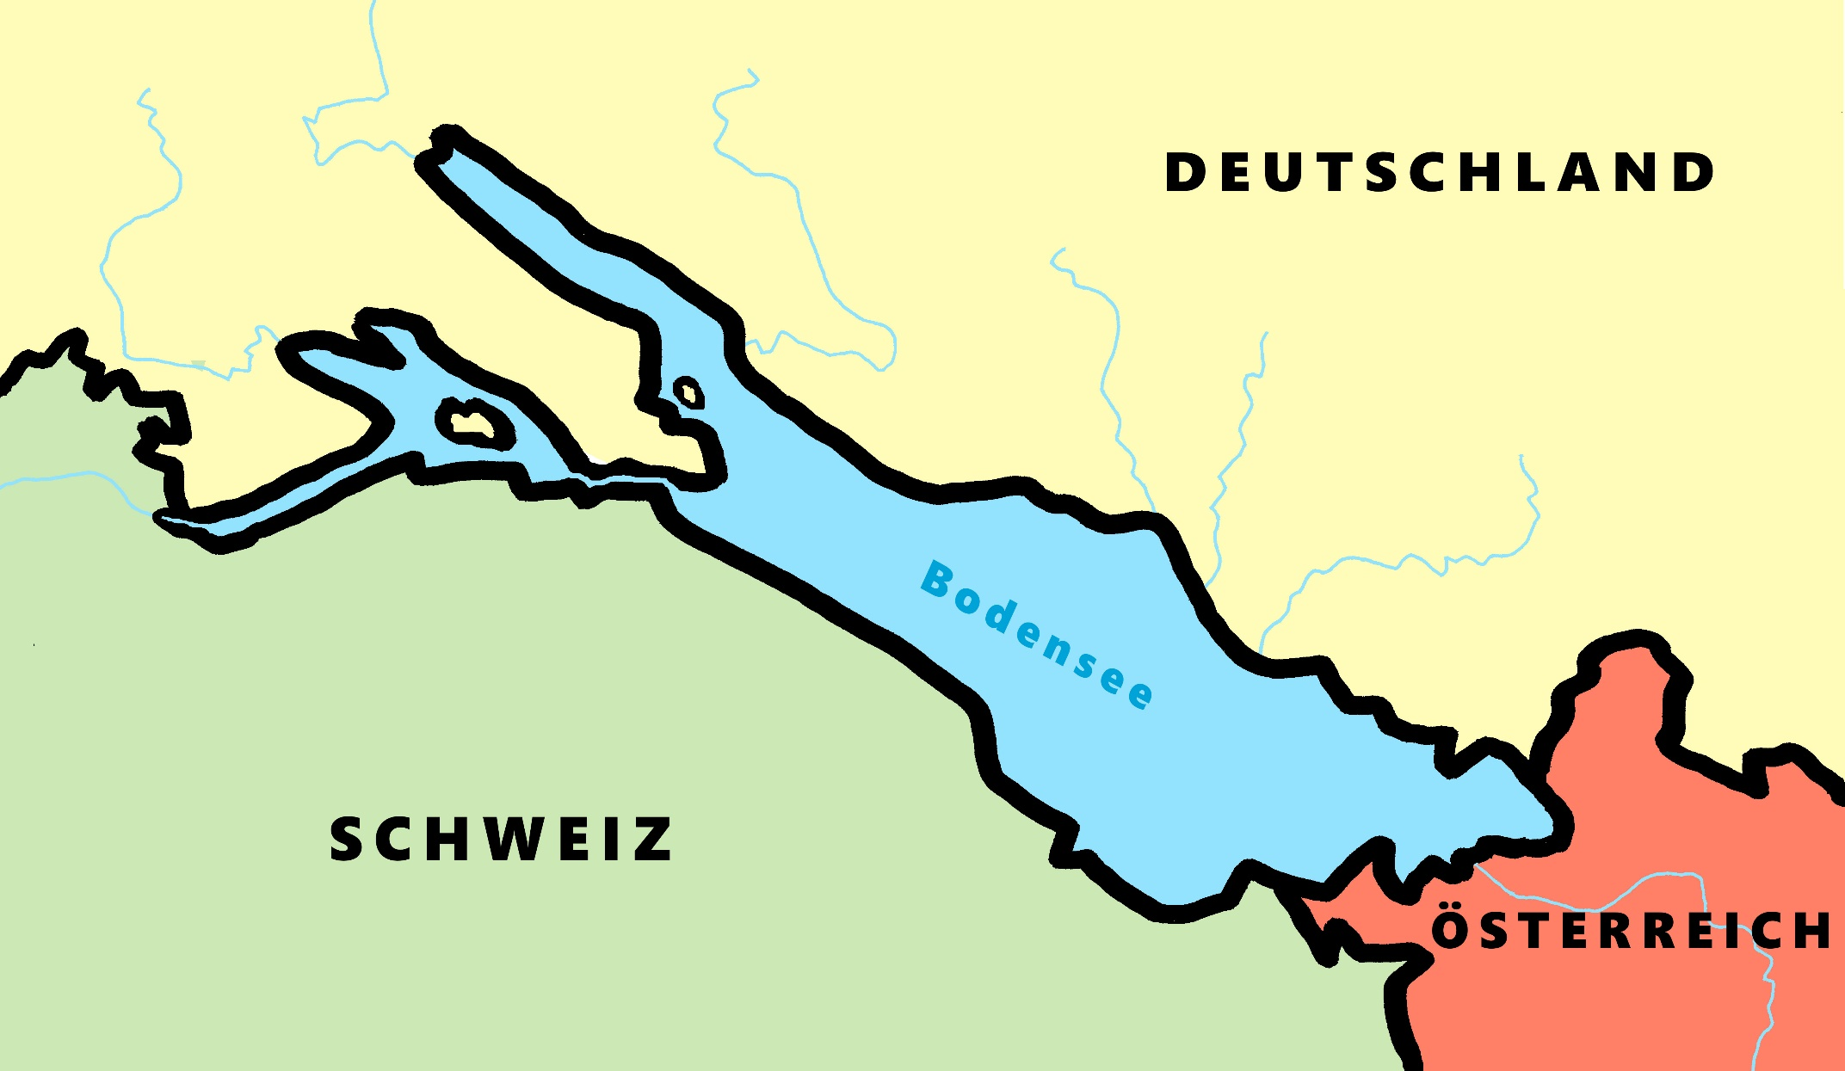
Phonetik - der Bodensee [1/2]
hören / schreiben
4
Allensbach
5
Wallhausen
3
Radolfzell
6
Hagnau
7
Friedrichshafen
1
Kreuzlingen
2
Steckborn
9
Romanshorn
8
Altenrhein
Notes:
Phonetik [1]
Time: 5 minutes Aim: To practise recognising and transcribing 10 previously taught SSC, in unknown words.
Procedure: 1. Click number to hear the full word. Students listen and transcribe only the missing letters. 2. Animations support item-by-item checking, as instant feedback on each SSC may be particularly helpful for students’ learning. 3. Teachers can additionally ask, Wo liegt [Hagnau]? Es liegt in [Deutschland]… Students have met the use of ‘in’ with die Schweiz. It will be helpful to focus their attention on the use of ‘in’ + der + Schweiz here, reminding them of the ‘in’ + movement (R2-accusative) or location (R3-dative) change. SSC revisited here: [eu] [st-] [z] [ch-hard] [w] [au] [ie] [ch-soft] [ei] [r] Transcript: 1 Kreuzlingen 2 Steckborn 3 Radolfzell 4 Allensbach 5 Wallhausen 6 Hagnau 7 Friedrichshafen 8 Altenrhein 9 Romanshorn

Slide 28
Phonetik - der Bodensee [1/2]
lesen / sprechen
9
Ludwigshafen
1
2
Friedrichshafen
Stein am Rhein
6
Konstanz
8
7
Reichenau
5
Altnau
3
Bregenz
4
Rorschach
Notes:
Phonetik [2]
Time: 5 minutes Aim: To practise reading aloud / saying 10 previously taught SSC, in unknown words (apart from Deutschland, which starts the task off). Here, 9 additional towns on the Bodensee are used.
Procedure: 1. Students work in pairs to pronounce each of the towns. 2. Click number to hear and check pronunciation. SSC revisited here: [eu] [st-] [z] [ch-hard] [w] [au] [ie] [ch-soft] [ei] [r] [sch] Transcript: 1 Deutschland 2 Friedrichshafen 3 Bregenz 4 Rorschach 5 Altnau 6 Konstanz 7 Reichenau 8 Stein am Rhein 9 Ludwigshafen

Slide 29
Hard and soft [ch]
Phonetik
Consolidation [4]
Y8 T1.2 Week 2 Slides 2; 6; 30-35

Slide 30
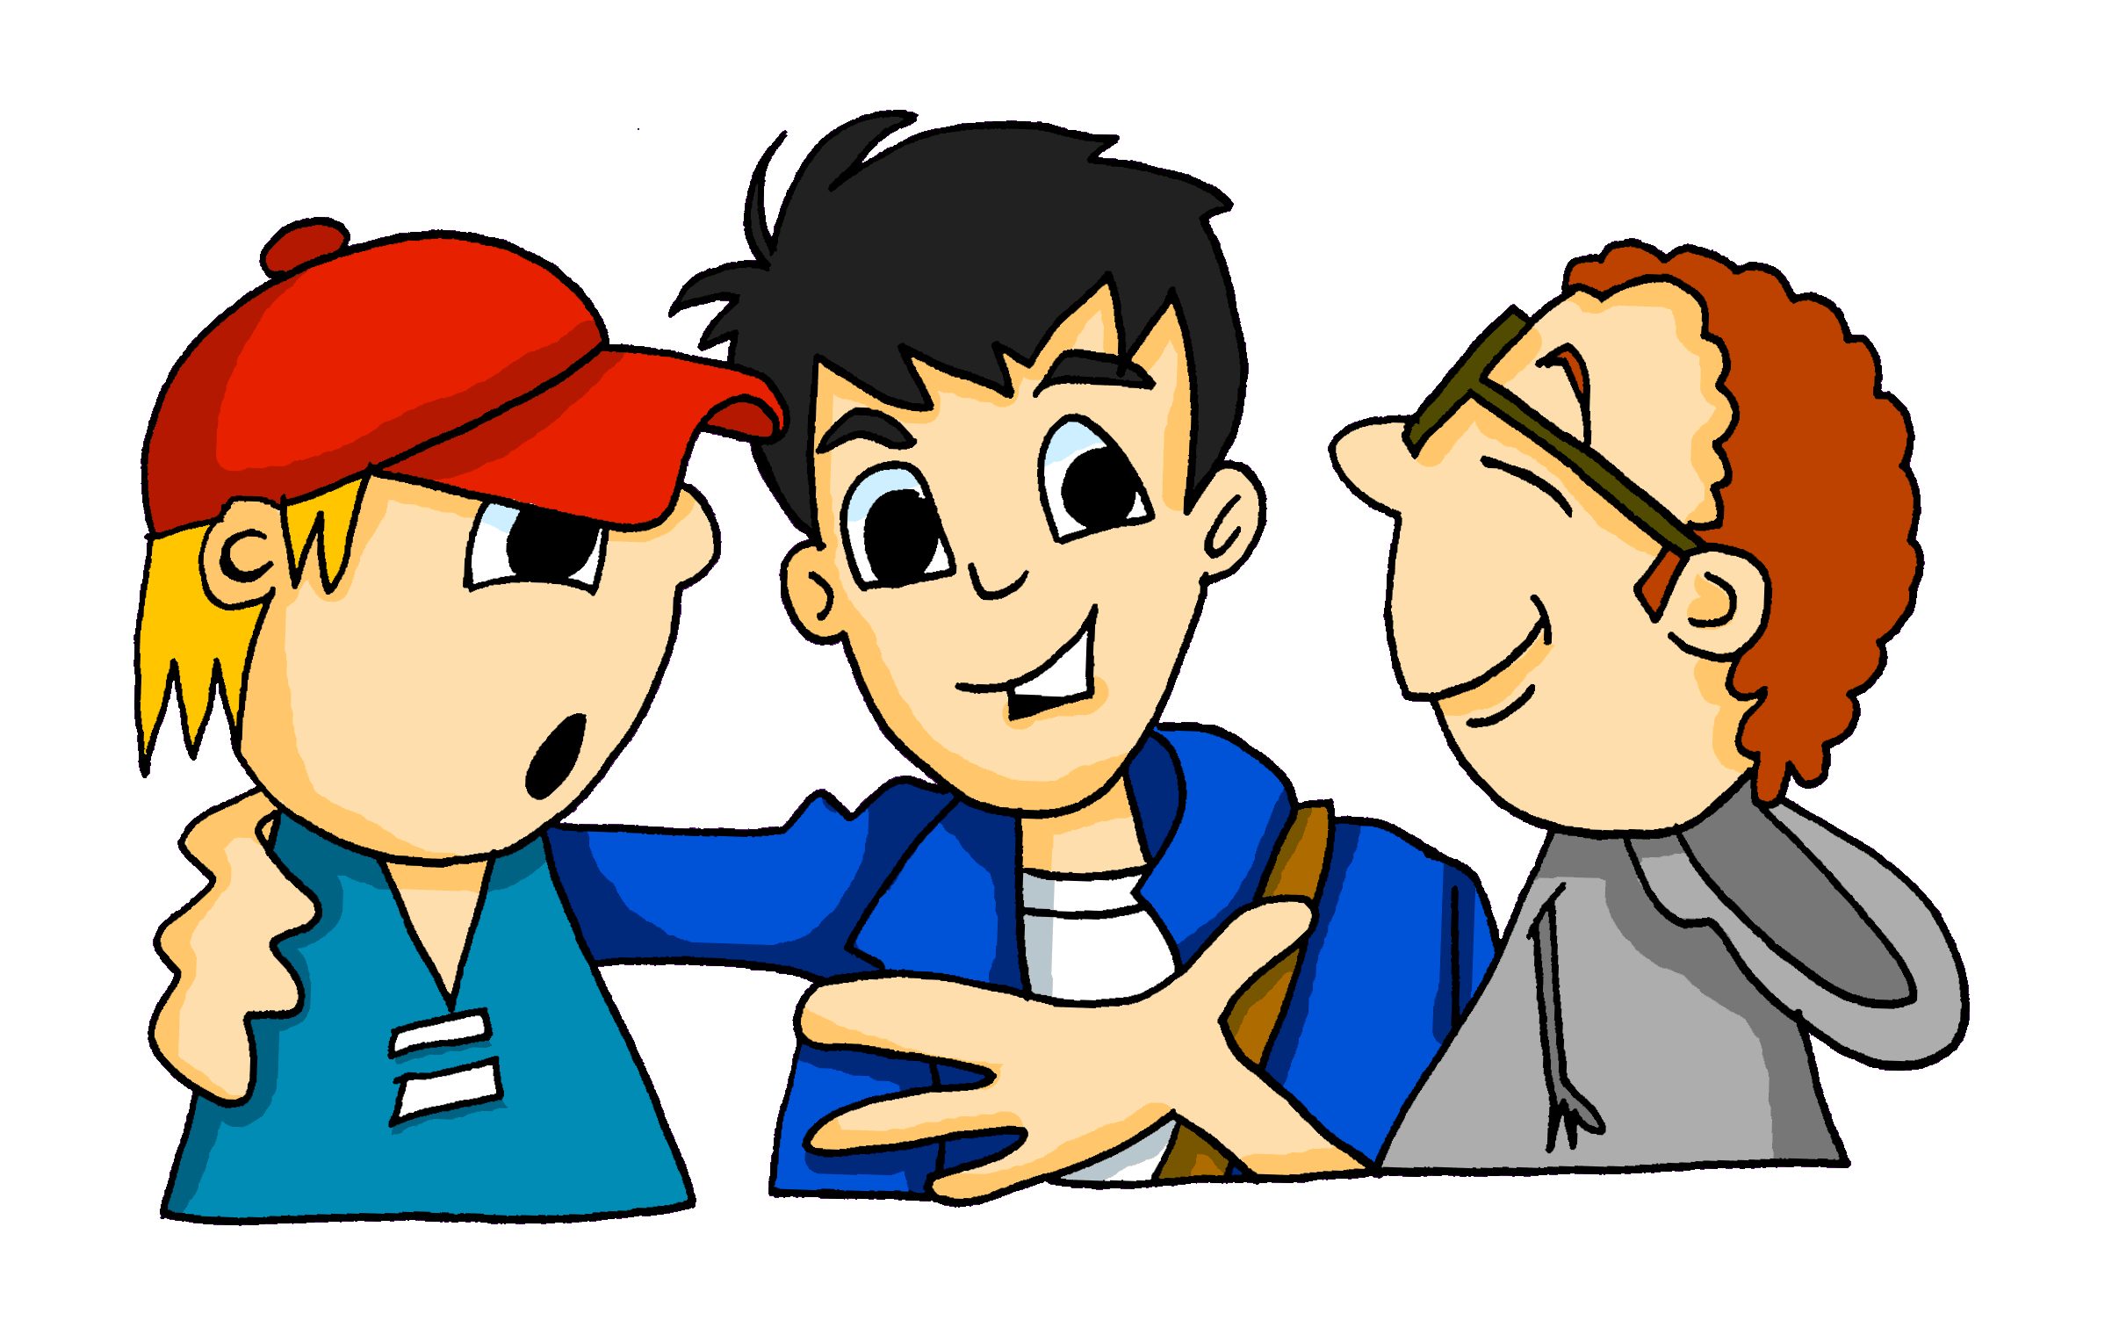
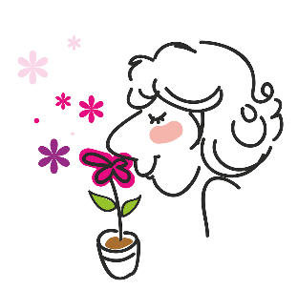
Phonetik [ch]
hören / schreiben
The German [CH] can be pronounced in two different ways:
[CH] soft
[CH] hard
Careful! [CH] and [CK] are different sounds!
Ach!
The hard-soft difference depends on the vowel that comes before it and how open your mouth is when you close the back of your throat to form the [CH].
Gespräch
Gepäck
roch
Rock
Notes:
Timing: 2 minutes Aim: To revisit the pronunciation of [ch] in different contexts and to contrast [ch] with [ck] Procedure: 1. Cycle through the explanation using the animation sequence.
2. Click on the pictures to hear each word pronounced.

Slide 31
Welches Wort passt nicht in die Reihe?
lesen / sprechen
1 | wirklich | Gesicht | danach
2 | gesprochen | machen | ähnlich
3 | Fach | glücklich | Sprache
4 | noch | Frankreich | besuchen
Notes:
Phonetik Timing: 3 minutes Aim: To focus on the two different pronunciations of [ch] (soft [ch] and hard [ch].
Procedure: 1. Identify the word which has a different [ch] from the other two in the set. 2. Click to reveal the answers.
3. Check that word meanings are also known.

Slide 32
Phonetik [ch]
hören / schreiben
As you know, [CH] in German can be pronounced in two ways:
Careful! [CH] and [CK] are different sounds!
[CH] hard
[CH] soft
Ach!
Chemie and China are pronounced differently in Austria and Germany
However, [CH] is sometimes pronounced [CK] often at the start of a word:
Chor
Orchester
Wechsel
wechseln
Chemie
China
Chemie
China
Notes:
Timing: 3 minutes Aim: Explaining that sometimes [ch] is pronound [ck] Procedure: 1. Cycle through the explanation.
2. Click on the words to play the sound.
Transcript: Ach! Ich Chor
Orchester
China
Chemie
Wechsel wechseln

Slide 33
Was hörst du?
[CH] hard
[CH] soft
hören
Ach!
Soft [CH]
Both
Hard [CH]
ich
dich
wirklich
nicht
1
Ich sehe dich wirklich nicht.
Notes:
Time: 5 minutes
Aim: To practise listening out for the difference between soft and hard [ch] within full sentences.
Procedure:
Click on the number to play the sentence.
Decide for each sentence whether the sentence contains only soft [ch], only hard [ch], or both.
Click to see answer and the words in which the sounds appear.
Click again to see the sentence.
Say the sentence out loud. Click on the number again to hear the sentence again.
Transcript: Ich sehe dich wirklich nicht.

Slide 34
Was hörst du?
[CH] hard
[CH] soft
hören
Ach!
Soft [CH]
Both
Hard [CH]
Woche
verbracht
2
Letzte Woche hat die Schülerin Zeit in Hamburg verbracht.
Notes:
Transcript: Letzte Woche hat die Schülerin Zeit in Hamburg verbracht.

Slide 35
Was hörst du?
[CH] hard
[CH] soft
hören
Ach!
Only soft [CH]
Both
Only hard [CH]
Buch
Bücher
acht
3
Es gibt acht interessante Bücher und ein langweiliges Buch.
Notes:
Transcript:
Es gibt acht interessante Bücher und ein langweiliges Buch.

Slide 36
Was hörst du?
[CH] hard
[CH] soft
hören
Ach!
Soft [CH]
Both
Hard [CH]
vielleicht
nochmal
kochen
[ch] = [ck] denn die Person ist Österreicher.
4
Willst du vielleicht nochmal chinesisches Essen kochen?
Notes:
Transcript:
Willst du vielleicht nochmal chinesisches Essen kochen?

Slide 37
Was hörst du?
[CH] hard
[CH] soft
hören
Ach!
Soft [CH]
Both
Hard [CH]
Österreicher
glückliche
5
Österreicher sind immer glückliche Menschen.
Notes:
Transcript: Österreicher sind immer glückliche Menschen.

Slide 38
Hard and soft [ch]
Phonetik
Consolidation [5]
Y8 T2.1 Week 6 Slides 4-5

Slide 39
Phonetik [1/2]
lesen / sprechen
Partner/Partnerin A sagt die Wörter mit [-ich]. Partner/Partnerin B sagt die Wörter mit [-isch].
12
wirklich | sportlich | musikalisch | monatlich | praktisch | historisch | kritisch
1
Partner/Partnerin A sagt die Wörter mit [-isch]. Partner/Partnerin B sagt die Wörter mit [-ich].
politisch | technisch | komisch | glücklich | ähnlich | katholisch | wöchentlich
2
0
LOS!
Notes:
Timing: 3 minutes (2 slides)
Aim: Oral production of [-ich] and [-isch] adjectives. A mixture of near-cognates and previously taught words is used. The addition of a time constraint prompts students to increase their speed of oral production.
Procedure:
1. Students partner up and label themselves A and B.
2. They then treat the table row as a script but have to say words in tandem, A saying [-ich] words and B saying [-isch] words.
3. Click 12-second timer to start round 1.
4. Click action button to hear native audio for comparison.
6. Clarify meaning of the cognate words.
Word frequency (1 is the most frequent word in German): All words are in the top 2000. Source: Jones, R.L. & Tschirner, E. (2019). A frequency dictionary of German: core vocabulary for learners. Routledge

Slide 40
Phonetik [2/2]
The audio has the Austrian pronunciation of ‘chemisch’. How would a German typically say it?
lesen / sprechen
8
Partner/Partnerin A sagt alle Wörter. Partner/Partnerin B hört ihm/ihr zu.
elektrisch | biologisch | möglich | jährlich | demokratisch | natürlich | chemisch
1
Partner/Partnerin B sagt alle Wörter. Partner/Partnerin A hört ihm/ihr zu.
russisch | täglich | amerikanisch | plötzlich | freundlich | statistisch | literarisch
2
0
LOS!
Notes:
Procedure:
1. This time, Partner A says all the words in their row (1). The timer is set for 8 seconds.
2. The listening student (Partner B) notes any pronunciation errors and gives their partner a score out of 7.
3. Click for Round 2, where students swap roles: B says all the words in their row while A listens and gives a score.

Slide 41
Hard and soft [ch]
Phonetik
Consolidation [6]
Y8 T2.2 Week 3 Slide 15

Slide 42
Phonetik
lesen / hören
A
B
1. Er sieht viele Männchen.
1. Er sieht viele Menschen.
2. Ich habe das schon gemacht.
2. Ich habe das schön gemacht.
3. Sie hat die Kirsche fotografiert.
3. Sie hat die Kirche fotografiert.
4. Waschen ist schneller als Wachsen.
4. Wachsen ist schneller als Waschen.
5. Schälen oder schellen?
5. Schellen oder schälen?
6. Zeichnen ist besser als Zeigen.
6. Zeigen ist besser als Zeichnen.
das Männchen – little man die Kirsche – cherry
waschen – to wash wachsen – to grow
schälen – to peel schellen – to ring
zeichnen – to draw
Notes:
Timing: 5 minutes Aim: To practise this week’s SSCs in a sentence context. The format encourages attention to both pronunciation and listening. Procedure: 1. Students work in pairs.
2. Student says both versions of the sentence. 3. Their partner writes down in which order the sentences were said.
4. They take turns speaking and listening, so each student says three sentences. 5. Click each sentence to hear it pronounced.
Word frequency of unknown words (1 is the most frequent word in German):
Männchen [>5009] Kirsche [>5009] waschen [2315] wachsen [470] schälen [>5009] schellen [>5009] zeichnen [1259] Source: Jones, R.L & Tschirner, E. (2019). A frequency dictionary of German: Core vocabulary for learners. London: Routledge.

Slide 43
Hard and soft [ch]
Phonetik
Consolidation [7]
Y8 T2.2 Week 4 Slide 2

Slide 44
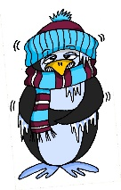
Phonetik
lesen / sprechen
Sag die Wörter. Wie viele enthalten die SSC?
[e]
[ch]
[s]
[o]
[a]
[ä]
denken
ich
sollen
Wo?
kalt
lächeln
 |  | ?
 | [e]
 | [ch]
 | [s]
 |  | ?
 | [o]
 | [a]
 | [ä]
eng – Bett – Weg
2
ohne – Telefon – Rock
2
reich – jedoch – einfach
1
alt – arm – normal
1
unser – langsam – alles
2
2
hängen – Aktivität – schnell
Notes:
Timing: 3 minutes Aim: A read aloud activity to revise 12 SSC (six explicitly, and six by contrast) using a range of new, revisited and unfamiliar vocabulary. Procedure: 1. Click on each individual SSC to hear it.
2. Elicit the source word from students, if remembered. Note that 4/6 these words have since been taught as key vocabulary (with sollen and lächeln to follow on the SOW)
3. Bring up the source words to check, and for reference for the read aloud activity.
4. Students pronounce the sets of three words, individually or in pairs, and decide how many contain the target SSC.
5. Optional – Click on the words to hear the sets of words pronounced. 6. Reveal the answers. 7. Optional – elicit the English meanings of the vocabulary.
Transcript:
eng – Bett – Weg
reich – jedoch – einfach
unser – langsam – alles
ohne – Telefon – Rock
alt – arm – normal
hängen – Aktivität – schnell
Word frequency of unknown words (1 is the most frequent word in German): hängen [580] Weg [220] Source: Jones, R.L. & Tschirner, E. (2019). A frequency dictionary of German: core vocabulary for learners. Routledge

Slide 45
Hard and soft [ch]
Phonetik
Consolidation [8]
Y8 T3.1 Week 1 Slides 2-3; 24

Slide 46
ch
Buch
Notes:
Timing: 1 minute
Aim: To introduce/consolidate SSC [ch]
Procedure: 1. Present the letter(s) and say the [ch] sound first, on its own. Students repeat it with you. 2. Bring up the word ”Buch” on its own, say it, students repeat it, so that they have the opportunity to focus all of their attention on the connection between the written word and its sound.
3. A possible gesture for this would be to mime opening the pages of a book with both hands.
4. Roll back the animations and work through 1-3 again, but this time, dropping your voice completely to listen carefully to the students saying the [ch] sound, pronouncing ”Buch” and, if using, doing the gesture. Word frequency (1 is the most frequent word in German): Buch [195]
Source: Jones, R.L. & Tschirner, E. (2006). A frequency dictionary of German: core vocabulary for learners. Routledge

Slide 47
ch
machen
nochmal
Buch
acht
Nacht
Fach
Notes:
Timing: 2 minutes
Aim: To introduce/consolidate SSC [ch]
Procedure:
Introduce and elicit the pronunciation of the individual SSC [ch] and then the source word again ‘Buch’ (with gesture, if using).
Then present and elicit the pronunciation of the five cluster words.
The cluster words have been chosen for their high-frequency, from a range of word classes, with the SSC (where possible) positioned within a variety of syllables within the words (e.g. initial, 2nd, final etc.). Additionally, we have tried to use words that build cumulatively on previously taught SSCs (see the Phonics Teaching Sequence document) and do not include new SSCs. Where new SSCs are used, they are often consonants which have a similar symbol-sound correspondence in English.
Word frequency (1 is the most frequent word in German): Buch [195]; machen [49] nochmal [773]; acht [458]; Fach [698]; Nacht [335]. Source: Jones, R.L. & Tschirner, E. (2006). A frequency dictionary of German: core vocabulary for learners. Routledge

Slide 48
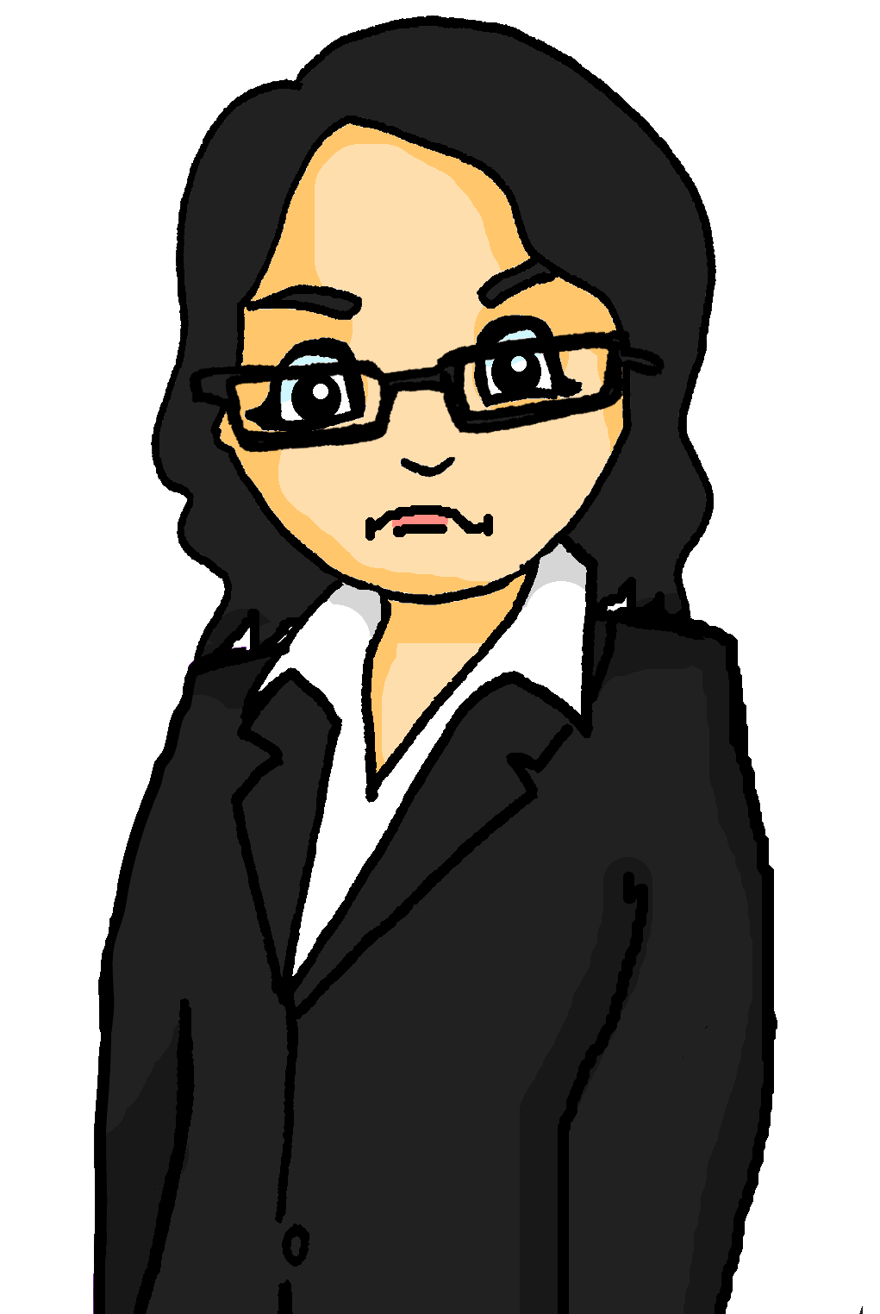
Phonetik
sprechen
Katrin received a mysterious note.
See how quickly you can read it out.
Der Dachdecker deckt
dein Dach,
drum dank
dem Dachdecker,
der dein Dach deckt.
1
2
3
Translation:
The roofer roofs your roof,
so thank the roofer who roofs your roof.
Notes:
Timing: 2 minutes Aim: Practise pronunciation of SSC [ch] and [ck] Procedure: 1. Students read out tongue twister, increasing speed to increase challenge. This could also be done in pairs (one student speaks while the other checks pronunciation).
2. Teacher circulates to listen in to students.
3. Click to hear the tongue twister said by a native spear at increasing speeds.
Transcript: Der Dachdecker deckt dein Dach, drum dank dem Dachdecker der dein Dach deckt Word frequency (1 is the most frequent word in German): Dachdecker [>5000], decken [2636], darum [518], Dach [1812] Source: Jones, R.L. & Tschirner, E. (2019). A frequency dictionary of German: core vocabulary for learners. Routledge

Slide 49
Hard and soft [ch]
Phonetik
Consolidation [9]
Y8 T3.2 Week 4 Slide 2

Slide 50
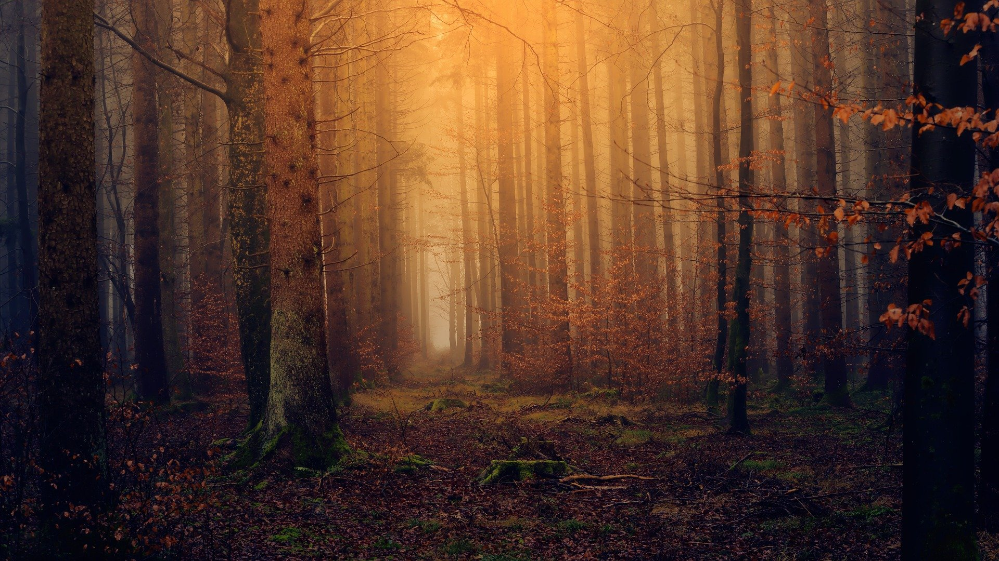
Phonetik
der Schweif – tail geschwind - quickly
sprechen / hören
schön
geschwind*
sicher
scheinen
mich
Gesicht
ächzende
schöne
brauch
Nacht
Töchter
durch
verspricht
nicht
ich
Schweif*
manch-
nächtlichen
dich
erreicht
Notes:
Timing: 3 minutes Aim: To practise the SSC [sch] and [ch] in a pairwork read aloud and listening task.
Procedure: 1. Students work in pairs. Student A picks five words from the board, jotting them down, without showing Student B.
2. Student B has to name the correct five words, by saying each one until s/he has found all five.
3. When all five words have been said students swap roles and repeat. 4. Teachers can click on each word to check pronunciation with the class, as required.
Note: all words come from the Goethe poem that we are studying in this sequence. Word frequency of unknown and/or cognate words (1 is the most frequent word in German): Schweif [>5009] geschwind >5009]
Source: Jones, R.L. & Tschirner, E. (2006). A frequency dictionary of German: core vocabulary for learners. Routledge

Slide 51
Hard and soft [ch]
Phonetik
Consolidation [10]
Y9 T3.2 Week 4 Slides 2-3; 16

Slide 52
Phonetik [ch]
hören / lesen
Remember! The German [ch] can be pronounced in two different ways:
[ch] soft
[ch] hard
Careful! [ch] and [ck] are different sounds!
Ach!
The hard-soft difference depends on the vowel that comes before it and how open your mouth is when you close the back of your throat to say [ch].
After a, o, u, [ch] is hard.
After i, e, ä, ö, ü, [ch] is soft.
roch
Rock
Gespräch
Gepäck
Notes:
Timing: 2 minutes Aim: to revisit the pronunciation of [ch] in different contexts and to contrast [ch] with [ck]. Procedure: 1. Cycle through the explanation using the animation sequence.
2. Click on the pictures to hear each word pronounced.

Slide 53
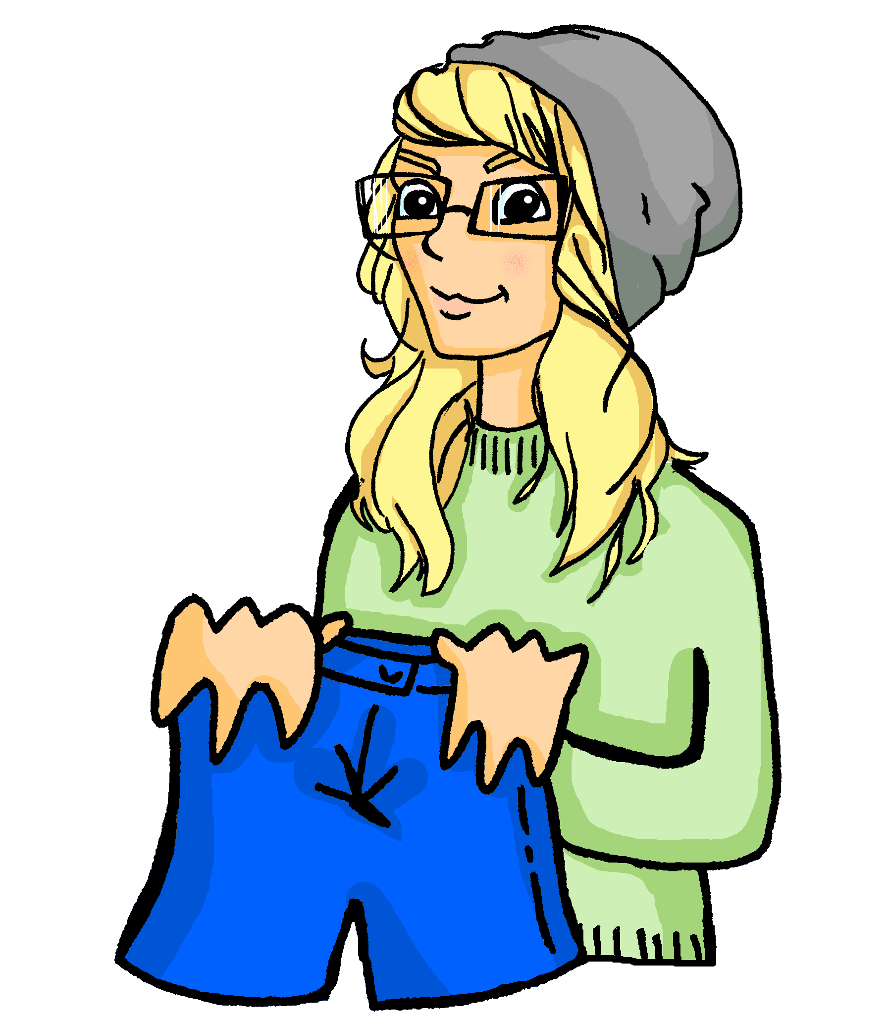
Phonetik [ch]
lesen / hören
Es wird Nacht, aber Heidis Bruder ist noch wach. Heidi macht ein Buch auf und sagt:
1
2
3
4
5
ach! (hard) | ich (soft)
Komm, Brüderchen, ich erzähle dir eine Geschichte. Was willst du hören? Dornröschen, Rotkäppchen, Schneewittchen oder die drei kleinen Schweinchen?
6
7
1
6
8
2
7
3
8
9
10
11
4
9
5
10
12
11
12
Notice that after a consonant, [ch] is soft.
Notes:
Timing: 4 minutes Aim: to practise oral production of hard and soft [ch].
Procedure: 1. Students read the text aloud, noting for each [ch] whether it is hard or soft.
2. Click on the audio player to listen and check by listening to a native speaker version of the text. 3. Click to reveal answers.

Slide 54
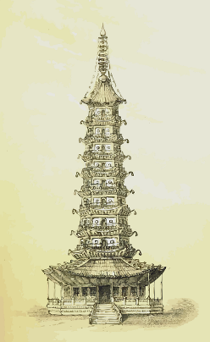
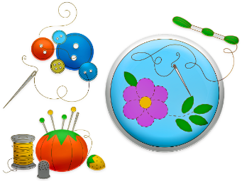
Das kleine Mädchen
Person A liest.
Phonetik
Person B dreht sich um und schreibt.
Dann tauscht die Rollen!
Person A liest:
Person B liest:
Das kleine Mädchen
Es war ein armes kleines Mädchen,
Das stickte nur mit kurzen Fädchen;
Ich glaube, Lina war ihr Name.
Sie wurde eine schöne Dame,
War fleißig, brav und lernte gerne,…
…Da kam ein Prinz aus weiter Ferne.
Der sagte: »Liebe gute Lina,
Komm mit mir auf mein Schloß nach China.«
Dort sitzen sie nun alle beide
Auf einem Thron von gelber Seide.
Joachim Ringelnatz (1883 – 1934)
Notes:
Timing: 10 minutes Aim: to practise this week’s and previous phonics using an authentic poem for paired transcription. Procedure: 1. Person A looks at the board, Person B turns around so that they can’t see the board.
2. Person A reads out the first half of the poem, Person B transcribes.
3. Then swap roles for the second half of the poem. 4. Continue to the next slide for a lexical inference task based on the same text.
Word frequency (1 is the most frequent word in German): brav [4836] Faden [>5009] Ferne [3158] fleißig [>5009] nun [114] Seide [>5009] sticken [>5009] Thron [>5009] weiter [221] Source: Jones, R.L. & Tschirner, E. (2019). A frequency dictionary of German: core vocabulary for learners. Routledge
Source acknowledgment: Joachim Ringelnatz (1883 - 1934), eigentlich Hans Bötticher, deutscher Lyriker, Erzähler und Maler
Ringelnatz, J., Gedichte. Kleine Wesen, 1910

