Slide 1
German phonics collection
[äu]
Artwork: Steve Clarke
Date updated: 10 / 02 / 21
Notes:
Artwork by Steve Clarke. All additional pictures selected are available under a Creative Commons license, no attribution required.

Slide 2
[äu]
Phonetik
Introduction
Y7 T2.1 Week 2 Slides 17-22

Slide 3
äu
Mäuse
Notes:
Timing: 1 minute
Aim: To introduce/consolidate SSC [äu]
Procedure: 1. Present the letter(s) and say the [äu] sound first, on its own. Students repeat it with you. 2. Bring up the word ”Mäuse” on its own, say it, students repeat it, so that they have the opportunity to focus all of their attention on the connection between the written word and its sound.
3. A possible gesture for this would be to mime whiskers, holding your fingers up to the side of your mouth.
4. Roll back the animations and work through 1-3 again, but this time, dropping your voice completely to listen carefully to the students saying the [äu] sound, pronouncing ”Mäuse” and, if using, doing the gesture. Word frequency (1 is the most frequent word in German): Mäuse [3757] Source: Jones, R.L. & Tschirner, E. (2006). A frequency dictionary of German: core vocabulary for learners. Routledge

Slide 4
äu
Mäuse
Notes:
With sound and no pictures to focus all attention on the sound-symbol correspondence.

Slide 5
äu
Mäuse
Notes:
Without sound to elicit pronunciation (without first hearing the teacher).
Teacher to elicit pronunciation by asking “Wie sagt man…”

Slide 6
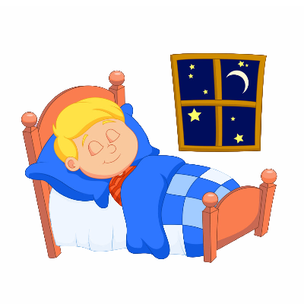
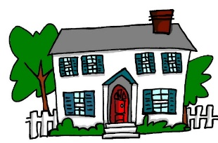
äu
Bäume
häufig
Mäuse
träumen
Gebäude
Häuser
Notes:
Timing: 2 minutes
Aim: To introduce/consolidate SSC [äu]
Procedure:
Introduce and elicit the pronunciation of the individual SSC [äu] and then the source word again ‘Mäuse’ (with gesture, if using).
Then present and elicit the pronunciation of the five cluster words.
The cluster words have been chosen for their high-frequency, from a range of word classes, with the SSC (where possible) positioned within a variety of syllables within the words (e.g. initial, 2nd, final etc.). Additionally, we have tried to use words that build cumulatively on previously taught SSCs (see the Phonics Teaching Sequence document) and do not include new SSCs. Where new SSCs are used, they are often consonants which have a similar symbol-sound correspondence in English.
Word frequency (1 is the most frequent word in German): Mäuse [3757]; Bäume [994] häufig [432]; träumen [1907]; Häuser [159]; Gebäude[1202]. Source: Jones, R.L. & Tschirner, E. (2006). A frequency dictionary of German: core vocabulary for learners. Routledge

Slide 7
äu
Bäume
häufig
Mäuse
träumen
Gebäude
Häuser
Notes:
With sound and no pictures to focus all attention on the sound-symbol correspondence.

Slide 8
äu
Bäume
häufig
Mäuse
träumen
Gebäude
Häuser
Notes:
Without sound to elicit pronunciation (without first hearing the teacher).
Teacher to elicit pronunciation by asking “Wie sagt man…”

Slide 9
[äu]
Phonetik
Consolidation [1]
Y7 T2.2 Week 2 Slides 23-33

Slide 10
Hörst du [au] oder [äu]?
hören / schreiben
 |  | au | äu
auf Deutsch
A | E
B | F
C | G
D | H
D
häufig
[to believe]
1
F
genau
2
[exact(ly)]
H
Träume
[to go out]
3
[8:07:25]
B
ausgehen
4
G
auf
5
A
Bäume
6
E
glauben
7
C
Gebäude
8
Notes:
Timing: 5 minutes
Aim: Phonics: au/äu contrast.
Procedure:
1. Teachers click each number for the audio. 2. Students write 1-8 in books, and write ‘au’ or ‘äu’. 3. On 2nd listening, they should try to write the words. 4.Then, to prompt meaning recall, students match the letters of the pictures to the words 1-8. Teach can elicit answers: Teacher: Was ist Nummer eins? Student: häufig. D This requires students both to pronounce the German word and produce the alphabet letter in German.
Word frequency (1 is the most frequent word in German):
Mäuse [3757]; Bäume [994] häufig [432]; träumen [1907]; Häuser [159]; Gebäude[1202]; Haus [159]; genau [183] auch [16]; glauben [143]; ausgehen [493]; auf [17]. Source: Jones, R.L & Tschirner, E. (2019). A frequency dictionary of German: Core vocabulary for learners. London: Routledge.

Slide 11
[AU] oder [ÄU] oder beide?
Was hörst du? [AU], [ÄU] oder [AU] und [ÄU]?
1
AU
Er kann laufen.
He can run.
Notes:
Timing: 3 minutes (for 10 slides)
Aim: This is a second phonics activity using whole sentences. The students must listen to determine which SSC(s) is/are used in the sentence- only au, only äu, or both.
Procedure:
1. Click on number 1 to hear the audio. 2. Students write au, äu OR au und äu. 3. Click to reveal the answer. 4. Click to show the full German sentence. 5. Elicit the English translation from students, and reveal the English translation.
Note: If timing is too tight, it would be possible to omit this task.
Transcript:
Er kann laufen.

Slide 12
Er kann laufen.
1
Notes:
Timing: 3 minutes (for 10 slides)
Aim: The students must listen to determine which SSC(s) is/are used in the sentence- only au, only äu, or both.
Procedure:
1. Now the same sentences are presented, but with gaps. 2. Teacher prompts students (chorally) to say the full sentence, and then clicks to show the missing SSC. 3. If desired, the audio can be played to hear the SSC(s) again.
Note: If timing is too tight, it would be possible to omit this task.
Transcript:
Er kann laufen.

Slide 13
‘AU’ oder ÄU oder beide?
[AU] oder [ÄU] oder beide?
Was hörst du? [AU], [ÄU] oder [AU] und [ÄU]?
2
ÄU
Träumst du von Bäumen?
Do you dream / are you dreaming about trees?
Notes:
Repeat steps as for Number 1.
Transcript:
Träumst du von Bäumen?

Slide 14
Träumst du von Bäumen?
2
Notes:
Repeat steps as for Number 1
Transcript:
Träumst du von Bäumen?

Slide 15
‘AU’ oder ÄU oder beide?
[AU] oder [ÄU] oder beide?
Was hörst du? [AU], [ÄU] oder [AU] und [ÄU]?
AU und ÄU
3
Die Mäuse sind zu Hause.
The mice are at home.
Notes:
Repeat steps as for Number 1.
Transcript:
Die Mäuse sind zu Hause.

Slide 16
Die Mäuse sind zu Hause.
3
Notes:
Repeat steps as for Number 1.
Transcript:
Die Mäuse sind zu Hause

Slide 17
‘AU’ oder ÄU oder beide?
[AU] oder [ÄU] oder beide?
Was hörst du? [AU], [ÄU] oder [AU] und [ÄU]?
4
AU
Ich gehe ins Baumhaus.
I go / am going to the treehouse.
Notes:
Repeat steps as for Number 1.
Transcript:
Ich gehe ins Baumhaus.

Slide 18
Ich gehe ins Baumhaus.
4
Notes:
Repeat steps as for Number 1.
Transcript:
Ich gehe ins Baumhaus.

Slide 19
‘AU’ oder ÄU oder beide?
[AU] oder [ÄU] oder beide?
Was hörst du? [AU], [ÄU] oder [AU] und [ÄU]?
5
AU
Ich glaube das auch.
I believe that, also/too.
Notes:
Repeat steps as for Number 1.
Transcript:
Ich glaube das auch.

Slide 20
Ich glaube das auch.
5
Notes:
Repeat steps as for Number 1.
Transcript:
Ich glaube das auch.

Slide 21
[äu]
Phonetik
Consolidation [2]
Y7 Term 2.2 Week 3 Slide 5

Slide 22
au/äu
au
glauben
äu
Gebäude
genau
auf
Bäume
träumen
auch
häufig
Haus
Mäuse
Häuser
ausgehen
laufen
räumlich
äußern
läuft
Urlaub
brauchen
Käufer
nach Hause
Notes:
Timing: 3 minutes
Aim: Phonics revision. The SSC [äu] was only introduced last week. We’re revisiting it here, because it is relevant for this week’s grammar point (strong verbs and the stem change from au to äu)
Procedure:
1. This is a paired read aloud task. The students use different colours to play. Pupil A says one of the words/phrases and pupil B has 3 seconds to locate it and cross it off with their colour. If the pupil takes longer than 3 seconds pupil A can steal the point. Clearly, the classroom conditions need to be right with the individual class for friendly competition.
2. Alternatively, they can do it more slowly and carefully, scrutinising each other’s pronunciation. If one makes a mistake, then the other pupil corrects and crosses off in his/her colour.
Note: Not all of these words have been taught before, so there is the opportunity for some genuine decoding.
Word frequency (1 is the most frequent word in German):
genau [] ausgehen [] auf [] Gebäude [] träumen [] Mäuse [] läuft [] Bäume [] häufig [] äußern [] räumlich [] Käufer []
Source: Jones, R.L & Tschirner, E. (2019). A frequency dictionary of German: Core vocabulary for learners. London: Routledge.

Slide 23
[äu]
Phonetik
Consolidation [3]
Y7 Term 3.1 Week 2 Slide 3

Slide 24
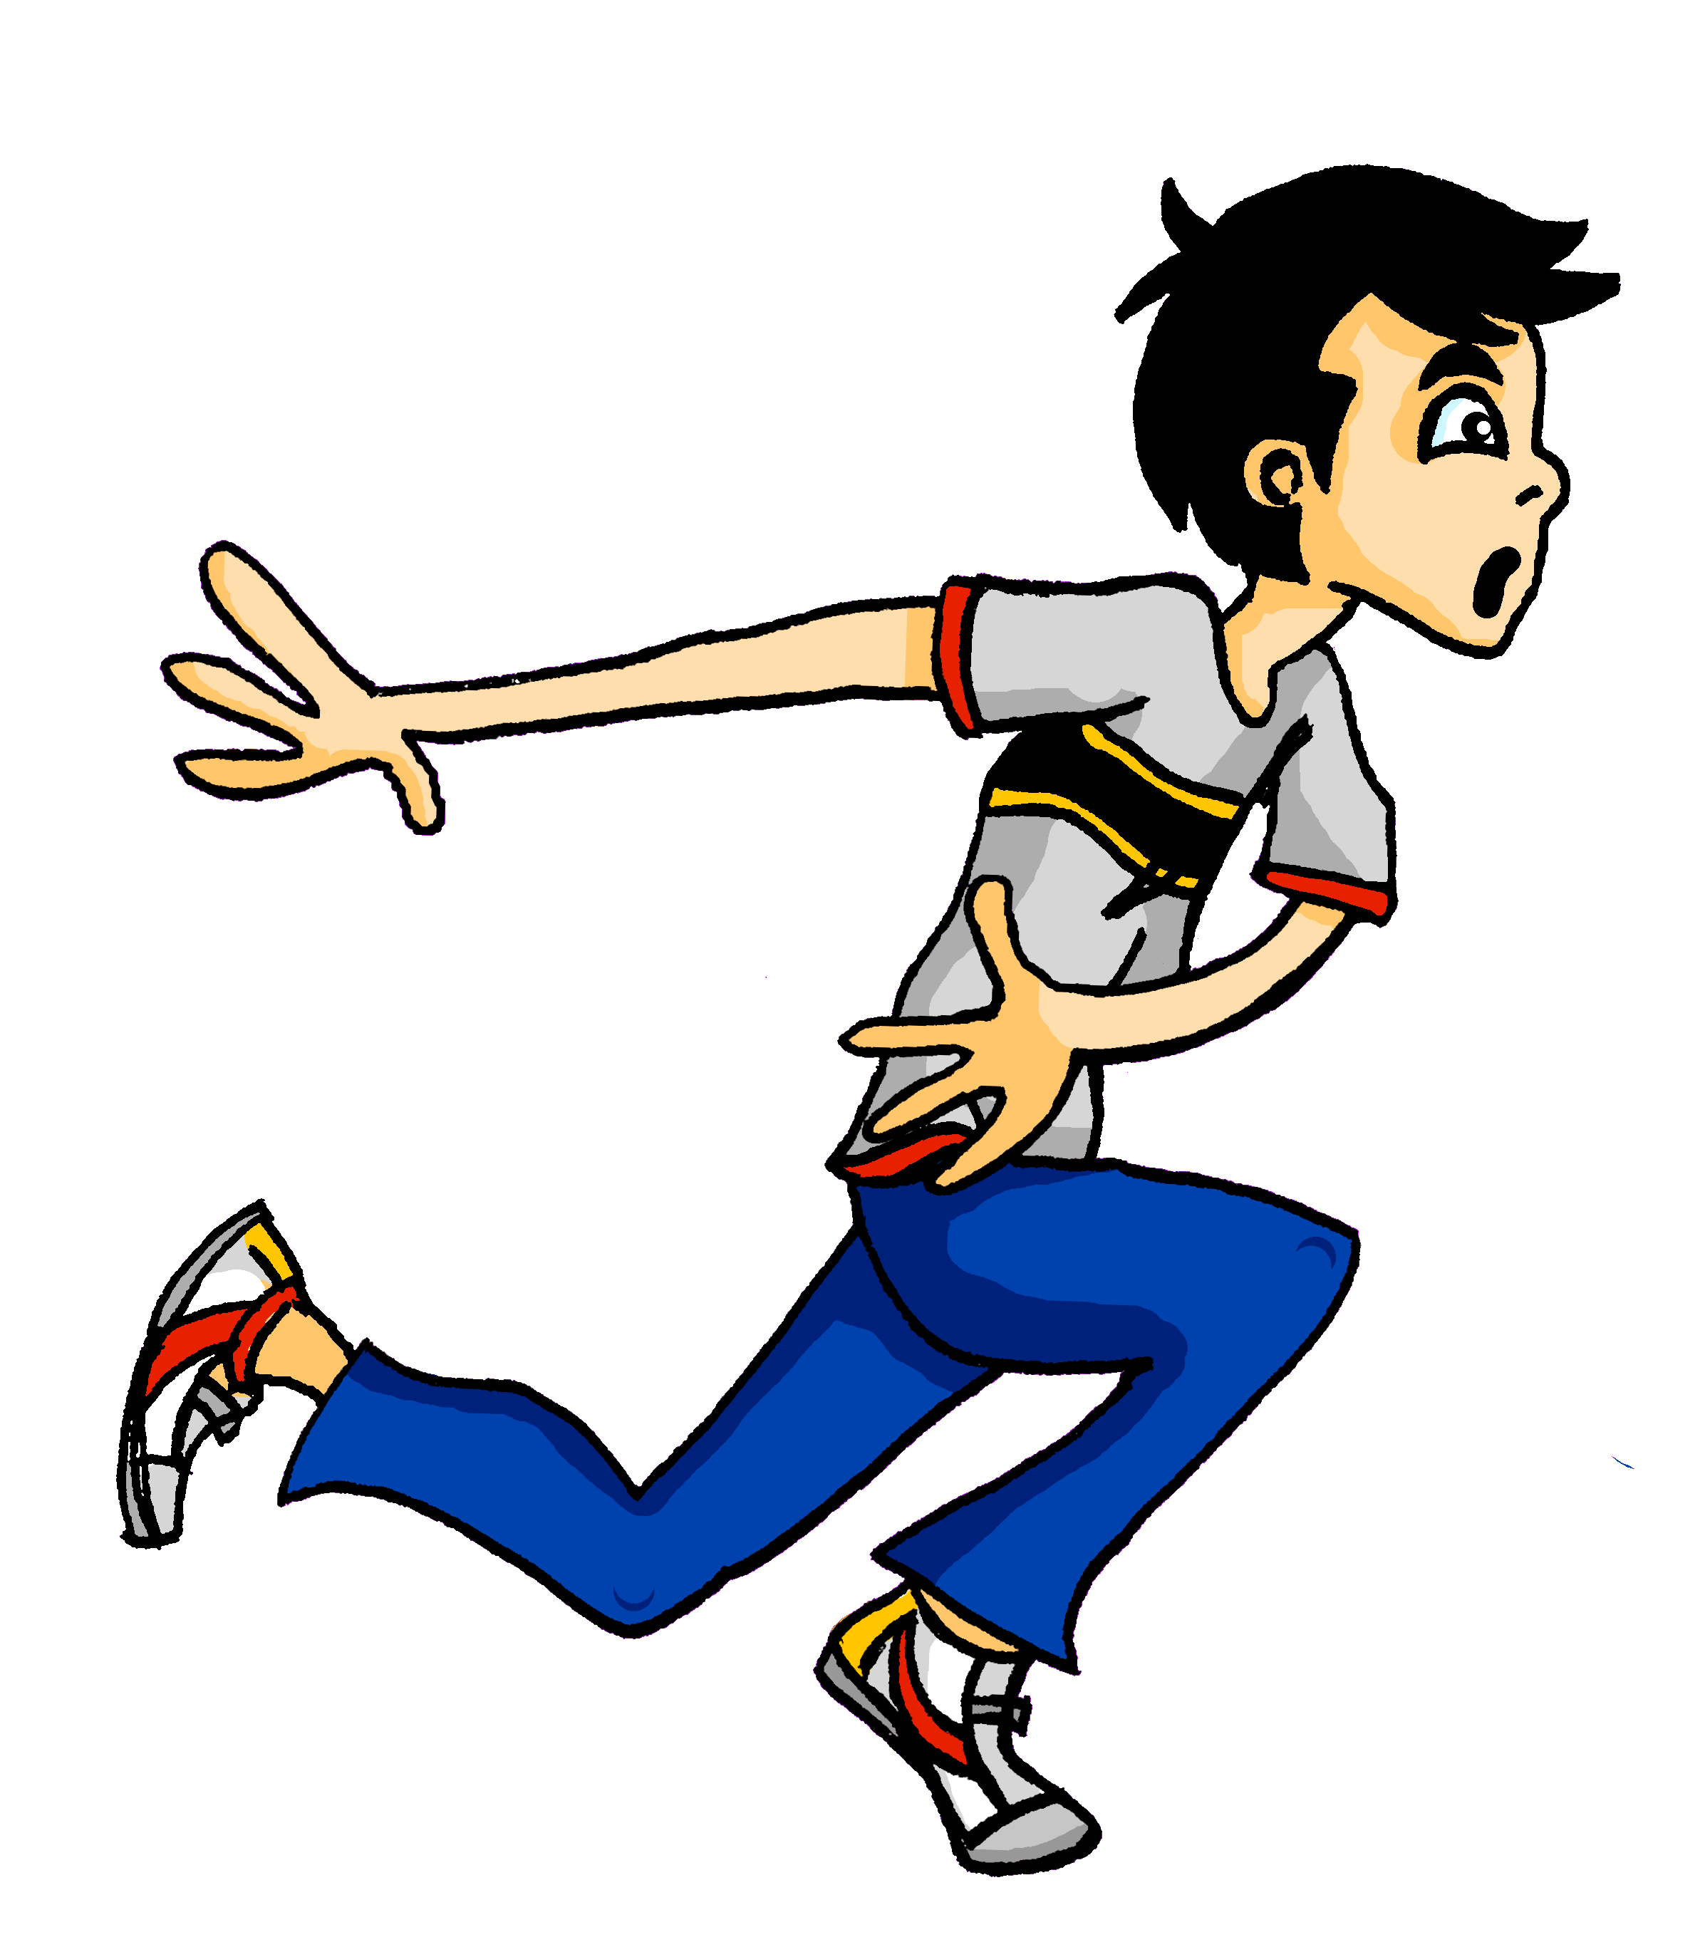
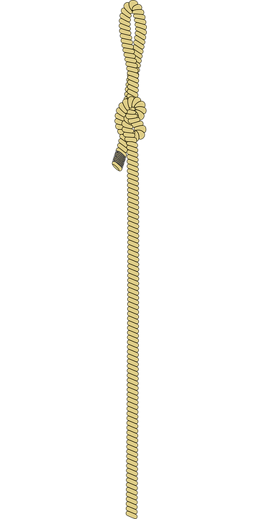
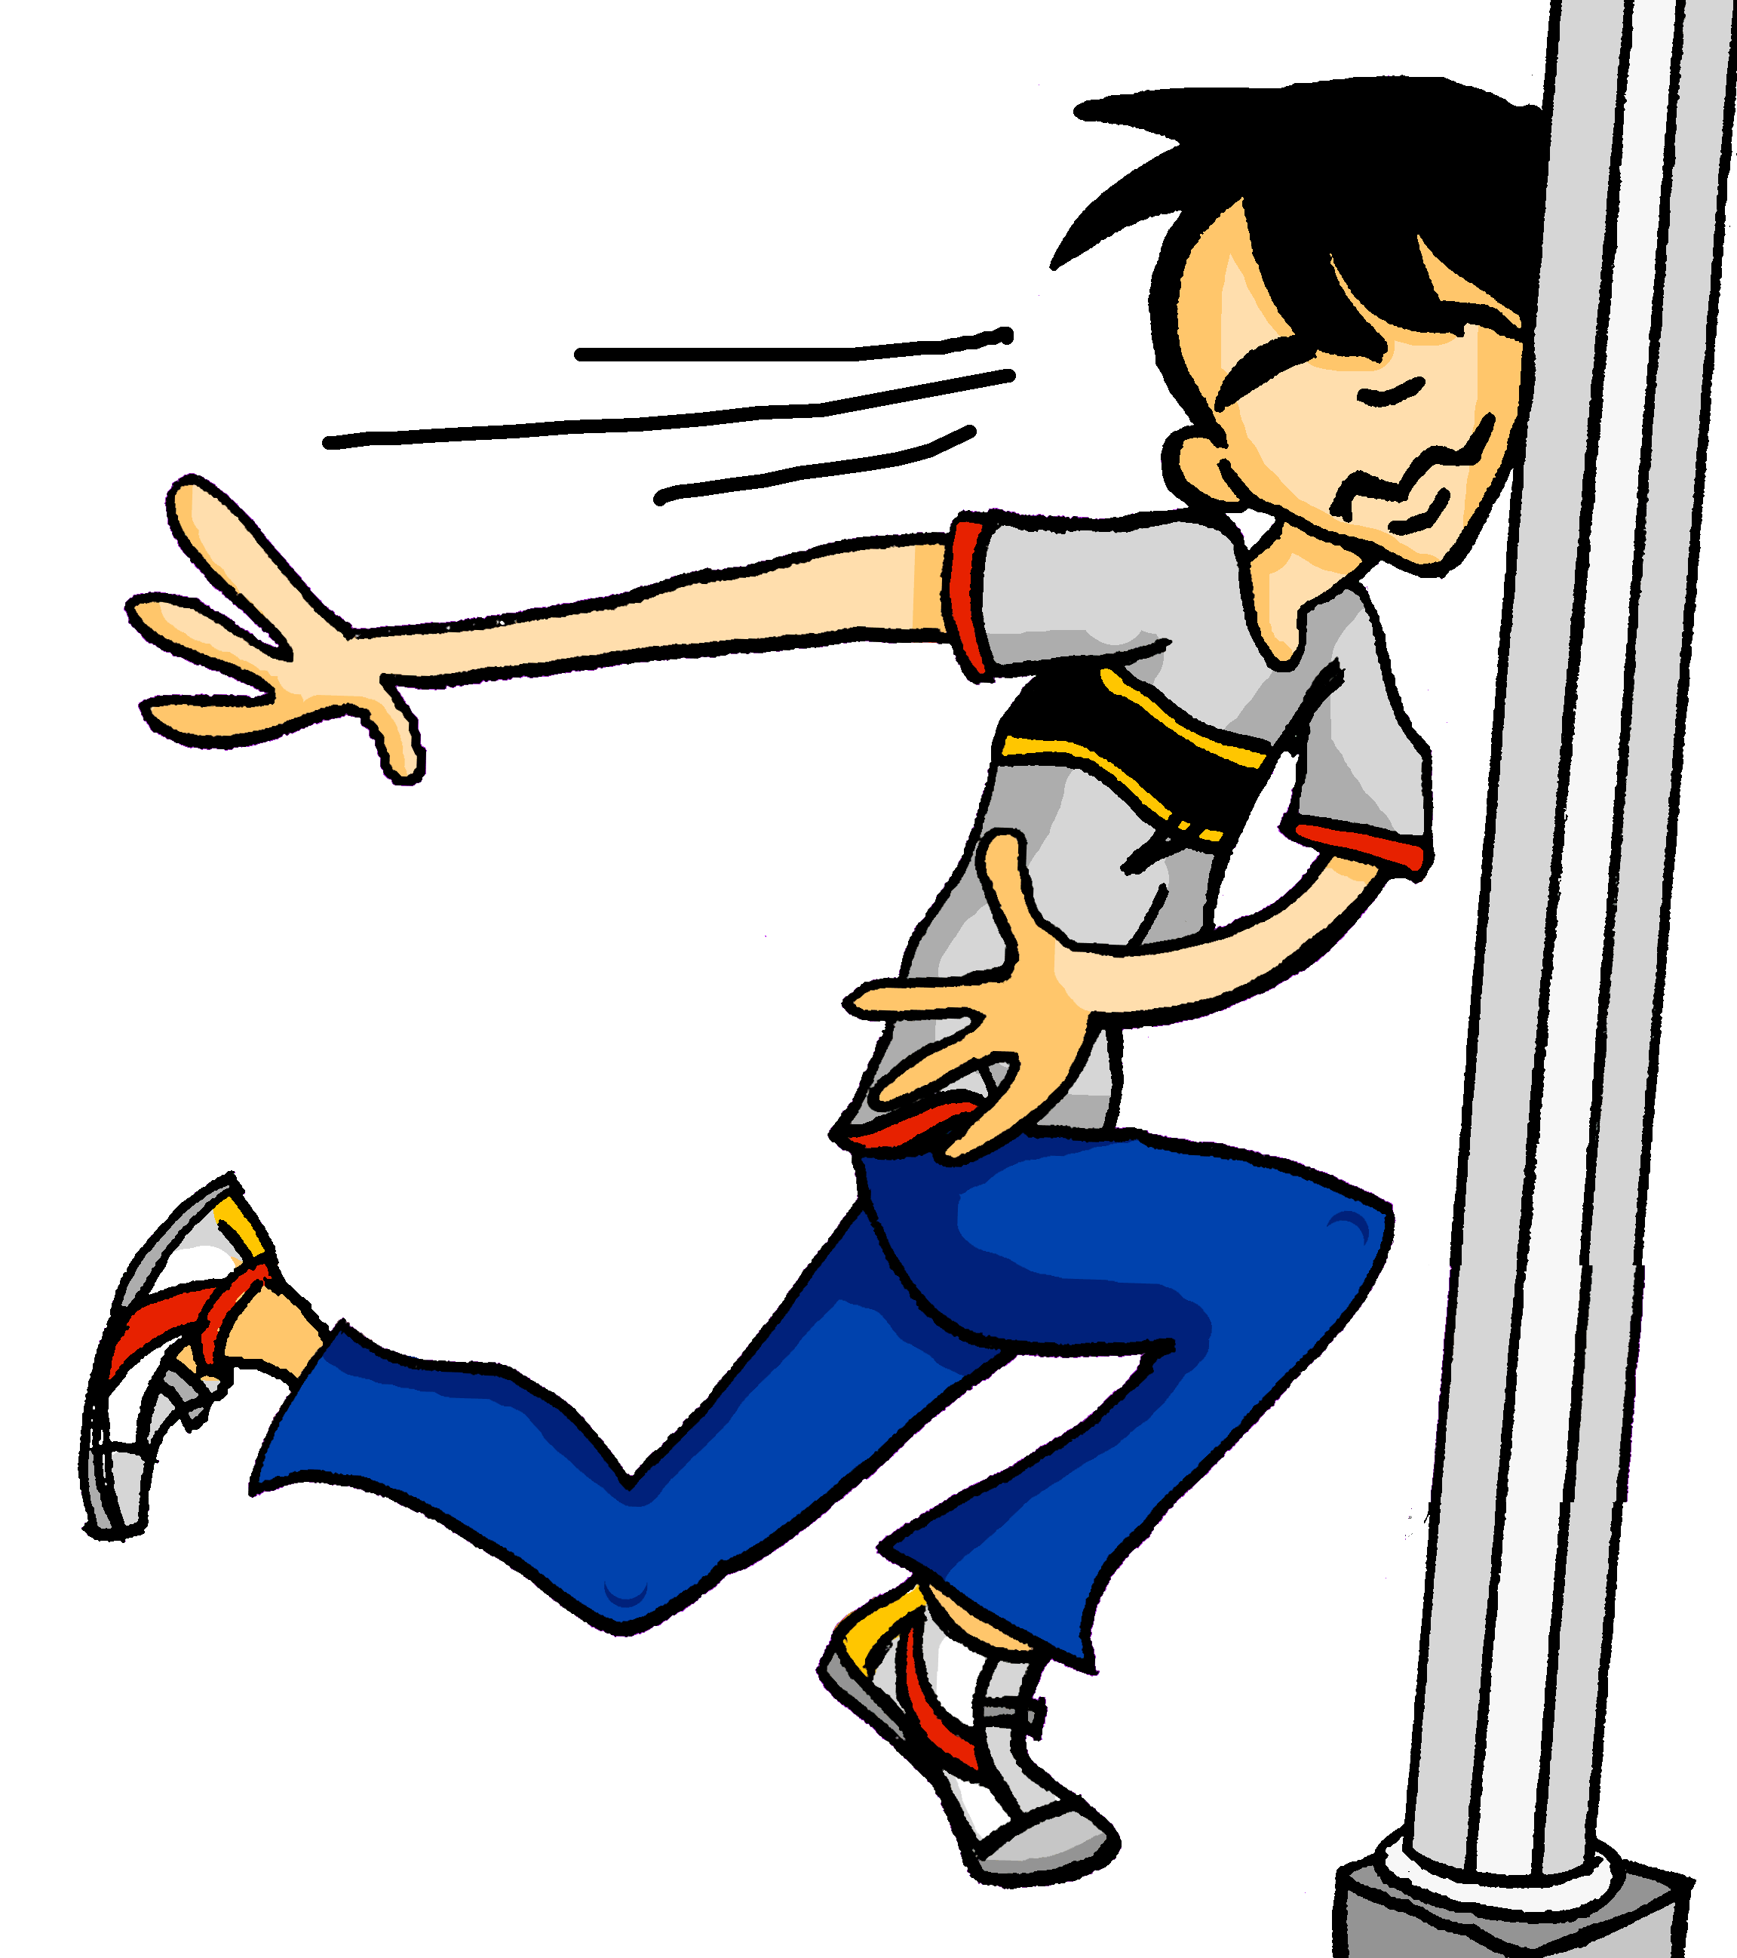
Samstagnachmittag
lesen / hören
Wolfgang ist im Stress. Er läuft in den Park. Leider sieht er nicht die …
a) Seile
b) Säule
7
Notes:
Here, SSCs [ei] and [äu] are contrasted.
Teacher to draw attention to the strong verb stem in läuft, eliciting the infinitive form and meaning from students. Students have not yet been taught ‘in’ and its use with/without movement, but this will be taught next week. The use of ‘den’ here will not be a barrier to understanding, as students know its meaning.
Students have not yet met the cognate Stress [2566]. They will need some guidance with pronunciation, as they have not yet encountered SSC [st-]. This is the SSC for next week.
Frequencies of unknown vocabulary: Seil [>4034], Säule [3778]
Transcript
Säule

Slide 25
[äu]
Phonetik
Consolidation [4]
Y8 Term 3.1 Week 5 Slides 2-7; 32-33

Slide 26
äu
Mäuse
Notes:
Aim: To consolidate SSC [äu]
Procedure: 1. Present the letter(s) and say the [äu] sound first, on its own. Students repeat it with you. 2. Bring up the word ”Mäuse” on its own, say it, students repeat it, so that they have the opportunity to focus all of their attention on the connection between the written word and its sound.
3. A possible gesture for this would be to mime whiskers, holding your fingers up to the side of your mouth.
4. Roll back the animations and work through 1-3 again, but this time, dropping your voice completely to listen carefully to the students saying the [äu] sound, pronouncing ”Mäuse” and, if using, doing the gesture. Word frequency (1 is the most frequent word in German): Mäuse [3757] Source: Jones, R.L. & Tschirner, E. (2006). A frequency dictionary of German: core vocabulary for learners. Routledge

Slide 27
äu
Bäume
häufig
Mäuse
träumen
Gebäude
Häuser
Notes:
Aim: To consolidate SSC [äu]
Procedure:
Introduce and elicit the pronunciation of the individual SSC [äu] and then the source word again ‘Mäuse’ (with gesture, if using).
Then present and elicit the pronunciation of the five cluster words.
The cluster words have been chosen for their high-frequency, from a range of word classes, with the SSC (where possible) positioned within a variety of syllables within the words (e.g. initial, 2nd, final etc.). Additionally, we have tried to use words that build cumulatively on previously taught SSCs (see the Phonics Teaching Sequence document) and do not include new SSCs. Where new SSCs are used, they are often consonants which have a similar symbol-sound correspondence in English.
Word frequency (1 is the most frequent word in German): Mäuse [3757]; Bäume [994] häufig [432]; träumen [1907]; Häuser [159]; Gebäude[1202]. Source: Jones, R.L. & Tschirner, E. (2006). A frequency dictionary of German: core vocabulary for learners. Routledge

Slide 28
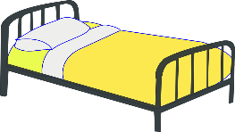
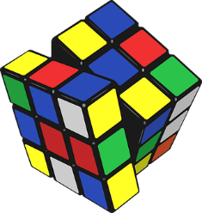
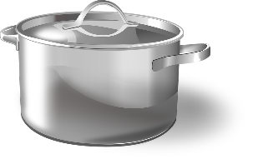
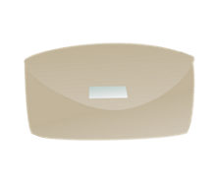
Was packt Wolfgang ein*?
hören / schreiben
Die Familie zieht um*. Es gibt nicht viel Platz im Auto! Wolfgang darf nur die Sachen mit [eu] und [äu] mitnehmen. Welche sind das?
das Bettzeug
die Leuchte
__
__
die Vorh ä nge
__
die Puppenhäuser
die Handt ü cher
der Kl ei derschrank
__
__
__
die T ö pfe
die Fäustlinge
__
__
das Spielzeug
__
__
*einpacken = to wrap up, box
*umziehen = to move house
der Geldbeutel
der Fotor a hmen
__
Notes:
Timing: 5 minutes Aim: Aural recognition of SSCs [eu] and [äu]. Raising awareness that this sound corresponds to two spelling patterns. Procedure: 1. Check students understand the context and task instructions. They haven’t come across the word mitnehmen before, but should be able to work out its meaning using their knowledge of mit and nehmen.
2. Begin with Bettzeug in the top left. Click on picture to hear the word said aloud.
3. Students decide whether they hear the target sound or not. Ask: Hörst du SSC eu? Students respond ja/nein, or the teacher could ask ‘Wer denkt ja/nein?’ to take a vote. At advanced levels, students could volunteer the correct SSC where they answer nein.
4. Click to reveal the missing SSC. Where a different SSC is revealed, click again to make the item disappear as Wolfgang doesn’t pack it!
5. Continue for the others, working from left to right.
Transcript: das Bettzeug
die Leuchte
die Vorhänge
die Puppenhäuser
die Handtücher
der Kleiderschrank
die Töpfe
die Fäustlinge
das Spielzeug
der Geldbeutel
der Fotorahmen Word frequency of unknown words used (1 is the most frequent word in German): Bettzeug [>5000], Vorhang [3513], Topf [4136], Geldbeutel [>5000], Leuchte [>5000], Spielzeug [>5000], Handtücher [>5000], Fäustling [>5000], Kleiderschrank [>5000], Fotorahmen [633/753], Puppenhaus [4676/147], mitnehmen [1459], einpacken [>5000], umziehen [>5000] Source: Jones, R.L. & Tschirner, E. (2019). A frequency dictionary of German: core vocabulary for learners. Routledge

Slide 29
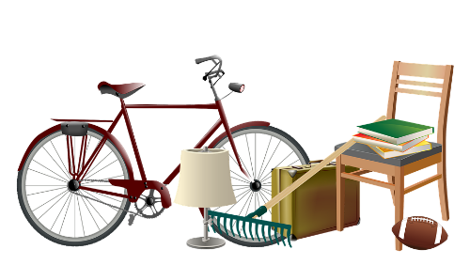
Was packt Mia nicht ein?
Was bringt Mia mit? Lies die Wörter laut vor.
Mia darf keine Sachen mit diesen SSC mitbringen. Was packt sie nicht ein? Lies die Wörter laut vor.
lesen / sprechen
die Zukäufe
[additional purchases]
die Seife
der Zaun
das Kreuz
das Brettspiel
die sauren Gurken
das Zeug
[stuff]
die Eule
die Werkzeuge
das Zeugnis
die Gläser
die Kräuter
Notes:
Timing: 5 minutes Aim: Written recognition of SSCs pronounced liked [eu]. Oral production of these and a selection of other SSCs. Procedure: 1. Click to bring up the first task. Say the target SSC aloud to remind students what to look for.
2. Students work in pairs and decide which words contain the target SSC. They practise saying these aloud for 2 minutes.
3. Elicit answers by asking: Was packt Mia nicht ein?
4. Click on the pictures representing words containing [eu] and [äu] to hear them said aloud.
5. Click to remove these words, as Mia is not packing them.
6. Click to bring up the second task. Students practise saying the words for 1 minute.
7. Click on the pictures to hear the remaining words said aloud. Students repeat.
Transcript: die Zukäufe
der Zaun
die Seife
das Zeug
das Kreuz
das Zeugnis
die Gläser
die saure Gurken
das Brettspiel
die Kräuter
die Werkzeuge
die Eule
Word frequency of unknown words used (1 is the most frequent word in German): Kräuter [>5000], Eule [>5000], Schlagzeuge [>5000], Werkzeug [3681], Zeugnis [4456], Brettspiel [>5000], Zukauf [>5000], Kreuz [2358], Zeug [3069], Zaun [3279], Brettspiel [4845/328], Glas [885], mitnehmen [1459], einpacken [>5000] Source: Jones, R.L. & Tschirner, E. (2019). A frequency dictionary of German: core vocabulary for learners. Routledge

Slide 30
Phonetik
lesen / sprechen
Partner A’s Sentences:
1. Er träumt von einstürzenden Gebäuden.
2. Der Verkäufer ist über die häufigen Diebstähle enttäuscht.
3. Der europäische Zeuge täuscht den Richter, und kommt ins
Gefängnis.
 | Tally of [eu] [äu] heard
1
2
3
Partner B’s Sentences:
4. Das Fräulein seufzt, denn das ganze Zeug ist weg.
5. Heutzutage werden viele Leute
neunzig Jahre alt.
6. Man hat vor Kurzem ein neues Gebäude gebaut.
 | Tally of [eu] [äu] heard
4
5
6
Notes:
DO NOT DISPLAY THIS SLIDE Printable version is provided.
Timing: 5 minutes [2 slides].
Aim: Fluency development. Procedure: 1. Students work in pairs.
2. Partner A reads a sentence containing a mixture of known and unknown words.
3. Partner B tallies the number of [eu/äu] SSCs they hear. Hence there is a joint responsibility to get the answer right.
4. Native speaker recordings are provided on the following slides. Students can use these to check their tallies.
5. Answers and translations are also provided on the following slide.
Word frequency of unknown words used (1 is the most frequent word in German): träumen [1793], einstürzend [>5000], Gebäude [1386], Verkäufer [2374], enttäuschen [2042], Diebstahl [>5000], wenn [42], Zeug [3069], Richter [2286]. Täuschen [3613], Europäer [2750], Gefängnis [2523], Fräulein [3265], seufen [>5000], weg [965], heutzutage [3356], erscheinen [408] Source: Jones, R.L. & Tschirner, E. (2019). A frequency dictionary of German: core vocabulary for learners. Routledge

Slide 31
Phonetik
lesen / sprechen
 | Er träumt von einstürzenden Gebäuden. | He dreams of falling buildings.
 | Der Verkäufer ist über die häufigen Diebstähle enttäuscht. | The salesman is disappointed by the frequent thefts.
 | Der europäische Zeuge täuscht den Richter und kommt ins Gefängnis. | The European witness deceives the judge and goes to prison.
 | Das Fräulein seufzt, denn das ganze Zeug ist weg. | The young lady is sighing because all the stuff is gone.
 | Heutzutage werden viele Leute neunzig Jahre alt. | Nowadays a lot of people live to be ninety.
 | Ein neues Gebäude ist vor kurzer Zeit erschienen. | A new building has recently appeared.
1
2
3
4
5
6
Notes:
Answers for the activity on the previous slide.
Procedure: 1. Click numbers to hear sentence pronounced by native speaker.
2. Click to reveal transcript with highlighted SSCs.
3. Click again to reveal translation of sentence.
Transcript: 1. Er träumt von einstürzenden Gebäuden.
2. Der Verkäufer ist über die häufigen Diebstähle enttäuscht.
3. Der europäische Zeuge täuscht den Richter und kommt ins Gefängnis.
4. Das Fräulein seufzt, denn das ganze Zeug ist weg.
5. Heutzutage werden viele Leute neunzig Jahre alt.
6. Man hat vor Kurzem ein neues Gebäude gebaut.
Word frequency of unknown words used (1 is the most frequent word in German): träumen [1793], einstürzend [>5000], Gebäude [1386], Verkäufer [2374], enttäuschen [2042], Diebstahl [>5000], wenn [42], Zeug [3069], Richter [2286]. Täuschen [3613], Europäer [2750], Gefängnis [2523], Fräulein [3265], seufen [>5000], weg [965], heutzutage [3356], erscheinen [408] Source: Jones, R.L. & Tschirner, E. (2019). A frequency dictionary of German: core vocabulary for learners. Routledge

