Slide 1
German phonics collection
long and short [ä]
Artwork: Steve Clarke
Date updated: 10 / 02 / 21
Notes:
Artwork by Steve Clarke. All additional pictures selected are available under a Creative Commons license, no attribution required.

Slide 2
long and short [ä]
Phonetik
Introduction
Y7 T1.2 Week 7 Slides 38-52

Slide 3
ä
[ɛ:]
spät
Notes:
Timing: 1 minute
Aim: To introduce/consolidate SSC [ä]
Procedure: 1. Present the letter(s) and say the [ä] sound first, on its own. Students repeat it with you. 2. Bring up the word ”spät” on its own, say it, students repeat it, so that they have the opportunity to focus all of their attention on the connection between the written word and its sound.
3. A possible gesture for this would be to bring your left arm up to mime suddenly looking at your watch.
4. Roll back the animations and work through 1-3 again, but this time, dropping your voice completely to listen carefully to the students saying the [ä] sound, pronouncing ”spät’” and, if using, doing the gesture. Word frequency (1 is the most frequent word in German): spät [171]
Source: Jones, R.L. & Tschirner, E. (2006). A frequency dictionary of German: core vocabulary for learners. Routledge

Slide 4
ä
[ɛ:]
spät
Notes:
With sound and no pictures to focus all attention on the sound-symbol correspondence.

Slide 5
ä
[ɛ:]
spät
Notes:
Without sound to elicit pronunciation (without first hearing the teacher).
Teacher to elicit pronunciation by asking “Wie sagt man…”

Slide 6
ä
zählen
ähnlich
1, 2, 3, …100
spät
Nähe
wählen
Berlin 1KM
erklären
[to explain]
Notes:
Timing: 1 minute
Aim: To introduce/consolidate SSC [ä]
Procedure:
Introduce and elicit the pronunciation of the individual SSC [ä] and then the source word again ‘spät’ (with gesture, if using).
Then present and elicit the pronunciation of the five cluster words.
The cluster words have been chosen for their high-frequency, from a range of word classes, with the SSC (where possible) positioned within a variety of syllables within the words (e.g. initial, 2nd, final etc.). Additionally, we have tried to use words that build cumulatively on previously taught SSCs (see the Phonics Teaching Sequence document) and do not include new SSCs. Where new SSCs are used, they are often consonants which have a similar symbol-sound correspondence in English.
Word frequency (1 is the most frequent word in German): spät [171]; zählen [680] ähnlich [429]; Nähe [795]; erklären [250]; wählen [64]. Source: Jones, R.L. & Tschirner, E. (2006). A frequency dictionary of German: core vocabulary for learners. Routledge

Slide 7
ä
zählen
ähnlich
spät
Nähe
wählen
erklären
Notes:
With sound and no pictures to focus all attention on the sound-symbol correspondence.

Slide 8
ä
zählen
ähnlich
spät
Nähe
wählen
erklären
Notes:
Without sound to elicit pronunciation (without first hearing the teacher).
Teacher to elicit pronunciation by asking “Wie sagt man…”

Slide 9
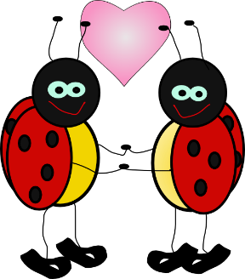
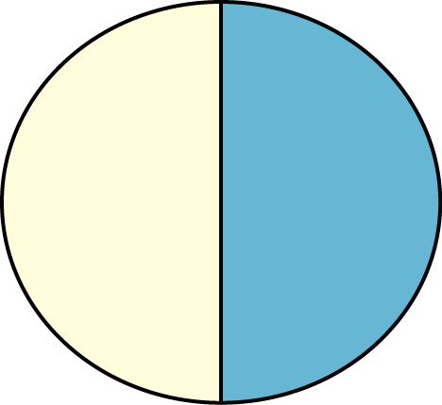
ä
Verhältnis
Mädchen
[relationship]
lächeln
Hälfte
ändern
ständig
[constant(ly)]
Notes:
Introduce and elicit the pronunciation of the individual SSC ‘ä’ and then the source word again (with gesture, if using). Then present and elicit the pronunciation of the five cluster words. The cluster words have been chosen for their high-frequency, from a range of word classes, with the SSC (where possible) positioned within a variety of syllables within the words(e.g. initial, 2nd, final etc..) and additionally, we have tried to use words that build cumulatively on previously taught SSCs (see the Phonics Teaching Sequence document) and do not include new SSCs. Where new SSCs are used, they are often consonants which have a similar symbol-sound correspondence in English.
Word frequency rankings (1 is the most common word in German): lächeln [793]; Verhältnis [517] Mädchen [537]; Hälfte [972]; ständig [612]; ändern [476]. Source: Jones, R.L. & Tschirner, E. (2006). A frequency dictionary of German: core vocabulary for learners. Routledge

Slide 10
ä
Verhältnis
Mädchen
lächeln
Hälfte
ändern
ständig
Notes:
With sound and no pictures to focus all attention on the sound-symbol correspondence.
Word frequency rankings (1 is the most common word in German): lächeln [793]; Verhältnis [517] Mädchen [537]; Hälfte [972]; ständig [612]; ändern [476]. Source: Jones, R.L. & Tschirner, E. (2006). A frequency dictionary of German: core vocabulary for learners. Routledge

Slide 11
ä
Verhältnis
Mädchen
lächeln
Hälfte
ändern
ständig
Notes:
Without sound to elicit production from students.
Word frequency rankings (1 is the most common word in German): lächeln [793]; Verhältnis [517] Mädchen [537]; Hälfte [972]; ständig [612]; ändern [476]. Source: Jones, R.L. & Tschirner, E. (2006). A frequency dictionary of German: core vocabulary for learners. Routledge

Slide 12
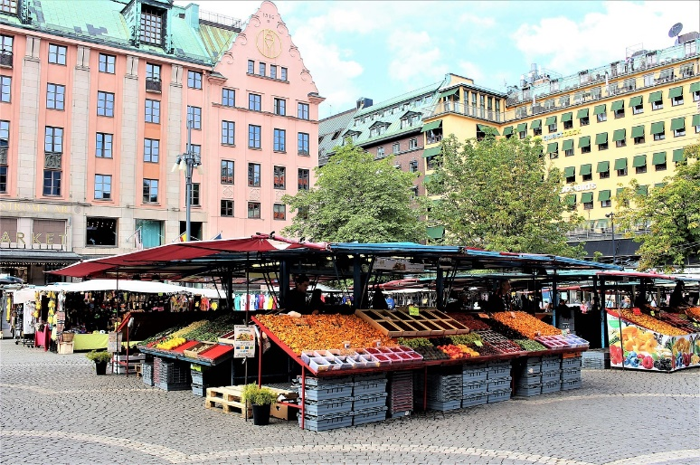
Sag es!
hören und sprechen
die Marktplätze
der Marktplatz
Notes:
1a. Phonics practice
This activity involves plurals learnt previous week with ä sounds (Platz / Plätze, Markt / Märkte, Arzt / Ärzte, Mann / Männer, Garten / Gärten, Nacht / Nächte). The last 3 are exceptions to the plural rules - good for them to hear and practise the difference between singular / plural even when they don't follow the rule.
Whole class saying out loud activity, contrasting the pairs.
NB: sprechen is on the list of words to repeat for this week, so this could be an opportunity to elicit the meaning from students.

Slide 13
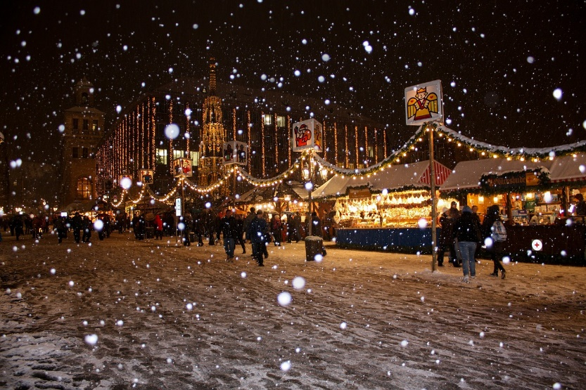
Sag es!
hören und sprechen
der Weihnachtsmarkt
die Weihnachtsmärkte

Slide 14
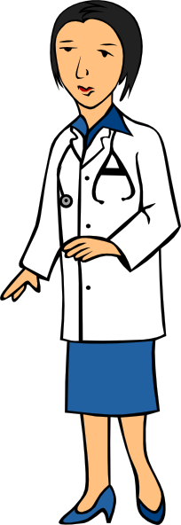
Sag es!
hören und sprechen
der Arzt
die Ärzte

Slide 15
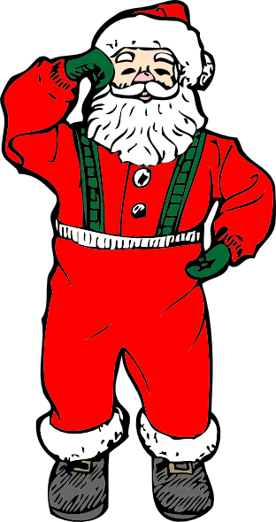
Sag es!
hören und sprechen
die Männer
der Mann

Slide 16
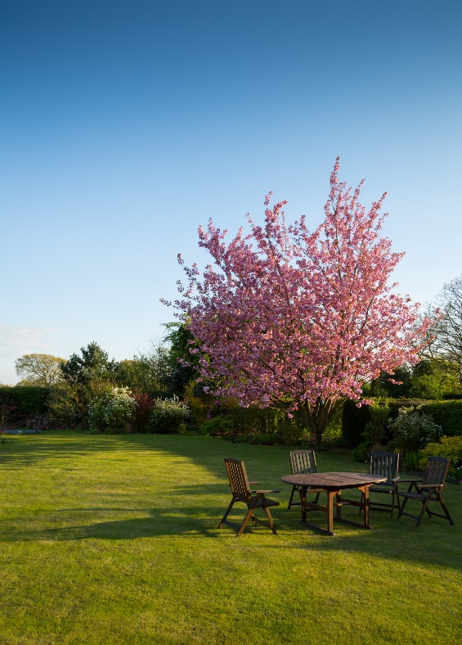
Sag es!
hören und sprechen
der Garten
die Gärten

Slide 17
Sag es!
hören und sprechen
die Nacht
die Nächte

Slide 18
long and short [ä]
Phonetik
Consolidation [1]
Y7 T2.2 Week 3 Slide 3

Slide 19
[a] vs [ä]
Phonetik
a[long]
ä[long]
sagen
spät
a[short]
ä[short]
kalt
lächeln
1
egal
2
ständig
zählen / zahlen
7
zählen / zahlen
3
hängen
Wahlen / wählen
8
Wahlen / wählen
4
unbekannt
Geschäft / geschafft
9
Geschäft / geschafft
5
Bad
schätzen / schatzen
10
schätzen / schatzen
6
Nähe
Notes:
Timing: 3 minutes
Aim: Phonics refresher - a vs ä.
The contrast between a and ä is important for this week’s grammar point (strong verbs). Both sounds have been introduced already, we are simply revisiting them here.
Procedure:
Click on the SSCs and their example words (sagen / kalt / lächeln / spät) to play them and remind the students of the the sounds.
The first 6 words is a transcription (fill in the blank) task. The words are high-frequency, but haven’t yet been taught.
The second four are minimal pairs (some of these are rare).
The task is set up to do 1-6 first and correct those, and then complete 7-10.
Transcript:
egal
ständig
hängen
unbekannt
Bad
Nähe
zählen /zahlen
Wahlen / wählen
Geschäft / geschafft
schätzen / schatzen
Word frequency (1 is the most frequent word in German):
egal [932] ständig [779] hängen [590] unbekannt [1292] Bad [1637] Nähe [918] zählen [704] zahlen [832] Wahl [799] wählen [636] Geschäft [765] schaffen (geschafft) [285] schätzen [1294] schatzen [>5009]
Source: Jones, R.L & Tschirner, E. (2019). A frequency dictionary of German: Core vocabulary for learners. London: Routledge.

Slide 20
long and short [ä]
Phonetik
Consolidation [2]
Y7 T2.2 Week 5 Slides 3-4

Slide 21
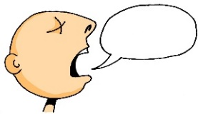
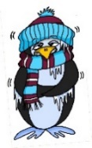
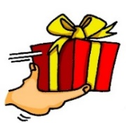
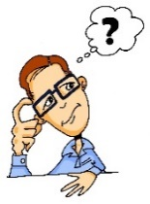
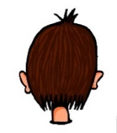
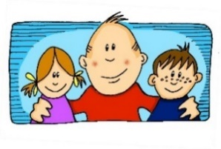
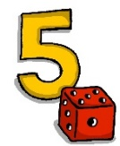
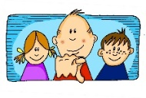
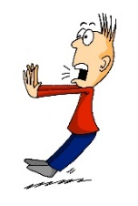
Phonetik
e
e
a
a
sagen
kalt
geben
denken
i
i
o
o
u
wir
u
finden
wo?
Kopf
ü
ü
ö
du
ö
Punkt
Tür
fünf
ä
ä
schön
plötzlich
spät
lächeln
Notes:
Timing: 3 minutes
Aim: The long and short vowel sounds in German are practised here in familiar words, with audio.
Procedure:
1. Students should listen and repeat.

Slide 22
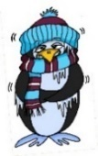
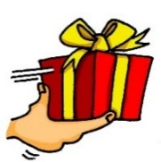
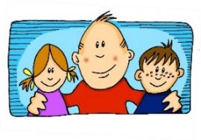
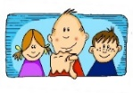
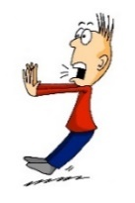
Phonetik
e
e
a
a
sagen
kalt
geben
denken
i
i
o
o
u
wir
u
finden
wo?
Kopf
ü
ü
ö
ö
fünf
du
Punkt
Tür
ä
ä
schön
plötzlich
spät
lächeln
Notes:
Timing: 3 minutes
Aim: This version of the slide is without audio.
Procedure:
1. Students should chant the words chorally first, as they appear, then perhaps individually (the teacher quizzing students on individual words; it will be important to continue to juxtapose the long and short forms of each vowel in this practice).

Slide 23
long and short [ä]
Phonetik
Consolidation [3]
Y7 T3.2 Week 6 Slide 20

Slide 24
Wie heißt die Band?
Phonetik
Alastair telefoniert mit Mia. Sie reden über deutsche Bands. Wie heißen sie?
 | die P r i n z e n
 | J u l i
 | F e t t e s B r o t
 | die F a n t a s t i s c h e n V i e r
 | S ö h n e M a n n h e i m s
 | S p o r t f r e u n d e S t i l l e r
 | R o s e n s t o l z
 | die Ä r t z e
1
_
2
_
3
_
_
4
_
_
_
_
_
5
_
_
_
6
_
_
_
_
7
_
_
8
_
_
Notes:
Phonetik [1] Time: 5 minutes
Aim: To practise recognising and transcribing 14 previously taught SSC, in unknown words.
Note: These are real German band names.
Procedure: 1. Click number to hear the full word. Students listen and transcribe only the missing letters. 2. Animations support item-by-item checking, as instant feedback on each SSC may be particularly helpful for students’ learning. SSC revisited here: [z] [j] [r-consonantal] [o-long] [sch] [v] [r-vocalic] [ö-long] [ei] [st] [-er] [st] [ä] [-e]
Transcript: [1] die Prinzen
[2] Juli
[3] Fettes Brot
[4] die Fantastischen Vier
[5] Söhne Mannheims
[6] Sportfreunde Stiller
[7] Rosenstolz
[8] die Ärzte

Slide 25
long and short [ä]
Phonetik
Consolidation [4]
Y8 T1.2 Week 5 Slides 2-15; 39

Slide 26
ä
[ɛ:]
spät
Notes:
Timing: 1 minute
Aim: To introduce/consolidate SSC [ä]
Procedure: 1. Present the letter(s) and say the [ä] sound first, on its own. Students repeat it with you. 2. Bring up the word ”spät” on its own, say it, students repeat it, so that they have the opportunity to focus all of their attention on the connection between the written word and its sound.
3. A possible gesture for this would be to bring your left arm up to mime suddenly looking at your watch.
4. Roll back the animations and work through 1-3 again, but this time, dropping your voice completely to listen carefully to the students saying the [ä] sound, pronouncing ”spät’” and, if using, doing the gesture. Word frequency (1 is the most frequent word in German): spät [171]
Source: Jones, R.L. & Tschirner, E. (2006). A frequency dictionary of German: core vocabulary for learners. Routledge

Slide 27
ä
[ɛ:]
spät
Notes:
With sound and no pictures to focus all attention on the sound-symbol correspondence.

Slide 28
ä
[ɛ:]
spät
Notes:
Without sound to elicit pronunciation (without first hearing the teacher).
Teacher to elicit pronunciation by asking “Wie sagt man…”

Slide 29
ä
zählen
ähnlich
1, 2, 3, …100
spät
Nähe
wählen
Berlin 1KM
erklären
[to explain]
Notes:
Timing: 1 minute
Aim: To introduce/consolidate SSC [ä]
Procedure:
Introduce and elicit the pronunciation of the individual SSC [ä] and then the source word again ‘spät’ (with gesture, if using).
Then present and elicit the pronunciation of the five cluster words.
The cluster words have been chosen for their high-frequency, from a range of word classes, with the SSC (where possible) positioned within a variety of syllables within the words (e.g. initial, 2nd, final etc.). Additionally, we have tried to use words that build cumulatively on previously taught SSCs (see the Phonics Teaching Sequence document) and do not include new SSCs. Where new SSCs are used, they are often consonants which have a similar symbol-sound correspondence in English.
Word frequency (1 is the most frequent word in German): spät [171]; zählen [680] ähnlich [429]; Nähe [795]; erklären [250]; wählen [64]. Source: Jones, R.L. & Tschirner, E. (2006). A frequency dictionary of German: core vocabulary for learners. Routledge

Slide 30
ä
zählen
ähnlich
spät
Nähe
wählen
erklären
Notes:
With sound and no pictures to focus all attention on the sound-symbol correspondence.

Slide 31
ä
zählen
ähnlich
spät
Nähe
wählen
erklären
Notes:
Without sound to elicit pronunciation (without first hearing the teacher).
Teacher to elicit pronunciation by asking “Wie sagt man…”

Slide 32
ä
[ɛ]
lächeln
Notes:
Timing: 1 minute
Aim: To introduce/consolidate SSC [ä]
Procedure: 1. Present the letter(s) and say the [ä] sound first, on its own. Students repeat it with you. 2. Bring up the word ”lächeln” on its own, say it, students repeat it, so that they have the opportunity to focus all of their attention on the connection between the written word and its sound.
3. A possible gesture for this would be to trace a broad smile on your own face, drawing your index fingers away from the middle of your mouth to the outer edges.
4. Roll back the animations and work through 1-3 again, but this time, dropping your voice completely to listen carefully to the students saying the [ä] sound, pronouncing “lächeln” and, if using, doing the gesture. Word frequency (1 is the most frequent word in German): lächeln [793]
Source: Jones, R.L. & Tschirner, E. (2006). A frequency dictionary of German: core vocabulary for learners. Routledge

Slide 33
ä
[ɛ]
lächeln
Notes:
With sound and no pictures to focus all attention on the sound-symbol correspondence.

Slide 34
ä
[ɛ]
lächeln
Notes:
Without sound to elicit pronunciation (without first hearing the teacher).
Teacher to elicit pronunciation by asking “Wie sagt man…”

Slide 35
ä
Verhältnis
Mädchen
[relationship]
lächeln
Hälfte
ändern
ständig
[constant(ly)]
Notes:
Timing: 2 minutes
Aim: To introduce/consolidate SSC [ä]
Procedure:
Introduce and elicit the pronunciation of the individual SSC [ä] and then the source word again ‘lächeln’ (with gesture, if using).
Then present and elicit the pronunciation of the five cluster words.
The cluster words have been chosen for their high-frequency, from a range of word classes, with the SSC (where possible) positioned within a variety of syllables within the words (e.g. initial, 2nd, final etc.). Additionally, we have tried to use words that build cumulatively on previously taught SSCs (see the Phonics Teaching Sequence document) and do not include new SSCs. Where new SSCs are used, they are often consonants which have a similar symbol-sound correspondence in English.
Word frequency (1 is the most frequent word in German): lächeln [793]; Verhältnis [517] Mädchen [537]; Hälfte [972]; ständig [612]; ändern [476].
Source: Jones, R.L. & Tschirner, E. (2006). A frequency dictionary of German: core vocabulary for learners. Routledge

Slide 36
ä
Verhältnis
Mädchen
lächeln
Hälfte
ändern
ständig
Notes:
With sound and no pictures to focus all attention on the sound-symbol correspondence.

Slide 37
ä
Verhältnis
Mädchen
lächeln
Hälfte
ändern
ständig
Notes:
Without sound to elicit pronunciation (without first hearing the teacher).
Teacher to elicit pronunciation by asking “Wie sagt man…”

Slide 38
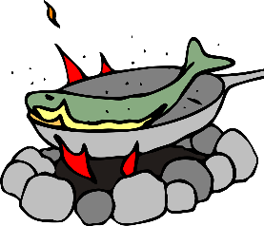
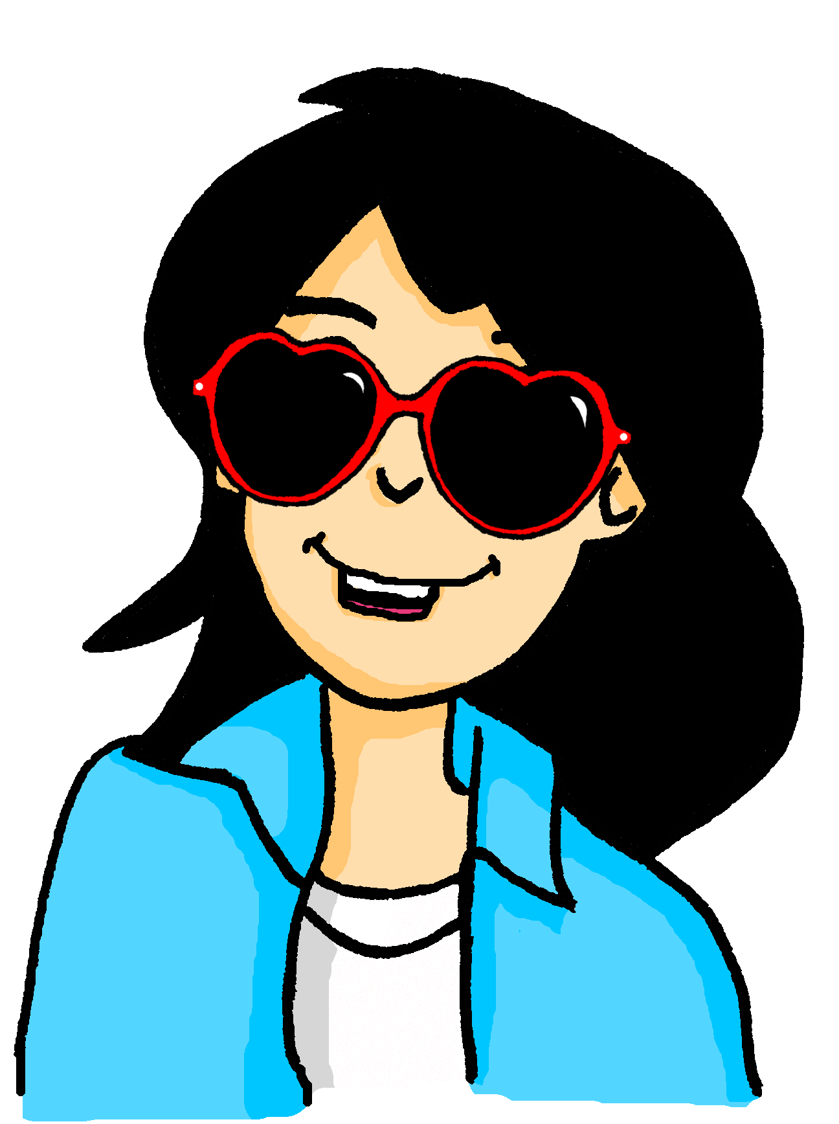
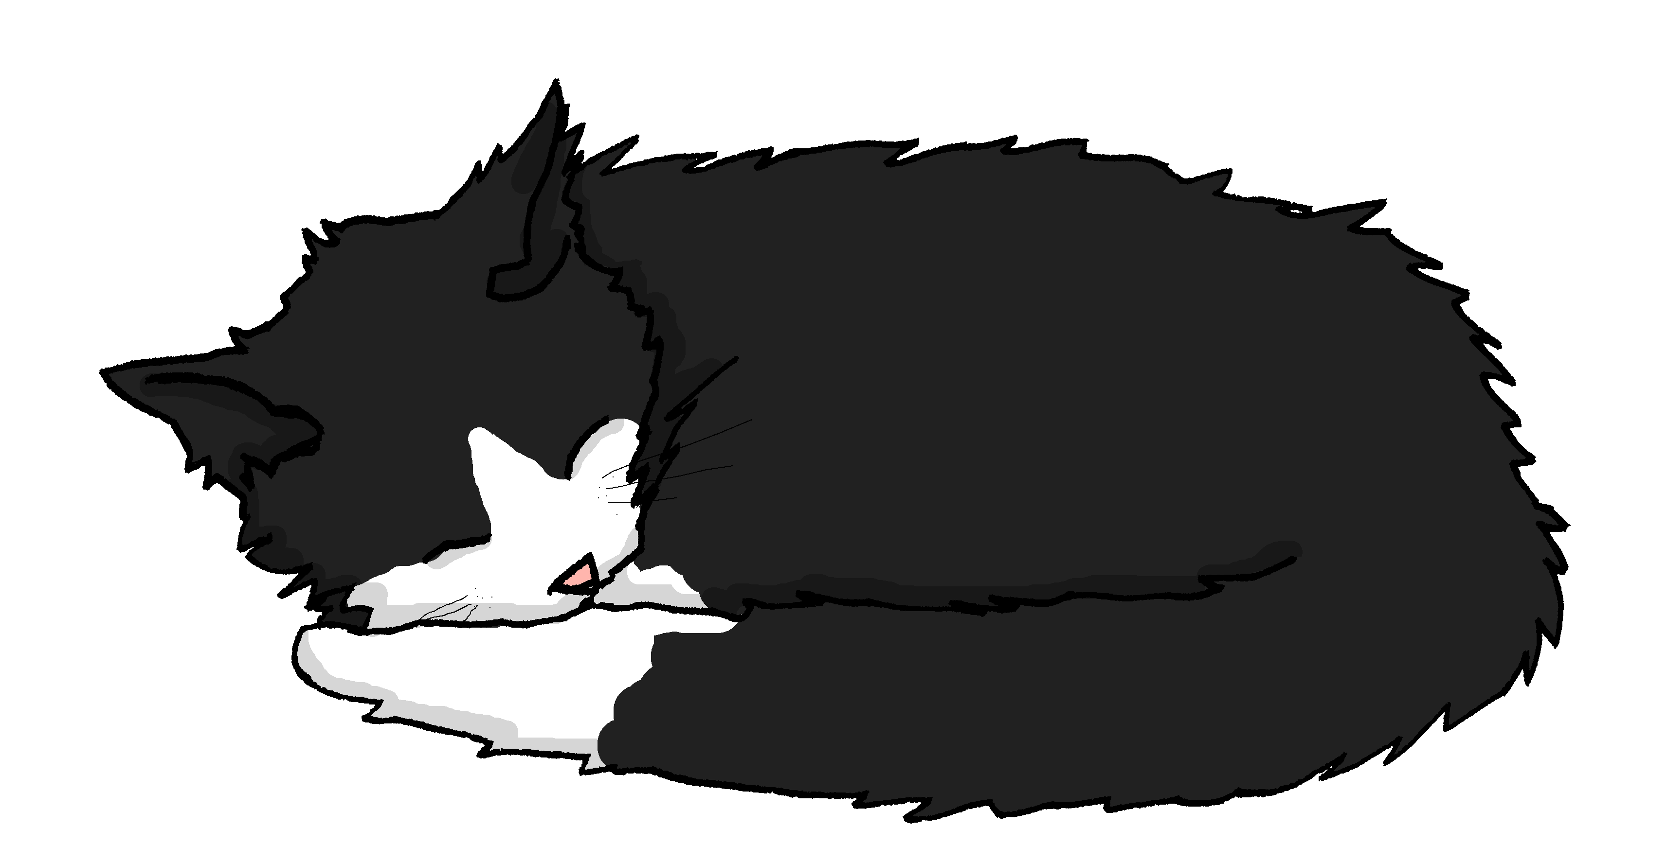
Miezes Traum
hören / schreiben
Miezes Traum
ohne Pausen
fällt
fängt
Mieze schläft… und träumt…
Sie _______ ins Wasser. Sie _________ einen großen Fisch. Sie ________ ihn in ihrem Mund fest. Sie ________ ihn nicht los. Sie ________ ihn nach Hause. Mia ist glücklich. Sie hat Hunger. Sie _______ den Fisch und ________ ihn. Mieze und Mia essen zusammen den Fisch. Er ist lecker!
hält
lässt
trägt
wäscht
brät
lassen | braten (to fry) | fangen (to catch)
halten (to hold) | fallen | tragen | waschen
Notes:
Timing: 5 mins Aim: To practise (through scaffolded transcription) the SSC [ä] in sentences. Procedure: 1. Ensure students understand Traum and the context (a cat’s dream!) for this narrative.
2. Students write 1-7. They listen to the dream story and transcribe the verbs they hear. The infinitives are provided – jumbled – in a table at the bottom.
3. The audio is provided as a whole piece, (no beeps as it is a transcription task) with some pauses built in. Students may need to listen 2-4 times. There is an ‘ohne Pausen’ version, too.
4. Answers are animated to appear on clicks.
5. Elicit an oral translate of the story from students.
Transcript: Mieze schläft und träumt. Sie fällt ins Wasser. Sie fängt einen großen Fisch. Sie hält ihn in ihrem Mund fest. Sie lässt ihn nicht los. Sie trägt ihn nach Hause. Mia ist glücklich. Sie hat Hunger. Sie wäscht den Fisch und brät ihn. Mieze und Mia essen zusammen den Fisch. Er ist lecker!
Previously taught word frequency (1 is the most frequent word in German): fallen [278] halten [144] lassen [82] tragen [271] Unfamiliar word frequency (1 is the most frequent word in German): fangen [2044] waschen [2315] braten [>5009] fest [567] los [658] Source: Jones, R.L. & Tschirner, E. (2006). A frequency dictionary of German: core vocabulary for learners. Routledge

Slide 39
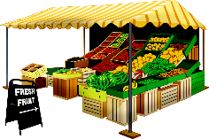
Phonetik
lesen / sprechen
Sag die Wörter.
 | Singular | Plural
1 | Wald (m) | Wälder
2 | Kraft | Kräfte
3 | Apfel | Äpfel
4 | Angst | Ängste
5 | Markt (m) | Märkte
6 | Gast (m) | Gäste
7 | Nacht (f) | Nächte
8 | Fach (nt) | Fächer
1
_________
2
[power]
_________
[powers]
3
_________
4
[fear]
_________
[fears]
5
_________
6
[guest]
[guests]
_________
7
[night]
[nights]
_________
8
_________
Notes:
Timing: 5 minutes Aim: To practise in productive oral modality the SSC [a] and [ä], with unfamiliar [1-4] and familiar [5-8] plurals. Procedure: 1. In pairs. One person pronounces the one of the pair of words that is on the slide. The other person pronounces the unwritten one of the pair.
2. When finished, reveal the missed text and click on the audio to hear both singular and plural forms.
Transcript:
1. Wald – Wälder
2. Kraft - Kräfter
3. Apfel – Äpfel
4. Angst - Ängst
5. Markt - Märkte
6. Gast – Gäste
7. Nacht – Nächte
8. Fach - Fächer
Word frequency (1 is the most frequent word in German): Wald [1028], Kraft [458], Apfel [3490], Angst [392], Markt [476], Gast [576], Nacht [325], Fach [1731] Source: Jones, R.L. & Tschirner, E. (2006). A frequency dictionary of German: core vocabulary for learners. Routledge

Slide 40
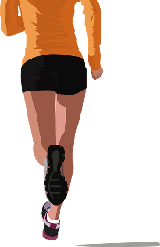
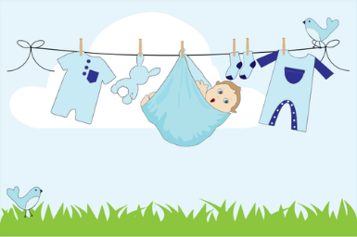
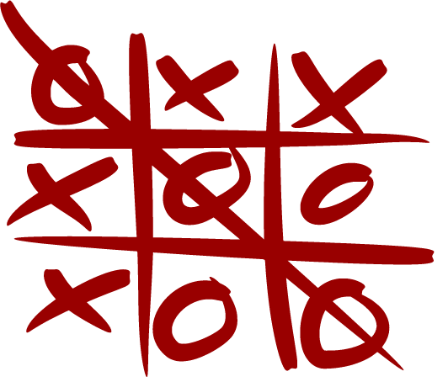
Phonetik [2/2]
Schreib die Wörter. Alle Wörter enthalten den [ä].
hören / schreiben
Sag jetzt die Wörter.
1
1/2
2
3
4
Hälfte
Präsident
erzählen
Aktivität
5
6
7
8
hängen
Realität
Bär
kämpfen
9
10
11
12
[complete]
Atmosphäre
Hände
vollständig
Universität
Notes:
Timing: 7 minutes Aim: to practise written production of short and long [ä]. Procedure: 1. Students listen and transcribe each word.
2. Click to reveal the word.
3. Students read all the words aloud again.
Transcript: 1. Hälfte 2. Präsident 3. erzählen 4. Aktivität 5. hängen 6. Realität 7. Bär 8. kämpfen 9. Atmosphäre 10. Hände 11. vollständig 12. Universität Word frequency (1 is the most frequent word in German): Source: Jones, R.L. & Tschirner, E. (2006). A frequency dictionary of German: core vocabulary for learners. Routledge

Slide 41
long and short [ä]
Phonetik
Consolidation [5]
Y8 T2.1 Week 3 Slide 3

Slide 42
Phonetik
lesen / sprechen
Sag die Zungenbrecher.
5
2.
[a]
[ä]
Acht ähnliche Männer machen acht ähnliche Fächer.
Eight similar men do eight similar subjects.
Sekunden
ähnliche
machen
Männer
acht
Fächer
0
langsamer
LOS!
Notes:
Transcript: Acht ähnliche Männer machen acht ähnliche Fächer

Slide 43
long and short [ä]
Phonetik
Consolidation [6]
Y8 T2.2 Week 4 Slide 2

Slide 44
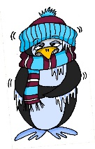
Phonetik
lesen / sprechen
Sag die Wörter. Wie viele enthalten die SSC?
[e]
[ch]
[s]
[o]
[a]
[ä]
denken
ich
sollen
Wo?
kalt
lächeln
 |  | ?
 | [e]
 | [ch]
 | [s]
 |  | ?
 | [o]
 | [a]
 | [ä]
eng – Bett – Weg
2
ohne – Telefon – Rock
2
reich – jedoch – einfach
1
alt – arm – normal
1
unser – langsam – alles
2
2
hängen – Aktivität – schnell
Notes:
Timing: 3 minutes Aim: A read aloud activity to revise 12 SSC (six explicitly, and six by contrast) using a range of new, revisited and unfamiliar vocabulary. Procedure: 1. Click on each individual SSC to hear it.
2. Elicit the source word from students, if remembered. Note that 4/6 these words have since been taught as key vocabulary (with sollen and lächeln to follow on the SOW)
3. Bring up the source words to check, and for reference for the read aloud activity.
4. Students pronounce the sets of three words, individually or in pairs, and decide how many contain the target SSC.
5. Optional – Click on the words to hear the sets of words pronounced. 6. Reveal the answers. 7. Optional – elicit the English meanings of the vocabulary.
Transcript:
eng – Bett – Weg
reich – jedoch – einfach
unser – langsam – alles
ohne – Telefon – Rock
alt – arm – normal
hängen – Aktivität – schnell
Word frequency of unknown words (1 is the most frequent word in German): hängen [580] Weg [220] Source: Jones, R.L. & Tschirner, E. (2019). A frequency dictionary of German: core vocabulary for learners. Routledge

Slide 45
long and short [ä]
Phonetik
Consolidation [7]
Y8 T2.2 Week 5 Slides 3-5; 23-26

Slide 46
ä
Verhältnis
Mädchen
[relationship]
lächeln
Hälfte
ändern
ständig
[constant(ly)]
Notes:
Timing: 2 minutes
Aim: To introduce/consolidate SSC [ä]
Procedure:
Introduce and elicit the pronunciation of the individual SSC [ä] and then the source word again ‘lächeln’ (with gesture, if using).
Then present and elicit the pronunciation of the five cluster words.
The cluster words have been chosen for their high-frequency, from a range of word classes, with the SSC (where possible) positioned within a variety of syllables within the words (e.g. initial, 2nd, final etc.). Additionally, we have tried to use words that build cumulatively on previously taught SSCs (see the Phonics Teaching Sequence document) and do not include new SSCs. Where new SSCs are used, they are often consonants which have a similar symbol-sound correspondence in English.
Word frequency (1 is the most frequent word in German): lächeln [793]; Verhältnis [517] Mädchen [537]; Hälfte [972]; ständig [612]; ändern [476].
Source: Jones, R.L. & Tschirner, E. (2006). A frequency dictionary of German: core vocabulary for learners. Routledge

Slide 47
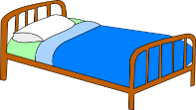
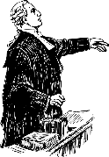
kurzes [e] oder [ä]?
hören / schreiben
Short [e] and [ä] sound the same in German.
As you know, some nouns with [a] form their plural by adding –e and an umlaut.
Hör dir die Pluralformen an. Ist das [e] oder [ä]? Schreib die Plural- und Singularformen.
1
Hände
Hand
4
Städte
Stadt
7
Konzepte
Konzept
2
Betten
Bett
5
Enden
Ende
8
Elemente
Element
3
Modelle
Modell
6
Fälle
Fall
[case]
9
Anwälte
Anwalt
Notes:
Timing: 5 minutes Aim: To practise recall of plural forms with [e] and [ä] and to associate them with singular forms. Procedure: 1. Click on an action button to play the recording of a plural form.
2. Write down the plural and singular form of the word.
3. Click on the mouse to reveal and check answers.
4. Ensure meanings are clear.
Transcript: Hände
Betten Modelle Enden Städte
Fälle Konzept Elemente Anwälte Word frequency untaught and cognate words (1 is the most frequent word in German): Bett [638] Modell [708] Ende [183] Konzept [1623] Element [699] Source: Jones, R.L. & Tschirner, E. (2019). A frequency dictionary of German: core vocabulary for learners. Routledge

Slide 48
Phonetik – kurzes [ä]
lesen / sprechen
Länder – Land
Sag die Wörter.
20
Strände – Strand
Fächer – Fach
Nächte – Nacht
Wälder – Wald
Sekunden
Männer – Mann
Großstädte – Großstadt
0
Stände – Stand
LOS!
Notes:
Timing: 1 minute Aim: To link plural and singular forms of words, with a change of vowel [a] → [ä]. The time limit helps the atomisation process. Procedure: 1. Click on the LOS! action button to start the timer.
2. Read each plural-singular pair out loud before the timer runs out.
Frequency of untaught / cognate words: Stand [1357] Source: Jones, R.L. & Tschirner, E. (2019). A frequency dictionary of German: core vocabulary for learners. Routledge

Slide 49
ä
zählen
ähnlich
1, 2, 3, …100
spät
Nähe
wählen
Berlin 1KM
erklären
[to explain]
Notes:
Timing: 1 minute
Aim: To introduce/consolidate SSC [ä]
Procedure:
Introduce and elicit the pronunciation of the individual SSC [ä] and then the source word again ‘spät’ (with gesture, if using).
Then present and elicit the pronunciation of the five cluster words.
The cluster words have been chosen for their high-frequency, from a range of word classes, with the SSC (where possible) positioned within a variety of syllables within the words (e.g. initial, 2nd, final etc.). Additionally, we have tried to use words that build cumulatively on previously taught SSCs (see the Phonics Teaching Sequence document) and do not include new SSCs. Where new SSCs are used, they are often consonants which have a similar symbol-sound correspondence in English.
Word frequency (1 is the most frequent word in German): spät [171]; zählen [680] ähnlich [429]; Nähe [795]; erklären [250]; wählen [64]. Source: Jones, R.L. & Tschirner, E. (2006). A frequency dictionary of German: core vocabulary for learners. Routledge

Slide 50
long [e] oder [ä]?
hören / schreiben
As you know, short [e] and [ä] sound the same in German.
Long [e] and [ä] sound a bit different.
However, some German speakers pronounce the long [e] and [ä] in the same way.
To practise, our speaker always pronounces [ä] differently from [e] in the next activity.
Notes:
Timing: 1 minute Aim: To explain the pronunciation similarity/difference between long [e] and [ä] and prepare students for the next activity. Procedure: 1. Click to present the new information.

Slide 51
Phonetik
hören
Hör zu. Schreib 1- 8 und [e] oder [ä].
 | [e] | [ä] | Wort auf Deutsch
1
ähnlich
(similar)
2
zählen
(to count)
3
Fehler
(mistake)
4
Fernsehen
(tv)
5
Jahrzehnt
(decade)
6
jährlich
(annually)
7
dreht
(turns)
8
ehrlich
(honest)
Notes:
Timing: 4 minutes Aim: To practise SSC long [e] and [ä] with mostly unknown vocabulary, compelling students to apply their phonics knowledge. Much of this vocabulary will appear later in Year 8. Procedure: 1. Click to hear the words. Note: the first word is known. The idea is that this will help students to ‘anchor’ the [ä] sound securely before listening to the other words.
2. Students write [e] or [ä] and try to transcribe the whole word, if able. 3. Click to reveal answer and word spelling. Word frequency (1 is the most frequent word in German): Fehler [861] zählen [704] jährlich [1707] Fernsehen [1444] Jahrzehnt [1123] ähnlich [437] drehen [788] ehrlich [1588]
Source: Jones, R.L. & Tschirner, E. (2019). A frequency dictionary of German: core vocabulary for learners. Routledge
Transcript: 1. Fehler 2. zählen 3. jährlich 4. Fernsehen 5. Jahrzehnt 6. ähnlich 7. dreht 8. ehrlich

Slide 52
Phonetik
sprechen / hören / schreiben
Jetzt bist du dran!
1 – 4: Partner A sagt die Wörter. Partner B schreibt.
5 – 8: Partner B sagt die Wörter. Partner A schreibt.
[e] | [ä] | Wort auf Deutsch
1. Aktivität [activity]
2. mehr [more]
3. spät [late] 4. Universität [university]
Aktivität
mehr
spät
Universität
5. geht [goes]
6. wählen [to choose]
7. ungefähr [approx.] 8. Nähe [nearby]
geht
wählen
ungefähr
Nähe
Notes:
Timing: 4 minutes Aim: To practise SSC long [e] and [ä] with a mixture of familiar and cognate vocabulary, to give students the opportunity to produce the two SSC.
Procedure: 1. Partner B writes 1-4 and turns away from the board. 2. Partner A reads words 1-4 aloud in German. 3. Partner B writes the words down. 4. Partner B turns back to check his/her answers. Click on the green ticks to hear the words pronounced again. 5. Partner A turns away from the board, and the process is repeated with words 5-8. Note: Remind students that they are deliberately making a difference between [e] and [ä] here, but that it is also likely that they will hear some German native speakers pronouncing them in the same way. Word frequency unknown words (1 is the most frequent word in German): wählen [636] ungefähr ]1458] Nähe [918]
Source: Jones, R.L. & Tschirner, E. (2019). A frequency dictionary of German: core vocabulary for learners. Routledge
Transcript: 1. Aktivität 2. mehr 3. spät 4. Universität 5. geht 6. wählen 7. ungefähr 8. Nähe

