Slide 1
German phonics collection
[au]
Artwork: Steve Clarke
Date updated: 24 / 07 / 21
Notes:
Artwork by Steve Clarke. All additional pictures selected are available under a Creative Commons license, no attribution required.

Slide 2
[au]
Phonetik
Introduction
Y7 T2.2 Week 2 Slides 2-7; 23-33

Slide 3
au
Haus
Notes:
Timing: 1 minute
Aim: To introduce/consolidate SSC [au]
Procedure: 1. Present the letter(s) and say the [au] sound first, on its own. Students repeat it with you. 2. Bring up the word ”Haus” on its own, say it, students repeat it, so that they have the opportunity to focus all of their attention on the connection between the written word and its sound.
3. A possible gesture for this would be to form a roof shape by touching your fingertips together, in front of you.
4. Roll back the animations and work through 1-3 again, but this time, dropping your voice completely to listen carefully to the students saying the [au] sound, pronouncing ”Haus” and, if using, doing the gesture. Word frequency (1 is the most frequent word in German): Haus [159] Source: Jones, R.L. & Tschirner, E. (2006). A frequency dictionary of German: core vocabulary for learners. Routledge

Slide 4
au
Haus
Notes:
With sound and no pictures to focus all attention on the sound-symbol correspondence.

Slide 5
au
Haus
Notes:
Without sound to elicit pronunciation (without first hearing the teacher).
Teacher to elicit pronunciation by asking “Wie sagt man…”

Slide 6
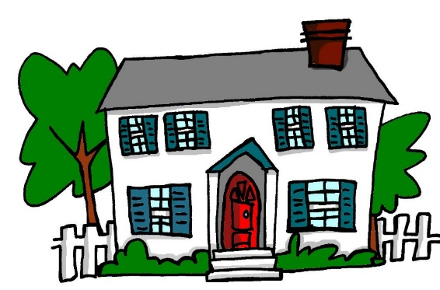
au
genau
auch
[exact(ly)]
Haus
[8:07:25]
glauben
auf
[to believe]
ausgehen
[to go out]
Notes:
Timing: 2 minutes
Aim: To introduce/consolidate SSC [au]
Procedure:
Introduce and elicit the pronunciation of the individual SSC [au] and then the source word again ‘Haus’ (with gesture, if using).
Then present and elicit the pronunciation of the five cluster words.
The cluster words have been chosen for their high-frequency, from a range of word classes, with the SSC (where possible) positioned within a variety of syllables within the words (e.g. initial, 2nd, final etc.). Additionally, we have tried to use words that build cumulatively on previously taught SSCs (see the Phonics Teaching Sequence document) and do not include new SSCs. Where new SSCs are used, they are often consonants which have a similar symbol-sound correspondence in English.
Word frequency (1 is the most frequent word in German): Haus [159]; genau [183] auch [16]; glauben [143]; ausgehen [493]; auf [17]. Source: Jones, R.L. & Tschirner, E. (2006). A frequency dictionary of German: core vocabulary for learners. Routledge

Slide 7
au
genau
auch
Haus
glauben
auf
ausgehen
Notes:
With sound and no pictures to focus all attention on the sound-symbol correspondence.

Slide 8
au
genau
auch
Haus
glauben
auf
ausgehen
Notes:
Without sound to elicit pronunciation (without first hearing the teacher).
Teacher to elicit pronunciation by asking “Wie sagt man…”

Slide 9
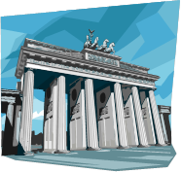
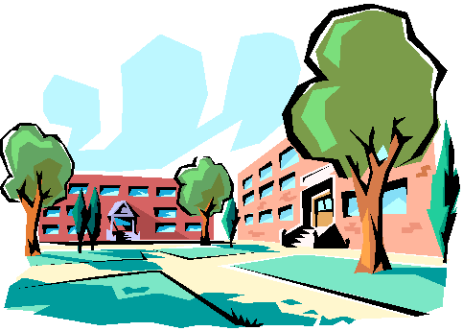
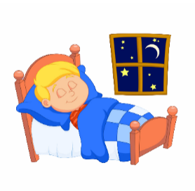
Hörst du [au] oder [äu]?
hören / schreiben
 |  | au | äu
auf Deutsch
A | E
B | F
C | G
D | H
D
häufig
[to believe]
1
F
genau
2
[exact(ly)]
H
Träume
[to go out]
3
[8:07:25]
B
ausgehen
4
G
auf
5
A
Bäume
6
E
glauben
7
C
Gebäude
8
Notes:
Timing: 5 minutes
Aim: Phonics: au/äu contrast.
Procedure:
1. Teachers click each number for the audio. 2. Students write 1-8 in books, and write ‘au’ or ‘äu’. 3. On 2nd listening, they should try to write the words. 4.Then, to prompt meaning recall, students match the letters of the pictures to the words 1-8. Teach can elicit answers: Teacher: Was ist Nummer eins? Student: häufig. D This requires students both to pronounce the German word and produce the alphabet letter in German.
Word frequency (1 is the most frequent word in German):
Mäuse [3757]; Bäume [994] häufig [432]; träumen [1907]; Häuser [159]; Gebäude[1202]; Haus [159]; genau [183] auch [16]; glauben [143]; ausgehen [493]; auf [17]. Source: Jones, R.L & Tschirner, E. (2019). A frequency dictionary of German: Core vocabulary for learners. London: Routledge.

Slide 10
[AU] oder [ÄU] oder beide?
Was hörst du? [AU], [ÄU] oder [AU] und [ÄU]?
1
AU
Er kann laufen.
He can run.
Notes:
Timing: 3 minutes (for 10 slides)
Aim: This is a second phonics activity using whole sentences. The students must listen to determine which SSC(s) is/are used in the sentence- only au, only äu, or both.
Procedure:
1. Click on number 1 to hear the audio. 2. Students write au, äu OR au und äu. 3. Click to reveal the answer. 4. Click to show the full German sentence. 5. Elicit the English translation from students, and reveal the English translation.
Note: If timing is too tight, it would be possible to omit this task.
Transcript:
Er kann laufen.

Slide 11
Er kann laufen.
1
Notes:
Timing: 3 minutes (for 10 slides)
Aim: The students must listen to determine which SSC(s) is/are used in the sentence- only au, only äu, or both.
Procedure:
1. Now the same sentences are presented, but with gaps. 2. Teacher prompts students (chorally) to say the full sentence, and then clicks to show the missing SSC. 3. If desired, the audio can be played to hear the SSC(s) again.
Note: If timing is too tight, it would be possible to omit this task.
Transcript:
Er kann laufen.

Slide 12
‘AU’ oder ÄU oder beide?
[AU] oder [ÄU] oder beide?
Was hörst du? [AU], [ÄU] oder [AU] und [ÄU]?
2
ÄU
Träumst du von Bäumen?
Do you dream / are you dreaming about trees?
Notes:
Repeat steps as for Number 1.
Transcript:
Träumst du von Bäumen?

Slide 13
Träumst du von Bäumen?
2
Notes:
Repeat steps as for Number 1
Transcript:
Träumst du von Bäumen?

Slide 14
‘AU’ oder ÄU oder beide?
[AU] oder [ÄU] oder beide?
Was hörst du? [AU], [ÄU] oder [AU] und [ÄU]?
AU und ÄU
3
Die Mäuse sind zu Hause.
The mice are at home.
Notes:
Repeat steps as for Number 1.
Transcript:
Die Mäuse sind zu Hause.

Slide 15
Die Mäuse sind zu Hause.
3
Notes:
Repeat steps as for Number 1.
Transcript:
Die Mäuse sind zu Hause

Slide 16
‘AU’ oder ÄU oder beide?
[AU] oder [ÄU] oder beide?
Was hörst du? [AU], [ÄU] oder [AU] und [ÄU]?
4
AU
Ich gehe ins Baumhaus.
I go / am going to the treehouse.
Notes:
Repeat steps as for Number 1.
Transcript:
Ich gehe ins Baumhaus.

Slide 17
Ich gehe ins Baumhaus.
4
Notes:
Repeat steps as for Number 1.
Transcript:
Ich gehe ins Baumhaus.

Slide 18
‘AU’ oder ÄU oder beide?
[AU] oder [ÄU] oder beide?
Was hörst du? [AU], [ÄU] oder [AU] und [ÄU]?
5
AU
Ich glaube das auch.
I believe that, also/too.
Notes:
Repeat steps as for Number 1.
Transcript:
Ich glaube das auch.

Slide 19
Ich glaube das auch.
5
Notes:
Repeat steps as for Number 1.
Transcript:
Ich glaube das auch.

Slide 20
[au]
Phonetik
Consolidation [1]
Y7 Term 2.2 Week 3 Slide 5

Slide 21
au/äu
au
glauben
äu
Gebäude
genau
auf
Bäume
träumen
auch
häufig
Haus
Mäuse
Häuser
ausgehen
laufen
räumlich
äußern
läuft
Urlaub
brauchen
Käufer
nach Hause
Notes:
Timing: 3 minutes
Aim: Phonics revision. The SSC [äu] was only introduced last week. We’re revisiting it here, because it is relevant for this week’s grammar point (strong verbs and the stem change from au to äu)
Procedure:
1. This is a paired read aloud task. The students use different colours to play. Pupil A says one of the words/phrases and pupil B has 3 seconds to locate it and cross it off with their colour. If the pupil takes longer than 3 seconds pupil A can steal the point. Clearly, the classroom conditions need to be right with the individual class for friendly competition.
2. Alternatively, they can do it more slowly and carefully, scrutinising each other’s pronunciation. If one makes a mistake, then the other pupil corrects and crosses off in his/her colour.
Note: Not all of these words have been taught before, so there is the opportunity for some genuine decoding.
Word frequency (1 is the most frequent word in German):
genau [] ausgehen [] auf [] Gebäude [] träumen [] Mäuse [] läuft [] Bäume [] häufig [] äußern [] räumlich [] Käufer []
Source: Jones, R.L & Tschirner, E. (2019). A frequency dictionary of German: Core vocabulary for learners. London: Routledge.

Slide 22
[au]
Phonetik
Consolidation [2]
Y7 T3.2 Week 6 Slides 2-3

Slide 23
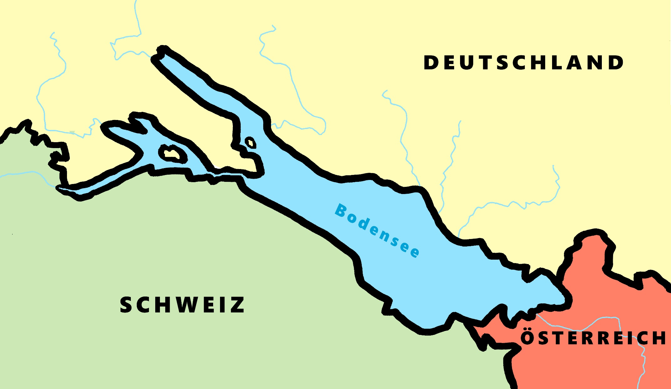
Phonetik - der Bodensee [1/2]
hören / schreiben
4
Allensbach
5
Wallhausen
3
Radolfzell
6
Hagnau
7
Friedrichshafen
1
Kreuzlingen
2
Steckborn
9
Romanshorn
8
Altenrhein
Notes:
Phonetik [1]
Time: 5 minutes Aim: To practise recognising and transcribing 10 previously taught SSC, in unknown words.
Procedure: 1. Click number to hear the full word. Students listen and transcribe only the missing letters. 2. Animations support item-by-item checking, as instant feedback on each SSC may be particularly helpful for students’ learning. 3. Teachers can additionally ask, Wo liegt [Hagnau]? Es liegt in [Deutschland]… Students have met the use of ‘in’ with die Schweiz. It will be helpful to focus their attention on the use of ‘in’ + der + Schweiz here, reminding them of the ‘in’ + movement (R2-accusative) or location (R3-dative) change. SSC revisited here: [eu] [st-] [z] [ch-hard] [w] [au] [ie] [ch-soft] [ei] [r] Transcript: 1 Kreuzlingen 2 Steckborn 3 Radolfzell 4 Allensbach 5 Wallhausen 6 Hagnau 7 Friedrichshafen 8 Altenrhein 9 Romanshorn

Slide 24
Phonetik - der Bodensee [1/2]
lesen / sprechen
9
Ludwigshafen
1
2
Friedrichshafen
Stein am Rhein
6
Konstanz
8
7
Reichenau
5
Altnau
3
Bregenz
4
Rorschach
Notes:
Phonetik [2]
Time: 5 minutes Aim: To practise reading aloud / saying 10 previously taught SSC, in unknown words (apart from Deutschland, which starts the task off). Here, 9 additional towns on the Bodensee are used.
Procedure: 1. Students work in pairs to pronounce each of the towns. 2. Click number to hear and check pronunciation. SSC revisited here: [eu] [st-] [z] [ch-hard] [w] [au] [ie] [ch-soft] [ei] [r] [sch] Transcript: 1 Deutschland 2 Friedrichshafen 3 Bregenz 4 Rorschach 5 Altnau 6 Konstanz 7 Reichenau 8 Stein am Rhein 9 Ludwigshafen

