Slide 1
German phonics collection
long and short [a]
Artwork: Steve Clarke
Date updated: 10 / 08 / 21
Notes:
Artwork by Steve Clarke. All additional pictures selected are available under a Creative Commons license, no attribution required.

Slide 2
long and short [a]
Phonetik
Introduction
Y7 T1.1. Week 1 Slides 8-15; 19-26

Slide 3
Phonetik: Vowels
German vowels can be short or long.
Vowels are short when followed by more than one consonant, e.g., Mann, Gast.
Vowels are long when:
there is a double vowel, e.g. Paar,
or when followed by the letter ‘h’, e.g., fahren,
or by a single consonant, e.g., sagen.
NB: German final ‘e’is not silent, but very short, e.g. danke, Klasse.
Notes:
Note: It is important to give this explanation, but in the same way as with explicit grammar explanation, it is the practice that counts most. Timing: 1 minute Aim: to introduce students to key knowledge about German vowels. Procedure:
It may be helpful to ensure that ‘vowel’ is 100% understood, eliciting an example in English from students.
Bring up each line of text and read it clearly with appropriate stress and intonation.
3. Proceed to the practice on the next slides.
Note: There are, of course, exceptions to these rules – ‘mit’ has a short vowel sound, and so does ‘das’ which they have just met. It may be helpful to draw attention to the trickiness of English vowel/letter strings and show that there are many exceptions here, too – e.g. the pronunciation of ‘o’ in ‘love’ and ‘move’ and ‘cove’ – different in all three.

Slide 4
long and short [a]
Phonetik
Introduction
Y7 T1.1. Week 1 Slides 9-11; 14; 19-24

Slide 5
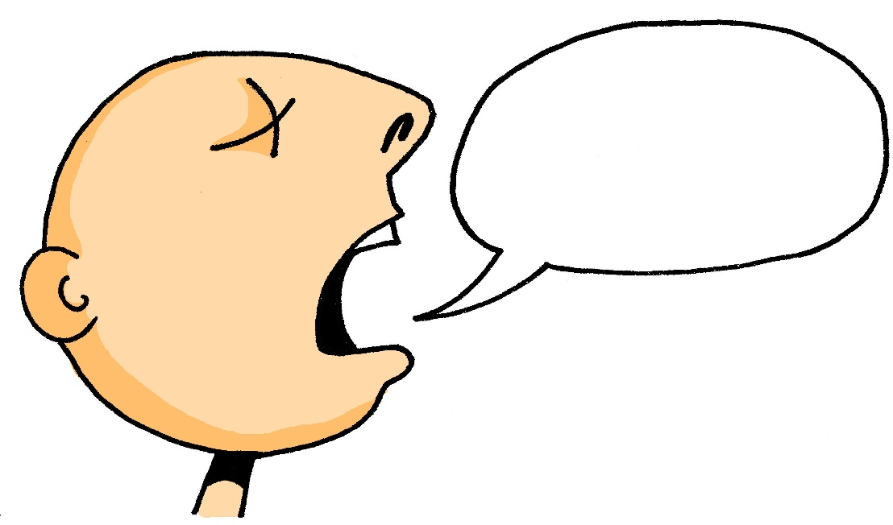
a
sagen
Notes:
Timing: 1 minute
Aim: To introduce/consolidate SSC [a]
Procedure: 1. Present the letter(s) and say the [a] sound first, on its own. Students repeat it with you. 2. Bring up the word ”sagen” on its own, say it, students repeat it, so that they have the opportunity to focus all of their attention on the connection between the written word and its sound.
3. A possible gesture for this would be mime speech coming out of your mouth, opening your mouth and drawing your hand away quickly away from you.
4. Roll back the animations and work through 1-3 again, but this time, dropping your voice completely to listen carefully to the students saying the [a] sound, pronouncing ”sagen” and, if using, doing the gesture. Word frequency (1 is the most frequent word in German): sagen [46] Source: Jones, R.L. & Tschirner, E. (2006). A frequency dictionary of German: core vocabulary for learners. Routledge

Slide 6
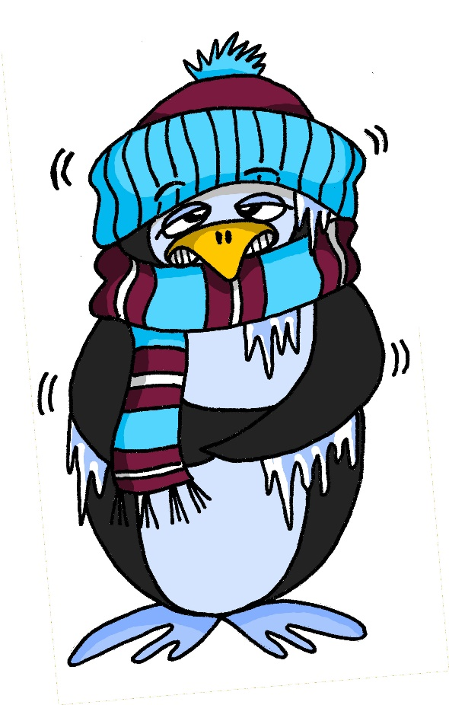
a
kalt
Notes:
Timing: 1 minute
Aim: To introduce/consolidate SSC [a]
Procedure: 1. Present the letter(s) and say the [a] sound first, on its own. Students repeat it with you. 2. Bring up the word ”kalt” on its own, say it, students repeat it, so that they have the opportunity to focus all of their attention on the connection between the written word and its sound.
3. A possible gesture for this would be to mime a shiver, crossing your arms in front of your body.
4. Roll back the animations and work through 1-3 again, but this time, dropping your voice completely to listen carefully to the students saying the [a] sound, pronouncing ”kalt” and, if using, doing the gesture. Word frequency (1 is the most frequent word in German): kalt [875] Source: Jones, R.L. & Tschirner, E. (2006). A frequency dictionary of German: core vocabulary for learners. Routledge

Slide 7
a
sagen
Notes:
With sound and no pictures to focus all attention on the sound-symbol correspondence.

Slide 8
Vokabeln
hören / lesen / sprechen
Wo ist ?
die Tafel
Die Tafel ist hier.
Notes:
Timing: 1 minute Aim: to introduce further vocabulary, given students the opportunity to practise their new SSC knowledge. Procedure: 1. Present picture and word and elicit the pronunciation from students (this is an opportunity for them to apply their phonics knowledge and decode the new word)
2. Bring up the question. Wo ist...? and model ‘Die Tafel ist hier’, pointing to the real (or picture) board.
3. Elicit a translation for ‘die Tafel’ and stress ‘die’ to prompt them to notice another word for ‘the’. They have now met the three words for ‘the’ for singular nouns. We will focus explicitly on this soon. Word frequency (1 is the most frequent word in German): ist [3] die Tafel [3656] wo? [94] hier [71] der, die, das [1]
Source: Jones, R.L. & Tschirner, E. (2006). A frequency dictionary of German: core vocabulary for learners. Routledge

Slide 9
Vokabeln
hören / lesen / sprechen
da
Notes:
Timing: 1 minute Aim: to introduce further vocabulary, given students the opportunity to practise their new SSC knowledge. Procedure: 1. Present picture and word and elicit the pronunciation from students (this is an opportunity for them to apply their phonics knowledge and decode the new word)
2. Point away as in the picture and repeat ‘da’ with students.
3. Elicit a translation for ‘da’ again. Word frequency (1 is the most frequent word in German): da [35]
Source: Jones, R.L. & Tschirner, E. (2006). A frequency dictionary of German: core vocabulary for learners. Routledge

Slide 10
a
kalt
Notes:
With sound and no pictures to focus all attention on the sound-symbol correspondence.

Slide 11
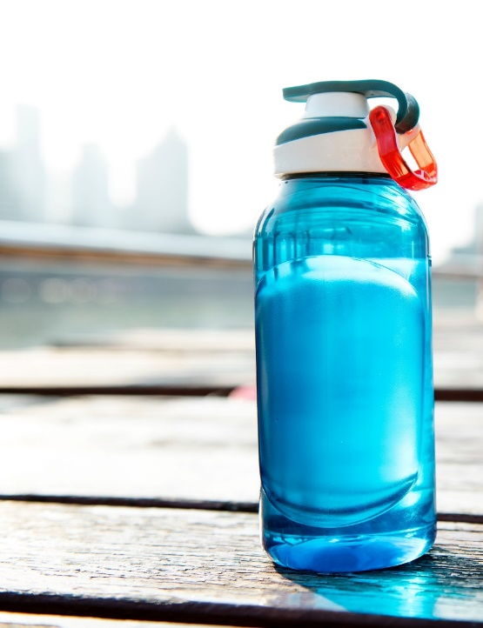
Vokabeln
hören / lesen / sprechen
Wo ist ?
die Flasche
Die Flasche ist da.
Notes:
Aim: to introduce further vocabulary, given students the opportunity to practise their new SSC knowledge. Procedure: 1. Present picture and word and elicit the pronunciation from students (this is an opportunity for them to apply their phonics knowledge and decode the new word)
2. Bring up the question. Wo ist...? and model ‘Die Flasche ist da’, pointing to the real (or picture) board.
3. Elicit a translation for ‘die Flasche’ and stress ‘die’ to prompt them to notice another word for ‘the’. They have now met the three words for ‘the’ for singular nouns. We will focus explicitly on this soon. Word frequency (1 is the most frequent word in German): ist [3] die Flasche [1758] wo? [94] hier [71] der, die, das [1]
Source: Jones, R.L. & Tschirner, E. (2006). A frequency dictionary of German: core vocabulary for learners. Routledge

Slide 12
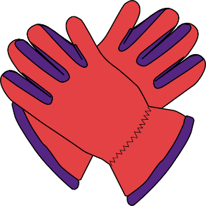
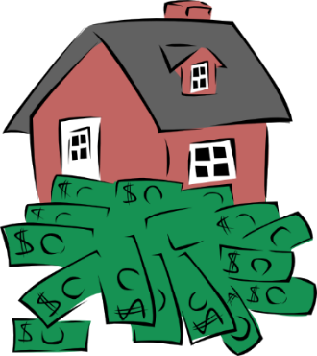
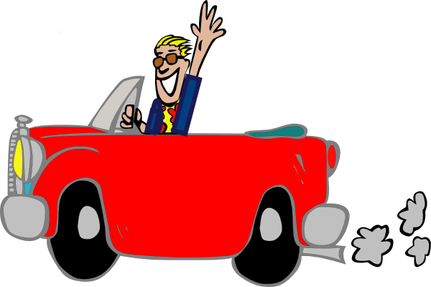
a
Paar
haben
sagen
fahren
Tag
klar
Notes:
Timing: 2 minutes
Aim: To introduce/consolidate SSC [a]
Procedure:
Introduce and elicit the pronunciation of the individual SSC [a] and then the source word again ‘sagen’ (with gesture, if using).
Then present and elicit the pronunciation of the five cluster words.
The cluster words have been chosen for their high-frequency, from a range of word classes, with the SSC (where possible) positioned within a variety of syllables within the words (e.g. initial, 2nd, final etc.). Additionally, we have tried to use words that build cumulatively on previously taught SSCs (see the Phonics Teaching Sequence document) and do not include new SSCs. Where new SSCs are used, they are often consonants which have a similar symbol-sound correspondence in English.
Word frequency (1 is the most frequent word in German): sagen [46]; Paar [284] haben [7]; fahren [169]; klar [255]; Tag [108].
Source: Jones, R.L. & Tschirner, E. (2006). A frequency dictionary of German: core vocabulary for learners. Routledge

Slide 13
a
Paar
haben
sagen
fahren
Tag
klar
Notes:
With sound and no pictures to focus all attention on the sound-symbol correspondence.

Slide 14
a
Paar
haben
sagen
fahren
Tag
klar
Notes:
Without sound to elicit pronunciation (without first hearing the teacher).
Teacher to elicit pronunciation by asking “Wie sagt man…”

Slide 15
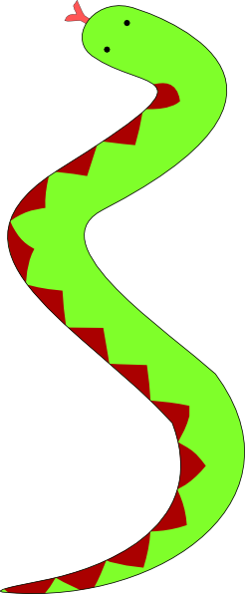
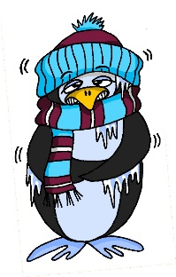
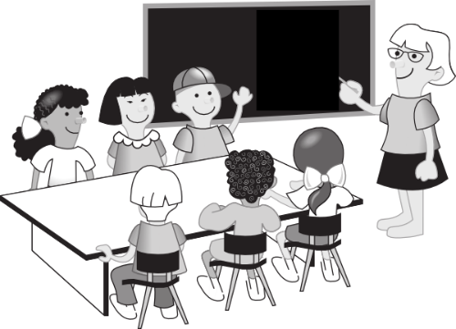
a
lang
Mann
6 Meter
kalt
Klasse
danke
Gast
[guest]
Notes:
Timing: 2 minutes
Aim: To introduce/consolidate SSC [a]
Procedure:
Introduce and elicit the pronunciation of the individual SSC [a] and then the source word again ‘kalt’ (with gesture, if using).
Then present and elicit the pronunciation of the five cluster words.
The cluster words have been chosen for their high-frequency, from a range of word classes, with the SSC (where possible) positioned within a variety of syllables within the words (e.g. initial, 2nd, final etc.). Additionally, we have tried to use words that build cumulatively on previously taught SSCs (see the Phonics Teaching Sequence document) and do not include new SSCs. Where new SSCs are used, they are often consonants which have a similar symbol-sound correspondence in English.
Word frequency (1 is the most frequent word in German): kalt [875]; lang [95] Mann [131]; Klasse [619]; Gast [675]; danke [778]. Source: Jones, R.L. & Tschirner, E. (2006). A frequency dictionary of German: core vocabulary for learners. Routledge

Slide 16
a
lang
Mann
kalt
Klasse
danke
Gast
Notes:
With sound and no pictures to focus all attention on the sound-symbol correspondence.

Slide 17
a
lang
Mann
kalt
Klasse
danke
Gast
Notes:
Without sound to elicit pronunciation (without first hearing the teacher).
Teacher to elicit pronunciation by asking “Wie sagt man…”

Slide 18
Phonetik
hören
Hör zu. [a:] oder [a]?
 | sagen | kalt
1
Mann
2
Paar
3
fahren
4
Klasse
5
danke
Notes:
Timing: 2 minutes Aim: to focus on differentiating the long and short [a] sounds in German. Procedure: 1. Click to hear the word. Decide if it is long [a] as in ‘sagen’ or short [a] as in ‘kalt’. Students are NOT expected to transcribe the words – there are several ways to write the sound long [a] and these are not words that have yet been taught, merely seen briefly in phonics practice.
2. Bring up the answers and the written word for students’ information. They will be learning these highly frequent words soon.
Transcript:
Mann
Paar
fahren
Klasse
danke
Word frequency (1 is the most frequent word in German): Mann [131]; Paar [284] fahren [169]; Klasse [619]; danke [778] Source: Jones, R.L. & Tschirner, E. (2006). A frequency dictionary of German: core vocabulary for learners. Routledge

Slide 19
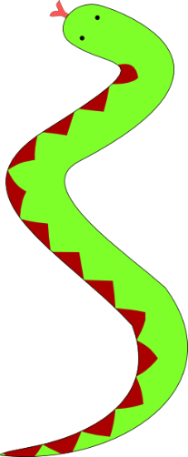
a
lang
der
Mann
kalt
6 Meter
die
Klasse
danke
der
Gast
[guest]
Notes:
Timing: 2 minutes (two slides) Aim: Awareness-raising
Procedure: 1. Ask students to suggest why some of these words have capital letters. 2. Do they know any other German words like this? 3. Click for the definite articles to appear.

Slide 20
long and short [a]
Phonetik
Consolidation [1]
Y7 T1.1 Week 6 Slides 38-41; 45-46

Slide 21
Phonetik
hören / sprechen
sagen
geben
Welt
Zug
frei
kalt
denken
Notes:
Timing: 3 minutes Aim: To revise all the SSCs introduced so far: long and short a, long and short e, ei, W, Z.
Procedure: 1. Click on the word to play the audio. Repeat if necessary.
2. Students write the whole word in full in their exercise books.
3. The next slide allows removal of the ‘blots’ to reveal the missing SSCs.

Slide 22
Phonetik
hören / sprechen
sagen
geben
Welt
Zug
frei
kalt
denken
Notes:
Timing: 1 minute Aim: To reveal the answers to the activity. Procedure: 1. Click on the ‘blots to remove them individually and reveal the missing SSCs.

Slide 23
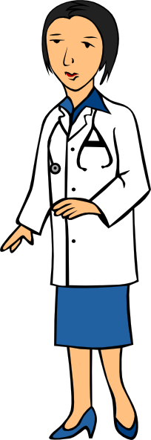
Phonetik
zehn
antworten
A
D
Zug
H
allein
C
E
Welt
klein
[alone]
Wasser
I
F
G
frei
B
Arzt
Notes:
Timing: 5 minutes Aim: To consolidate SSC knowledge
Ask students to write down which pictures go together (based on the obscured SSC).
The teacher can remind them of the source words they have just seen.
Clicking on the pictures will play the word if the students need an extra prompt.
Clicking on the paw prints will remove them.

Slide 24
Phonetik
Arzt
lesen / sprechen
antworten
60
zehn
Zug
allein
Sekunden
Welt
frei
klein
Wasser
0
LOS!
Notes:
Timing: 2 minutes (one minute per attempt) Aim: To consolidate SSC knowledge Procedure: 1. Pupils read out the words but in alphabetical order. They keep going for one minute.
2. Teacher can circulate to listen into their SSC knowledge.
Word frequency (1 is the most frequent word in German): der Arzt [614] allein [258] Source: Jones, R.L. & Tschirner, E. (2006). A frequency dictionary of German: core vocabulary for learners. Routledge

Slide 25
Phonetik
hören / schreiben
1
ei
Der Mann sit_t all__n. ☹
z
2
e
a
Der Arzt d_nkt ’W_s?!’
3
ei
i
Der Gast hat __n Z_mmer.
4
Der Freund ge_ innt __n B_tt.
w
ei
e
5
ei
a
Die Frau h_t __nen G_st.
a
6
a
Der Lehrer s_gt ‘Hurr_’. ☺
a
Notes:
Timing: 5 minutes Aim: To consolidate all SSCs introduced so far in a written transcription activity Procedure: 1. Click on the audio buttons to play the sentences.
2. Certain SSCs are missing from the transcript on the slide.
Students listen and write out the sentences in full.
3. Click to bring up the missing SSCs.
Transcript: As displayed on the slide. Word frequency (1 is the most frequent word in German): gewinnen [410] der Arzt [614] der Gast [675] das Zimmer [609] allein [258] Source: Jones, R.L. & Tschirner, E. (2006). A frequency dictionary of German: core vocabulary for learners. Routledge

Slide 26
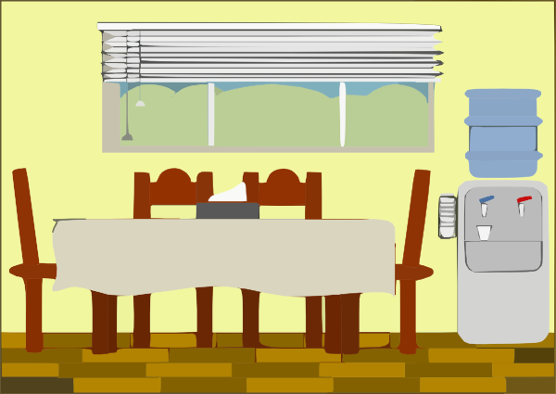
Phonetik
hören / sprechen
1
Der Mann sitzt allein. ☹
2
Der Arzt denkt ’Was?!’
3
der Artzt
Der Gast hat ein Zimmer.
4
Der Freund gewinnt ein Bett.
das Zimmer
5
Die Frau hat einen Gast.
6
Der Lehrer sagt ‘Hurra’. ☺
Notes:
Timing: 5-10 minutes Aim: To consolidate SSC and word knowledge in a listening and speaking activity Procedure (alternatives): 1. Students read each sentence aloud, as a whole-class activity or in pairs.
2) Students translate the sentences into English (orally or in writing).
3) Students play a paired vocabulary tennis task (with gestures for the verbs)
Word frequency (1 is the most frequent word in German): gewinnen [410] der Arzt [614] der Gast [675] das Zimmer [609] allein [258] Source: Jones, R.L. & Tschirner, E. (2006). A frequency dictionary of German: core vocabulary for learners. Routledge

Slide 27
long and short [a]
Phonetik
Consolidation [2]
Y7 T2.2 Week 3 Slide 3

Slide 28
[a] vs [ä]
Phonetik
a[long]
ä[long]
sagen
spät
a[short]
ä[short]
kalt
lächeln
1
egal
2
ständig
zählen / zahlen
7
zählen / zahlen
3
hängen
Wahlen / wählen
8
Wahlen / wählen
4
unbekannt
Geschäft / geschafft
9
Geschäft / geschafft
5
Bad
schätzen / schatzen
10
schätzen / schatzen
6
Nähe
Notes:
Timing: 3 minutes
Aim: Phonics refresher - a vs ä.
The contrast between a and ä is important for this week’s grammar point (strong verbs). Both sounds have been introduced already, we are simply revisiting them here.
Procedure:
Click on the SSCs and their example words (sagen / kalt / lächeln / spät) to play them and remind the students of the the sounds.
The first 6 words is a transcription (fill in the blank) task. The words are high-frequency, but haven’t yet been taught.
The second four are minimal pairs (some of these are rare).
The task is set up to do 1-6 first and correct those, and then complete 7-10.
Transcript:
egal
ständig
hängen
unbekannt
Bad
Nähe
zählen /zahlen
Wahlen / wählen
Geschäft / geschafft
schätzen / schatzen
Word frequency (1 is the most frequent word in German):
egal [932] ständig [779] hängen [590] unbekannt [1292] Bad [1637] Nähe [918] zählen [704] zahlen [832] Wahl [799] wählen [636] Geschäft [765] schaffen (geschafft) [285] schätzen [1294] schatzen [>5009]
Source: Jones, R.L & Tschirner, E. (2019). A frequency dictionary of German: Core vocabulary for learners. London: Routledge.

Slide 29
long and short [a]
Phonetik
Consolidation [3]
Y7 T2.2 Week 5 Slides 3-4; 6; 34

Slide 30
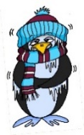
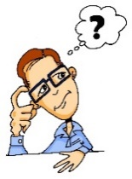
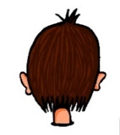
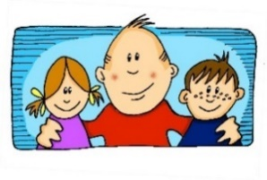
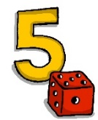
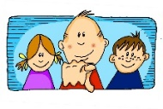
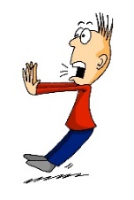
Phonetik
e
e
a
a
sagen
kalt
geben
denken
i
i
o
o
u
wir
u
finden
wo?
Kopf
ü
ü
ö
du
ö
Punkt
Tür
fünf
ä
ä
schön
plötzlich
spät
lächeln
Notes:
Timing: 3 minutes
Aim: The long and short vowel sounds in German are practised here in familiar words, with audio.
Procedure:
1. Students should listen and repeat.

Slide 31
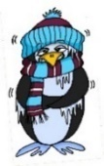
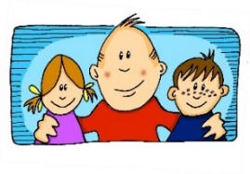
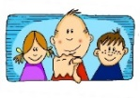
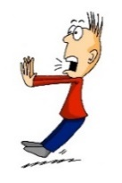
Phonetik
e
e
a
a
sagen
kalt
geben
denken
i
i
o
o
u
wir
u
finden
wo?
Kopf
ü
ü
ö
ö
fünf
du
Punkt
Tür
ä
ä
schön
plötzlich
spät
lächeln
Notes:
Timing: 3 minutes
Aim: This version of the slide is without audio.
Procedure:
1. Students should chant the words chorally first, as they appear, then perhaps individually (the teacher quizzing students on individual words; it will be important to continue to juxtapose the long and short forms of each vowel in this practice).

Slide 32
Phonetik
lesen / sprechen
Wie sagt man das?
 | a [lang] | a [kurz]
Hamburg
Graz
Kassel
Hannover
Aachen
 | e [lang] | e [kurz]
Genf
Bremen
Gelsenkirchen
Essen
Regensburg
1
1
2
2
3
3
4
4
5
5
Notes:
Timing: 5 minutes
Aim: This is a phonics recap of long and short ‘a’ and ‘e’.
Procedure:
1. Students are asked to read aloud each city, either chorally or in pairs. The table prompts ‘lang’ and ‘kurz’ are there to remind students to think about their vowels before saying them.
2. Audio to check is then available upon clicking each word, and answers are animated.
Note: Two of the towns have examples of both long and short ‘e’.
Towns listed are from Germany, Austria and Switzerland. As an additional self-study task, students may like to do an extension research task to identify which towns they know (e.g from the football team) and/or where the towns are situated.

Slide 33
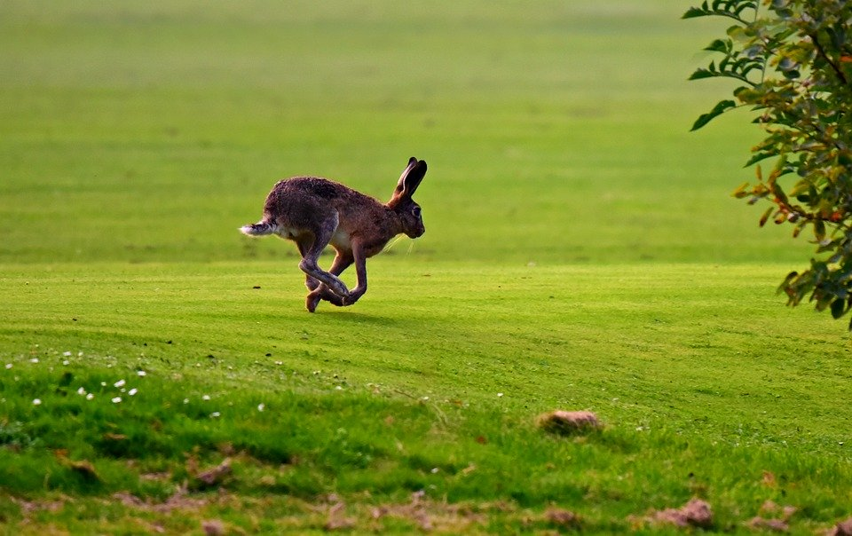
Zungenbrecher [1]
Phonetik
1
Auf dem Rasen rasen Hasen, atmen rasselnd durch die Nasen.
2
Notes:
Timing: 3 minutes
Aim: Opportunity to practise long and short ‘a’ sounds.
Note: ‘atmen’ does not follow the standard rules, owing to its Sanskrit origins.
Procedure:
1. Students listen to either the slower [1] or the faster [2] version of the tonguetwister (or both in turn), then try to say it chorally or in pairs.
Transcription:
Auf dem Rasen rasen Hasen, atmen rasselnd durch die Nasen.
Translation: On the lawn hares are racing, breathing raspingly?noisily? through their noses.
Word frequency (1 is the most frequent word in German):
der Rasen [>4029]; rasen [>4029]; atmen [2454]; durch [56]; rasselnd[>4029] die Nase [1530]
Source: Jones, R.L & Tschirner, E. (2019). A frequency dictionary of German: Core vocabulary for learners. London: Routledge.

Slide 34
long and short [a]
Phonetik
Consolidation [4]
Y8 T1.2 Week 3 Slides 2-3; 6-7; 21-24

Slide 35
a
Paar
haben
sagen
fahren
Tag
klar
Notes:
Timing: 2 minutes
Aim: To introduce/consolidate SSC [a]
Procedure:
Introduce and elicit the pronunciation of the individual SSC [a] and then the source word again ‘sagen’ (with gesture, if using).
Then present and elicit the pronunciation of the five cluster words.
The cluster words have been chosen for their high-frequency, from a range of word classes, with the SSC (where possible) positioned within a variety of syllables within the words (e.g. initial, 2nd, final etc.). Additionally, we have tried to use words that build cumulatively on previously taught SSCs (see the Phonics Teaching Sequence document) and do not include new SSCs. Where new SSCs are used, they are often consonants which have a similar symbol-sound correspondence in English.
Word frequency (1 is the most frequent word in German): sagen [46]; Paar [284] haben [7]; fahren [169]; klar [255]; Tag [108].
Source: Jones, R.L. & Tschirner, E. (2006). A frequency dictionary of German: core vocabulary for learners. Routledge

Slide 36
a
lang
Mann
6 Meter
kalt
Klasse
danke
Gast
[guest]
Notes:
Timing: 2 minutes
Aim: To introduce/consolidate SSC [a]
Procedure:
Introduce and elicit the pronunciation of the individual SSC [a] and then the source word again ‘kalt’ (with gesture, if using).
Then present and elicit the pronunciation of the five cluster words.
The cluster words have been chosen for their high-frequency, from a range of word classes, with the SSC (where possible) positioned within a variety of syllables within the words (e.g. initial, 2nd, final etc.). Additionally, we have tried to use words that build cumulatively on previously taught SSCs (see the Phonics Teaching Sequence document) and do not include new SSCs. Where new SSCs are used, they are often consonants which have a similar symbol-sound correspondence in English.
Word frequency (1 is the most frequent word in German): kalt [875]; lang [95] Mann [131]; Klasse [619]; Gast [675]; danke [778]. Source: Jones, R.L. & Tschirner, E. (2006). A frequency dictionary of German: core vocabulary for learners. Routledge

Slide 37
Phonetik
hören
As you know, German vowels can be long or short.
Vowels followed by more than one consonant are short.
Other vowels are long.
sagen
kalt
a
a
o
o
wo?
Kopf
Notes:
Timing: 30 seconds Aim: To bring the four source words together in summary before the transcription task on the next slide. Procedure:

Slide 38
Phonetik
hören / schreiben
Hör zu. Schreib das Wort.
1
[a] sagen
[a] kalt
2
Bahnhof
spannend
3
gefahren
Tante
4
5
[o] wo?
[o] Kopf
geflogen
Osten
6
7
Polen
polnisch
8
Notes:
Timing: 4 minutes Aim: To practise SSC long and short [a] and [o] with vocabulary that is part of this week’s and revisited vocabulary sets. The task is thus also a vocabulary practice task. Procedure: 1. Draw a 2 x 2 and write the source words. 2. Click to listen and write each word into the correct square. 3. Click to hear and see and word again. NB: Words will appear on clicks, so take care that the mouse is on action button when you click for audio (or the answers will appear too soon). Word frequency (1 is the most frequent word in German): Osten [1208] der Bahnhof [1953] polnisch [3237] geflogen [824] gefahren [215] spannend [1810] Polen [2023] Tante [1826] Source: Jones, R.L. & Tschirner, E. (2006). A frequency dictionary of German: core vocabulary for learners. Routledge
Transcript: 1. Osten (short [o] 2. Bahnhof (long [a]) 3. polnisch (short [o]) 4. geflogen (long [o]) 5. gefahren (long [a]) 6. spannend (short [a]) 7. Polen (long [o]) 8. Tante (short [a])

Slide 39
Phonetik
sprechen / hören / schreiben
Partner A sagt die Wörter. Partner B schreibt.
[a] sagen
[a] kalt
_______
_______
1. Kosten [costs]
2, planen [to plan]
3. Stoff [material] 4. Sohn [son] 5. einladen [to invite] 6. Gast [guest] 7. wohl [well] 8. relativ [relatively]
_______
_______
[o] wo?
[o] Kopf
_______
_______
_______
_______
Notes:
Timing: 4 minutes Aim: To practise SSC long and short [a] and [o] with mostly unknown vocabulary, compelling students to apply their phonics knowledge. This vocabulary will appear later in Year 8. Procedure: 1. Partner B draws a 2 x 2 and write the source words. 2. Partner A reads the words aloud. Partner B must turn away from the board and must write the words in the corresponding boxes. 3. The next slide has the answers. Click to hear and see and word again. Word frequency (1 is the most frequent word in German):
relativ [571] Gast [576] einladen [1279] planen [597] Kosten [564] Stoff [702] Sohn [596] wohl [261] Source: Jones, R.L. & Tschirner, E. (2006). A frequency dictionary of German: core vocabulary for learners. Routledge
Transcript: 1. Kosten (short [o] 2. planen (long [a]) 3. Stoff (short [o]) 4. Sohn (long [o]) 5. einladen (long [a]) 6. Gast (short [a]) 7. wohl (long [o]) 8. relativ (short [a])

Slide 40
Antworten
sprechen / hören / schreiben
[a] sagen
[a] kalt
This word comes from another language and doesn't follow German vowel length patterns. Other examples include: informativ, alternativ.
einladen [to invite]
relativ [relatively]
planen [to plan]
Gast [guest]
[o] wo?
[o] Kopf
Sohn [son]
Kosten [costs]
wohl [well]
Stoff [material]
Notes:
Answers
Timing: 30 seconds
Aim: to check work of Partner B (who write) and Partner A (who spoke)
Answers appear in order of the transcript.
Transcript:
1. Kosten 2. planen 3. Stoff 4. Sohn 5. einladen 6. Gast 7. wohl 8. relativ
Word frequency (1 is the most frequent word in German):
Source: Jones, R.L. & Tschirner, E. (2006). A frequency dictionary of German: core vocabulary for learners. Routledge

Slide 41
Phonetik
sprechen / hören / schreiben
Partner A schreibt. Partner B sagt die Wörter.
[a] sagen
[a] kalt
_______
_______
1. doch [however,but] 2. Rahmen [frame] 3. modern 4. ohne [without]
5. Daten [data] 6. Blatt [leaf, sheet] 7. Lohn [wage] 8. fassen [to grasp]
_______
_______
[o] wo?
[o] Kopf
_______
_______
_______
_______
Notes:
Same activity, roles reversed.
Timing: 4 minutes Aim: To practise SSC long and short [a] and [o] with mostly unknown vocabulary, compelling students to apply their phonics knowledge. This vocabulary will appear later in Year 8. Procedure: 1. Partner B draws a 2 x 2 and write the source words. 2. Partner A reads the words aloud. Partner B must turn away from the board and must write the words in the corresponding boxes. 3. The next slide has the answers. Click to hear and see and word again. NB: Words will appear on clicks, so take care that the mouse is on action button when you click for audio (or the answers will appear too soon). Word frequency (1 is the most frequent word in German):
fassen [1144] Blatt [1270] Daten [574] Rahmen [753] doch [73] modern [747] ohne [120] Lohn [2243] Source: Jones, R.L. & Tschirner, E. (2006). A frequency dictionary of German: core vocabulary for learners. Routledge
Transcript: 1. Doch (short [o] 2. Rahmen (long [a]) 3. modern (short [o]) 4. ohne (long [o]) 5. Daten (long [a]) 6. Blatt (short [a]) 7. Lohn (long [o]) 8. fassen (short [a])

Slide 42
Antworten
hören / sprechen
[a] sagen
[a] kalt
Daten [data]
fassen [to grasp]
Rahmen [frame]
Blatt [leaf, sheet]
[o] wo?
[o] Kopf
modern [modern]
doch [however, but]
ohne [without]
Lohn [wage]
Notes:
Antworten

Slide 43
long and short [a]
Phonetik
Consolidation [5]
Y8 T1.2 Week 5 Slide 38

Slide 44
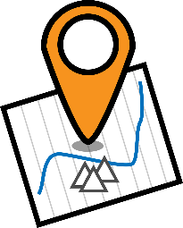
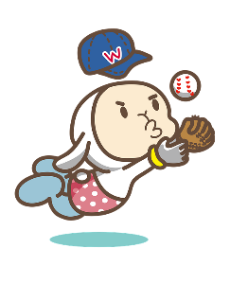
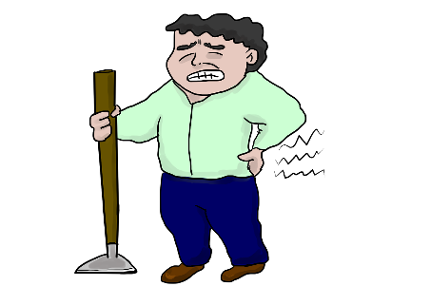
Phonetik [1/2]
Say only the words with short [a].
lesen / sprechen
Sag jetzt die anderen Wörter.
zentral
Kontakt
fangen
Abendessen
Truth
Mannschaft
Wahrheit
Reaktion
Partnerin
planen
Macht
unangenehm
Landschaft
Notes:
Timing: 3 minutes Aim: to practise spoken production of short and long [a]. Procedure: 1. Students read the words, identifying from their SSC knowledge which contain short [a] sound, and saying those aloud.
2. Click to highlight the words containing short [a].
3. Students read aloud the remaining words, containing long [a] sound.
4. Click on the images to hear each word pronounced, as required.
Transcript: 1. zentral 2. Kontakt 3. fangen 4. Abendessen 5. Mannschaft 6. Wahrheit 7. Reaktion 8. Partnerin 9. planen 10. Macht 11. unangehemn 12. Landschaft Word frequency (1 is the most frequent word in German): Source: Jones, R.L. & Tschirner, E. (2006). A frequency dictionary of German: core vocabulary for learners. Routledge

Slide 45
long and short [a]
Phonetik
Consolidation [6]
Y8 T2.1 Week 3 Slide 3

Slide 46
Phonetik
lesen / sprechen
Sag die Zungenbrecher.
5
2.
[a]
[ä]
Acht ähnliche Männer machen acht ähnliche Fächer.
Eight similar men do eight similar subjects.
Sekunden
ähnliche
machen
Männer
acht
Fächer
0
langsamer
LOS!
Notes:
Transcript: Acht ähnliche Männer machen acht ähnliche Fächer

Slide 47
long and short [a]
Phonetik
Consolidation [7]
Y8 T2.2 Week 4 Slide 2

Slide 48
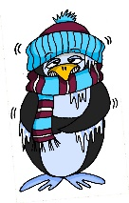
Phonetik
lesen / sprechen
Sag die Wörter. Wie viele enthalten die SSC?
[e]
[ch]
[s]
[o]
[a]
[ä]
denken
ich
sollen
Wo?
kalt
lächeln
 |  | ?
 | [e]
 | [ch]
 | [s]
 |  | ?
 | [o]
 | [a]
 | [ä]
eng – Bett – Weg
2
ohne – Telefon – Rock
2
reich – jedoch – einfach
1
alt – arm – normal
1
unser – langsam – alles
2
2
hängen – Aktivität – schnell
Notes:
Timing: 3 minutes Aim: A read aloud activity to revise 12 SSC (six explicitly, and six by contrast) using a range of new, revisited and unfamiliar vocabulary. Procedure: 1. Click on each individual SSC to hear it.
2. Elicit the source word from students, if remembered. Note that 4/6 these words have since been taught as key vocabulary (with sollen and lächeln to follow on the SOW)
3. Bring up the source words to check, and for reference for the read aloud activity.
4. Students pronounce the sets of three words, individually or in pairs, and decide how many contain the target SSC.
5. Optional – Click on the words to hear the sets of words pronounced. 6. Reveal the answers. 7. Optional – elicit the English meanings of the vocabulary.
Transcript:
eng – Bett – Weg
reich – jedoch – einfach
unser – langsam – alles
ohne – Telefon – Rock
alt – arm – normal
hängen – Aktivität – schnell
Word frequency of unknown words (1 is the most frequent word in German): hängen [580] Weg [220] Source: Jones, R.L. & Tschirner, E. (2019). A frequency dictionary of German: core vocabulary for learners. Routledge

Slide 49
long and short [a]
Phonetik
Consolidation [8]
Y9 T1.1 Week 2 Slide 4; 15

Slide 50
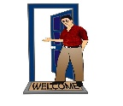
Phonetik
Hör zu. Ist der Buchstabe [a] oder [ä]? Schreibe die Wörter. Wie heißen sie auf Englisch?
hören / schreiben
 | [a] | [ä] | Deutsch | Englisch
 |  |  | Blätter | leaves
 |  |  | Arme | arms
 |  |  | Angriffe | attacks
 |  |  | Gäste | guests
 |  |  | Pläne | plans
 |  |  | Äpfel | apples
 |  |  | Wälder | forests
 |  |  | Fälle | cases
1
2
3
4
5
6
7
8
Notes:
Timing: 7 minutes Aim: to distinguish between [a] and [ä] in the aural modality. Transcribe unknown plurals. Procedure: 1. Click audio button 1. Students listen and indicate whether they hear [a] or [ä].
2. Click for tick to appear in correct column.
3. Click audio again and students transcribe the word they hear. Hopefully when looking at what they have written, students will recognise the plurals of previously taught singular nouns.
4. Click to reveal answer – German transcription.
5. Students then write the English meaning.
6. Click to reveal answer – an image will appear at the same time.
7. Repeat for 2 – 4. For 5 – 8, depending on level of the class, possibly only play the audio once, students tick [a] / [ä] and transcribe at the same time.
8. When all times 1 – 8 have been ‘done’, students read the words aloud with a partner.
Word frequency (1 is the most frequent word in German):
Apfel [3491] Fall [188] Plan [955] Source: Jones, R.L. & Tschirner, E. (2019). A frequency dictionary of German: core vocabulary for learners. Routledge

Slide 51
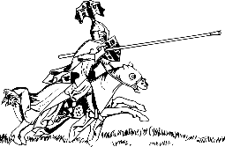
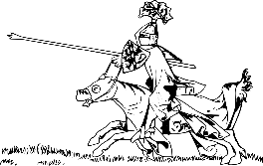
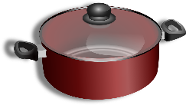
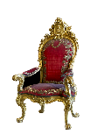
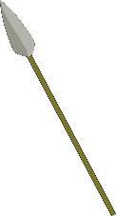
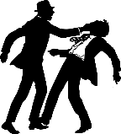
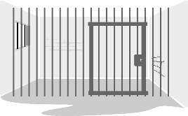
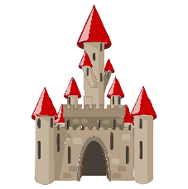
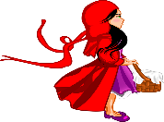
Phonetik
hören / schreiben
Person A liest die Wörter, Person B schreibt auf. Dann tauscht die Rollen.
6 Wörter – Person A liest:
6 Wörter – Person B liest:
1. Lanzen
1. Töpfe
2. Throne
2. Kronen
3. Rösser
3. Waffen
4. Kämpfe
4. Stäbe
5. Gewänder
5. Wassergräben
6. Schlösser
6. Köpfe
Notes:
Timing: 5 minutes Aim: to read aloud to practise spoken production of a, ä, o, ö. Procedure: 1. Partner B turns away from the board.
2. Click to make the words and images appear for Person A to read out. Person B writes down what Person A says.
3. When all 6 words have been read and transcribed, Person B turns back to the board, and together with Person A, checks their spelling.
4. Students work out meaning of the words using the images as clues – they may need help with this.
5. Swap roles and follow procedure 1 – 5 for the second set of six words.
Word frequency of unknown words (1 is the most frequent word in German): Lanze [>5009] Thron [>5009] [4962] Ross [>5009] Kampf [867] Gewand [>5009] Topf [4136] Krone [3743] Waffe [1625] Stab [>5009] Wassergraben [>5009]

