Slide 1
Phonics
Year 7 French
Term 1.2 - Week 6
Stephen Owen / Rachel Hawkes
Date updated: 23/02/20
Notes:
Phonics learning aims for Term 1.2, Week 6:
revisiting ‘a’
All pictures selected are available under a Creative Commons license; no attribution required.

Slide 2
a
animal
Notes:
The SoW indicates that the phonics element for this week is revisiting ‘a’ (originally taught in Term 1.1 – Week 1).
The introductory slides are included plus opportunities for developing and consolidating use.
Here these four original slides can be re-used to refresh students’ memory of pronunciation, either in the way the original teacher notes suggest (by introducing and eliciting the pronunciation of the individual SSC ‘a’ and then presenting and practising the pronunciation of the source word ‘animal’), or with eliciting the pronunciation first from the students, foregoing the introductory teacher’s step. (This will test if students can remember the pronunciation – if so, less listen and repeat will be needed and teachers could move quicker onto slide 6, which is more challenging).
NB teachers will need to mute the sound if choosing to elicit the responses from the students first, as the text and images appear simultaneously with sound.
Remember - a possible gesture for this source word would be to mimic an animal’s motion, perhaps holding ones arms and hands close to the chest as ‘paws’

Slide 3
a
animal
Notes:
Introduce and elicit the pronunciation of the individual SSC ‘a’ and then present and practise the pronunciation of the source word ‘animal’. Or:
elicit pronunciation first from the students, if appropriate to the group

Slide 4
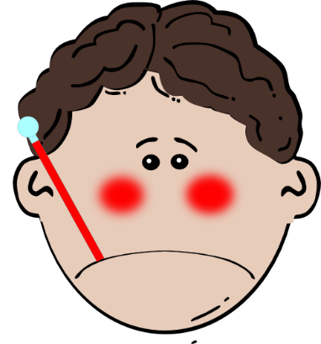
a
ça va ?
table
animal
malade
sac
mal
Notes:
Introduce and elicit the pronunciation of the individual SSC ‘a’ and then the source word ‘animal’ again (with gesture, if using). Then present and elicit the pronunciation of the five cluster words. Or:
elicit pronunciation first from the students, if appropriate to the group.

Slide 5
a
ça va ?
table
animal
malade
sac
mal
Notes:
Introduce and elicit the pronunciation of the individual SSC ‘a’ and then the source word ‘animal’ again (with gesture, if using). Then present and elicit the pronunciation of the five cluster words. Or:
elicit pronunciation first from the students, if appropriate to the group.

Slide 6
écouter et écrire
1) Tu as un animal.
2) Elle a un cadeau.
3) Il a un animal malade.
4) Tu as un ami sympa.
5) L’acteur a une classe calme.
6) Elle a un ami amusant.
Notes:
Further SSC practice:
There are several ways to use this slide:
students transcribe what is heard
read aloud sentences – either as choral class work or pairs reading to each other, with audio played afterwards for reinforcing correct pronunciation
students read the sentence as they are listening to the recording; the teacher pauses the recording at the end of one of the words, just before one begins, and students say aloud the next word. This helps students to link the sound to the written form, and helps them “segment” the input into words. When listening gets faster, students need to be really good at this – chopping up the input into words from one continuous stream.

