Slide 1
Spanish Vocabulary Learning Sequence
En la ciudad (in town)

Slide 2
Stages of Vocabulary Learning
Topic-based vocabulary lists of one single word class are not optimal.
Introduction (i.e. first encounters with new words, and initial memorisation routines)
Consolidation (i.e. speed of retrieval building, controlled production, e.g. sentence-building)
Developing use (i.e. revisiting across different contexts, modalities, synthesising with previously-learnt language)
Assessment

Slide 3
First encounters
Directed, pre-learning (e.g. using Quizlet)
Peer- / Self-introduction in the lesson
Teacher-led presentation and elicitation (e.g. with pictures)
Self-made flashcard routines
Text / mini-story-based introduction
Notes:
There are many ways for learners to encounter new language, particularly when we are confident that they can ‘sound out’ new words with relative accuracy. Here is a list of 5 different ways for learners to start the learning process.

Slide 4
En la ciudad [in town]
 | Word | Frequency ranking | Part of speech
1 | la plaza | 806 | noun
2 | la iglesia | 437 | noun
3 | el teatro | 605 | noun
4 | ser | 7 | verb
5 | grande | 66 | adjective
6 | pequeño/a | 202 | adjective
7 | estar | 21 | verb
8 | cerca (de) | 1042 | adverb
9 | lejos (de) | 833 | adverb
10 | el museo | 1114 | noun
Notes:
This is the slide of 10 words pupils are going to learn.
Note the mixed word class selection, and the frequency (all well within the top 2000 more frequently occurring words in Spanish).

Slide 5
1. Quizlet
Completa la sección LEARN
Objetivo: obtener ‘Mastered’ en todas las palabras
Notes:
1. Quizlet Pupils are given a 30-minute pre-learning homework. They need some guidance and instruction about how to use Quizlet. 1. For pre-learning spend 30 minutes on LEARN 2. Objective is to get ‘Mastered’ in all of the words 3. Have the audio audible (either headphones or out loud if you are working alone)
4. Vocalise the words as well as looking at them. Don’t just do this silently in your head – get into the habit of saying the words out loud when you learn

Slide 6
2. Peer or Self Introduction
60
 | Word | English meaning
1 | la plaza | town square
2 | la iglesia | chuch
3 | el teatro | theatre
4 | ser | to be (description)
5 | grande | big
6 | pequeño/a | small
7 | estar | to be (location)
8 | cerca (de) | near (to)
9 | lejos (de) | far (from)
10 | el museo | museum
Segundos
0
INICIO
Notes:
2. Peer or self-introduction Pupils either work by themselves or in pairs, reading out the words and studying their English meaning (1 minute). Then the English meanings are removed and they try to recall them, looking at the Spanish (1 minute). Then the Spanish meaning are removed and they to recall them, looking at the English (1 minute) NB: It is not expected that they will be able to do them all. However, in a mixed ability class, some pupils will come close to being able to do this, whilst others may just manage one or two. It is important to have open-ended routines for first encounters of new words, where learners are ‘self-serving’, as it prevents the frustration hat can be caused by a mismatched pace of presentation.
Further rounds of learning can be facilitated by one pupil turning away from the board, and his/her partner asking him/her the meanings. This activity can work from L2 → L1 or L1 → L2.

Slide 7
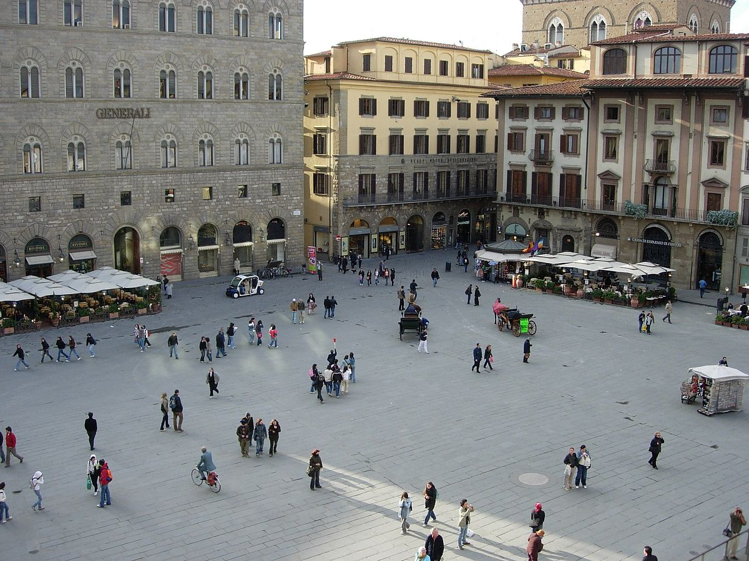
3. Teacher-led Presentation
la plaza
Notes:
Teacher presentation
Here the teacher is the source of the input, and presents the written form of the word, says the spoken form and displays a picture. As there is no English in this presentation, it’s important to check that pupils are completely clear about the meanings of these new words. If they are unclear about the meaning, this may delay the learning.

Slide 8
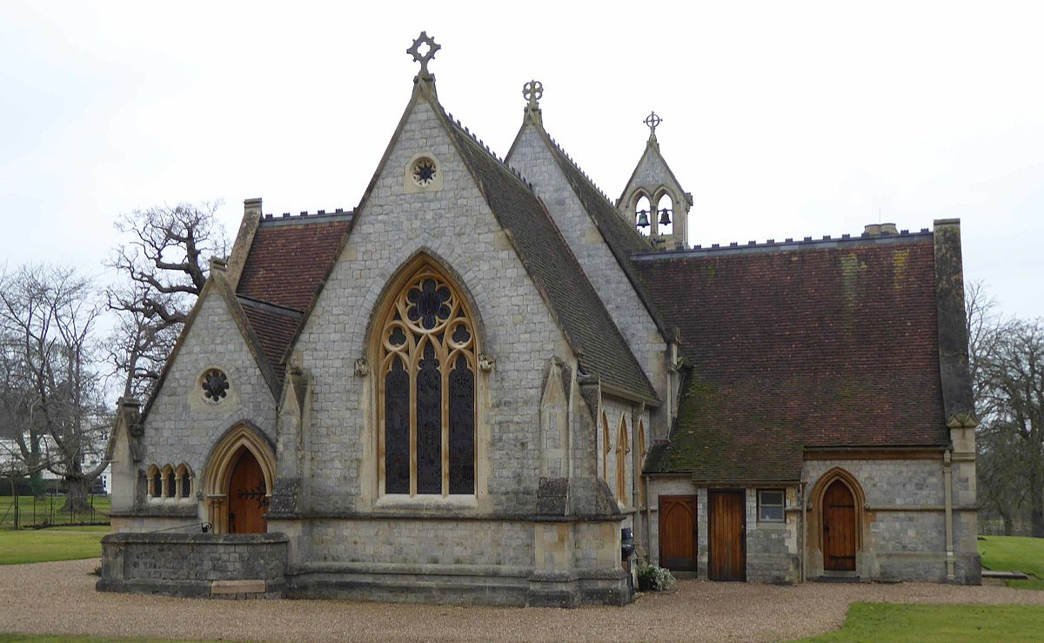
la iglesia

Slide 9
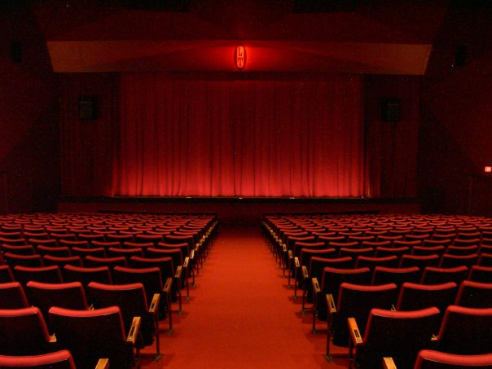
el teatro

Slide 10
ser
[ to be / being ]
[description]
es
[ is ]

Slide 11
grande

Slide 12
pequeño/a

Slide 13
estar
[ to be / being ]
[location]
está
[ is ]

Slide 14
Madrid 1KM
cerca (de)

Slide 15
Madrid 1000KM
lejos (de)

Slide 16
4. Self-made flashcard routines
Pupils create their own paper flashcards (English on one side, Spanish on the other)
Beginning with Spanish side facing up, read the word aloud and turn it over to see the meaning
Repeat 2-3 times with each word, then move to the next one
After the third word, re-visit the first and second words and try to recall their meaning
Build up until all words have been practised
Notes:
4. Self-made flashcard routines
Additional details: Learners can work in pairs to do this routine. There are many uses for these paper flashcards, also in the consolidation phase. 1) in pairs, pelmanism (not guessing of course, but working from English to Spanish – have to say the words correctly to claim the pair) 2) in fours, happy families – Tienes ‘la iglesia?’ 3) listening tasks – one partner calls out the words in Spanish, the other has to put his/her cards in the correct order (when viewing English side up) 4) sentence-building tasks – take two at random and put them into a sentence (can be written or spoken)

Slide 17
5. Text/Story presentation
¿Cómo es tu ciudad? Mi ciudad no es grande. Hay una plaza pequeña en el centro. La iglesia está en la plaza y el museo está cerca de la iglesia. También hay un teatro pequeño. El teatro está lejos de la plaza pero cerca de mi casa.
Notes:
5. Text/Story presentation
Formatting here shows the ‘target words’ to be learned. Routine might be used either as very first encounter or after one of the methods 1,2 or 4: 1) Pupils read aloud (either for themselves or in pairs) as decoding task – teacher circulates to listen in 2) Teacher reads aloud, emphasising meaning through intonation and, where appropriate, gestures to support meaning. 3) Teacher elicits meaning of the key words from pupils (elicits meaning of the verb forms and relates them back to the infinitive – asks why not SER, why not ESTAR) 4) One pupil can read aloud, partner put his/her paper flashcards in order. 5) Pupils read and draw their understanding of the text in a picture.

Slide 18
Consolidation
Individual word level tasks (e.g. L1:L2 table completion, Look-Say-Cover-Write-Check)
Listening tasks
Sentence-completion tasks
Sentence-level production tasks

Slide 19
1a) Give the meanings of the following words:
e.g. | la biblioteca | library | p
1. | la plaza |  |  | 6. | la iglesia
2. | estar |  |  | 7. | cerca (de)
3. | el museo |  |  | 8. | el teatro
4. | lejos (de) |  |  | 9. | pequeño/a
5. | grande |  |  | 10. | ser

Slide 20
1b) Give the correct Spanish spellings
(with the definite article (el/la), if needed,) for the following words:
e.g. | museum | el | museo | p | p
1 | theatre
2 | near (to)
3 | small
4 | to be (location)
5 | town square
6 | church

Slide 21
2) Listening: Individual Words
1
2
3
4
5
6
7
8
9
10
Notes:
Pupils are looking away anyway, but if desired, this slide can be hidden, so pupils cannot see which number the teacher is clicking (because s/he will repeat the words several times).
1 individual words recorded
Use these in conjunction with the self-made flashcards, in several ways. First, pupils look at Spanish side facing up, and when they hear the word, they just turn it over to the English side (simple recognition). The turn it back. Second, pupils look at English side facing up and select the correct card in response to what they hear [individual words]. Then turn it back.

Slide 22
2) Listening: Sentences 1a
1
2
3
4
5
6
Notes:
2 Sentences recorded [I suggest 3 x sets of 6 sentences for each bunch of 10 words] SET 1a Third, with Spanish side up, pupils hear sentences with 2-3-4 of the items in them and they place them down in order – this might sound easy, but remember they will be seeing the infinitive, but hearing the short form, so there is still some significant processing to do (plus the fact that you will have several items together in an order, so not as easy as it might seem). Fourth, a bingo game. Pupils place 6 of their cards English side up in a 3 x 2 formation and they turn them to Spanish when they hear the word called. Winner is i) a complete row then ii) a full house. Fifth, with English side up, pupils listen to a set of sentences containing 2-4 of the items and have to put them in order. E.g. El teatro es grande (they would need to place ‘theatre’, then ‘to be(description)’ then ‘big’. This is challenging (sentences will be slow and careful), but it will be useful to have them recorded at 3 different speeds! I normally do this just with my voice).
TRANSCRIPT
1 La iglesia es pequeña.
2 El museo está lejos.
3 El teatro es grande.
4 La plaza está cerca.
5 La iglesia está en la plaza.
6 El museo es pequeño.

Slide 23
Listening: Sentences 1b
1
2
3
4
5
6
Notes:
2 Sentences recorded [Suggestion: 3 x sets of 6 sentences for each bunch of 10 words] SET 1b Third, with Spanish side up, pupils hear sentences with 2-3-4 of the items in them and they place them down in order – this might sound easy, but remember they will be seeing the infinitive, but hearing the short form, so there is still some significant processing to do (plus the fact that you will have several items together in an order, so not as easy as it might seem).
Fourth, a bingo game. Pupils place 6 of their cards English side up in a 3 x 2 formation and they turn them to Spanish when they hear the word called. Winner is i) a complete row then ii) a full house.
Fifth, with English side up, pupils listen to a set of sentences containing 2-4 of the items and have to put them in order. E.g. El teatro es grande (they would need to place ‘theatre’, then ‘to be(description)’ then ‘big’. This is challenging (sentences will be slow and careful), but have been recorded at 3 different speeds, building up. Alternatively the teacher can do this him/herself.
TRANSCRIPT
1 El teatro está cerca.
2 El museo es grande.
3 El teatro está lejos.
4 La iglesia está cerca.
5 Ls plaza es grande.
6 La iglesia es pequeña.

Slide 24
Listening: Sentences 1c
1
2
3
4
5
6
Notes:
2 Sentences recorded [I suggest 3 x sets of 6 sentences for each bunch of 10 words] SET 1c Third, with Spanish side up, pupils hear sentences with 2-3-4 of the items in them and they place them down in order – this might sound easy, but remember they will be seeing the infinitive, but hearing the short form, so there is still some significant processing to do (plus the fact that you will have several items together in an order, so not as easy as it might seem).
Fourth, a bingo game. Pupils place 6 of their cards English side up in a 3 x 2 formation and they turn them to Spanish when they hear the word called. Winner is i) a complete row then ii) a full house.
Fifth, with English side up, pupils listen to a set of sentences containing 2-4 of the items and have to put them in order. E.g. El teatro es grande (they would need to place ‘theatre’, then ‘to be(description)’ then ‘big’. This is challenging (sentences will be slow and careful), but have been recorded at 3 different speeds, building up. Alternatively the teacher can do this him/herself.
TRANSCRIPT
1 El teatro es grande. 2 Está lejos la iglesia? 3 La iglesia está en la plaza. 4 La plaza está cerca del museo. 5 El teatro está lejos. 6 ¿Cómo es el museo? ¿Es grande o pequeño?

Slide 25
Listening: Sentences 1d
Question or statement?
1
2
3
4
5
6
Notes:
SET 1d There are obviously many other ways to use listening sentences – ‘Do you’ questions are hardly ever taught in Spanish textbooks but it is worth focusing on noticing the difference between statements and questions, when the word order is exactly the same, which is purely a question of intonation. If pupils are using the English side of their self-made flashcards upwards, as they listen they put the cards in order. But they also determine whether it is a question or a statement. This encourages continued deep processing of the meaning of the words, but also focuses on intonation, and practises the use of intonation to form ‘Yes/No’ questions, with identical word order.
A speaking activity could follow. Pupils say either a sentence or a question with the prompts given, and the other pupil needs to respond appropriately. E.g. Sí, es cierto. No, no es cierto for a statement OR Sí, está lejos / No, está cerca / No lo sé.
TRANSCRIPT
1 El museo es pequeño.
2 ¿El museo está lejos?
3 ¿El teatro es grande?
4 La iglesia es pequeña.
5 La plaza está cerca.
6 ¿La iglesia está en la plaza?

Slide 26
Listening: Sentences 1e
SER or ESTAR?
1
1. El teatro ________ cerca de la iglesia.
2
2. La plaza ________ muy pequeña.
3
3. ¿Dónde _________ la plaza?
4
4. El museo no __________ aburrido.
5
5. La iglesia, que ________ grande, _________ en la plaza mayor.
6
6. La plaza, que _____ en el centro, ______ pequeña.
Notes:
SET 1e This focuses pupils’ attention on the two verbs to be. A sound effect obscures the verb – pupils have to fill in their choice of ‘es’ or ‘está’
TRANSCRIPT
1 El teatro ________ cerca de la iglesia.
2 La plaza ________ muy pequeña.
3 ¿Dónde _________ la plaza?
4 El museo no __________ aburrido.
5 La iglesia, que ________ grande, _________ en la plaza mayor.
6 La plaza, que _____ en el centro, ______ pequeña

Slide 27
Listening: Sentences 1e
ANSWERS
1
está
1. El teatro ________ cerca de la iglesia.
2
es
2. La plaza ________ muy pequeña.
3
está
3. ¿Dónde _________ la plaza?
4
es
4. El museo no __________ aburrido.
5
es
está
5. La iglesia, que ________ grande, _________ en la plaza mayor.
6
está
es
6. La plaza, que _____ en el centro, ______ pequeña.
Notes:
SET 1e This focuses pupils’ attention on the two verbs to be. A sound effect obscures the verb – pupils have to fill in their choice of ‘es’ or ‘está’
TRANSCRIPT
1 El teatro está cerca de la iglesia.
2 La plaza es muy pequeña.
3 ¿Dónde está la plaza?
4 El museo no es aburrido.
5 La iglesia, que es grande, está en la plaza mayor.
6 La plaza, que está en el centro, es pequeña

Slide 28
3) Use the correct verb and write the
correct form of the verb.
 | Sentences
1 | El teatro _______ grande.
2 | ¿_________ lejos la iglesia?
3 | La iglesia ______ en la plaza.
4 | La plaza ______cerca del museo.
5 | 6 ¿Cómo _______ el museo? ¿_________ grande o pequeño?
Notes:
[Could also be done as a listening OR use the audio for a listen and check] NB: Audio not recorded for this slide
TRANSCRIPT 1 El teatro es grande. 2 Está lejos la iglesia? 3 La iglesia está en la plaza. 4 La plaza está cerca del museo. 5 ¿Cómo es el museo? ¿Es grande o pequeño?

Slide 29
Sentence-level production tasks [1]
en la plaza
grande pequeño/a aburrido/a interesante
en la calle González
a la derecha
a la izquierda
lejos cerca
viejo/a nuevo/a
al lado del parque
1 | la iglesia | 1 | es
2 | el museo | 2 | está
3 | la plaza | 3 | es
4 | el teatro | 4 | está
5 | el parque | 5 | es
6 | la oficina de correos | 6 | está
Notes:
Player A rolls the dice to generate 1) a place and 2) a verb. They then choose a word from the oval to finish their sentence. Each word from the oval can only be used once. Players keep a tally of their correctly formed sentences. Once a word is used it can be crossed out. As the number of possible words decreases, players may have to ‘knock’ if there is no appropriate word to finish their sentence. In this case, play passes to their partner. E.g. Player A throws 1)el museo and 2) está but there are only adjectives remaining. No correct sentence can be formed and play passes to the Player B. The player who is able to make the most sentences within the time or until all the words run out is the winner.
You could use up to 11 places by using 2 dice together – in that case, just no number one and add extra rows to the first column.
The sheets could be laminated so that players could cross out the words but then wipe clean the sheets and re-use.

Slide 30
 | Word | Frequency ranking | Part of speech |  | Word | Frequency ranking | Part of speech
1 | la plaza | 806 | noun | 11 | la oficina de correos | 1638 | noun
2 | la iglesia | 437 | noun | 12 | el parque | 1354 | noun
3 | el teatro | 605 | noun | 13 | a la derecha | 1573 | preposition
4 | ser | 7 | verb | 14 | a la izquierda | 1352 | preposition
5 | grande | 66 | adjective | 15 | al lado (de) | 214 | preposition
6 | pequeño/a | 202 | adjective | 16 | viejo/a | 225 | adjective
7 | estar | 21 | verb | 17 | nuevo/a | 94 | adjective
8 | cerca (de) | 1042 | adverb | 18 | calle | 269 | noun
9 | lejos (de) | 833 | adverb | 19 | aburrido/a | 3917 | adjective
10 | el museo | 1114 | noun | 20 | interesante | 575 | adjective

Slide 31
Sentence-level production tasks [2]
¿ Dónde está el/la …?
¿ Está cerca el/la …?
¿ Está lejos el/la …?
Notes:
Players take it in turns to select a card. They formulate a question based on the picture prompt using an está
question.
¿ Dónde está el/la …?
¿ Está cerca el/la…?
¿ Está lejos el/la…?
NB: Here inversion is used for the questions. This represents a further stage of development. Equally, intonation could be used instead to ask the questions. El museo está lejos? The partner gives a response based on the map.

Slide 32
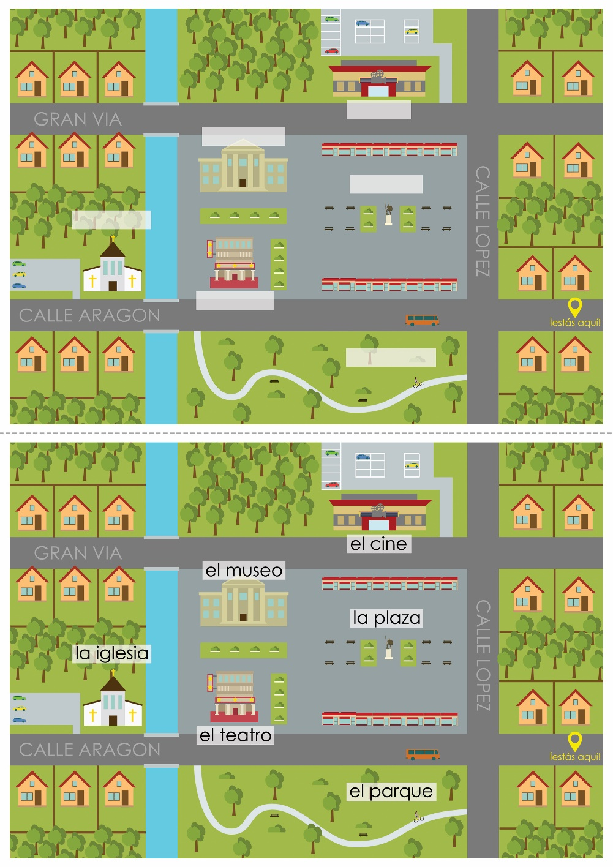
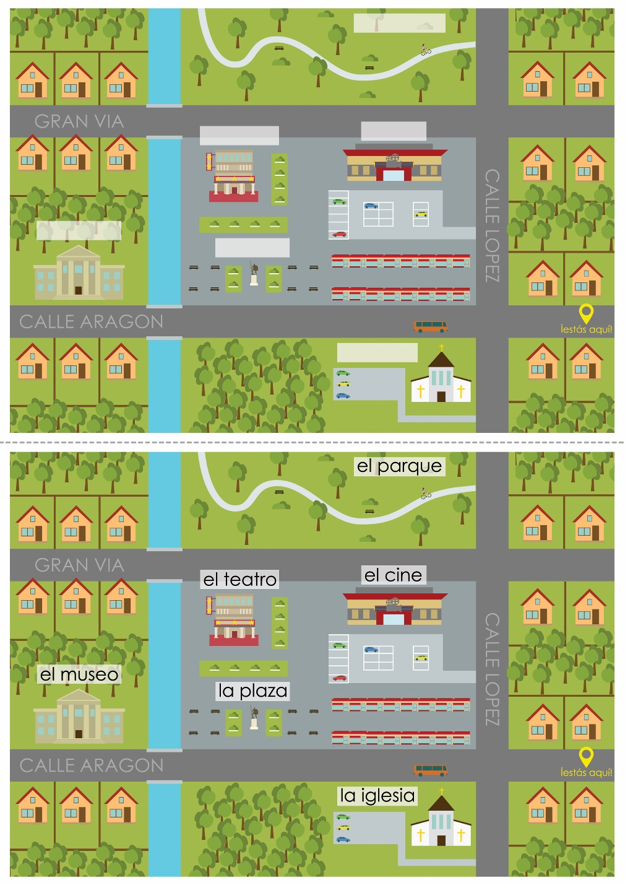
Notes:
Maps to accompany the Q&A
There are two so as to swap roles and repeat the task.

Slide 33
Sentence-level production tasks [3]
1
cerca de / la plaza
2
ser / el teatro
3
la iglesia / el museo
4
pequeño / grande
5
lejos de / el teatro
Notes:
Give two words – pupils create sentences

Slide 34
Developing use
Build in new vocabulary (additional nouns, prepositions of place)
Spot the difference
Map task
Notes:
The sentence-building game added new vocabulary.

Slide 35
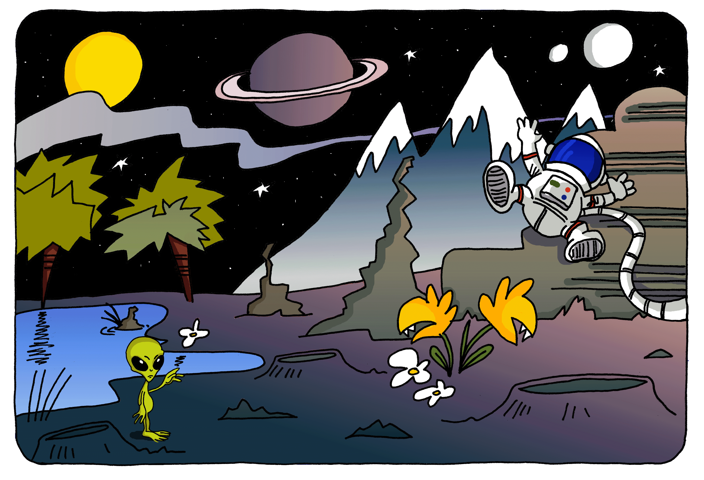
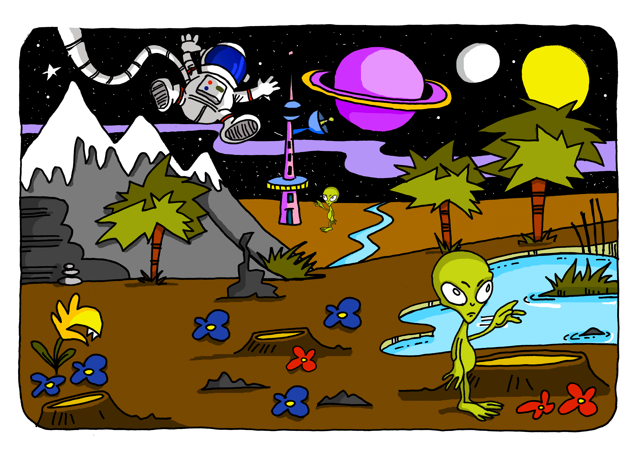
Spot the difference
You and your partner have been travelling separately through time and space and have both landed on a new planet. You phone each other. Ask your partner questions to identify any differences in what you see.
Notes:
When pupils have learnt how to use ESTAR (in 3rd person singular and plural) to describe location, to use HAY to ask what there is / isn’t, and also TENER to ask ‘Do you have?’ or ‘Does it have?’ they are well equipped to use those key verbs to compare and contrast pictures. In addition they will need prepositions, and a few key nouns. lake(s) moon(s) sun(s) flowers (could have colours) trees mountain(s)
Positions to be limited to: on the right/left In the background / foreground In the centre (possibly also next to)

Slide 36
Assessment
Self-assessment checklist
Sentence-level vocabulary test

Slide 37
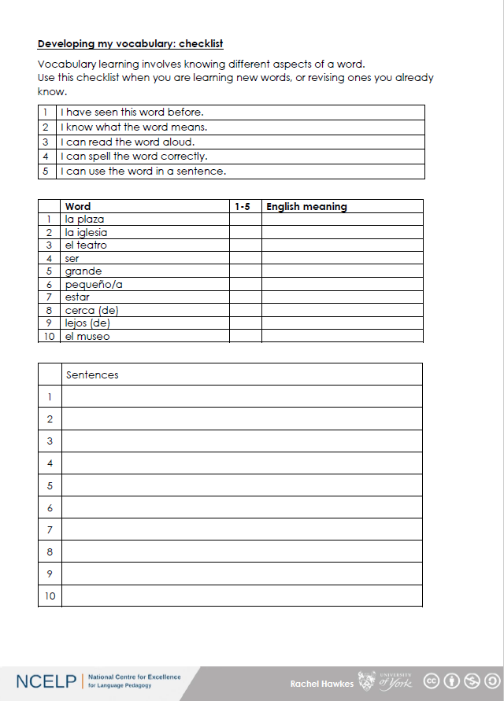

Slide 38
1
The museum is near to the church.
2
The museum is small.
3
The church is large.
4
Is the theatre far away?
5
No, it is near the square.
Notes:
English sentences for translation

