Slide 1
GRAMMAR
Weak verbs in the present tense:
‘I’ or ‘s/he’
Y7 German - Term 1.2 - Week 2 - Lesson 17
Elinor Parks / Rachel Hawkes
Notes:
arbeiten [200] putzen [2851] kochen [1005] sitzen [261] das Auto [490] zu Hause [6/159] der Garten [959] der Boden [445] die Liste [1975] das Zimmer [609]

Slide 2
Knowing who does what: Weak verbs: ‘I’ versus ‘s/he’
In German, the verb ending often tells us who is doing the action.
Compare:
Remember: the infinitive is the dictionary form. It tells you ‘what’ but not ‘who’.
Infinitive
singen
= to sing
s/he
Sie / er singt
= S/he sings
I
‘Weak’ is another word for ‘regular’.
Ich singe
= I sing
So, for weak German verbs:
For ‘s/he’, remove –en and add –t.
lernen →
lern- →
sie/er lernt →
s/he learns
sagen →
sag- →
ich sage →
I say
For ‘I’, remove –en and add –e.
Notes:
Last lesson students were taught about the infinitive form and the s/he form. This week, we vary the vocabulary/lexicon and context, whilst adding the 1st person singular ‘I’ form.
Individual pieces of text are animated to allow teachers to elicit/revisit knowledge from last week, before adding the new information.

Slide 3
Wolfgang und Mia sind Zwillinge (twins).
lesen
Wer macht was in der Schule?
 | Wolfgang sagt:
1
2
3
4
5
6
7
8
9
Wolfgang oder Mia? Schreib W oder M.
W
singe ein Lied.
Wolfgang redet.
macht Sport.
Ich …. aber sie…
rede mit Freunden.
hört Englisch im Unterricht.
lerne Mathe in der Schule.
spiele Gitarre.
schreibe Musik.
denkt viel.
macht Hausaufgaben.
Notes:
Emphasize the information in the speech bubble, i.e. that Wolfgang is speaking, so he uses ‘ich’ to talk about himself and ‘sie’ to talk about Mia.
Verb frequency rankings: denken [124] das Englisch [628] der Freund [327] hören [1557] lernen [203] das Lied [1726] machen [49] die Mathematik [1827] die Musik [469] reden [356] schreiben [245] die Schule [208] singen [979] spielen [197] der Sport [845] der Unterricht [1107] viel [60] Hausaufgaben [159/317]

Slide 4
Antworten
 | Wolfgang sagt:
1
2
3
4
5
6
7
8
9
Wolfgang
Mia
W
singe ein Lied.
Ich …. aber sie…
M
macht Sport.
rede mit Freunden.
W
M
hört Englisch im Unterricht.
W
lerne Mathe in der Schule.
spiele Gitarre.
W
schreibe Musik.
W
M
denkt viel.
M
macht Hausaufgaben.

Slide 5
hören
Ich …. aber er…
Und zu Hause?
 | Mia redet: = ‘ich’ | Wolfgang = ‘er’
Who makes pizza?
Who plays on the computer?
Who cleans the car?
Who makes the bed?
Who dances?
Who sits in the garden?
Who works in the garden?
Who writes a list?
Who sings often?
Mia oder Wolfgang? Schreib M oder W.
1
✔
2
✔
3
✔
4
✔
5
✔
6
✔
7
✔
8
✔
9
✔
Notes:
Und zu Hause? (Zu Hause is part of this week’s vocabulary set – Elicit the meaning from students for clarity).
Transcript.
Note: Pronouns are ‘beeped’ out to trap the form, i.e. focus learners only on the verb ending to give the meaning ‘I’ or ‘s/he’.
Er macht Pizza. / 2. Ich spiele am Computer. / 3. Er putzt das Auto. / 4. Er macht das Bett. / 5. Ich tanze. / 6. Ich sitze im Garten. / 7. Er arbeitet im Garten. / 8. Er schreibt eine Liste. / 9. ich singe oft.
It might be good to give item-by-item feedback with each one, reminding students to focus on the –t or –e sound at the end of the verb.
Once all the answers are displayed the teacher could elicit the full German phrase for each answer from students, as a first, structured production activity.
Teacher: Wer macht Pizza? Students: Wolfgang Teacher: Ja, wie sagt man ‘He makes Pizza’ auf Deutsch? Students: Er macht Pizza.
Students could then be asked to decide who helps at home (wer hilft zu Hause?)

Slide 6
Wer macht was zu Hause?
sprechen
Tennis
gut
machen arbeiten reden sitzen
singen spielen wohnen putzen kochen schreiben lernen sagen haben sein
Ich Er / Sie
oft
Deutsch
nichts
im Garten
den Boden
Remember: you have to change the verb ending to say ‘who’ does the action.
das Zimmer
in Leipzig
‘Ja!’
Curry
ein Haustier
ein Lied
Notes:
Pairwork activity to develop more fluent production whilst still activating grammar knowledge and focusing on meaning. Partner A: Creates an English sentence that can be made from a combination of the options given (using grammatical knowledge of verb endings, and lexical knowledge of vocabulary provided). S/he tries to use each verb and each item in the circle once. S/he crosses them off on his/her sheet to keep track. When s/he runs out of possible combinations, partners swap roles. Partner B: Translates the sentence into German (developing speed of retrieval and word production / pronunciation)
Note: Most verb forms can go with more than one option.
Differentiation: If vocabulary is already well known, Partner B can challenge him/herself to produce the sentences without reference to the sheet.
Plenary: Teachers can use this slide to create sentences in English for students to translate into German on mini whiteboards. (Alternatively, students can volunteer English sentences for the class to write in German)
Additional, more challenging plenary on the following slide.

Slide 7
schreiben
Wer macht was?
Articles: ‘the’ or ‘a’? Remember that masculine nouns change their article after these verbs : der → den ein → einen
football friend water world word pet house car garden floor list room at home
Schreib auf Deutsch.
I clean
she sits
he cooks
I work
I have
1
2
3
4
5
Notes:
Alternative / additional plenary (assessment)
Students write a sentence, adding one additional element (beyond the pronoun and verb). Remind them of English translations of nouns we are revising this week, and that any masculine nouns that follow these verbs will change their article (der → den, ein → einen) They write without reference to resources. This assesses retention of key vocabulary from Week 5 and 1.2.3, as well as grammatical knowledge of verb endings. In addition, the past half-term’s learning of noun gender, definite and indefinite articles, and Row 2 accusative are assessed.
Week 5 vocabulary haben [7] hat [7] wer? [173] der Lehrer [433] der Fußball [1497] der Freund [326] das Wasser [297] die Welt [190] das Wort [243] nicht wahr? [14/662] das Haustier [>5000] das Haus [159] Note that 6 of these words were built into this week‘s lessons, as well. Term 1.2, Week 2 vocabulary arbeiten [200] putzen [2851] kochen [1005] sitzen [261] das Auto [490] zu Hause [6/159] der Garten [959] der Boden [445] die Liste [1975] das Zimmer [609]

Slide 8
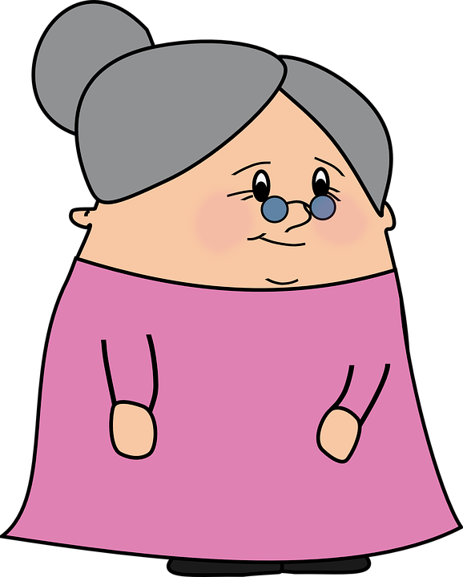
Wer arbeitet zu Hause?
sprechen / hören
Oma (granny) says Wolfgang and Mia don’t help at home.
Partner A: You are Mia. Tell your granny what you (me) and your brother (he) do at home.
Partner B: Make a note of who does what, according to Mia.
Notes:
Elicit the meaning of the TL title. All language has been previously taught. Instructions here are given in English, for clarity. Information gap tasks can be tricky to explain.

Slide 9
Partner A
sprechen / hören
me
work in garden
2. me
clean floor
3. he
play guitar
4. he
sing
5. he
do sport
6. me
make the bed
7. me
clean the room
8. he
sit in the garden

Slide 10
sprechen / hören
Partner B – Write who does what. Write 1-8, ‘Mia’ or ‘he’ and the activity.
1
2
3
4
5
6
7
8
Notes:
Note: This slide does not need printing. Students write 1-8 in their books and complete the activity.

Slide 11
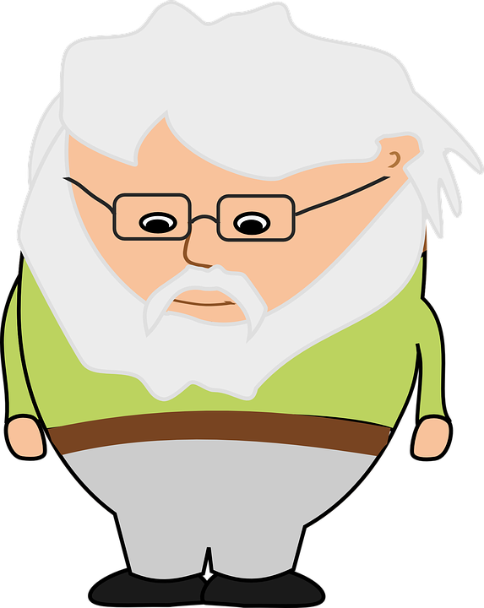
Das ist falsch!
Das ist falsch!
Opa (grandpa)arrives.
He says he and Oma do it all.
Partner B: You are Opa. Say what you do (me) and what Oma does (she).
Partner A: Make a note of who does what, according to Opa.

Slide 12
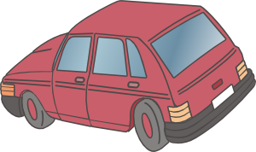
Partner B
sprechen / hören
me
clean car
2. she
cook
3. she
clean the floor
4. me
sit in the garden
5. me
write a list
6. me
make the bed
7. she
works in the garden
8. me
work on computer

Slide 13
sprechen / hören
Partner A – Write who does what. Write 1-8, ‘Opa’ or ‘she’ and the activity.
1
2
3
4
5
6
7
8
Notes:
Note: This slide does not need printing. Students write 1-8 in their books and complete the activity.

Slide 14
schreiben
Wolfgang oder ich (Mia)
Schreib auf Deutsch.
E.g. He makes the bed →
Er macht das Bett.
Er macht
1) ______ ________ das Bett.
2) ______ ________ Nudeln.
3) ______ ________ im Garten
Ich bin Mia.
4) ______ ________ am Computer.
5) ______ ________ Sport.

Slide 15
Antworten
Wolfgang und ich
Er macht
1) ______ ________ das Bett.
Ich bin Mia.
Er kocht
2) ______ ________ Nudeln.
Ich sitze
3) ______ ________ im Garten.
Ich arbeite
4) ______ ________ am Computer.
Er macht
5) ______ ________ Sport.
Nick Avery / Emma Marsden / Rachel Hawkes

Slide 16
Wer macht was zu Hause?
Use ‘und’, ‘oder’ or ‘aber’ to join ideas together and write longer sentences.
Schreib einen Text auf Deutsch.
Write 10 sentences explaining who does different activities at your home.
Use at least eight different verbs.
arbeiten
sitzen
putzen
kochen
machen
spielen
schreiben
lernen
denken
reden
Notes:
Production task – who does what in your house…. This could also be a homework task

