Slide 1
Identität:
eine neue Sprache lernen
Year 10 Term 1.1 Week 3 Lesson 3
Hilary Potter, Heike Krüsemann, Janine Turner
Date updated: 15/02/2023
Notes:
Artwork by Steve Clarke. All additional pictures selected are available under a Creative Commons license, no attribution required.
Native-speaker teacher feedback provided by Stephanie Cross.
Learning outcomes:
Revisit compound nouns
Revisit word patterns 1&2 Haupt- & Lieblings-
Revisit definite and indefinite articles R2 (acc.)
Revisit present tense weak verbs; irregular verb HABEN
Revisit negation: nicht + adjective/adverb, definite article, possessive adjectives, proper nouns
Revisit kein + indefinite article
Revisit Plural rules 4-6
Phonics:
long and short [a]
[link to grammar: haben]
[a] vs [ä]|[u] vs [ü]|[o] vs [ö]
[link to grammar: plural rule 4]
New vocabulary: beantworten [1865] Aktion¹ [1838] Artikel [1378] Bedeutung [484] Gespräch [517] Reihe [738] Satz [432] Sinn [380] Unterschied [632] anders [303] betonen (H) [782] bilden¹ (H) [315] klingen (H) [700] merken (H) [566] unterrichten (H) [3188] Ausdruck (H) [970] Begriff¹ (H) [569] Übung (H) [1434] deutlich (H) [302] international (H) [426] verschieden (H) [254]
Revisited vocabulary: - Thematic revisited vocabulary: ankommen¹ [653] hören [146] sagen [40] schreiben¹ [184] üben [1928] übersetzen [1765] wiederholen [988] Abend [342] Antwort (auf^{acc.} + noun) [522] Aufgabe [256] Bild [253] Blatt [1270] Buch [300] Fehler [861] Frage [157] Hobby [3608] Interview [931] Kind [133] Lied [1733] Sache [318] Vergangenheit [1196] Vorteil [983] Wand [828] Wort [194] falsch [524] fremd [859] nahe, nah [480] richtig [177] schwierig [580] jetzt [72] plötzlich [456] unten [710] vorne, vorn [785] Gegenwart (H) [1932] doch (H) [73]
Revisited function words: haben, hast, hat, man, nicht, der, die, das, ein, eine, kein, keine, Haupt-, Lieblings-
Source: Jones, R.L & Tschirner, E. (2019). A frequency dictionary of German: Core vocabulary for learners. London: Routledge.
The frequency rankings for words that occur in this PowerPoint which have been previously introduced in NCELP resources are given in the NCELP SOW and in the resources that first introduced and formally re-visited those words.
For any other words that occur incidentally in this PowerPoint, frequency rankings will be provided in the notes field wherever possible.

Slide 2
Vokabeln
Auftakt
Finde die passenden Wörter aus A und B.
A B
hören
present
Sache
sagen
at/to the front
down
ankommen
unten
thing
evening
right/correct
Gegenwart
schreiben
write
richtig
Abend
say/tell
arrive
hear/listen
vorne
Notes:
Timing: 3 minutes (two slides)
Slide 1/2
Aim: to revisit remaining vocabulary from this week.
Procedure:
In pairs or individually, students select a word from circle A and match its correct translation in circle B. Note: German vocabulary in orange is Higher only. An answer has not been given in English as this would identify the matching word without students having to identify it for themselves. Foundation students are not required to find the match for this but may if they so wish.
Move to the next slide to elicit answers orally in German after 3 minutes.

Slide 3
Antworten
Auftakt
Englisch | Deutsch
to arrive, arriving | ankommen
to hear, listen | hören
to say, tell | sagen
to write, writing | schreiben
(the) evening | der Abend
(the) thing | die Sache
at/to the front | vorne
down, downstairs, below | unten
right, correct, correctly | richtig
(the) present | die Gegenwart
Notes:
Slide 2/2 (Answers)
Procedure:
1. Elicit the answers from students in German, chorally.
2. Click to reveal the written answer.

Slide 4
Vokabeln [1/2]
schreiben
Füll die Lücken aus und benutz die Wörter da unten:
1 | Ich sitze in der ersten _______ ________ | I sit in the first row at the front.
2 | Wir haben _________ Aufgaben | We have got different tasks.
3 | Wir beantworten die Fragen nicht | We won’t ________ the questions.
4 | Wer will uns unterrichten? | Who wants to ________ us?
5 | Jede ________ hat eine Folge | Every action has a consequence.
1 | Ich sitze in der ersten Reihe vorne | I sit in the first row at the front.
2 | Wir haben verschiedene Aufgaben | We have got different tasks.
3 | Wir beantworten die Fragen nicht | We won’t answer the questions.
4 | Wer will uns unterrichten? | Who wants to teach us?
5 | Jede Aktion hat eine Folge | Every action has a consequence.
Aktion, verschieden vorne,
Reihe
answer, teach
Notes:
Timing: 4 minutes
Slide 1/2
Aim: to revisit remaining new vocabulary from this week, applying it in context. This activity allows for translation practice into and out of German with a focus solely on vocabulary.
Procedure:
1. Students read the source text and target text sentences and then select the missing vocabulary from the box to complete the translation. Even sentences (2, 4, 6, 8 ,10) are higher tier only. Foundation tier students are not expected to complete them but may do so if they wish. By switching between German and English translations students are required to focus on the vocabulary but without just spotting the word. Students will also need to conjugate some of the verbs/decline the adjective correctly.
2. Click to reveal the written answers.
3. Move to the next slide (slide 4) and repeat the procedure for the remaining 5 sentences.

Slide 5
Vokabeln [2/2]
schreiben
6 | Merkst du das? Dieser Ausdruck klingt lustig. | Do you notice that? This expression sounds funny.
6 | __________du das? Dieser ________ ________ lustig. | Do you notice that? This expression sounds funny.
7 | Dieser Satz ist kurz | This __________ is short
8 | Ich muss ________ ________, wie international unsere Klasse ist. Wunderbar! | I have to stress clearly how international our class is. Wonderful!
9 | Welche Bedeutung hat dieses Wort? | What is the _________ of this word?
10 | Wir bilden Sätze aus den neuen Wörtern. | We’re ________ sentences from the new words.
7 | Dieser Satz ist kurz | This sentence is short.
8 | Ich muss deutlich betonen, wie international unsere Klasse ist. Wunderbar! | I have to stress clearly how international our class is. Wonderful!
9 | Welche Bedeutung hat dieses Wort? | What is the meaning of this word?
10 | Wir bilden Sätze aus den neuen Wörtern. | We’re forming sentences from the new words.
Deutlich, Ausdruck, merken, klingen,betonen, international
form, sentence, meaning
Notes:
Slide 2/2

Slide 6
Plural rules 4-6
Grammatik
Remember: die is the plural word for ‘the’ for all nouns.
Remember these plural rules:
das Blatt die Blätter
Rule 4
Add –er at the end of masculine/neuter nouns
(with or without an umlaut).
Rule 5
Add – s on nouns borrowed from other languages.
das Interview die Interviews
Add – nen on all female person nouns.
die Lehrerin die Lehrerinnen
Rule 6
Notes:
Timing: 1 minute
Aim: to revisit plural rules 4-6
Procedure:
Cycle through the plural rules and examples.
Address any questions the students may have about plural rules.

Slide 7
[a] oder [ä]?
Phonetik
Kennst du noch das kurze [a]?
Sag es: [a] [a] [a].
Jetzt übe [ä]
Wiederhole es: [ä] [ä] [ä].
Was ist das?
Was sind das?
Was ist das?
Was sind sie?
eine Wand
ein Blatt
Blätter
Wände
Notes:
Timing: 3 minutes
Aim: to practise SSC pronunciation of a/ä prior to testing the sound spelling correspondence.
Procedure:
1. Teacher reminds students of the short [a] sound.
2. Students say the sound x 3.
3. Teacher clicks to present the [ä] sound.
4. Students say the sound x 3.
5. Click to bring up the prompt for Wand, Blatt, Wände, Blätter and elicit the words from students. Teacher clicks on the picture to hear the audio.

Slide 8
Plural rules 4-6
Grammatik
Wort Kind Hobby Blatt Interview Übersetzerin Lied Bürgerin Bild Buch
Bild, Blatt,
Buch, Kind,
Lied, Wort
Hobby, Interview
Bürgerin,
Übersetzerin
Rule 4
Rule 5
Rule 6
Bilder, Blätter, Bücher, Kinder, Lieder, Wörter
Hobbys, Interviews
Bürgerinnen,
Übersetzerinnen
Notes:
Timing: 4 minutes
Aim: to practise plural rules 4-6 based on the rules revisited.
Procedure:
Students order the nouns according to their plural rule. This stage can be done orally.
Students provide the plural forms of each noun, applying rule 4, 5 or 6.

Slide 9
[o] oder [ö]?
Phonetik
As you know, all vowels can be short (usually before a double consonant) or long (usually before a single consonant, and after ‘r’.)
der Vorteil | die Antwort | vorn | doch
ankommen | die Wörter | das Wort | betonen
plötzlich | hören | die Ostsee | österreichisch
Hör zu und wiederhole.
Hobby
This is short
[o]
plötzlich
This is short
[ö]
Round lips to ‘o’ shape, drop jaw a little.
Make an ‘o’ shape; say the ‘ur’ sound in ‘burn’.
This is long
[o]
This is long
[ö]
wiederholen
hören
Make smaller ‘o’ shape.
Say a longer version of short [ö].
Notes:
Timing: 3 minutes
Aim: to revisit and practise o/ö; to revisit vocabulary from this and previous weeks.
Note: Higher only vocabulary are in dark red font.
Procedure:
Click through the information and elicit pronunciation of each word, encouraging students to follow the pronunciation guidance and notice the sound and feel of the SSC in the mouth, within the different words. Teacher clicks on the examples and circles to hear a native speaker.
Click to bring up the table of words and give students two minutes to pronounce them.

Slide 10
[u] und [ü]
Phonetik
Hör zu und wiederhole.
der Unterschied
This is short
[u]
übt
This is short
[ü]
Say German [u] like the vowel in English ‘do’.
Shape lips as for German [u] but say English [ee].
This is long
[u]
This is long
[ü]
Uhr
üben
Shape lips as for short [u] but say it longer.
Say a longer version of short [ü].
Jetzt sag diesen Satz:
Üben und übersetzen rund um die Uhr!
Notes:
Timing: 2 minutes
Aim: to revisit and practise u/ü; to revisit vocabulary from this and previous weeks.
Procedure:
Click through the information and elicit pronunciation of each word, encouraging students to follow the pronunciation guidance and notice the sound and feel of the SSC in the mouth, within the different words.
Teacher clicks on each circle to play the audio.
Click to bring up the sentence and give students a minute to pronounce it. Click to hear the audio version.

Slide 11
Ein Gespräch
Phonetik
Partner A liest den Text vor und Partner B füllt die Lücken aus.
Partner B liest den Text vor und Partner A füllt die Lücken aus.
Notes:
F/H tier version Runde 1/2 Timing: 5 minutes
Aim: to practise pronunciation and SSC in writing.
Procedure:
Partner A reads out their half of the text whilst Partner B fills in the gaps in their text. (See separate printable worksheet).
Partners swap roles and Partner B reads out their corresponding half of the text whilst Partner A fills in the gaps in their text.
Teacher can move around the room and check on progress.
Together they practise the whole conversation. Use feedback to check comprehension.

Slide 12
Ein Gespräch
Phonetik
Partner A Runde 1
Partner B Runde 1
Lies deinem/deiner Partner*in den Text vor
1. Ich habe eine Frage.
2. Ich sage: was üben wir nächste Woche?
3. Was? „Müssen wir nur einen Satz üben?”
4. „Müssen wir nur einen Satz üben?”
5. Was? Wir gehen nach vorne und schreiben an die Wand?
6. Plötzlich macht mir die Übung Spaβ!
Hör deinem/deiner Partner*in zu und schreib auf Deutsch.
1. Ich _____ eine ______.
2. Ich _______: was ______ wir _______ Woche?
3. Was?
4. _________ wir nur einen Satz ______?
5. Was? Wir gehen nach ______ und schreiben an die _____?
________ macht mir die Aufgabe Spaβ!
Notes:
F/H tier version ANSWERS Runde 1
Procedure:
Click to reveal.

Slide 13
Ein Gespräch
Phonetik
Partner B Runde 2
Partner A Runde 2
Lies deinem/deiner Partner*in den Text vor.
1. Komm nah, ich höre dich nicht.
2. Ich habe die Antwort.
3. Übersetzung.
4. Doch. Wir müssen viele Sätze übersetzen und an die Wände schreiben.
5. Ja
6. Mir auch!
Hör deinem/deiner Partner*in zu und schreib auf Deutsch.
Komm ____, ich _____dich nicht.
Ich ______ die _______.
Übersetzung.
Nein. Wir müssen viele _______ _________ und an die ________ schreiben.
Ja.
Notes:
F/H tier version Runde 2 ANSWERS
Procedure:
Click to reveal.

Slide 14
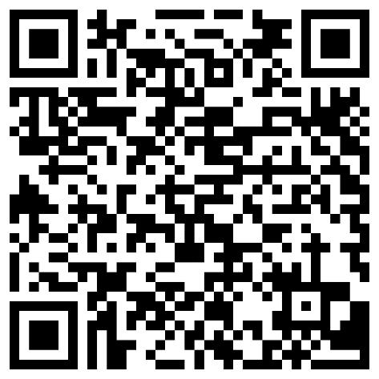
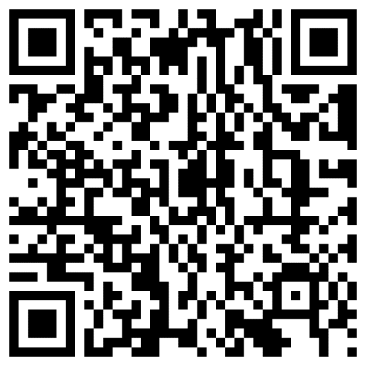
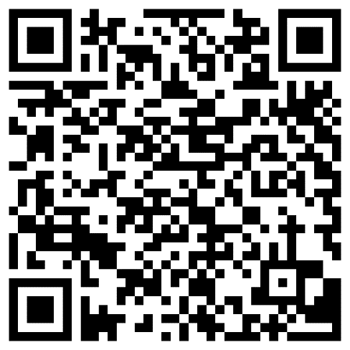
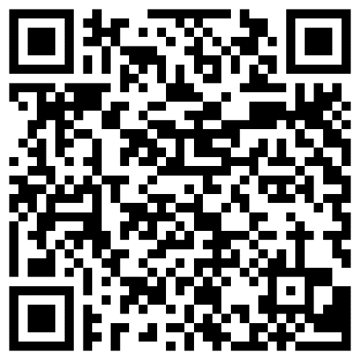
Hausaufgaben- Quizlets
New vocabulary
Revisited vocabulary
Foundation
Higher
Foundation
Higher
Notes:
Note: Lesson 3 of each week’s sequence will often have time for teacher follow up / feedback or consolidation tasks that are appropriate to each group. We will generally leave at least half of the lesson time (e.g., 25-30 minutes) free for teachers to use as appropriate with their classes.
Timing: 2 minutes Aim: to set homework for the following week.,
Note: the vocabulary learning is pre-learning for Y10.1.1 Week 4. Procedure: 1. Display the slide. Explain the tasks. 2. Post this slide or its information for students, using the usual school system for this.
Notes: A regular feature of the scheme of work (as for KS3) is that students spend time learning the vocabulary for the following week’s lessons. This can be done using any platform. We provide the words on Quizlet. Most lists are also available (free to all schools, not just subscribers) on LanguageNut. Teachers may of course create their own versions of vocabulary learning activities in any of the different platforms available. At KS4, there are several sets for learning/revisiting: 1. The new vocabulary for the following week. 2. The revisited thematic vocabulary (from KS3 SOW) assigned to the week. 3. The systematic revisiting (at +3 and +9 weekly intervals) of new vocabulary.
In the KS4 SOW every word from the GCSE vocabulary list has been tracked to ensure that: 1. New words are introduced, revisited twice at intervals during the course, and once again during the final 9-week revision phase. 2. KS3 revisited thematic vocabulary is revisited twice during the course, and once again during the final 9-week revision phase. 3. KS3 function words (listed as R(equired) on Annex E of the GCSE Subject Content are all revisited multiple times (Column D on the KS4 SOW) and the revisits are also tracked on the KS4 Vocabulary tracker.
We anticipate that students will spend on average 2 hours on homework per week at KS4. As a general rule, one hour would be assigned to vocabulary learning (and ideally this time will be spread across the week). The aim at KS3 was to establish a ‘little and often’ approach to vocabulary learning, using an app to facilitate this. This learning habit will hopefully continue into KS4. The 2nd hour will generally include additional reading, listening, speaking tasks. Teachers will be best placed to decide whether to include extended writing tasks for homework. However, given the availability of online translation tools and the strong temptation to use them, such tasks might best be undertaken in class, where teachers can replicate the conditions for written language production that will apply for students at GCSE.

