Slide 1
Making plans
The future tense [revisited]
Revisit several SSC, develop fluency
Y8 German
Term 3.2 - Week 5 - Lesson 67
Author name(s): Heike Krüsemann / Rachel Hawkes
Artwork: Steve Clarke
Date updated: 14 / 01 / 21
Notes:
Artwork by Steve Clarke. All additional pictures selected are available under a Creative Commons license, no attribution required.
Native-speaker teacher feedback provided by Stephanie Cross.
Learning outcomes (lesson 1):
Revisit several SSC Revisit future tense
Word frequency (1 is the most frequent word in German):
8.3.2.5 (introduce) No new words introduced this week
8.3.1.6 (revisit) Baum [1013] Feld [834] Gebäude [1316] Nähe [918] Seite2 [197] Teil [198] Universität [415] bekannt [319] aus1 [37] hinter [269] neben [266] vor2 [50]
8.2.2.4 (revisit) erklären [238] erlauben [963] erzählen [263] gegeben [49] geholfen [338] ihnen [125] uns [75] Geschichte2 [262] Wahrheit [1156] unser [86] ihr3 [28] alleine [267] jedoch [227] ohne [120]
Source: Jones, R.L & Tschirner, E. (2019). A frequency dictionary of German: Core vocabulary for learners. London: Routledge.
The frequency rankings for words that occur in this PowerPoint which have been previously introduced in NCELP resources are given in the NCELP SOW and in the resources that first introduced and formally re-visited those words.
For any other words that occur incidentally in this PowerPoint, frequency rankings will be provided in the notes field wherever possible.

Slide 2
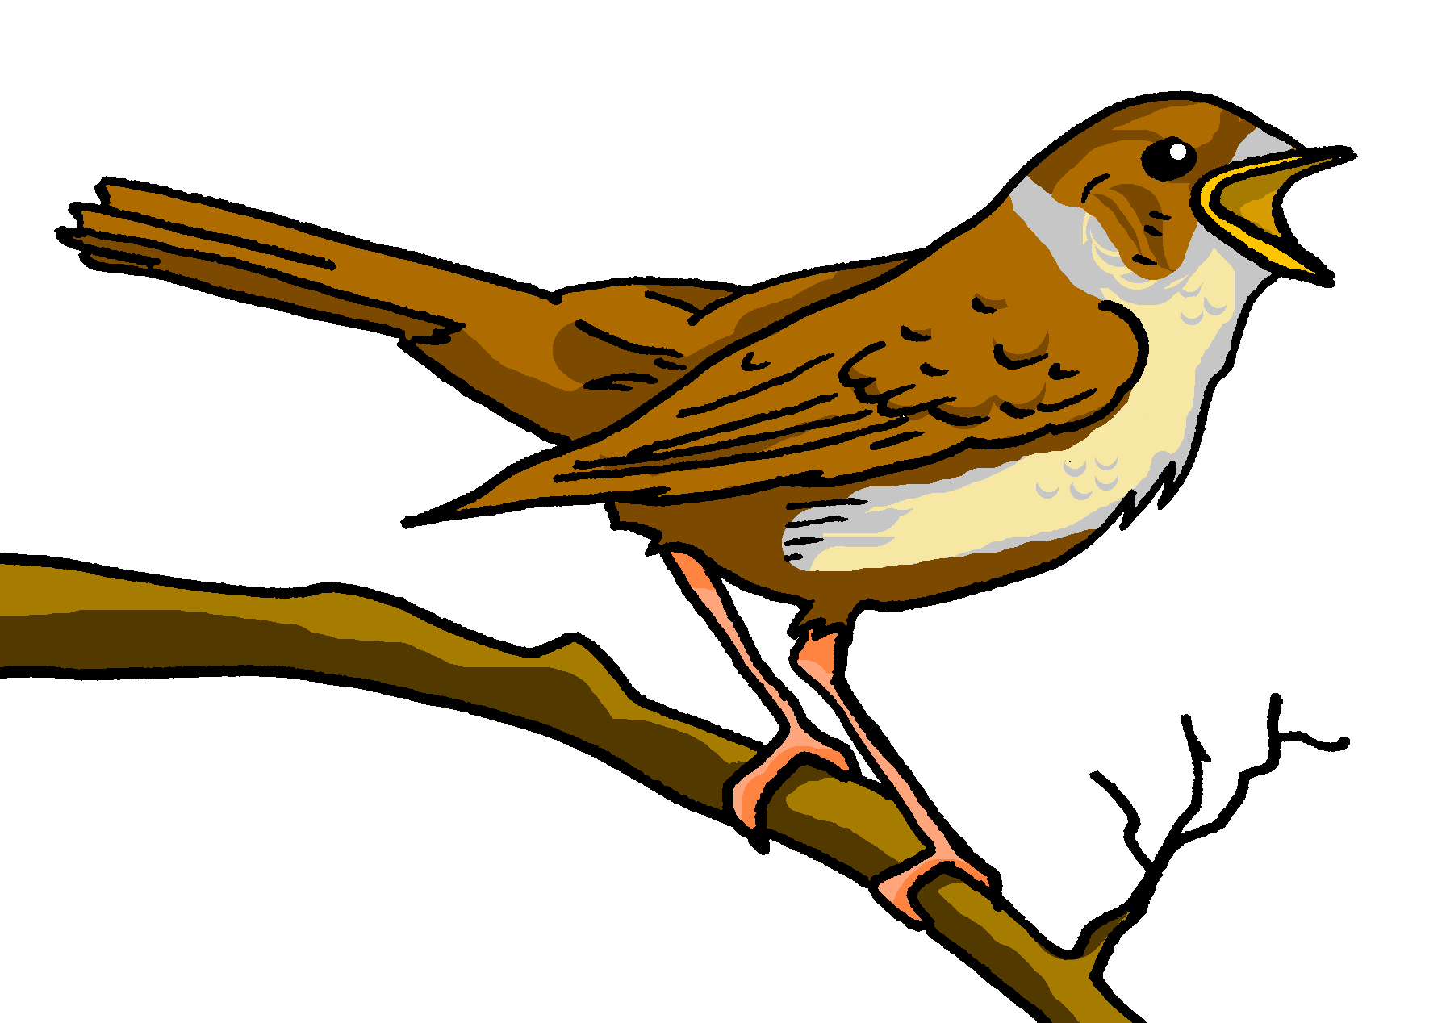
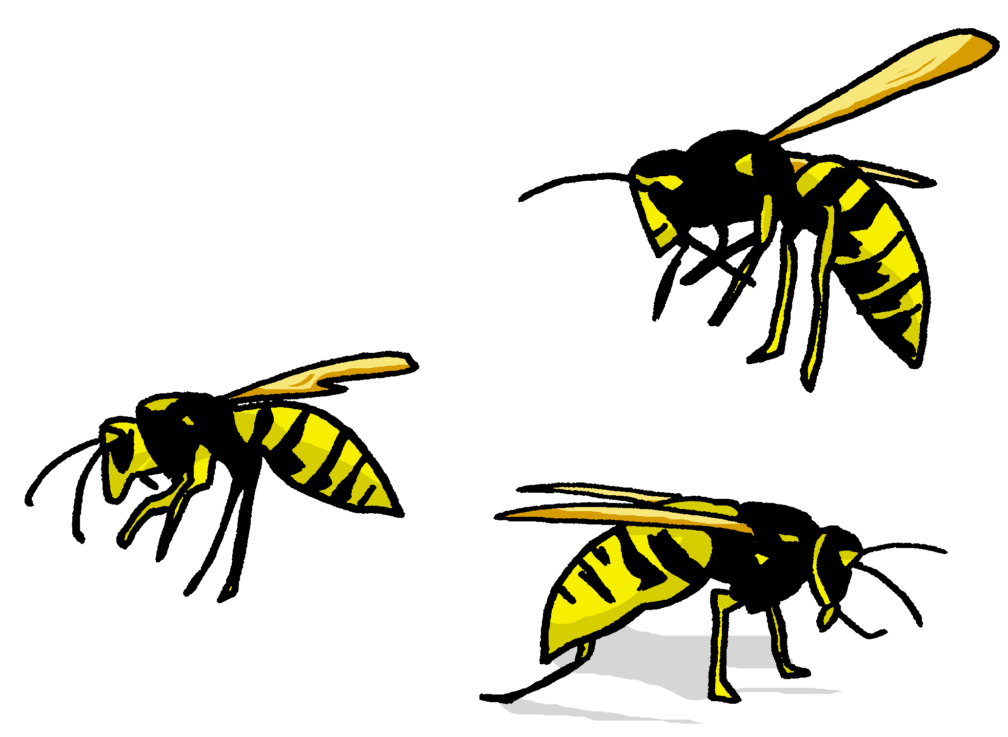
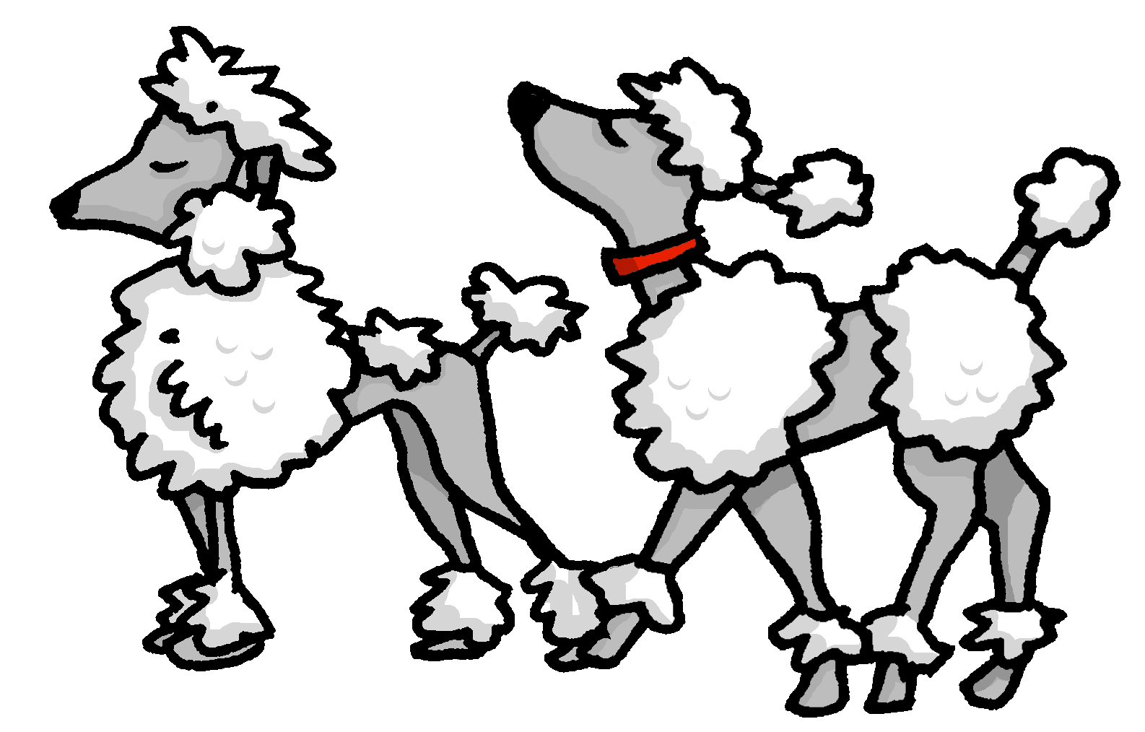
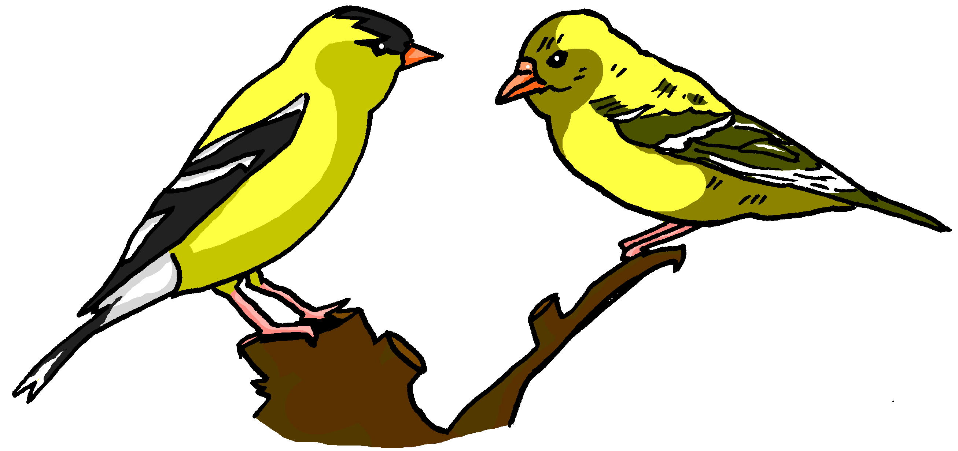
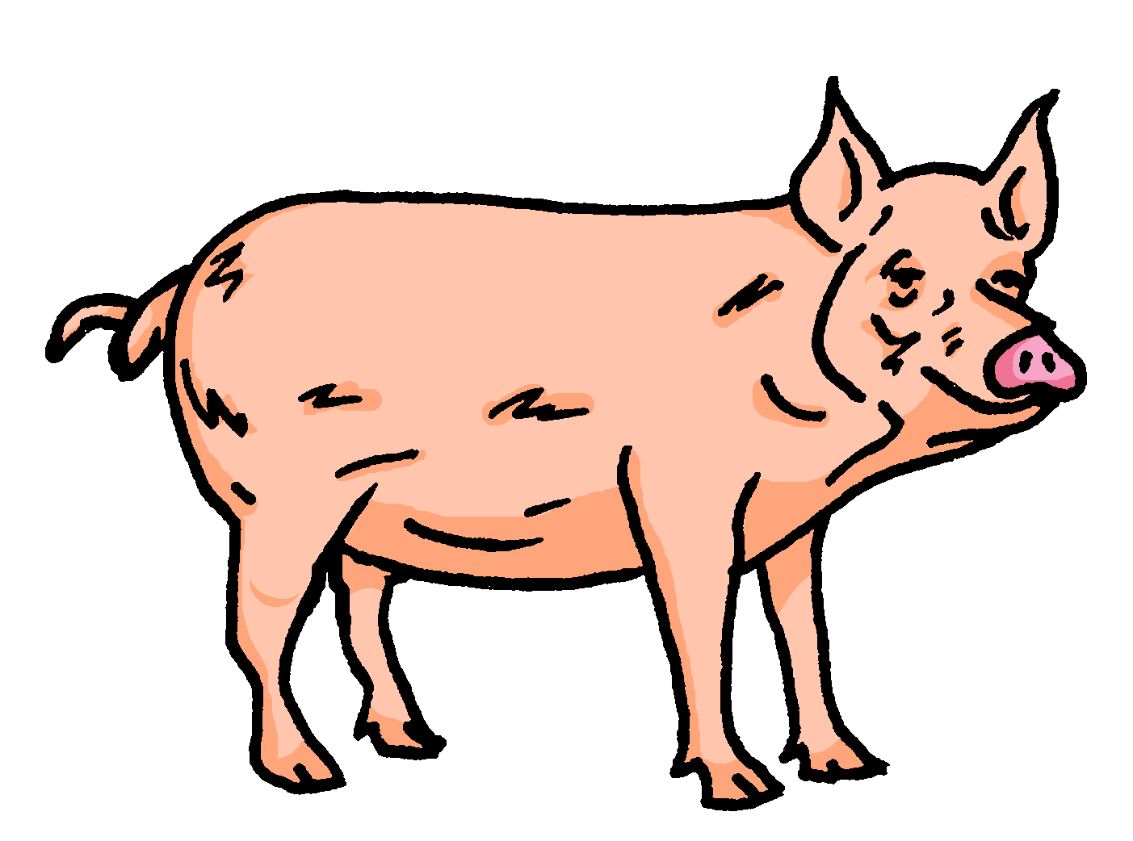
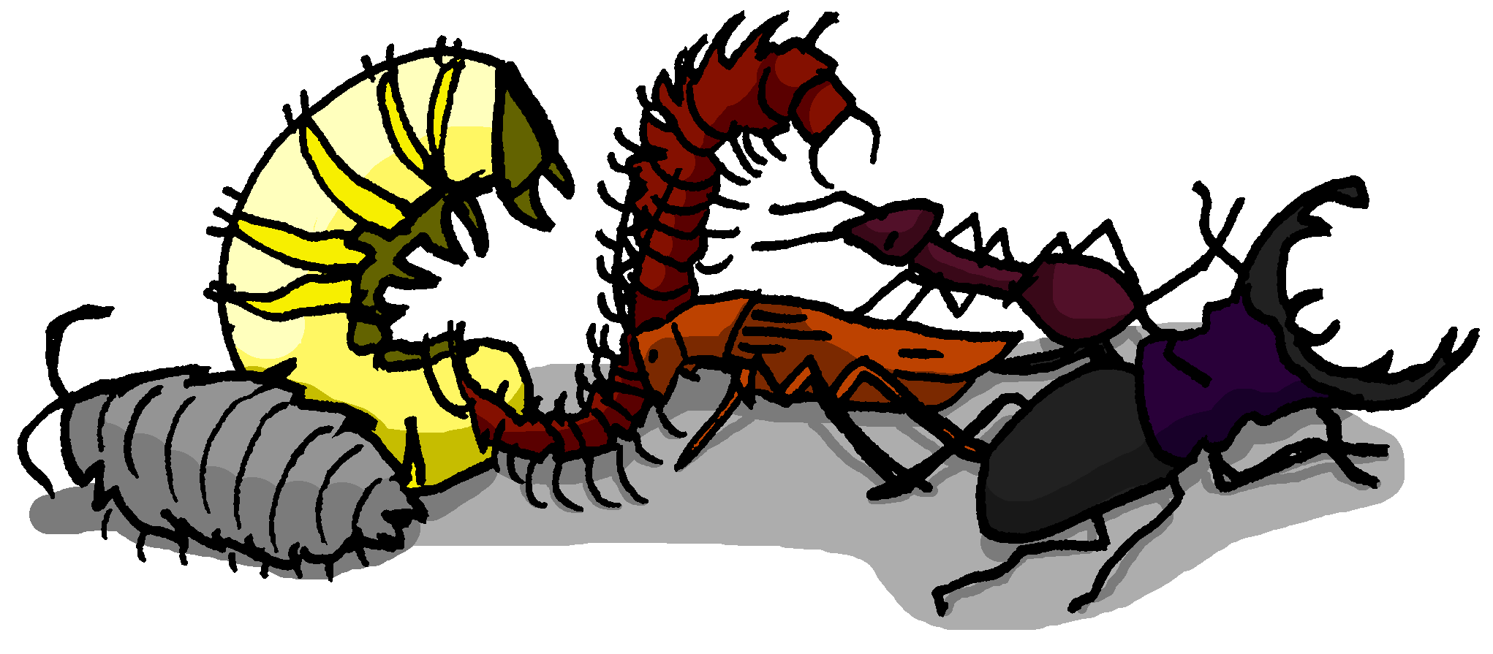
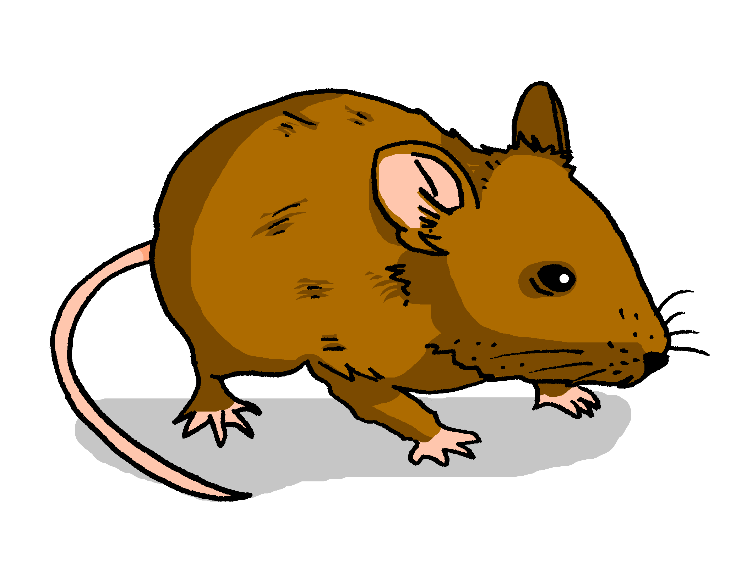
Phonetik
Hör zu. Schreib die fehlenden Wörter auf.
hören / schreiben
Wir geben einen Ball! sagt die Nachtigall,
So? sagt der Floh.
Was werden wir essen? fragen die Wespen
Nudeln! sagen die Pudeln.
Was werden wir trinken? fragen die Finken.
Bier! sagt der Stier.
Nein! Wein! sagt das Schwein.
Wo werden wir tanzen? fragen die Wanzen.
Im Haus! sagt die Maus.
1
_ _ _ _ _ _ _ _ _ _,
2
_ _ _ _.
3
_ _ _ _ _ _.
4
_ _ _ _ _ _.
5
_ _ _ _ _ _.
6
_ _ _ _ _.
7
_ _ _ _ _ _ _.
8
_ _ _ _ _ _.
9
_ _ _ _.
Notes:
Timing: 6 minutes Aim: Revision of SSCs using a light-hearted poem, with a mixture of familiar and unfamiliar language. Note that it is the unfamiliar words that are to be transcribed in this activity. Procedure: 1. Teacher explains/clarifies meaning of any unknown words/cognates. NB: double meaning of ball (same as in English); here it means a ‘big party with dancing’.
2. Teacher elicits anticipated ending of the missing words to fit the rhyme – e.g.1 will end in –all.
3. Click the sound buttons to play the recording for each item in turn.
4. Click again to reveal the missing word, and ensure meaning is clear.
5. For no. 4, explain that the correct plural is Pudel not Pudeln, and that the n is added for the sake of the rhyme.
6. Teacher reads out items, leaving out the last word. Students say the missing word out loud as a group.
7. Repeat for items 2-9.
Transcript: Wir geben einen Ball ! Sagt die Nachtigall,
So ? Sagt der Floh.
Was werden wir essen ? fragen die Wespen
Nudeln ! sagen die Pudeln.
Was werden wir trinken ? fragen die Finken.
Bier ! sagt der Stier.
Nein ! Wein ! sagt das Schwein.
Wo werden wir tanzen ? fragen die Wanzen.
Im Haus ! sagt die Maus.
Word frequency (1 is the most frequent word in German):
Ball [1782], Fink [>5009], Floh [>5009], Maus [3463], Nachtigall [>5009], Nudeln [>5009], Pudel [>5009], Stier [>5009], Schwein [2975], Wespe [>5009], Wanze [>5009] Source: Jones, R.L. & Tschirner, E. (2019). A frequency dictionary of German: core vocabulary for learners. Routledge

Slide 3
Phonetik
Partnerarbeit. Sag die Wörter. Wie schnell kannst du das?
lesen / sprechen
Wir geben einen Ball! sagt die Nachtigall,
So? sagt der Floh.
Was werden wir essen? fragen die Wespen
Nudeln! sagen die Pudeln.
Was werden wir trinken? fragen die Finken.
Bier! sagt der Stier.
Nein! Wein! sagt das Schwein.
Wo werden wir tanzen? fragen die Wanzen.
Im Haus! sagt die Maus.
25
Sekunden
0
LOS!
Notes:
Timing: 4 minutes Aim: A read aloud activity to develop fluency, practising a range of SSC. Procedure: 1. In pairs, students practise reading out the poem as fast as they can.
2. After a practice run, use the timer to challenge students to read the poem aloud in fewer than 25 seconds.
Transcript: Wir geben einen Ball ! Sagt die Nachtigall,
So ? Sagt der Floh.
Was werden wir essen ? fragen die Wespen
Nudeln ! sagen die Pudeln.
Was werden wir trinken ? fragen die Finken.
Bier ! sagt der Stier.
Nein ! Wein ! sagt das Schwein.
Wo werden wir tanzen ? fragen die Wanzen.
Im Haus ! sagt die Maus.
Word frequency (1 is the most frequent word in German):
Ball [1782], Fink [>5009], Floh [>5009], Maus [3463], Nachtigall [>5009], Nudeln [>5009], Pudel [>5009], Stier [>5009], Schwein [2975], Wespe [>5009], Wanze [>5009] Source: Jones, R.L. & Tschirner, E. (2019). A frequency dictionary of German: core vocabulary for learners. Routledge

Slide 4
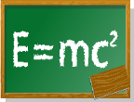
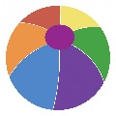
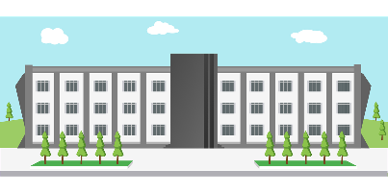
Vokabeln [1/2]
A
G
hören
[in front of]
Hör zu. Schreib das Wort auf Deutsch. Ist das A, B, C…?
B
H
[part]
 | auf Deutsch | A,B..?
 | hinter | J
 | die Universität | F
 | der Baum | A
 | bekannt | E
 | vor | G
 | der Teil | B
 | auf Deutsch | A,B..?
 | das Gebäude | D
 | aus | K
 | das Feld | H
 | die Seite | I
 | die Nähe | L
 | neben | C
C
I
[next to, beside]
[page, side]
1
7
D
J
2
8
[behind]
3
9
E
K
4
10
[well-known, famous]
[out, out of]
5
11
L
F
6
12
[nearby area]
Notes:
Timing: 3 minutes
Aim: to revisit vocabulary from set Y8 3.1.6, as per the SoW cycle of revisiting, in receptive mode, oral and written modality.
Procedure:
1. Give students a minute in pairs to try to look at the pictures and anticipate the vocabulary items they will hear.
2. Click the number triggers to play the audio.
3. Students write the word in German and match to the correct picture
4. Click to bring up the answers.
Transcript:
hinter
die Universität
der Baum
bekannt
vor
der Teil
das Gebäude
aus
das Feld
die Seite
die Nähe
neben

Slide 5
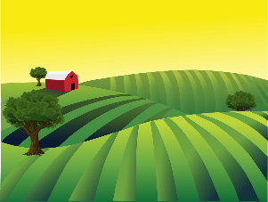
Vokabeln [2/2]
Wir müssen so schnell wie möglich reden!
sprechen
Sag A, B, C… Dein Partner / deine Partnerin muss das Wort auf Deutsch sagen.
A
B
C
D
E
F
[well-known, famous]
[behind]
[out, out of]
[part]
[nearby area]
G
H
I
J
K
L
[next to, beside]
[page,side]
[in front of]
Notes:
Timing: 2 minutes
Aim: to recap vocabulary from set 8.3.1.6, as per the SoW cycle of revisiting, in the productive mode, oral modality.
Procedure:
1. Students work in pairs. One says any letter and the other says the word in German as fast possible. Students take turns.

Slide 6
das Futur
Remember: in German sentences, the first verb goes 2nd, the second verb goes at the end.
Grammatik
As you know, one way to talk about the future in German is to use the present tense of werden and a verb in infinitive:
I will / am going to get up early.
Ich werde früh aufstehen.
You will / are going to help at home.
Du wirst zu Hause helfen.
S/he, it will / is going to go by bike.
Er/Sie/Es wird mit dem Rad fahren.
Note: in English we can say either 'will' or '..going to' for future plans.
Notes:
Timing: 2 minutes
Aim: To revisit the formation of the future tense with the three singular person forms of werden. Procedure: 1. Use the animated sequence to revisit the grammar point.
2. Elicit responses from students, where appropriate. 3. Check understanding at each stage.

Slide 7
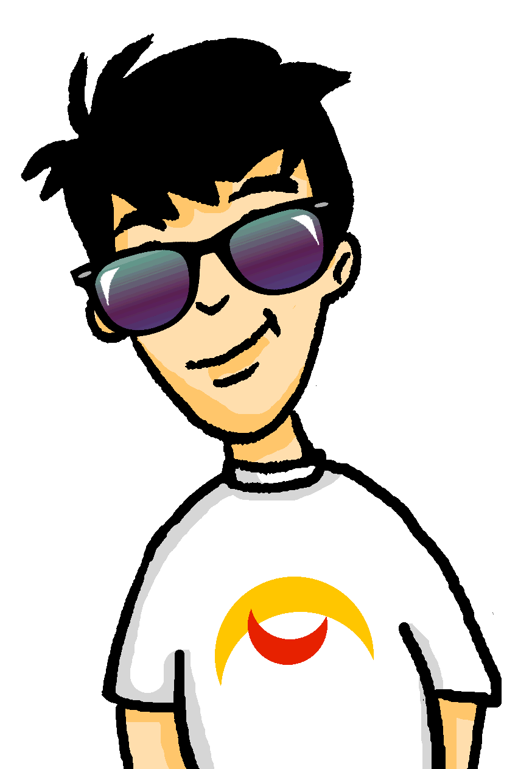
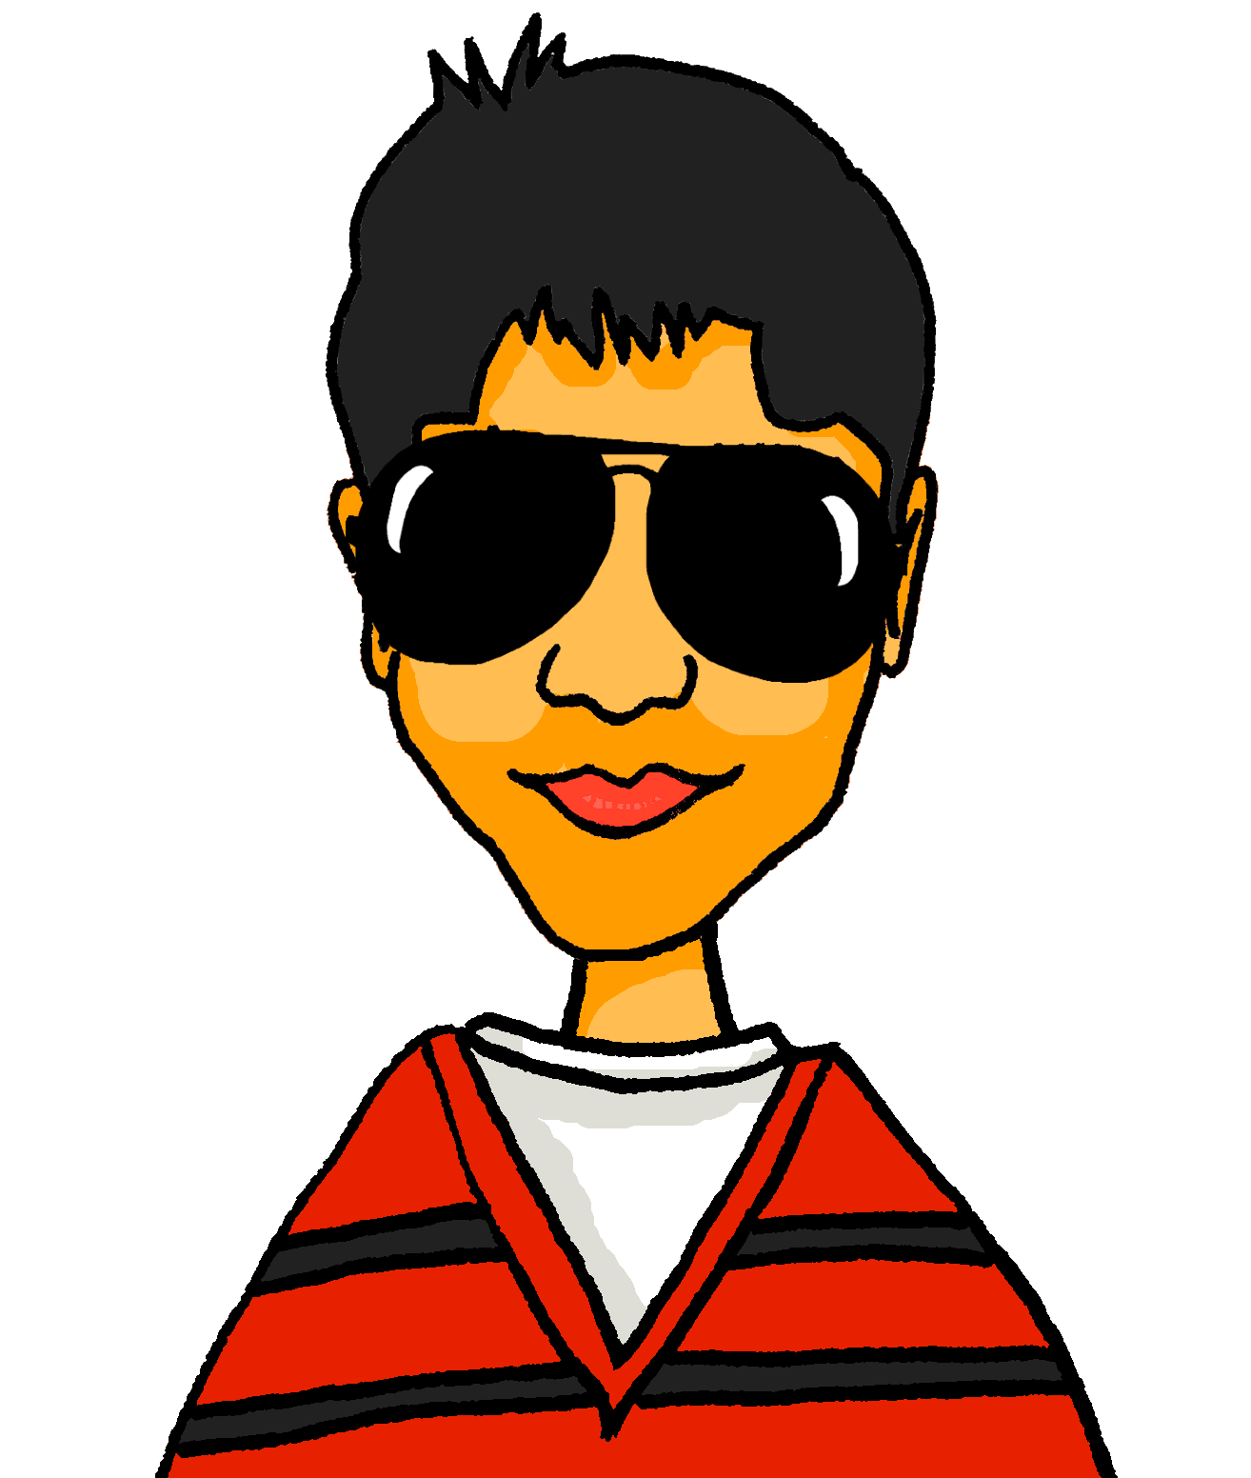
Welche Pläne* haben sie?
lesen / sprechen
* der Plan – plan
Mia redet. Wer wird was machen?
Mia [ich] | Wolfgang [du] | Mehmet [er]
1 | Ich werde Schlagzeug spielen.
2 | Er wird mit dem Bus fahren.
3 | Ich werde mit dem Rad fahren.
4 | Du wirst Basketball spielen.
5 | Er wird Tennis spielen.
6 | Ich werde ins Kino gehen.
7 | Er wird in den Park gehen.
8 | Du wirst mit dem Auto fahren.
[Basketball]
Notes:
Timing: 7 minutes Aim: to practise understanding (in written modality) the three singular persons of werden in the future tense, and to revise some previously taught vocabulary in spoken production. Procedure: 1. Model the first sentence with students, so that they are clear they need to focus on the part of werden to identify the person column, and then the infinitive verb plus three possible pictures to decide the activity, and that the two processes combined enable them to know who is going to do what, and to complete the sentence, orally.
2. Give students 2-3 minutes in pairs to work out the sentences.
3. Conduct oral feedback, eliciting the full sentences from students, before revealing them.
4. Note: one picture is not used in the task. Conclude the task by asking students to generate a sentence. E.g., Du wirst ins Geschäft gehen.

Slide 8
Futuristic present
Grammatik
You know that you can also use the present tense to talk about the future:
Nächste Woche sehe ich einen Film.
Next week I’m seeing a film.
Nächste Woche werde ich einen Film sehen.
Next week I will / am going to see a film.
Use either the present + time adverb or the future tense to talk about future plans.
Always remember to switch the pronoun and verb in a question:
Kochst du morgen?
Are you cooking tomorrow?
Are you going to cook tomorrow?
Wirst du morgen kochen?
Will you cook tomorrow?
When are you going to cook tomorrow?
Wann wirst du morgen kochen?
When will you cook tomorrow?
Notes:
Timing: 3 minutes Aim: To recap the futuristic present alongside the future tense, and how to form questions with both structures. Procedure: 1. Use the animated sequence to introduce the grammar point.
2. Check understanding at each stage.

Slide 9
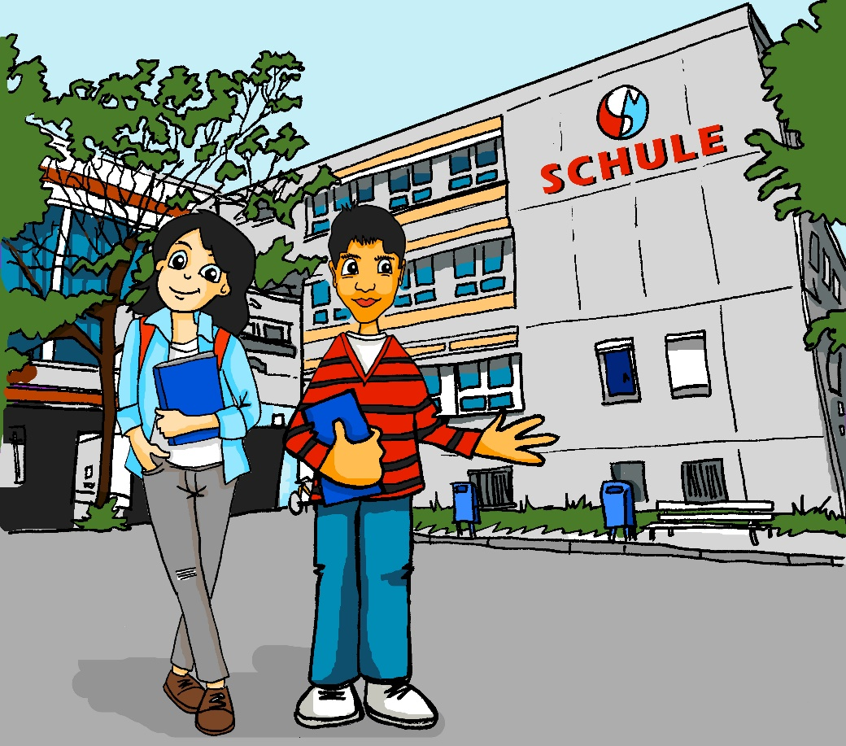
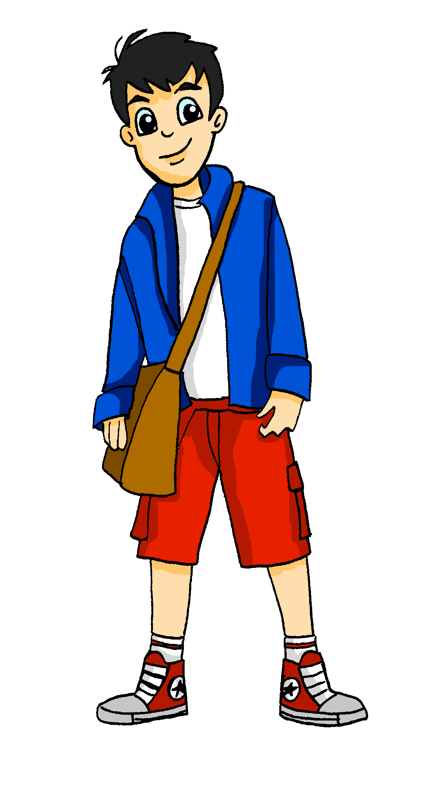
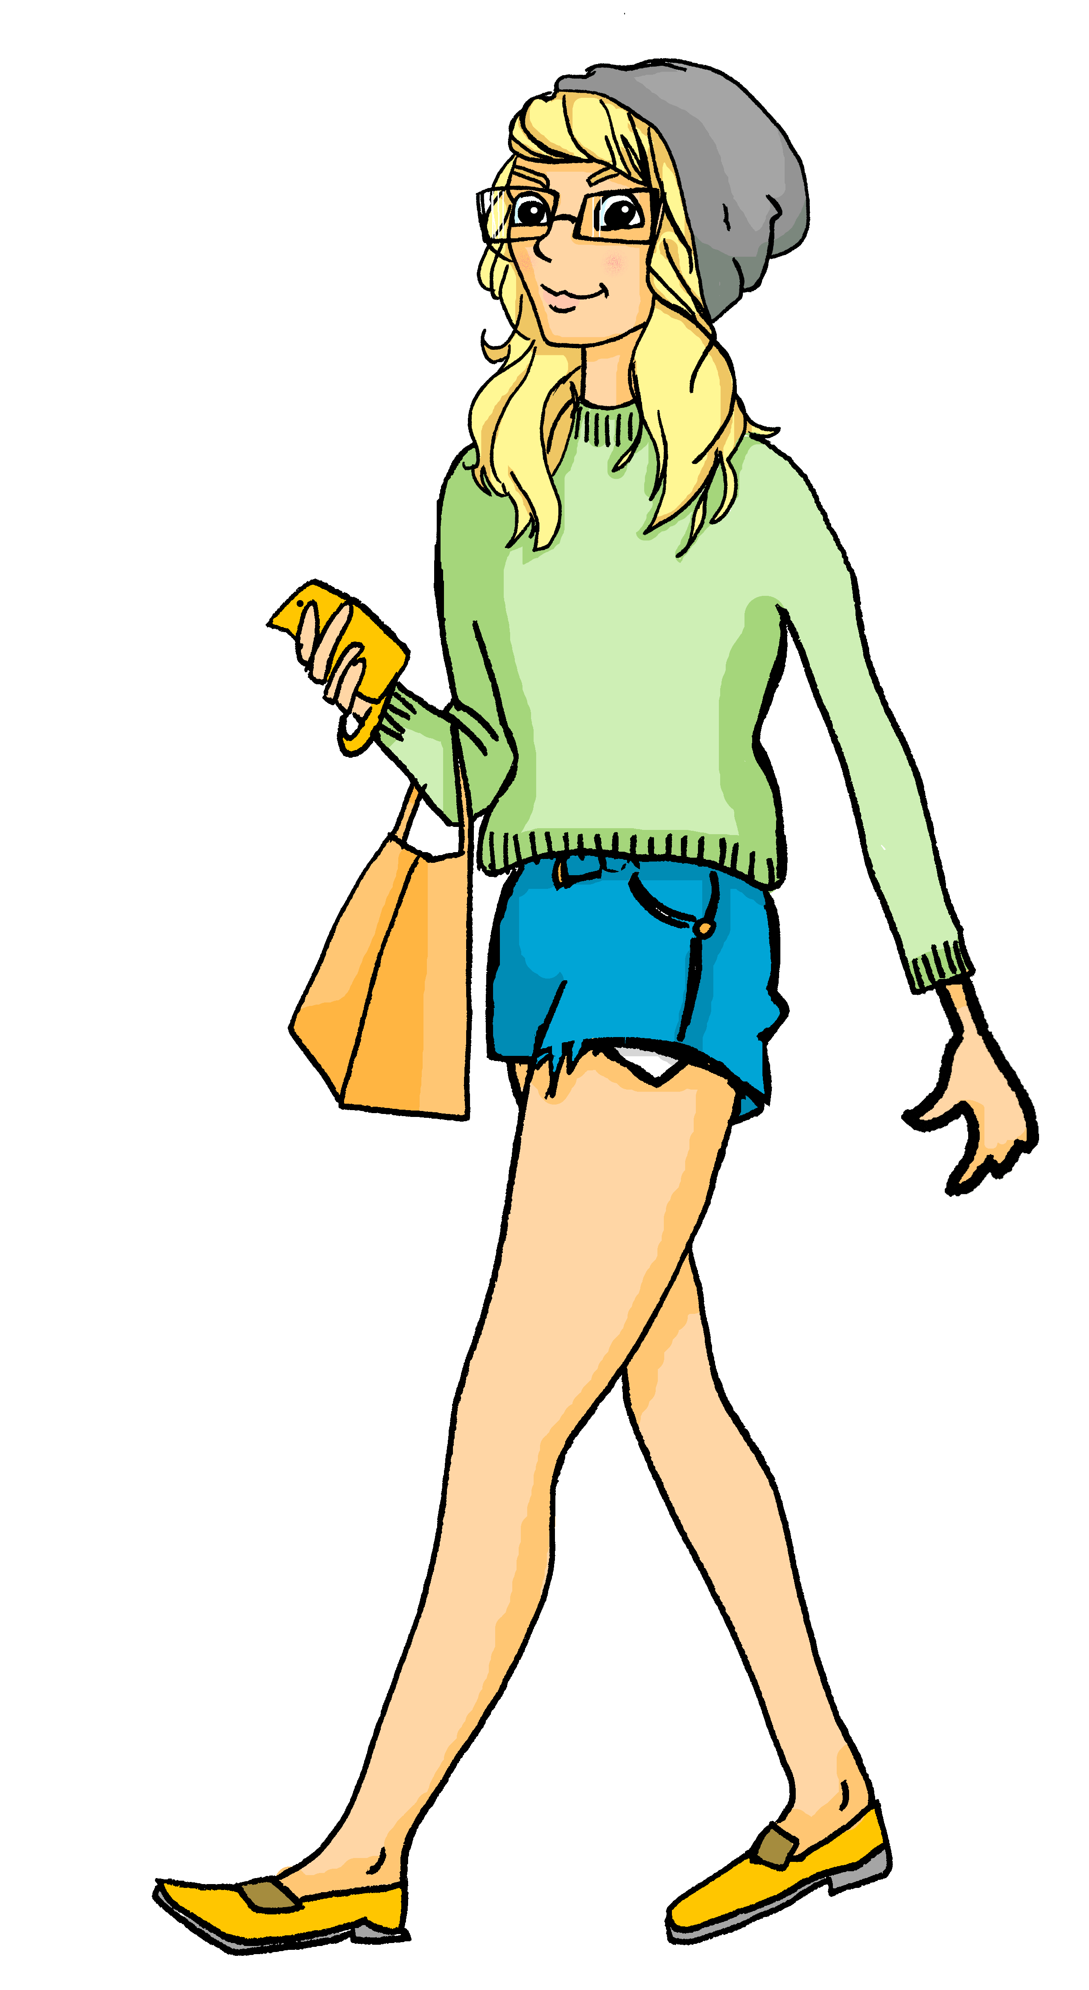
Heute Nachmittag
Ist es –ing oder will/going to?
Dann schreibe wer und was auf Englisch.
hören
Wird Wolfgang Heidi sehen – oder Hausaufgaben machen? Hm…
 | Who? | -ing | will/ going to | What?
 | You |  |  | see Heidi again.
 | I |  |  | see her in 2 hours.
 | we |  |  | go to town.
 | you |  |  | do homework.
 | she |  |  | be in town.
 | I |  |  | be in town with Heidi.
 | I |  |  | start on his own.
 | I |  |  | go to town too.
1
2
3
4
5
6
7
8
Notes:
Timing: 7 minutes Aim: Revision of two the future tense patterns (present/ -ing, v. future /will/going to) and grammatical person recognition. Procedure: 1. Explain that lovey-dovey Wolfgang and Heidi say goodbye for the day after school– but then Wolfgang hears about Heidi’s plans from Mehmet and Mia in this conversation.
2. Play first item by clicking audio button.
3. Students write either –ing (present tense), or will/going to (future tense), and write (in English) who is doing the action/grammatical person of the subject, and what the action is.
4. Click to reveal answer to tense tick.
5. Click again to reveal who is doing the action / grammatical person of the subject.
6. Click again to reveal what the action is.
7. Repeat for items 2-8.
Transcript: 1. [Mehmet]: Wolfgang, morgen [wirst] du Heidi wiedersehen. 2. [Mia]: Ja, aber in zwei Stunden [sehe] ich sie. [Wolfgang]: Was?!!
3. [Mia]: Ja, Wolfgang. Heute Nachmittag [gehen] wir in die Stadt. [Wolfgang] Oh. 4. [Mehmet]: Nein, Wolfgang, du darfst nicht mitgehen! Du hast gesagt, du [wirst] deine Mathehausaufgaben machen! 5. [Wolfgang]: Ja, aber Mia soll mir helfen und sie [wird] in der Stadt sein. 6. [Mia]: Ja, ich [werde] mit Heidi in der Stadt sein. Und du sollst die Hausaufgaben alleine anfangen, Wolfgang!
7. [Wolfgang]: Ok… ich [fange] jetzt alleine an… [Mia] Ja, genau!
8. [Wolfgang]: … aber danach [gehe] ich auch in die Stadt! [Mia]: Wenn’s sein muss, Wolfgang!
Word frequency (1 is the most frequent word in German): Source: Jones, R.L. & Tschirner, E. (2019). A frequency dictionary of German: core vocabulary for learners. Routledge

Slide 10
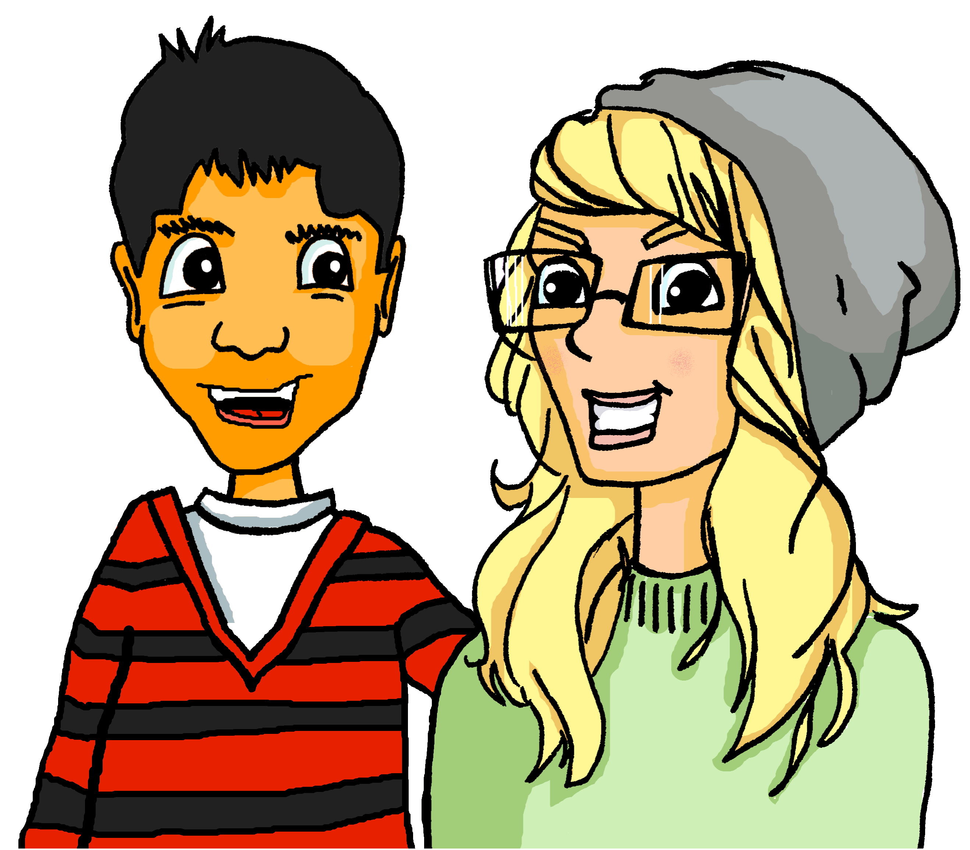
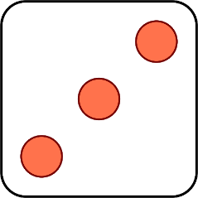
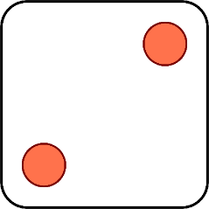
Was für Pläne haben sie?
Remember: will (wollen) – want(s), werden – will
sprechen
Partnerarbeit. Sag Sätze.
1 | She is going to / She will…
2 | He wants to…
3 | Do you want to…?
4 | I’m going to / I will…
5 | Are you going to / Will you…?
6 | I want to…
1 | read lots of books
2 | learn a new instrument
3 | find a job
4 | travel more often
5 | get up early
6 | get (become) fitter
Ich werde viele Bücher lesen.
Sie wird einen Job finden.
Er will ein neues Instrument lernen.
Ich will fitter werden.
Wirst du öfter reisen?
Willst du früh aufstehen?
Notes:
Timing: 5 minutes
Aim: to practise spoken production of future structures, using werden and wollen, revising the awkward semantic overlap between German will (wollen) (English want) and English will (German werden) Procedure: 1. Click to ‘roll’ the dice.
2. Students create the cued sentence. This can be done chorally (i.e., all students speaking at once, not in time).
3. Click to reveal the correct sentence.
4. Repeat until all combinations have been tried. 5. Students then spend two further minutes cueing sentences for each other by giving pairs of numbers, in German. E.g., Student A: zwei – fünf Student B: Er will früh aufstehen.

Slide 11
Was?!
Ich rede online mit Freunden.
schreiben / hören
1
2
3
Ich bin in die Stadt gefahren.
Ich werde ein Instrument lernen.
Partnerarbeit
Beide Partner schreiben drei Sätze. Write one sentence about every week, one about last month and one about your future plans for after the summer. Don’t include a time phrase and jumble the order.
letzten Monat | jede Woche | nach dem Sommer
Beispiel:
Ich werde ein Instrument lernen.
ein Instrument lernen.
Schreib Notizen.
Person A
Person B
Sag den Satz. Benutze ‘du’.
Lies einen Satz vor.
Nach dem Sommer wirst du ein Instrument lernen.
Notes:
Timing: 7 minutes Aim: to model the writing / listening activity. Procedure: 1. Click through the animations carefully to show the steps for the activity. 2. Make it clear that students know they need to swap roles so both share three sentences with the other. 3. Depending on time, students might repeat the activity, ensuring that they write and listen to six sentences each.
Note that students need to copy the headings letzten Montat, jede Woche and nach dem Sommer. There is no answer slide as the activity is open-ended in terms of semantic content. The structure ensures that students have practice in producing and understanding the target structure (future tense) and revisiting present and past (perfect) tenses, too.

Slide 12
3, 2 oder 1?
Lies die Sätze. Welche Optionen passen?
Ein Wort? Zwei oder drei Wörter?
lesen
 |  | Optionen
1 | Das Feld ist in der Nähe.
2 | Sie hat ihnen geholfen.
3 | Er erklärt uns die Geschichte.
4 | Die Katze sitzt auf dem Baum.
5 | Ich bin vor der Universität.
6 | Er erzählt uns jedoch die Wahrheit.
7 | Sie erzählt die bekannte Geschichte.
8 | Das Gebäude ist ein Teil von der Geschichte.
Universität / Gebäude / Baum
Universität / Gebäude / Baum
ihr / unser / uns
ihr / unser / uns
Antwort / Kunst / Hausaufgaben
Antwort / Kunst / Hausaufgaben
gegeben / neben / hinter
gegeben / neben / hinter
hinter / aus / neben
hinter / aus / neben
ihnen / unser / ohne
ihnen / unser / ohne
erlaubt / erklärt / geholfen
erlaubt / erklärt / geholfen
Baum / Seite / Universität
Baum / Seite / Universität
Notes:
Timing: 4 minutes
Aim: to practise the revisited vocabulary from this week in a word substitution task in written modality.
Procedure: 1. Tell students that it could be all three words, two of three, or just one of the three that can replace the underlined words and still make a sentence that makes sense. 2. Give students 30 seconds in pairs to discuss the first one. Teacher says the first sentence with ‘SSS’ option inserted: XXX. Teacher elicits the English translation and asks if the sentence works. Then repeats for the other two options. Students suggest which answers are / are not possible. 3. The answers appears as highlighted correct options. 4. Then give students time to work through questions 2-8 in pairs, orally, noting only 3,2,1.

Slide 13
Making plans
zu + infinitive [revisited]
Revisit several SSC, develop fluency
Y8 German
Term 3.2 - Week 5 - Lesson 68
Author name(s): Heike Krüsemann / Rachel Hawkes
Artwork: Steve Clarke
Date updated: 14 / 01/ 21
Notes:
Artwork by Steve Clarke. All additional pictures selected are available under a Creative Commons license, no attribution required.
Native-speaker teacher feedback provided by Stephanie Cross.
Learning outcomes (lesson 2):
Revisit several SSC Revisit zu + infinitive
Word frequency (1 is the most frequent word in German):
8.3.2.5 (introduce) No new words introduced this week
8.3.1.6 (revisit) Baum [1013] Feld [834] Gebäude [1316] Nähe [918] Seite² [197] Teil [198] Universität [415] bekannt [319] aus¹ [37] hinter [269] neben [266] vor² [50]
8.2.2.4 (revisit) erklären [238] erlauben [963] erzählen [263] gegeben [49] geholfen [338] ihnen [125] uns [75] Geschichte² [262] Wahrheit [1156] unser [86] ihr³ [28] alleine [267] jedoch [227] ohne [120]
Source: Jones, R.L & Tschirner, E. (2019). A frequency dictionary of German: Core vocabulary for learners. London: Routledge.
The frequency rankings for words that occur in this PowerPoint which have been previously introduced in NCELP resources are given in the NCELP SOW and in the resources that first introduced and formally re-visited those words.
For any other words that occur incidentally in this PowerPoint, frequency rankings will be provided in the notes field wherever possible.

Slide 14
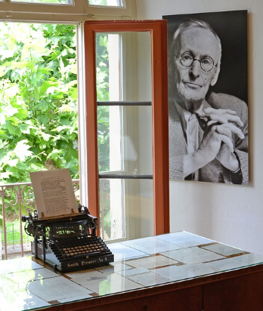
Phonetik
In this scene from the novel Siddharta, by Hermann Hesse, Siddharta wants to leave home, but his father wants him to stay. So Siddharta stands outside his father’s house for several days, waiting patiently for his father to give his blessing for him to leave. This is a dialogue between Siddharta and his father.
sprechen
I will stand and wait.
Hermann Hesse
Siddharta: Ich werde stehen und warten. Vater: Du wirst müde werden, Siddharta. Siddharta: Ich werde müde werden. Vater: Du wirst einschlafen, Siddharta. Siddharta: Ich werde nicht einschlafen.
Vater: Du wirst sterben, Siddharta. Siddharta: Ich werde sterben.
You will become tired.
Hermann Hesse, Autor, 1877-1962. 1922 schreibt er den Roman* Siddharta über das Leben des jungen Buddha. 1946 gewinnt er den Nobelpreis für Literatur.
I will become tired.
You will fall asleep.
I will not fall asleep.
You will die.
I will die.
der Roman – novel
Notes:
Timing: 10 mins Aim: Oral practice of 1st and 2nd person future tense using an authentic literary text extract. Procedure: 1. Go through the contextual information (cream box) on the slide with the class.
2. In pairs, students perform the dialogue, taking turns to play the father and Siddharta.
3. Click for recording – listen and check.
4. Clarify meanings. All words have been previously taught, except einschlafen. Prompt for meaning of ‚einschlafen‘ – they have learnt schlafen and may infer the meaning variation from the context.
5. Click to blank out the infinitives. Students work in pairs, filling in their own words, this time the father repeating back to Siddharta what he does. e.g.:
Siddharta: Ich werde Tennis spielen.
Vater: Du wirst Tennis spielen, Siddharta.
Alternatively, students can use their real names. 6. Teacher reads aloud the short text about the author, Herman Hesse, under the picture. Students will learn how to read years in German explicitly in Year 9, but prompt students to recognise the pattern, here. It is as in English, with the compulsory addition of ‘hundert’, which cannot be dropped, as we do in English, and there is no ‘and’: 1877 – Achtzehn hundert siebenundsiebzig. Eighteen (hundred and) seventy seven.
Transcript:
S: Ich werde stehen und warten.
V: Du wirst müde werden, Siddharta.
S: Ich werde müde werden.
V: Du wirst einschlafen, Siddharta.
S: Ich werde nicht einschlafen.
V: Du wirst sterben, Siddharta.
S: Ich werde sterben.
Word frequency (1 is the most frequent word in German): Roman [1051] einschlafen [2680] Source: Jones, R.L. & Tschirner, E. (2019). A frequency dictionary of German: core vocabulary for learners. Routledge
Original quote: See planning form for notes. Original quote:
„Siddharta“, sprach er, „worauf wartest du?“
„Du weißt es.“
„Wirst du immer so stehen und warten, bis es Tag wird, Mittag wird, Abend wird?“
„Ich werde stehen und warten.“
„Du wirst müde werden, Siddharta.“
„Ich werde müde werden.“
„Du wirst einschlafen, Siddharta.“
„Ich werde nicht einschlafen.“
„Du wirst sterben, Siddharta.“
„Ich werde sterben.“
„Und willst lieber sterben, als deinem Vater gehorchen?“
„Siddharta hat immer seinem Vater gehorcht.“
„So willst du dein Vorhaben aufgeben?“
„Siddharta wird tun, was sein Vater ihm sagen wird.“
Der erste Schein des Tages fiel in die Kammer. Der Brahmane sah, dass Siddharta in den Knien zitterte. In Siddhartas Gesicht sah er kein Zittern, fernhin blickten die Augen. Da erkannte der Vater, dass Siddharta schon jetzt nicht mehr bei ihm und in der Heimat weile, dass er ihn schon jetzt verlassen habe.

Slide 15
Vokabeln [1/2]
schreiben
Schreib die Wörter auf Deutsch.
e
r
k
l
ä
r
e
n
g
e
g
e
b
e
n
u
n
s
e
r
a
l
l
e
i
n
e
to explain, explaining
gave, given
our
alone
W
a
h
r
h
e
i
t
e
r
l
a
u
b
e
n
g
e
h
o
l
f
e
n
o
h
n
e
truth
to allow, allowing
helped
without
i
h
r
e
r
z
ä
h
l
e
n
G
e
s
c
h
i
c
h
t
e
i
h
n
e
n
her, (to) her, their
to tell, telling
story, history
(to) them
j
e
d
o
c
h
u
n
s
however
us
Notes:
Timing: 6 minutes
Aim: To recap vocabulary from set 8.2.2.4, as per the SoW cycle of revisiting. The first and last letter prompt recall of the word in German.
Procedure:
1. Give students 4 minutes in pairs to write the German word for the English translation.
2. Click to reveal the answers sequentially from left to right.

Slide 16
Vokabeln [2/2]
Wie heißt … auf Deutsch?
sprechen
e
r
k
l
ä
r
e
n
g
e
g
e
b
e
n
u
n
s
e
r
a
l
l
e
i
n
e
to explain, explaining
gave, given
our
alone
W
a
h
r
h
e
i
t
e
r
l
a
u
b
e
n
g
e
h
o
l
f
e
n
o
h
n
e
truth
to allow, allowing
helped
without
i
h
r
e
r
z
ä
h
l
e
n
G
e
s
c
h
i
c
h
t
e
i
h
n
e
n
her, (to) her, their
to tell, telling
story, history
(to) them
j
e
d
o
c
h
u
n
s
however
us
Notes:
Timing: 3 minutes
Aim: To practise oral recall in German of vocabulary from set 8.2.2.4, as per the SoW cycle of revisiting.
Procedure:
Partner A turns away from the board.
Partner B asks partner A for the German for the 14 words. Partner B chooses the order in which to ask.
Encourage use of target language, ‘Ja, richtig!’, ‘fast’ ,‘leider nicht’ , ‘noch mal’.
Partners swap roles.

Slide 17
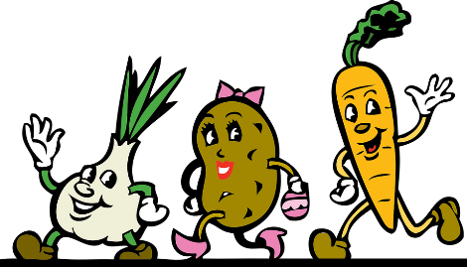
zu + infinitive
Grammatik
You already know how to use a verb + zu + infinitive:
Ich habe keine Lust, zu arbeiten.
I don’t feel like working.
Er vergisst immer, sein Zimmer zu putzen.
He always forgets to clean his room.
Es ist wichtig, Deutsch zu lernen.
It’s important to learn German.
Ich plane, mehr Gemüse zu essen.
I plan to eat more vegetables.
Don’t forget to add a comma here!
Guten Appetit!
Remember: there is no zu in two-verb structures with werden or modal verbs:
Ich werde mehr Gemüse essen.
I am going to/will eat more vegetables.
Notes:
Timing: 3 minutes Aim: Recap zu + infinitive structure, drawing attention to use of werden (for future tense) and modals, where no ‘zu’ is needed. Procedure: 1. Click through the animations on the slide, making sure students understand when to use zu + infinitive, and when not. Elicit the English sentence meanings from students, if known. 2. Draw attention to the phrase ‘Guten Appetit’ and explain it’s standard use at the start of a meal time. We don’t have the equivalent English phrase for wishing people a good meal, though people often use the French ‘Bon appetit’, and it has become more common to say ‘Enjoy!’ or similar, possibly as a result of the fast food worker’s mantra of ‘Enjoy your meal’!
Word frequency (1 is the most frequent word in German): Appetit [<5000] Source: Jones, R.L. & Tschirner, E. (2019). A frequency dictionary of German: core vocabulary for learners. Routledge

Slide 18
Katjas Jahr
Hallo Paula! Wie geht’s?
hören
schicken – to send
Katja schickt* ihrer Cousine Paula eine Sprachnachricht*.
Ist das Antwort 1 oder 2?
die Sprachnachricht – voice message
 |  | Antwort 1 | Antwort 2
 | talking on the phone | feel like | want
 | to talk to you | want | plan
 | find a time for it | have (to) | have the task
 | of helping in the house | have the task | should
 | learn a new language | plan | will
 | learning a new language | feel like | want
 | to talk to you on the phone | feel like | want
 | call me | plan | will
Was ist der Plan auf Englisch?
1
2
3
Mir geht’s nicht so gut…
4
5
6
Paula
7
8
dafür – for it, for that
Notes:
Timing: 8 minutes Aim: a referential activity bringing together previously taught zu + infinitive structures, werden and modal verbs in oral modality. Procedure: 1. Explain the task. Students need to write 1 or 2, selecting the correct English verb, though the German equivalent verb is bleeped out. Prompt students to say how they will know whether it is ‘feel like’ or ‘want’ (i.e., the presence of ‘zu’ for feel like, the absence of ‘zu’ for want). They then write the English for the ‘plan’, the stated activity. 2. Click to play the audio for number 1. 3. Click to reveal that it is Antwort 1 or Antwort 2
4. Click to reveal the planned activity for number 1. 5. Repeat for items 2-8.
Transcript: 1. Hallo Paula, hier ist Katja, [hast du Lust] mit mir am Telefon zu sprechen?
2. Ich [will] mit dir sprechen.
3. Aber zuerst [müssen] wir eine Zeit dafür finden.
4. Am Wochenende kann ich nicht - ich [habe die Aufgabe], im Haus zu helfen.
5. Mein Schuljahr war toll – und wie war dein Jahr in der neuen Schule? Nächstes Jahr [werde] ich eine neue Sprache lernen!
6. Ich [habe große Lust], eine neue Sprache zu lernen, und du?
7. Ich [will] so gerne mit dir am Telefon sprechen, Paula.
8. [Wirst] du mich anrufen?
Word frequency of unknown or cognate words (1 is the most frequent word in German): dafür [175] schicken [929] Nachricht [1218] Source: Jones, R.L. & Tschirner, E. (2019). A frequency dictionary of German: core vocabulary for learners. Routledge

Slide 19
Paulas Jahr [1/2]
lesen
Nächstes Jahr!
Letztes Jahr
*SMS – text message
Hi Katja, ja, dein Jahr war toll – mein Schuljahr war nicht so toll ☹. 1. Aber nächstes Jahr werde ich alles besser machen! ☺ 2. Ich plane, netter zu sein. 3. Ich will mehr Zeit mit meiner Familie verbringen, 4. und ich habe die Aufgabe, öfter zu Hause zu helfen.
Paula schreibt Katja eine SMS* zurück. Aber Katjas Handy ist schmutzig*!
Wähle das richtige Verb aus. Was will Katja nächstes Jahr machen?
 | Verb | What?
1
2
3
4
will / plan
- do everything better
want / plan
- be nicer
*schmutzig – dirty, stained
have the task / want
- spend more time with family
have the task / should
- help more often at home
Notes:
Timing: 8 minutes Aim: a referential activity (over 2 slides) bringing together previously taught zu + infinitive structures, werden and modal verbs in reading modality. This activity forms a pair with the listening activity on the previous slide. Procedure:
Explain that this reading task is very similar to the previous listening activity. Students need to select the correct English verb, though the German equivalent verb is covered up. Prompt students to say how they will know whether it is ‘will’ or ‘plan’ (i.e., the absence of ‘zu’ for will, the presence of ‘zu’ for plan). Students then write the English for the ‘plan’, the stated activity (or teacher can elicit this part orally).
1. Click to reveal which of the two verb meanings it is.
2. Click to reveal the planned activity for number 1. 3. Repeat for items 2-8. (continued text and items 5-8 on next slide).
Word frequency (1 is the most frequent word in German): schmutzig [3869] SMS [>5009]
Source: Jones, R.L. & Tschirner, E. (2019). A frequency dictionary of German: core vocabulary for learners. Routledge

Slide 20
Paulas Jahr [2/2]
lesen
Nächstes Jahr!
Letztes Jahr
5. Ich soll natürlich auch weniger Fastfood essen und mehr Wasser trinken! 6. Ich habe Lust, mehr Sport zu machen, 7. und ich plane, mit dem Rad zur Schule zu fahren. Aber mein bester Plan: 8. ich habe Lust, ein Tier zu adoptieren!
Wie findest du das? ☺ Paula.
Wähle das richtige Verb aus. Was will Katja nächstes Jahr machen?
 | Verb | What?
1
2
3
4
should / plan
- eat less fast food
*adoptieren – to adopt
want / feel like
- do more sport
will / plan
- cycle to school
feel like / want
- adopt an animal
Notes:
Activity continued from previous slide.
1. Click to reveal which of the two verbs it is.
2. Click to reveal the planned activity. Word frequency (1 is the most frequent word in German):
adoptieren [3869] Source: Jones, R.L. & Tschirner, E. (2019). A frequency dictionary of German: core vocabulary for learners. Routledge

Slide 21
Beschreib deine Pläne
Extra: Link the ideas and language together in a paragraph. Use…
schreiben
Schreib Sätze.
1 | Ich plane, …
2 | Mein Freund (Max) / Meine Freundin (Lily) hat Lust, …
3 | Ich will…
4 | Wirst du…?
5 | Ich habe die Aufgabe, …
6 | Ich meine, mein Lehrer/meine Lehrerin soll…
7 | Schreib deinen eigenen Satz.
8 | Schreib deinen eigenen Satz.
time adverbs and phrases (and WO2): E.g. Nächsten Monat plane ich, …
WO1 / WO3 conjunctions: [WO1] und, aber, oder, denn [WO3] weil, dass, wenn
other adverbs: E.g., gern, lieber, besonders, nochmal, zuerst, danach, wieder, zusammen, immer
Notes:
Timing: 12 minutes Aim: To practise written production of future plans, using a range of zu + infinitive structures, werden and modal verbs. Procedure: 1. Ensure that task instructions are clear. Note: The task is differentiated; students can write a set of individual sentences or challenge themselves to link the sentences into a coherent paragraph, by joining the ideas. For this they can make use of some of the suggested additional structures.
2. Ensure sentence prompts are clear.
3. If necessary, prompt students to say for each sentence whether or not they will need to use ‘zu’ before the infinitive.

Slide 22
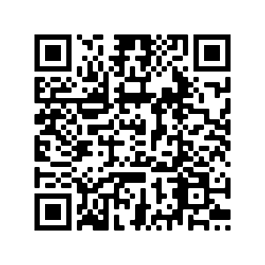
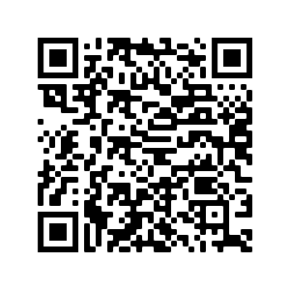
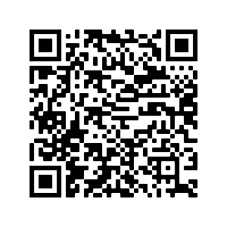
Hausaufgaben
Pre-learning for lesson: Year 8 German Term 3.2 Week 6
Revisit 1: [Year 8 German Term 3.1 Week 6]
Revisit 2: [Year 8 German Term 2.2 Week 4]
Notes:
This is the HW slide for the Oak Academy videoed lesson. Don’t upload to the portal with this slide, but do save a separate version on the Google drive and send link to RH, when complete.

Slide 23
Hausaufgaben
Vocabulary Learning Homework (Y8, Term 3.2, Week 6)
Audio file
Audio file QR code:
Quizlet link
In addition, revisit: Term 3.1 Week 6
Term 2.2 Week 4
Notes:
Student homework worksheet answers :

