Slide 1
Present tense:’er /sie’ and ‘sie’
Explanation and tasks

Slide 2

Present tense: singular and plural
Present tense: verb stems and verb endings
All verbs have a stem and an ending.
The stem is the first part of the verb.
Find the stem of a German verb by removing the -en ending.
sagen → sag-
machen → mach-
gehen → geh-
Add different endings to the stem to create different verb forms.
ich sage
er macht
wir gehen
Inge Alferink / Rachel Hawkes / Rowena Kasprowicz
Notes:
Teacher note: Short grammar explanations can never be fully complete. (For example, of course, some verbs don’t follow this pattern as they are irregular). But the aim is to get pupils to learn a ‘default’, main pattern and then introduce the complexities and exceptions to the rule later. In any case, evidence suggests that it is the practice activities that are most helpful for learning (rather than these grammar explanations). But … these short grammar explanations do seem to speed up some learners in becoming accurate in the practice activities that follow.

Slide 3
Grammar explanation
Present tense: ‘er’ / ‘sie’ / ‘es’ (he / she / it) and ‘sie’ (they)
Make the ‘er’ / ‘sie’ / ‘es’ form by adding -t to the stem: sag- → er sagt (he says).
Make the ‘sie’ (they) form by adding -en to the stem: sag- → sie sagen (they say).
Infinitive | Stem | Er / sie / es (+ t) | Sie (+ en)
sagen | sag- | sagt | sagen
machen | mach- | macht | machen
gehen | geh- | geht | gehen
German verbs need pronouns and verb endings.
Why?
1. Some pronouns are the same: 'sie' = 'she' and 'they’.
2. Some endings are the same: ’wir sagen’ and ‘sie sagen’.
Inge Alferink / Rachel Hawkes / Rowena Kasprowicz

Slide 4


Hören
Im Zoo
You are visiting the zoo. The zookeeper is telling you all about
the animals they have. But the animals are noisy!
Can you tell whether the zookeeper is talking about one or more than one of the animals?
Remember to pay attention to the ending of the verb.
Inge Alferink
Notes:
The script is a tour around a zoo. The zookeeper / tour guide provides a set of statements about different animals.
The start of the sentence (i.e. the noun phrase) is obscured by animal sounds.
The students circle a picture of a single animal or multiple animals depending on whether the statement is singular or plural.
Any strong verbs are plural, so as not to overcomplicate at this stage.
Verb frequency rankings (1 is the most common word in German): essen (655); spielen (197); rennen (2558); schlafen (787); trinken (609)
Source: Jones, R.L., & Tschirner, E. (2006 ). A Frequency Dictionary of German. Routledge
Transcript
Eins. Die Affen essen gern Bananen.
Zwei. Die Elefanten spielen gern Fußball.
Drei. Das Zebra rennt ganz schnell.
Vier. Die Giraffen schlafen viel.
Fünf. Der Löwe trinkt Wasser.

Slide 5
Hören
1
A
B
Inge Alferink
Notes:
Eins. [general zoo background noise] [BLEEP] essen gern Bananen.
[TRANSCRIPT: Die Affen essen gern Bananen]

Slide 6

Hören
2
A
B
Inge Alferink
Notes:
Zwei. [general zoo background noise] [BLEEP] spielen gern Fußball.
[TRANSCRIPT: Die Elefanten spielen gern Fußball]

Slide 7
Hören
3
A
B
Inge Alferink
Notes:
Drei. [general zoo background noise] [BLEEP] rennt ganz schnell.
[TRANSCIPT: Das Zebra rennt ganz schnell]

Slide 8
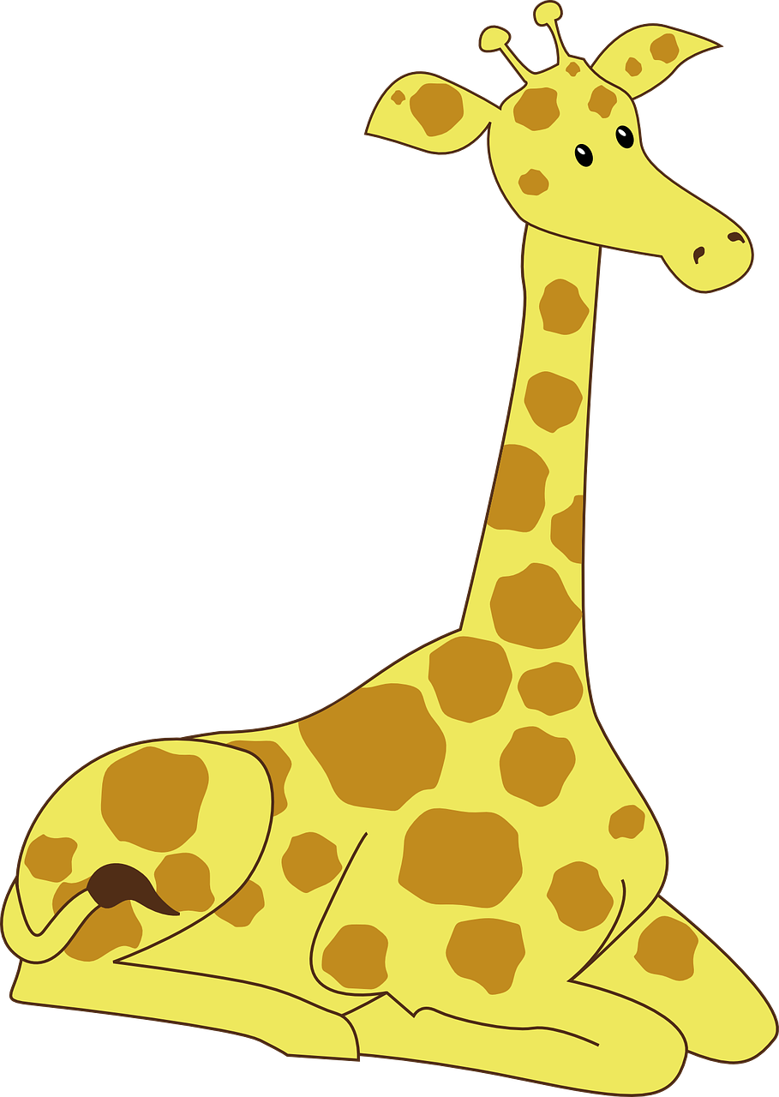
Hören
4
A
B
Inge Alferink
Notes:
Vier. [general zoo background noise] [BLEEP] schlafen viel.
[TRANSCRIPT: Die Giraffen schlafen viel.

Slide 9

Hören
5
A
B
Inge Alferink
Notes:
Fünf. [general zoo background noise] [BLEEP] trinkt Wasser.
[TRANSCRIPT: Der Löwe trinkt Wasser.]

Slide 10
Lesen
Das Reisebüro und die Reise
When you go away on holiday, travel agencies often help you (or not!) with many of the arrangements, decisions and activities.
A travel agency wrote this list to explain what they do.
The list also explains what the traveller does.
The person who wrote it seems to have got some things a bit confused.
In this activity:
er (he) refers to the traveller (e.g. he – the traveller – books tickets)
sie (they) refers to the travel agents (e.g. they – the travel agents – book tickets).
Inge Alferink
Informed by a Language and Linguistics Area Studies Subject Centre materials development project
Notes:
Reading - Das Reisebürio und die Reise
Verb frequency rankings (1 is the most common word in German): stellen (192); geben (57); empfehlen (1199); wählen (564); anrufen (1386) erklären (250); finden (110); organisieren (1163); reservieren (>5000); entscheiden (576)
Source: Jones, R.L., & Tschirner, E. (2006 ). A Frequency Dictionary of German. Routledge

Slide 11
Lesen
Er (he) … / sie (they) … |  | Traveller | Agents
1. | …stellt viele Fragen.
2. | …geben Information.
3. | …empfehlen ein Hotel.
4. | …wählt ein Reiseziel.
5. | …rufen das Hotel an.
6. | …erklären die Kultur.
7. | …findet seinen Reisepass.
8. | …organisiert das Geld.
9 | …reservieren den Flug.
10. | …entscheidet die Reisepläne.
x
x
x
x
x
x
x
x
x
x
Inge Alferink
Informed by a Language and Linguistics Area Studies Subject Centre materials development project
Notes:
Note to teachers:
Whilst this might not appear typical KS3 beginner vocabulary, it is worth noting the high-frequency of many of the verbs and other vocabulary in this task, as well as some cognates, which will enable most students (perhaps with some prompting led by the teacher) to work out what the sentences mean.
In addition, the activity’s main focus is verb endings, so even if students are not completely sure of the meaning of every sentence, they will still be able to notice and understand the meaning of the verb endings.
Verb frequency rankings (1 is the most common word in German): stellen (192); geben (57); empfehlen (1199); wählen (564); anrufen (1386) erklären (250); finden (110); organisieren (1163); reservieren (>5000); entscheiden (576)
Source: Jones, R.L., & Tschirner, E. (2006 ). A Frequency Dictionary of German. Routledge

Slide 12
Lesen
Nützliche Wörter
Verb | English
(eine Frage) stellen | to ask (a question)
geben | to give
empfehlen | to recommend
wählen | to choose
anrufen | to phone / call up
erklären | to explain
entscheiden | to decide
Rowena Kasprowicz
Notes:
Teacher note: These verbs can be practised / revised before the reading activity or used as a support during the activity, if necessary.
Verb frequency rankings (1 is the most common word in German): stellen (192); geben (57); empfehlen (1199); wählen (564); anrufen (1386) erklären (250); finden (110); organisieren (1163); reservieren (>5000); entscheiden (576)
Source: Jones, R.L., & Tschirner, E. (2006 ). A Frequency Dictionary of German. Routledge

Slide 13
Sprechen und schreiben
Nützliche Wörter
Verb | English
kaufen | to buy
kochen | to cook
fahren | to ride / drive
studieren | to study
lesen | to read
laufen | to run
waschen | to wash
schreiben | to write
Inge Alferink
Notes:
Teacher note: These verbs should be practised before the speaking exercise following in order to ‘force recall’ during the practice and active the meaning rather than mechanical manipulation.
Verb frequency rankings (1 is the most common word in German): kaufen (581); kochen (1005); fahren (169); studieren (436); lesen (323); laufen (248); waschen (1780); schreiben (245)
Source: Jones, R.L., & Tschirner, E. (2006 ). A Frequency Dictionary of German. Routledge

Slide 14
Sprechen und schreiben
Instructions
Person A
• Look at the four pictures.
• Write what you see.
• Your sentence should start with ‘sie’, which can mean ‘she’ or ‘they’.
• Make sure you use the correct form of the verb!
• Say your four sentences to your partner.
• Now swap roles!
Person B
Listen to your partner’s description.
Write down what you hear.
Then circle the picture your partner described.
Remember to pay attention to the verb ending!
Now swap roles!
Now swap roles for numbers 5-8.
Inge Alferink
Notes:
Speaking exercise (using the pictures from Marsden, Williams & Liu). Doubles as a listening exercise for the speaking partner. The students can use sie (she / they) for each picture, but need to use the correct verb form to indicate the singular or plural form. Verb endings are the only meaningful cue here. The sentences where they are prompted to use the singular form are with weak verbs, so we don’t force production of stem changes at this point.
The full set consists of 8 items. Each student does 4 speaking and 4 writing items.
[NB: this exercise could be re-used with the strong verbs in the singular once weak / strong forms have been introduced]

Slide 15
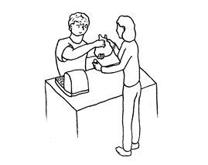
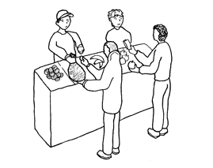
Sprechen und schreiben
Person A
Person B
1A.
1B.
ODER
Sie _________________________
Sie____________________________
Inge Alferink
Notes:
This slide just shows the structure of the task for items 1-4. For 5-8 the roles are reversed.

Slide 16
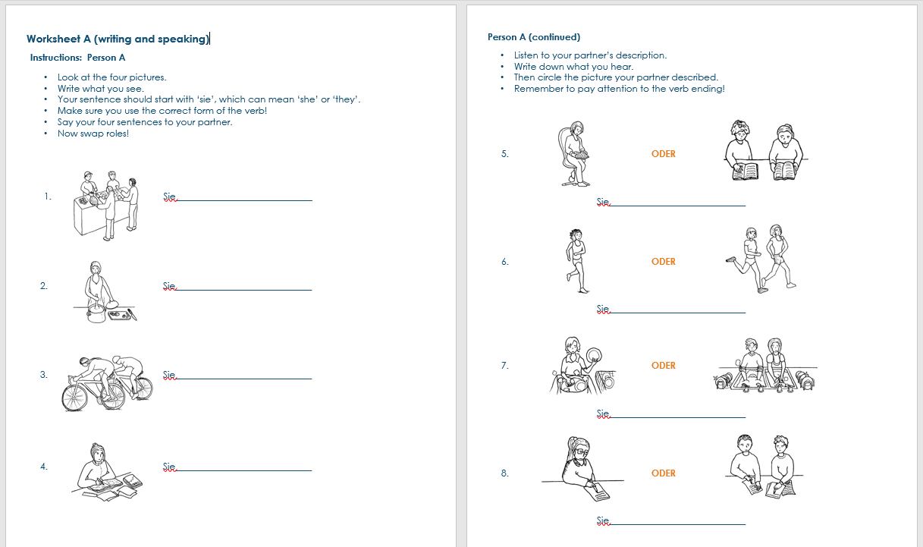
Inge Alferink
Notes:
Screen shot of Pupil A task

Slide 17
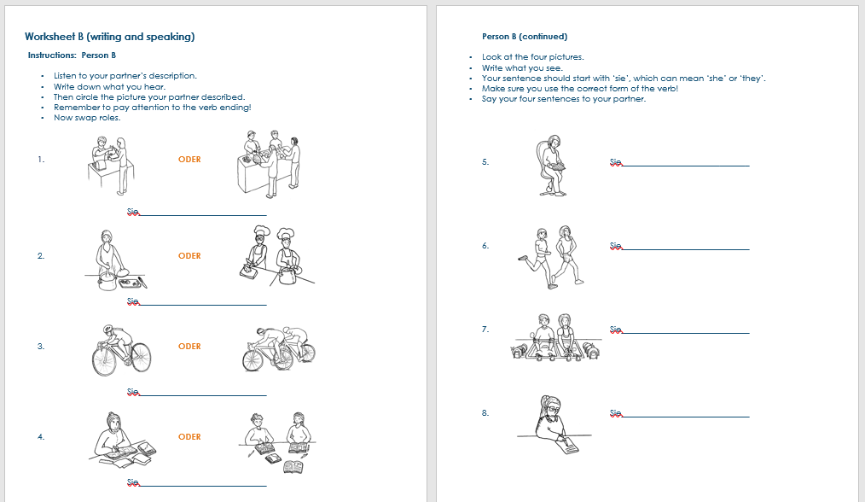
Inge Alferink
Notes:
Screen shot of Pupil B task

