Slide 1
German word patterns
Resource collection
Artwork: Steve Clarke
Date updated: 20/09/ 21
Notes:
Artwork by Steve Clarke. All additional pictures selected are available under a Creative Commons license, no attribution required.

Slide 2
Word patterns
Grammatik
Add prefix Lieblings- to nouns to mean ‘favourite’
Notes:
Add prefix Lieblings- to nouns to mean ‘favourite’

Slide 3
Word patterns
Grammatik
Introduction
Y7 T1.1 Week 7 Slides 12; 40-45
Notes:
7.1.1.7

Slide 4
Vokabeln
sprechen
Lieblings-
L – I – E – B – L – I – N – G - S
Notes:
Timing: 1 minute Aim: To introduce the new vocabulary for this week. Procedure: 1. Ask: ‘Wie schreibt man favourite auf Deutsch?’
2. Students respond: - ‘Ich weiß – L-I-E-B-L-I-N-G-S’, spelling out the word.
3. The contrast between this and the previous slide provides a useful introduction to this week’s SSC. Draw attention to the [ie] combination.

Slide 5
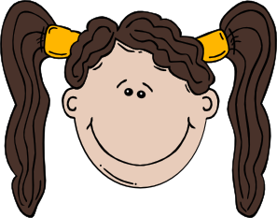
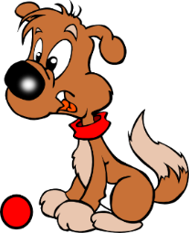
Lieblingsdinge
hören
Frau Organisiert is talking to granddaughter, Heike, about favourite things. The line is bad. Listen and decide whether Heike does (✔) or does not (✖) have a favourite.
A
Have you got … ?
I’ve got / I haven’t got …
B
C
D
E
Notes:
Timing: 2 minutes Aim: To provide practice in noticing negation with kein. Procedure: 1. This listening activity and the reading activity that follows focus on connecting articles ein- and kein- to nouns, in order to decide what someone does and doesn’t have. The articles are all in accusative (Row 2).
2. The nouns in the recording are obscured by noises. The students decide based on the article they hear whether Heike has a favourite or not. The objects in each pair have different genders to allow for this.
3. The order in which nouns with ein- and kein- appear varies so that students cannot guess based o:n word order. It is worth telling students this. ie. In the answer the noun on the right could be mentioned first.
4. Recording plays on clicking individual letters.
5. Note: point out pronunciation of ‘Heike’.
Transcript:
a. Hast du ein Lieblingsbuch oder einen Lieblingsfilm?
Ich habe einen ____ [Lieblingsfilm] aber ich habe kein ____ [Lieblingsbuch].
b. Hast du einen Lieblingssänger oder eine Lieblingssängerin?
Ich habe keinen ____ [Lieblingssänger ] aber ich habe eine ____ [Lieblingssängerin].
c. Hast du ein Lieblingslied oder eine Lieblingsband?
Ich habe keine [Lieblingsband] aber ich habe ein ____ [Lieblingslied].
d. Hast du eine ____ [Lieblingslehrerin] oder einen ____ [Lieblingslehrer]?
Ich habe keine [Lieblingslehrerin] aber ich habe einen ____ [Lieblingslehrer].
e. Hast du ein _____ [Lieblingstier] oder einen [Lieblingsort]?
Ich habe einen ____ [Lieblingsort] aber kein ___ [Lieblingstier].

Slide 6
Lieblingsdinge - Antworten
hören
Frau Organisiert is talking to granddaughter, Heike, about favourite things. The line is bad. Listen and decide whether Heike does (✔) or does not (✖) have a favourite.
A
✖
✔
Have you got … ?
I’ve got / I haven’t got …
B
✖
✔
C
✔
✖
D
✖
✔
E
✖
✔
Notes:
Timing: 2 minutes Aim: To provide the answers to the acivity on the previous slide. Procedure: 1. Full recording (including answers) plays on clicking individual letters.
2. Correct answers revealed one at a time on click.
Transcript:
a. Hast du ein Lieblingsbuch oder einen Lieblingsfilm?
Ich habe einen Lieblingsfilm aber ich habe kein Lieblingsbuch.
b. Hast du einen Lieblingssänger oder eine Lieblingssängerin?
Ich habe keinen Lieblingssänger aber ich habe eine Lieblingssängerin.
c. Hast du ein Lieblingslied oder eine Lieblingsband?
Ich habe keine Lieblingsband aber ich habe ein Lieblingslied.
d. Hast du eine Lieblingslehrerin oder einen Lieblingslehrer?
Ich habe keine Lieblingslehrerin aber ich habe einen Lieblingslehrer.
e. Hast du ein Lieblingstier oder einen Lieblingsort?
Ich habe einen Lieblingsort aber kein Lieblingstier].

Slide 7
Grammatik
lesen
Oh je! Frau Organisiert listed Heike’s favourite things, but smudged the articles! Help her complete the sentences.
kein
keinen
ein
keine
kein
Lieblingsbuch aber
Lieblingssänger aber
Lieblingslied aber
Lieblingslehrerin aber
Lieblingstier aber
einen
eine
keine
einen
einen
Lieblingsfilm.
Lieblingssängerin.
Lieblingsband.
Lieblingslehrer.
Lieblingsort.
Notes:
Timing: 5 minutes Aim: To provide production practice (writing) of the use of kein versus the indefinite article. Procedure: 1. Students need to use their answers to the listening to complete this, by writing ein(e) or kein(e) before each item as appropriate, according to whether Heike does or does not have a favourite.
2. Answers revealed on click.

Slide 8
My → mein, mein, meine
Grammatik
Ja, m___ L______________ i__ Star Wars.
Ja, mein Lieblingsfilm ist Star Wars.
Add the prefix Lieblings- to a noun to talk about your favourite things. Introduce them using mein/meine.
Mein Lieblingsbuch ist …
Ja, mein Lieblingslied ist Rocket Man.
Ja, m___ L______________ i__ Rocket Man.
Ja, meine Lieblingslehrerin ist Frau Schmidt.
Ja, m___ L______________ i__ Frau Schmidt.
Zorg, hast du eine Lieblingsband?
Zorg, hast du eine Lieblingslehrerin?
Zorg, hast du ein Lieblingslied?
Zorg, hast du einen Lieblingsfilm?
Nein, ich habe keine Lieblingsband!
Notes:
Timing: 2 minutes Aim: To introduce mein/meine.
Note: This is not a full introduction of possessive adjectives here. Mein/meine are introduced here because: a) they are communicatively important and students will often ask how to say ‘my’ now that they know a bank of nouns b) the words themselves are easy to remember and say, as mein sounds like ‘my’ and acts like ‘ein’. c) students have had a thorough grounding in definite and indefinite articles and the implications of noun gender, so that, with some inevitable reminding, they will use them accurately and begin to apply them to the nouns they know well. Procedure: 1. Click to animate the explanation.
2. Check students’ understanding at each stage.

Slide 9
Do you have a favourite...?
sprechen
Ask your partner.
If yes, write (✔) and their answer.
If no, write (✘).
1. Favourite book?
2. Favourite band?
3. Favourite film?
4. Favourite singer?
5. Favourite song?
6. Favourite place?
7. Favourite teacher?
Notes:
Timing: 5 minutes Aim: To provide practice (speaking modality) in asking and answering questions about having (favourite things).
Procedure: 1. Students to ask/answer each other’s questions following the model on the previous slide. 2. Depending on the class, the teacher could choose to prime students for this task by eliciting the questions chorally from students, giving them a drei-zwei-eins countdown to think/construct the question in their heads, then s/he can offer an answer to model the task. Sample dialogue:
Teacher: Ok. Frage eins. Drei-zwei-eins… Students all together: Hast du ein Lieblingsbuch? Teacher: Ja, mein Lieblingsbuch ist Born to run. Also, drei-zwei-eins… Students: Hast du eine Lieblingsband? Teacher: Nein, ich habe leider keine Lieblingsband.
Etc…

Slide 10
Favourite things
schreiben
Write sentences to describe your partner’s favourite things.
1.
2.
3.
4.
5.
6.
Mias Lieblingsbuch ist Harry Potter.
Mias Lieblingsband ist Silbermond.
Mia hat keinen Lieblingsfilm.
Mias Lieblingsbuch [Mia’s favourite book]. No apostrophe in German.
Notes:
Timing: 5 minutes Aim: To provide practice (writing modality) in answering questions about having (favourite things). Procedure: 1. This task may be an additional homework task, if lesson time is short. Students write sentences to describe their partner’s favourite things.
2. The first three answers are modelled to give full sentence examples.
3. This can be expanded into a speaking activity in which answers are presented orally. The teacher asks students about their partners’ favourite things. Where the pupil does not have a favourite thing, use this as a chance to practise ‘leider’ e.g. ‘Wolfgang, hat Mia ein Lieblingsbuch?’ ‘Ja, Mias Lieblingsbuch ist …’ / ‘Leider nicht’

Slide 11
Word patterns
Grammatik
Consolidation [1]
Y7 T1.2 Week 3 Slide 49
Notes:
7.1.2.3

Slide 12
Open (wh-) questions
Grammatik
Open (wh-) questions
To ask an open question, place a question word directly in front of the verb:
Closed
Schreibst | du | ein Buch?
Are you writing a book?
Open
Wer
Who is writing a book?
Wo
schreibst | du | ein Buch?
Where are you writing a book?
schreibt |  | ein Buch?
Beispiel:
Was hast du am Montag?
What do you have on Monday?
Wo spielst du Tennis?
Where do you play tennis?
Wie oft putzt du dein Zimmer?
How often do you clean your room?
Wer ist dein Lieblingslehrer?
Who is your favourite (male) teacher?
Notes:
Timing: 3 minutes Aim: To revisit knowledge that students were taught in 1.1.7 on the formation of closed questions.
Procedure: 1. Click to animate the explanation.
2. Draw attention to word order: VSO for closed questions, Question word + VSO or VO for open questions.
3. Ensure students’ understanding at each stage.

Slide 13
Word patterns
Grammatik
Consolidation [2]
Y7 T3.1 Week 4 Slide 18-20; 29-37

Slide 14
Possessives: your, his and her
Notice that the ending follows the gender of the noun, NOT whether it’s his or hers !
Grammatik
You have already learnt how to say my:
my favourite film
my favourite band
my favourite book
mein Lieblingsfilm (m)
meine Lieblingsband (f)
mein Lieblingsbuch (n)
This is a possessive adjective, as it describes the noun by saying who possesses it.
There is a possessive adjective for each of the pronouns:
dein - your
sein - his
ihr - her
Just like mein they must agree with the gender of the noun that follows:
dein Lieblingsfilm (m)
seine Lieblingsband (f)
ihr Lieblingsbuch (n)
your favourite film
his favourite band
her favourite book
Notes:
Timing: 3 minutes
Aim: To explain the possessives ‘dein’, ‘sein’ and ‘ihr’.
Procedure: 1. Cycle through the information on the slide using the animation sequence.

Slide 15
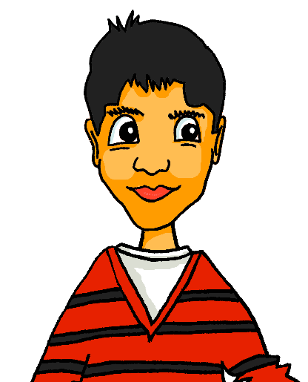
Mehmets Klasse
hören
Mehmet spricht über seine Klasse. Ist das ein Junge oder ein Mädchen? Sein(e) oder ihr(e)?
 | Junge? | Mädchen? | Lieblingssache?
 | Noah | Katharina | Band – Cro
 | Elias | Emilia | Sängerin – Rihanna
 | Til | Léonie | Schauspieler – Daniel Brühl
 | Friedrich | Franziska | Lehrerin – Frau Braun
 | Uwe | Lena | Sport – Rugby
 | Max | Frieda | Ort – Wien
 | Wolfgang | Irene | Tier – Hund
 | Heinrich | Clara | Film – Vorstadtkrokodile
1
2
3
4
5
6
7
8
Notes:
Timing: 10 minutes
Aim: To practise distinguishing between ‘sein’ and ‘ihr’ in the oral modality.
Procedure: 1. Students listen to determine whether the sentences refer to a boy or girl (sein / ihr). They can write 1-8 and note the names. Note: The names have been chosen to provide additional productive read aloud practice of the SSC ‘ei’ and ‘ie’. 2. Teachers can therefore elicit the answers as student names: Wer ist das? Noah oder Katharina? 3. Students can then listen again to record the additional details.
4. Students were taught Lieblings- combined with a range of nouns in 1.1.7. Since then, they have been explicitly introduced to the concept of compound nouns - teachers might want to consolidate this knowledge here by asking follow up questions about the gender of a few of the compounds: e.g. What’s the gender of Lieblingsband, Lieblingsort, Lieblingstier? 5. Wolfgang is in Mehmet’s class, of course. Here teachers might ask if students remember the name of Wolfgang’s dog - Einstein (two more examples of ‘ei’)!
Transcript:
Seine Lieblingsband ist Cro.
Seine Lieblingssängerin ist Rihanna.
Ihr Lieblingsschauspieler ist Daniel Brühl.
Seine Lieblingslehrerin ist Frau Braun.
Ihr Lieblingssport ist Rugby.
Ihr Lieblingsort ist Wien.
Sein Lieblingstier ist sein Hund.
Sein Lieblingsfilm ist Vorstadtkrokodile.

Slide 16
Mehmets Klasse
lesen
Mehmet schreibt über seine Freunde. Ist das sein oder ihr?
1. Katharina hat einen Bruder. Sein / Ihr Lieblingsbuch ist „der Sänger”.
2. Tils Mutter ist vierzig. Sein / Ihr Lieblingssport ist Fußball.
3. Léonies Vater mag Musik. Seine / Ihre Lieblingsband ist Die Toten Hosen.
4. Emilias Bruder ist sechs. Ihre / Seine Lieblingssängerin ist Rihanna.
5. Friedas Mutter ist sehr nett. Ihr / Sein Lieblingstier ist eine Katze.
6. Lena hat einen Bruder. Ihr / Sein Lieblingsort ist Leipzig.
7. Friedrichs Schwester hat eine Freundin. Sein / Ihr Lieblingsfußballspieler ist Messi.
8. Heinrich hat eine Schwester. Ihre / Seine Lieblingssprache ist Deutsch.
Notes:
Timing: 7 minutes
Aim: To practise distinguishing between ‘sein’ and ‘ihr’ in the written modality.
Procedure: 1. Students identify the gender of the person mentioned last in the first sentence and choose the correct possessive adjective in the second sentence. 2. Teachers elicit full sentence answers so that students gain additional read aloud practice with ‘ie’ and ‘ei’.
Note: Examples of males possessing feminine nouns, and females possessing masculine or neuter nouns, have been deliberately included, to reinforce that fact that the gender of the possessive adjective agrees with the thing possessed, rather than with the possessor.

Slide 17
Lieblingsdinge
hören / lesen
Katja redet mit Mehmet auf dem Handy aber das Handysignal ist nicht gut! Was sagen sie? Ist das mein/meine, dein/deine, sein/seine, ihr/ihre?
“Sag mal” is a conversational filler, the equivalent of ‘Tell me’
 |  | - Hallo Mehmet. Sag mal*, was ist [1] dein Lieblingssport?
 |  | - Fußball.
 |  | - Und hast du einen Lieblingsfußballspieler?
 |  | - Ja, [2] mein Lieblingsfußballspieler ist Mesut Özil. [3] Sein Bruder Mutlu Özil mag Fußball auch.
 |  | - Und [4] deine Lieblingsfarbe?
 |  | - rot.
 |  | Und [5] deine Lieblingsband?
 |  | [6] Meine Lieblingsband ist Rammstein.
A
B
C
D
Notes:
Timing: 8 minutes (two slides)
Aim: To practise written production of possessive adjectives in context.
In these multi-modal conversations students need to choose the correct possessive adjective and the correct form of each, dependent on the gender of the noun that follows. Clearly, we need to suspend disbelief in this scenario, as we don’t usually get to see conversations written down (!). However, the spoken modality provides useful modelling for the subsequent pair speaking task, and the written support allows students a little more opportunity to refer to the words (and utterances) before and after the gap, to help them process for meaning, and choose the correct word.
Note: Too wordy to put in the instructions (and probably not necessary) but a scenario that then leads into the writing task that follows would be that Katja is interviewing Mehmet for her English homework. She therefore records the conversation, tries to type it up in German, so that she has notes to refer to, to write her English sentences. The bad signal means that some of the audio is lost.
Procedure: 1. Audio for each exchange is activated by clicking each letter A - D.
2. Students listen and read each section of the dialogue. They use their understanding of the sentence context to identify which possessive is needed, and their knowledge of gender of the following word to decide which form is required. They write the possessive form in German.
3. The answers are animated to appear.
4. There is then a full version of this half of the conversation to listen to, by clicking the player on the top right of the slide. 5. The 2nd part of the conversation then follows on the next slide.
Transcript
1. Katja: Hallo Mehmet. Sag mal, was ist [dein] Lieblingssport? Mehmet: Fußball. Katja: Und hast du einen Lieblingsfußballspieler? Mehmet: Ja, [mein] Lieblingsfußballspieler ist Mesut Özil. [Sein] Bruder Mutlu mag Fußball auch.
Katja: Und [deine] Lieblingsfarbe? Mehmet: rot
Katja: Und [deine] Lieblingsband? Meh. [Meine] Lieblingsband ist Rammstein.

Slide 18
Lieblingsdinge [2]
hören / lesen
immer noch = still
Katja fragt Mehmet über seine Geschwister, aber das Handysignal ist immer noch* nicht gut! Was sagen sie? Ist das mein/meine, dein/deine, sein/seine, ihr/ihre?
 |  | - Und Mehmet, hast du Geschwister?
 |  | - Ja, [7] Meine Schwester heißt Esma.
 |  | - Ihr Name ist schön! Was ist [8] ihr Lieblingsessen?
 |  | - Sie hat kein Lieblingsessen. Sie isst alles!
 |  | - Und was ist [9] ihre Lieblingsmusik?
 |  | - Sie mag Jazz sehr. Deshalb haben wir nicht viel gemeinsam. [10] Meine Lieblingsmusik ist Rock. Und du, Katja, was ist [11] deine Lieblingsmusik?
 |  | Ich habe keine Lieblingsband aber [12] mein Lieblingssänger ist Mark Forster. [13] Seine Musik ist toll!
E
F
G
Notes:
Aim: To practise written production of possessive adjectives in context.
Note: In this second part of the conversation, there are two examples of ‘kein’, which students first learnt in 1.1.7. Teachers will want to draw students’ attention to it, and there are further opportunities to revisit it in the writing and speaking tasks that follow.
Note: deshalb is to be revisited this week. Teachers to check that students know its meaning.
Procedure: 1. Audio for each exchange is activated by clicking each letter E - G.
2. Students listen and read each section of the dialogue. They use their understanding of the sentence context to identify which possessive is needed, and their knowledge of gender of the following word to decide which form is required. They write the possessive form in German.
3. The answers are animated to appear.
4. There is then a full version of this half of the conversation to listen to, by clicking the player on the top right of the slide.
Transcript
2. Katja: Mehmet, hast du Geschwister? Mehmet: Ja, [meine] Schwester heißt Esma.
Katja: Ihr Name ist schön. Was ist [ihr] Lieblingsessen? Mehmet: Sie hat kein Lieblingsessen. Sie isst alles!
Katja: Und was ist [ihre] Lieblingsmusik? (can we avoid saying ‘art’ on the end, here?) Mehmet: Sie mag Jazz sehr. Wir haben nicht viel gemeinsam. [Meine] Lieblingsmusik is Rock. Und du, Katja, was ist [deine] Lieblingsband?
Katja: Ich habe keine Lieblingsband aber [mein] Lieblingssänger ist Mark Forster. [Seine] Musik ist toll!

Slide 19
Katjas Englischhausaufgaben
schreiben
Katja schreibt über Mehmets Familie auf Englisch. Kannst du das auf Deutsch schreiben?
My friend is called Mehmet. His favourite sport is football.
His sister is called Esma. Her favourite place is Sylt.
His mother is very healthy. Her favourite food is fruit.
His father is a bit boring. His favourite band is Abba!
Mehmet’s favourite language is Turkish. What is your favourite language?
Mehmet’s favourite day is Friday, but my favourite day is Saturday.
Notes:
Timing: 10 minutes
Aim: The context here is that Katja’s English homework involved her having to interview Mehmet (as we saw in the previous task) and write up some of the interview in English. Pupils challenge themselves to see if they can do the equivalent of Katja’s English homework, but in German. Procedure:
1. Teachers to draw attention to the compound noun Englischhausaufgaben and ensure that the meaning is clear. Students can be reminded to try to break down longer, unfamiliar-looking words to see if they can understand them. Animated lines appears upon the first clicks of the mouse, to divide the nouns. 2. Pupils translate Katjas English HW sentences into German. 3. The answers are on the next slide.

Slide 20
Antworten
schreiben
My friend is called Mehmet. His favourite sport is football.
His sister is called Esma. Her favourite place is Sylt.
His mother is very healthy. Her favourite food is fruit.
His father is a bit boring. His favourite band is Abba!
Mehmet’s favourite language is Turkish. What is your favourite language?
Mehmet’s favourite day is Friday, but my favourite day is Saturday.
Mein Freund heißt Mehmet. Sein Lieblingssport ist Fußball.
Mehmets Schwester heißt Esma. Ihr Lieblingsort ist Sylt.
Seine Mutter ist sehr gesund. Ihr Lieblingsessen ist Obst.
Sein Vater ist ein bisschen langweilig. Seine Lieblingsband ist Abba.
Mehmets Lieblingssprache ist Türkisch. Was ist deine Lieblingssprache?
Mehmets Lieblingstag ist Freitag, aber mein Lieblingstag ist Samstag.
Notes:
Timing: 2 minutes
Aim: The context here is that Katja’s English homework involved her having to interview Mehmet (as we saw in the previous task) and write up some of the interview in English. Pupils challenge themselves to see if they can do the equivalent of Katja’s English homework, but in German. Procedure:
1. The answers appear a sentence at a time upon clicking the mouse.

Slide 21
Fragen über Familien!
sprechen
Note that German quotation marks are different: „ “
Beispiel:
Partner A: „Hast du Geschwister?“
Partner B: „Ja, ich habe eine Schwester.“
Partner A: „Was ist ihr Lieblingssport?“
Partner B: „Ihr Lieblingssport ist Rugby.“
Beispiel:
Partner A: „Hast du Geschwister?“
Partner B: „Nein, ich habe keine Geschwister.“
Partner A: „OK. Was ist dein Lieblingssport?“
Partner B: „Mein Lieblingssport ist Rugby.“
----------- = has no favourite → keinen / keine / kein
Notes:
Timing: 8 minutes (model slide and task)
Aim: To practise spoken production of possessive adjectives and/or kein in questions and answers, contingent on partner’s responses. In this oral exercise, pupils must obtain information from their partner in order to complete the grids on the next two slides (for Partner A and Partner B respectively. This slide models the task. Procedure:
1. Model the dialogue on the left. If the partner says s/he has no siblings, then the next question must use dein and the answer mein.
2. Model the dialogue on the right.
They choose the correct possessive adjective for the information obtained from the first question, and then choose whether to add an ‘e’ from their knowledge of the noun they are given already in the grid. Note: the ----------- on students’ grids indicates that the person has no favourite and the student needs to use ‘keinen / keine / kein’.
3. The answers are displayed on the final slide of the activity.

Slide 22
Fragen über Familien
sprechen
Partner A
 | Bruder oder Schwester?
1 |  | Lieblingssport:
2 | Schwester | Lieblingsort: | Leipzig
3 |  | Lieblingssängerin:
4 | Bruder | Lieblingstag: | Freitag
5 |  | Lieblingsspieler:
6 | Schwester | Lieblingsfilm: | -----------
7 |  | Lieblingsband:
8 | keine | Lieblingsfarbe: | grün
Notes:
This is Partner A’s task. Do not display! Note: There are copier-friendly student versions of the task downloadable with this resource.

Slide 23
Fragen über Familien
sprechen
Partner B
 | Bruder oder Schwester?
1 | Schwester | Lieblingssport: | Rugby
2 |  | Lieblingsort:
3 | Bruder | Lieblingssängerin: | ------------
4 |  | Lieblingstag:
5 | keine | Lieblingsspieler: | Rafa Nadal, Tennisspieler
6 |  | Lieblingsfilm:
7 | Bruder | Lieblingsband: | Cro
8 |  | Lieblingsfarbe:
Notes:
This is Partner B’s task. Do not display! Note: There are copier-friendly student versions of the task downloadable with this resource.

Slide 24
Self-study version
sprechen
Partner A
 | Bruder oder Schwester?
1 |  | Lieblingssport:
2 | Schwester | Lieblingsort: | Leipzig
3 |  | Lieblingssängerin:
4 | Bruder | Lieblingstag: | Freitag
5 |  | Lieblingsspieler:
6 | Schwester | Lieblingsfilm: | -----------
7 |  | Lieblingsband:
8 | keine | Lieblingsfarbe: | grün
A
B
C
D
E
F
G
H
Notes:
Timing: 8 minutes
Aim: This is the self-study version of the speaking activity on the previous slides.
Procedure:
1. You are Partner A. Ask the questions in German: “Have you got any brothers and sisters?’
2. Click to hear the answer. From that you will know which question to ask: What is his/her favourite (sport)? Remember that if the person doesn’t have any brothers and sisters, you ask: What is your favourite…? 3. Click on the play button to hear the answer. Write both answers into the 1st row of the table. 4. For your information in 2,4,6,8, just give your answers out loud in German. E.g., for number 2, you say: Ja, ich habe eine Schwester. Ihr Lieblingsort ist Leipzig.
5. The answers are displeyed on the next slide.

Slide 25
Fragen über Familien
Partner A & B
 | Bruder oder Schwester?
1 | Schwester | Lieblingssport: | Rugby
2 | Schwester | Lieblingsort: | Leipzig
3 | Bruder | Lieblingssängerin: | ------------
4 | Bruder | Lieblingstag: | Freitag
5 | keine | Lieblingsspieler: | Rafa Nadal, Tennisspieler
6 | Schwester | Lieblingsfilm: | ---------------
7 | Bruder | Lieblingsband: | Cro
8 | keine | Lieblingsfarbe: | grün
Notes:
This (non-animated) slide displays the answers to the exercise.

Slide 26
Word patterns
Grammatik
Consolidation [3]
Y9 T2.1 Week 6

Slide 27
Lieblings-, Haupt-
Remember!
Lieblings- means favourite Haupt- means main
_________
_________
These prefixes can be added to almost any noun to make a new word.
favourite language 
die Lieblingssprache
main place 
der Hauptort
Note: two words in English become one word in German.
The gender of the new noun is the gender of the base word.
The gender of the new noun is the gender of the base word.
Notes:
Timing: 1 minute
Aim: to revisit the meaning of two known prefixes in German and their function in creating new nouns.
Procedure:
Click through the animations and elicit the meaning of the German as indicated.
Click to bring up callouts to compare German and English noun formation.

Slide 28
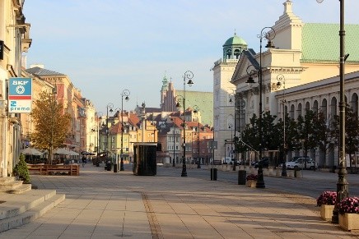
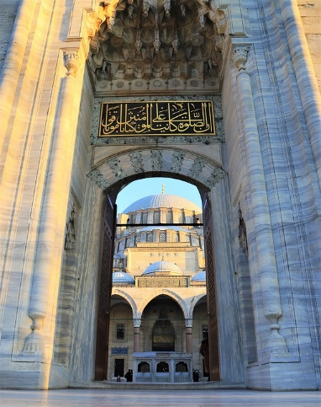
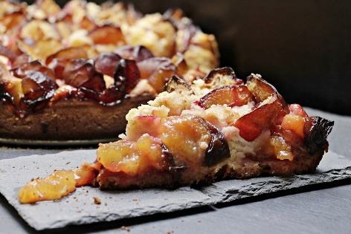
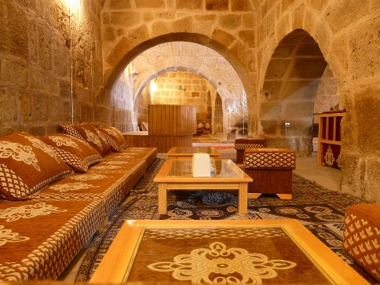
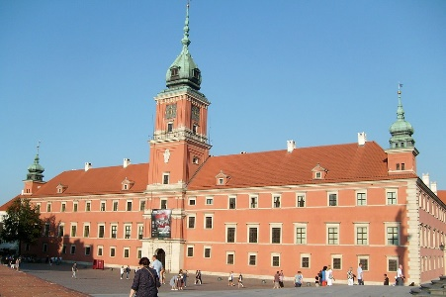
Vokabeln [1/2]
Hör zu. Ist es A, B, ? Schreib das englische Wort.
hören
C
A,B,C? Englisch
1
C
favourite animal
A
2
B
main door
B
A
main street
3
4
H
favourite course
E
D
F
main building
5
6
G
favourite room
7
E
favourite food
G
8
D
main language
F
H
Notes:
Timing: 15 minutes (three slides) – 10 minutes listening, 5 minutes spoken recall
Aim: to practise aural comprehension of vocabulary from this week’s revisited set from Y7 and Y8.
Procedure:
1. Give students a minute in pairs to look at the pictures and anticipate the vocabulary items they will hear.
2. Click the number triggers to play the audio.
3. Students match to the correct picture and write the word in English if they are able.
4. Click to bring up the answers.
Transcript:
1] Lieblingstier 2] Haupttür 3] Hauptstraße 4] Lieblingskurs 5] Hauptgebäude 6] Lieblingsraum 7] Lieblingsessen 8] Hauptsprache 9] Lieblingswald 10] Lieblingszeitung 11] Lieblingstag 12] Hauptessen 13] Hauptmoschee 14] Hauptberg 15] Lieblingsbild 16] Hauptarbeit

Slide 29
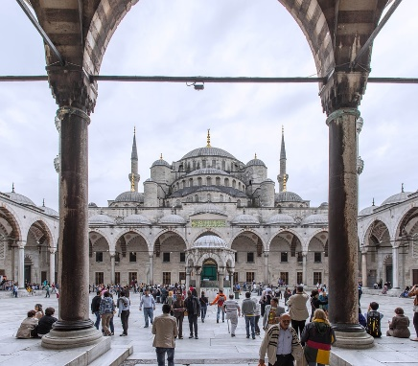
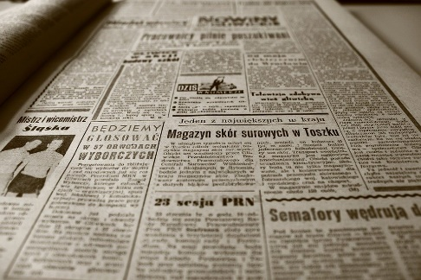
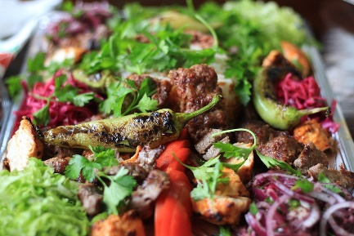
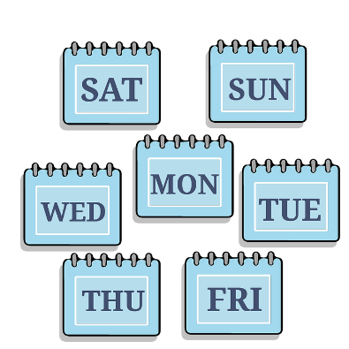
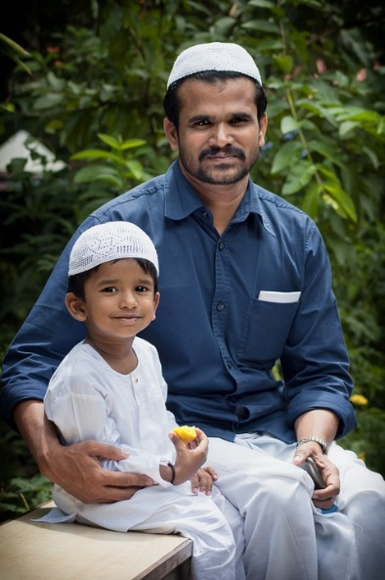
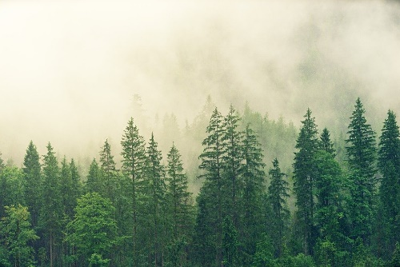
Vokabeln [2/2]
hören
A,B,C? Englisch
K
I
J
9
P
favourite wood
10
I
favourite newspaper
11
L
favourite day
L
12
J
main meal
M
N
13
K
main mosque
14
M
main mountain
15
N
favourite picture
O
P
16
O
main work

Slide 30
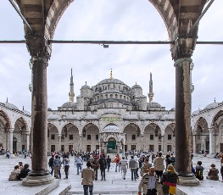
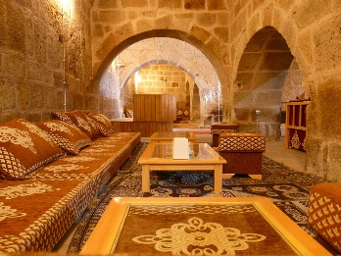
Vokabeln
sprechen
Sag die Wörter so schnell wie möglich.
A
B
C
D
favourite wood/forest
main door
favourite food
main meal
E
F
G
H
main language
main street
main mosque
favourite day
I
J
K
L
favourite room
favourite course
main mountain
favourite animal
M
N
O
P
main building
main work
favourite newspaper
favourite picture
Notes:
Timing: 5 minutes Aim: to practise spoken recall of compound nouns with Lieblings- and Haupt- prefixes and known vocabulary base words from this week’s vocabulary set.
Procedure:
Students work in pairs.
One says a random letter and the other says the word in German as fast as possible.
Students take turns.

Slide 31
Word patterns
Grammatik
Add prefix Haupt- to nouns to mean ‘main ’
Notes:
Add prefix Lieblings- to nouns to mean ‘favourite’

Slide 32
Word patterns
Grammatik
Introduction
Y8 T3.1 Week 5 Slides 39-40
Notes:
7.1.1.7

Slide 33
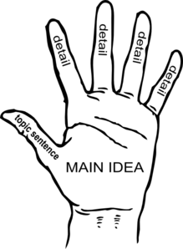
German ←→ German
Note the gender: die Idee → die Hauptidee.
Add Haupt- to nouns to mean ‘main.
That is the main idea.
Das ist die Hauptidee.
What would the following nouns be in German?
main train station main (high) street main role main reason Choose one and write a sentence in German.
Translate these sentences.
1. Wien ist die Hauptstadt von Österreich!
2. That is the main problem.
Notes:
Timing: 5 minutes
Aim: Introduce the prefix H/haupt- and practise written comprehension and production of compound nouns using it.
Procedure:
1. Click through the presentation and elicitation steps. 2. Correct answers on the following slide. 3. Then pronounce the words.
Word frequency: Hauptstadt [1694] Idee [451] Stadt [204] Rolle [385] Problem [210] Grund [249] Bahnhof [2027] Straße [391]
Other high frequency words that combine with H/haupt-: Wort [195] Ziel [320] Fach [1731]
Source: Jones, R.L. & Tschirner, E. (2019). A frequency dictionary of German: core vocabulary for learners. Routledge

Slide 34
ANTWORTEN
For main city we say ‘capital’ city
Wien ist die Hauptstadt von Österreich!
That is the main problem.
main train station
main (high) street
main role
main reason
Vienna is the capital city of Austria!
Das ist das Hauptproblem.
der Hauptbahnhof
die Hauptstraße
die Hauptrolle
der Hauptgrund
What do you notice about the gender of these nouns?
They are the gender of the final noun.
Don’t forget to pronounce the words!

Slide 35
Word patterns
Grammatik
Consolidation [1]
Y9 T2.1 Week 6 Slides 8-11

Slide 36
Lieblings-, Haupt-
Remember!
Lieblings- means favourite Haupt- means main
_________
_________
These prefixes can be added to almost any noun to make a new word.
favourite language 
die Lieblingssprache
main place 
der Hauptort
Note: two words in English become one word in German.
The gender of the new noun is the gender of the base word.
The gender of the new noun is the gender of the base word.
Notes:
Timing: 1 minute
Aim: to revisit the meaning of two known prefixes in German and their function in creating new nouns.
Procedure:
Click through the animations and elicit the meaning of the German as indicated.
Click to bring up callouts to compare German and English noun formation.

Slide 37
Vokabeln [1/2]
Hör zu. Ist es A, B, ? Schreib das englische Wort.
hören
C
A,B,C? Englisch
1
C
favourite animal
A
2
B
main door
B
A
main street
3
4
H
favourite course
E
D
F
main building
5
6
G
favourite room
7
E
favourite food
G
8
D
main language
F
H
Notes:
Timing: 15 minutes (three slides) – 10 minutes listening, 5 minutes spoken recall
Aim: to practise aural comprehension of vocabulary from this week’s revisited set from Y7 and Y8.
Procedure:
1. Give students a minute in pairs to look at the pictures and anticipate the vocabulary items they will hear.
2. Click the number triggers to play the audio.
3. Students match to the correct picture and write the word in English if they are able.
4. Click to bring up the answers.
Transcript:
1] Lieblingstier 2] Haupttür 3] Hauptstraße 4] Lieblingskurs 5] Hauptgebäude 6] Lieblingsraum 7] Lieblingsessen 8] Hauptsprache 9] Lieblingswald 10] Lieblingszeitung 11] Lieblingstag 12] Hauptessen 13] Hauptmoschee 14] Hauptberg 15] Lieblingsbild 16] Hauptarbeit

Slide 38
Vokabeln [2/2]
hören
A,B,C? Englisch
K
I
J
9
P
favourite wood
10
I
favourite newspaper
11
L
favourite day
L
12
J
main meal
M
N
13
K
main mosque
14
M
main mountain
15
N
favourite picture
O
P
16
O
main work

Slide 39
Vokabeln
sprechen
Sag die Wörter so schnell wie möglich.
A
B
C
D
favourite wood/forest
main door
favourite food
main meal
E
F
G
H
main language
main street
main mosque
favourite day
I
J
K
L
favourite room
favourite course
main mountain
favourite animal
M
N
O
P
main building
main work
favourite newspaper
favourite picture
Notes:
Timing: 5 minutes Aim: to practise spoken recall of compound nouns with Lieblings- and Haupt- prefixes and known vocabulary base words from this week’s vocabulary set.
Procedure:
Students work in pairs.
One says a random letter and the other says the word in German as fast as possible.
Students take turns.

Slide 40
Word patterns
Grammatik
Add prefix un- to adjectives mean the opposite (e.g. unmöglich, unglücklich)
Notes:
7.1.1.7

Slide 41
Word patterns
Grammatik
Introduction
Y8 T1.1 Week 7 Slides 20-21
Notes:
8.1.1.7

Slide 42
English → German → English
Add un- to make some German adjectives negative, as in English un-/im-.
That is impossible!
Das ist unmöglich!
Translate these sentences.
1. Die Stadt ist unfreundlich und unangenehm.
2. He is still rather unhappy.
What would the following be in German?
uninteresting unhealthy uncomfortable Choose one and write a sentence in German.
Notes:
Timing: 5 minutes (both slides)
Aim: Word pattern tasks have been written particularly with the NCELP Y8 SOW in mind. Current thinking is to include one short activity to introduce and practise a pattern once every two weeks.
We have not included every single pattern that exists, of course - just those where there were sufficient, high-frequency words in the top 2000 to suggest that it would be a useful pattern to highlight to students in Y8. NB: Within the Y8 German SOW document you will find a ‘word patterns’ tab, an inventory of all the patterns and their words that were considered. The idea is that these patterns not only reinforce, revisit, extend vocabulary knowledge, but they also revisit key basic grammar knowledge (parts of speech, capital letters on nouns, definite articles/gender, plural rules) and can provide opportunities for students to apply their phonics knowledge when they sound out the new words they've created. In short, these are PVG-rich tasks.
Suggested procedure:
1. Click on the mouse to animate the explanation.
2. Students tranlsate the sentences and words shown.
Word frequency: interessant [810], uninteressant [>5009], glücklich [1070], unglücklich [3772], gesund [1275], ungesund [>5009], möglich [171], unmöglich [1879], angenehm [2214], unangenehm [2870] freundlich [1566], unfreundlich [>5009], bequem [3369], unbequem [>5009]
Source: Jones, R.L. & Tschirner, E. (2019). A frequency dictionary of German: core vocabulary for learners. Routledge
Note: the negative versions of these adjectives do not tend to fall within the top 5000 words. However, their affirmative pairs are high-frequency and this short task provides a useful way to revisit their form and meaning.
Image by mohamed Hassan from Pixabay

Slide 43
ANTWORTEN
Die Stadt ist unfreundlich und unangenehm.
He is still rather unhappy.
uninteresting
unhealthy
uncomfortable
The town is unfriendly and unpleasant.
Er ist (immer) noch ziemlich unglücklich.
uninteressant
ungesund
unbequem
Note: immer is often added to ‘noch’ to emphasise ‘still’.
Don’t forget to pronounce the words!
Notes:
This slide shows the answers to the questions on the previous slide.
Word frequency: interessant [810], uninteressant [>5009], glücklich [1070], unglücklich [3772], gesund [1275], ungesund [>5009], möglich [171], unmöglich [1879], angenehm [2214], unangenehm [2870] freundlich [1566], unfreundlich [>5009], bequem [3369], unbequem [>5009]
Source: Jones, R.L. & Tschirner, E. (2019). A frequency dictionary of German: core vocabulary for learners. Routledge
Note: the negative versions of these adjectives do not tend to fall within the top 5000 words. However, their affirmative pairs are high-frequency and this short task provides a useful way to revisit their form and meaning.

Slide 44
Word patterns
Grammatik
Consolidation [1]
Y9 T3.2 Week 2

Slide 45
Word patterns
Grammatik
Add suffix -te (1-19) and -ste (20-) to change cardinal into ordinal numbers (e.g. zweite, zwanzigste)
Notes:
7.1.1.7

Slide 46
Word patterns
Grammatik
Introduction
Y7 T3.2 Week 6 Slides 23-24
Notes:
8.1.1.7

Slide 47
Wann ist das?
Use ‘der’ because it’s ‘der Tag’.
Grammatik
Don’t use ‘of’ in German.
As in English, use ordinal numbers to say dates in German:
Add -te to the numbers 1-19:
Heute ist der neunte Juli.
Today is the ninth of July.
Exceptions:
Add -ste to the numbers 20+:
Heute ist der zwanzigste August.
der erste - 1st
Today is the twentieth of August.
der dritte - 3rd
To say ‘on the’ use an + dem → am:
der siebte - 7th
das Konzert ist am neunten Juli.
Note: After ‘am’ also add -n to the number.
Nein! Es ist am zwanzigsten August.
Notes:
Time: 2 minutes
Aim: To introduce the way to form ordinal numbers in German, and how to use them to say which day it is (R1-nominative) and when an event is taking place (an+R3-dative).
Note: Students already know ‘der Erste / die Erste / das Erste’ as a noun. We will return to dates again in Y8 when we teach prenominal adjectives more broadly as a structure.
Procedure:
1. Teachers present the new information. It is animated to allow for a paced, interactive delivery, eliciting the English for the examples from students. Audio has been added to the final two examples, so that students can hear how the ordinal numbers sound.
2. Click on each speech bubble to hear it.

Slide 48
Wann ist das?
lesen
Mia schreibt Katja ihre Ideen für den Sommer. Ihr Handy hat Probleme! Was schreibt sie? Schreib die Nummern richtig.
1
2
3
Also, das Konzert ist am fünfundzwanzigsten Juni.
die Grillparty ist am vierten Juli.
der Filmabend
ist am zwölften Juli.
4
5
6
Das Theaterstück* ist am achtzehnten Juli.
Die Show ist am sechsundzwanzigsten Juli…
..und der Tanzabend ist am dreißigsten August. Toll, nicht?
Notes:
Time: 5 minutes
Aim: To focus on the two different ways to form ordinal numbers.
Note: The endings -ten and -sten are obscured. Students decide which ending is needed, based on the cardinal number that is visible.
Procedure: 1. Students read the sentences and write the full ordinal number. 2. Answers are revealed on mouse clicks. Full sentence answers can be elicited to practise saying the dates.

Slide 49
Word patterns
Grammatik
Consolidation [1]
Y8 T3.2 Week 2 Slide 51

Slide 50
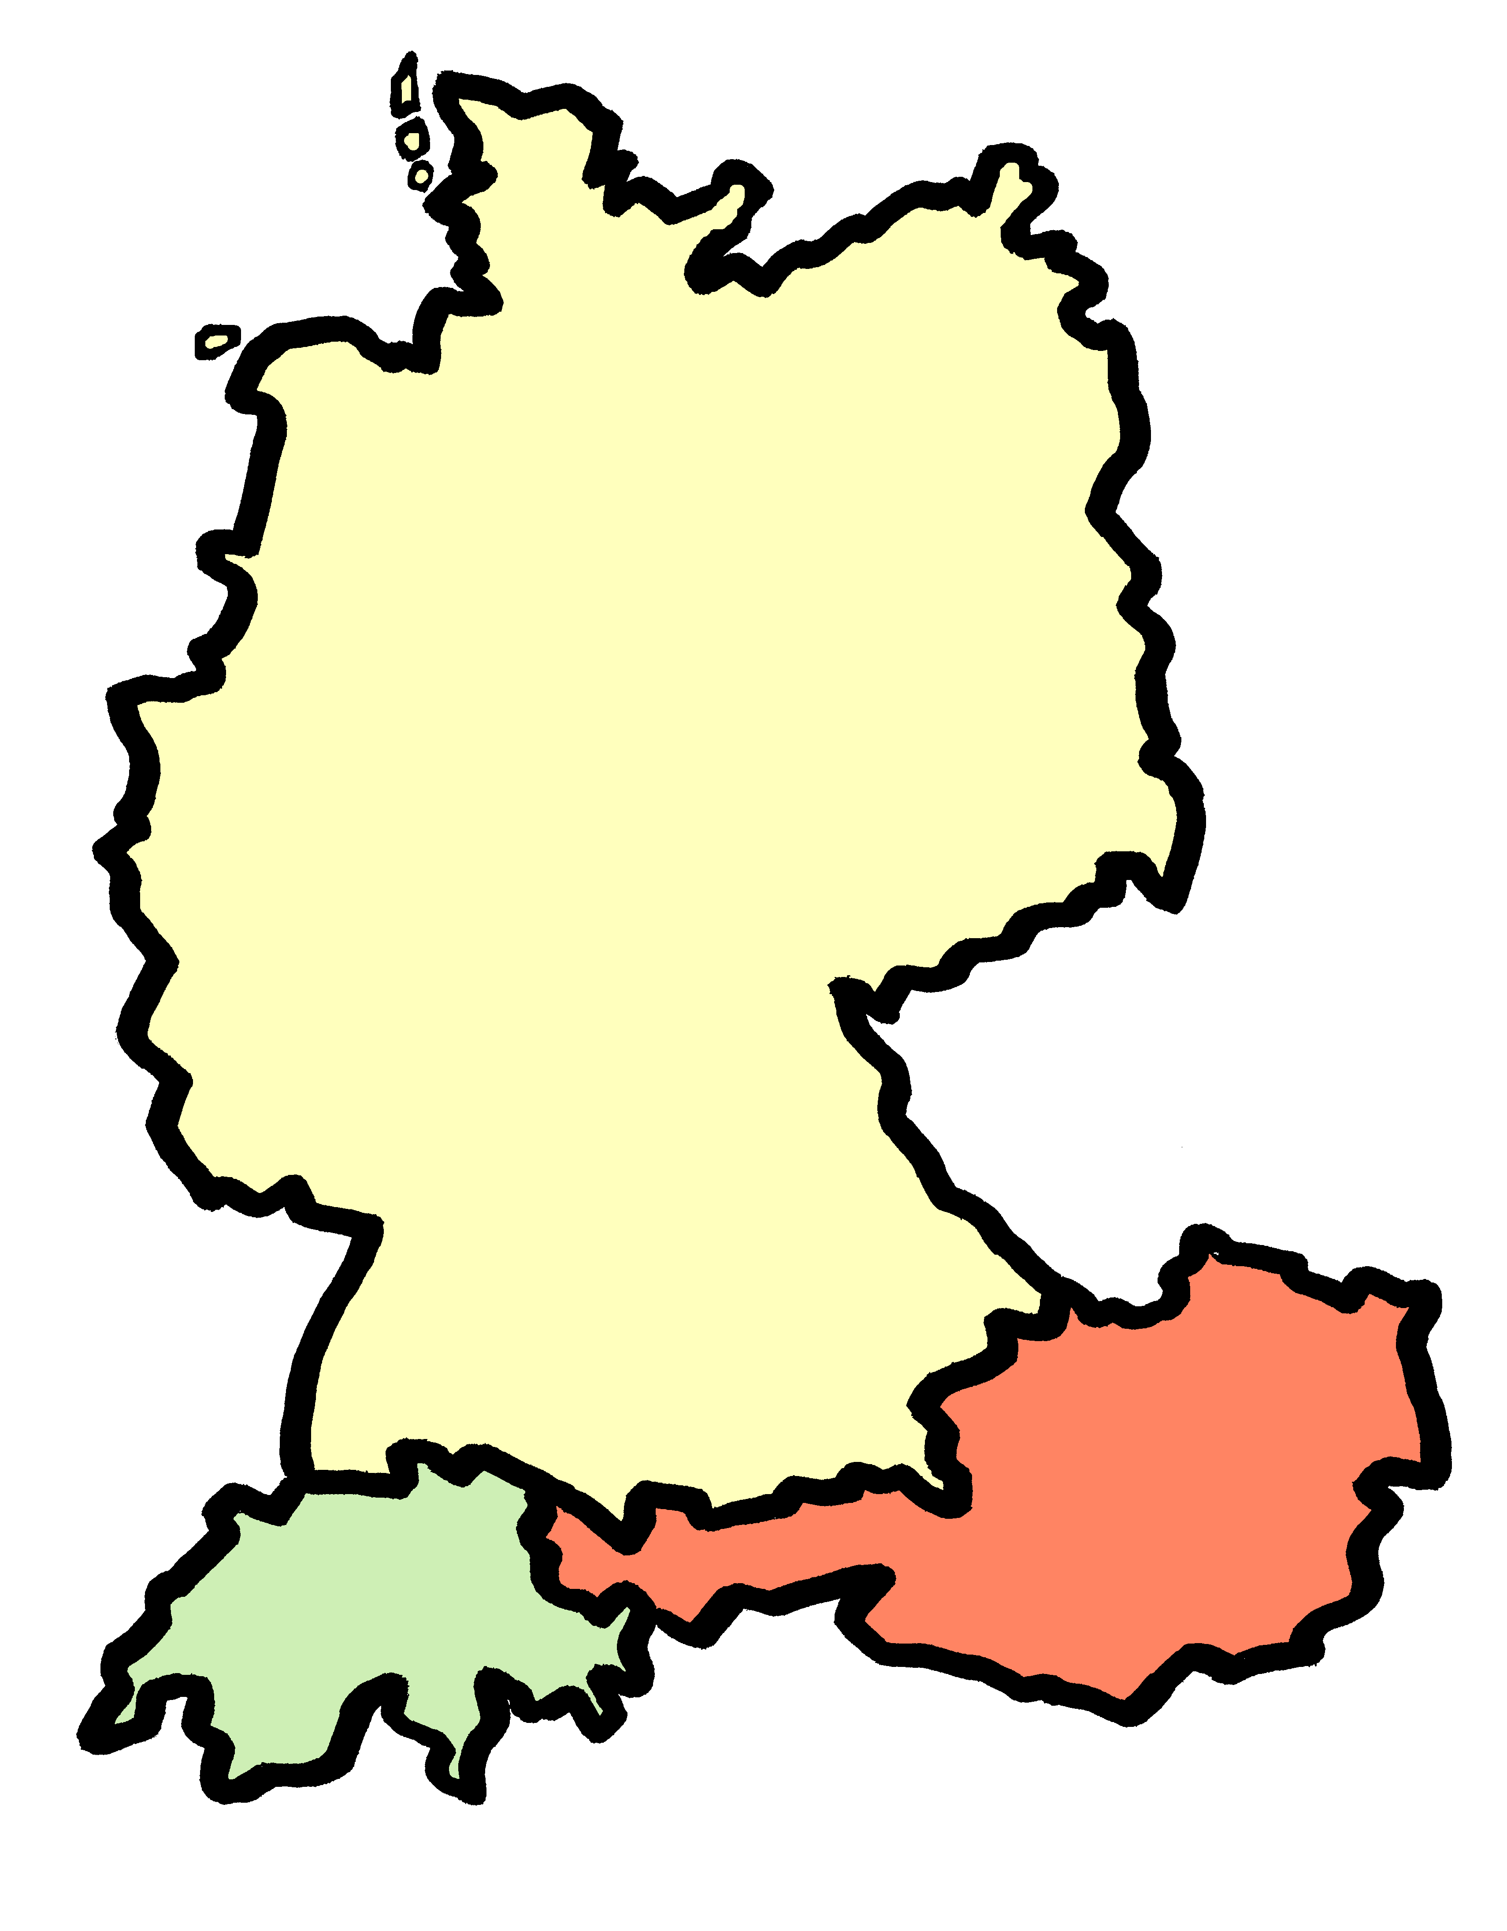
Wann ist das?
schreiben
vollständig – in full
Mia liest Infos über ihre Lieblingsband, Mondlicht, und schreibt mit Andrea. Schreib die Daten vollständig* auf.
1
Also ihre Tourdaten… am 25.06 sind sie in Berlin. Das ist jetzt! ☺
2
3
...am 28.06 in Leipzig...
...und am 14.07 in München.
am fünfundzwanzigsten Juni
am achtundzwanzigsten Juni
am vierzehnten Juli
4
5
6
Dann sind sie am 17.07 in Zürich...
...am 24.07 in Salzburg...
...und schließlich am 03.08 in Wien.
Toll, nicht?
am siebzehnten Juli
am vierundzwanzigsten Juli
am dritten August
Notes:
Time: 7 minutes
Aim: This writing activity practises written production of ordinal numbers in dates. Students practise how to write the number and form the date correctly.
Procedure: 1. Students read the sentences and write the full ordinal number for each date. 2. Answers are revealed on mouse clicks.
3. Full sentence answers can be elicited to practise saying the dates.
Word frequency of cognate words (1 is the most frequent word in German):
Band [>5000]
Source: Jones, R.L & Tschirner, E. (2019). A frequency dictionary of German: Core vocabulary for learners. London: Routledge.

Slide 51
Word patterns
Grammatik
Consolidation [2]
Y9 T2.1 Week 4 Slides 20-22

Slide 52
Wann ist das?
Grammatik
Use ‘der’ because it’s ‘der Tag’.
Don’t use ‘of’ in German.
As you know, we use ordinal numbers to say dates in German:
Add -te to the numbers 1-19:
Heute ist der neunte Juli.
Today is the ninth of July.
Exceptions:
Add -ste to the numbers 20+:
Heute ist der zwanzigste August.
der erste – 1st
Today is the twentieth of August.
der dritte – 3rd
To say ‘on the’ use an + dem → am:
der siebte – 7th
Das Konzert ist am neunten Juli.
Note: After ‘am’ also add -n to the number.
Nein! Es ist am zwanzigsten August.
Notes:
Time: 2 minutes
Aim: to recap how to form ordinal numbers in German, and how to use them to say which day it is (R1-nominative) and when an event is taking place (an+R3-dative).
Procedure: 1. Click to present the information. 2. Elicit English from students.

Slide 53
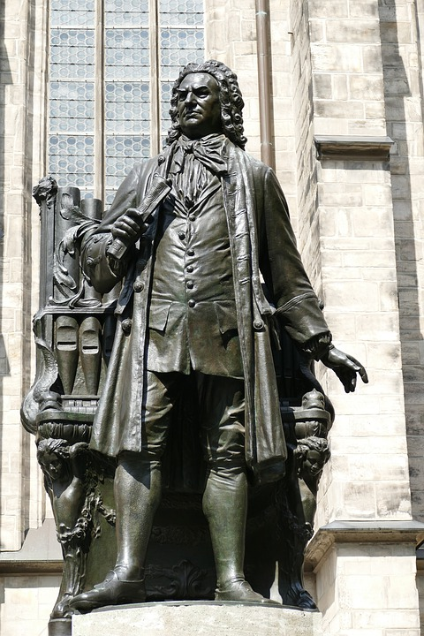
Johann Sebastian Bach
lesen / schreiben
Remember, add -te to numbers 1-19 and –ste to numbers 20+ to make them ordinal.
Cardinal or ordinal number?
Schreib die Nummern richtig.
After ‘am’ also add -n to an ordinal number.
Das ist Johann Sebastian Bach der Erste. Er war ein berühmter Komponist*. Er wurde am einunddreißigsten März 1685 geboren. Er hat über tausend Musikstücke geschrieben. Er hatte zwei Frauen und zwanzig Kinder! Seine zweite Frau, Anna Bach, war Sängerin. Sein fünfter Sohn, Johann, war auch Komponist. Johann Bach ist am achtundzwanzigsten Juni 1750 gestorben, er war fünfundsechzig Jahre alt.
1
31
1000
2
20
2
5
28
65
*der Komponist – composer
Notes:
Timing: 5 minutes Aim: to revisit ordinal numbers and contrast with cardinal numbers.
Note: A less challenging version can be found on the next slide. Procedure: 1. Explain to students that the number written in full under the orange squares could either be cardinal or ordinal.
2. Ask them to work out from the context which it should be and then to write out the number in full.
3. Click to reveal the answers.
Word frequency of unknown words (1 is the most frequent word in German):
Komponist [4778] Source: Jones, R.L. & Tschirner, E. (2019). A frequency dictionary of German: core vocabulary for learners. Routledge

Slide 54
Johann Sebastian Bach
lesen / schreiben
Remember, add -te to numbers 1-19 and –ste to numbers 20+ to make them ordinal.
Cardinal or ordinal number?
Schreib die Nummern richtig.
After ‘am’ also add -n to an ordinal number.
Das ist Johann Sebastian Bach der Erste. Er war ein berühmter Komponist*. Er wurde am einunddreißigsten März 1685 geboren. Er hat über tausend Musikstücke geschrieben. Er hatte zwei Frauen und zwanzig Kinder! Seine zweite Frau, Anna Bach, war Sängerin. Sein fünfter Sohn, Johann, war auch Komponist. Johann Bach ist am achtundzwanzigsten Juni 1750 gestorben, er war fünfundsechzig Jahre alt.
1st
31st
1000
2
20
2nd
5th
28th
65
*der Komponist – composer
Notes:
Timing: 5 minutes Aim: to revisit ordinal numbers and contrast with cardinal numbers.
Note: A more challenging version can be found on the previous slide. Procedure: 1. Ask students to write out the number behind each orange box in full. The boxes highlight whether the number should be ordinal or cardinal.
2. Click to reveal the answers.
Word frequency of unknown words (1 is the most frequent word in German):
Komponist [4778] Source: Jones, R.L. & Tschirner, E. (2019). A frequency dictionary of German: core vocabulary for learners. Routledge

Slide 55
Word patterns
Grammatik
Add suffix -ung to a verb stem to change into nouns with equivalent and transparent meaning (e.g., lösen > die Lösung)
Notes:
Add suffix -ung to a verb stem to change into nouns with equivalent and transparent meaning (e.g., lösen > die Lösung)

Slide 56
Word patterns
Grammatik
Introduction
Y8 T1.2 Week 4 Slides 24-25
Notes:
8.1.2.4

Slide 57
English → German → English
All German nouns ending in -ung are feminine.
Many German nouns end in -ung, meaning –tion (or –ion) in English.
I have the solution. I can solve the problem.
Ich habe die Lösung. Ich kann das Problem lösen.
Use these verbs to help you understand / create the nouns: bilden - to educate, beschreiben - to describe, meinen - to hold an opinion, erklären - to explain, prüfen - to examine.
Translate these sentences.
1. Die Bildung ist total wichtig!
2. The description is not clear.
What would the following nouns be in German?
opinion explanation examination Choose one and write a sentence in German.
Notes:
Timing: 5 minutes Aim: To introduce and practise the word pattern –ung in German. Procedure: 1. Use the animations to present and elicit key information.
2. Students complete the tasks. 3. Answers on the next slide.
Note: words selected are all within the most frequent 2000 words in German. There are many more nouns and verbs like this in the most frequent 2000 words.
Word frequency: die Lösung [317] lösen [625] die Meinung [787] meinen [213] die Bildung [850 bilden [315] die Erklärung [1185] erklären [238] die Beschreibung [1666] beschreiben [435] die Prüfung [1827] prüfen [1408]
Source: Jones, R.L. & Tschirner, E. (2019). A frequency dictionary of German: core vocabulary for learners. Routledge
Image from publicdomainpictures.net

Slide 58
ANTWORTEN
Die Bildung ist total wichtig!
The description is not clear.
opinion
explanation
examination
Education is totally important!
Die Beschreibung ist nicht klar.
die Meinung
die Erklärung
die Prüfung
What do you notice about the gender of these nouns?
Just like ‘Erfahrung’ they are all feminine!
Don’t forget to pronounce the words!

Slide 59
Word patterns
Grammatik
Consolidation [1]
Y8 T1.2 Week 6 Slides 26-27

Slide 60
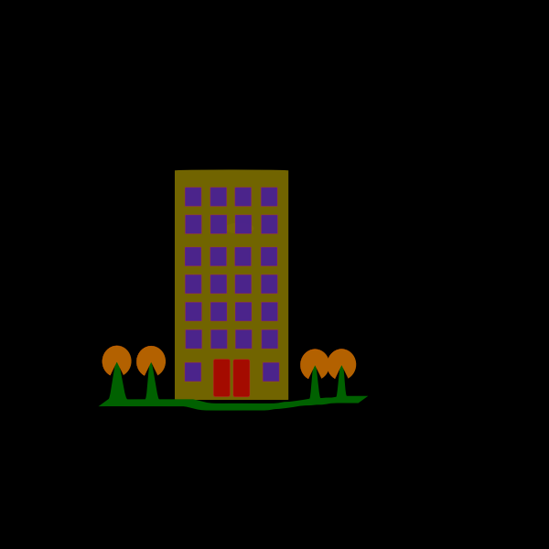
English → German → English
All German nouns ending in -ung are feminine.
Many German nouns end in -ung, meaning -tion OR –ment in English.
I have an apartment. I want to live there.
Ich habe eine Wohnung. Ich will dort wohnen.
Use these verbs to help you understand / create the nouns: bewegen – to move, entwickeln - to develop, verbinden - to connect, entscheiden – to decide, leisten- to achieve.
Translate these sentences.
1. Ich bin glücklich über diese Leistung!
2. The connection is not good.
What would the following nouns be in German?
development decision movement Choose one and write a sentence in German.
Notes:
Timing: 5 minutes Aim: To practise the noun pattern –ung and its connection with infinitive verbs in the written modality. Procedure: 1. Present the information, using the animations. 2. Students complete the word tasks. 3. Answers on the following slide.
Word frequency: die Wohnung [502] wohnen [560] die Leistung [646] leisten [693] die Bewegung [709] bewegen [562] die Entwicklung [347] entwickeln [377] die Verbindung [434] verbinden [452] die Entscheidung [449] entscheiden [414]
Source: Jones, R.L. & Tschirner, E. (2019). A frequency dictionary of German: core vocabulary for learners. Routledge
Note: There are many more nouns and verbs like this in the most frequent 2000 words.

Slide 61
ANTWORTEN
Ich bin glücklich über diese Leistung!
The connection is not good.
opinion
explanation
examination
I am happy about this achievement!
Die Verbindung ist nicht gut.
die Entwicklung
die Entscheidung
die Bewegung
What do you notice about the gender of these nouns?
They are all feminine!
Don’t forget to pronounce the words!

Slide 62
Word patterns
Grammatik
Consolidation [2]
Y9 T2.2 Week 3 Slides 2-3; 24-25

Slide 63
Suffix - ung
Grammatik
Add –ung to a verb stem to create a noun with equivalent meaning.
meinen means to think (be of the opinion)
_________
_________
The gender of –ung nouns is always feminine.
die Meinung means opinion
This pattern works for most verbs. Create the verb from this noun. What does it mean?
_________
die Leistung means achievement, performance
leisten means to achieve, perform
_________
Notes:
Timing: 2 minutes
Aim: to formally introduce the word pattern of adding suffix –ung to a verb stem to create nouns (with equivalent and transparent meaning).
Procedure:
Click through the animations and elicit the meaning of the English as indicated.
Click to bring up the callout about gender.

Slide 64
Wolf und Mia suchen online
Grammatik
Mia and Wolfgang are looking for places to visit.
Deutsch | Englisch | Deutsches Verb | Englisch
die Wohnung | flat, apartment | wohnen | to live, living
die Erfahrung | experience | erfahren | to experience
die Kleidung | clothing | kleiden | to dress
die Ausbildung | training | ausbilden | to train
die Ordnung | order | ordnen | to arrange
die Bevölkerung | population | bevölkern | to populate
die Bewegung | movement | bewegen | to move
die Leistung | achievement, performance | leisten | to achieve, perform
1
2
3
4
5
6
7
8
Notes:
Timing: 8 minutes Aim: to practise using the ‘ung’ word pattern. Procedure: 1. Explain the task. Students are to listen for the ‘ung’ noun (English translation provided). Then they are to write the verb and suggest and English translation.
2. Click on audio buttons to hear the sentences.
3. Click to reveal answers.
Transcript: 1. Diese Wohnung ist bequem mit dem Bus zu erreichen. 2. Hast du schon Erfahrungen mit Glas-Boden-Booten gemacht. 3. [Mia] Hey, dieser Rock ist toll! Ich brauche neue Kleidung!
4. Dieses Museum bietet eine Ausbildung an.
5. Diese Webseite ist in Ordnung, nicht wahr?
6. Guck mal! Die Großstadt hat eine Bevölkerung von mehr als zehn Millionen!
7. Willst du Freitag wandern gehen? Ich will in Bewegung bleiben!
8. Ja! Ich möchte meine Leistung verbessern. Word frequency of unknown words (1 is the most frequent word in German): kleiden [3930] ausbilden [1893] ordnen [2055] bevölkern [>5000] bewegen [561] leisten [693] Source: Jones, R.L. & Tschirner, E. (2019). A frequency dictionary of German: core vocabulary for learners. Routledge

Slide 65
Suffix - ung
Grammatik
Remove –ung from a noun, add –en to create a verb with equivalent meaning:
_____???____
die Bezahlung means payment
_________
bezahlen means to pay, paying
Knowing the verb can help you work out the meaning of the noun, and vice versa.
Notes:
Timing: 1 minute
Aim: to recap the word pattern of removing suffix –ung from a noun to create a verb stem (with equivalent and transparent meaning)
Procedure:
Click through the animations and elicit the meaning of the English as indicated.
Click to bring up callout.

Slide 66
Was machen wir?
Die Familie redet über Aktivitäten. Übersetze die fettgedruckten* Wörter.
Grammatik
fettgedruckt – bold
2
1
Lies mal diese Beschreibung von der Kirche. Wollen wir Mittwoch gehen?
3
Die Stadtführung scheint mir eine gute Option für den ersten Tag!
Oooh wir haben eine Einladung von Mehmets Cousin, der hier wohnt!
city tour
description
invitation
4
5
Ich möchte unbedingt die Autosammlung im Museum besuchen.
Donnerstag Abend können wir alle eine Strandwanderung machen.
collection
walk
6
Die Mischung von Kultur und Sport ist ideal – es gibt etwas für uns alle, nicht wahr?)
mixture
7
8
Alles sieht so toll aus! Jetzt habe ich sehr hohe Erwartungen!
Wildwassersport oder Go-Kart fahren? Die Entscheidung fällt mir schwer.
decision
expectations!
Notes:
Timing: 8 minutes Aim: to apply knowledge of the word pattern suffix –ung + verb stem = noun with transparent meaning from verb in the written comprehension of unknown nouns. Procedure: 1. Explain that students know the verbs that the unknown nouns in bold derive from.
2. Tell them to use their knowledge of the verbs, and the –ung pattern to translate the words in bold.
3. Click to provide English noun meanings.
4. If time allows, elicit also the corresponding verbs, orally.
Word frequency (1 is the most frequent word in German): Option [] Source: Jones, R.L. & Tschirner, E. (2019). A frequency dictionary of German: core vocabulary for learners. Routledge

Slide 67
Word patterns
Grammatik
Add suffix -er to a verb stem (-en verbs) to change into male agent nouns with equivalent and transparent meaning (e.g., besuchen > der Besucher)
Notes:
Add suffix -er to a verb stem (-en verbs) to change into male agent nouns with equivalent and transparent meaning (e.g., besuchen → der Besucher)

Slide 68
Word patterns
Grammatik
Introduction
Y9 T1.2 Week 2 Slides 4-5
Notes:
9.1.1.6

Slide 69
Vokabeln
Make many German person nouns by adding der + capital letter + er to the verb stem:
lesen
Beispiel: arbeiten (to work) → der Arbeiter (worker)
Schreib A-F und das Substantiv:
Schreib G-L und das Verb:
   
A | B
C | D
E | F
G | H
I
K
mitarbeiten
der Mitarbeiter
fahren
der Fahrer
lehren
der Lehrer
schauspielen
der Schauspieler
-ieren verbs remove –ieren and add –er!
___________
___________
__ ___________
__ ___________
Note that [au] changes to [äu] – it changes the pronunciation too!
Note that [au] changes to [äu] – it changes the pronunciation too!
managen
der Manager
singen
der Sänger
übersetzen
der Übersetzer
kaufen
der Käufer
___________
_________
__ ___________
__ ___________
helfen
der Helfer
forschen
der Forscher
verkaufen
der Verkäufer
trainieren
der Trainer
__________
___________
__ ___________
__ ___________
übersetzen – to translate
Notes:
Timing: 5 minutes Aim: to practise a highly frequent word pattern. In the list of 2000 most frequent words, 205 additional words can be created by taking either the infinitive verb and adding der + capital letter +er to create the person noun OR verbs by reversing the pattern. Procedure: 1. Click through animations explaining the word pattern. Note that students either already know the verb OR the noun, with the exception of übersetzen, which is therefore glossed.
2. A-F: students write the noun based on the verb, following the pattern. Nb. D and E: after item E, the next click will bring up a bubble drawing attention to [au] → [äu]. Go over difference in pronunciation too.
3. G-L: students write the verb based on the noun, reversing the pattern.
Transcript: 1. mitarbeiten → co-worker (Mitarbeiter)
2. trainieren → coach (Trainer)
3. fahren → driver (Fahrer)
4. kaufen → buyer (Käufer)
5. verkaufen → seller/salesperson (Verkäufer)
6. übersetzen → translator (Übersetzer)
7. Lehrer → to teach/train (lehren)
8. Schauspieler → to act (schauspielen)
9. Manager → to manage (managen)
10. Sänger → to sing (singen)
11. Helfer → helper/assistant (helfen)
12. Forscher → to research (forschen)
Word frequency unknown words (1 is the most frequent word in German): Mitarbeiter [639] Trainer [1003] Fahrer [1554] Käufer [2051] Verkäufer [2374] Übersetzer [2902] übersetzen [1765] lehren [2540] schauspielen [>5009] managen [>5009] singen [1063] helfen [338] forschen [4222] Source: Jones, R.L. & Tschirner, E. (2019). A frequency dictionary of German: core vocabulary for learners. Routledge

Slide 70
Phonetik
Person A wählt aus, Person B spricht.
Dann tauscht die Rollen.
lesen / sprechen
Person A:
Diese Person trainiert als Beruf.
1.
Person B:
Trainer
[driver]
60
For the German word ending –er, drop your jaw more than you would for English –er.
9
Fahrer
[actor]
5
Schauspieler
10
[translator]
[researcher]
2
6
[salesperson]
Übersetzer
Forscher
Sekunden
Verkäufer
[teacher]
11
[buyer]
3
7
[helper/assistant]
Lehrer
Käufer
Helfer
[co-worker]
[manager]
[singer]
0
4
8
12
Mitarbeiter
Manager
Sänger
LOS!
Notes:
Timing: 5 minutes Aim: to practise the new word pattern in oral production. For differentiation, two versions can be used with this slide. Procedure:
1. Click to bring up bubble explaining that German ending –er sounds different to English ending –er. Compare helper/ Helfer, trainer/ Trainer.
More challenging version: 2. Students describe the person’s job. Person A: “Diese Person trainiert als Beruf”, Person B: “Trainer. Diese Person forscht als Beruf”, Person A: “Forscher”, etc.
Easier version:
2. Students pick and read out an item number. Person A: “Nummer 1”, Person B:” Trainer. Nummer 12”, Person A: ”Forscher”, etc.
For both versions:
3. Use timer if appropriate for your class.
4. Click to reveal answers.
Word frequency unknown words and cognates (1 is the most frequent word in German): Mitarbeiter [639] Trainer [1003] Fahrer [1554] Käufer [2051] Verkäufer [2374] Übersetzer [2902] übersetzen [1765] lehren [2540] schauspielen [>5009] managen [>5009] forschen [4222] Source: Jones, R.L. & Tschirner, E. (2019). A frequency dictionary of German: core vocabulary for learners. Routledge
Note that students either know the noun or the verb already, with the exception of übersetzen / Übersetzer

Slide 71
Word patterns
Grammatik
Add suffix -s to nouns for days and times of day to change into adverbs (e.g., Montag > montags; Nachmittag > nachmittags)
Notes:
Add suffix -er to a verb stem (-en verbs) to change into male agent nouns with equivalent and transparent meaning (e.g., besuchen → der Besucher)

Slide 72
Word patterns
Grammatik
Introduction
Y7 T3.1 Week 2 Slides 12-14; 17
Notes:
9.1.1.6

Slide 73
‘Am Montag’ oder ‘montags’?
Der Tag is a masculine noun, so Dienstag and Nachmittag are masculine, too!
Grammatik
As you know, days of the week and times of day (der Dienstag, der Nachmittag) are nouns.
We add ‘am’ to talk about what we are doing on a specific day, or at a specific time of day:
To talk about what we normally do on a day or time of day, we change the nouns into adverbs.
We do this by removing the capital letter and adding –s.
Use am Dienstag to talk about a one-off event. Use dienstags to talk about a regular event.
Ich spiele am Dienstag im Orchester.
am Dienstag
on Tuesday
I’m playing in the orchestra on (this) Tuesday.
am Nachmittag
in the afternoon
Ich spiele dienstags im Orchester.
dienstags
on Tuesdays
I (always) play in the orchestra on Tuesdays.
nachmittags
in the afternoons
Notes:
Timing: 3 minutes
Aim: To explain how to talk about what we are doing on specific days/at specific times, as contrasted with what we normally do on a particular day/at a particular time.
Procedure:
1. Teachers to invite students to suggest the English for ‘Am Montag’ and ‘montags’. They know ‘am Montag’ from 3.1.1 and are likely to make the link from the English ‘s’ to ‘Mondays’. 2. Cycle through the information on the slide using the animation sequence. The English sentence ‘I’m playing in the orchestra on Tuesday’ appears before its German translation, so that teachers can elicit the German from students.
3. Teacher to point out the present tense difference in English. Present continuous with nouns (one-off events), present simple with adverbs (repeated events). 4. Teacher also to elicit from students the reason why ‘dienstags’ doesn’t have a capital letter, but ‘am Dienstag’ does, to reinforce the knowledge of word classes and German use of a capital letter on all nouns.
Note: The text in the bubble provides an opportunity for teachers to revise compound noun formation, first encountered in week 1.1.1 as a phonics cluster word and in 1.1.2 as part of a vocabulary set.

Slide 74
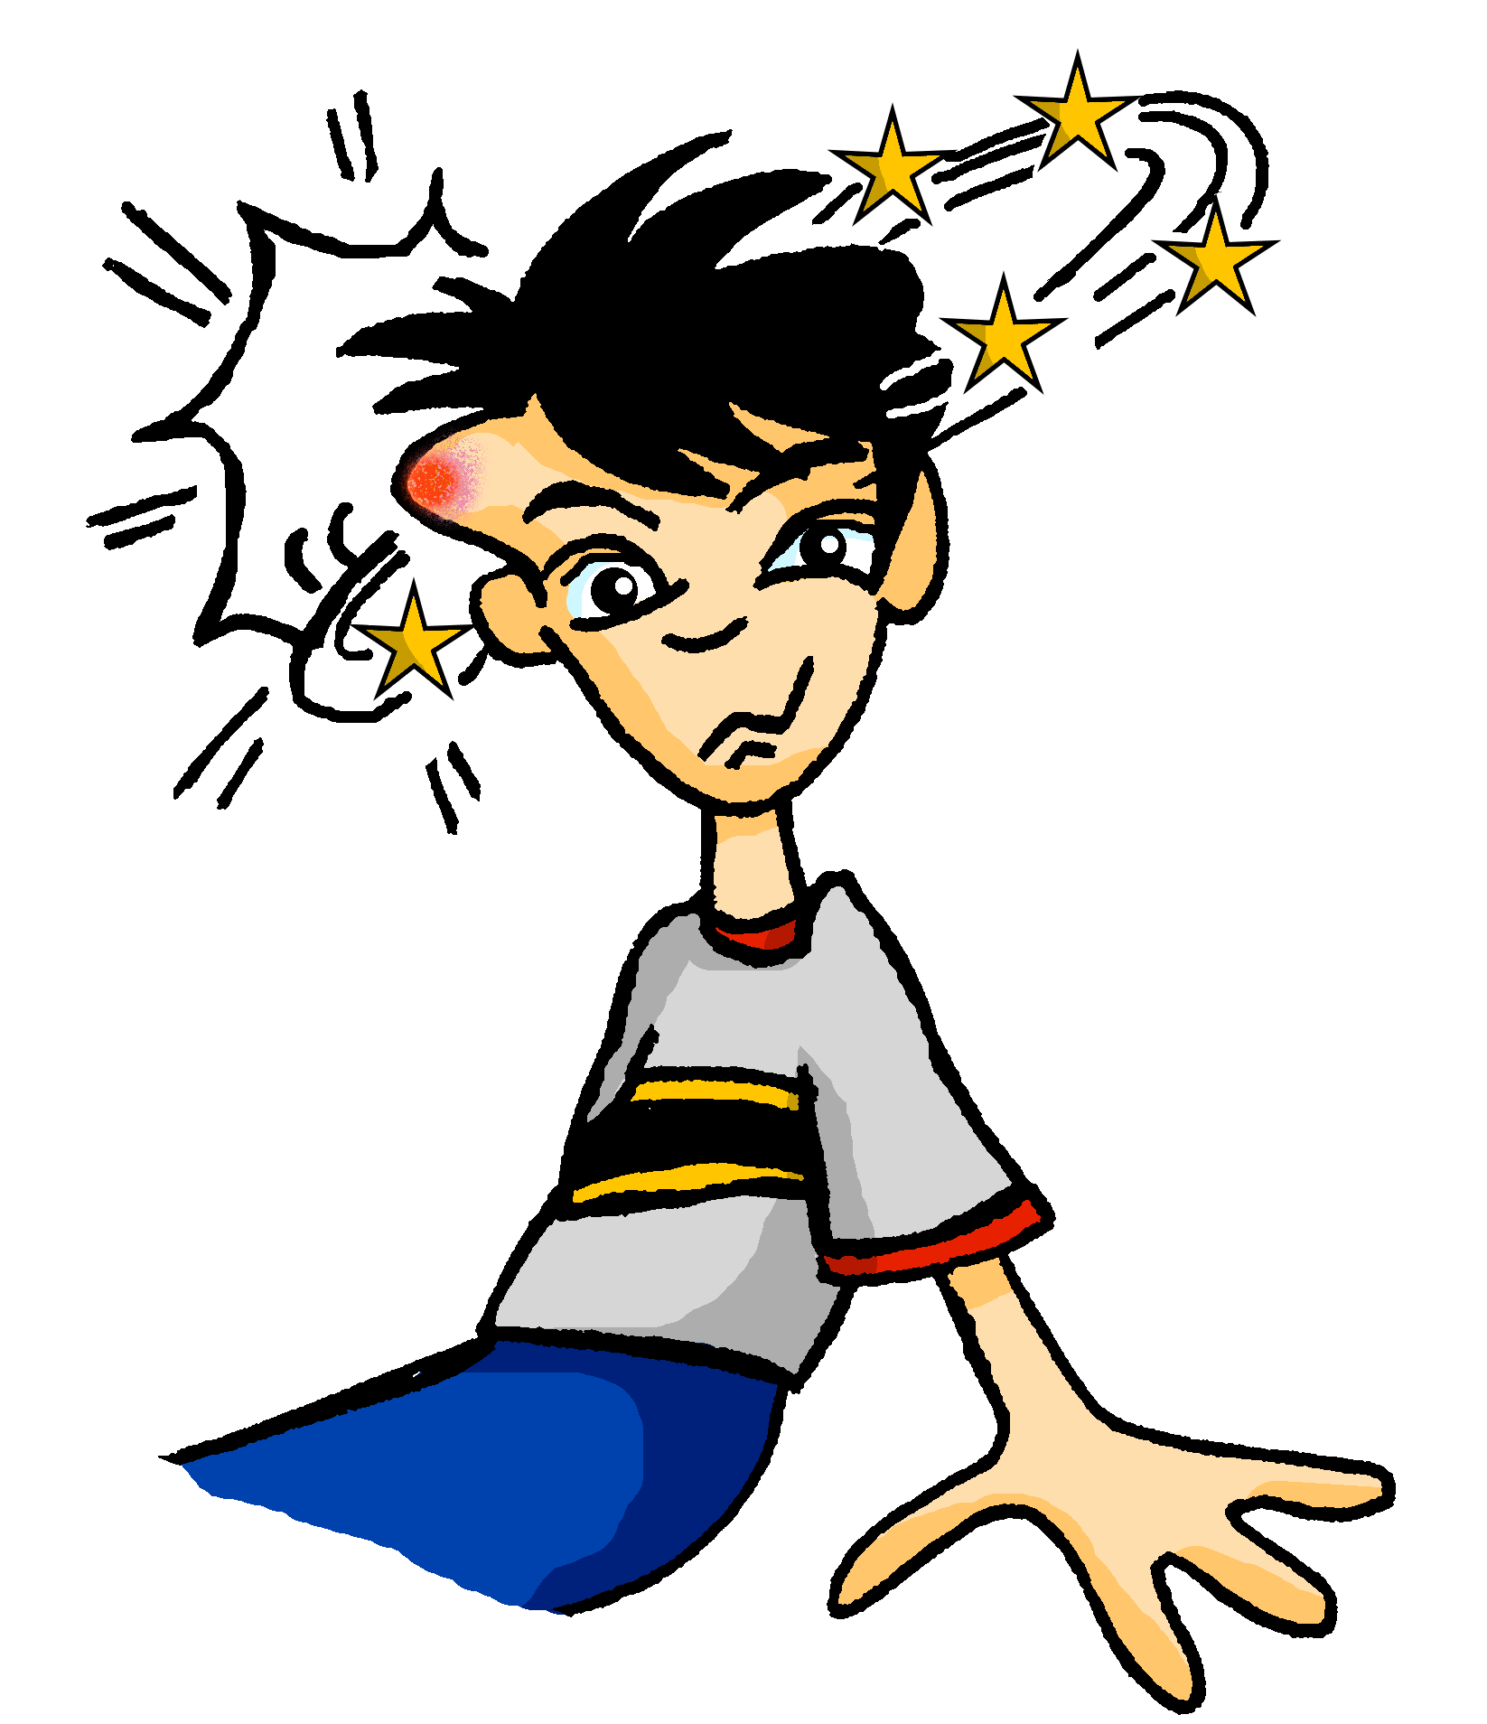
Wolfgangs Kopf!
hören
Wolfgang braucht einen Arzt! Der Arzt hat viele Fragen. Is the doctor asking questions about the week ahead, or about Wolfgang’s regular routine?
 | week ahead | regular routine
 |  | nachmittags
 | am Sonntag
 |  | abends
 |  | morgens
 | am Montag
 | am Abend
 |  | samstags
1
2
3
4
5
6
7
Notes:
Timing: 7 minutes
Aim: To connect temporal adverbials forms with meaning in the oral modality.
Procedure:
1. Remind students that they must listen carefully to the time phrase to determine whether one-off or habitual actions are being talked about. The presence of am indicates a specific day or time of day. The presence of the –s suffix indicates routine.
2. Audio plays on clicking individual number buttons. Students tick the appropriate column in each case.
3. Answers revealed on clicks.
4. Draw attention to the patterns highlighted in the answer columns.
Transcript:
Läufst du nachmittags oft in den Park?
Kannst du am Sonntag chillen?
Wann gehst du abends schlafen?
Isst du morgens Obst?
Hast du am Montag Schule?
Fährst du am Abend mit dem Fahrrad nach Hause?
Trägst du samstags manchmal einen Hut … ?

Slide 75
Wolfgangs Kopf!
lesen
Der Arzt gibt Wolfgang ein Formular. Was schreibt Wolfgang?
1. Was isst du normalerweise?
Morgens / am Morgen esse ich ein Butterbot und nachmittags / am Nachmittag esse ich Kekse.
2. Was machst du heute?
Ich habe nachmittags / am Nachmittag ein Date und ich spiele abends / am Abend Computer.
3. Fährst du später Fahrrad?
Ich fahre abends / am Abend mit dem Bus
nach Hause.
4. Trinkst du jeden Tag Wasser?
Morgens / am Morgen trinke ich Wasser, aber abends / am Abend trinke ich eine Cola.
5. Machst du jede Woche Sport?
Ich tanze montags / am Montag und spiele freitags / am Freitag mit Freunden Fußball.
6. Kannst du jetzt relaxen?
Ich bleibe sonntags / am Sonntag zu Hause.
Der Arzt denkt, die Antworten sind in Ordnung. Wolfgang kann gehen.
Er gibt Wolfgang einen Pflaster und sagt: ‘Obst essen ist wichtig!’
Notes:
Timing: 8 minutes
Aim: To practise written comprehension of the contextual clues in the questions to decide whether one-off events or routines are being asked about. Then, they must choose a time-phrase accordingly to complete the response.
Procedure:
1. Teacher to remind students that the words in the questions will tell them which form of the time phrase to use. Is the question asking about how things are at the moment, or about general routine?
2. Students have not yet met cognates and near-cognates Formular [>4034], Pflaster [>4034] and normalerweise [1898]. Teacher to clarify meaning.
3. Students state which of the two options is correct in each sentence.
4. Answers revealed on clicks.
Word frequency (1 is the most frequent word in German):
Formular [>4034], Pflaster [>4034] and normalerweise [1898].
Source: Jones, R.L & Tschirner, E. (2011). A frequency dictionary of German: Core vocabulary for learners. London: Routledge.

Slide 76
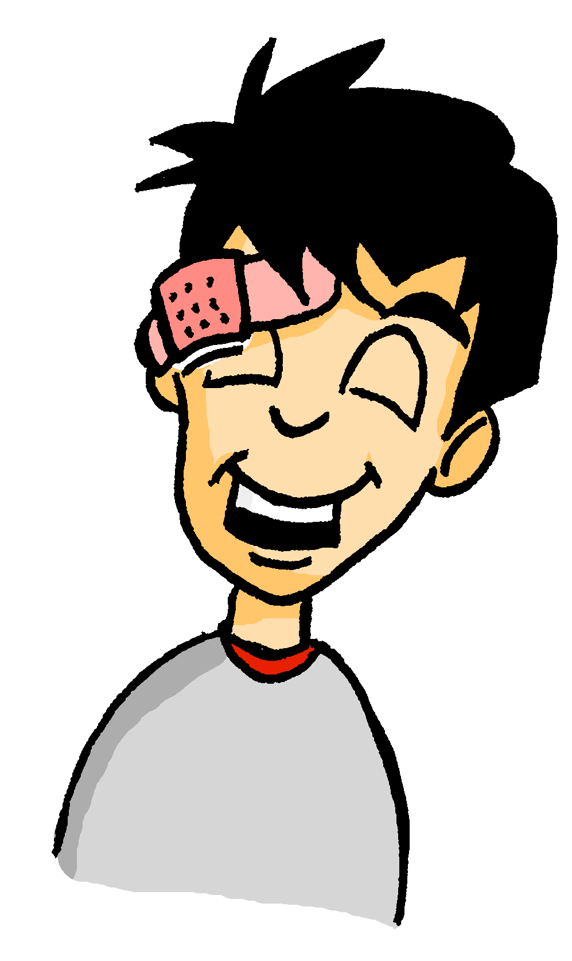
Wolfgang ist hier!
lesen
Was sagt er?
What do you think comes next in English? ‘on/in’ or ‘this’?
1) Sorry, Heidi! Ich schlafe am Samstag / samstags immer viel.
Sorry, Heidi, I always sleep a lot on Saturdays.
2) Und am Morgen / morgens denke ich nicht klar.
And I don’t think clearly in the mornings.
3) Ich habe ein Problem, aber es it okay. Am Abend / abends chille ich.
I have a problem, but it’s okay. I’m chilling out this evening.
4) Und montags / am Montag gehe ich nicht in die Schule!
And I’m not going to school on Monday!
5) Ich trage nachmittags / am Nachmittag einen Hut, denke ich. Los geht’s!
I guess I’m wearing a hat this afternoon. Let’s go!
____________ .
____________ .
____________ .
____________ .
____________ .
Notes:
Timing: 5 minutes
Aim: To revisit the difference in meaning between nominal and adverbial forms of days of the week, this time asking the students to identify the form required using the English tense to help them.
Procedure:
1. Teachers may wish to expand on the hint given in the bubble, explaining that one possible translation of the am + noun form (e.g. am Samstag, am Nachmittag) is ‘this Saturday, this afternoon’, while the adverbial forms (samstags, nachmittags) are most often equivalent to ‘on Saturdays, in the afternoons’ etc.
2. On completing the exercise, teachers should ask students to compare the English tenses with their German translations, highlighting once again that the two English present tense forms (simple and continuous) correspond to only one present tense in German.
3. Answers revealed on clicks. The English appears simultaneously in 1-3, but is delayed by another click in 4 and 5, to allow the teacher to elicit it from the students.

Slide 77
Word patterns
Grammatik
Consolidation [1]
Y9 T3.1 Week 2 Slides 4-5

Slide 78
‘Am Montag’ oder ‘montags’?
Grammatik
You know morgen means morning. Used without am it can also mean tomorrow.
Morgen fahre ich mit dem Zug nach München.
Tomorrow I am going to Munich by train.
As you know, days of the week and times of day (der Dienstag, der Nachmittag) are nouns.
We add ‘am’ to talk about what we are doing on a specific day, or at a specific time of day:
To talk about what we normally do on a day or time of day, we change the nouns into adverbs.
We do this by removing the capital letter and adding –s.
Use am Dienstag to talk about a one-off event. Use dienstags to talk about a regular event.
Am Dienstag fahre ich nach Köln.
am Dienstag
on Tuesday
I’m travelling to Cologne on (this) Tuesday.
am Morgen
in the morning
Dienstags fahre ich nach Köln.
dienstags
on Tuesdays
I (always) travel to Cologne on Tuesdays.
morgens
in the mornings
Notes:
Timing: 2 minutes Aim: to recap the suffix -s to nouns for days and times of day to change them into adverbs.
Procedure:
1. Teachers to invite students to suggest the English for ‘Am Montag’ and ‘montags’. They know ‘am Montag’ and are likely to make the link from the English ‘s’ to ‘Mondays’.
2. Click through the explanation. The English sentence ‘I’m travelling to Cologne on Tuesday’ appears before its German translation, so that teachers can elicit the German from students.
3. Point out the present tense difference in English. Present continuous with nouns (one-off events), present simple with adverbs (repeated events). Teacher also to elicit from students the reason why ‘dienstags’ doesn’t have a capital letter, but ‘am Dienstag’ does, to reinforce the knowledge of word classes and German use of a capital letter on all nouns.
4. Click to bring up a call out to introduce ‘morgen’ as ‘tomorrow’.

Slide 79
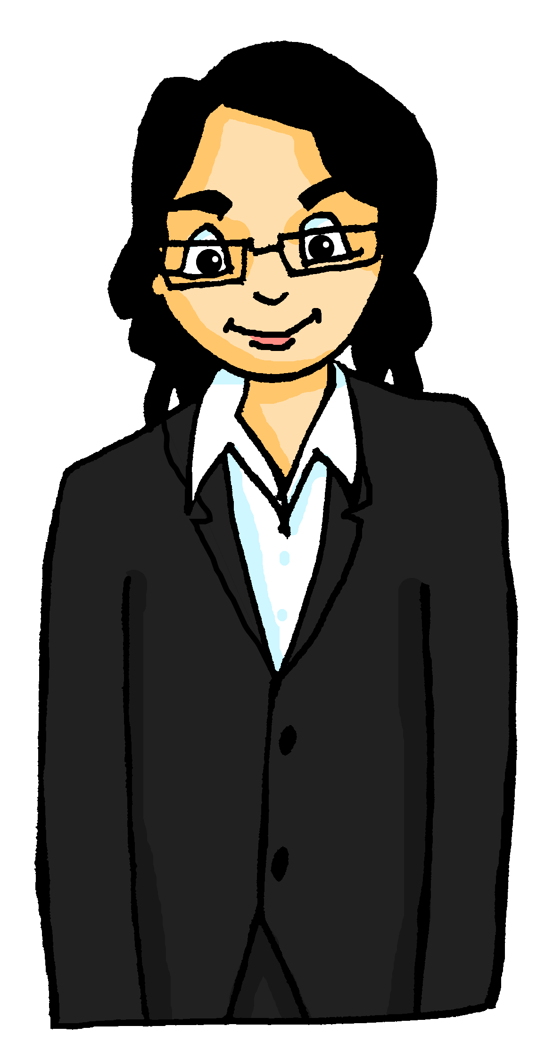
Mutti ruft an
Mutti ruft Mia und Wolfgang an mit Fragen über die Reise.
hören
Is she asking questions about particular plans or their travels in general?
Hör zu. Schreib den Adverb auf Deutsch in die richtige Kategorie. Dann schreib weitere Details auf Englisch.
der Sonnenuntergang – sunset
 | particular plans | travels in general | details
 |  | morgens | travel by train
 | am Montag |  | buy tickets for the castle
 |  | nachmittags | take lots of photos
 |  | abends | visit old villages on foot
 | am Samstag |  | go by car to Schaan
 | am Abend |  | look towards the west
 |  | samstags | trains go fast
1
2
3
4
5
6
7
Notes:
Timing: 5 minutes Aim: to practise aural comprehension and connection of time phrase forms with meaning.
Procedure: 1. Remind students that they must listen carefully to the time phrase to determine whether one-off or habitual actions are being talked about. The presence of am indicates a specific day or time of day. The presence of the –s suffix indicates routine.
2. Click on the audio buttons to hear the sentences. Do the first item in its entirety as an example. (Note: the animations reveal both parts of the answer for number 1. Thereafter the task answers appear first for part 1 and then part 2.
3. Click to listen to items 2- 8. Students decide whether Mutti is asking about particular plans or travels in general. They write the time adverb in German in the correct column.
4. Click to reveal answers. 5. Listen again and write any other details in English. 6. Click to reveal the answers.
Note: if time is short, the comprehension stage can be omitted here as all of the vocabulary will be re-used elsewhere in the sequence.
Transcript
Fahrt ihr morgens mit dem Zug?
Kauft ihr am Montag Karten für das Schloss?
Macht ihr nachmittags viele Fotos?
Besucht ihr abends zu Fuß alte Dörfer?
Fahrt ihr am Samstag mit dem Auto nach Schaan?
Schaut ihr am Abend nach Westen? Der Sonnenuntergang soll schön sein.
Fahren die Züge samstags schnell in Liechtenstein?
Word frequency (1 is the most frequent word in German): Sonnenuntergang [>5000] Source: Jones, R.L. & Tschirner, E. (2019). A frequency dictionary of German: core vocabulary for learners. Routledge

Slide 80
Word patterns
Grammatik
Add -heit to adjectives/adverbs for nouns with the English equivalent ‘-ty’ or ‘-ness’ (e.g., Krankheit, Notwendigkeit)
Notes:
Add -heit to adjectives/adverbs for nouns with the English equivalent ‘-ty’ or ‘-ness’ (e.g., Krankheit, Notwendigkeit)

Slide 81
Word patterns
Grammatik
Introduction
Y8 T2.2 Week 4 Slides 12-14; 17
Notes:
8.2.2.4

Slide 82
English → German → English
All German nouns ending in -heit are feminine.
Many German nouns end in -heit, often meaning -ity or -ness in English.
Security is important in London.
Die Sicherheit ist in London wichtig.
Use these words to help you understand and create the nouns: gesund (healthy), mehr (more), krank (ill), ein (one), wahr (true), vergangen (gone)
Translate these sentences.
1. Seine Krankheit ist in der Vergangenheit.
2. The truth is sad.
What would the following nouns be in German?
majority unity health Choose one and write a sentence in German.
Notes:
Timing: 5 minutes Aim: To raise awareness of the pattern of German nouns ending in -heit Procedure: 1. Cycle through the information on the slide using the animation sequence.
2. Students attempts the translation of the two sentences bottom left, and the noun-based activity on the bottom right of the siide.
3. Advance to the next slide to display the answers.
Word frequency:
Sicherheit [776] Einheit [756] Krankheit [1132] Mehrheit [1584], also Freiheit [814], Gesundheit [1851] Wahrheit [1156] Vergangenheit [1196] Gelegenheit [1658] Kindheit [2324]
Source: Jones, R.L. & Tschirner, E. (2019). A frequency dictionary of German: core vocabulary for learners. Routledge

Slide 83
ANTWORTEN
Seine Krankheit ist in der Vergangenheit!
The truth is sad.
majority
unity
health
His illness is in the past!
Die Wahrheit ist traurig.
die Mehrheit
die Einheit
die Gesundheit
You say this word, if someone sneezes, wishing them back to good health!
What do you remember about the gender of these nouns?
They are all feminine!
Don’t forget to pronounce the words!
Notes:
Timing: 2 minutes Aim: This slide displays the answers to the activity on the previous slide.
Procedure: 1. Cycle through the information on the slide using the animation sequence. The answers appear line by line.
Word frequency:
Sicherheit [776] Einheit [756] Krankheit [1132] Mehrheit [1584], also Freiheit [814], Gesundheit [1851] Wahrheit [1156] Vergangenheit [1196] Gelegenheit [1658] Kindheit [2324]
Source: Jones, R.L. & Tschirner, E. (2019). A frequency dictionary of German: core vocabulary for learners. Routledge

Slide 84
Word patterns
Grammatik
Consolidation [1]
Y9 T1.1 Week 7 Slide 2

Slide 85
English → German → English
Many German nouns end in -heit, often meaning -ity or -ness in English.
Auftakt
Word patterns & word families
Wie heißen die Wörter auf Englisch?
Einheit
All German nouns ending in -heit are feminine.
unity
Krankheit
Sicherheit
illness
safety/security
Mehrheit
Vergangenheit
Wahrheit
majority
past
truth
Freiheit
Gesundheit
freedom
health
Use words you know to help you translate the nouns.
Kindheit
childhood
Notes:
Auftakt (Upbeat) independent pre-lesson revisiting activities On arrival to the lesson students can prepare for learning by doing a short, independent revisiting activity giving the teacher the opportunity to talk to individuals and/or complete any additional setting up activities for the lesson.
Timing: 5 minutes Aim: to revisit the suffix –heit for nouns, and to revisit known vocabulary. Procedure: 1. Click to present the nine nouns.
2. Students write English meanings. 3. Click to reveal answers. Differentiation: If required, the prompt could contain more support, as follows: Use words you know to help you understand nouns: gesund (healthy), mehr (more), krank (ill), ein(one), wahr (true), vergangen (gone).
Word frequency (1 is the most frequent word in German): Sicherheit [776] Einheit [756] Krankheit [1132] Mehrheit [1584], also Freiheit [814], Gesundheit [1851] Wahrheit [1156] Vergangenheit [1196] Kindheit [2324]
Source: Jones, R.L. & Tschirner, E. (2019). A frequency dictionary of German: core vocabulary for learners. Routledge

Slide 86
Word patterns
Grammatik
Add -keit to adjectives/adverbs for nouns with the English equivalent ‘-ty’ or ‘-ness’ (e.g., Krankheit, Notwendigkeit)
Notes:
Add -keit to adjectives/adverbs for nouns with the English equivalent ‘-ty’ or ‘-ness’ (e.g., Krankheit, Notwendigkeit)

Slide 87
Word patterns
Grammatik
Introduction
Y9 T2.2 Week 1 Slide 2
Notes:
8.2.2.4

Slide 88
English → German → English
Many German nouns end in -keit, often meaning -ity or -ness in English.
Auftakt
Wie heißen die Wörter auf Englisch?
All German nouns ending in -keit are feminine.
You already know a similar pattern: add –heit to adjectives/adverbs to make nouns. Wie heißen diese Wörter auf Englisch?
Sicherheit | Freiheit | Vergangenheit | safety | freedom | past
Berühmtheit | Fremdheit
fame/famousness | strangeness
Möglichkeit
Wirklichkeit
Schwierigkeit
possibility
reality
difficulty
Häufigkeit
Freundlichkeit
Einzigkeit
Freiwilligkeit
frequentness
friendliness
uniqueness
voluntariness
Gefährlichkeit
Ähnlichkeit
Notwendigkeit
dangerousness
similarity
necessity
Use words you know to help you translate the nouns.
Hässlichkeit
Lustigkeit
ugliness
jollity
Notes:
Auftakt (Upbeat) independent pre-lesson revisiting activities On arrival to the lesson students can prepare for learning by doing a short, independent revisiting activity giving the teacher the opportunity to talk to individuals and/or complete any additional setting up activities for the lesson.
Timing: 4 minutes Aim: to introduce the suffix –keit for nouns; to revisit known vocabulary. Procedure: 1. Click to present the nine nouns.
2. Students write English meanings. 3. Click to reveal answers. Word frequency of unknown words (1 is the most frequent word in German): Möglichkeit [379] Wirklichkeit [1396] Schwierigkeit [1541] Freundlichkeit [>5009] Einzigkeit [>5009] Freiwilligkeit [>5009] Ähnlichkeit [4691] Notwendigkeit [3310] Lustigkeit [>5009] Hässlichkeit [>5009] Gefährlichkeit [>5009]
Source: Jones, R.L. & Tschirner, E. (2019). A frequency dictionary of German: core vocabulary for learners. Routledge
Note: all the adjectives/adverbs have been previously taught: möglich [171] wirklich [189] schwierig [580] freundlich [1566] einzig [343] freiwillig [1652] ähnlich [437] notwendig [742] lustig [1973] hässlich [3883] gefährlich [1211]
Note: frequency is more common in English than frequentness, but here the latter is preferred to maintain consistency of the pattern (-ty, -ness). Lustigkeit could also be translated as hilarity or merriness.

Slide 89
Word patterns
Grammatik
Add -los to nouns for adjectives with the English equivalent ‘-less’ or meaning ‘without’
Notes:
Add -los to nouns for adjectives 9.2.1.3 with the English equivalent ‘-less’ or meaning ‘without’

Slide 90
Word patterns
Grammatik
Introduction
Y9 T2.1 Week 3 Slides 2-4
Notes:
9.2.1.3

Slide 91
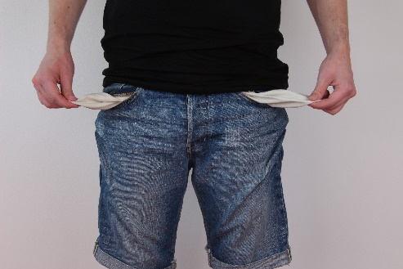
German suffix -los → English -less
Note: German adjectives and adverbs are usually the same word.
lesen
Add –los to German nouns to create adjectives meaning –less or without.
Beispiel:
Substantiv
Adjektiv/Adverb
das Geld
(money)
geldlos
(moneyless)
(plan)
?
der Plan
planlos
(planless)
Adjectives and adverbs do not need capital letters.
In German word final [-s] is pronounced like English ‘s’.
Notes:
Timing: 1 minute
Aim: to present a new word pattern, the suffix –los and prepare students for the following practice activities.
Procedure: 1. Click through the animations. 2. Elicit responses from students, where appropriate.

Slide 92
Adjektiv/Adverb → Substantiv*
Hör zu. Schreib das Adjektiv/Adverb. Welches Substantiv* ist das? Wie heißt das Adjektiv auf Englisch?
lesen
 | Adjektiv/Adverb | Substantiv | Englisch
 | kopflos | der Kopf | headless
 | fensterlos | das Fenster | windowless
 | haarlos | das Haar | hairless
 | wortlos | das Wort | wordless
 | hutlos | der Hut | hatless
 | blattlos | das Blatt | leafless
 | ziellos | das Ziel | goal/aimless
 | landlos | das Land | country/landless
1
2
3
4
5
6
7
8
*das Substantiv – noun
Notes:
Timing: 3 minutes
Aim: to practise aural transcription of unknown words, connection and written recall of their base nouns (which are all previously taught), and extrapolation of the English meaning of the adjective/adverb from the known meaning of the revisited vocabulary.
Procedure:
Click to play audio.
Students transcribe the word.
They write the base noun with definite article.
They write the English meaning of the adjective/adverb based on their recognition of meaning of the base noun.
Word frequency of unknown words (1 is the most frequent word in German): kopflos [>5009] fensterlos [>5009] haarlos [>5009] wortlos [>5009] hutlos [>5009] blattlos [>5009] ziellos [>5009] landlos [>5009] Source: Jones, R.L. & Tschirner, E. (2019). A frequency dictionary of German: core vocabulary for learners. Routledge

Slide 93
Substantiv → Adjektiv/Adverb
Sieh dir das Substantiv an. Schreib das Adjektiv/Adverb. Schreib auf Englisch.
lesen
 | Substantiv | Adjektiv/Adverb | Englisch
1. | die Kosten | kostenlos | free
2. | das Auto | autolos | car-less
3. | das Gefühl | gefühllos | unfeeling
4. | der Grund | grundlos | reasonless
5. | die Angst | angstlos | fearless
6. | der Schmerz | schmerzlos | painless
Notes:
Timing: 3 minutes
Aim: to practise written production of adjective/adverbs with –los pattern, using familiar nouns, and demonstrate written comprehension.
Procedure:
Students create the adjective/adverb from the given base nouns.
They write the English meaning of the adjective/adverb based on their recognition of meaning of the base noun.
Word frequency of unknown words (1 is the most frequent word in German): kostenlos [3462] autolos [>5009] gefühllos [>5009] grundlos [>5009] angstlos [>5009] schmerzlos [>5009] Source: Jones, R.L. & Tschirner, E. (2019). A frequency dictionary of German: core vocabulary for learners. Routledge

Slide 94
Word patterns
Grammatik
Add -chen or -lein to nouns to create neuter nouns with the meaning 'little'
Notes:
Add -chen or -lein to nouns to create neuter nouns with the meaning 'little' X.

Slide 95
Word patterns
Grammatik
Introduction
Y9 T3.2 Week 5
Notes:
9.2.1.3

Slide 96
Word patterns
Grammatik
Consolidation [1]
Y9 T3.2 Week 6

Slide 97
Word patterns
Grammatik
Compound nouns
Notes:
Compound nouns

Slide 98
Word patterns
Grammatik
Introduction
Y7 T2.2 Week 3 Slides 21-22
Notes:
9.2.1.3

Slide 99
German compound nouns
Separate unfamiliar words to try to understand them.
German often combines two (or more!) nouns to make one word, a compound noun.
Beispiel:
der Urlaub → der Campingurlaub
___ Camping + ___ Urlaub →
das
der
der
camping holiday →
?
___ Campingurlaub
The gender of the new noun is the gender of the final noun.
Sometimes, extra letters join the two nouns to make the new noun easier to say: -s-, -es-, -e-, -n-, -en-, -(e)r-
What is the definite article (‘the’) for these compound nouns?
holiday money →
Urlaub + Geld →
das
____ Urlaubsgeld
daily newspaper →
Tag + -es- + Zeitung →
die
____ Tageszeitung
market place →
Markt + Platz →
der
____ Marktplatz
So, German has some very long words. For example…
das Rindfleischetikettierungsüberwachungsaufgabenübertragungsgesetz
Notes:
Developing vocabulary knowledge One of the most fascinating things about German is its habit of joining nouns to make new words, new meanings. This is the first formal introduction to compound nouns in German. It is taken from a lesson in the second half of term 2. In Term 1.1 Week 7 students previously learnt the prefix ‘Lieblings-’ and the way it combines with other nouns: Lieblingsband, Lieblingsbuch, Lieblingsfilm, Lieblingslehrerin, Lieblingslied, Lieblingssäanger, Lieblingssängerin die Band [<4034] das Buch [295] der Film [524] die Lehrerin [2696] das Lied [1726] der Sänger [3916] die Sängerin [3916] Lieblings- [>4034]
This slide looks busy but the animations break the content into very small steps. It is designed to work interactively, with the teacher eliciting responses from students at every stage to gauge their understanding. The main knowledge is that: 1] German combines nouns to make single, new words. 2] The gender of the new word is the gender of the final noun 3] Some additional letters can be required (the rules for these are complex and have many exceptions so will not be explicitly taught so students will not automatically be able to produce accurate new compound nouns themselves) 4] However, they will vastly increase their receptive vocabulary and often be able to comprehend compound nous, even if only one part is known, by using the surrounding context in addition. They should be encouraged, when faced with apparently unfamiliar, to try to separate them, as they may find they know both nouns, individually. The final item is for fun, and teachers may omit, if preferred. The information point is that German places no limits on the number of nouns that can be combined, which leads to some very long German words. This particular example has 63 letters. Word for word in English it means ‘beef-meat labelling monitoring tasks legislative law’
Or, slightly more freely translated, it means: ‘legislative law for the monitoring of beef labelling’

Slide 100
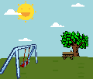
3 Lieblingsurlaube. Separate the words. Was ist das auf Englisch?
1 Schreib den Artikel (der, die, das, die). Schreib das Wort auf Englisch, auch.
Sometimes the English is NOT a word-for-word translation, and could also be one word: das Haustier → house animal → pet! Try exercise 2. The pictures may help.
Winterurlaub
Aktivurlaub
Rucksackurlaub
Familienurlaub
Tagesurlaub
Bootsurlaub
Strandurlaub
1 ____ Lieblingsnummer
2 ____ Deutschunterricht
3 ____ Frühzug
4 ____ Sprachschule
5 ____ Wochentag
winter holiday
die
favourite number
der
German lesson
activity holiday / active holiday
der
early train
backpacking holiday
die
language school
family holiday
der
week day
day’s holiday
boating holiday
beach holiday
2 Schreib den Artikel (der, die, das, die). Schreib das Wort auf Englisch, auch.
4 Urlaubssachen Separate the words. Was ist das auf Englisch?
die
____ Haustür
____ Liebespaar
____ Spielplatz
____ Grünblau
____ Schlafzimmer
front door
____ Urlaubstag
____ Urlaubsideen
____ Urlaubsort
____ Urlaubshotel
____ Urlaubsgeld
der
holiday day
das
(romantic)couple
die
holiday ideas
der
playground
der
holiday place / location
das
greeny blue
das
holiday hotel
das
bedroom
das
holiday money
Notes:
Vocabulary development - compound nouns Note: This task also includes three words from the revisited sets for this week: der Zug [613] der Platz [344] grün [556] In tasks 1 and 2, all words have been previously taught within the SOW, although some featured as verbs - e.g. lieben (Liebe as phonics source word), schlafen.
Lieblings- [>4037] Nummer [1048] Deutsch [105] Unterricht [1107] früh [322] Sprache [1791] Schule [208] Woche [209] Tag [108] Haus [159] Tür [400] Liebe [843] lieben [816] Paar [284] Spiel [500] Platz [344] grün [556] blau [1016] schlafen [787] Zimmer [609] There is a clear overlap with word families work, here, though the focus is on compound nouns. Subsequent lessons will explore links between word classes: how verbs become nouns, nouns become verbs etc.. Task 1:
We first practise the application of gender knowledge of previously taught nouns, combining them to make new compound nouns, which students should then also know the meaning of, without reference to a dictionary. This reinforces the importance of gender knowledge, which is a theme running right through this SOW! Task 2: Using previously-taught words, students are again asked to provide the gender and the English meaning. This time, however, the English meanings are less transparent, and require further thinking. This represents a very important opportunity for developing vocabulary depth - many high-frequency words have multiple meanings. Students have been taught these words previously in one context. The way they are combined here is often with a slightly different meaning. Task 3: This task moves us into the theme of holidays. Second, we practise segmentation of some compound nouns, all starting or ending with the word Urlaub. Some of these will feature previously taught language, some will contain cognates, and finally, others with have unfamiliar words. With the unfamiliar words, it is not expected that students guess the meaning. They are to segment the word, and then look up the unfamiliar part to try to work out its meaning. Note: in good online dictionaries many compound nouns will be listed. However, typically school paper dictionaries may not, and either way, it is helpful for students to recognise the usefulness of breaking compound nouns down into their component nouns, as a comprehension strategy. Ask the students why they don’t need to work out the articles in Task 3 (answer - they will all be ‘der’ like ‘der Urlaub’). der Urlaub [1192] is in this week’s vocabulary set. Winter [1288] is a cognate and was met in the Christmas lesson sequence; aktiv [861] a near cognate; Rucksack [3915] cognate and previously met; Familie [310] previously taught; Tag [108] is known but the -es may confuse at first; Boot [1927] not yet met - will need looking up; Strand [2047] not yet met - will need looking up.
Task 4 This task continues the focus on holidays, but this time, Urlaub- is the first word, meaning that the genders need to be worked out, as well as the English meanings. All words were previously taught, except the cognate Hotel. Tag [108], Idee [641] Ort [383] Hotel - cognate [1129] Geld [249] Note: Not all tasks need to be completed in one lesson. Teachers to differentiate for their own classes.

Slide 101
Word patterns
Grammatik
Consolidation [1]
Y8 T1.1 Week 2 Slide 13
Notes:
9.2.1.3

Slide 102
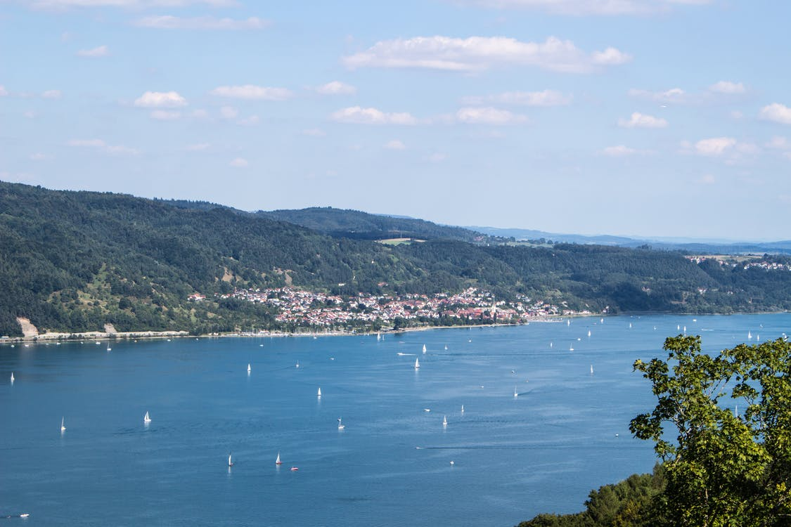
Mehmet redet über seinen Urlaub in der Schweiz
hören und lesen
Diesen Sommer mache ich in Kreuzlingen in der Schweiz Sommerurlaub.
Ich mag das Haus sehr. Ich habe bisher nie in einem Ferienhaus gewohnt! Mein Schlafzimmer hat einen Schreibtisch, eine Stehlampe und... ein Schlagzeug!
Letzte Woche habe ich jeden Tag den Bodensee besucht und danach Fu$ß$ball gespielt. Ich habe auch schon einen Wasserpark besucht. Heute Nachmittag habe ich eine Radtour gemacht. Nächste Woche gehen wir jeden Morgen zum Strand. Ich finde den Bodensee wunderschön!
der Bodensee
1
4
2
5
3
6
Wie heißen diese Wörter? Schlagzeug, Bodensee, Fußball, Wasserpark, Radtour.
Wie heißen diese sechs Wörter? → Schreib eine Liste!
Notes:
Timing
8 minutes
Aim
To practise hearing and reading the recently-introduced grammar, together with vocabulary featured in this week’s new and revisited sets. The suggested procedure includes strategic pausing of the audio to help students to connect the spoken and written forms of the language more securely. Eliciting suggested changes to the text consolidates word and grammar knowledge. Additionally, this task further highlights compound words in German.
Suggested procedure
1. Click on the audio button to play the text. Read and listen. Note: There is a full version of the audio top right with a player. Alternatively the audio is in 6 sections with a pause just after the words 1-5 below, to facilitate easy stop/start. 2. To support segmentation, stop the audio and ask students to say: i. the next word ii. the previous word 3. In addition, to develop understanding, vocabulary and grammar knowledge, pause at key points and ask students to suggest an alternative word that could replace the next word. Useful words to replace in this text would be: i. Ferienhaus (alternative Hotel – does this change the article? No, because Haus and Hotel are both ‘das’) ii. Schreibtisch (nouns of all three genders could be elicited as replacements here, focusing on R2 (acc) indefinite articles iii. Woche (replacing this word, e.g. with a particular day, or month would require a change to Letzte, which was practised last week) iv. habe ich (the one straight after letzte Woche) – here any past tense activity would word, recycling some verbs from last week or some of the new language v. Wasserpark 4. Check students’ understanding of the three compound nouns already met (in white bold text). Note: Schlagzeug and Fußball have not been explicitly presented as compound nouns but students should know the meanings and might be able to subdivide into two nouns. The noun ‘das Zeug’ (meaning ‘thing, stuff’) has two other useful compounds: Fahrzeug (vehicle, literally travel/go thing) and Spielzeug (toy, literally play thing) that could be mentioned.
5. Students use their existing vocabulary knowledge to work out the meanings of the five compound nouns in orange text (they have met the component parts previously), and the one compound adjective. It’s useful to note that many compounds are formed using a verb stem: schreib-, steh-, schlaf-, schlag-, spiel-, fahr- etc..
Transcript
Diesen Sommer mache ich in Kreuzlingen in der Schweiz Sommerurlaub. Ich mag das Haus sehr. Ich habe bisher nie in einem Ferienhaus gewohnt! Mein Schlafzimmer hat einen Schreibtisch, eine Stehlampe und... ein Schlagzeug! Letzte Woche habe ich jeden Tag den Bodensee besucht und danach Fu$ß$ball gespielt. Ich habe auch schon einen Wasserpark besucht. Heute Nachmittag habe ich eine Radtour gemacht. Nächste Woche gehen wir jeden Morgen zum Strand. Ich finde den Bodensee wunderschön!
Word frequencies: der See [1167] nächste Woche [249/211] der Strand [2047] Sommer [771]

Slide 103
Word patterns
Grammatik
Consolidation [2]
Y8 T1.1 Week 3 Slides 25-26

Slide 104
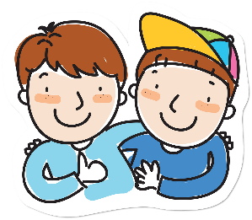
English → German → English
You can often make new nouns by joining two other nouns.
der Brief (letter) + der Freund (friend)
der Brieffreund (pen friend)
What would the following words be in German?
host dad / father
bedroom dining room
evening meal
Choose one and write a sentence in German.
Translate these sentences.
1. Meine Gastmutti ist sehr nett.
2. The living room is lovely.
Notes:
Timing: 8 minutes for two slides
Aim: Students following the NCELP SOW had a formal introduction to cognates in 7.2.2.3, and they had previously been taught the prefix ‘Lieblings-’ and combined it with several frequent nouns.
This task offers a further opportunity to practising recognising and producing compound nouns from familiar nouns and other cognates. It fits with the context of staying in a host family, at the start of the Y8 SOW. Word frequency: der Brief [838] der Freund [273] der Gast [576] die Mutter [218] der Vater [232] der Abend [342] das Brot [2095] das Essen [323-vb] das Zimmer [665] (Wohnzimmer / Schlafzimmer / Esszimmer)
Source: Jones, R.L. & Tschirner, E. (2019). A frequency dictionary of German: core vocabulary for learners. Routledge
[Friend] Image by eommina from Pixabay [Letter] Image by OpenClipart-Vectors from Pixabay
The main knowledge previously taught: 1] German combines nouns to make single, new words. 2] The gender of the new word is the gender of the final noun 3] Some additional letters can be required (the rules for these are complex and have many exceptions so will not be explicitly taught so students will not automatically be able to produce accurate new compound nouns themselves) 4] However, they will vastly increase their receptive vocabulary and often be able to comprehend compound nous, even if only one part is known, by using the surrounding context in addition. They should be encouraged, when faced with apparently unfamiliar, to try to separate them, as they may find they know both nouns, individually.

Slide 105
ANTWORTEN
Meine Gastmutti ist sehr nett.
The living room is lovely.
host dad/father
bedroom
dining room
evening meal
My host mum is very nice.
Das Wohnzimmer ist schön.
der Gastvati
das Schlafzimmer
das Esszimmer
das Abendessen
Verb stems are often used (without the -en).
What do you notice about the gender of these nouns?
The gender of the new noun is always the gender of the final noun.
Don’t forget to pronounce the words.
Notes:
Source: Jones, R.L. & Tschirner, E. (2019). A frequency dictionary of German: core vocabulary for learners. Routledge

Slide 106
Word patterns
Grammatik
Consolidation [3]
Y8 T3.2 Week 2 Slide 11

Slide 107
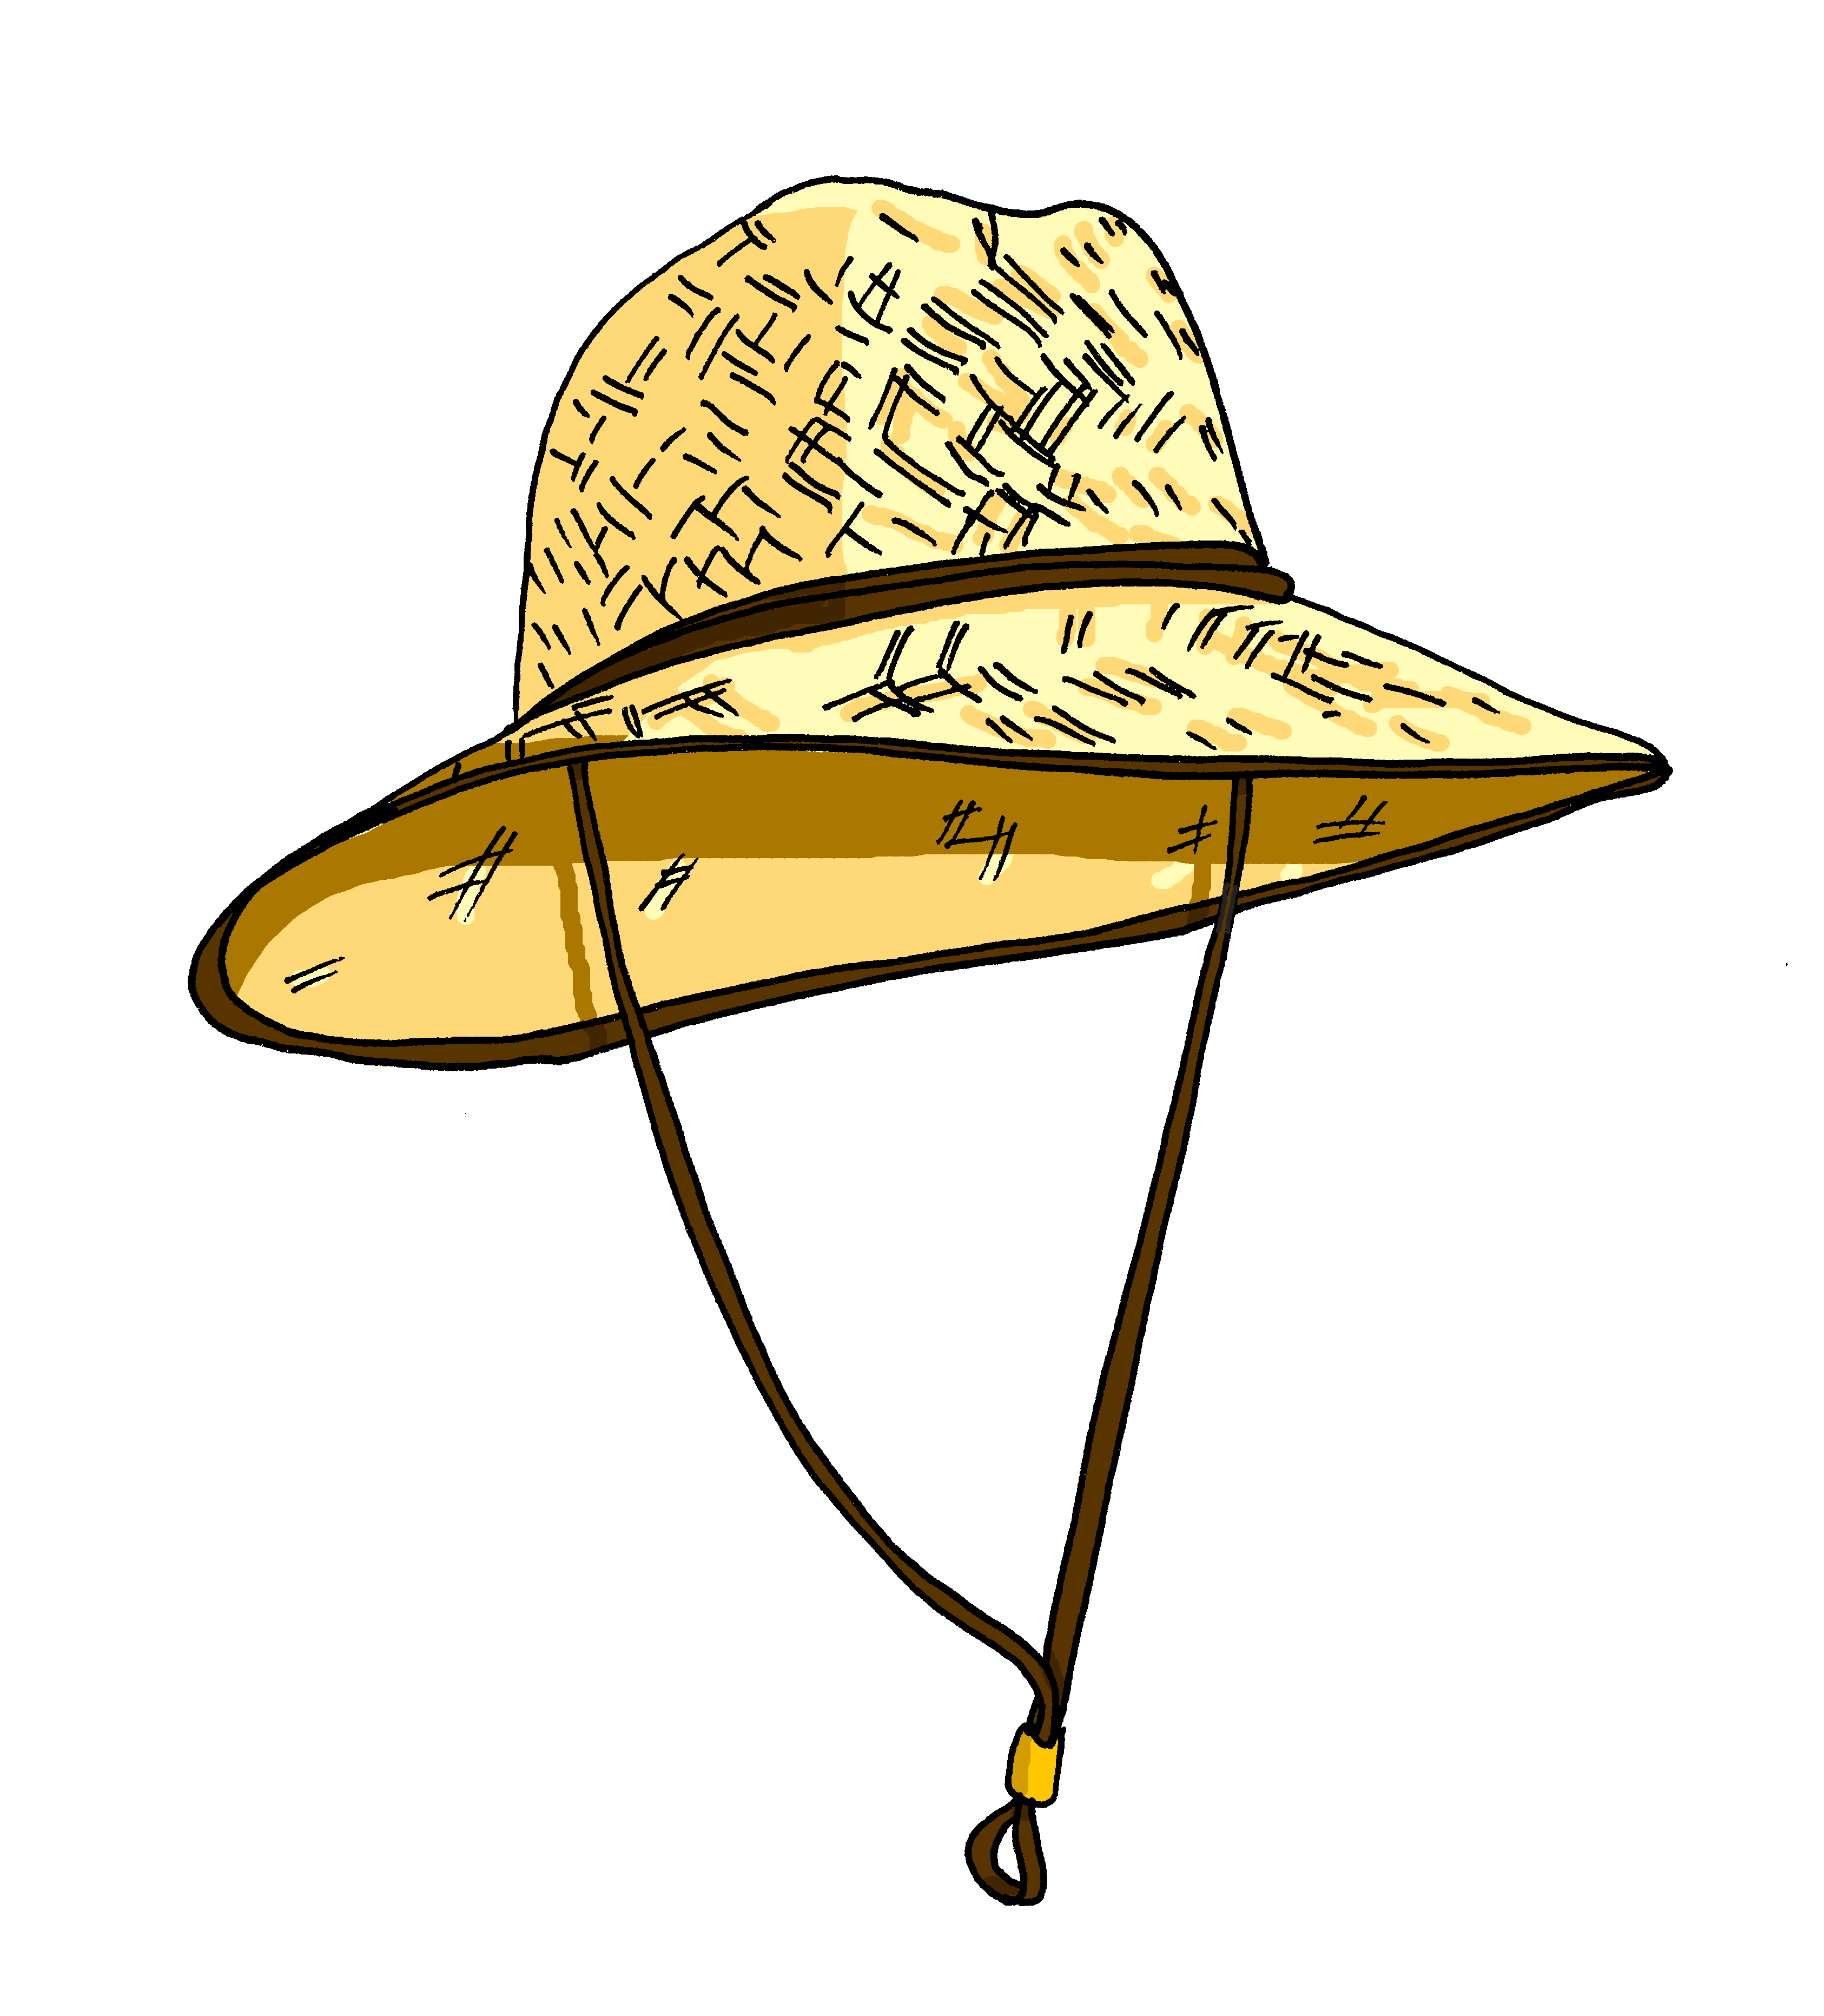
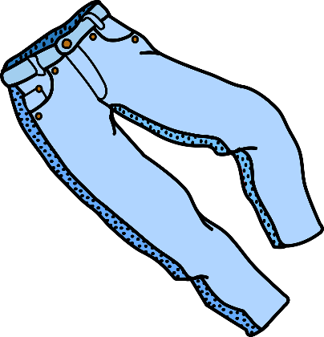
Vokabeln
sprechen
358
Roman (m.)
Konzertprogramm (nt.)
Geldtasche (f.)
der
Shorts(f.)
Sonnenhut (m.)
die
das
Notes:
Timing: 2 minutes Aim: To recap known vocab and prime three compound nouns made of known components, plus ‘der Roman’. All of these items are needed for the following activity. Note: where the words have not previously been taught, (included the compound nouns) the text is presented on the slide and the completely new noun (Roman) glossed in the activity that follows.
Procedure: 1. Ask students: Ist es der, die oder das? Students respond with the article and the word. E.g. der Sonnenhut.
2. Click to see where the word goes.
Word frequency (1 is the most frequent word in German): Sonnenhut [>5000] Geldtasche [>5000] Konzertprogramm [>5000] Roman [1051]
Source: Jones, R.L. & Tschirner, E. (2006). A frequency dictionary of German: core vocabulary for learners. Routledge

Slide 108
Word patterns
Grammatik
Consolidation [4]
Y9 T1.1 Week 5 Slides 2; 18-19

Slide 109
Auftakt
Wie viele Dingwörter kannst du zusammenstellen?
lesen / schreiben
Schreibe auch den Artikel zu jedem neuen Wort.
Ferien
Kind
Bruder
Sommer
Schule
Wasser
Zeit
Urlaub
Reise
Flasche
Kurs
Schwester
halb
Winter
Haus
der/ein | die/eine | das/ein | die
Halbbruder | Sommerschule | Sommerkind | Sommerferien
Sommerurlaub | Sommerzeit | Sommerhaus | Winterferien
Schulkurs | Wasserflasche | Schulkind | Schulferien
Notes:
Auftakt (Upbeat) independent pre-lesson revisiting activities On arrival to the lesson students can prepare for learning by doing a short, independent revisiting activity, giving the teacher the opportunity to talk to individuals and/or complete any additional setting up activities for the lesson.
Timing: 5 minutes In this lesson, Auftakt is included in the lesson timings, as the focus is on words from this week’s or last week’s vocabulary.
Aim: to revise known vocabulary and recap knowledge about compound noun formation (i.e. the gender is the gender of the final noun; capital letter on initial letter only; occasional letter omission (e.g. Schul-). Procedure: 1. Write as many compound nouns as possible in the time allowed. 2. Elicit some answers from students orally. 3. Click to reveal answer table. Note: not all the answers are provided. In particular, Winter could replace Sommer in most of the answers given.

Slide 110
Phonetik
Person B sagt so viele zusammengesetze Dingwörter wie möglich in 1 Minute. Person A hört zu und schreibt auf Englisch. Person A sagt so viele Wörter auf Deutsch wie möglich! Person B hilft.
lesen / sprechen
60
Essen
Nacht
Abend
Kleidung
Sekunden
Nachmittag
Geburtstag
Musik
Geschäft
Karte
Party
Sonntag
Stunde
0
LOS!
Notes:
Timing: 6 minutes (two slides) Aim: to practise creation and spoken production of compound nouns made up of previously taught individual words. Procedure: 1. Partner A turns away from the board.
2. Teacher clicks to bring up word selection. 3. Partner B says as many compound nouns as s/he can in one minute, allowing Partner A to write the meanings down in English.
4. When the minute is up, Partner A turns back to the board, and uses his/her notes to say as many German compound nouns as s/he can.
5. Partner B listens and offers feedback. 6. Then partners swap roles and move to the next slide.

Slide 111
Phonetik
lesen / sprechen
Tauscht* die Rollen.
*tauschen – change
60
Bad
Morgen
Ausflug
Teil
Zimmer
Traum
Sekunden
Spiel
Gymnastik
Boot
Wort
Körper
Urlaub
0
LOS!
Notes:
As for previous slide.
Students swap roles.

