Slide 1
Saying what people do
Present tense -ar verbs
Indefinite articles [revisited]
SSCs [ce], [ci]
Y7 Spanish
Term 1.1 - Week 7 - Lesson 13
Nick Avery / Rachel Hawkes Artwork: Mark Davies
Date updated: 19/07/22
Notes:
Learning outcomes (lesson 1):
Introduction of SSCs [ce], [ci]
Introduction of present tense -ar verbs: 1st person singular (-o)
Consolidation of 3rd person singular (-a)
Consolidation of indefinite articles
Word frequency (1 is the most frequent word in Spanish):
7.1.1.7 (introduce) necesitar [276]; usar [317]; llevar¹ [75]; zapato [1477]; vaso [1609]; producto [394]; bolsa [1581]; camisa [1873]; cosa [69]; ayuda [784]; voluntario¹ [2732]; gracias [275]; de nada [nada-87]; luego¹ [150]
7.1.1.4 (revisit) tener [19]; tengo; tiene; tienes; moneda [1577]; cama [609]; casa [106]; cámara [903]; bicicleta [3684]; libro [230]; barco [1384]; bolígrafo [>5000]; gato [1728]; ¿qué? [50]; nuevo [94]; un/a [6]; lee [leer-209]; frase [1036]; letra [977]; papel [393]
Source: Davies, M. & Davies, K. (2018). A frequency dictionary of Spanish: Core vocabulary for learners (2nd ed.). Routledge: London

Slide 2
ce
MADRID 1KM
cerca
Nick Avery
Notes:
Introduce and elicit the pronunciation of the individual SSC ‘ce’ and then present and practise the pronunciation of the source word ‘cerca’.
A possible gesture for this source word would be to bring two open palms close together (but not touching)

Slide 3
ce
cerca
Nick Avery
Notes:
Repeat the sound and elicit the source word.

Slide 4
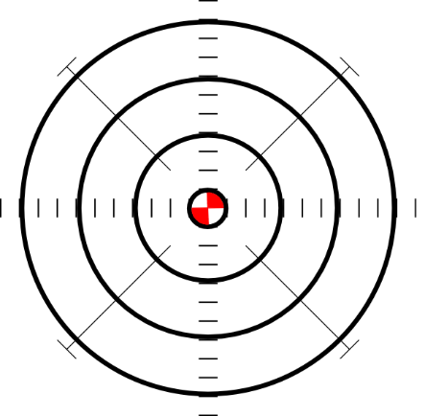
ce
doce
centro
MADRID 1KM
cerca
necesitar
necesario
[necessary]
[to need]
parecer
[to seem; appear]
Nick Avery
Notes:
Introduce and elicit the pronunciation of the individual SSC ‘ce’ and then the source word again (with gesture, if using). Then present and elicit the pronunciation of the five cluster words.
The cluster words have been chosen for their high-frequency, from a range of word classes, with the SSC (where possible) positioned within a variety of syllables within the words (e.g. initial, 2nd, final etc.). Additionally, we have tried to use words that build cumulatively on previously taught SSCs (see the Phonics Teaching Sequence document) and do not include new SSCs. Where new SSCs are used, they are often consonants which have a similar symbol-sound correspondence in English.

Slide 5
ce
doce
centro
cerca
necesitar
necesario
parecer
Nick Avery
Notes:
Without the images, students focus this time again closely on the SSC and the cluster words

Slide 6
ce
doce
centro
cerca
necesitar
necesario
parecer
Nick Avery
Notes:
Without the images or sound, students have to pronounce the words themselves.

Slide 7
ci
cierto
Nick Avery
Notes:
Introduce and elicit the pronunciation of the individual SSC ‘ci’ and then present and practise the pronunciation of the source word ‘cierto’.
A possible gesture for this source word would be to give a ‘thumbs up’

Slide 8
ci
cierto
Nick Avery
Notes:
Repeat the sound and elicit the source word.

Slide 9
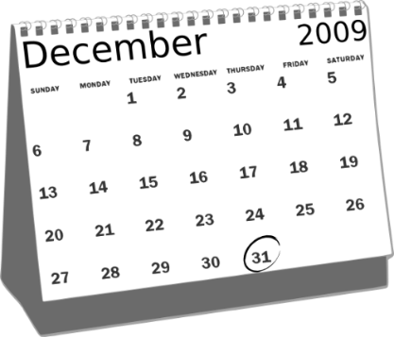
ci
cine
diciembre
ciencias
ciudad
cierto
decir
[to say; tell]
Nick Avery
Notes:
Introduce and elicit the pronunciation of the individual SSC ‘ci’ and then the source word again (with gesture, if using). Then present and elicit the pronunciation of the five cluster words.
The cluster words have been chosen for their high-frequency, from a range of word classes, with the SSC (where possible) positioned within a variety of syllables within the words (e.g. initial, 2nd, final etc.). Additionally, we have tried to use words that build cumulatively on previously taught SSCs (see the Phonics Teaching Sequence document) and do not include new SSCs. Where new SSCs are used, they are often consonants which have a similar symbol-sound correspondence in English.

Slide 10
ci
cine
diciembre
ciencias
ciudad
cierto
decir
Nick Avery
Notes:
Without the images, students focus this time again closely on the SSC and the cluster words.

Slide 11
ci
cine
diciembre
ciencias
ciudad
cierto
decir
Nick Avery
Notes:
Without the images or sound, students have to pronounce the words themselves.

Slide 12
There are different ways to pronounce CE and CI.
Fonética
In most of Spain, the ‘c’ before ‘e’ or ‘i’ is pronounced like the ‘th’ in English (as you just heard).
In the Canary Islands and Latin America, this ‘c’ is often pronounced like an ‘s’.
Compare:
ciencias
(mainland Spain)
1
ciencias
(Canaries & Latin America)
2
Notes:
Phonics introduction slide
Timing: 2 minutes
Aim: to raise awareness of variation in sound-spelling correspondences within the Spanish-speaking world
Procedure:
Click to bring up each new part of the explanation
Click on the orange action buttons to hear the difference in pronunciation modelled by a native speaker.
Notes:
1. Teachers may find it useful to consider the information from exam board specifications below:
AQA: “The [listening] test will be studio recorded using native speakers speaking Castilian in clearly articulated, standard speech at near normal speed. Different types of spoken language will be used, using familiar language across a range of contemporary and cultural themes. (p. 82)
EdExcel/Pearson : “For listening and reading assessments, the majority of contexts are based on the culture and countries where the assessed language is spoken. […] It is, therefore, important that students are exposed to materials relating to Spanish-speaking countries throughout the course.” (p. 7)
WJEC : “This GCSE specification in Spanish for use in Wales is based on a conviction that learners studying a modern foreign language will develop their desire and ability to communicate with and understand speakers of Spanish in a variety of contexts and for a variety of purposes.” (p. 3)

Slide 13
escuchar
Latin America/Canaries | Mainland Spain
1
2
Is the pronunciation more likely to be mainland Spain or Latin America / Canaries?
3
4
5
Listen and tick the most likely answer.
6
7
8
9
10
Notes:
Listening activity - phonics
Timing: 6 minutes
Aim: to help students to recognize pronunciation of [ce] and [ci] in different parts of the Spanish-speaking world
Procedure:
Click on each action button to hear the audio.
Note: you could additionally ask students to listen again and write the word
Transcript:
Doce
Ciencias
Decir
Necesario
Cine
Diciembre
Necesitar
Centro
Ciudad
Cierto
Image with creative commons public domain licence
https://mycsres.com/freesheet/spanish-speaking-world-map-18.html.html
Word frequency (1 is the most frequent word in Spanish): doce [1138], centro [ 316], necesitar [276], cierto [159], ciudad [178], decir [31], ciencia [738], necesario [362], cine [952], diciembre [1165]
Source: Davies, M. & Davies, K. (2018). A frequency dictionary of Spanish: Core vocabulary for learners (2nd ed.). Routledge: London

Slide 14
Vocabulario
leer
usar
to use, using
Which ones are the same type of word as these?
una camisa
a shirt
una cosa
a thing
hablar
comprar
llevar
to wear, wearing
una bolsa
a bag
olvidar
escuchar
necesitar
to need, needing
un zapato
a shoe
usar
bailar
llegar
un producto
a product
un vaso
a glass
llevar
necesitar
Notes:
Vocabulary presentation slide
Timing: 3 minutes
Aim: to introduce new vocabulary and support word class recognition
Procedure:
1. Present each Spanish word and its English translation.
2. Bring up the verbs on the right hand side (these have been previously taught).
3. Ask students which words what kind of words these are and which words in the list are also verbs. This should help to focus attention on Spanish verbs as words that often end in –ar.
Word frequency (1 is the most frequent word in Spanish): zapato [1477]; producto [394]; camisa [1873]; llevar [75]; vaso [1609]; bolsa [1581]; cosa [69]; necesitar [276]; usar [317].
Source: Davies, M. & Davies, K. (2018). A frequency dictionary of Spanish: Core vocabulary for learners (2nd ed.). Routledge: London

Slide 15
llevo
llevo
[I wear]
lleva
[s/he wears | it wears]
Notes:
Timing: 3 minutes for sequence of six verb slides
To introduce the verb llevar more explicitly. Llevar is one of the 25 most frequently used verbs in Spanish. All 25 most frequent verbs will be introduced early on using the same format. Both 1st and 3rd person singular are presented here in order to familiarise students with various forms of the same verb. Note that the 3rd person singular was previously seen in 1.1.6.
Procedure
Bring up the word llevo on its own, say it, students repeat it, and remind them of the phonics. Draw attention to SSC [ll].
Try to elicit the meaning from the students.
Bring up the picture, and, if using gestures, a possible gesture would be to mime putting on a coat.
Then bring up the English translations. Emphasise the two meanings for the infinitive.
Bring up the short form lleva, say it, students repeat it. Draw attention to SSC [ll]
Try to elicit the meaning from the students. Emphasise the two meanings for the short form.

Slide 16
llevo
llevo
[I wear]
lleva
[s/he wears | it wears]
Notes:
Cycle through ‘llevo’ and ‘lleva’ again.

Slide 17
llevo
llevo
[I wear]
Llevo una camisa.
[I wear a shirt.]
Notes:
Introduce ‘llevo’ in a sentence.

Slide 18
lleva
lleva
[s/he wears| it wears]
Sara lleva zapatos.
[Sarah wears shoes.]
Notes:
Introduce ‘lleva’ in a sentence.

Slide 19
llevo
llevo
[I wear ]
Llevo
______ una camisa.
[I wear a shirt.]
Notes:
Cycle through ‘llevo’ in context again.

Slide 20
lleva
lleva
[s/he wears| it wears]
lleva
Sara ______ zapatos.
[Sarah wears trainers.]
Notes:
Cycle through ‘lleva’ in context again.

Slide 21
Saying what I do and s/he does
-ar verbs – 1st and 3rd person singular
Many Spanish infinitives end in –ar.
The verb ending changes depending on who the verb refers to.
Compare:
Escucha música.
S/he listens to music.
Escucho música.
I listen to music.
This part of the verb is called the ‘stem’.
To mean ‘I’ with an –ar verb, remove –ar and add –o.
Escuchar
Escucho
Notes:
Grammar presentation slide
Timing: 2 minutes
Notes:
1. The 3rd person singular form is used for comparison with the new verb form (1st person singular) as it was introduced last week (1.1.6) in the SoW.
2. The 2nd person singular form will be taught in the second of this two-lesson sequence.

Slide 22
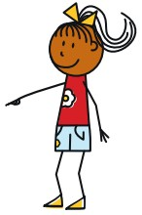
leer
Maria and Ana are twins. María talks about herself (I) and her sister (she).
Write 1-10 and who does what, I or she.
 | Maria says: | Maria (‘I’) | Ana (‘she’) | What exactly does she say?
1
2
3
4
5
6
7
8
9
10
✔
Compra unas cosas en Valencia.
“She buys some things in Valencia.”
Bailo en el sur.
✔
“I dance in the south.”
Lleva una camisa.
✔
“She wears a shirt.”
Baila en el norte.
✔
“She dances in the north.”
Necesito un amigo.
✔
“I need a (male) friend.”
Usa una bicicleta.
✔
“She uses a bike.”
Necesita una amiga.
✔
“She needs a (female) friend.”
Uso un teléfono. Es muy nuevo.
✔
“I use a phone. It’s very new.”
Lleva zapatos.
✔
“She wears shoes.”
Compro productos en Madrid.
✔
“I buy products in Madrid.”
Notes:
Grammar practice (reading)
Timing: 8 minutes
Aim: to practise attending to the meanings of the 1st and 3rd person singular verb forms
Procedure:
1. Instruction to write 1-10 and columns I or she. 2. Work through the first sentence together as an example. At this point prompt students, if necessary, to focus on the verb ending. 3. Prompt students then to tell you exactly what María says – i.e. to translate the sentence word for word. Reveal the answer: ‘She buys some things in Valencia.’ 4. Bring up sentences 2-10. Ask students to write i/she for each sentence first AND THEN to fill in the final column. This introduces differentiation by outcome, whilst at the same time ensuring that even the lower attaining students focus their attention first on the essential grammatical understanding, and only later on the additional lexical/grammatical information from the rest of the sentence.
5. Answers are then animated to appear with the I/she AND the translation so that even those learners who haven’t managed to get to all of the translations, will be able to reinforce their knowledge during feedback.
Word frequency (1 is the most frequent word in Spanish): necesitar [276]; usar [317]; llevar¹ [75]; comprar [361]; bailar [1323]; zapato [1477]; producto [394]; camisa [1873]; cosa [69]; bicicleta [3684]; amigo [210], amiga [1172], teléfono [866]; sur [661]; norte [624]; nuevo [94]
Source: Davies, M. & Davies, K. (2018). A frequency dictionary of Spanish: Core vocabulary for learners (2nd ed.). Routledge: London

Slide 23
escuchar
Escucha.
María tiene una lista de cosas.
Marca ‘I need’ o ‘she needs’.
Escribe A o B.
“I need” | “she needs”
A
B
1
2
3
4
5
Notes:
Grammar practice task (listening) [1/2]
Aim: to practise attending to the meanings of 1st and 3rd person singular present tense –ar verbs
Procedure:
1. There’s no need to print off the slide. Students can just copy the first two column headings of the grid into their books and write A or B instead of circling pictures.
2. Note that there are 1-10 items in this task so instruct students accordingly. Numbers 6-10 are on the next slide.
3. Ask students to focus only on the first two columns the first time they listen. Play audio.
4. Play the audio again. Identify whether each item is singular or plural.
Notes:
1. The rubric is in Spanish this time. Each short sentence is animated separated so that the teacher can ensure that students understand each tiny step. If needed, the teacher can ask students to identify the difference between A and B. For example: La diferencia entre A y B? A? Qué es? Una botella or unas botellas? Sí, unas botellas. Y B? Sí, una botella. Perfecto. 2. Teachers can therefore differentiate the task, as required. Some classes may be able to complete both parts of the table at the same time.
Transcript:
Necesito una botella
Necesita un caballo
Necesito unas revistas
Necesita una cama
Necesita unas plantas
Items 6-10 on next slide
Word frequency (1 is the most frequent word in Spanish): necesitar [276]; botella [1878]; caballo [907], revista [920], cama [609], planta [768]
Source: Davies, M. & Davies, K. (2018). A frequency dictionary of Spanish: Core vocabulary for learners (2nd ed.). Routledge: London

Slide 24
escuchar
6 - 10
“I need” | “she needs”
A
B
6
7
8
9
10
Notes:
Grammar practice task (listening) [2/2]
Transcript:
6. Necesito un zapato
7. Necesita unas bolsas
8. Necesito un gato
9. Necesita una camisa
10. Necesito unos vasos
Word frequency (1 is the most frequent word in Spanish): necesitar [276]; zapato [1477]; bolsa [1581]; gato [1728]; camisa [1873]
Source: Davies, M. & Davies, K. (2018). A frequency dictionary of Spanish: Core vocabulary for learners (2nd ed.). Routledge: London

Slide 25
You have an identical twin!
The two of you look the same, but how are you different?
Tell your partner what you do and what your twin does, using the speaking cards.
Remember to use the right verb ending for ‘I’ and ‘s/he’.
Notes:
Paired speaking/listening task
Timing: 10-12 mins
Aim: to practise producing and understanding present tense –ar verbs in 1st and 3rd person in the oral modality; to practise producing and recognising the meaning of vocabulary items
Procedure:
1. Go through the instructions, drawing attention to the target verb forms. Correct use of these is needed for successful task completion.
2. Before beginning, ask both students to write 1-3 on the LHS of their books with 2 columns: 1) my partner ‘I’; 2) my partner’s brother (‘he’)
4. Student A speaks, Student B listens and takes notes in English
5. Swap roles. Student B speaks, Student A listens and takes notes in English

Slide 26
Student A
brother
[uses a pen]
me
[buy some shoes]
brother
[listens to music]
me
[need a shirt!]
me
[dance in the north]
brother
[wears some shoes]
Notes:
Student A speaking cards
A printer-friendly version of these cards is available in Word format.

Slide 27
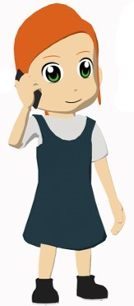
Student B
sister
[buys glasses]
me
[use a phone]
me
[listen to music]
sister
[needs a shirt!]
sister
[dances in the south]
me
[wear a shirt]
Notes:
Student B speaking cards
A printer-friendly version of these cards is available in Word format.

Slide 28
Student B answer grid
My partner (‘I’) | My partner’s brother (‘he’)
buy some shoes
listens to music
dance in the north
uses a pen
need a shirt
wears some shoes
Notes:
Students can just complete this in their books.

Slide 29
Student A answer grid
My partner (‘I’) | My partner’s sister (‘she’)
listen to music
buys some glasses
use a phone
dances in the south
wear a shirt
needs a shirt
Notes:
Students can just complete this in their books.

Slide 30
Respuestas
escuchar
Persona A
Usa las cartas. Escribe 6 frases.
Compro
(unos)
zapatos
1) _________ ______ _________.
This sentence is also correct without ‘unos’.
It means ‘I buy shoes’ (not ‘I buy some shoes).
Escucha
música
2) _________ _________.
Usa
un
bolígrafo
3) _____ ____ ___________.
Bailo
en
el
norte
4) ______ ___ ___ ______.
Lleva
(unos)
zapatos
5) _______ _______ _________.
Necesito
una
camisa
6) __________ _____ _______.
Notes:
Writing exercise with answers – Student B
Timing: 6 minutes
Procedure:
Ask students to write six sentences in Spanish, based on their prompt cards. It may help them to know that these are the sentences they produced orally in the last activity.
Check answers.
Note:
1. This could be done before the speaking/listening activity and it would help preparation for it. However, make sure that students don’t just read these sentences aloud, as they would then not be practising retrieval of language or active manipulation of verb forms.

Slide 31
Respuestas
escuchar
Persona B
Usa las cartas. Escribe 6 frases.
Compra
(unos)
vasos
1) _________ ______ _______.
This sentence is also correct without ‘unos’.
It means ‘She buys glasses’ (not ‘She buys some glasses).
Escucho
música
2) _________ _________.
Uso
un
teléfono
3) _____ ____ ___________.
Baila
en
el
norte
4) ______ ___ ___ ______.
Llevo
(una)
camisa
5) _______ _______ _______.
Necesita
una
camisa
6) __________ _____ ________.
Notes:
Writing exercise with answers – Student A

Slide 32
Saying what people do
Present tense -ar verbs
SSCs [ce], [ci]
Y7 Spanish
Term 1.1 - Week 7 - Lesson 14
Nick Avery / Rachel Hawkes Artwork: Mark Davies
Date updated: 11/10/20
Notes:
Learning outcomes (lesson 2):
Consolidation of SSC [ce], [ci] Introduction of present tense –ar verbs: 2nd person singular (-as)
Consolidation of present tense –ar verbs 1st person singular (-o)
Consolidation of present tense –ar verbs 3rd person singular (-a)
Consolidation of indefinite articles
Word frequency (1 is the most frequent word in Spanish):
7.1.1.7 (introduce) necesitar [276]; usar [317]; llevar¹ [75]; zapato [1477]; vaso [1609]; producto [394]; bolsa [1581]; camisa [1873]; cosa [69]; ayuda [784]; voluntario¹ [2732]; gracias [275]; de nada [nada-87]; luego¹ [150]
7.1.1.4 (revisit) tener [19]; tengo; tiene; tienes; moneda [1577]; cama [609]; casa [106]; cámara [903]; bicicleta [3684]; libro [230]; barco [1384]; bolígrafo [>5000]; gato [1728]; ¿qué? [50]; nuevo [94]; un/a [6]; lee [leer-209]; frase [1036]; letra [977]; papel [393]
Source: Davies, M. & Davies, K. (2018). A frequency dictionary of Spanish: Core vocabulary for learners (2nd ed.). Routledge: London

Slide 33
Fonética
escuchar / escribir
Escucha y escribe las letras.
¿CE o CI?
ci
__udad
ce
do__
1
6
___ntro
ce
ne___sario
ce
2
7
ci
ci
de__r
di__embre
3
8
ce
Escucha la pronunciación.
Where is the person more likely to be from?
mainland Spain
Latin America / Canaries
ne___sitar
4
__en__as
ci
ci
5
Notes:
Phonics practice activity
Timing: 5 minutes
Aim: to practise mapping sound to spelling
Procedure:
1. Play the word.
2. Complete the missing letters.
3. Check answers.
Notes: To challenge students further, ask them to turn away from the board to complete the task and write the whole word independently. This allows for differentiation through more/less support. If the whole class is high attaining, then the prompts can be removed from the slide, of course, as per the following slide.
Transcript:
Ciudad
Centro
Decir
Necesitar
Ciencias
Doce
Necesario
Diciembre
Word frequency (1 is the most frequent word in Spanish): doce [1138], centro [ 316], necesitar [276], ciudad [178], decir [31], ciencia [738], necesario [362], diciembre [1165]
Source: Davies, M. & Davies, K. (2018). A frequency dictionary of Spanish: Core vocabulary for learners (2nd ed.). Routledge: London

Slide 34
Fonética
escuchar / escribir
Escucha y escribe la palabra.
¿CE o CI?
ciudad
doce
1
6
centro
necesario
2
7
decir
diciembre
3
8
necesitar
Escucha la pronunciación.
Where is the person more likely to be from?
mainland Spain
Latin America / Canaries
4
ciencias
5
Notes:
Same task, but answers appear as a whole word, rather than just the target graphemes.
Transcript:
Ciudad
Centro
Decir
Necesitar
Ciencias
Doce
Necesario
Diciembre
Word frequency (1 is the most frequent word in Spanish): doce [1138], centro [ 316], necesitar [276], ciudad [178], decir [31], ciencia [738], necesario [362], diciembre [1165]
Source: Davies, M. & Davies, K. (2018). A frequency dictionary of Spanish: Core vocabulary for learners (2nd ed.). Routledge: London

Slide 35
Juan tiene unas cosas.
Vocabulario
Juan ________________
has some things.
Pero, ¿qué tiene?
Notes:
Vocabulary revision slide
Timing: 4 minutes (slides 31-36)
Aim: to practise recalling previously taught Spanish nouns
Procedure:
1. Bring up the English word/picture and say the Spanish

Slide 36
¿Qué tiene?
Tiene…
un vaso
Notes:
Vocabulary recap

Slide 37
¿___ ______?
______…
una bolsa
Notes:
From here the written prompts are removed, and the teacher can split the class in half to elicit question ¿qué tiene? and answer ‘Tiene…’ from different halves of the class, alternating roles with each new slide.

Slide 38
¿___ _____?
_____…
un zapato
Notes:
vocabulary recap

Slide 39
¿___ _____?
_____…
una camisa
Notes:
vocabulary recap

Slide 40
¿___ _____?
_____…
[a product]
un producto
Notes:
vocabulary recap

Slide 41
Vocabulario
leer
to arrive
necesitar
to use
to speak
to carry, to wear
bailar
escuchar
llevar
to buy
to listen
llegar
to need
to dance
comprar
hablar
usar
Notes:
Vocabulary recap slide
Timing: 3 minutes
Aim: to recognise the Spanish verb with the same meaning as the English
Procedure:
Click to make each word move towards its English translation
Word frequency (1 is the most frequent word in Spanish): necesitar [276]; usar [317]; llevar¹ [75]; comprar [361]; bailar [1323]; escuchar [281]; llegar [75]; hablar [90]
Source: Davies, M. & Davies, K. (2018). A frequency dictionary of Spanish: Core vocabulary for learners (2nd ed.). Routledge: London

Slide 42
Saying what you do and s/he does
-ar verbs –2nd and 3rd person singular
Verb endings change depending on who the verb refers to.
Compare:
Llega temprano.
S/he arrives early.
Llegas temprano.
You arrive early.
What is this verb part called?
To mean ‘you’ (singular), remove –ar from the infinitive and add –as.
escuchar
escuchas
hablar
hablas
Notes:
Grammar presentation slide
Timing: 2 minutes
Aim: to introduce the 2nd person singular form of present tense –ar verbs
Procedure:
1. Click to bring up each part of the explanation
Notes:
1. The 3rd person singular form is used for comparison with the new verb form (2nd person singular) as it was introduced last week in the SoW.
2. The 1st person singular present (-o ending) was taught in lesson 1 of this two-lesson sequence.

Slide 43
leer
Your class is doing a Spanish play.
Your teacher gives you and a friend stage directions.
Choose the correct sentence starter and translate the rest.
1. “Llevas unos vasos en una bolsa.”
You carry…
You carry some glasses in a bag.
S/he carries…
2. “Escuchas una conversación.”
S/he listens…
You listen to a conversation.
You listen…
3. “Usa un bolígrafo. Es blanco.”
You use…
S/he uses a pen. It’s white.
S/he uses…
4. “Compra una botella de Pepsi.”
S/he buys…
S/he buys a bottle of Coca-Cola.
You buy…
5. “Necesitas un periódico.”
S/he needs…
You need a newspaper.
You need…
Notes:
Grammar practice activity (reading)
Timing: 5 minutes
Aim: to practise attending to the meanings of present tense –ar verbs in 2nd and 3rd person singular
Procedure:
1. Write 1-5.
2. Read the sentence.
3. For each sentence, write ‘you’ or ‘she’.
Word frequency (1 is the most frequent word in Spanish): necesitar [276]; usar [317]; llevar¹ [75]; comprar [361]; escuchar [281]; vaso [1609]; bolsa [1581]; conversación [989]; bolígrafo [>5000]; blanco [372]; botella [1878]; periódico [1026]
Source: Davies, M. & Davies, K. (2018). A frequency dictionary of Spanish: Core vocabulary for learners (2nd ed.). Routledge: London

Slide 44
leer
It’s the day of the play, but the teacher has forgotten everything!
She needs help. Translate her questions.
1. “¿Qué llevas?.”
5. “¿Hablas con Sara?.”
What do you wear/carry?
Do you speak with Sarah?
2. “¿Cómo baila?”
6. “¿Usa un teléfono?.”
How does s/he dance?
Does s/he use a phone?
3. “¿Quién compra un producto?”
7. “¿Qué necesitas?.”
Who buys a product?
What do you need?
4. “¿Dónde bailas?”
8. “¿Quién usa una bolsa?.”
Where do you dance?
Who uses a bag?
Notes:
Timing: 7 minutes
Aim: to revisit question words and yes-no questions along with the same pair of verb forms (2nd person singular vs 3rd person singular).
Procedure:
1. Students read the sentences.
2. They translate them into English
3. Teacher checks the answers.
Note: This could be done as a ‘think-pair-share’ and feedback task, rather than a written activity. The following slide offers an extension to the task, whereby the Spanish questions are then re-covered, to prompt students to produce Spanish from the English prompts.
Word frequency (1 is the most frequent word in Spanish): necesitar [276]; usar [317]; llevar¹ [75]; comprar [361]; bolsa [1581]; bailar [1323]; producto [394]; teléfono [866]; hablar [90]
Source: Davies, M. & Davies, K. (2018). A frequency dictionary of Spanish: Core vocabulary for learners (2nd ed.). Routledge: London

Slide 45
hablar
¿Cómo se dice en español?
1. “¿Qué llevas?.”
5. “¿Hablas con Sara?.”
What do you wear/carry?
Do you speak with Sarah?
2. “¿Cómo baila?”
6. “¿Usa un télefono?.”
How does s/he dance?
Does s/he use a phone?
3. “¿Quién compra un producto?”
7. “¿Qué necesitas?.”
Who buys a product?
What do you need?
4. “¿Dónde bailas?”
8. “¿Quién usa una bolsa?.”
Where do you dance?
Who uses a bag?
Notes:
OPTIONAL EXTENSION SLIDE
Timing: 8 minutes
Aim: to translate English sentences to translate into Spanish (orally or in writing, depending on time/appropriateness)
Procedure:
1. Students read the English sentence in orange.
2. Students say (or write) the Spanish.
3. Teacher checks answers
Note: students can opt to produce the questions in any order. The shapes are triggered to reveal the Spanish question when the shape itself is clicked.
Word frequency (1 is the most frequent word in Spanish): necesitar [276]; usar [317]; llevar¹ [75]; comprar [361]; bolsa [1581]; bailar [1323]; producto [394]; teléfono [866]; hablar [90]
Source: Davies, M. & Davies, K. (2018). A frequency dictionary of Spanish: Core vocabulary for learners (2nd ed.). Routledge: London

Slide 46
escuchar
Your friend describes what your character and another character does.
Listen. Is it ‘you’ or ‘s/he’?
Talking about ‘you’ (singular) | Talking about ‘s/he’
1
2
3
4
5
6
7
8
9
10
Notes:
Grammar activity (listening) [1/2]
Timing: 6 minutes
Aim: to practise attending to present tense -ar verbs in 2nd and 3rd person singular
Procedure:
1. Students write 1-10 on the LHS, with ‘you’ and ‘she’ as headers.
2. Click on the orange action button to play audio.
3. Check answers
Note:
1. See next slide for second part of activity
Transcript:
Llevas una camisa.
Necesita unas cámaras.
Usas unos teléfonos.
Compras un bolígrafo.
Usa un teléfono.
Llega con unos amigos.
Necesitas una cámara
Lleva unas camisas
Compra unos bolígrafos.
Llegas con un amigo.
Word frequency (1 is the most frequent word in Spanish): necesitar [276]; usar [317]; llevar¹ [75]; comprar [361]; llegar [75]; teléfono [866]; camisa [1873]; cámara [903], bolígrafo [>5000], amigo [210]
Source: Davies, M. & Davies, K. (2018). A frequency dictionary of Spanish: Core vocabulary for learners (2nd ed.). Routledge: London

Slide 47
escuchar
B
D
A
1
K
C
2
G
[need]
[buy]
[arrive with]
3
E
[wear]
E
4
F
K
Listen again.
Match the sentence to the card.
5
I
6
A
[use]
G
7
B
[wear]
F
8
C
J
I
9
D
[need]
10
J
[buy]
[arrive with]
[use]
Notes:
Grammar activity (listening) [2/2]
Timing: 7 minutes
Aim:
Procedure:
1. Students will have already written 1-10 on previous slide.
2. Students listen again and note down the correct letter of the image. They will need to look carefully at whether the image is singular or plural.
3. When checking answers, teachers ask students to say the letter aloud for oral alphabet practice.
Transcript:
Llevas una camisa.
Necesita unas cámaras.
Usas unos teléfonos.
Compras un bolígrafo.
Usa un teléfono.
Llega con unos amigos.
Necesitas una cámara.
Lleva unas camisas.
Compra unos bolígrafos.
Llegas con un amigo.
Word frequency (1 is the most frequent word in Spanish): necesitar [276]; usar [317]; llevar¹ [75]; comprar [361]; llegar [75]; teléfono [866]; camisa [1873]; cámara [903], bolígrafo [>5000], amigo [210]
Source: Davies, M. & Davies, K. (2018). A frequency dictionary of Spanish: Core vocabulary for learners (2nd ed.). Routledge: London

Slide 48
leer
You overhear the head of languages talking to a new teacher.
You challenge yourself to translate into Spanish. Choose the correct verb.
1. “You use some books.”
Uso / usas / usa unos libros.
2. “I arrive with José.”
Llegas / llega / llego con José.
3. “He arrives by car.”
Llego / llega / llegas en coche.
4. “You buy some things.”
Compra / compras / compro unas cosas.
5. “He needs a task.”
Necesitas / necesito / necesita una tarea.
6. “I forget some words.”
Olvido / olvidas / olvida unas palabras.
7. “You listen to a question.”
Escucha / escucho / escuchas una pregunta.
8. “She needs to arrive early.”
Necesitas / necesita / necesito llegar temprano.
9. “I buy magazines.”
Compro / compra / compras revistas.
10. “You listen very well!”
¡Escucha / escucho / escuchas muy bien!
Notes:
Grammar activity (reading)
Students have now had plenty of practice with 1st, 2nd and 3rd person singular -ar verbs, so here we include a more challenging reading exercise in which attention to the three verb forms is needed.
Timing: 7 minutes
Aim: to practise attending to different forms of present tense –ar verbs and their meanings
Procedure:
1. Students read the English sentence and decide which of the three options iscorrect.
2. Teacher checks answers.
Note:
1. This task gives teachers the opportunity to sow the seed of an idea for using language beyond the classroom. Not all will do it, of course, but setting them the challenge to go around generally (e.g. on the walks between lessons) listening out for things people say and seeing if they can translate any of those messages into Spanish.
Word frequency (1 is the most frequent word in Spanish): necesitar [276]; usar [317]; comprar [361]; llegar [75]; olvidar [415]; escuchar [281]
Source: Davies, M. & Davies, K. (2018). A frequency dictionary of Spanish: Core vocabulary for learners (2nd ed.). Routledge: London

Slide 49
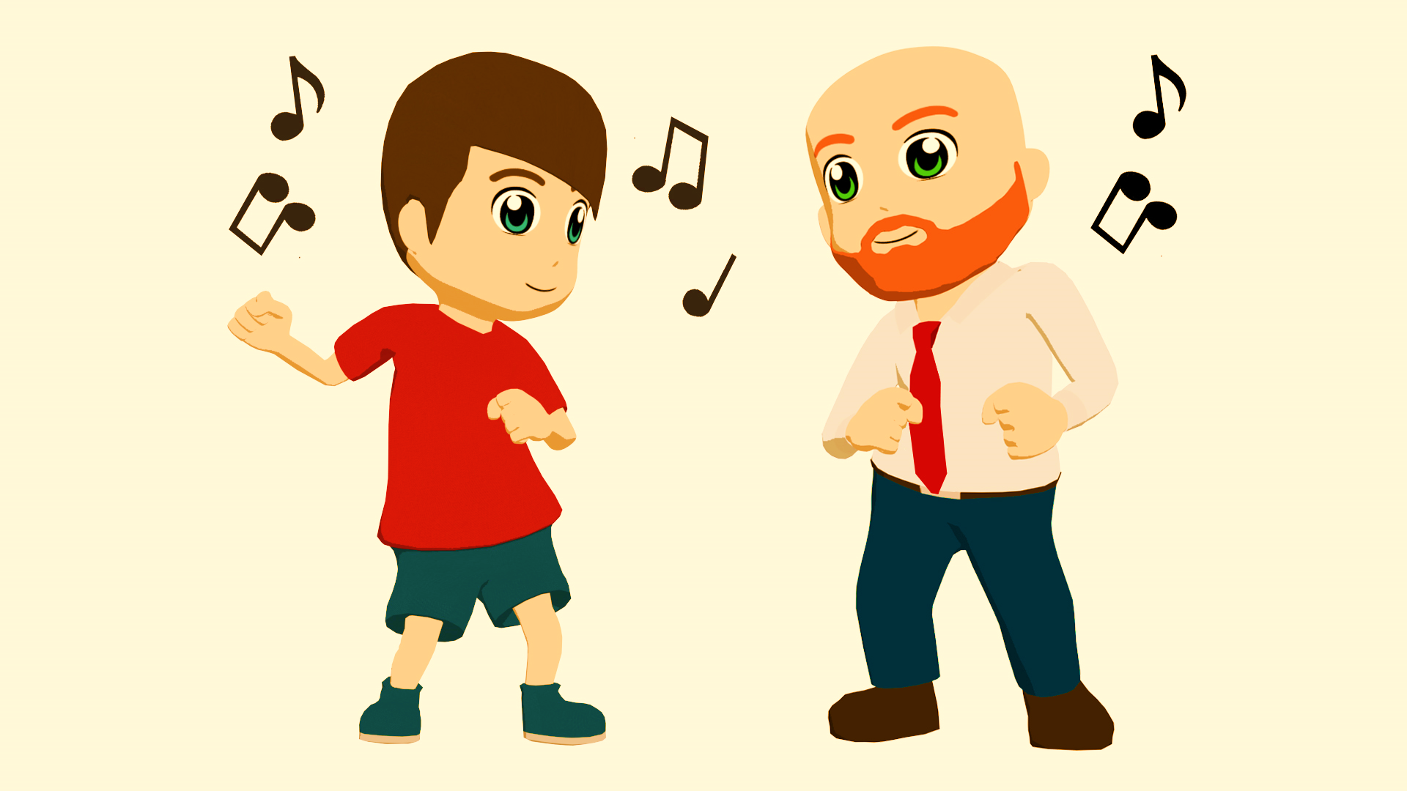
Qué
leer / hablar
¿ ________?
_______ swing.
¿_________?
En un bar en Salamanca.
¿______ en el centro?
Sí, en el centro.
¿Con ________?
Un amigo.
¿________ bailas?
¡Con energía!
bailas
Bailo
[1/2]
Dónde
bailo
cómo
Está
está
dónde
quién
bailas
quién
Cómo
Notes:
Text completion task [1/2]
Timing: 7 minutes
Aim: to further practise recognising the 1st & 2nd person singular form of verbs & vocabulary items, this time within a conversation; to gain confidence in oral production
Procedure:
Students read the text and complete the gaps with one of the options.
Once complete, they can practise reading this conversation in pairs.
Notes:
1. After initial practice reading their own (completed) texts, an extra challenge could be to ask them to practise with the incomplete text displayed on the board. This will prompt speeded recall of the words that are missing!

Slide 50
¿______ música ____________?
leer / hablar
___________ hip-hop.
¿_________?
En una casa en San Sebastián.
¿Con ________?
Con una amiga, Sara.
¿ _______ también?
Sí, ¡es fantástico!
Qué
escuchas
[2/2]
Escucho
qué
bailas
Dónde
dónde
quién
quién
escuchas
escucho
Bailas
Notes:
Text completion task [2/2]
Timing: 7 minutes
Aim: to further practise recognising the 1st & 2nd person singular form of verbs & vocabulary items, this time within a conversation; to gain confidence in oral production
Procedure:
Students read the text and complete the gaps with one of the options.
Once complete, they can practise reading this conversation in pairs.
Notes:
1. After initial practice reading their own (completed) texts, an extra challenge could be to ask them to practise with the incomplete text displayed on the board. This will prompt speeded recall of the words that are missing!

Slide 51
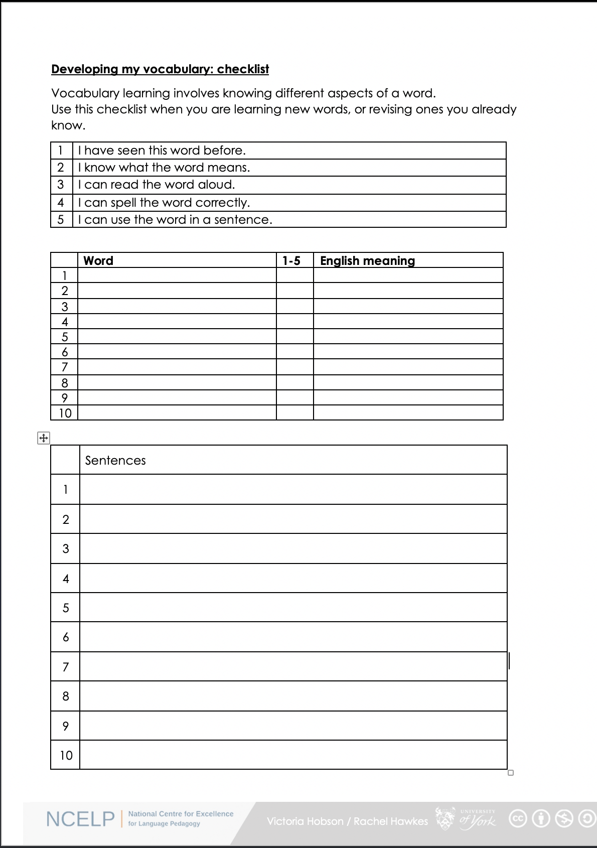
Vocabulary checklist
1. I have seen this word before.
2. I know what the word means.
3. I can read the word aloud.
4. I can spell the word correctly.
5. I can use the word in a sentence.
6. For nouns, I know the gender and the correct word for ‘the’
Notes:
This sheet could be part of a homework task for Week 7 vocabulary, if desired (or a previous week – In week 7 students should also be revisiting Week 4 vocabulary). Scroll down for the link to this resource.
Vocabulary learning involves knowing different aspects of a word. Students can use this checklist when to check what they know when they are learning new words, or revising ones they already know.
For each word the checklist asks students to asses whether the following statement apply:
1. I have seen this word before.
2. I know what the word means.
3. I can read the word aloud.
4. I can spell the word correctly.
5. I can use the word in a sentence.
Students then translate the word and try to use it in a sentence.
We suggest giving students a print out of the template they can refer to throughout the year.
A word template is available on the NCELP resource portal.
https://resources.ncelp.org/concern/resources/gf06g264k?locale=en

Slide 52
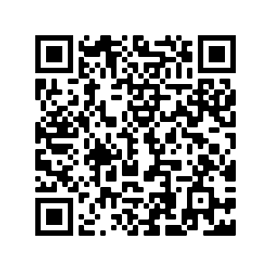
Deberes
Vocabulary Learning Homework (Term 1.2, Week 1)
Audio file
Audio file QR code:
Student worksheet
Quizlet link
In addition, revisit: Term 1.1 Week 5

