Slide 1
Grammar
Prenominal adjective position
Y7 French
Term 3.1 - Week 6 - Lesson 59
Jane Wood / Stephen Owen
Date updated: 5/06/2020
Notes:
Learning outcomes
Introducing pre-nominal position of certain common adjectives and certain common irregular adjectival forms
Frequency rankings of vocabulary introduced this week (1 is the most common word in French):
3.1.6 – bon [54], bonne [54], belle [393 haut [264], nouveau [52], nouvelle [52], vieille [671], vieux [671], bâtiment [1952], église [1782], jardin [2284], pont [1889]
Frequency rankings of vocabulary revisited this week (1 is the most common word in French):
3.1.3 - langue¹ [712], matière¹ [562], quel [146], combien [800], que² [9]
2.2.3 - frapper [745], ressembler [1398], cœur [568], temps [65], noir [572], blanc [708], pourquoi [193], si¹ [34]
Source: Londsale, D., & Le Bras, Y. (2009). A Frequency Dictionary of French: Core vocabulary for learners London: Routledge.

Slide 2
Adjectives after the noun
grammaire
In French, most adjectives go AFTER the noun:
Remember that the feminine form of a regular adjective adds -e
un livre intéressant
an interesting book
an expensive bike
un vélo cher
une femme intelligente
an intelligent woman
une voiture bleue
a blue car
un homme drôle
a funny man
une maison moderne
a modern house
Adjectives already ending in –e do not add another –e for the feminine!
une amie sympathique
a nice friend
Notes:
This slide reminds students of what they have learned previously about adjectival position (and agreement). Given that this is previously-taught language, students are challenged to provide the French from the English prompts.
Timing (total for grammar explanations on Slides 17-19): 5 minutes

Slide 3
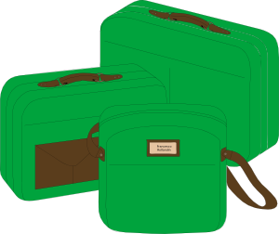
Adjectives before noun
grammaire
However, some adjectives go BEFORE the noun:
These are adjectives that refer to BEAUTY, AGE, GOOD/BAD or SIZE (BAGS)
B
un beau jardin a beautiful garden
une belle langue a beautiful language
A
un jeune homme a young man
une vieille femme an old woman
G
une bonne idée a good idea
une mauvaise question a bad question
S
une grande maison a big house
une petite voiture a small car
Notes:
The fact that some adjectives are used pre-nominally is now introduced (grand, petit, beau, bon and mauvais have all been introduced in previous vocabulary sets; two of this week’s new words also feature here: belle and vieille).

Slide 4
Irregular adjective forms
grammaire
The adjectives in this week’s vocabulary come BEFORE the noun.
One of these – haut – forms its feminine as we have learnt before(add –e):
un haut bâtiment une haute montagne
[a tall building] [a high mountain]
_______
The other new adjectives have an irregular feminine form:
un beau jardin une belle voiture
[a beautiful garden] [a beautiful car]
______
un nouveau pont une nouvelle idée
[a new bridge] [a new idea]
___________
un vieux bâtiment une vieille église
[an old building] [an old church]
______
un bon livre une bonne réponse
[a good book] [a good answer]]
________
Notes:
The new adjectives from this week’s vocabulary set are now presented in their masculine and feminine forms. Apart from haut, these are irregular.
Frequency rankings of vocabulary introduced this week (1 is the most common word in French):
3.1.6 – bon [54], bonne [54], belle [393 haut [264], nouveau [52], nouvelle [52], vieille [671], vieux [671], bâtiment [1952], église [1782], jardin [2284], pont [1889]
Source: Londsale, D., & Le Bras, Y. (2009). A Frequency Dictionary of French: Core vocabulary for learners London: Routledge.

Slide 5
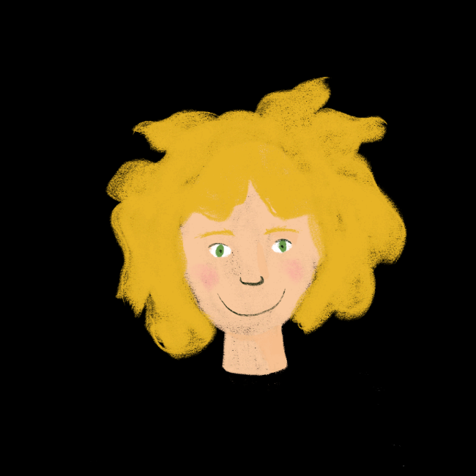
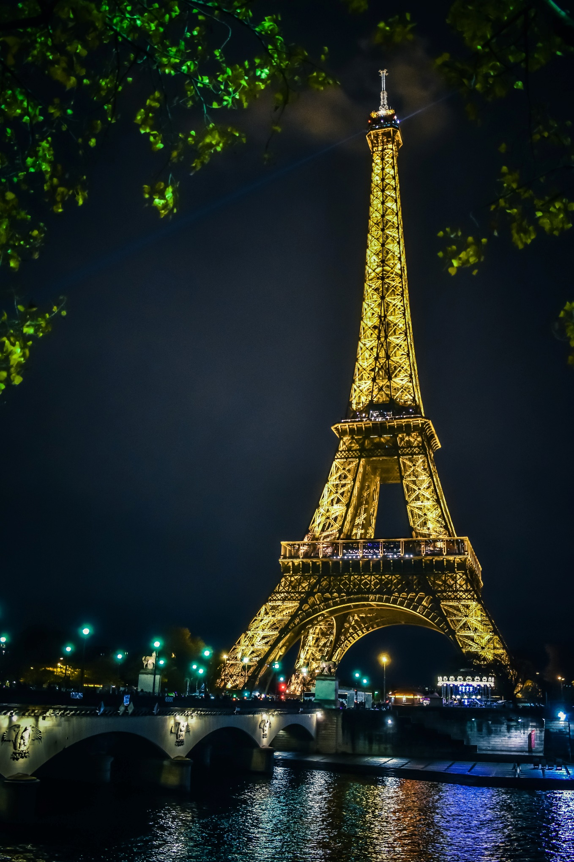
Comment est Paris? (1/6)
lire
Écris la réponse correcte:
haut / haute
Salut Amir !
À Paris, il y a
un _____ monument :
la Tour Eiffel.
haut
The adjectives in this activity all come before the noun they describe!
Notes:
This reading exercise introduces some of the sights of Paris and practises adjective agreement with the new adjectives and other vocabulary introduced this week (mostly irregular). It continues the storyline with our characters.
Frequency rankings of vocabulary introduced this week (1 is the most common word in French):
3.1.6 – bon [54], bonne [54], belle [393 haut [264], nouveau [52], nouvelle [52], vieille [671], vieux [671], bâtiment [1952], église [1782], jardin [2284], pont [1889]
Source: Londsale, D., & Le Bras, Y. (2009). A Frequency Dictionary of French: Core vocabulary for learners London: Routledge.
Timing (total for reading and listening activities on Slides 20-27): 10 minutes

Slide 6
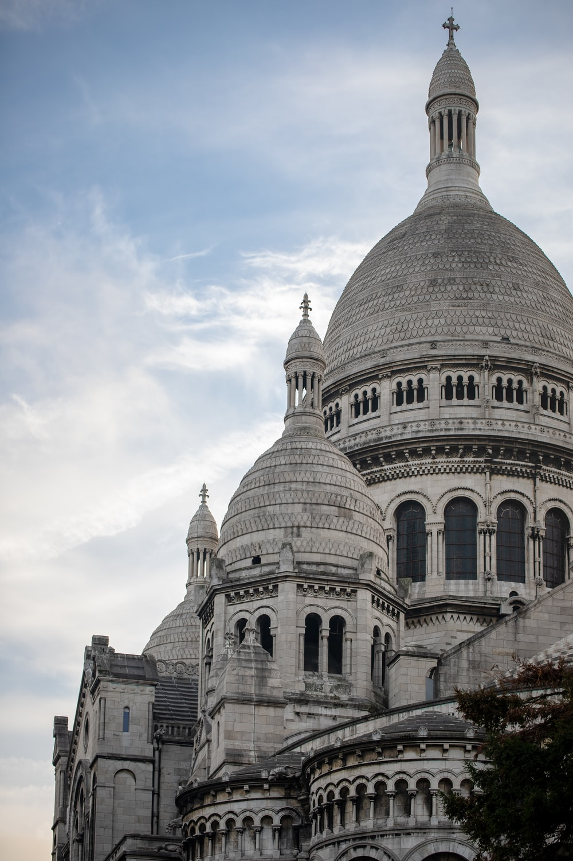
Comment est Paris? (2/6)
lire
What do you think the name of this church means in English?
Écris la réponse correcte:
beau / belle
Il y a
une _____ église :
le Sacré-Cœur.
belle
Some of the adjectives in this activity have an irregular feminine form, like beau/belle!
Notes:
This reading exercise introduces some of the sights of Paris and practises adjective agreement with the new adjectives and other vocabulary introduced this week (mostly irregular). It continues the storyline with our characters.
Frequency rankings of vocabulary introduced this week (1 is the most common word in French):
3.1.6 – bon [54], bonne [54], belle [393 haut [264], nouveau [52], nouvelle [52], vieille [671], vieux [671], bâtiment [1952], église [1782], jardin [2284], pont [1889]
Source: Londsale, D., & Le Bras, Y. (2009). A Frequency Dictionary of French: Core vocabulary for learners London: Routledge.

Slide 7
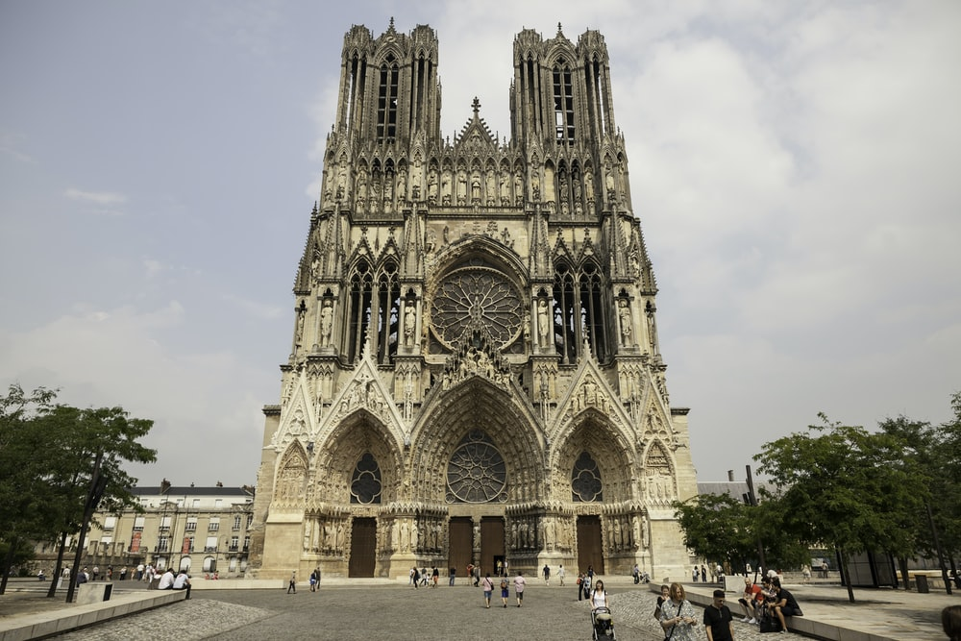
Comment est Paris? (3/6)
lire
Écris la réponse correcte:
vieux / vieille
Il y a
une ______
cathédrale :
Notre-Dame.
vieille
Notes:
This reading exercise introduces some of the sights of Paris and practises adjective agreement with the new adjectives and other vocabulary introduced this week (mostly irregular). It continues the storyline with our characters.
Frequency rankings of vocabulary introduced this week (1 is the most common word in French):
3.1.6 – bon [54], bonne [54], belle [393 haut [264], nouveau [52], nouvelle [52], vieille [671], vieux [671], bâtiment [1952], église [1782], jardin [2284], pont [1889]
Source: Londsale, D., & Le Bras, Y. (2009). A Frequency Dictionary of French: Core vocabulary for learners London: Routledge.

Slide 8
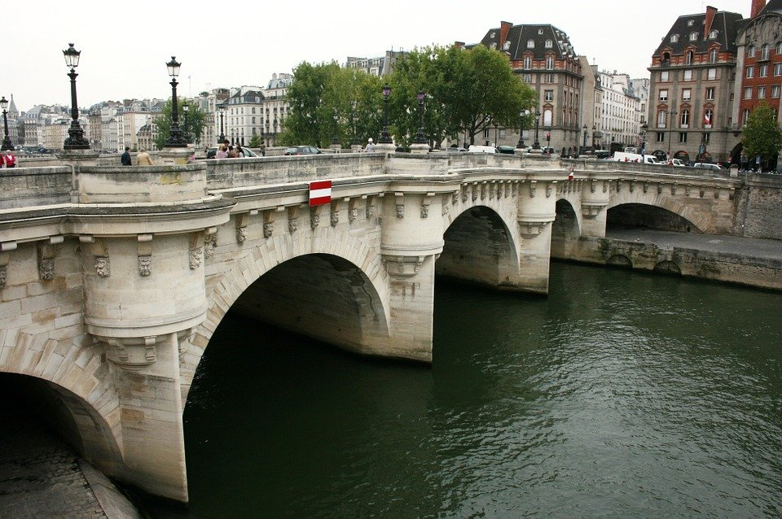
Comment est Paris? (4/6)
lire
Écris la réponse correcte:
beau / belle
vieux / vieille
Il y a un _____ pont :
le Pont Neuf.
C’est un _____ pont !
beau
vieux
Notes:
This reading exercise introduces some of the sights of Paris and practises adjective agreement with the new adjectives and other vocabulary introduced this week (mostly irregular). It continues the storyline with our characters.
Frequency rankings of vocabulary introduced this week (1 is the most common word in French):
3.1.6 – bon [54], bonne [54], belle [393 haut [264], nouveau [52], nouvelle [52], vieille [671], vieux [671], bâtiment [1952], église [1782], jardin [2284], pont [1889]
Source: Londsale, D., & Le Bras, Y. (2009). A Frequency Dictionary of French: Core vocabulary for learners London: Routledge.

Slide 9
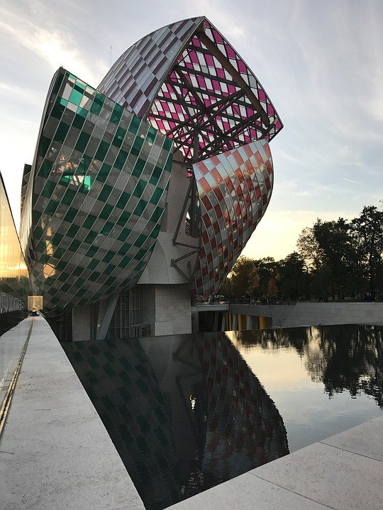
Comment est Paris? (5/6)
lire
Écris la réponse correcte:
nouveau / nouvelle
Il y a un
________ bâtiment :
la Fondation
Luis Vuitton.
Une ________ idée !
nouveau
nouvelle
Notes:
This reading exercise introduces some of the sights of Paris and practises adjective agreement with the new adjectives and other vocabulary introduced this week (mostly irregular). It continues the storyline with our characters.
Frequency rankings of vocabulary introduced this week (1 is the most common word in French):
3.1.6 – bon [54], bonne [54], belle [393 haut [264], nouveau [52], nouvelle [52], vieille [671], vieux [671], bâtiment [1952], église [1782], jardin [2284], pont [1889]
Source: Londsale, D., & Le Bras, Y. (2009). A Frequency Dictionary of French: Core vocabulary for learners London: Routledge.

Slide 10
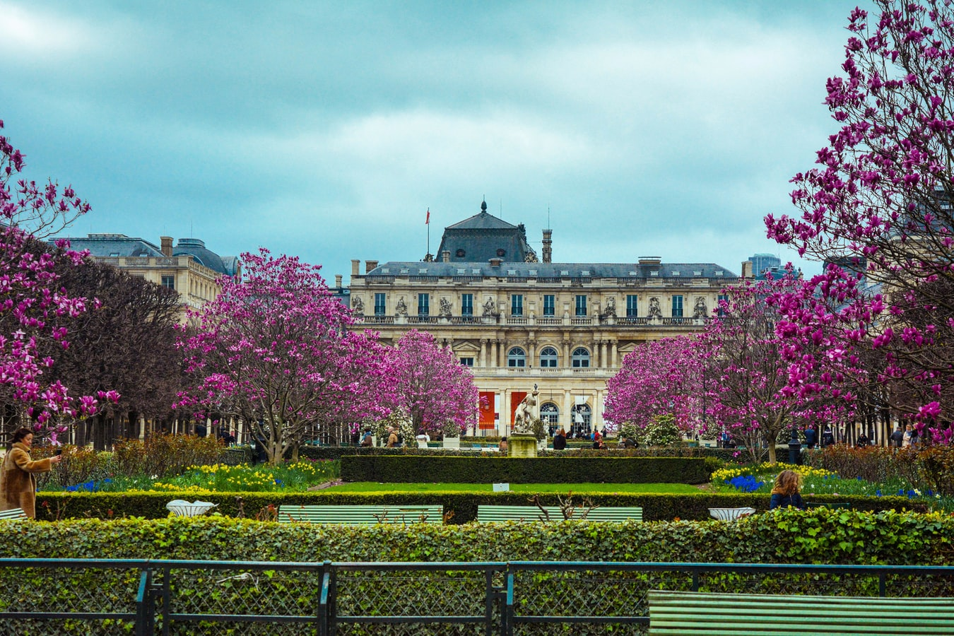
Comment est Paris? (6/6)
lire
Écris la réponse correcte:
beau / belle
Et il y a un _____
jardin : le Jardin du
Luxembourg.
Bises,
Léa
beau
Notes:
This reading exercise introduces some of the sights of Paris and practises adjective agreement with the new adjectives and other vocabulary introduced this week (mostly irregular). It continues the storyline with our characters.
Frequency rankings of vocabulary introduced this week (1 is the most common word in French):
3.1.6 – bon [54], bonne [54], belle [393 haut [264], nouveau [52], nouvelle [52], vieille [671], vieux [671], bâtiment [1952], église [1782], jardin [2284], pont [1889]
Source: Londsale, D., & Le Bras, Y. (2009). A Frequency Dictionary of French: Core vocabulary for learners London: Routledge.

Slide 11
Comment est Nice?
écouter
EITHER
OR
1
plage
bâtiment
2
maison
pont
3
magasin
école
4
bâtiment
poste
5
université
parc
6
poste
magasin
7
bâtiment
église
8
église
bâtiment
Notes:
This listening exercise further practises adjective agreement (including irregular forms). It continues the storyline with our characters.
Students have to decide which noun follows the adjective heard, based upon the adjective gender agreement (pre-nominal adjectives). The article also gives gender information of course, but we felt it would be confusing to have this beeped out immediately prior to the gap which students have to fill. The answers are animated.
Transcript
1) À Nice, il y a une belle [plage].
2) Il y a un vieux [pont] aussi.
3) Devant le pont, il y a une bonne [école].
4) C’est un beau [bâtiment]!
5) Il y a une nouvelle [université].
6) Il y a aussi un nouveau [magasin].
7) Il y a une haute [église].
8) Et il y a un haut [bâtiment].
Word frequency rankings:
beau [393], belle [393], haut [264], nouveau [52], nouvelle [52], vieille [671], vieux [671], bâtiment [1952], église [1782], école [477], pont [1889], université [1398], plage [2693]
Source: Londsale, D., & Le Bras, Y. (2009). A Frequency Dictionary of French: Core vocabulary for learners London: Routledge.

Slide 12
Réponses
écouter
EITHER
OR
1
plage
bâtiment
2
maison
pont
3
magasin
école
4
bâtiment
poste
5
université
parc
6
poste
magasin
7
bâtiment
église
8
église
bâtiment
Notes:
The answers to the listening exercise are on this slide. The full audio is available under each number this time, so students can listen and check, rather than just see the animated answer.
Word frequency rankings:
beau [393], belle [393], haut [264], nouveau [52], nouvelle [52], vieille [671], vieux [671], bâtiment [1952], église [1782], école [477], pont [1889], université [1398], plage [2693]
Source: Londsale, D., & Le Bras, Y. (2009). A Frequency Dictionary of French: Core vocabulary for learners London: Routledge.
Transcript
1) À Nice, il y a une belle plage.
2) Il y a un vieux pont aussi.
3) Devant le pont, il y a une bonne école.
4) C’est un beau bâtiment!
5) Il y a une nouvelle université.
6) Il y a aussi un nouveau magasin.
7) Il y a une haute église.
8) Et il y a un haut bâtiment.

Slide 13
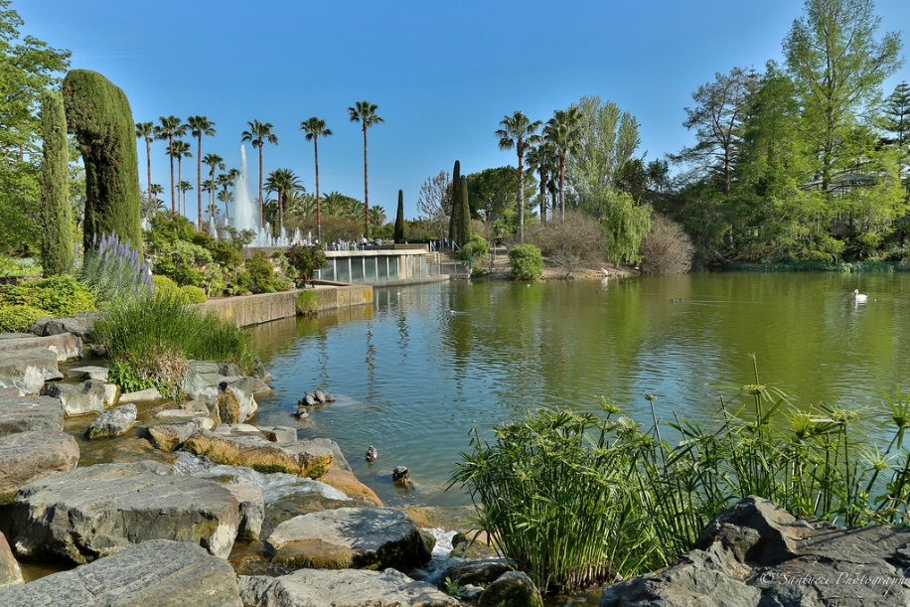
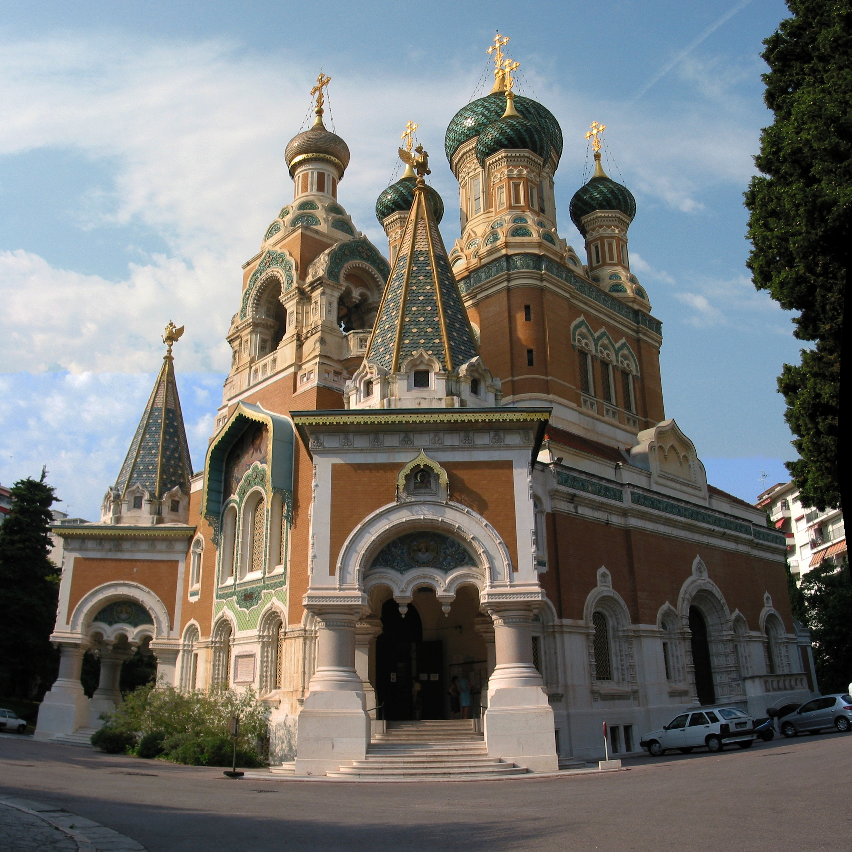
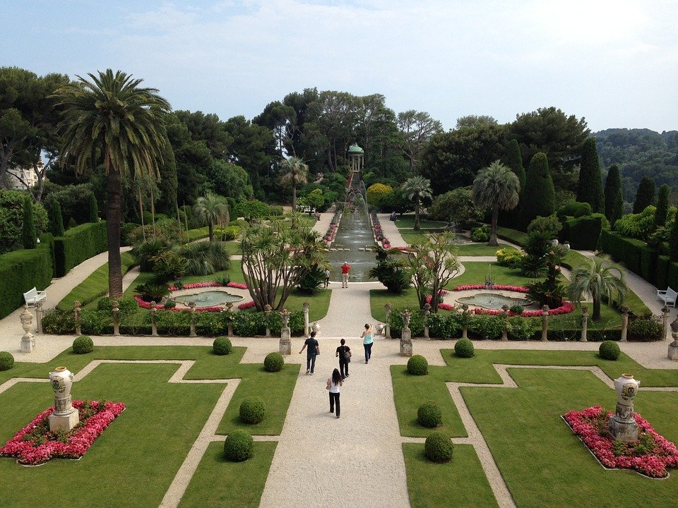
Nice et Paris
écouter / parler
Partner A
À Nice, il y a un beau…
parc
église
Partner B
À Paris, Il y a une vieille ...
jardin
poste
Notes:
Speaking (model slide) There is a student worksheet for this activity, which can be downloaded from the NCELP Resource Portal and printed out.
Timing (total for speaking activities on Slides 28-32): 10 minutes Aim: Further practice of prenominal adjectives in the oral modality.
Procedure: Use this slide to model the task with students. Partner A says the sentence beginning, Partner B finishes the sentence. Make it clear that students will not see their partner’s sentences, so they need to listen carefully. After four sentences, they swap roles. Partner A describes Nice, Partner B describes Paris.
Students work in pairs, one reading the start of each sentence on their sheet, the other selecting the appropriate noun from their sheet to complete it, based upon the gender of the adjective they hear. Students should not look at each other’s sheets, but base their selection on what they hear.
Frequency rankings of vocabulary introduced this week (1 is the most common word in French):
3.1.6 – bon [54], bonne [54], belle [393 haut [264], nouveau [52], nouvelle [52], vieille [671], vieux [671], bâtiment [1952], église [1782], jardin [2284], pont [1889]
Source: Londsale, D., & Le Bras, Y. (2009). A Frequency Dictionary of French: Core vocabulary for learners London: Routledge.

Slide 14
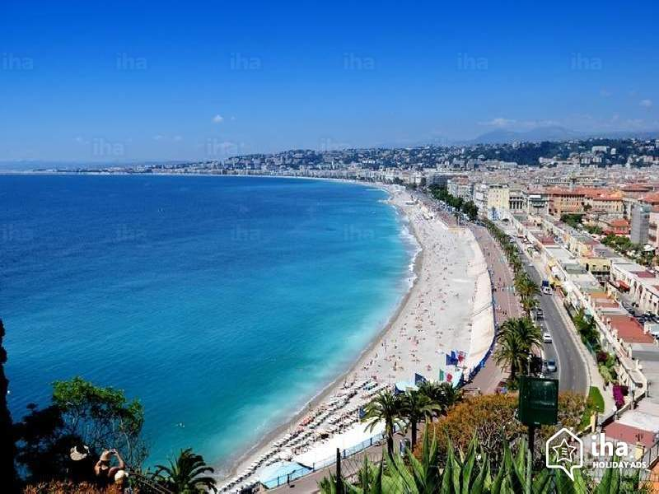
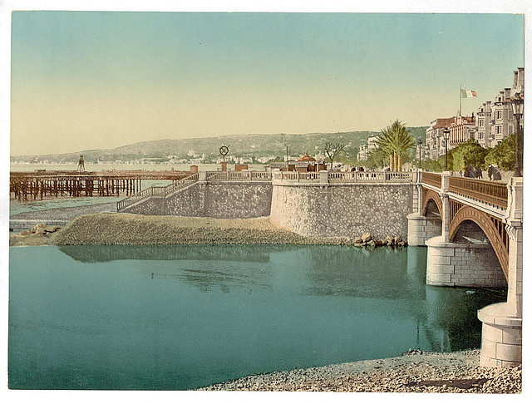
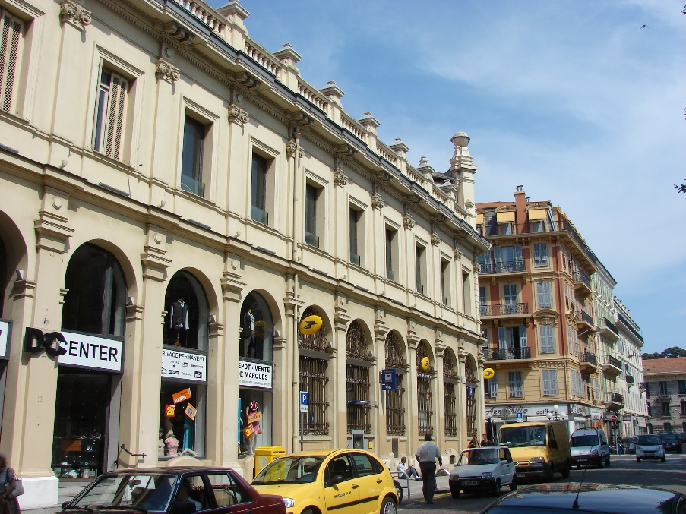
Nice [Réponses]
écouter / parler
1
À Nice, il y a une belle...
parc
plage
2
Il y a un vieux...
pont
poste
Notes:
DO NOT DISPLAY. These slides should not be displayed during the exercise, but are animated to reveal the correct answers.
Home learning – the audio for each complete French sentence is accessible upon clicking the button.
Transcript
1. À Nice, il y a une belle plage.
2. Il y a un vieux pont.

Slide 15
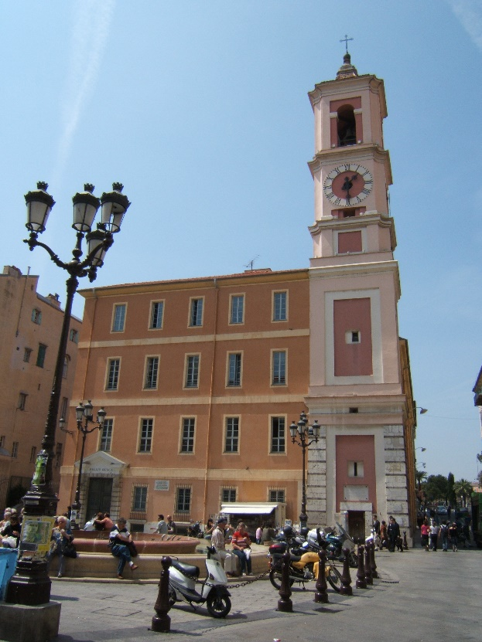
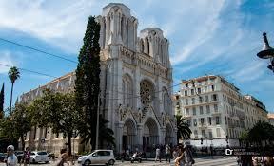
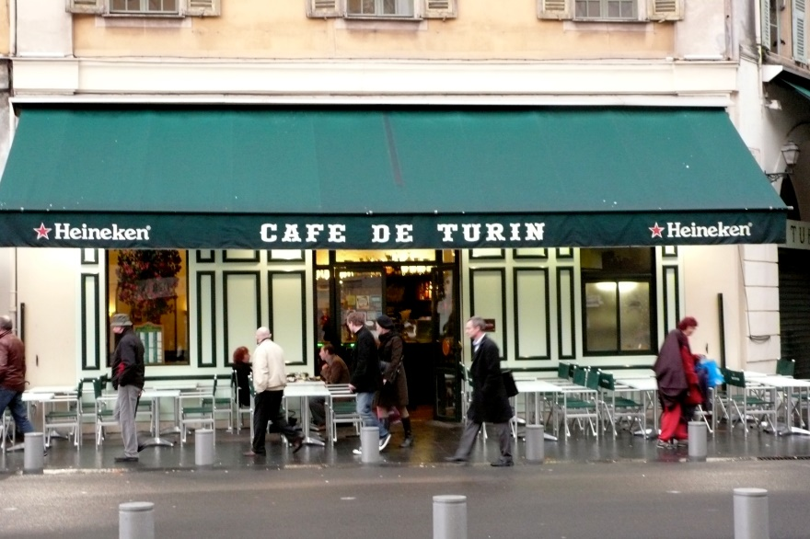
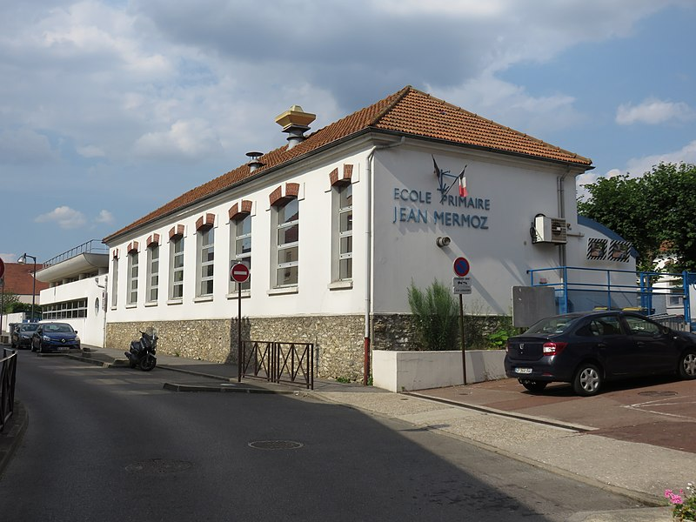
Nice [cont’d]
écouter / parler
3
Il y a une vieille...
église
bâtiment
4
Il y a aussi un bon...
café
école
Notes:
DO NOT DISPLAY. These slides should not be displayed during the exercise, but are animated to reveal the correct answers.
Home learning – the audio for each complete French sentence is accessible upon clicking the button.
Transcript
3. Il y a une vieille église.
4. Il y a aussi un bon café.

Slide 16
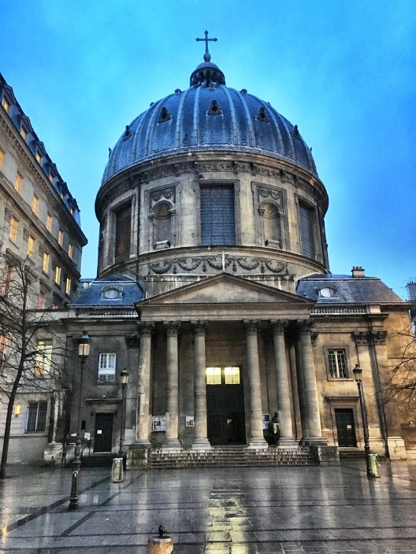
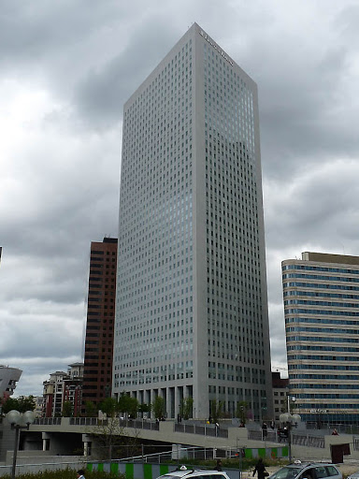
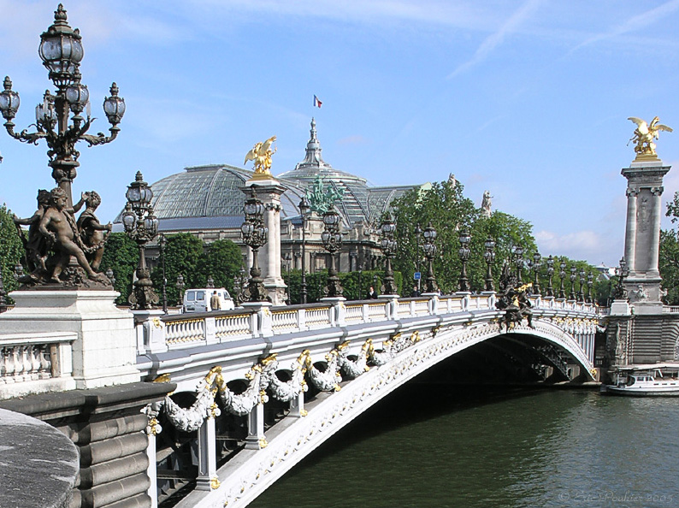
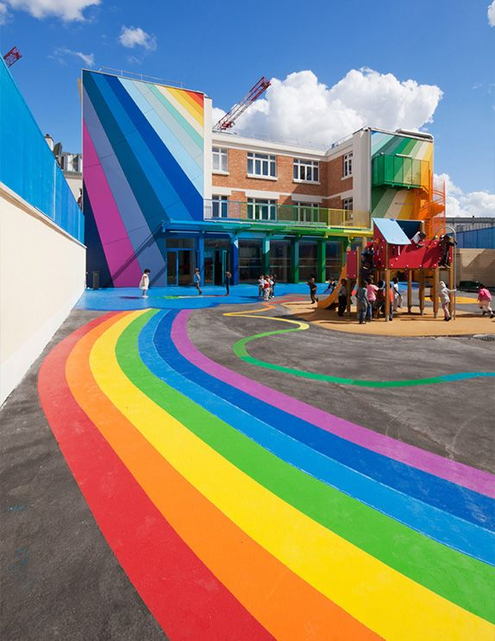
Paris [Réponses]
écouter / parler
5
À Paris, il y a un haut...
église
bâtiment
6
Il y a une nouvelle...
pont
école
Notes:
DO NOT DISPLAY. These slides should not be displayed during the exercise, but are animated to reveal the correct answers.
Home learning – the audio for each complete French sentence is accessible upon clicking the button.
Transcript
5. À Paris, il y a un haut bâtiment.
6. Il y a une nouvelle école.

Slide 17
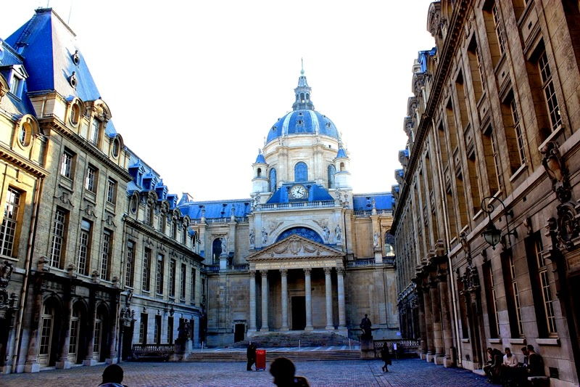
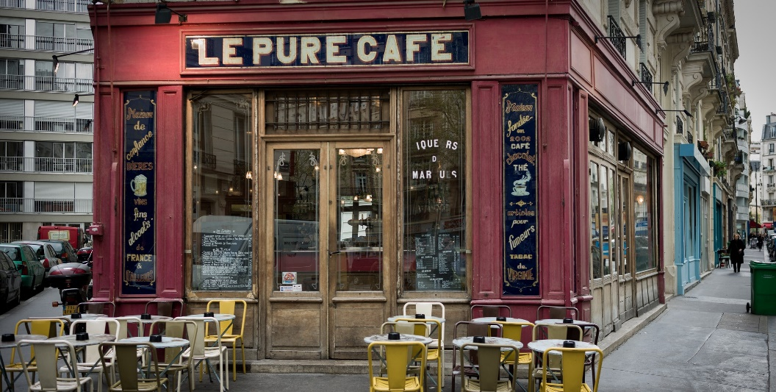
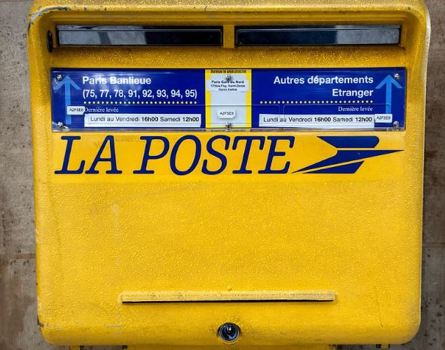
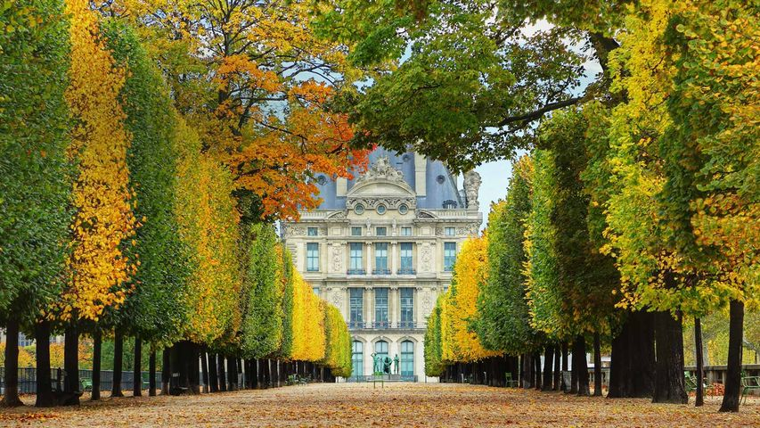
Paris [cont’d]
écouter / parler
7
Il y a une vieille...
université
café
8
Il y a aussi un beau...
poste
jardin
Notes:
DO NOT DISPLAY. These slides should not be displayed during the exercise, but are animated to reveal the correct answers.
Home learning – the audio for each complete French sentence is accessible upon clicking the button.
Transcript
7. Il y a une vieille université.
8. Il y a aussi un beau jardin.

Slide 18
Vocabulary introduction
Adjectives – masculine
Où va l’adjectif ?
bon
bleu
BAGS
moderne
nouveau
noir
vieux
calme
haut
beau
before
after
Notes:
This grammar activity practises the adjective position rules learned last lesson, with the masculine form of the adjectives.
Note: Students can volunteer answers in any order. Words are triggered. Click the word and it flies to before/after.
[Noir [572], omitted from the vocabulary revision exercise for 2.2.3 earlier, is included here].
Timing (total for grammar activities on Slides 36-37): 5 minutes

Slide 19
Vocabulary introduction
Adjectives – feminine
Où va l’adjectif ?
moderne
vieille
BAGS
bonne
noire
bleue
belle
calme
haute
nouvelle
before
after
Notes:
This grammar activity practises the adjective position rules learned last lesson, with the feminine form of the adjectives. The position of each adjective has been altered from that on the previous slide, so that students’ memory of the latter cannot influence their decisions.
Note: Students can volunteer answers in any order. Words are triggered. Click the word and it flies to before/after.
[Noir [572], omitted from the vocabulary revision exercise for 2.2.3 earlier, is included here in its feminine form].

Slide 20
Où est l’adjectif ? [1/10]
lire
C’est la position A ou B pour l’adjectif?
une
A
B
vieille
église
[vieille]
Notes:
This reading exercise challenges students to identify position in which the adjective would appear in the phrase.
Timing (total for reading activities on Slides 38-47): 5 minutes

Slide 21
Où est l’adjectif ? [2/10]
lire
C’est la position A ou B pour l’adjectif?
ordinateur
blanc
un
A
B
[blanc]
Notes:
This reading exercise challenges students to identify position in which the adjective would appear in the phrase.

Slide 22
Où est l’adjectif ? [3/10]
lire
C’est la position A ou B pour l’adjectif?
un
A
vélo
B
beau
[beau]
Notes:
This reading exercise challenges students to identify position in which the adjective would appear in the phrase.

Slide 23
Où est l’adjectif ? [4/10]
lire
C’est la position A ou B pour l’adjectif?
une
A
voiture
B
nouvelle
[nouvelle]
Notes:
This reading exercise challenges students to identify position in which the adjective would appear in the phrase.

Slide 24
Où est l’adjectif ? [5/10]
lire
C’est la position A ou B pour l’adjectif?
un
A
hôtel
cher
B
[cher]
Notes:
This reading exercise challenges students to identify position in which the adjective would appear in the phrase.

Slide 25
Où est l’adjectif ? [6/10]
lire
C’est la position A ou B pour l’adjectif?
un
A
magasin
B
nouveau
[nouveau]
Notes:
This reading exercise challenges students to identify position in which the adjective would appear in the phrase.

Slide 26
Où est l’adjectif ? [7/10]
lire
C’est la position A ou B pour l’adjectif?
un
A
café
B
vieux
[vieux]
Notes:
This reading exercise challenges students to identify position in which the adjective would appear in the phrase.

Slide 27
Où est l’adjectif ? [8/10]
lire
C’est la position A ou B pour l’adjectif?
un
A
bâtiment
B
haut
[haut]
Notes:
This reading exercise challenges students to identify position in which the adjective would appear in the phrase.

Slide 28
Où est l’adjectif ? [9/10]
lire
C’est la position A ou B pour l’adjectif?
une
A
matière
facile
B
[facile]
Notes:
This reading exercise challenges students to identify position in which the adjective would appear in the phrase.

Slide 29
Où est l’adjectif ? [10/10]
lire
C’est la position A ou B pour l’adjectif?
une
belle
A
langue
B
[belle]
Notes:
This reading exercise challenges students to identify position in which the adjective would appear in the phrase.

Slide 30
Dans un café à Nice
écouter
Écoute la conversation. C’est quel adjectif?
Circle your choice in the box.
 | petite / moderne |  | vieux / cher
 | nouveau / intéressant |  | vieille / intéressante
 | vieux / intéressant |  | belle / facile
 | petit / moderne |  | bon / intéressant
 | vieille / bleue |  | petit / moderne
1
6
2
7
3
8
4
9
5
10
Notes:
This listening exercise challenges students to identify which adjective would appear in each sentence, based upon the position in which it is heard bleeped out. The answers are animated on the next slide.
Transcript
1) Où est la [petite] église ?
2) C’est derrière le [nouveau] pont.
3) Ce bâtiment-là, c’est un bâtiment [intéressant] ?
4) Non, c’est un [petit] magasin.
5) Tu as une voiture [bleue] ?
6) Ben, non, j’ai un [vieux] vélo.
7) Le français, c’est une [vieille] langue.
8) Oui, et c’est une [belle] langue aussi !
9) Ça, c’est un [bon] livre?
10) Oui, et c’est un livre [moderne].
Timing (total for listening activities on Slides 48-50): 10 minutes

Slide 31
Réponses
écouter
 | petite / moderne |  | vieux / cher
 | nouveau / intéressant |  | vieille / intéressante
 | vieux / intéressant |  | belle / facile
 | petit / moderne |  | bon / intéressant
 | vieille / bleue |  | petit / moderne
1
6
2
7
3
8
4
9
5
10
Notes:
The answers are animated on this slide. The full audio is available under each number this time, so students can listen and check, rather than just see the animated answer.
Transcript
1) Où est la [petite] église ?
2) C’est derrière le [nouveau] pont.
3) Ce bâtiment-là, c’est un bâtiment [intéressant] ?
4) Non, c’est un [petit] magasin.
5) Tu as une voiture [bleue] ?
6) Ben, non, j’ai un [vieux] vélo.
7) Le français, c’est une [vieille] langue.
8) Oui, et c’est une [belle] langue aussi !
9) Ça, c’est un [bon] livre?
10) Oui, et c’est un livre [moderne].

Slide 32
Quel adjectif ?
écouter
1
Où est la petite église ?
- C’est derrière le nouveau pont.
C’est un bâtiment intéressant ?
- Non, c’est un petit magasin.
Tu as une voiture bleue ?
- Ben, non, j’ai un vieux vélo.
C’est un bon livre ?
- Oui, et c’est un livre moderne.
Le français, c’est une vieille langue.
- Oui, et c’est une belle langue aussi !
Et en anglais ?
Now translate the five conversation extracts into English. Which adjectives have a different position in English?
2
3
4
5
Notes:
This slide shows the students the mini-dialogues in full, challenging them to translate orally (or optionally - if time - in writing) what is said into English.
Transcript
1) Où est la petite église ?
- C’est derrière le [nouveau] pont.
2) Ce bâtiment-là, c’est un bâtiment intéressant ?
- Non, c’est un petit magasin.
3) Tu as une voiture bleue ?
- Ben, non, j’ai un vieux vélo.
4) Ça, c’est un bon livre?
- Oui, et c’est un livre moderne.
5) Le français, c’est une vieille langue.
- Oui, et c’est une belle langue aussi !

Slide 33
Parlez en français!
parler / écouter
Décris les images 1-6: “C’est un/une ....”.
Use the correct adjective in French to go with the noun (remember position and agreement!).
E.g., C’est une matière facile.
Écoute ton/ta partenaire. Coche la description correcte ou écris la description en anglais.
[easy subject]
Notes:
These are the instructions for the speaking task, with an example which is different from those on the cards. The cards themselves are available to print out in a separate document on the NCELP Resource Portal, as are the answer grids. The harder version removes the noun and adjective prompts from the answer grid.
Students should take turns, and can describe their pictures in any order.
These following two slides cannot be displayed during the exercise, but may be useful in reviewing it.
Timing (total for speaking activities on Slides 51-55): 5 minutes

Slide 34
Parlez en français!
A
parler
1
2
3
Hahaha
[new building]
[intelligent girl]
[funny teacher]
[good question]
4
5
6
[beautiful idea]
[interesting subject]
Notes:
DO NOT DISPLAY. There is a student worksheet for this activity, which can be downloaded from the NCELP Resource Portal and printed out.
Pupils have to describe what is in each box – their partner has to specify what they say, on one of the response sheets which follow. This is Partner A’s prompt card (the answer grids follow the prompt cards).
These slides cannot be displayed during the exercise.
N.B. in this task it has been impossible to make the grammar, in terms of the position of the adjective, task-essential (i.e. students can put the adjective before or after the noun and meanings will still be successfully conveyed). Teachers should circulate and listen in, offering feedback to prompt students to correct their adjectival placement as necessary.
Home learning – the audio for each complete French sentence is accessible upon clicking the button.
Transcript
1. C’est un nouveau bâtiment.
2. C’est une fille intelligente.
3. C’est un professeur drôle.
4. C’est une belle idée.
5. C’est une matière intéressante.
6. C’est une bonne question.

Slide 35
Parlez en français!
B
parler
1
2
3
[beautiful building]
[new girl]
[interesting teacher]
4
5
[funny question]
6
Hahaha
[intelligent idea]
[good subject]
Notes:
DO NOT DISPLAY. There is a student worksheet for this activity, which can be downloaded from the NCELP Resource Portal and printed out.
Pupils have to describe what is in each box – their partner has to specify what they say, on one of the response sheets which follows. This is Partner B’s card. Two answer grids – an easier and a more difficult one – follow on the next two sides.
These slides cannot be displayed during the exercise.
Home learning – the audio for each complete French sentence is accessible upon clicking the button.
Transcript
1. C’est un beau bâtiment.
2. C’est une nouvelle fille.
3. C’est un professeur intéressant.
4. C’est une idée intelligente.
5. C’est une bonne matière.
6. C’est une question drôle.

Slide 36
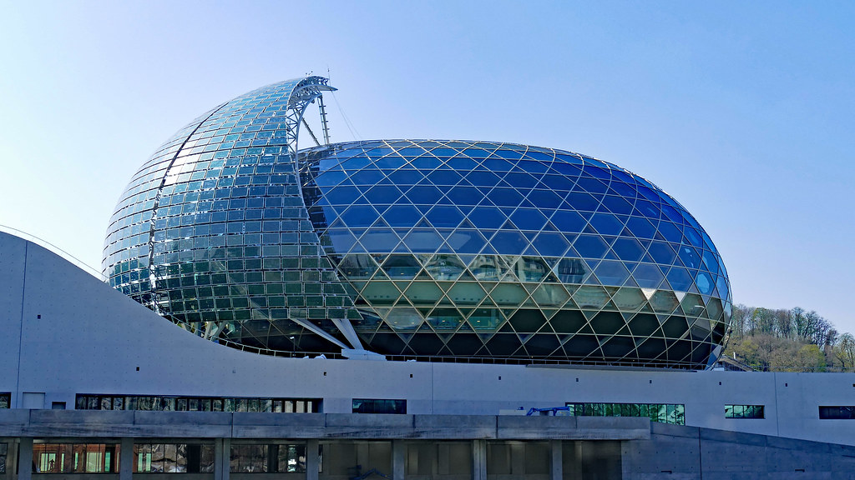
Partenaire A
Utilise les cartes. Écris les 6 phrases.
écrire
Remember!
- position
- agreement
1
C’est un nouveau bâtiment.
2
C’est une fille intelligente.
3
C’est un professeur drôle.
4
C’est une belle idée.
5
C’est une matière intéressante.
La Seine Musicale, Paris.
6
C’est une bonne question.
Notes:
Writing exercise with animated answers – Partner A.
Timing (total for writing activities on Slides 56-58): 15 minutes

Slide 37
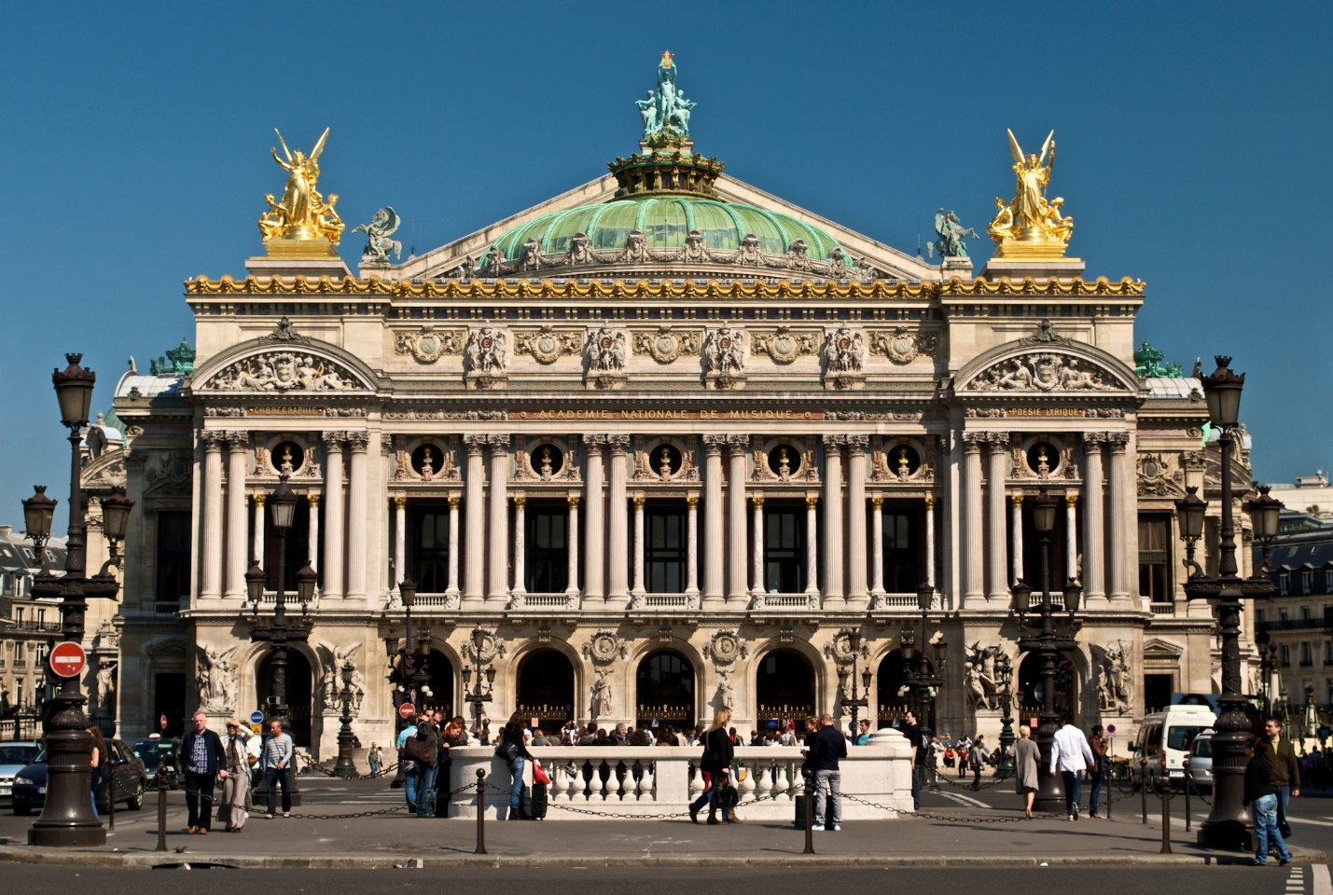
Partenaire B
Utilise les cartes. Écris les 6 phrases.
écrire
Remember!
- position
- agreement
1
C’est un beau bâtiment.
2
C’est une nouvelle fille.
3
C’est un professeur intéressant.
4
C’est une idée intelligente.
5
C’est une bonne matière.
C’est une question drôle.
Palais Garnier, Paris.
6
Notes:
Writing exercise with animated answers – Partner B.

Slide 38
Écris en français !
écrire
Remember to make longer sentences using these conjunctions (linking words):
et and
mais but
ou or
comme like
aussi also
Write some sentences contrasting your town/village with your ideal town/village. You could start as follows:
Dans mon village / ma ville, il y a ...
Dans mon village idéal / ma ville idéale, il y a ...
Use the vocabulary from this sequence, and the dictionary to look up other places to mention.
Notes:
Students are now challenged to write some sentences of their own, contrasting their town/village with their ideal town/village (note that the conditional tense is not introduced at this stage), following the model of the sentences in this resource sequence.

