Slide 1
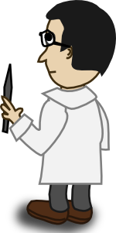
Parler et écouter: Personne B
Écoute ton/ta partenaire. Coche la description correcte.
 | new | intelligent | funny | good | interesting | beautiful
building
girl
teacher
idea
subject
question
Décris les images 1-6: “C’est un/une ....”.
Use the correct adjective in French to go with the noun (remember position and agreement!).
E.g., C’est une matière facile.
[beautiful building]
[new girl]
[interesting teacher]
[intelligent idea]
[good subject]
[funny question]
Hahaha
Material licensed as CC BY-NC-SA 4.0

Slide 2
Parler et écouter: Personne B
Écoute ton/ta partenaire. Écris la description correcte.
 | description?
1
2
3
4
5
6
Décris les images 1-6: “C’est un/une ....”.
Use the correct adjective in French to go with the noun (remember position and agreement!).
E.g., C’est une matière facile.
[beautiful building]
[new girl]
[interesting teacher]
[intelligent idea]
[good subject]
[funny question]
Hahaha
Material licensed as CC BY-NC-SA 4.0
Notes:
This alternative version is more challenging for the listener.

