Slide 1
Changing countries
Imperfect modal verbs – konnte, musste, wollte
Revisit long and short [e]
Y9 German
Term 2.1 - Week 6 - Lesson 37
Heike Krüsemann / Charlotte Moss / Rachel Hawkes
Artwork: Steve Clarke
Date updated: 20/12/21
Notes:
Artwork by Steve Clarke. All additional pictures selected are available under a Creative Commons license, no attribution required.
Native-speaker teacher feedback provided by Stephanie Cross.
Learning outcomes (lesson 1):
Consolidation of SSC long and short [e] Consolidation of imperfect tense modal verbs, konnte, musste, wollte: 1st, 2nd, 3rd person singular Word frequency (1 is the most frequent word in German):
9.2.1.6 (revisit) denken [128] es gibt [n/a] hängen [590] liegen [107] sterben [475] Arbeit [208] Art [260] Berg [934] Bild [253] Deutsch [112] Essen [323] Fremdsprache [3770] Gebäude [1316] Geschwister [3929] Haustier [>5009] Hund [825] Katze [2235] Kultur [594] Kurs [1549] Lieblings- [n/a] Moschee [>5009] Nachbar [1283] Raum2 [403] Straße [391] Tag [111] Tür [400] Türkei [922] Wald [1028] Wand [828] Wechsel [2525] Weile [1631] Wohnung [501] Zeitung [670] ähnlich [437] freundlich [1566] grün [682] heiß [1195] kalt [887] polnisch [3237] tot [513] türkisch [1531] unser [86] nach Hause [n/a] statt [680] vor1 [50] hallo [1077] oder [35] tschüs [3766]
Source: Jones, R.L & Tschirner, E. (2019). A frequency dictionary of German: Core vocabulary for learners. London: Routledge.
The frequency rankings for words that occur in this PowerPoint which have been previously introduced in NCELP resources are given in the NCELP SOW and in the resources that first introduced and formally re-visited those words.
For any other words that occur incidentally in this PowerPoint, frequency rankings will be provided in the notes field wherever possible.

Slide 2
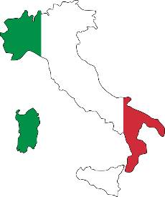
Tschüs Heimat*, Hallo Deutschland!
Kultur
21,2 Millionen Menschen mit Migrationshintergrund* leben in Deutschland (Gesamt*bevölkerung: 83,1 Millionen).
Fast 50 Prozent von ihnen sind deutsche Staatsbürger*.
Von den 11,2 Millionen Ausländern* in Deutschland sind die meisten aus der Türkei und dann Polen, Syrien, Rumänien und Italien.
die Heimat – homeland
der Migrationshintergrund – migration background
gesamt – total
der Bürger – citizen
der Ausländer – foreigner
Notes:
Timing: 2 minutes Aim: to provide cultural information relevant to this week’s context of changing countries and German immigration. Procedure: 1. Students read the information for themselves.
2. Teachers prompts for the key facts in English. (Around ¼ Germany’s population has a migration background; almost half of these have German citizenship; most foreigners living in German are from Turkey, Poland, Syria, Rumania and Italy.)
Note: next week we will focus on the theme of migration a little more, through the work of poet Adel Karasholi.
Note:
- flags/country images not to scale!!
- statistics from 2019, see also https://www.destatis.de/DE/Themen/Gesellschaft-Umwelt/Bevoelkerung/_inhalt.html
Word frequency (1 is the most frequent word in German): Bürger [683] gesamt [557] Heimat [1305] Hintergrund [1207] Migration [4123] Rumänien [>5009] Syrien [1416] Source: Jones, R.L. & Tschirner, E. (2019). A frequency dictionary of German: core vocabulary for learners. Routledge

Slide 3
der Vokal ‘e’
Remember! German [e] can be short or long.
It is short when followed by more than one consonant, e.g. denken, Essen.
It is long when:
there is a double vowel, e.g. Meer,
or when followed by the letter ‘h’, e.g. Lehrerin,
or by a single consonant, e.g. geben.
Note: German final [e] is pronounced ‘uh’, e.g. danke, Klasse.
It is the same sound in the inseparable prefix ‘ge’, e.g. Gebäude.
Notes:
Timing: 1 minute
Aim: to introduce/consolidate SSC [e]
Procedure:
Introduce and elicit the pronunciation of the individual SSC [e] and then the source word again ‘geben’ (with gesture, if using).
Then present and elicit the pronunciation of the five cluster words.

Slide 4
e
mehr
Leben
geben
sehen
Idee
Meer
Notes:
Timing: 1 minute
Aim: to introduce/consolidate SSC [e]
Procedure:
Introduce and elicit the pronunciation of the individual SSC [e] and then the source word again ‘geben’ (with gesture, if using).
Then present and elicit the pronunciation of the five cluster words.
The cluster words have been chosen for their high-frequency, from a range of word classes, with the SSC (where possible) positioned within a variety of syllables within the words (e.g. initial, 2nd, final etc.). Additionally, we have tried to use words that build cumulatively on previously taught SSCs (see the Phonics Teaching Sequence document) and do not include new SSCs. Where new SSCs are used, they are often consonants which have a similar symbol-sound correspondence in English.
Word frequency (1 is the most frequent word in German): geben [57]; mehr [58] Leben [220]; sehen [81]; Meer [977]; Idee [641].
Source: Jones, R.L. & Tschirner, E. (2006). A frequency dictionary of German: core vocabulary for learners. Routledge

Slide 5
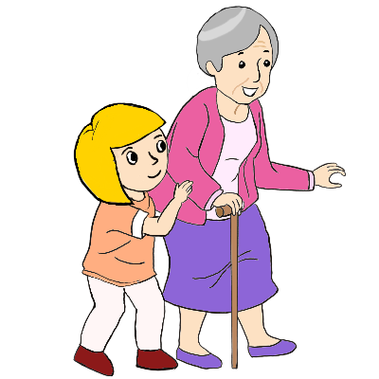
e
besser
Ende
denken
helfen
eng
Bett
Notes:
Timing: 2 minutes
Aim: to introduce/consolidate SSC [e]
Procedure:
Introduce and elicit the pronunciation of the individual SSC [e] and then the source word again ‘denken’ (with gesture, if using).
Then present and elicit the pronunciation of the five cluster words.
The cluster words have been chosen for their high-frequency, from a range of word classes, with the SSC (where possible) positioned within a variety of syllables within the words (e.g. initial, 2nd, final etc.). Additionally, we have tried to use words that build cumulatively on previously taught SSCs (see the Phonics Teaching Sequence document) and do not include new SSCs. Where new SSCs are used, they are often consonants which have a similar symbol-sound correspondence in English.
Word frequency (1 is the most frequent word in German): denken [124]; besser [231] Ende [204]; helfen [406]; Bett [654]; eng [591].
Source: Jones, R.L. & Tschirner, E. (2006). A frequency dictionary of German: core vocabulary for learners. Routledge

Slide 6
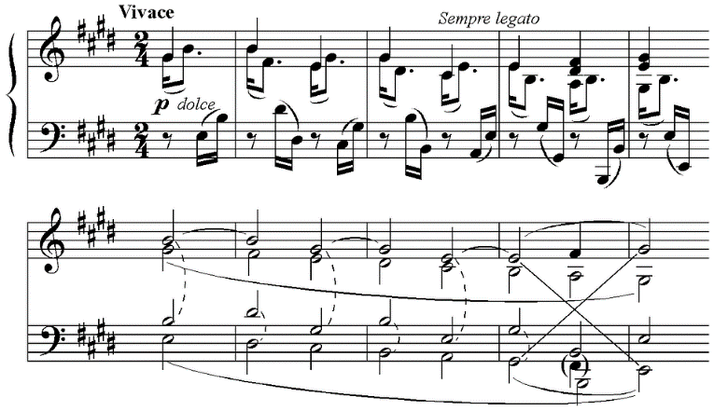
Phonetik [1/2]
Welches Wort passt nicht?
die Ausnahme – exception
hören / schreiben
Person A liest die Wörter laut vor. Person B dreht sich um  und schreibt die Ausnahme* auf.
 | Beethoven | Wechsel | zehn
 | Bett | Männer | leben
 | Nest | Bremen | See
 | steht | Essen | Mensch
1
2
3
4
Note: the ‘e’s not in bold are pronounced ‘uh’. We have a lot of this sound in English in, for example, ‘the butter’. It is called ‘schwa’.
Notes:
Timing: 8 minutes (2 slides) Aim: to practise long and short [e] sounds. Procedure: 1. Ensure that students are clear that the odd one out is based on the long and short [e] sounds.
2. Partner B turns away.
3. Click for the words to appear.
4. Partner A reads the four sets of three words.
5. For each set, Partner B writes down the odd one out in each set, based on long and short [e].
6. Partner B turns back to check answers.
7. Click audio buttons to hear a native speaker pronouncing the words.
8. Repeat on the following slide with partners swapping roles.
Word frequency of unknown words (1 is the most frequent word in German): Nest [>5009] Allee [>5009] Athlet [>5000] Insekt [4736] Source: Jones, R.L. & Tschirner, E. (2019). A frequency dictionary of German: core vocabulary for learners. Routledge

Slide 7
Phonetik [2/2]
Welches Wort passt nicht?
hören / schreiben
Person A liest die Wörter laut vor. Person B dreht sich um  und schreibt die Ausnahme* auf.
 | Fehler | Allee | helfen
 | schlecht | gegen | Athlet
 | perfekt | fängt | legen
 | geben | Insekt | letzte
1
2
3
4
Notes:
Slide 2

Slide 8
Lieblings-, Haupt-
Remember!
Lieblings- means favourite Haupt- means main
_________
_________
These prefixes can be added to almost any noun to make a new word.
favourite language 
die Lieblingssprache
main place 
der Hauptort
Note: two words in English become one word in German.
The gender of the new noun is the gender of the base word.
The gender of the new noun is the gender of the base word.
Notes:
Timing: 1 minute
Aim: to revisit the meaning of two known prefixes in German and their function in creating new nouns.
Procedure:
Click through the animations and elicit the meaning of the German as indicated.
Click to bring up callouts to compare German and English noun formation.

Slide 9
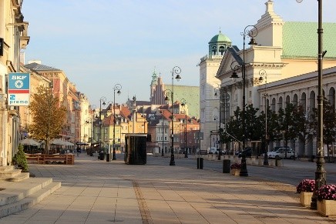
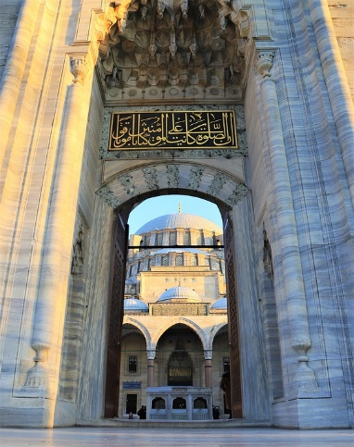
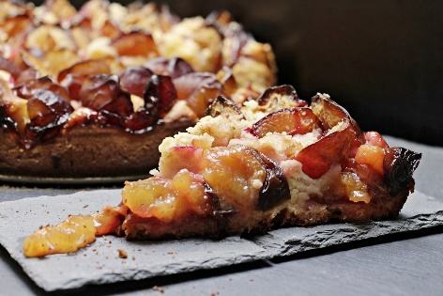
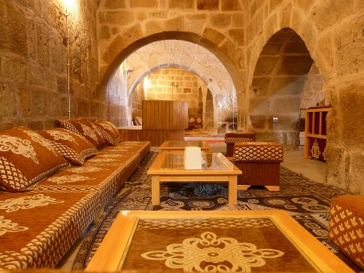
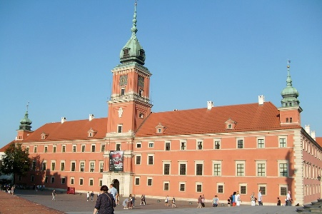
Vokabeln [1/2]
Hör zu. Ist es A, B, ? Schreib das englische Wort.
hören
C
A,B,C? Englisch
1
C
favourite animal
A
2
B
main door
B
A
main street
3
4
H
favourite course
E
D
F
main building
5
6
G
favourite room
7
E
favourite food
G
8
D
main language
F
H
Notes:
Timing: 15 minutes (three slides) – 10 minutes listening, 5 minutes spoken recall
Aim: to practise aural comprehension of vocabulary from this week’s revisited set from Y7 and Y8.
Procedure:
1. Give students a minute in pairs to look at the pictures and anticipate the vocabulary items they will hear.
2. Click the number triggers to play the audio.
3. Students match to the correct picture and write the word in English if they are able.
4. Click to bring up the answers.
Transcript:
1] Lieblingstier 2] Haupttür 3] Hauptstraße 4] Lieblingskurs 5] Hauptgebäude 6] Lieblingsraum 7] Lieblingsessen 8] Hauptsprache 9] Lieblingswald 10] Lieblingszeitung 11] Lieblingstag 12] Hauptessen 13] Hauptmoschee 14] Hauptberg 15] Lieblingsbild 16] Hauptarbeit

Slide 10
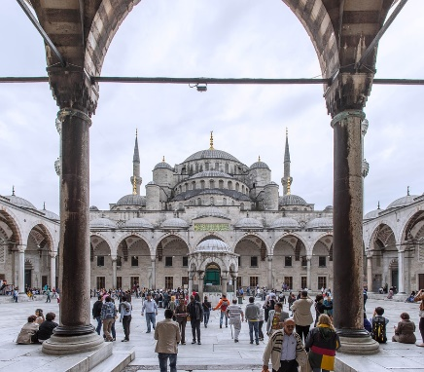
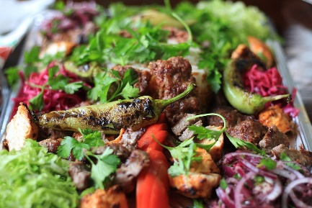
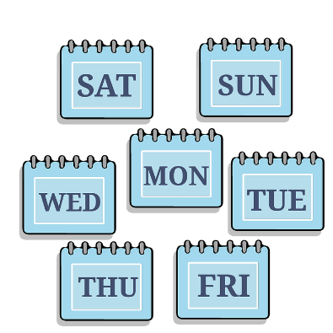
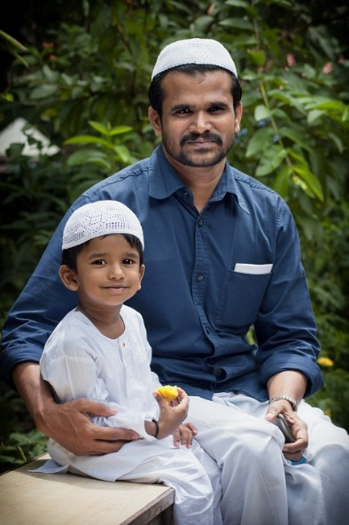
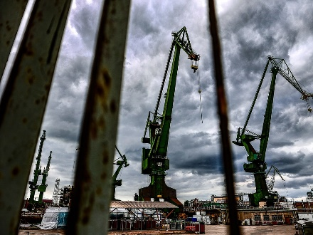
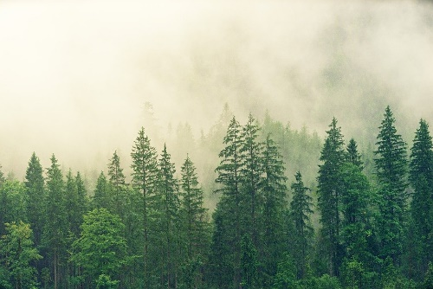
Vokabeln [2/2]
hören
A,B,C? Englisch
K
I
J
9
P
favourite wood
10
I
favourite newspaper
11
L
favourite day
L
12
J
main meal
M
N
13
K
main mosque
14
M
main mountain
15
N
favourite picture
O
P
16
O
main work

Slide 11
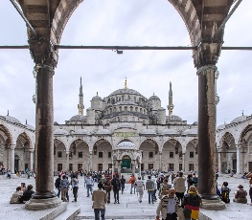
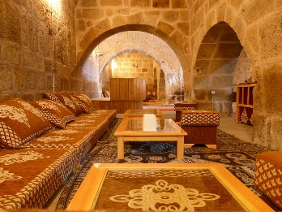
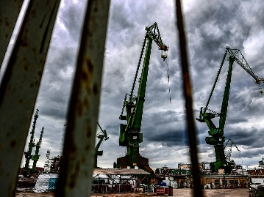
Vokabeln
sprechen
Sag die Wörter so schnell wie möglich.
A
B
C
D
favourite wood/forest
main door
favourite food
main meal
E
F
G
H
main language
main street
main mosque
favourite day
I
J
K
L
favourite room
favourite course
main mountain
favourite animal
M
N
O
P
main building
main work
favourite newspaper
favourite picture
Notes:
Timing: 5 minutes Aim: to practise spoken recall of compound nouns with Lieblings- and Haupt- prefixes and known vocabulary base words from this week’s vocabulary set.
Procedure:
Students work in pairs.
One says a random letter and the other says the word in German as fast as possible.
Students take turns.

Slide 12
Imperfect modal verbs
Grammatik
Remember how to form the imperfect (simple past) of modal verbs:
1. remove -en and any umlauts
2. add -te
 | können | wollen | müssen
ich | konnte | wollte | musste
du | konntest | wolltest | musstest
er/sie/es | konnte | wollte | musste
3. also add -st to the du form
Remember that the 2nd verb is at the end of the sentence, in infinitive:
I wanted to get up early.
Ich wollte früh aufstehen.
Notes:
Timing: 3 minutes Aim: to recap three imperfect modal verbs in 1st, 2nd, 3rd persons singular. Procedure: 1. Click to bring up the stages of the explanation. 2. Elicit the German from students, where appropriate.

Slide 13
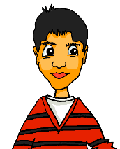
Erzähl mir von dir
In German the verb always comes 2nd. These informal answers start with the verb because there is an unspoken das (that), which comes first, e.g. Das musste ich.
hören
Mia fragt junge Leute mit Migrationshintergrund über ihr Leben.
War das früher (F) oder ist das heute (H)? Wie antworten sie?
 |  | F | H | Antwort
 | Musstest du jeden Tag Deutsch sprechen?
 | Willst du polnisches Essen kochen?
 | Konntest du in die Mosche gehen?
 | Wolltest du Fremdsprachen lernen?
 | Musst du deutsches Essen essen?
 | Kannst du Türkisch sprechen?
 | Wolltest du in Italien bleiben?
 | Kannst du eine arabische Zeitung lesen?
arabisch – arabic
1
Muss / Musste ich.
2
Will / Wollte ich nicht.
3
Kann / Konnte ich.
4
Will / Wollte ich.
5
Muss / Musste ich nicht.
6
Kann / Konnte ich.
7
Will / Wollte ich.
8
Kann / Konnte ich nicht.
Notes:
Timing: 8 minutes Aim: to distinguish between past and present modal verbs in the second person singular and first person singular. Procedure: 1. Explain the task – Mia is interviewing young people with a migration background about their lives today and in the past.
2. Play recording for item 1. Students listen out for modal verb – if it is in the past they write F for früher, if it is in the present they write H for heute.
3. Click to bring up answer ticks.
4. Click again to bring up choice of verb forms in the young person’s answer – present or past tense. Answers match the tense of the question.
5. Click again on the audio button so students listen a second time to item one. The students select one of the verbs in the Antwort column.
6. Click to bring up the answer. Click again to bring up the written form of the question, for checking.
7. Continue for items 2-8. Note: these could be completed item by item, or all together. Animations work for both options.
Transcript:
1. Musstest du jeden Tag Deutsch sprechen?
2. Willst du polnisches Essen kochen?
3. Konntest du in die Moschee gehen?
4. Wolltest du Fremdsprachen lernen?
5. Musst du deutsches Essen essen?
6. Kannst du Türkisch sprechen?
7. Wolltest du in Italien bleiben?
8. Kannst du eine arabische Zeitung lesen?
Word frequency (1 is the most frequent word in German):
arabisch [2159] Source: Jones, R.L. & Tschirner, E. (2019). A frequency dictionary of German: core vocabulary for learners. Routledge

Slide 14
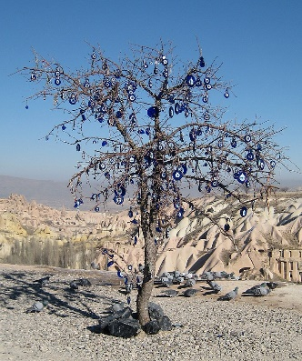
Das böse Auge
das Souvenir – souvenir
lesen
Lies den Text. Use the words you know to understand the
general meaning of the words in bold.
In der Türkei und auch in einigen anderen Ländern sieht man oft ein blaues Amulett in Form von einem Auge. Es hat verschiedene Namen, aber es soll immer vor dem bösen Blick schützen – das ist, wenn einem jemand etwas Böses wünscht. Zum Schutz hängt man das Amulett gerne im Haus, im Auto oder an der Kleidung auf. In Kappadokien, eine Gegend in der Türkei, hängen die Menschen es in Bäume, und auch als Schmuck ist es beliebt. Das 'böse Auge' ist ursprünglich aus Glas, und die Farbe sieht aus wie der schöne blaue Himmel. Touristen kaufen es immer gerne als Souvenir*.
amulet
1. Amulett: type of country | body part | form | decoration
2. verschieden: expresses similarity |colour | fun | difference
3. Schutz: type of ornament | prevention | prayer | personality
4. Gegend: part of geography | plant | custom | family
5. Schmuck: type of body decoration | person | tree |food
6. ursprünglich: expresses duration| origin| never | time of day
various
protection
region
jewellery
originally
Notes:
Timing: 5 minutes Aim: to practise lexical inferencing; the written comprehension of known words to arrive at a general understanding of one unknown word in a sentence context. In addition, to revise previously learnt vocabulary in new contexts. Procedure:
1. Ensure that students understand the task (as this is only the second time they do this type of activity). Students need to know that they are aiming to understand the general meaning, rather than specific meaning (though they may in some cases also arrive at this).
2. Students read each text and decide which of the four options is most likely, depending on their understanding of the surrounding words.
3. Click to reveal answers as well as the specific meaning of each word.
4. Proceed to the next slide for the comprehension part of the activity.
Image credit: tree in Cappadocia with evil eye amulets. By: Shakko – Own work, CC BY-SA 3.0, https://commons.wikimedia.org/w/index.php?curid=3703598
Word frequency (1 is the most frequent word in German):
arabisch [2159] Gegend [1575] Schmuck [>5009] Schutz [1152] Souvenir [>5009] ursprünglich [1332] [verschieden [254] Source: Jones, R.L. & Tschirner, E. (2019). A frequency dictionary of German: core vocabulary for learners. Routledge

Slide 15
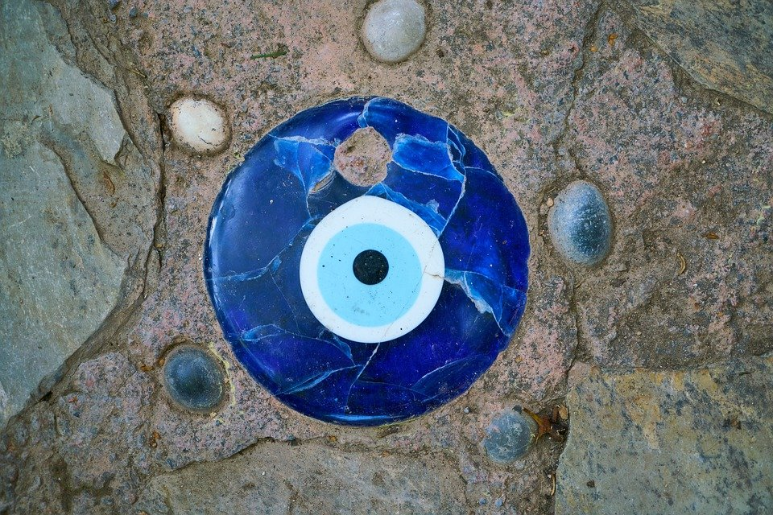
Richtig oder falsch?
das Souvenir – souvenir
lesen
In der Türkei und auch in einigen anderen Ländern sieht man oft ein blaues Amulett in Form von einem Auge. Es hat verschiedene Namen, aber es soll immer vor dem bösen Blick schützen – das ist, wenn einem jemand etwas Böses wünscht. Zum Schutz hängt man das Amulett gerne im Haus, im Auto oder an der Kleidung auf. In Kappadokien, eine Gegend in der Türkei, hängen die Menschen es in Bäume, und auch als Schmuck ist es beliebt. Das 'böse Auge' ist ursprünglich aus Glas, und die Farbe sieht aus wie der schöne blaue Himmel. Touristen kaufen es immer gerne als Souvenir*.
The ‘böse Auge’ is a part of the human face.
It only exists in Turkey.
It has different names.
It is used for protection from an evil glare or a curse.
You can hang it anywhere but not in trees.
In Turkey people do not like to use it as jewellery.
An original evil eye is made from glass.
The colour reminds us of a beautiufl blue sky.
Notes:
Timing: 5 minutes Aim: to practise written comprehension of the main ideas and detail of the text.
Procedure:
1. Students read the text.
2. Students write R (richtig) or F (falsch) for each sentence.
3. Click to reveal answers.
4. Oral translation of text if time allows.
Image credit: tree in Cappadocia with evil eye amulets. By: Shakko – Own work, CC BY-SA 3.0, https://commons.wikimedia.org/w/index.php?curid=3703598
Word frequency (1 is the most frequent word in German):
arabisch [2159] Gegend [1575] Schmuck [>5009] Schutz [1152] Souvenir [>5009] ursprünglich [1332] [verschieden [254] Source: Jones, R.L. & Tschirner, E. (2019). A frequency dictionary of German: core vocabulary for learners. Routledge

Slide 16
Frau Nowaks Tagebuch
schreiben
Katja hat Muttis Tagebuch gelesen, und sie schreibt Mehmet. Füll die Lücken aus.
Mutti:
Katja:
1. Die Leute in Deutschland sind freundlich, aber ich kann nichts verstehen.
1. Die Leute in Deutschland waren freundlich, aber Mutti konnte nichts verstehen.
_____
2. Ich möchte arbeiten, aber ich muss Deutsch als Fremdsprache lernen.
2. Sie wollte arbeiten, aber sie musste Deutsch als Fremdsprache lernen.
_____
3. Ich gehe einkaufen, aber ich will im Geschäft Polnisch sprechen.
3. Sie ist einkaufen gegangen, aber sie wollte im Geschäft Polnisch sprechen.
____
4. Manchmal will ich zurück nach Polen gehen.
4. Manchmal wollte sie zurück nach Polen gehen.
_____
5. Ich will mehr deutsche Freunde kennenlernen*.
5. Sie wollte mehr deutsche Freunde kennenlernen*.
_____
6. Ich möchte die Kultur verstehen, aber ich kann keine Zeitung lesen.
6. Sie wollte die Kultur verstehen, aber sie konnte keine Zeitung lesen.
______
kennenlernen – to meet, get to know
Notes:
Timing: 6 minutes Aim: to practise spoken production of imperfect modal verb forms, with the support of present tense forms. Procedure:
Katja finds a diary entry written by mum when she was in her first few weeks in Germany. She is writing to Mehmet about it. 1. Students read the sentences 1-6 from Mutti’s diary.
2. Click to bring up Katja’s first sentence to Mehmet.
2. Students write out Katja’s sentence to Mehmet replacing the blanked out present tense modal with an imperfect from. 3. Click for answer.
4. Repeat for items 2-6. Word frequency (1 is the most frequent word in German): kennenlernen [2303] Source: Jones, R.L. & Tschirner, E. (2019). A frequency dictionary of German: core vocabulary for learners. Routledge

Slide 17
Changing countries
Imperfect modal verbs – konnte, musste, wollte
Word order 1 and 3 conjunctions
Revisit long and short [e]
Y9 German
Term 2.1 - Week 5 - Lesson 36
Charlotte Moss / Rachel Hawkes
Artwork: Steve Clarke
Date updated: 20/12/21
Notes:
Artwork by Steve Clarke. All additional pictures selected are available under a Creative Commons license, no attribution required.
Native-speaker teacher feedback provided by Stephanie Cross.
Learning outcomes (lesson 2):
Consolidation of SSC long and short [e] Consolidation of imperfect tense modal verbs, konnte, musste, wollte: 1st, 2nd, 3rd person singular
Word frequency (1 is the most frequent word in German):
9.2.1.6 (revisit) denken [128] es gibt [n/a] hängen [590] liegen [107] sterben [475] Arbeit [208] Art [260] Berg [934] Bild [253] Deutsch [112] Essen [323] Fremdsprache [3770] Gebäude [1316] Geschwister [3929] Haustier [>5009] Hund [825] Katze [2235] Kultur [594] Kurs [1549] Lieblings- [n/a] Moschee [>5009] Nachbar [1283] Raum2 [403] Straße [391] Tag [111] Tür [400] Türkei [922] Wald [1028] Wand [828] Wechsel [2525] Weile [1631] Wohnung [501] Zeitung [670] ähnlich [437] freundlich [1566] grün [682] heiß [1195] kalt [887] polnisch [3237] tot [513] türkisch [1531] unser [86] nach Hause [n/a] statt [680] vor1 [50] hallo [1077] oder [35] tschüs [3766]
The frequency rankings for words that occur in this PowerPoint which have been previously introduced in NCELP resources are given in the NCELP SOW and in the resources that first introduced and formally re-visited those words.
For any other words that occur incidentally in this PowerPoint, frequency rankings will be provided in the notes field wherever possible.

Slide 18
Phonetik [1/2]
lesen / hören
Hör zu. Wie viele Wörter haben ein langes oder kurzes [e]?
Person A liest die Sätze laut. Person B dreht sich um  und schreibt / für jede SSC.
 |  | langes [e] | kurzes [e]
 | Meine Eltern hatten ein Haus am Mittelmeer.
 | Der türkische Kaffee ist so lecker. Er fehlt mir immer noch.
 | Im Winter gab es sehr wenig Schnee.
 | In der englischen Gesellschaft trinkt man viel Tee.
1
/
/
2
//
/
3
///
/
4
/
//
Notes:
Timing: 10 minutes (2 slides) Aim: to practise long and short [e] sounds.
Notes:
i) There is an easier version of this activity on slide 19. ii) Remind students that they are only listening out for long [e] and short [e], not schwa or [er] sounds. Procedure: 1. Partner B turns away.
2. Click to bring up the table of four sentences.
3. Partner A reads the four sentences.
4. Partner B writes down how many long and short [e] sounds they hear in each sentence.
5. Click to reveal answers.
6. Click audio buttons to hear a native speaker.
7. Repeat on the following slide with partners swapping roles.
Word frequency (1 is the most frequent word in German): Mittelmeer [4033] Schnee [1760] Gesellschaft [363] Armee [2209] Beere [>5009] ehemalig [883] Source: Jones, R.L. & Tschirner, E. (2019). A frequency dictionary of German: core vocabulary for learners. Routledge

Slide 19
Phonetik [2/2]
lesen / hören
Hör zu. Wie viele Wörter haben ein langes oder kurzes [e]?
Person B liest die Sätze laut. Person A dreht sich um  und schreibt / für jede SSC.
 |  | langes [e] | kurzes [e]
 | Ich habe ein Jahr in der Armee gelebt.
 | Jetzt esse ich weniger frische Beeren.
 | Ich werde mein ehemaliges Unternehmen in Belgien nie vergessen.
 | Ich konnte jeden Tag im See schwimmen.
1
//
--
2
//
/
3
//
//
4
//
--
Notes:
Slide 2

Slide 20
Phonetik
lesen / hören
Hör zu. Schreibe die Wörter mit [e].
 | Meine Eltern hatten ein Haus am Mittelmeer.
 | Der türkische Kaffee ist so lecker. Er fehlt mir immer noch.
 | Im Winter gab es sehr wenig Schnee.
 | In der englischen Gesellschaft trinkt man viel Tee.
 | Ich habe ein Jahr in der Armee gelebt.
 | Jetzt esse ich weniger frische Beeren.
 | Ich werde mein ehemaliges Unternehmen in Belgien nie vergessen.
 | Ich konnte jeden Tag im See schwimmen.
1
___
________.
2
_____
_____.
___
3
___ ____ _____.
4
_______ _____________
_____.
5
_______ ______.
6
___
_____
_____.
7
_______ ___________
___
______.
8
_____
__
Notes:
Note: A more challenging version of this activity can be found on the previous two slides.
Timing: 10 minutes Aim: to practise long and short [e] sounds.
Procedure: 1. Click to play audio.
2. Students transcribe gapped words with long and short [e].
3. Click to reveal the sentence. Note: Some words are known, some are unknown. Where words are underknown and multiple spellings of the SSC are possible (i.e. e, ee, eh), teachers should acknowledge all appropriate attempts at transcription.
Word frequency (1 is the most frequent word in German): Mittelmeer [4033] Schnee [1760] Gesellschaft [363] Armee [2209] Beere [>5009] ehemalig [883] Source: Jones, R.L. & Tschirner, E. (2019). A frequency dictionary of German: core vocabulary for learners. Routledge

Slide 21
Kategorien
Kategorien
hören / schreiben
Hör drei Wörter an. Schreib die Kategorie.
Türkei | Polen | Schweiz
Wand | Tür | Raum
1
Länder
5
Wohnung
2
Türkisch | Polnisch | Deutsch
6
Weile | Moment | Stunde
Zeit
Sprachen
3
Hund | Katze | Maus
7
hängen | liegen | sitzen
Positionen
Haustiere
4
kalt | heiß | lecker
8
Nachbar | Gast | Geschwister
Menschen
Essen
Po_______
Es____
Wo________
Ha_______
Sp_______
Ze___
Lä______
Me_______
Notes:
Timing: 8 minutes
Aim: to practise aural comprehension of 24 vocabulary items and their association with 8 further written vocabulary items.
Note: A less challenging version of this activity can be found on the following slide.
Procedure:
1. Students write 1-8 in books. 2. They listen to each set of three words and write the most appropriate category word based on the prompts at the bottom. Note: Teachers may wish to encourage students to write any words down that they hear, so that they have more time to review them and select the most appropriate category word. 3. Answers (including a written version of the three words in each set) appear on mouse clicks. 4. At this point, teachers may wish to encourage learners to ask the meanings of any words they can’t remember the English for.
Transcript: 1. Türkei | Polen | Schweiz
2. Türkisch | Polnisch | Deutsch 3. Hund | Katze | Maus 4. kalt | heiß | lecker 5. Wand | Tür | Raum 6. Weile | Moment | Stunde 7. hängen | liegen | sitzen 8. Nachbar | Gast | Geschwister

Slide 22
Kategorien
Kategorien
hören / schreiben
Hör drei Wörter an. Schreib die Kategorie.
Türkei | Polen | Schweiz
Wand | Tür | Raum
1
Länder
5
Wohnung
2
Türkisch | Polnisch | Deutsch
6
Weile | Moment | Stunde
Zeit
Sprachen
3
Hund | Katze | Maus
7
hängen | liegen | sitzen
Positionen
Haustiere
4
kalt | heiß | lecker
8
Nachbar | Gast | Geschwister
Menschen
Essen
Positionen
Essen
Wohnung
Haustiere
Sprachen
Zeit
Länder
Menschen
Notes:
Timing: 8 minutes
Aim: to practise aural comprehension of 24 vocabulary items and their association with 8 further written vocabulary items.
Note: A more challenging version of this activity can be found on the previous slide.
Procedure:
1. Students write 1-8 in books. 2. They listen to each set of three words and write the most appropriate category word based on the prompts at the bottom. Note: Teachers may wish to encourage students to write any words down that they hear, so that they have more time to review them and select the most appropriate category word. 3. Answers (including a written version of the three words in each set) appear on mouse clicks. 4. At this point, teachers may wish to encourage learners to ask the meanings of any words they can’t remember the English for.
Transcript: 1. Türkei | Polen | Schweiz
2. Türkisch | Polnisch | Deutsch 3. Hund | Katze | Maus 4. kalt | heiß | lecker 5. Wand | Tür | Raum 6. Weile | Moment | Stunde 7. hängen | liegen | sitzen 8. Nachbar | Gast | Geschwister

Slide 23
sprechen
t _ _
d_ _ _ _ _ _
v _ _
ä_ _ _ _ _ _
d_ _ R _ _ _
d_ _ B _ _ _
d_ _ W_ _ _ _
h _ _ _
t _ _ _ _ _
d_ _ B_ _ _
instead
d_ _ A _ _
statt
s_ _ _ _
l_ _ _ _ _
h_ _ _ _ _
d_ _ W_ _ _ _
s_ _ _ _ _ _
Notes:
Timing: 5 minutes (16 slides) Aim: to practise spoken recall of 16 further items of vocabulary.
Procedure: 1. Teacher elicits vocabulary orally from students in response to the prompt (picture and word) in the centre.
2. Click for answer.
3. Continue for the remaining 15 slides.

Slide 24
sprechen
t _ _
d_ _ _ _ _ _
v _ _
ä_ _ _ _ _ _
d_ _ R _ _ _
d_ _ B _ _ _
die Wand
h _ _ _
d_ _ W_ _ _ _
t _ _ _ _ _
d_ _ B_ _ _
wall (inside)
d_ _ A _ _
s_ _ _ _
l_ _ _ _ _
h_ _ _ _ _
d_ _ W_ _ _ _
s_ _ _ _ _ _

Slide 25
sprechen
t _ _
d_ _ _ _ _ _
v _ _
ä_ _ _ _ _ _
das Bild
d_ _ R _ _ _
d_ _ B _ _ _
d_ _ W_ _ _ _
h _ _ _
t _ _ _ _ _
d_ _ B_ _ _
picture
d_ _ A _ _
s_ _ _ _
l_ _ _ _ _
h_ _ _ _ _
d_ _ W_ _ _ _
s_ _ _ _ _ _

Slide 26
sprechen
tot
t _ _
d_ _ _ _ _ _
v _ _
ä_ _ _ _ _ _
d_ _ R _ _ _
d_ _ B _ _ _
d_ _ W_ _ _ _
h _ _ _
t _ _ _ _ _
d_ _ B_ _ _
dead
d_ _ A _ _
s_ _ _ _
l_ _ _ _ _
h_ _ _ _ _
d_ _ W_ _ _ _
s_ _ _ _ _ _

Slide 27
sprechen
t _ _
d_ _ _ _ _ _
v _ _
ä_ _ _ _ _ _
d_ _ R _ _ _
d_ _ B _ _ _
d_ _ W_ _ _ _
h _ _ _
t _ _ _ _ _
der Berg
d_ _ B_ _ _
hill, mountain
d_ _ A _ _
s_ _ _ _
l_ _ _ _ _
h_ _ _ _ _
d_ _ W_ _ _ _
s_ _ _ _ _ _

Slide 28
sprechen
denken
t _ _
d_ _ _ _ _ _
v _ _
ä_ _ _ _ _ _
d_ _ R _ _ _
d_ _ B _ _ _
d_ _ W_ _ _ _
h _ _ _
t _ _ _ _ _
d_ _ B_ _ _
to think, thinking
d_ _ A _ _
s_ _ _ _
l_ _ _ _ _
h_ _ _ _ _
d_ _ W_ _ _ _
s_ _ _ _ _ _

Slide 29
sprechen
t _ _
d_ _ _ _ _ _
v _ _
ä_ _ _ _ _ _
d_ _ R _ _ _
d_ _ B _ _ _
d_ _ W_ _ _ _
h _ _ _
t _ _ _ _ _
d_ _ B_ _ _
type, kind
die Art
d_ _ A _ _
s_ _ _ _
l_ _ _ _ _
h_ _ _ _ _
d_ _ W_ _ _ _
s_ _ _ _ _ _

Slide 30
sprechen
t _ _
d_ _ _ _ _ _
v _ _
ä_ _ _ _ _ _
ähnlich
d_ _ R _ _ _
d_ _ B _ _ _
d_ _ W_ _ _ _
h _ _ _
t _ _ _ _ _
d_ _ B_ _ _
similar
d_ _ A _ _
s_ _ _ _
l_ _ _ _ _
h_ _ _ _ _
d_ _ W_ _ _ _
s_ _ _ _ _ _

Slide 31
sprechen
t _ _
d_ _ _ _ _ _
v _ _
ä_ _ _ _ _ _
d_ _ R _ _ _
d_ _ B _ _ _
d_ _ W_ _ _ _
h _ _ _
t _ _ _ _ _
d_ _ B_ _ _
to die
d_ _ A _ _
s_ _ _ _
l_ _ _ _ _
h_ _ _ _ _
s_ _ _ _ _ _
d_ _ W_ _ _ _
sterben

Slide 32
sprechen
t _ _
d_ _ _ _ _ _
v _ _
ä_ _ _ _ _ _
d_ _ R _ _ _
d_ _ B _ _ _
d_ _ W_ _ _ _
h _ _ _
tschüs
t _ _ _ _ _
d_ _ B_ _ _
bye
d_ _ A _ _
s_ _ _ _
l_ _ _ _ _
h_ _ _ _ _
d_ _ W_ _ _ _
s_ _ _ _ _ _

Slide 33
sprechen
t _ _
d_ _ _ _ _ _
v _ _
ä_ _ _ _ _ _
d_ _ R _ _ _
d_ _ B _ _ _
d_ _ W_ _ _ _
h _ _ _
t _ _ _ _ _
d_ _ B_ _ _
while
d_ _ A _ _
s_ _ _ _
l_ _ _ _ _
h_ _ _ _ _
d_ _ W_ _ _ _
s_ _ _ _ _ _
die Weile

Slide 34
sprechen
t _ _
d_ _ _ _ _ _
v _ _
ä_ _ _ _ _ _
vor
d_ _ R _ _ _
d_ _ B _ _ _
d_ _ W_ _ _ _
h _ _ _
t _ _ _ _ _
d_ _ B_ _ _
ago
d_ _ A _ _
s_ _ _ _
l_ _ _ _ _
h_ _ _ _ _
d_ _ W_ _ _ _
s_ _ _ _ _ _

Slide 35
sprechen
t _ _
d_ _ _ _ _ _
v _ _
ä_ _ _ _ _ _
d_ _ R _ _ _
d_ _ B _ _ _
d_ _ W_ _ _ _
h _ _ _
t _ _ _ _ _
d_ _ B_ _ _
to hang, be hanging
d_ _ A _ _
s_ _ _ _
l_ _ _ _ _
h_ _ _ _ _
s_ _ _ _ _ _
hängen
d_ _ W_ _ _ _

Slide 36
sprechen
t _ _
d_ _ _ _ _ _
v _ _
ä_ _ _ _ _ _
d_ _ R _ _ _
d_ _ B _ _ _
heiß
d_ _ W_ _ _ _
h _ _ _
t _ _ _ _ _
d_ _ B_ _ _
hot
d_ _ A _ _
s_ _ _ _
l_ _ _ _ _
h_ _ _ _ _
d_ _ W_ _ _ _
s_ _ _ _ _ _

Slide 37
sprechen
t _ _
d_ _ _ _ _ _
v _ _
ä_ _ _ _ _ _
der Raum
d_ _ B _ _ _
d_ _ R _ _ _
d_ _ W_ _ _ _
h _ _ _
t _ _ _ _ _
d_ _ B_ _ _
room
d_ _ A _ _
s_ _ _ _
l_ _ _ _ _
h_ _ _ _ _
d_ _ W_ _ _ _
s_ _ _ _ _ _

Slide 38
sprechen
t _ _
d_ _ _ _ _ _
v _ _
ä_ _ _ _ _ _
d_ _ R _ _ _
d_ _ B _ _ _
d_ _ W_ _ _ _
h _ _ _
t _ _ _ _ _
d_ _ B_ _ _
to lie, be lying (down)
d_ _ A _ _
s_ _ _ _
liegen
l_ _ _ _ _
h_ _ _ _ _
d_ _ W_ _ _ _
s_ _ _ _ _ _

Slide 39
Bindewörter (conjunctions)
Grammatik
You know that some conjunctions kick the short form verb to the end of the clause:
Other conjunctions do not change the word order:
This is word order 3 (WO3).
This is word order 1 (WO1).
Ich musste einen Kurs machen, weil ich kein Deutsch sprechen konnte.
Ich musste einen Kurs machen, denn ich konnte kein Deutsch sprechen.
I had to do a course because I couldn’t speak German.
I had to do a course as/because I couldn’t speak German.
Ich habe eine Arbeit gefunden, obwohl ich lange suchen musste.
Ich habe eine Arbeit gefunden, aber ich musste lange suchen.
I found a job although I had to look for a long time.
I found a job but I had to look for a long time.
Other WO3 conjunctions are: bevor, nachdem, dass, während
Other WO1 conjunctions are: und, oder
Notes:
Timing: 3 minutes Aim: to recap some previously taught WO1 and WO3 conjunctions and compare the syntax.
Procedure: 1. Click to present the information. 2. Elicit English meanings.

Slide 40
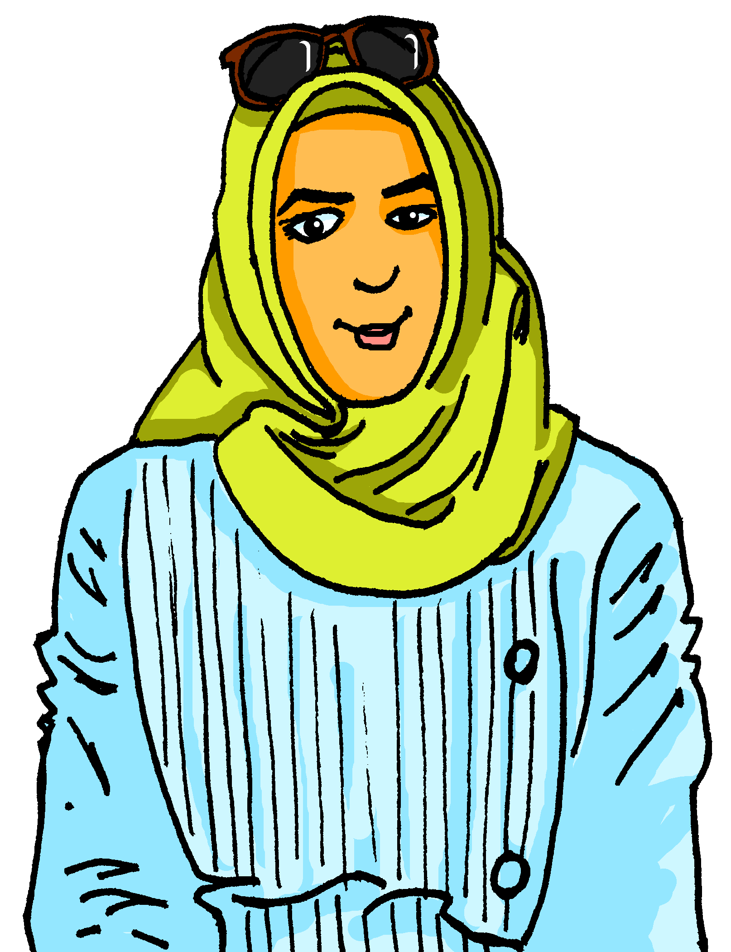
Migration
Mehmet spricht mit seiner Mutter. Welche Konjunktion passt?
lesen
had to do a German course but
1. Mehmet’s mum __________________________________ Mehmet learnt German from his friends.
2. The neighbours in the street were friendly __________________________ say “hello”.
3. She read the Turkish newspaper ____________________
__________ forget Turkish culture.
4. Mehmet says _______________________ similar problems.
5. He came to Germany __________________________ speak German.
After a while he got to know friends at school,
___________________ also read and write German better.
1. Ich musste einen Deutschkurs machen, aber / während du hast die Sprache von deinen Freunden gelernt.
2. Die Nachbarn in unserer Straße waren freundlich obwohl / aber ich kaum “Hallo” sagen konnte.
3. Ich habe die türkische Zeitung gelesen, denn / weil ich wollte die türkische Kultur nicht vergessen.
1
although she could hardly
because she didn’t
2
want to
he had to work through
before he could
3
after he could
4. Mutti, ich denke, dass / -- ich musste ähnliche Probleme durcharbeiten.
5. Ich bin nach Deutschland gekommen, bevor / und ich Deutsch sprechen konnte.
6. Ich habe nach einer Weile Freunde in der Schule kennengelernt, nachdem / aber ich auch besser Deutsch lesen und schreiben konnte.
4
5
6
Notes:
Timing: 8 minutes Aim: to distinguish between WO1 and WO3 conjunctions based on syntax; to practise written comprehension of a variety of revisited vocabulary in a longer context. Procedure:
1. Explain the scenario: Mehmet and his mum are having a conversation about first arriving in Germany. She moved to Germany very recently (in Y7 in SOW so two years ago – neither she nor Mehmet could speak German when they arrived). 2. Students read Mehmet’s mum’s first sentence and decide, based on word order, which one out of the two conjunctions (in bold) is correct.
3. Click for answer.
4. For comprehension, students read item 1 on the right and fill in the gap (in English), which includes the conjunction and the imperfect modal.
5. Click to bring up answer.
6. Continue for items 2-6.

Slide 41
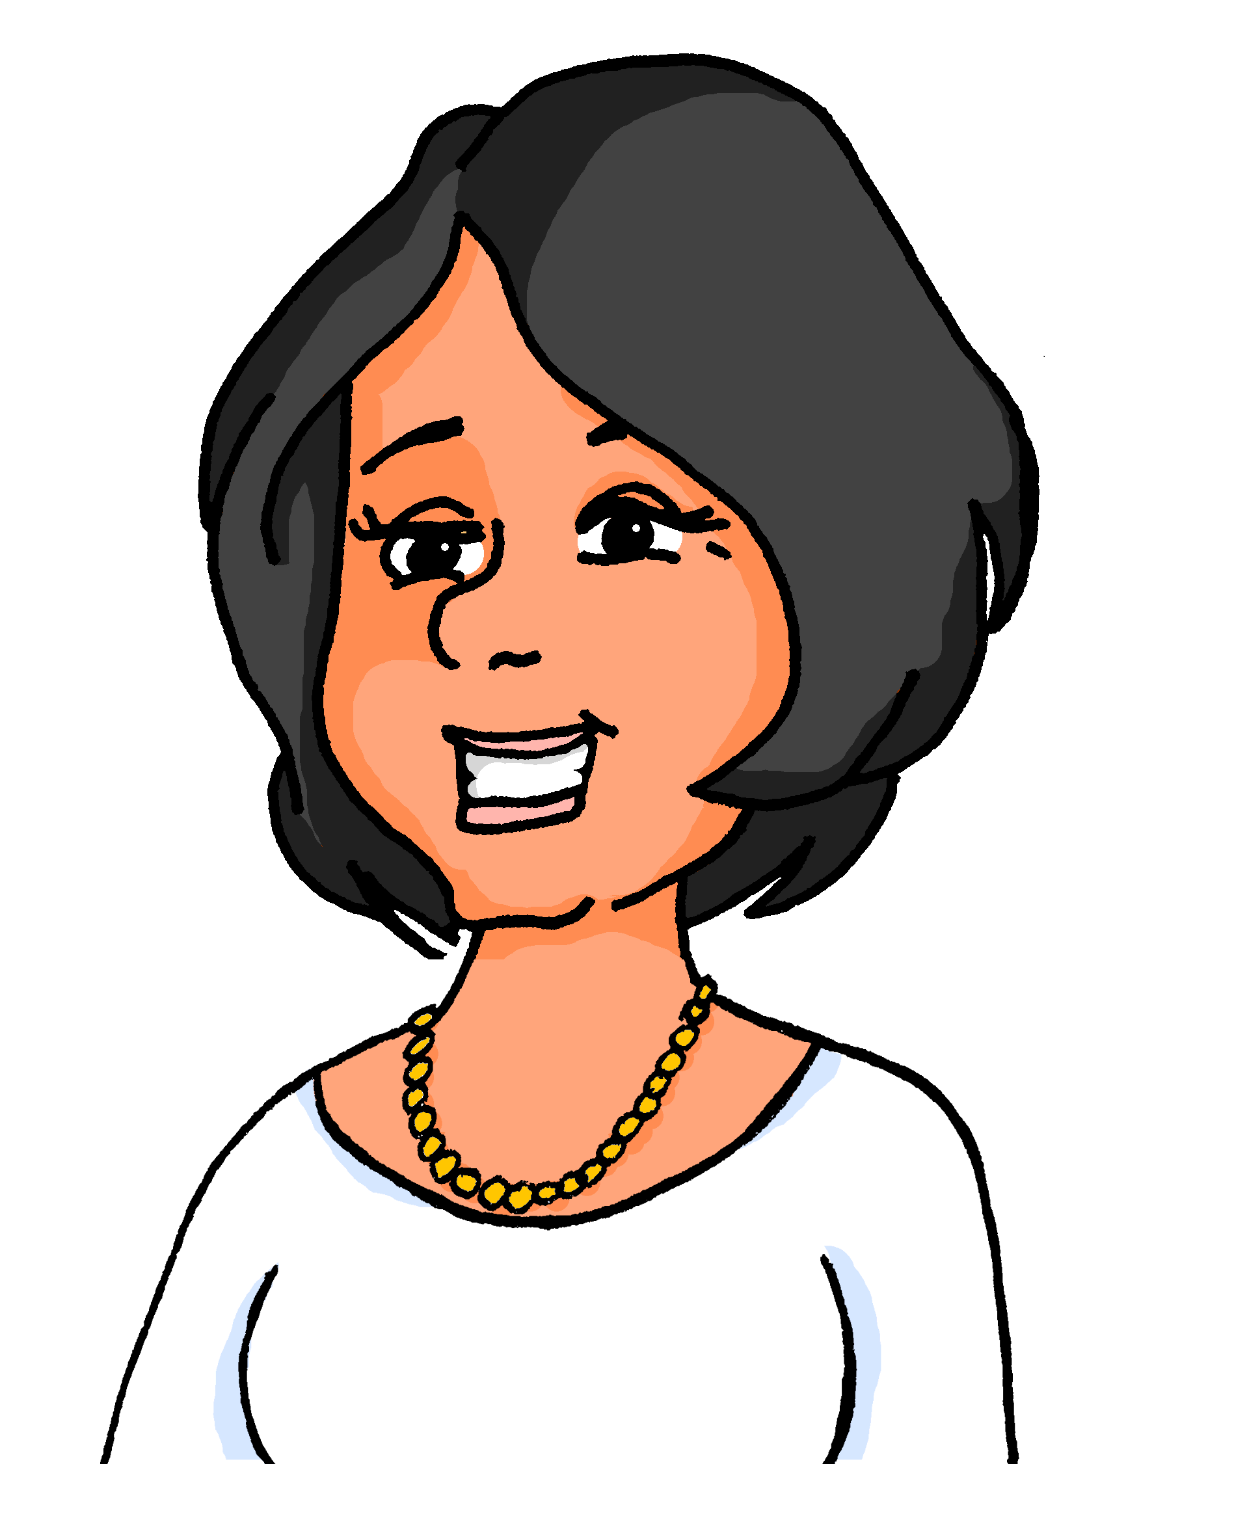
Katja erzählt
hören
Katja erzählt von ihrer Kindheit und ihrer Mutter.
 |  | R/F | Konjunktion
 | My mum didn’t want to forget her country.
 | She couldn’t fly back to Poland, because her mum died.
 | I preferred the Polish food she always cooked.
 | It did not take long before she could read a newspaper.
 | I had to speak Polish with her, after I had lessons.
 | The summer wasn’t hot enough, the winter was too cold.
 | I didn’t want to speak Polish before I started school.
 | I could speak Polish with my mum in the evenings.
Wähle die Konjunktion, dann schreib richtig (R) oder falsch (F).
1
R
weil | denn
2
F
denn | weil
3
F
aber | obwohl
4
F
bevor | aber
5
R
oder | nachdem
6
R
während| und
7
F
bevor | aber
8
R
--- | dass
Notes:
Timing: 8 minutes Aim: to practise aural recognition of syntax with known conjunctions in two-verb structures; to practise aural comprehension of a range of revisited vocabulary in a longer context. Procedure: 1. Explain the scenario: Katja was born in Germany so Katja is 2nd generation. Katja herself has had to learn Polish to keep in touch with family. Katja talks about her childhood and her mum.
2. Click audio button for item 1. The conjunction is bleeped out. Based on word order, students select the correct conjunction. Note: for one item the choice is between a conjunction and no conjunction (item 8).
3. Click to reveal answer.
4. Click to bring up true/false statement in English.
5. Click audio button again, learners listen to item 1 a second time. This time they decide whether the statement is true or false.
6. Repeat for items 2-8.
Transcript:
1. Meine Mutter hat polnische Bilder an die Wand gehängt, [weil] sie Polen nicht vergessen wollte.
2. Dann musste sie nach Polen fliegen, [denn] ihre Mutter ist gestorben.
3. Sie hat immer polnische Gerichte gekocht, [obwohl] ich lieber deutsches Essen essen wollte.
4. Es hat eine lange Weile gedauert, [aber] sie hat jeden Tag die deutsche Zeitung gelesen.
5. Ich musste Polnisch mit ihr reden, [nachdem] ich Sprachunterricht hatte.
6. Der Sommer war nicht heiß genug, [während] der Winter zu kalt war.
7. Ich wollte Polnisch sprechen, [bevor] ich in die Schule gehen musste.
8. Es war toll [--] ich konnte abends mit meiner Mutter Polnisch reden.

Slide 42
Ein neuer Start
sprechen
Sprich mit deinem Partner/deiner Partnerin.
Partner A
Partner B
Sag den Satzbeginn auf Deutsch.
Sag die richtige Satzendung auf Deutsch.
Schreib die Satzendung auf Englisch.
Beispiel:
…ich wollte mehr sagen.
Ich habe ‘Hallo’ gesagt, aber…
1. I said ‘hello’ but… ________________
1 | although… I couldn’t speak German | but… I wanted to say more
✍
I wanted to say more.
Notes:
Timing: 8 minutes (three slides) Aim: to practise spoken production of imperfect modal sentences with a mixture of WO1 and WO3 conjunctions. Procedure: 1. Use this slide to model the task.
2. Give out handouts (next two slides).
3. Complete tasks. 4. Go through the answers on following slides.

Slide 43
Ein neuer Start
sprechen
Sprich mit deinem Partner/deiner Partnerin.
✍
Partner A
1 | before… I had to go to Germany. | but… I was able to find two good friends.
2 | because… I wasn’t able to visit my grandma. | as… I didn’t want to forget my culture.
3 | after… I could speak German. | and… I wanted to go out more often.
4 | although… I didn’t want to go to the party. | and I was able to meet* new people.
5 | although… I still wanted to go home. | and… I wanted to stay in Germany.
I said ‘hello’ and ‘goodbye’ but…
I tried the new food whilst…
It was difficult but…
It was great that…
It took a while before…
*kennenlernen – to meet, get to know
Notes:
DO NOT DISPLAY Task sheet A to hand out

Slide 44
Ein neuer Start
sprechen
Sprich mit deinem Partner/deiner Partnerin.
✍
1 | although… I couldn’t speak German. | but… I wanted to say more.
2 | whilst… my brother wanted to eat his favourite food. | and… my pets also ate it.
3 | when… I had to go to school. | but… I had to do my homework.
4 | that… I could talk with my family. | -- I could talk with my mum.
5 | before… I was able to find new friends. | but… I was able to speak German.
Partner B
I had no German friends before…
The change was hard as…
After three months it was better and…
My neighbour invited me although
I felt better after six months although
Notes:
DO NOT DISPLAY Task sheet B to hand out

Slide 45
Antworten
sprechen
Sprich mit deinem Partner/deiner Partnerin.
✍
Partner A
Partner B
I said ‘hello’ and ‘goodbye’ but…
I had no German friends before…
I wanted to say more.
I had to go to Germany.
I tried the new food whilst…
I found the change hard as…
my brother wanted to eat his favourite food.
I didn’t want to forget my culture.
It was difficult but…
After three months it was better and…
I had to do my homework
I wanted to go out more.
It was great that…
My neighbour invited me although
I could talk with my family.
I didn’t want to go to the party.
It took a while before…
I felt better after six months although
I was able to find new friends.
I still wanted to go home.
Notes:
ENGLISH ANSWERS Procedure: Click to bring up English sentence ending translations for Partners A and B.

Slide 46
Antworten
sprechen
✍
Partner A
Partner B
Ich habe ‘Hallo’ und ‘Tschüs’ gesagt, aber
Ich hatte keine deutschen Freunde, bevor…
ich wollte mehr sagen.
ich nach Deutschland fahren musste.
Ich habe das neue Essen probiert, während..
Der Wechsel war schwer, denn…
mein Bruder sein Lieblingsessen essen wollte.
ich wollte meine Kultur nicht vergessen.
Es war schwer, aber…
Nach drei Monaten war es besser und…
ich musste meine Hausaufgaben machen.
ich wollte öfter ausgehen.
Es war toll, dass…
Mein Nachbar hat mich eingeladen, obwohl
ich mit meiner Familie reden konnte .
ich nicht auf die Party gehen wollte.
Es hat eine Weile gedauert, bevor…
Ich habe mich besser gefühlt, obwohl…
ich neue Freunde finden konnte.
ich immer noch nach Hause gehen wollte.
Notes:
GERMAN ANSWERS Procedure: Click to bring up German sentence ending translations for Partners A and B.

Slide 47
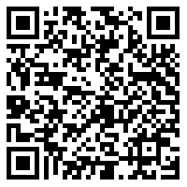
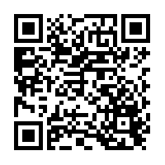
Hausaufgaben
Vocabulary Learning Homework (Y9, Term 2.2 Week 1)
Audio file
Audio file QR code:
Student worksheet
Quizlet link
Quizlet QR code:
In addition, revisit: Term 2.1 Week 4
Term 1.1 Week 7
Notes:
Use this slide to set homework. Student worksheet answers: https://resources.ncelp.org/concern/resources/qn59q513h?locale=en

