Slide 1
Phonics
SSC [sch], [st-], [sp-]
Y7 German
Term 3.2 - Week 4 - Lesson 65
Author name(s): Inge Alferink / Rachel Hawkes
Date updated: 30/05/20

Slide 2
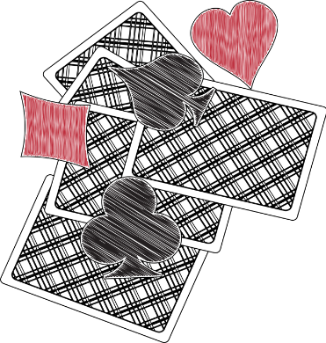
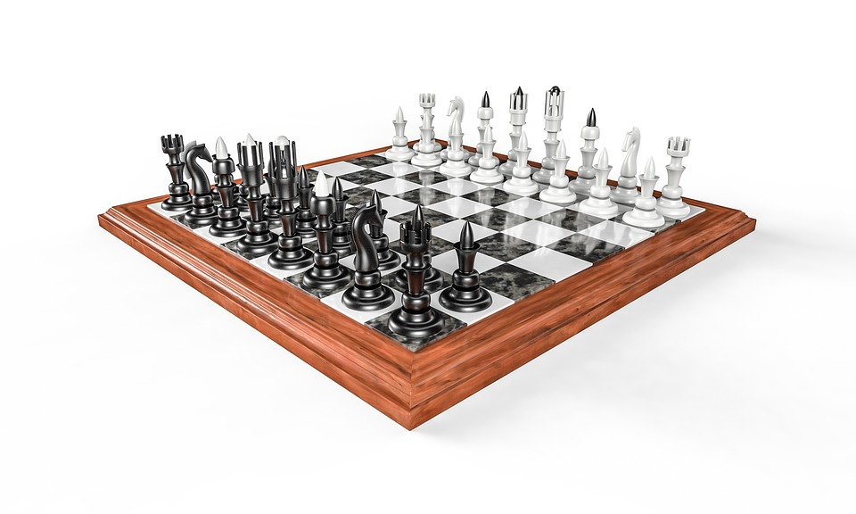
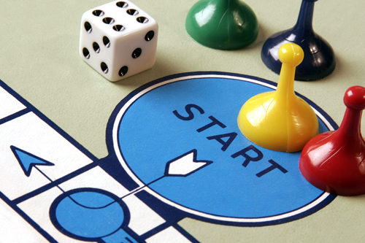
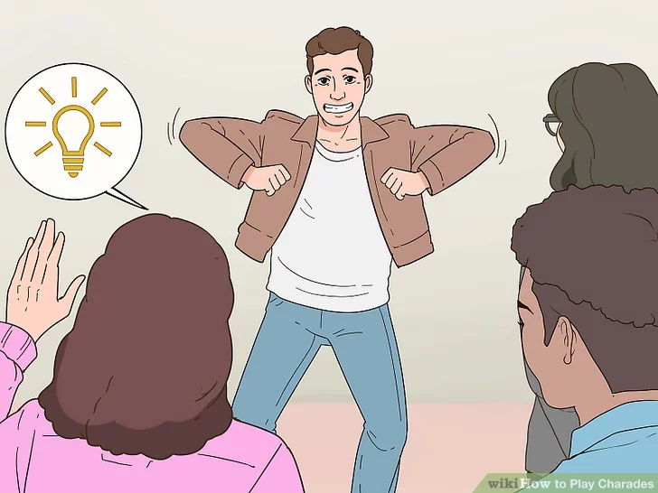
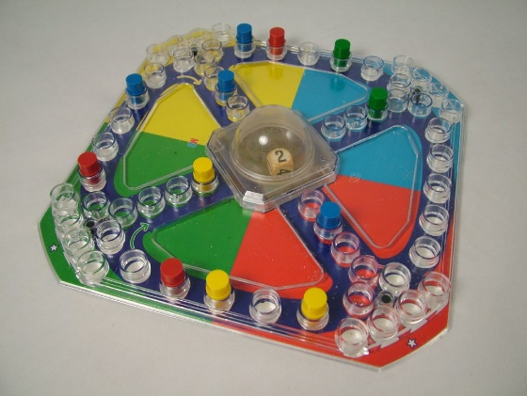
Phonetik
hören
5
St
Kein __ich
1
Sch
das ____ach
6
sp
das Brett____iel
2
St
___adt – Land - Fluss
7
Sch
die ____arade
3
Sp
___itzeln
4
sch
Men____ ärgere
Dich nicht
8
Sch
St
____ere-____ein-Papier
Notes:
Phonetik – revisit [sch] [sp] [st]
This phonics listening / writing activity revisits the SSCs [sch], [sp], and [st]. The activity uses the names of common games to practise.
Click for the first picture and the gapped word.
Listen to the word (sound will play on clicking the number)
Write in the missing SSC.
Check the answer.
Repeat for numbers 2-8.
Cultural interest: Germany has a long history of game creation. Two famous and popular games were invented by Germans. Klaus Teuber created Die Siedler von Catan (1995) and Josef Friedrich Schmidt created Mensch ärgere dich nicht. Can students guess how old the game is? (1907)
Estimated time: 5 minutes

Slide 3
Phonetik
sprechen
1
Gesellschaftsspiele wie Mensch-ärgere-Dich-nicht machen Spaß*.
2
Bei Scharaden darf man nicht sprechen und auch nicht schreiben.
3
Meine Geschwister spielen Schere-Stein-Papier.
4
Seine Schwester versteht Sport ganz gut.
5
Schachfiguren sind schwarz und weiß und sehr schön.
6
Die Mitspieler sind bestimmt* schnell und stark.
*Spaß machen - to be fun *bestimmt - certainly
Notes:
Phonetik – revisit [sch] [sp] [st]
This phonics reading / speaking activity revisits the SSCs [sch], [sp], and [st]. The names of some of the games on the previous slide and some SSC cluster words are used in a sentence to practise production of the target SSCs.
Students read the sentences out loud (to each other). Either bring up the sentences one by one, or alternatively all at once to allow pairs to work at their own speed.
Click on buttons to hear the spoken sentences
Games from previous slide:
Schach / Geselschaftspiel / Mensch ärgere Dich nicht / die Scharade / Schere-Stein-Papier
SSC cluster words:
schreiben [245];] schnell [233]; Mensch [104]; schwarz [451].
Spaß [666] sprechen [157]; Sport [845]; Spiel [500]. stark [207]; verstehen [222]; bestimmt [226] Note: the glossed vocabulary will be explicitly taught in Y8.
Estimated time: 5 minutes

