Slide 1
Shopping
Direct object pronouns (le, la) (preverbal position) with –ER verbs (present)
Les numéros 70-99
SSC: [th]
Y9 French
Term 3.1 - Week 3 - Lesson 51
Author name(s): Catherine Salkeld / Louise Bibbey
Artwork by: Chloé Motard
Date updated: 08/08/22
Notes:
Artwork by Chloé Motard. All additional pictures selected are available under a Creative Commons license, no attribution required.
Native teacher feedback provided by Sarah Brichory.
With thanks to Rachel Hawkes for her input on the lesson material.
Learning outcomes (lesson 1):
Introduction of direct object pronouns le and la in the preverbal position with –ER verbs
Consolidation of SSC [th]
Word frequency (1 is the most frequent word in French):
9.3.1.3: livrer [613], oublier [504], payer [537], le2 [1], la2 [1], coût [830], client [917], marque [1344], mode [1137], cent [704], mille [1008], quatre-vingt [>5000], quatre-vingt-dix [>5000], soixante-dix [4887]
revisit 9.2.2.2: construire [793], réagir (à) [1052], réfléchir (à) [1058], an [76], clé [1200], club [1860], comportement [1489], enfance [2207], habitude [1221], ancien [392], familial [1622], libre [344], quotidien [1318], responsable [511], il y a2 [13/36/8]
revisit 9.1.2.7: contenir [1033], air [761], bonheur [1948], symbole [1427], souvenir [616], vent [1307], fort [107], long, longue [202], vers [182], Afrique [n/a], Asie [n/a], Europe [n/a]
Source: Lonsdale, D., & Le Bras, Y. (2009). A Frequency Dictionary of French: Core vocabulary for learners London: Routledge.
The frequency rankings for words that occur in this PowerPoint which have been previously introduced in NCELP resources are given in the NCELP SOW and in the resources that first introduced and formally re-visited those words.
For any other words that occur incidentally in this PowerPoint, frequency rankings will be provided in the notes field wherever possible.
The additional English meanings of the following words have been added to Quizlet since the creation of this resource:
client – customer, client

Slide 2
th
thé
Notes:
Timing: 1 minute
Aim: To consolidate SSC [th]
Procedure: 1. Present the letter(s) and say the [th] sound first, on its own. Students repeat it with you. 2. Bring up the word ”thé” on its own, say it, students repeat it, so that they have the opportunity to focus all of their attention on the connection between the written word and its sound.
3. A possible gesture for this would be to mime drinking tea. 4. Roll back the animations and work through 1-3 again, but this time, dropping your voice completely to listen carefully to the students saying the [th] sound, pronouncing ”thé” and, if using, doing the gesture.
Word frequency (1 is the most frequent word in French):
thé [3517]
Source: Lonsdale, D., & Le Bras, Y. (2009). A Frequency Dictionary of French: Core vocabulary for learners London: Routledge.

Slide 3
th
théâtre
bibliothèque
sympathique
thé
maths
[nice]
méthode
[method]
Notes:
Timing: 2 minutes
Aim: To consolidate SSC [th]
Procedure:
Consolidate and elicit the pronunciation of the individual SSC [th] and then the source word again ‘thé’ (with gesture, if using). Then present and elicit the pronunciation of the five cluster words. The cluster words have been chosen for their high-frequency, from a range of word classes, with the SSC (where possible) positioned within a variety of syllables within the words (e.g. initial, 2nd, final etc.). Additionally, we have tried to use words that build cumulatively on previously taught SSCs (see the Phonics Teaching Sequence document) and do not include new SSCs. Where new SSCs are used, they are often consonants which have a similar symbol-sound correspondence in English.
Word frequency (1 is the most frequent word in French): thé [3517]; méthode [1149]; théâtre [1701]; bibliothèque [2511]; maths [3438]; sympathique [4164]. Source: Lonsdale, D., & Le Bras, Y. (2009). A Frequency Dictionary of French: Core vocabulary for learners London: Routledge.

Slide 4
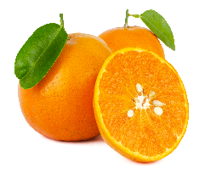
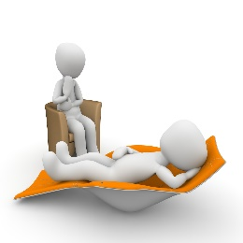
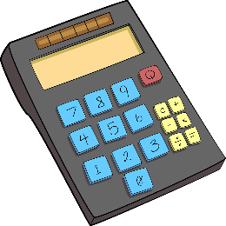
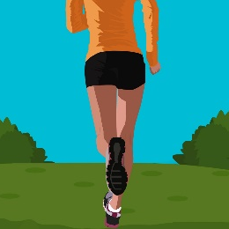
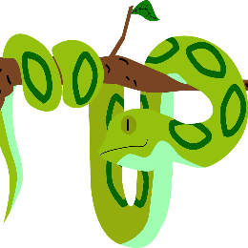
Phonétique: SSC [th]
Qui va avec chaque phrase?
parler
Catherine
Mathéo
Nathalie
Théophile
Elizabeth
Nathan
Elizabeth
1
Catherine
2
Théophile
3
…veut être
athlète.
…mange de la menthe avec sa mandarine.
…trouve les
maths difficiles.
Nathalie
4
Nathan
5
Mathéo
6
…a besoin
de thérapie.
…adore les
pythons.
…est enthousiaste
pour la météo.
*menthe = mint, météo = weather forecast
Notes:
Timing: 4 minutes
Aim: Consolidation of SSC [th]
Procedure:
Students read the phrases aloud in pairs and match them to each person.
Click on buttons to play the audio.
Students listen and check their answers.
Click to reveal answers.
Word frequency of cognates used (1 is the most frequent word in French): athlète [4722], mandarine [>5000], thérapie [4420], python [>5000], enthousiaste [4287]
Source: Lonsdale, D., & Le Bras, Y. (2009). A Frequency Dictionary of French: Core vocabulary for learners London: Routledge.
Word frequency (1 is the most frequent word in French): menthe [>5000], météo [4574]
Source: Lonsdale, D., & Le Bras, Y. (2009). A Frequency Dictionary of French: Core vocabulary for learners London: Routledge.

Slide 5
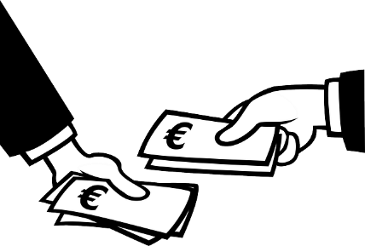
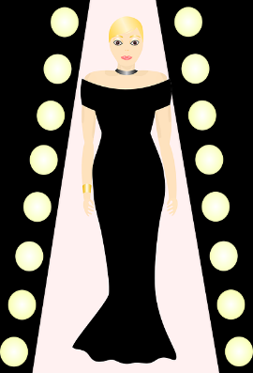
Vocabulaire
80
it (m)
écouter
B
9
A
13
1
livrer
8
cent
C
4
D
5
E
2
2
oublier
9
le
3
payer
10
la
4
le coût
11
mille
100
F
8
G
3
H
10
5
le client
12
quatre-vingt-dix
it (f)
6
la marque
13
quatre-vingts
70
I
14
7
la mode
14
soixante-dix
90
1000
J
6
K
11
L
7
M
1
N
12
Notes:
Timing: 3 minutes
Aim: Aural recognition of this week’s vocabulary
Procedure:
Click the buttons to play the audio.
Students listen and write the letter of the corresponding picture for each word. Students can also be challenged to transcribe the words, for additional practice, as appropriate to the proficiency of the class/individual students.
Click to reveal answers.

Slide 6
payer
[to pay (for) | paying (for)]
paie/paye
[pays (for) | is paying (for)]
Notes:
Timing: 2 minutes [1/6]
Aim: to introduce the verb payer more explicitly. payer is one of the NCELP prototypical verbs in French. Prototypical verbs are common verbs that illustrate the typical characteristics of a class of verb – the French prototypical verbs contain examples of regular/weak verbs, but also common examples of changes to the stem. All 15 prototypical verbs will be introduced early on using the same format. Both long form (infinitive) and short form (3rd person singular) are introduced in order to familiarise students with various forms of the same verb.
Procedure
Bring up the word payer on its own, say it, students repeat it, and remind them of the phonics. Draw attention to the pronunciation of [ay], which is an SSC students have not yet encountered.
Try to elicit the meaning from the students. Students have had explicit teaching that the present tense in French communicates two different present tense meanings in English. This reinforces that learning. Emphasise the two meanings for the short form, reminding students that French only has one form and does not have a direct equivalent of the grammar for ‘is + ing’, the continuous form (as covered in previous weeks).
Bring up the picture, and, if using gestures, a possible gesture would be to hand over banknotes.
Then bring up the English translations. Emphasise the two meanings for the infinitive.
Bring up the short form paie/paye say it, students repeat it. Draw attention to the two possible spellings of the short from, which are pronounced the same way.
Try to elicit the meaning from the students. Emphasise the two meanings for the short form.

Slide 7
payer
[to pay (for) | paying (for)]
paie/paye
[pays (for) | is paying (for)]
Notes:
Cycle through the long and short form again.

Slide 8
paie/paye
[pays (for) | is paying (for)]
Je paie les billets de cinéma.
[I pay for | I am paying for the cinema tickets.]
Notes:
Introduce the short form in a sentence.

Slide 9
payer
[to pay (for) | paying (for)]
Il faut payer les billets de cinéma.
[You have to pay for the cinema tickets. ]
Notes:
Introduce the long form in a sentence.

Slide 10
paie/paye
[pays (for) | is paying (for)]
paie
Je les billets de cinéma.
[I pay for | I am paying for the cinema tickets.]
Notes:
Cycle through the short form in context again.

Slide 11
payer
[to pay (for) | paying (for)]
Il faut les billets de cinéma.
payer
[You have to pay for the cinema tickets.]
Notes:
Cycle through the long form in context again.

Slide 12
Les numéros 70-99
grammaire
Remember, the numbers 17-69 are made up of a combination of numbers in French:
trente-trois
thirty-three
soixante et un
sixty-one
Add a hyphen between the numbers.
Add et before un.
Note: the -s is added only on 80
The numbers 70-99 are also made from a combination of numbers:
80
4x20
quatre-vingts
70
60+10
soixante-dix
81
4x20+1
quatre-vingt-un
71
60+11
soixante et onze
82
4x20+2
quatre-vingt-deux
72
60+12
soixante-douze
90
4x20+10
quatre-vingt-dix
73
60+13
soixante-treize
91
4x20+11
quatre-vingt-onze
79
60+19
soixante-dix-neuf
99
4x20+19
quatre-vingt-dix-neuf
Notes:
Timing: 2 minutes
Aim: To revise construction rules for numbers 1-69, then the construction rules for numbers 70-99.
Procedure:
Click through the explanation and examples.
Ensure understanding.
Transcript:
33, 61, 70, 71, 72, 73, 79, 80, 81, 82, 90, 91, 99

Slide 13
1 un | 2 deux | 3 trois | 4 quatre | 5 cinq | 6 six | 7 sept | 8 huit | 9 neuf | 10 dix
11 onze | 12 douze | 13 treize | 14 quatorze | 15 quinze | 16 seize | 17 dix-sept | 18 dix-huit | 19 dix-neuf | 20 vingt
21 vingt et un | 22 vingt- deux | 23 vingt- trois | 24 vingt- quatre | 25 vingt- cinq | 26 vingt- six | 27 vingt- sept | 28 vingt- huit | 29 vingt- neuf | 30 trente
31 trente et un | 32 trente- deux | 33 trente- trois | 34 trente- quatre | 35 trente- cinq | 36 trente- six | 37 trente- sept | 38 trente- huit | 39 trente- neuf | 40 quarante
41 quarante et un | 42 quarante-deux | 43 quarante-trois | 44 quarante-quatre | 45 quarante-cinq | 46 quarante- six | 47 quarante-sept | 48 quarante-huit | 49 quarante-neuf | 50 cinquante
51 cinquante et un | 52 cinquante-deux | 53 cinquante-trois | 54 cinquante-quatre | 55 cinquante-cinq | 56 cinquante- six | 57 cinquante-sept | 58 cinquante-huit | 59 cinquante-neuf | 60 soixante
61 soixante et un | 62 soixante- deux | 63 soixante- trois | 64 soixante-quatre | 65 soixante- cinq | 66 soixante- six | 67 soixante- sept | 68 soixante- huit | 69 soixante- neuf | 70 soixante- dix
71 soixante et onze | 72 soixante-douze | 73 soixante-treize | 74 soixante-quatorze | 75 soixante-quinze | 76 soixante-seize | 77 soixante-dix-sept | 78 soixante-dix-huit | 79 soixante-dix-neuf | 80 quatre-vingts
81 quatre-vingt-un | 82 quatre-vingt-deux | 83 quatre-vingt-trois | 84 quatre-vingt-quatre | 85 quatre-vingt-cinq | 86 quatre-vingt-six | 87 quatre-vingt-sept | 88 quatre-vingt-huit | 89 quatre-vingt-neuf | 90 quatre-vingt-dix
91 quatre-vingt-onze | 92 quatre-vingt-douze | 93 quatre-vingt-treize | 94 quatre-vingt-quatorze | 95 quatre-vingt-quinze | 96 quatre-vingt-seize | 97 quatre-vingt-dix-sept | 98 quatre-vingt-dix-huit | 99 quatre-vingt-dix-neuf | 100 cent
Notes:
Printable handout of numbers 1-100

Slide 14
Les prix
grammaire
Prices in French are given in Euros.
e.g. forty euros
quarante euros
£40
£40.25
In the UK, the pound (£) symbol comes before the number.
For prices in pounds and pence, in the UK, we use a decimal point.
40 €
40,25 €
In France, the euro (€) symbol comes after the number.
For prices in euros and centimes, in France, we use a comma.
When buying items in France, you will usually hear 40,25 € as “quarante euros, vingt-cinq centimes”
1
52,38 €
cinquante-deux euros, trente-huit centimes
Listen to these prices
2
94,75 €
quatre-vingt-quatorze euros, soixante-quinze centimes
3
72,93 €
soixante-douze euros, quatre-vingt-treize centimes
Notes:
Timing: 2 minutes
Aim: To explain how to say and write prices in French
Procedure:
Click to reveal information
Click on numbers to listen to three prices, then click to reveal the digits and written form.
Transcript:
quarante euros
quarante euros, vingt-cinq centimes
cinquante-deux euros, trente-huit centimes
quatre-vingt-quatorze euros, soixante-quinze centimes
soixante-douze euros, quatre-vingt-treize centimes

Slide 15
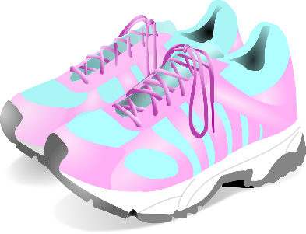
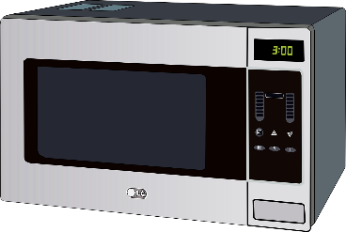
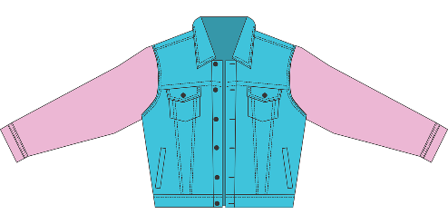
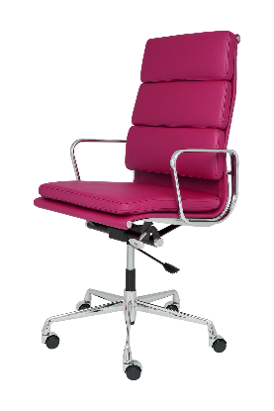
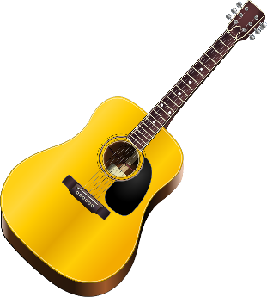
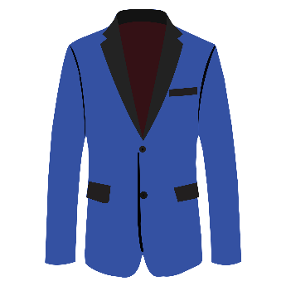
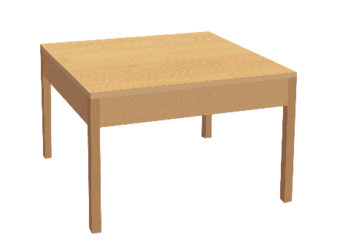
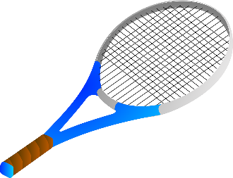
Les prix
écouter
Ça coûte combien ? Écoute et écris les prix.
1
40,75€
2
67,50€
3
92,15€
4
84,99€
5
38,95€
6
74,25€
7
82,74€
8
99,95€
9
75,89€
10
68,49€
Notes:
Timing: 5 minutes
Aim: Aural recognition of numbers up to 99 in the context of prices
Procedure:
1. Click the buttons to play the audio.
2. Students listen and write the prices they hear.
3. Click to reveal answers.
Transcript:
1. 40,75€
2. 67,50€
3. 92,15€
4. 84,99€
5. 38,95€
6. 74,25€
7. 82,74€
8. 99,95€
9. 75,89€
10. 68,49€

Slide 16
Saying ‘it’
grammaire
The word for ‘it’ in French changes according to whether the noun it replaces is masculine or feminine.
To replace a masculine noun, we use le.
To replace a feminine noun, we use la.
The word for ‘it’ goes before the verb.
Je construis le modèle.
Je le construis.
I build the model.
I build it.
Je trouve la clé.
Je la trouve.
I find the key.
I find it.
Notes:
Timing: 3 minutes
Aim: Introduction of direct object pronouns le and la
Procedure:
1. Click to reveal explanations and examples.
2. Ensure understanding.

Slide 17
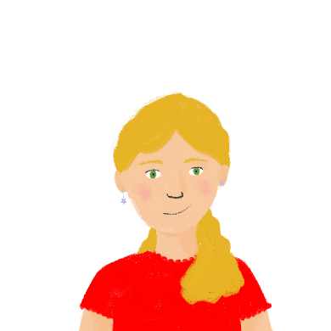
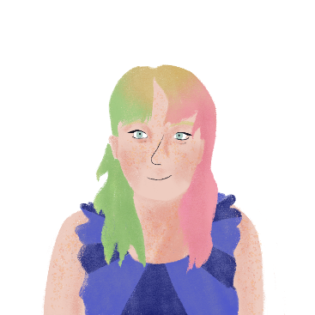
Aux magasins
écouter
Léa et Stéphanie cherchent un cadeau pour un ami. De quoi parlent-elles ?
Q | A | B | les réponses | R
 | le manteau | la chemise | J’aime le manteau. Je le veux !
 | le livre | la guitare | Tu aimes la guitare ? Tu la regardes beaucoup!
 | l’instrument | la radio | L’instrument coûte trop cher ! Je le repose !
 | le piano | la télé | Mes parents veulent la télé. Vous la livrez ?
 | le sac | la viande | Si nous achetons le sac, nous le payons ensemble.
 | le coût | la marque | Il n’y a pas de problème avec le coût. Nous le partageons.
 | le vélo | la chemise | Il va aimer la chemise. Nous la prenons !
 | le fromage | la glace | J’aime bien la glace. Vous la faites ici ?
 | le roman | l’histoire | Vous avez trouvé le roman ? Vous le montrez à mon amie ?
 | le chapeau | la règle | Tu veux la règle ? Je la regarde.
1
1
2
2
3
3
4
4
5
5
6
6
7
7
8
8
9
9
10
10
Notes:
Timing: 12 minutes
Aim: Aural recognition of direct object pronouns le and la
Procedure:
1. Click buttons to play audio.
2. Students choose correct noun according to whether they hear le or la.
3. Click to reveal answers.
4. Click buttons to play full audio.
5. Students make notes in English.
6. Students rewrite the French from their notes.
7. Click to reveal answers.
Transcript:
1. J’aime [le manteau]. Je le veux !
2. Tu aimes [la guitare] ? Tu la regardes beaucoup !
3. [L’instrument] coûte trop cher ! Je le repose !
4. Mes parents veulent [la télé]. Vous la livrez ?
5. Si nous achetons [le sac], nous le payons ensemble.
6. Il n’y a pas de problème avec [le coût]. Nous le partageons.
7. Il va aimer [la chemise]. Nous la prenons !
8. J’aime bien [la glace]. Vous la faites ici ?
9. Vous avez trouvé [le roman] ? Vous le montrez à mon amie ?
10. Tu veux [la règle] ? Je la regarde.

Slide 18
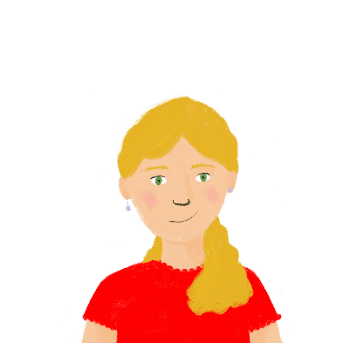
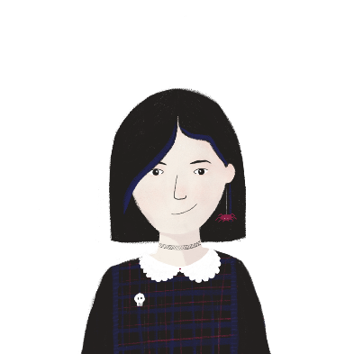
Les achats*
Léa et Sophie envoient des messages sur des achats*. Choisis le bon mot.
lire
*l’achat (m.) = purchase
Léa
Sophie
Tu as acheté [un long manteau/une règle] ?
Oui, je le montre à ma mère ce soir.
Stéphanie a acheté [l’instrument/la guitare] ?
Non, mais elle la veut !
Tu as trouvé [ta marque préférée/ton fromage préféré] ?
Non, je la cherche la prochaine fois.
Vous avez trouvé [un petit cadeau/une belle chemise] ?
Oui, nous le donnons à notre ami demain.
Vous avez mangé [du gâteau/de la glace] ?
Non, ils ne le font pas au café.
Stéphanie a trouvé [le livre/l’histoire] ?
Oui, elle la lit ce soir.
Tes parents ont commandé [le vélo/la télé] ?
Oui, ils la livrent demain !
Tu as acheté du pain/de la glace ?
Oui, on le mange ce soir.
Notes:
Slide 1 of 4
Timing: 8 minutes
Aim: Written recognition of direct object pronouns le and la.
Procedure:
Students read the messages and choose the noun that the direct object pronouns refer to.
Click to reveal answers.
Move to slide 2 of 4 and instruct the students to draw a table like the one on the screen, with four columns and nine rows.
Once the table has been drawn, go to slide 3 of 4 showing the sentences with ticked answers. Students read the sentences and use the information to complete the table in English: they must complete: the item being discussed, who is interested in having the item, whether or not the item was purchased, and any other information provided in the exchange between Léa and Sophie.
Once students have completed their tables, go to slide 4 of 4 to click and reveal the answers.
Word frequency of unknown words used (1 is the most frequent word in French): achat [1804]
Source: Lonsdale, D., & Le Bras, Y. (2009). A Frequency Dictionary of French: Core vocabulary for learners London: Routledge.

Slide 19
Les achats*
Draw a table with four columns and nine rows, and, and for each item being discussed by Léa and Sophie, complete the table in English.
lire
Item being discussed | Who was interested in buying the item? | Was the item bought? | Extra details
Notes:
Slide 2 of 4

Slide 20
Les achats*
lire
Utilise les informations pour compléter le tableau.
Léa
Sophie
Tu as acheté [un long manteau/une règle] ?
Oui, je le montre à ma mère ce soir.
Stéphanie a acheté [l’instrument/la guitare] ?
Non, mais elle la veut !
Tu as trouvé [ta marque préférée/ton fromage préféré] ?
Non, je la cherche la prochaine fois.
Vous avez trouvé [un petit cadeau/une belle chemise] ?
Oui, nous le donnons à notre ami demain.
Vous avez mangé [du gâteau/de la glace] ?
Non, ils ne le font pas au café.
Stéphanie a trouvé [le livre/l’histoire] ?
Oui, elle la lit ce soir.
Tes parents ont commandé [le vélo/la télé] ?
Oui, ils la livrent demain !
Tu as acheté du pain/de la glace ?
Oui, on le mange ce soir.
Notes:
Slide 3 of 4

Slide 21
Les achats*
lire
Item being discussed | Who was interested in buying the item? | Was the item bought? | Extra details
Long coat | Sophie | Yes | Sophie is showing it to her mother this evening.
Guitar | Stéphanie | No | She didn’t buy it, but wants it.
Favourite brand | Sophie | No | Sophie will look for it next time.
Small gift | Sophie and someone else | Yes | They are giving it to their friend tomorrow.
Cake | Sophie and someone else | No | The café didn’t make cakes
Story | Stéphanie | Yes | She will be reading it this evening.
Television | Sophie’s parents | Yes | It’s being delivered tomorrow.
Bread | Sophie | Yes | She is going to eat it with someone else this evening.
Notes:
Slide 4 of 4

Slide 22
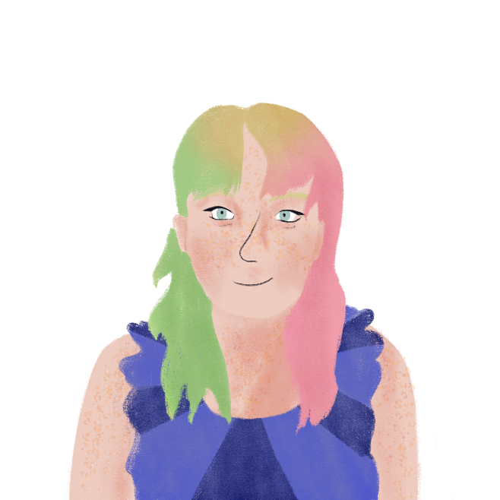
Aux magasins
parler
Tu fais du shopping avec ton/ta partenaire.
Je la trouve.
I find it. (the shirt)
the book/the shirt
Notes:
Timing: 10 minutes
Aim: Oral production of direct object pronouns le and la
Procedure:
Print the role cards from slide 23.
A differentiated version is available on slide 24 with the French words provided.
Model the task with this slide.
Students work in pairs.
Partner A uses the prompts on the cards to say a sentence with a direct object pronoun.
Partner B listens for le/la and ticks the corresponding noun on their card.
Students swap roles.

Slide 23
Aux magasins
parler
Partenaire A
I look for it. (the coat)
I look at it. (the television)
I don’t find it. (the book)
They deliver it. (the piano)
the book | the table
the cheese | the ice cream
the meal | the guitar
the bike | the car
Partenaire B
I show it to my brother. (the table)
I do not eat it. (the cheese)
I’m paying for it tomorrow. (the meal)
We are ordering. (the car)
the coat | the key
the novel | the television
the book | the shirt
the piano | the guitar
Notes:
ROLECARDS FOR PRINTING

Slide 24
Aux magasins
parler
Partenaire A
I look for it. (the coat – le manteau)
I look at it. (the television – la télévision)
I don’t find it. (the book – le livre)
They deliver it. (the piano – le piano)
the book (le livre)|the table (la table)
the cheese (le fromage)|the ice cream (la glace)
the meal (le repas)|the guitar (la guitare)
the bike (le vélo)|the car (la voiture)
Partenaire B
I show it to my brother. (the table – la table)
I do not eat it. (the cheese – le fromage)
I’m paying for it tomorrow. (the meal – le repas)
We are ordering. (the car – la voiture)
the coat (le manteau)|the key (la clé)
the novel (le roman)|the television (la télévision)
the book (le livre)|the shirt (la chemise)
the piano (le piano)|the guitar (la guitare)
Notes:
Differentiated version, with vocabulary provided

Slide 25
Aux magasins
parler
Je le cherche. (le manteau)
Je la regarde. (la télé)
Je ne le trouve pas. (le livre)
Ils le livrent. (le piano)
Je la montre à mon frère. (la table)
Je ne le mange pas. (le fromage)
Je le paie demain. (le repas)
Nous la commandons. (la voiture)
Notes:
SUGGESTED ANSWERS

Slide 26
Shopping
Contraction of pronouns (le/la ➜ l’) before a vowel or h muet
SSCs: [th], [ch]
Y9 French
Term 3.1 - Week 2 - Lesson 52
Author name(s): Catherine Salkeld / Louise Bibbey
Artwork by: Chloé Motard
Date updated: 08/08/22
Notes:
Artwork by Chloé Motard. All additional pictures selected are available under a Creative Commons license, no attribution required.
Native teacher feedback provided by Sarah Brichory.
With thanks to Rachel Hawkes for her input on the lesson material.
Learning outcomes (lesson 2):
Introduction of contraction of direct object pronouns le and la before a vowel or h muet
Consolidation of SSCs [th] and [ch]
Word frequency (1 is the most frequent word in French):
9.3.1.3: livrer [613], oublier [504], payer [537], le2 [1], la2 [1], coût [830], client [917], marque [1344], mode [1137], cent [704], mille [1008], quatre-vingt [>5000], quatre-vingt-dix [>5000], soixante-dix [4887]
revisit 9.2.2.2: construire [793], réagir (à) [1052], réfléchir (à) [1058], an [76], clé [1200], club [1860], comportement [1489], enfance [2207], habitude [1221], ancien [392], familial [1622], libre [344], quotidien [1318], responsable [511], il y a2 [13/36/8]
revisit 9.1.2.7: contenir [1033], air [761], bonheur [1948], symbole [1427], souvenir [616], vent [1307], fort [107], long, longue [202], vers [182], Afrique [n/a], Asie [n/a], Europe [n/a]
Source: Lonsdale, D., & Le Bras, Y. (2009). A Frequency Dictionary of French: Core vocabulary for learners London: Routledge.
The frequency rankings for words that occur in this PowerPoint which have been previously introduced in NCELP resources are given in the NCELP SOW and in the resources that first introduced and formally re-visited those words.
For any other words that occur incidentally in this PowerPoint, frequency rankings will be provided in the notes field wherever possible.
The additional English meanings of the following words have been added to Quizlet since the creation of this resource:
client – customer, client

Slide 27
ch
chercher
Notes:
Timing: 1 minute
Aim: To consolidate SSC [ch]
Procedure: 1. Present the letter(s) and say the [ch] sound first, on its own. Students repeat it with you. 2. Bring up the word ”chercher” on its own, say it, students repeat it, so that they have the opportunity to focus all of their attention on the connection between the written word and its sound.
3. A possible gesture for this would be to mime looking for something everywhere. 4. Roll back the animations and work through 1-3 again, but this time, dropping your voice completely to listen carefully to the students saying the [ch] sound, pronouncing ”chercher” and, if using, doing the gesture.
Word frequency (1 is the most frequent word in French):
chercher [336]. Source: Lonsdale, D., & Le Bras, Y. (2009). A Frequency Dictionary of French: Core vocabulary for learners London: Routledge.

Slide 28
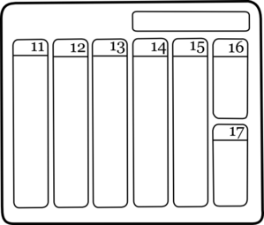
ch
dimanche
chanter
chercher
bouche
chat
champ
[field]
Notes:
Timing: 2 minutes
Aim: To consolidate SSC [ch]
Procedure:
1. Introduce and elicit the pronunciation of the individual SSC [ch] and then the source word again ‘chercher’ (with gesture, if using). 2. Then present and elicit the pronunciation of the five cluster words.
The cluster words have been chosen for their high-frequency, from a range of word classes, with the SSC (where possible) positioned within a variety of syllables within the words (e.g. initial, 2nd, final etc.). Additionally, we have tried to use words that build cumulatively on previously taught SSCs (see the Phonics Teaching Sequence document) and do not include new SSCs. Where new SSCs are used, they are often consonants which have a similar symbol-sound correspondence in English.
Word frequency (1 is the most frequent word in French): dimanche [1235]; chanter [1820] bouche [1838]; champ [847]; chat [3138]; chercher [336]. Source: Lonsdale, D., & Le Bras, Y. (2009). A Frequency Dictionary of French: Core vocabulary for learners London: Routledge.

Slide 29
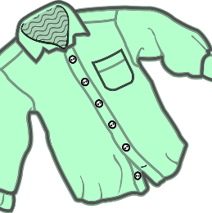
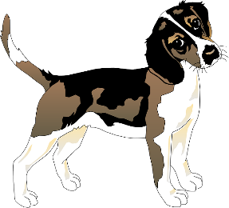
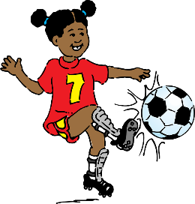
Phonétique: SSC [ch]
Qui va avec chaque phrase?
parler
Catherine
Mathéo
Nathalie
Théophile
Elizabeth
Nathan
Mathéo
1
Nathan
2
Nathalie
3
…cherche son chien, Charles
…. boit du chocolat chaud
… est la prochaine championne de foot
Théophile
4
Elizabeth
5
Catherine
6
…. va chez le boucher chaque dimanche.
… touche un chapeau en chenille
…choisit une chemise chère de Chanel
Notes:
Timing: 3 minutes
Aim: To consolidate pronunciation of SSC [th] and [ch]
Procedure:
Ask students to match each person to the correct sentence, using the picture clues.
Students read the complete matched sentences, paying close attention to the pronunciation of the SSC [th].
Click on the audio boxes to hear the sentences spoken by a native speaker to verify the answers.
Transcript:
Mathéo cherche son chien, Charles.
Nathan boit du chocolat chaud.
Nathalie est la prochaine championne de foot.
Théophile va chez le boucher chaque dimanche.
Élizabeth touche un chapeau en chenille.
Catherine choisit une chemise chère de Chanel.
Word frequency of cognates used (1 is the most frequent word in French): athlète [4722], mandarine [>5000], thérapie [4420], python [>5000], enthousiaste [4287]
Source: Lonsdale, D., & Le Bras, Y. (2009). A Frequency Dictionary of French: Core vocabulary for learners London: Routledge.
Word frequency (1 is the most frequent word in French): menthe [>5000], météo [4574]
Source: Londsale, D., & Le Bras, Y. (2009). A Frequency Dictionary of French: Core vocabulary for learners London: Routledge.

Slide 30
Des virelangues
Écoute. Combien de fois entends-tu les SSCs [th] et [ch] ?
écouter/parler
[th] and [t] sound the same, but in this task, if you hear a ‘t’ sound, it is written [th].
 |  | [th] | [ch]
 | Cinq chiens chassent six chats. |  | |||
 | Charlène cherche une chemise sans manches. |  | |||||
 | Édith est sympathique mais son chapeau est moche. | || | ||
 | Thierry marche sur chaque chemin sans changer de chaussures. | | | |||||
 | L'athénien charmant aime les bonbons à la menthe. | || | |
 | Sacha le professeur de chimie aime les maths et l'éthique. | || | ||
1
2
3
4
#
5
6
Notes:
Timing: 6 minutes
Aim: Consolidation of recognition of SSCs [th] and [ch]
Procedure:
Click the buttons to play audio.
Students tally how many times they hear [th] and [ch].
Click to reveal answers and sentences.
Transcript:
Cinq chiens chassent six chats.
Charlène cherche une chemise sans manches.
Édith est sympathique mais son chapeau est moche.
Thierry marche sur chaque chemin sans changer de chaussures.
L’athénien charmant aime les bonbons à la menthe.
Sacha le professeur de chimie aime les maths et l’éthique.
Word frequency of unknown words used (1 is the most frequent word in French): chaser [2364], manche [3437], moche [>5000], chaussure [3638], athénien [>5000], charmant [4030], bonbon [>5000], menthe [>5000], chimie [4073], éthique [2747]
Source: Lonsdale, D., & Le Bras, Y. (2009). A Frequency Dictionary of French: Core vocabulary for learners London: Routledge.

Slide 31
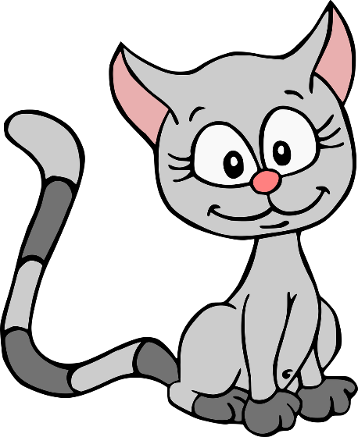
Des virelangues avec [ch] et [th]
lire / parler
Parle aussi vite que possible!
Cinq chiens chassent six chats.
[Five dogs chase six cats]
A
B
C
Notes:
Slide 1 of 6
Timing: 6 minutes for 6 slides
Aim: Practise pronunciation of SSC [ch] and [th] in the form of tongue twisters
Procedure:
1. Students read the sentences aloud, aiming for accurate pronunciation as quickly as possible.
2. Click audio buttons to hear three different speeds (A = slowest, C = fastest).
3. Repeat on next three slides for three more tongue twisters.
Transcript:
Cinq chiens chassent six chats.

Slide 32
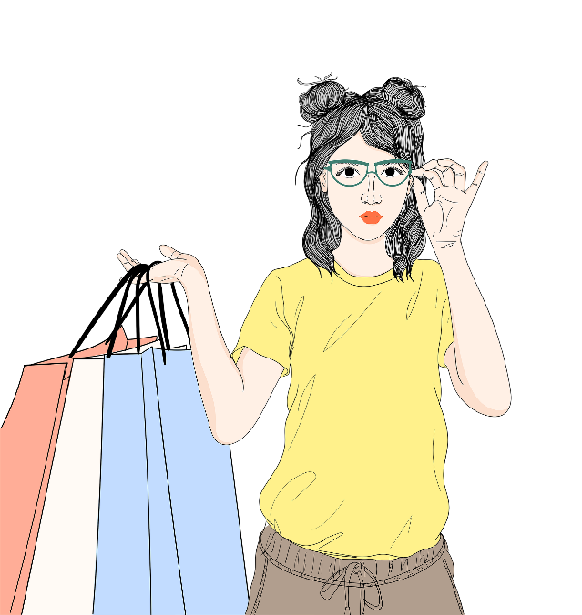
Des virelangues avec [ch] et [th]
lire / parler
Parle aussi vite que possible!
Charlène cherche une chemise sans manches.
[Charlène is looking for a blouse with no sleeves.]
A
B
C
Notes:
Slide 2 of 6
Transcript:
Charlène cherche une chemise sans manches.

Slide 33
Des virelangues avec [ch] et [th]
lire / parler
Parle aussi vite que possible!
Édith est sympathique mais son chapeau est moche.
[Édith is nice but her hat is ugly.]
A
B
C
Notes:
Slide 3 of 6
Transcript:
Édith est sympathique mais son chapeau est moche.

Slide 34
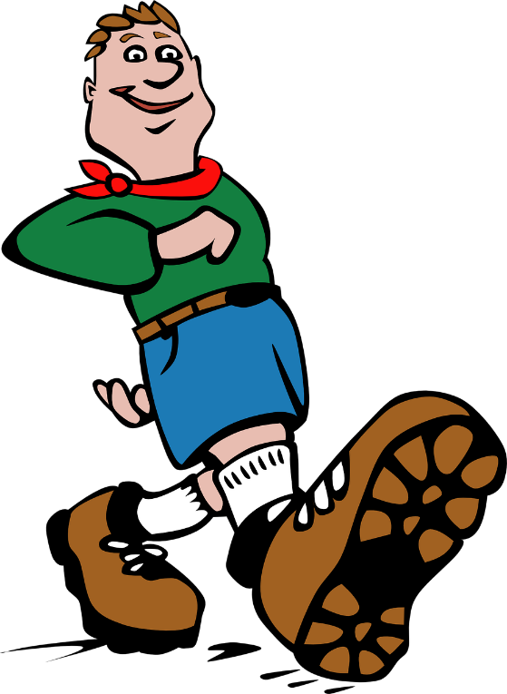
Des virelangues avec [ch] et [th]
lire / parler
Parle aussi vite que possible!
Thierry marche sur chaque chemin sans changer de chaussures.
[Thierry walks on every path without changing shoes.]
A
B
C
Notes:
Slide 4 of 6
Transcript:
Thierry marche sur chaque chemin sans changer de chaussures.

Slide 35
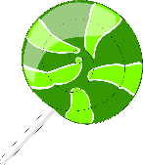
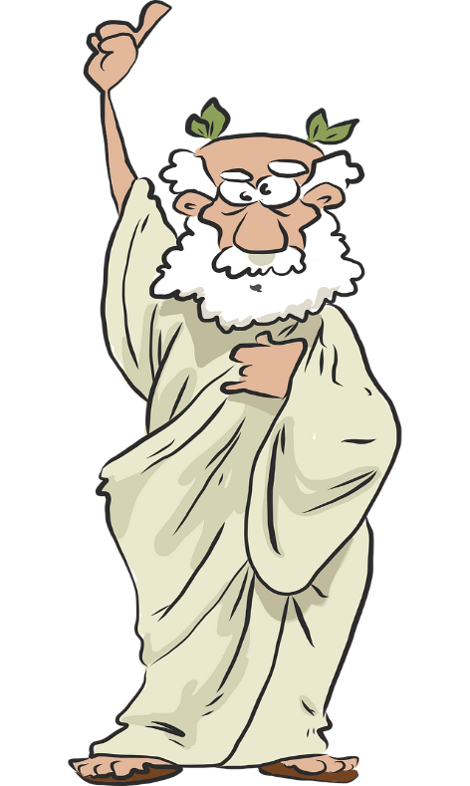
Des virelangues avec [ch] et [th]
lire / parler
Parle aussi vite que possible!
L’athénien charmant aime les bonbons à la menthe.
[The charming man from Athens likes mint sweets.]
A
B
C
Notes:
Slide 5 of 6
Transcript:
L’athénien charmant aime les bonbons à la menthe.

Slide 36
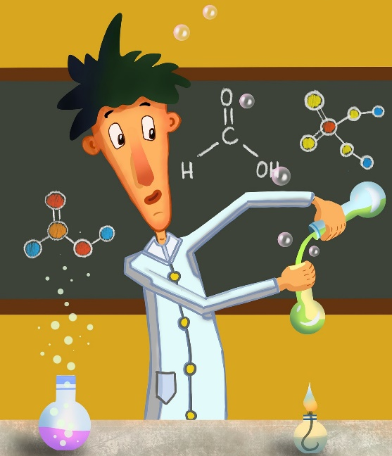
Des virelangues avec [ch] et [th]
lire / parler
Parle aussi vite que possible!
Sacha le professeur de chimie aime les maths et l’éthique.
[Sacha the chemistry teacher likes maths and ethics.]
A
B
C
Notes:
Slide 6 of 6
Transcript:
Sacha le professeur de chimie aime les maths et l’éthique.

Slide 37
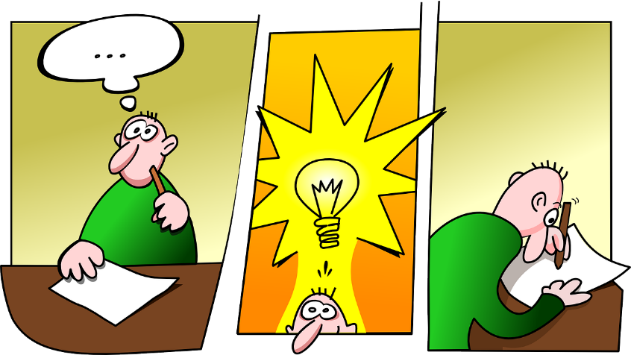
Vocabulaire
Traduis les mots en anglais.
lire
réagir (à)
réfléchir (à)
l’an (m.)
le club
le comportement
l’habitude (f.)
ancien
familial
libre
responsable
symbole
fort
vers
to react (to)
to think (about)
year
club
behaviour
habit
former
family-related
free
responsible
symbol
strong
towards
Notes:
Timing: 4 minutes
Aim: Written recognition of revisited vocabulary
Procedure:
Students write the English for each word.
Click to reveal answers.

Slide 38
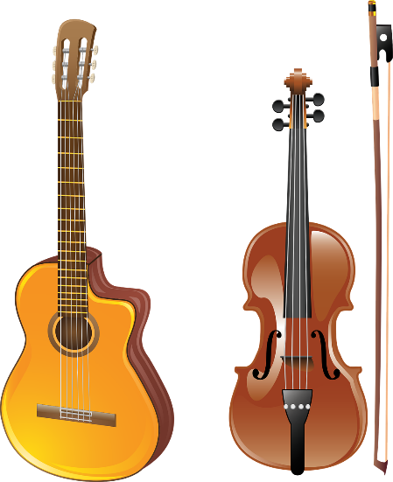
Contraction of le and la
grammaire
When the direct object pronouns le and la come before a verb beginning with a vowel or h, they are shortened to l’.
J’aime la guitare.
Tu l’achètes ?
I like the guitar.
Are you buying it ?
Je regarde le chapeau.
Tu l’essaies ?
I’m looking at the hat.
Are you trying it on?
Note: the verb essayer (to try) can also mean to try on (clothes)
Notes:
Timing: 3 minutes
Aim: Introduction of contraction of direct object pronouns le and la before a verb beginning with a vowel or h muet.
Procedure:
1. Click to reveal examples and explanations.
2. Ensure understanding.

Slide 39
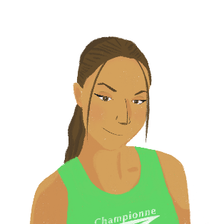
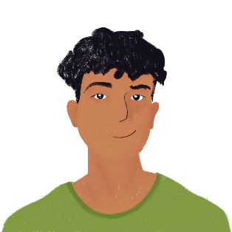
En ville
écouter
Amir et Océane font du shopping. Amir dit le, la, ou l’ ?
Q | le | la | l’ | les réponses | R
 |  |  |  | Où est mon chapeau ? Je l’oublie chaque fois !
 |  |  |  | J’ai acheté un modèle. Je le construis ce soir.
 |  |  |  | Tu trouves la mode importante ? Je l’aime bien.
 |  |  |  | Mon argent ? Je l’ai dans mon sac.
 |  |  |  | Tu as acheté du fromage ? On le mange demain ?
 |  |  |  | J’ai trouvé une belle chemise. Je la porte ce samedi.
 |  |  |  | Tu as acheté un journal anglais ? Tu l’apportes chez moi ?
 |  |  |  | Tu aimes cette marque ? Je la trouve très chère !
1
1
2
2
3
3
4
4
5
5
6
6
7
7
8
8
Notes:
Timing: 12 minutes
Aim: Aural recognition of direct object pronouns le, la, and contracted forms in context
Procedure:
1. Click the buttons on the left to play audio.
2. Students listen and tick the appropriate direct object pronoun.
3. Click to reveal answers.
4. Click the buttons on the right to play the full audio.
5. Students make notes in English.
6. Students rewrite the French from their notes.
7. Click to reveal answers.
Transcript:
1. Où est mon chapeau ? Je [l’]oublie chaque fois !
2. J’ai acheté un modèle. Je [le] construis ce soir.
3. Tu trouves la mode importante ? Je [l’]aime bien.
4. Mon argent ? Je [l’]ai dans mon sac.
5. Tu as acheté du fromage ? On [le] mange demain ?
6. J’ai trouvé une belle chemise. Je [la] porte ce samedi.
7. Tu as acheté un journal anglais ? Tu [l’]apportes chez moi ?
8. Tu aimes cette marque ? Je [la] trouve très chère !

Slide 40
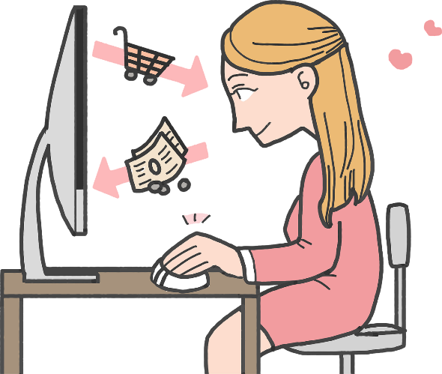
Faire du shopping
Lis l’interview et écris le, la, ou l’.
lire
Tu fais du shopping sur internet ?
Oui, je l’ utilise pour acheter une chemise chaque mois.
Ils la livrent vite ?
Oui, ils l’ envoient très vite.
Et tu la paies comment ?
Je la paie avec ma carte bleue*.
Et l’uniforme scolaire ? Tu le cherches sur internet ?
Je le regarde, mais je ne l’ achète pas. Je préfère aller au magasin.
What is she using?
1
2
What are they delivering?
3
What are they sending?
4
What is she paying for?
5
6
What is she looking for?
7
8
*la carte bleue = debit/credit card
Notes:
Timing: 5 minutes
Aim: Written production of direct object pronouns le and la, with contractions where required.
Procedure:
The task comes with prompts to support students to think carefully about what is being referred to in each sentence.
The teacher can discuss this further with students, pointing out that the direct object pronoun can be replacing something mentioned in a previous part of the conversation or text, pointing out that the direct object pronouns in lines 2-5 all refer back to “la chemise” from the first sentence.
Students write le, la, or l’.
Click to reveal answers.
Word frequency of cognates used (1 is the most frequent word in French): internet [>5000]
Source: Lonsdale, D., & Le Bras, Y. (2009). A Frequency Dictionary of French: Core vocabulary for learners London: Routledge.

Slide 41
Une lettre
écrire
Tu écris une lettre pour dire merci à un ami pour tes cadeaux d’anniversaire. Traduis la lettre en français.
Hi!
Thank you for the hat! I like it, and I wear it almost every day. I don’t wear it when it’s windy! I like the book about Africa. I use it for my homework, and sometimes my sister borrows it. Thank you for the shirt from Asia. I look at it often, but I don’t wear it for daily life. It’s too beautiful ! The novel about Europe contains lots of memories of childhood. I read it when I want a feeling of happiness.
See you soon
Notes:
A differentiated version of this is on the following slide, with a focus on translating only sentences with direct object pronouns.
Timing: 8 minutes
Aim: Written production of direct object pronouns le and la, with contractions where required, and revisited vocabulary.
Procedure:
Students translate the text into French.
Check answers on next slide.
The teacher can prompt students to remind them of the translation of “a feeling of happiness” as “un air de bonheur” which they have seen before.

Slide 42
Une lettre
écrire
Tu écris une lettre pour dire merci à un ami pour tes
cadeaux d’anniversaire. Traduis la lettre en français.
Hi!
Merci pour le chapeau! I like it, and I wear it almost every day. I don’t wear it when it’s windy! J’aime le livre sur l’Afrique. I use it for my homework, and sometimes my sister borrows it. Merci pour la chemise d’Asie. I look at it often, but I don’t wear it for daily life. It’s too beautiful ! Le roman sur l’Europe contient beaucoup de souvenirs d’enfance. I read it when I want a feeling of happiness.
See you soon
Notes:
Differentiated version, with translations of sentences not containing direct object pronouns already done, to reduce time taken on task and to focus on the main grammar point for this lesson.

Slide 43
Une lettre
écrire
Salut !
Merci pour le chapeau ! Je l’aime, et je le porte presque tous les jours. Je ne le porte pas quand il y a du vent ! J’aime le livre sur l’Afrique. Je l’utilise pour mes devoirs, et quelquefois ma sœur l’emprunte. Merci pour la chemise d’Asie. Je la regarde souvent, mais je ne la porte pas pour la vie quotidienne. Elle est trop belle ! Le roman sur l’Europe contient beaucoup de souvenirs d’enfance. Je le lit quand je veux un air de bonheur.
À bientôt !
Notes:
SUGGESTED ANSWER, highlighting the four items discussed in the letter, and the direct object pronouns.

Slide 44
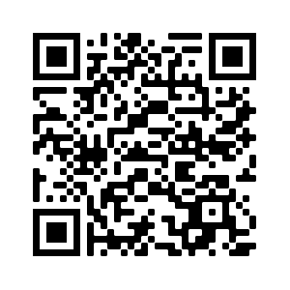
Devoirs
Vocabulary Learning Homework (Y9, Term 3.1, Week 4)
Student worksheet link
Quizlet link
Quizlet QR code
Notes:
The answer sheet for the 9.3.1.4 vocabulary learning homework is here: Resource | French SOW Y9 Term 3.1 Week 4 - vocabulary learning homework answers | ID: 3f462761r | NCELP

