Slide 1
Communicating in other languages [3]
verbs like entendre in the present (nous, vous)
SSCs [-aill-/-ail], [-eill-/-eil], [-euill-/-euil] and [-ouill-/-ouil]
Y8 French
Term 3.1 - Week 6 - Lesson 59
Stephen Owen / Catherine Morris / Catherine Salkeld
Artwork by: Chloé Motard
Date updated: 08/08/22
Notes:
Artwork by Chloé Motard. All additional pictures selected are available under a Creative Commons license, no attribution required.
Native speaker feedback provided by Sarah Brichory.
With thanks to Rachel Hawkes for her input on the lesson material.
Learning outcomes (lesson 1):
Revision of SSCs SSCs [-aill-/-ail], [-eill-/-eil], [-euill-/-euil], and [-ouill-/-ouil]
Introduction of verbs like entendre in the present tense (nous, vous)
Word frequency (1 is the most frequent word in French):
8.3.1.6 (introduce) attendre [155], descendre [1705], (en) bas [7/468], histoire² [263], règle² [488], piste [1902], roman [1262], texte [631]
8.3.1.2 (revisit) décision [370], soin [1109], dur [1029], facilement [1194], lentement [2637], mal¹ [277], mieux [217], vite [711]
8.2.1.5 (revisit) sortir² [309], vous² [50], maman [2168], papa [2458], possible [175], seul [101], sans [71], salut^{1, 2} [2205], s’il te plaît [34/13/112/804], s'il vous plaît [34/13/50/804]
Source: Londsale, D., & Le Bras, Y. (2009). A Frequency Dictionary of French: Core vocabulary for learners London: Routledge.
The frequency rankings for words that occur in this PowerPoint which have been previously introduced in NCELP resources are given in the NCELP SOW and in the resources that first introduced and formally re-visited those words.
For any other words that occur incidentally in this PowerPoint, frequency rankings will be provided in the notes field wherever possible.
The additional English meanings of the following words have been added to Quizlet since the creation of this resource: descendre – to go down, to ride down, to drive down

Slide 2
-aill-/-ail
taille
Notes:
Timing: 2 minutes for four SSC slides.
Aim: To consolidate SSC [-aill-/-ail]
Procedure: 1. Present the letter(s) and say the [-aill-/-ail] sound first, on its own. Students repeat it with you. 2. Bring up the word ”taille” on its own, say it, students repeat it, so that they have the opportunity to focus all of their attention on the connection between the written word and its sound.
3. A possible gesture for this would be to start with hands together and move them apart, representing varying size. 4. Roll back the animations and work through 1-3 again, but this time, dropping your voice completely to listen carefully to the students saying the [-aill-/-ail] sound, pronouncing ”taille” and, if using, doing the gesture.
Word frequency (1 is the most frequent word in French):
taille [1500]
Source: Londsale, D., & Le Bras, Y. (2009). A Frequency Dictionary of French: Core vocabulary for learners London: Routledge.

Slide 3
-eill-/-eil
oreille
Notes:
Aim: To consolidate SSC [-eill-/-eil]
Procedure: 1. Present the letter(s) and say the [-eill-/-eil] sound first, on its own. Students repeat it with you. 2. Bring up the word ”oreille” on its own, say it, students repeat it, so that they have the opportunity to focus all of their attention on the connection between the written word and its sound.
3. A possible gesture for this would be to point to your ear. 4. Roll back the animations and work through 1-3 again, but this time, dropping your voice completely to listen carefully to the students saying the [-eill-/-eil] sound, pronouncing ”oreille” and, if using, doing the gesture.
Word frequency (1 is the most frequent word in French):
oreille [1884]
Source: Londsale, D., & Le Bras, Y. (2009). A Frequency Dictionary of French: Core vocabulary for learners London: Routledge.

Slide 4
-euill-/-euil
[-ueill-/-ueill, -œill-/-œil]
feuille
Notes:
Aim: To consolidate SSC [-euill-/-euil]
Procedure: 1. Present the letter(s) and say the [-euill-/-euil] sound first, on its own. Students repeat it with you. 2. Bring up the word ”feuille” on its own, say it, students repeat it, so that they have the opportunity to focus all of their attention on the connection between the written word and its sound.
3. A possible gesture for this would be [to stroke the back of one hand]. 4. Roll back the animations and work through 1-3 again, but this time, dropping your voice completely to listen carefully to the students saying the [-euill-/-euil] sound, pronouncing ”feuille” and, if using, doing the gesture.
Word frequency (1 is the most frequent word in French):
feuille [2440]
Source: Londsale, D., & Le Bras, Y. (2009). A Frequency Dictionary of French: Core vocabulary for learners London: Routledge.

Slide 5
-ouill-/-ouil
brouillard
Notes:
Aim: To consolidate SSC [-ouill-/-ouil]
Procedure: 1. Present the letter(s) and say the [-ouill-/-ouil] sound first, on its own. Students repeat it with you. 2. Bring up the word ”brouillard” on its own, say it, students repeat it, so that they have the opportunity to focus all of their attention on the connection between the written word and its sound.
3. A possible gesture for this would be [to squint and wiggle fingers in front of face miming being unable to see through fog]. 4. Roll back the animations and work through 1-3 again, but this time, dropping your voice completely to listen carefully to the students saying the [-ouill-/-ouil] sound, pronouncing ”brouillard” and, if using, doing the gesture.
Word frequency (1 is the most frequent word in French):
brouillard [4452]
Source: Londsale, D., & Le Bras, Y. (2009). A Frequency Dictionary of French: Core vocabulary for learners London: Routledge.
Word frequency (1 is the most frequent word in French):
brouiller [4682]
Source: Londsale, D., & Le Bras, Y. (2009). A Frequency Dictionary of French: Core vocabulary for learners London: Routledge.

Slide 6
Phonétique
phonétique
Remember! These SSCs sound like a vowel + ‘yih’:
[-ail/aill]
= a + ‘yih’
e.g. taille
[-eil/eill]
= è + ‘yih’
e.g. oreille
[-ouil/ouill]
= ou + ‘yih’
e.g. brouillard
[-euil/euill]
= long eu/œ + ‘yih’
e.g. feuille
Notes:
Timing: 2 minutes
Aim: Revising the breakdown of SSCs [-aill-/-ail], [-eill-/-eil], [-ouill-/-ouil] and [-euill-/-euil].
Procedure:
1. Click to remind students of the SSCs, drawing attention to the fact that they can be broken down into vowels + yih.
2. Click to reveal ‘decoded’ pronunciation and example word. Students repeat.
Word frequency of unknown words (1 is the most frequent word in French):
oreille [1884], feuille [2440], brouillard [4452], taille [1500]
Source: Londsale, D., & Le Bras, Y. (2009). A Frequency Dictionary of French: Core vocabulary for learners London: Routledge.

Slide 7
Phonétique
écouter
Écoute les mots et choisis la bonne SSC.
 |  |  | [-aill-/-ail] | [-eill-/-eil] | [-ouill-/-ouil] | [-euill-/-euil]
 | la pagaille | chaos
 | l’œillade | wink
 | l’orteil | toe
 | le deuil | grief
 | mouiller | to wet
 | conseiller | to advise
 | la maille | stitch
 | ouille ! | ouch !
1
__
2
__
3
__
4
__
5
__
6
__
7
__
8
__
Notes:
Timing: 5 minutes
Aim: Aural recognition of SSCs [-aill-/-ail], [-eill-/-eil], [-ouill-/-ouil] and [-euill-/-euil] in isolated words.
Procedure:
1. Click on the number to play the audio. Remind students that they should focus on the part of the word which is covered, and listen for ‘vowel+ yih’.
2. Students choose which of the SSCs the word contains.
3. Click to reveal answers.
4. Play the words again. Students repeat.
Transcript:
1. la pagaille
2. l’œillade
3. l’orteil
4. le deuil
5. mouiller
6. conseiller
7. la maille
8. ouille !
Word frequency of unknown words used (1 is the most frequent word in French):
pagaille [>5000], œillade [>5000], orteil [>5000], deuil [3540], mouiller [>5000], conseiller [970], maille [>5000], ouille [>5000]
Source: Londsale, D., & Le Bras, Y. (2009). A Frequency Dictionary of French: Core vocabulary for learners London: Routledge.

Slide 8
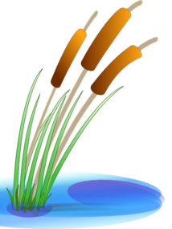
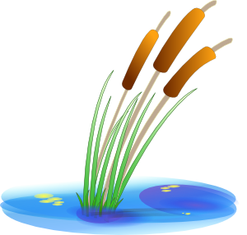
Vocabulaire
écouter / lire
Cross the river by filling the gaps with a suitable word.
Be careful! Some of the rocks are wobbly.
1
2
3
4
5
descendre
le roman
une histoire
vite
un texte
attendre
la piste
un bas
en bas
une règle
Notes:
Timing: 5 minutes
Aim: Gap fill activity to practise written and aural recognition of words in this week’s vocabulary set.
Procedure:
1. Click the numbers to hear sentences with words beeped out.
2. Students decide which word in the pair underneath the number best fits the gap.
3. Click on the chosen word to reveal whether students were correct (stone stays) or incorrect (stone disappears).
4. Answer audio will play when correct rock is clicked on.
Transcript:
1. On doit [descendre] la piste pour aller en bas de la montagne.
2. Les règles de [la piste] sont dans le texte.
3. C’est [une histoire] triste.
4. On trouve l’histoire [en bas] de ce texte.
5. J’attends son nouveau roman. C’est [un texte] intéressant.

Slide 9
Verbs like entendre in the plural
grammaire
You already know the je, tu and il/elle forms of verbs like entendre:
I answer /
I am answering
you answer /
you are answering
he/she answers /
he/she is answering
je réponds
tu réponds
il/elle répond
Verbs like entendre in the ‘nous’ and ‘vous’ form have the same ending as –ER verbs.
Remove -RE and add -ONS (nous), -EZ (vous)
The ‘d’ of the stem is pronounced in the plural forms, but not in the singular forms
nous répondons
vous répondez
we answer /
we are answering
you answer / you are
answering (plural/formal)
Notes:
Timing: 3 minutes
Aim: To introduce the nous and vous forms of verbs like entendre. To revise the je, tu and il/ells forms of verbs like entendre.
Procedure: 1. Cycle through the information on the slide using the animation sequence.
2. Pay particular attention to the pronunciation of –d in each new form. Explain that the vowel in the plural forms forces the –d to be pronounced.

Slide 10
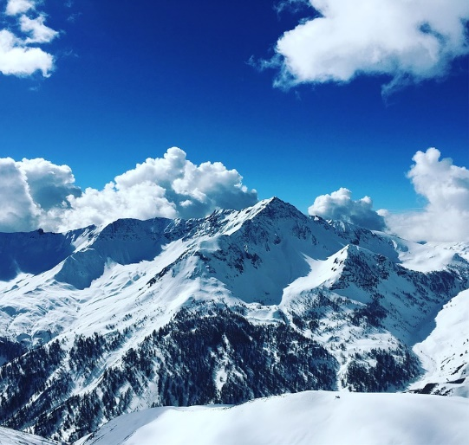
Le voyage scolaire d’Océane
C’est qui – Océane et ses amies ou Amir et Noura ?
lire
Salut Amir et Noura !
Nous sommes dans les Alpes à Argentera en Italie !
Nous entendons que* les personnes parlent plusieurs langues ici. Parfois, nous dépendons des profs pour traduire des choses. Vous ne dépendez pas des profs pour traduire – c’est tres impressionnant ! Nous descendons les pistes bleues. C’est mieux parce qu’elles sont moins dures que les pistes rouges. Vous descendez facilement les pistes rouges – est-ce que c’est dangereux ? Nous attendons une réponse, mais je sais que** vous attendez le bus en ce moment. Vous répondez dans une heure ou deux, alors !
1)
Les Alpes italiennes sont près de Nice !
C’est un voyage d'une heure en bus !
2)
3)
4)
5)
6)
7)
8)
**je sais que
= I know that
Notes:
Timing: 8 minutes (two slides)
Aim: To practise distinguishing between of the nous and vous forms of verbs like entendre (reading).
Procedure:
1. Check students understand the context. Those unfamiliar with skiing will find a clarification of ski-run classification (blue = intermediate, red = advanced) helpful for comprehension/
2. Students write 1-8.
3. They read the text and write the pronoun obscured by each of the numbers, using the verb form which follows to inform their choices.
4. Click to reveal the correct answers one by one.
5. Students look at the English activities on the table on the next slide and note who does what in the text. At more advanced levels, have students complete this step before revealing the answers to 3.
Word frequency of cognates used (1 is the most frequent word in French):
bus [4027], impressionnant [2465]
Source: Londsale, D., & Le Bras, Y. (2009). A Frequency Dictionary of French: Core vocabulary for learners London: Routledge.

Slide 11
Le voyage scolaire d’Océane
lire
Qui fait quoi ?
 | Océane et ses amies | Amir et Noura
1. hear people speaking several languages
2. depend on teachers to translate
3. don’t depend on teachers to translate
4. go down the blue ski slopes
5. go down the red ski slopes
6. are waiting for a reply
7. are waiting for the bus
8. will reply in an hour or two

Slide 12
Le directeur donne des instructions
*le moniteur de ski – ski instructor (m)
écouter
C’est une instruction juste pour les élèves (vous) ou pour les profs aussi (nous) ?
Q | instruction | chacun (nous) | élèves (vous) | R
 | hear the announcements
 | depend on the rules to go down safely
 | go down the slopes together
 | go down the red slopes slowly
 | wait for friends at the bottom
 | depend on ski instructors if there is a problem
 | wait for the instructor at the office
 | answer in Italian if possible
1
1
2
2
3
3
4
4
5
5
6
6
7
7
8
8
Notes:
Timing: 8 minutes
Aim: To practise distinguishing aurally between the nous and vous forms of verbs like entendre. Aural recognition of vocabulary in longer contexts.
Procedure:
1. Click on the numbered audio buttons on the left to play the sentences (pronoun is obscured in each).
2. Students listen and tick the appropriate column, based upon the verb ending heard. (just the pupils – vous, the teachers and pupils – nous)
3. Click to reveal answers.
4. Click on the numbers on the right to play the full audio including the pronoun.
5. Students note down the instruction.
6. Answers revealed on clicks.
Transcript:
1. Bonjour la classe ! [Vous] entendez les annonces ?
2. [Nous] dépendons des règles pour bien descendre la montagne.
3. Aujourd’hui [nous] descendons les pistes ensemble, d’accord ?
4. [Vous] descendez très lentement les pistes rouges.
5. [Nous] attendons nos amis en bas.
6. S’il y a un problème, [nous] dépendons des moniteurs de ski.
7. [Vous] attendez le moniteur au bureau.
8. [Vous] répondez en italien si possible.

Slide 13
La réponse d’Amir
Amir répond à Océane. Écris les verbes.
écrire
Salut Océane !
Je réponds vite, puisque vous attendez la réponse ! Oui, nous descendons les pistes rouges très vite ! Ce n’est pas dangereux si vous attendez les instructions du moniteur de ski et vous faites attention. Mais Abdel ne vient pas souvent. Quand il descend les pistes, il dépend de nous. Nous attendons Abdel en bas et nous répondons à ses questions. Quand vous descendez les pistes, vous entendez les instructions en italien ? C’est difficile ! Bon, nous sortons le chien - à bientôt ! Amir
1. répondre
2. attendre
3. descendre
4. attendre
5. descendre
6. dépendre
7. attendre
8. répondre
9. descendre
10. entendre
Notes:
Timing: 8 minutes
Aim: Written production of all forms of verbs like entendre.
Procedure:
1. Students read Amir’s reply to Océane and replace the infinitives with the appropriate form of the verbs.
2. Click to reveal the answers.
3. Oral translation of the text as a class.
Word frequency (1 is the most frequent word in French): instruction [1632], verbe [>5000]
Source: Londsale, D., & Le Bras, Y. (2009). A Frequency Dictionary of French: Core vocabulary for learners London: Routledge.

Slide 14
Trouve les paires
parler
Groupe A
Groupe B
hear the announcement
takes the train
hear the announcement
takes the bus
Vous entendez l’annonce ?
Oui, nous entendons l’annonce.
Vous prenez le train ?
Non, nous prenons le bus.
Notes:
Timing: 8 minutes (this slide models the activity) Aim: Oral production of verbs like entendre covered in this lesson in the nous/vous form and revision of the prendre group which take the same endings (with a spelling change). This is a spot the difference task (information gap). Students work in pairs with another pair. Each pair has 10 cards. Speakers exchange information to find the differences together.
Procedure: 1. Remind students of the stem changes in the prendre group. Use this slide to model the task by checking students can form questions and responses in the nous and vous forms (click to reveal pictures and model questions/answers).
2. Distribute the rolecards on slides 12-13.
3. Students in pair A take turns asking a question about one of the cards to the other pair, addressing them in the vous forms (e.g., Vous prenez le train ?).
4. Students in pair B check whether the information on their card is the same (Oui, nous prenons le train / Non, nous prenons le bus).
5. Then students in pair B offers a piece of information and so on until all cards have been discussed and the differences found.
Word frequency of unknown words and cognates used (1 is the most frequent word in French):
bus [4027]
Source: Londsale, D., & Le Bras, Y. (2009). A Frequency Dictionary of French: Core vocabulary for learners London: Routledge.

Slide 15
Trouve les paires – groupe A
parler
learn new Spanish words
take the car
understand the conversations
hear the announcements
depend on a mobile
reply to messages
go down the ski slope
wait for a boat
Salut!
Salut!
Notes:
NOT FOR DISPLAY DURING THE ACTIVITY

Slide 16
Trouve les paires – groupe B
parler
learn difficult Spanish words
take the train
understand the conversations
hear the announcements
depend on social media
reply to messages
go down the street
wait for a plane
Salut!
Salut!
Notes:
NOT FOR DISPLAY DURING THE ACTIVITY

Slide 17
Communicating in other languages [3]
verbs like entendre in the present (nous, vous)
SSCs [-aill-/-ail], [-eill-/-eil], [-euill-/-euil] and [-ouill-/-ouil]
Y8 French
Term 3.1 - Week 6 - Lesson 60
Stephen Owen / Catherine Morris / Catherine Salkeld
Artwork by: Chloé Motard
Date updated: 09/07/21
Notes:
Artwork by Chloé Motard. All additional pictures selected are available under a Creative Commons license, no attribution required.
Native speaker feedback provided by Sarah Brichory.
With thanks to Rachel Hawkes for her input on the lesson material.
Learning outcomes (lesson 2):
Revision of SSCs [-aill-/-ail], [-eill-/-eil], [-euill-/-euil], and [-ouill-/-ouil] [revisited]
Introduction of verbs like entendre in the present tense (ils/elles)
Word frequency (1 is the most frequent word in French):
8.3.1.6 (introduce) attendre [155], descendre [1705], (en) bas [7/468], histoire² [263], règle² [488], piste [1902], roman [1262], texte [631]
8.3.1.2 (revisit) décision [370], soin [1109], dur [1029], facilement [1194], lentement [2637], mal¹ [277], mieux [217], vite [711]
8.2.1.5 (revisit) sortir² [309], vous² [50], maman [2168], papa [2458], possible [175], seul [101], sans [71], salut^{1, 2} [2205], s’il te plaît [34/13/112/804], s'il vous plaît [34/13/50/804]
Source: Londsale, D., & Le Bras, Y. (2009). A Frequency Dictionary of French: Core vocabulary for learners London: Routledge.
The frequency rankings for words that occur in this PowerPoint which have been previously introduced in NCELP resources are given in the NCELP SOW and in the resources that first introduced and formally re-visited those words.
For any other words that occur incidentally in this PowerPoint, frequency rankings will be provided in the notes field wherever possible.
The additional English meanings of the following words have been added to Quizlet since the creation of this resource: descendre – to go down, to ride down, to drive down

Slide 18
-aill-/-ail
[garlic]
détail
ail
[detail]
taille
medaille
ailleurs
travailler
[elsewhere]
[to work]
Notes:
Timing: 2 minutes for four SSC slides.
Aim: To consolidate SSC [-aill-/-ail]
Procedure:
Introduce and elicit the pronunciation of the individual SSC [-aill-/-ail] and then the source word again ‘taille’ (with gesture, if using). Then present and elicit the pronunciation of the five cluster words. The cluster words have been chosen for their high-frequency, from a range of word classes, with the SSC (where possible) positioned within a variety of syllables within the words (e.g. initial, 2nd, final etc.). Additionally, we have tried to use words that build cumulatively on previously taught SSCs (see the Phonics Teaching Sequence document) and do not include new SSCs. Where new SSCs are used, they are often consonants which have a similar symbol-sound correspondence in English.
Word frequency (1 is the most frequent word in French): taille [1500]; ail [>5000]; détail[318]; médaille [3361] travailler [290]; ailleurs [360]. Source: Londsale, D., & Le Bras, Y. (2009). A Frequency Dictionary of French: Core vocabulary for learners London: Routledge.

Slide 19
-eill-/-eil
soleil
bouteille
oreille
meilleur
appareil
[best]
merveilleux
[device]
[marvellous]
Notes:
Aim: To consolidate SSC [-eill-/-eil]
Procedure:
Introduce and elicit the pronunciation of the individual SSC [-eill-/-eil] and then the source word again ‘oreille’ (with gesture, if using). Then present and elicit the pronunciation of the five cluster words. The cluster words have been chosen for their high-frequency, from a range of word classes, with the SSC (where possible) positioned within a variety of syllables within the words (e.g. initial, second, final etc.). Additionally, we have tried to use words that build cumulatively on previously taught SSCs (see the Phonics Teaching Sequence document) and do not include new SSCs. Where new SSCs are used, they are often consonants which have a similar symbol-sound correspondence in English.
Word frequency (1 is the most frequent word in French): oreille [1844], meilleur [194], soleil [1713], bouteille [2979], merveilleux [2209], appareil [1420] Source: Londsale, D., & Le Bras, Y. (2009). A Frequency Dictionary of French: Core vocabulary for learners London: Routledge.

Slide 20
-euill-/-euil
fauteuil
[-ueill-/-ueill, -œill-/-œil]
recueillir
[to collect]
feuille
accueil
[welcome]
œil
écureuil
Notes:
Aim: To consolidate SSC [-euill-/-euil]
Procedure:
1. Introduce and elicit the pronunciation of the individual SSC [-euill-/-euil] and then the source word again ‘feuille’ (with gesture, if using). 2. Then present and elicit the pronunciation of the four cluster words.
The cluster words have been chosen for their high-frequency, from a range of word classes, with the SSC (where possible) positioned within a variety of syllables within the words (e.g. initial, second, final etc.). Additionally, we have tried to use words that build cumulatively on previously taught SSCs (see the Phonics Teaching Sequence document) and do not include new SSCs. Where new SSCs are used, they are often consonants which have a similar symbol-sound correspondence in English.
Word frequency (1 is the most frequent word in French): fauteuil [2743]; feuille [2440] recueillir [1230]; accueil [2541], écureuil [>5000], oeil [474] Source: Londsale, D., & Le Bras, Y. (2009). A Frequency Dictionary of French: Core vocabulary for learners London: Routledge.

Slide 21
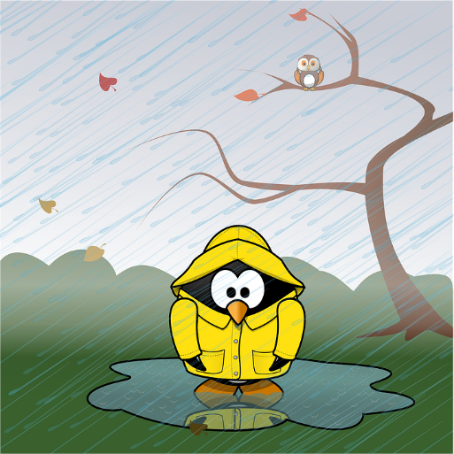
-ouill-/-ouil
fouiller
grenouille
[to rummage]
brouillard
débrouiller
[wet]
brouiller
mouillé
[disentangle]
[to scramble]
Notes:
Aim: To consolidate SSC [-ouill-/-ouil]
Procedure:
1. Introduce and elicit the pronunciation of the individual SSC [-ouill-/-ouil] and then the source word again ‘brouiller’ (with gesture, if using). 2. Then present and elicit the pronunciation of the four cluster words.
The cluster words have been chosen for their high-frequency, from a range of word classes, with the SSC (where possible) positioned within a variety of syllables within the words (e.g. initial, second, final etc.). Additionally, we have tried to use words that build cumulatively on previously taught SSCs (see the Phonics Teaching Sequence document) and do not include new SSCs. Where new SSCs are used, they are often consonants which have a similar symbol-sound correspondence in English.
Word frequency (1 is the most frequent word in French): fouiller [3431]; brouiller [4682] débrouiller [3618]; grenouille [>5000], mouillé [>5000] Source: Londsale, D., & Le Bras, Y. (2009). A Frequency Dictionary of French: Core vocabulary for learners London: Routledge.

Slide 22
Rolecards for printing
Partenaire A
1. L’écur___ recu___e un évent___ de c___oux. 2. Un épouvant___ assis dans un faut___ surv___ des citr___es.
Partenaire B
3. Les filles merv___euses pi___ent au cons___er à l’acc___.
4. Les ab___es et les bouvr___s débr___ent les tas de p___.
Partenaire A
1. L’écur___ recu___e un évent___ de c___oux. 2. Un épouvant___ assis dans un faut___ surv___ des citr___es.
Partenaire B
3. Les filles merv___euses pi___ent au cons___er à l’acc___.
4. Les ab___es et les bouvr___s débr___ent les tas de p___.
Partenaire A
1. L’écur___ recu___e un évent___ de c___oux. 2. Un épouvant___ assis dans un faut___ surv___ des citr___es.
Partenaire B
3. Les filles merv___euses pi___ent au cons___er à l’acc___.
4. Les ab___es et les bouvr___s débr___ent les tas de p___.
Notes:
Timing: 6 minutes. This is slide 1/5.
Aim: Oral production of sentences containing SSCs [-aill-/-ail], [-eill-/-eil], [-euill-/-euil], and [-ouill-/-ouil]; fluency of production.
Procedure:
1. Print and distribute the role cards on this slide.
2. Student B faces the board, Student A turns away. Display slide 31.
3. Students B reads the sentences aloud, two or three times depending on the needs of the class. Student A listens and fills in the gaps in sentence 1 of the rolecard.
4. Click on the audio button to hear the sentence said aloud by a native speaker. Student A uses this to check their writing.
5. Student A turns back to the board to self-correct.
6. Display slide 32 and repeat steps 2-5.
7. Students swap roles. Repeat steps 2-5 with slides 33 and 34.
Word frequency of unknown words used (1 is the most frequent word in French):
abeille [>5000], accueil [2541], bafouiller [>5000], bain [3458], bouiller [>5000], caillou [>5000], cocktail [4992], conseiller [577], écureuil [>5000], éventail [4621], feuilleter [>5000], leur [35], maillot [>5000], mail [>5000], médaille [3361], merveilleux [2209], paille [>5000], piaille [>5000], portail [>5000], recueillir [>1230]
Source: Londsale, D., & Le Bras, Y. (2009). A Frequency Dictionary of French: Core vocabulary for learners London: Routledge.

Slide 23
Réponses
écouter / parler
L’écureuil recueille un éventail de cailloux. The squirrel is collecting a range of stones.
1
Notes:
This is slide 2/5.

Slide 24
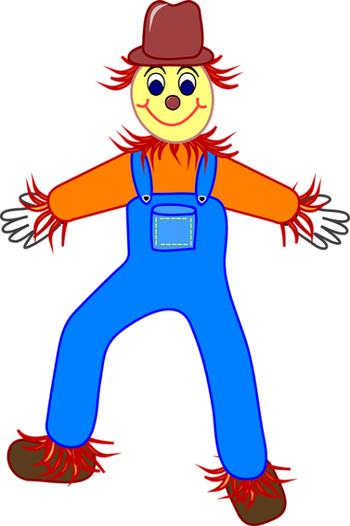
Réponses
écouter / parler
Un épouvantail assis dans un fauteuil surveille des citrouilles. A scarecrow sitting in an armchair is keeping an eye on the pumpkins.
2
Notes:
This is slide 3/5.

Slide 25
Réponses
écouter / parler
Les filles merveilleuses piaillent au conseiller à l'accueil. The brilliant girls are complaining to the advisor at the reception.
3
Notes:
This is slide 4/5.

Slide 26
Réponses
écouter / parler
Les abeilles et les bouvreuils débrouillent les tas de paille. The bees and the bullfinches are arranging the piles of straw.
4
Notes:
This is slide 5/5.

Slide 27
Trouve l’image !
parler
 | 1 | 2 | 3
A
B
C
novel
le roman
text
to go down, going down
le texte
descendre
history, story
to wait for, waiting for
l’histoire (f)
attendre
at the bottom
en bas
ski run
le bas
la piste
la règle
ruler, rule
bottom
Notes:
Timing: 3 minutes
Aim: Oral recall of new vocabulary.
Procedure:
1. Whole class choral activity. Students should volunteer a letter/number combination relating to a square on the grid.
2. The whole class then says the translation.
3. Click the blue box to reveal answer.
4. If the majority of the class says the correct answer, click the yellow box to reveal part of the underlying image.
5. Students guess which revisited word the image represents is as more is revealed.
Answer : lentement

Slide 28
Une carte postale
écrire
Salut la famille ! Le voyage est fantastique !
J’aime descendre les pistes seule.
Je dois attendre les autres en bas .
Les règles sont strictes mais nécessaires.
Je lis des histoires et des romans dans ma chambre.
Je vais écrire un texte sur mon voyage.
Vous venez à l’aéroport samedi, s’il vous plaît ?
À bientôt, Ocèane
go down
ski runs
wait
at the bottom
rules
Océane écrit une carte postale à sa famille.
Remplis les blancs !
stories
novels
text
Notes:
Timing: 5 minutes
Aim: Written recall of new vocabulary.
Procedure:
1. Students should replace the words in English with the relevant new vocabulary from this week’s set.
2. Click to reveal answers one by one.
3. Oral translation of the whole text.
Word frequency of unknown words and cognates used (1 is the most frequent word in French):
fantastique [4107], nécessaire [451], postale [>5000]
Source: Londsale, D., & Le Bras, Y. (2009). A Frequency Dictionary of French: Core vocabulary for learners London: Routledge.

Slide 29
Verbs like entendre (ils/elles)
grammaire
Verbs like entendre in the ‘ils’ and ‘elles’ form have the same ending as –ER verbs:
Remove -RE and add -ENT (ils/elles)
ils/elles répondent
they answer / they are answering
The ‘d’ of the stem is pronounced in the plural forms, but not in the singular forms.
ils répondent
they (m.) reply
elles répondent
they (f.) reply
il répond
he replies
elle répond
she replies
Although we don’t hear a difference between the singular and plural in the pronoun: we do hear it in the –d of the stem.
Notes:
Timing: 3 minutes
Aim: To introduce the ils/elles forms of verbs like entendre and focus on differences in pronunciation between the third person singular and plural forms of verbs like entendre.
Procedure: 1. Cycle through the information on the slide using the animation sequence.
2. Explain that the vowel in the plural forms forces the –d to be pronounced.

Slide 30
Ils attendent la famille à la gare*
*la gare
= train station
lire
Amandine est dans le parking et Amir est dans la gare. Amandine devient un peu nerveuse! Je/j’ ou ils ?
J’ attends dans la voiture… Papa et Noura viennent ?
1
Je ne sais pas. Ils ne répondent pas aux messages.
2
Ils entendent des portables dans la gare ? Ils prennent une éternité !
3
J’ entends une annonce. Ils descendent du train.
4
5
J’ attends combien de minutes ? Je dépends de tes messages!
6
7
Maman, s’il te plaît ! J’ attends une réponse.
8
Ils répondent maintenant. Ils attendent devant la porte de la gare.
9
10
D’accord, je descends avec la voiture.
11
Notes:
Timing: 7 minutes
Aim: Written recognition of je and ils forms of verbs like entendre.
Procedure:
1. Students read the messages and write je or ils in each gap.
2. Click to reveal the answers. Teachers could elicit full sentences from students in the feedback, for additional read aloud practice at sentence level. This is particularly useful here to contrast the silent ‘d’ in the ‘je’ forms with the sounded ‘d’ in the plural forms.
3. Oral translation of full text.
Word frequency of unknown words used (1 is the most frequent word in French): gare [2581]
Source: Londsale, D., & Le Bras, Y. (2009). A Frequency Dictionary of French: Core vocabulary for learners London: Routledge.
Word frequency of cognates used (1 is the most frequent word in French): nerveux [3735], parking [>5000], éternité [>5000]
Source: Londsale, D., & Le Bras, Y. (2009). A Frequency Dictionary of French: Core vocabulary for learners London: Routledge.

Slide 31
La liaison avec ‘aux’
SFC – oui ou non ?
écouter
La liaison avec ‘aux’
Il attend le train.
He is waiting for the train.
SFC = we do not hear the -d at the end of the stem
Notes:
Timing: 3 minutes for 6 slides.
Aim: Pronunciation practice with third person plural pronouns + liaison versus third person singular pronouns without.
Procedure:
1. Listen and repeat.
2. Ask students to translate the sentence.
3. Reveal picture on a click, ask students to check their translations.
4. Reveal English translation on click.
5. Bring up callout explaining pronunciation in this case.
Transcript
Il attend le train.

Slide 32
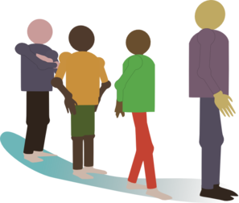
La liaison avec ‘aux’
SFC – oui ou non ?
écouter
La liaison avec ‘aux’
Ils attendent le train.
They are waiting for the train.
SFe + SFC = we hear the -d at the end of the stem
Notes:
Transcript
Ils attendent le train.

Slide 33
La liaison avec ‘aux’
SFC – oui ou non ?
écouter
La liaison avec ‘aux’
EIle entend la conversation.
She hears the conversation.
SFC = we do not hear the -d at the end of the stem
Notes:
Transcript
EIle entend la conversation.

Slide 34
La liaison avec ‘aux’
SFC – oui ou non ?
écouter
La liaison avec ‘aux’
EIles entendent la conversation.
They hear the conversation.
SFe + SFC = we hear the ‘d’ of the stem
Notes:
Transcript
EIles entendent la conversation.

Slide 35
La liaison avec ‘aux’
SFC – oui ou non ?
écouter
La liaison avec ‘aux’
EIle répond à la question.
She responds to the question.
SFC = we do not hear the -d at the end of the stem
Notes:
Transcript
EIle répond à la question.

Slide 36
La liaison avec ‘aux’
SFC – oui ou non ?
écouter
La liaison avec ‘aux’
EIles répondent à la question.
They respond to the question.
SFe + SFC = we hear the ‘d’ of the stem
Notes:
Transcript
EIles répondent à la question.

Slide 37
Au ou aux ?
C’est ‘elle’ ou ‘elles’ ?
écouter / écrire
Au ou aux ?
elles répondent
Notes:
Timing: 4 minutes for 6 slides
Aim: To connect the spoken and written forms of third person singular and plural verbs like entendre, given that the singular and plural pronouns sound identical before a verb beginning with a consonant.
Procedure:
1. Click on play button to hear a verb phrase (here: elles répondent).
2. Click to reveal a circle around the picture to indicate whether it indicates singular or plural.
3. Students now write the correct form.
4. Then, click again so that they see the correct written form that they should have written down.
Transcript
elles répondent

Slide 38
Au ou aux ?
C’est ‘il’ ou ‘ils’ ?
écouter / écrire
Au ou aux ?
ils descendent
Notes:
Transcript
ils descendent

Slide 39
Au ou aux ?
C’est ‘elle’ ou ‘elles’ ?
écouter / écrire
Au ou aux ?
elles dépendent
Notes:
Transcript
elles dépendent

Slide 40
Au ou aux ?
C’est ‘il’ ou ‘ils’ ?
écouter / écrire
Au ou aux ?
il défend
Notes:
Transcript
il defend
Word frequency of cognates used (1 is the most frequent word in French): défendre [385]
Source: Londsale, D., & Le Bras, Y. (2009). A Frequency Dictionary of French: Core vocabulary for learners London: Routledge.

Slide 41
Au ou aux ?
C’est ‘elle’ ou ‘elles’ ?
écouter / écrire
Au ou aux ?
elle correspond
Notes:
Transcript
elle correspond
Word frequency of cognates used (1 is the most frequent word in French): correspondre [1415]
Source: Londsale, D., & Le Bras, Y. (2009). A Frequency Dictionary of French: Core vocabulary for learners London: Routledge.

Slide 42
Au ou aux ?
C’est ‘il’ ou ‘ils’ ?
vendre
= to sell
écouter / écrire
Au ou aux ?
ils vendent
Notes:
Transcript
ils vendent
Word frequency of unknown words used (1 is the most frequent word in French): vendre [710]
Source: Londsale, D., & Le Bras, Y. (2009). A Frequency Dictionary of French: Core vocabulary for learners London: Routledge.

Slide 43
On va où ?
*l’arrêt de bus –
bus stop
écouter
Qui fait quoi à l’arrêt* de bus ?
l’activité | qui | ils/elles
are going down the street | Océane | les filles
are waiting for the bus to go to the slopes | Océane | les filles
hears a message on her mobile phone | Océane | les filles
doesn’t answer | Océane | les filles
1
2
3
4
Notes:
Timing: 8 minutes (two slides)
Aim: Aural recognition of il and ils forms of verbs like entendre and connecting these with meaning. Aural comprehension of vocabulary.
Procedure:
1. Click on a number to hear a sentence with the pronoun obscured.
2. Students listen to the pronunciation of the verb and use their knowledge of ‘d’ pronunciation to determine whether the sentence has a singular or plural subject.
3. Subjects revealed on clicks.
4. Click on circles to hear full audio.
5. On the second listen, students write what the subject is doing.
6. Click again to reveal the answers in picture and word form.
Transcript
1) [Océane et son amie] descendent la rue.
2) [Elles] attendent le bus pour aller aux pistes.
3) [Océane] entend un message sur son portable.
4) Mais [elle] ne répond pas.
5) [Elle] ne dépend pas des réseaux sociaux pour être contente pendant des vacances.
6) [Les filles] parlent avec des autres personnes et répondent parfois en italien.
7) [Elles] entendent finalement le bus !
8) [Le bus] descend lentement de la montagne.
Word frequency of unknown words and cognates used (1 is the most frequent word in French):
arrêt [1374], finalement [843]
Source: Londsale, D., & Le Bras, Y. (2009). A Frequency Dictionary of French: Core vocabulary for learners London: Routledge.

Slide 44
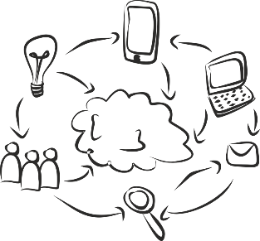
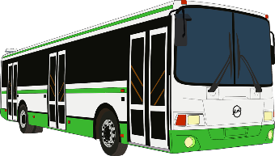
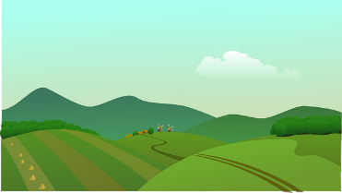
On va où ?
*l’arrêt de bus –
bus stop
écouter
Qui fait quoi à l’arrêt* de bus ?
l’activité | qui | ils/elles
doesn’t depend on social networks to be happy during holidays | Océane | les filles
speak to other people and sometimes respond in Italian | Océane | les filles
finally hear the bus | Océane | les filles
goes slowly down the mountain | le bus | les filles
5
6
7
8
Notes:
continuation from the previous slide.

Slide 45
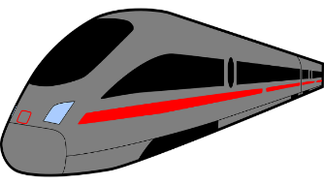
Quelle est la question ?
parler
la réponse
Partenaire A:
“Nous attendons le train.”
Partenaire B:
“Vous attendez quoi ?”
la question
Échangez de rôles !
Notes:
Timing: 8 minutes
Aim: Oral production of intonation questions with verbs like entendre in all forms.
Procedure: 1. Cycle through the example on this slide to illustrate how the paired speaking activity on the following slide is intended to work. Ensure students realise the pronouns and verb forms need to change when forming questions to answers in the 1st and 2nd person (tu → je, je → tu, nous → vous pl, vous pl → nous).
2. Partners are given a copy of the relevant card printed on the next slide. The slide may be printed out and cut into two sets of prompt cards, one for each partner. Alternatively, the slide may be displayed on the board, with Partner B’s cards hidden. Partner B then turns away from the board. 3. Explain that Partner A says the answer first, following which Partner B formulates the question that would lead to that answer. Possible question words are listed below the answers for each partner.
4. The teacher can circulate and listen in to check.
5. After Partner A has given all six answers on the card, partners swap roles.

Slide 46
A
Nous attendons le train pour voyager à Londres.
Ils entendent une annonce à l’aéroport.
Tu dépends des moniteurs du ski.
Vous descendez les pistes rouges.
Je réponds aux messages.
Elle attend la décision.
quoi ? –qui ? – où ? – quand ? – pourquoi ?
------------------------------------------------------------------------------------------------------------
B
Vous répondez mal à la question.
Nous entendons un gros oiseau.
Tu dépends du portable.
Je descends pour boire un café.
Ils attendent en ville.
Il entend l’avion.
quoi ? – qui ? – où ? – quand ? – pourquoi ?
Notes:
Do not display this slide during the activity. It provides the ANSWERS that the partners give when it is their turn to lead the activity.
This slide may be printed out and cut into two sets of prompt cards, one for each partner.

Slide 47
Quelle est la question ?
parler
Les réponses:
Les questions:
Nous attendons le train pour voyager à Londres.
Vous attendez quoi ?
Vous attendez le train pour voyager où ?
Ils entendent une annonce à l’aéroport.
Ils entendent quoi ? /
Ils entendent une annonce où ?
Tu dépends des moniteurs du ski.
Je dépends de qui ?
Je réponds aux messages.
Tu réponds à quoi ?
Vous (pl) descendez les pistes rouges.
Nous descendons quoi ?
Elle attend la décision.
Elle attend quoi ?
Notes:
Suggested answers for the activity on the previous slide.
Procedure: 1. Elicit answers from students.
2. Click to reveal answers one by one.
[answers to partner B set on next slide]

Slide 48
Quelle est la question ?
parler
Les réponses:
Les questions:
Ils attendent en ville.
Ils attendent où ?
Vous (pl) répondez mal à la question.
Nous répondons mal à quoi ?
Nous répondons comment à la question ?
Nous entendons un gros oiseau.
Vous entendez quoi ?
Tu dépends du portable.
Je dépends de quoi ?
Je descends pour boire un café.
Tu descends pourquoi ?
Tu descends pour boire quoi ?
Il entend l’avion.
Il entend quoi ?
Notes:
Answers
Procedure: 1. Elicit answers from students.
2. Click to reveal answers one by one.

Slide 49
Gaming Grammar
Gaming Grammar
Relevant mini game(s):
Verbs (present): 1st person singular/plural (Verb agreement (present))
Verbs (present): 2nd person singular/plural (Verb agreement (present))
Verbs (present): 3rd person singular/plural (Verb agreement (present))
Notes:
This slide links to Gaming Grammar login screen. The appropriate mission can then be selected from the menu page.
Students will progress through the game at their own rate; teachers should use the teacher interface to check progress. This will help to inform future lesson planning.

Slide 50
Devoirs
Vocabulary Learning Homework (Y8, Term 3.2, Week 1)
Quizlet link: Y8 Term 3.2 Week 1
Quizlet QR code:
In addition, revisit: Y8 Term 3.1 Week 4
Y8 Term 2.2 Week 1
Notes:
The answer sheet for the Y8, Term 3.2, Week 1 vocabulary learning HW is here: https://resources.ncelp.org/concern/resources/bz60cx05r?locale=en

