Slide 1

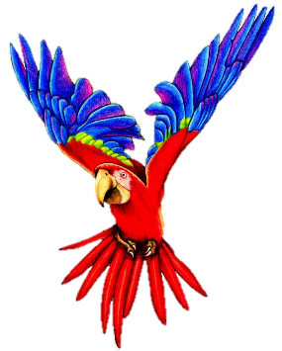

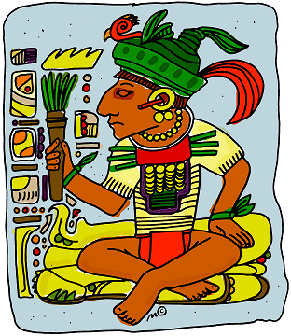

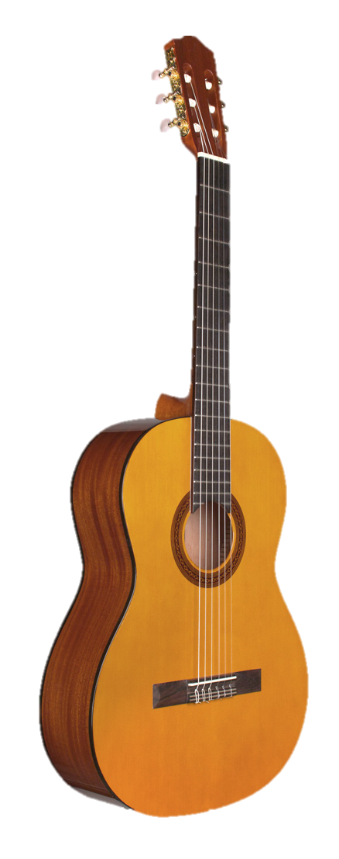
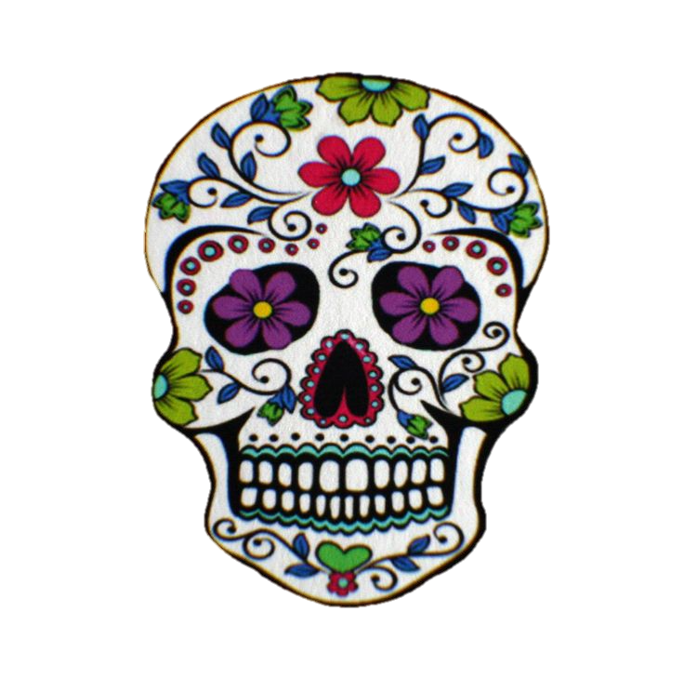
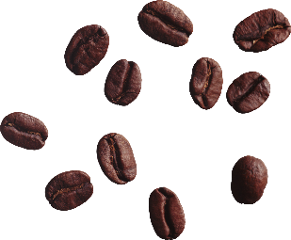

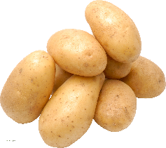


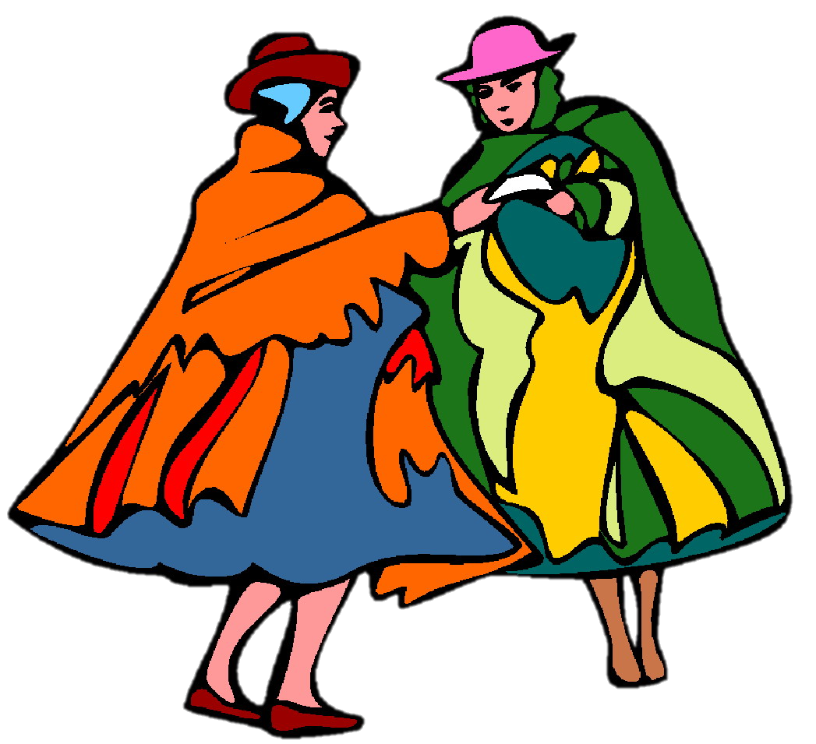



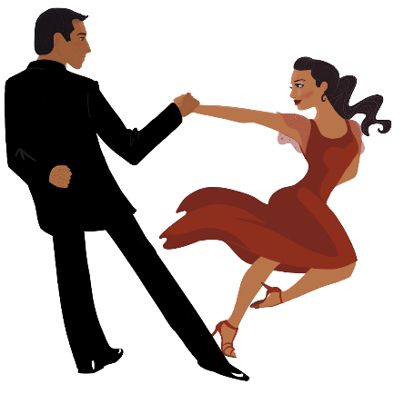
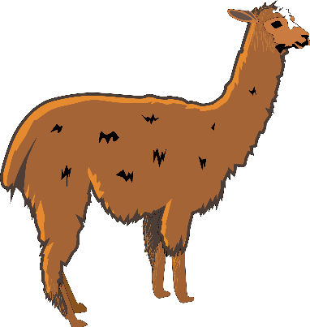
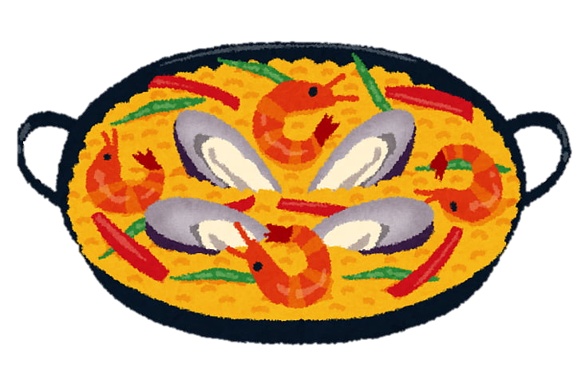
Español
la historia
la naturaleza
la música
la cultura
la comida
Year 8 Language Guide
Nombre: ………………………………………
Profesor/a: ……………………………………
Last updated: 26/03/2021

Slide 2
Contents
Themes overview | 2 | REVISION (-ar/-er/ir verbs in past) Environment | 32
Sounds of the language | 4-7 | Personal ‘a’ What you do for others | 33
Past tense (preterite) -ar verbs Travel in past and present | 8 | Reflexive ‘me’ & ‘te’ Daily life and routines | 34
Past tense (preterite) -ar verbs Comparing past experiences | 9 | OVS word order; direct objects Describing a series of events | 35-36
SER vs ESTAR [revisited] People & places (now vs generally) | 10-11 | Indirect object pronouns Giving and receiving (birthdays) | 37
Present tense –er verbs News and media | 12-13 | Gustar-type verbs Giving opinions about something | 38
HACER; subject pronouns At home | 14-15 | Work on a challenging text Ayaymamá | 39
PODER and DEBER In class | 16 | REVISION (‘para’ + infinitive) Describing people’s intentions | 40-41
Present tense –ir verbs Parties / celebrations | 17 | Possessive adjectives Possessions | 44-45
Past tense (preterite) –er & –ir verbs At school | 18-19 | Comparatives ‘más’ & ‘menos’ Comparing things | 46
Past tense (preterite) –er & –ir verbs Free time activities | 20-21 | Demonstratives Comparing things | 47-48
Idiomatic uses of TENER Feelings and emotions | 22-23 | HACER in preterite (singular forms) Talking about the weather | 49-50
DAR & QUERER Feelings and emotions | 24 | IR in preterite (singular forms) Saying where people went | 51-52
IR; para + infinitive Where people go and why | 25-26 | REVISION (preterite) Asking questions | 53
Work on a challenging text (Bolivia: un país diverso) | 27 | REVISION (present tense) Asking questions | 54
REVISION (-ar/-er/ir verbs, present) Food and restaurants | 28 | Present continuous –ar verbs Saying what is happening now | 55
Past tense (preterite) –ar verbs Technology and social networks | 29 | Present continuous –er/-ir verbs Saying what is happening now | 56
Past tense (preterite) –er/–ir verbs Travel | 30-31 | 1. Describing a Spanish tradition 2. Talking about future plans | 57-8

Slide 3
Overview
Overview | Theme / Topic
Autumn Term 1 | Describing events in the past and present (Travel) Comparing past experiences Talking about people and places now vs in general Comparing what you and someone else (‘we’) do (News and Media) Describing what different people do (At home) Asking what people can and must do (In class) Describing wat you and someone else (we) do (Parties / celebrations)
Autumn Term 2 | Describing events in the past and present (At school) Describing events in the past and present (Free time activities) Describing how people feel in the present (Feelings and emotions) Describing where people go and why Learning about a South American country
Spring Term 1 | Describing what people do (Technology and Social networks) Describing events in the past and present (Travel) Describing events in the past and present (Environment) Saying what you do for others Talking about daily life and routines
Spring Term 2 | Describing a series of events Talking about giving and receiving Giving opinions about school
Summer Term 1 | Describing people’s intentions Describing and comparing possessions Describing the weather at different times Comparing where people go and went
Summer Term 2 | Learning about a famous Spanish speaking person Describing what is happening now Describing traditions in Spanish-speaking countries Comparing future plans

Slide 4






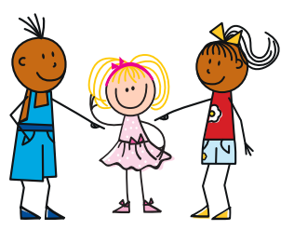


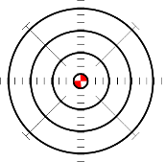





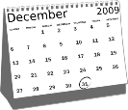



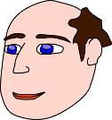
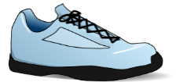
Sounds of the language
In Year 8, we continue to practise sound-spelling correspondences (SSC) in activities focused on two or more SSC. Often these are tricky pairs, such as [r] vs [rr]. Here are some of the SSC that we will revisit, with their source and cluster words.
Double ll, as in calle, is very different to a single l.
In most parts of Spain it sounds like the letter “y” in English.
[to arrive]
[then]
llegar
llave
amarillo
palabra
luego
luz
[she]
[list; ready (f)]
llevar
ella
lista
salir
The SSCs [ce], [ci] and [z] are pronounced differently in different parts of the Spanish-speaking world. In most of mainland Spain, this ‘c’ and ‘z’ is pronounced like “th” in English. In the Canary Islands and Latin America, they are pronounced like an “s”.
It doesn’t matter which way you say it – you will be understood!
[to need]
[to seem; appear]
[necessary]
centro
necesitar
doce
parecer
necesario
[to say; tell]
[city]
decir
ciencias
ciudad
cine
diciembre
[to start]
cabeza
voz
empezar
zapato
diez
3

Slide 5

















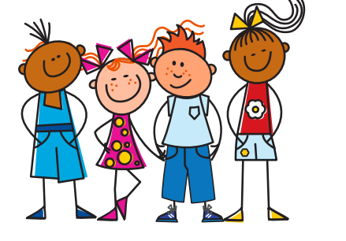





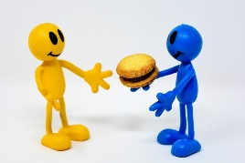

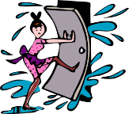


Sounds of the language (con’t)
[Argentinian]
[gesture]
[generally]
imagen
gesto
recoger
argentino
generalmente
47
48
[to choose, choosing]
Versión original
página
elegir
religión
original
colegio
[red]
[better]
[to leave]
julio
rojo
dejar
mujer
mejor
Ñ is a separate letter in Spanish. It is pronounced like
the ne in lasagne.
2020
[night]
[we]
año
señora
noche
nosotros
H is silent in Spanish.
Imagine it’s not there.
[to do; to make]
[See you later!]
[son]
hospital
hacer
helado
hijo
¡hasta luego!
[about]
correr
cerrar
sobre
dar
Remember that if a word starts with R, this will be pronounced just like RR.
rico

Slide 6

Sounds of the language (con’t)
In Year 8, we focus in particular on stress (the part of a word that is given most emphasis) and the use of the written accent to indicate which part of the word is stressed.
Syllables in Spanish and English
In Spanish, syllables often come in single consonant-vowel pairs.
Spanish
English
Four clear, separate syllables:
cho-co-la-te
Each part is always pronounced.
Three syllables if speaking slowly.
(‘cho-co-lat’).
Often two syllables (‘choc–lat’)!
‘Strong’ vowels
When they appear next to each other, the Spanish vowels [a], [e] and [o] are pronounced separately (as two syllables).
idea
oeste
leer
aeropuerto
feo
These vowels are often short, open and crisp!
‘Weak’ vowels
The vowels [i] and [u] merge with [a], [e] and [o] to make a single syllable.
igual
antiguo
bien
puerta
sucio
Because the [u] sound ‘glides’ into the next vowel, it sounds like a [w]!
In Y7, we saw the SSC [cu] + vowel. This is an example of how a weak vowel, [u], merges with a following vowel:
cuerpo
escuela
cuidar
cuatro
cuarenta

Slide 7
Sounds of the language (con’t)
Final-syllable stress
The part of a word that is ‘stressed’ is the part given most emphasis.
The position of the stress is sometimes marked by a written accent.
opción
op-CIÓN
Rule #1: If the final syllable is stressed, and the word ends in the consonants ‘n’ or ‘s’, write an accent above the stressed vowel.
según
quizás
también
después
autobús
(‘se-GÚN’)
(‘qui-ZÁS’)
(‘tam-BIÉN’)
(‘des-PUÉS’)
(‘auto-BÚS’)
Rule #2: If the final syllable is stressed and the word ends in a vowel write an accent above the stressed vowel.
café
decidí
Panamá
escuché
papá
(‘ca-FÉ’)
(‘de-ci-DÍ’)
(‘pa-na-MÁ’)
(‘es-cu-CHÉ’)
(‘pa-PÁ’)
Now try saying the words aloud! Emphasise the final syllable.
Penultimate (second-last) syllable stress
Rule #1: if the second-last syllable is stressed and the word ends in any vowel OR ‘n’ or ‘s’, there is no accent on the stressed vowel.
minuto
triste
martes
ejemplo
(‘mi-NU-to’)
(‘TRIS-te’)
(‘MAR-tes’)
(‘e-JEM-plo’)
Rule #2: if the second-last syllable is stressed and the word ends in any consonant except ‘n’ or ‘s’, write an accent above the stressed vowel.
fútbol
fácil
difícil
líder
(‘FÚT-bol)
(‘FÁ-cil’)
(‘di-Fí-cil’)
(‘LÍ-der’)
Now say them aloud! Emphasise the second-last syllable.

Slide 8
Sounds of the language (con’t)
Ante-penultimate (third-last) syllable stress
Words with stress on the third-last syllable always have an accent on the stressed vowel.
cámara
página
teléfono
sábado
(‘CÁ-ma-ra’)
(‘PÁ-gi-na’)
(‘te-LÉ-fo-no’)
(‘SÁ-ba-do’)
Now say them aloud! Emphasise the third-last syllable.
Stress position on common verb endings and suffixes
Spanish verb endings change when talking about completed actions in the past (this is called the ‘preterite’ tense).
For –ar/–er/–ir verbs in 1st person singular (talking about ‘I’), this can change the position of the stress.
present tense
past tense (preterite)
-AR verbs
(e.g. escuchar):
escucho - I listen
escuché - I listened
(‘es-CU-cho’)
(‘es-cu-CHÉ’)
-ER/-IR verbs
(e.g. abrir):
abro - I open
abrí - I opened
(‘A-bro’)
(‘a-BRÍ’)
This is final-syllable stress.
The suffix ‘–tion’ at the end of an English word (e.g. option) often changes to ‘–ción’ in Spanish (e.g. opción). The singular and plural forms follow two of the rules mentioned on the last page:
opción
(the final syllable is stressed and word ends in ‘n’, so an accent is needed)
opciones
(the second-last syllable is stressed and word ends in ‘s’, so there is no accent)

Slide 9

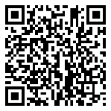

T1.1 Semana 1
Gramática
Past tense (preterite) –ar verbs: 1st person singular (-é)
Many Spanish infinitives end in –ar. Remember, the verb ending changes depending on who the verb refers to:
Ayudo en casa. I help at home.
Ayudar Ayudé
Pintar Pinté
Ayudé en casa. I helped at home.
Pinté la pared. I painted the wall.
This is the present tense.
To talk about ‘I’ with an action completed in the past, remove –ar and add an –é.
This past tense is called the ‘preterite’.
Notice the stress on the final –é.
Describing events in the past and present
Vocabulario
vb
vb
vb
vb
nm
nm
nf
adj
adj
aprovechar | to make the most of | making the most of
quedar | to meet up | meeting up
pintar | to paint | painting
ayudar | to help | helping
el verano | summer
el máximo | maximum
la pared | wall
libre | free
pasado | past | last
Revisit vocab 7.3.1.2 & 7.3.2.4
adj
adv
adv
conj
negro | black
(un) poco | (a) little
antes | before
sin embargo | however

Slide 10

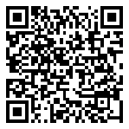
T1.1 Semana 2
Gramática
Past tense (preterite) -ar verbs: 2nd person singular (-aste)
Many Spanish infinitives end in –ar. To talk about ‘you’ with an action completed in the past, we use the verb ending –aste:
Caminas Caminaste You walk You walked
Cantaste en el concierto. You sang in the concert.
Visitaste la ciudad. You visited the city.
How to use the preposition ‘por’
1) to express movement:
Viajaste por el mundo.
You travelled around the world.
2) to give reasons for things:
Estoy nervioso por el perro
I am nervous about/because of the dog.
Comparing past experiences
Vocabulario
vb
vb
vb
vb
vb
nm
nm
nm
nm
nf
adv
adv
prep
cantar | to sing | singing
tomar | to take | taking
coger | to take | taking
intentar | to try (to) | trying (to)
ganar | to win | winning
el concierto | concert
el premio | prize
el año | year
el autobús | bus
la canción | song
hasta | as far as, up to
además | besides | as well
por | around |because of
‘Coger’ is used more in Spain for transport or for physically grabbing something.
‘Tomar’ is used more in Latin America in this way.
Revisit vocab 7.3.2.5 & 7.3.1.4

Slide 11
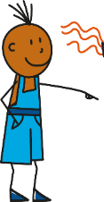
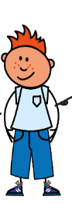

T1.1 Semana 3
Gramática
SER and ESTAR [revisited]
In Spanish there are two verbs for ‘to be’: SER and ESTAR.
We use ser to describe general traits or characteristics and estar to describe temporary states, moods and location.
Somos tranquilos. We are calm people (in general).
Estamos tranquilos. We are feeling calm (at the moment).
We use ser to describe general traits or characteristics and estar to describe temporary states, moods and location.
 | ser | estar
I am | soy | estoy
you are | eres | estás
s/he/it is | es | está
we are | somos | estamos
they are | son | están
Can you remember which other adjectives can be used with ser or estar?
Asking yes/no questions [revisited]
In Spanish, change a statement into a question by raising your voice at the end:
Eres alegre.
Statement
You are cheerful.
Question
¿Eres alegre?
The upside down question mark (¿) tells us that there is a question coming up!
Are you cheerful?
Adjective agreement [revisited]
Remember that adjective endings agree with the gender of the person referred to.
Es simpático.
Adjectives ending in a different letter (e.g. alegre, grande) don’t change in this way.
Masculine (-o):
Feminine (-a):
Es simpática.

Slide 12
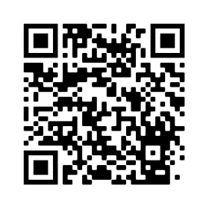
Talking about people and places now vs in general
Vocabulario
nf
adj
adj
adj
adj
adj
adj
adj
adj
adj
adv
adv
adv
adv
prep
la gente | people
malo | bad | ill
sucio | dirty
limpio | clean
listo | ready | intelligent
precioso | precious | beautiful
contento | content | happy
triste | sad
seguro | sure | safe
igual | same | equal
quizás | maybe
ahora | now
así | like this, like that
generalmente | generally
según | according to
Revisit vocab 7.3.2.6 & 7.3.1.5
Use ‘contento’ with ‘estar’.
Some adjectives in Spanish can have different meanings depending on the verb ‘ser’ or ‘estar’.
Soy malo/a.
I’m a bad person.
I’m ill/sick.
Estoy malo/a.
‘Está seguro/a’ can also mean ‘s/he/it is safe’ (as a state).
It is sure, certain.
Está seguro/a.
It’s safe.
Es seguro/a.
Estoy listo/a.
I’m ready.
Soy listo/a.
I’m intelligent, smart.

Slide 13



T1.1 Semana 4
Gramática
Present tense –er verbs: 1st person plural
Some Spanish verbs end in –er . The verb ending changes depending on who the verb refers to.
To mean ‘we’ with an –er verb, remove the –er and add –emos.
Entendemos la realidad.
We understand (the) reality.
Vendemos periódicos.
We sell newspapers.
Hacemos entrevistas.
We do interviews.
Routine vs ongoing/current actions
English has two present tense forms:
We make calls – present simple (normally, routine)
We are making calls – present continuous (BE + ing) – current, unfinished
In Spanish you can use the same verb for routine actions AND current, unfinished actions.
we do | we make
Hacemos
we are doing | we are making
Nouns ending in –dad
-ty at the end of an English word often changes to –dad in Spanish
variedad variety
actividad activity
In Spanish all –dad words are feminine, so use ‘la’ for ‘the’ and ‘una’ for ‘a’, ‘an’.
realidad
reality
sociedad
society

Slide 14
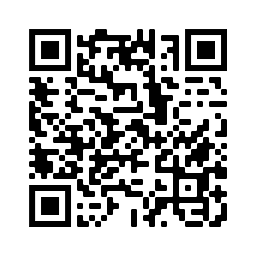
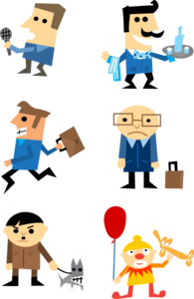

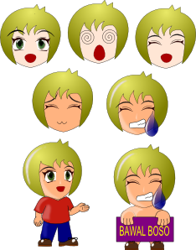
Comparing what you and someone else (we) do
Vocabulario
vb
vb
vb
vb
vb
nf
nm/f
nf
nf
nf
nf
prep
prep
vender | to sell | selling
entender | to understand | understanding
creer | to believe | to think
esconder | to hide | hiding
poner | to put | putting
la noticia | news item
el/la periodista | journalist (m/f)
la entrevista | interview
la página | page
la realidad | reality
la sociedad | society
que | that
sobre | about
I put -> pongo
E.g. Creo que la casa es bonita.
I think that the house is beautiful.
-ty | -dad (nf)
society
curiosity
university
variety
personality
Escribe las palabras en español.
Revisit vocab 8.1.1.1 & 7.3.1.6

Slide 15
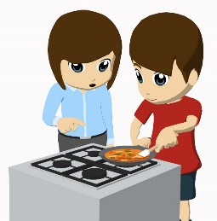
T1.1 Semana 5
Gramática
HACER in singular or plural persons
You have already learnt the verb ‘hacer’ for a singular person:
hago | I do, make (am doing, making)
haces | you do, make (are doing, making)
hace | s/he/it does, makes (is doing, making)
To refer to ‘we’ and ‘they, use the same endings that you have already learnt for –er and –ir verbs:
hacemos | we do, make (are doing, making)
hacen | they do, make (are doing, making)
Subject pronouns
Remember, the verb ending tells us who it refers to. When comparing different people, Spanish also uses a subject pronoun (e.g. I, he) before the verb. This makes it clear who the verb refers to.
yo | I
tú | you
él | he
ella | she
nosotros / nosotras | we
ellos / ellas | they
Ellas hacen poco ejercicio, pero nosotras ¡hacemos mucho!
They (f) do little exercise, but we (f) do a lot!
Another reason why we need subject pronouns is that the same verb is used for ‘he’ and ‘she’. We need the subject pronouns to make it clear who is being referred to.
Él hace la comida mientras ella hace deporte.
He makes the food while she does sport.

Slide 16
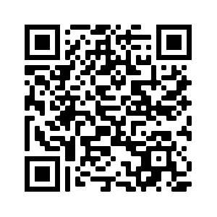
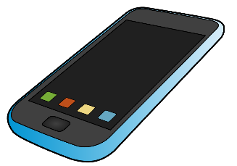

Describing what different people do (At home)
Vocabulario
vb
vb
nm
nm
nm
nm
nm
adj
conj
conj
hacemos | we do | we make
hacen | they do | they make
el cambio | change
el ruido | noise
el esfuerzo | effort
el viaje | trip | journey
el gesto | gesture
genial | great
mientras | while
mientras que | whereas
Revisit vocab 8.1.1.2 & 7.3.2.3
Want to say
‘to go on a trip’? Use ‘hacer un viaje’.
Use ‘mientras que’ to contrast two things.
Vocabulario útil
nm
nf
nf
nm
adj
adj
adj
adv
el móvil | mobile phone
la llave | key
la calle | street
el niño | boy
perdido | lost
mi, mis | my (singular/plural)
tu, tus | your (singular/plural)
completamente | completely

Slide 17
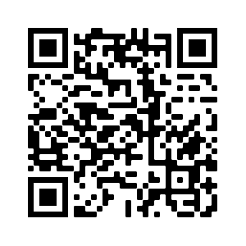
T1.1 Semana 6
Gramática
To mean ‘we’ with the verbs ‘poder’ (can, to be able to) and ‘deber’ (must, to have to), use the –emos ending.
podemos | we can, we are able to
debemos | we must, we have to
Use an infinitive after both of these verbs.
Podemos aprender alemán.
We can learn German.
Debemos trabajar juntos.
We must / have to work together.
Remember that ‘poder’ is also used for requests.
¿Puedo terminar la actividad ahora?
Can I finish the activity now?
¿Podemos decir la verdad?
Can we tell the truth?
Vocabulario
vb
vb
vb
vb
vb
vb
pron
nm
nm
nf
nf
nm/f
nm
podemos | we are able to | we can
debemos | we have to | we must
empezar | to start | starting
terminar | to finish | finishing
decir | to say | saying
ver | to see | seeing
todo | all (adj) | everything (pron)
el minuto | minute
el ejemplo | example
la opinión | opinion
la verdad | truth
el/la estudiante | student (m/f)
el alemán | German (language)
Revisit vocab 8.1.1.3 & 7.3.2.4

Slide 18

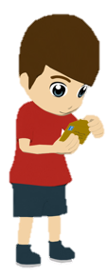

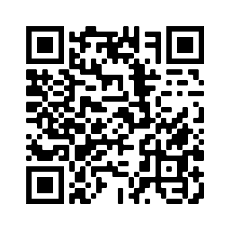
T1.1 Semana 7
Gramática
Present tense -ir verbs in 1st person plural
Remember, some Spanish infinitives end in –ir.
To mean ‘we’ with an –ir verb, remove –ir and add –imos.
Abrimos los regalos.
We open the presents.
Solo permitimos juegos divertidos.
We only allow fun games.
Repartimos las bebidas.
We hand out the drinks.
Saying what you and someone else (we) do (parties/celebrations)
Vocabulario
vb
vb
vb
vb
vb
nf
nf
nf
nm
nm
adj
adj
permitir | to allow | allowing
decidir | to decide | deciding
dividir | to divide | dividing
cubrir | to cover | covering
repartir | to share out | to hand out
la fiesta | party
la canción | song
la bebida | drink
el costo* | cost
el juego | game
incluso | even
fuerte | strong | loud
Revisit vocab 8.1.1.4 & 7.3.2.5
*coste in Spain

Slide 19



T1.2 Semana 1
Gramática
Past tense (preterite) -er/-ir verb: 1st person singular
Some Spanish infinitives end in –er and –ir. Remember, the verb ending changes depending on who the verb refers to.
I learn in class.
I write a little.
→ Aprendo en clase
→ Escribo un poco.
This is the present tense.
To mean ‘I’ with an action completed in the past, remove –er/-ir and add í:
Aprender
Escribir
This is the past tense (preterite).
→ Aprendí I learnt
→ Escribí I wrote
Prenominal adjectives
As you know, the adjective often comes after the noun.
un diálogo corto
un diálogo largo
a short dialogue
a long dialogue
However, some other adjectives come before the noun, just like in English.
Tengo mi propio ordenador.
I have my own computer.
Estamos en el mismo lugar.
We are in the same place.
Certain prenominal adjectives are shortened before a singular masculine noun.
primero
→
primer
el primer libro
the first book
tercero
→
tercer
el tercer regalo
the third present
bueno
→
buen
un buen cambio
a good change
malo
→
mal
un mal día
a bad day

Slide 20
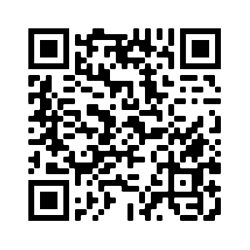
Describing events in the present and past (At school)
Vocabulario
vb
vb
vb
vb
vb
nm
adj
adj
adj
adj
adj
adj
adj
adj
adv
elegir | to choose | choosing
elijo | I choose
describir | to describe | describing
compartir | to share | sharing
imprimir | to print | printing
el diálogo | dialogue
mismo | same
primero | first
segundo | second
tercero | third
propio | own
último | last
corto | short
largo | long
finalmente | finally
Want to say ‘to choose to do something’?
Use ‘elegir + inifinitive’.
All six words can appear before the noun.
Remember, before a singular masculine noun,
primero → primer
tercero → tercer
Revisit vocab 8.1.1.5 & 7.3.2.6
inglés | español
1. the same person
2. the second question
3. the last bus
4. the first building
5. my own horse
6. the third day
Escribe las frases en español.

Slide 21

T1.2 Semana 2
Gramática
Past tense (preterite) –er/–ir verbs: 2nd person singular
As you know, to mean ‘you’ for routine actions in the present, remove –er or –ir and add –es.
subir
sub-
subes (you go up)
¡Atención! Los verbos pueden cambiar.
Elegir Eliges (you choose)
Perder Pierdes (you lose)
To mean ‘you’ for a completed action in the past, remove –er or –ir and add -iste.
subir sub- subiste (you went up)
Types of things: using ‘de’ between two nouns
In English, we often use one noun before another to describe a particular type of something, e.g., football match, train ticket.
In Spanish, it is common to use ‘de’ between these two nouns:
ropa de verano summer clothes
billete de tren train ticket
partido de fútbol football match
fin de semana
weekend
Notice how the order of the nouns is different in English and Spanish!
‘Partido de fútbol’ is literally ‘match of football’!

Slide 22
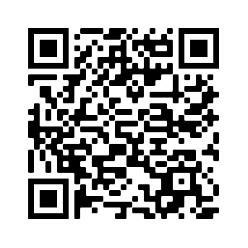
Describing events in the present and past (Free time activities)
Vocabulario
vb
vb
vb
vb
nm
nm
nf
salir | to go out | going out
subir | to go up | going up
perder | to lose | losing
recoger | to pick up | picking up
el partido | match
el fútbol | football
la entrada | ticket (event)
el billete | ticket (transport)
el fin | end
la semana | week
el inglés, la inglesa | English person (m/f)
el jugador, la jugadora | player (m/f)
(a) pie | (on) foot
pues | well
nm
nm
nf
nm/f
nm/f
nm
conj
‘Pues’ is often used when people are thinking about what to say! “Well…”

Slide 23
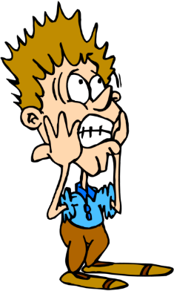
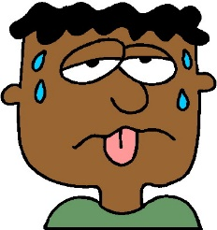
T1.2 Semana 3
Gramática
‘Tener’ [revisited]
As you know, the verb tener means ‘to have / having’.
Remember, when comparing different people, subject pronouns (I, you, etc) are used in Spanish to add clarity about who the verb refers to.
Yo tengo un perro, pero tú tienes un gato.
I have a dog, but you have a cat.
If you are referring back to the same idea (e.g. having the answers), you don’t need to repeat the verb.
Nosotros tenemos las respuestas; ellas no.
We have the answers; they (f) don’t.
Idiomatic uses of tener + noun
To say ‘to be lucky’ and ‘to be scared in Spanish, use tener (to have) + noun.
This is different from English. We use ‘to be’ + adjective
Here are some examples:
Tengo suerte.
I am lucky. (literally, ‘I have luck’)
Tienes miedo.
You are scared. (literally, ‘You have fear).
Tienen sueño.
They are sleepy. (literally, ‘They have sleepiness)
Tiene catorce años.
S/he is fourteen. (literally, ‘S/he has 14 years)
Other nouns used in this way are ‘éxito’ (success), calor (heat) and razón (reason):
Tener éxito = to be successful
Tener calor = to be hot
Tener razón = to be right

Slide 24
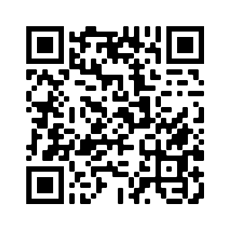
Describing how people feel in the present
Vocabulario
nm
nm
nm
nf
nf
nm
nm
adj
adj
conj
el cine | cinema
el calor | heat
el miedo (de) | fear (of)
la razón | reason
la suerte | luck
el éxito | success
el sueño | sleepiness
cerrado | closed
abierto | open
en cambio | on the other hand
Revisit vocab 8.1.1.7 & 8.1.1.2
Remember, adjectives need to agree in number with the noun.
El cine está cerrado.
The cinema is closed.
Los cines están cerrados.
The cinemas are closed.
13
14
15
16
trece
catorce
quince
dieciséis
17
18
19
20
diecisiete
dieciocho
diecinueve
veinte

Slide 25
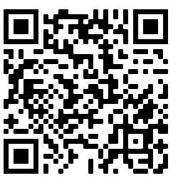
T1.2 Semana 4
Gramática
‘Dar’ and ‘querer’ in the 1st person plural
To say ‘we give’, use ‘damos’.
To say ‘we want’, use ‘queremos’.
Idiomatic uses of ‘dar’
‘Dar’ usually translates as ‘give’, but there are some exceptions. For example, ‘dar’ is often used to describe how something makes people feel. In English, we often use ‘to be’ + adjective.
Da risa.
It’s funny. (literally, ‘it gives laughter’)
Da miedo.
It’s scary. (literally, ‘it gives fear’)
Other nouns that work in this way are ‘pena’, ‘tristeza’, ‘ánimo’, ‘rabia’, ‘vergüenza’, ‘sueño’ and ‘alegría’.
Suffix -ción
Vocabulario
-tion at the end of an English word often changes to –ción in Spanish. All –ción words in Spanish are feminine.
option → la opción station → la estación
nm
nm
nf
nf
nf
nf
nf
nf
el ánimo | encouragement
el apoyo | support
la pena | sadness
la vergüenza | embarrassment
la rabia | anger
la tristeza | sadness
la risa | laughter
la alegría | happiness | joy
la traducción | translation
la intención | intention
la izquierda | left
la derecha | right
el paso | step
adelante | forward
atrás | backward
así que | so
nf
nf
nf
nf
nm
adv
adv
conj

Slide 26
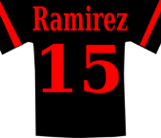

T1.2 Semana 5
Gramática
‘Ir’ in the 3rd personal plural
To say ‘they go’ (or ‘they are going’), use ‘van’.
As you know, to talk about what someone is going to do (future plans), use part of the verb ‘ir’ + a + infinitive
Vas a ir al cine. You are going to go to the cinema.
Va a ir a la costa. S/he is going to go to the coast.
Remember, to mean ‘to the’ use ‘a la’ for singular feminine nouns and ‘al’ for singular masculine nouns.
Using ‘para’ + infinitive
The word ‘para’ can mean ‘for’ or ‘in order to’:
El regalo es para mi madre. The present is for my mum.
Voy para ver un partido.
I go (in order) to watch a match.
When used in this way, ‘para’ is always followed by an infinitive.
Expressions with ‘ir de’ + noun
Vocabulario
There are a number of expressions in Spanish with ‘ir de + noun’.
ir de vacaciones
to go on holiday
ir de paseo
to go for an outing
ir de tiendas
to go window shopping
ir de compras
to go shopping (with the intention of buying)
ir de copas
to go for a drink
Tapas: small plates of food served in bars in Spain! These include olives and dried meats.
ir de tapas
to go for tapas

Slide 27
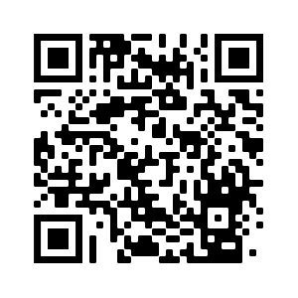
Describing where people go and why
Vocabulario
vb
vb
vb
vb
nm
nm
nf
nm
van | they go | they are going
tomar | to take | to drink
presentar | to present | presenting
enseñar | to teach | teaching
el país | country
el café | coffee, café
la costa | coast
el tema | topic | issue
el paseo | outing
la compra | purchase
la tapa | lid, cover
la copa | drink, glass
próximo | next
pronto | soon
para | for | in order to
nm
nf
nf
nf
adj
adv
prep
Próximo is commonly used before the noun
(e.g. la próxima clase).
Revisit vocab 8.1.2.2 & 8.1.1.4

Slide 28
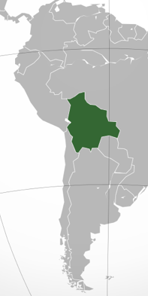
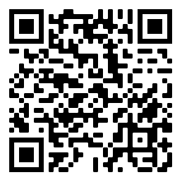
T1.2 Semana 6
Gramática
present tense -er/-ir verbs in the 3rd person [revisited]
Use the verb ending –e to mean ‘s/he’ or ‘it’.
Un idioma indígena existe en Bolivia.
An indigenous language exists in Bolivia.
Use the verb ending –en to mean ‘they’.
Las montañas pueden ser muy altas.
Bolivia
The mountains can be very high.
Suffixes –ía and –ia
Vocabulario
-y at the end of an English word often changes to –ía or –ia in Spanish.
economía
economy
family
familia
geografía
geography
memory
memoria
Words ending in –ía have stress on the final syllable.
Words ending in –ia have stress on the penultimate syllable.
Revisit vocab 1.2.3 & 1.1.5
vb
vb
vb
vb
nm
nf
nm
desaparecer | to disappear | disappearing
crecer | to grow | growing
ganar | to win, to earn
dice | s/he says, it says
el paisaje | landscape
la lluvia | rain
el clima | climate
nf
nf
adj
adj
adj
adv
other
la frontera | border
la altura | altitude
seco | dry
suficiente | enough
mejor | better
más | more
mil | (a) thousand

Slide 29
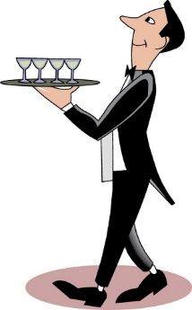
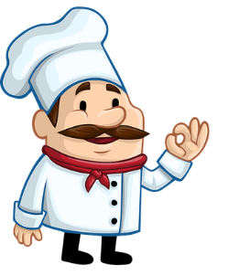


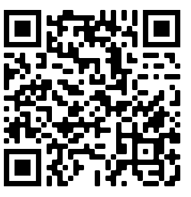
T1.2 Semana 7
Gramática
present tense –ar/–er/–ir verbs: 1st person plural [revisited]
–ar verbs: to mean ‘we’ in the present, use the ending –amos.
Limpiamos el suelo.
We clean the floor.
–er verbs: to mean ‘we’ in the present, use the ending –emos.
Debemos preparar la comida.
We must prepare the food.
–ir verbs: to mean ‘we’ in the present, use the ending –imos.
Pedimos ayuda.
We ask for help.
How many other words can you think of that are related to food and restaurants?
present tense –ar/–er/–ir verbs: 3rd person plural [revisited]
–ar verbs: to mean ‘they’ in the present, use the ending –an.
Cenan juntos.
They have dinner together.
–er/ir verbs: to mean ‘they’ in the present, use the ending –en.
Beben agua y comen fruta.
They drink water and eat fruit.

Slide 30
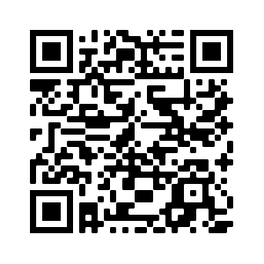
T2.1 Semana 1
Gramática
–ar verbs in 1st person singular present (-o) [revisited]
Use the verb ending –o to mean ‘I’ in the present.
Publico comentarios en Facebook.
I post comments on Facebook.
–ar verbs in 3rd person singular preterite (-ó)
Use the verb ending –ó to mean ‘s/he’ or ‘it’ in the past.
Envió un correo sobre una fiesta.
Verbs ending in –ó have stress on the final syllable.
S/he sent an email about a party.
Using ‘mucho’ and ‘poco’
When they are adjectives they need to agree in gender and number with the noun that they refer to.
Estudio muchas cosas
Revisit vocab 1.2.5 & 1.1.7
I study many things.
Estudio poca geografía
I study little (don’t study much) geography.
Vocabulario
vb
vb
vb
vb
nf
nm
nf
crear | to create | creating
publicar | to publish | to post
dejar | to leave| leaving
enviar | to send| sending
el comentario | comment
la foto | photo
la red | network
adv
adj, adv
adv
adv
ayer | yesterday
poco | little, few
al lado de | to the side of, next to
encima de | on top of
¡Atención! ‘Foto’ ends in ‘o’ but is feminine!

Slide 31
T2.1 Semana 2
Gramática
–er, –ir verbs in 3rd person singular present (-e) [revisited]
Use the verb ending –e to mean ‘s/he’ or ‘it’ in the present.
Ofrece regalos a los amigos.
S/he offers OR is offering gifts to friends.
–er, –ir verbs in 1st person singular preterite (-í) [revisited]
Use the verb ending –í to mean ‘I’ for completed past events.
Sufrí un accidente.
I suffered an accident.
–er, –ir verbs in 2nd person singular preterite (-iste) [revisited]
Use the verb ending –iste to mean ‘you’ for completed past events.
Rompiste la cámara.
You broke the camera.
–er, –ir verbs in 3rd person singular preterite (-ió)
Use the verb ending –ió to mean ‘s/he’ or ‘it’ for completed past events.
Conoció la cultura del país.
S/he got to know the culture of the country.
Prenominal adjectives [revisited]
Some adjectives can come before the noun
mismo
último
primero
segundo
tercero
propio
same
last
first
second
third
own
el último partido
the last match
Remember to change the ending of the adjective depending on the noun.
la última llamada
the last call
‘Primero’ and ‘tercero’ lose the –o when they come before a singular masculine noun → e.g., el primer correo, el tercer regalo.

Slide 32

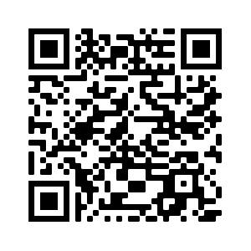
T2.1 Semana 2
Vocabulario
Using the verbs ‘saber’ and ‘conocer’
Use the verb ‘saber’ to talk about facts and information.
¿Sabes dónde está el mercado?
Do you know where the market is?
Use the verb ‘conocer’ to refer to familiarity with a person, place or thing, including becoming familiar with it (‘to get to know’).
¿Conoces Argentina?
Do you know Argentina?
vb
vb
vb
vb
vb
nf
nm
nm
conocer | to know, to get to know
ofrecer | to offer| offering
sufrir | to suffer | suffering
romper | to break | breaking
pasar | to pass, to spend (time), to happen
la cultura | culture
el accidente | accident
los Estados Unidos | United States
apenas | hardly, barely
ya | already
adv
adv
Revisit vocab 1.2.6 & 1.2.1
You can use ‘ya’ in different tenses:
> Miguel ya está aquí.
Miguel is already here. (present)
> El concierto ya pasó.
The concert already happened. (preterite)

Slide 33


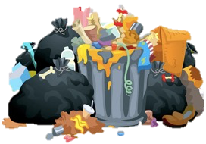
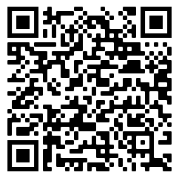
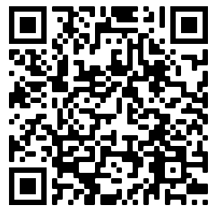

T2.1 Semana 3
Gramática
–ar verbs in 1st person singular preterite (-é) [revisited]
Use the verb ending –é to mean ‘I’ in the past.
Caminé en la playa.
I walked on the beach.
–ar verbs in 2nd person singular preterite (-aste) [revisited]
Use the verb ending –aste to mean ‘you’ in the past.
Viajaste a Costa Rica.
You travelled to Costa Rica.
–ar verbs in 3rd person singular preterite (-ó) [revisited]
Use the verb ending –ó to mean ‘s/he’ or ‘it’ in the past.
Sacó la basura.
S/he took the rubbish out.
–er, –ir verbs in 1st person singular preterite (-í) [revisited]
Use the verb ending –í to mean ‘I’ in the past.
I chose the new ticket.
Elegí el billete nuevo.
–er, –ir verbs in 2nd person singular preterite (-iste) [revisited]
Use the verb ending –iste to mean ‘you’ in the past.
Perdiste el partido otra vez.
You lost the match again.
–er, –ir verbs in 3rd person singular preterite (-ió) [revisited]
Use the verb ending –ió to mean ‘s/he’ or ‘it’ in the past.
Recibió el periódico.
S/he received the newspaper.
Vocabulary mashups:

Slide 34



T2.1 Semana 5
Gramática
Direct object
A direct object is the person, animal or thing that receives the action of the verb.
Olvido las fotos.
I forget / am forgetting the photos.
You can often ask ‘what’ or ‘who’ to identify the direct object.
Question: What do I forget?
Answer: the photos (the photos is the direct object in the sentence)
Saying what you do to others: using personal ‘a’
When the direct object is animate (a living thing) you need to use an ‘a’ after the verb. When the direct object is inanimate (not a living thing) this ‘a’ is not used.
Visito el país.
I visit the country.
Revisit vocab 2.1.1 & 1.2.3
Visito al niño.
I visit the child.
Remember, if ‘a’ is followed by ‘el’ (the), use al.
Vocabulario
vb
vb
vb
nf
cuidar | to look after | looking after
olvidar | to forget | forgetting
traer | to bring| bringing
la salud | health
nm
nf
nm
adv
el novio | boyfriend
la novia | girlfriend
el cumpleaños | birthday
casi | almost

Slide 35


T2.1 Semana 6
Gramática
Words like ‘myself’ are called reflexive pronouns. We use them when the subject (‘doer’) and object (‘receiver’) are the same.
Doing something to ‘myself’: reflexive pronoun ‘me’
To mean ‘myself’ in Spanish use ‘me’ before the verb.
Me lavo.
I wash (myself).
In English, sometimes we just say the verb without ‘myself’.
Me levanto.
I get (myself) up.
Doing something to yourself: reflexive ‘te’
To mean ‘yourself’ in Spanish use ‘te’ before the verb.
Te despiertas.
You get (yourself)up.
You look at yourself.
Te miras.
vb
vb
vb
vb
vb
vb
nm
nm
llamar | to call | calling
despertar | to wake up | waking up
levantar | to get up | getting up
presentar | to present | to introduce
desayunar | to have breakfast | having breakfast
poner | to put | to put on
el pantalón | trousers
el vestido | dress
el espejo | mirror
demasiado | too much | too many
me | myself
te | yourself
Vocabulario
nm
adj
pron
pron
Revisit vocab 2.1.2 & 1.2.4

Slide 36
T2.2 Semana 1
Gramática
Object-first sentences
The person (or thing) that ‘receives’ the action is called the object. In English, the object comes after the verb.
In Spanish, the object may come before or after the verb.
.
1
SUBJECT
VERB
OBJECT
The man
calls
the woman.
El hombre
llama
a la mujer.
2
OBJECT
VERB
SUBJECT
¡Ojo! el and la (‘the’) are different words!
A la mujer
la llama
el hombre.
If the object comes first, use lo or la (object pronouns) between the object and verb. There is no translation for this.
Using the pronoun to avoid repeating a noun
Use ‘lo’ to mean ‘him’ or ‘it’ (for a masculine object):
→ The woman carries the man.
La mujer lleva al hombre.
La mujer lleva el libro.
Lo lleva la mujer.
El hombre lleva a la mujer.
El hombre lleva la carta.
La lleva el hombre.
→ The woman carries the book.
→ The woman carries it/him.
Use ‘la’ to mean ‘her’ or ‘it’ (for a masculine object):
→ The man carries the woman.
→ The man carries the letter.
→ The man carries it/her.

Slide 37



Describing a series of events
Vocabulario
vb
vb
vb
vb
vb
vb vb
acompañar | to go with| to accompany
besar | to kiss | kissing
dejar | to leave | to let
parar | to stop | stopping
saludar | to greet | greeting
seguir | to follow| following
sigo | I follow| I am following
la cocina | kitchen
el/la policía | police| police officer
lo | him | it
la | her | it
nf
nf
pron
pron
Revisit vocab 2.1.3 & 1.2.5

Slide 38

T2.2 Semana 2
Gramática
Indirect object pronouns ‘me’, ‘te’ and ‘le’
An indirect object is the person or thing that is indirectly affected by the verb.
If the person indirectly affected is ‘me’, use the pronoun ‘me’
La chica me trae chocolate.
The girl brings chocolate to me.
The girl brings me chocolate.
INDIRECT OBJECT
DIRECT OBJECT
If the person indirectly affected is ‘you’, use the pronoun ‘te’.
Te regalo un reloj.
I give you a watch (as a gift).
I give a watch to you.
For a person indirectly affected is ‘him’, her’ or ‘it’, say ‘le’.
Le traen chocolate.
They bring him/her/it chocolate.
In Spanish, indirect object pronouns go before a conjugated verb. In English, they come after it.
Vocabulario
vb
vb
vb
nf
quitar | to take away | to take off
regalar | to give| giving
tirar | to throw | throwing
la caja | box
el reloj | watch
la tarjeta | card
adj
adj
pron
lleno | full
vacío | empty
me | myself |to me
te | yourself|to you
le | to him|to her|to it
pron
pron
nm
nf
Revisit vocab 2.1.5 & 1.2.6

Slide 39

T2.2 Semana 3
Gramática
Gustar-type verbs
Some verbs in Spanish are very commonly used with an indirect object pronoun (e.g., me, te) because they show an effect on someone/something.
Me
molesta
el ruido.
Literally:
to me
it is annoying
the noise
(The noise annoys me.)
Remember, in Spanish the subject (the ‘doer’) can come at the end of the sentence!
-a
When the subject is singular (e.g. ‘it’ ), use the verb ending ____ for a present tense –ar verb.
Me interesa el tema.
The topic/issue interests me.
-an
When the subject is plural (‘they’), use the verb ending _____ for a present tense –ar verb.
The topics/issues interest me.
Me interesan los temas.
vb
vb
vb vb vb vb adj adj
alegrar | to make happy
encantar | to delight | to be delightful to
gustar | to please | to be pleasing to
importar | to matter | to be important to
interesar | to interest | to be interesting to
molestar | to annoy | to bother
preocupar | to worry | to be worrying to
fácil | easy
difícil | difficult
Vocabulario
Revisit vocab 2.1.6 & 2.1.1

Slide 40


T2.2 Semana 4
Gramática
Indirect object pronouns and gustar-type verbs [revisited]
Remember that an indirect object is the person or thing that is indirectly affected by the verb.
me
If the person affected by the action is ‘me’, use _____.
Me interesa.
It interests me.
Sounds like ‘meh’!
te
If the person affected by the action is ‘you’, use ____.
Te molesta.
It annoys/bothers you.
le
If the person affected by the action is ‘him, ‘her’ or ‘it’, use ___.
Le importan.
They matter to her/him/it.
Using gustar and encantar
Gustar and encantar can be translated in more than one way:
¡El director me encanta!
The headteacher delights me!
OR I love the headteacher!
El chico tonto te gusta.
The silly boy pleases you.
OR You like the silly boy.
This week we revisit vocabulary from Year 7.
Write the English next to each Spanish word.
Vocabulario
simpático | ____________ | aburrido | _____________
caro | ____________ | pequeño | _____________
barato | _____________ | nervioso | _____________
Now cover up the Spanish words. Look at the English words and write the Spanish on a piece of paper. Then check your answers.

Slide 41


T2.2 Semana 5
Gramática
‘Ser’ for traits and ‘estar’ for state & location [revisited]
Ser is used to describe traits and characteristics.
Soy tu madre. I am your mother.
Eres pequeño. You are small.
Es extraña. She is strange.
Perú
Estar is used to describe states and locations.
Estoy mala. I am ill/sick.
¿Estás bien? Are you ok?
Está en el suelo. S/he is (or ‘it is’) on the floor.
Iquitos es una ciudad en Perú. Está en el río Amazonas y no puedes ir en coche, en autobús o en tren porque no hay una *carretera, así que ¡solo puedes llegar en barco o en *avión!
*carretera = road; avión = plane
Iquitos, Perú
El Amazonas es un lugar con mucha vida donde hay animales, árboles y flores diferentes.
Una orquídea

Slide 42



Telling the time
Gramática
To tell the time in Spanish, use ‘es’ for 1 o’clock and ‘son’ for 2 o’clock or later. Spanish also uses the feminine definite article (la, las).
To say ‘at’ a time, Spanish uses ‘a’.
At six o’clock
= A las seis
Es la una.
Son las cuatro.
Use ‘de’ before the time of day
‘de la mañana’ for ‘in the morning’ (not ‘por’)
‘de la tarde’ for the afternoon and evening
Es la una de la tarde.
Vocabulario
It’s one (o’clock) in the afternoon.
vb | encontrar | to find | finding
vb | esperar | to wait (for) | waiting (for)
vb | gritar | to shout | shouting
vb | llorar | to cry | crying
vb | querer | to want | to love
vb | volver | to return | returning
nm | el frío | coldness
nf | la historia | story
nf | la mamá | Mum
nm | el mes | month
nm | el papá | Dad
Revisit vocab 2.2.1 & 2.1.2

Slide 43


T3.1 Semana 1
Gramática
Present tense verbs in singular persons [revisited]
As you know, some Spanish infinitives end in –ar.
The verb ending changes depending on who the verb refers to.
To refer to a particular person, first remove –ar and then:
-o
To mean ‘I’ add ____.
Descanso en el parque.
I rest in the park.
-as
To mean ‘you’ add ____.
Bailas bien.
You dance well.
-a
Visita la ciudad.
S/he visits the city.
To mean ‘s/he’ or ‘it’ add ___.
Other Spanish infinitives end in –er or –ir.
To refer to a particular person, first remove –er or –ir and then:
-o
To mean ‘I’ add ____.
Corro en la plaza.
I run in the square.
-es
You make plans.
To mean ‘you’ add ____.
Haces planes.
-e
Escribe mucho.
To mean ‘s/he’ or ‘it’ add ____.
S/he writes a lot.
Using subject pronouns [revisited]
Remember that when comparing different people, Spanish uses a subject pronoun (e.g. I, you, he) before the verb. This adds clarity and emphasises the contrast.
I = yo you = tú she = ella he = él
Tú tienes vacaciones, pero ella no puede ir.
You have holidays, but she can’t go.

Slide 44



T3.1 Semana 1
Gramática
Talking about intentions: using ‘para’ + infinitive [revisited]
Remember that ‘para’ can mean ‘in order to’.
When used in this way, ‘para’ is always followed by an infinitive.
Llevo una revista para leer en el coche.
I take a magazine (in order) to read in the car.
Routine vs ongoing events [revisited]
Remember that in Spanish you can use the same verb for routine events and ongoing events (things in progress).
Descansa en la playa.
S/he rests on the beach.
S/he is resting on the beach.
Sometimes time markers can tell us which English tense to choose. Other times the context will make this clear.
Siempre descansa en la playa.
She always rests on the beach.
Ahora descansa en la playa.
She is resting on the beach now.
This week we revisit vocabulary from Year 7.
Write the English next to each Spanish word.
Vocabulario
bailar | ____________ | cambiar | _____________
pasar | ____________ | preguntar | _____________
llevar | _____________ | participar | _____________
Now cover up the Spanish words. Look at the English words and write the Spanish on a piece of paper. Then check your answers.

Slide 45

T3.1 Semana 2
Possessive adjectives mi vs mis; tu vs tus [revisited]
Remember that to say ‘my’ before a singular or uncountable noun you use mi. To say ‘my’ before a plural use noun, use mis.
To say ‘your’ before a singular or uncountable noun you use tu. To say ‘your’ before a plural noun use tus.
Gramática
Possessive adjectives su vs sus
To say ‘his’, ‘her’ or ‘its’ before a singular or uncountable noun, use su.
Su hijo es alto.
His / her son is tall.
To say ‘his’, ‘her’ or ‘its’ before a plural noun, use sus.
Sus hijas son bajas.
His / her daughters are short.
Possessive adjectives nuestro vs nuestros
To say ‘our’ before a singular masculine noun, use nuestro.
Nuestro tio es abogado.
Our uncle is a lawyer.
To say ‘our’ before a singular feminine noun, use nuestra.
Nuestra madre es científica.
Our Mum is a scientist.
Use of the article in English and Spanish
In English, we use the indefinite article (a, an) to say what job someone does. In Spanish, no article is used.
Mi primo es músico.
My cousin (m) is a musician.
If you use an adjective to describe the job, the indefinite article is used.
Mi primo es un músico genial.
My cousin (m) is a great musician.

Slide 46











T3.1 Semana 2
Vocabulario
Numbers 21-30
veintiuno
veintidós
veintitrés
veinticuatro
veinticinco
veintiséis
veintisiete
veintiocho
veintinueve
treinta
adj | nuestro/a | our
nm | el tío | uncle
nf | la tía | aunt
nm | el hijo | son
nf | la hija | daughter
nmf | el/la científico/a | scientist
nmf | el/la médico/a | doctor
nmf | el/la músico/a | musician
nmf | el/la abogado/a | lawyer
adj | débil | weak
nmf | conocido/a | well-known
adv | tan | so (for emphasis)
Revisit vocab 2.2.2 & 2.1.5

Slide 47


T3.1 Semana 3
Gramática
Comparing things (comparatives)
In Spanish, to compare things, you can use:
‘más + adjective + que’ (more… than)
‘menos + adjective + que’ (less… than)
Rafael está más enojado que Quique.
Rafael is angrier / more angry than Quique.
To say ‘better than’, use mejor que.
Sometimes in English we add ‘-er’ to the adjective.
To say ‘worse than’ say peor que.
Talking about possessions
In Spanish you say the possession first, followed by ‘de’ and then the ‘owner’. This word order is different from English.
La madre de Hugo
Hugo’s mother
(literally, ‘the mother of Hugo’)
vb | entrar | to go in, to enter
vb | prestar | to lend, lending
nm | el ambiente | atmosphere
adj | cansado/a | tired
adj | enfermo/a | ill, sick
adj | emocionado/a | excited
adj | enojado/a | angry
adj | peor | worse
adv | menos | less
conj | que | that, than
interj | vale | ok
interj | ¿de verdad? | really
Vocabulario
Revisit vocab 2.2.3 & 2.1.6

Slide 48




T3.1 Semana 4
Gramática
Demonstrative adjectives
Demonstratives are used to distinguish one object from another.
In Spanish to say ‘this’ for a singular masculine object, use este.
este precio = this price
To say ‘this’ for a singular feminine object, use esta.
esta falda = this skirt
To say ‘these’ for a plural masculine object, use estos.
estos precios = these prices
To say ‘these’ for a plural feminine object, use estas.
estas faldas = these skirts
Question words [revisited]
Vocabulario
¿Dónde = Where?
¿Cuándo? = When?
¿Qué? = What?
¿Quién? = Who?
¿Por qué? = Why?
¿Cuál? ¿Cuáles? = Which?
¿Cuánto? = How much?
¿Cuántos? (masculine) ¿Cuántas? (feminine) = How many?
¿Cómo? = How?
¿Cómo es? = What is it like?
¿Cómo son? = What are they like?

Slide 49




T3.1 Semana 4
Gramática
Question formation in Spanish
When asking questions in English, we often include ‘do’ (or ‘did’ for the past tense) before the subject and main verb.
Spanish doesn’t have a word for ‘do’. Only the main verb is used.
¿Dónde guardas estos zapatos?
Where do you keep these shoes?
¿Cuándo necesitaste estas tarjetas?
When did you need these cards?
Vocabulario
vb | parecer | to seem, to appear
vb | guardar | to keep, keeping
vb | pagar | to pay, paying
nf | la marca | brand
nm | la falda | skirt
nf | la mitad | half
nm | el precio | price
nm | el tipo | type
nm | el euro | euro
adj | ligero/a | light
adj | práctico/a | practical, useful
adj | este/a, estos/as | this, these
Revisit vocab 2.2.5 & 2.2.1

Slide 50


T3.1 Semana 5
Gramática
HACER in present (singular forms) [revisited]
To say ‘I do’ or ‘I make’ in Spanish, use hago.
Hago ruido. I make noise.
To say ‘you do’ or ‘you make’, use haces.
Haces la cama. You make the bed.
To say ‘s/he or it does/makes’, use hace.
Hace los deberes. She does the homework.
HACER in preterite (singular forms)
To say ‘I did’ or ‘I made’ in Spanish we use hice.
I did the activity. Hice la actividad.
To say ‘you did’ or ‘you made’, use hiciste.
You made a change. Hiciste un cambio.
To say ‘s/he did/made’ or ‘it did/made’, use hizo.
S/he made the fire. Hizo el fuego.
Using ‘del’ and ‘de la’ with adverbs of position [revisited]
Remember, in Spanish you can give locations using adverbs like ‘cerca’ or ‘lejos’.
You often use ‘de’ after them to refer to a person, place or thing.
Hay un reloj dentro de la caja. There is a watch inside the box.

Slide 51




T3.1 Semana 5
Vocabulario
vb | hice | I did, I made
vb | hiciste | you did, you made
vb | hizo | s/he/it did, s/he/it made
adj | viejo/a | old
nm | el fondo | back, end (of an area)
vb | evitar | to avoid, avoiding
adv | dentro | inside
nm | el fuego | fire
nm | mayo | May
nm | junio | June
nf | la habitación | bedroom
nm | el jardín | garden
nm | el daño | harm, damage
nf | la fila | line
nm | el campo | countryside, pitch
nm | el estadio | stadium
Revisit vocab 3.1.2 & 2.2.2

Slide 52


T3.1 Semana 6
Gramática
IR in present (singular forms) [revisited]
To say ‘I go’, use voy.
Voy en avión.
I go by plane.
To say ‘you go’, use vas.
Vas en noviembre.
You go in November.
To say ‘s/he goes’ or ‘it goes’, use va.
Va a la montaña.
S/he goes to the mountain.
IR in preterite (singular forms)
To say ‘I went’, use fui.
Fui en septiembre.
I went in September.
To say ‘you went’, use fuiste.
Fuiste a una fiesta.
You went to a party.
To say ‘s/he went’ or ‘it went’, use fue.
Fue a la playa.
S/he went to the beach.
Using ‘al’ [revisited]
Remember that the word ‘a’ (to) is often used to say where someone goes.
Before a singular masculine noun (e.g. colegio), ‘a’ and ‘el’ always come together as ‘al’.
Fuiste al market. You went to the market.

Slide 53



T3.1 Semana 6
Vocabulario
vb | fui | I went
vb | fuiste | you went
vb | fue | s/he/it went
nf | la historia | story, history
nf | la zona | area, zone
vb | apoyar | to support, supporting
adv | simplemente | simply
vb | celebrar | to celebrate, celebrating
adv | directo | direct
nm | septiembre | September
nm | octubre | October
nm | noviembre | November
nm | diciembre | December
nm | el avión | plane
nm | el colegio | school, primary school
adv | principalmente | mainly, principally
Revisit vocab 3.1.3 & 2.2.3

Slide 54


T3.2 Semana 1
Gramática
Regular –ar verbs in the preterite [revisited]
The preterite tense is used for completed events in the past.
To use –ar verbs in this way, take off the –ar and:
To mean ‘I’, add –é.
Olvidé los billetes.
I forgot the tickets.
To mean ‘you’, add –aste.
Lloraste en clase.
You cried in class.
To mean ‘s/he’ or ‘it’, add –ó.
Jugó un partido.
S/he played a match.
Regular –er, –ir verbs in the preterite [revisited]
To use –er or –ir verbs in the past, we take off the –er or –ir and:
To mean ‘I’ add –í.
Comí algo.
I ate something.
To mean ‘you’ add –iste.
Viviste en España.
You lived in Spain.
To mean ‘s/he’ or ‘it’ add –ió.
Creció en Argentina.
He grew up in Argentina.
Saying dates in Spanish
To say the date in English, we say, for example, the second of December or the twenty third of June.
To say the date in Spanish, use numbers such as uno, dos, tres etc.
el seis de julio
the sixth of July

Slide 55


T3.2 Semana 2
Gramática
regular –ar verbs: plural persons in the present [revisited]
Remember, the verb ending changes depending on who the verb refers to.
to mean ‘we’, add –amos to the stem.
Estudiamos chino. We study Chinese.
to mean ‘they’, add –an to the stem.
Enseñan arte y ciencias.
They teach art and science.
regular –er, –ir verbs: plural persons in the present [revisited]
To mean ‘we’ with –er verbs add –emos to the stem.
Vendemos libros.
We sell books.
To mean ‘we’ with –ir verbs add –imos to the stem.
Escribimos historias.
We write stories.
To mean ‘they’ add –en to the stem.
Aprenden poco.
They learn little (don’t learn much).
Uses of the present simple [revisited]
Remember that in Spanish the same verb in present can be used for routine and ongoing events (things in progress).
Hacemos los deberes los martes. We do homework on Tuesdays.
Hacemos los deberes en este momento.
We are doing homework at the moment.

Slide 56




T3.2 Semana 4
Gramática
Present continuous with –ar verbs
The present continuous tense is used for an ongoing event in the present (something in progress).
Estoy mostrando el ejercicio.
I am showing the exercise.
Estás saltando.
You are jumping.
The –ando ending (and –ing in English) is called the ‘present participle’.
To form the present continuous, use
a present tense form of ‘estar’ (estoy, estás etc.)
an –ar verb with the ending ‘-ando’.
vb | grabar | to record, recording
vb | tocar | to touch, touching
vb | mostrar | to show, showing
vb | bajar | to go down, to lower
vb | saltar | to jump, jumping
pron | alguien | someone, somebody
nf | la mano | hand
nf | la pierna | leg
nm | el brazo | arm
adv | levantar | to get up; to lift, raise
adv | ahora mismo | right now
Vocabulario
Revisit vocab 3.1.4 & 2.2.5

Slide 57



T3.2 Semana 5
Gramática
Present continuous –er and –ir verbs
Remember that to describe an ongoing event in the present, you can use estar with a verb ending in –ando.
For –er and –ir verbs, the ending is different. Remove ‘er’ or ‘ir’ and add ‘–iendo’.
Estamos dirigiendo una película. We are directing a film.
Están discutiendo. They are arguing.
Querer + infinitive [revisited]
Remember that a form of ‘querer’ can be used before an infinitive, to mean ‘to want to’.
They want to make a film. Quieren hacer una pelíula.
vb | conducir | to drive, driving
vb | traducir | to translate, translating
vb | discutir | to argue, arguing
vb | dirigir | to direct, directing
nm | el francés | French (language)
nm | el ruso | Russian (language)
adv | rápido | fast
adv | despacio | slow
nm | el personaje | character (e.g. film)
nm | el actor | actor
nf | la actriz | actress
nf | la escena | scene
Vocabulario
Revisit vocab 3.1.5 & 3.1.2

Slide 58





T3.2 Semana 6
Gramática
Present tense -ar verbs in the 3rd person [revisited]
Remember that to mean ‘s/he’ or ‘it’ with an –ar verb, use –a.
La chica baila en la calle. The girl dances in the street.
¡Atención! Some words in Spanish, such as ‘familia’ (family) and ‘gente’ (people) are considered singular, even though they refer to more than one person. Use the –a ending for these words.
To mean ‘they’ with an –ar verb, use –an.
Tiran tomates. They throw tomatoes.
3rd person singular past (-ó)
Remember, to mean ‘s/he’ or ‘it’ for a completed event in the past, use the verb ending –ó.
Limpió la calle después. S/he cleaned the street afterwards.
Vocabulario
nm | el tomate | tomato
nf | la guerra | war
adv | hoy en día | nowadays
nf | la cantidad | amount, quantity
vb | tener lugar | to take place
adv | aproximadamente | approximately
vb | comenzar | to start, starting
adv | por todas partes | everywhere
Revisit vocab 3.1.6 & 3.1.3

Slide 59





T3.2 Semana 7
Gramática
Verb ‘hacer’ in the preterite [revisited]
To say ‘I did’ or ‘I made’ in Spanish we use hice.
I did activities on the beach. Hice actividades en la playa.
To say ‘you did’ or ‘you made’, use hiciste.
You made a list of places. Hiciste una lista de lugares.
To say ‘s/he did/made’ or ‘it did/made’, use hizo.
S/he did fun things. Hizo cosas divertidas.
Verb ‘ir’ in the preterite [revisited]
To say ‘I went’, use fui.
Fui a la torre.
I went to the tower.
To say ‘you went’, use fuiste.
Fuiste a una fiesta.
You went to a party.
To say ‘s/he went’ or ‘it went’, use fue.
Fue a la playa.
S/he went to the beach.
Future plans with ir + infinitive [revisited]
Remember, to say where someone goes, use the verb ‘ir’ in the present tense.
Voy a Italia. I go to Italy.
To say what someone is going to do, use ‘ir in the present, followed by ‘a’ + infinitive.
Revisit vocab 3.1.6 & 3.1.3
Voy a conducir. I am going to drive.

