Slide 1
Phonics
SSC [j]
Y7 German
Term 3.2 – Week 3
Rachel Hawkes / Stephen Owen
Date updated: 21/05/20

Slide 2
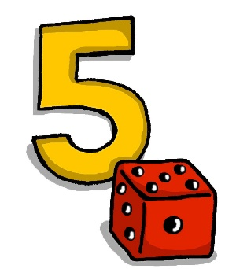
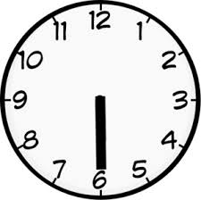
SSC?
hören
05:30!!!
Notes:
Students work in pairs to work out the sound we are revisiting – first pair to put hands up have a go – must say all words correctly and work out the sound. Click the image to play the audio.
Note: we are assuming that teachers will remove the [ü] from the title slide, before the lesson, so as not to give away the answer!
ANSWERS:
grün
früh
fünf

Slide 3
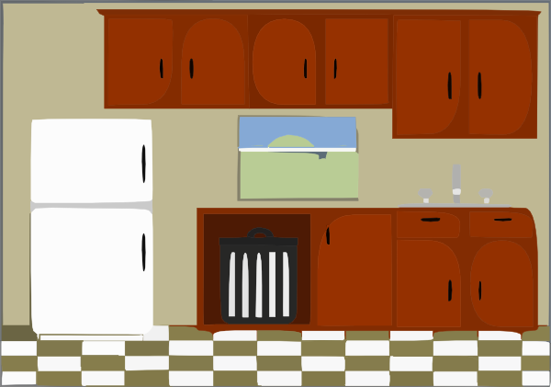
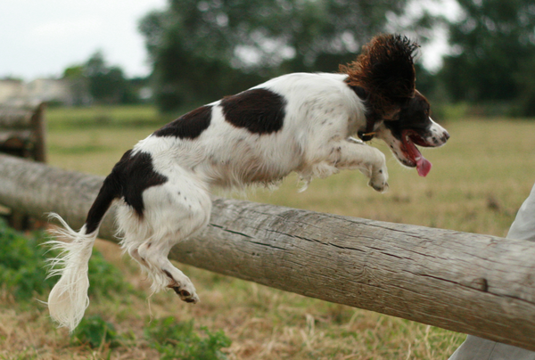
ü
fühlen
grün
Tür
Küche
über
früh
05:30!!!
Notes:
Elicit the pronunciation of the individual SSC ‘ü’ and then the source word again (with gesture, if using). Then elicit the pronunciation of the five cluster words.
Word frequency rankings (1 is the most common word in German): Tür [400]; fühlen [419] grün [556]; Küche [960]; früh [322]; über [48]. Source: Jones, R.L. & Tschirner, E. (2006). A frequency dictionary of German: core vocabulary for learners. Routledge

Slide 4
ü
fühlen
grün
Tür
Küche
über
früh
Notes:
Audio but no pictures, to focus on the sound-symbol relationship.

Slide 5
ü
fühlen
grün
Tür
Küche
über
früh
Notes:
No audio, to elicit pronunciation from students.

Slide 6
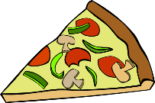
ü
Rücken
wünschen
[to wish]
fünf
Stück
Glück
[luck/happiness]
müssen
[to have to/must]
Notes:
Elicit the pronunciation of the individual SSC ‘ü’ and then the source word again (with gesture, if using). Then elicit the pronunciation of the five cluster words.
Word frequency rankings (1 is the most common word in German): fünf [272]; Rücken [914] wünschen [684]; Glück [763]; müssen [45]; Stück [417]. Source: Jones, R.L. & Tschirner, E. (2006). A frequency dictionary of German: core vocabulary for learners. Routledge

Slide 7
ü
Rücken
wünschen
fünf
Stück
Glück
müssen
Notes:
Audio with text only, to focus more closely on the sound-symbol relationship.

Slide 8
ü
Rücken
wünschen
fünf
Stück
Glück
müssen
Notes:
No audio, to elicit responses from students.

Slide 9
U oder Ü?
sprechen
das Buch
60
fühlen
grün
gut
die Nummer
Sekunden
die Küche
über
früh
der Zug
0
die Kunst
LOS!
Notes:
Pairwork ‘tennis’ – pupils say the words alternately out loud with a partner, building up speed, over 1 minute’s intensive practice. Pupils call in any order they like, but are not allowed to repeat the one they said in their last turn. Teacher can circulate to listen into their SSC knowledge. Click on ‘LOS!’ to start a one-minute timer on the screen.

Slide 10
U oder Ü?
Hören
 | U | Ü
1
2
3
4
5
6
1
2
3
4
5
6
Notes:
Phonics contrast activity
Click on the number to play the audio. Words from the new and revisited vocabulary sets for this week are used.
1. das Museum
2. dürfen
3. ruhig
4. früh
5. genug
6. glücklich

Slide 11
U oder Ü? [2]
Hören
 | U | Ü
1
2
3
4
5
6
7
8
9
10
11
12
Notes:
Phonics contrast activity
Click on the number to play the audio. Words from the new and revisited vocabulary sets for this week are used.
7. türkisch
8. zusammen
9. gesund
10. müssen
11. sie muss
12. du musst

Slide 12
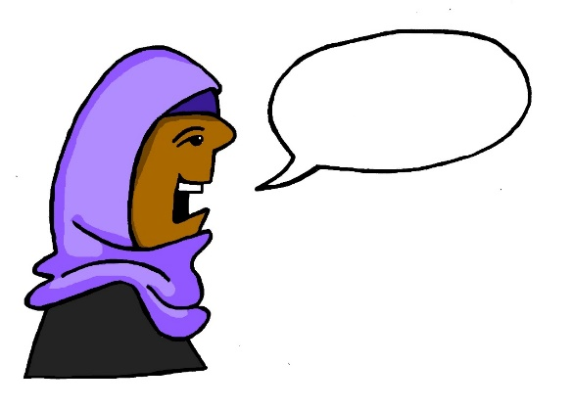
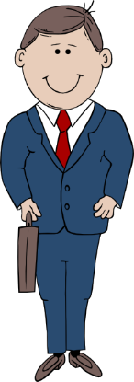
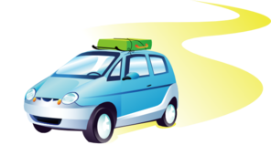
r
Regel
rot
reden
warum?
Beruf
Reise
Notes:
This set of three slides focuses on the sound of the ‘r’ at the beginning of a word or syllable in German.
The following three slides contrast the sound of the post-vocalic ‘r’ with this.
The SSC slides are followed by a listening exercise requiring students to listen out for these two different ‘r’ sounds, so please point this distinction out to them as we go through.
Elicit the pronunciation of the individual SSC ‘r’ and then the source word again (with gesture, if using). Then elicit the pronunciation of the five cluster words.
Word frequency rankings (1 is the most common word in German): reden [356]; Regel [484] rot[381]; warum? [246]; Reise [786]; Beruf [477]. Source: Jones, R.L. & Tschirner, E. (2006). A frequency dictionary of German: core vocabulary for learners. Routledge

Slide 13
r
Regel
rot
reden
warum?
Beruf
Reise
Notes:
Without pictures to focus on the SSC alone.

Slide 14
r
Regel
rot
reden
warum?
Beruf
Reise
Notes:
Without sound to elicit the pronunciation.

Slide 15
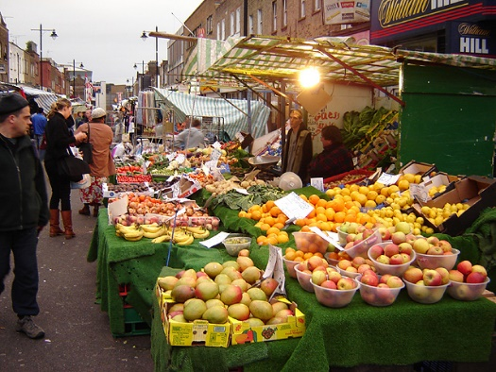
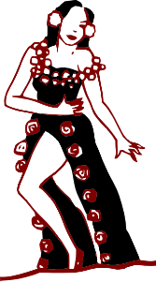
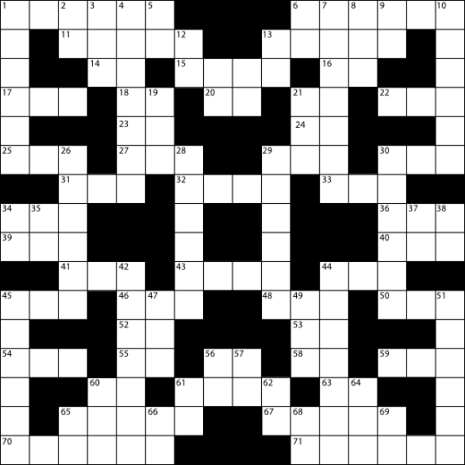
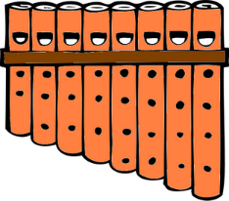
r
Markt
Morgen
Uhr
By Tarquin Binary - Own work, CC BY-SA 2.5
Kultur
Wort
dort
W O R T
Notes:
This set of three slides focuses on the sound of the post-vocalic ‘r’ in German.
Elicit the pronunciation of the individual SSC ‘r’ and then the source word again (with gesture, if using). Then elicit the pronunciation of the five cluster words.
Word frequency rankings (1 is the most common word in German): Uhr [349]; Markt [508] Morgen [311]; Kultur [593]; dort [104]; Wort [243]. Source: Jones, R.L. & Tschirner, E. (2006). A frequency dictionary of German: core vocabulary for learners. Routledge
By Tarquin Binary - Own work, CC BY-SA 2.5, https://commons.wikimedia.org/w/index.php?curid=406547

Slide 16
r
Markt
Morgen
Uhr
Kultur
Wort
dort
Notes:
Without pictures to focus on the SSC alone.

Slide 17
r
Markt
Morgen
Uhr
By Tarquin Binary - Own work, CC BY-SA 2.5
Kultur
Wort
dort
W O R T
Notes:
Without sound to elicit the pronunciation.

Slide 18
Welcher R?
Hören
 | ‘r’ as in ‘Regel’ | ‘r’ as in ‘Wort’
1
2
3
4
5
6
1
2
3
4
5
6
Notes:
Phonics contrast activity
Students are challenged to distinguish between the sounds of the ‘r’ at the beginning of a word or syllable and the post-vocalic ‘r’. Click on the number to play the audio. Words from the new and revisited vocabulary sets for this week are used.
1. dürfen
2. die Straße
3. ruhig
4. der Markt
5. springen
6. die Party

