Slide 1
Grammar Matters in MFL
Grammar matters in MFL
Making form-meaning connections an essential part of practice
Presenters: Emma Marsden, Nick Avery
Date updated: 28.06.21

Slide 2

Aims for the session
Part 1:
to understand research findings relating to L2 grammar teaching & learning
  whether to explicitly teach grammar
  deciding which grammar features to teach and in what order
  the most effective ways to teach and practise grammar
Part 2:
to evaluate a few examples of grammar activities in textbooks
to explore alternative types of task design and practice
Questions, discussion and next steps
Notes:
EM

Slide 3
The main approaches to addressing grammar
The main approaches to addressing grammar
Implicit, incidental
Incidental, inductive, can be explicit
Explicit, deductive, intentional
Focus on MEANING
Provide extensive input
Grammar features acquired naturally
No explicit instruction or feedback
Focus on FORM
Incidental
Exposure through communicative activities
‘Notice’ grammar features that cause difficulty
Focus on FORMS
Intentional
Pre-planned
Grammar taught in isolation
Mechanical drills
(adapted from Long & Robinson, 1998)
Notes:
EM
Whether or not to teach grammar has been under debate for several decades in foreign language education and, as a result, messages have not always been clear in policy documents, in textbooks, or across different schools.
In UK classrooms we have seen and still see all of the above approaches - a plea for content and language integrated learning, where there isn’t an upfront focus on grammar – grammar would be acquired incidentally at best, or by a focus on form, in the middle column.
A strong focus on
NCELP materials and approaches will be found in the centre to the right-hand side of this continuum.

Slide 4
Should we teach Grammar? Evidence ‘for’
Should We Teach Grammar? Evidence ‘for’
Yes, instruction can speed up the rate of learning
(e.g. White, Spada, Lightbown, & Ranta, 1991)
and…
Yes, instruction can influence the route of learning
(e.g. N. Ellis, 2006; McManus & Marsden, 2017, 2018; Murakami & Alexopoulou, 2016; Tolentino & Tokowicz, 2014)
Notes:
EM

Slide 5
Should we teach Grammar? Arguments ‘for’
Should We Teach Grammar? Arguments ‘for’
Learners need to notice (consciously register) a grammar feature for it to be learned (e.g. Ellis, 2001; Schmidt, 1990, 2001)
  Teaching activities can force learners’ attention on particular parts of the language in the input
Not teaching grammar means hoping that they will learn incidentally, inductively, and/or implicitly
But implicit learning takes a long time –
  we only have 450 hours available between ages 11-16!
Not teaching grammar makes learning vulnerable to individual pupils' capacities
Grammar is meaningful! (no false dichotomies please!)
Notes:
EM

Slide 6
Should we teach Grammar? Yes, BUT…
Should We Teach Grammar? Yes, BUT ….
Clear benefits of explicit teaching grammar
(e.g. Norris & Ortega, 2000, 2001; Spada & Tomita, 2010) but …
accuracy with which a feature is learnt can be influenced by its…
salience
complexity
communicative usefulness
frequency of the grammar features
differences with the first language
context in which it is used / tested (speaking, writing, spontaneous, prepared)
AND learner characteristics (“individual differences”)
(e.g. DeKeyser, 2005; Kasprowicz & Marsden, 2018; Lichtman, 2016; Marsden, 2006; Norris & Ortega, 2001; Schmidt, 1990; Spada & Tomita, 2010; White, Spada, Lightbown, & Ranta, 1991)
Notes:
EM
So, we have ascertained that it is useful to teach grammar and we have seen some of the evidence supporting this
BUT, if learning grammar depends on so many things, how do we make sense of all this?
What we really need to do is … decide which grammar features to teach and the order in which to teach them.

Slide 7
Key Question: Which grammar to teach, and in what order?
Key question: Which grammar to teach, and in what order?
  What makes certain grammar features difficult?
  What grammar can we expect learners to use, and when?
Which grammar features do your pupils (in years 7, 8 & 9) find difficult?
Why do you think those features cause difficulty?
  Do they find it harder in one particular mode (comprehension vs production) or modality of language use (oral vs written)?
Notes:
EM
The first key issue relates to the notion of progression: what should be taught when, what can we expect learners to learn, when – that is, can we determine the difficulty of grammar to put it in a sensible order for teaching?

Slide 8
Why are certain grammar features problematic?
Why Are Certain Grammar Features Problematic?
Reason 1) Low communicative salience (VanPatten, 2004)
Meaning expressed by another, more salient element of the sentence
More salient cue ‘overshadows’ less salient, cue (N. Ellis 2006)
Prior knowledge of more salient cues (e.g. temporal adverbs) can ‘block’ learning of other cues (e.g. verb inflections) (N. Ellis 2006)
Importance of building knowledge of verbs to facilitate learning of inflections
Reason 2) Low perceptual salience e.g., inflections (N. Ellis, 2006)
Hard to hear / easy to overlook
Often short and not stressed, non-syllabic, in spelling only
Fluent speakers perceive such elements very rapidly and unconsciously, until something sounds or looks wrong (‘she go’!)
Notes:
EM
N. Ellis (2006, p. 171) and p. 180
Learners often encouraged to rely on temporal adverbs (effective strategy to aid understanding and communication), knowledge of temporal adverbs from L1 and their meaning / function conveying temporality. But reliance on such cues can mean that the less salient cues e.g. verb inflections are overlooked and can be ‘blocked’ from being learned.
Marsden & David, 2008 – size of verb lexicon correlated positively with inflectional diversity (UK learners Year 9 vs. A-level)

Slide 9
Why are certain grammar features problematic?
Why Are Certain Grammar Features Problematic?
Reason 3) English ‘habits’ entrenched
Der Mann verfolgt den Hund.
Subject (almost) always comes first in English
Ignored!
Notes:
EM

Slide 10
Why are certain grammar features problematic?
Why Are Certain Grammar Features Problematic?
Some ‘cues’ are more reliable in some languages than others (MacWhinney, 2002)
Different meaning
The man chased the dog.
The dog chased the man.
Der Mann verfolgt den Hund.
Den Hund verfolgt der Mann.
Same
meaning
Learners try to apply the reliable ‘cues’ from their L1, when interpreting the L2
e.g. L1 English learners rely on word order and overlook case marking in L2 German
(even though case marking is more reliable for understanding meaning in German)
(e.g. Jackson, 2007; Kasprowicz & Marsden, 2017; MacWhinney, 2002)
Notes:
EM

Slide 11
Why are certain grammar features problematic?
Why Are Certain Grammar Features Problematic?
Understanding a new language through the ‘lens’ of our previous language experience (N. Ellis, 2006)
  Existing (L1) form-meaning associations compete for attention with new associations
  Similarities / differences between L1 and L2 → ‘Positive’ / ‘negative’ transfer
Notes:
EM

Slide 12
Why are certain grammar features problematic?
Why Are Certain Grammar Features Problematic?
Reason 4) Common sense! Our expectations about the world
The children
works in a bank.
The man
Children don’t work in banks!
Ignored!
Notes:
EM

Slide 13
What order should grammar be taught in?
What order should grammar be taught in?
There is little strong evidence to support one prescribed order for teaching grammar
Many factors affect what can effectively be taught and learnt and when
But we do know…
  Learners can only pay attention to a limited number of features at any one time
    The introduction of whole ‘paradigms’ at once has little support from research
  Introducing and practising pairs of grammar features with contrasting meanings (or functions) can lead to accurate understanding and production of the grammar features.
  Regular practice and re-visiting are necessary
  (DeKeyser, 2005; DeKeyser, 2015; Ellis, 2006; Mitchell, Myles, & Marsden, 2019; VanPatten, 2004)
Notes:
EM
Summarising What we know (or don’t know!) about the order grammar should be taught
Some extra information about the avoidance of whole paradigms. There is no need to dwell on this but we put it here for your information, in case teachers ask. This is a really important message and should not be diluted, as hedging is likely to reduce the clarity and impact of the message. The evidence and arguments for this are also explained in the ‘what makes grammar difficult’ document. The evidence is multi-layered, drawn from multiple sources and even multiple disciplines.
Explicit information (i.e., ’rules about language’) in and of itself, no matter when, how or what is taught, is not as effective as the practice itself. Whether explicit information is given as a whole paradigm or whether it is before or after practice, or given by teachers or worked out by learners is less important than the nature and the amount of practice. It is the practice that has been found to help: Making grammar essential for comprehension and production is where the most benefits lie (not in the explicit information) – so, in a way, this debate is not important, and, if dwelt upon, could seriously detract attention from the much, much more important messages. But for the sake of argument… here are some additional points:
Explicit information is prone to decay over time.
Explicit information alone does not result in evidence of learning in different contexts, modes and modalities (evidence from the old grammar translation approaches).
The usefulness of explicit information is very variable for different learners.
There is ample evidence in cognitive psychology and language learning research that presenting whole new sets (of anything) all at once cannot be expected to result in robust or reliable learning in the longer term.
The conceptual and formal complexity of (and, often, lack of familiarity with) morphology is an additional reason not to expect ‘whole paradigms’ per se to really show many learning benefits, compared to other more conceptually-oriented presentations, which focus on the meaning and function of grammar.
Languages are not learnt in whole sets as these are artificially put together by grammarians (that are based on the early teaching of Latin).
There is evidence from cognitive linguistics that it is awareness and understanding of concepts that are often not reliably, overtly expressed in the L1 (such as plurality of subjects; temporal such as ‘complete in the past’; or ‘doubt’; habituality) that can help learning. ‘Paradigms’ (within one of these ‘concepts’, such as ‘past complete’) do not serve the aim of teaching learners about the function of grammar.
In a time-poor classroom, giving (a lot of) explicit information is unlikely to be an efficient use of time
It risks confusing or overloading many learners during the initial presentation stages
It sets unrealistic expectations about what has really been learnt.
Grammar is learnt by frequent re-visiting and practising, and its success depends on a much wider range of factors than ‘whether the inflections happen to fit together in one paradigm’.
By sending the message that whole paradigm teaching is very unlikely to be effective (in terms of robust, reliable learning, in all modes and modalities, in the long term memory), we are helping teachers to set their expectations more realistically.

Slide 14
What grammar can we expect learners to use, and when?
What grammar can we expect learners to use, and when?
Learners need to understand the meaning (or function) of grammar before producing it
There is often a difference between the grammar learners understand (in reading or listening) and the grammar learners can produce accurately (in speech or writing)
The grammar learners can produce in writing is often different from the grammar they can use in spontaneous, meaningful speaking
Once knowledge has been practised, it can become “skill-specific”
  This means that it can be less useful for other skills: if it has been practised and proceduralised for one purpose, the knowledge is less transferable to other purposes
Therefore, learners need lots of practice in both modalities (oral and written) and both modes (comprehension and production)
(Bui & Skehan, 2018; DeKeyser, 2015; Mitchell, Myles, & Marsden, 2019; VanPatten, 2004)
Notes:
EM
Key issue 1: What we can expect from learners

Slide 15
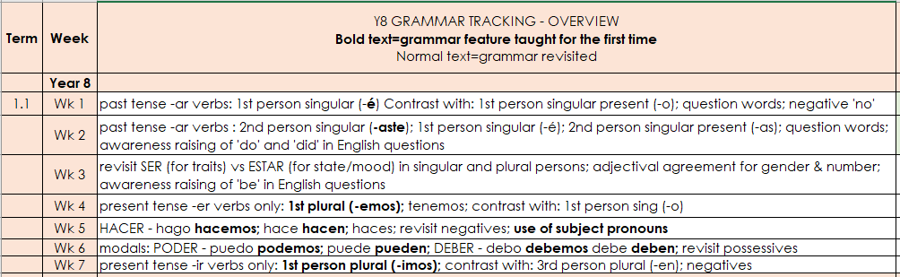
NCELP’s decisions regarding the order of grammar teaching
A new feature is often ‘paired up’ with a known one (e.g. –é vs –o in week 1)
That new feature is often introduced over two weeks
Weeks also need to be set aside for revisiting and consolidation
Notes:
NA: This is a screenshot of the first half term of the NCELP Year 8 Spanish scheme of work. Each row shows the grammar features to be taught or revisited in a week’s teaching. New grammar features are in bold and previously taught grammar features are in normal typeface.
As I said before, there is little strong evidence to suggest that this has to be the only order of teaching. But it was chosen with several key principles in mind:
The first was to introduce one new feature alongside one other one, which may have already been taught. For example, we introduce the 1st person singular preterite form of –ar verbs in 8.1.1.1 and juxtapose it with the present tense form of the same verb (-o) for practice. Question words and the negative ‘no’ are other relevant grammar features that lend themselves to lessons practising these verb endings.
The second is that sometimes we spread the teaching of a new grammar feature over two weeks. So, while 8.1.1.1 is the very first introduction of the –é ending, we also use 8.1.1.2 to continue practising it, this time against the ‘you’ form of the same verb (-aste). There is often a number of possible ‘pairings’, which means extensive practice of a feature but also variety in terms of the contexts used for its teaching.
Finally, you’ll see that there is one week with no new grammar. This has been set aside for consolidation of ‘ser’ and ‘estar’, which were taught in Year 7. This grammar feature is complex (English only has one verb for ‘to be’ while Spanish has two), so these consolidation weeks are critical to ensuring that the grammar is learnt.

Slide 16
Ensuring opportunities for consolidation declarative -> proceduralised -> automatized knowledge
A ‘tracking’ tab
Tracks how many times each grammar feature is actively revisited
2 main benefits
deciding whether the revisiting of a feature is sufficiently frequent
deciding whether that revisiting is sensibly spaced
Notes:
NA: We also need to know how many times and when each feature is going to be revisited after its initial introduction. Opportunities for revisiting in different modes (comprehension, production) and modalities (oral, written) are critical for long-term retention and in order to avoid knowledge becoming too ‘skill-specific’.
In the screenshot below you can see that we have tracked the weeks where each feature is going to be actively revisited. There are two main benefits here:
First, it can give us confidence that students have enough opportunities to be able secure the new knowledge and move gradually towards accuracy and fluency.
Secondly, it allows us to see the approximate time interval between each encounter with the feature. These encounters need to be sufficiently spaced, yet not too far apart either.

Slide 17

Aims for the session
Part 1:
to understand research findings relating to L2 grammar teaching & learning
  whether to teach grammar
  deciding what grammar to teach and in what order
  the most effective ways to teach and practise grammar
Part 2:
to evaluate existing examples of grammar activities
to explore alternative types of task design and practice
Questions, discussion and next steps
Notes:
EM

Slide 18
Key issue 2
Key issue 2
What are the best ways to teach grammar?
  how can this be most effective at different stages (introduction, embedding, consolidation and extension)?
Notes:
EM

Slide 19
Key recommendations
Key Recommendations
Provide explicit, succinct description of the feature to be taught before practice
Provide practice of the grammar in ‘input’ to make the feature mean something
Provide practice in meaningful production of the feature – the meaning of the grammar must really matter to the person reading or listening to the learner
Practice productive use in free writing and speech in a range of contexts
Use standard grammatical terminology
Build on knowledge about language developed at key stage 2
Notes:
EM

Slide 20
Explicit, succinct, up-front description of feature
Explicit, Succinct, Up-front Description of Feature
Example: French 1st person present vs. Past tense (Marsden, 2006)
Present Past
Explain the grammatical rule very briefly
Je fais J ’ ai fait
Je dis J ’ ai dit
Focus on one pair of meanings
The problem is that learners of French often write and say
je faire or je fait not j ’ ai.
Perhaps they find this difficult because
je and j ’ ai sound a bit similar!
Also, words like 'le weekend dernier' already tell us
it is in the past, so we don't notice j ’ ai.
Explain the problem(s) the learner might encounter
Notes:
EM
The explanation should be kept very brief – long explanations are forgotten and research studies have shown that it is the practice that counts – not the explanation of a rule!

Slide 21
Explicit, succinct description of grammar feature then lots of practice in meaningful and varied contexts
Explicit, succinct description of grammar feature then
….lots of practice in meaningful and varied contexts
Knowledge about a language feature
Knowledge about how and when to use a feature
Fast and accurate use of the feature
Declarative Knowledge
Proceduralised Knowledge
Automatised Knowledge
Extensive, repeated, meaningful practice
A key account of conscious learning, Skill Acquisition Theory (e.g., DeKeyser, 2015)
Notes:
EM
The initial succinct description of the grammar feature is the start of a process of skill development going from explicit/declarative knowledge (‘knowing about’ or ‘knowing that’) to procedural knowledge (‘knowing how’) to do something in practice, and eventually, with further practice, moving to quicker, more accurate ability to use the language.

Slide 22
Explicit, succinct, up-front, description of feature
Explicit, Succinct, Up-front, Description of Feature
Providing a BRIEF explanation up-front can help learners to…
…‘break down’ and organise the language they hear / read (Terrell, 1991)
… notice particular language features (Schmidt, 1990)
… pick up language features more quickly (e.g. Henry, et al., 2009)
Deductive (“here’s a pattern”) approaches
are generally more reliably effective than
Inductive (“work it out”) approaches
(Erlam, 2003; Robinson, 1996)
Notes:
EM
Erlam 2003
This article presents results from a recent study that isolated grammar instruction that is deductive (i.e., involving rule presentation and metalinguistic information) as a variable and contrasted it with an instructional treatment that is inductive (i.e., focusing on form with no explicit grammar instruction). The effectiveness of these two types of instruction was compared on measures of both comprehension and production. The study also investigated the interaction between type of instruction and the morphological and syntactical features involved in the acquisition of direct object pronouns in French as a second language. The results revealed a significant advantage for the deductive instruction group. The study highlighted the difficulty of designing language measures that access implicit language knowledge. It also underlined the strong relationship that exists between the observed effectiveness of a particular type of instruction and tests/measures used.
Robinson 1996
This study examines the generalizability of claims by Reber (1989, 1993) about the implicit learning of artificial grammars to the context of adult second language acquisition (SLA). In the field of SLA Krashen (1981, 1982, 1985, 1994) has made claims parallel to those of Reber regarding the differential effectiveness of conscious learning of rules and unconscious incidental acquisition of rules. Specifically addressed are Reber's and Krashen's claims that (a) implicit learning is more effective than explicit learning when the stimulus domain is complex, and (b) explicit learning of simple and complex stimulus domains is possible if the underlying rules are made salient. One hundred four adult learners of English as a second language were randomly assigned to implicit, incidental, rule-search, or instructed computerized training conditions. Speed and accuracy of judgments of novel tokens of easy and hard rule sentence types presented during training were used as dependent measures. Results do not support the first of Reber's and Krashen's claims but do support the second. Implicit learners do not outperform other learners on complex rules, but instructed learners outperform all others in learning simple rules. Analyses of the effect of sentence type and grammaticality on learning suggest a transfer-appropriate processing account of the relationship among consciousness, rule awareness, training, and transfer task performance.

Slide 23
Explicit, succinct, up-front description of feature
Explicit, Succinct, Up-front Description of Feature
Important benefits of providing brief explanation before practice
  Speeds up learning (e.g. Henry, et al., 2009; Henry, et al., 2017; VanPatten & Borst, 2012)
  Beneficial for more complex grammatical forms (e.g. Fernández, 2008)
  Reduces individual differences e.g. some learners’ can’t work it out
  Avoids learners working it out ‘wrongly’
Why risk it?
Why not try to level the playing field?
We acknowledge that an initial explanation may not be essential if the practice leads to ‘inductive learning’ but it is only recommended to drop the initial explanation if the practice pushes all learners to work out all the rules successfully (Benati, 2004; Farley, 2004; DeKeyser & Prieto-Botana, 2015; Marsden, 2006; VanPatten & Oikennon, 1996). This is unlikely!
No matter whether a rule comes from a teacher or learner who worked it out,
IT IS THE NATURE, AMOUNT, & FREQUENCY OF THE PRACTICE THAT REALLY COUNT!
Notes:
EM

Slide 24
Explicit, succinct description of the grammatical feature
Explicit, Succinct Description of the Grammatical Feature
Is information about the L1 and L1-L2 differences also useful?
Awareness of L1-L2 differences relates to L2 performance
(Ammar, Lightbown, & Spada, 2010)
Providing information about grammatical meanings that are mapped differently in L1 / L2 can be beneficial
(e.g. McManus & Marsden, 2017; McManus & Marsden, 2018; McManus & Marsden, 2019)
Notes:
EM

Slide 25
Explicit, succinct description of feature and L1-L2 differences
Explicit, Succinct Description of Feature and L1-L2 Differences
L1 & L2 information and practice → improvement in reading and listening
‘Remapping’ concepts and reinforcing correct L2 form-meaning mappings
(McManus & Marsden, 2017; 2018)
Two forms in French could map onto one form in English
One form in French could map onto two forms in English
Il jouait au foot…
Il a joué au foot…
(Trying ‘used to…’ could help to disambiguate)
He played football...
…quand j’ai appellé.
…quand nous étions petits.
He was playing football, when I called.
Il jouait au foot…
He played football, when we were little.
Notes:
EM

Slide 26
Saying who is affected by the verb
Object pronoun ‘te’
gramática
If the person affected by the verb is ‘you’, use the pronoun ‘te’.
I give you a watch.
Te regalo un reloj.
There are often two ways of translating this into English.
I give a watch to you.
I bring you the box.
Te traigo la caja.
I bring the box to you.
In Spanish, object pronouns go before a conjugated verb.
This is different from English, where they come after the verb.
Notes:
NA
Timing: 2 minutes.
Aim: to introduce the indirect direct object pronoun ‘te’
Procedure:
Go through the grammar explanation with students, revealing each new sentence on a mouse click.

Slide 27
Key recommendations
Key Recommendations
✓
Provide an explicit but succinct description of the grammatical feature to be taught
Provide practice of the grammar point in ‘input language’ (comprehension)
Provide practice in productive use of the features being taught
Practice productive use in free writing and speech in a range of contexts
Utilise standard grammatical terminology
Build on knowledge developed at key stage 2
Notes:
NA

Slide 28
Practice of the grammar point in ‘input language’
Practice of the Grammar Point In ’Input Language’
Common elements in ‘typical’ grammar activities:
  Introduce whole paradigm /
  multiple grammatical features
  Written / aural texts providing lots of examples
  Focus on content words; possible for learners to complete activities without paying attention to the key grammatical feature(s)
  Scaffolded production practice; possible for learners to copy patterns without paying attention to the function/meaning of the grammatical feature(s)
Something missing?
Reading / Listening practice requiring attention to the grammatical feature
Notes:
NA

Slide 29
Practice of the grammar point in ‘input language’
Practice of the Grammar Point In ’Input Language’
Why is it important to make learners pay attention to grammar in ‘input language’?
→ Some features are hard to notice
→ Some features can be ignored by learners
A lack of accuracy and inability to manipulate language to make new meaning:
partly caused by
comprehension of set, rote-learned phrases without breaking them down and
learners’ attention not being forced onto grammar in the input
Le weekend dernier nous manger
(pupil adapted from a chunk:
“Le weekend dernier j’ai joué au foot”)
Le garçon m’appelle
(pupil adapted from a chunk:
“Je m’appelle…”)
Notes:
NA
Examples of lack of accuracy are shown here, BEFORE clicking to see why this might be

Slide 30
Input: ‘chunks’ versus orienting attention to meaning of components
Input: ‘Chunks’ versus orienting attention to meaning of components
Rote-learned chunks might be helpful…
”It doesn’t matter if chunks lead to errors when learners try to manipulate chunks”, because the errors are ‘developmental’
But the errors only reduce if learners can break chunks down successfully and efficiently
Do we have time to let some pupils work it out and others not?
Many learners cannot work out the ‘system’ from ready-made phrases for quite some time (Myles, Hooper & Mitchell, 1998; Myles, Mitchell & Hooper, 1999)
“Lexico-grammatical multi-word phrases” that we know are frequent and useful are likely the result of learning patterns
  rather than being a main driver for learning, they become ‘chunk-like’ because they are useful phrases!
  We have ‘ah-haaa!’ moments when we realise that a phrase we have used a lot is made up of component parts that we now know!
Notes:
NA

Slide 31
Practice of the grammar point in ‘input language’
Practice of the Grammar Point In ’Input Language’
Why are certain bits of grammar problematic?
Low frequency?
Poor knowledge of rules?
BUT these can’t fully explain some errors…really common grammar and we’ve taught the ‘rules’ over and over!
So, why don’t learners seem to pick up some grammar rules?
→ ‘Noticing and extracting’ some features of the input seems to be difficult
Je fais du ski.
J’ai fait du ski.
Notes:
NA

Slide 32
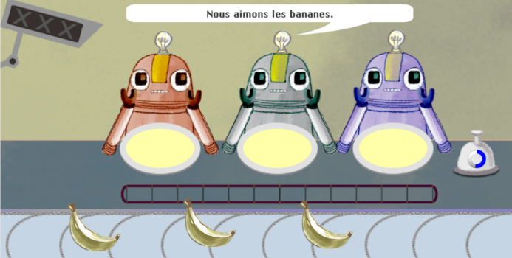
Gaming grammar
Feed ONE robot or ALL of the robots?
Gaming Grammar
https://www.gaminggrammar.com/
Evidence that learners ignore the grammar in the input!
Practising present
tense 1st person singular/plural verb endings
High accuracy when pronoun (nous, je) is present
Drop in accuracy when pronoun is removed
Then ... increase in accuracy when their attention is made to focus on verb ending
Notes:
NA
Evidence showing that learners ignore bits of grammar!

Slide 33
Practice of the grammar point in ‘input language’
Practice of the Grammar Point In ’Input Language’
Reading & Listening
What can we do?
Focused practice in ‘input language’ to…
…draw learners’ attention to problematic grammatical features
…and make those grammatical features matter
…by temporarily removing the cues that learners rely on.
Notes:
NA

Slide 34
Practice of the grammar point in ‘input language’
Practice of the Grammar Point In ’Input Language’
Form-meaning mapping
50+ experimental studies (in classrooms and ‘laboratories’) since early 1990s, e.g.
French verb inflections with 11 to 14 year olds (Marsden, 2006)
German case marking with 9 to 11 year olds (Kasprowicz & Marsden, 2017)
Evidence suggests benefits for:
Improving analysis of language
‘Training the ear’ to notice small phonemic differences (e.g. je / j’ai)
Improving comprehension and production
A range of ages, proficiencies, languages, grammar features
Notes:
NA

Slide 35
Practice of the grammar point in ‘input language’
Practice of the Grammar Point In ’Input Language’
Example: English present tense subject-verb agreement
(3rd person singular vs plural)
Separated subject noun phrase and verb
and
removed real world expectations
→ Use verb inflection and connect to meaning to identify the subject of the sentence
The following sentences have become jumbled.
Underline who you think does the activities:
1. The cat / parents walks the dog
2. The child / men work in a bank
3. The baby / parents cry all night
4. The child / adults listen to the news
Notes:
NA

Slide 36
Practice of the grammar point in ‘input language’
Practice of the Grammar Point In ’Input Language’
Example: French 1st person present versus past tense with avoir (je vs. j’ai)
Listen to these people talking about what they normally do at the weekend and what they did last weekend. You will hear each sentence twice.
Removed temporal adverb
and
kept main verb constant
(no phonemic difference between present tense and past participle, e.g. fais vs. fait)
→ Use presence/absence of auxiliary and connect to meaning to identify the tense
You will hear the whole sentence but the only clue is whether you hear “je” (something happens regularly) or “j’ai” (past).
1. Normalement Le weekend dernier
2. Normalement Le weekend dernier
3. Normalement Le weekend dernier
4. Normalement Le weekend dernier
5. Normalement Le weekend dernier
(Marsden, 2006)
Notes:
NA
e.g.
Je fais du sport.
J’ai dit la verité.
Je conduis quelque part.

Slide 37
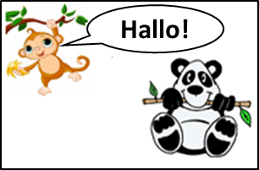
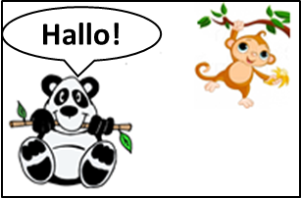


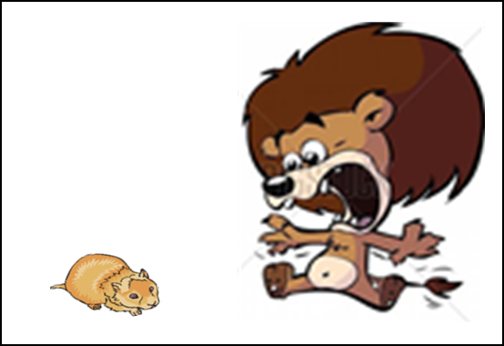
Practice of the grammar point in ‘input language’
Practice of the Grammar Point In ’Input Language’
Example: German definite article case marking for masculine nouns (der vs. den)
1. Der Affe begrüβt den Panda.
Removed word order cue
and
removed real world expectations
→ Use case marking and connect to meaning to identify subject and object
A
B
2. Den Löwen erschreckt der Hamster.
A
B
(Kasprowicz & Marsden, 2017)
Notes:
NA
The monkey greets the panda.
The hamster scares the lion.
In item 1, the word aligns with the usual English SVO word order. But in item 2, they are having to process the input in a way that does not align with (usual) L1 word order, as the object comes first.

Slide 38
Practice of the grammar point in ‘input language’
Practice of the Grammar Point In ’Input Language’
Avoid working with whole paradigms at one time, particularly in the first stages of language learning
Attention is a limited resource; learners can only pay attention to so much at any one time (Lee & VanPatten, 1995; VanPatten, 2002; Wong, 2004)
Focus on accurate and reliable knowledge of one form juxtaposed with another (e.g. je joue vs. nous jouons)
Provide plenty of practice for each pair of grammatical forms/meaning
Gradually build up wider system
Notes:
NA

Slide 39
The key recommendations
The Key Recommendations
✓
Provide an explicit but succinct description of the grammatical feature to be taught
Provide practice of the grammar point in ‘input language’ (comprehension)
Provide practice in productive use of the features being taught
Practice productive use in free writing and speech in a range of contexts
Utilise standard grammatical terminology
Build on knowledge developed at key stage 2
✓
Notes:
EM

Slide 40
Utilise standard grammartical terminology and build on knowledge developed at key stage 2
Utilise Standard Grammatical Terminology
Utilise Standard Grammatical Terminology
Build on Knowledge Developed at key Stage 2
KS2 English curriculum:
“Grammar should be taught explicitly: pupils should be taught the terminology and concepts set out in English Appendix 2, and be able to apply them correctly to examples of real language, such as their own writing or books that they have read.”
Notes:
EM

Slide 41
Utilise standard grammatical terminology and build on knowledge developed at key stage 2
Utilise Standard Grammatical Terminology
Build on Knowledge Developed at key Stage 2
KS2 languages curriculum:
“understand basic grammar relevant to the language being studied, including (where relevant): feminine, masculine and neuter forms and the conjugation of high-frequency verbs; key features and patterns of the language; how to apply these, for instance to build sentences; and how these differ from or are similar to English”
Notes:
EM

Slide 42
Utilise standard grammatical terminology and build on knowledge developed at key stage 2
Utilise Standard Grammatical Terminology
Build on Knowledge Developed at key Stage 2
Issues around transition, but:
Extensive learning about L1 English grammar (SPaG test in Year 6 SATs) at KS1 and KS2
(At least some) foreign language grammar teaching is happening at KS2
And…
Sense of progression key to motivation and engagement
(Graham et al, 2016)
Younger learners can benefit from instruction in grammar
(Kasprowicz & Marsden, 2017; Lichtman, 2016; Marsden & Chen, 2011)
Drawing comparisons between English and another language is useful
(McManus & Marsden, 2017)
Younger learners are able to engage in ‘analysis of language’, if taught how to (Bouffard & Sarkar, 2008)
Notes:
EM

Slide 43
Summary
Summary
Lots of evidence that teaching grammar is helpful
Many factors can make grammar difficult:
  hard to perceive,
  differences with L1,
  when meaning duplicated elsewhere in the sentence
Useful to keep these in mind when planning what to teach, when, & how
Activities that address, head-on, these causes of difficulty can help
Make sure there are opportunities for practice where the learner has to pay attention to the grammar and its meaning
Notes:
EM

Slide 44
What are the best ways to teach grammar?
What are the best ways to teach grammar?
Key recommendations:
Provide a short description of the grammar before practice in the input
Focus on pairs or very small sets of meaningful features; avoid introducing whole paradigms at once, especially in the early stages.
Regularly strip out all other cues so that the learner has to pay attention to the grammar and its meaning in reading and listening
Establish grammatical knowledge in reading and listening before expecting learners to produce the grammar in writing and speaking
Gradually move from scaffolded to freer production practice
Use writing and speaking activities that make the grammar matter to communicate meaning
Regularly re-visit the feature, in different contexts, with different vocabulary
Notes:
EM
NB: These are NCELP’s key ‘take-home’ messages and recommendations for grammar learning
Give teachers a chance to read through these key principles and recommendations.
*explanation first – most reliable for most learners most of the time
*Pre-emptive – anticipating the features learners will have difficulty with

Slide 45
Aims for the session
Part 1:
to understand research findings relating to L2 grammar teaching & learning
  whether to teach grammar
  deciding what grammar to teach and in what order
  the most effective ways to teach and practise grammar
Part 2:
to evaluate existing examples of grammar activities
to explore alternative types of task design and practice
Questions, discussion and next steps
Notes:
EM

Slide 46

BREAK

Slide 47
Grammar Matters in MFL [2]
Grammar matters in MFL [2]
Making form-meaning connections an essential part of practice
Presenters: Emma Marsden, Nick Avery
Date updated: 21.06.21

Slide 48
Aims for the session
Part 1:
to understand research findings relating to L2 grammar teaching & learning
  whether to teach grammar
  deciding what grammar to teach and in what order
  the most effective ways to teach and practise grammar
Part 2:
to evaluate existing examples of grammar activities
to explore alternative types of task design and practice
Questions, discussion and next steps
Notes:
EM

Slide 49
Evaluating existing examples of grammar activities
Evaluate existing examples of grammar activities
First, reflect on some concerns about how grammar is often presented and practised.
Keep a look out for potential problems, such as :
whole paradigms at once
no or little active (=forced) practice to link grammar to meaning in input
jumping straight from explanation or mere ‘exposure’ to production
production practice that is mechanical, e.g.,
  doesn’t force learners to actively choose which grammar is needed;
  practice with just a small, fixed set of vocabulary.
Notes:
EM
The handouts are the excerpts that were used at the Residential. These textbook example activities illustrate 5 key concerns:
INPUT BASED ACTIVITIES THAT DON’T ACTUALLY ORIENT/FORCE LEARNERS’ ATTENTION ON THE GRAMMAR, AS THEY ALLOW THEM TO ANSWER WITHOUT REALLY HAVING TO ATTEND TO THE FEATURE
WHOLE PARADIGMS BEING PRESENTED ALL AT ONCE with no clear follow up to practise them all in meaningful ways
SWIFT MOVES FROM GRAMMAR EXPLANATION TO PRODUCTION PRACTICE;
PRODUCTION PRACTICE THAT IS ‘MECHANICAL’ – THE ACTIVITIES DON’T FORCE THE LEARNER TO ACTIVELY CHOOSE BETWEEN DIFFERENT GRAMMATICAL FEATURES (E.G. THEY MIGHT SAY ‘DESCRIBE WHAT YOU DID LAST WEEKEND’ OR ‘DESCRIBE YOUR FRIEND’S APPEARNACE’ OR ‘YOUR IDEAL X’ – BUT THEY DON’T ENSURE DIFFERENT FEATURES NEED TO BE ACTIVELY CHOSEN (INSTEAD, LEARNERS CAN COPY FROM A FRAME, OR MECHANICALLY REPEAT A PATTERN THEY HAVE JUST BEEN TOLD ABOUT, WITHOUT CONNECTING TO A MEANING (OR FUNCTION) EACH TIME THEY USE IT).
PRACTICE IS JUST WITH A SMALL SET OF VOCABULARY WITHIN ONE TOPIC E.G. ‘PAS’ JUST PRACTISED WITH ‘AIMER’, OR PAST TENSE (EVEN PERHAPS IN ONE OR TWO ‘PERSONS’) WITH JUST 3 OR 4 VERBS ABOUT HOLIDAY ACTIVITIES AND THEN NOT REVISITED LATER WITH A WIDER RANGE OF VERBS
It might be helpful to explain that when we talk about textbooks, we note that:
They are space-limited and they should not represent all the teaching that needs to take place. Using them requires judicious selection, omission, independent planning. Teachers should not feel that they need to slavishly follow the book's own SOW, cramming the pages in without really thinking about what is realistic for learners to learn. Planning should always 'step away from the textbook', whichever textbook it is, both longer term planning but also day-to-day reflection about the sort of opportunities for practice that learners need (this applies to all of our strands: phonics, vocabulary, grammar and MP).

Slide 50
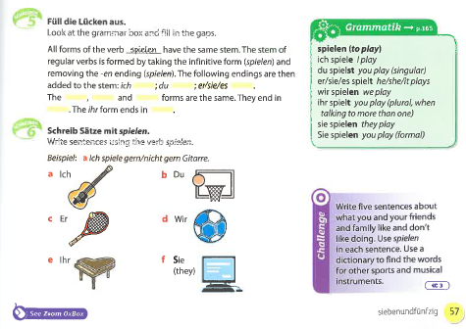
German example
Example from a KS3 German textbook
  Which grammar feature(s) are the activities practising?
  What are the activities asking the students to do?
  What are the activities asking the students to pay attention to?
Schicker, C., Waltl, M., & Malz, C. (2011). Zoom Deutsch 1. Oxford: Oxford University Press
Notes:
EM

Slide 51
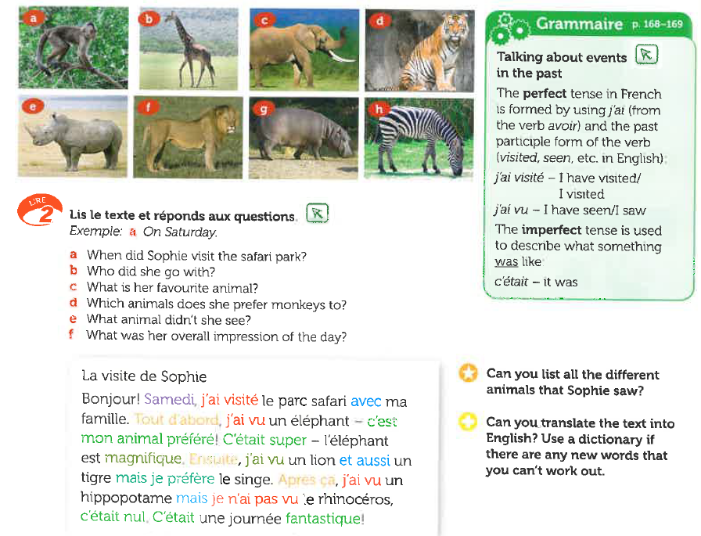
French example
Example from a KS3 French textbook
  Which grammar feature(s) are the activities practising?
  What are the activities asking the students to do?
  What are the activities asking the students to pay attention to?
Dzuilka-Heywood, C., Kennedy, Y., & Smith, K. (2014). Allez 1. Oxford: Oxford University Press
Notes:
EM

Slide 52
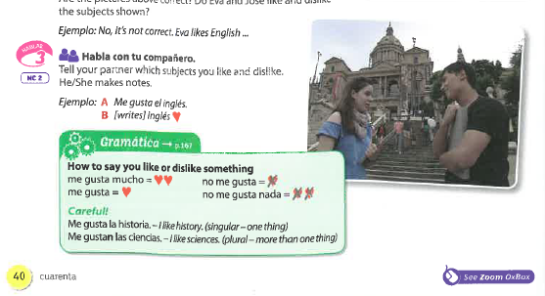
Spanish example
Example from a KS3 Spanish textbook
  Which grammar feature(s) are the activities practising?
  What are the activities asking the students to do?
  What are the activities asking the students to pay attention to?
De Sudea, I.A., Isern Vivancos, M.I., Hardwick, A. (2011). Zoom español 1. Oxford: Oxford University Press
Notes:
NA

Slide 53
Aims for the session
Part 1:
to understand research findings relating to L2 grammar teaching & learning
  whether to teach grammar
  deciding what grammar to teach and in what order
  the most effective ways to teach and practise grammar
Part 2:
to evaluate existing examples of grammar activities
to explore alternative types of task design and practice
Questions, discussion and next steps
Notes:
NA

Slide 54



Doing something to myself:
Reflexive ‘me’
gramática
Sometimes, the ‘doer’ (subject) and ‘receiver’ (object) of an action are the same person.
For example, ‘I wash myself’ or ‘you introduce yourself’.
Words like ‘myself’ or ‘yourself’ are called reflexive pronouns.
To mean ‘myself’ in Spanish, use ‘me’ before a verb.
Compare:
Me lavo. =
Lavo a mi perro. =
I wash my dog.
I wash myself.
Notes:
NA
For the first example, we have chosen a grammar feature that is normally taught in the context of daily routine, with a fixed set of vocabulary - using verbs that we tell the students are “reflexive verbs”. But of course lots of verbs can be used reflexively or not!
Timing: 2 minutes.
Aim: to introduce the reflexive pronoun ‘me’.
Procedure:
Teacher goes through the grammar explanation with students, revealing each new sentence on a mouse click.
Note:
In Spanish, it is very common to use the indirect object pronoun even when the indirect object is present. For example, it's perfectly grammatical to say 'Pongo un vestido a mi prima', but it's more frequent to say 'Le pongo un vestido a mi prima'. This happens with verbs that have both a direct object and an indirect object: decir, regalar, poner...
This is from the RAE (in pronombres personales átonos): a) En el caso del complemento indirecto, la coaparición del pronombre átono es normalmente opcional y suele ser lo más frecuente, especialmente en la lengua oral: No (les) da importancia a los problemas; (Les) he contado nuestro secreto a unos amigos; (Le) han denegado la beca a Juan; (Le) he dicho la verdad a mi madre.
This will be formally taught once indirect object pronouns have been introduced and practised in Y8 Term 2.2.

Slide 55

Vocabulario
Es el director.
Lee las frases. Escribe 1-6 y la letra a-f.
¿Qué significa en inglés?
leer
¡Hola!
Verbos |  | Letra |  | Letra
presentar to introduce | 1. Me presento. |  | 2. Presento a [...]
levantar to get up | 3. Me levanto. |  | 4. Levanto a [...]
despertar to wake up | 5. Me despierto. |  | 6. Despierto a [...]
a
b
f
a
I introduce myself.
I introduce [someone].
c
d
c
d
I get up.
I get [someone] up.
Soy Pepe.
b
e
I wake up.
I wake [someone] up.
e
f
Notes:
NA
Vocabulary practice slide
Timing: 3 minutes
Aim: to introduce and practise three of the new verbs for this week, modelling their reflexive and non-reflexive forms and meanings.
Procedure
1. Teacher presents the task, and the additional information about the stem change in despertar.
2. Students read the verbs with a reflexive pronoun and those with a personal ‘a’ and match them with the most appropriate picture. They write 1-6 and match a-f.
3. Teacher clicks to reveal the correct letter, and then elicits the English meaning from students, clicking to provide written confirmation.
Word frequency (1 is the most frequent word in Spanish):
New vocabulary (introduce in lesson 1): me [22] despertar [894] levantar [354] presentar² [235]
Source: Davies, M. & Davies, K. (2018). A frequency dictionary of Spanish: Core vocabulary for learners (2nd ed.). Routledge: London

Slide 56


Escucha las frases
Escucha las frases. No están completas.
¿Cuál es la imagen correcta para cada frase? Escribe 1-8 y A o B.
escuchar
 | Imagen A | Imagen B
1
2
3
4
5
6
7
8
Notes:
NA
Timing: 5 minutes.
Aim: to listen out for verbs with and without reflexive pronoun; to consolidate understanding of the meaning conveyed by these verbs in their reflexive and their non-reflexive form.
Procedure:
1. Students copy the basic table on this slide into their books before starting the activity.
2. Students listen to each recording (1 recording per slide on slides 9-16) and decide whether the picture refers to the image A or B.
3. Teacher reveals answers.
Transcript:
presento...
me despierto...
lavo...
me levanto...
me miro...
saco fotos...
escondo...
me preparo...

Slide 57
Escuchar
escuchar
1
1a.
1b.
Él es Juan.
Hola, soy Pedro.
¡Hola, Juan!
Notes:
NA
Audio: presento...

Slide 58
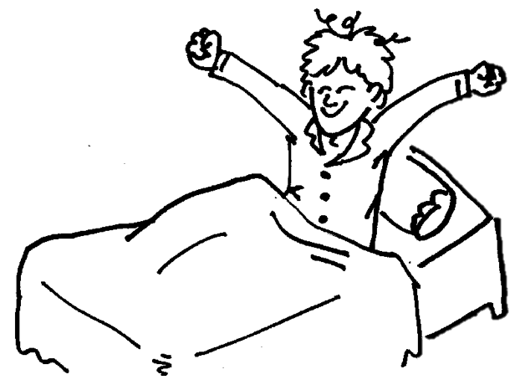
Escuchar
escuchar
2
2a.
2b.
Notes:
NA
Audio: me despierto...

Slide 59
Escuchar
escuchar
3
3a.
3b.
Notes:
NA
Audio: lavo...

Slide 60

Escuchar
escuchar
4
4a.
4b.
Notes:
NA
Audio: me levanto...

Slide 61
Escuchar
escuchar
5
5a.
5b.
Notes:
NA
Audio: me miro...

Slide 62


Escuchar
escuchar
6
6a.
6b.
Notes:
NA
Audio: saco fotos.

Slide 63
Escuchar
escuchar
7
7a.
7b.
Notes:
NA
Audio: escondo...

Slide 64
Escuchar
escuchar
8
8a.
8b.
Notes:
NA
Audio: me preparo...

Slide 65

Repuestas
Respuestas
escuchar
 | Imagen A | Imagen B
1
2
3
4
5
6
7
8
Notes:
NA
RESPUESTAS

Slide 66
El diario de Daniel
Daniel escribió sobre las actividades de cada día en su diario, pero el gato caminó encima y ahora no puedes leer las frases completas.
leer
Read the sentences and tick true or false. Some language might be missing.
 | V | F
I always get up early.
I hide my partner during the class.
It’s good to make friends, so I introduce myself.
On Mondays I wake someone up.
I never wash my dog too much.
In the square I introduce myself.
Before breakfast I look at myself in the mirror.
I hide myself under the table.
1. Siempre me levanto temprano.
2. Me escondo durante la clase.
3. Es bueno hacer amigos, así que me presento.
4. Los lunes despierto a
5. Nunca me lavo demasiado.
6. En la plaza presento a
7. Antes de desayunar me miro en el espejo.
8. Escondo a debajo de la mesa.
Notes:
NA
Timing: 7 minutes.
Aim: to compare the use of verbs with a reflexive pronoun or with a personal ‘a’; to put newly introduced verbs into practice along with previously taught verbs which can also work reflexively and non-reflexively.
Procedure:
1. Students read the sentences in Spanish and try to figure out if there could be some language missing or not.
2. Students read the phrases in English and decide whether they are true or false depending on what the phrases in Spanish say.
3. Teacher shows the answers.
4. Students can be asked for suggestions for what might be behind the obscured bits of the sentences where the action is being done to someone else. This can be left to students’ imagination, but it’s a good chance for the teacher to check their understanding of personal ‘a’ (i.e. whether they are using it when referring to animate objects).
Revisiting:
Y8 1.2.4
así que [que-3]

Slide 67


Cuidamos al abuelo
hablar
Cuidamos al abuelo
Lucía y Daniel cuidan al abuelo.
What do they do to help him? And what do they do by themselves?
Estudiante A: eres Lucía. Debes decir frases con la información de las tarjetas.
Estudiante B: eres Daniel. Escucha y marca en la tabla.
Ejemplo:
Me despierto
Daniel escucha y marca:
 | to herself | to Grandpa
wake up
(myself)
Lucía habla:
wake up
Notes:
NA
OPTIONAL – ALTERNATIVE ACTIVITY
Timing: 8 minutes.
Aim: to consolidate understanding of the use of verbs in their reflexive and non-reflexive form.
Procedure:
1. Student A says a phrase using the information on the card.
2. Student B ticks the correct option: is it to herself or to someone else?
3. Students swap roles.

Slide 68

Estudiante A
Estudiante A
Lucía
hablar
 | to himself | to Grandpa
get up
prepare
take photos
look
wash
wake up
(myself)
(myself)
get up
prepare
take photos
(myself)
look
wash
wake up
Notes:
NA
Student A HANDOUT
DO NOT DISPLAY
Note that Student A listens to sentences about Daniel, why is why the column header is ‘to himself’.

Slide 69
Estudiante B
Estudiante B
Daniel
hablar
 | to herself | to Grandpa
get up
prepare
take photos
look
wash
wake up
(myself)
(myself)
get up
prepare
take photos
(myself)
(myself)
look
wash
wake up
Notes:
NA
Student B HANOUT
DO NOT DISPLAY
Note that Student A listens to sentences about Lucía, why is why the column header is ‘to herself’.

Slide 70
Estudiante A - Solución
Estudiante A - Solución
Lucía
hablar
 | to himself | to Grandpa
get up
prepare
take photos
look
wash
wake up
(myself)
(myself)
get up
prepare
take photos
(myself)
look
wash
wake up
Notes:
NA
Student A SOLUCIÓN

Slide 71
Estudiante B - Solución
Estudiante B - Solución
Daniel
hablar
 | to herself | to Grandpa
get up
prepare
take photos
look
wash
wake up
(myself)
(myself)
get up
prepare
take photos
(myself)
(myself)
look
wash
wake up
Notes:
NA
Student B SOLUCIÓN

Slide 72
Extension phase
Oral production (narration) using reflexive ‘me’
Scope for creativity in the order of the sentences used
Also compels active listening (to determine order of events)
Example taken from Year 9, Term 1
Notes:
NA

Slide 73



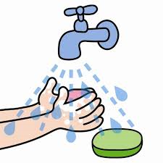

hablar / escuchar
Las actividades de Lucía por las mañanas no están en orden*.
Persona A: decide el orden de las actividades, luego habla con un/a compañero/a.
Persona B: escucha y escribe las letras en el orden correcto, según tu companera/a.
a
b
c
d
[I take photos of myself in the garden]
[I look at myself in the mirror behind the door]
[I put on a shirt]
[I get up at 7:30]
e
f
g
h
[I prepare myself a coffee]
[I ask myself what time it is]
[I wake up late]
[I wash]
*order
Notes:
NA
Narration activity [1/2]
Timing: 10 minutes
Aims:
to practise the use of reflexive ‘me’ with verbs in 1st person singular (present tense) in oral production.
to use the language in a slightly freer, more creative way.
Procedure:
Student A writes down the letters a-h in any preferred order without showing these to his/her partner. The order could be quite imaginative and doesn’t necessarily need to be based on what seems most likely.
Student A then reads out the eight activities in Spanish in this same order.
Student B listens and writes the number of the card that matches what the partner says for each of the eight utterances (e.g., 1=f, 2=e, etc.)
The two students then compare answers to check that student B correctly understood the sequence of events.
Students swap roles. Student B does the same, but this time describes Daniel’s mornings. In this set of cards, six of the eight prompts have been slightly altered to vary the language used.
Notes:
This is typically what a short narration would involve, so there is a move here towards more ‘real-life’ language use in the production activity.
Should teachers wish to further increase the level of difficulty for a higher-ability group, the listener could be required to listen and take notes, rather than look at the board.

Slide 74


hablar / escuchar
Las actividades de Daniel por las mañanas.
a
b
c
d
[I take photos of myself in the kitchen]
[I look at myself in the mirror above the chair]
[I put on some trousers]
[I get up at 6]
e
f
g
h
[I prepare my lunch]
[I ask myself what time it is]
[I wake up early]
[I wash my hands]
Notes:
NA
[2/2]

Slide 75
hablar / escuchar
Un orden posible
a
b
c
d
[I look at myself in the mirror above the chair]
[I put on some trousers]
[I wake up early]
[I get up at 6]
e
f
g
h
[I take photos of myself in the kitchen]
[I prepare my lunch]
[I ask myself what time it is]
[I wash my hands]
Notes:
NA
Whole class oral production slide (DO NOT DISPLAY DURING PREVIOUS PART OF THE ACTIVITY)
Note: there is no ‘correct’ order of activities as students can make their own decisions based on their experience. However, this slide, with one possible order, may be used to repeat oral production to develop fluency, and allow the teacher to give feedback.
Timing: 3 minutes
Aims: to provide a second opportunity for students to practise oral production of key language and structures, which (evidence suggests) develops fluency.
Procedure:
Teacher elicits choral responses from all students for each of the sentences, giving feedback and additional repetition practice, as needed.

Slide 76


Example resources for French
Explanation
Reading
Listening
Writing (controlled)
Speaking (controlled)
Rowena Kasprowicz & Emma Marsden
Notes:
NA
How to teach and learn grammar
Go through and discuss example sequence of resources in each language (different grammar features across the three languages).
Please note: There will always be a ‘vocabulary challenge’ with the move from input (R/L) activities to production (W/S) activities, in terms of the vocabulary (nouns, prepositions, adjectives etc) that will be needed for production activities.
The aim is to let learners try to recall the necessary vocabulary (i.e., not always provide whole speaking or writing frames for everything).
But, where necessary, more scaffolding is possible (we have provided lists of vocabulary for teachers to use with selected pupils, perhaps)
Try to focus on rewarding the grammar point under focus, and not worry too much about everything else being accurate . If we want everything to be accurate all the time, this is what leads to very rigid formulae teaching, and the over-use of strict writing frames that don’t provide any desirable difficulty for the learners.
In other words:
The key is that learners are getting the grammatical markers correct and pulling out the verbs from memory. Support with the other vocabulary is ok (particularly in the earlier controlled production activities) and some errors in this other vocabulary can be tolerated (e.g., adjectival agreement if that hasn’t been taught yet).
Try to aim for ‘desirable difficulty’ and resist the temptation to use lots of frames and holistic phrases.
We will now look at an example sequence of resources for French. We have an example to show you about syntax (question formation, using SV inversion).

Slide 77
Statements vs Questions
Statements vs. Questions
‘You’. 2nd person singular
Notes:
NA

Slide 78
Asking questions – revision
grammaire
Asking questions - revision
Remember - we can use voice intonation to ask a question:
Statement
Tu comprends.
You understand.
Question
Tu comprends ?
Do you understand?
Remember!
In French, we leave a space before the question mark. This is different from English!
Remember!
The pitch of your voice rises at the end of a question. This is called intonation.
Notes:
NA
Timing: 1 minute
Aim: Revision of the intonation method of question formation.

Slide 79
Asking questions – subject-verb inversion
grammaire
Subject-verb inversion
To ask a question, we can also swap the subject and the verb around:
Statement
Tu comprends.
You understand.
Question
Comprends-tu ?
Do you understand?
Swapping round the subject and verb is called inversion. We add a hyphen between them.
Notes:
NA
Timing: 2 minutes
Aim: Introduce subject-verb inversion method of question formation.
Procedure:
The subject-verb inversion method of question formation is now presented. It will be practised in the activities that follow.
After presenting the statement prompt students to identify the ‘subject’ and the ‘verb’ in both the French and English statements. Then present the question with inversion.

Slide 80
Asking questions – subject-verb inversion
grammaire
Subject-verb inversion
We use inversion to form ‘do/does’ questions and ‘am/are/is’ questions.
Tu comprends.
You understand / are understanding.
Comprends-tu ?
Do you understand?
There are no question words for ‘do’ and ‘are’ in French!
Inversion tells us these are questions.
Tu apprends le français.
You learn / are learning French.
Apprends-tu le français ?
Are you learning French?
Notes:
NA
Timing: 2 minutes
Aim: This slide reinforces that in French, subject-verb inversion applies to the main verb in the present tense, regardless of the English tense (simple or continuous). Explain to students that the most appropriate translation into English will depend on the context.

Slide 81

Les parents et la professeure
lire
Les parents et la professeure
Les parents de Léa parlent à la professeure.
C’est une description (D) de Léa, ou une question (Q) pour la professeure ?
 |  | D / Q
1) | Elle dit les réponses
2) | Elle apprend l’anglais
3) | Est elle calme en classe
4) | Prend elle une règle au collège
5) | Elle a des problèmes en maths
6) | Fait elle des erreurs
7) | Comprend elle les solutions
8) | Elle trouve la géographie facile
Léa’s parents took notes quickly and missed out the punctuation!
Pay attention to the word order.
D
D
Q
Q
D
Q
Q
D
Notes:
NA
Timing: 5 minutes
Aim: Written recognition of questions and statements from word order.
Procedure:
1. In this reading activity, the punctuation is removed to focus students’ attention on the word order – prompt them to do this when setting up the task.
2. Students write 1-8 and the letter ‘Q’ or ‘D’. If time permits, they could translate the questions into English, reflecting on which ones sound better with ‘is’ or ‘does’ in English.
3. The task incorporates further revision of this week’s new vocabulary, as well as vocabulary taught in previous weeks.
Frequency rankings of cognates used (1 is the most frequent word in French):
description [2779]
Source: Londsale, D., & Le Bras, Y. (2009). A Frequency Dictionary of French: Core vocabulary for learners London: Routledge.

Slide 82

Un robot à la maison !
écouter
Un robot à la maison !
Un robot apprend comment habiter avec une famille humaine.
C’est une description (D) de la famille, ou une question (Q) pour la famille ?
D
D
I haven’t learned to use intonation yet! Pay attention to the word order.
Remember! Forms of être and avoir are verbs, too!
1
7
Q
Q
2
8
Q
Q
3
9
D
Q
4
10
Q
D
5
11
D
D
6
12
Notes:
NA
Timing: 5 minutes
Aim: Aural recognition of questions and statements from word order.
Procedure:
This listening activity practises recognition of subject-verb inversion questions with a range of previously learned vocabulary, incorporating the sets revisited this week.
A ‘robot voice’ is used to remove any cues from intonation.
Students write 1-12 and the letter ‘Q’ or ‘D’. The English translation can be elicited when checking answers.
Transcript
Il y a deux frères.
Sont-ils sages ?
Ont-ils une sœur ?
Elle joue contre les fils.
Est-elle jeune ?
Elle parle avec les parents.
Vous êtes stricts.
Dis-tu ça à ta mère ?
Comprends-tu ton père ?
Sommes-nous amis ?
Nous avons une vie heureuse.
12. Je suis content ici.
Frequency rankings (1 is the most frequent word in French):
robot [>5000], humain [286]
Source: Londsale, D., & Le Bras, Y. (2009). A Frequency Dictionary of French: Core vocabulary for learners London: Routledge.

Slide 83
Parle et écris en français !
Parle et écris en français !
parler / écrire
Partnenaire A Task 1
Réponses:
Exemples
A: Fais-tu l’activité ?
B: oui / non (you can be truthful here!).
A: Tu fais les devoirs.
B: D’accord (‘Okay’).
1.
?
apprendre – le français
Apprends-tu le français ?
2.
être – jeune
Tu es jeune.
3.
aller – au collège
Tu vas au collège.
4.
?
Comprends-tu la question ?
comprendre – la question
5.
?
Prends-tu le déjeuner ?
prendre – le déjeuner
Notes:
NA
In-class version (NB: a self-study version of this activity is provided on slide 59)
Timing: 10 minutes (4 slides)
Aim: Oral production of statements and inversion questions.
Procedure (Partner A):
Where there is a question mark, students use the words provided to ask their partner a question.
Where there is no question mark, they use the words to make a statement about what their partner does/is doing.
They say their questions/ statements to their partner to get his/her response.
They then write them down in French.
Remind them to use subject-verb inversion to make their questions (rather than just intonation alone).
The answers (i.e. what Partner A should have said/written) are animated and appear upon successive mouse clicks.

Slide 84
Parle et écris en français !
Parle et écris en français !
parler / écrire
Partnenaire B Task 1
Réponses:
Exemples
A: Fais-tu l’activité ?
B: Oui / non (you can be truthful here!).
A: Tu fais les devoirs.
B: D’accord (‘Okay’).
1.
?
Apprends-tu le français ?
Are you learning/do you learn French?
2.
You are young.
Tu es jeune.
3.
You are going/you go to school.
Tu vas au collège.
4.
?
Do you understand the question?
Comprends-tu la question ?
5.
?
Are you having/do you have lunch?
Prends-tu le déjeuner ?
Notes:
NA
Procedure (Partner B):
Students listen to their Partner and determine whether s/he is asking a question or making a statement for each item 1-5.
They write a question mark if it is a question, answering yes/no, as they feel, in French. They simply say ‘OK’ in response to the statements.
They then translate the question/statement into English.
The statements and questions (i.e. what Partner A should have said in French) are animated and appear upon successive mouse clicks, as do the English translations and the question mark for the question items.

Slide 85
Parle et écris en français !
Parle et écris en français !
parler / écrire
Partnenaire B Task 2
Réponses:
Exemples
B: Fais-tu l’activité ?
A: Oui / non (you can be truthful here!).
B: Tu fais les devoirs.
A: D’accord (‘Okay’).
1.
apprendre – l’anglais
Tu apprends l’anglais.
2.
?
être – sage
Es-tu sage ?
3.
?
aimer – l’histoire
Aimes-tu l’histoire ?
4.
comprendre – le professeur
Tu comprends le professeur.
5.
?
Prends-tu le train ?
prendre – train
Notes:
NA
Partners swap roles for this second version of the task.

Slide 86
Parle et écris en français !
Parle et écris en français !
parler / écrire
Partnenaire A Task 2
Réponses:
Exemples
B: Fais-tu l’activité ?
A: Oui / non (you can be truthful here!).
B: Tu fais les devoirs.
A: D’accord (‘Okay’).
1.
You are learning/you learn English.
Tu apprends l’anglais.
2.
?
Are you well-behaved?
Es-tu sage ?
?
3.
Do you like history?
Aimes-tu l’histoire ?
4.
You understand the teacher.
Tu comprends le professeur.
5.
?
Are you taking/do you take the train?
Prends-tu le train?
Notes:
NA

Slide 87
Écoute et parle en français !
Exemples
B: Oui, je fais l’activité.
→ A: Fais-tu l’activité ?
B: C’est vrai, je fais les devoirs.
→ A: Tu fais les devoirs.
écouter / parler
Écoute et parle en français !
« oui » = question
« c’est vrai » = description
Écoute les réponses de partenaire B.
Dis la question ou la description de partenaire A en français.
1
Apprends-tu le français ?
6
Tu apprends l’anglais.
2
Tu es jeune.
Es-tu sage ?
7
3
Tu vas au collège.
8
Aimes-tu l’histoire ?
Comprends-tu la question ?
Tu comprends le professeur.
4
9
5
Prends-tu le déjeuner ?
10
Prends-tu le train ?
Notes:
NA
Self-study version (NB: an in-class version of this activity is provided on slides 55-58)
Timing: 10 minutes
Aim: Aural identification of the statement/question that corresponds to the answer heard
Procedure:
In this version of the task, students click to listen to the response, and say the corresponding question or statement.
Responses beginning with “oui” indicate that a question is required, while responses beginning with “c’est vrai” indicate a description.
Click the yellow boxes to view the correct question/statement.
TRANSCRIPT:
Oui, j’apprends le français,
C’est vrai, je suis jeune.
C’est vrai, je vais au collège.
Oui, je comprends la question.
Oui, je prends le déjeuner.
C’est vrai, j’apprends le français.
Oui, je suis sage.
Oui, j’aime l’histoire.
C’est vrai, je comprends le professeur.
Oui, je prends le train.

Slide 88
Vrai ou faux ?
Vrai ou faux ?
parler
 |  | oui / non | vrai / faux
1) | __________: tu es content(e) aujourd’hui.
2) | __________: tu as un animal.
3) | __________: tu aimes la couleur rouge.
4) | __________: tu regardes un film le week-end.
5) | __________: tu écoutes la musique rock.
6) | __________: tu chantes bien.
7) | __________: tu manges un fruit chaque jour.
8) | __________: tu marches à l’école.
Notes:
NA
Timing: 10 minutes
Aim: Oral production and aural comprehension of questions and answers.
Procedure:
In this speaking activity, students have to guess each others’ answers to a set of questions, then ask them the question to find out if their guess was correct.
The questions can be written out before speaking if the group would benefit from the extra support and processing time.
This could be done in several ways:
In groups (ideally of 8): students write 1-8 and the name of a different group member for each statement, and predict their answer by writing ‘oui’ / ‘non’. They then take turns to ask each other the questions, marking ‘vrai’ if their guess was correct and ‘faux’ if not. One point for each correct guess.
In pairs: students simply guess their partner’s answer to each question and ask each other the questions to check.
4. The next slide includes a more challenging version of this task, where the statements are written in the 3rd person, so students must change the verb form as well as the word order – delete as necessary.
Frequency rankings (1 is the most frequent word in French):
musique [1139], week-end [2475], rock [4081]
Source: Londsale, D., & Le Bras, Y. (2009). A Frequency Dictionary of French: Core vocabulary for learners London: Routledge.

Slide 89
Vrai ou faux ?
Vrai ou faux ?
parler
The verbs are in the il/elle form – remember to change them to the tu form when you ask the questions.
 |  | oui / non | vrai / faux
1) | __________ est content(e) aujourd’hui.
2) | __________ a un animal.
3) | __________ aime la couleur rouge.
4) | __________ regarde un film le week-end.
5) | __________ écoute la musique rock.
6) | __________ chante bien.
7) | __________ mange un fruit chaque jour.
8) | __________ marche à l’école.
Notes:
NA
More challenging version

Slide 90
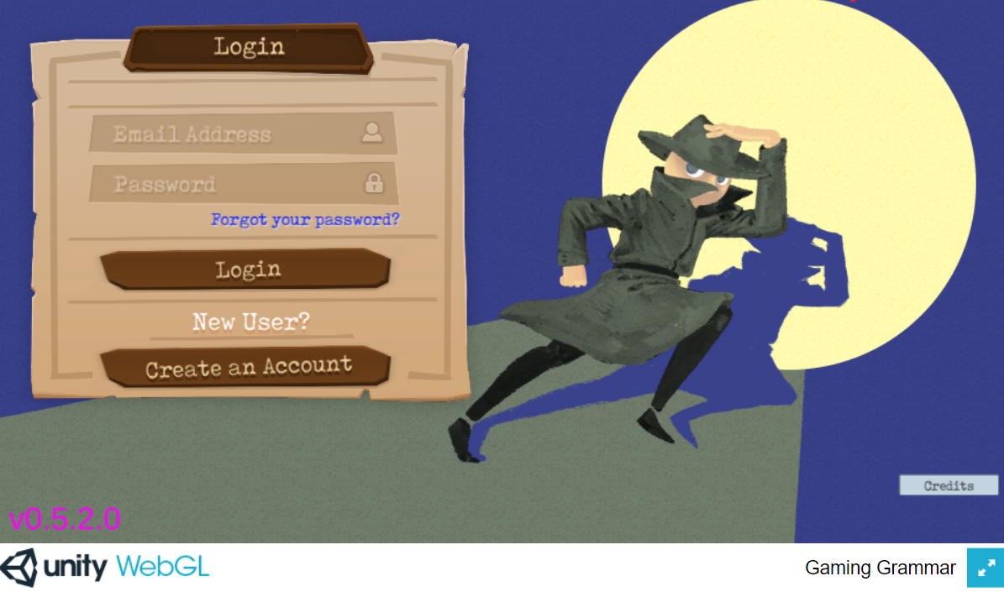
Gaming Grammar
Gaming Grammar
informatique
Gaming Grammar Mission 8: Canine Conundrum deals with subject-verb inversion.
Notes:
NA
This slide links to Gaming Grammar login screen. The appropriate mission can then be selected from the menu page.
Mission 8 deals with subject-verb inversion in questions, providing interactive practice in this grammar feature.
Students will progress through the game at their own rate; teachers should use the teacher interface to check progress. This will help to inform future lesson planning.

Slide 91

Past (perfect) tense
Note the word order!
The past participle goes at the end of the sentence.
Grammatik
To talk about what you did, use the present tense of ‘haben’ and a past participle:
Present
Past (perfect)
Ich
mache
eine Tour.
Ich
habe
eine Tour
gemacht.
I’m
doing
a tour.
I
have
done
a tour.
I
do
a tour.
I
did
a tour.
Regular past participles sandwich the stem with ge- and –t.
Some verbs don’t add –ge!
besuchen → besucht
erleben → erlebt
It would be harder to pronounce them if they did!
machen
ge
t
→
mach
spielen
ge
t
→
spiel
kaufen
ge
t
→
kauf
Notes:
EM (all of German)
Timing: 3 minutes
Aim: To explain how to form and use the 1st person singular (I-form) perfect tense in German.
Procedure:
1. Present and carefully read each statement.
2. Wherever possible, elicit the English from students before presenting it.
Word frequency (1 is the most frequent word in German):
Tour [2640] spielen [205] kaufen [506] machen [58] besuchen [820]
Source: Jones, R.L. & Tschirner, E. (2006). A frequency dictionary of German: core vocabulary for learners. Routledge

Slide 92

Was sagt Mia?
lesen
Present or past? Ich oder ich habe?
 |  | Ich | Ich habe
1. | Ich habe im Juli Freunde besucht.
2. | Ich habe oft im Park Hockey gespielt.
3. | Ich habe keinen Spaß gehabt.
4. | Ich kaufe selbst viel Kleidung.
5. | Ich koche immer das Abendessen.
6. | Ich besuche das Museum.
7. | Ich habe Chinesisch gelernt.
8. | Ich habe schon eine Bootfahrt gemacht.
_______
_______
_______
_______
_______
_______
_______
_______
Notes:
EM
Timing: 5 minutes
Aim: Reading activity to practise noticing the the present form or past participle.
Procedure:
1. Remind that it is the presence of a past participle at the end of the sentence that is the cue for ‘ich habe’.
2. Read the sentences.
3. Which word(s) fit in the gap?
Frequency rankings of vocabulary introduced and revisited this week (1 is the most common word in German):
8.1.1.1 - besuchen [820] erleben [570] kaufen [506] August [1929] Ferien [3448] Juli [1544] Kleidung [2820] Kultur [594] Spaß [1045] Tour [2640] Türkei [922] dieser, diese, dieses [24] letzter, letzte, letztes [152] schon [61] selbst, selber [101]
7.3.2.4 - ziehen [266] gewinnen [408] erhalten [283] beginnen [239] legen [296] werfen [672] mischen [2105] das Ziel [325] die Mitte [756] der Punkt [427] jeder, jede, jedes [88]
7.2.2.5 - lassen [82] nehmen [141] halten [144] dann [33] zuerst [726] spät(er) [171] danach [437] schließlich [307] deshalb [264]

Slide 93
Grammatik
hören
Mia telefoniert. Was sagt sie?
 | Ich | Ich habe
te
Hör dir die Sätze an.
Ich oder ich habe?
1
2
3
4
5
6
7
8
Notes:
EM
Timing: 5 minutes
Aim: Practising to notice the present form or past participle.
Procedure:
1. Click on number to play sound.
2. Say whether they have been done (ich habe xxx) or are being done (ich xxx).
Transcript:
1. [Ich habe] die Stadt besucht.
2. [Ich habe] immer Spaß gehabt.
3. [Ich] mache eine Radtour.
4. [Ich] spiele oft Fußball.
5. [Ich habe] manchmal gekocht.
6. [Ich habe] in der Türkei Kleidung gekauft.
7. [Ich] lerne ein bisschen Türkisch.
8. [Ich] wohne in einem Ferienhaus.

Slide 94
Und auf Englisch?
Grammatik
The perfect tense in German can be translated in two ways in English:
Ich habe Berlin besucht.
→ I have visited Berlin.
→ I visited Berlin.
The English meaning we use often depends on information about when it happened.
Specified times that are finished use simple past.
Ich habe im August Berlin besucht → I visited Berlin in August.
Unspecified, general times in the past use present perfect.
Ich habe oft Berlin besucht → I have often visited Berlin.
Other words to look out for: im Juli, letzten Monat, letztes Jahr.
Other words to look out for: schon, nie
Notes:
EM
Timing: 3 minutes
Aim: To present the two different translations of the German perfect tense.
Procedure:
1. Go through the information on the slide using the animation.

Slide 95

Mia findet Englisch schwierig!
lesen
Kannst du helfen? Wie heißen die Säzte auf Englisch?
1 | Letzten Monat habe ich jeden Tag die Stadt besucht.
2 | Ich habe nie in einem Hotel gewohnt.
3 | Ich habe die Kultur in der Türkei schon erlebt.
4 | Ich habe heute morgen das Essen selber gekauft.
5 | Letzte Woche habe ich viel Spaß gehabt.
6 | Ich habe immer meine Kleidung selbst gemacht.
7 | Ich habe im Juli viele Fotos gemacht.
8 | Ich habe schon eine Reise nach London gemacht.
I visited | I have visited
I have never stayed |
I never stayed
I already experienced |
I have already experienced
I have bought|
I bought
I had | I have had
I always made|
I have always made
I have taken|
I took
I made|
I have already made
Notes:
EM
Timing: 5 minutes
Aim: To practise translating the German perfect tense into English.
Procedure:
1. Model the task using number 1.
2. Remind students to look carefully at the temporal adverbs.
3. Complete each sentence and then feed back. This knowledge is very new and the process of establishing it needs to be very supported.
Word frequency (1 is the most frequent word in German):
8.1.1.1 - besuchen [820] erleben [570] kaufen [506] August [1929] Ferien [3448] Juli [1544] Kleidung [2820] Kultur [594] Spaß [1045] Tour [2640] Türkei [922] dieser, diese, dieses [24] letzter, letzte, letztes [152] schon [61] selbst, selber [101]
Source: Jones, R.L. & Tschirner, E. (2006). A frequency dictionary of German: core vocabulary for learners. Routledge

Slide 96



Grammatik
sprechen / hören
Start present sentences with ‘ich’
Finish the sentence with the present: → mache Fotos.
1] Person B
1] Person A
Present
1.
Finish the past sentence: → eine Hose gekauft.
Start past sentences with ‘ich habe’
2] Person A
2] Person B
Past
1.
Notes:
EM
EXAMPLE SLIDE to model the speaking task. The following slide NOT to be displayed, but printed.
NOTE: this is for the live-in classroom version, for the video lesson version see the next two slides.
Timing: 1 minute
Aim: Trapping the form (ich vs ich habe)
Procedure:
1. Print slide and make sure each person has their information for round 1 and 2.
2. For round 1 person A starts a sentence with Ich (present) or Ich habe (past).
3. Person B than finishes the sentence with the activity cued on their card using the correct form of the verb.
4. Person A write down the activity.
5. For round 2 person A and B swap roles.

Slide 97







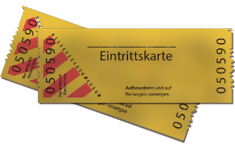







Grammatik
sprechen
1] Person B
1] Person A
Present 4. Present
Past 5. Past
Past
1.
[Volleyball]
2.
2] Person A
1.
3.
4.
5.
2.
3.
[Berlin]
2] Person B
Present 4. Present
Past 5. Past
Past
4.
[New York]
5.
[Basketball]
Notes:
EM
DO NOT DISPLAY
NOTE: this is for the live-in classroom version, for the video lesson version see the next two slides.
Timing: 7 minutes
Aim: Trapping the form (ich vs ich habe)
Procedure:
1. Print slide and make sure each person has their information for round 1 and 2.
2. For round 1 person A starts a sentence with Ich (present) or Ich habe (past).
3. Person B than finishes the sentence with the activity cued on their card using the correct form of the verb.
4. Person A write down the activity.
5. For round 2 person A and B swap roles.

Slide 98
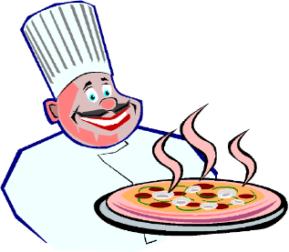
Grammatik
hören / sprechen
1.
[Volleyball]
I am playing volleyball
2.
I (have) bought ice cream
3.
I (have) made pizza
4.
I am listening to a concert
5.
I (have) visited Berlin
[Berlin]
Notes:
EM
NOTE: This is the video lesson version of this task.
Timing: 7 minutes
Aim: Trapping the form (ich vs ich habe)
Procedure:
1. Look at the pictures.
2. Listen to the teacher saying the sentences.
3. Write down the meaning of each sentence.
4. Cycle through the answers.
Script for video teacher
Ich spiele Volleyball.
Ich habe Eis gekauft.
Ich habe Pizza gemacht.
Ich höre ein Konzert.
Ich habe Berlin besucht.
What did I say?
I am playing volleyball
I bought ice cream / I have bought ice cream
I made pizza / I have made pizza
I am listening to a concert
I visited Berlin / I have visited Berlin
Now it’s your turn!

Slide 99
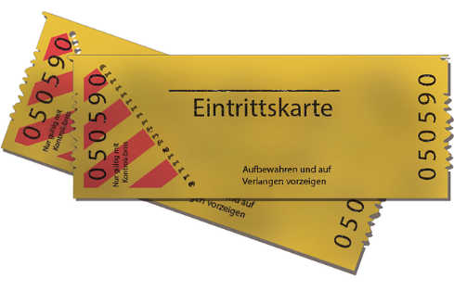


Grammatik
hören / sprechen
1.
Past
2.
Present
3.
Past
4.
Past
[Basketball]
[New York]
5.
Present
Notes:
EM
NOTE: This is the video lesson version of this task.
Timing: 7 minutes
Aim: Trapping the form (ich vs ich habe)
Procedure:
1. For item use the tense and picture cues to create a sentence and speak it out loud.
2. Check the answers
Script for the video teacher:
Now it’s your turn!
You say 5 sentences to me.
…
…
…
Ok, I think you said:
Ich habe (Eintritts)karten gekauft.
Ich lerne Englisch.
Ich habe in einem Hotel gewohnt.
Ich habe Basketball gespielt.
Ich besuche New York.

Slide 100

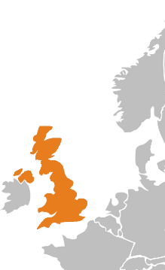






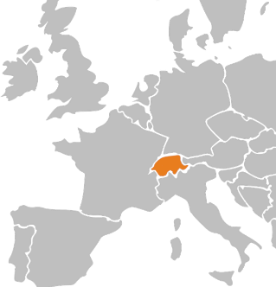






Grammatik
schreiben
Du bist im Urlaub!
You are doing a lot this year, but nothing is the same as you did last year on holiday.
Write five sentences to describe your activities this year, and five to say what you did last year. Remember to use the right verb(s) for past and present. Use all the cards.
Notes:
EM
Timing: 10 minutes
Aim: To practise 1st person present tense vs perfect tense in writing.
Procedure:
1. Use all the cards.
2. Write 5 sentences to describe your activities this year and 5 sentences to describe your activities last year.

Slide 101
Aims for the session
Part 1:
to understand research findings relating to L2 grammar teaching & learning
  whether to teach grammar
  deciding what grammar to teach and in what order
  the most effective ways to teach and practise grammar
Part 2:
to evaluate existing examples of grammar activities
to explore alternative types of task design and practice
Questions, discussion and next steps
Notes:
EM

Slide 102
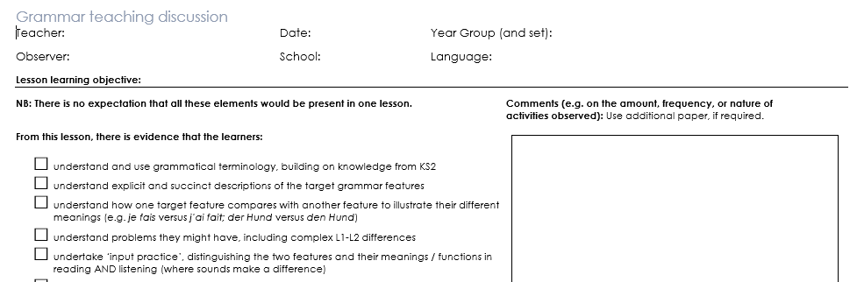
Observation sheet
https://resources.ncelp.org/concern/parent/z316q156s/file_sets/qn59q3974
Observation sheet
Notes:
EM
Observation sheet to check for evidence of these principles in practice.
How to teach and learn grammar
This slide takes the statements from the Grammar Teaching Discussion document and puts them into phases of grammar learning.
The different phases are not clear cut, they definitely merge in to each other: you practise when you are establishing knowledge for the first time, and consolidating knowledge is often also extending it.
Many activities can be repeated for different purposes, depending on how well the grammar is already embedded.
These ways of working with grammar are intended to broaden thinking about the range of opportunities we give learners in and outside the classroom.

Slide 103

Gaming Grammar
Digital game with activities in a ‘spy mission’ context
Reading and listening-based grammar practice
Gives students immediate feedback
Allows teachers to track student progress on teacher interface
Linked to NCELP SOW
https://www.gaminggrammar.com/
Notes:
EM

Slide 104

Would you like to know more?
Many more grammar resources available https://resources.ncelp.org
Join the mailing list, email: enquiries@ncelp.org for regular bulletins about resources arriving on the portal
To get monthly alerts to summaries of new research, sign up in 10 seconds at
  https://oasis-database.org/
Notes:
EM

Slide 105
References
Bui, G., & Skehan, P. (2018). Complexity, fluency and accuracy. In J. Liontas (Ed.), TESOL encyclopedia of English language teaching (pp.1-7). Hoboken, NJ: John Wiley & Sons
De Sudea, I.A., Isern Vivancos, M.I., Hardwick, A. (2011). Zoom español 1. Oxford: Oxford University Press
DeKeyser, R. (2005). What makes learning second-language grammar difficult? A review of issues. Language Learning, 55(S1), 1-25.
DeKeyser, R. (2015). Skill acquisition theory. In B. VanPatten & J. Williams (Eds.), Theories in second language acquisition: An introduction (pp. 94–112). London, UK: Routledge. Mitchell, Myles & Marsden, E. (2018).
Dzuilka-Heywood, C., Kennedy, Y., & Smith, K. (2014). Allez 1. Oxford: Oxford University Press
Ellis, N. (2006). Selective attention, and transfer phenomena in L2 acquisition: Contingency, cue competition, salience, interference, overshadowing, blocking, and perceptual learning. Applied Linguistics, 27(2), 164-194.
Kasprowicz, R. & Marsden, E. (2018). Towards ecological validity in research into input-based practice: Form spotting can be as beneficial as form-meaning practice. Applied Linguistics, 39(6), 886-911.
Lichtman, K. (2016). Age and learning environment: Are children implicit second language learners? Journal of Child Language, 43, 707-730.
Marsden, E. (2006). Exploring input processing in the classroom: An experimental comparison of processing instruction and enriched input. Language Learning, 56, 507–566.
McManus, K. & Marsden, E. (2017). L1 explicit instruction can improve L2 online and offline performance. Studies in Second Language Acquisition, 39(3), 459-492
McManus, K. & Marsden, E. (2018). Online and offline effects of L1 practice in L2 grammar learning: A partial replication. Studies in Second Language Acquisition, 40(2), 459-475.
Mitchell, R., Myles, F. & Marsden, E. (2019) Second Language Learning Theories. New York: Routledge.
Notes:
Selection of relevant research references.

Slide 106
References
Murakami, A. & Alexopoulou, T. (2016). L1 Influence on the acquisition order of English grammatical morphemes. Studies in Second Language Acquisition, 38(0), 365-401.
Myles, F., Hooper, J., & Mitchell, R. (1998). Rote or rule? Exploring the role of formulaic language in classroom foreign language learning. Language Learning, 48(3), pp. 323-363.
Myles, F., Mitchell, R. & Hooper, J. (1999). Interrogative chunks in French L2: a basis for creative construction? Studies in Second Language Acquisition, 21(1), pp.49-80.
Norris, J.M. & Ortega, L. (2000). Effectiveness of L2 instruction: A research synthesis and quantitative meta-analysis. Language Learning, 50(3), 417-528.
Norris, J., & Ortega, L. (2001). Does type of instruction make a difference? Substantive findings from a meta-analytic review. Language Learning, 51(S1), 157-213.
Schicker, C., Waltl, M., & Malz, C. (2011). Zoom Deutsch 1. Oxford: Oxford University Press
Schmidt, R. (1990). The role of consciousness in second language learning. Applied Linguistics, 11(2), 129-158.
Spada, N., & Tomita, Y. (2010) Interactions between type of instruction and type of language feature: A meta-analysis. Language Learning, 60(2), 263-308.
Tolentino, L. & Tokowicz, N. (2014). Cross-language similarity modulates effectiveness of L2 grammar instruction. Language Learning, 64(2), 279-309
VanPatten, B. (2004). Input processing in SLA. In, VanPatten, B. (ed.), Processing instruction: Theory, research, and commentary. Mahwah, NJ: Lawrence Erlbaum Associates.
White, L., Spada, N., Lightbown, P., & Ranta, L. (1991). Input enhancement and L2 question formation. Applied Linguistics, 12(4), 416-432.
Notes:
Selection of relevant research references.
References with OASIS summaries have the hyperlinks embedded.

