Slide 1
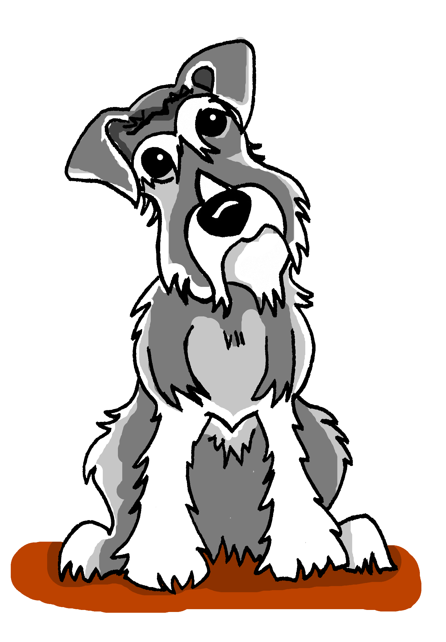
Old dogs can learn new tricks:
This presentation: https://ncelp.org/ncelp-teacher-cpd/
research- and practice-informed ideas for language teaching
Author name: Rachel Hawkes
Artwork: Steve Clarke
Date updated: 17/ 06 / 20
Notes:
‘Old dogs can learn new tricks: research- and practice-informed ideas for language teaching’ Old dogs (that’s me – 50 next week, maybe not old, but ‘with some experience behind me’!) can learn new tricks. As many language teachers are, I have always been passionate about teaching phonics and grammar (I’m not sure I gave vocabulary teaching deep enough thought to say I was passionate about that, previously – it just was part of my practice!), In the last couple of years I have learnt some new things about teaching it, and have developed aspects of my practice as a result, working with Professor Emma Marsden and the NCELP team. This one-hour session cannot hope to contain everything that’s useful and important from NCELP’s work (!), and it very deliberately is not setting out to be a summary or overview session (as I did last last year). If you were at last June’s ALL Event or you are already familiar with NCELP’s work and resources, then this session will probably feel like a ‘next instalment’. If not, then it’s probably useful to access other sessions, including perhaps the ALL London Event presentation from last year.

Slide 2
In this session...
Minimal pairs (P)
Multiple word meanings (V)
Processing pairs (G)
Using unknown words (P)
Teaching word patterns (V)
Lexical profiling (V)
Trapping the forms (G)
Assessing the knowledge (P,V,G)
ALL London June 2019
Other sessions: https://ncelp.org/ncelp-teacher-cpd/
Notes:
Image by OpenClipart-Vectors from Pixabay
This is a list of what we will talk about in this session. I won’t get stuck on this slide, giving a summary of what each one is, as it’s going to be more useful to go directly to resources that are examples of these things, and talk about those.

Slide 3
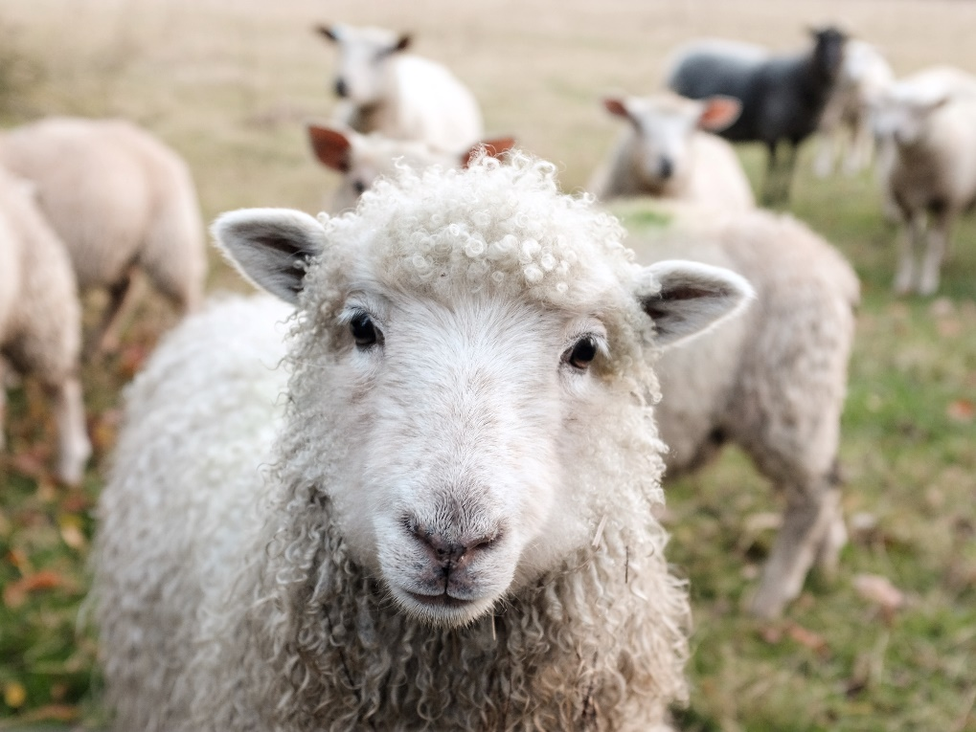
Minimal pairs
Minimal pairs are two similar sounding words that differ in only one phoneme and have distinct meanings.
sheep
ship
Notes:
[Ship] Photo by Peter Hansen on Unsplash [Sheep] Photo by Sam Carter on Unsplash
It’s not hard to recognise why these are important. We only need to have heard a colleague who is not a native English speaker instruct a student to pick up a ‘sheet’ or try not to smile when a Y7 student tells us earnestly that he or she ‘tiene once anos’!
Focusing on them explicitly, though. If you’d asked me two years ago whether I did that in my teaching, I would have said ‘well, yes, incidentally, when it comes up’.

Slide 4
Pirates!
1
c
w
Riese
leider
Riese
One of the chests contains buried treasure. All the others contain poison!
Listen carefully to the secret code and follow the arrows to find the treasure.
Reise
Lieder
Reise
h
z
Wien
Biene
Feile
v
Wein
Beine
viele
Riese
k
Riese
Biene
Feile
leider
i
Reise
Beine
viele
Lieder
Reise
Riese
leider
Feile
leider
Riese
r
Reise
Lieder
viele
Lieder
Reise
Riese
y
j
q
Reise
Natalie Finlayson
Notes:
This task, created by Natalie Finlayson, one of NCELP’s resource developers, is one of my favourites!
Timing: 20-30 seconds per slide
Aim: This activity makes use of minimal pairs of unknown words to compel students to focus on a pair of SSC (sound-symbol correspondence) that often cause difficulty, both in pronunciation, reading aloud of written text, and also in spelling. (Unknown words are used so that pupils focus closely on the sound. Definitions are given on a later slide).
Procedure: Starting on the red square, pupils listen to the words and decide whether they hear /ei/ or /ei/. They follow the arrows indicated by their choice to finish at one of the chests. There is only one correct route per slide, so pupils must correctly identify all words to find the treasure. The order or /ei/ and /ie/ changes (i.e. sometimes /ei/ is on the white square and sometimes on the blue) so the pupils must read the spellings.
Pupils can follow the slide on the projector, or the slide can be printed so they can trace the route with a pen/finger.
Teacher asks ‘Wo bist du?’ Pupils respond ‘Z, W’ etc. to practise the alphabet. Teacher clicks on the chests they say to reveal treasure (or not!)
Audio plays on clicking play. Pupils will probably need to hear the audio at least three times.
Note: Each treasure chest is triggered to reveal what is underneath. You see a hand icon appear when you mouse over it – click and the chest disappears. Each slide only has one treasure chest – the rest reveal skulls.
Transcript:
Wein, Biene, Feile, Lieder, Riese
Treasure is located in chest r

Slide 5
En anglais et en français
lire / écouter
same [ch]
different [ch]
same [ch]
different [ch]
1
chef
6
champagne
2
avalanche
7
chocolat
3
touche
8
champion
4
brochure
9
moustache
5
charge
10
riche
Kirsten Somerville / St James’ Hub / Natalie Finlayson
Notes:
This is a slightly different angle, but I’ve included it to show the breadth and depth of NCELP’s phonics work as it’s developed through Y7. Here English has two pronunciations for ‘ch’ where French has one (there’s a reason for that, as where the English and French pronunciations overlap, those are words ‘borrowed’ form French).
Timing: 2 minutes Aim: This activity highlights similarities and differences in the English and French pronunciation of the SSC [ch], using near-cognates which have not been previously taught. Images are provided to aid recognition. The activity aims to show that while the pronunciation of this SSC changes in English, it is consistent in French. Teachers to highlight that, where the sound is ‘sh’ in English, these words are “borrowed” from French (chef, brochure, champagne, moustache).
Procedure: Students write 1-10 in their exercise books and decide if the [ch] in the French word sounds the same as in English, or different from the English. They then listen to the words and check their answers.
TRANSCRIPT:
chef
avalanche
touche
brochure
charge
champagne
chocolat
champion
moustache
riche
Frequency rankings of non-SOW (near-)cognates (1 is the most common word in French):
avalanche [4426], brochure [>5000], champagne [>5000], champion [2443], charge [849], chef [386], chocolat [4556], moustache [>5000], riche [599], touche [3775]
Source: Londsale, D., & Le Bras, Y. (2009). A Frequency Dictionary of French: Core vocabulary for learners London: Routledge

Slide 6
parler
Remember ! Two pronunciations in English, one pronunciation in French!
chef
champagne
avalanche
chocolat
touche
champion
brochure
moustache
charge
riche
Kirsten Somerville / St James’ Hub / Natalie Finlayson
Notes:
Timing: 1 minute Aim: To practise the same SSC [ch] in oral modality, productive mode. Procedure: Students now practise saying the words in pairs, each choosing a word from a different side, then swapping sides. Students check each others’ pronunciation, trying to get the longest ‘rally’ of correct pronunciations. The teacher circulates to check that students are drawing on their existing knowledge of French SSCs to pronounce the words accurately and avoid L1 interference.
Before beginning the task, teacher to remind students: two pronunciations in English, one pronunciation in French.

Slide 7
Multiple word meanings
UK
How to pronounce polysemous in British English
US
How to pronounce polysemous in American English
Polysemous words are words with more than one meaning.
Unsurprisingly, the most frequent words in a language are often polysemous.
We have added a tab called ‘Multiple senses’ to the NCELP SOW.
This sheet documents when each meaning is introduced.
Meanings are introduced cumulatively, so previously taught meanings are included in each new English translation.
Notes:
Again, I think I’d previously approached the teaching of polysemous words in much more of an incidental than a strategic or planned way. I had to try out ways of pronouncing here, there is more than one way!

Slide 8
Saying ‘to’ and ‘in’ in French
Remember!
The translation is different for verbs of movement and location.
lire
Lis les phrases. Coche la réponse correcte.
 |  | ‘in’ | ‘to’
1. | Je vais à Lausanne.
2. | Tu habites à Lille.
3. | Il arrive à Dakar.
4. | Elle va à Londres.
 |  | ‘in’ | ‘to’
5. | J’arrive en Angleterre.
6. | Tu vas en Écosse.
7. | Il va en Guadeloupe.
8. | Elle habite en Tunisie.
Kirsten Somerville / Natalie Finlayson
Notes:
Timing: 2 minutes Aim: To practise the different translation of the two prepositions with verbs of movement and location.
Attention should be drawn to the fact that the same preposition can be translated differently depending on the context. Procedure: Students write 1 – 8 in their books. For each sentence, they decide between the two meanings. Click to reveal answers.

Slide 9
Mehmet redet über seinen Urlaub in der Schweiz
lesen
Diesen Sommer mache ich in Kreuzlingen in der Schweiz Sommerurlaub.
Ich mag das Haus sehr. [1] Ich habe bisher nie in einem Ferienhaus gewohnt! Mein Schlafzimmer hat einen Schreibtisch, eine Stehlampe und... ein Schlagzeug!
[2] Letzte Woche habe ich jeden Tag den Bodensee besucht und danach Fu$ß$ball gespielt. [3] Ich habe auch schon einen Wasserpark besucht. [4] Heute Nachmittag habe ich eine Radtour gemacht. Nächste Woche gehen wir jeden Morgen zum Strand. Ich finde den Bodensee wunderschön!
Remember: English translates the German perfect tense in two ways: I did (specified time) OR I have done (unspecified time)
Stephen Owen / Rachel Hawkes
Notes:
Although this is NOT the same as polysemous words, the idea of multiple English meanings for one foreign language form also extends to grammar features, and is a major source of cross-linguistic difficulty. In the early stages of learning the perfect tense, I think most German teachers will have had their students produce things like ‘Ich gekauft ein T-Shirt’. We often teach students the English perfect tense mapping onto the German perfect tense first, because it’s the closest match: Ich habe Fußball gespielt. I have played football. Then we tell them that the German perfect tense also translates ‘I played football’. And often perhaps we might leave it there, and then just remind them about that, when they make mistakes. But when you think about it, you hardly ever / never (?) use the English perfect tense on its own, without a adverb that triggers it. Decontextualised examples like ‘I have played football’ sound oddly incomplete. It needs something like: I have never / often / always / already. And the same applies, perhaps to a lesser extent, to ‘I played football’ – here, we can usefully add ‘last week / yesterday morning / in July’.
Before expecting students to be able to use the perfect tense well in German, it might be a good idea to give some specific practice in understanding it. To do that, we’ll also find ourselves teaching and focusing intently on some very high-frequency adverbs that might otherwise get overlooked, too. I’m not sure I’ve ever taught bisher [441], or spent as much time on schon [61]!
Reading
Timing: 3 minutes
Aim: To connect the four perfect tense sentences with their correct meaning in English. Procedure: 1. Remind that there are two ways to translate the perfect tense in German. 2. Translate the sentences (individually or in pairs) 3. Use the next slide to correct the sentences.

Slide 10
Mehmet redet über seinen Urlaub in der Schweiz
Antworten
1
2
3
4
I have never stayed in a holiday house before!
Diesen Sommer mache ich in Kreuzlingen in der Schweiz Sommerurlaub.
Ich mag das Haus sehr. [1] Ich habe bisher nie in einem Ferienhaus gewohnt! Mein Schlafzimmer hat einen Schreibtisch, eine Stehlampe und... ein Schlagzeug!
[2] Letzte Woche habe ich jeden Tag den Bodensee besucht und danach Fu$ß$ball gespielt. [3] Ich habe auch schon einen Wasserpark besucht. [4] Heute Nachmittag habe ich eine Radtour gemacht. Nächste Woche gehen wir jeden Morgen zum Strand. Ich finde den Bodensee wunderschön!
Last week I visited Lake Constance every day and played football afterwards.
I have also already visited an aqua park.
This afternoon I went on (I did) a bike ride.
Artwork: Steve Clarke
Notes:
This genuinely feels like strong use of translation into English.
Reading [ANSWERS]
Timing: 2 minutes
Note: Elicit the key trigger words (for specified / unspecified time) that determine which tense to use in English (specified = simple past, unspecified = present perfect).

Slide 11
Processing pairs
50+ experimental studies, including:
French verb inflections with 11 to 14 yr olds (Marsden, 2006)
German case marking with 9 to 11 yr olds (Kasprowicz & Marsden, 2017)
Avoid working with whole paradigms at one time, particularly in the first stages of language learning
Attention is a limited resource; learners can only pay attention to so much at any one time (Lee & VanPatten, 1995; VanPatten, 2002; Wong, 2004)
Focus on accurate and reliable knowledge of one form juxtaposed with another (e.g. je joue vs. nous jouons)
Provide plenty of practice for each pair of grammatical forms/meanings
Remove other ‘cues’ so that learners focus on the target feature: e.g., le weekend dernier, j’ai mangé
Gradually build up wider system
Rowena Kasprowicz / Emma Marsden
Notes:
This aspect of NCELP’s work owes a lot to the research of Professor Emma Marsden, which has contributed to a now substantial number (50+) of experimental studies (in classrooms as well as laboratories) since the early 1990s, looking at the teaching of a range of grammar features.
[I want to take a moment to flag OASIS, too, which is an incredible idea and resource for anyone interested in languages teaching and research. Essentially it’s a searchable repository of one-page summaries of research studies into language acquisition and language learning.] Building on the work of Bill VanPatten, (e.g., https://oasis-database.org/concern/summaries/9019s2443?locale=en), researchers have experimented by practising in the input (L & R) many ‘harder to reach’ grammar features, which learners typically don’t just pick up by being asked to understand the main details of a text containing the target feature. Evidence suggests benefits for:
Improving analysis of language
‘Training the ear’ to notice small phonemic differences (e.g. je / j’ai)
Improving comprehension and production
A range of ages, proficiencies, languages, grammar features

Slide 12
Problemas con Siri
escuchar
 | the action in general | someone does the action
¡Siri no funciona en tu móvil hoy! What is it talking about?
Escucha los mensajes.
Marca la opción correcta.
1
2
3
4
5
6
7
8
St. James’ Hub Teachers / Victoria Hobson / Nick Avery
Notes:
Here is just one quick example from the Y7 resources. This principle is in action in every sequence in which a new grammar feature is introduced and practised. Compelling students to process pairs of forms/meanings isn’t just for verbs, or tenses, there are examples from both morphology (the forms of words) and syntax (order of words within a sentence) with all word classes: with adjectives (masculine vs feminine agreements, pre- vs post-nominal placement), with adverbs (time vs manner, time vs place), word order, with prepositions (e.g., accusative vs dative uses in German). On the next slide, we have one more example, a reading this time, practising
Timing: 2 minutes Aim: This task aims to help learners understand the difference in meaning between the infinitive and the third person singular. Tell students to pay careful attention to the verb that they hear. The vocabulary other than the verbs in this activity is either already known to students or is a cognate. Procedure: 1. Students write 1-8 in their books.
2. They listen to each phrase to decide if they are hearing the infinitive or the 3rd person, and they choose the category ‘action in genera’ or ‘someone does the action’ to connect securely the form and its meaning. 3. Answer ticks are animated to appear.
[‘pling’ sound] Lee frases interesantes.
[‘pling’ sound] Vivir cerca del pueblo.
[‘pling’ sound] Bebe coca cola.
[‘pling’ sound] Come comida.
[‘pling’ sound] Leer juntos.
[‘pling’ sound] Vive lejos de aquí.
[‘pling’ sound] Comer mucho.
[‘pling’ sound] Beber limonada.
Ask students to translate the text extracts to ensure comprehension of meaning.

Slide 13
Steigt oder steht?
lesen
1 Der Tisch _________ auf dem Haus.
2 Der Mann _________ auf den Tisch.
3 Der Mond __________ auf die Nacht.
4 Der Sessel __________ auf dem Tisch.
5 Der Tisch ___________ auf das Haus.
6 Das Haus ___________ auf den Berg.
7 Der Berg ___________ auf dem Mond.
8 Der Mann ___________ auf dem Sessel.
9 Der Mond ___________ auf der Nacht.
steht
steigt
steigt
steigen
steht
steigt
stehen
steigt
der Mond
steht
der Sessel
steht
der Berg
steht
extracts from Immer höher – Ernst Jandl
Notes:
Poem - Immer höher (Ernst Jandl) Time: 7 mins approx Here are nine assorted lines from the poem. NB: for the whole poem, search for German SOW Y7 Term 3.2 Week 7 on the NCELP Resource Portal. https://resources.ncelp.org/ Students needs to decide which verb ‘steigt’ or ‘steht’ is the correct option. Remind as necessary that it is the article after the preposition ‘auf’ that will tell them which verb (movement or location) is correct. 1. Students write 1-9 and write either ‘steigt’ or ‘steht’. 2. Teachers elicit the answers (chorally) by inviting students to say each full line of the poem, and then confirm by clicking for the verbs to appear, one by one. 3. Teachers then elicit the English translation for each line (this might also be done chorally, or individually, as preferred).

Slide 14
Using unknown words [phonics]
To practise applying SSC (symbol-sound correspondence) knowledge, we need to use unknown words. For example:
Place names
People’s names
Names of other things (e.g. games, bands)
Cognates (not previously-taught)
Notes:
This seems like such an obvious one now, but I realise that I hadn’t systematically differentiated between activities that practise pronunciation / reading aloud of previously-taught language (i.e., with the aim of reactivating the sound-symbol representations of particular words, which is essentially one aspect of vocabulary knowledge) and practising SSC knowledge itself, for which you need unknown words (so that you’re sure that students are apply the knowledge rather than remembering the pronunciation of a previously-taught word)

Slide 15
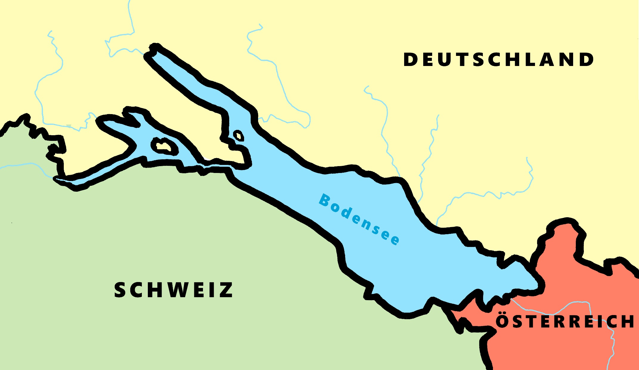
Phonetik - der Bodensee [1/2]
hören / schreiben
[4] Allensba_ _
ch
[5] _allhausen
4
W
5
z
[3] Radolf_ell
3
[6] Hagn_ _
6
au
ch
[7] Fr_ _dri_ _shafen
7
ie
S t
[2] _ _eckborn
eu
2
1
Kr_ _zlingen
[9] _omanshorn
R
9
ei
[8] Altenrh_ _n
8
Artwork: Steve Clarke
Notes:
Phonetik [1]
Time: 5 minutes Aim: To practise recognising and transcribing 10 previously taught SSC, in unknown words.
Procedure: 1. Click number to hear the full word. Students listen and transcribe only the missing letters. 2. Animations support item-by-item checking, as instant feedback on each SSC may be particularly helpful for students’ learning. 3. Teachers can additionally ask, Wo liegt [Hagnau]? Es liegt in [Deutschland]… Students have met the use of ‘in’ with die Schweiz. It will be helpful to focus their attention on the use of ‘in’ + der + Schweiz here, reminding them of the ‘in’ + movement (R2-accusative) or location (R3-dative) change. SSC revisited here: [eu] [st-] [z] [ch-hard] [w] [au] [ie] [ch-soft] [ei] [r] Transcript: 1 Kreuzlingen 2 Steckborn 3 Radolfzell 4 Allensbach 5 Wallhausen 6 Hagnau 7 Friedrichshafen 8 Altenrhein 9 Romanshorn

Slide 16
Phonétique
parler 1/8
lire / parler
Dis les noms.
Attention! C’est hard [g] ou [j]/soft [g] ?
Mon nom est …
1
Gérard
5
Gilles
9
Jacques
2
Gaelle
6
Julien
10
Jérôme
3
Angéline
7
Joséphine
11
Margaux
4
Agathe
8
Morgane
12
Georges
Adeline Charlton / Natalie Finlayson
Notes:
Timing: 8 minutes
Aim: To raise awareness of [j]/soft [g] and hard [g] by using known spelling rules to pronounce these correctly in unknown vocabulary items.
Procedure:
1. Explain that these are popular French names that look like names students may recognise from English, but are pronounced differently.
2. Give students four minutes to work with a partner to decide how to pronounce [j] or [g], and to have a go at sounding out the names. All other SSCs in the words are either known or transferable from English, with the exception of the [ô] in Jérôme.
3. Click on the numbers to hear the names pronounced. The voices indicate whether the name is traditionally a male or female one. Students repeat chorally.
4. Now, teachers encourage students to read the names in increasing speed intervals (30 seconds, 20 seconds, 10 seconds … may vary according to the individual needs of the class) to work on fluency.
Transcript
1. Gérard
2. Gaelle
3. Angéline
4. Agathe
5. Gilles
6. Julien
7. Joséphine
8. Morgane
9. Jacques
10. Jérôme
11. Margaux
12. Georges

Slide 17
Teaching word patterns
“When words that can be understood using these rules occur in context, students will be expected to understand them.” AQA Specification section 3.4.1.17
Word patterns between English and another language in this context refer to categories of near-cognates that follow a commonly occurring pattern.
The Spanish word adds an –o (and sometimes a tilde: aspecto, económico
Words ending in –c, -k and –cal often change to -que in French: publique, banque, historique
German ‘k’ is often English ‘c’: Oktober, Musik
Spanish
German
Notes:
This is something else that I think many of us would say that we teach, but ‘as and when’ rather than in a planned way. The useful thing about a planned approach, is that we can be more confident about which patterns to prioritise. Which word patterns are the most frequent? i.e., which patterns occur most often in the most frequent 2000 words?
The following activities have been created to provide opportunities to:
- make connections and understand patterns between the new language and English - practise those links by translating new language → English and English → new language
consolidate their SSC (phonics) knowledge by reading the words / sentences aloud
reinforce their knowledge of spelling and pronunciation rules (e.g. single vs double consonants in writing and syllable stress in speaking)
I’m just going to show one example here. One idea for delivery is that each pattern is given 10 minutes in tutor time (so NOT taking time out of language lessons!) each week; they are written so that non-linguist tutors could deliver them.
Alternatively they could be built into KS3 lessons.

Slide 18
English → German → English
1
Change English ‘c’ to ‘k’ to create many German words.
October is a month.
Oktober ist ein Monat.
What would the following words be in German?
discussion (f) contact (m) article (m) costs (pl) product (nt) Choose one and write a sentence in German.
Translate these sentences.
1. Der Zug fährt direkt.
2. I love music and I’m doing a project.
Notes:
Word frequencies: Oktober [757] Musik [469] die Diskussion [850] direkt [370] das Projekt [605] die Kosten [722] der Kontakt [700] der Artikel [903] das Produkt [643]
Source: Jones, R.L. & Tschirner, E. (2019). A frequency dictionary of German: core vocabulary for learners. Routledge
These word pattern tasks have been written particularly with the NCELP Y8 SOW in mind. Current thinking is to include one short activity to introduce and practise a pattern once every two weeks.
We have not included every single pattern that exists, of course - just those where there were sufficient, high-frequency words in the top 2000 to suggest that it would be a useful pattern to highlight to students in Y8. NB: Within the Y8 German SOW document you will find a ‘word patterns’ tab, an inventory of all the patterns and their words that were considered. The idea is that these patterns not only reinforce, revisit, extend vocabulary knowledge, but they also revisit key basic grammar knowledge (parts of speech, capital letters on nouns, definite articles/gender, plural rules) and can provide opportunities for students to apply their phonics knowledge when they sound out the new words they've created. In short, these are PVG-rich tasks.

Slide 19
ANTWORTEN
1
Der Zug fährt direkt.
I love music and I‘m doing a project.
discussion (f)
contact (m)
article (m)
costs (pl)
product (nt)
The train goes direct(ly).
Ich liebe Musik und ich mache ein Projekt.
die Diskussion
der Kontakt
der Artikel
die Kosten
das Produkt
In German ‘el’ replaces English ‘le’
‘en’ is a common plural ending (Rule 3)
What do you notice about the gender of these nouns?
Don’t forget to pronounce the words.
Notes:
Source: Jones, R.L. & Tschirner, E. (2019). A frequency dictionary of German: core vocabulary for learners. Routledge

Slide 20
English → German → English
8
All of these nouns are the stem of their sibling verb.
1. the work (f)
2. the fall, case (m)
3. the plan (m)
4. the part (m)
5. the game, match (nt)
6. the start (m) x 2
7. the answer (f)
8. the attempt, try (m)
antworten
fragen
enden
folgen
teilen
anfangen
versuchen
arbeiten
beginnen
reden
spielen
lieben
planen
fallen
Wie heißt das Verb auf Deutsch?
die Frage | die Rede | die Liebe | das Ende | die Folge
Notes:
Where the word pattern is within the new language rather than between the new language and English, we are talking about word families. Definition of a word family: any parts of speech/word classes connected by a common, semantically-related stem.
These sorts of patterns can be incredibly useful for developing students’ ability to understand the language they’re learning.
Note: Students either know the noun or the verb (or both), or there is a cognate element. Both nouns and verbs are highly-frequent, almost all within the top 1000 words. The genders of the new nouns are given in brackets next to the English word. Students need to activate the following prior knowledge to complete the task: 1] definite articles for (m) - der, (f) - die, and (nt) - das nouns 2] capital letters needed on all nouns 3] stem is the word for the meaning carrying part of the verb, and (generally, and in all the examples in this task) is the full infinitive minus -en. Note: der was selected as the gender for Teil, here as students first learn the word of ‘part’ in the more abstract sense (e.g. first part of a match, film, book homework) rather than a physical component part. Note: The five nouns in the 2nd table are ‘stem + -e’. Teachers should draw attention to this additional pattern.
Word frequencies: die Arbeit 208
der Fall 187
der Plan 954
der/das Teil 198
das Spiel 328
der Anfang 427
die Antwort 522
der Versuch 791
der Beginn 845
die Frage 157
die Folge 431
die Liebe 844
die Rede 759
das Ende 183
arbeiten 234
fallen 332
planen 579
teilen 906
spielen 205
anfangen 497
antworten 826
versuchen 247
beginnen 251
fragen 153
folgen 160
lieben 701
reden 368
enden 1313
Source: Jones, R.L. & Tschirner, E. (2019). A frequency dictionary of German: core vocabulary for learners. Routledge

Slide 21
ANTWORTEN
8
All of these nouns are the stem of their sibling verb.
1. the work (f)
2. the fall, case (m)
3. the plan (m)
4. the part (m)
5. the game, match (nt)
6. the start (m) x 2
7. the answer (f)
8. the attempt, try (m)
die Arbeit
antworten
fragen
enden
der Fall
folgen
der Plan
teilen
anfangen
der Teil
versuchen
das Spiel
arbeiten
der Anfang, der Beginn
beginnen
reden
spielen
die Antwort
der Versuch
lieben
planen
fallen
Wie heißt das Verb auf Deutsch?
die Frage | die Rede | die Liebe | das Ende | die Folge
fragen
reden
lieben
enden
folgen
Don’t forget to pronounce the words!

Slide 22
Lexical profiling
Lexical profiling is an analysis of words in a text to assess its suitability.
It can be done manually (!! ☹) or electronically (☺), using a tool such as AntProfiler-NCELP (Anthony 2020).
A free, online version of AntProfiler-NCELP will soon be available!
Anthony, L. (2020). AntProfiler-NCELP 1.0.0 [Computer Software]. Tokyo, Japan: Waseda University.
With thanks to Laurence Anthony / Natalie Finlayson
Notes:
These are the sorts of questions lexical profiling can answer: 1] What percentage of the words in this text are high-frequency words?
2] Does this text contain any low-frequency words which I may want to gloss or replace?
3] How many of the words in this text have students learned so far?

Slide 23
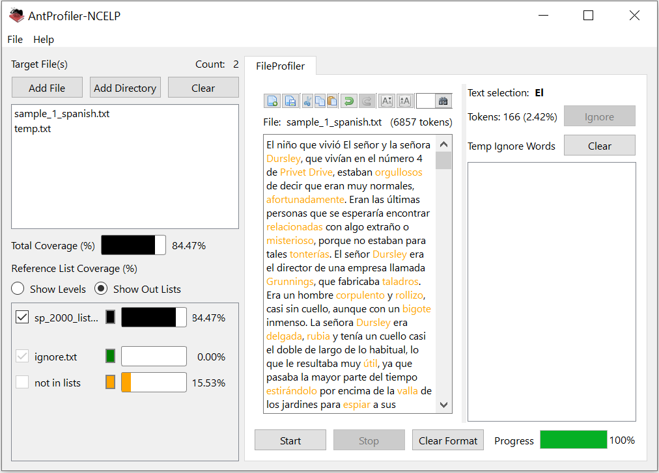
Lexical profiling (frequency)
This is what lexical profiling using AntProfiler-NCELP with a 2000-band frequency list looks like.
The total coverage value tells you the percentage of words in the text which appear in the top 2000.
Words in black have a frequency of 1-2000. Words in orange have a frequency value of >2000.
Teachers can edit texts directly in the program by removing, glossing or replacing highlighted words and, checking the edits for suitability.
Natalie Finlayson
Notes:
One of the NCELP STs (specialist teachers), Louise Bergon, from Archbishop Temple in Preston, used the profiler to analyse the Edexcel Higher French and Spanish reading papers from 2018 and 2019, finding consistently that around 90% words in them are in the top 2000. This really underlines the importance of teaching high-frequency words to all of our students, including those in Y8-11 heading for the current GCSE. We have to remember that the awarding bodies were explicitly told that words not listed in the vocabulary lists must appear in the exams, to stop the exams from being predictable. Which words are being included therefore? It’s unsurprising that they include high-frequency words in the top 2000.
When I’m asked whether the NCELP SOW are a good grounding for the current GCSE, I have to have to conclude, on the basis of word knowledge, (which we also know from research is the most decisive factor in achievement at GCSE) that they are. The NCELP SOW list the frequency of every word taught and keep a track of the overall frequency. Now that Y7 SOW and resources are finished, we can see that this % is between 90 – 92% for the different languages.
Analysis carried out by Louise Bergon:
Higher Edexcel Reading Papers from 2018 and 20019 in Spanish and French
2018 Higher French average score = 90.48%
2019 Higher French average score = 89%
2018 Higher Spanish average score = 90.87%
2019 Higher Spanish average score = 91.14%

Slide 24
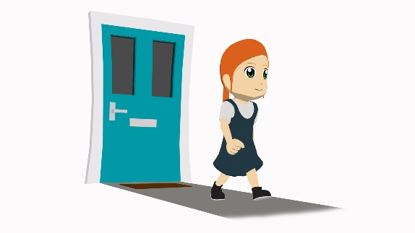
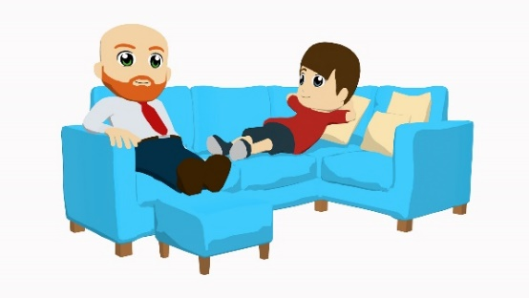
La familia López En casa
leer
Lucía
Diego
Daniel
Ana
Hola, soy Lucía y vivo con mi familia en una casa moderna y hermosa. También es bastante grande. Está en el centro de San Sebastián y somos felices allí. La casa tiene vistas bonitas del mar. Muy cerca tenemos tiendas, restaurantes y un museo famoso, el Museo San Telmo.
Tengo una habitación* grande y Daniel tiene otra bastante grande. Mis padres tienen una habitación pequeña, pero es muy bonita y tranquila. Mi madre tiene muchos libros allí y lee delante de la ventana. Mi padre tiene una mesa donde hace el trabajo de la escuela. La mesa está detrás de la puerta. Mi madre tiene otra mesa en el balcón donde escribe libros. Debajo de la cama tienen ropa, bolsas y zapatos nuevos. Los domingos, cuando hago tareas domésticas, organizo las cosas. Mi madre siempre comenta, ‘¡Tienes mucha paciencia!’. Es cierto porque es una tarea muy aburrida.
Fuera de la casa tenemos un jardín* con plantas, flores y árboles. En mi familia tenemos animales también. Tengo un gato blanco y negro. Pasa mucho tiempo detrás de la casa en los árboles con los pájaros. Daniel tiene un perro. ¡El gato y el perro no son amigos!
Artwork: Mark Davies
*la habitación = bedroom; el jardín = garden
Notes:
Victoria Hobson / Nick Avery / Rachel Hawkes
What difference does this tool make on a daily basis to us in our teaching? It’s probably useful to look at an example... This is a text from Term 3 Y7 1st week after half-term - It is impossible to analyse at a glance how ‘readable’ this text is. But, copy and paste it into the Ant-Profiler NCELP, and select the wordlist from up to and including the week before May half-term, and you can see at a glance that it has 97% readability. Even more usefully, you can see which words haven’t yet been taught, and make a judgement about any tweaks or glosses to make. You can edit the text within the profiler, and it instantly adjusts the readability.
Timing: 12 minutes (including reading activity on next slide)
Aim: To practise understanding of different persons of the verb ‘tener’.
Procedure: students first read the text through once silently, or listen to their teacher read it. Once finished, students work individually or in pairs/groups to find what different members of the family have (see task on the next slide).
Text readability (with reference to 2000 most frequent words, discounting proper nouns): 96%
Words from outside top 2000: restaurante [2626]; detrás [2044] – taught in 2.2.4; balcón [3133] – seen in poem ‘La plaza tiene una torre’ (2.1.1) and later revisited as part of revisiting cycle; doméstico [2521].
Text readability (using Y7 SoW vocabulary up to 3.1.6 and discounting cognates/near-cognates): 97%
All words have been previously taught in the Y7 scheme of work or used for phonics practice, with the exceptions listed below:
Cognates/near-cognates: ‘Comentar’ [634], ‘doméstico’ [2521], ‘restaurante’ [2626], paciencia’ [2357] and ‘moderno’ [861].
‘Mi’ (and ‘mis’) will be taught as a grammar feature in Y7, T3.2, Week 3. The word has frequently appeared in earlier resources, however.
Glosses are given for ‘jardín’ [1195] and habitación [1069], as these words haven’t been previously taught and they are not cognates.
We would expect students to be able to understand ‘donde’ and ‘cuando’ as the question forms of these words (with tilde) have been taught in Y7.
‘Cierto’ and ‘porque’ have been encountered in phonics practice activities. We recommend eliciting the meaning of these words, since they may be less familiar.
It may be possible for students to guess the meaning of ‘negro’ in ‘un gato blanco y negro’, given that the collocation ‘black and white’ also exists in English.

Slide 25
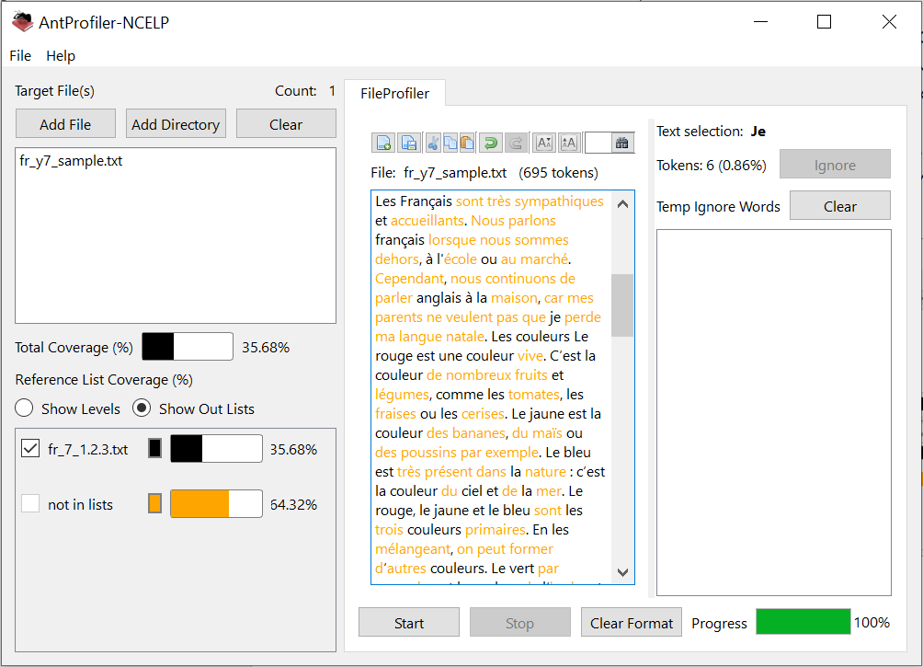
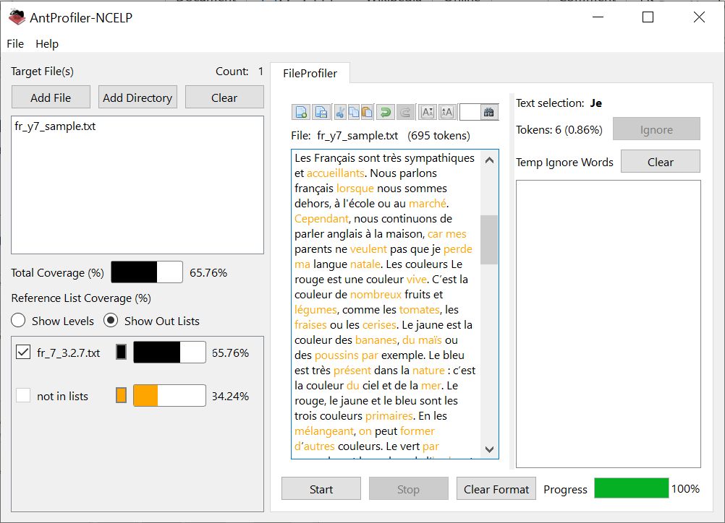
Lexical profiling (NCELP SOW)
If you are adopting the NCELP scheme of work, you might be interested to know how suitable a text is for inclusion in a given NCELP week.
Using special SOW-compatible wordlists created by NCELP, AntProfiler-NCELP can perform bespoke lexical profiling.
On the top right, you can see the results of profiling a text using the wordlist for French Y7 SOW 1.2.3.
On the bottom right, you can see the results of profiling the same text using the wordlist for French Y7 SOW 3.2.7.
Natalie Finlayson

Slide 26
Trapping the forms
Trapping a form means making a language feature essential for completion of the task.
It can be tricky to do this, particularly in spoken interaction!
It is much easier to achieve in straightforward spoken or written production tasks i.e., translation from English into the new language.

Slide 27
hablar / escuchar
Hablas con un compañero sobre una amiga en Italia.
Persona A: Tell your partner where you go and when, and where your friend in Italy goes, and when.
Use ‘voy’ to talk about ‘I’.
Use ‘va’ to talk about ‘she’.
Persona B: Escucha y completa la tabla en inglés.
Ejemplo:
Persona A:
Persona B:
 | X | el norte – los domingos
 | ‘I go’ or ‘she goes’? | ¿Dónde? | ¿Cuándo?
1
¿Dónde y cuándo?
Yo
Mi amiga
She goes
the north
Sundays
Va al norte los domingos.
Nick Avery / Amanda Izquierdo
Notes:
The no.1 aim of the first example here it to trap the verb form (it’s helpful that Spanish usually drops the pronoun so it’s natural for students to have to rely on the verb form/ending to distinguish between different persons)
However, it doesn’t 100% trap the ‘al’ or ‘a la’ because students can still write down the necessary information (i.e. the where) even if their partner says ‘al’ when it should be ‘a la’. This is a secondary focus rather than the main aim of the task. To trap two target features at once is often either impossible or renders the interaction too disjointed and awkward
There is sometimes a delicate balance to be found between being able to trap the form and setting the parameters for a satisfying spoken exchange
However, the structure of this task strongly tips the balance in favour of students producing the correct ‘al’ or ‘a la’ by: i. having provided ample practice in the listening and reading tasks that precede this one ii. providing a supportive structure that provides some of the vocabulary for the task, freeing up attentional resources to focus on the verb ending and the ‘al’/’a la’.
Timing: 10 minutes
Aim: The main aim of this paired speaking/listening activity is correct use and understanding of ‘voy’ and ‘va’ to convey ‘I go’ or ‘s/he goes’. The activity also provides the opportunity to consolidate use of ‘al’ with singular masculine nouns and ‘a la’ with singular feminine nouns.
The lexical information (where and when each person goes) is given in Spanish to the person speaking. This allows for greater focus on the grammar (choosing whether to say ‘voy’ or ‘va’ and ‘al’ or ‘a la’). This also prevents copying, since the listener is expected to write the English. In lesson 2, the person speaking will be expected to produce the sentence in Spanish, based on an English prompt. Procedure: 1. Before starting, copy down a blank version of the grid on the right-hand side of this slide, numbered 1-6 2. Person A starts speaking – Person B completes the details in his/her grid. 3. Roles can be swapped after every turn, or after Person A has done all six utterances.
4. Answers are checked on the next slide.
Clipart from http://clipart-library.com

Slide 28
Persona A
Persona B
hablar / escuchar
 |  |  | ¿Dónde y cuándo?
 | X |  | el norte – los sábados
 |  | X | el edificio antiguo – durante las vacaciones
 |  | X | la estación – por la mañana
 | X |  | el este – en enero.
 | X |  | la clase de Chino – los martes
 |  | X | la playa – todas las tardes
 |  |  | ¿Dónde y cuándo?
 | X |  | el banco – a veces
 | X |  | la iglesia grande – los domingos
 |  | X | el barrio bonito – normalmente
 |  | X | la calle – todos los días.
 | X |  | el mercado – febrero
 |  | X | la tienda – los lunes
Yo
Mi amiga
Yo
Mi amiga
1.
1.
2.
2.
3.
3.
4.
4.
5.
5.
6.
6.
Nick Avery / Amanda Izquierdo
Notes:
SPEAKING CARDS - DO NOT DISPLAY DURING ACTIVITY
Target sentences:
Person A
Voy al norte los sábados.
Va al edificio antiguo durante las vacaciones.
Va a la estación por la mañana.
Voy al este en enero.
Voy a la clase de chino los martes.
Va a la playa todas las tardes.
Person B
Voy al banco a veces.
Voy a la iglesia grande los domingos.
Va al barrio bonito normalmente.
Va a la calle todos los días.
Voy al mercado en febrero.
Va a la tiendas los lunes.

Slide 29
Persona A
Respuestas
hablar / escuchar
Persona B
 | ‘I go’ or ‘she goes? | ¿Dónde? | ¿Cuándo?
1
2
3
4
5
6
 | ‘I go’ or ‘she goes? | ¿Dónde? | ¿Cuándo?
1
2
3
4
5
6
I go
the bank
sometimes
I go
the north
Saturdays
the old building
during the holidays
I go
the big church
Sundays
She goes
the beautiful neighbourhood
the station
in the morning
She goes
normally
She goes
I go
the east
January
She goes
the street
every day
I go
the Chinese class
Tuesdays
I go
the market
February
the shop
Mondays
She goes
the beach
every evening
She goes
Nick Avery / Amanda Izquierdo
Notes:
ANSWERS – DISPLAY DURING FEEDBACK

Slide 30
Chez Léa
parler
Regarde l’image. Travaille avec un(e) partenaire et dis les phrases en français.
Partenaire A
1
Léa lives in a tall building.
Léa habite dans un haut bâtiment.
2
She is speaking to Amir outside.
Elle parle à Amir dehors.
3
The street is quiet.
La rue est calme.
4
There is a red car in front of the house.
Il y a une voiture rouge devant la maison.
5
The door isn’t open.
La porte n’est pas ouverte.
Artwork: Chloé Motard
Notes:
Applied speaking: picture description
In this speaking activity, students apply their knowledge of a range of vocabulary and grammar points to describe an image.
Students work in pairs. Partner A says the sentences to describe the image on this slide, with Partner B giving corrections and feedback. Partner B’s image and sentences are on the following slide. Answers are displayed on clicks.
Estimated timings: approx. 10 minutes

Slide 31
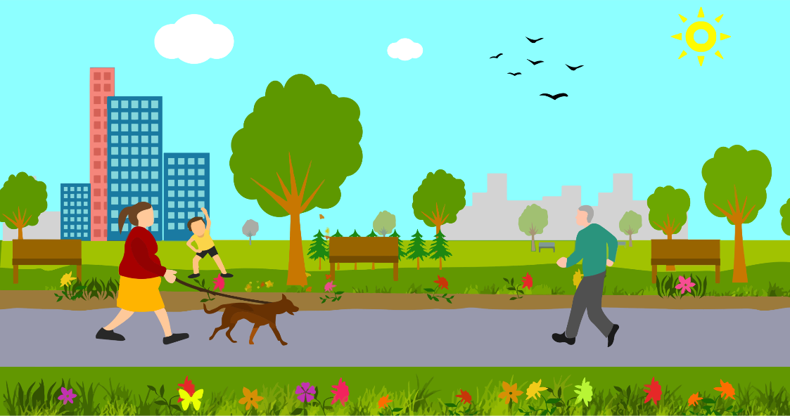
hablar
Describe la imagen a un compañero.
Say the five sentences in Spanish.
A
B
The house is big.
Diego is near a window.
Daniel has a letter.
Lucía and Ana are outside.
They have some bags.
The park is pretty.
It has flowers and trees.
There are also some birds.
The buildings are behind the park.
The dog is happy (now).
Victoria Hobson / Nick Avery
Notes:
Speaking: 6 minutes
This activity reflects the type of speaking task that students will do in the ‘applying your knowledge’ test in 3.2.2 (next week), using Vocaroo.
A number of previously taught features are revisited here, including several features revisited in this week’s lessons. These include TENER; SER for permanent traits; ESTAR for location; ESTAR for temporary state; ‘hay’; use of del vs de la; choice of definite vs indefinite article.
Encourage students to take their time (up to a minute) to think what they want to say, but to try not to write it down. Encourage them also to break each sentence down into groups of words as this may make the task seem more achievable.

Slide 32
hablar
Respuestas
A
B
La casa es grande.
Diego está cerca de la ventana.
Daniel tiene una carta.
Lucía y Ana están fuera.
Tienen unas bolsas.
El parque es bonito.
Tiene flores y árboles.
Hay unos pájaros también.
Los edificios están detrás del parque.
El perro está feliz.
1
1
2
2
3
3
4
4
5
5
Victoria Hobson / Nick Avery
Notes:
This is the answers slide. Most of the speaking tasks in the Term 3 resources have additional audio designed to support students who are completing speaking tasks at home.
ANSWERS
Click on the orange action button to hear the sentence. This can be useful for students accessing this material from home to check the accuracy of their pronunciation.

Slide 33
Assessing the knowledge
There are two types of assessment in the third term of Year 7 SOW:
an achievement test designed to assess students' knowledge of a principled sample of phonics, vocabulary and grammar features
an applying your knowledge test that assesses students' ability to apply knowledge of phonics, vocabulary and grammar in context. Tasks include listening comprehension, oral picture description and short translation tasks.
Notes:
And finally, one of the things I’ve got most excited about recently is assessment. I’ve always been a bit uncomfortable about the imprecision of some tests we’ve used in school, some of which I designed myself over the years! I’ve felt for a long time that the most secure information I get about how students are doing is when I do sentence level English → new language (or vice versa) translation tasks as short tests in class. I hadn’t really analysed why these feel so much more secure than the sort of task that gets students to read a passage and complete true/false questions, but clearly it’s because one is a test of what they have been taught, and the other is a more holistic test of what they’ve been taught plus what they can work out from the context (i.e. it implies a use of strategies, and one which is quite loose and open-ended).
I’ve also been unconvinced by the amount of time tests end up taking out of teaching, particularly if there’s an extended preparation or revision period. The 2nd set of tests that we’ve created this year for Y7 is designed to be done over two lessons. The achievement test assesses each strand of phonics, vocabulary and grammar in each mode and modality, so grammar is assessed through speaking, listening, reading and writing, for example. I particularly like some of the vocabulary tests – they also make very good classroom activities! The applying your knowledge test looks much more like a test we recognise (listening passage with comprehension, reading and writing translations and picture description. But what feels particularly good about it is that across the whole test, every grammar feature taught is tested somewhere.

Slide 34
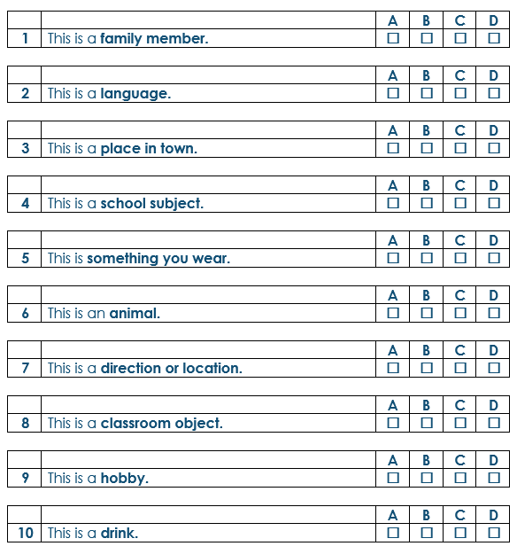
Y7 Spanish achievement test
Here are ten English categories. You will hear the categories read out to you.
Then, you will hear four words in Spanish.
Click on a box to put a cross (x) under one word (A, B, C or D) that is a good example of the category.
You will hear each set of Spanish words twice.
Nick Avery
Notes:
This is an extract from the Y7 Spanish achievement test.
VOCABULARY (PART B)
[Words in the list have a 6s pause between each word. Each list of four words plays twice.]
1) A – el correo B – el padre C – el vaso D – el parque
2) A – la moneda B – el material C – el chino D – la fruta
3) A – la carta B – el hermano C – el perro D – el mercado
4) A – la palabra B – la tarea C – la mesa D – el arte
5) A – la ropa B – la música C – el barco D – el viernes
6) A – la actividad B – el gato C – la noche D – el lugar
7) A – el jueves B – el trabajo C – el oeste D – el producto
8) A – el centro B – el bolígrafo C – el tiempo D – el pueblo
9) A – bailar B – necesitar C – llevar D – dar
10) A – la silla B – la ciudad C – el domingo D – el agua

Slide 35
Kategorien
Hör drei Wörter an. Schreib die Kategorie.
hören / schreiben
1
Mittwoch, Freitag, Dienstag
7
die Frage, die Antwort, Englisch
Wochentage
Sprache
2
der Chor, das Orchester, das Konzert
die Tafel, die Tür, die Flasche
Musik
8
Klassenzimmer
3
die Schwester, der Bruder die Mutter
das Handy, der Gutschein, die Katze
Familie
9
Geschenke
4
die Moschee, das Geschäft das Museum
10
der Fluss, der See, das Schwimmbad
Großstadt
Wasser
5
der Morgen, der Nachmittag,
der Abend
11
der Arzt, das Mädchen, der Junge
Tag
Menschen
6
Herr, Frau,
Naturwissenschaften
12
die Woche, der Monat, das Jahr
Unterricht
2020
Familie | Musik | 2020 | Geschenke | Sprache | Tag | Unterricht
Menschen | Klassenzimmer | Wasser | Wochentage | Großstadt
Rachel Hawkes
Notes:
This is from the final lesson in Y7 that revises 141 nouns.
Vokabeln [4] Time: 10 mins approx.
This written task revisits 42 further nouns. Here time is once again constrained to compel learners to comprehend words more quickly, a valuable component in vocabulary practice that speeds up the process of recall.
1. Students write 1-12 in books. 2. They listen to each set of three words and write the most appropriate category word. Note: Teachers may wish to encourage students to write any words down that they hear, so that they have more time to review them and select the most appropriate category word. 3. Answers (including a written version of the three words in each set) appear on mouse clicks. 4. At this point, teachers may wish to encourage learners to ask the meanings of any words they can’t remember the English for.
Word frequencies: Mittwoch [1091] Freitag [1277] Dienstag [1032] Chor [3714] Orchester [2553] Konzert [1721] Schwester [776] Bruder [687] Mutter [227] Moschee [>4034] Geschäft [663] Museum [1360] Morgen [311] Nachmittag [1426] Abend [313] Herr [187] Frau [103] Naturwissenschaften [3772] Frage [152] Antwort [708] Englisch [628] Tafel [3660] Tür [400] Flasche [1762] Handy [2466] Gutschein [78/3025] Katze [1500] Fluss [1551] See [1167] Schwimmbad [>4034/1579] Arzt [614] Mädchen [537] Junge [630] Woche [209] Monat [306] Jahr [53] Familie [310] Musik [471] Großstadt [3314] Tag [108] Unterricht [1107] Sprache [367] Klassenzimmer [609/619] Geschenk [3610] Wasser [297] Mensch [104]
Transcript: [1] Mittwoch, Freitag, Dienstag [2] der Chor, das Orchester, das Konzert [3] die Schwester, der Bruder, die Mutter [4] die Moschee, das Geschäft, das Museum [5] der Morgen, der Nachmittag, der Abend [6] Herr, Frau, Naturwissenschaften [7] die Frage, die Antwort, Englisch [8] die Tafel, die Tür, die Flasche [9] das Handy, der Gutschein, die Katze [10] der Fluss, der See, das Schwimmbad [11] der Arzt, das Mädchen, der Junge [12] die Woche, der Monat, das Jahr

Slide 36
In this session...
Minimal pairs (P)
Multiple word meanings (V)
Processing pairs (G)
Using unknown words (P)
Teaching word patterns (V)
Lexical profiling (V)
Trapping the forms (G)
Assessing the knowledge (P,V,G)
ALL London June 2019
Other sessions: https://ncelp.org/ncelp-teacher-cpd/
Notes:
Image by OpenClipart-Vectors from Pixabay
This is a list of what we just talked about. And maybe it’s a good time to open up to questions (I hope I have enough time!). If there aren’t’ any questions, I will just leave you with the link to the session and thank you very much for joining me today.

Slide 37
Old dogs can learn new tricks:
This presentation: https://ncelp.org/ncelp-teacher-cpd/
research- and practice-informed ideas for language teaching
Author name(s): Rachel Hawkes
Artwork: Steve Clarke
Date updated: 14 / 06 / 20

