Slide 1
An Introduction to NCELP pedagogy and resources Saturday 2nd October
Presenters:
Nick Avery – Resource Developer
Jo Cairns – Specialist Teacher,
Archbishop Temple School, Preston

Slide 2
Overview
What is NCELP?
Principles of pedagogy and sample Spanish resources
Q&A
Notes:
This session introduces NCELP, explaining the project's aims and some of the core principles of our pedagogy. We’ll be talking in particular about three areas of knowledge: phonics, vocabulary and grammar.
For each of these, we’ll also present some sample Spanish resources that were made as we resourced our schemes of work.
We plan to leave about 10 minutes for questions at the end of the session.

Slide 3
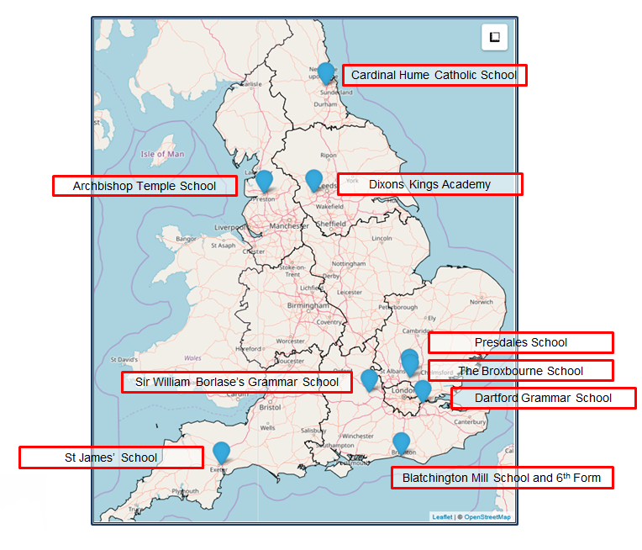
What is NCELP?
Notes:
NCELP (National Centre for Excellence for Language Pedagogy) was established in December 2018, funded by the UK Government’s Department for Education (DfE) to create and deliver research-informed resources and professional development for teaching French, German, and Spanish in collaboration with a network of school teachers. NCELP is housed within the University of York’s Department of Education. NCELP works with 9 Lead Schools shown here. Each lead school has a set of ‘hub’ schools in its area with which it works closely to support implementation of NCELP pedagogy and resources, making a network of around 45 schools.
As our strapline says, our business is to understand, improve, and promote the learning of foreign languages. This involves a wide range of activities such as creating a wide range of resources, developing and delivering CPD, maintaining the resource portal, communicating research findings, monitoring progress, addressing feedback, and providing technical and administrative support.

Slide 4
NCELP aims to…
Connect classroom practice and research
Develop pedagogy, with resources to deliver it
Improve intrinsic motivation and increase GCSE uptake
Notes:
NCELP’s overarching purposes are:
1 to link research and practice more closely than has previously been the case – a longstanding issue due to a lack of time, tight school budgets and issues of access.
2 to develop research-informed pedagogy and a full suite of supporting resources – this means taking account of relevant research and working with teachers to adapt and align their pedagogy with those findings.
3 to improve intrinsic motivation and increase numbers at KS4 – research suggests that pedagogy can improve intrinsic motivation (even though there are other external factors outside of our control)
The bottom line for the DfE (and therefore for NCELP, too) is that more students choose to continue to study languages at KS4. Currently this is the situation (talk through the bullets):
- Fewer than 1/2 Y11 students takes a language at GCSE
- Only 1/3 all Y11 pupils achieves a Grade 4 or better
There is also regional and socio-economic inequality of language learning provision
--------------------------------------------------------------------------------------
Full notes
Let’s take the core purposes one by one. Why has it been and continues to be a challenge to link language learning research and practice? It is not for a lack of interest on the part of teachers (or motivation on the part of researchers). The difficulties are lack of time and money and problems of access – this includes the difficulty of gaining access to high-quality research journals. Once no longer in full-time study, access to these journals is expensive and not supported by school CPD budgets. There are also sometimes issues in a) relating the terminology of research to the pedagogy of the classroom and b) in discerning the applicability of findings from studies in which the contexts differ wildly from our own (e.g. university learners of English in China vs secondary-age learners of FL in the UK).
So, NCELP aims help improve this situation.
2 to develop research-informed pedagogy and a full suite of supporting resources
The difficulties just mentioned explain why research and practice are not generally mutually informing.
NCELP’s work aims to articulate pedagogy that has these features: it does take account of relevant and compelling research findings and then works directly with teachers to adapt and align pedagogy with those findings. It seeks to describe teaching methods that are sound and work for as many pupils as possible for as much of the time as possible, with the aim of making language teaching less reliant on personal charisma and craft knowledge of individual teachers.
It stresses the importance of establishing a body of phonics, vocabulary and grammar knowledge and sets out to define what that could look like.
It brings this knowledge together in practice of various kinds, but above all practice that doesn’t lose the connection with the meaning and the function of language.
In all this, the aspect that is downplayed is the topic, for reasons we will come back to.
3 in order to improve intrinsic motivation and increase numbers at KS4.
Re increasing intrinsic motivation…
Leaving aside factors associated with demotivation that lie outside our control (English is the global lingua franca, Brexit, harsh grading at GCSE and A level, etc…),
NCELP is set on developing pedagogy to improve intrinsic motivation, which is something that research suggests we can influence through changes to pedagogy.
The innovations to pedagogy that NCELP suggests are designed to: 1] make explicit / increase the transparency of certain features of a language that are particularly tricky to notice, and therefore to learn 2] increase the level of understanding in the classroom and take sufficient time and include sufficient practice to enable students to feel that they are achieving and progressing
3] explicitly teach students how to decode the L2 accurately (phonics), as research has shown that a) not to do so means that students don’t learn how to do and b) not to be able to do so is demotivating for students 4] ensure that we focus on teaching a large proportion of high-frequency words (and that we are explicit about this) so that students are learning language that is important for communication outside (as well as inside) the classroom, and that they know they are.
Re increasing uptake…
The bottom line for the DfE (and therefore for NCELP, too) is that more students choose to continue to study languages at KS4. Currently this is the situation (talk through the bullets):
- Fewer than 1/2 Y11 students takes a language at GCSE
- Only 1/3 all Y11 pupils achieves a Grade 4 or better
- In 34.5% state schools the majority of the Y9 cohort no longer learns languages (2-year KS3)
- There is regional and socio-economic inequality of language learning provision (for example, there is regional disparity (62% in London, 40% in the North East, 29% in Middlesborough), but also disparity in provision between schools with low PP / low FSM (Free School Meals) numbers and those with a much higher ratio of students from more challenging socio-economic backgrounds.

Slide 5
Current GCSE review
Nov, 2019: Department for Education convened an independent panel to review the current MFL subject content
Key recommendations:
Particular themes and topics no longer specified
Vocabulary selection informed by frequency of occurrence
Creation of a word list to use for designing assessment
Notes:
Given that increasing GCSE uptake is a major aim of the project, it is worth noting that a review has recently been undertaken of the existing GCSE subject content for French, German and Spanish.
In November 2019 the DfE announced a 7 member expert panel that would consider potential changes to the existing subject content. One of the motivators of this was to align policy with the recommendations of the 2016 TSC pedagogy review. Earlier this year, the panel’s recommendations were put to public consultation. These include
A GCSE in which set themes and topics are no longer specified. One reason for this is that when topics are taken as a starting point, the vocabulary chosen is very often topic-specific, rather than transferrable across contexts, and therefore limited in usefulness.
It is proposed that vocabulary selection should be informed by frequency of occurrence. It is proposed that this will allow students to talk about a wide range of themes and topics.
It is proposed that exam boards create a set vocabulary list, which will form the basis for vocabulary assessment. To date, there has been a requirement for unknown language to be included, but it is now proposed that students are only tested using words on the list, and that any unknown words (no more than 2% of the total) would be glossed.
To the best of our knowledge, those changes are due to come into effect.

Slide 6
The NCELP Pillars
Pupils need to gain systematic knowledge of the vocabulary, grammar, and sound and spelling systems (phonics) of their new language, and how these are used by speakers of the language.
They need to reinforce this knowledge with extensive planned practice and use in order to build the skills needed for communication.
+ meaningful practice
Teaching Schools Council (2016), MFL Pedagogy Review.
Notes:
Regardless of the nature of the assessment, the core purpose for language learning has not changed: this is the need to understand and communicate about cultures and societies (both their own and in countries where the language is spoken), and to stimulate interest in the language itself.
To be able to do this, students need to gain an understanding of the fundamental building blocks of language: the vocabulary, grammar and sound/spelling systems, and how these are used. This then needs to be reinforced with extensive planned practice and use.
Image by Steve Clarke

Slide 7
Phonics
explicit teaching of the key sound-spelling correspondences (SSCs)
improves ability to accurately ‘sound out’ unknown words (reducing reliance on English SSCs) and produce accurate spellings
positively associated with motivation, autonomy and vocabulary learning
supports errorless learning from first exposure
staged roll-out, with systematic revisiting in order to maintain progress
Notes:
The first of the three ‘strands’ is phonics: explicit teaching of the relationships between the letters of written words and their sounds.
In recent years there has been a lot of emphasis on phonics teaching in primary education for learning English, but this is still relatively uncommon in the MFL classroom.
Yet research suggests that without explicit phonics teaching, learners make little progress and that English SSCs remain entrenched. Students know that the words should sound different, but they are unsure how they should sound
There are many benefits associated with explicit phonics teaching. Research has found that this improves students’ phonological decoding ability (their ability to sound out unknown words).
There are also many related benefits in terms of motivation and confidence in oral and written production, autonomy and vocabulary learning.
This also supports errorless learning – avoiding inaccurate representations regarding how the how new language sounds and is spelt.
In the NCELP schemes of work, the SSCs are gradually introduced and are revisited over time – this is key in order to maintain progress.
(Sources: Erler, 2003, 2004; Erler & Macaro, 2012; Porter, 2014, forthcoming; Woore, 2009, 2010, 2011, 2014, 2018).

Slide 8
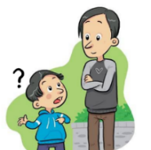
a
e
i
o
u
ll
libro
alto
elefante
idea
yo
universo
llamar
l
ca
co
cu
ce
ci
z
MADRID 1KM
casa
comer
cuerpo
cerca
cierto
zona
ga
go
gu
ge
gi
j
ganar
gol
preguntar
gente
imaginar
ojo
ñ
mano
v
celebrar
rr
pero
h
porque
qui
guerra
gui
español
n
ver
b
perro
r
hablar
que
quiero
gue
guitarra
Notes:
Phonics poster with key Spanish SSCs
This can be used just to give an overview of those that are taught and practised in the NCELP Spanish scheme of work. It is worth re-emphasising here the phased roll-out and focused nature of the practice. In any given week, one SSC or a group of closely related SSCs is introduced. Later on, multiple SSCs can be brought together in revision activities.
Each SSC here as a ‘source word’ (a highly frequent word that contains the target SSC and can be captured in an image and/or gesture).

Slide 9
Teaching steps
Present the SSC itself, the source word, and five cluster words and their meanings
Practise with the SSC further in a variety of listening and read aloud activities
Produce the SSC in other contexts, with increasing fluency, e.g., unprompted classroom interaction (¿Cómo se dice…?)
Notes:
In terms of practical teaching steps, we might begin with a presentation of the SSC itself, along with its source word and a further five ‘cluster’ words. These can be then be practised through reading and listening activities, then used more freely (e.g. in spontaneous classroom interaction).
Now let’s see a few examples of these steps in lesson material.

Slide 10
ce
doce
centro
MADRID 1KM
cerca
necesitar
necesario
[necessary]
[to need]
parecer
[to seem; appear]
Notes:
Introduce and elicit the pronunciation of the individual SSC ‘ce’ and then the source word again (with gesture, if using). Then present and elicit the pronunciation of the five cluster words.
The cluster words have been chosen for their high-frequency, from a range of word classes, with the SSC (where possible) positioned within a variety of syllables within the words (e.g. initial, 2nd, final etc.). Additionally, we have tried to use words that build cumulatively on previously taught SSCs (see the Phonics Teaching Sequence document) and do not include new SSCs. Where new SSCs are used, they are often consonants which have a similar symbol-sound correspondence in English.

Slide 11
ce
doce
centro
cerca
necesitar
necesario
parecer
Notes:
Without the images, students focus this time again closely on the SSC and the cluster words.

Slide 12
ce
doce
centro
cerca
necesitar
necesario
parecer
Notes:
Without the images or sound, students have to pronounce the words themselves.

Slide 13
ci
cine
diciembre
ciencias
ciudad
cierto
decir
[to say; tell]
Notes:
Introduce and elicit the pronunciation of the individual SSC ‘ci’ and then the source word again (with gesture, if using). Then present and elicit the pronunciation of the five cluster words.
The cluster words have been chosen for their high-frequency, from a range of word classes, with the SSC (where possible) positioned within a variety of syllables within the words (e.g. initial, 2nd, final etc.). Additionally, we have tried to use words that build cumulatively on previously taught SSCs (see the Phonics Teaching Sequence document) and do not include new SSCs. Where new SSCs are used, they are often consonants which have a similar symbol-sound correspondence in English.

Slide 14
ci
cine
diciembre
ciencias
ciudad
cierto
decir
Notes:
Without the images, students focus this time again closely on the SSC and the cluster words.

Slide 15
ci
cine
diciembre
ciencias
ciudad
cierto
decir
Notes:
Without the images or sound, students have to pronounce the words themselves.

Slide 16
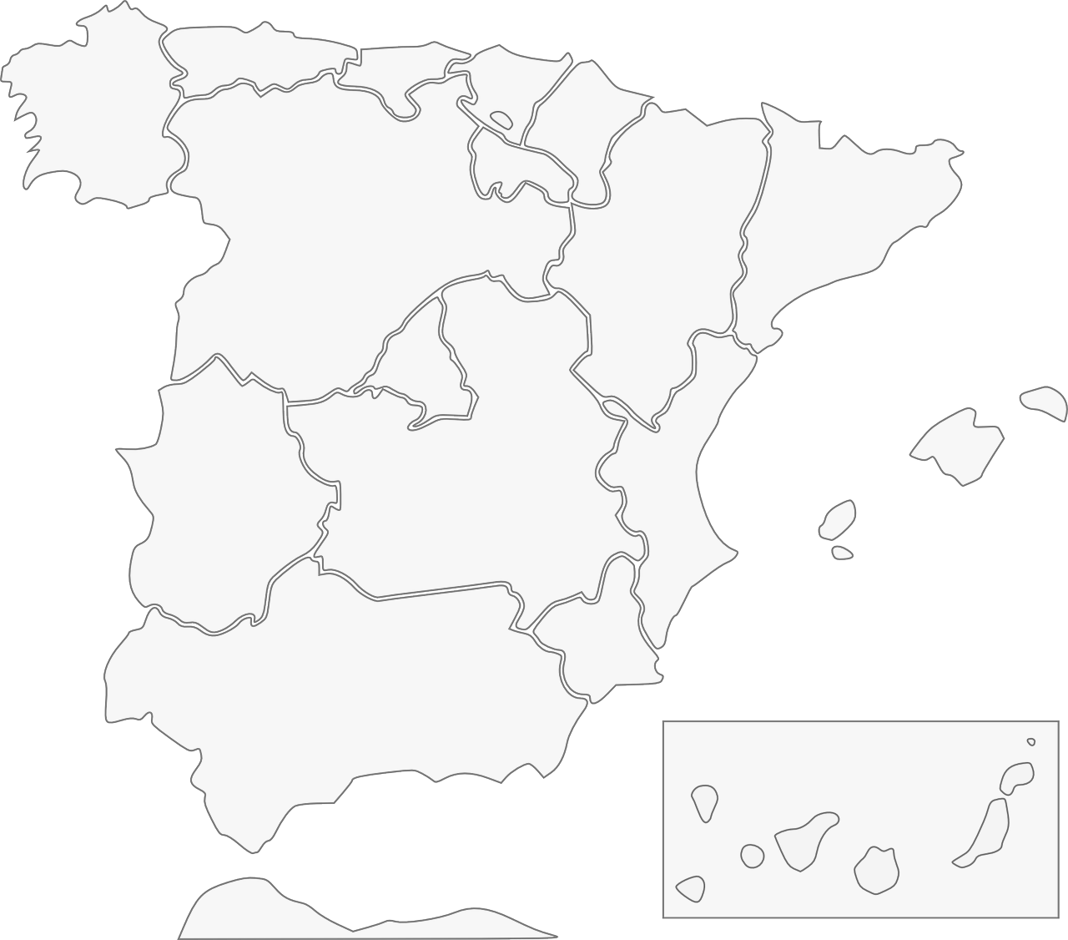
Fonética: [ci] & [ce]
escuchar / escribir
Escucha y escribe en español el nombre correcto del lugar.
1
Galicia
2
Barcelona
3
Cáceres
4
Valencia
Albacete
5
Murcia
Andalucía
7
6
Ceuta
8
Notes:
This is an example activity used to practise transcription of the SSCs [ce] and [ci]. Students listen and complete the place names on the map. If students need extra support, the activity could be adapted so that they simply need to add the missing SSC. The use of the map is also a chance to integrate language learning with cultural knowledge regarding Spanish cities and autonomous communities.
------------
Teacher notes:
Timing: 5 minutes
Aim: to revisit the sound-spelling correspondence for the SSCs [ce] and [ci] with eight names of cities/autonomous communities Spain
Procedure:
Click on the action button to play the audio.
Reveal the place by clicking on the red line. Answers can be given in any order.
Transcript:
1. Galicia
2. Barcelona
3. Valencia
4. Murcia
5. Ceuta
6. Andalucía
7. Albacete
8. Cáceres

Slide 17
SSCs [CE] y [CI]
escuchar
Remember, there are different ways to pronounce CE and CI.
In most of mainland Spain, the ‘c’ before ‘e’ or ‘i’ is pronounced
like _____ in English.
‘th’
In the Canary Islands (part of Spain) and Latin America, this ‘c’ is often pronounced like an ____.
‘s’
Escucha. Es ¿España o Canarias / Latinoamérica?
ciencias
España
1
________________________________
ciencias
Canarias / Latinoamérica
2
________________________________
doce
Canarias / Latinoamérica
3
________________________________
doce
España
4
________________________________
Notes:
Learning can be extended by explaining to students the geographical variation in pronunciation of key SSCs, such as [ce] and [ci]. Here, students recap the key information, and can be given a walk-through with a couple of examples that contrast the two types of pronunciation. This prepares them for the subsequent listening activity.
--------------------------
Teacher notes
Phonics recap slide
Timing: 3 minutes
Aim: to revisit the SSCs [CE] and [CI] and consolidate understanding of the different ways in which they are pronounced in the Spanish-speaking world.
Procedure:
Read the explanation, eliciting the answers from students where prompted by gaps.
Play the audio and ask where the person is from (‘¿La persona es de…?’)
Ask students which other words they can recall from Y7 which have [ce] and [ci]. This will help to prepare them for the next activity.
Anticipate, for [CI], cine, diciembre, decir, cierto, ciudad
Anticipate, for [CE], centro, necesitar, necesario, cerca, doce, parecer.
Notes:
Teachers may also find it useful to consider the information from exam board specifications below:
AQA : “The [listening] test will be studio recorded using native speakers speaking Castilian in clearly articulated, standard speech at near normal speed. Different types of spoken language will be used, using familiar language across a range of contemporary and cultural themes. (p. 82)
EdExcel : “For listening and reading assessments, the majority of contexts are based on the culture and countries where the assessed language is spoken. […] It is, therefore, important that students are exposed to materials relating to Spanish-speaking countries throughout the course.” (p. 7)
WJEC : “This GCSE specification in Spanish for use in Wales is based on a conviction that learners studying a modern foreign language will develop their desire and ability to communicate with and understand speakers of Spanish in a variety of contexts and for a variety of purposes.” (p. 3)

Slide 18
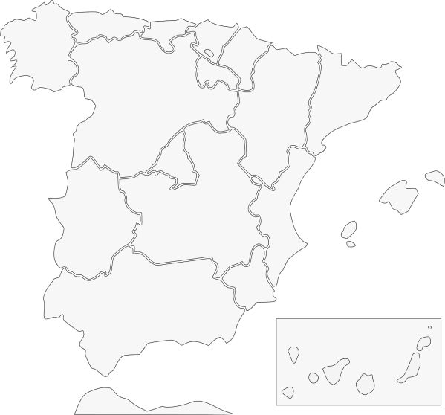
Pilar y Conchi son de lugares diferentes, así que no tienen la misma pronunciación de [ce] y [ci]. Escucha. Quién habla, ¿Conchi o Pilar? Escribe el lugar también.
escuchar
Pilar (Islas Canarias) | Conchi (Alicante)
İHola! ¿Cómo estás? Soy Pilar y soy de Puerto Rico en las Islas Canarias.
1
Ceuta
2
Galicia
3
Valencia
4
Murcia
İBuenos días! Soy Conchi y soy de Alicante en la Comunidad Valenciana.
5
Cáceres
6
Barcelona
7
Andalucía
8
Albacete
Notes:
Phonics practice activity
Timing: 6 minutes
Aim: to raise awareness of the different ways in which the SSCs [ce] and [ci] are pronounced in the Spanish-speaking world.
Procedure:
Go through instructions with students.
Check understanding of instructions by asking students an example. E.g., ciudad (pronounced with seseo): ¿Es Pilar or Conchi? ¿Por qué? Sí, perfecto, porque Pilar es de las Islas Canarias. ¿Y en Alicante, cómo es la pronunciación?
Play the audio and ask students to tick the correct column and write the place with the target SSCs.
Check answers, including spelling, in the feedback.
Note:
Some students may be able to write the entire sentence.
Transcript:
Tengo un amigo de Ceuta.
Mi prima vive en Galicia
¿Tu madre es de Valencia?
Voy a ir de vacaciones a Murcia.
Hay una universidad muy famosa en Cárceres.
Barcelona tiene unos museos geniales.
Andalucía es una zona muy bonita.
Albacete está en el sureste de España.

Slide 19
Grammar
practising with ‘pairs’ of features (e.g. –é vs –aste)
activities that require learners to connect form with meaning
other cues may need to be removed (e.g., time markers)
plenty of initial comprehension practice (reading and listening)
later moving to production (speaking and writing)
(e.g., Marsden, 2006; Kasprowicz & Marsden, 2018; VanPatten & Cadierno, 1993; VanPatten & Oikkenon, 1996)
Notes:
There are of course many factors that affect what can be effectively learnt, and when, but here are some general principles drawn from research in second language learning.
The first is to practise pairs of features together. For example, two verb endings can be ‘paired up’ to juxtapose two meanings (or functions). Practising a whole new set of features together, e.g., a full range of verb endings, is unlikely to lead to be effective, as it is beyond what most learners can pay attention to at any one time.
The practice itself should require attention to form and meaning. A simple example could be to read sentences with two types of verb ending and decide, in each case, when an action occurred.
It may be necessary to remove other ‘cues’ from the sentence, such as time markers, as these otherwise give the answer away, and it is no longer necessary to pay attention to the grammar.
There should be plenty of initial reading and listening practice with the new features before production, and there is evidence that this controlled approach can actually make the production practice more successful.

Slide 20
Las vacaciones de Lucía y Daniel
leer
leer
Lucía habla con Nadia. Lucía describe las vacaciones en San Sebastián.
Lee las frases y escribe quién hizo cada actividad.
Who… | Lucía (‘I’) | Daniel (‘he’)
1. decided to spend time in San Sebastián?
2. went out every afternoon/evening?
3. ran every day on the beach?
4. took the bus on Monday?
5. went up the mountain on foot?
6. picked up the tickets (for an event)?
1. En julio decidí pasar tiempo en San Sebastián.
2. Salí todas las tardes.
3. ¡Corrió en la playa todos los días!
4. El lunes cogí el autobús.
5. Subió la montaña a pie.
6. Recogí las entradas.
Notes:
This is an example of a grammar practice activity in which we practise with a single pair of features: the –í and –ió verb endings on –er and –ir verbs. As you can see, students read six sentences and have to decide, in each instance, who Lucía is talking about. Is she talking about herself or her brother Daniel? You’ll notice that there are no pronouns (no ‘yo’, no ‘él’) as this would give away the answer. Each time students’ attention is directed towards the verb ending.
To increase the difficulty of the activity, we might, for example, jumble the order the English questions, so that students have to think about the meaning of the vocabulary and match the question to the correct statement.
This is of course quite controlled, but it can act as a lead-in to a longer text, allowing students to familiarise themselves with extracts before reading the whole thing.
------------------
Teacher notes
Timing: 7 minutes
Aim: reading activity to practise connecting the 1st and 3rd person singular –er and –ir preterite verb forms with their meanings.
Procedure:
Students read the extracts in order to fill in the table, ticking the column for the person who did each action. If working in their exercise books, they can just write, e.g., 1. I.
Click to reveal the answers.
The full text is shown on the next slide.
Notes:
The activity could easily be adapted for a higher-achieving group by changing the order of the questions, which currently appear in the same order as in the text.
The text has been slightly adapted to facilitate grammar practice (e.g. by omitting pronouns).

Slide 21
Ahora Lucía habla de las vacaciones de un amigo, Enrique. Escucha las frases. ¿La acción pasa normalmente o ya pasó? También escribe el verbo en español y la actividad en inglés.
escuchar
 | Pasa normalmente | Ya pasó en el pasado
El verbo en español
La actividad en inglés
1
vivió
lived for a year in Mexico
2
conoce
knows the border with the United States
3
sufrió
suffered a car accident there
4
ofrece
offers gifts to friends after the holidays
5
decide
decides to visit old villages/towns
6
aprende
learns things about the culture of the cities
7
rompió
broke the camera near a mountain
8
salió
went out with a friend
Notes:
In this activity, we have a slightly different pair of features: two verb endings for past and present.
Students are asked to listen to sentences that have the verb ending –e (for a habitual present action) or –ió (for a completed past action). They have to recognise the ending and then decide which meaning it corresponds to (‘happens normally’ or ‘happened last year’). The sentences that students hear do not have any time markers, so the only way to complete the task is to pay attention to the verb ending.
The task also gets the learner to transcribe the verb, after listening again, to practise use of the written accent, and also involves note taking to check comprehension of the vocabulary. This is an important thing to note: grammar and vocabulary practice are closely connected, and happen as part of the same activities.
-------
Teacher notes
Timing: 8 minutes
Aim: 1) to consolidate understanding of the difference between 3rd person singular present (-e) and preterite (-ió) through listening; 2) to focus on the position of the stress and how this affects the use of the written accent.
Procedure:
Students listen to each recording.
They tick the correct column depending on whether the sentence refers to the present or to a completed action in the past.
Students listen again. This time, they write the verb in Spanish and the activity in English.
Note:
Some students may be able to complete the different parts in one go, rather than as separate steps.
Transcript
Vivió un año en México.
Conoce la frontera con Estados Unidos.
Sufrió un accidente de coche allí.
Ofrece regalos a los amigos después de las vacaciones .
Decide visitar pueblos antiguos.
Aprende cosas sobre la cultura de las ciudades.
Rompió la cámara cerca de una montaña.
Salió con un amigo.

Slide 22
hablar / escuchar
Hablamos de las vacaciones.
Persona A lee cada tarjeta en inglés y habla en español.
Persona B mira las opciones con el mismo número y escucha: ¿es presente o pasado? Luego, escribe el nombre correcto, según el verbo.
Ejemplo:
Persona B escucha, mira las opciones y escribe el nombre correcto en una lista:
Persona A habla:
 | Nombres
1
2
3
4
5
6
7
8
Perdió una cámara.
Paula
1
loses a camera
[Marta]
lost a camera
[Paula]
1
Say: S/he lost a camera.
Después, Persona B habla y Persona A escucha.
Notes:
This is a paired listening/speaking activity from the end of the same lesson. Person A is prompted to produce sentences that either have a verb with the ending –e or –ió, depending on the English prompt. The person listening has to decide who that sentence corresponds to, based on the verb ending they hear and the answer option that matches it (which juxtaposes ‘past’ and ‘present’). This isn’t all that different to the last activity, except that a student is now giving the ‘input’ that a native speaker was giving on the last slide.
Again, there are no time markers to give away the answer.
As well as making grammar essential to task completion, the activity also allows for productive and receptive practice of the vocabulary used in the lesson.
-----------------------------
Activity notes
Timing: 10 min.
Aim: to practise producing and understanding the 1st person singular present and 3rd person singular preterite forms of –ar verbs in the oral modality; to practise producing and understanding vocabulary
Procedure:
1. Person A says the card number and reads the question aloud in Spanish. (Saying the card number will help the partner to follow the order.)
2. Person B looks at the card displayed on the interactive whiteboard with the same number that s/he just heard. Depending on what Person A says, Person B writes the name of the person that the sentence corresponds to (e.g. 1. Paula).
Notes:
The cards for the person speaking are on the next slide. These need to be printed.
The cards for the person listening are on the following slide. These can be displayed on the board during the activity (no need to print).

Slide 23
HABLAR
Persona A
Persona B
1
2
1
2
Say: S/he suffered accidents.
Say: S/he broke a mobile.
Say: S/he suffers accidents.
Say: S/he broke a mobile.
3
4
3
4
Say: S/he learns about the culture.
Say: S/he shares an ice cream.
Say: S/he learnt about the culture.
Say: S/he shared an ice cream.
5
6
5
6
Say: S/he offers drinks.
Say: S/he printed the tickets.
Say: S/he prints the tickets.
Say: S/he offers drinks.
7
8
7
8
Say: S/he lives in the United States.
Say: S/he got to know France.
Say: S/he lived in the United States.
Say: S/he got to know France.
Notes:
These are the prompt cards. As you can see, half of the sentences that each person produces are in the present tense and half are in the past, and this cannot be known in advance, so there is no predictability. Every interaction requires the speaker and listener to actively choose between the two verb forms and the meanings that they convey. There is no other way to successfully complete the task, without cheating!

Slide 24
hablar
1
2
3
suffers accidents
[Marta]
suffered accidents
[Paula]
breaks a mobile
[Pablo]
broke a mobile
[Quique]
learns about the culture
[Irene]
learnt about the culture
[David]
4
5
6
shares an ice cream
[Alba]
shared an ice cream
[Adrián]
prints the tickets
[Pablo]
printed the tickets
[Marta]
offers drinks
[Nerea]
offered drinks
[Álvaro]
7
8
lives in the United Stated
[Irene]
lived in the United Stated
[Adrián]
gets to know France
[Alba]
got to know France
[Álvaro]
Notes:
While the other student reads his/her sentences aloud, the other student will be looking at these on the interactive whiteboard, and will decide which person is referred to for each item.

Slide 25
Solución – Persona A
1
2
3
suffers accidents
[Marta]
suffered accidents
[Paula]
breaks a mobile
[Pablo]
broke a mobile
[Quique]
learns about the culture
[Irene]
learnt about the culture
[David]
4
5
6
shares an ice cream
[Alba]
shared an ice cream
[Adrián]
prints the tickets
[Pablo]
printed the tickets
[Marta]
offers drinks
[Nerea]
offered drinks
[Álvaro]
7
8
lives in the United Stated
[Irene]
lived in the United States
[Adrián]
gets to know France
[Alba]
got to know France
[Álvaro]
Notes:
DO NOT DISPLAY DURING ACTIVITY

Slide 26
Vocabulary
using frequency to inform vocabulary selection
vocabulary sets with mixed word classes
cohesion of vocabulary with grammar practice activities
teaching one new meaning of a word at a time
systematic revisiting inside and outside class (CALL)
Notes:
Earlier I mentioned the concept of vocabulary frequency. Up until now we’ve had to rely on intuition about which words might be useful to learn. However, there is now data available from corpora (large electronic collections of oral and written language) on the frequency with which words occur in the language. As high-frequency words can be used across contexts (rather than for a single topic), they are particularly useful in a time-limited teaching context, where it is difficult to learn large numbers of words.
Other principles for vocabulary teaching include:
combining different word classes in a each vocabulary set. This offers great potential for sentence building and creative language use. Traditionally, it has been quite common to present a list of nouns that simply fill a slot after a verb (e.g., juego al…) but this offers very little scope for students to manipulate language themselves.
choosing words that are closely related to the grammar being practised. If we are practising adjectival gender agreement, it makes sense to introduce a number of adjectives on which those endings are used, rather than treating the grammar and vocabulary practice as separate parts of the lesson.
teaching each meaning of a word separately to avoid confusion and unnecessary difficulty. High-frequency words often have more than one meaning – e.g. rico for rich and tasty.
systematically revisiting previously taught words. This is the crucial factor affecting students’ long term retention and needs to be planned into the curriculum. Encounters with the word – specifically, activities that require students to do something with it – are planned into the SOW as part of several cycles of vocabulary revisiting. This may be facilitated by CALL, e.g., Quizlet. It’s important to find a desirable level of difficulty here (e.g. moving from receptive to productive language use, using language in new contexts, and introducing an element of time pressure to speed up recall).
--------------------------
Notes from another relevant slide
Decisions had to be made about vocabulary teaching
Which vocabulary is carefully selected from the highest frequency words according to a well constructed corpus of millions of words – the words that appear most are the most useful for communication across different situations
We know from research that you need to have a bank of verbs before you can create the sentences you want to create – the meaning of verbs is like the anchor in a sentence. We know that learning mixed sets of words allows you to create a number of sentences very quickly – but if you just know a set of nouns for sports or animals or types of television programmes, it is harder to be creative with what you can understand and say. Also we know that very closely semantically related words (sets of fruits or animals) can be confusing and more difficult to learn than more mixed sets. Research can also tell us what kinds of activities are most efficient for establishing robust knowledge that lasts and can be recalled fast and when under some pressure
And it can tell us about the kinds of activities that can help promote depth of vocabulary knowledge – knowing when to use a word, what its opposites are, which words often occur with it

Slide 27
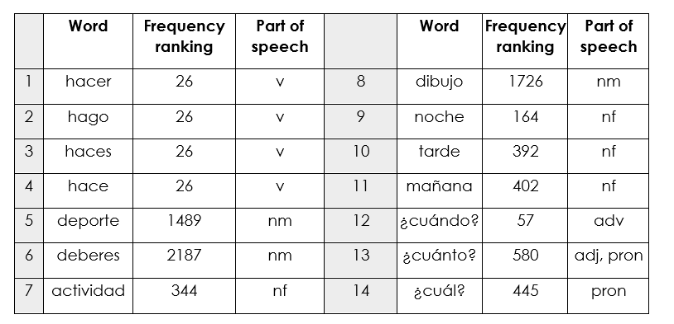
Mixed word class sets
Sample mixed word class set
Year 7 Term 2.1 Week 4
Source of frequency data: A Frequency Dictionary of Spanish (2nd ed.) (Davies, M. & Davies, K., 2018), Published by Routledge.
Notes:
This screenshot illustrates the first three points on the last slide (frequency, mixed word classes, cohesion of vocab selection with the grammar being practised).
Here is an example of set of mixed word class words. These words were planned for teaching in Term 2 of our Year 7 SOW. In the first column is the word, in the second is the frequency ranking (1 being the most common word in Spanish).
Three forms of the verb ‘hacer’ are introduced over two lessons, along with nouns that can be used with it and several question words that can be used to ask questions about what people do/make. The inclusion of mañana, tarde and noche allows for question-answer interactions using ‘cuándo’.
--------------------------------------------
Mixed word class sets There is some research evidence that teaching vocabulary in topic-based lists of words with a single word class (e.g. a list of just nouns) is not optimal (Häcker, 2008).
Teaching mixed word class sets provides the means for learners to encounter words in sentences, as well as individually, at present stage, but without running the risk of cognitive overload if too much language (new and previously taught) is presented at once.
Working with words in context is identified by Schmitt as an important strategy for embedding and developing word knowledge.
As mentioned previously, NCELP has been tasked with KS3 pedagogy, but given the very mixed picture of provision nationally, has had to start from a position of ‘ab initio’ learner in its curriculum planning. However, were there to be a KS2 SOW it is likely not only that the same overarching principles would apply, but also that some of the Y7 SOW could be repurposed for earlier years.
Here are some examples of a week’s vocabulary set from each of the three languages, Fr, Gm and Sp, showing the mixed word class composition.

Slide 28
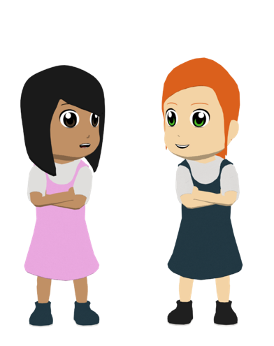
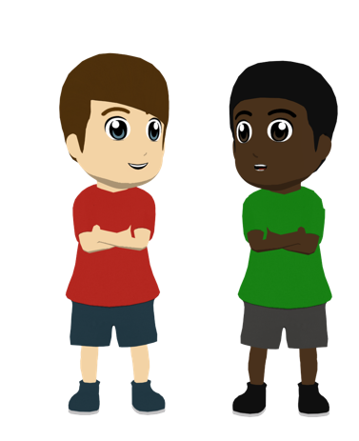
Lucía y Daniel están con sus amigos fuera de la escuela. Completa la frase en inglés.
Diálogo 2
leer
¡Voy a disfrutar del partido de fútbol al máximo!
I’m going to really enjoy the ________ _______!
Diálogo 1
¡Sí! hay música divertida en la calle todo el día.
Yes _______ ____ music in the street ___ day.
El plan de mañana es muy interesante, ¿no?
The plan for _________ is very ___________, right?
football
match
there is
fun
Quizás también vamos a tener tiempo libre para ir al cine.
Maybe we’ll also have ______ time to go to the ________.
tomorrow
all
interesting
Visito la ciudad a veces porque una amiga vive allí. ¡Es genial ir otra vez!
I visit the city sometimes because a ______ lives there. It’s great to go _______!
free
cinema
¡Y para subir a la torre y comprar cosas en el mercado!
And to go up the _______ and to buy things in the ________!
friend
tower
again
market
Notes:
This activity is taken from one of the lessons in our Year 9 scheme of work. Its main purpose is to revisit specific vocabulary items as per the revisiting cycle for this week. On this slide, students read Spanish sentences and note down (or say aloud) the English translation. For some students, this may be fairly straightforward, so the next slide flips the activity, getting them to read the English and produce the Spanish themselves.
Although the activities are vocabulary focused, the mini-dialogue component allows for a short read aloud where students can put their SSC knowledge into productive use.
---------------------------------
Vocabulary practice slide [1/2]
Timing: 5 minutes
Aim: to practise receptive recall of vocabulary (this slide) and then oral productive recall (next slide).
Procedure: 1. Students read the sentences in Spanish and complete the English sentences.
2. On the next slide, students have to say the Spanish words themselves, reading each mini-dialogue aloud with a partner.

Slide 29
Lucía y Daniel están con sus amigos fuera de la escuela. Completa la frase en español.
Diálogo 2
hablar
partido
fútbol
¡Voy a disfrutar del _______ de ______ al ________!
I’m going to really enjoy the football match!
Diálogo 1
¡Sí! ____ música _________ en la calle _____ el día.
Yes there is fun music in the street all day.
hay
máximo
plan
mañana
divertida
El _____ de ________ es muy ___________, ¿no?
The plan for tomorrow is very interesting, right?
interesante
todo
Quizás también vamos a tener tiempo _____ para ir al _____.
Maybe we’ll also have free time to go to the cinema.
libre
cine
Visito la ciudad a veces porque una _______ vive allí. ¡Es genial ir ________!
I visit the city sometimes because a friend lives there. It’s great to go again!
amiga
otra vez
torre
¡Y para subir a la _____ y comprar cosas en el _________!
And to go up the tower and to buy things in the market!
mercado
Notes:
Vocabulary practice slide [2/2]
The activity continues from the previous slide (now involving L1 -> L2 oral translation).

Slide 30
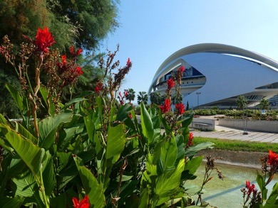
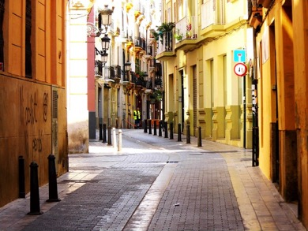
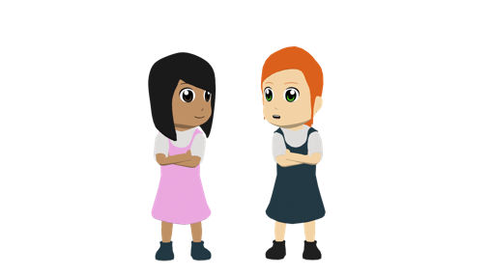
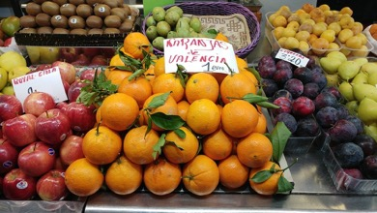
¿Qué hacemos hoy? Lucía y Nadia deciden las actividades del día. Lee y escucha:
leer / escuchar
L: Bueno, Nadia, hoy podemos elegir las actividades. Me interesan las visitas a los museos y a las iglesias antiguas ¿te gusta el arte?
N: Claro, pero también me gustan las tiendas. ¿Te importa ir de compras primero? Me gusta el mercado de segunda mano* en el barrio de Ruzafa y me interesan los productos típicos* en la Plaza Redonda. ¡Ah! Y me encantan las naranjas* de Valencia, ¡son famosas porque están muy buenas!
L: Vale, es buena idea. Además, por la tarde los chicos quieren ver deporte. Me encanta ver partidos de fútbol, me interesa ver el equipo Villarreal y conocer a los jugadores.
N: Sí, pero, el estadio está un poco lejos, ¿no? Me preocupa llegar tarde a los conciertos en la playa. Empiezan a las nueve.
L: Es verdad... También me molesta coger autobuses todo el tiempo. Pues quizás podemos ir de paseo al Jardín del Turia, es un parque natural muy grande y bonito. ¿Te gusta ir a lugares así?
N: ¡Sí! Me alegra pasar tiempo en la naturaleza. ¡Me encantan los planes para hoy!
1
2
3
Jardínes del Turia
4
5
6
7
8
*de segunda mano = second-hand
*la naranja = orange; *típico = typical
Naranjas de Valencia
Notes:
This text has been carefully written using almost entirely previously taught language, including the language planned for revisiting this week. Once cognates/near-cognates and proper nouns are excluded, over 94% of the text is ‘readable’. This shows how, over time, the teaching of highly frequent language allows topics (in this case, the topic of free time activities) to emerge, without the topics having to drive what words we decide to teach initially. Many of the words in this text will have first been taught in other contexts, yet they are highly transferrable across contexts and so can be reused here.
The activity itself involves listening and reading at the same time. Students pay close attention to when the audio stops, in order to suggest a word that could come next (replacing the word that they can see in the text).
For example, after ‘me interesan…’ students could suggest an alternative word to ‘las visitas’ (e.g., las tiendas, los parques, las plazas, las playas, las calles bonitas). In this way it’s an opportunity for them to recall previously taught vocabulary and use it creatively, while also thinking about words that would fit with the grammar being used (e.g. after interesan, using a plural noun). The activity could also be used for a readaloud, or could be jumbled so that students have to understand the gist in order to put the parts in the correct order.
Where possible, we also try to use contexts that allow students to learn about the Spanish speaking world. In this case, real places in Valencia were included, as well as a typical food of the area.
Note: if there is time, we could mention the text profiler created by NCELP, https://www.multilingprofiler.net/
-----------------------------
Timing: 8 minutes
Aim:
to consolidate understanding of agreement patterns (-a, -an) on gustar-type verbs
to practise this in the context of a interactive dialogue
to improve segmentation ability
Procedure:
Give students initial time (c. 1-2 minutes) to read the text for gist.
Play the audio.
To support segmentation, stop the audio and ask students to say: a) the next word b) the previous word
In addition, to develop understanding, vocabulary and grammar knowledge, pause at key points and ask students to suggest an alternative word or phrase that could replace the next word. The key points will be places where students can choose a different subject.
... hoy podemos elegir las actividades. Me interesan ... (e.g., las tiendas, los parques, las plazas, las playas, las calles bonitas)
... Claro, pero también me gustan ... (e.g., los teatros, los estadios, los mercados)
... me encanta ver partidos de fútbol, me interesa... (e.g. aprender sobre el equipo, saber más del equipo, ir al estadio, comprar unas entradas)
... el estadio está un poco lejos, ¿no? Me preocupa ... (e.g., el coste/el precio de los billetes, el tiempo, la opinión de la profesora, no tener suficiente dinero para el viaje)
... Es verdad... También me molesta... (e.g., viajar por la noche, el calor en el autobús)
... es un parque natural muy grande y bonito. ¿Te gusta ... (e.g., ver las flores, sacar fotos de los árboles, caminar, montar en bici, descansar)
... Me alegra pasar tiempo en la naturaleza. ¡Me encantan ... (e.g., las actividades, los paseos)
Notes: verbs with the ending –a do not require a verb afterwards and students may well think of a singular noun instead. In this event, a follow up question could be to ask for a verb that would work, in order to practise the grammar for this week.
The Turia Gardens are a large park in Valencia – the largest urban park in all of Spain. It receives close to 7 million visitors per year. Source: https://theculturetrip.com/europe/spain/articles/the-history-of-the-valencian-jardin-del-turia-in-1-minute/
Frequency of unknown words or cognates:
naranja [2924]; típico [1934]

Slide 31
Where to find more resources
NCELP resource portal
https://resources.ncelp.org/
Hundreds of resources (lessons, tests, schemes of work, CPD presentations)
Gaming grammar
Digital game with activities in a ‘spy mission’ context
Reading and listening-based grammar practice
Open Accessible Summaries in Language Studies (OASIS)
Sign up to get monthly alerts to summaries of new research, from OASIS
2022 NCELP CPD courses
5 x 2.5 hour courses on curriculum design and pedagogy, starting Jan 2022
Free, but places are limited
Notes:
Just before we finish, we wanted to let you know about a few of the free resources available.
The NCELP resource portal has hundreds of resources, including all the lessons from the scheme of work, homework, test, scheme of work documents and CPD presentations.
Gaming Grammar is a digital game partly funded by NCELP that allows for reading and listening-based grammar practice in line with the principles of grammar practice that I mentioned earlier.
OASIS is a database with single-side A4 summaries of relevant research published in international peer-reviewed journals. All summaries are written in non-technical language.
Finally, in 2022 NCELP will be running five CPD courses on curriculum design and pedagogy. These courses are free but places are limited. We recommend that a single HoD per school applies (someone who can cascade the knowledge and learning on to other members of their department).

