Slide 1
Understanding a non-fiction text
an vs auf - R2 (acc) and R3 (dat)
SSCs [ch] and [ck]
Y8 German
Term 3.1 - Week 1 - Lesson 49
Catherine Morris / Natalie Finlayson / Rachel Hawkes
Artwork: Steve Clarke
Date updated: 21/07/21
Notes:
Artwork by Steve Clarke. All additional pictures selected are available under a Creative Commons license, no attribution required.
Native speaker teacher feedback provided by Stephanie Cross.
Learning outcomes (lesson 1):
Consolidation of SSC [ch] and contrast with [ck]
Introduction of an vs auf – R2 (acc) and R3 (dat)
Word frequency (1 is the most frequent word in German):
8.3.1.1 (introduce) hängen [590] schützen [996] verdienen [836] Angriff [1489] Daten [574] Euro [207] Gesetz [578] Milliarde [453] Million [209] Unternehmen [236] Wand [828] an² [19] gegen [104] laut [835]
8.2.2.3 (revisit) was für [38/17] Art [260] Bild [253] Musik [509] Stimme [399] modern [747] traditionell [1555] besonders [270] lieber [459] statt [680]
8.2.1.1 (revisit) antworten [826] danken [1276] kriegen [724] schenken [1614] dir [244] ihm [91] ihr [27] Uhr² [348] eigen [166] für [17]
Source: Jones, R.L & Tschirner, E. (2019). A frequency dictionary of German: Core vocabulary for learners. London: Routledge.
The frequency rankings for words that occur in this PowerPoint which have been previously introduced in NCELP resources are given in the NCELP SOW and in the resources that first introduced and formally re-visited those words.
For any other words that occur incidentally in this PowerPoint, frequency rankings will be provided in the notes field wherever possible.

Slide 2
ch
Buch
Notes:
Timing: 1 minute
Aim: To introduce/consolidate SSC [ch]
Procedure: 1. Present the letter(s) and say the [ch] sound first, on its own. Students repeat it with you. 2. Bring up the word ”Buch” on its own, say it, students repeat it, so that they have the opportunity to focus all of their attention on the connection between the written word and its sound.
3. A possible gesture for this would be to mime opening the pages of a book with both hands.
4. Roll back the animations and work through 1-3 again, but this time, dropping your voice completely to listen carefully to the students saying the [ch] sound, pronouncing ”Buch” and, if using, doing the gesture. Word frequency (1 is the most frequent word in German): Buch [195]
Source: Jones, R.L. & Tschirner, E. (2006). A frequency dictionary of German: core vocabulary for learners. Routledge

Slide 3
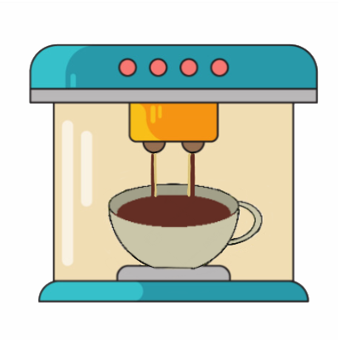
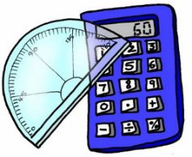
ch
machen
nochmal
Buch
acht
Nacht
Fach
Notes:
Timing: 2 minutes
Aim: To introduce/consolidate SSC [ch]
Procedure:
Introduce and elicit the pronunciation of the individual SSC [ch] and then the source word again ‘Buch’ (with gesture, if using).
Then present and elicit the pronunciation of the five cluster words.
The cluster words have been chosen for their high-frequency, from a range of word classes, with the SSC (where possible) positioned within a variety of syllables within the words (e.g. initial, 2nd, final etc.). Additionally, we have tried to use words that build cumulatively on previously taught SSCs (see the Phonics Teaching Sequence document) and do not include new SSCs. Where new SSCs are used, they are often consonants which have a similar symbol-sound correspondence in English.
Word frequency (1 is the most frequent word in German): Buch [195]; machen [49] nochmal [773]; acht [458]; Fach [698]; Nacht [335]. Source: Jones, R.L. & Tschirner, E. (2006). A frequency dictionary of German: core vocabulary for learners. Routledge

Slide 4
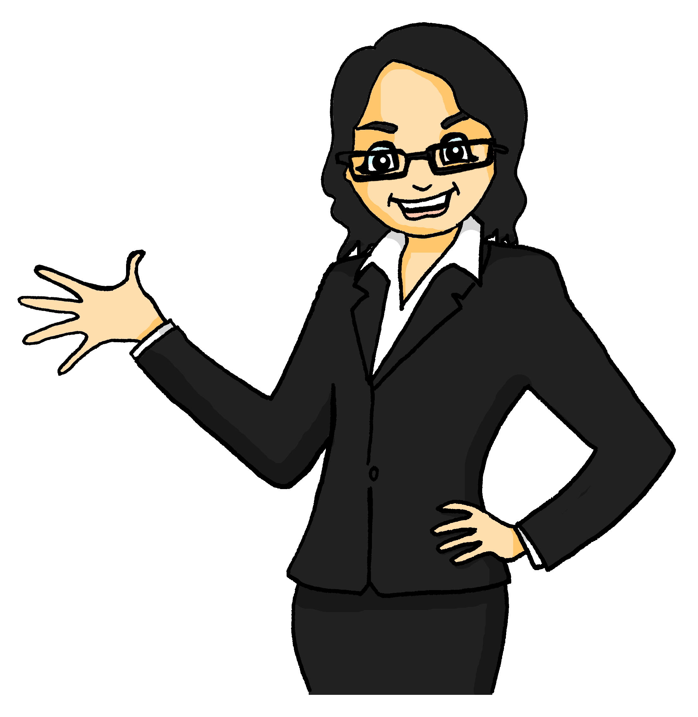
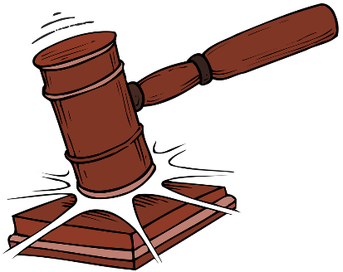
Mutti
lesen
Hallo! Ich heiße Katrin und bin die Mutter von Wolfgang und Mia. Ich bin Strafrechtsanwältin*.
* das Strafrecht – criminal justice
Notes:
Timing: 1 minute
Aim: Getting to know Katrin Note: Students learnt Anwalt last week, and have been introduced to the pattern of feminisation of person nouns. However, it is still worth drawing attention to the pronunciation change [a] → [ä] and practising this.
Word frequency (1 is the most frequent word in German): Strafrecht [>5000] Source: Jones, R.L. & Tschirner, E. (2019). A frequency dictionary of German: core vocabulary for learners. Routledge

Slide 5
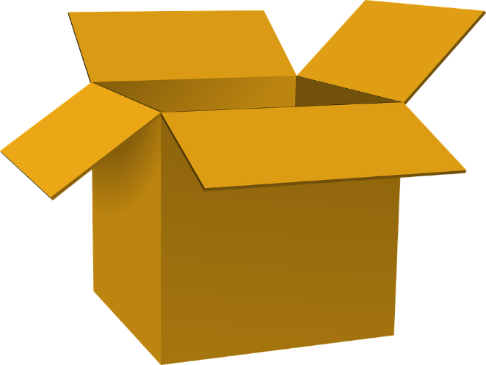
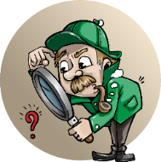
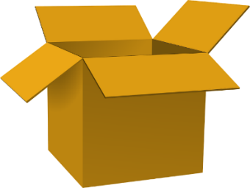
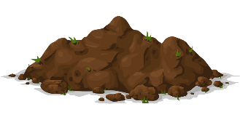
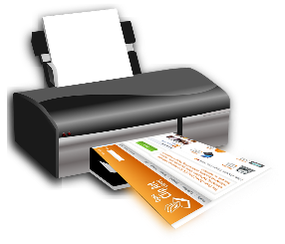
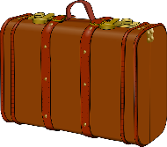
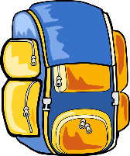
Katrin packt ihre Arbeitstasche
*die Quelle = source
hören / schreiben
Katrin is gathering evidence for her latest case.
1
Laut meinen Quellen* enthalten die wichtigen Wörter SSC [ch]! Können Sie mir helfen?
_
Entdeckung
[discovery]
3
4
_
[ch]
2
Gutachten
[report]
_
Blutfleck
[bloodstain]
_
Knochen
[bones]
6
7
8
_
Überwachung
[surveillance]
_
_
5
Drucker
[printer]
Dreck
[dirt]
_
Beobachter
[witness]
10
_
11
12
[ck]
Gepäck
[luggage]
9
_
_
Suche
[search]
Nachweis
[evidence]
_
Rucksack
Notes:
Timing: 5 minutes Aim: To distinguish orally between SSCs [ch] and [ck]; to create a sense of anticipation for the content of the texts to come. Procedure: 1. Click on the pictures to hear the words said aloud.
2. Students determine whether Katrin needs to take the item or not by deciding whether the missing sound is [ch] or [ck].
3. Click on the blank to fill the gap.
4. Click on word to send it flying to the box to pack, or the bin to discard.
Transcript: 1. Knochen
2. Blutfleck
3. Beobachter
4. Nachweis
5. Dreck
6. Entdeckung
7. Überwachung
8. Gepäck
9. Rucksack
10. Gutachten
11. Drucker
12. Suche Word frequency (1 is the most frequent word in German): Knochen [>5000], Blutfleck [851/2926], Beobachter [3908], Nachweis [3659], Dreck [4309], Entdeckung [3447], Überwachung [4815], Gepäck [3771], Rucksack [3180], Gutachten [4654], Drücker [>5000], Suche [1508], Quellen [1108] Source: Jones, R.L. & Tschirner, E. (2019). A frequency dictionary of German: core vocabulary for learners. Routledge

Slide 6
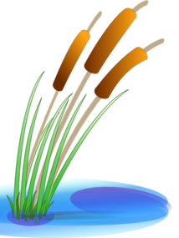
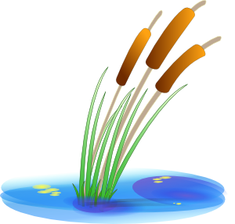
Vokabeln
hören
Choose the right words to cross the river.
Be careful! Some of the rocks are wobbly.
1
2
3
4
5
6
7
arbeiten
viel
billig
die Stimme
der Anwalt
der Ort
verdienen
die Zeitung
die Firma
das Geld
wissen
wenig
gefährlich
die Wahrheit
Notes:
Timing: 5 minutes (two slides) Aim: Aural recognition of new vocabulary; building semantic associations with known vocabulary. Procedure: 1. Click numbers to hear audio.
2. Students pick which word on a rock is most closely associated with the word that they heard.
3. Click on rock to find out if the answer is right or wrong (wrong answers fall into the water).
4. Continue to the next slide to cross the river.
Transcript: 1. das Unternehmen
2. der Euro
3. das Gesetz
4. die Daten
5. die Milliarde
6. der Angriff
7. laut

Slide 7
Vokabeln
hören
Choose the right words to cross the river.
Be careful! Some of the rocks are wobbly.
8
9
10
11
12
13
14
die
Bevölkerung
sitzen
die Musik
für
unter
wer
Geld
hängen
das Bild
das Kind
ohne
auf
an
Musik
Notes:
Transcript: 8. die Wand
9. die Million
10. schützen
11. gegen
12. an
13. hängen
14. verdienen

Slide 8
Katrins Arbeit
*wert = worth, *das Büro = office
*die Schaubilder = charts, graphs
lesen
Ich arbeite als Strafrechtsanwältin für ein großes Unternehmen in Berlin. Die Firma ist eine Milliarde Euro wert*.
Im Moment arbeite ich daran, wichtige Daten gegen Angriffe zu schützen. In meinem sehr modernen Büro* hängen große Schaubilder* an der Wand. Ich bin keine traditionelle Anwältin!
Gesetze sind für meine Arbeit sehr wichtig.
Ich mag meine Arbeit, und arbeite viel. Laut Wolfgang und Mia muss ich eine Million Euro verdienen!
ein großes
Unternehmen in Berlin
eine Milliarde Euro
Daten gegen Angriffe
zu schützen.
hängen große
Schaubilder* an der Wand.
Gesetze
eine Million Euro
4. Where are the graphs in her office?
3. What does Katrin do at work?
5. What else is important in Katrin’s job?
6. How much do Wolfgang and Mia think Katrin must earn?
1. Who does Katrin work for?
2. How much is the company worth?
A big company in Berlin
Hanging on the wall
Protects data from attacks
A million euros
A billion euros
Laws
Notes:
Timing: 4 minutes Aim: Written recognition of new vocabulary at sentence level. Procedure: 1. Allow a few minutes for students to read the text.
2. Click to bring up a question.
3. Elicit answer from students in German and English.
4. Click again to bring up answer.
5. Repeat for six questions in total. Word frequency of unknown words (1 is the most frequent word in German): wert [290], Schaubild [>5000], Strafrechtsanwalt [>5000], Büro [1663] Source: Jones, R.L. & Tschirner, E. (2019). A frequency dictionary of German: core vocabulary for learners. Routledge
Word frequency of cognates (1 is the most frequent word in German): Moment [358] Source: Jones, R.L. & Tschirner, E. (2019). A frequency dictionary of German: core vocabulary for learners. Routledge

Slide 9
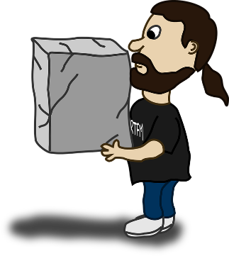
Wohin? Auf oder an?
Grammatik
‘Auf’ and ‘an’ give information about where something/someone is moving to
(R2, accusative).
‘Auf’ tells us something is moving on top of something else:
Er stellt das Paket auf den Tisch.
‘An’ tells us something is moving next to/side by side with something else:
Sie stellt die Blumen ans (an + das) Fenster.
Use auf/an + Row 2 article with verbs of movement like gehen, tragen, stellen, legen, setzen, hängen and kommen.
auf + horizontal surface
an + vertical surface
Notes:
Timing: 2 minutes Aim: To focus on the semantic differences between prepositions auf and an as expressions of movement; to revise use of accusative case with movement towards a place; to introduce contractions with an + accusative. Word frequency of unknown words used (1 is the most frequent word in German): Paket [3585] Source: Jones, R.L. & Tschirner, E. (2019). A frequency dictionary of German: core vocabulary for learners. Routledge

Slide 10
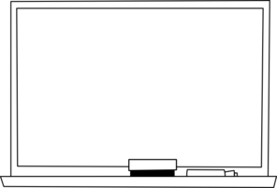
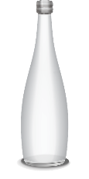
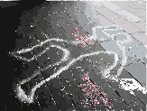
Katrin hat ein neues Büro!
Wohin kommen ihre Dinge?
hören
den Tisch / die Wand
1
den Boden / die Wand
2
den Tisch / die Wand
3
4
den Tisch / die Wand
5
den Boden / die Tafel
6
den Boden / den Bildschirm
7
den Boden / die Wand
8
den Boden / das Fenster
das Schaubild = chart
die Haftnotiz = sticky note
der Bildschirm = screen
Notes:
Timing: 5 minutes Aim: To distinguish orally between prepositions auf and an and connect these with meaning (moving towards horizontal surfaces vs vertical surfaces/adjacency). Procedure: 1. Click on a number to hear a sentence with the noun phrase bleeped out. The verb kommen is used in each case so as not to provide additional lexical clues about location from stellen, legen, setzen and hängen.
2. Students identify the noun from the box in the bottom right and use the preposition they hear to decide whether it lands on a horizontal surface, a vertical surface or adjacent to something, choose between the two given options. NB: The next slide contains a version of the exercise for lower-level classes in which the items in the box are ordered in line with the audio. Here, students only have to focus on the preposition.
3. Elicit answers by asking e.g. ‘Wohin kommt die Uhr?’
4. On clicks, the items move to the correct place in the office. This triggers the full audio (including the noun) to play.
Transcript: 1. Die Uhr kommt auf [den Tisch].
2. Das Buch kommt auf [den Boden]
3. Das Schaubild kommt an [die Wand]
4. Der Kaffee kommt auf [den Tisch]
5. Das Foto kommt an [die Tafel]
6. Die Haftnotiz kommt an [den Bildschirm]
7. Der Brief kommt auf [den Boden]
8. Die Flasche kommt an [das Fenster]
Word frequency of unknown words used (1 is the most frequent word in German): Büro [1663], Schaubild [>5000], Haftnotiz [>5000], Bildschirm [2754] Source: Jones, R.L. & Tschirner, E. (2019). A frequency dictionary of German: core vocabulary for learners. Routledge

Slide 11
Katrin hat ein neues Büro!
Wohin kommen ihre Dinge?
hören
den Tisch / die Wand
1
den Boden / die Wand
2
den Tisch / die Wand
3
4
den Tisch / die Wand
5
den Boden / die Tafel
6
den Boden / den Bildschirm
7
den Boden / die Wand
8
den Boden / das Fenster
das Schaubild = chart
die Haftnotiz = sticky note
der Bildschirm = screen
Notes:
Differentiated version of previous for lower-level classes.

Slide 12
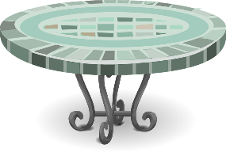
Wo? Auf oder an?
Grammatik
‘Auf’ and ‘an’ also give information about where something/someone is (R3, dative).
‘Auf’ tells us something is on top of something else:
Die Pflanze steht auf dem Tisch.
‘An’ tells us something is next to/side by side with something else:
Ich sitze am (an + dem) Tisch.
Das Poster hängt an der Tafel.
Use auf/an + Row 3 article with verbs of location like sein, stehen, liegen, sitzen and hängen.
auf + horizontal surface
an + vertical surface
Notes:
Timing: 2 minutes Aim: To focus on the semantic differences between prepositions auf and an as expressions of location; to revise use of dative case with location; to introduce contractions with an + dative.
Word frequency of unknown words used (1 is the most frequent word in German): Blume [2463] Source: Jones, R.L. & Tschirner, E. (2019). A frequency dictionary of German: core vocabulary for learners. Routledge
Word frequency of cognates used (1 is the most frequent word in German): Poster [>5000] Source: Jones, R.L. & Tschirner, E. (2019). A frequency dictionary of German: core vocabulary for learners. Routledge

Slide 13
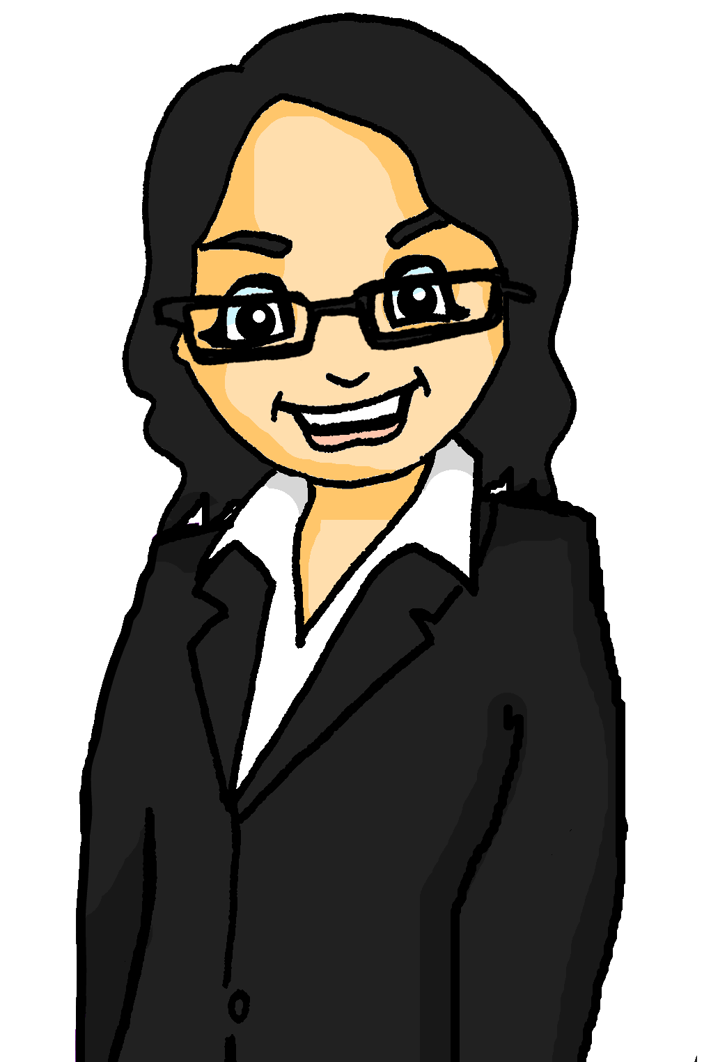
Mein neues Büro
endlich* = finally, falls* = in case
zu guter Letzt* = last but not least
lesen
Das neue Büro macht Katrin ganz glücklich! Sie schreibt Oma eine E-mail. Welche Verben sind richtig?
Hallo Mutti! So, endlich* kriegst du von mir eine E-mail!
Ich habe mein eigenes Büro! Ich dekoriere es selber. Die Uhr stelle ich/ist auf dem Tisch. Den Computer steht/setze ich auf den Schreibtisch. Die Zeitung liegt/lege ich auf den Tisch. Meine Jacke und meinen Hut hängen/hänge ich an die Tür. Falls* du mich brauchst, liegt/lege ich das Telefon auf dem Tisch. Und zu guter Letzt* stelle ich/steht die Pflanze an das Fenster. Nett von Papa, mir eine Pflanze zu schenken - ich danke ihm!
Deine Katrin
Notes:
Timing: 5 minutes Aim: Written recognition of definite articles in R2 (accusative) and R3 (dative) and connecting these with meaning (movement towards a place vs location in a place). Procedure: 1. Teacher ensures understanding of the verbs in bold, focusing on distinguishing between verbs of movement and location.
2. Students choose between the given options, using the subsequent definite article (in accusative or dative) to help them decide whether a verb of movement or location is required.
3. Click to reveal answers one by one.
4. Oral translation of sentences.
5. Draw attention to the use of deine as an informal sign-off here.
NB: The text contains examples of Object-Verb-Subject word order, as it was difficult to make the task work with SVO order. Students have already been taught and practised WO2 and seen that when anything other than the subject starts the sentence, the element and the subject swap places, and the verb remains in 2nd place. They haven’t explicitly practised the swap of subject and object, but this is coming up soon.
Word frequency of unknown words used (1 is the most frequent word in German): Büro [1663], falls [1171], endlich [454], Letzt [>5000] Source: Jones, R.L. & Tschirner, E. (2019). A frequency dictionary of German: core vocabulary for learners. Routledge
Word frequency of cognates used (1 is the most frequent word in German): dekorieren [>5000], E-mail [2172], Verb [4557] Source: Jones, R.L. & Tschirner, E. (2019). A frequency dictionary of German: core vocabulary for learners. Routledge

Slide 14
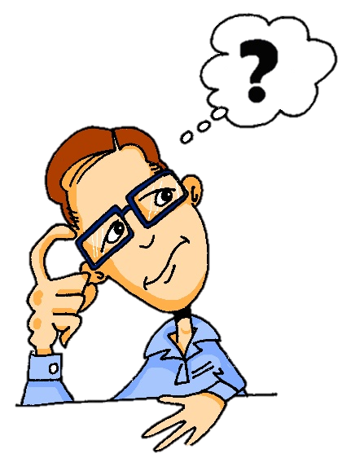
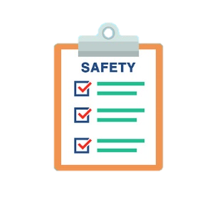
Einen Text verstehen (1)
lesen / schreiben
Knowledge of word patterns can help you understand unknown words in a text.
What do you think these words mean? How are they spelled?
politics | die Politik
_
Welche Art von Text kann das sein?
a) eine Geschichte
b) ein Zeitungsartikel
c) ein Lied
d) ein Schauspiel
document | das Dokument
_
credit card | die Kreditkarte
_
_
protocol | das Protokoll
_
Notes:
Timing: 3 minutes Aim: Pre-text activity to introduce key vocabulary; to revise the English ‘C’ to German ‘K’ word pattern; to ask learners to anticipate what kind of text they will be reading. Procedure: 1. Students read the words and think about what English words they look like. If students need an extra hint, pictorial clues appear on clicks.
2. One by one, English definitions appear on clicks.
3. Students use their knowledge of the c→k spelling rule to complete the German words (at more advanced levels, step 2 could be carried out after step 3).
4. Click to reveal the German words in full.
5. Click to bring up the second part of the task. Give students just a few seconds to confer in pairs and share their views. There is no right or wrong answer – the purpose is to raise their interest by anticipating what the text might be about.
Word frequency of unknown words used (1 is the most frequent word in German): Schauspiel [>5000] Source: Jones, R.L. & Tschirner, E. (2019). A frequency dictionary of German: core vocabulary for learners. Routledge
Word frequency of cognates used (1 is the most frequent word in German): Politik [540] Dokument [3230] Kredit [2555] Protokoll [3624] Text [473] Artikel [1378] Source: Jones, R.L. & Tschirner, E. (2019). A frequency dictionary of German: core vocabulary for learners. Routledge

Slide 15
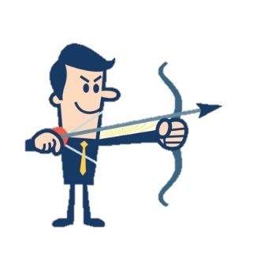
Einen Text verstehen (2)
lesen / schreiben
Knowledge about word families can also help you understand more words in a text. Complete the tables with the noun, verb and agent (‘doer’) forms of these words.
das Schauspiel | play
der Schauspieler | actor
der Angriff | attack
der Angreifer | attacker
angreifen | to attack
1
4
die Kunst | art
der Künstler | artist
2
die Politik | politics
der Politiker | politician
5
der Hack | hack
der Hacker | hacker
hacken | to hack
3
die Musik | music
der Musiker | musician (m)
6
Notes:
Timing: 3 minutes Aim: increasing students’ vocabulary coverage for comprehension of texts; to encourage students to think more broadly about vocabulary; inference of meanings of word family members of known words; priming students for recognising these words in short texts. Procedure: 1. Complete question 1 as a class. Students know the meaning of Schauspieler. Ask what a likely related noun might be. Click to reveal. Explain that an –ER ending on a familiar noun suggests that this is the person who is doing that noun (the agent). Students can now use this information to complete the rest of the task, drawing too on their knowledge of noun-verb pairs.
2. At this point, answer can be revealed on clicks. Teachers should elicit the feminine forms of the agent nouns while doing this. Alternatively, students can check their answers using the context on slide 17.
Word frequency (1 is the most frequent word in German): Text [473], Schauspiel [>5000], Künstler [789], Kredit [2555], Protokoll [3624], Hack [>5000], Hacker [>5000], hacken [>5000], angreifen [2193], Angreifer [>5000], Politiker [1140], Musiker [2577] Source: Jones, R.L. & Tschirner, E. (2019). A frequency dictionary of German: core vocabulary for learners. Routledge

Slide 16
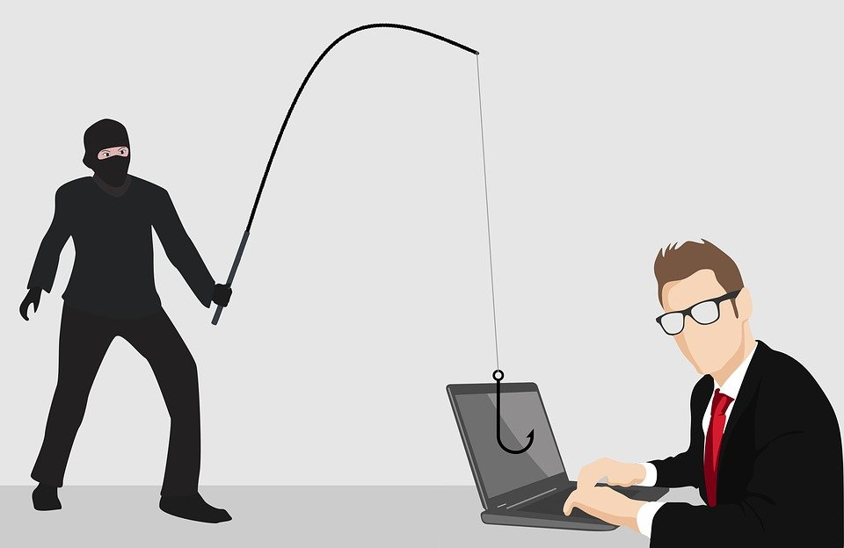
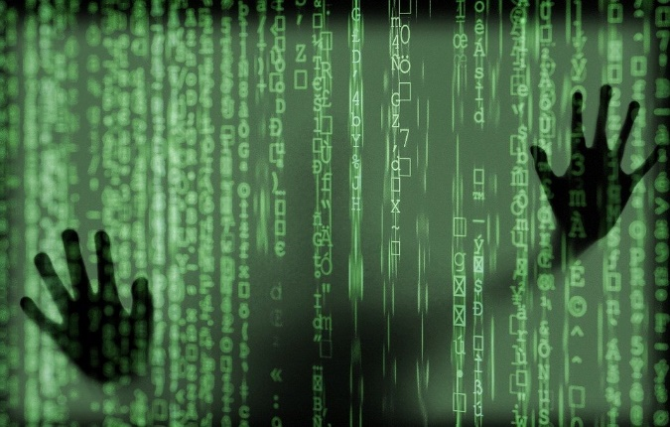
Zeitungsartikel
schreiben
Daten deutscher Politiker gehackt!
4.1.2019 • 7.27 Uhr • 3 Min • Autor/Autorin: Deutsche Welle
Wer hat den Text geschrieben?
Wann haben sie den Text geschrieben?
Wie lange dauert es, den Text zu lesen?
Was für Wörter finden wir im Text?
Notes:
Timing: 3 minutes Aim: To present the ‘shape’ of the text; to introduce students to the structure of a German news headline, to ask students to anticipate what kind of language the text might contain. Procedure: 1. Ensure students understand the headline. They should recognise gehackt as a past participle of the cognate verb hacken, introduced on the previous slide. As they have not yet encountered the genitive case, they may need some help deducing the possessive sense of the headline. Ask students which preposition they would expect to see connecting Daten and deutscher Politiker. Explain that in formal writing, von is normally omitted.
2. In pairs, students study the headline, pictures and metadata and discuss possible answers to the questions. Students should be encouraged to respond in full sentences to practise production in the past tense and structures with … zu + infinitive. For the last question, students can draw on information gleaned from slides 14 and 15 to predict vocabulary.
3. Teacher elicits answers from the class – not for the purpose of correction, but to build interest and anticipation. Word frequency (1 is the most frequent word in German): Text [474], Politiker [1140], hacken [>5000], Autor [723], lang [97] Source: Jones, R.L. & Tschirner, E. (2019). A frequency dictionary of German: core vocabulary for learners. Routledge

Slide 17
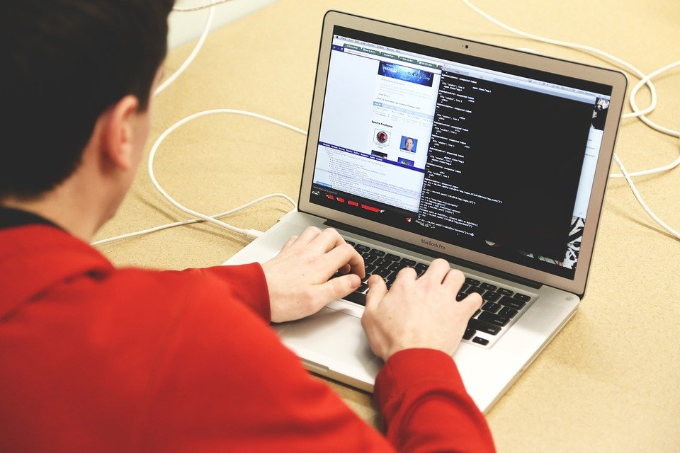
Zeitungsartikel 1
*die Quelle = source
*betroffen = affected
lesen
Daten deutscher Politiker gehackt!
4.1.2019 • 7.27 Uhr • 3 Min • Autor/Autorin: Deutsche Welle
Hacker haben die Computernetze von hunderten Politikern und Künstlern angegriffen. Laut Quellen* haben sie persönliche Daten und Dokumente wie Handynummern und Wohn-Adressen, Chatprotokolle,
Kreditkarteninformationen und auch Fotos von Familien ins Internet gestellt. Betroffen* sind Politiker von fast allen politischen Parteien, Musiker und Schauspieler wie Til Schweiger und Oliver Welke.
Wer genau die Hacker sind, ist noch nicht klar.
Notes:
Timing: 4 minutes Aim: to verify students’ answers to the activity on slide 15; to verify students predictions about the text; to demonstrate how much of a text can be understood through combining known vocabulary with word pattern and word family knowledge. Procedure: 1. Print copies of this slide and distribute to students for use with the activities that follow.
2. On clicks, some of the word family members presented on slide 15 appear in the order in which they were introduced. Students verify their answers, using the context to determine whether their answers are correct.
3. Students read the text in preparation for the comprehension exercise on the slides that follow.
4. Check understanding of all words in the text, especially Künstlern and Politikern, as students have not yet encountered plural nouns in the dative form, and angegriffen, which students might not immediately recognise as the past participle of angreifen.
Word frequency of unknown words (1 is the most frequent word in German): Politiker [1140] Künstler [789] angreifen [2193] Quelle [1108] betreffen [416] Musiker [2577] Source: Jones, R.L. & Tschirner, E. (2019). A frequency dictionary of German: core vocabulary for learners. Routledge
Word frequency of cognates (1 is the most frequent word in German): Artikel [1378] Hacker [>5000] Autor [723] Computernetz [1252/1325] persönlich [545] Dokument [3229] Adresse [2739] Protokoll [3623] Kreditkarte [2554/1474] Information [465] Foto [633] Internet [805] politisch [2082] Partei [588] Source: Jones, R.L. & Tschirner, E. (2019). A frequency dictionary of German: core vocabulary for learners. Routledge
Source:
Adapted from: https://www.dw.com/de/04012019-langsam-gesprochene-nachrichten/a-46956693 (Accessed and adapted 26th October 2020)

Slide 18
Wötter finden
Wörter finden und sagen
lesen / sprechen
Wörter finden
Such die deutschen Wörter im Artikel.
Sprich die Wörter aus.
 | Englisch | Deutsch
1. | network | das Netz
2. | personal | persönlich
3. | mobile number | die Handynummer
4. | address | die Adresse
5. | political | politisch
6. | online | im Internet
7. | (political) party | die Partei
8. | information | die Information
_______
_____________
_____________
__________
Make sure to use the German pronunciation – what SSCs do the words contain?
______________
_________________
______________
__________________
Notes:
Timing: 5 minutes
Aim: applying grammar knowledge to produce the ‘dictionary’ forms of near-cognates in the text, applying phonics knowledge to pronounce these accurately.
Procedure:
1. First, students re-read the article on slide 15 to find the German words for 1-8.
2. They use grammar clues in the text to identify the ‘dictionary’ form of the word (i.e. singular noun or masculine singular adjective).
3. Click to reveal the answers. Pay particular attention to the use of preposition in (rather than auf) with ‘Internet’, pointing out the cross-linguistic difference.
4. Students use SSC knowledge to read the words aloud using German pronunciation.
5. Click to reveal the play buttons. Note the position of the stress on the German word.
6. Students repeat.
Transcript:
das Netz, persönlich, die Handynummer, die Adresse, politisch, im Internet, die Partei, die Information
Word frequency of cognates (1 is the most frequent word in German): Artikel [1378], Netz [1325], persönlich [545], Adresse [2739], politisch [2082], Internet [805], Partei [588], Information [465] Source: Jones, R.L. & Tschirner, E. (2019). A frequency dictionary of German: core vocabulary for learners. Routledge

Slide 19
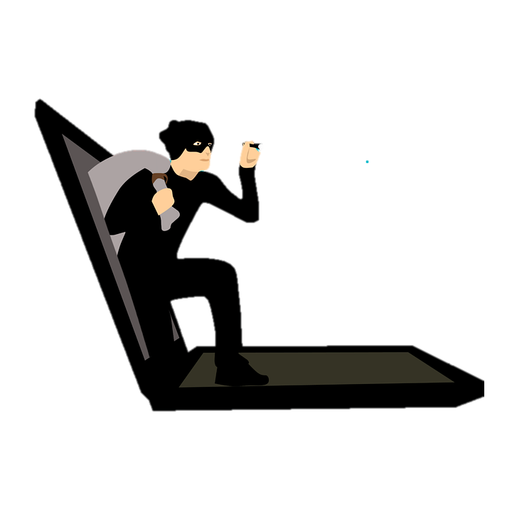
Wer macht was?
sprechen
Partner(in) A fängt an, einen Satz zu lesen.
Partner(in) B hört zu, und sagt das richtige Satzende.
Beide schreiben den ganzen Satz auf Englisch.
Beispiel:
Partner(in) A
Partner(in) B
1 | Die Hacker …
1 | haben Handynummern ins Internet gestellt
The hackers put mobile phone numbers on(to) the internet.
Notes:
Timing: 5 minutes
Aim: to consolidate comprehension of the text through matching sentences’ subjects with appropriate actions in the oral modality.
Procedure:
1. Print and distribute the prompt cards on the following slide.
2. The first time round, Student A reads the subject aloud (e.g. Die Hacker…). Student B listens and searches for the correct sentence ending among the options given on their role cards, before saying it aloud (haben Handynummern ins Internet gestellt.) NB: all verb subjects are in the third person plural, so as to avoid giving additional gramatical clues.
3. The students then work together to translate the sentence into German.
4. Students repeat for the rest of items, then swap roles. This time, Student B will repeat the sentence starter and Student A will listen and complete it.
Word frequency (1 is the most frequent word in German): Ende [183] Source: Jones, R.L. & Tschirner, E. (2019). A frequency dictionary of German: core vocabulary for learners. Routledge

Slide 20
Rollenkarten
lesen
Til Schweiger und Oliver Welke …
Die Fotos …
Die Hacker …
Alle …
… haben persönliche Daten ins Internet gestellt.
… sagen, dass die Geschichte wahr ist.
… wissen nicht, wer die Hacker sind.
… gehören vielen Parteien.
A
B
Die Hacker …
Die Politiker …
Die Quellen …
Wir ...
… gehören hunderten Politikern und Künstlern.
… können jetzt die Daten im Internet finden.
… sind deutsche Schauspieler.
… haben Computernetze angegriffen.
B
A
Notes:
DO NOT DISPLAY DURING ACTIVITY
Read aloud cards (printable version available)
Word frequency of unknown words (1 is the most frequent word in German): angreifen [2193] Source: Jones, R.L. & Tschirner, E. (2019). A frequency dictionary of German: core vocabulary for learners. Routledge
Word frequency of cognates (1 is the most frequent word in German): Foto [644], [1378], Hacker [>5000], persönlich [545], Computernetz [1252/1325], Partei [588], Politiker [1140], Künstler [789], Dokument [3229], Internet [805], politisch [2082] Source: Jones, R.L. & Tschirner, E. (2019). A frequency dictionary of German: core vocabulary for learners. Routledge

Slide 21
Antworten (A)
lesen
Til Schweiger und Oliver Welke …
Die Fotos …
Die Hacker …
Alle …
… sind deutsche Schauspieler.
… gehören hunderten Politikern und Künstlern.
… haben Computernetze angegriffen.
… können jetzt die Daten im Internet finden.
Til Schweiger and Oliver Welke …
The photos …
The hackers …
Everyone …
… are German actors.
… belong to hundreds of politicians and artists.
… attacked computer networks.
… can find the data on the internet now.
Notes:
Answers to set A

Slide 22
Antworten (B)
lesen
Die Hacker …
Die Politiker …
Die Quellen …
Wir ...
… haben persönliche Daten ins Internet gestellt.
… gehören vielen Parteien.
… sagen, dass die Geschichte wahr ist.
… wissen nicht, wer die Hacker sind.
The hackers …
The politicians …
The sources …
Wir ...
… put personal data online.
… belong to lots of political parties.
… say that the story is true.
… don’t know who the hackers are.
Notes:
Answers to set B

Slide 23
Understanding a non-fiction text
gegen with Row 2 [acc]
German 'cht' to English 'ght'
Y8 German
Term 3.1 - Week 1 - Lesson 50
Natalie Finlayson / Catherine Morris / Rachel Hawkes
Artwork: Steve Clarke
Date updated: 21/07/21
Notes:
Artwork by Steve Clarke. All additional pictures selected are available under a Creative Commons license, no attribution required.
Native teacher feedback provided by Stephanie Cross.
Learning outcomes (lesson 1):
Introduction of preposition gegen with R2 (acc) Introduction to word pattern German ‘cht’ to English ‘ght’
Word frequency (1 is the most frequent word in German):
8.3.1.1 (introduce) hängen [590] schützen [996] Angriff [1489] Daten [574] Euro [207] Gesetz [578] Milliarde [453] Million [209] Unternehmen [236] Wand [828] an² [19] gegen [104] laut [835]
8.2.2.3 (revisit) was für [38/17] Art [260] Bild [253] Musik [509] Stimme [399] modern [747] traditionell [1555] besonders [270] lieber [459] statt [680]
8.2.1.1 (revisit) antworten [826] danken [1276] kriegen [724] schenken [1614] dir [244] ihm [91] ihr [27] Uhr² [348] eigen [166] für [17]
Source: Jones, R.L & Tschirner, E. (2019). A frequency dictionary of German: Core vocabulary for learners. London: Routledge.
The frequency rankings for words that occur in this PowerPoint which have been previously introduced in NCELP resources are given in the NCELP SOW and in the resources that first introduced and formally re-visited those words.
For any other words that occur incidentally in this PowerPoint, frequency rankings will be provided in the notes field wherever possible.

Slide 24
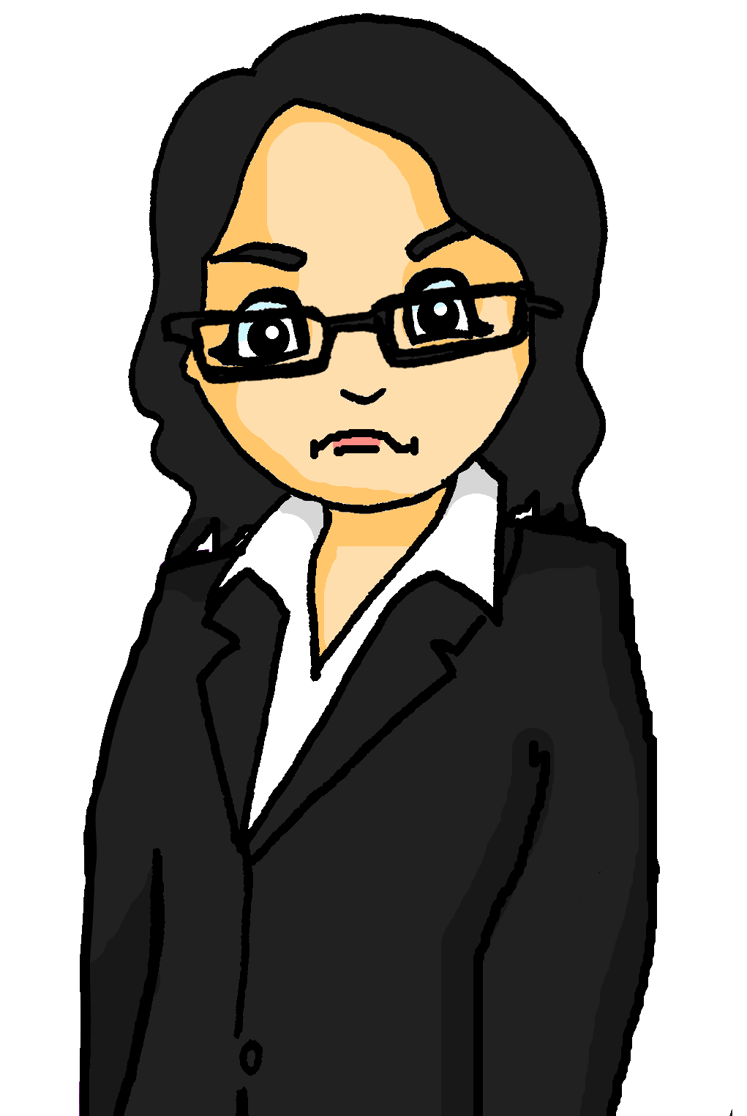
Phonetik
sprechen
Katrin received a mysterious note.
See how quickly you can read it out.
Der Dachdecker deckt
dein Dach,
drum dank
dem Dachdecker,
der dein Dach deckt.
1
2
3
Translation:
The roofer roofs your roof,
so thank the roofer who roofs your roof.
Notes:
Timing: 2 minutes Aim: Practise pronunciation of SSC [ch] and [ck] Procedure: 1. Students read out tongue twister, increasing speed to increase challenge. This could also be done in pairs (one student speaks while the other checks pronunciation).
2. Teacher circulates to listen in to students.
3. Click to hear the tongue twister said by a native spear at increasing speeds.
Transcript: Der Dachdecker deckt dein Dach, drum dank dem Dachdecker der dein Dach deckt Word frequency (1 is the most frequent word in German): Dachdecker [>5000], decken [2636], darum [518], Dach [1812] Source: Jones, R.L. & Tschirner, E. (2019). A frequency dictionary of German: core vocabulary for learners. Routledge

Slide 25
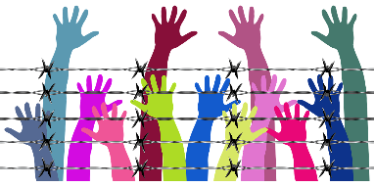
English → German → English
Some German words have -cht, where English words have -ght.
All people have rights! And that is right!
Alle Menschen haben Rechte! Und das ist richtig!
Use the words you recognise to help you complete the tasks: die Sicht, die Macht, die Tochter, die Nacht, das Licht, sichtbar
Translate these sentences.
1. Der Mann beschreibt seine Flucht aus Syrien.
2. He needs a light in the night.
What would the following be in German?
power/might visible / sight daughter Choose one and write a sentence in German.
Notes:
Timing: 5 minutes Aim: to practise understanding and applying the German-English word pattern –cht / -ght. Procedure: 1. Present the information to students, using the animated text. 2. Students complete the short tasks and check their answers on the following slide.
Word frequency: richtig [177], Recht [242], Macht [1098], sichtbar [1537], Nacht [325], Licht [436], Sicht [940], Tochter [694], Flucht [2008], leicht [311], rechts [829], acht [645]
Source: Jones, R.L. & Tschirner, E. (2019). A frequency dictionary of German: core vocabulary for learners. Routledge
Image by Gordon Johnson from Pixabay

Slide 26
ANTWORTEN
Der Mann beschreibt seine Flucht aus Syrien.
He needs a light in the night.
power/might
visible, sight
daughter
The man describes his flight/escape out of Syria.
Er braucht ein Licht in der Nacht.
die Macht
sichtbar, die Sicht
die Tochter
Don’t forget to pronounce the words!

Slide 27
Präpositionen ‘laut’ und ‘gegen’
Grammatik
You already know some words which are always used with R3 (dative) articles:
mit von zu seit bei
‘Laut’ also belongs to this group.
_ _
_ _
_
_ _ _
_ _
masculine
feminine
neuter
der Autor
die Zeitung
das Buch
laut dem Autor
laut der Zeitung
laut dem Buch
You already know some words which are always used with R2 (accusative) articles:
für ohne durch um
‘Gegen’ also belongs to this group.
_ _
_ _ _
_ _ _ _
_
masculine
feminine
neuter
der Plan
die Idee
das Gesetz
gegen den Plan
gegen die Idee
gegen das Gesetz
Notes:
Timing: 3 minutes Aim: To revise prepositions taking R3 (dative) and R2 (accusative) articles, and adding laut and gegen to the respective groups. Word frequency of cognates used (1 is the most frequent word in German): Autor [723], Plan [954], Präposition [>5000] Source: Jones, R.L. & Tschirner, E. (2019). A frequency dictionary of German: core vocabulary for learners. Routledge
Note: for any teachers who have previously taught laut + Genitiv, Duden lists it as with dative, also with genitive.

Slide 28
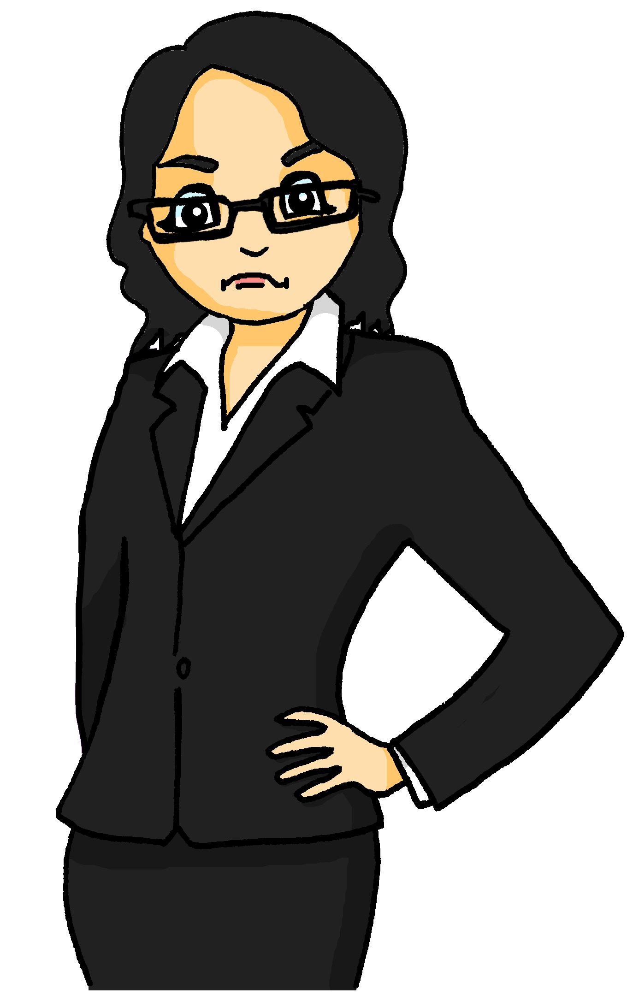
Wer sagt was? (1/2)
der Kampf* = fight
klagen* = to sue
lesen
Katrin is looking at statements from witnesses, but they are incomplete.
Schreib ‘gegen’ oder ‘laut’. Was heißen die Sätze auf Englisch?
__?__
1. Der Politiker ist streng gegen die Zeitung.
Note the comma before ‘laut’.
__?__
2. Die Arbeiter klagen*, laut der Firma.
__?__
3. Gegen sie hat der Manager nicht besonders viel zu sagen.
4. Dieser Mann hat nichts, laut dem Anwalt.
__?__
__?__
5. Die Firma gewinnt nicht den Kampf*, laut dem Hacker.
6. Der Manager arbeitet nicht gegen das Unternehmen.
__?__
Notes:
Timing: 8 minutes for four slides Aim: Written recognition and production of articles, pronouns and possessive adjectives with gegen (Row 2, accusative) and laut (Row 3, dative); raising awareness of the semantic differences between gegen and laut. Procedure (part 1): 1. Students read the sentences and decide, based on the case form of the word to the right of the gap, whether the missing word must be gegen or laut.
2. Click to reveal answers.
3. Students translate the sentences into English.
4. Check translations on the following slide, and proceed to part 2.
Word frequency of unknown words (1 is the most frequent word in German): klagen [2787], Kampf [867], Arbeiter [2404]
Source: Jones, R.L. & Tschirner, E. (2006). A frequency dictionary of German: core vocabulary for learners. Routledge
Word frequency of cognates (1 is the most frequent word in German): Manager [2174], Hacker [>5000], Politiker [1140
Source: Jones, R.L. & Tschirner, E. (2006). A frequency dictionary of German: core vocabulary for learners. Routledge

Slide 29
Antworten (1/2)
der Kampf* = fight
klagen* = to sue
lesen
Katrin is looking at statements from witnesses, but they are incomplete.
Schreib ‘gegen’ oder ‘laut’. Was heißen die Sätze auf Englisch?
1. The politician is strictly against the newspaper.
2. According to the company, the workers are suing.
3. The manager doesn’t have particularly much to say against her.
4. According to the lawyer, this man has nothing.
5. According to the hacker, the company is not winning the fight.
6. The manager is not working against the company.

Slide 30
Wer sagt was? (2/2)
der Kampf* = fight
klagen* = to sue
schreiben
Katrin isn’t sure if the statements are right. She tries swapping the words around.
Schreib den Artikel. Was heißen die Sätze jetzt auf Englisch?
_?_
1. Der Politiker ist streng, laut der Zeitung. (the)
2. Die Arbeiter klagen gegen die Firma. (the)
_?_
_?_
3. Laut ihr hat der Manager nicht besonders viel zu sagen. (her)
_?_
4. Dieser Mann hat nichts gegen den Anwalt. (the)
_?_
5. Die Firma gewinnt nicht den Kampf* gegen den Hacker. (the)
_?_
6. Der Manager arbeitet nicht, laut dem Unternehmen. (the)
Notes:
Procedure (part 2): 1. Students read the sentences and decide, based on the preposition, what the form of the missing word must be.
2. Click to reveal answers.
3. Students translate the sentences into English.
4. Check translations on the following slide.
Word frequency of cognates (1 is the most frequent word in German): Artikel [1378] Source: Jones, R.L. & Tschirner, E. (2019). A frequency dictionary of German: core vocabulary for learners. Routledge

Slide 31
Wer sagt was? (2/2)
der Kampf* = fight
klagen* = to sue
schreiben
Katrin isn’t sure if the statements are right. She tries swapping the words around.
Schreib den Artikel. Was heißen die Sätze jetzt auf Englisch?
1. According to the newspaper, the politician is strict.
2. The workers are suing (against) the company.
3. According to the woman, the manager doesn’t have much in particular to say.
4. This man has nothing against the lawyer.
5. The company is not winning the fight against the hacker.
6. According to the company, the manager doesn’t work.

Slide 32
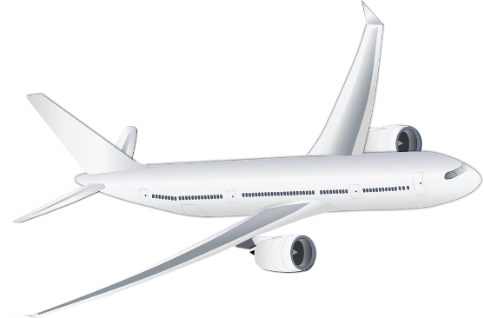
Was steht in den Headlines?
sprechen / hören / schreiben
1.4 billion euros
TUI verliert 1,4 Milliarden Euro
durch Corona
TUI loses 1.4 billion euros due to Corona
Notes:
Timing: 6 minutes (8 slides) Aim: Oral production and aural comprehension of vocabulary (new and revisited) in context. Procedure: 1. Student A copies the sentence (including the gap) and turns away from the board.
2. On a click, the English translation of the missing word(s) appears. Student B reads the full headline out, including the German for the missing word.
3. Student A writes they word they heard in the gap, and turns back to the board.
4. On a second click, the translation is revealed.
5. Students work together to guess the meaning of the headline. As these are authentic news headlines, some of the words are unknown. The teachers can choose to display as many or as few of the suggested pictorial hints as necessary to help students (simply delete as desired).
6. Translation revealed on a third click.
7. Students swap roles.
8. Repeat steps 1-7 for the rest of the activity.
Word frequency unknown words (1 is the most frequent word in German): verlieren [313] Source: Jones, R.L. & Tschirner, E. (2019). A frequency dictionary of German: core vocabulary for learners. Routledge
Source:
https://www.ndr.de/nachrichten/niedersachsen/hannover_weser-leinegebiet/TUI-verliert-14-Milliarden-Euro-durch-Corona,tui560.html

Slide 33
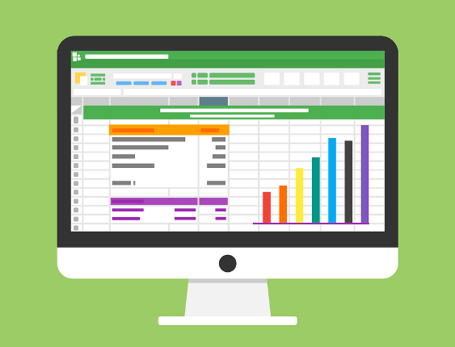
Was steht in den Headlines?
sprechen / hören / schreiben
attack
protect
Hackerangriff: So schütze ich meine Daten
data
Hacker attack:
I protect
my data in this way
Notes:
Word frequency of cognates (1 is the most frequent word in German): Hacker [>5000] Source: Jones, R.L. & Tschirner, E. (2019). A frequency dictionary of German: core vocabulary for learners. Routledge
Source:
https://www.swp.de/panorama/wie-schuetze-ich-meine-daten_-23681309.html

Slide 34
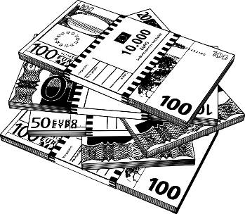
Was steht in den Headlines?
sprechen / hören / schreiben
million
Million verdienen mit
1-Mann-Unternehmen
enterprise, company
Earn a million with a one man company
Notes:
Source:
https://omr.com/de/1-mann-unternehmen-millionen-umsatz-neu/

Slide 35
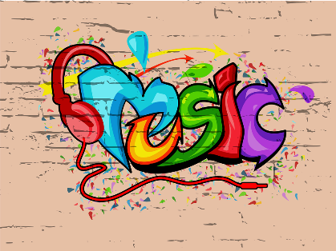
Was steht in den Headlines?
sprechen / hören / schreiben
against
wall
Stadt. Wand. Kunst. Graffiti gegen *Tristesse
*die Tristesse = sadness
City. Wall. Art.
Graffiti against sadness
Notes:
Word frequency of unknown words (1 is the most frequent word in German): Tristesse [>5000] Source: Jones, R.L. & Tschirner, E. (2019). A frequency dictionary of German: core vocabulary for learners. Routledge
Word frequency of cognates (1 is the most frequent word in German): Graffiti [>5000] Source: Jones, R.L. & Tschirner, E. (2019). A frequency dictionary of German: core vocabulary for learners. Routledge
Source:
https://www.zdf.de/nachrichten/heute-journal/mannheim-graffiti-gegen-tristesse-100.html

Slide 36
Was steht in den Headlines?
sprechen / hören / schreiben
at
Law
Gesetz gegen Hass an der Universität
Law against hatred
at university
Notes:
Word frequency of unknown words (1 is the most frequent word in German): Hass [3155] Source: Jones, R.L. & Tschirner, E. (2019). A frequency dictionary of German: core vocabulary for learners. Routledge
Source:
https://www.zdf.de/nachrichten/heute/ministerin-lambrecht-legt-gesetz-gegen-hatespeech-vor-100.html

Slide 37
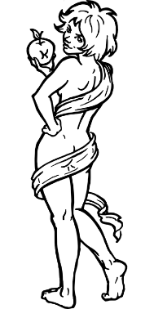
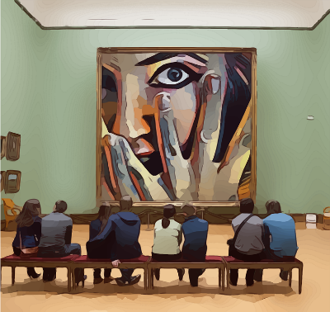
Was steht in den Headlines?
sprechen / hören / schreiben
are hanging
*überall – everywhere
Sexismus: Warum hängen *überall nackte Frauen im Museum
Sexism: Why are naked women hanging everywhere in the museum?
Notes:
Word frequency of unknown words (1 is the most frequent word in German): überall [757] Source: Jones, R.L. & Tschirner, E. (2019). A frequency dictionary of German: core vocabulary for learners. Routledge
Word frequency of cognates (1 is the most frequent word in German): Sexismus [>5000], nackt [1979] Source: Jones, R.L. & Tschirner, E. (2019). A frequency dictionary of German: core vocabulary for learners. Routledge
Source:
https://www.spiegel.de/kultur/sexismus-warum-haengen-ueberall-nackte-frauen-im-museum-a-00000000-0003-0001-0000-000002065274

Slide 38
Was steht in den Headlines?
sprechen / hören / schreiben
against
Krieg gegen die Natur
*der Krieg – war
War against nature
Notes:
Word frequency of unknown words (1 is the most frequent word in German): Krieg [576] Source: Jones, R.L. & Tschirner, E. (2019). A frequency dictionary of German: core vocabulary for learners. Routledge
Word frequency of cognates (1 is the most frequent word in German): Natur [740] Source: Jones, R.L. & Tschirner, E. (2019). A frequency dictionary of German: core vocabulary for learners. Routledge
Source:
https://www.nachrichten.at/politik/aussenpolitik/-gegen-die-natur-klare-worte-zum-auftakt-des-un-klimagipfels;art391,3195229

Slide 39
Was steht in den Headlines?
sprechen / hören / schreiben
aufsprechen* = to record
voice
instead of
Stimme statt *Buchstaben: Handy-Nutzer sprechen ihre *Nachricht lieber auf*
rather
*der Buchstabe – letter *die Nachricht – message
Voice instead of letters: Mobile phone users prefer to record their message
Notes:
Word frequency of unknown words (1 is the most frequent word in German): Buchstabe [2906], Nutzer [2941], Nachricht [1219], aufsprechen [>5000] Source: Jones, R.L. & Tschirner, E. (2019). A frequency dictionary of German: core vocabulary for learners. Routledge
Source:
https://www.muensterschezeitung.de/Leben-und-Erleben/Ratgeber/Digitales/3304472-Stimme-statt-Buchstaben-Sprachnachrichten-sind-beliebt

Slide 40
Wörter in neuen Kontexten
6. Was heißt ‘erlauben’?
5. Was heißt ‘manchmal’?
4. Was heißt ‘alt’?
3. Wie heißt das Gegenwort zu ‘kaufen’?
2. Was heißt ‘gewinnen’?
1. Was macht man in einem Geschäft?
lesen
When reading, you might recognise a word or part of a word but find that the meaning you know doesn’t make sense in the context. It can help to think creatively!
Some words have second meanings which are related to the meaning you already know. What is the most likely second meaning of the words below?
1. das Geschäft | a) business | b) cousin | c) forehead | d) picture book
2. der Gewinn | a) beginning | b) health | c) profit | d) memory
3. verkaufen | a) to start | b) to sell | c) to assign | d) to race
4. das Alter | a) bus stop | b) receipt | c) frost | d) age
5. manche | a) few | b) some | c) lots of | d) all
6. die Erlaubnis | a) permission | b) relaxation | c) break | d) adventure
Notes:
Timing: 3 minutes Aim: increasing students’ vocabulary coverage for comprehension of texts; to encourage students to think more broadly about vocabulary; inference of second (related) meanings of known words by drawing on existing knowledge; priming students for recognising these words in short texts. Procedure: 1. Students read the word in bold, and decide which of the four options it most resembles.
2. If students need a bit of extra help, clues to help them think creatively about known words appear on clicks.
3. Answers revealed on clicks. Word frequency of unknown words (1 is the most frequent word in German): Gewinn [985], verkaufen [721], Alter [775], manche [433], Erlaubnis [>5000] Source: Jones, R.L. & Tschirner, E. (2019). A frequency dictionary of German: core vocabulary for learners. Routledge

Slide 41
Möglich oder unmöglich?
*sammeln = to collect
*löschen = to delete
lesen
Katrin is examining evidence for a case involving two well-known companies.
Wie ist deine Meinung? Ist die Information möglich oder unmöglich?
Ich brauche mehr Information. Was steht in der Zeitung?
Große Firmen sammeln* manchmal ohne Erlaubnis unsere Daten.
2011 haben Hacker Daten von Sony Online Entertainment gesammelt.
Zwei Millionen Personen benutzen jeden Tag Facebook.
2017 hat Facebook einen Profit von 16 Milliarden Dollar gemacht.
Facebook schützt immer unsere persönlichen Daten.
Viele User haben dieses Jahr ihre Facebook-Seiten gelöscht.
Notes:
Timing: 5 minutes Aim: To predict some of the content in the second text of the lesson; to support understanding of relevant vocabulary. Procedure: 1. Check students understand the task rubric. They have not yet encountered the word möglich but should be able to work out the meaning from their knowledge of unmöglich and the meaning of the un- prefix.
2. Students read the sentences and decide whether they think the information they contain is possible (möglich) or impossible (unmöglich).
Word frequency of unknown words (1 is the most frequent word in German): Information [465], unmöglich [1759], sammeln [1219], löschen [3433], Erlaubnis [>5000] Source: Jones, R.L. & Tschirner, E. (2019). A frequency dictionary of German: core vocabulary for learners. Routledge
Word frequency of cognates (1 is the most frequent word in German): Hacker [>5000], Person [357], Profit [>5000], Dollar [941], persönlich [545], User [>5000] Source: Jones, R.L. & Tschirner, E. (2019). A frequency dictionary of German: core vocabulary for learners. Routledge

Slide 42
Zeitungsartikel 2
*sammeln = to collect
*löschen = to delete
*die Quelle = source
lesen
Daten-Skandal im Internet!
13.4.2018 • 16.36 Uhr • 4 Min • Autorinnen: Anne Schwedt, Anna-Lena Weber
Manche Unternehmen sammeln* persönliche Daten, ohne dass die User es wissen. Andere Firmen schützen ihre Daten nicht richtig. 2011 haben Hacker 100 Millionen persönliche Daten wie Namen, Alter und Passwörter von der Firma Sony Online
Entertainment gesammelt.
Zwei Milliarden Menschen benutzen jeden Tag Facebook. 2017 hat die Firma einen Gewinn von 16 Milliarden Dollar gemacht. Aber Facebook steht oft in
der Kritik, weil es persönliche Daten nicht schützt. Laut Quellen* hat eine Analysefirma dieses Jahr die Daten von 87 Millionen Facebook-Usern gesammelt. Wenige User haben aber ihre Facebook-Seiten gelöscht.
Notes:
Timing: 5 minutes (2 slides) Aim: To compare predictions with the content of an adapted news article. Procedure: 1. Students read the article and decide whether or not its content agrees with the statements on the previous slide.
2. Students write gleich or nicht gleich next to each sentence to indicate their choices. At more advanced levels, students should be encouraged to identify the parts of the sentences that don’t match and re-write them to match the newspaper’s take.
NB: teacher to reinforce that the task is about drawing comparisons, rather than verifying whether the statements are true or false. While the article may or may not agree with students’ predictions, a newspaper article should not be read as fact – as Katrin points out on the next slide, we cannot know for sure whether the statements are true or false without more evidence!
3. Answers on the following slide.
Word frequency of unknown words (1 is the most frequent word in German): sammeln [1219], Alter [775], Quelle [1108], manche [433], Gewinn [985], löschen [3433] Source: Jones, R.L. & Tschirner, E. (2019). A frequency dictionary of German: core vocabulary for learners. Routledge
Word frequency of cognates (1 is the most frequent word in German): Autor [723], Name [255], Adresse [2739], Passwort [>5000], Kritik [1001], Skandal [3654], User [>5000], Internet [805], persönlich [545], Hacker [>5000], Dollar [941], Analyse [881] Source: Jones, R.L. & Tschirner, E. (2019). A frequency dictionary of German: core vocabulary for learners. Routledge
Sources:
https://www.dw.com/de/datenklau-im-internet/a-15049601 (Accessed and adapted 27th October 2020)
https://www.dw.com/de/daten-skandal-bei-facebook/l-43362439 (Accessed and adapted 27th October 2020)

Slide 43
Gleich oder anders?
lesen
Welche Informationen sind gleich wie in der Zeitung? Welche sind nicht gleich?
Wie heißt das richtig, laut der Zeitung ?
Wichtig!
Manchmal gibt es falsche Informationen in der Zeitung.
gleich
Große Firmen sammeln* manchmal ohne Erlaubnis unsere Daten.
gleich
2011 haben Hacker Daten von Sony Online Entertainment gesammelt.
nicht gleich
Zwei Millionen Personen benutzen jeden Tag Facebook.
Zwei Milliarden Personen benutzen jeden Tag Facebook.
gleich
2017 hat Facebook einen Profit von 16 Milliarden Dollar gemacht.
nicht gleich
Facebook schützt immer unsere persönlichen Daten.
Facebook schützt nicht unsere persönlichen Daten.
nicht gleich
Wenige User haben dieses Jahr ihre Facebook-Seiten gelöscht.
Viele User haben dieses Jahr ihre Facebook-Seiten gelöscht.
Notes:
Answers to the activity on the previous slide.

Slide 44
Zeitungsartikel 3
lesen / hören / sprechen
1
2
3
4
5
6
7
8
9
Das Geschäft mit unseren Daten
5.9.2018 • 18.30 Uhr • 5 Min • Autorinnen: Claudia Laszczak, Anna-Lena Weber
Firmen wie Facebook und Google machen mit unseren persönlichen Daten Gewinn. User geben ihre Daten freiwillig ein*, und die Firmen verkaufen sie und bekommen Geld. Google verdient im Jahr über 100 Milliarden Dollar mit den Daten.
In vielen Ländern gibt es keine Datenschutzgesetze. In der EU gibt es aber ein neues Gesetz: persönliche Daten gehören noch dem User. Können wir also auch Geld verdienen, *wenn Firmen unsere Daten verkaufen?
Das Start-up-Unternehmen Datawallet präsentiert ein
neues Geschäftsmodell. Über ihre Webseite können User kontrollieren, welche Daten sie verkaufen. Sie bekommen für ihre Informationen etwas Geld.
4. __
1. ___
7. ___
5. ______
2. __
3. ____
6. _______
8. ___________
*eingeben – to enter
*wenn – if, whenever
Notes:
Timing: 10 minutes Aim: Text segmentation exercise to help students to connect the spoken and written forms of the language; to consolidate vocabulary and grammar knowledge by eliciting possible vocabulary items to complete a challenging text. Procedure: 1. Click on a number to hear a section of the text. The recording will stop before the corresponding number in the text (apart from recording 9, which completes the text).
2. Students listen to the audio and read along. Elicit oral translations to ensure students’ understanding of what they have heard. Check especially understanding of unseren and vielen as students have not encountered these with the –en ending, and Ländern, as students have only recently encountered plurals in the dative form. Note also that students have not yet met the conjunction wenn + WO3, though they will be taught this later this term.
3. When the audio stops, ask students to look at the words or punctuation before and after the gap, and consider what type of word the missing item is likely to be (noun, verb, adjective, number …)
4. Then, students think about what words could fill the gaps. They should deliver their suggestions orally, including the two words surrounding the item in their responses (or only the preceding word, if the item appears before a full stop). Suggested responses:
a relevant plural noun (Geschichten, Erfahrungen …)
a relevant noun (eine Antwort, einen Gutschein …)
a number
a relevant plural article, determiner or adjective (kaum, viele, sichere …)
a relevant noun or pronoun in the dative form (dem Mensch, der Bevölkerung, dir …)
a relevant noun or pronoun in the nominative form (wir, sie, Unternehmen …)
a relevant adjective in the neuter form (gutes, tolles, interessantes …)
a relevant noun in the feminine or plural form (Zeit, Arbeit…)
5. Click to reveal the missing word. Students read the sentence aloud together with the preceding and subsequent words.
6. Click on the next number to continue.
Transcript: 1. Firmen wie Facebook und Google machen mit unseren persönlichen ...
2. Daten Gewinn. User geben ihre Daten freiwillig ein, und die Firmen verkaufen sie und bekommen ...
3. Geld. Google verdient im Jahr über ...
4. 100 Milliarden Dollar mit den Daten. In vielen Ländern gibt es ...
5. keine Datenschutzgesetze. In der EU gibt es aber ein neues Gesetz: persönlichen Daten gehören noch ...
6. dem User. Können wir also auch Geld verdienen, wenn ...
7. Firmen unsere Daten verkaufen? Das Start-up-Unternehmen Datawallet präsentiert ein …
8. neues Geschäftsmodell. Über ihre Webseite können User kontrollieren, welche Daten sie verkaufen wollen. Sie bekommen für ihre ...
9. Informationen etwas Geld. Word frequency of unknown words (1 is the most frequent word in German): Gewinn [985], verkaufen [721], eingeben [4461] wenn [42], Source: Jones, R.L. & Tschirner, E. (2019). A frequency dictionary of German: core vocabulary for learners. Routledge
Word frequency of cognates (1 is the most frequent word in German): Autor [723], persönlich [545], präsentieren [1400], kontrollieren [1546], EU [726], Start-up [>5000], Modell [708], Webseite [2837], User [>5000] Source: Jones, R.L. & Tschirner, E. (2019). A frequency dictionary of German: core vocabulary for learners. Routledge
Sources:
https://www.dw.com/de/datenklau-im-internet/a-15049601 (Accessed and adapted 27th October 2020)
https://www.dw.com/de/daten-skandal-bei-facebook/l-43362439 (Accessed and adapted 27th October 2020)

Slide 45
Für oder gegen?
schreiben
In der EU gibt es ein neues Gesetz:
Persönliche Daten gehören noch dem User.
Sind die Autorinnen für oder gegen das Gesetz, deiner Meinung nach? Oder haben sie keine Meinung? Schreib einen Satz mit denn oder weil.
Beispiel:
Die Autorinnen sind gegen das Gesetz, denn die User geben ihre Daten freiwillig ein.
Notes:
OPTIONAL
Timing: 3 minutes Aim: To consider some of the wider themes in the text; to interpret journalistic texts; to react in writing to information in a news article; to produce some of this week’s new words in context; to revise giving opinions using structures with weil and denn. Procedure: 1. In pairs, students discuss whether or not they think the writers are expressing an opinion on the text, and, if yes, which opinion it is.
2. Students write a sentence with weil or denn justifying their choice.
2. Again, there is no right or wrong answer – praise should be given for a grammatically correct sentence with a semantically appropriate justification. Note: this task is challenging and likely not for all classes. A task to elicit a simpler but still personal response to the text is provided on the next slide.
Word frequency of unknown words (1 is the most frequent word in German): Gewinn [985], verkaufen [721], eingeben [4461] Source: Jones, R.L. & Tschirner, E. (2019). A frequency dictionary of German: core vocabulary for learners. Routledge
Word frequency of cognates (1 is the most frequent word in German): Autor [723], persönlich [545], EU [726], wenn [42], User [>5000] Source: Jones, R.L. & Tschirner, E. (2019). A frequency dictionary of German: core vocabulary for learners. Routledge

Slide 46
Deine Meinung
sprechen
Wie findest du die Texte?
Ich finde sie …
interessant lustig traurig
pessimistisch optimistisch
wichtig langweilig spannend
Notes:
Timing: 2 minutes Aim: It is appropriate to end this lesson with a short paired/group discussion of students’ reactions to text and topic. The slide suggests vocabulary but students may of course offer more/different adjectives/opinions. Word frequency (1 is the most frequent word in German): pessimistisch [>5000], optimistisch [4687] Source: Jones, R.L. & Tschirner, E. (2019). A frequency dictionary of German: core vocabulary for learners. Routledge

Slide 47
Lustige deutsche Gesetzte
schreiben / sprechen
*verboten = forbidden
Hier sind vier lustige Gesetze. Diese Gesetze gibt es in Deustchland wirklich!
Bist du für oder gegen die Gesetze? Schreib Sätze mit weil und denn.
In Deutschland ist es verboten, im Gleichschritt
über eine Brücke zu marschieren.
Nackt Autofahren ist verboten.
Man darf nicht ‚du‘ zu einem Polizisten sagen.
In Deutschland ist eine Eheschließung nicht gültig, wenn der Partner betrunken ist.
Notes:
Optional extra for higher proficiency learners
Timing: 10 minutes Aim: To react in writing to information in a factual text; to produce some of this week’s new words in context; to revise structures with weil and denn. Procedure: 1. Look at the laws on the slide – work out their meaning with students. Many of the vocabulary items are known words or cognates, but some dictionary work will be required.
2. Students write their thoughts on the laws, using weil and denn at least twice each. Word frequency (1 is the most frequent word in German): verbieten [1320], Gleichschritt [141/376], Brücke [1938], marschieren [4544], Ehe [2321], gültig [3651], betrunken [>5000], Tod [540], Einbrecher [>5000], nackt [1978], Autobahn [2966], leer [874], Tank [>5000] Source: Jones, R.L. & Tschirner, E. (2019). A frequency dictionary of German: core vocabulary for learners. Routledge
Source:
https://www.wmn.de/lifestyle/social-life/die-lustigsten-gesetze-in-deutschland-df1hmexa-id4769

Slide 48
Hausaufgaben
This week’s homework is to revise a set of Y7 vocabulary.
Pre-learning for lesson: Year 8 German Term 3.1 Week 2
Notes:
This is the HW slide for the Oak Academy videoed lesson. Don’t upload to the portal with this slide, but do save a separate version on the Google drive and send link to RH, when complete.

Slide 49
Hausaufgaben
Vocabulary Learning Homework (Y8 Term 3.1 Week 2) Year 7 revisiting Mashup 4
Quizlet link
Notes:
Note to resource creators: links needs to be properly formatted as hyperlinks (copy url, select target text, right click, and add hyperlink), do not paste the website url directly on the slide. The Student worksheet link to the resource portal needs to be formatted like the other links on the slide; if this is done correctly there is no need to shorten the url.

