Slide 1
Phonics
SSC [sch], [sp]
Y7 German
Term 2.1 - Week 3
Natalie Finlayson / Rachel Hawkes
Date updated: 14/01/20

Slide 2
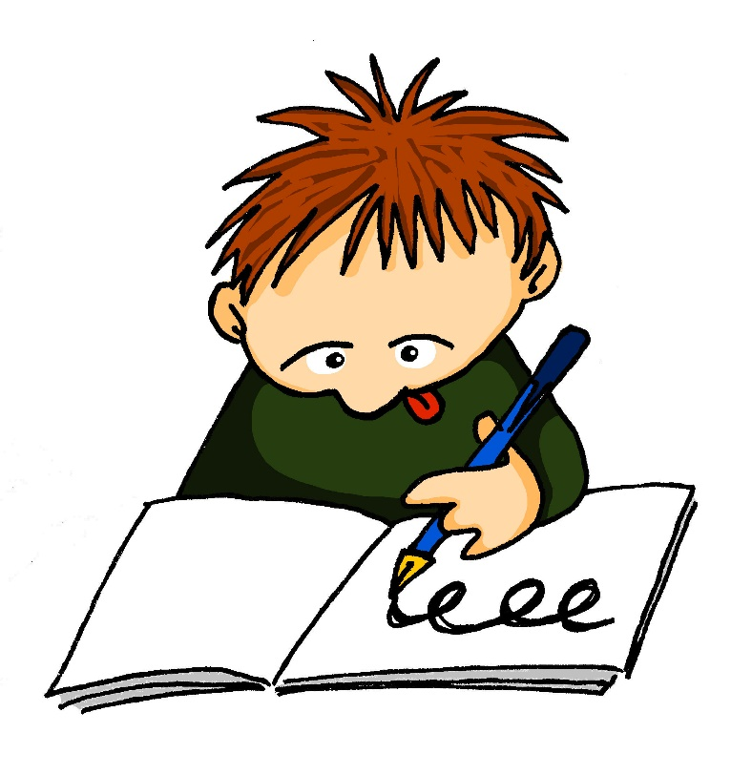
sch
schreiben
Notes:
Introduce and elicit the pronunciation of the individual SSC ‘sch’ and then present and practise the pronunciation of the source word ‘schreiben’.
A possible gesture for this would be to mime writing.

Slide 3
sch
schreiben
Notes:
With SSC and word but not pictures, to focus more clearly on the sound-writing relationship.

Slide 4
sch
schreiben
Notes:
Without sounds to elicit SSC and source word from students.

Slide 5
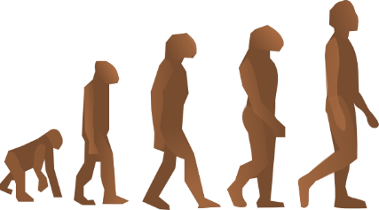
sch
falsch
schnell
[fast]
schreiben
schwarz
zwischen
Mensch
Notes:
Introduce and elicit the pronunciation of the individual SSC [sch] and then the source word again (with gesture, if using). Then present and elicit the pronunciation of the five cluster words. The cluster words have been chosen for their high-frequency, from a range of word classes, with the SSC (where possible) positioned within a variety of syllables within the words (e.g. initial, 2nd, final etc.) Additionally, we have tried to use words that build cumulatively on previously taught SSCs (see the Phonics Teaching Sequence document) and do not include new SSCs. Where new SSCs are used, they are often consonants which have a similar symbol-sound correspondence in English.
Word frequency rankings (1 is the most common word in German): schreiben [245]; falsch [638] schnell [233]; zwischen [115]; Mensch [104]; schwarz [451]. Source: Jones, R.L. & Tschirner, E. (2006). A frequency dictionary of German: core vocabulary for learners. Routledge

Slide 6
sch
falsch
schnell
schreiben
schwarz
zwischen
Mensch
Notes:
With sound and no pictures to focus all attention on the sound-symbol correspondence.

Slide 7
sch
falsch
schnell
[fast]
schreiben
schwarz
zwischen
Mensch
Notes:
Without sound to elicit pronunciation (without first hearing the teacher).
Teacher to elicit pronunciation by asking “Wie sagt man …”

Slide 8
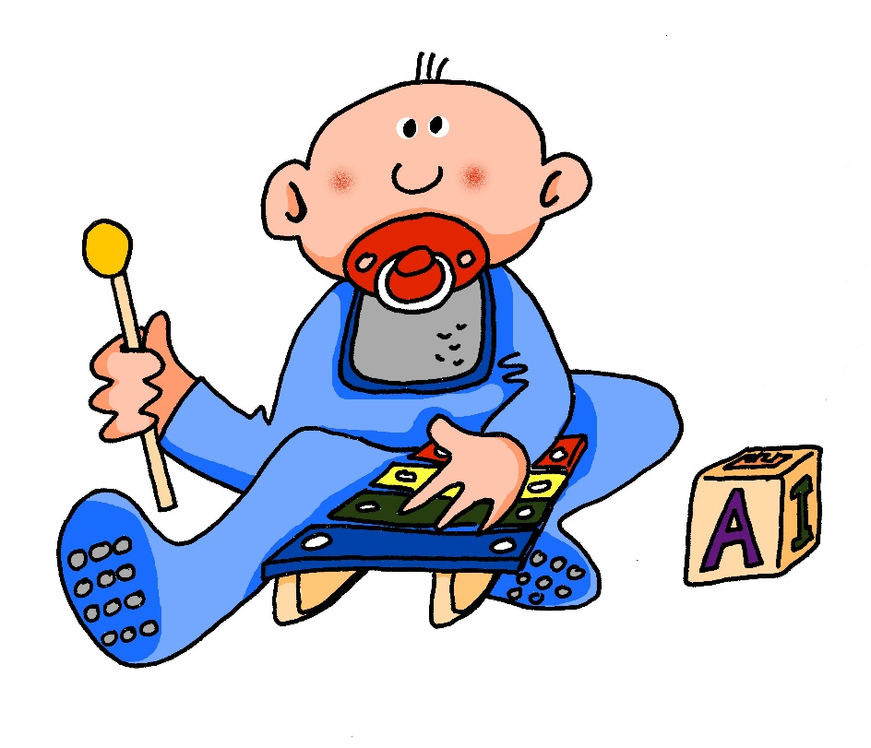
sp-
spielen
Notes:
Introduce and elicit the pronunciation of the individual SSC ‘sp-’ and then present and practise the pronunciation of the source word ‘spielen’.
A possible gesture for this would be to mime playing a xylophone.

Slide 9
sp-
spielen
Notes:
Without pictures to focus on the SSC alone.

Slide 10
sp-
spielen
Notes:
Without sound to elicit pronunciation (without first hearing the teacher).
Teacher to elicit pronunciation by asking “Wie sagt man …”

Slide 11
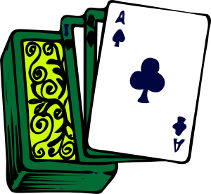
sp
Spaß
Sprache
[fun] (noun)
spielen
sprechen
Spiel
Sport
Rachel Hawkes
Notes:
Introduce and elicit the pronunciation of the individual SSC ‘sp’ and then the source word again (with gesture, if using). Then present and elicit the pronunciation of the five cluster words. The cluster words have been chosen for their high-frequency, from a range of word classes, with the SSC (where possible) positioned within a variety of syllables within the words(e.g. initial, 2nd, final etc..) and additionally, we have tried to use words that build cumulatively on previously taught SSCs (see the Phonics Teaching Sequence document) and do not include new SSCs. Where new SSCs are used, they are often consonants which have a similar symbol-sound correspondence in English.
Word frequency rankings (1 is the most common word in German): spielen [197]; Spaß [666] Sprache [367]; sprechen [157]; Sport [845]; Spiel [500]. Source: Jones, R.L. & Tschirner, E. (2006). A frequency dictionary of German: core vocabulary for learners. Routledge

Slide 12
sp
Spaß
Sprache
spielen
sprechen
Spiel
Sport
Rachel Hawkes
Notes:
Without pictures to focus on the SSC alone.

Slide 13
sp
Spaß
Sprache
spielen
sprechen
Spiel
Sport
Rachel Hawkes
Notes:
Without sound to elicit pronunciation (without first hearing the teacher).
Teacher to elicit pronunciation by asking “Wie sagt man …”

Slide 14
Wie sagt man …
Spinne
sprechen
15
Spiegel
spanisch
Speck
Spaniel
Spezialität
Spargel
Sport
springen
spät
sprechen
0
Spagetti
spielen
LOS!
Notes:
In this pronunciation activity, students must correctly pronounce as many words as they can in 15 seconds.
1/ Students work in pairs, and decide who will go first (Student A).
2/ Teacher starts the timer begins by clicking on ‘los!’
3/ Student A reads words at random from the screen. Their partner (Student B) counts the number of words Student A says, and acts as a ‘juror’ by listening for any ‘English’ pronunciations of sp-. If Student A makes a mistake, the game is stopped and their total number of words counted.
4/ Students swap roles. Teacher restarts the timer.
5/ The student with the most words wins.
The teacher may wish to run this activity two or three times.
NB: For differentiation purposes, a mix of known words, cognates, and unknown words (illustrated with pictures) are used. With the exception of [r] in Spargel and springen, the words chosen contain previously studied SSCs and transferable consonants only.
Frequency rankings of unknown vocabulary: der Spiegel [2046]; der Spargel [>4037]; springen [1468]; der Speck [>4037]; die Spinne [>4037];

Slide 15
Zungenbrecher!
Phonetik
Sieben spanische Spinnen schauen ein spanisches Fußballspiel an!
1
2
3
4
Notes:
This tongue twister offers practice of this week’s SSCs in a full sentence. It consists of previously encountered vocabulary with the exception of schauen [470] to look (at), which will need to be translated for students.
Recordings of the tongue twister said at various speeds play on clicking numbers 1 (slow) to 4 (very fast). All students should start by listening and repeating recording 1. Higher level students may enjoy the challenge of trying the faster versions.
English translation: Seven Spanish spiders are watching a Spanish football match.
sieben [570], spanisch [1865], Spinne [>4037] anschauen [1271], schauen [470], Fußball [1497], Spiel [500].

Slide 16
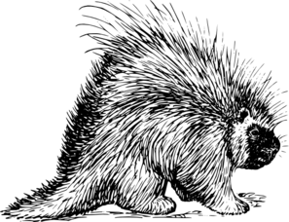
Zungenbrecher!
Phonetik
Ein Stachelschwein, ein Stachelschwein,
das muss ein Schwein mit Stacheln sein!
1
2
3
4
Notes:
Recordings of the tongue twister said at various speeds play on clicking numbers 1 (slow) to 4 (very fast). All students should start by listening and repeating recording 1. Higher level students may enjoy the challenge of trying the faster versions.
English translation: a porcupine, a porcupine, that must be a pig with spines!
Schwein [4009], Stachel [>4037], müssen [45], mit [13], sein [3]

