Slide 1
Familiale
Jacques Prévert
SSC [é / -er / -ez] [revisited]
Y7 French
Term 2.2 - Week 3 - Lesson 43
Suzanne Graham / Julia Hofweber / Kirsten Somerville
Date updated: 11/08/21
Notes:
Artwork by Chloé Motard. All additional pictures selected are available under a Creative Commons license, no attribution required.
Please note: teachers will need to insert lines from the poem into slides 23-28 (lesson 1) and slide 51 (lesson 2) before teaching.
Unless otherwise attributed, all images are from pixabay.com and require no attribution.
Learning outcomes (lesson 1)
Understanding an authentic text, learning vocabulary, understanding the poet and his values
Frequency rankings of vocabulary introduced this week (1 is the most common word in French):
2.2.3 (introduce): tuer [591], affaires [170], fils [735], guerre [266], mère [645], père [569], vie [132], naturel [760], naturelle [760], heureux [764], heureuse [764], absolument [1009], contre [121]
2.1.4 (revisit): faisons [25], faites [25], font [25], attention [482], effort [388], exercice¹ [1290], fête [1490], liste [924], d'accord [736]
1.2.6 (revisit): chanter [1820], étudier [960], jouer [219], ils [13], elles [38], élève [1068], fruit [896], histoire^{1, 2} [263], radio [1526], ensemble [124]
Source: Londsale, D., & Le Bras, Y. (2009). A Frequency Dictionary of French: Core vocabulary for learners London: Routledge.

Slide 2
é/-er/-ez
écrire
Notes:
Timing: 1 minute
Aim: To introduce/consolidate SSC [é]
Procedure: 1. Present the letter(s) and say the [é] sound first, on its own. Students repeat it with you. 2. Bring up the word ”écrire” on its own, say it, students repeat it, so that they have the opportunity to focus all of their attention on the connection between the written word and its sound.
3. A possible gesture for this would be to mime the act of writing (onto the palm of the other hand perhaps). 4. Roll back the animations and work through 1-3 again, but this time, dropping your voice completely to listen carefully to the students saying the [é] sound, pronouncing ”écrire” and, if using, doing the gesture.
Word frequency (1 is the most frequent word in French):
écrire [382] Source: Londsale, D., & Le Bras, Y. (2009). A Frequency Dictionary of French: Core vocabulary for learners London: Routledge.

Slide 3
é/-er/-ez
écrire
Notes:
With sound and no pictures to focus all attention on the sound-symbol correspondence.

Slide 4
é/-er/-ez
écrire
Notes:
Without sound to elicit pronunciation (without first hearing the teacher).
Teacher to elicit pronunciation by asking “Comment dit-on …"

Slide 5
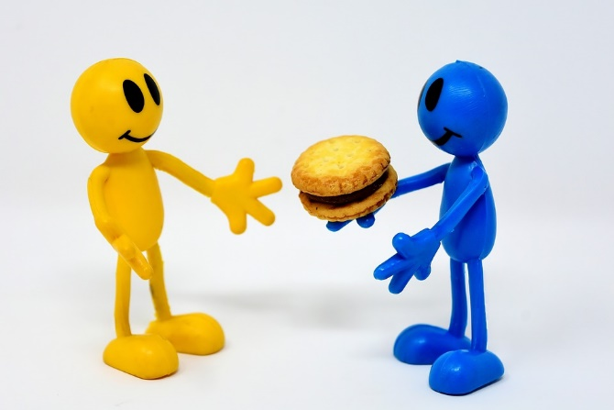
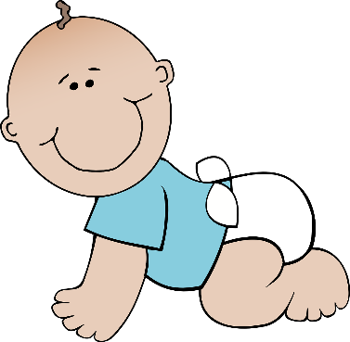
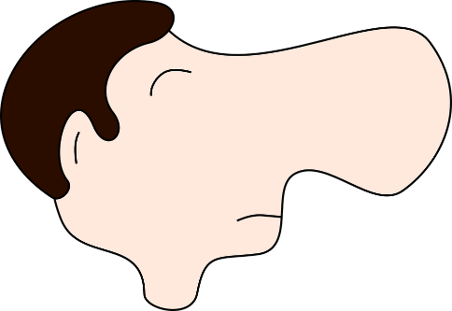
é/-er/-ez
bébé
donner
nez
parler
écrire
aller
[to go]
Notes:
Timing: 2 minutes
Aim: To introduce/consolidate SSC [é]
Procedure:
1. Introduce and elicit the pronunciation of the individual SSC [é] and then the source word again ‘écrire’ (with gesture, if using). 2. Then present and elicit the pronunciation of the five cluster words.
The cluster words have been chosen for their high-frequency, from a range of word classes, with the SSC (where possible) positioned within a variety of syllables within the words (e.g. initial, 2nd, final etc.). Additionally, we have tried to use words that build cumulatively on previously taught SSCs (see the Phonics Teaching Sequence document) and do not include new SSCs. Where new SSCs are used, they are often consonants which have a similar symbol-sound correspondence in English.
Word frequency (1 is the most frequent word in French): écrire [382]; bébé [>5000]; aller [55] donner [46]; nez [2661]; parler [106]. Source: Londsale, D., & Le Bras, Y. (2009). A Frequency Dictionary of French: Core vocabulary for learners London: Routledge.

Slide 6
é/-er-ez
donner
bébé
nez
parler
écrire
aller
Notes:
With sound and no pictures to focus all attention on the sound-symbol correspondence.

Slide 7
é/-er/-ez
donner
bébé
nez
parler
écrire
aller
Notes:
Without sound to elicit pronunciation (without first hearing the teacher).
Teacher to elicit pronunciation by asking “Comment dit-on …"

Slide 8
Amies ou ennemies ?
écouter
Elles ont une chose en commun:
1
Elles sont très différentes !
Agnès
é
è
e
et
Chloé
Notes:
Timing: 5 minutes (for 8 slides)
Aim: Aural recognition of SSC [è] in contrast to [é] and [e]. Names are used so that students focus on the SSCs rather than vocabulary knowledge.
Procedure:
1. Students write 1-8 in their workbooks, and for each write down either the SSC that is common to both names, or “[-]”.
2. Click the number to hear the pairs of names. This can be repeated as necessary depending on the level of the class.
3. The answers are animated to show first whether the two names have “something in common” (the SSC [e], [è] or [e]!) or if they are “very different” (no common SSC).
4. On a final click, the names in full including the SSC highlighted in blue.
Transcript:
1. Agnès et Chloé

Slide 9
Amies ou ennemies ?
écouter
Elles ont une chose en commun:
2
Elles sont très différentes !
Léa
é
è
e
et
Zoé
Notes:
Transcript:
2. Léa et Zoé

Slide 10
Amies ou ennemies ?
écouter
Elles ont une chose en commun:
3
Elles sont très différentes !
Madeleine
é
è
e
et
Renée
Notes:
Transcript:
3. Madeleine et Renée

Slide 11
Amies ou ennemies ?
écouter
Elles ont une chose en commun:
4
Elles sont très différentes !
Marylène
é
è
e
et
Émeline
Notes:
Transcript:
4. Marylène et Émeline

Slide 12
Amies ou ennemies ?
écouter
Elles ont une chose en commun:
5
Elles sont très différentes !
Solène
é
è
e
et
Cécile
Notes:
Transcript:
5. Solène et Cécile

Slide 13
Amies ou ennemies ?
écouter
Elles ont une chose en commun:
6
Elles sont très différentes !
Michèle
é
è
e
et
Mylène
Notes:
Transcript:
6. Michèle et Mylène

Slide 14
Amies ou ennemies ?
écouter
Elles ont une chose en commun:
7
Elles sont très différentes !
Ségolène
é
è
e
et
Aurélie
Notes:
Transcript:
7. Ségolène et Aurélie

Slide 15
Amies ou ennemies ?
écouter
Elles ont une chose en commun:
8
Elles sont très différentes !
Adèle
é
è
e
et
Hélène
Notes:
Transcript:
8. Adèle et Hélène

Slide 16
Vocabulaire
écouter
life
happy (m)
mother
war
absolutely
to kill
son
father
business
against
natural
happy (f)
1
Notes:
Timing: 5 minutes (for 12 slides)
Aim: Aural recognition of this week’s new vocabulary.
Procedure:
1. This activity can be carried out as a game in pairs or as a class.
2. Click on the number to hear a word said aloud.
3. Students use their exercise books or mini whiteboards to write down the English translation for the word they hear – the first to hold up the correct translation wins.
4. A more challenging variation would be to hide the English words on the board, so that students write the translation from memory.
Transcript:
1. les affaires

Slide 17
Vocabulaire
écouter
life
happy (m)
mother
war
absolutely
to kill
son
father
business
against
natural
happy (f)
2
Notes:
Transcript:
2. heureux

Slide 18
Vocabulaire
écouter
life
happy (m)
mother
war
absolutely
to kill
son
father
business
against
natural
happy (f)
3
Notes:
Transcript:
3. absolument

Slide 19
Vocabulaire
écouter
life
happy (m)
mother
war
absolutely
to kill
son
father
business
against
natural
happy (f)
4
Notes:
Transcript:
4. le père

Slide 20
Vocabulaire
écouter
life
happy (m)
mother
war
absolutely
to kill
son
father
business
against
natural
happy (f)
5
Notes:
Transcript:
5. la vie

Slide 21
Vocabulaire
écouter
life
happy (m)
mother
war
absolutely
to kill
son
father
business
against
natural
happy (f)
6
Notes:
Transcript:
6. la mère

Slide 22
Vocabulaire
écouter
life
happy (m)
mother
war
absolutely
to kill
son
father
business
against
natural
happy (f)
7
Notes:
Transcript:
7. tuer

Slide 23
Vocabulaire
écouter
life
happy (m)
mother
war
absolutely
to kill
son
father
business
against
natural
happy (f)
8
Notes:
Transcript:
8. heureuse

Slide 24
Vocabulaire
écouter
life
happy (m)
mother
war
absolutely
to kill
son
father
business
against
natural
happy (f)
9
Notes:
Transcript:
9. naturel

Slide 25
Vocabulaire
écouter
life
happy (m)
mother
war
absolutely
to kill
son
father
business
against
natural
happy (f)
10
Notes:
Transcript:
10. la guerre

Slide 26
Vocabulaire
écouter
life
happy (m)
mother
war
absolutely
to kill
son
father
business
against
natural
happy (f)
11
Notes:
Transcript:
11. le fils

Slide 27
Vocabulaire
écouter
life
happy (m)
mother
war
absolutely
to kill
son
father
business
against
natural
happy (f)
12
Notes:
Transcript:
12. contre

Slide 28
Fais des paires
Some of these words are new – try to work out the meaning!
lire
aller au cimetière
to do knitting
to do business
faire du tricot
faire des affaires
to go to war / make war
to go to the cemetery
faire la guerre
Notes:
Timing: 2 minutes
Aim: To introduce the key phrases in the poem.
NB: This slide contains two words which have not been pre-learned – cimetière [3583] and tricot [>5000] – these are not included the French SOW due to their low frequency. Encourage students to work in pairs, beginning with the familiar words and making an educated guess for the remaining two (cimetière is a near-cognate). It may be useful for them to write these key phrases in their books. Click the French phrase to ‘fly’ over the English.
The task instructions also contain the cognate paire [3926].

Slide 29
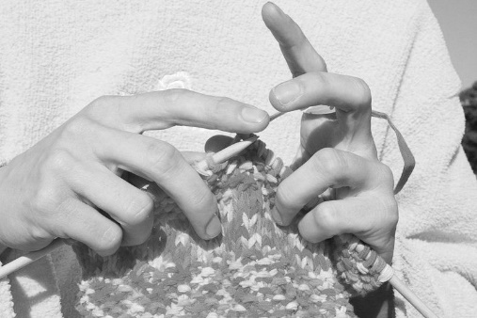
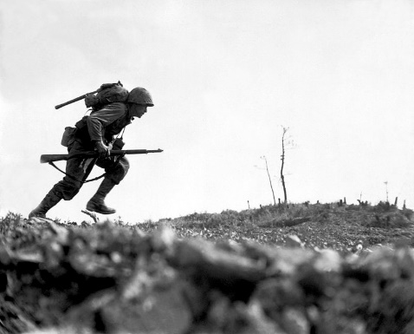
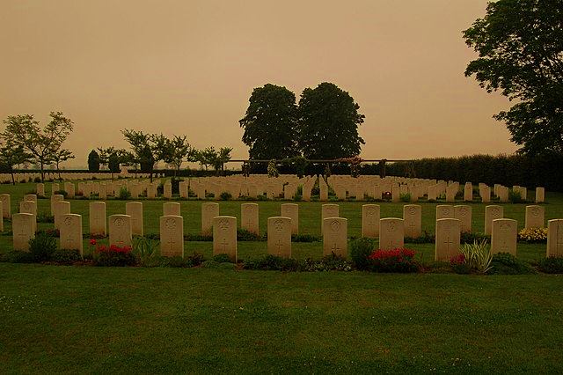
Choisis une image
écouter
a
b
1
c
2
a
3
d
4
b
c
d
Notes:
Timing: 2 minutes
Aim: Aural recognition of the key phrases in the poem.
Procedure:
1. Students write 1-4 and choose a-d for each.
2. Click the numbers to play the audio.
3. Answers are revealed on clicks.
Transcript:
Il fait des affaires
Elle fait du tricot
Ils vont au cimetière
Il fait la guerre
Word frequency of cognates used (1 is the most frequent word in French): choisir [226], image [659]
Source: Londsale, D., & Le Bras, Y. (2009). A Frequency Dictionary of French: Core vocabulary for learners London: Routledge.
Optional extension (depending on the class): 1. After checking answers by letter, the teacher could play the phrases again to elicit the full meaning of each phrase – (i.e. aural translation) 2. Further, students could be invited to recall any of the four phrases, orally.
Attribution:
Image a: Pink knitting in front of pink sweatshirt by Johntex under the Creative Commons Attribution-Share Alike 3.0 Unported license
Image b: Marine dashes through Japanese machine gun fire by Pvt. Bob Bailey is in the public domain
Image c: Business to Business Agreement by Onyxxo is licensed under the Creative Commons Attribution-Share Alike 4.0 International license
Image d: Headstones in Banville-la-Campagne war cemetery, Normandy by Londonclanger is licensed under the Creative Commons Attribution-Share Alike 4.0 International license

Slide 30
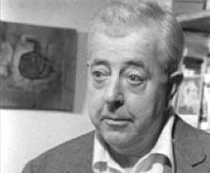
Des dates importantes
lire
Choisis la description correcte pour les dates.
1900 - 1977
Jacques Prévert écrit « Familiale » :
le poème
Jacques Prévert
1939 - 1945
b) Jacques Prévert – vie:
le poète
1946
c) la Seconde Guerre mondiale :
une période importante pour le poète
Notes:
Timing: 3 minutes
Aim: To present some key dates to provide background to the poem and the poet.
Procedure:
1. Students write the dates and choose a), b) or c). Answers are provided on the next slide.
NB: Not all vocabulary has been previously taught in the SOW, but much of it can be inferred by combining context with prior language knowledge.
Word frequency of cognates used (1 is the most frequent word in French): date [660], important [215], choisir [226], description [2779], correct [2617], second [379], mondial [549], période [407].
Source: Londsale, D., & Le Bras, Y. (2009). A Frequency Dictionary of French: Core vocabulary for learners London: Routledge.
Attribution – photo: Jacques Prévert by PRÉVERT Catherine is licensed under the Creative Commons Attribution-Share Alike 1.0 Generic license

Slide 31
Des dates importantes
lire
Réponses :
1900 - 1977
b) Jacques Prévert – vie :
le poète
Jacques Prévert
1939 - 1945
c) la Seconde Guerre mondiale :
une période importante pour le poète
1946
a) Jacques Prévert écrit « Familiale » :
le poème
Notes:
Answers slide.
Students could also be asked to describe Prévert based on what they have learnt about him and the vocabulary from the poem. (Comment est-il ? Est-il… heureux, triste, calme, amusant, intelligent… ?)

Slide 32
Des idées importantes
lire
Lis les idées. Tu penses que le poète est pour ou contre ?
Écris deux listes avec un(e) partenaire.
pour | contre
la liberté
la justice
l’autorité
la guerre
l’égalité
le nationalisme
Notes:
Timing: 3 minutes
Aim: To introduce students to some of the wider themes in Prévert’s work by exploring the poet’s values and concerns.
Procedure:
1. Students work in pairs to discuss the meaning of each word and decide if they think the poet agrees or disagrees with these values, based on what they have learnt about him and the vocabulary from the poem.
2. Answers fly to the correct column on clicks.
Word frequency of near-cognates used (1 is the most frequent word in French): liberté [320], autorité [783], égalité [1898], justice [637], nationalisme [>5000].
Source: Londsale, D., & Le Bras, Y. (2009). A Frequency Dictionary of French: Core vocabulary for learners London: Routledge.

Slide 33
Familiale
lire / parler
Lis le vocabulaire et parle avec un(e) partenaire.
Le sujet de « Familiale » est…
la famille ?
l’histoire ?
le travail ?
la violence ?
aller au cimetière
naturel
la mère
tuer
faire du tricot
faire des affaires
le fils
le père
faire la guerre
la vie
Notes:
Timing: 3 minutes
Aim: A final pre-text activity to review key vocabulary and try to predict the subject of the poem.
Procedure:
1. Bring up the questions and options.
2. Give students just a few seconds to confer in pairs and share their views. There is no right or wrong answer – the purpose is to raise their interest by anticipating what the poem might be about. Some may be able to use the information about the poet on the previous slide to give an answer. NB: students have not yet encountered the nominal for travail, but should be able to infer the meaning form the verb travailler.
Word frequency of unknown words used (1 is the most frequent word in French): travail [153], violence [602].
Source: Londsale, D., & Le Bras, Y. (2009). A Frequency Dictionary of French: Core vocabulary for learners London: Routledge.

Slide 34
Écoute le poème
écouter
https://www.youtube.com/watch?v=cV19CfuswyM&t=51s
Notes:
Timing: 3 minutes
Aim: The present the text without a transcript to focus students on the mood of the poem initially. The link in the slide has been suggested in order to convey the meaning of the poem ie the futility of war and the indifference/coldness of the mother and father, whose lives (knitting and business) just continue while the son loses his life in the war.
If you find the delivery too fast for students, alternatives are as follows:
https://www.youtube.com/watch?v=mvn6kBjWyf0
https://www.youtube.com/watch?v=MGytqDEXoGQ
Note that this last one is read by students (German L1) but conveys the poem’s meaning well.

Slide 35
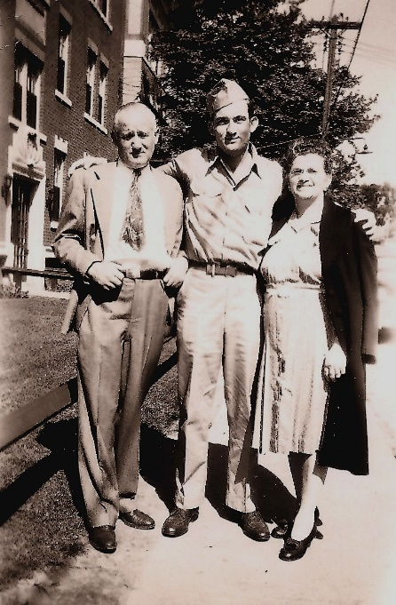
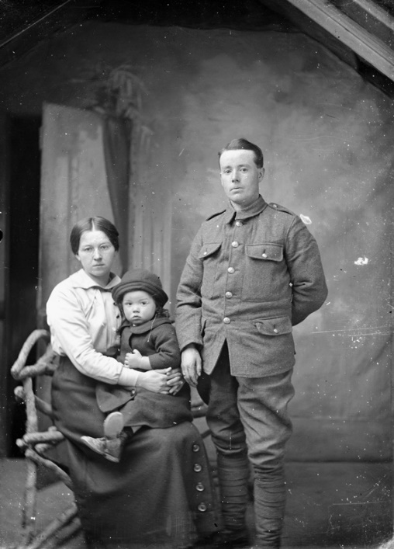
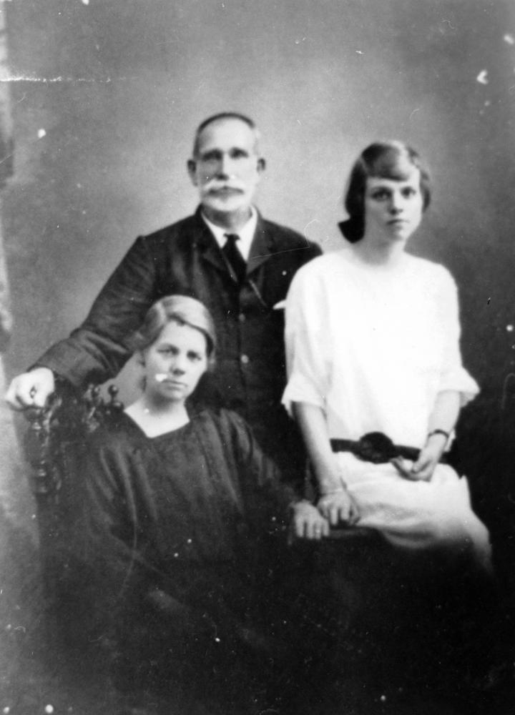
La famille
écouter
Choisis une image pour représenter la famille. Il y a qui ?
a)
b)
c)
Notes:
Timing: 2 minutes
Aim: This slide checks students’ initial global understanding by identifying the main characters in the poem.
Procedure:
1. Students say which photo they have chosen and why, re-using the vocab for family members in the poem.
2. The answer is revealed on a click.
Word frequency of cognates used (1 is the most frequent word in French): choisir [226], image [659], représenter [293].
Source: Londsale, D., & Le Bras, Y. (2009). A Frequency Dictionary of French: Core vocabulary for learners London: Routledge.
Attribution:
Image a: "Herbert Swadosh with his parents Ralph and Jennie, Hartford, CT, 1946" by Jswad is licensed under CC BY-NC-ND 2.0
Image b: Family portrait by Auckland Museum is licensed under CC BY 4.0
Image c: Robert Peut with his family, ca. 1935 by John Oxley Library, State Library of Queensland is in the public domain

Slide 36
La famille
écouter
Écoute le poème :
https://www.youtube.com/watch?v=cV19CfuswyM&t=51s
1
b)
2
a)
Choisis une image pour représenter…
(a) le fils
(b) la mère
(c) le père
(d) les deux parents
3
c)
4
d)
Notes:
Timing: 5 minutes
Aim: Focus on the role of each character in the poem.
Procedure:
1. Click the link to hear the poem.
2. Students may need to listen twice to answer the questions. Answers appear on clicks.
Answers:
2 – il fait la guerre
1 – elle fait du tricot
3 – il fait des affaires
4 – ils vont au cimetière
Word frequency of cognates used (1 is the most frequent word in French): choisir [226], image [659] and représenter [293].
Source: Londsale, D., & Le Bras, Y. (2009). A Frequency Dictionary of French: Core vocabulary for learners London: Routledge.
Attribution:
Image a: Pink knitting in front of pink sweatshirt by Johntex under the Creative Commons Attribution-Share Alike 3.0 Unported license
Image b: Marine dashes through Japanese machine gun fire by Pvt. Bob Bailey is in the public domain
Image c: Business to Business Agreement by Onyxxo is licensed under the Creative Commons Attribution-Share Alike 4.0 International license
Image d: Headstones in Banville-la-Campagne war cemetery, Normandy by Londonclanger is licensed under the Creative Commons Attribution-Share Alike 4.0 International license

Slide 37
Complète le poème
lire
[Line 15] [Line 16] [5]… [Line 17] [Line 18] [Line 19] [Line 20] [Line 21] [6]… [Line 22] [Line 23] [Line 24] [Line 25] [7]… [Line 26] [Line 27] [8]…
[Line 1] [1]… [Line 2] [Line 3] [2]… [Line 4] [Line 5] [3]… [Line 6] [Line 7] [Line 8] [Line 9] [Line 10] [Line 11] [4]… [Line 12] [Line 13] [Line 14]
cimitière affaires guerre
mère père fait fils vie
Notes:
Please note: teachers to insert the full text of the poem, replacing the missing words with the orange numbers in the lines indicated. See slide 24 for answers. Line breaks are indicated in the English translation on slides 27-28.
Timing: 6 minutes
Aim: Written recognition of key words in the poem.
Procedure:
1. Students complete the gap-fill with or without the gapped words showing (click to show the box of words).
2. Answers provided on the next slide.
Word frequency of cognates used (1 is the most frequent word in French): compléter [2034]
Source: Londsale, D., & Le Bras, Y. (2009). A Frequency Dictionary of French: Core vocabulary for learners London: Routledge.

Slide 38
Familiale
Réponses :
lire
[Line 1] fait [Line 2] [Line 3] mère [Line 4] [Line 5] affaires [Line 6] [Line 7] [Line 8] [Line 9] [Line 10] [Line 11] fils [Line 12] [Line 13] [Line 14]
[Line 15] [Line 16] père [Line 17] [Line 18] [Line 19] [Line 20] [Line 21] cimetière [Line 22] [Line 23] [Line 24] [Line 25] guerre [Line 26] [Line 27] vie
Notes:
Please note: teachers to insert the full text of the poem, with the missing words in orange.
Answers

Slide 39
lire
Français | Anglais
[Line 1] | The mother ___
[Line 2] | The ___ is fighting in the war
[Line 3] | The mother, she __this perfectly natural
[Line 4] | And the father, what is the father doing
[Line 5] | He is doing ______
[Line 6] | ___ wife is knitting
[Line 7] | ___ son is fighting in the war
[Line 8] | He is doing _____
[Line 9] | The father, he finds this perfectly natural
[Line 10] | And the ___, the ___?
[Line 11] | What does the son ____?
[Line 12] | The son, he thinks absolutely nothing
[Line 13] | The son his _____ knits
[Line 14] | His _____ does business he fights in the war
lire
Notes:
Please note: teachers to insert the full text of the poem, line by line, according to the English translation.
Timing: 8 minutes
Aim: Whole-class activity to elicit meaning and clarify any remaining unknown vocabulary, arriving at a working English translation by completing the gaps.
Pay particular attention to where the translation moves away from the literal (fait la guerre; trouve/think) and ask students why the translator might have done that. Draw out also the meaning of ‘son/sa’ and clarify the two forms seen here. Students have met ‘mon, ma, mes’ / ‘ton, ta, tes’ and should be encouraged to make the link and explain their understanding.

Slide 40
lire
Français | Anglais
[Line 15] | When the war is over
[Line 16] | He will do business ___ his father
[Line 17] | The ___ carries on
[Line 18] | The mother carries on knitting
[Line 19] | The father carries on doing business
[Line 20] | The son is killed he doesn’t _______
[Line 21] | The father and the mother go to the _____
[Line 22] | The father and the mother ____ it natural
[Line 23] | ____ carries on
[Line 24] | ____ with its knitting its war its business
[Line 25] | Business war knitting war
[Line 26] | Business business business
[Line 27] | Life with the _____
lire
lire
Notes:
Please note: teachers to insert the full text of the poem, line by line, according to the English translation.
Elicit meanings and clarify any unknown vocabulary that has not yet been understood, i.e. arrive at a working English translation orally with the whole class by completing the gaps.
Pay particular attention to where the translation moves away from the literal (fait la guerre; trouve/think; goes on knitting, doing business) and ask students why the translator might have done that. Draw out also the meaning of ‘son/sa’ and clarify the two forms seen here. Students have met ‘mon, ma, mes’ / ‘ton, ta, tes’ and should be encouraged to make the link and explain their understanding.

Slide 41
lire
Français | Anglais
[Line 1] | The mother _____
[Line 2] | The ___ is fighting in the war
[Line 3] | The mother, she _____this perfectly natural
[Line 4] | And the father, what is the father doing
[Line 5] | He is doing ________
[Line 6] | ___ wife is knitting
[Line 7] | ___ son is fighting in the war
[Line 8] | He is doing ________
[Line 9] | The father, he finds this perfectly natural
[Line 10] | And the ___, the ___?
[Line 11] | What does the son _____?
[Line 12] | The son, he thinks absolutely nothing
[Line 13] | The son his _______ is knitting
[Line 14] | His ______ is doing business he is fighting in the war
lire
is knitting
son
finds
business
His
His
business
son
son
think
mother
father
Notes:
Please note: teachers to insert the full text of the poem, line by line, according to the English translation.
ANSWER SLIDE

Slide 42
lire
Français_ | Anglais
[Line 15] | When the war is over
[Line 16] | He will do business ____ his father
[Line 17] | The ___ carries on
[Line 18] | The mother carries on knitting
[Line 19] | The father carries on doing business
[Line 20] | The son is killed he doesn’t ________
[Line 21] | The father and the mother go to the _________
[Line 22] | The father and the mother ____ it natural
[Line 23] | ___ carries on
[Line 24] | ___ with its knitting its war its business
[Line 25] | Business war knitting war
[Line 26] | Business business business
[Line 27] | Life with the _________
lire
lire
with
war
carry on
cemetery
find
Life
Life
cemetery
Notes:
Please note: teachers to insert the full text of the poem, line by line, according to the English translation.
ANSWER SLIDE

Slide 43
Réactions
lire
Le poème, c’est comment ?
C’est….
heureux triste tragique
pessimiste optimiste
sarcastique monotone bizarre
Notes:
Timing: 2 minutes
Aim: The next provides further opportunities for students to express their views on the poem but it is appropriate to end this lesson with a short paired/group discussion of students’ initial reactions to it. The slide suggests vocabulary but students may of course offer more/different adjectives/opinions.
Word frequency of cognates used (1 is the most frequent word in French): tragique [2042], pessimiste [4971], optimiste [2751], sarcastique [>5000], monotone [>5000], bizarre [2756], réaction [947].
Source: Londsale, D., & Le Bras, Y. (2009). A Frequency Dictionary of French: Core vocabulary for learners London: Routledge.

Slide 44
Familiale
Jacques Prévert
SSC [é / -er / -ez] [revisited]
Y7 French
Term 2.2 - Week 3 - Lesson 44
Suzanne Graham / Julia Hofweber / Kirsten Somerville
Date updated: 27/09/20
Notes:
Learning outcomes (lesson 2)
Pronouncing of words in the text, understanding an authentic text, being creative with the text
Revisiting SSC [é]
Frequency rankings of vocabulary introduced this week (1 is the most common word in French):
2.2.3 (introduce): tuer [591], affaires [170], fils [735], guerre [266], mère [645], père [569], vie [132], naturel [760], naturelle [760], heureux [764], heureuse [764], absolument [1009], contre [121]
2.1.4 (revisit): faisons [25], faites [25], font [25], attention [482], effort [388], exercice¹ [1290], fête [1490], liste [924], d'accord [736]
1.2.6 (revisit): chanter [1820], étudier [960], jouer [219], ils [13], elles [38], élève [1068], fruit [896], histoire^{1, 2} [263], radio [1526], ensemble [124]
Source: Londsale, D., & Le Bras, Y. (2009). A Frequency Dictionary of French: Core vocabulary for learners London: Routledge.

Slide 45
Phonétique
parler
C’est quoi le mot français avec la SSC é (-er, -ez) ?
ou
[together]
ch______
semble
anter
en_______
Notes:
Timing: 3 minutes for 5 slides
Aim: Oral production of SSC [é (-er, -ez)] and vocabulary from this week’s revisited sets.
Procedure:
1. Students call out the answers as a class.
2. Elicit both words before moving on.
3. The answers are animated to show the word with the SSC [é (-er, -ez)] first, followed by the other word.

Slide 46
Phonétique
parler
C’est quoi le mot français avec la SSC é (-er, -ez) ?
ou
é
ou
er
ruit
__c___t___
l__ f______
e

Slide 47
Phonétique
parler
C’est quoi le mot français avec la SSC é (-er, -ez) ?
[attention]
ou
l’a______
ttention
j______
ouer

Slide 48
Phonétique
parler
C’est quoi le mot français avec la SSC é (-er, -ez) ?
ou
[what]
é
u
__t___d___
ier
______oi
qu

Slide 49
Phonétique
parler
C’est quoi le mot français avec la SSC é (-er, -ez) ?
ou
[to eat]
a
adio
anger
l__ r______
m______

Slide 50
Phonétique
écrire
En français, c’est … ?
they (m)
ils
SFC
SFe
Notes:
Timing: 6 minutes for 10 slides
Aim: Written production of words containing SSCs [SFC] and [SFe], which feature heavily in the poem.
Procedure:
1. Students write the words in exercise books or on mini whiteboards.
2. Pronunciation can be checked when eliciting answers.
3. The answers are animated to show the full word in French first, then the correct SSC.

Slide 51
Phonétique
écrire
En français, c’est … ?
(we) do
(nous) faisons
SFC
SFe

Slide 52
Phonétique
écrire
En français, c’est … ?
history
histoire
SFC
SFe

Slide 53
Phonétique
écrire
En français, c’est … ?
history
histoire
SFC
SFe

Slide 54
Phonétique
écrire
En français, c’est … ?
effort
effort
SFC
SFe

Slide 55
Phonétique
écrire
En français, c’est … ?
they (f)
elles
SFC
SFe

Slide 56
Phonétique
écrire
En français, c’est … ?
(you (pl)) do
(vous) faites
SFC
SFe

Slide 57
Phonétique
écrire
En français, c’est … ?
party
fête
SFC
SFe

Slide 58
Phonétique
écrire
En français, c’est … ?
exercise
exercice
SFC
SFe

Slide 59
Phonétique
écrire
En français, c’est … ?
(they) do
(ils / elles) font
SFC
SFe

Slide 60
Vocabulaire
écrire
A
B
C
D
E
F
[we do, we make]
[okay, alright]
[party]
[pupil]
[radio]
[together]
G
H
I
J
K
L
[they do, they make (f)]
[to study, studying]
[written exercise]
[to sing, singing]
[history, story]
[attention]
M
N
O
P
Q
R
[they (m)]
[you do, you make (plural)]
[to play, playing]
[list]
[effort]
[fruit]
Notes:
Timing: 8 minutes
Aim: Written production of vocabulary in this week’s revisited set in a limited time frame.
Procedure:
1. Students write A-L in books.
2. Click / press enter to flash a picture. It will disappear after 3 seconds. Note that the pictures do not appear in alphabetical order to increase the challenge.
3. Students write down the French word before the picture has faded away. 4. Ensure that gender/definite articles are known for any words that are nouns.

Slide 61
Prononce les mots
parler
60
mère | affaires | tricot | continue | tout
fait | trouve | absolument | naturel | fils
guerre | vie | cimetière | trouvent | père
secondes
0
Commencer
Notes:
Timing: 2 minutes
Aim: Oral production of key vocabulary from the poem.
Procedure:
1. Click ‘commencer’ to start the timer.
2. Students say the words aloud in pairs.
3. Teacher can circulate to listen out for pronunciation.

Slide 62
Familiale : la répétition
parler
mère | affaires | tricot | continue | tout
guerre | vie | cimetière | trouvent | père
[Line 22] [Line 23]
[Line 24] [Line 25] [Line 26] [Line 27]
La répétition, ça évoque … ?
la monotonie
la routine
l’indifférence
Notes:
Please note: teachers to insert lines 22-27 of the poem in the text box.
Timing: 2 minutes
Aim: To convey the monotony implied by the repetition in the poem. The poet uses this technique to suggest that society has become indifferent to war, which has become routine.
Procedure:
1. Read aloud the words in orange to the students and the last few lines of the poem.
2. Students will need to discuss the effect of the repetition in English, but provide them with the French (in text box) to express the key features.
Word frequency of cognates used (1 is the most frequent word in French): évoquer [1143], monotonie [>5000], routine [4120], indifférence [4176], répétition [2804]
Source: Londsale, D., & Le Bras, Y. (2009). A Frequency Dictionary of French: Core vocabulary for learners London: Routledge.

Slide 63
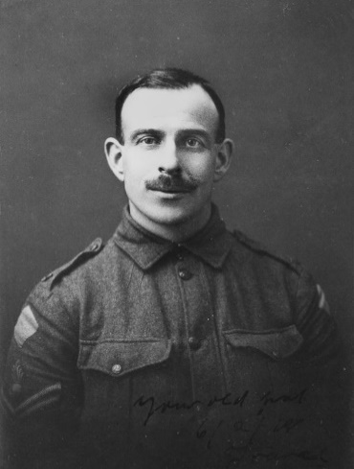
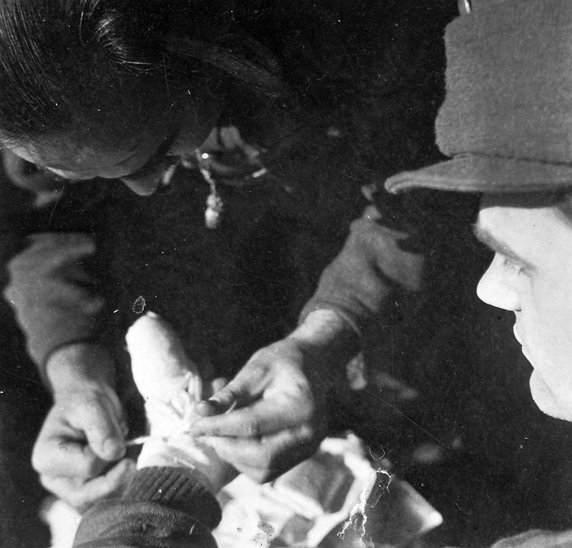
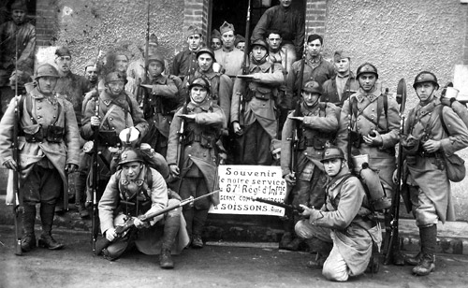
Familiale: le message
parler
Lis le poème. C’est quoi le message ?
Les hommes qui font la guerre…
(A) sont des héros
(B) sont des victimes
(C) sont courageux
La guerre…
(A) est nécessaire
(B) est une tragédie humaine
(C) est une chose naturelle
La société…
(A) accepte la guerre – c’est normale
(B) résiste la guerre
(C) est cruelle
Notes:
Timing: 5 minutes
Aim: Close reading of the poem to decipher its central message.
Procedure:
1. Students silently re-read the poem, silently, and decide what its central message is. There are no strictly right or wrong answers to the questions (and worth emphasising that these are the views of the poet), but the most likely ones are:
Les hommes qui font la guerre (B) sont des victimes
La guerre (B) est une tragédie humaine
La société (A) accepte la guerre – c’est normale
Word frequency of cognates used (1 is the most frequent word in French): message [792], héros [1883], victime [697], courageux [2198], nécessaire [451], tragédie [1910], humain [286], société [295], accepter [210], normal [833], résister [1611], cruel [3357]
Source: Londsale, D., & Le Bras, Y. (2009). A Frequency Dictionary of French: Core vocabulary for learners London: Routledge.
Attribution:
Soldier portrait by State Library of Queensland is licensed under Flickr API
Hungarian soldiers by FOTO:FORTEPAN / Saly Noémi is licensed under CC BY-SA 3.0
French soldiers from the 67th Infantry Regiment by Lafayette53 is licensed under CC BY-SA 4.0

Slide 64
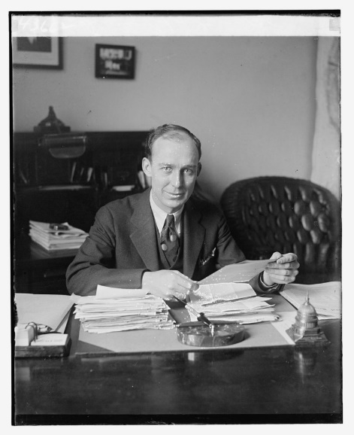
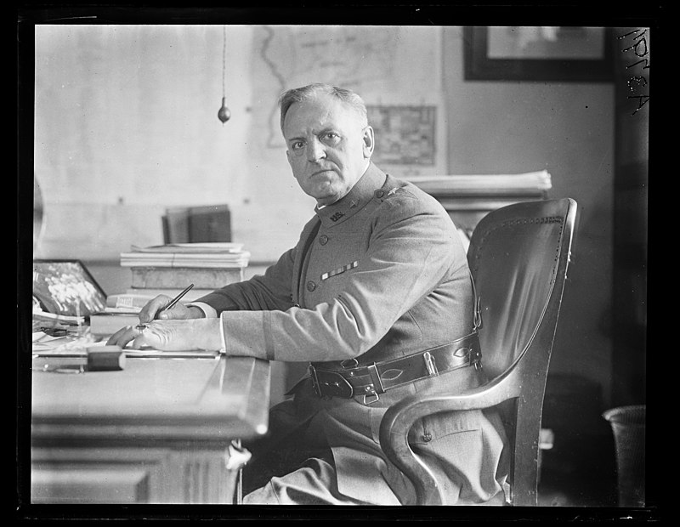
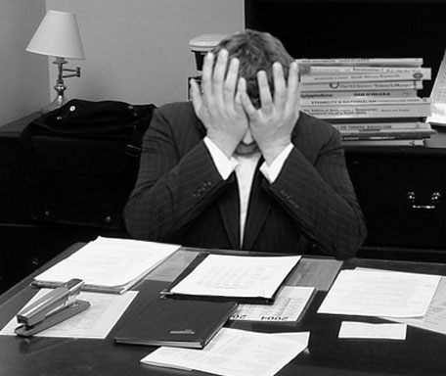
Le père et la mère
parler
Choisis une image pour représenter le père. Il est comment ?
a)
b)
c)
Le père est…
triste sympa indifférent strict affectueux heureux autoritaire
Et la mère ? Elle est comment ?
Notes:
Timing: 2 minutes
Aim: To express opinions in French based on interpretation of the text.
Procedure:
1. Students choose an image to represent the father and justify their choice.
2. Students describe the mother.
3. No right or wrong answer for either.
Word frequency of cognates used (1 is the most frequent word in French): image [659], représenter [293], indifférent [4151], affectueux [>5000], autoritaire [4661].
Source: Londsale, D., & Le Bras, Y. (2009). A Frequency Dictionary of French: Core vocabulary for learners London: Routledge.
Attribution:
Unidentified man by National Photo Company Collection is in the public domain
Frustrated man at a desk by LaurMG. is licensed under CC BY-SA 3.0
Military man at desk by Library of Congress, Prints & Photographs Division, photograph by Harris & Ewing, LCCN2016891032

Slide 65
Les versions différentes
écouter / parler
Écoute les trois versions différentes. Parle avec un(e) partenaire.
Version 1
Version 1, c’est…
Version 2, c’est…
Version 3, c’est…
amusant
triste
bizarre
rapide
monotone
intéressant
pessimiste
drôle
calme
moderne
J’aime version…
1
2
3
Version 2
Version 3
Notes:
Timing: 10 minutes
Aim: To express reactions/opinions of different versions heard in the links.
Procedure:
1. Play the video. There are three versions to listen to/choose from a) A man reads the poem, with dramatic images to represent the story/themes of the poem. This is the version students already heard from slide 6 Version 1: https://www.youtube.com/watch?v=cV19CfuswyM&t=51s b) An older-sounding man reads a version, without images. It is more light-hearted but perhaps does not convey so well the darker side of the poem. Version 2: https://www.youtube.com/watch?v=mvn6kBjWyf0 c) German students read this version, with music/images, and with efforts to convey the meaning of poem – monotony, banality of war, coldness of the parents. Version 3: https://www.youtube.com/watch?v=MGytqDEXoGQ
2. Give students time to discuss in pairs. The adjectives given are just suggestions based on cognates, words met/already known.
3. You might also draw attention to how in some versions the tone of the poem changes – it becomes more monotonous as it goes on, culminating in the last verse.
Word frequency of cognates used (1 is the most frequent word in French): bizarre [2756], monotone [>5000], pessimiste [4971]
Source: Londsale, D., & Le Bras, Y. (2009). A Frequency Dictionary of French: Core vocabulary for learners London: Routledge.

Slide 66
À ton tour !
parler
Lis le poème à haute voix. Fais attention à la répétition - exprime la monotonie, la routine et l’indifférence !
ou
Choisis une ou deux lignes que tu trouves importantes. Fais une présentation mémorisée et creative, avec un(e) partenaire ou en groupe.
Notes:
Timing: 10 minutes
Aim: Class read-aloud of the poem.
Procedure: Offer a choice of activities if possible:
1. Give students the opportunity to read the poem aloud (à haute voix will need to be explained in the instructions), either a line each at a time, or a verse each at a time. Encourage them to read expressively, thinking about the meaning and trying to convey the sense of monotony.
2. Ask them to choose the section of the poem that they think is most important and to memorise it so that they can perform it.
Word frequency of cognates used (1 is the most frequent word in French): haut [264], voix [414], répétition [2804], exprimer [466], monotonie [>5000], routine [4120], indifférence [4176], choisir [226], ligne [342], présentation [1723], mémorisé [>5000], créatif [>5000], groupe [187]
Source: Londsale, D., & Le Bras, Y. (2009). A Frequency Dictionary of French: Core vocabulary for learners London: Routledge.

Slide 67
En conclusion…
parler
Quand je lis le texte, je suis…
heureux/heureuse motivé(e) calme intéressé(e) amusé(e) … | indifférent(e) … | triste impatient(e) …
Notes:
Timing: 1 minute
Aim: Closing task allowing students to express their views on the poem.

Slide 68
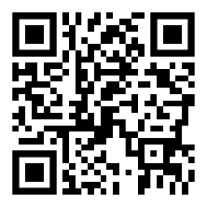
Devoirs
Vocabulary Learning Homework (Term 2.2, Week 4)
Audio file
Audio file QR code:
Student worksheet
Quizlet link
In addition, revisit: Term 2.2 Week 1
Term 1.2 Week 7

