Slide 1
An introduction to NCELP pedagogy and resources 10 Oct 2022
Presenter: Prof. Emma Marsden

Slide 2
Overview
Context: NCELP, the new GCSE, curriculum design
Pedagogy and sample resources
Phonics, grammar, vocabulary, cultural content
Q&A

Slide 3
Part 1: Context: NCELP, the new GCSE, what drives curriculum design?

Slide 4
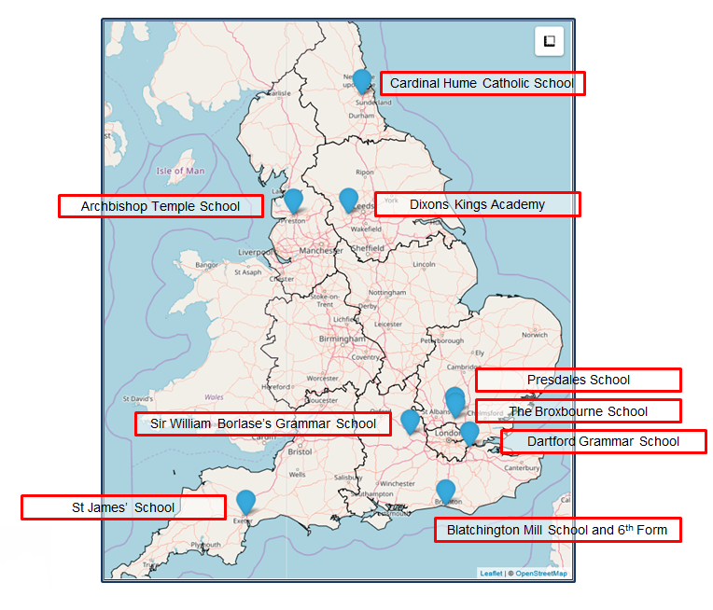
What is NCELP?
Notes:
NCELP (National Centre for Excellence for Language Pedagogy) was established in December 2018, funded by the UK Government’s Department for Education (DfE), and its sister projects are supported by various other funders including the ESRC, Research England, and the British Academy. We create and deliver research-informed resources and professional development for teaching French, German, and Spanish in collaboration with a network of school teachers. NCELP is housed within the University of York’s Department of Education.
NCELP was first set up with 9 Lead Schools, making a network of around 45 schools.
Now we are working with the specialist teachers from those 9 lead schools to deliver CPD in courses and sessions that are open to any teacher in any state school, and teacher educators working with schools.
Anyone can use our asynchronous courses.

Slide 5
NCELP aims to…
Connect classroom practice and research
Develop pedagogy, with resources to deliver it
Improve intrinsic motivation and increase GCSE uptake

Slide 6
New GCSE Subject Content: first study in 2024; first exam in 2026 = current year 7!
Nov, 2019: Department for Education convened panel to review MFL subject content -> consultation
Jan, 2022: New Subject Content announced
AQA, Edexcel, Eduqas (part of WJEC) use this to write the exams
Eduqas are using the NCELP word lists to create their exams
This means that any students currently in years 7 and 8, using NCELP SOW are already learning the words that they will need in their GCSEs, if they take Eduqas’s exams

Slide 7
New GCSE Subject content – see NCELP briefing events for more info
Key changes:
A word list will be used for creating each exam
85% vocabulary from most highly frequent words (plus 15% mid to low frequency) -> themes emerge
Versus the current set up,
any words can be included!
only 49% of words on current lists had actually been used over FOUR exams!
Grammar more clearly defined and amount reduced
Phonics tested in reading aloud and transcription
Unprepared conversation after picture description and after read aloud (not a separate task)
Reduction of rote-learning of slot and fill ‘topic phrases’ that cannot really be manipulated

Slide 8
Reasons for learning?
The core reasons for learning a language haven’t changed!
Develop ability and ambition to communicate (in speech and writing)
Step beyond familiar cultural boundaries
Develop new ways of seeing the world
Provide a strong foundation for further study.
Notes:
Regardless of the nature of the assessment, the core purpose for language learning has not changed: this is the need to understand and communicate about cultures and societies (both their own and in countries where the language is spoken), and to stimulate interest in the language itself.

Slide 9
What drives curriculum planning?
Pupils need to gain systematic knowledge of the vocabulary, grammar, and sound and spelling systems (phonics) of their new language, and how these are used by speakers of the language.
They need to reinforce this knowledge with extensive planned practice and use in order to build the skills needed for communication.
Teaching Schools Council (2016), MFL Pedagogy Review.
Notes:
To be able to do this, students need to be able to manipulate vocabulary, grammar and sound/spelling systems, and how these are used to communicate meaning. Knowledge building is reinforced with extensive planned practice and use.
Image by Steve Clarke and adapted by Katie Marsden

Slide 10
What drives curriculum planning?
Examples of research suggesting lexical, grammatical, phonological, and orthographical knowledge strongly predict proficiency in:
reading (e.g., Jeon & Yamashita, 2014; van Gelderen et al., 2003);
listening (e.g., Andringa, Olsthoorn, van Beuningen, Schoonen, & Hulstijn, 2012; Vafaee & Suzuki, 2020);
speaking (e.g., Bergeron & Trofimovich 2017; Saito, Trofimovich, & Isaacs, 2016);
writing (e.g., Crossley & McNamara, 2012; Schoonen, et al., 2002).
NCELP offers one way of how these components could be weaved into a curriculum that serves interaction and promotes cultural interest
Jeon, E. H., & In'nami, Y. (in press). Understanding L2 proficiency: Theoretical and meta-analytic investigations. Amsterdam, the Netherlands: John Benjamins.

Slide 11
NCELP curriculum planning and syllabus design
Sequencing of content is carefully planned to support progression
-> Synthetic syllabus (versus an ‘analytic syllabus’)
Themes, substantive content emerges ‘out of’ the language content (versus topics driving the content planning)
Phonics – sequenced explicit teaching of new sound-symbol correspondences (SSC) followed by revisiting and consolidation throughout.
Vocabulary – teaching of ca. ten new words per week, sets of words from different parts of speech, most common verbs, selected on the basis of word frequency.
Grammar – no more than one new grammar function every two weeks. Core grammar taught and revisited several times over KS3 and KS4.
Notes:
An example of careful progression planning is to avoid introducing AVOIR first with ages, which introduces an aspect of cross-linguistic difference that continues to trip students up as it is likely to give them the impression that ‘j’ai’ might mean ‘I am’. Instead, at NCELP, AVOIR is introduced with high-frequency nouns and thoroughly practised and embedded with its meaning of ‘HAVE’ before more idiomatic, less straightforward uses of the verb are encountered.

Slide 12
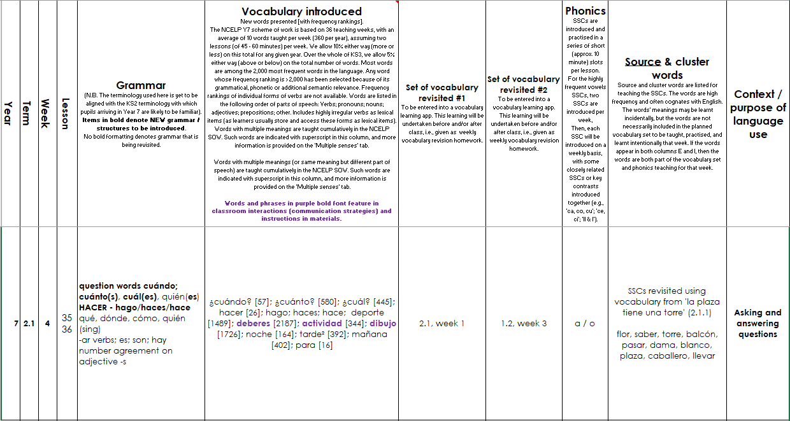
Screen shot of a SOW
Systematic revisiting of vocabulary every 3 weeks and 9 weeks
‘Context’: purpose of the language
e.g., “Asking / answering questions”
phonics practice every lesson
Grammar sequencing is language specific
Extremely high frequency (irregular!) verbs at start
Then highly regular and frequent verbs
Weeks set aside for work on ‘rich texts’
Notes:
This is what a page from Spanish SoW looks like –this is from week 4 of the Spring term
Starts with grammar introduced – question words and use of hacer – 1st 2nd and 3rd person – so high frequency , including high frequency irregular verbs – then we see new vocabulary introduced as well as vocabulary to be revisited – here we have new question words as well as revisited question words and there is also revisiting of previous vocab worked into lesson activities. Then the phonics practiced is laid out – here revisit of a/o . There is still a context – no topic but there is a context asking and answering questions.
At regular intervals there are weeks set aside for some revision and consolidation, assessment (in term 2 and 3) and also for work on “rich” texts or authentic text exploitation.

Slide 13
Part 2: Pedagogy and example resources

Slide 14
Phonics
explicit teaching of the key sound-spelling correspondences (SSCs)
helps students to avoid relying on English SSCs when they ‘sound out’ words
positively associated with motivation, autonomy and vocabulary learning
supports accurate understandings from the beginning
gradual roll-out, with systematic revisiting in order to maintain progress
Notes:
The first of the three ‘strands’ is phonics: explicit teaching of the relationships between the letters of written words and their sounds.
In recent years there has been a lot of emphasis on phonics teaching in primary education for learning English, but this is still relatively uncommon in the MFL classroom.
Yet some research suggests that without explicit phonics teaching, learners make little progress and that English SSCs remain entrenched. Students know that the words should sound different, but they are unsure how they should sound
There are many benefits associated with explicit phonics teaching. Some research has found that this improves students’ phonological decoding ability (their ability to sound out unknown words).
There are also potential related benefits in terms of motivation and confidence in oral and written production, autonomy and vocabulary learning.
This also supports errorless learning – avoiding inaccurate representations regarding how the new language sounds and is spelt.
In the NCELP schemes of work, the SSCs are gradually introduced and are revisited over time – this is key in order to maintain progress.
(Sources: Erler, 2003, 2004; Erler & Macaro, 2012; Porter, 2014, forthcoming; Woore, 2009, 2010, 2011, 2014, 2018).

Slide 15
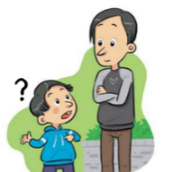
a
e
i
o
u
ll
libro
alto
elefante
idea
yo
universo
llamar
l
ca
co
cu
ce
ci
z
MADRID 1KM
casa
comer
cuerpo
cerca
cierto
zona
ga
go
gu
ge
gi
j
ganar
gol
preguntar
gente
imaginar
ojo
ñ
mano
v
celebrar
rr
pero
h
porque
qui
guerra
gui
español
n
ver
b
perro
r
hablar
que
quiero
gue
guitarra
Notes:
Phonics poster with key Spanish SSCs
This can be used just to give an overview of those that are taught and practised in the NCELP Spanish scheme of work. It is worth re-emphasising here the phased roll-out and focused nature of the practice. In any given week, one SSC or a group of closely related SSCs is introduced. Later on, multiple SSCs can be brought together in revision activities.
Each SSC here as a ‘source word’ (a highly frequent word that contains the target SSC and can be captured in an image and/or gesture).

Slide 16
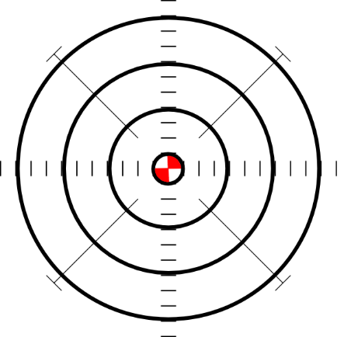
ce
doce
centro
MADRID 1KM
cerca
necesitar
necesario
[necessary]
[to need]
parecer
[to seem; appear]
Notes:
Introduce and elicit the pronunciation of the individual SSC ‘ce’ and then the source word again (with gesture, if using). Then present and elicit the pronunciation of the five cluster words.
The cluster words have been chosen for their high-frequency, from a range of word classes, with the SSC (where possible) positioned within a variety of syllables within the words (e.g. initial, 2nd, final etc.). Additionally, we have tried to use words that build cumulatively on previously taught SSCs (see the Phonics Teaching Sequence document) and do not include new SSCs. Where new SSCs are used, they are often consonants which have a similar symbol-sound correspondence in English.
Might also be presented after without images + without images or sound

Slide 17
ce
doce
centro
cerca
necesitar
necesario
parecer
Notes:
Without the images, students focus this time again closely on the SSC and the cluster words.

Slide 18
ce
doce
centro
cerca
necesitar
necesario
parecer
Notes:
Without the images or sound, students have to pronounce the words themselves.

Slide 19
ci
cine
diciembre
ciencias
ciudad
cierto
decir
[to say; tell]
Notes:
Introduce and elicit the pronunciation of the individual SSC ‘ci’ and then the source word again (with gesture, if using). Then present and elicit the pronunciation of the five cluster words.
The cluster words have been chosen for their high-frequency, from a range of word classes, with the SSC (where possible) positioned within a variety of syllables within the words (e.g. initial, 2nd, final etc.). Additionally, we have tried to use words that build cumulatively on previously taught SSCs (see the Phonics Teaching Sequence document) and do not include new SSCs. Where new SSCs are used, they are often consonants which have a similar symbol-sound correspondence in English.

Slide 20
ci
cine
diciembre
ciencias
ciudad
cierto
decir
Notes:
Without the images, students focus this time again closely on the SSC and the cluster words.

Slide 21
ci
cine
diciembre
ciencias
ciudad
cierto
decir
Notes:
Without the images or sound, students have to pronounce the words themselves.

Slide 22
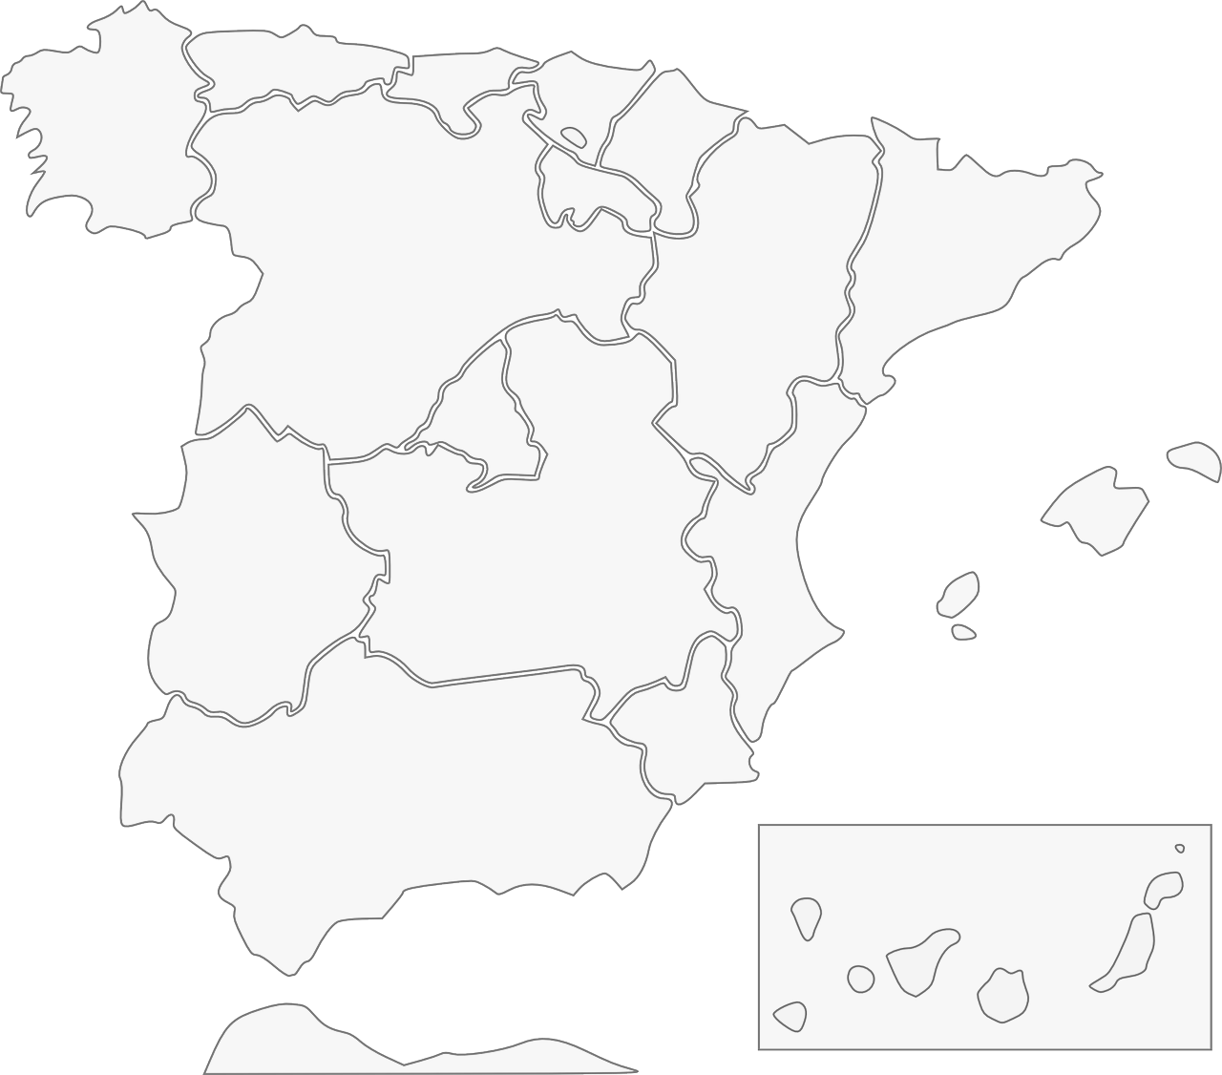
Fonética: [ci] & [ce]
escuchar / escribir
Escucha y escribe en español el nombre correcto del lugar.
1
Galicia
2
Barcelona
3
Cáceres
4
Valencia
Albacete
5
Murcia
Andalucía
7
6
Ceuta
8
Notes:
This is an example activity used to practise transcription of the SSCs [ce] and [ci]. Students listen and complete the place names on the map. If students need extra support, the activity could be adapted so that they simply need to add the missing SSC. The use of the map is also a chance to integrate language learning with cultural knowledge regarding Spanish cities and autonomous communities.
------------
Teacher notes:
Timing: 5 minutes
Aim: to revisit the sound-spelling correspondence for the SSCs [ce] and [ci] with eight names of cities/autonomous communities Spain
Procedure:
Click on the action button to play the audio.
Reveal the place by clicking on the red line. Answers can be given in any order.
Transcript:
1. Galicia
2. Barcelona
3. Valencia
4. Murcia
5. Ceuta
6. Andalucía
7. Albacete
8. Cáceres

Slide 23
SSCs [CE] y [CI]
escuchar
Remember, there are different ways to pronounce CE and CI.
In most of mainland Spain, the ‘c’ before ‘e’ or ‘i’ is pronounced
like _____ in English.
‘th’
In the Canary Islands (part of Spain) and Latin America, this ‘c’ is often pronounced like an ____.
‘s’
Escucha. Es ¿España o Canarias / Latinoamérica?
ciencias
España
1
________________________________
ciencias
Canarias / Latinoamérica
2
________________________________
doce
Canarias / Latinoamérica
3
________________________________
doce
España
4
________________________________
Notes:
Learning can be extended by explaining to students the geographical variation in pronunciation of key SSCs, such as [ce] and [ci]. Here, students recap the key information, and can be given a walk-through with a couple of examples that contrast the two types of pronunciation. This prepares them for the subsequent listening activity.
--------------------------
Teacher notes
Phonics recap slide
Timing: 3 minutes
Aim: to revisit the SSCs [CE] and [CI] and consolidate understanding of the different ways in which they are pronounced in the Spanish-speaking world.
Procedure:
Read the explanation, eliciting the answers from students where prompted by gaps.
Play the audio and ask where the person is from (‘¿La persona es de…?’)
Ask students which other words they can recall from Y7 which have [ce] and [ci]. This will help to prepare them for the next activity.
Anticipate, for [CI], cine, diciembre, decir, cierto, ciudad
Anticipate, for [CE], centro, necesitar, necesario, cerca, doce, parecer.
Notes:
Teachers may also find it useful to consider the information from exam board specifications below:
AQA : “The [listening] test will be studio recorded using native speakers speaking Castilian in clearly articulated, standard speech at near normal speed. Different types of spoken language will be used, using familiar language across a range of contemporary and cultural themes. (p. 82)
EdExcel : “For listening and reading assessments, the majority of contexts are based on the culture and countries where the assessed language is spoken. […] It is, therefore, important that students are exposed to materials relating to Spanish-speaking countries throughout the course.” (p. 7)
WJEC : “This GCSE specification in Spanish for use in Wales is based on a conviction that learners studying a modern foreign language will develop their desire and ability to communicate with and understand speakers of Spanish in a variety of contexts and for a variety of purposes.” (p. 3)

Slide 24
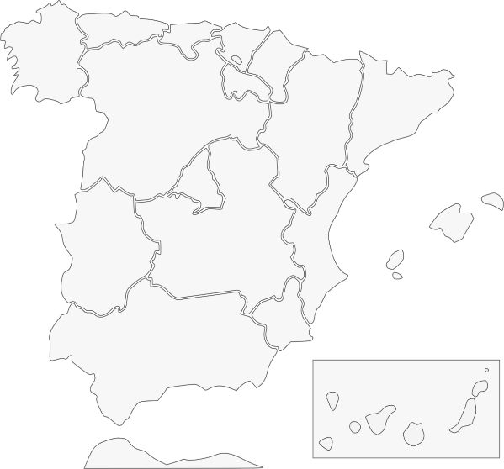
Pilar y Conchi son de lugares diferentes, así que no tienen la misma pronunciación de [ce] y [ci]. Escucha. Quién habla, ¿Conchi o Pilar? Escribe el lugar también.
escuchar
Pilar (Islas Canarias) | Conchi (Alicante)
İHola! ¿Cómo estás? Soy Pilar y soy de Puerto Rico en las Islas Canarias.
1
Ceuta
2
Galicia
3
Valencia
4
Murcia
İBuenos días! Soy Conchi y soy de Alicante en la Comunidad Valenciana.
5
Cáceres
6
Barcelona
7
Andalucía
8
Albacete
Notes:
Phonics practice activity
Timing: 6 minutes
Aim: to raise awareness of the different ways in which the SSCs [ce] and [ci] are pronounced in the Spanish-speaking world.
Procedure:
Go through instructions with students.
Check understanding of instructions by asking students an example. E.g., ciudad (pronounced with seseo): ¿Es Pilar or Conchi? ¿Por qué? Sí, perfecto, porque Pilar es de las Islas Canarias. ¿Y en Alicante, cómo es la pronunciación?
Play the audio and ask students to tick the correct column and write the place with the target SSCs.
Check answers, including spelling, in the feedback.
Note:
Some students may be able to write the entire sentence.
Transcript:
Tengo un amigo de Ceuta.
Mi prima vive en Galicia
¿Tu madre es de Valencia?
Voy a ir de vacaciones a Murcia.
Hay una universidad muy famosa en Cárceres.
Barcelona tiene unos museos geniales.
Andalucía es una zona muy bonita.
Albacete está en el sureste de España.

Slide 25
Phonetik
lesen / sprechen
Sag die Zungenbrecher.
15
1.
[u]
[ü]
Fünf gute Schüler müssen Kunst in der Küche üben.
Five good pupils must practise art in the kitchen.
üben
Sekunden
in der Küche
Kunst
fünf
müssen
gute
Schüler
0
langsamer
LOS!
Notes:
Procedure: 1. Students use the English and German prompts to construct and say aloud the tongue twister within the five seconds.
2. Click the blue text box to hear it pronounced.
3. Follow the same procedure for the next two slides.
Transcript: Fünf gute Schüler müssen Kunst in der Küche üben.
Word frequency of unknown words and cognates (1 is the most frequent word in German): üben [1928] Source: Jones, R.L. & Tschirner, E. (2019). A frequency dictionary of German: core vocabulary for learners. Routledge

Slide 26
Phonetik
lesen / sprechen
Sag die Zungenbrecher.
5
2.
[a]
[ä]
Acht ähnliche Männer machen acht ähnliche Fächer.
Eight similar men do eight similar subjects.
Sekunden
ähnliche
machen
Männer
acht
Fächer
0
langsamer
LOS!
Notes:
Transcript: Acht ähnliche Männer machen acht ähnliche Fächer

Slide 27
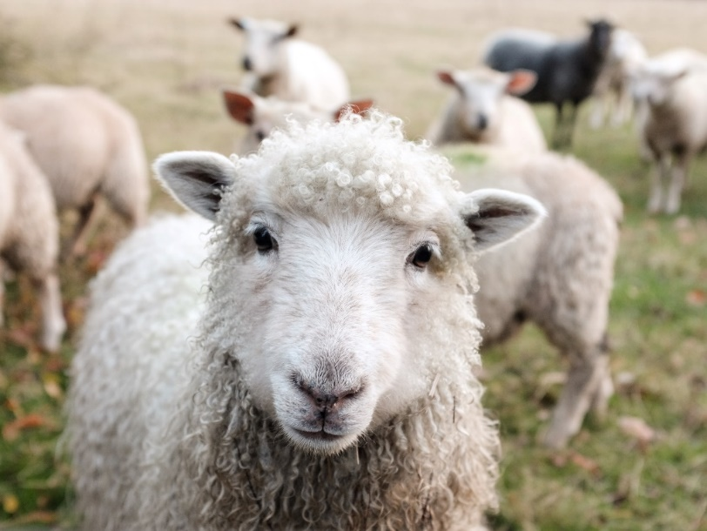
Minimal pairs
Minimal pairs are two similar sounding words that differ in only one phoneme and have distinct meanings.
ship
sheep
ship
Notes:
[Ship] Photo by Peter Hansen on Unsplash [Sheep] Photo by Sam Carter on Unsplash

Slide 28
Pirates!
1
c
w
Riese
leider
Riese
One of the chests contains buried treasure. All the others contain poison!
Listen carefully to the secret code and follow the arrows to find the treasure.
Reise
Lieder
Reise
h
z
Wien
Biene
Feile
v
Wein
Beine
viele
Riese
Biene
Feile
leider
Riese
k
i
Reise
Beine
viele
Lieder
Reise
Riese
leider
Feile
leider
Riese
r
Reise
Lieder
viele
Lieder
Reise
y
Riese
j
q
Reise
Notes:
This task, created by Natalie Finlayson, one of NCELP’s resource developers, is one of my favourites!
Timing: 20-30 seconds per slide
Aim: This activity makes use of minimal pairs of unknown words to compel students to focus on a pair of SSC (sound-symbol correspondence) that often cause difficulty, both in pronunciation, reading aloud of written text, and also in spelling. (Unknown words are used so that pupils focus closely on the sound. Definitions are given on a later slide).
Procedure: Starting on the red square, pupils listen to the words and decide whether they hear /ei/ or /ei/. They follow the arrows indicated by their choice to finish at one of the chests. There is only one correct route per slide, so pupils must correctly identify all words to find the treasure. The order or /ei/ and /ie/ changes (i.e. sometimes /ei/ is on the white square and sometimes on the blue) so the pupils must read the spellings.
Pupils can follow the slide on the projector, or the slide can be printed so they can trace the route with a pen/finger.
Teacher asks ‘Wo bist du?’ Pupils respond ‘Z, W’ etc. to practise the alphabet. Teacher clicks on the chests they say to reveal treasure (or not!)
Audio plays on clicking play. Pupils will probably need to hear the audio at least three times.
Note: Each treasure chest is triggered to reveal what is underneath. You see a hand icon appear when you mouse over it – click and the chest disappears. Each slide only has one treasure chest – the rest reveal skulls.
Transcript:
Wein, Biene, Feile, Lieder, Riese
Treasure is located in chest r

Slide 29
Using unknown words [phonics]
To practise applying SSC (symbol-sound correspondence) knowledge, we need to use unknown words. For example:
Place names
People’s names
Names of other things (e.g. games, bands)
Cognates (not previously-taught)

Slide 30
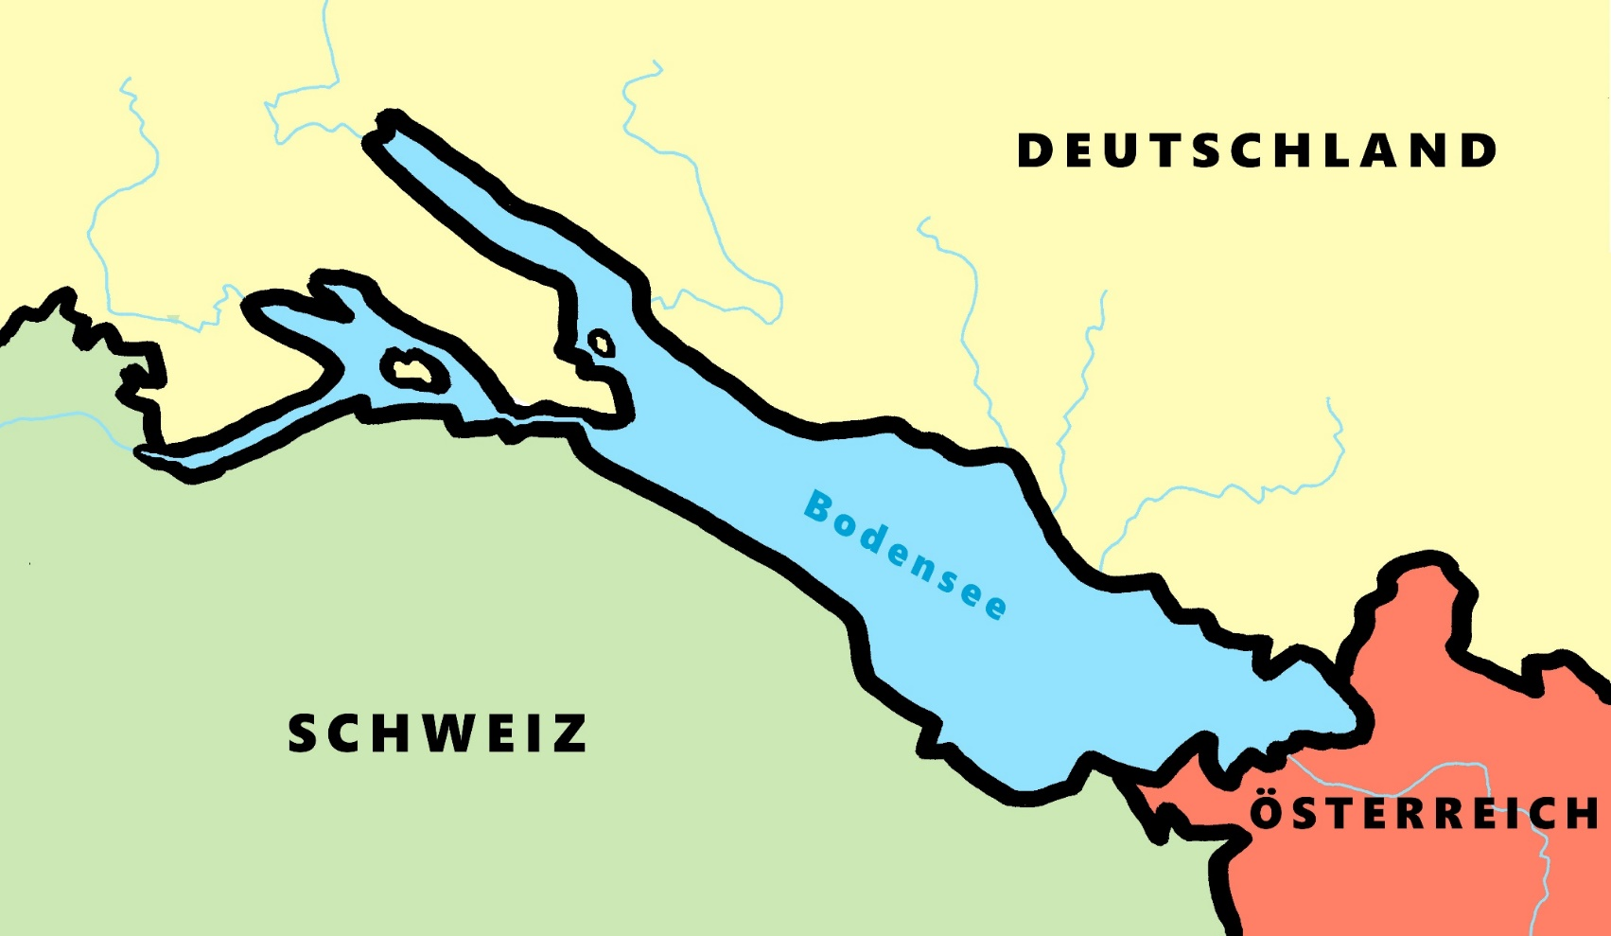
Phonetik - der Bodensee [1/2]
hören / schreiben
[4] Allensba_ _
ch
[5] _allhausen
4
W
5
z
[3] Radolf_ell
3
[6] Hagn_ _
6
au
ch
[7] Fr_ _dri_ _shafen
7
ie
S t
[2] _ _eckborn
eu
2
1
Kr_ _zlingen
[9] _omanshorn
R
9
ei
[8] Altenrh_ _n
8
Notes:
Phonetik [1]
Time: 5 minutes Aim: To practise recognising and transcribing 10 previously taught SSC, in unknown words.
Procedure: 1. Click number to hear the full word. Students listen and transcribe only the missing letters. 2. Animations support item-by-item checking, as instant feedback on each SSC may be particularly helpful for students’ learning. 3. Teachers can additionally ask, Wo liegt [Hagnau]? Es liegt in [Deutschland]… Students have met the use of ‘in’ with die Schweiz. It will be helpful to focus their attention on the use of ‘in’ + der + Schweiz here, reminding them of the ‘in’ + movement (R2-accusative) or location (R3-dative) change. SSC revisited here: [eu] [st-] [z] [ch-hard] [w] [au] [ie] [ch-soft] [ei] [r] Transcript: 1 Kreuzlingen 2 Steckborn 3 Radolfzell 4 Allensbach 5 Wallhausen 6 Hagnau 7 Friedrichshafen 8 Altenrhein 9 Romanshorn

Slide 31
Phonétique
lire / parler
Dis les noms.
Attention! C’est hard [g] ou [j]/soft [g] ?
Mon nom est …
1
Gérard
5
Gilles
9
Jacques
2
Gaelle
6
Julien
10
Jérôme
3
Angéline
7
Joséphine
11
Margaux
4
Agathe
8
Morgane
12
Georges
Notes:
Timing: 8 minutes
Aim: To raise awareness of [j]/soft [g] and hard [g] by using known spelling rules to pronounce these correctly in unknown vocabulary items.
Procedure:
1. Explain that these are popular French names that look like names students may recognise from English, but are pronounced differently.
2. Give students four minutes to work with a partner to decide how to pronounce [j] or [g], and to have a go at sounding out the names. All other SSCs in the words are either known or transferable from English, with the exception of the [ô] in Jérôme.
3. Click on the numbers to hear the names pronounced. The voices indicate whether the name is traditionally a male or female one. Students repeat chorally.
4. Now, teachers encourage students to read the names in increasing speed intervals (30 seconds, 20 seconds, 10 seconds … may vary according to the individual needs of the class) to work on fluency.
Transcript
1. Gérard
2. Gaelle
3. Angéline
4. Agathe
5. Gilles
6. Julien
7. Joséphine
8. Morgane
9. Jacques
10. Jérôme
11. Margaux
12. Georges

Slide 32
Grammar – the ‘glue’ and ‘driver of meaning’
DeKeyser, R. (2005). What makes second-language grammar learning difficult? A review of issues. Language Learning, 55, 1-25. https://doi.org/10.1111/j.0023-8333.2005.00294.x
DeKeyser, R. (2015). Skill acquisition theory. In B. VanPatten & J. Williams (Eds.), Theories in second language acquisition: An introduction (pp. 94–112). London, UK: Routledge.
DeKeyser, R., & Prieto Botana, G. (2015). The effectiveness of processing instruction in L2 grammar acquisition: A narrative review. Applied Linguistics, 36, 290–305. Ellis, N. (2006). Selective attention, and transfer phenomena in L2 acquisition: Contingency, cue competition, salience, interference, overshadowing, blocking, and perceptual learning. Applied Linguistics, 27(2), 164-194. Lichtman, K. (2016). Age and learning environment: Are children implicit second language learners? Journal of Child Language, 43, 707-730. https://doi.org/10.1017/S0305000915000598 Marsden, E. (2006). Exploring input processing in the classroom: An experimental comparison of processing instruction and enriched input. Language Learning, 56, 507–566. Marsden, E. J., & Chen, H-Y. (2011). The Roles of Structured Input Activities in Processing Instruction and the Kinds of Knowledge They Promote. Language Learning, 61(4), 1058–1098. https://doi.org/10.1111/j.1467-9922.2011.00661.x
McManus, K., & Marsden, E. J. (2019a). Using explicit instruction about L1 to reduce crosslinguistic effects in L2 grammar learning: Evidence from oral production in L2 French. The Modern Language Journal, 103(2), 459-480. https://doi.org/10.1111/modl.12567
McManus, K., & Marsden, E. J. (2019b). Signatures of automaticity during practice: Explicit instruction about L1 processing routines can improve L2 grammatical processing. Applied Psycholinguistics, 40(1), 205-234 https://doi.org/10.1017/S0142716418000553
Norris, J. & Ortega, L. (2001). Does type of instruction make a difference? Substantive findings from a meta-analytic review. Language Learning, 51, 157-213. https://doi.org/10.1111/j.1467-1770.2001.tb00017.x VanPatten, B. (2002). Processing instruction: An update. Language Learning, 52(4), 755-803.
Upfront, very brief, explanation of one feature
practice contrasting ‘pairs’ of grammar features
activities that require learners to connect form with meaning
other ‘clues’ for meaning removed (e.g., time markers)
plenty of initial comprehension practice (reading & listening)
later moving to production (speaking & writing)
(e.g., Marsden, 2006; Kasprowicz & Marsden, 2018; VanPatten & Cadierno, 1993; VanPatten & Oikkenon, 1996)
comprehension AND production activities that make feature ‘essential’
Notes:
There are of course many factors that affect what can be effectively learnt, and when, but here are some general principles drawn from research in second language learning.
The first is to practise pairs of features together. For example, two verb endings can be ‘paired up’ to juxtapose two meanings (or functions). Practising a whole new set of features together, e.g., a full range of verb endings, is unlikely to lead to be effective, as it is beyond what most learners can pay attention to at any one time.
The practice itself should require attention to form and meaning. A simple example could be to read sentences with two types of verb ending and decide, in each case, when an action occurred.
It may be necessary to remove other ‘cues’ from the sentence, such as time markers, as these otherwise give the answer away, and it is no longer necessary to pay attention to the grammar.
There should be plenty of initial reading and listening practice with the new features before production, and there is evidence that this controlled approach can actually make the production practice more successful.

Slide 33
Me llamo Mia y vivo en Arequipa, en Perú. Tengo catorce años. Tengo dos hermanos y una hermana.
Me llamo Daniel y vivo en Bogotá, en Colombia. Tengo trece años. Tengo dos hermanas y un hermanastro.
Me llamo Santi y vivo en Montevideo, en Uruguay. Tengo once años. No tengo hermanos. Soy hijo único.
1 _________ lives in Colombia.
2 Mia lives in _________.
3 _________ is eleven years old.
4 Mia has two _________ and one _______.
5 _________ has no brothers or sisters.
6 Daniel has two _________ and one_______.
Notes:
We tried to find a published resource that has listening, reading, speaking and writing practice tasks that focus on understanding and using TENER – making it essential for the task - but we couldn’t find one in current published resources. It’s straightforward to find texts that feature TENER (alongside other features - e.g. reflexive verbs, ER-regular verbs, plural and singular nouns, definite and indefinite articles.
There are six examples of the verb tener in these texts. How many of them are task essential? Which questions require students to know that ‘tengo’ means ‘I have’? And what do we do about that fact that in three of these six examples, ‘tengo’ actually translates as ‘I am’.
In these texts we have a number of grammar features represented but none of them is task essential.
To what extent do reading (and listening) comprehension tasks like this support students’ learning of grammar? In this typical reading comprehension task, it is very easy to avoid any engagement beyond the lexis, i.e., avoid processing, therefore avoid learning, the grammar. Could we make more efficient use of limited lesson time (i.e. get more learning for our time!) if we could include listening and reading tasks that make the grammar essential. How might they look?

Slide 34
Example of: Listening – where attention is oriented to the meaning of the grammar

Slide 35
En la maleta…Mrs Organised is going on holiday with Mr Organised. Who has what in each suitcase? Tick I have or you have.
I have
you have
 |  | Object | Description
1
boat
fantastic
2
bicycle
white
3
cat
mad (now)
4
book
famous
5
coin
new
6
bed
high
7
pen
famous
8
camera
new
escuchar y escribir
Victoria Hobson / Nick Avery
Notes:
Teachers need not print the slide. Students could use their ex books to write their responses.
Ask students if there are any surprising items in their suitcases (gato, barco!). In checking the descriptions, students might be encouraged to notice adjective agreement (from the previous week). This point may only need to be noted in passing, or teachers may wish to make more of the explanation as a teaching point, depending on the profile of the group.
See if students can distinguish the temporary state in item 3 (“está loco”) from the general attributes (‘es famoso’, ‘es blanco’ in the others)
To focus on sound-spelling correspondences, students could also listen again and transcribe the sentences.
TRANSCRIPT:
Tengo un barco. Es fantástico.
Tienes una bicicleta. Es blanca.
Tienes un gato. Está loco.
Tengo un libro. Es famoso.
Tengo una moneda. Es nueva.
Tienes una cama. Es alta.
Tengo un bolígrafo. Es famoso.
Tienes una cámara. Es nueva.

Slide 36
Example of: Reading – where attention is oriented to the meaning of the grammar

Slide 37
Their children are also going. Their daughter is messaging her brother. Write who has what in the correct column.
 |  | Daughter (‘I’) | Her brother (‘you’)
1 | Tengo una moneda y un bolígrafo
 | Tienes una bicicleta y una cámara
2 | Tienes una casa y un gato
 | Tengo una cámara y una moneda
3 | Tienes una cama y un libro
 | Tengo un gato y una cámara
4 | Tengo un libro y un bolígrafo
 | Tienes un barco y una casa
5 | Tienes una cama y un barco
 | Tengo una bicicleta y una casa
6 | Tienes un gato y un libro
 | Tengo un libro y una moneda
coin
pen
bike
camera
camera
coin
house
cat
cat
camera
bed
book
book
pen
boat
house
bike
house
bed
boat
book
coin
cat
book
leer
Victoria Hobson / Nick Avery
Notes:
Teachers need not print the slide. Students could use their ex books to write their responses. Students do not need to copy out the whole table.

Slide 38
Pepe is talking to a friend (‘you’)about belongings. Pepe also mentions what his sister Paula has. Write the item in English that each person has.
 |  | Pepe |  | Paula
1 | Tiene un barco y tengo una cámara.
2 | Tengo una bicicleta y tienes un libro.
3 | Tiene una casa y tengo un barco.
4 | Tengo una moneda y tiene un bolígrafo.
5 | Tengo un gato y tienes una cama.
6 | Tiene una bicicleta y tengo una cama.
You have
she has
I have
leer
Notes:
Students need to pay close attention to the instructions.
By now, students will be very familiar with the vocabulary plus the three singular parts of tener, which have up to now featured in pairs. In this activity, all sentences have ‘tengo’, but not all have ‘tiene’ – some have ‘tienes’ instead. In this way, students have to pay close attention to both the verb form and the item. NB: Of course there are only two items mentioned each time so one person is not mentioned in each question.
Students do not need a copy of this slide. They can write I, you, she at the top of the page, 1-6 down the side and the English words in the correct places.

Slide 39
Example of: Speaking – where learners have to ‘choose’ which grammar to use and their partner must understand that grammar …selecting between the pairs of features they have just been practising in the input

Slide 40
Partner A
1)
2)
3)
4)
5)
Partner B
………………….a house
………………….a bike
…………………..a pen
………………….a boat
……………….a camera
S/he has
I have
You have
S/he has
I have
Victoria Hobson / Nick Avery
Notes:
Prompt cards (see accompanying Word doc for printable version). Alternatively students could write the answers in their ex books and the cards used again.
Partner A says their sentence to partner B in Spanish. Partner B listens carefully and then writes the verb accordingly.
Note: the layout of the task as it is includes an additional level of challenge, as Partner B’s items are not on the page in numerical order. This forces Partner B to attend to the meaning of the noun and the verb form at the same time. If felt to be too challenging, the items can be edited to follow the same order as Partner A’s items 1-5.

Slide 41
Partner B
1)
2)
3)
4)
5)
Partner A
………………….a cat
………………….a book
…………………..a pen
………………….a coin
……………….a bed
You have
You have
S/he has
I have
S/he has
Victoria Hobson / Nick Avery
Notes:
Printable student prompt cards. Alternatively students could write the answers in their ex books and the cards used again.
Partner B says their sentence to partner A in Spanish. Partner A listens carefully and then writes the verb accordingly.
Note: the layout of the task as it is includes an additional level of challenge, as Partner B’s items are not on the page in numerical order. This forces Partner B to attend to the meaning of the noun and the verb form at the same time. If felt to be too challenging, the items can be edited to follow the same order as Partner A’s items 1-5.

Slide 42
Example of: Writing – where learners have to ‘choose’ which grammar to use, selecting between the pairs of features they have just been practising in the input

Slide 43
¿Cómo es España?
old
cheap
strange
Completa las frases.
escribir
beautiful
calm
small
famous
old
expensive
beautiful
Barcelona y San Sebastián son
1) _______________________________ bonitos.
Bilbao es
2) ____________________ barato.
Bilbao y Barcelona son
3) __________________________ antiguos.
famous
calm
strange
San Sebastián es
4) ________________________ pequeño.
Zaragoza y San Sebastián son
5) ______________________________ tranquilos.
Bilbao y Zaragoza son
6) ________________________ raros.
Notes:
Year 7 Spanish Term 1.2 week 4 - Using ‘es’ and ‘son’ & adjective number agreement (-s) as complement to verb.
Resource Teacher Notes
Ask students to translate the title as it contains core vocabulary introduced this week (¿Cómo es?)
Notice that the Spanish adjectives are already provided. In lesson 1 we want students to focus on the correct use of es/son and the meaning of the new adjectives. In lesson 2, students will focus on manipulating their endings to reflect number (and gender) agreement.
Image courtesy www.pinterest.com (no author found).

Slide 44
Some more examples
Different languages, different features
But the same principle: make the feature you want them to learn ‘essential’
Make the learner work to:
understand it, in the input
actively choose it from among others, in their output

Slide 45
Word order 2
Grammatik
As you know, the order of words in a simple German sentence is:
Mia spielt jeden Dienstag Klarinette.
Sometimes, we want to start the sentence with the adverb to emphasise it.
When we do this, the adverb and subject swap places.
Jeden Dienstag spielt Mia Klarinette.
The position of the verb does not change. It is always between the subject and the adverb.
Word order
1
SUBJECT
VERB
ADVERB
NOUN
Word order
2
ADVERB
VERB
SUBJECT
NOUN
Notes:
In German, sentences may either begin with a subject or an adverb. The adverb comes first when it is given more emphasis.
-----------------------------
Activity notes
Timing: 2 minutes
Aim: To explain the order of words in a German sentence, and how this is affected by an initial adverb.
Procedure:
1. Cycle through the information on the slide using the animation sequence.

Slide 46
Was schreiben sie?
lesen
Wolfgang und Mehmet finden Mathe langweilig. Sie dürfen aber im Unterrricht nicht reden!
Was schreiben sie?
Am Dienstag
chille ich ein bisschen zu Hause. Und du?
C
-
Hey Mehmet, was machst du heute?
Am Dienstag
ich habe Tanzunterricht. Was machst du am Samstag?
D
-
Heute
ich spiele Gitarre. Und du?
Am Samstag
gehe ich mit Mama ins Theater. Langweilig!.Und du?
A
E
-
-
Heute
spiele ich Schlagzeug!
Und am Dienstag?
Am Samstag
gehe ich shoppen! Mit Heidi :D
B
F
-
-
Notes:
In this reading activity, students need to read the sentences and decide how they must begin: with an adverb (like Heute-today; Am Dienstag – on Tuesday) or without anything. To do this, they have to look carefully at the first word of the sentence. If it begins with a subject (like ich), nothing is missing. If it begins with a verb (like spiele), the sentence must begin with an adverb. It is followed in the same teaching sequence by a listening activity and then a scaffolded written production task, which cues production of the two different word orders.
-----------------------------
Activity notes
Timing: 5 minutes
Aim: In this referential reading activity and the listening exercise that follow, students must decide whether a time phrase is included in the sentence or not.
Procedure:
1. Explain that the word order will tell them whether or not whether a time phrase is included in the sentence.
2. Students select between the time phrase shown in each case, or a blank (indicated by a dash), in order to complete the sectence.
2. Answers revealed on clicks.
Notes:
1. Capital letters have been removed from all sentences so as not to give lexical clues. Teachers to note that Wolfgang und Mehmet should have used capital letters at the beginning of sentences 1 and 4!
2. This week’s SSC ‘TH’ appears in the word ‘Mathe’ - it is worth pointing this out to students. ☺
Word frequency (1 is the most frequent word in German):
chillen [>4034] shoppen [>4034]
Source: Jones, R.L & Tschirner, E. (2019). A frequency dictionary of German: Core vocabulary for learners. London: Routledge.

Slide 47
Der Lehrer ist streng!
hören
Herr Mürrisch, der Mathelehrer, findet die Situation nicht so toll! Er redet mit Oma am Telefon.
Was sagt er?
1
heute | -
5
heute | -
2
jeden Tag | -
6
jetzt | -
3
oft | -
7
am Montag | -
4
immer | -
8
dann| -
Notes:
Timing: 8 minutes
Aim: To use knowledge of word order to decide whether a time phrase is included in the sentence or not.
Procedure:
1. Again, teacher to remind students that word order will tell them whether or not the sentence starts with a time phrase.
2. Students may need reminding that dann and danach, which students met in 2.2.5, also count as time phrases.
3. Audio plays on number clicks (with time phrases blanked out – and ‘decoy’ beeps where there are no time phrases missing, to avoid the beep itself becoming the clue).
Transcript:
Guten Tag. [beep] Wir haben ein Problem.
[beep] sitzt Wolfgang im Klassenzimmer und macht nichts.
[beep] redet er mit Mehmet im Unterricht.
[beep] vergisst er die Hausaufgaben.
[beep] Ich denke, ich habe die Antwort.
[beep] Wolfgang und Mehmet können nicht zusammen sitzen. Das ist klar.
[beep] sitzt Wolfgang allein.
[beep] kann er ja den Kopf benutzen!

Slide 48
Antworten
hören
Herr Mürrisch, der Mathelehrer, findet die Situation nicht so toll! Er redet mit Oma am Telefon.
Was sagt er?
1
heute | -
5
heute | -
2
jeden Tag | -
6
jetzt | -
3
oft | -
7
am Montag | -
4
immer | -
8
dann| -
Notes:
Timing: 2 minutes
Aim: To provide the answers to the activity on the previous slide.
Procedure:
1. Full answers, including time phrases, play on number clicks.
Transcript:
Guten Tag. Wir haben ein Problem.
Jeden Tag sitzt Wolfgang im Klassenzimmer und macht nichts.
Oft redet er mit Mehmet im Unterricht.
Immer vergisst er die Hausaufgaben.
Ich denke, ich habe die Antwort.
Wolfgang und Mehmet können nicht zusammen sitzen. Das ist klar.
Am Montag sitzt Wolfgang allein.
Dann kann er ja den Kopf benutzen!

Slide 49
Meine Woche
schreiben
Dein Freund versteht kein Englisch! Schreib die Sätze auf Deutsch. Word order 1 or 2?
1. I’m cleaning my room on Monday.
2. I’m staying at home on Tuesday.
3. I’m eating ice cream on Wednesday.
4. I’m sleeping on Thursday.
5. I’m playing in the Orchestra on Friday.
6. I’m singing in the choir on Saturday.
7. I’m getting a present on Sunday!
1. Am Montag putze ich mein Zimmer.
2. Ich bleibe am Dienstag zu Hause.
3. Ich esse am Mittwoch Eis.
4. Am Donnerstag schlafe ich.
5. Ich spiele am Freitag im Orchester.
6. Am Samstag singe ich im Chor.
7. Am Sonntag bekomme ich ein Geschenk!
…
Wo
…
…
…
…
…
…
Notes:
This scaffolded writing task is taken from the end of the same lesson. It practises the same features (word order one vs word order two). To compel students to use both word orders, the sentence starter is given. After further practice, students could be asked to produce such sentences more freely, writing their own sentences using the two word orders.
---------------------------
Timing: 3 minutes
Aim: This exercise is a scaffolded task that prepares students for the freer spoken and written exercises in the next lesson. The starts of the German sentences are given so that students must practise both WO1 and WO2.
Procedure:
1. Teacher to note the use of the present continuous in English throughout, and highlight to students. 2. Students translate each sentence into German, following the start indicated.
Note: Students may be inclined to reproduce English word order (i.e. put the days of the week at the end of the sentence). It is worth perhaps doing the first two sentences and then providing whole class feedback, reminding students that the adverb (here it is an adverbial time expression - on Monday etc..) goes straight after the verb in WO1, as they have previously learnt and practised with other adverbs.

Slide 50
Present simple or continuous?
grammaire
English has two present tense forms.
I make the bed every week. I am making the bed at the moment.
French has one present tense only. The BE + -ing form does not exist.
Je fais le lit chaque semaine. Je fais le lit en ce moment.
Present simple - normally; routine
Present continuous (BE + -ing) - ongoing; current
Je fais = I make AND
I’m making
Adverbs of time tell us which English tense to choose.
In French, the present simple is used with all adverbs.
Notes:
Timing: 3 minutes
Aim: to describe and explain the metalanguage (present simple, present continuous and adverbs) used to talk about verbs in this and subsequent sequences.
Procedure:
Click to bring up the explanation
Highlight the distinction between present simple for routine actions and present continuous for current/ongoing actions.
Stress the fact that the BE + -ing form is an English construction only. ‘Être’ cannot be used with a verb this way.

Slide 51
Adverbs of time
grammaire
chaque semaine
[every week]
[at the moment]
en ce moment
Notes:
Timing: 1 minute
Aim: To clarify which form of the English present tense is indicated by ‘chaque semaine’ and ‘en ce moment’.
Procedure:
Elicit pronunciation and English meaning from students of ‘chaque semaine’ and ‘en ce moment’.
Clarify that ‘chaque semaine’ indicates routine action and requires present simple in English and ‘en ce moment’ indicates current/ongoing actions and requires present continuous in English.

Slide 52
Present simple or continuous?
lire
Nick, an exchange student, is babysitting for the Petit family. He makes notes about the children, Jacques and Géraldine.
1.1 Choose the correct adverb.
A
Jacques is playing tennis at the moment/every week.
B
Géraldine wears a uniform at the moment/every week.
C
Géraldine is having lunch at the moment/every week.
D
Jacques is doing his homework at the moment/every week.
E
Jacques goes for a walk at the moment/every week.
Notes:
Timing: 3 minutes
Aim: Awareness-raising exercise in English to teach students to connect temporal adverbs with tense.
Procedure:
1. Students read the sentences and choose the correct adverb according to whether the tense is present simple or continuous.
Note:
Choice of French names incorporates this week’s SSCs: Jacques and Géraldine.

Slide 53
Present simple or continuous?
lire
Nick, an exchange student, is babysitting for the Petit family. He makes notes about the children, Jacques and Géraldine.
1.2 Choose present simple (normally; routine) or continuous (ongoing; current).
F
Jacques washes/is washing up at the moment.
G
Géraldine learns/is learning English every week.
H
Géraldine plays/is playing with her friends at the moment.
I
Jacques reads/is reading a book at the moment.
J
Géraldine sings/is singing every week.
Notes:
Timing: 3 minutes
Aim: Awareness-raising exercise in English to teach students to connect temporal adverbs with tense.
Procedure:
1. Students read the sentences and choose the correct tense (present simple or continuous) according to the temporal adverb.

Slide 54
Present simple or continuous?
écouter
Madame Petit calls Nick with more information about her children.
Help Nick take notes. Choose present simple or continuous.
A
Jacques does/is doing his homework.
B
Jacques has/is having an idea.
C
Géraldine does/is doing the housework.
D
Géraldine is/is being naughty.
E
Géraldine cooks/is cooking.
Notes:
Timing: 5 minutes
Aim: to practise translating the present tense successfully from French into English in the oral modality by connecting temporal adverbs with tense.
Procedure:
Click the letter trigger to play the audio for each sentence.
Students listen to the French and decide if the translation required in English is present simple or continuous.
Draw attention to fact that French tense is the same throughout, and that students will have to listen out for the adverb in French to find out this information.
Explain that the temporal adverbs are not given in the English translation because the verb tense provides information about whether things happen routinely, or are ongoing right now.
Answers are revealed on clicks.
Transcript:
A. Jacques fait les devoirs en ce moment.
B. Jacques a une idée chaque semaine.
C. Géraldine fait le ménage en ce moment.
D. Géraldine est méchante chaque semaine.
E. Géraldine fait la cuisine chaque semaine.

Slide 55
Present simple or continuous?
lire/écouter
Nick is talking about the Petit family to his English friends. Decide whether to translate what he says with ‘en ce moment’ or ‘chaque semaine’.
A
Madame Petit fait une visite [en ce moment / chaque semaine] mais elle fait la cuisine [en ce moment / chaque semaine].
B
Monsieur Petit fait le lit [en ce moment / chaque semaine] et fait le ménage [en ce moment / chaque semaine].
C
Géraldine fait un modèle [en ce moment / chaque semaine] et fait une promenade [en ce moment / chaque semaine].
D
Jacques est méchant en [en ce moment / chaque semaine] mais il fait les devoirs [en ce moment / chaque semaine].
Notes:
Timing: 5 minutes
Aim: to practise connecting temporal adverbs with tense.
Procedure:
Click on the letter triggers to play the audio (sentences in English).
Students must work out from the present tense form alone whether these things happen every week, or are happening at the moment. (The adverbs are obscured by noises.)
Answers are revealed on clicks.
Transcript:
A. Mrs Petit goes on a tour [noise] but is cooking [noise].
B. Mr Petit is making the bed [noise] and does the housework [noise].
C. Géraldine is making a model [noise] and goes for a walk [noise].
D. Jacques is being naughty [noise] but does his homework [noise].

Slide 56
Bringing it together: practice that combines different modes and modalities
declarative knowledge (knowing ‘that’ something)
-> proceduralized knowledge (knowing how to do it)
with errors, gradually getting faster, gradually getting more reliable with less variable performance
-> automatization
(DeKeyser, 2015)
Dictogloss
Elicited imitation
Oral translation

Slide 57
Wie sagt man das auf Englisch?
hören
Frau Bayrak und Frau Nowak reden über Mehmet und Katja am Telefon .
Hör zu und schreib die Sätze auf Englisch.
Ihm gefallen die Hausaufgaben nicht besonders, aber er soll sie früher anfangen!
1
He doesn’t especially like homework, but he should start it earlier.
Sie hat die Aufgabe, jeden Abend zu Hause zu helfen.
2
It is her job to help at home every evening.
3
Er hat auch immer gern zu Hause geholfen, und er kann ganz gut alleine kochen.
He has also always liked helping at home, and he can cook really well by himself.
4
Das ist gut, denn ich kann jetzt die Kinder alleine zu Hause lassen.
It’s good, because I can now leave the children at home alone.
5
Jedoch ist es manchmal schwer, Mutti zu sein.
However, it is sometimes hard to be a mum.
6
Ja, ich habe das Gefühl, dass er mir nicht immer die Wahrheit sagt.
Yes, I have the feeling that he’s not always telling me the truth.
Notes:
Bringing it together … declarative knowledge -> proceduralized knowledge -> automatization
Timing: 10 minutes Aim: to practise comprehension of the modal + infinitive and other + zu + infinitive structures in the oral modality. Procedure Note: this activity can be carried out in a variety of ways: A – Dictogloss 1. Students listen once and make notes in German (or English). 2. They confer with a partner to try to reconstruct the whole German sentence. 3. They listen and check. 4. They translate their sentence into English. B – Elicited imitation (oral or written) 1. Students listen once to the sentence. 2. There is then a pause for a few seconds. (During this time, students could be silently thinking about the meaning of the sentence in English. OR they could discuss with a partner what the sentence means, trying to arrive at an oral translation. 3. Then they try to produce the sentence meaning in German (either orally or written) 4. Click to listen and check. 5. Elicit the English meaning of each sentence. C – Aural translation (tweak the animation order for this one) 1. Click to play the German sentence. (It can be played more than once, as needed). 2. Students translate the sentence directly into English. 3. Click to bring up the English version of the sentence. 4. Elicit a German translation of the English sentence from students (either chorally or individually). 5. Click to listen and check.
D – Errorless transcription 1. Students listen to each sentence several times, as many times as they need. 2. They transcribe the full sentence in German. 3. They then translate their sentence into English. 4. Click to listen and check, and click to bring up both German and English sentences. Note: Task D is more straightforward than the other tasks and might be usefully used with classes who need more support.
Transcript:
Ihm gefallen die Hausaufgaben nicht besonders, aber er soll sie früher anfangen.
Sie hat die Aufgabe, jeden Abend zu Hause zu helfen.
Er hat auch immer gern zu Hause geholfen, und er kann ganz gut alleine kochen.
Das ist gut, denn ich kann jetzt die Kinder alleine zu Hause lassen.
Jedoch ist es manchmal schwer, Mutti zu sein.
Ja, ich habe das Gefühl, dass er mir nicht immer die Wahrheit sagt.
Translation:
He doesn’t like homework especially, but he should start it earlier.
It is her job to lay the table every night.
He has also helped a lot at home, and he can cook quite well by himself.
That’s good, because now I can leave the children at home alone.
However, sometimes it’s hard to be a mum.
Yes, I have a feeling that he’s not always telling me the truth.
Source: Gm Y8 3.1.3

Slide 58
Vocabulary
Davies, M, & Davies, K.H. (2018). A Frequency Dictionary of Spanish: Core Vocabulary for Learners. Routledge. *Dudley & Marsden (under revision). Exploring the lexical content of GCSEs. Language Testing
Häcker, M. (2008). Eleven pets and 20 ways to express one's opinion: the vocabulary learners of German acquire at English secondary schools, The Language Learning Journal, 36:2, 215-226. *Finlayson, N., & Marsden, E. (In press). Assessing depth of word knowledge of beginner learners of French, German, and Spanish aged 11-14 in England. In S. W. Chong, & H. Reinders (Eds.), Learner-Centred Approaches to Language Assessment Palgrave Macmillan.
Jones, R.L. & Tschirner, E. (2006). A frequency dictionary of German: core vocabulary for learners. Routledge. Lonsdale, D. & Le Bras, Y. (2009) A Frequency dictionary for French. Routledge. Marsden, E., & David, A. (2008). Vocabulary use during conversation: a cross-sectional study of development from year 9 to year 13 among learners of Spanish and French. Language Learning Journal, 36(2), 181-198.
*Marsden, E. & Hawkes R. (forthcoming). Situating practice in a foreign language curriculum. In Y. Suzuki & T. Nakata (Eds). (2022) Practice and automatization. Routledge.
Milton, J. (2006). Language Lite? Learning French Vocabulary in School. Journal of French Language Studies, 16,187-205. Milton, J. (2009). Measuring second language vocabulary acquisition. Multilingual Matters Milton, J. (2013). Measuring the contribution of vocabulary knowledge to proficiency in the four skills. Eurosla Monographs Series 2, 57-78. http://www.eurosla.org/monographs/EM02/Milton.pdf
Schmitt, N. (2008). Instructed second language vocabulary learning. Language Teaching Research, 12(3), 329–363. https://doi.org/10.1177/1362168808089921 Swan, M. (2008). Talking sense about learning strategies, RELC, Vol 39(2), 262-273.
using ‘frequency’ to inform vocabulary selection
most generally useful across lots of topics
vocabulary sets with mixed word classes
ensuring a wide ‘verb’ lexicon
about 10 new items per week (5 per hour)
cohesion of vocabulary with grammar practice activities
teaching one new meaning of a word at a time
systematic revisiting of vocabulary in different contexts
depth of knowledge
robust and reliable knowledge
Notes:
Earlier I mentioned the concept of vocabulary frequency. Up until now we’ve had to rely on intuition about which words might be useful to learn. However, there is now data available from corpora (large electronic collections of oral and written language) on the frequency with which words occur in the language. As high-frequency words can be used across contexts (rather than for a single topic), they are particularly useful in a time-limited teaching context, where it is difficult to learn large numbers of words.
Other principles for vocabulary teaching include:
combining different word classes in a each vocabulary set. This offers great potential for sentence building and creative language use. Traditionally, it has been quite common to present a list of nouns that simply fill a slot after a verb (e.g., juego al…) but this offers very little scope for students to manipulate language themselves.
choosing words that are closely related to the grammar being practised. If we are practising adjectival gender agreement, it makes sense to introduce a number of adjectives on which those endings are used, rather than treating the grammar and vocabulary practice as separate parts of the lesson.
teaching each meaning of a word separately to avoid confusion and unnecessary difficulty. High-frequency words often have more than one meaning – e.g. rico for rich and tasty.
systematically revisiting previously taught words. This is the crucial factor affecting students’ long term retention and needs to be planned into the curriculum. Encounters with the word – specifically, activities that require students to do something with it – are planned into the SOW as part of several cycles of vocabulary revisiting. This may be facilitated by CALL, e.g., Quizlet. It’s important to find a desirable level of difficulty here (e.g. moving from receptive to productive language use, using language in new contexts, and introducing an element of time pressure to speed up recall).
--------------------------
Notes from another relevant slide
Decisions had to be made about vocabulary teaching
Which vocabulary is carefully selected from the highest frequency words according to a well constructed corpus of millions of words – the words that appear most are the most useful for communication across different situations
We know from research that you need to have a bank of verbs before you can create the sentences you want to create – the meaning of verbs is like the anchor in a sentence. We know that learning mixed sets of words allows you to create a number of sentences very quickly – but if you just know a set of nouns for sports or animals or types of television programmes, it is harder to be creative with what you can understand and say. Also we know that very closely semantically related words (sets of fruits or animals) can be confusing and more difficult to learn than more mixed sets. Research can also tell us what kinds of activities are most efficient for establishing robust knowledge that lasts and can be recalled fast and when under some pressure
And it can tell us about the kinds of activities that can help promote depth of vocabulary knowledge – knowing when to use a word, what its opposites are, which words often occur with it

Slide 59
VOCABULARY
words that are very high-frequency → most useful (but often most complex)
a wide vocabulary of verbs (meanings)
mixed word class sets: 10 per week
developing robust knowledge
developing depth of knowledge
Notes:
Decisions had to be made about vocabulary teaching
Which vocabulary is carefully selected from the highest frequency words according to a well constructed corpus of millions of words – the words that appear most are the most useful for communication across different situations
We know from research that you need to have a bank of verbs before you can create the sentences you want to create – the meaning of verbs is like the anchor in a sentence. We know that learning mixed sets of words allows you to create a number of sentences very quickly – but if you just know a set of nouns for sports or animals or types of television programmes, it is harder to be creative with what you can understand and say. Also we know that very closely semantically related words (sets of fruits or animals) can be confusing and more difficult to learn than more mixed sets. Research can also tell us what kinds of activities are most efficient for establishing robust knowledge that lasts and can be recalled fast and when under some pressure
And it can tell us about the kinds of activities that can help promote depth of vocabulary knowledge – knowing when to use a word, what its opposites are, which words often occur with it

Slide 60
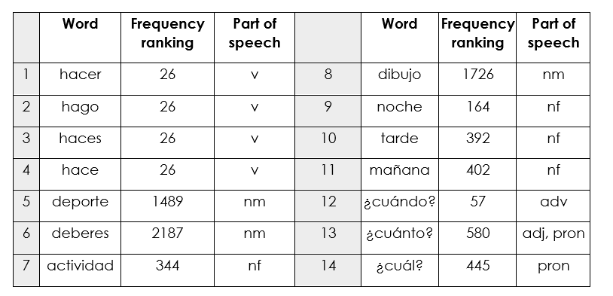
Mixed word class sets
Sample mixed word class set set
Year 7 Spanish Term 2.1 Week 4
Source of frequency data: A Frequency Dictionary of Spanish (2nd ed.) (Davies, M. & Davies, K., 2018), Published by Routledge.
Notes:
This screenshot illustrates the first three points on the last slide (frequency, mixed word classes, cohesion of vocab selection with the grammar being practised).
Here is an example of set of mixed word class words. These words were planned for teaching in Term 2 of our Year 7 SOW. In the first column is the word, in the second is the frequency ranking (1 being the most common word in Spanish).
Three forms of the verb ‘hacer’ are introduced over two lessons, along with nouns that can be used with it and several question words that can be used to ask questions about what people do/make. The inclusion of mañana, tarde and noche allows for question-answer interactions using ‘cuándo’.
--------------------------------------------
Mixed word class sets There is some research evidence that teaching vocabulary in topic-based lists of words with a single word class (e.g. a list of just nouns) is not optimal (Häcker, 2008).
Teaching mixed word class sets provides the means for learners to encounter words in sentences, as well as individually, at present stage, but without running the risk of cognitive overload if too much language (new and previously taught) is presented at once.
Working with words in context is identified by Schmitt as an important strategy for embedding and developing word knowledge.
As mentioned previously, NCELP has been tasked with KS3 pedagogy, but given the very mixed picture of provision nationally, has had to start from a position of ‘ab initio’ learner in its curriculum planning. However, were there to be a KS2 SOW it is likely not only that the same overarching principles would apply, but also that some of the Y7 SOW could be repurposed for earlier years.
Here are some examples of a week’s vocabulary set from each of the three languages, Fr, Gm and Sp, showing the mixed word class composition.

Slide 61
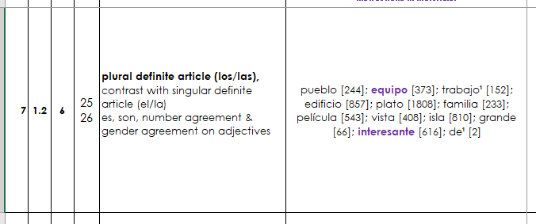
Cohesion of grammar and vocabulary
Context: “Describing a place”
Bold = new grammar
Normal = revisited grammar
Vocabulary to introduce

Slide 62
Multiple senses

Slide 63
Revisiting vocabulary in different grammatical and semantic contexts
Talking about people’s lives
NEW
Asking about future intentions
REVISITED
Talking about the environment
REVISITED
Notes:
The vocabulary is not revisited in the same contexts e.g., aller is seen in a wide range of topics (not just holidays), laver is seen texts that are not just about a personal routine or helping at home.
Here you can see the same vocabulary is practised in three different sets of activities: people’s lives, future intentions, and talking about the environment
And the vocabulary appears with a wide range of grammar too. So, items of vocabulary are not stuck in the same grammatical structures or sentence frames. The words are carefully moved across different grammar features.
So, here you can see the same set of vocabulary is used with er verbs in the 3rd person, with a verb + infinitive structure, and then in a revision lesson which covers a wide range of grammar features.

Slide 64
Slide 32
But what about…
the country/ people / culture?
social communication and interaction?
inferencing skills for when unknown language appears?
Notes:
One question that was persistently raised in the consultation on the new GCSE Subject Content was a misapprehension that defining the linguistic content in clear ways – by listing vocabulary, the details of grammar, and the sounds-symbol correspondences - would mean that language learning was no longer about engendering an interest in the countries and people associated with the language. That clearly defining linguistic content somehow meant that the rationale suddenly became only an academic one. Defining the language content seemed to be interpreted by some as neglecting other rationales such as raising awareness about language (in a way that could be applied to other languages later in the pupils’ lives) or imbuing a sense of curiosity in culture, places, and people.
Here are some texts I will whizz through to illustrate, I hope, that these views resulted from a false dichotomy, a conflation of completely different issues.
I hope to illustrate in a whistle stop tour of some of the 966 classroom resources that NCELP have created, that interesting texts and ideas can be communicated with high frequency words and basic grammar structures, in a curriculum where the vocab and grammar adheres to a schedule to ensure that particular vocab and grammar are revisited at specific times.

Slide 65
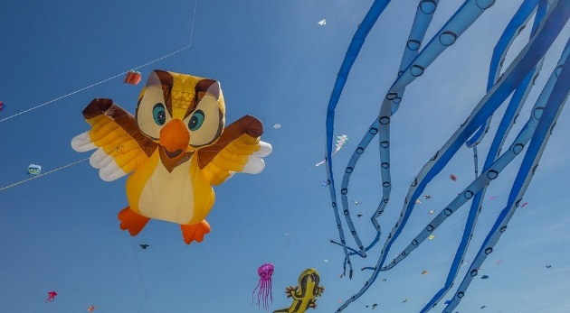
Le festival de Dieppe
lire
*le plus grand =
the biggest
*le cerf-volant = kite
*le son = sound
Comment dit-on les mots orange en anglais ?
What noun does this word look like?
What adjective does this word look like?
Le festival de Dieppe est le plus grand* festival de cerfs-volants* au monde.
On trouve le festival sur la plage.
Les visiteurs viennent de beaucoup de pays pour regarder des cerfs-volants traditionnels, de l'art et des acrobates. Un aspect important du festival est qu’on peut visiter sans acheter de billet. Il est gratuit !
Il y a beaucoup d'activités pour les enfants et le festival encourage l'imagination. Cet événement culturel célèbre les relations internationales. Pendant le dernier week-end du festival, on regarde les cerfs-volants illuminés pendant un show son* et lumière. Je pense à visiter le festival. Tu veut voyager au festival avec ma famille ?
What noun does this word look like?
visitors
What does this sentence tell you about the festival?
acrobats
traditional
The start of this word looks like the English
free
What adjective does this look like?
This word has the same stem as the previous one you worked out. What might it mean?
event
illuminated
light
What words that you already know could you use instead of the words in orange?
Now answer the question at the end.
Notes:
Here is a text about a kite-festival in Dieppe with lots of language awareness activities to help learners understand cognates
Then drawing on their current lexicons – which we know what they are precisely as they have been tracked so carefully - to replace these cognates with words they know
Then giving their reaction to the content of the text by answering a question about whether they would like to go to the festival
----------
Timing: 5 minutes
Aim: Developing inferencing skills by using surrounding context to work out meaning of unknown words; word substitution with known words.
Procedure:
1. Students try to work out the meaning of the highlighted words based on context (text and images) and similarity to English words.
2. If students need some help, click to bring up a clue
3. Click gain to reveal the translations.
4. Click to bring up the extension. Students think of known words that could replace the orange words to make a sensible sentence.
Some suggested answers:
visiteurs -> gens, enfants, personnes … any relevant noun to describe people
traditionnels -> grands, nouveaux… any relevant adjective to describe kites
acrobates -> artistes, chanteurs … any relevant noun to describe performers
événement -> lieu, festival … (note that any relevant masculine noun works here but ‘cet’ would need to change to agree)
illuminés -> verts, bons … any relevant adjective to describe kites
lumière -> musique, film … any relevant noun to describe a show

Slide 66
Hanoucca
*la bougie = candle
**deuxième = second
lire
Lis le texte. Use the words you know to understand the general meaning of the words in bold.
Pour la communauté juive, la fête importante de décembre est Hanoucca. C’est une fête de lumières et on utilise des bougies* pour célébrer. La fête est de huit jours, et on allume une bougie le premier jour, deux bougies la deuxième** jour … Les bougies sont un symbole de la bonté de Dieu. Dans une vieille histoire juive, une petite bouteille d’huile a nourri une lampe pendant huit jours, beaucoup plus de temps que normalement. On mange des beignets comme un symbole de l’huile. Les enfants jouent avec des toupies qui contiennent une phrase religieuse. Hanoucca est plus familial et spirituel que religieux.
bonté : part of body / personality / room / song
huile : a type of wood / plant / liquid / shoe
beignet : a type of drink / chair / cup / food
toupie : a type of toy / book / hat / sweet
goodness
oil
doughnut
spinning top
Notes:
Here is a text about Hanoucca . This activity includes some practice at inferencing the meaning of words by using the words that we know they have already met several times and have been tested on
At this stage of learning, lexical inferencing becomes (more) possible and likely to happen successfully, because we can be more confident that they have a critical mass of vocabulary to start doing this, than if we had used a curriculum where we weren’t very sure about which vocabulary had been covered several times already.
Timing: 5 minutes Aim: to practise lexical inferencing; the written comprehension of known words to arrive at a general understanding of one unknown word in a sentence context. In addition, to revise previously learnt vocabulary in new contexts. Procedure: 1. Ensure that students understand the task (as this is the first time they are doing this type of activity). Students need to know that they are aiming to understand the general meaning, rather than specific meaning (though they may in some cases also arrive at this).
2. Students read each text and decide which of the four options is most likely, depending on their understanding of the surrounding words.
3. Click to reveal answers.
4. Proceed to the next slide for the comprehension part of the activity.
Word frequency of unknown words used (1 is the most frequent word in French):
lumière [1059], allumer [3169], bougie [>5000], deuxième [427], bonté [>5000], huile [2340], beignet [>5000], toupie [>5000]
Word frequency of cognates used (1 is the most frequent word in French): Hanoucca [>5000], bouteille [2979], lampe [4699], normal [833], familial [1622], spirituel [3047]
Source: Lonsdale, D., & Le Bras, Y. (2009). A Frequency Dictionary of French: Core vocabulary for learners London: Routledge.

Slide 67
La Manche
Remplis les blancs avec les formes des verbes correctes.
lire / écrire
La Manche* sépare la France et l’Angleterre. On peut traverser la Manche en bateau ou en train sous l’eau. Quand nous visitons l’Angleterre, nous aimons prendre le train – c’est plus rapide. Ils préfèrent prendre le bateau pour regarder la vue. Comment traversez-vous la Manche ?
Le tunnel sous la Manche constitue le plus long tunnel sous-marin* du monde – on trouve 38 de ses 50 kilomètres sous la mer*.
On utilise le tunnel pour voyager entre l'Angleterre et la France. C'est idéal pour les vacances et les affaires.
[1]
[2]
[3]
[4]
[5]
[6]
[7]
[8]
*la Manche = the English Channel
*sous-marin = underwater
*la mer = sea
séparer (to separate)
visiter
aimer
préférer
traverser
constituer (to form)
trouver
utiliser
Notes:
Here is a text about the channel and how to cross it
This is a standard gap fill including manipulation of verbs
-----------------------
Timing: 4 minutes
Aim: Written production of –ER verbs in all forms; raising cultural awareness (geography).
Procedure:
1. Students read the text about the English Channel and fill the gaps with the appropriate form of the given verbs. For an added challenge at higher levels, remove the numbers from the verbs in the box and mix up the order so that students must also read for semantic meaning and assign the words to the correct gaps.
2. Click to reveal answers.
3. Click to proceed to comprehension questions on next slide.
Word frequency of unknown words used (1 is the most frequent word in French): constituer [495], marin [2101], mer [921]
Source: Londsale, D., & Le Bras, Y. (2009). A Frequency Dictionary of French: Core vocabulary for learners London: Routledge.
Word frequency of cognates (1 is the most frequent word in French): séparer [946], tunnel [3386], long [202], kilomètre [1435]
Source: Londsale, D., & Le Bras, Y. (2009). A Frequency Dictionary of French: Core vocabulary for learners London: Routledge.

Slide 68
Lee este artículo y escribe el título correcto. Debes elegir ‘su’ o ‘sus’.
¿Por qué hacer un viaje a México? Aquí te damos cinco razones.
leer
gente
1. Su / sus________________
Si vienes a México es seguro que puedes hacer amigos. Los mexicanos son muy simpáticos y reciben a los visitantes* con los brazos abiertos.
2. Su / sus ________________
Los paisajes de México son geniales. Puedes visitar sus playas hermosas, sus montañas altas, sus lagos* grandes o sus bosques* llenos de vida.
3. Su / sus ________________
En sus calles vas a encontrar todo tipo de edificios: iglesias antiguas, plazas llenas de gente, mercados, teatros, tiendas con productos locales...
4. Su / sus ________________
México es conocido por sus platos deliciosos. Los mexicanos comen bien y preparan muchas cosas tradicionales: tacos, tamales, mole...
5. Su / sus ________________
Si te interesa la cultura, México es un lugar ideal. Las tradiciones son muy importantes para los mexicanos y sus celebraciones son muy especiales.
Opciones
gente
costumbres
museos
ciudades
música
comida
bebidas
naturaleza
naturaleza
ciudades
comida
*el/la visitante - visitor
costumbres
*el bosque - forest
*el lago - lake
Notes:
Here is an activity that is in a series based introducing the culture and people of Mexico,
but it is also a grammar activity that is based on VanPatten & Cadierno’s processing instruction – forcing attention on the function of the su versus sus possessive pronouns to mean ‘it / its’. This is combined with a task that focuses on the general meaning of the text in order to put the correct subtitle over the text.
So, this activity is an example of all three things: a focus on grammar, a focus on the general meaning of a text, whilst embedded in material about the culture and people.
-------------
Timing: 7 minutes
Aims:
to correctly identify the section headers.
to use the correct form of the possessive adjective (‘su’ or ‘sus’).
Procedure: 1. Students read each section and decide on the correct title from the options available. Note that there are eight options but students will only need to choose five.
2. Show the answers one by one and give feedback. As part of feedback, oral translations could be given in English for each short section.
Frequency of unknown words and cognates:
visitante [2428]; lago [2151]; bosque [1444]; local [734]; ideal [2388]
Image from Pixabay (free to use)

Slide 69
Una tradición mexicana: el Día de Muertos
leer / escuchar
Lee y escucha el texto sobre el Día de Muertos:
1
5
‘Pan de muerto’ es un tipo de pan tradicional en este día.
México tiene muchas tradiciones, pero su tradición del Día de Muertos es especialmente conocida. Es una costumbre única y muy importante para su comunidad porque es una forma de pensar en los muertos. Para los mexicanos, los muertos vienen a la tierra este día.
Nadia es mexicana y celebra el Día de Muertos con su familia. Por la mañana se levanta temprano para ayudar a su abuela: preparan pan* de muerto y un poco de fruta para el altar. Su altar tiene varios* niveles. Los niveles del altar son las diferentes partes del mundo: el primer nivel es la tierra y el segundo nivel es el cielo*. Nadia pone allí fotos de su abuelo y se sienta al lado de su abuela. Se queda unas horas en casa con su familia y se acuerda de su abuelo muerto.
Por la tarde se pone ropa divertida, se pinta de blanco y negro y va a la calle con su hermano. En su barrio hay un festival con música fuerte y luces de colores. ¡Es muy divertido!
2
6
3
7
4
*el pan = bread; *el cielo = sky, heaven; *varios = various
Notes:
Following this was a task focusing on the Day of the Dead in Mexico. This was a bimodal reading and listening task – where learners are asked to follow the text whilst they listen; every so often the audio stops and they have to say the next word or the previous one, or replace the next word with something else
This was informed by evidence that bimodal input helps learners to segment the input into words and helps their comprehension.
Timing: 8 minutes
Aims:
to reinforce understanding of the difference between ‘se’ and ‘su’.
to help students to connect the spoken and written forms of the language more securely.
to consolidate vocabulary and grammar knowledge by eliciting suggested changes to the text.
Procedure:
Students read the text and write ‘se’ or ‘su’ for each space.
Click on the audio button to play the text. Read and listen.
Note: There is a full version of the audio top right with a player. Alternatively, the audio is in 6 sections with a pause just after the words 1-5 below, to facilitate easy stop/start.
To support segmentation, stop the audio and ask students to say: a) the next word b) the previous word
In addition, to develop understanding, vocabulary and grammar knowledge, pause at key points and ask students to suggest an alternative word that could replace the next word. This is a chance to draw on previously taught grammar and vocabulary knowledge.
Es una costumbre única y muy importante para su... (students volunteer other possible nouns – e.g., gente, historia, país).
y celebra el Día de Muertos con su…..(students volunteer other possible nouns – e.g., padre, madre, primo etc.).
de su abuelo y se... (students volunteer verbs in third person singular that fit after ‘se’ – e.g., se acuerda de..., se queda, se prepara (para), etc)
en casa con su familia y se ... (students volunteer other possible verbs that fit after ‘se’ – e.g., se saca (fotos), se mira en el espejo, se presenta a otra gente).
Por la tarde se…… (students are prompted other possible verbs that fit after ‘se’)
va a la calle con su…. (students volunteer other possible nouns)
Notes:
1. The word for ‘bread’ (‘pan’) will be introduced in the next week’s vocabulary set.
Transcript
México tiene muchas tradiciones, pero su tradición del Día de Muertos es especialmente conocida. Es una costumbre única y muy importante para su comunidad porque es una forma de pensar en los muertos. Para los mexicanos, los muertos vienen a la tierra este día.
Nadia es mexicana y celebra el Día de Muertos con su familia. Por la mañana se levanta temprano para ayudar a su abuela: preparan pan* de muerto y un poco de fruta para el altar. Sualtar tiene varios niveles. Los niveles del altar son las diferentes partes del mundo: el primer nivel es la tierra y el segundo nivel es el cielo. Nadia pone allí fotos de su abuelo y se sienta al lado de su abuela. Se queda unas horas en casa con su familia y se acuerda de su abuelo muerto.
Por la tarde se pone ropa divertida, sepinta de blanco y negro y va a la calle con su hermano. En su barrio hay un festival con música fuerte y luces de colores. ¡Es muy divertido!
Frequency of unknown words and cognates:
pan [1342]; cielo [620]; varios [386]
Photos:
Photo of the child by Christian Newman, from Unsplash.
Photo of ‘Pan de muertos’ by Alejandro Ávila Cortez, from Pixabay.

Slide 70
30 seconds to give feedback please! Usefulness / attendance & link to newsletter sign up
https://docs.google.com/forms/d/e/1FAIpQLSfgXTuT2SP74Ct0-_scQjz5pNHPmk6tLQMce4v3Yabe-yISDw/viewform
https://docs.google.com/forms/d/e/1FAIpQLSdJdNqh_lXf68qC1LRBb9BuD7G1leE8S6p6uzk-tGLrwt5zGA/viewform

Slide 71
Further resources from https://resources.ncelp.org/
Over 1000 resources: lesson materials and CPD resources, free to use or adapt!
Fully resourced SOW + materials Spanish, French, German
Year 7, 8, and 9 complete!
including audio files, homeworks, tests with mark schemes
Sample GCSE word lists
Phonics collection : Sound-symbol correspondences systematically taught and revisited from Y7-Y9, incl. read aloud and transcription opportunities
‘The culture collection’ (year 7 & 8 only currently)
Link to all resource collections
Notes:
You can see many more NCELP resources for 13-14 year olds, after 200 hours of instruction, that cover topics such as secularism in France, the Berlin Wall and divided Germany, the ‘polite you’.
One teacher has shared with us some humorous versions of well known fairy tales that they have written with the high frequency words.

Slide 72
More resources
Gaming grammar
Digital game with activities in a ‘spy mission’ context
Reading and listening-based grammar practice
Multiling profiler
This text profiling tool allows the user to see what proportion of a text is within the 2000 most frequent words or has been previously taught
Notes:
Just before we finish, we wanted to let you know about a few of the free resources available.
The NCELP resource portal has hundreds of resources, including all the lessons from the scheme of work, homework, test, scheme of work documents and CPD presentations.
Gaming Grammar is a digital game partly funded by NCELP that allows for reading and listening-based grammar practice in line with the principles of grammar practice that I mentioned earlier.
OASIS is a database with single-side A4 summaries of relevant research published in international peer-reviewed journals. All summaries are written in non-technical language.

Slide 73
Related initiatives
Oak online national academy videoed lessons
All year 7 and year 8; using NCELP resources
Years 9, 10, 11; informed by pedagogy review and NCELP principles; preparation for current GCSE.
BBC Bitesize
NCELP teachers talking about grammar and phonics!
https://www.bbc.co.uk/teach/teacher-support/mfl-teaching-aids/zjfckmn
New content focusing on vocab, phonics, grammar:
French: https://www.bbc.co.uk/bitesize/subjects/zgdqxnb
German: https://www.bbc.co.uk/bitesize/subjects/zcj2tfr
Spanish: https://www.bbc.co.uk/bitesize/subjects/zfckjxs

Slide 74
Free CPD
Short course is free to teachers in state schools
Content is research-informed languages teaching at KS3 and KS4
Course leaders are practising teachers from NCELP networks
5 remote learning sessions of 2.5 hours
OR shorter sessions to suit need
Additional online peer and instructor support
Online self-study version of the course available
GCSE briefings (1.5 hours) available
Register for courses here: www.ncelp.org/cpd
Notes:
As much as possible, participants are assigned to courses regionally - led by an NCELP Specialist Teacher near them, with other participants from their region.
This offers the potential to make the most of local networking and peer support, both online and potentially also face-to-face. A self-study version of the course (with similar certification) for anyone who is unable to access a ‘live’ place will be available shortly.
---------
If this CPD deck is delivered by others, please use this feedback survey, and paste into the chat:
Google Form: https://forms.gle/Y2ztbpRTrkKZRjcp9

Slide 75
Want to keep in touch?
Join the mailing list, email: enquiries@ncelp.org for regular bulletins about resources arriving on the portal
Open Accessible Summaries in Language Studies (OASIS)
To get monthly alerts to summaries of new research, sign up in 10 seconds at
https://oasis-database.org/

