Slide 1
Who, what, how and where?
Definite articles (singular)
SSC [w]
Y7 German
Term 1 - Week 5 - Lesson 9
Inge Alferink / Rachel Hawkes
Artwork: Steve Clarke
Date updated: 15/12/21
Notes:
Artwork by Steve Clarke. All additional pictures selected are available under a Creative Common license; no attribution required.
Learning outcomes (lesson 1):
Introduction of SSC [w]
Consolidation of definite articles (singular) R1(nominative) Consolidation of question words wer, was, wie and wo
Word frequency (1 is the most frequent word in German):
7.1.1.5 (introduce) haben, hat [6] er1 [15] sie1 [7] wer? [149] Freund [273] Fußball [1277] Haus [159] Haustier [>5009] Lehrer [695] Wasser [245] Welt [164] Wort [194] wahr [737] nicht wahr? [n/a] Ist es warm/kalt heute?
7.1.1.2 (revisit) sagen, sagt [40] was?[38] Klasse [961] Mann [121] Paar [241] Tag [111] falsch [524] richtig [177] oder [35] ja1 [45] nein [148] nicht [11] Ist das klar? [n/a]
Source: Jones, R.L. & Tschirner, E. (2019). A frequency dictionary of German: core vocabulary for learners. Routledge

Slide 2
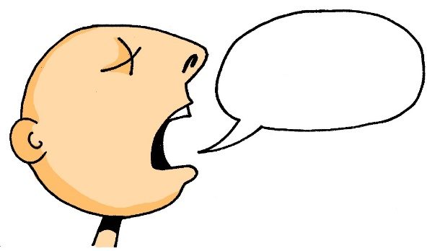
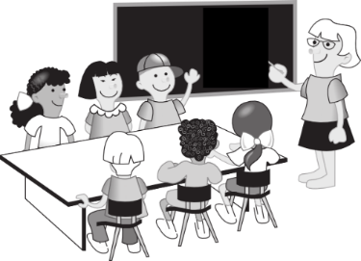
Vokabeln
lesen / sprechen
60
A
d__ P___
E
f_____
r______
B
F
d__ M___
Sekunden
C
s______
0
d__ K___
LOS!
D
G
d__ T__
Notes:
Timing: 5 minutes Aim: To revisit the vocabulary from 7.1.1.2. Procedure: 1. Give students 60 seconds to fill in correct words. This also offers the opportunity for them to re-visit some alphabet letters from last week.
2. The answers are displayed on the next slide.

Slide 3
Vokabeln
lesen / sprechen
A
das Paar
E
falsch
richtig
B
F
der Mann
C
sagen
die Klasse
der Tag
D
G
Notes:
This slide displays the answers to the activity on the previous slide.

Slide 4
Vokabeln
sprechen
Das ist…
Notes:
Timing: 5 minutes Aim: To revise use of indefinite and definite articles in whole-class feedback.
Note: This is a placeholder slide as no slides are needed for this activity. It’s useful to use ‘real world’ referents when possible, and for variety. Use the B key to turn off the powerpoint temporarily if you find the slide distracting.
Procedure:
1.Teacher cues (example): Das ist ein Fenster, nicht wahr? Student reponse: Nein! Das ist ein Heft.
Teacher then prompts for definite article - Ja, aber wie schreibt man ‘the exercise book’?
Students respond with their written answer. 2. Point to: table. Say: Das ist ein Heft, nicht wahr? … 3. Point to bottle: Say: Das ist ein Tier, nicht wahr? … 4. Point to board: Say: Das ist ein Mann, nicht wahr? … 5. Point to window: Say: Das ist eine Flasche, nicht wahr? …
Vocabulary: This revisits the gender and written form of Week 1 and 2 vocabulary, which were not elicited in the previous activity.
This activity introduces ‘nicht wahr’. This is Week 5 vocabulary – students were assigned Week 5 vocabulary as pre-learning, so they may recognise it, but the teacher will want to establish that students know both the literal meaning of each word ‘nicht’ and ‘wahr’ and also the functional meaning as a tag question ‘isn’t it?’ It’s worth pointing out that it can stand for any tag question (don’t you, aren’t they, etc.), so is VERY useful and much easier to use than English tag questions are for learners of English.
This activity also revisits ‘ja’, ‘nein’ (Week 2) ‘aber’ and ‘wie schreibt man’ (Week 4).

Slide 5
w
Welt
Notes:
Timing: 1 minute
Aim: To introduce/consolidate SSC [w]
Procedure: 1. Present the letter(s) and say the [w] sound first, on its own. Students repeat it with you. 2. Bring up the word ”Welt” on its own, say it, students repeat it, so that they have the opportunity to focus all of their attention on the connection between the written word and its sound.
3. A possible gesture for this would be to start with your hands above your head and draw them down, out and then back into the body, tracing the shape of the world.
4. Roll back the animations and work through 1-3 again, but this time, dropping your voice completely to listen carefully to the students saying the [w] sound, pronouncing ”Welt” and, if using, doing the gesture. Word frequency (1 is the most frequent word in German): Welt [190] Source: Jones, R.L. & Tschirner, E. (2006). A frequency dictionary of German: core vocabulary for learners. Routledge

Slide 6
w
Welt
Notes:
With sound and no pictures to focus all attention on the sound-symbol correspondence.

Slide 7
w
Welt
Notes:
Without sound to elicit pronunciation (without first hearing the teacher).
Teacher to elicit pronunciation by asking “Wie sagt man…”

Slide 8
Vokabeln
sprechen
wer?
who?
Notes:
Timing: 3 minutes (all four slides) Aim: To introduce the 4th Question word: ‘wer’.
Note: Following the introduction of ‘ wer’, we will revisit the question words students have encountered so far.
Procedure: 1. Model pronunciation of the question word.
2. Optional: Note that ‘wer’ might be considered a false friend as it sounds similar to ‘where’ in English.
One useful ‘hook’ for students is to say ‘Who? wer?’ (and mime the action of ‘hoovering’!) This (perhaps bizarrely) has the effect of fixing the association of the English ‘who’ with the German ‘wer’and does help students to map the L1:L2 meaning more securely.

Slide 9
Vokabeln
sprechen
wer?
who?
Notes:
Procedure: 1. Elicit the question word from students.

Slide 10
Vokabeln
sprechen
wer?
who?
Wer ist dein Mathelehrer?
[Who is your maths teacher?]
Notes:
Procedure: 1. Model the question word and the question.

Slide 11
Vokabeln
sprechen
wer?
who?
____ ist dein Mathelehrer?
Wer
[Who is your maths teacher?]
Notes:
Procedure: 1. Elicit the the question word and the question from students.

Slide 12
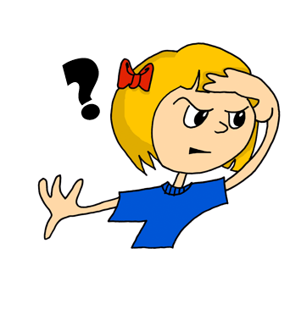
Vokabeln
sprechen
Was
____ denkst du?
__ ist Niko?
Wo
___ schreibt man …?
Wie
Wer
___ ist dein Mathelehrer?
Notes:
Timing: 3 minutes Aim: To revisit the question words learnt so far. Procedure: 1. Use the images to elicit the question words and a whole question. The questions on the slide are examples they have seen before, but other options are possible, of course.
2. Note: remember to revisit both meanings of ‘wie’ (‘how’ and ‘like what’) E.g. Ask: Wie ist das Heft hier? Rot oder blau?

Slide 13
Vokabeln
sprechen
Wie?
Wer?
Was?
Wo?
Notes:
Timing: 3 minutes (both slides) Aim: To revise questions words with their assocoated gestures. Procedure: 1. If teachers have used gestures to teach the questions, it is straightforward here to practise retrieval with students, whilst they show their understanding of each question word’s meaning.
2. Move quickly onto the next slide, where students can be invited to call out a question word and the rest of the class shows their understanding with the appropriate gesture. The teacher can also do the gestures (in jumbled order) and elicit the German from students.

Slide 14
Vokabeln
sprechen
W__?
W__?
W__?
W_?
Notes:
Procedure:
1. Students can now be invited to call out a question word and the rest of the class shows their understanding with the appropriate gesture.
2. The teacher can also do the gestures (in jumbled order) and elicit the German from students.

Slide 15
Vokabeln
sprechen
Wer
der Tag
Was
das Tier
Wo
der Mann
der Gast
?
Was
IST
Wie
Wer
die Farbe
die Flasche
Wo
Wie
der Mensch
das Ding
Notes:
Timing: 10 minutes Aim: To provide production practice (speaking) in question formation with question words. Procedure: 1. In pairs, students take turns to create a question using a question and a noun from each set. Once a word has been used it is crossed out. Note that not all question words can go with all nouns, e.g. ‘wer’ only makes sense with living things.
2. Rather than answering the questions, students translate their partner’s question into English.
They can do this orally or write down their questions.
3. For higher challenge, suggest that only the student creating the questions has sight of the sheet. This ensures that the listener relies only on the aural input for understanding.

Slide 16
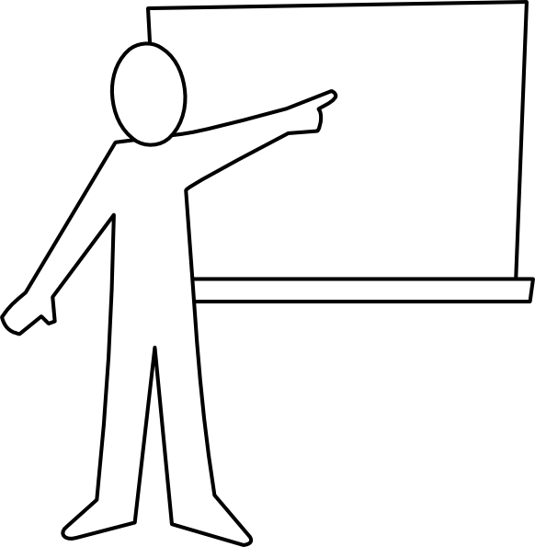
Vokabeln
sprechen
der Lehrer
Notes:
Timing: 4 minutes (all six slides) Aim: To present this week’s new vocabulary. Procedure: 1. The words are animated to allow teachers to elicit prior knowledge from students, but there will obviously (as always) be different levels of knowledge in the room, particularly as their first encounters with these words were self-access via Quizlet. Teachers can use these slides flexibly to move students to more secure knowledge of the words.

Slide 17
Vokabeln
sprechen
der Fußball

Slide 18
Vokabeln
sprechen
der Freund

Slide 19
Vokabeln
sprechen
das Wasser

Slide 20
Vokabeln
sprechen
die Welt

Slide 21
Vokabeln
sprechen
das Wort

Slide 22
Vokabeln
sprechen
der Lehrer
die Welt
der Freund
das Wort
der Fußball
das Wasser
N
J
L
I
K
M
Notes:
Timing: 6 minutes Aim: To provide production (speaking) practice with the new vocabulary.
Procedure: 1. The teacher chooses which order to ask the letters in – clearly, it would be easy to ask in alphabetical order, but this would be what students would naturally expect, so it reduces the need for them to listen attentively to them.
2. The letter prompts are the trigger (i.e. click on the letter) for the lines to connect the word to the picture. This means that students are practising their understanding of another set of alphabet letters at the same time.

Slide 23
Vokabeln
sprechen
6. der Lehrer
1. der Fußball
5. die Welt
4. das Wort
3. das Wasser
2. der Freund
Notes:
Timing: 5 minutes Aim: To provide production (speaking) practice with the new vocabulary. Procedure: 1. Students write 1-6 in books.
2. Ask students to write down the English translation before the word has faded away.
3. Click to bring up each option
4. Check answers by eliciting the German from students, with definite article. (i.e. so that they are translating back from their written English into spoken German). Note: Students have not yet done numbers but will be taught them explicitly in Week 9. However, in the next few weeks, certain activities will prime for them. Here the teacher can say the number when eliciting the answers, but support understanding by holding up the appropriate number of fingers each time. Obviously, the items proceed in number order in any case, so the finger gesture is more to draw learners attention to the sound – meaning connection of the number with the German word for that number.
5. Pay particular attention to the pronunciation of ‘W’, our SSC for this week, and also to the correct recall of the genders. It’s all too easy for students to lose the connection between the gender and the noun.
ANSWERS 1. der Fußball 2. der Freund 3. das Wasser 4. das Wort 5. die Welt 6. der Lehrer

Slide 24
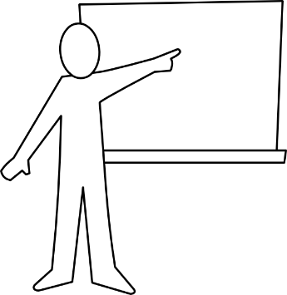
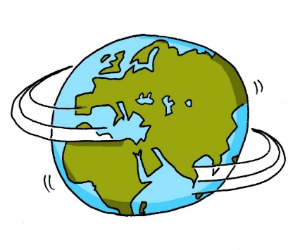
Vokabeln
sprechen
der
die
das
Notes:
Timing: 5 minutes Aim: To practice recall of the gender of nouns learned. Procedure: 1. Ask students to predict which pacman will eat the word based on the word’s gender.
2. Click to see where the word goes.

Slide 25
Who has what? Possession
Definite articles (singular) – R2 (accusative)
SSC [w]
Y7 German
Term 1.1 - Week 5 - Lesson 10
Inge Alferink / Rachel Hawkes
Artwork: Steve Clarke
Date updated: 15/12/21
Notes:
Artwork by Steve Clarke. All additional pictures selected are available under a Creative Common license; no attribution required.
Learning outcomes (lesson 1):
Introduction of SSC [w]
Introduction of Definite articles (singular) - Row 2 (accusative)
Word frequency (1 is the most frequent word in German):
7.1.1.5 (introduce) haben, hat [6] er1 [15] sie1 [7] wer? [149] Freund [273] Fußball [1277] Haus [159] Haustier [>5009] Lehrer [695] Wasser [245] Welt [164] Wort [194] wahr [737] nicht wahr? [n/a] Ist es warm/kalt heute?
7.1.1.2 (revisit) sagen, sagt [40] was?[38] Klasse [961] Mann [121] Paar [241] Tag [111] falsch [524] richtig [177] oder [35] ja1 [45] nein [148] nicht [11] Ist das klar? [n/a]
Source: Jones, R.L. & Tschirner, E. (2019). A frequency dictionary of German: core vocabulary for learners. Routledge

Slide 26
w
Welt
Notes:
Timing: 1 minute
Aim: To introduce/consolidate SSC [w]
Procedure: 1. Present the letter(s) and say the [w] sound first, on its own. Students repeat it with you. 2. Bring up the word ”Welt” on its own, say it, students repeat it, so that they have the opportunity to focus all of their attention on the connection between the written word and its sound.
3. A possible gesture for this would be to start with your hands above your head and draw them down, out and then back into the body, tracing the shape of the world.
4. Roll back the animations and work through 1-3 again, but this time, dropping your voice completely to listen carefully to the students saying the [w] sound, pronouncing ”Welt” and, if using, doing the gesture. Word frequency (1 is the most frequent word in German): Welt [190] Source: Jones, R.L. & Tschirner, E. (2006). A frequency dictionary of German: core vocabulary for learners. Routledge

Slide 27
w
Welt
Notes:
With sound and no pictures to focus all attention on the sound-symbol correspondence.

Slide 28
w
Welt
Notes:
Without sound to elicit pronunciation (without first hearing the teacher).
Teacher to elicit pronunciation by asking “Wie sagt man…”

Slide 29
w
Wasser
wahr
Welt
Was?
gewinnen
antworten
Notes:
Timing: 2 minutes
Aim: To introduce/consolidate SSC [w]
Procedure:
Introduce and elicit the pronunciation of the individual SSC [w] and then the source word again ‘Welt’ (with gesture, if using).
Then present and elicit the pronunciation of the five cluster words.
The cluster words have been chosen for their high-frequency, from a range of word classes, with the SSC (where possible) positioned within a variety of syllables within the words (e.g. initial, 2nd, final etc.). Additionally, we have tried to use words that build cumulatively on previously taught SSCs (see the Phonics Teaching Sequence document) and do not include new SSCs. Where new SSCs are used, they are often consonants which have a similar symbol-sound correspondence in English.
Word frequency (1 is the most frequent word in German): Welt [190]; Wasser [297] wahr [662]; Was? [39]; antworten [804]; gewinnen [410]. Source: Jones, R.L. & Tschirner, E. (2006). A frequency dictionary of German: core vocabulary for learners. Routledge

Slide 30
w
Wasser
wahr
Welt
Was?
gewinnen
antworten
Notes:
With sound and no pictures to focus all attention on the sound-symbol correspondence.

Slide 31
w
Wasser
wahr
Welt
Was?
gewinnen
antworten
Notes:
Without sound to elicit pronunciation (without first hearing the teacher).
Teacher to elicit pronunciation by asking “Wie sagt man…”

Slide 32
haben
[to have | having]
hat
[has]
Notes:
Timing: 3 minutes for sequence of six verbs
Aim: To introduce the verb haben more explicitly.
Note: Haben is one of the 25 most frequently used verbs in German. All 25 most frequent verbs will be introduced early on using the same format. Both long form (infinitive) and short form (3rd person singular) are introduced in order to familiarise students with various forms of the same verb.
Procedure
Bring up the word haben on its own, say it, students repeat it, and remind them of the phonics. Draw attention to the long [a].
Try to elicit the meaning from the students. Students have had explicit teaching that the present tense in German communicates two different present tense meanings in English. This reinforces that learning.
Then bring up the English translations. Emphasise the two meanings for the infinitive.
Bring up the short form hat, say it, students repeat it. Draw attention to the short [a].
Try to elicit the meaning from the students.

Slide 33
haben
[to have| having]
hat
[has]
Notes:
Cycle through the long and short form again.

Slide 34
hat
[has]
Markus hat ein Fahrrad.
[Markus has a bike.]
Notes:
Introduce the short form in a sentence.

Slide 35
haben
[to have | having]
Markus muss ein Fahrrad haben.
[Markus must have a bike.]
Notes:
Introduce the long form in a sentence.

Slide 36
hat
[has]
hat
Markus ____ ein Fahrrad.
[Markus has a bike].
Notes:
Cycle through the short form in context again.

Slide 37
haben
[to have | having]
Markus muss ein Fahrrad_______.
haben
[Markus must have a bike.]
Notes:
Cycle through the long form in context again.

Slide 38
den = ‘the’ after a verb
Grammatik
As you know, German has three words for the:
Only the masculine changes. Feminine and neuter words for ‘the’ stay the same!
masculine
feminine
neuter
die Flasche
das Fenster
der
die
das
der Tisch
After a verb the masculine word for the changes:
Niko hat den Tisch.
Niko hat den Rucksack.
Niko hat den Mann.
This change happens after most verbs but not SEIN / ist (BE / is).
Notes:
Timing: 5 minutes Aim: To introduce the Row 2 (accusative) form of the definite article.
Note: There are of course a few verbs other than SEIN that are not followed by the accusative (Row 2): sein, werden, bleiben, scheinen, dünken, heißen. These are not followed by objects, but typically by a ‚predicative nominal‘ (essentially like a 2nd version of the subject – e.g. Polly is a parrot. / A parrot is Polly.) At this stage, though, it is only important for students to know that SEIN is followed by nominative (Row 1), and other verbs generally by accusative (Row 2).
Procedure: 1. Click to animate the explanation.
2. Ensure students understanding at each stage.

Slide 39
Grammatik
hören
Wer hat _____?
Zorg is staying on earth. He has some possessions stored with Wolfgang and Mia. Unfortunately, he can’t remember who has what. ☹
Listen to Zorg. What is he asking about? Tick the correct person.
Wer hat die /den /das ________ ?
Wolfgang
Mia
Notes:
Timing: 5 minutes (all 5 slides) Aim: To practise connecting nouns with the correct form of the definite article. Procedure: 1. Use this slide to explain the task. The noun itself is omitted, forcing students to listen for the article and use this to determine the object.
2. The questions are on the next two slides (click on the audio buttons to play) and the answers on the following two slides (click on the audio buttons to play the full sentences this time).

Slide 40
Grammatik
hören
Wer hat ________ ?
Wolfgang
Mia
1
2
3
4
10
Notes:
Questions 1-4.

Slide 41
Grammatik
hören
Wer hat ________ ?
Wolfgang
Mia
5
6
7
8
10
Notes:
Questions 5-8.

Slide 42
Grammatik
hören
Wer hat ________ ?
Wolfgang
Mia
1
2
3
4
10
Notes:
Transcript:
Wer hat die Flasche?
Wer hat den Fußball?
Wer hat die Tafel?
Wer hat das Heft?

Slide 43
Grammatik
hören
Wer hat ________ ?
Wolfgang
Mia
5
6
7
8
10
Notes:
Transcript:
5. Wer hat den Tisch?
6. Wer hat das Tier?
7. Wer hat das Paar?
8. Wer hat die Zahl?

Slide 44
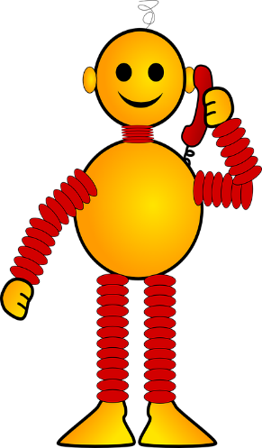
Vokabeln
lesen
Zorg made a list of his possessions and who has them, but he forgot to add the articles. Can you fill in the gaps?
Wolfgang hat ____ Flasche.
Wolfgang hat ____ Fußball.
Mia hat ____ Tafel.
Wolfgang hat ____ Heft.
Mia hat ____ Tisch.
Mia hat ____ Tier.
Wolfgang hat ____ Paar.
Mia hat ____ Zahl.
die
den
die
das
den
das
das
die
Notes:
Timing: 6 minutes Aim: To practise using the correct form of the article for nouns. Procedure: 1. Click to display the sentences based on the previous exercise one by one. The definite article is missing from each.
2. Students supply the correct for mof the article in each case.
3. Click to display the answers.

Slide 45
Vokabeln
sprechen
https://www.bensound.com
Notes:
Timing: 12 minutes Aim: To practise use of the correct article form with nouns. Procedure: 1. Pass the parcel with cards. To start the music, click the audio player icon, which displays a pause button when the music is playing, allowing full control.
2. Music stops, everyone holds up their cards (we will have 9-10 nouns in play, all the masc. ones). Teacher first asks 'Wer hat den Tisch?' Wer hat den Lehrer?'. After a few more turns, the teacher asks: 'Was hat David?' to elicit the definite article in Row 2.
3. A variation: Teacher has an extra set of the nouns in pictures. After the music stops holds a card up and ask ‘Was ist das?’ (‘Das ist der Tisch’) followed by ‘Wer hat das’? (‘David hat den Tisch’). This emphasises that masculine ‘the’ does not change after ist, but does change after other verbs.
4. The cards themselves are on the next slide.
Masculine words
der Tisch
der Tag
der Mann
der Mensch
der Ort
der Lehrer
der Fußball
der Freund der Gast
Additions
die Welt
das Wort
das Wasser
das Tier
die Sache / das Ding
die Zahl
die Farbe

Slide 46
Vokabeln
sprechen
10
Notes:
These are the cards for the game on the previous slide.

Slide 47
Vokabeln
sprechen
You are organising a garage sale for charity.
Person A has a list of all the items you’re selling and person B knows who is donating what.
Was hat Niko?
Niko has das Tier und die Flasche.
PERSON B
+
PERSON A
Niko
Notes:
Timing: 10 minutes Aim: To provide production (speaking) practice in the use of the correct form of the definite article with nouns.
Note: This slide explains the task - the cards themselves are on following two slides.
Procedure: 1. You are organising a garage sale for charity. Person A has a list of all the items you’re collecting and person B knows who is donating what. 2. Person A: Was hat Niko? (alternative: Hat Niko x?)
3. Person B: Niko hat das Tier und die Flasche.
4. Person A: writes down Niko’s items on the response grid (…hat das Tier. … hat die Flasche.)
Which items are left over at the end?
5. Note: this activity combines speaking, listening, and writing. The teacher can remind students that the masculine article ‘der’ changes after a verb.

Slide 48
Vokabeln
sprechen
PERSON A
Person | Ding
Hannah
Julius
Noah
Sarah
Notes:
This is Person A’s card.

Slide 49
Vokabeln
sprechen
PERSON B
+
+
Hannah
Julius
+
+
Noah
Sarah
Notes:
This is person B’s card. Each box shows a person and the two items s/he is donating.

Slide 50
Phonetik
hören / schreiben
Wo ist der Lehrer?
Das Ding ist blau.
Du bist klein.
Der Mann hat den Fußball.
Wie schreibt man das?
Ist das Ding rot oder gelb?
1
2
3
4
5
6
Notes:
Timing: 5 minutes Aim: To practise the phonics, vocabulary and grammar learnt, via transcription.
Note: A lot of the activities so far have used isolated words. This activity puts the vocabulary they have learnt in context. It also focuses the students’ attention on spelling of the words.
Procedure: 1. Play the audio recording of the sentences. Click the number to repeat the sentence as many times as needed.
2. Students write the sentences down.
3. Discuss the answers. For each item ask a student to read what they have written. Play the recording again and then show the written version.
Transcript: 1. Wo ist der Lehrer?
2. Das Ding ist blau.
3. Du bist klein.
4. Der Mann hat den Fußball.
5. Wie schreibt man das?
6. Ist das Ding rot oder gelb?

Slide 51
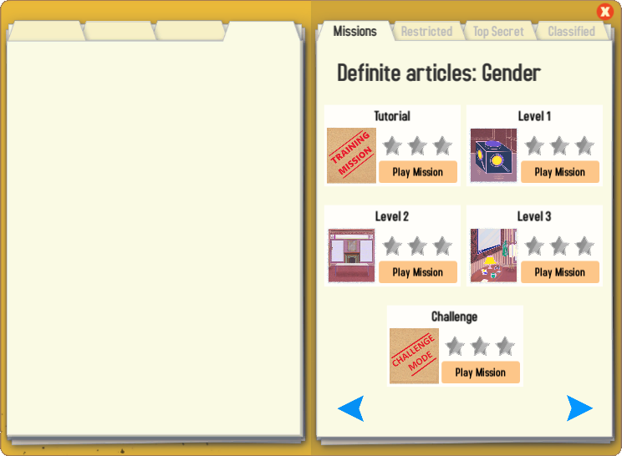
Gaming Grammar
Try the following Gaming Grammar missions to practise:

Slide 52
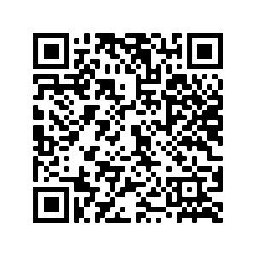
Hausaufgaben
Vocabulary Learning Homework (Y7, Term 1.1, Week 6)
Audio file
Audio file QR code:
Student worksheet
Quizlet link
In addition, revisit: Term 1.1 Week 3
Notes:
Use this slide to set the homework.

