Slide 1
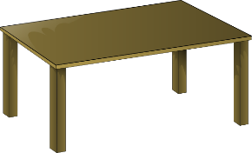
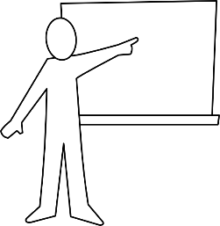
10
Inge Alferink / Rachel Hawkes
Notes:
Pass the parcel with cards - music stops, everyone holds up their cards (we will have 12 nouns in play, all the masc. ones met in the SOW to date, plus 4 die/das words). Teacher first asks 'Wer hat den Tisch?' Wer hat den Mann? → Harriet hat den Mann. John hat den Mann. (there will be 2-3 students with the same noun card). After a few more turns, the teacher asks: 'Was hat David?' to elicit the definite article in Row 2.
A variation: Teacher has an extra set of the nouns in pictures. After the music stops holds a card up and ask ‘Was ist das?’ (‘Das ist der Tisch’) followed by ‘Wer hat das’? (‘David hat den Tisch’). This emphasises that the does not change after ist, but does change after other verbs.
Masculine words
der Tisch
der Tag
der Mann
der Ort (this picture is new, although students have learnt the word, so worth flagging this up)
der Lehrer
der Fußball
der Freund der Gast (this word recycled from Week 1)
Not included: (Der Mensch → difficult to distinguish from the man in a simple picture)
Additions
das Wort
die Flasche
das Tier
die Zahl

