Slide 1
Avion supersonique: L'histoire de Concorde
prepositions of place and movement + noun/place name numbers as years
SSCs [-tion] and [on]
Y9 French
Term 3.1 - Week 6 - Lesson 57
Author names: Natalie Finlayson and Louise Bibbey
Artwork by: Chloé Motard
Date updated: 15/09/22
Notes:
Artwork by Chloé Motard. All additional pictures selected are available under a Creative Commons license, no attribution required.
Native teacher feedback provided by Stephanie Schmitt.
With thanks to Rachel Hawkes for her input on the lesson material.
Learning outcomes (lesson 1):
Revisit SSCs [-tion] and [on]
Revisit use of prepositions à and en with masculine countries, feminine countries and cities
Revisit prepositions of location + noun (with and without de)
Introduction of numbers over 1000 as years
Cultural awareness: French/British collaboration on a technical innovation
Word frequency (1 is the most frequent word in French):
dormir [1836], finir [534], nourrir [1251], partir [163], remplir [751], revenir [184], sortir [309], venir [88], accident [1227], conversation [1747], Allemagne [n/a], Alger [n/a], Belgique [n/a], Bruxelles [n/a], États-Unis [n/a], Genève [n/a], Londres [n/a], Italie [n/a], nom [171], personne [84], poisson [1616], programme [340], projet [228], réponse [456], Suisse [n/a], verre [2174], allemand (adj) [844], alors [81], à [4], de [2], en3 [7], derrière [805], devant [198], entre [55], loin de [n/a], près de [n/a], sous [122], sur [16], attention ! [482], loin [341], près [225], un, une, des [3], cinq [288], deux [41], dix [372], huit [877], neuf [787], quatre [253], sept [905], six [450], trois [115]
Source: Lonsdale, D., & Le Bras, Y. (2009). A Frequency Dictionary of French: Core vocabulary for learners London: Routledge.
The frequency rankings for words that occur in this PowerPoint which have been previously introduced in NCELP resources are given in the NCELP SOW and in the resources that first introduced and formally re-visited those words.
For any other words that occur incidentally in this PowerPoint, frequency rankings will be provided in the notes field wherever possible.

Slide 2
-tion
Attention!
Notes:
Timing: 1 minute [1/4]
Aim: To consolidate SSC [-tion]
Procedure: 1. Present the letter(s) and say the [-tion] sound first, on its own. Students repeat it with you. 2. Bring up the word ”attention” on its own, say it, students repeat it, so that they have the opportunity to focus all of their attention on the connection between the written word and its sound.
3. A possible gesture for this would be to wave one’s hand in front of oneself to indicate not to proceed. 4. Roll back the animations and work through 1-3 again, but this time, dropping your voice completely to listen carefully to the students saying the [-tion] sound, pronouncing ”attention” and, if using, doing the gesture.
Word frequency (1 is the most frequent word in French):
attention [482].
Source: Londsale, D., & Le Bras, Y. (2009). A Frequency Dictionary of French: Core vocabulary for learners London: Routledge.

Slide 3
-tion
population
situation
attention!
action
solution
international
Notes:
[2/4]
Aim: To consolidate SSC [-tion]
Procedure:
1. Introduce and elicit the pronunciation of the individual SSC [-tion] and then the source word again ‘attention’ (with gesture, if using). 2. Then present and elicit the pronunciation of the five cluster words.
The cluster words have been chosen for their high-frequency, from a range of word classes, with the SSC (where possible) positioned within a variety of syllables within the words (e.g. initial, 2nd, final etc.). Additionally, we have tried to use words that build cumulatively on previously taught SSCs (see the Phonics Teaching Sequence document) and do not include new SSCs. Where new SSCs are used, they are often consonants which have a similar symbol-sound correspondence in English.
Word frequency (1 is the most frequent word in French): population [509]; action [355] situation [223]; international [282]; solution [608]; attention [482]. Source: Londsale, D., & Le Bras, Y. (2009). A Frequency Dictionary of French: Core vocabulary for learners London: Routledge.

Slide 4
on
non!
Notes:
[3/4]
Aim: To consolidate SSC [on]
Procedure: 1. Present the letter(s) and say the [on] sound first, on its own. Students repeat it with you. 2. Bring up the word ”non” on its own, say it, students repeat it, so that they have the opportunity to focus all of their attention on the connection between the written word and its sound.
3. A possible gesture for this would be to shake ones head whilst waggling one’s index finger, to indicate ‘no!’ 4. Roll back the animations and work through 1-3 again, but this time, dropping your voice completely to listen carefully to the students saying the [on] sound, pronouncing ”non” and, if using, doing the gesture.
Word frequency (1 is the most frequent word in French):
onze [2447]
Source: Londsale, D., & Le Bras, Y. (2009). A Frequency Dictionary of French: Core vocabulary for learners London: Routledge.

Slide 5
on
onze
continuer
[to continue]
non!
monde
au fond
montrer
[at the back]
[to show]
Notes:
[4/4]
Aim: To consolidate SSC [on]
Procedure:
1. Introduce and elicit the pronunciation of the individual SSC [on] and then the source word again ‘non’ (with gesture, if using). 2. Then present and elicit the pronunciation of the five cluster words.
The cluster words have been chosen for their high-frequency, from a range of word classes, with the SSC (where possible) positioned within a variety of syllables within the words (e.g. initial, 2nd, final etc.). Additionally, we have tried to use words that build cumulatively on previously taught SSCs (see the Phonics Teaching Sequence document) and do not include new SSCs. Where new SSCs are used, they are often consonants which have a similar symbol-sound correspondence in English.
Word frequency (1 is the most frequent word in French): onze [2447]; continuer [113] monde [77]; montrer [108]; au fond [553]; non [72]. Source: Londsale, D., & Le Bras, Y. (2009). A Frequency Dictionary of French: Core vocabulary for learners London: Routledge.

Slide 6
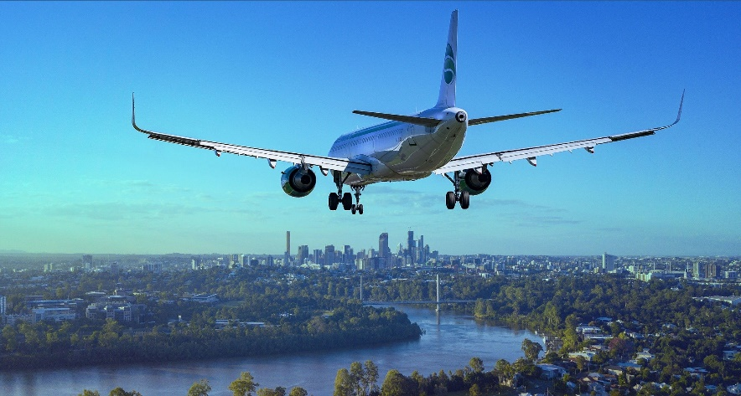
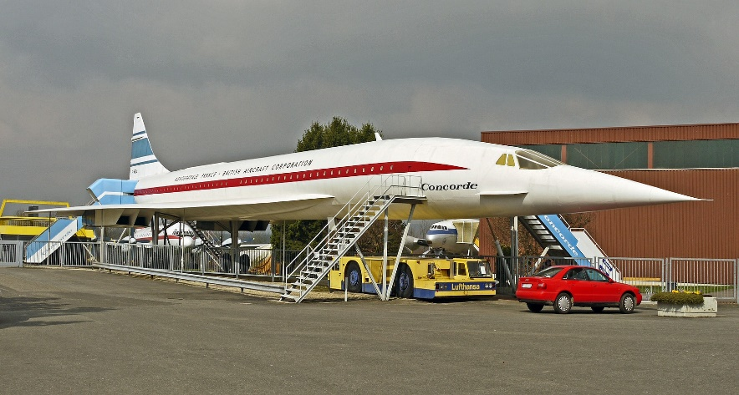
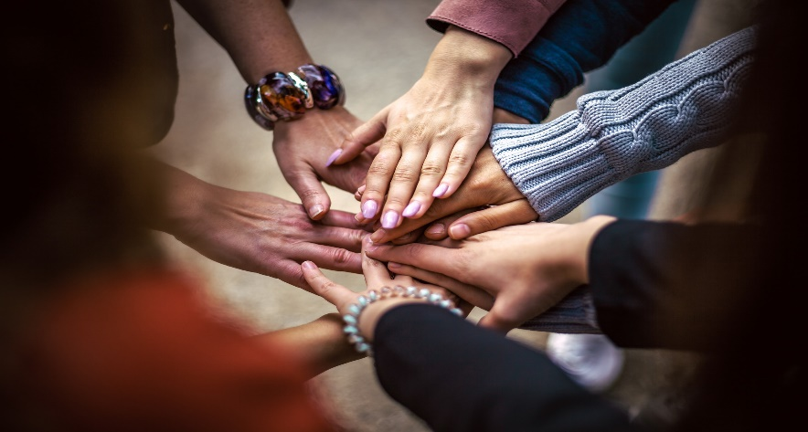
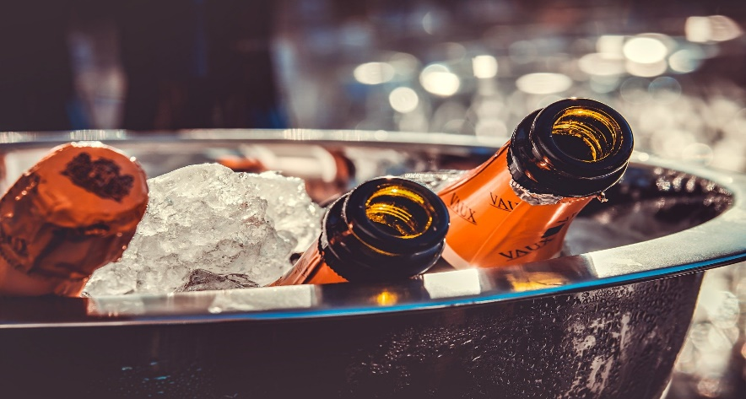
Quel est le thème?
*luxe = luxury
phonétique
avion
concorde
Oui… on va étudier l’histoire d’une création anglo-française: un avion de luxe* extraordinaire…
le Concorde!
On va étudier une histoire très intéressante.
Écoute et dis ces mots.
coopération
boissons
Parle avec ton partenaire.
Quel est le thème de cette histoire ?
Notes:
Timing: 3 minutes
Aim: To contrast the target SSCs in a range of challenging letter strings with a similar sound [on]/[ion]/[sson]/[tion] in preparation for the exercise on the next slide; ice breaker to set the scene for the lesson.
Procedure:
1. Click to reveal the text and pictures to hear the words spoken.
2. Ask students to repeat the words heard, focusing on the sounds highlighted in orange. Draw attention to the ‘s’ sound in the coopération and boissons, noting the difference in spelling.
3. Click through the second set of instructions and ask students to discuss in pairs or as a whole class what the theme of the lesson will be.
Transcript:
avion
coopération
concorde
boissons
Word frequency of unknown words (1 is the most frequent word in French): boisson [3614], luxe [3009]
Source: Londsale, D., & Le Bras, Y. (2009). A Frequency Dictionary of French: Core vocabulary for learners London: Routledge.
Word frequency of cognates (1 is the most frequent word in French): coopération [1496], creation [634], extraordinaire [1234], thème [1720]
Source: Lonsdale, D., & Le Bras, Y. (2009). A Frequency Dictionary of French: Core vocabulary for learners London: Routledge.

Slide 7
SSC décollage*: [on], [ion], [tion] ou [sson] ?
*le décollage = take-off
écouter
1
s?dage
avia?
sondage
2
aviation
3
potir?
potiron
4
mou?
mousson
5
espion
esp?
[survey]
[aviation]
[pumpkin]
[monsoon]
[spy]
6
inonda?
fri?ner
torch?
inondation
7
sonder
s?der
8
frissonner
9
torchon
10
buisson
bui?
11
hérisson
héri?
[flood]
[probe]
[shiver]
[tea towel]
[bush]
[hedgehog]
12
sta?nement
stationnement
15
réun?
réunion
16
pioncer
jonction
p?cer
jonc?
camion
13
14
cam?
[parking]
[junction]
[lorry]
[meeting]
[snooze]
Notes:
Timing: 6 minutes
Aim: To practise distinguishing between sounds [on], [ion], [tion] and [sson]
Procedure:
Click on the number boxes to hear the full word.
Students must identify which sound they hear. This can be done using mini-whiteboards, either writing the sound or transcribing the full word.
The teacher clicks to reveal the correct spelling, and the aeroplane moves to the next word.
Transcript:
sondage
aviation
potiron
mousson
espion
inondation
sonder
frissonner
torchon
buisson
hérisson
stationnement
jonction
camion
réunion
pioncer
Word frequency of unknown words (1 is the most frequent word in French):
sondage [2232], potiron [>5000], mousson [>5000], inondation [4677], espion [>5000], torchon [>5000], frissonner [>5000], sonder [4930], buisson [>5000], stationnement [>5000], hérisson [>5000], camion [2542], pioncer [>5000]
Source: Lonsdale, D., & Le Bras, Y. (2009). A Frequency Dictionary of French: Core vocabulary for learners London: Routledge.
Word frequency of cognates used (1 is the most frequent word in French): aviation [4084], jonction [>5000], réunion [971]
Source: Lonsdale, D., & Le Bras, Y. (2009). A Frequency Dictionary of French: Core vocabulary for learners London: Routledge.

Slide 8
Un projet anglo-français
*le Royaume-Uni = United Kingdom
l*ingénieur (m) = engineer *la vitesse du son = spend of sound
lire
En 1962, la France et le Royaume-Uni* ont décidé de travailler ensemble sur un projet qui a duré quarante ans.
Après la seconde guerre mondiale, des équipes d'ingénieurs* britanniques, françaises, allemandes et américaines ont commencé à construire des avions supersoniques. Ce sont des avions qui peuvent voler plus vite que la vitesse du son*. La construction d’un avion supersonique a coûté 100 M£.
Dans une atmosphère compétitive,
les équipes anglaises et françaises ont
décidé de combiner leurs plans pour partager les coûts. On a considéré ce développement très positif pour deux nations historiquement rivales.
1. For how long did the Anglo-French project last?
2. Which countries were building supersonic planes?
3. What is a supersonic plane?
4. Why did France and the UK decide to work together? 5. Why might this have been surprising?
40 years
UK, France, Germany and USA
A plane that can fly faster than the speed of sound
To share the costs (in a competitive environment)
Historically, the countries were rivals
Notes:
Timing: 5 minutes
Aim: Reading comprehension; cultural awareness: Anglo-French relations pre- and post-WW2. Note that reading comprehension will be practised throughout this resource in a series of longer rubrics in French, which both continue the story and explain the associated tasks.
Procedure: 1. Check students understand the introductory text in the rubric, which begins the Concorde story. Note that reading will mainly be practised in this resource through a series of longer rubrics in French, which both continue the story and explain the associated tasks.
2. Students read through the text. Draw attention to the following key features of the text that might be unfamiliar to students: the pronunciation of Royaume-Uni, and britannique, the second meaning of son, the meaning of 100 M£.
3. Click to reveal the questions. Check students understand the meaning of Anglo-French.
4. Students answer the questions.
5. Click to show and hide answers to each question.
Word frequency of unknown words (1 is the most frequent word in French): Royaume-Uni [>5000], britannique [1296]
Source: Lonsdale, D., & Le Bras, Y. (2009). A Frequency Dictionary of French: Core vocabulary for learners London: Routledge.
Word frequency of cognates (1 is the most frequent word in French): second [379], ingénieur [2848], américain [374], supersonique [>5000], vitesse [1065], construction [976], atmosphere [2493], compétitif [4173], combiner [2652], plan [164], considerer [255], nation [576], historiquement [>5000], rival [3758]
Source: Lonsdale, D., & Le Bras, Y. (2009). A Frequency Dictionary of French: Core vocabulary for learners London: Routledge.

Slide 9
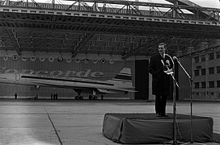
Concord(e) ?
*le désaccord = disagreement
phonétique
En général, les deux équipes ont travaillé très bien ensemble. Il y avait juste un désaccord* important : le nom de l’avion !
What do the words ‘concord’ (English) and la concorde (French) mean?
Concorde has an 'e' for excellence, England, Europe and entente cordiale. (Tony Benn, 1967)
concord / la concorde
= agreement or harmony between people or groups
The countries couldn’t decide whether the name of the plane should have an –e or not! How would the French word sound without it?
Notes:
Timing: 2 minutes
Aim: Cultural awareness: importance of SSC SFe in a historical event!
Procedure: 1. Check students understand the introductory text in the rubric.
2. Click to reveal the sentence encouraging students to think about/research the meaning of the name of the plane.
3. Click again to reveal a definition. Discuss the relevance of this to the Concorde project.
4. Click again to reveal the sentence about spelling. Students try to pronounce the hypothetical word concord in French (SFC). Point out that the SFe is necessary for the word to sound the same in both languages.
5. Click to reveal the picture of the then Minister for Technology Tony Benn presenting the Concorde, and announcing the official spelling (picture source: https://commons.wikimedia.org/wiki/File:11.12.67_Pr%C3%A9sentation_officielle_du_Concorde_(1967)_-_53Fi1780.jpg).
6. Explain to students that although the ‘to –e or not to –e’ debate caused heated arguments between politicians (Harold Wilson was furious with Charles de Gaulle for adding the –e and removed it, but de Gaulle!) the engineers and people of the UK thought it was a nice touch that was symbolic of the partnership. Minutes 7.36-8.40 of this BBC documentary bring this piece of French phonics in history to life: https://www.youtube.com/watch?v=1OIrV7ztsK0
Word frequency of unknown words (1 is the most frequent word in French): concorde [>5000], désaccord [2843], juste [304]
Source: Lonsdale, D., & Le Bras, Y. (2009). A Frequency Dictionary of French: Core vocabulary for learners London: Routledge.
Word frequency of cognates (1 is the most frequent word in French): juste [304]
Source: Lonsdale, D., & Le Bras, Y. (2009). A Frequency Dictionary of French: Core vocabulary for learners London: Routledge.

Slide 10
Prepositions of place
grammaire
Prepositions of place tell us where things are in relation to other things.
Can you think of some examples?
Which of these need de before a noun?
L’addition est sur la table.
L’addition est à droite de la carte et à gauche du verre.
dans
à côté
entre
à droite
à gauche
derrière
sous
sur
près
loin
devant
Remember! de + le → du de + les → des
Notes:
Timing: 3 minutes
Aim: To revise forms and uses of known prepositions of place by bringing them together and introducing them to students as such; to recap contraction of de + definite article.
Procedure:
1. Give students a minute to write down all prepositions of place that they can think of. Encourage students to do this in French, using English only for those they cannot remember. Note that although they are not dealt with here, à, en and chez are also correct examples.
2. Click to bring up the orange prepositions one by one. Students translate.
3. Students consider which prepositions must be followed by de before a noun.
4. Click to reveal answers.
5. Click again to reveal reminder about contracted forms of de + definite article.

Slide 11
On construit ensemble un avion
*l’ingénieur (m) = engineer *que veut dire … ? = what does … mean?
parler
Les ingénieurs* anglais et français ont travaillé ensemble à Bristol pour construire les avions. Ils ont pris des cours de langue, mais il y avait encore des obstacles linguistiques !
Tu es un ingénieur anglais. Tu ne comprends pas les mots dans les diagrammes. Travaille avec un(e) partenaire et complétez ensemble les diagrammes.
Example Que veut dire* … - l’équerre (f) ?
- les dessins (m) ?
Remember! Il est = it is (masculine object) Elle est = it is (feminine object)
Remember! ils sont = they are (masculine objects) elles sont = they are (feminine objects)
Ils sont sous la lampe.
Elle est à droite de la lampe.
Où est l’équerre (f) ?
Où sont les dessins (m) ?
Notes:
Timing: 8 minutes [1/7]
Aim: Oral production of short phrases with il(s)/elle(s) meaning it/they and prepositions of place with nouns; dealing with unknown words (picture description); phonics practice (reading aloud).
Procedure: 1. Check students understand the rubric. Explain they are going to recreate the experience of English and French engineers who worked together on the construction of Concorde.
2. Divide students into pairs. Print and distribute the role cards on slides 2 and 3 in this sequence and give each student either the outside or the inside of the plane.
3. Explain that students are going to complete their role cards by asking their partner where each of the unknown items at the bottom are. Each rolecard has a central ‘starter item’ already filled.
4. Use this slide to demo the task. Remind students of the use of il(s) and elle(s) to refer to masculine and feminine objects, and that these must agree with est and sont respectively.
5. Display the fourth slide in this sequence. Partner B turns away from the board. Explain to partner A that the word in green (le cockpit) is the only word student B has on their card, and they should give the locations of other items in relation to this in the first instance.
6. Student B asks Où est/sont and sounds out the unknown word to ask its location.
7. Student A gives the location of the word in relation to the cockpit.
8. Student B writes the word in the appropriate box, and asks a new question about a new item.
9. Student A can now give the location of the new item in relation to either the cockpit, the previous item or both.
10. Repeat steps 6-9 until the role card is complete.
11. Display the fifth slide in the sequence to reveal the correct answers.
12. Students swap roles. Display the sixth slide in this sequence and repeat steps 6-10.
Word frequency of unknown words (1 is the most frequent word in French):
ingénieur [2848], dessin [2624], équerre [>5000]
Source: Lonsdale, D., & Le Bras, Y. (2009). A Frequency Dictionary of French: Core vocabulary for learners London: Routledge.
Word frequency of cognates (1 is the most frequent word in French): obstacle [1393], linguistique [3907], diagramme [>5000], compléter [2034], obstacle [1393], linguistique [3907], diagramme [>5000], lampe [4699] Source: Lonsdale, D., & Le Bras, Y. (2009). A Frequency Dictionary of French: Core vocabulary for learners London: Routledge.

Slide 12
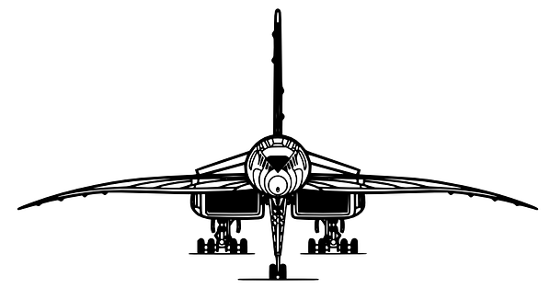
le nez - les roues (m) - la queue - les réacteurs (m) - les ailes (f)
le cockpit
le cockpit
le nez - les roues (m) - la queue - les réacteurs (m) - les ailes (f)
Notes:
[2/7] ROLECARDS FOR PRINTING (PARTNER A)

Slide 13
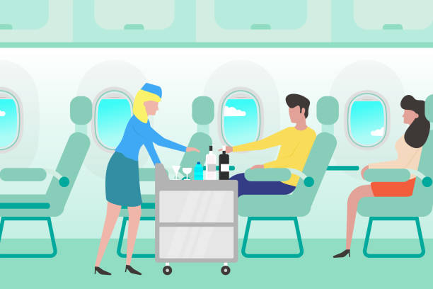
les hublots - le couloir - les sièges (m) - les coffres à bagages (m) - le chariot
l'hôtesse de l'air (f)
l'hôtesse de l'air (f)
les hublots - le couloir - les sièges (m) - les coffres à bagages (m) - le chariot
Notes:
[3/7] ROLECARDS FOR PRINTING (PARTNER B)

Slide 14
L'extérieur (A)
parler
parler
la queue
les ailes
le nez
le cockpit
les réacteurs
les roues
Notes:
[4/7] DISPLAY WITH PARTNER B FACING AWAY FROM THE BOARD.
Word frequency of unknown words (1 is the most frequent word in French):
aile [2923], queue [3255], nez [2661], réacteur [3390], roue [3916]
Source: Lonsdale, D., & Le Bras, Y. (2009). A Frequency Dictionary of French: Core vocabulary for learners London: Routledge.
Word frequency of cognates (1 is the most frequent word in French): extérieur [625], cockpit [<5000] Source: Lonsdale, D., & Le Bras, Y. (2009). A Frequency Dictionary of French: Core vocabulary for learners London: Routledge.

Slide 15
L'extérieur (réponses)
parler
le nez
la queue
les ailes
les roues (m)
la queue
les réacteurs (m)
le nez
les ailes (f)
le cockpit
les réacteurs
les roues
Notes:
[5/7] ANSWERS TO PREVIOUS

Slide 16
L'intérieur (B)
parler
les hublots
les coffres à bagages
l'hôtesse de l'air (f)
les sièges
le couloir
le chariot
Notes:
[6/7] DISPLAY WITH PARTNER A FACING AWAY FROM THE BOARD.
Word frequency of unknown words (1 is the most frequent word in French):
hublot [<5000], coffre [4776], couloir [2744], chariot [>5000], siège [1571]
Source: Lonsdale, D., & Le Bras, Y. (2009). A Frequency Dictionary of French: Core vocabulary for learners London: Routledge.
Word frequency of cognates (1 is the most frequent word in French): intérieur [433], hôtesse [<5000], bagage [3566], Source: Lonsdale, D., & Le Bras, Y. (2009). A Frequency Dictionary of French: Core vocabulary for learners London: Routledge.

Slide 17
L'intérieur (réponses)
parler
les hublots
les hublots (m)
le couloir
les sièges (m)
les coffres à bagages (m)
les coffres à bagages
le chariot
l'hôtesse de l'air (f)
les sièges
le couloir
le chariot
Notes:
[7/7] ANSWERS TO PREVIOUS

Slide 18
Comment dire les années ?
écouter
You have already learned how to say numbers over 1,000 in French.
Attention ! Notice that, unlike in regular numbers, there is no –s after mille and cent in years.
Years in French are said in the same way as normal numbers, unlike English. For example: the year 1982
In English, we split the four-digit number in half:
nineteen
eighty-two
But in French, we say the whole number:
Now listen to these years and write them down:
mille
neuf cent
quatre-vingt-deux
1
2022
2
2003
3
1996
4
1975
5
1802
6
1412
7
1066
deux mille vingt-deux
deux mille trois
mille neuf cent quatre-vingt-seize
mille neuf cent soixante-quinze
mille huit cent deux
mille quatre cent douze
mille soixante-six
Notes:
Timing: 4 minutes
Aim: To revise construction of numbers over 1,000, to highlight how saying years differs between English and French.
Procedure:
1. Click to reveal information on how to say numbers in French, and how it differs from English.
2. Click
3. Click on audio boxes to hear years being spoken in French.
4. Ask students to write the numbers they hear in digits. This can be done on mini-whiteboards.
5. Click to reveal answers in digits and words.
Transcript:
deux mille vingt-deux
deux mille trois
mille neuf cent quatre-vingt-seize
mille neuf cent soixante-quinze
mille huit cent deux
mille quatre cent douze
mille soixante-six

Slide 19
Une grande promesse (1)
*la vitesse du son = the speed of sound
lire/écouter
Initialement, le projet a créé beaucoup d'enthousiasme ! C'est quel nombre, selon toi ? Écoute pour vérifier tes estimations.
Initially, 16 airlines ordered 75 planes.
1
?
?
?
?
Concorde flew at a speed of 2,179 km/h. That is more than 2 times the speed of sound!
2
But the project cost 5 times the initial estimate, and Concorde became a luxury aircraft.
?
3
In 1967 Concorde took its first flight from Toulouse in France.
4
?
?
?
Concorde 002 took a 22 minute flight in England in front of many enthusiastic spectators.
5
Notes:
Timing: 8 minutes [1/2]
Aim: Oral comprehension of numbers/years.
Procedure:
1. Check students understand the rubric and the positive start to Concorde’s story.
2. Students read the English sentences and have a guess at what the missing numbers might be. Tell students they will check their answers by listening to the sentences in French.
3. Click to hear sentences read by a native speaker. Students read along and write the missing numbers. Note that the sentences contain a number of unknown cognates. We consider this appropriate in this type of exercise because the English is displayed and students should be able to make the connection between these words in French and English. Note the speed is given in km/h (rather than mph).
4. Click to reveal answers.
5. Move to the next slide. Check students understand the rubric and the issues Concorde faced. Clarify the meaning of bang supersonique/sonic boom: the very loud noise made by planes when breaking the sound barrier. This noise, which could shatter windows, resulted in Concorde being banned from flying faster than the speed of sound when flying over land. Its supersonic capacity was, therefore, restricted to water crossing only.
6. Repeat steps 2-4 for four more sentences.
Transcript:
1. Initialement, seize compagnies aériennes ont commandé soixante-quinze avions.
2. Concorde a volé à une vitesse de 2,179 km/h. C’est plus de deux fois la vitesse du son !
3. Mais le projet a coûté cinq fois l'estimation initiale, et Concorde est devenu un avion de luxe.
4. En 1967, Concorde a pris son premier vol de Toulouse en France.
5. Concorde 002 a pris un vol de 22 minutes en Angleterre devant plusieurs spectateurs enthousiastes.
Word frequency of unknown words (1 is the most frequent word in French):
vitesse [1065], luxe [3009]
Source: Lonsdale, D., & Le Bras, Y. (2009). A Frequency Dictionary of French: Core vocabulary for learners London: Routledge.
Word frequency of cognates (1 is the most frequent word in French):
initialement [4252], enthousiasme [2745], nombre [249], verifier [1236], estimation [3464], compagnie [775], aérien [1765], estimation [3464], initial [2137], spectateur [2877], enthousiaste [4287] Source: Lonsdale, D., & Le Bras, Y. (2009). A Frequency Dictionary of French: Core vocabulary for learners London: Routledge.

Slide 20
Une grande promesse (2)
*le carburant = fuel *survoler = to fly over *à cause de = due to
lire/écouter
Mais il y avait plusieurs problèmes. Un avion rapide a besoin de beaucoup de carburant*, et des fumées noires ont pollué l’environnement. Aussi, on a interdit au Concorde de survoler* les villes à cause du* « bang supersonique ».
?
6
By the end of 1973, almost all airlines had cancelled their orders.
?
British Airways received 5 Concordes. Each aircraft had a value of 22 million pounds.
?
7
?
Flights between London and New York started in 1977, at a cost of 431 pounds (one way).
8
?
?
?
The flight took just 3.5 hours, compared to 8 hours for a regular flight.
9
Notes:
[2/2]
Transcript:
6. A la fin de l'année 1973, presque toutes les compagnies ont annulé leurs commandes.
7. British Airways a reçu cinq Concordes. Chaque avion a eu une valeur de 22 millions de livres.
8. Des vols entre Londres et New York ont commencé en 1977 pour un coût de 431 livres (aller simple). 9. Le vol a duré seulement trois heures et demi, comparé à huit heures sur un vol régulier.
Word frequency of unknown words (1 is the most frequent word in French):
carburant [3633], survoler [>5000], à cause de [n/a], fin [111], recevoir [199]
Source: Lonsdale, D., & Le Bras, Y. (2009). A Frequency Dictionary of French: Core vocabulary for learners London: Routledge.
Word frequency of cognates (1 is the most frequent word in French):
promesse [1184], fumée [4047], polluer [>5000], environnement [945], compagnie [775], aérien [1765], estimation [3464], initial [2137], spectateur [2877], enthousiaste [4287], valeur [453], million [307], simple [212], comparer [1560], régulier [1770] Source: Lonsdale, D., & Le Bras, Y. (2009). A Frequency Dictionary of French: Core vocabulary for learners London: Routledge.

Slide 21
Prepositions of movement
grammaire
Prepositions of movement are used to translate ‘to’ and ‘from’ (a place).
Can you think of some examples?
Which of these prepositions would you use to talk about going to …
1) a feminine country? Je vole en Italie.
2) a city? Ils vont à Edimbourg.
3) a masculine country or region? L’avion va au Japon (m).
à
chez
vers
de
à
en
Remember! à + definite article for masculine countries a + le → au a + les → aux
Notes:
Timing: 2 minutes
Aim: To revise forms and uses of known prepositions of movement by bringing them together and introducing them to students as such; to recap contraction of à + definite article.
Procedure:
1. Give students a minute to write down all prepositions of movement that they can think of.
2. Click to bring up the orange prepositions one by one. Students translate.
3. Students consider which prepositions must be used with each type of place name.
4. Click to reveal answers.
5. Click again to reveal reminder about contracted forms of à + definite article.

Slide 22
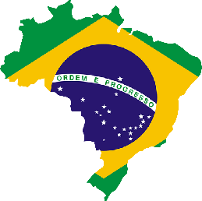
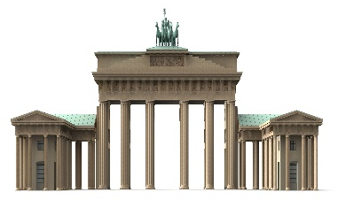
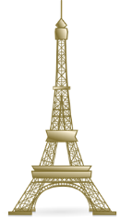
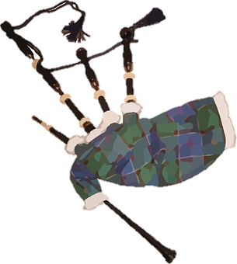
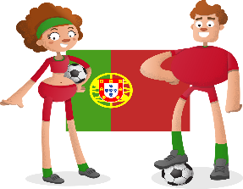
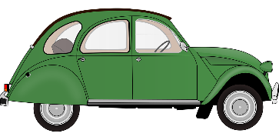
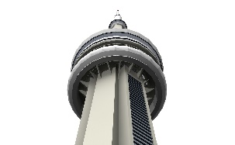
On vole où ?
écouter
Ces sont les seules destinations des vols publics. Il n’y avait pas beaucoup de choix…
Écoute et choisis la réponse correcte.
Mexique (m)
Alger
Québec
États-Unis
Brésil (m)
Allemagne
1
4
7
Écosse
Miami
Suisse
Paris
Australie (f)
Açores (pl)
2
5
8
France
3
Canada
Angleterre
6
Portugal (m)
Maroc (m)
9
Toronto
Notes:
Timing: 8 minutes [1/2]
Aim: To practise distinguishing orally between prepositions en, à and à + definite article, and connecting these with meaning (feminine country, city, masculine country or state).
Procedure:
1. Check students remember the gender of the known place names (i.e., those for which the gender is not provided in brackets).
2. Click on a number to hear a sentence with the name of the destination beeped out.
3. Students decide based on the preposition they hear what the destination must be.
4. Click to reveal the answer and hear a full sentence with the place name included.
5. Click to reveal the fact about the answers. Because of the restrictions which stopped Concorde flying supersonically over, these coastal locations were the only ever destinations of scheduled Concorde flights: http://www.concordesst.com/history/destinations.html
6. Move to the next slide for a follow-up writing activity.
Transcript:
1. On prend un vol au [Mexique].
2. Cet avion va à [Miami].
3. On vole en [France].
4. Nous allons aux [États-Unis]. [include x-liaison]
5. Ils voyageaient à [Paris].
6. Vous volez en [Angleterre] ?
7. Ces avions vont au [Brésil].
8. Nous voyageons aux [Açores]. [include x-liaison]
9. Je vais à [Toronto].
Word frequency of cognates (1 is the most frequent word in French):
correct [2617], destination [2301], public [285] Source: Lonsdale, D., & Le Bras, Y. (2009). A Frequency Dictionary of French: Core vocabulary for learners London: Routledge.

Slide 23
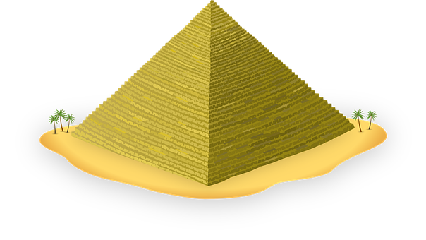
On vole où ?
*à cause de = due to
*la plupart = the majority
*affrété = chartered
écrire
À cause des* limitations sur les routes, Concorde n’a pas utilisé la plupart* de ses avions. Les billets de vol ont coûté très cher, et la compagnie n’a pas gagné beaucoup d’argent alors ! La solution ? Des vols affrétés* ! Ils volent où ?
?
On vole au pôle Nord (m) !
?
Nous allons aux Bahamas (pl) !
?
Je vais en Égypte (f) !
?
Ils volent à Bruxelles !
?
To voles aux Alpes (pl) !
?
L’avion va en Nouvelle-Zélande (f) !
Notes:
[2/2]
Procedure:
1. Check students understand the information. After a £10 million loss over the first 5 years of service, Concorde decided to offer chartered flights to make use of its fleet, much of which was sitting idle. This allowed for all sorts of exotic destinations to be offered as day trips (e.g., Egypt or Lapland and home for dinner) and also meant that flights were finally more affordable and not just for the elite.
2. Students fill in the blanks with en, à or à + definite article.
3. Click to reveal answers.
Word frequency of unknown words (1 is the most frequent word in French):
à cause de [n/a], plupart [426], affrété [>5000]
Source: Lonsdale, D., & Le Bras, Y. (2009). A Frequency Dictionary of French: Core vocabulary for learners London: Routledge.
Word frequency of cognates (1 is the most frequent word in French):
limitation [4236], route [512], compagnie [775] Source: Lonsdale, D., & Le Bras, Y. (2009). A Frequency Dictionary of French: Core vocabulary for learners London: Routledge.

Slide 24
Avion supersonique: L'histoire de Concorde
word patterns: verb stem + -ion/-ation → noun
verbs like sortir, choisir and venir (present)
Y9 French
Term 3.1 - Week 6 - Lesson 58
Author name: Natalie Finlayson and Louise Bibbey
Artwork by: Chloé Motard
Date updated: 05/07/22
Notes:
Artwork by Chloé Motard. All additional pictures selected are available under a Creative Commons license, no attribution required.
Native teacher feedback provided by Stephanie Schmitt.
With thanks to Rachel Hawkes for her input on the lesson material.
Learning outcomes (lesson 2):
Introduce word pattern ‘verb stem + -ion/-ation → noun’
Revisit verbs like sortir, choisir and venir
Cultural awareness: French/British collaboration on a technical innovation
Word frequency (1 is the most frequent word in French):
dormir [1836], finir [534], nourrir [1251], partir [163], remplir [751], revenir [184], sortir [309], venir [88], accident [1227], conversation [1747], Allemagne [n/a], Alger [n/a], Belgique [n/a], Bruxelles [n/a], États-Unis [n/a], Genève [n/a], Londres [n/a], Italie [n/a], nom [171], personne [84], poisson [1616], programme [340], projet [228], réponse [456], Suisse [n/a], verre [2174], allemand (adj) [844], alors [81], à [4], de [2], en3 [7], derrière [805], devant [198], entre [55], loin de [n/a], près de [n/a], sous [122], sur [16], attention ! [482], loin [341], près [225], un, une, des [3], cinq [288], deux [41], dix [372], huit [877], neuf [787], quatre [253], sept [905], six [450], trois [115]
Source: Lonsdale, D., & Le Bras, Y. (2009). A Frequency Dictionary of French: Core vocabulary for learners London: Routledge.
The frequency rankings for words that occur in this PowerPoint which have been previously introduced in NCELP resources are given in the NCELP SOW and in the resources that first introduced and formally re-visited those words.
For any other words that occur incidentally in this PowerPoint, frequency rankings will be provided in the notes field wherever possible.

Slide 25
Word pattern: -ion/-ation
*milliers = thousands, environ = approximately, *la fin = the end
info
Tu connais déjà des milliers* de mots en français…
Dans le livre d'Alexandre Dumas (1845), « Vingt ans après » [Twenty Years After], le mousquetaire D'Artagnan dit
« L'anglais n'est que du français mal prononcé »
[English is nothing but French pronounced badly].
Environ* 10 000 mots français sont arrivés dans la langue anglaise avec la conquête normande [Norman Conquest] de 1066.
Environ 33% de tous les mots anglais utilisés aujourd'hui ont leur origine en français. C'est pourquoi il est facile pour les personnes qui parlent anglais de comprendre les mots français avec -ation et -ion à la fin*.
Je dois préparer l’avion.
In French, many nouns end in -ation and -ion.
Many of these nouns have a verb in the same family.
These nouns are formed by removing the ending of verbs, leaving the stem, then adding -ation or -ion to the stem.
e.g.
La préparation est très importante pour les avions.
préparer
→ préparation
progresser
→ progression
Notes:
Timing: 3 minutes
Aim: To explain the word pattern, creating nouns ending –ation and –tion from verb stems.
Procedure:
1. Click through information and examples.
Word frequency of unknown words (1 is the most frequent word in French): préparation [2451], environ [678], fin [111]
Source: Lonsdale, D., & Le Bras, Y. (2009). A Frequency Dictionary of French: Core vocabulary for learners London: Routledge.
Word frequency of cognates (1 is the most frequent word in French): préparation [2451], progresser [1856], progression [2660], millier [1127], mousquetaire [>5000], prononcé [5000], conquête [3177], normand [<5000], utilise [<5000], origine [709] Source: Lonsdale, D., & Le Bras, Y. (2009). A Frequency Dictionary of French: Core vocabulary for learners London: Routledge.

Slide 26
Word pattern: -ion/-ation
parler
noun
verb
noun
verb
collaboration
collaborer
observation
observer
invention
inventer
situation
situer
consultation
consulter
division
diviser
information
informer
pollution
polluer
Notes:
Timing: 4 minutes
Aim: To practise –ation and –ion word patterns, converting verbs to nouns and nouns to verbs
Procedure:
Click to reveal either the noun or verb in each pair
If a noun is revealed, ask students to say the corresponding verb, and if a verb is revealed, to say the noun
Click to reveal answers
Word frequency of cognates (1 is the most frequent word in French): collaboration [2037], collaborer [2963], invention [3821], inventer [1964], consultation [1969], consulter [1595], information [317], informer [1356], observation [1863], observer [788], situation [223], situer [815], division [1440], diviser [1567], pollution [3073], polluer [>5000]
Source: Lonsdale, D., & Le Bras, Y. (2009). A Frequency Dictionary of French: Core vocabulary for learners London: Routledge.

Slide 27
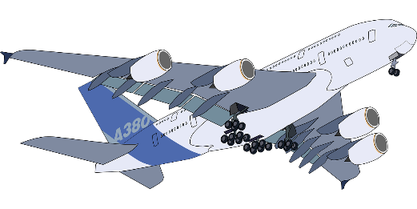
Word pattern: -ion/-ation
Airbus A380
écrire
noun?
verb?
cré-
noun? verb?
innov-
progress-
progression progresser
coopér-
coopération
coopérer
création
créer
noun? verb?
noun? verb?
innovation innover
travailler ensemble
faire
1. Le Concorde est le résultat* d’une coopération entre l’Angleterre et la France.
noun
3. Le projet est la création d'un avion supersonique*
noun
2. Les deux pays doivent coopérer pour créer un avion.
verb
verb
4. Les ingénieurs veulent créer un avion très innovant*.
avancer
nouvelles idées
5. Le Concorde aide à la progression de la nouvelle technologie* dans l'aviation*.
7. Airbus Toulouse et Bristol sont les centres européens de l’innovation aéronautique.
noun
noun
6. Des projets comme le Concorde peuvent faire progresser l’industrie aéronautique*.
8. Les ingénieurs d’Airbus doivent toujours innover pour être compétitifs*.
verb
verb
*le résultat = result, ingénieur = engineer, innovant = innovative, avancer = advance
Notes:
Timing: 8 minutes
Aim: to introduce the ‘verb root + -tion/ion as noun’ word pattern; dictionary skills.
Procedure:
Students listen to the sentences spoken by a native speaker.
Students use a dictionary to find the French verb from which the nouns ending –ion or –tion are formed.
Explain to students that they will need to use a dictionary to find the form because the verb cannot always be found by simply replacing the –ion ending with –er or other verb endings, such as -re. Point out that the verb roots of the nouns can be irregular.
Explain to students that they should start by looking up the English translation of the nouns, deduce the English verbs from the nouns, then find the French translations of the verbs.
Point out that the majority of nouns ending in –ion and –tion in French are cognates.
Answers revealed on clicks. As the answers are revealed, have students give English translations for both the adjective and the noun.
Word frequency of cognates (1 is the most frequent word in French): résultat [428], coopération [1496], coopérer [4026], invention [3821], inventer [1964], création [634], créer [332], supersonique [>5000], progression [2660], progresser [1856], technologie [1388], aviation [4084], collaboration [2037], collaborer [2963], innovation [2402], innover [>5000], aéronautique [>5000]
Source: Lonsdale, D., & Le Bras, Y. (2009). A Frequency Dictionary of French: Core vocabulary for learners London: Routledge.

Slide 28
Verbs like sortir, choisir and venir
Je sors!
grammaire
sortir
to go out, to take out
choisir
to choose
venir
to come
je choisis
je sors
I choose
I go out, take out
I come
je viens
tu choisis
tu sors
you (sing) choose
you (sing) go out, take out
you (sing) come
tu viens
Il, elle, on choisit
he/she/one goes out, takes out
he/she/one chooses
Il, elle, on sort
he/she/one comes
Il, elle, on vient
nous choisissons
we go out, take out
we choose
nous sortons
we come
nous venons
vous choisissez
vous sortez
you (fml, pl) choose
you (fml, pl) go out, take out
you (fml, pl) come
vous venez
ils/elles choisissent
they (m, f) go out, take out
they (m, f) choose
ils/elles sortent
they (m, f) come
ils/elles viennent
Notes:
Timing: 2 minutes
Aim: To revise the forms of verbs like sortir, choisir and venir
Procedure:
Elicit translations of each form of each verb from students, then click to reveal answers

Slide 29
Un jour dans la vie d’une hôtesse
1
2
3
4
lire / écouter / écrire
5
6
7
8
9
*le décollage = take-off *le décalage = time difference
*atterrir = to land
Tu es un(e) journaliste. Réécris le texte à la troisième personne.
Lis, écoute, et complète les mots.
J’appartiens à l'équipe d'hôtesses de l'air chez Air France qui travaillent sur le Concorde. Chaque jour, nous partons pour New York de l'aéroport de Paris-Charles-de-Gaulle à 10h30. Avant le décollage*, j’ai des conversations avec les passagers et je remplis leur verre de champagne. Dans les airs, nous nourrissons les passagers et réagissons à leurs demandes. Bizarrement, nous atterrissons* à 8h25 parce qu’il y a un décalage* entre Paris et New York. Nous finissons à midi et nous dormons à New York à l'hôtel de l'aéroport. Parfois, je sors en ville le soir. C’est un petit avantage de mon travail ! Le matin, nous allons encore au travail et nous revenons à Paris à 17h30.
___
___
___
___
___
___
___
___
___
Notes:
Timing: 15 minutes [1/4]
Aim: Oral production of 1st person singular and 1st person plural forms of verbs like sortir, choisir and venir; text segmentation; written production of 3rd person singular and 3rd person plural forms of verbs like sortir, choisir and venir.
Procedure:
1. Students begin the story by filling the first blank orally.
2. Click on button number 1 to hear the first segment of the story read aloud. Students check their answer (verb ending revealed on a click) and read along as far as the next gap.
3. Repeat steps 1-2 for 9 segments in total. Each time, students will have to recognise the verb from its base, and recall the verb types and appropriate ending.
4. Click to reveal the follow-up task.
5. Students re-write the text in the third person by changing the verb endings and any possessive pronouns.
6. Move to the next slide for answers and the translation exercise.
7. Suggested translations are provided on the final two slides in this sequence.
Transcript:
1. J’appartiens à l'équipe d'hôtesses de l'air chez Air France qui travaillent sur le Concorde. Chaque jour, nous … 2. … partons pour New York de l'aéroport de Paris-Charles-de-Gaulle à 10h30. Avant le décollage, j’ai des conversations avec les passagers et je … 3. … remplis leurs verres de champagne. Dans les airs, nous… 4. … nourrissons les passagers et nous … 5. … réagissons à leurs demandes. Bizarrement, nous atterrissons à 8h25 parce qu’il y a un décalage entre Paris et New York. Nous … 6. … finissons à midi et nous … 7. … dormons à New York à l'hôtel de l'aéroport. Parfois, je … 8. … sors en ville le soir. C’est un petit avantage de mon travail ! Le matin, nous allons encore au travail et nous … 9. … revenons à Paris à 17h30.
Word frequency of unknown words (1 is the most frequent word in French):
décollage [<5000], réécrire [>5000], bizarrement [>5000], atterrir [>5000], décalage [>5000],
Source: Lonsdale, D., & Le Bras, Y. (2009). A Frequency Dictionary of French: Core vocabulary for learners London: Routledge.
Word frequency of cognates (1 is the most frequent word in French):
hôtesse [>5000], passager [2329], journaliste [1337], champagne [>5000], avantage [900] Source: Lonsdale, D., & Le Bras, Y. (2009). A Frequency Dictionary of French: Core vocabulary for learners London: Routledge.

Slide 30
Un jour dans la vie d’une hôtesse
lire / écouter / écrire
*le décollage = take-off *le décalage = time difference
*atterrir = to land
Tu es un(e) journaliste. Réécris le texte à la troisième personne.
Traduis le texte pour un journal anglais.
Elle appartient à l'équipe d'hôtesses de l'air chez Air France qui travaillent sur le Concorde. Chaque jour, elles partent pour New York de l'aéroport de Paris-Charles-de-Gaulle à 10h30. Avant le décollage*, elle a des conversations avec les passagers et elle remplit leur verre de champagne. Dans les airs, elles nourrissent les passagers et réagissent à leurs demandes. Bizarrement, elles atterrissent* à 8h25 parce qu’il y a un décalage* entre Paris et New York. Elles finissent à midi et elles dorment à New York à l'hôtel de l'aéroport. Parfois, elle sort en ville le soir. C’est un petit avantage de son travail ! Le matin, elles vont encore au travail et elles reviennent à Paris à 17h30.
Notes:
[2/4]

Slide 31
Un jour dans la vie d’une hôtesse
lire / écouter / écrire
Elle appartient à l'équipe d'hôtesses de l'air chez Air France qui travaillent sur le Concorde. Chaque jour, elles partent pour New York de l'aéroport de Paris-Charles-de-Gaulle à 10h30.
Avant le décollage, elle a des conversations avec les passagers et elle remplit leur verre de champagne. Dans les airs, elles nourrissent les passagers et réagissent à leurs demandes.
She belongs to the team of air hostesses at Air France who work on the Concorde. Every day, they leave for New York from the Paris Charles de Gaulle airport at 10:30.
Before take-off, she has conversations with the passengers and fills their glasses with champagne.
In the air, they feed the passengers and react to their requests/demands.
Notes:
[3/4] ANSWERS TO PREVIOUS

Slide 32
Un jour dans la vie d’une hôtesse
lire / écouter / écrire
Bizarrement, elles atterrissent* à 8h25 parce qu’il y a un décalage* entre Paris et New York.
Elles finissent à midi et elles dorment à New York à l'hôtel de l'aéroport.
Parfois, elle sort en ville le soir.
C’est un petit avantage de son travail !
Le matin, elles vont encore au travail et elles reviennent à Paris à 17h30.
Bizarrely, they land at 8:25 because there is a time difference between Paris and New York.
They finish at midday and they sleep in New York at the airport hotel.
Sometimes, she goes out into town in the evening. It’s a little advantage of her job !
In the morning, they go to work again and they get back/come back to Paris at 17:30.
Notes:
[4/4] ANSWERS TO PREVIOUS

Slide 33
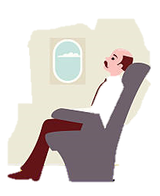
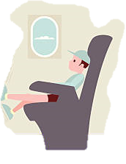
On interviewe des passagers
*le Coca = coke
*la vitesse = speed
lire / parler
Maintenant, tu écris un article sur l’expérience du vol en Concorde. Tu parles avec une famille qui est à bord. Lis les réponses. Dis les questions !
Tu réfléchis à quoi ?
À quoi réfléchis-tu ?
Vous choisissez quoi (à manger) ?
Qu'est-ce que vous choisissez (à manger) ?
Tu choisis quoi (à manger) ?
Qu'est-ce que tu choisis(à manger) ?
Tu viens d’où ?
D’où viens-tu ?
Tu dors où (ce soir) ?
Où dors-tu ce soir ?
Vous dormez où (ce soir) ?
Où dormez-vous ce soir ?
Vous venez d’où ?
D’où venez-vous ?
Vous réfléchissez à quoi ?
À quoi réfléchissez-vous ?
Moi je viens de Paris.
Je dors chez moi ce soir. Nous retournons à Paris après ma conférence.
Je dors dans l’avion ce soir.
Je viens de Genève, mais maintenant j’habite à Paris.
Je réfléchis à la vitesse ! On accélère à 200 km/h !
Je choisis la soupe, le fromage et le Coca*.
Je réfléchis aux célébrités qui sont à bord !
Je choisis le caviar, le poisson et le champagne.
Notes:
Timing: 5 minutes
Aim: Oral production of 2nd person singular and 2nd person plural forms of verbs like sortir, choisir and venir; question formation; cultural awareness: register.
Procedure:
1. Explain to students that they are going to see responses from a child and an adult. Check that students understand which pronoun and verb ending is needed in each context.
2. Click to reveal a response to a question. Students must form a question (their choice of intonation, est-ce que or inversion) that could elicit the answer using the same verb that appears in that answer, with the appropriate pronoun and in the appropriate form.
3. Click to reveal some suggested questions (other versions may be acceptable). Elicit translations of the question and answer pair from students. Point out that this exercise illustrates the main types of ‘regular flier’ who would use the two principal scheduled routes (London to New York and Paris to York) rather than the more affordable chartered flights: commuters working for large corporations, and celebrities. This was not the original intended clientele, and the very restricted routes and unaffordable prices were a factor in Concorde’s ultimate downfall.
4. Click to clear the conversation, and again to reveal a new response.
5. Repeats steps 2-5 for a total of 8 questions and responses.
Word frequency of unknown words (1 is the most frequent word in French):
vitesse [1065]
Source: Lonsdale, D., & Le Bras, Y. (2009). A Frequency Dictionary of French: Core vocabulary for learners London: Routledge.
Word frequency of cognates (1 is the most frequent word in French):
interviewer [<5000], article [604], bord [991], soupe [4563], accélérer [2082], conférence [1094], célébrité [>5000], caviar [>5000] Source: Lonsdale, D., & Le Bras, Y. (2009). A Frequency Dictionary of French: Core vocabulary for learners London: Routledge.

Slide 34
Une grande tragédie
*arriver³ = to happen *les tours jumelles = Twin Towers *voulait = wanted to
lire
En l’an 2000, il y avait une terrible tragédie. Qu’est-ce qui est arrivé* ? Fais des paires pour compléter l’histoire.
Le 25 juillet 2000, il y avait un …
L’accident a tué …
En 2001, Concorde a commencé …
Mais le programme a coûté …
Après l'attaque des tours jumelles* …
Il n’y avait pas de passagers, et Concorde a fait son dernier vol …
… 113 personnes.
… un programme pour renforcer la sécurité.
… commercial le 26 novembre 2003.
… crash de l’avion près de Paris.
… à New York en 2001, on ne voulait* pas voler.
… cher, et Concorde a commencé à perdre de l’argent une fois encore.
Notes:
Timing: 5 minutes
Aim: Reading comprehension.
Procedure:
1. Students read the sentence beginnings 1-6, and try to pair them with the correct sentence end a-f. There is only one correct answer for each sentence half. If in doubt, students can use their grammatical as well as semantic knowledge to help them work out what type of word the next word in each sentence is likely to be (i.e., a singular noun for sentence 1, a noun for sentence 2, a noun with an article for sentence 3, and adjective or number for sentence 4, an adjective for sentence 6 (leaving the answer to sentence 5). 2. Reveal answers on clicks.
3. Whole-class translation of complete sentences into English.
Word frequency of unknown words (1 is the most frequent word in French):
jumelle [>5000]
Source: Lonsdale, D., & Le Bras, Y. (2009). A Frequency Dictionary of French: Core vocabulary for learners London: Routledge.
Word frequency of cognates (1 is the most frequent word in French):
tragédie [1910], terrible [1310], paire [3926], compléter [2034], attaque [1655], tour [523], passager [2329], renforcer [1280], commercial [908], crash [>5000] Source: Lonsdale, D., & Le Bras, Y. (2009). A Frequency Dictionary of French: Core vocabulary for learners London: Routledge.

Slide 35
Des avions de rêve
*la fin = the end
*l’ingénieur (m) = engineer
écrire
La fin* de l'histoire de Concorde est tragique, mais Concorde inspire les ingénieurs* d’aujourd’hui ! En ce moment, plusieurs compagnies travaillent sur la construction d’avions hypersoniques qui peuvent voler de Londres à Sydney en moins de 3 heures ! Design a supersonic plane of the future. Describe it using:
prepositions of place, to say how it looks (outside and in)
prepositions of movement, to say where it goes
numbers over 100 to give its speed and cost
verbs venir, partir and choisir to say where it comes from, when/where it departs, and what the passengers choose to eat/drink/do on board.
Notes:
Timing: 8 minutes
Aim: Semi-structured creative writing to practice structures revisited in this lesson in writing.
Procedure:
Determined the desired length of text (in number of words, or number of required examples of each structure) by the level of the class, and the time available.
Encourage students’ use of dictionaries to develop a personal repertoire by search for new words to complement the core structures.
Word frequency of unknown words (1 is the most frequent word in French):
fin [111], ingénieur [2848],
Source: Lonsdale, D., & Le Bras, Y. (2009). A Frequency Dictionary of French: Core vocabulary for learners London: Routledge.
Word frequency of cognates (1 is the most frequent word in French):
tragique [2042], inspirer [1314], compagnie [775], construction [976], hypersonique [<5000] Source: Lonsdale, D., & Le Bras, Y. (2009). A Frequency Dictionary of French: Core vocabulary for learners London: Routledge.

Slide 36
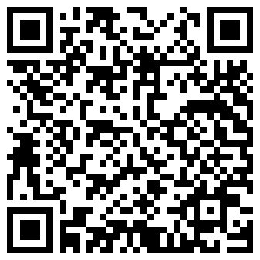
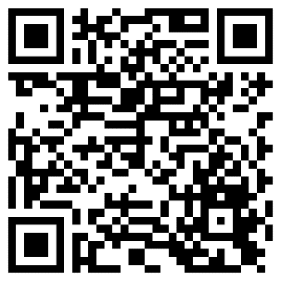
Devoirs
Vocabulary Learning Homework (Y9, Term 3.2, Week 1)
Audio file
Audio file QR code:
Student worksheet
Quizlet link
Quizlet QR code:
Notes:
The answer sheet for the 9.3.1.5 vocabulary learning homework is here: Resource | French SOW Y9 Term 3.2 Week 1 - vocabulary learning homework answers | ID: h415pc77x | NCELP

